Slide 1
Unit 1: Week 4
Grade 4

Slide 2
Copyright © Savvas Learning Company LLC. All Rights Reserved.
This publication is protected by copyright, and permission should be obtained from the publisher prior to any prohibited reproduction, storage in a retrieval system, or transmission in any form or by any means, electronic, mechanical, photocopying, recording, or otherwise. For information regarding permissions, request forms, and the appropriate contacts within the Savvas Learning Company Rights Management group, please send your query to:
Savvas Learning Company LLC, 15 East Midland Avenue, Paramus, NJ 07652
or
k12learningpermissions@savvas.com
myView Literacy® is an exclusive trademark of Savvas Learning Company LLC in the U.S. and/or other countries.

Slide 3
Lesson 1

Slide 4
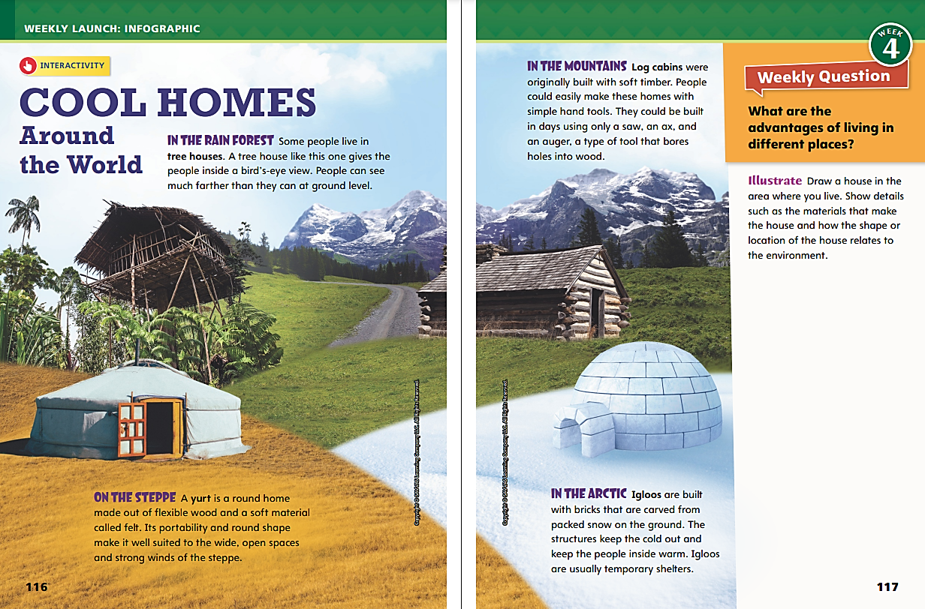
Page 116, 117
Interact with Sources
Discuss the the advantages of living in different places.
Draw where you live with details that relate to the environment.
Notes:
Remind students of the Essential Question for Unit 1: How can a place affect how we live? Point out the Week 4 Question: What are the advantages of living in different places?
Direct students’ attention to the infographic on pp. 116–117 of the Student Interactive. Explain that an infographic combines words and pictures to provide information. Have students read the infographic and discuss why people live in different kinds of homes.
Use the following questions to guide discussion:
Why do you think there are so many different kinds of homes?
Which kind of home is the most interesting to you?
What are the advantages of each of the homes shown?
WEEKLY QUESTION | Reread the Week 4 question: What are the advantages of living in different places? Tell students that they just learned about a few different types of places in the world and the different kinds of homes found there. Explain that they will read more about different places this week.
ILLUSTRATE | Have students respond to the Illustrate prompt on p. 117 and then share their drawings.

Slide 5
Listening Comprehension
EXPLORATION
North Star | Wave Patterns
Notes:
Tell students you are going to read an informational text aloud. Have students listen as you read “Early Exploration.” Explain that students should listen actively, paying careful attention to the text features as you read. Prompt them to ask questions to clarify information and follow agreed-upon discussion rules.
READ-ALOUD ROUTINE | Purpose - Have students actively listen for elements of informational text.
READ | the entire text aloud without stopping for the Think Aloud callouts.
REREAD | the text aloud, pausing to model Think Aloud strategies related to the genre and the text features.
THINK ALOUD | Analyze Informational Text | Say: I see that there is a heading in the first half of the text. I also see that there is a pronunciation guide that shows me how to say a new word: Polaris. When I see text features like headings and pronunciation guides, I know that I’m probably reading an informational text. Informational texts tell readers about a topic by sharing facts and details. They often use text features like headings and pronunciation guides to organize and highlight pieces of information. I’m going to pay close attention to how these text features help me understand the text better.
THINK ALOUD | Analyze Informational Text | Say: As I continue to read the text, I come to another pronunciation guide. This time, the new word is kamal. I see a second heading. The two headings in the text tell me that this text discusses two different ways that explorers used to find their way before compasses and maps were around: by using the North Star and by learning wave patterns. The headings also tell me where I can find this information, which is very helpful to me as I read.
WRAP-UP | Use a T-chart to help students recall the details they learned about each navigation method noted in the text.

Slide 6
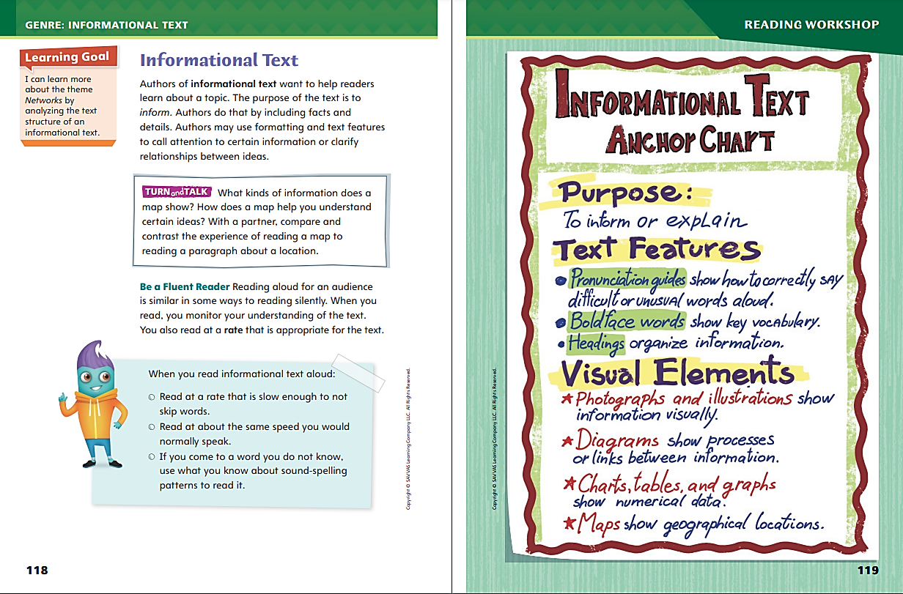
Page 118, 119
Informational Text
Turn to page 118 in your Student Interactive.
Notes:
Explain to students that authors of informational text often use text features and visual elements to help organize and clarify information. Text features such as pronunciation guides, bold words, and headings are common characteristics of informational text. Additionally, visual elements such as photographs, illustrations, diagrams, charts, tables, graphs, and maps can display information in interesting and specific ways to help readers better understand the text.
Ask yourself how the information in a text is organized or structured. What text features and visual elements are used?
Look for text features and visual elements that might signal informational text, such as pronunciation guides, bold words, headings, photographs, illustrations, diagrams, charts, tables, graphs, and maps.
Think about how these text features and visual elements help you to understand information in the text.
Model analyzing informational text features: In “Early Exploration,” the author uses headings and pronunciation guides to help the reader learn the ideas she’s trying to share. I ask myself, “What do these text features do?” The headings help organize the information in the text. The pronunciation guides help me understand new words. Then I ask myself, “Why did the author add these text features?” I think she added them to make the text easier to read and to help me understand ideas and words that might be new to me.
Talk about what visual elements could be added to “Early Exploration.” Discuss how visual elements would structure the text and help readers understand some of the ideas in the text.
Say: When you read informational text aloud, it’s important to make sure you understand what you read. Reading at a rate that is appropriate for the text will help you fully understand the information. You should read at a rate that is slow enough so that you don’t skip any words but quick enough to match the way you talk. Practice reading parts of a text aloud to find the appropriate rate. If you come to an unfamiliar word as you read an informational text aloud, you can use what you know about sound-spelling patterns to pronounce it correctly.

Slide 7
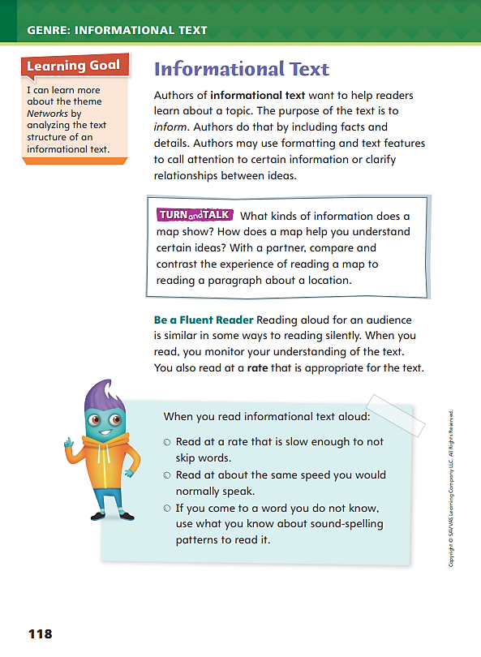
Page 118
Apply
Turn to page 118 in your Student Interactive and complete the activity with a partner.
Notes:
Have students use the strategies to identify informational text.
Have students work with a partner to complete the Turn and Talk on p. 118 of the Student Interactive. Circulate to discover whether students can analyze text features like maps and explain how they help them understand information.

Slide 8
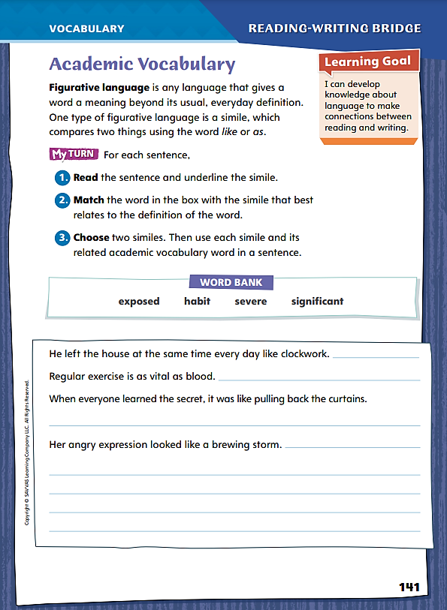
Page 141
Academic Vocabulary
Turn to page 141 in your Student Interactive.
Notes:
Explain to students that figurative language is any kind of language that departs from the literal meaning of the words themselves and takes on an imaginative or metaphoric meaning that typically appeals to the senses in some way.
Figurative language often takes the form of a simile in which unlike things are compared using the word like or as. For example: The lion cub looked like a chubby house cat, but his eyes were cold as ice.
Look for the words that introduce similes, like and as, but keep in mind that figurative language includes any language that is imaginative and goes beyond the literal meaning of the words themselves.
Authors often use figurative language to form vivid images in the reader’s mind as he or she reads.
Similes may also help readers understand vocabulary words.
Model this strategy using the academic vocabulary word habit on p. 141 in the Student Interactive.
Say: Figurative language often causes me to imagine something. For example, here are sentences that describe Uncle Yaris: My Uncle Yaris has a voice like a foghorn, which he uses every morning, like clockwork, to wake me up. From reading, I get a vivid image of a man with a deep, booming voice who wakes someone up every day. The vocabulary word that is closest to the simile “like clockwork” is habit.
Ask students to picture images in their minds as they read similes.

Slide 9
Page 141
Apply
Turn to page 141 in your Student Interactive and complete the activity.
Notes:
Have students try out the strategy shown on p. 141 by completing the simile activity for the academic words.

Slide 10
Word Study
brain
lead
boat
jaw
Identify the vowel teams and digraphs and pronounce each word aloud.
Notes:
Explain to students that vowel teams are two or three letters that spell one vowel sound. Vowel digraphs are vowel teams in which the first vowel has a long vowel sound and the second vowel is silent. Write the word teeth. Point out that ee is a vowel team that produces a long e sound. Write the word brain. Point out that the vowel team ai spells the long a sound.
Write the following words. Have students identify the vowel teams and digraphs and pronounce each word aloud.
boat
lead
jaw
Help students find other words that contain the vowel teams and digraphs on p. 142 of the Student Interactive.

Slide 11
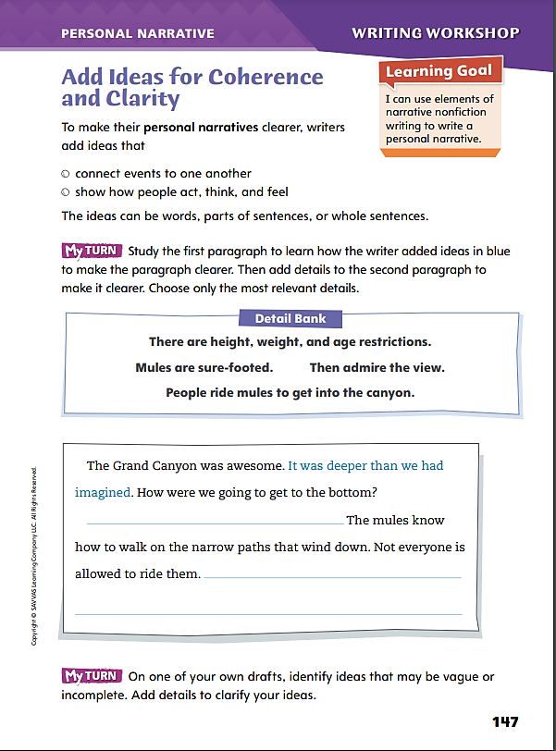
Page 147
Writing – Personal Narrative
Turn to page 147 in your Student Interactive.
Notes:
Explain to students that the purpose of revising ideas in your draft is to make sentence structure clearer and more coherent by
Strengthening time-order connections among events.
Strengthening cause-effect connections among events.
Adding more meaning to sentences.
Prepare a copy of several paragraphs from a stack text in which you cross out a sentence in each paragraph. Distribute copies to students. Use a Think Aloud to pose and answer questions about why the author included, or “added,” the first idea you have crossed out:
Say: Does this idea help explain a character or an event? Answer your question based on the specific example you are using.
Say: Does this idea belong here instead of in a different paragraph? Answer based on the specific example you are using.
Say: Do the words in this sentence add meaning to the narrative? Answer based on the specific example you are using.
Have students review the sentence structure in the remaining paragraphs based on your model. Then direct students to Student Interactive p. 147 and ask them to complete the activity

Slide 12
Independent Writing
On one of your own drafts, identify ideas that may be vague or incomplete.
Add details to clarify your ideas.
Describe to the class how you reviewed your drafts to see if ideas needed to be added.
Notes:
After the minilesson, students should transition into independent writing. If students need additional opportunities to understand what ideas might be missing in their drafts, provide individual feedback in conference.
If students struggle, choose one of the following options to provide further support.
Modeled – Use Think Alouds with a stack text to help students understand what specific ideas contribute to the sequence of events or the setting.
Shared – Invite students to suggest circumstances in which an idea should be added to a draft.
Guided – Use a stack text to provide explicit instruction about what a sentence—meaning an idea—contributes to the coherence and clarity of a setting or a sequence of events.
If students demonstrate understanding, have them use this time to revise drafts in their writing notebooks. See the Conference Prompts on p. T408.
At the end of writing time, ask two or three students to describe how they reviewed their drafts to see if ideas needed to be added.

Slide 13
Spelling
After her term ends, Susanna will continue to work in government.
It appears that Anthony was trying to deceive the news reporters.
After six days, I’m still trying to acquaint myself with the New Mexico landscape.
Proceed to check out after you order.
The road to ruin is not straight.
Dana’s great virtue is that she is incapable of telling a lie.
The campaign for governor was a long, tough fight.
We sold more hot dogs at a lower price, so our revenue stayed even.
Running a marathon is an impressive achievement.
Steve may disagree with you, but he will never betray you.
Notes:
(Note: Move the orange boxes to cover each bold spelling word before you read aloud the words and sentences.)
Use the sentences from Lesson 5, p. T428, to assess students’ prior knowledge of spelling patterns.
After her term ends, Susanna will continue to work in government.
It appears that Anthony was trying to deceive the news reporters.
After six days, I’m still trying to acquaint myself with the New Mexico landscape.
Proceed to check out after you order.
The road to ruin is not straight.
Dana’s great virtue is that she is incapable of telling a lie.
The campaign for governor was a long, tough fight.
We sold more hot dogs at a lower price, so our revenue stayed even.
Running a marathon is an impressive achievement.
Steve may disagree with you, but he will never betray you.
Reveal the spelling word and have students check their work.
For students who readily recognize vowel teams and digraphs, provide the following words for a challenge. Challenge Words: mayonnaise, reasonable, conceited

Slide 14
Language and Conventions
Janna plays the piano
Janna, musical and talented
Practices the piano
Write your own examples of complete sentences.
Notes:
Explain that a complete sentence has a subject and a predicate, and it expresses a complete thought, or idea. See p. T393.
Write these examples: Janna plays the piano; Janna, musical and talented; and, Practices the piano.
Point out that the first sentence is a complete simple sentence because Janna is the subject and plays the piano is the predicate. Explain that the second and third examples are fragments, not complete sentences, because they lack either a subject or a predicate.
The second sentence has a subject, Janna, but no predicate. The third sentence has a predicate, practices the piano, but no subject. Write other examples and have students identify them as fragments or complete sentences.
Have students write their own examples of complete sentences.

Slide 15
Lesson 2

Slide 16
Page 120
Preview Vocabulary
endurance
excel
capacity
motivation
drive
Notes:
Introduce the vocabulary words on p. 120 in the Student Interactive and define them as needed.
endurance: the ability to keep going
excel: to do well or to be the best at something
capacity: the ability to contain something
motivation: a reason for doing something
drive: the ambition or motivation to carry on
Say: These words will help you understand what you read and see in Life at the Top. What do you already know about these words? What can you predict, or guess, about Life at the Top based on what you know about these words? As you read, highlight the words when you see them in the text. Ask yourself how they help you understand the information in the text.

Slide 17
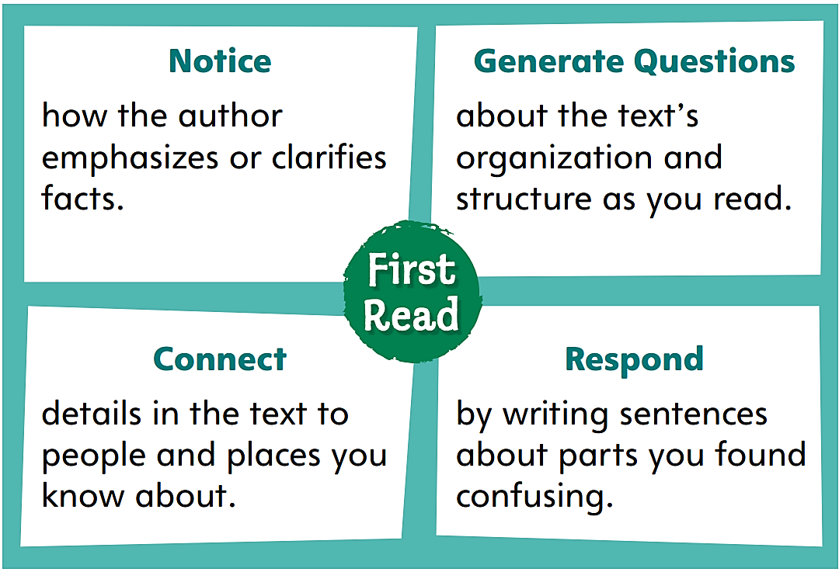
Page 120
First Read Strategies
Notes:
Discuss the First Read Strategies. Prompt students to scan the selection and notice text features. Have students make and record one or more predictions about the selection in the graphic organizer on p. 139 of the Student Interactive..
NOTICE - Remind students to focus on how the author emphasizes or clarifies facts.
GENERATE QUESTIONS - Have students record questions about the text’s organization and structure during reading to deepen understanding.
CONNECT - Have students identify how the details in the text connect to people and places they know about personally.
RESPOND - Have students write sentences about parts of the text that they find confusing.
Students may read the text independently, in pairs, or as a whole class. Use the First Read notes to help students connect with the text and guide their understanding.

Slide 18
Page 120, 121
First Read – Life at the Top
Notes:
Read the text. Pause to discuss the First Read notes with students.

Slide 19
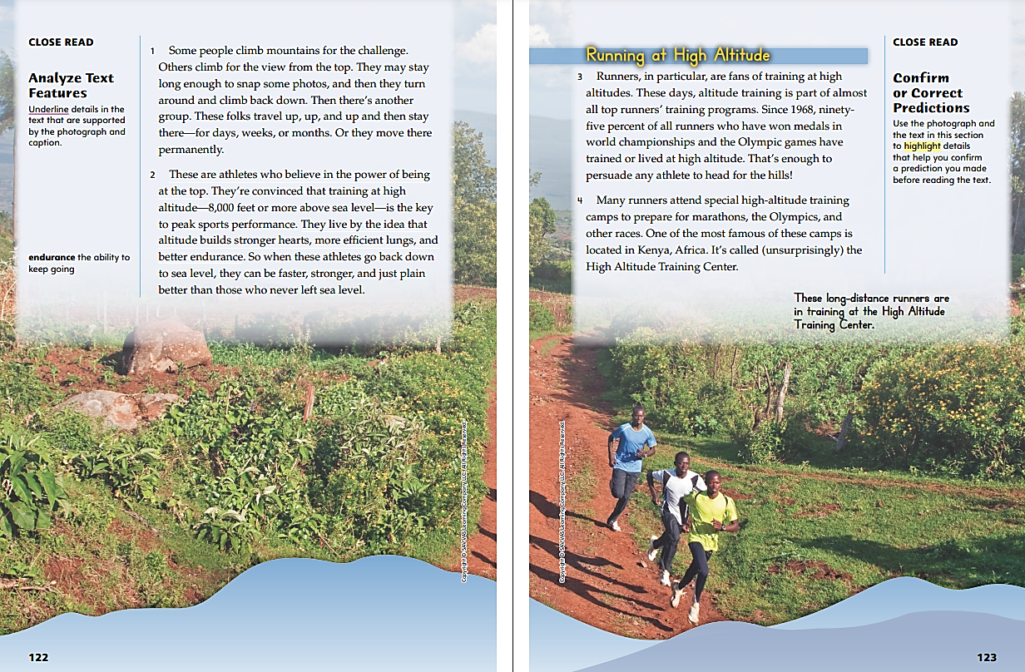
Page 122, 123
First Read – Life at the Top
Notes:
Read the text. Pause to discuss the First Read notes with students.
Say: At the beginning of the text, I learn that some top athletes train at high altitudes in the mountains to improve their performance. Veronica Ellis uses a photograph and caption to help me understand what these mountains look like and how athletes train in them.
Say: The author describes how runners especially like training at high altitude. Are you or is anyone you know a competitive runner or another type of competitive athlete? What kind of training programs do you or they use? Have you ever heard of a training program away from home like the High Altitude Training Center?
Possible Response: Students may talk about their own athletic experiences or those of others. They might mention sports camps, traveling sports teams or clubs, or other athletic programs.

Slide 20
Page 124, 125
First Read – Life at the Top
Notes:
Read the text. Pause to discuss the First Read notes with students.
Say: There are some big words on this page that I’ve never seen before. The author has added some guides to show me how to pronounce these words correctly.
Say: What do the photograph and caption on this page show us? Why do you think the author added them here?
Possible Response: The photo shows Lornah Kiplagat running in a race. The caption says which runner in the photo she is. I think the author added them so we can see what Lornah Kiplagat looks like as a runner..

Slide 21
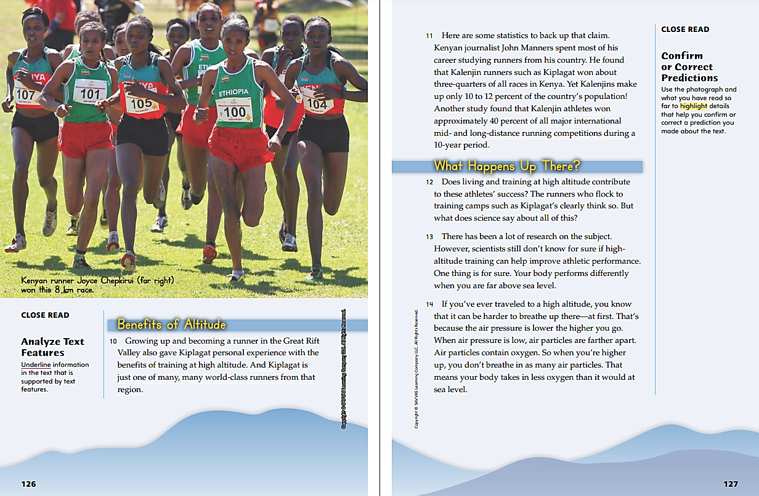
Page 126, 127
First Read – Life at the Top
Notes:
Read the text. Pause to discuss the First Read notes with students.
Say: As I read, I am going to think of questions I have about the text. I see the heading “Benefits of Altitude” and I form a question: “How does altitude benefit runners, specifically?” Maybe the next section of text, under the heading “What Happens Up There?,” will explain more.
Model for students how readers can use what they have learned so far to ask questions and make predictions about the rest of the text while they read. Say: It’s interesting that so many champion runners come from places of high altitude. I see that high altitude must help runners in some way, but I don’t understand how. What is special about high altitude? I think runners must run differently at high altitude than they do at sea level, and that helps them become better runners. Maybe the section “What Happens Up There?” will have more information about this. I will write down my questions about this section because it’s a bit confusing for me, and I want to know more about this topic.

Slide 22
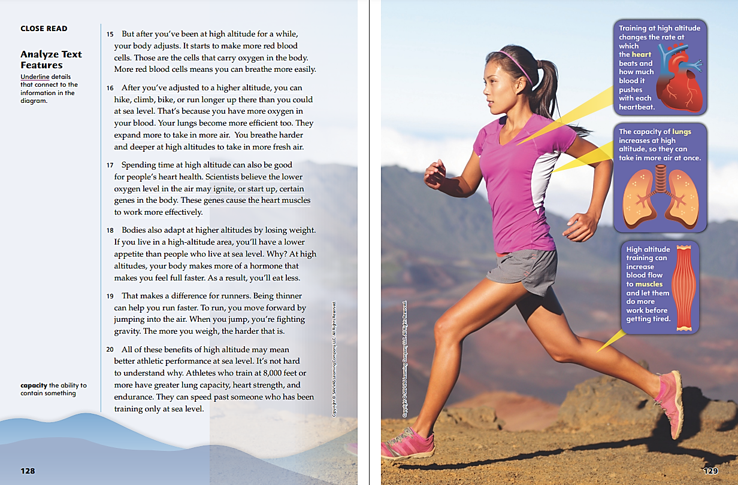
Page 128, 129
First Read – Life at the Top
Notes:
Read the text. Pause to discuss the First Read notes with students.
Say: The text explains how the human body adjusts to higher altitudes. Have you ever climbed a mountain or been to a high-altitude area? How did you feel? Did your body have time to adjust to the higher altitude?
Possible Response: Students may talk about time spent in the mountains or other high-altitude areas like Colorado or Arizona..
Introduce students to diagrams. Say: The picture here is called a diagram. A diagram is a picture that shows and describes parts of an object. I like how the diagram points out parts of the human body and how they all work differently at high altitudes. In this way, the diagram connects to the text directly. It shows how the human body changes at high altitudes in a more interesting way than the text can do alone.

Slide 23
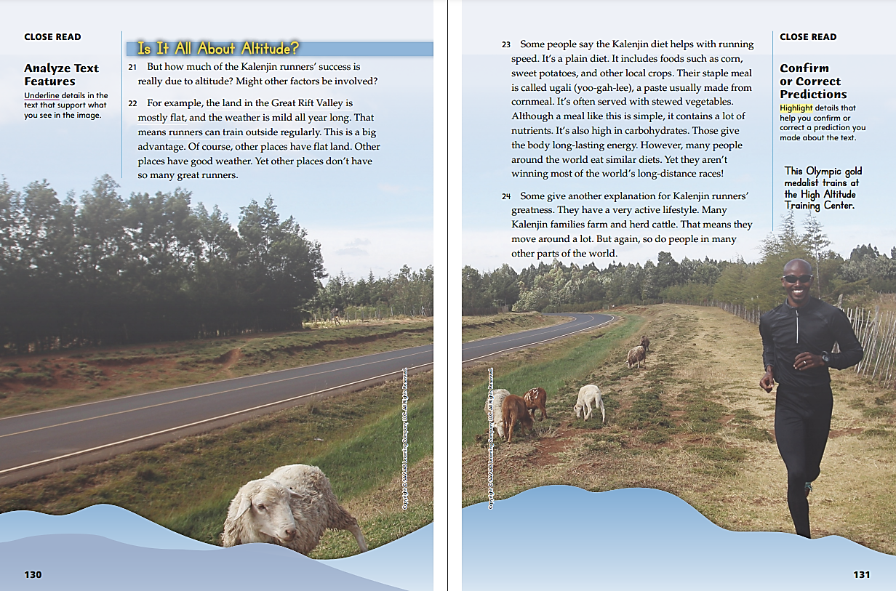
Page 130, 131
First Read – Life at the Top
Notes:
Read the text. Pause to discuss the First Read notes with students.
Say: This looks like an interesting section. So far, it sounds like training at high altitude is the only reason Kalenjins are such good runners. But the heading on this page asks whether altitude really is the only reason. I wonder if this section will talk about other reasons behind these runners’ success.
Remind students that they should continue to make predictions about the text as they keep reading. Say: I learned that there are a lot of reasons Kalenjins are such good runners, not just high-altitude training. Eating a healthful diet and keeping active by moving around a lot help, too. I’m going to use this information to make another prediction, or guess, about the rest of the text.

Slide 24
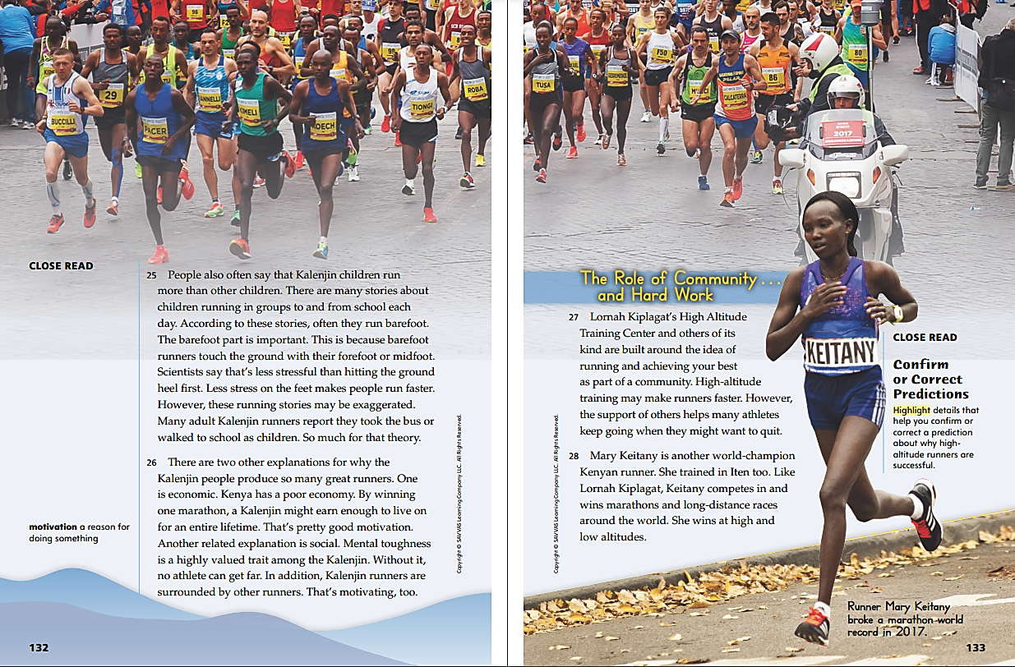
Page 132, 133
First Read – Life at the Top
Notes:
Read the text. Pause to discuss the First Read notes with students.
Remind students that active readers note parts of the text that surprise or confuse them. They write sentences about these parts to help themselves learn. Say: I’m surprised to learn in paragraph 25 that many Kalenjin children run to and from school in groups. I could never do that at my school—it’s too far away from my home! But I also see at the end of the paragraph that many adult Kalenjin runners said they took the bus or walked to school as children. It says some of these stories may be exaggerated, which means they were made to sound bigger than they really are. I’m going to highlight this paragraph and write my questions about it because it’s confusing to me.
Introduce students to the concept of community. Say: The text says that being part of a community and feeling supported by others are two big reasons runners at the High Altitude Training Center succeed. A community is a group of people who have something in common. They might all live in the same area or have the same interests. In this case, the runners at the High Altitude Training Center are all part of the same community because they’re all working to become better runners. Have you ever been part of a club, band, or sports team? Those are communities, too. How did the people in your community help and support you? How did you help and support them?
Possible Response: Students may talk about their own experiences with being involved in a club, band, sports team, or other community.

Slide 25
Page 134, 135
First Read – Life at the Top
Notes:
Read the text. Pause to discuss the First Read notes with students.
Say: The writer mentions that Keitany won a race organized by a charity that raises money for healthcare and education in Africa. We’ve already read that in Kenya, running and training are tied to a sense of community. Runners like Keitany probably feel that connection more strongly when they run for a charity that benefits the community. Have you or anyone in your family ever helped a charity? How did you help? How did that make you feel more connected to your community?
Possible Response: Students may share that they or someone in their family donated time or money to a charity. They may also comment on how that giving affected their sense of community.
Say: On the last page is a photo of a runner winning a race. The caption tells me it is Edna Kiplagat and that she won the 2017 Boston Marathon. I can ask questions about her, such as “Where did she train?” and “Is she a relative of Lornah Kiplagat?”

Slide 26
Respond and Analyze
Brainstorm: What did you think of this text? What about it did you like?
Discuss: What part of this text did you find most ? Did anything surprise you?
Notes:
Use these suggestions to prompt students’ initial responses to Life at the Top.
Brainstorm - What did you think of this text? What about it did you like?
Discuss - What part of this text did you find most interesting? Did anything surprise you?

Slide 27
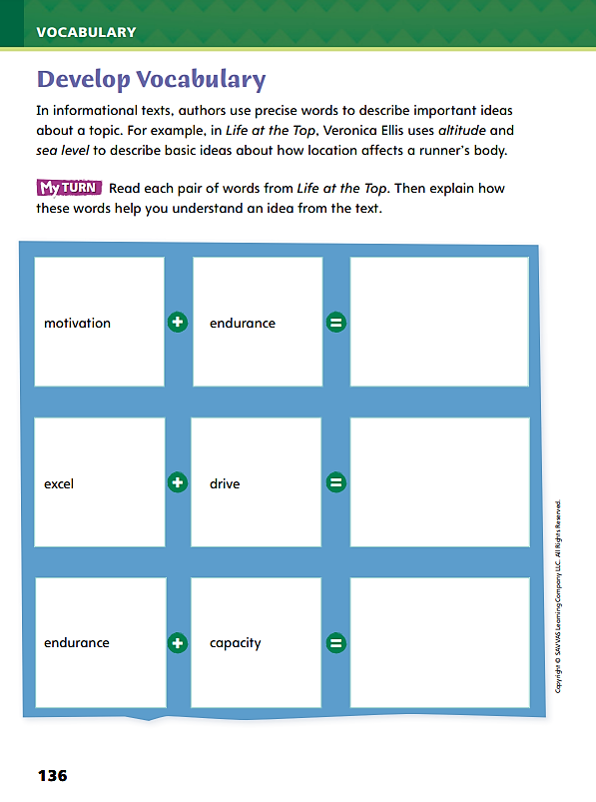
Page 136
Develop Vocabulary
Turn to page 136 in your Student Interactive and complete the activity.
Notes:
Tell students that authors of informational texts select terms to clearly explain their ideas. The vocabulary words endurance, excel, capacity, drive, and motivation develop ideas about what makes runners successful.
Remind yourself of each word’s meaning.
Ask yourself what the author is trying to tell you about high altitude and running.
Model filling out the chart on p. 136 using the words motivation and endurance:
Say: The author uses the words motivation and endurance to explain why and how runners run.
Say: Together, these two words help us understand two important ideas: that runners need a reason to keep running and that this reason helps them keep going for longer periods of time.
Help students use the process you modeled to complete the next row of the chart.
Have students use the strategies for developing vocabulary.
Have students respond using newly acquired vocabulary as they complete p. 136 of the Student Interactive. They should use text evidence in their answers.

Slide 28
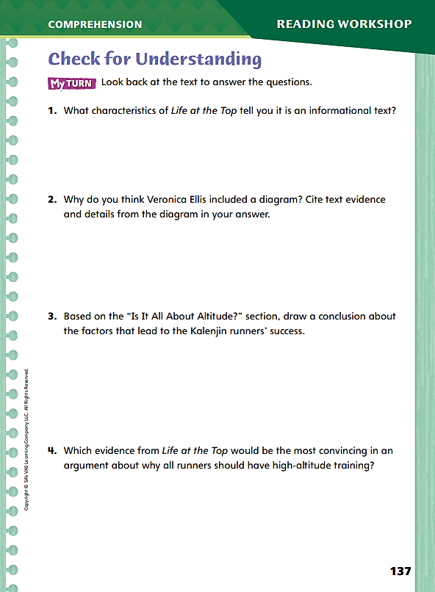
Page 137
Check for Understanding
Turn to page 137 in your Student Interactive and complete the activity.
Notes:
Have students complete p. 137 of the Student Interactive.

Slide 29
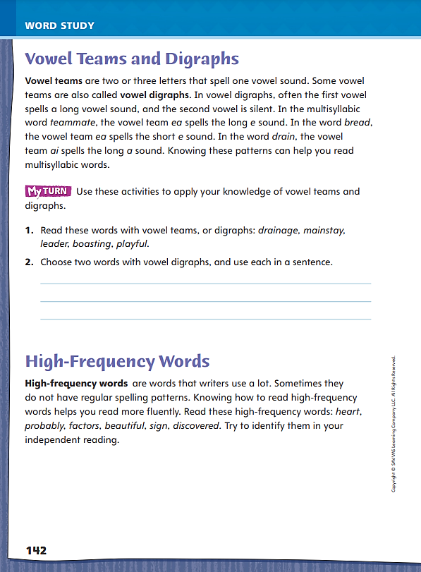
Page 142
Word Study
drainage
boasting
Turn to page 142 in your Student Interactive and complete the activity.
mainstay
playful
leader
Notes:
Instruct students to complete the activities on p. 142 in the Student Interactive to demonstrate their understanding of vowel teams and digraphs.
Students should decode the words. Then ask students to write sentences that include words with vowel digraphs.
High-Frequency Words | The high-frequency words heart, beautiful, and sign do not follow common pronunciation rules. Students should practice identifying and reading aloud these words in their independent reading.

Slide 30
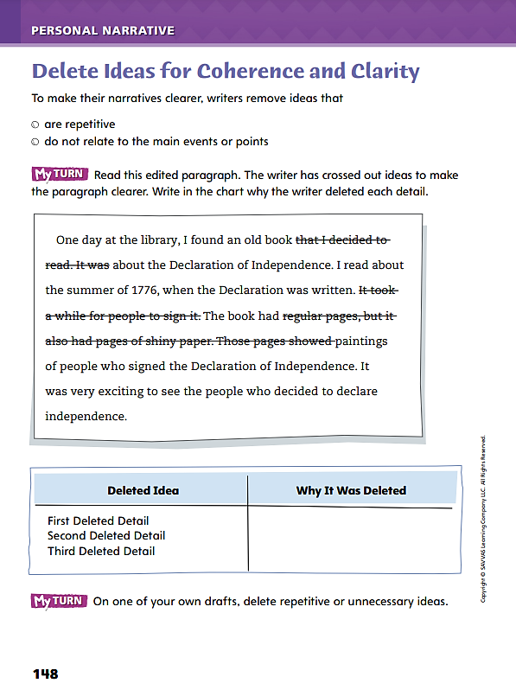
Page 148
Writing – Personal Narrative
Turn to page 148 in your Student Interactive.
Notes:
Explain to students that the purpose of deleting ideas in your draft is to make sentence structure clearer and more coherent by
Removing information that is not related to the main point.
Removing statements that repeat other information.
Choose a stack text students have read. Remind students of the narrator and the setting, and quickly retell the main events. Then ask students to speculate about ideas the author may have deleted using this routine:
Say: Why didn’t this writer include ideas about [name an extraneous character]? Why didn’t this writer include more details about [name the turning point event]?
Explain that writers delete ideas, sentences, and words to help readers focus on the main points and events in a personal narrative.
Direct students to p. 148 of the Student Interactive and have them complete the activity. Then transition students to independent writing.

Slide 31
Independent Writing
In your writing notebook, on one of your own drafts, delete repetitive or unnecessary ideas.
Use this time to look for ideas you can delete to improve the experience you r readers will have.
Share ways you made your drafts clearer by deleting words or sentences.
Notes:
After the minilesson, students should transition into independent writing. If students need a better understanding of what constitutes unnecessary detail, have them experiment with deleting ideas from a draft to see if it still makes sense.
If students struggle, choose one of the following options to provide further support.
Modeled – Do a Think Aloud about remembering a significant event in detail. Demonstrate how you can leave out several details to make the event more vivid for a reader.
Shared – Write a sentence with too many adverbs or adjectives, and have students suggest which ones you can delete without losing clarity.
Guided – Challenge students to read their drafts from a fresh perspective. Provide explicit instruction on how to delete ideas and reread a draft objectively.
If students demonstrate understanding and have completed drafts in their writing notebooks, have them spend this time looking for ideas they can delete to improve the experience their readers will have. See the Conference Prompts on p. T408.
At the end of writing time, invite several volunteers to share ways they made their drafts clearer by deleting words or sentences.

Slide 32
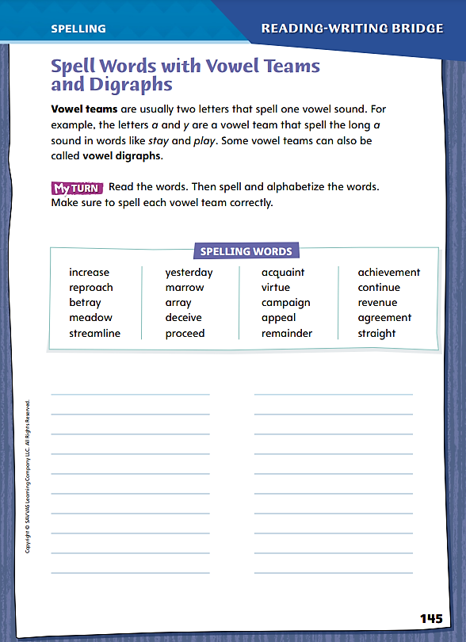
Page 145
Spelling
reproach
acquaint
Turn to page 145 in your Student Interactive and complete the activity.
Notes:
Explain to students that vowel teams are usually two letters that spell one vowel sound. Some vowel teams are also called vowel digraphs.
Go over the words reproach and acquaint from the spelling list. Have students identify each vowel team (oa, ai), then pronounce and spell each word.
Ask students to complete the activity on Student Interactive p. 145.

Slide 33
Language and Conventions
Nandita plans to run a half-marathon it is over 13 miles in length.
When the race starts, runners take off.
Identify whether it is a complete sentence or a run-on and correct each run-on sentence.
Notes:
Define a run-on sentence as two or more sentences that are joined without correct punctuation or a conjunction. A comma splice is a type of run-on that uses a comma to incorrectly connect sentences without also using a conjunction. A run-on can be corrected by breaking it up into two complete sentences or by creating a complete compound sentence using a comma and a conjunction such as and.
Write the following and have students: (a) identify whether it is a complete sentence or a run-on, and (b) correct each run-on sentence.
Nandita plans to run a half-marathon it is over 13 miles in length. run-on: Nandita plans to run a half-marathon. It is over 13 miles in length.
When the race starts, runners take off. complete
Have students write both simple and compound sentences, then exchange papers with a partner. Have partners identify if each sentence is complete or a run-on. If the sentence is a run-on, have students correct it.

Slide 34
Lesson 3

Slide 35
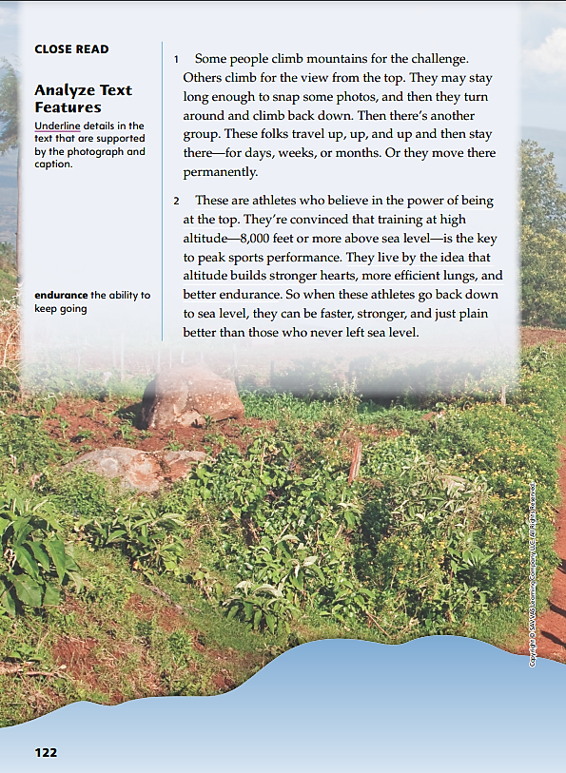
Page 122
Close Read – Analyze Text Features
Turn to page 122 in your Student Interactive.
Notes:
Remind students that authors of informational text often use text features to organize or clarify information. These features can include pronunciation guides, bold words, headings, photographs, illustrations, diagrams, tables, charts, graphs, and maps. By analyzing the purpose of both print and graphic text features, readers can better understand important ideas in the informational text.
Notice the visual and quantitative text features and analyze how they support information in the text.
Determine how the features help you understand the text.
Use the Close Read note on p. 122 of the Student Interactive to lead a discussion analyzing text features in the text.
Ask: What kinds of text features appear in Life at the Top? Have students use the characteristics of informational texts to respond. Underline details in the text that are supported by the photograph. Say: Why did the author include this photo? In the chart, write what the photograph shows.
Have students listen to the audio version of the text. Then have them analyze how the audio presentation of information was different from the visual.

Slide 36
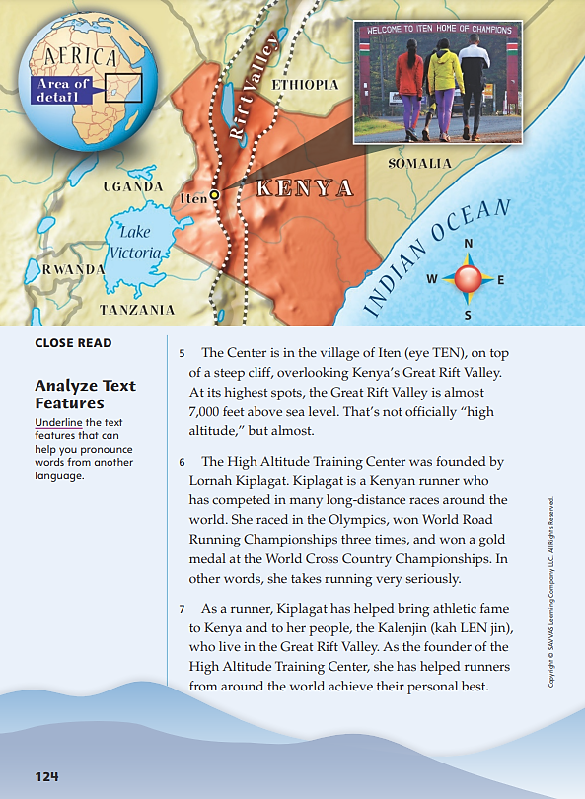
Page 124
Close Read – Analyze Text Features
Turn to page 124 in your Student Interactive.
Notes:
Have students use informational text structure to analyze text features. Remind students that authors of informational text often use text features to help explain information. Ask: What text features on this page can help us pronounce words from another language?
Have students scan paragraphs 5–7 to find and underline text features that can help them pronounce words from another language. See student page for possible responses. Ask students to explain how these text features helped them read and understand the text.
Possible Response: The pronunciation guides showed me how to pronounce “Iten” and “Kalenjin.” This made it easier for me to read the text and understand what it’s about. DOK 1

Slide 37
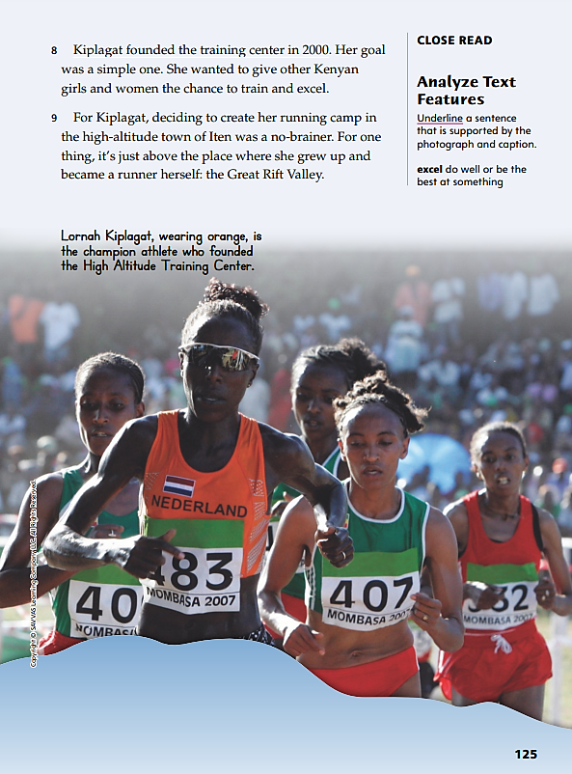
Page 125
Close Read – Analyze Text Features
Turn to page 125 in your Student Interactive.
Notes:
Have students scan paragraphs 8 and 9 to find and underline sentences that are supported by the photo and caption. See student page for possible responses.
Ask students how the sentences they underlined are supported by the photo and caption.
Possible Response: The caption supports the detail “Kiplagat founded the training center in 2000” because it says that Lornah Kiplagat founded the High Altitude Training Center. DOK 2

Slide 38
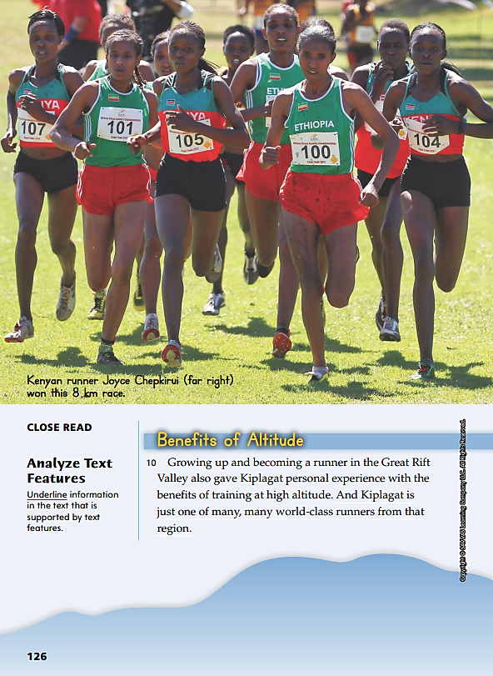
Page 126
Close Read – Analyze Text Features
Turn to page 126 in your Student Interactive.
Notes:
Remind students that authors of informational text often use text features to organize information. Say: Text features like headings help break up the text into smaller sections, making it easier to read and understand. Headings also tell the reader what each section is about.
Have students scan paragraphs 10 and 11 to find and underline information that is supported by text features. See student pages for possible responses.
Ask students to explain how the details they underlined are supported by text features.
Possible Response: The detail “And Kiplagat is just one of many, many world-class runners from that region” is supported by the heading “Benefits of Altitude” because if many world-class runners come from the Great Rift Valley, that must mean that living at high altitude is helpful for runners. DOK 2

Slide 39
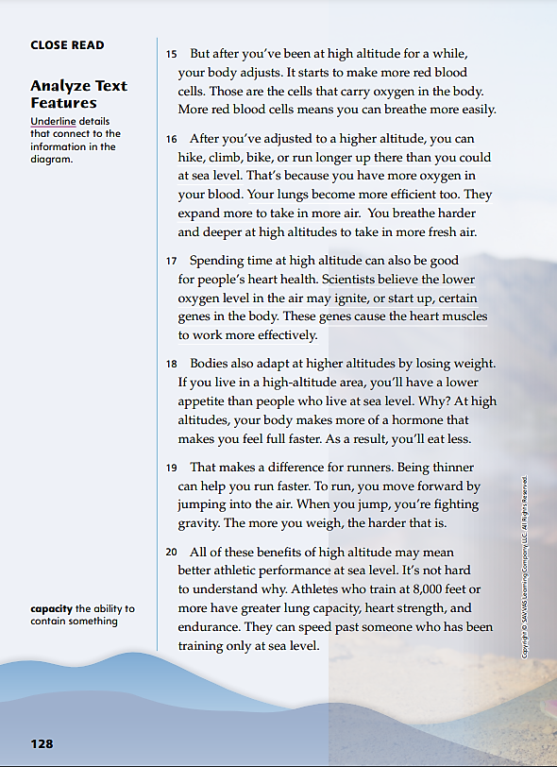
Page 128
Close Read – Analyze Text Features
Turn to page 128 in your Student Interactive.
Notes:
Introduce students to the diagram on the facing page. Say: The picture shows us what the text is talking about: how the human body adjusts to higher altitudes. Some of the details in the text and the picture are the same. I’m going to underline some of the details that connect the text to the picture.
Have students scan paragraphs 15–20 to find and underline information that directly relates to the diagram. See student page for possible responses.
Ask students to explain how the details they underlined are connected to the picture.
Possible Response: The detail “Your lungs become more efficient too. They expand more to take in more air” is connected to the part of the picture that describes how lungs can take in more air at once at high altitude. DOK 2

Slide 40
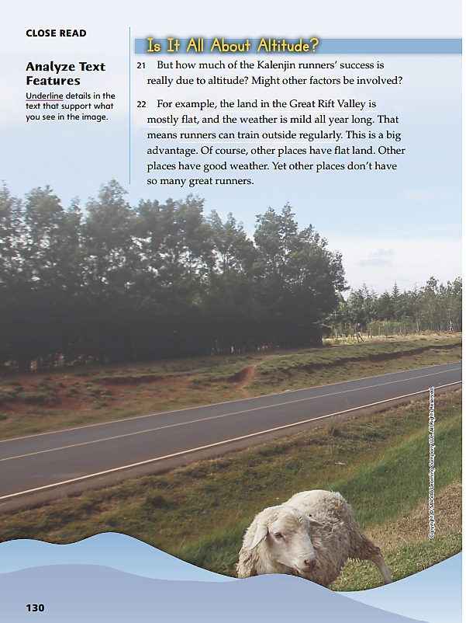
Page 130
Close Read – Analyze Text Features
Turn to page 130 in your Student Interactive.
Notes:
Ask students to describe what they see in the photograph. Say: I wonder how the photograph and caption connect to this part of the text. I’m going to look for details in the text that support what I see in the photo.
Have students scan paragraphs 21 and 22 to find and underline information that is supported by the photograph. See student page for possible responses.
Ask students to explain how the details they underlined are supported by the photograph.
Possible Response: The detail “the land in the Great Rift Valley is mostly flat” is supported by the photograph, which shows a man running on flat ground. The caption says the man is at the High Altitude Training Center, which I know is in the Great Rift Valley. DOK 2

Slide 41
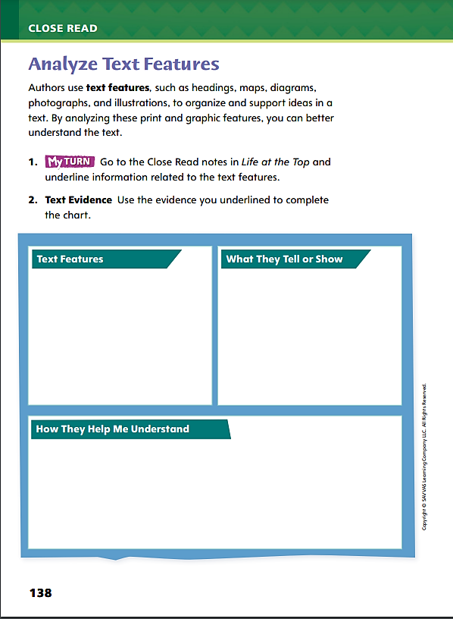
Page 138
Analyze Text Features
Turn to page 138 in your Student Interactive and complete the activity.
Notes:
Have students use the strategies for analyzing text features.
Have students annotate the text using the other Close Read notes for Analyze Text Features and then use the text evidence from their annotations to complete the chart on p. 138.

Slide 42
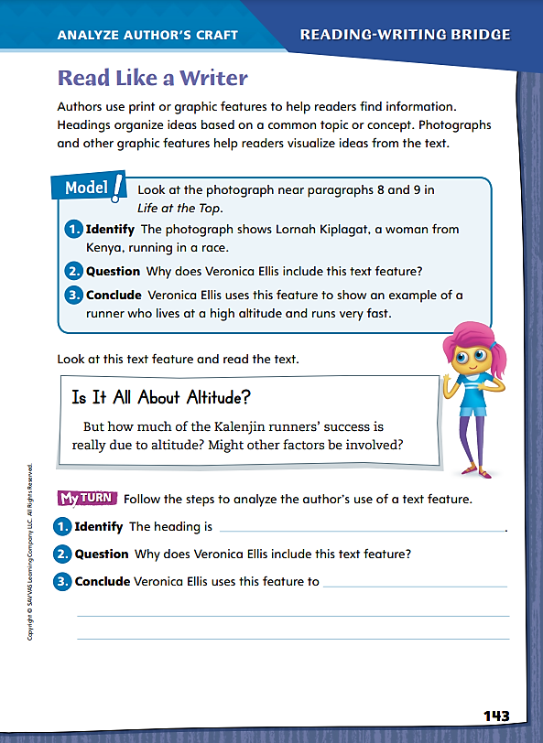
Page 143
Read Like a Writer
Turn to page 143 in your Student Interactive.
Notes:
Explain to students that authors use a variety of text features to help readers understand and navigate a text.
Headings help readers search through a text when they are looking for a specific fact or idea.
Photos and art help readers see what words describe. For example, the floor plan of a house shows how the rooms in the house are arranged.
Graphic organizers such as charts and graphs help readers find data.
Model analyzing print and graphic features by referring to the photograph near paragraphs 8 and 9 on Student Interactive p. 125.
Identify the photograph of the high-altitude runners.
Ask students to speculate about why a photograph appears here and why the author, Veronica Ellis, chose this particular photograph.
Point out that the photograph serves several purposes. First, it shows who the runners are. Second, it allows readers to see the determination on each runner’s face. Third, it identifies a subject of the text, Lornah Kiplagat.
Instruct students to identify a print or graphic feature from the selection. Provide prompts as they discuss the purpose of the feature with a partner.
Direct students to find examples of text features in Life at the Top. Then have students complete My Turn on p. 143 of the Student Interactive.

Slide 43
Word Study
rain
soap
bead
awful
claim
groan
Decode, or read, each word with vowel teams and digraphs.
Notes:
Point out that vowel teams and digraphs are two or three letters that spell one vowel sound.
Write the following words. Have students decode, or read, each word with vowel teams and digraphs.
rain
soap
bead
awful
claim
groan
Have students complete Word Study p. 4 from the Resource Download Center. Click path: Table of Contents -> Resource Download Center -> Word Study -> U1W4 Word Study

Slide 44
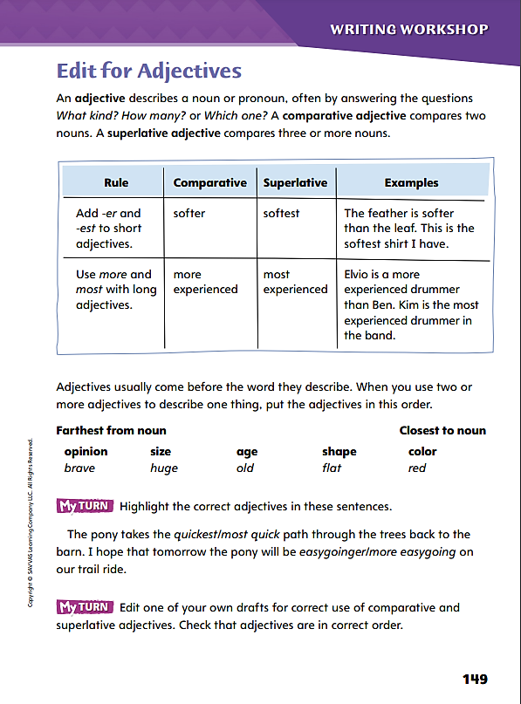
Page 149
Writing – Personal Narrative
Turn to page 149 in your Student Interactive.
Notes:
Adjectives give details about nouns and pronouns that name people, places, and things. An adjective can
Describe one thing: a small dog, an affectionate dog.
Compare two things: a smaller dog, a more affectionate dog.
Compare three or more things: the smallest dog, the most affectionate dog.
Point out that adjectives, including comparative and superlative adjectives, help readers know exactly which person, place, or thing a writer means. Say: Picture in your mind a shelf of drinking glasses that are different heights. If I say, “please get me a tall glass,” you could choose any glass you think is tall. If I say, “please get me a glass that is taller than a juice glass,” I want you to compare the glasses and choose one that will hold more than a juice glass. If I say, “please get me the tallest glass on the shelf,” you know that I want you to choose the single, specific glass with the greatest height. In this way, you can write with adjectives to be very specific about the noun or pronoun you are describing.
Direct students to look at the chart on p. 149 of the Student Interactive. Then have students choose a text from the stack and identify a comparative adjective and a superlative adjective. Ask students to discuss what each adjective tells them about the noun or pronoun.
Return students’ attention to Student Interactive p. 149. Review the order of adjectives, and explain that a writer may use more than one adjective to describe a noun or pronoun. Ask students to return to the stack text they chose and find an example of multiple adjectives used in the correct order.

Slide 45
Independent Writing
Let’s work on our own writing projects.
Edit one of your own drafts for correct use of comparative and superlative adjectives.
Check that adjectives are in correct order.
Share a favorite adjective-noun combination from one of your drafts.
Notes:
After the minilesson, students should transition into independent writing. If students need more opportunities to understand adjective forms, have them work with stack texts to identify examples, and have them explain the use of the adjectives to you.
If students struggle, choose one of the following options to provide further support.
Modeled - Hold up two common objects. Have students suggest and write comparative adjectives that could be used to distinguish them.
Shared - Hold up a common object. Have students suggest adjectives that describe it. Display these words and help students write a sentence about the object with the adjectives in the correct order.
Guided - Use a stack text to give instruction on comparative and superlative adjectives.
If students demonstrate understanding, they may edit for adjectives in their writing notebooks. See the Conference Prompts on p. T408.
At the end of writing time, ask several volunteers to share a favorite adjective-noun combination from one of their drafts.

Slide 46
Spelling
increase
meadow
p_ _ c_ _ _
a_ _ _a _ _ _
a_ _ _ _
s_ _ _ _ m _ _ _ _
Spell each word and identify each vowel team.
Notes:
Remind students that each vowel team usually produces the same vowel sound in different words. However, some vowel teams produce different sounds in different words.
Write and then read the following words aloud: increase, meadow. Point out that the ea vowel team makes a different sound in each word. Then read aloud the words proceed, acquaint, array, and streamline. Have students spell each word and identify each vowel team.
Have students complete Spelling p. 9 from the Resource Download Center. Click path: Table of Contents -> Resource Download Center -> Spelling -> U1 W4 Spelling.

Slide 47
Language and Conventions
Chickens are easy to raise, they lay several eggs a week.
Notes:
S Identify a run-on sentence as two sentences that have been joined incorrectly. Say that a run-on sentence can be corrected by breaking it into two sentences.
Display a run-on sentence. Invite a volunteer to tell how to correct the sentence.
Chickens are easy to raise, they lay several eggs a week. (Chickens are easy to raise. They lay several eggs a week.)

Slide 48
Lesson 4

Slide 49
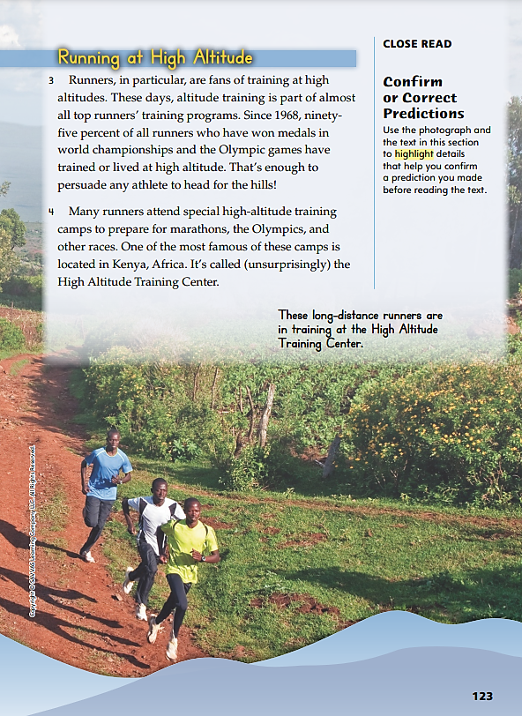
Page 123
Close Read – Confirm or Correct Predictions
Turn to page 123 in your Student Interactive.
Notes:
Explain that readers often make predictions, or guesses, about a text before they start reading. Then they use text features and details to either confirm or correct those predictions as they read.
Review the predictions you made before reading.
Before you read the text again, review the text features in Life at the Top.
As you read, look for genre characteristics or text structures that confirm or counter the predictions you made. Correct your predictions as needed.
Use the Close Read note on p. 123 of the Student Interactive to model how to annotate the text to make, correct, or confirm predictions about the text:
Say: Before I started reading, I looked at some of the text features in the text. I saw a lot of pictures showing runners training in the mountains. I predicted “This article will say that running at high altitudes helps people become better runners.” I wrote that in the Prediction box of the graphic organizer.
Say: Now, while I’m reading, I’m going to look for details that support, or confirm, my prediction. I will also look for any information that does not support, or contradicts, my prediction. I will write both kinds of details in the Evidence Related to My Prediction box. If my prediction was incorrect, I will update it by writing something more accurate.
Have students work in small groups to use text structure and their notes to correct or confirm a prediction.

Slide 50
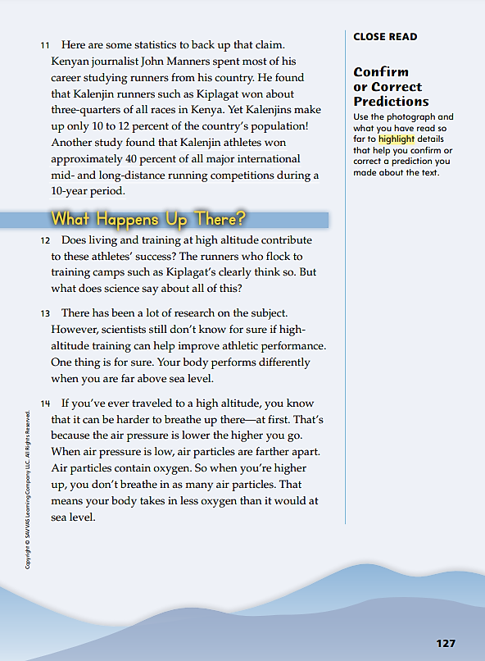
Page 127
Close Read – Confirm or Correct Predictions
Turn to page 127 in your Student Interactive.
Notes:
Have students scan paragraphs 12–14 to find and highlight details that help them confirm or correct a prediction they made about the text. See student page for possible responses.
Ask students to explain how the details they highlighted either support or counter a prediction, or guess, they made.
Possible Response: The detail “Your body performs differently when you are far above sea level” supports my prediction that runners must run differently at high altitudes, and that makes them better runners. DOK 2

Slide 51
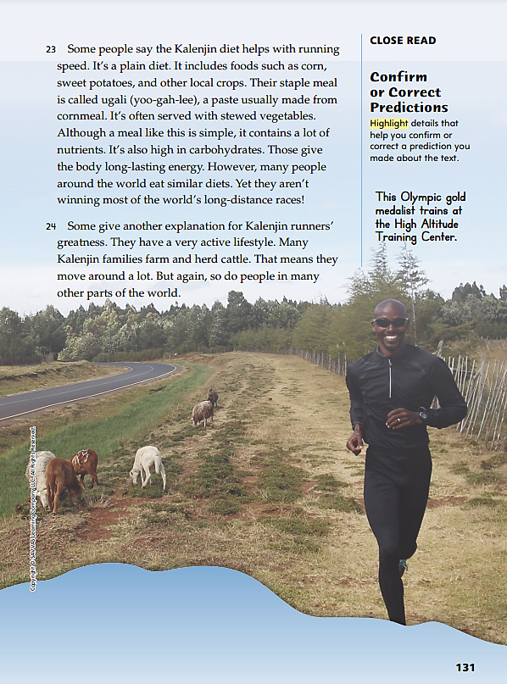
Page 131
Close Read – Confirm or Correct Predictions
Turn to page 131 in your Student Interactive.
Notes:
Have students scan paragraphs 23 and 24 to find and highlight details that help them confirm or correct a prediction they made about the text. See student page for possible responses.
Ask students to explain how the details they highlighted either support or counter a prediction they made.
Possible Response: The detail “They have a very active lifestyle” counters my prediction that training at high altitude is the only reason Kalenjin runners do so well in races. I will correct my prediction to say that I think there are many different reasons Kalenjins are such good runners. One is their high-altitude training. Another is their very active lifestyles. DOK 3

Slide 52
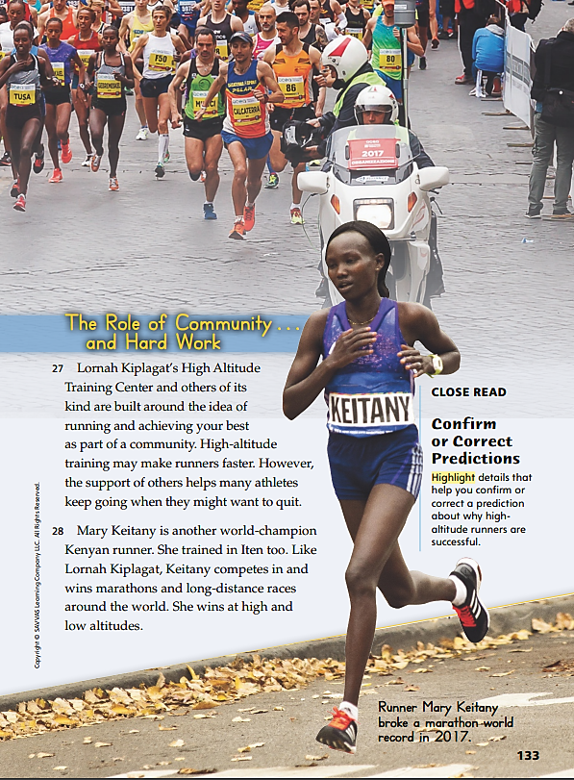
Page 133
Close Read – Confirm or Correct Predictions
Turn to page 133 in your Student Interactive.
Notes:
Have students scan paragraphs 27 and 28 to find and highlight details that help them confirm or correct a prediction they made about why high altitude runners are successful. See student page for possible responses.
Ask students to explain how the details they highlighted either support or counter their prediction about why high altitude runners are successful.
Possible Response: The detail “the support of others helps many athletes keep going when they might want to quit” confirms my prediction that runners do better when they train in groups. DOK 3

Slide 53
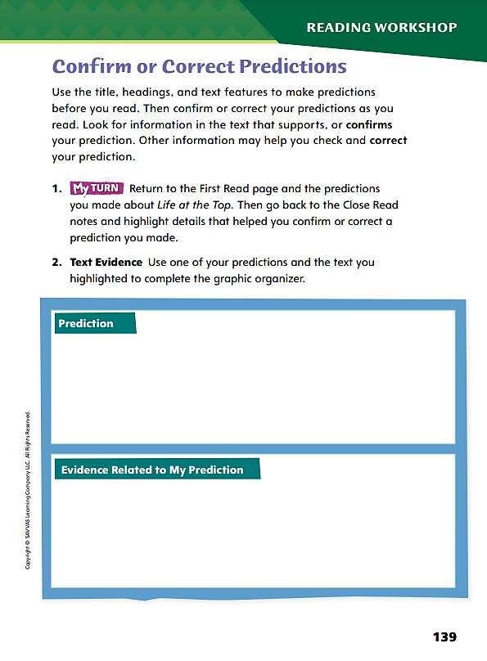
Page 139
Confirm or Correct Predictions
Use the text
evidence from your annotations to complete page 139.
Notes:
Have students use the strategies for confirming and correcting predictions.
Have students annotate the text using the other Close Read notes for Confirm or Correct Predictions, and then use the text evidence from their annotations to complete p. 139.

Slide 54
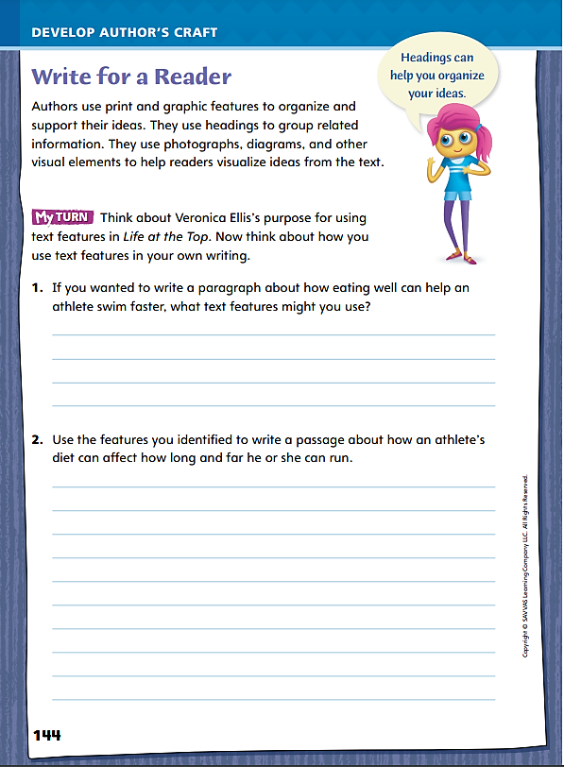
Page 144
Write for a Reader
Turn to page 144 in your Student Interactive.
Notes:
Explain to students that one of the most valuable tools in a writer’s toolbox is the use of print and graphic features. Point out the headings, photographs, map, and diagram in Life at the Top.
Discuss how students might use print and graphic features in their own writing. Model an example.
Identify a nonfiction topic to write about, such as the “thin air” that people experience at high altitudes. Discuss how students might find facts about the oxygen content of “thin air” from print or digital sources.
Ask: How might you use a graphic feature to show the change in how much oxygen air holds at elevations from 0 to 5,000 feet above sea level? Would a photo be useful here, or a graph or table? Pause for responses. Say: A graph might be best. You could use it to show how oxygen levels steadily decrease from 0 to 5,000 feet above sea level.
If time permits, find data for the relationship between elevation and oxygen levels, and use the data to construct a graph as a class.
Point out how this process resembles the one on p. 144 of the Student Interactive

Slide 55
Page 144
Apply
Turn to page 144 in your Student Interactive and complete the activity.
Notes:
Ask students to make a list of graphic features in Life at the Top. Then have students complete the activity on page 144 of the Student Interactive.

Slide 56
Word Study
dim
dime
Identify whether the VCe pattern has a long a, long i, long o, or long u.
educate
recognize
cyclone
ridicule
Notes:
Review the lesson from the previous week about how the VCe pattern produces a long vowel.
Write dim and dime. Say: Without the silent e, the i in dim has a short sound. When a silent e is attached, dime has a long i sound.
Display the following VCe pattern words: educate, recognize, cyclone, and ridicule. Point to the words and call on student volunteers to identify whether the VCe pattern has a long a, long i, long o, or long u.

Slide 57
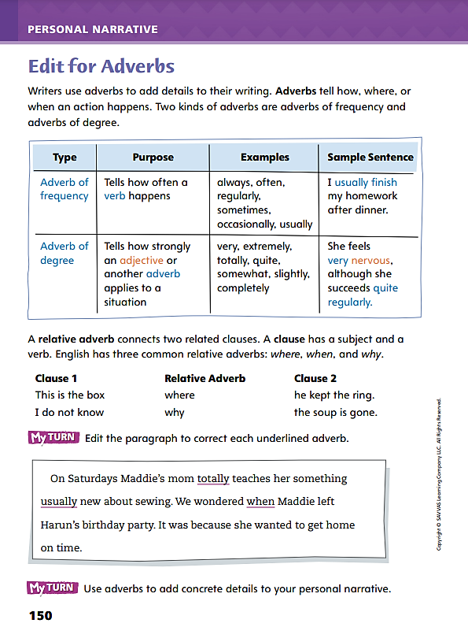
Page 150
Writing – Personal Narrative
Turn to page 150 in your Student Interactive and complete the activity.
Notes:
Explain to students that adverbs serve several functions in sentences. They provide readers with necessary information by
Describing how, where, or when actions happen.
Connecting related clauses to explain where, when, and why actions happen.
Say: A word for “how often” is frequency. If I want to tell you how often I read the newspaper, I could say that I read it “daily” or “weekly” or even “hourly.” Those words are adverbs of frequency. Model how to edit the sentence, I read the newspaper daily, by supplying other examples of words that give frequency, such as regularly, rarely, yearly, and always.
Explain that another word for “amount” is degree. Display examples of contrasting adverbs of degree, such as partially and completely. Work with students to use each one in a sentence about the same topic, for example, “I am partially finished, I am completely finished.” Have students explain the different meanings of the sentences.
Tell students that the words where, when, how, and why are adverbs writers may use to connect related ideas. They convey the place, the time, the manner or way, and the reason actions happen.
Direct students to complete the activity on p. 150.

Slide 58
Independent Writing
Continue working on your personal narratives.
Use adverbs to add concrete details to your personal narrative.
Share examples of adverbs of frequency and degree from your personal narratives.
Notes:
After the minilesson, students should transition into independent writing. If students need more models of adverb use, have them study stack texts for examples to imitate.
If students struggle, choose one of the following options to provide further support.
Modeled - Use a stack text to model adverb use. Work with students to find and copy examples of adverbs of frequency, adverbs of degree, and relative adverbs.
Shared - Write short clauses on the board and have students create sentences by adding adverbs either to describe verbs, adjectives, or other adverbs or to connect related clauses.
Guided - Provide explicit instruction on how adverbs can be used to modify verbs, adjectives, and other adverbs.
If students demonstrate understanding, have them incorporate relative adverbs into their personal narratives. See the Conference Prompts on p. T408.
After writing time is over, call on two or three students to share examples of adverbs of frequency and degree from their personal narratives.

Slide 59
Spelling
mat
mate
bit
bite
not
note
tub
tube
Notes:
Review the VCe sequence in which a silent e at the end of a syllable confers a long sound on the vowel that precedes it.
Read these word pairs aloud: mat and mate, bit and bite, not and note, tub and tube. Ask students to explain how the letter e functions in each word. Have students spell the words.
Invite students to play a game in which they analyze a text and circle every VCe syllable they can find. The player who finds the most examples wins the game.

Slide 60
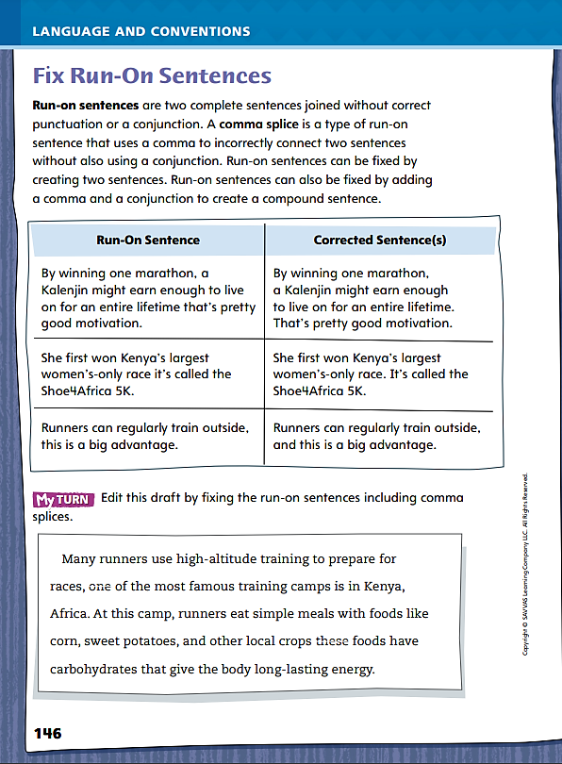
Page 146
Language and Conventions
Turn to page 146 in your Student Interactive and complete the activity.
Notes:
Have students complete the My Turn section on Student Interactive p. 146.

Slide 61
Lesson 5

Slide 62
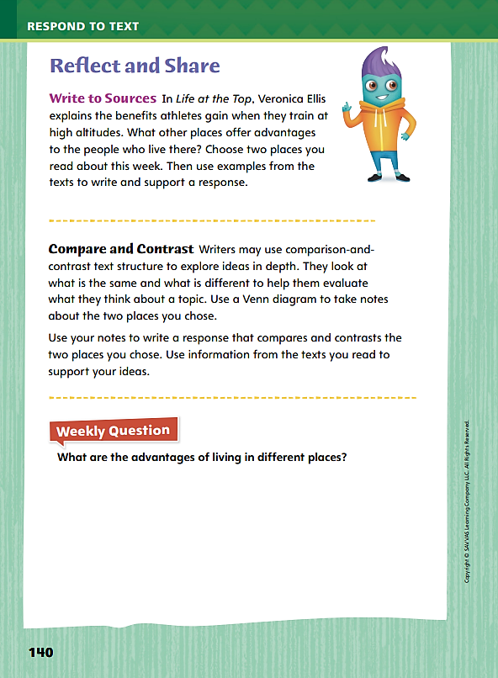
Page 140
Reflect and Share
Turn to page 140 in your Student Interactive.
Notes:
Explain to students that readers sometimes compare and contrast ideas across different texts so they can understand those ideas on a deeper level. A Venn diagram can help them identify similarities and differences between ideas and explore their thoughts before they start writing a response.
Model creating a Venn diagram using the Write to Sources prompt on p. 140 in the Student Interactive. Say: I’m going to use a Venn diagram to help me compare the place in Life at the Top with the place in Life in the West. One way that the Great Rift Valley in Life at the Top is different from the West in Life in the West is that people come to the Great Rift Valley to train for a race or other sporting event, while people went to the West to find a better a life. For some, that meant finding gold, while for others, it meant being free or owning land. On the left side of the diagram, I’m going to write “training” under Life at the Top, and on the right side, I’m going to write “better life” under Life in the West. One thing that the Great Rift Valley and the West have in common is that they both developed communities. I’m going to write “communities” in the middle of the Venn diagram because both places I read about have communities.
Have students continue filling out their Venn diagrams. Then ask them to use their diagrams to write a response that compares and contrasts the two places. Remind students that they should use evidence from both texts to support their ideas.

Slide 63
Page 140
Apply
What are the advantages of living in different places?
Notes:
Have students use the strategies for comparing and contrasting ideas across texts.
Have students write a response that compares and contrasts to complete the rest of p. 140 in the Student Interactive.
Have students use evidence from the texts they have read this week to respond to the Weekly Question. Tell them to write their response on a separate sheet of paper.

Slide 64
Word Study
raw
coal
feeling
clean
dream
coat
booth
draw
Notes:
To evaluate how well students recognize vowel teams and digraphs, have them echo-read the following words:
raw
coal
feeling
clean
dream
coat
booth
draw
Invite students to make a running list of words with vowel teams and digraphs that they encounter in their reading.

Slide 65
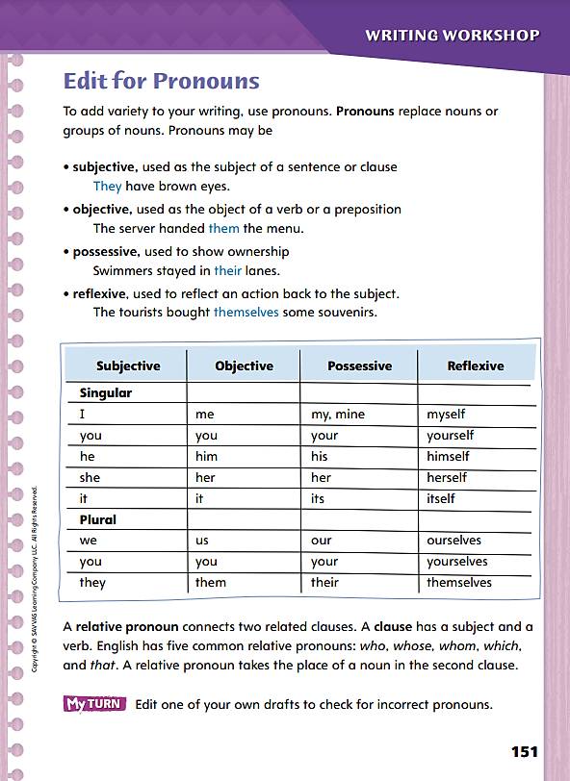
Page 151
Writing – Personal Narrative
Turn to page 151 in your Student Interactive.
Notes:
Writers use different pronouns based on the pronouns’
Role in a sentence, as subject or object.
Use as an adjective, such as a possessive.
Ability to clarify information.
Have students transcribe the following sentence as you say it several times: I hope Darnell will help me teach myself to use my computer, because I should know how to use what is mine. Tell students to underline the pronouns, and then explain the role each one plays in the sentence.
Say: I is a subjective pronoun, the subject of the sentence: I hope. Darnell is going to help me. Me is an objective pronoun because it receives the action of helping. Myself is reflexive, because the teaching from me will reflect back to me. My is possessive, and so is mine.
Direct attention to the chart on Student Interactive p. 151. Call on students to provide sentences for each row of pronouns. Challenge confident students to create sentences with correct usage of the pronouns that differ in subjective and objective cases: I and me, he and him, she and her, we and us, and they and them. Have a volunteer give the definition of a clause and list the relative pronouns. Explain that writers use relative pronouns in place of a noun to show relationships. Give some examples and ask students to identify the relative pronoun and its antecedent. This is the book that I wanted. (this, book) The box, which arrived today, came early. (which, box) The students, of whom I am proud, are successful. (whom, students) The teacher, whose students were successful, was proud. (whose, teacher) The runner who ran fastest won the race. (who, runner)

Slide 66
Independent Writing
In this week’s Writing Club, you will share revised drafts of your personal narratives.
Decide which elements of your work you would like feedback on in today’s Writing Club.
Explain how you tell the difference between a subjective and an objective pronoun.
Notes:
Place students into Writing Club groups. See p. T427 for details of how to run Writing Club. See the Conference Prompts on p. T408.
In this week’s Writing Club, students will share revised drafts of their personal narratives.
To gain confidence in giving and receiving constructive feedback, students should spend the first 5–10 minutes in their groups discussing how to:
tell a writer what is good or strong about his or her draft.
make specific, concrete suggestions for a writer to consider.
listen actively and ask relevant questions for clarification.
Before sharing their personal narratives, students should decide which elements of their work they would like feedback on in today’s Writing Club. Students should tell the club their concerns before they begin reading their narratives. This will help the group focus.
After writing time is over, call on a student to explain how he or she tells the difference between a subjective and an objective pronoun.

Slide 67
Spelling
After her term ends, Susanna will continue to work in government.
It appears that Anthony was trying to deceive the news reporters.
After six days, I’m still trying to acquaint myself with the New Mexico landscape.
Proceed to check out after you order.
The road to ruin is not straight.
Dana’s great virtue is that she is incapable of telling a lie.
The campaign for governor was a long, tough fight.
We sold more hot dogs at a lower price, so our revenue stayed even.
Running a marathon is an impressive achievement.
Steve may disagree with you, but he will never betray you.
Notes:
(Note: Move the orange boxes to cover each bold spelling word before you read aloud the words and sentences.)
Have students spell the bold words in the following sentences.
After her term ends, Susanna will continue to work in government.
It appears that Anthony was trying to deceive the news reporters.
After six days, I’m still trying to acquaint myself with the New Mexico landscape.
Proceed to check out after you order.
The road to ruin is not straight.
Dana’s great virtue is that she is incapable of telling a lie.
The campaign for governor was a long, tough fight.
We sold more hot dogs at a lower price, so our revenue stayed even.
Running a marathon is an impressive achievement.
Steve may disagree with you, but he will never betray you.
Reveal the spelling word and have students check their work.

Slide 68
Language and Conventions
Select the best revision.
Rennie led the race for the first 16 miles she got tired.
Rennie led the race for the first 16 miles, she got tired.
Rennie led the race for the first 16 miles. She got. Tired.
Rennie led the race for the first 16 miles. She got tired.
Rennie led the race. For the first 16 miles she got tired.
Notes:
Write this sentence:
Rennie led the race for the first 16 miles she got tired. Have students choose the best revision for the sentence.
Rennie led the race for the first 16 miles, she got tired.
Rennie led the race for the first 16 miles. She got. Tired.
Rennie led the race for the first 16 miles. She got tired.
Rennie led the race. For the first 16 miles she got tired.
Have students complete Language and Conventions p. 14 from the Resource Download Center. Click path: Table of Contents -> Resource Download Center -> Language and Conventions -> U1 W3

Slide 69
Unit 1: Week 4
Grade 4

