Slide 1
Unit 1: Week 3
Grade 1

Slide 2
Copyright © Savvas Learning Company LLC. All Rights Reserved.
This publication is protected by copyright, and permission should be obtained from the publisher prior to any prohibited reproduction, storage in a retrieval system, or transmission in any form or by any means, electronic, mechanical, photocopying, recording, or otherwise. For information regarding permissions, request forms, and the appropriate contacts within the Savvas Learning Company Rights Management group, please send your query to:
Savvas Learning Company LLC, 15 East Midland Avenue, Paramus, NJ 07652
or
k12learningpermissions@savvas.com
myView Literacy® is an exclusive trademark of Savvas Learning Company LLC in the U.S. and/or other countries.

Slide 3
Lesson 1

Slide 4
Page 98
Phonological Awareness
Notes:
Point to the picture of the sock on p. 98 in the Student Interactive. Tell students to listen to each sound as you say the word sock. Repeat the sounds in the word sock several times: /s/ /o/ /k/. Then have students repeat the activity with the pictures for fox and log.
Say the sounds in the word pot: /p/ /o/ /t/. Elongate the pronunciation of the medial sound /o/. Then say: Listen carefully as I say the sounds in the word pot: /p/ /o/ /t/. Now repeat the sounds in pot with me: /p/ /o/ /t/. What sound do you hear in the middle of the word pot? Good job! It is the sound /o/. Keep practicing the medial sound /o/ with the following words: mop, not, cod, tot. Say the sounds and have students repeat.

Slide 5
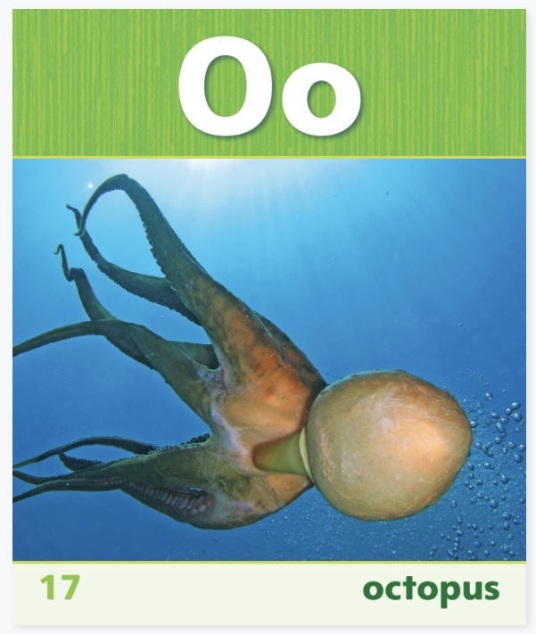
Phonics
pot
mop
not
cod
tot
Notes:
Use Sound-Spelling Card 17 (octopus) to introduce how to spell the short o sound.
Say: This is a picture of an octopus. Octopus begins with the sound /o/: /o/ (pause) /o/ (pause) /o/ (pause) octopus. Say the sound with me. Have students say the sound several times, then ask: What sound does octopus begin with? Elicit responses. Great work! Point to the Oo at the top of the card. The sound /o/ is called the short o sound and is spelled o. What letter spells the short o sound? Yes, the letter o. Write the words on and not, and have students decode them. Click path -> Table of Contents -> Unit 1 Week 3 Informational text -> Lesson 1

Slide 6
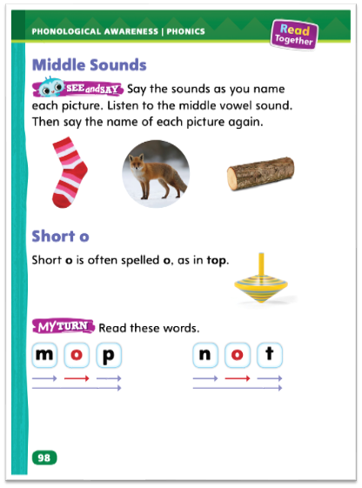
Page 98
Apply
Read the words on page 98 in your Student Interactive.
Notes:
Direct students to the bottom of p. 98 in the Student Interactive. Read aloud the text. Then have students segment (short arrows) and blend phonemes (long arrow) to decode the short o words.

Slide 7
High-Frequency Words
are
was
by
you
look
Notes:
Write the high-frequency words are, by, look, was, you. Display the words. Tell students to practice and remember these words.
Point to each word as you read it.
Then spell the word and read it again.
Have students spell and say the words with you.

Slide 8
Page 96,97
Interact with Sources
Traffic signals tell us when to stop and when to go.
Traffic signals can help walkers and drivers stay safe.
When you know what the signals are for walk and wait, you know when it is okay to cross the street.
Notes:
Remind students of the Essential Question for Unit 1: What is a neighborhood? Point out the Week 3 Question: How do signs in our neighborhood help us?
Have students follow along in their Student Interactive, pp. 96–97, as you read aloud “Traffic Signals.” Then organize students into small groups and have them use the pictures and text to discuss how the signs keep people safe. During the group discussions, encourage students to ask questions to clear up any confusion about the topic of the diagram.
Display the following statements as ideas the group might discuss:
Traffic signals tell us when to stop and when to go.
Traffic signals can help walkers and drivers stay safe.
When you know what the signals are for walk and wait, you know when it is okay to cross the street.
Then ask: How are the red light and the yellow hand the same? Guide students to return to the diagram. Then have each group reach a consensus on an answer and choose a representative to share the group’s answer with the class.
Have students interact with the diagram by underlining the names of the traffic signals on pp. 96–97. Remind students that underlining is a way to interact with a text.
Remind students of the Weekly Question: How do signs in our neighborhood help us? Tell them that traffic lights are only some of the helpful signs in the neighborhood. Point out that neighborhood signs can also tell street names and give directions. Say: You will read about other neighborhood signs that help us stay safe.

Slide 9
Listening Comprehension
A Railroad Crossing sign is near a railroad track.
Notes:
Tell students you are going to read aloud the informational text “Signs in Your Neighborhood.” Tell students to be active listeners by looking at you and thinking about what you are reading.
Purpose Have students listen actively for elements of informational text.
READ the entire text aloud without stopping for the Think Aloud callouts.
REREAD the text aloud, pausing to model Think Aloud strategies related to the genre.
Ask students: Why is a Railroad Crossing sign near a railroad track? Record student responses.

Slide 10
Page 108,109
Informational Text
Turn to page 109 in your Student Interactive.
Notes:
An informational text tells facts about real people, things, or events. Informational texts often use text features, such as headings, to help readers find information.
Does the text tell facts about real people, things, or events?
Look at the text features. How do the headings help you find information?
Informational texts, or books, are different from realistic fiction. Informational books give us information. Realistic fiction books tell us stories.
Read the model “Neighborhoods” with students on p. 108 of the Student Interactive. Then use “Neighborhoods” to demonstrate how to identify an informational text. Say: The title of this text is “Neighborhoods.” So the text must be about neighborhoods. Point to the first heading. I see the word PLACES. This word does not look like the other words. PLACES is a heading. It tells me that this part of the text is where I can read about places in a neighborhood. The text tells me what happens in a market and in a school. These are two real places in a neighborhood. These facts about real places show me that this is an informational text. Then read the Anchor Chart on p. 109 together. Editable Anchor Chart Click Path: Table of Contents -> Reading Anchor Charts -> Unit 1 Week 3: Informational Text Editable Reading Anchor Chart

Slide 11
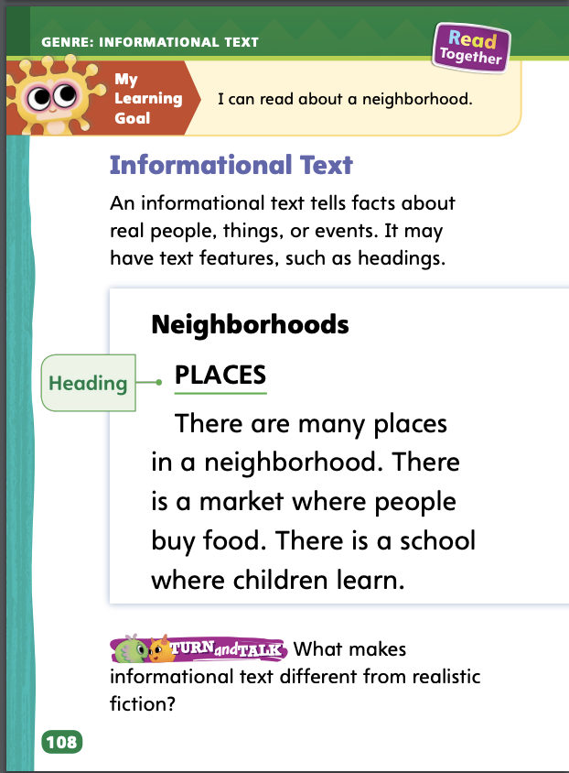
Page 108
Apply
Talk to a partner about what makes informational text different from realistic fiction.
Notes:
Have students use the strategies to identify informational texts.
Ask students to follow the Turn and Talk prompt on Student Interactive p. 108 by discussing with a partner what makes informational text different from realistic fiction.

Slide 12
Page 125
Academic Vocabulary
Turn to page 125 in your Student Interactive and complete the activity.
Notes:
Remind students of the Academic Vocabulary for the unit: group, type, settle, various. Explain that context clues can be other words in the sentence or in nearby sentences that help the reader understand what a word means.
Read the sentence that has an unfamiliar word.
Look for clues in the sentence that may help you figure out the meaning of the unknown word.
Read the sentence again. Did the context clue help you find the meaning of the unknown word?
Illustrations and photographs will also provide context clues for an unknown word.
Model an example: There are various colors in a traffic light. The colors are red, yellow, and green. The words red, yellow, and green seem like clues about the meaning of the word various. I know that red, yellow, and green are different colors. I think the word various means “different from each other.” Various colors are colors that are different from each other, so this meaning makes sense.
Have students practice identifying context clues by completing p. 125 in the Student Interactive.

Slide 13
Handwriting
Notes:
Horizontal lines go from the left to the right.
Model writing horizontal lines on the board, using dotted lines first. • Draw an arrow pointing right to indicate the direction to write. • Tell students that practicing horizontal lines will help them become better writers.
Have students use Handwriting p. 23 from the Resource Download Center to practice writing horizontal lines. Click path: Realize -> Table of Contents -> Resource Download Center -> Handwriting Practice -> U1W3L1 Handwriting Practice

Slide 14
Writing – Launching Writing Workshop
The features of a fiction book provide information.
The front cover tells the title, author’s name, and illustrator’s name.
The back cover tells details about the book.
The title page tells the title, author, and publisher.
The pages have words and pictures that tell a made-up story
Notes:
A fiction book has unique features. The features of a fiction book provide information.
The front cover tells the title, author’s name, and illustrator’s name.
The back cover tells details about the book.
The title page tells the title, author, and publisher.
The pages have words and pictures that tell a made-up story.
Hold up a fiction book from the stack. Let’s look at the front cover. The front cover tells the title and names of the author and illustrator. Point to and read the title. This is the title. Point to and read the author and illustrator, identifying each. Repeat this procedure pointing out the details on the back cover, the information on the title page, and the words and pictures on the interior pages.
Explore the features of one or two more books from your stack, following the routine above. Focus on the structure of how the features are organized for each fiction book. As you flip through a book, ask students to point out what they notice. Mention that fiction books are often made-up stories and include characters, setting, and plot.

Slide 15
Independent Writing
Let’s begin writing a fiction book.
Notes:
Have students transition to independent writing.
Remind students that a fiction book has characters, setting, and plot. It has a front cover, back cover, title page, and words and pictures.
Modeled Choose a stack text and do a Think Aloud to model how to identify the information in each feature of the fiction book.
Shared Have students choose a stack text. Prompt students to find the title, author, and illustrator.
Guided Use the stack texts to provide explicit instruction on the specific information contained in each feature of a fiction book.
Encourage students to begin or continue writing a fiction book.
As students write, use the conference prompts in the Teacher’s Edition or Resource Download Center to provide support. Click path: Table of Contents -> Resource Download Center -+ Writing Workshop Conference Notes
Invite a few students to share the information they would include on the front cover of their own fiction book

Slide 16
Spelling
I am on the cot.
Matt got the fan.
We will not go there.
Put the lid on the pot.
Look at the moon.
You are my friend.
Notes:
(Note: Move the orange boxes to cover each bold spelling word before you read aloud the words and sentences.)
Read aloud the words and sentences. Have students spell each word with initial consonant blends and the two high-frequency words.
I am on the cot.
Matt got the fan.
We will not go there.
Put the lid on the pot.
Look at the moon.
You are my friend.
Reveal the spelling word and have students check their work.

Slide 17
Language and Conventions
I sit.
I look.
Notes:
Remind students that verbs tell about action. A present tense verb tells about action that is happening at that moment.
Write the following sentence: I sit. Demonstrate the action as you read the sentence aloud. Ask students which word tells what you are doing. Remind students that this is a present tense verb because it is describing what you are doing now. Repeat with the sentence I look.
Have students work in pairs to make sentences with present tense verbs. Encourage them to think of things people do or actions that happen in neighborhoods. Invite them to share their sentences with the class and tell which word in their sentence is the verb.

Slide 18
Lesson 2

Slide 19
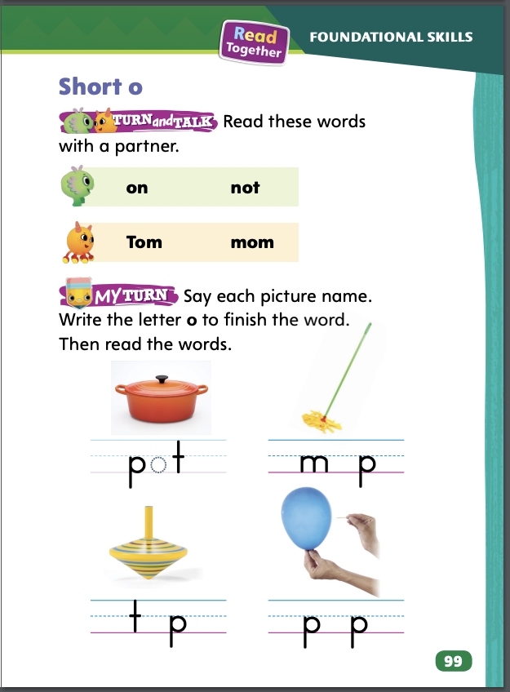
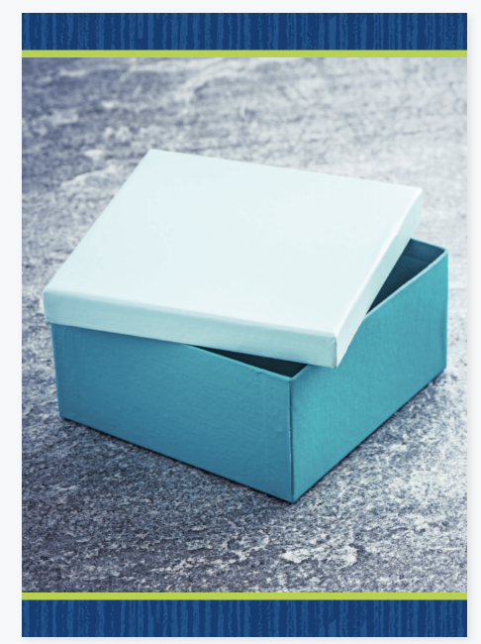
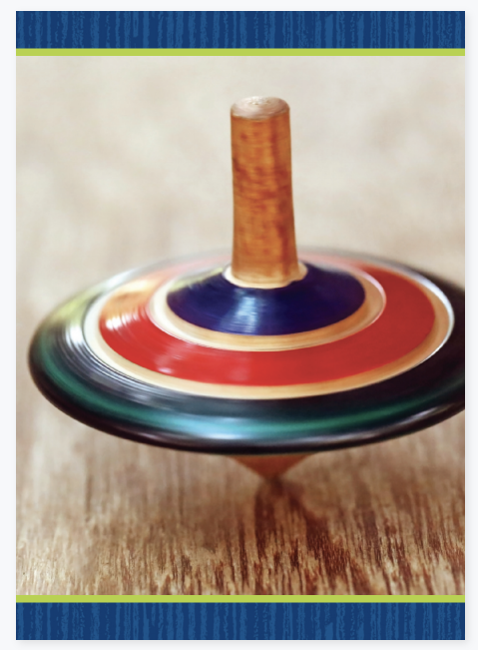
Page 99
Phonics
Turn to page 99 in your Student Interactive.
Notes:
Review that the short o sound is spelled o. Say the short sound /o/ and then write o to indicate the spelling of the sound.
Practice spelling the short o sound. Say: Let’s draw a picture of something we know that has the short sound /o/. What word have we already practiced saying that has the short o /o/? How about mop? Draw a picture of a mop. Beneath the picture, write the letters m and p with a blank space between them. Say mop and have students repeat after you. Remember to stretch out the sound /o/ as before. Then say: What is the middle sound in mop? Yes, /o/. What letter spells the sound /o/? Elicit a response from students. Say: Yes, o spells the sound /o/. Great! Write o on the line below the drawing. For additional practice with the sound /o/, use the box and top Picture Cards. Click path -> Table of Contents -> Unit 1 Week 3 Informational text -> Lesson 2
Have partners decode the words at the top of p. 99 in the Student Interactive.

Slide 20
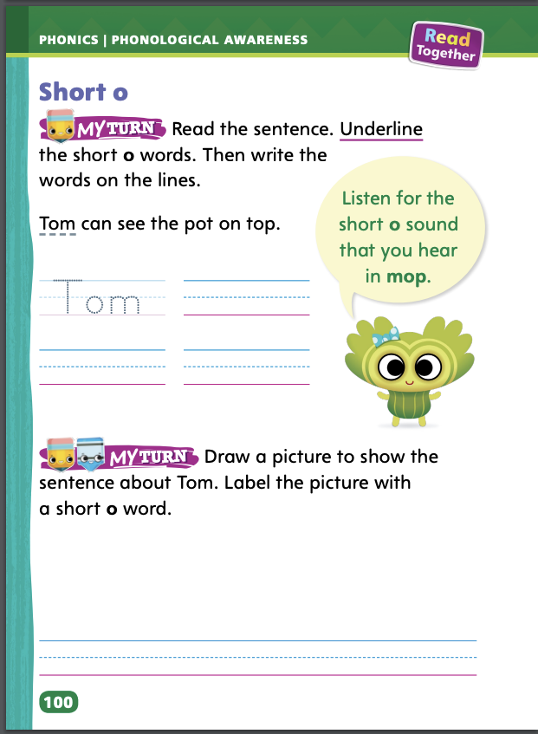
Page 100
Apply
Turn to page 100 in your Student Interactive and complete the activity.
Notes:
Have students complete the rest of p. 99 and p. 100 in the Student Interactive.

Slide 21
High-Frequency Words
are
by
look
was
you
Notes:
Write the words are, by, look, was, you. Have students
spell each word.
clap as they say each letter.

Slide 22
Page 110
Preview Vocabulary
left
right
guard
crosswalk
Notes:
Introduce the words left, right, guard, and crosswalk from p. 110 in the Student Interactive.
Have students share what they already know about the words. Ask questions such as the following: What do you call the part of the street where lines show that this is the place to cross? Who helps students cross the street to come to school? What are two directions you remember as you walk across a street?
Have students demonstrate what they know about the words. They might walk across the room and demonstrate turning left and then right. They might have one student play the role of a crossing guard while the other plays the role of a student crossing the street.
Provide definitions of the vocabulary words as needed. Definitions appear on the selection pages that follow. Diagrams, illustrations, and headings can help us understand the words in Look Both Ways!

Slide 23
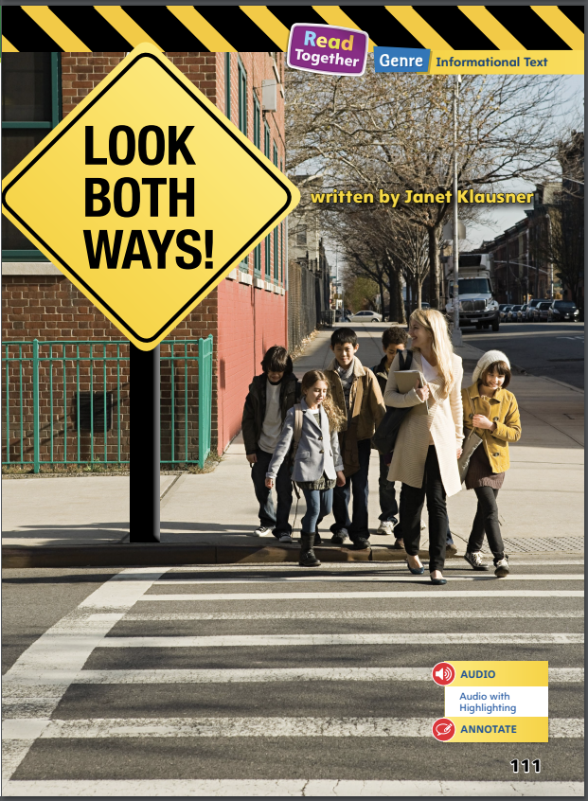
Page 111
Print Awareness
Can you find the title of the story?
Notes:
Direct students’ attention to p. 111. Ask: Can you find the title? Point out that the title, Look Both Ways!, is inside an image of a sign. Then tell students that they will find more text features on the following pages.

Slide 24
First Read Strategies
Notes:
Discuss the First Read Strategies with students. For this first read, prompt students to read for understanding and enjoyment.
READ Tell students to read or listen as you read the text. During the first read, students should work to understand the “gist” of the text, or what the text is about.
LOOK Have students look at the pictures and headings to help them understand the text.
ASK Have students generate, or ask, questions about the text to deepen their understanding.
TALK Guide students to talk to a partner about important ideas in the text.
Students may read the text independently, in pairs, or as a whole class. Use the First Read notes to help students connect with the text and guide their understanding.

Slide 25
Page 111
First Read – Look Both Ways
Notes:
Read Together.

Slide 26
Page 112,113
First Read – Look Both Ways
Notes:
Read together.
THINK ALOUD I read that lines on the street show a safe place to cross and that it is important to look both ways. I learned something about being safe when crossing the street! Now I want to learn more, so I’ll keep reading!

Slide 27
Page 114,115
First Read – Look Both Ways
Notes:
Read together.

Slide 28
Page 116,117
First Read – Look Both Ways
Notes:
Read together.
THINK ALOUD Why do the children walk across the street in the picture on page 117? Should they wait? I can look at the signal to find the answer. The signal shows a person walking. I see this signal in a picture on page 116. The word Walk is by this picture. Then that signal must mean “walk.” So, the kids can cross the street. They still need to look both ways first.

Slide 29
Page 118,119
First Read – Look Both Ways
Notes:
Read together.

Slide 30
Respond and Analyze
Retell Tell a partner about the part of the text that shows something you have seen before. Where did you see this thing?
Illustrate Details Have students draw a picture of a traffic light or walk and wait signals. Then have partners discuss the meaning of each signal and what they should do when they see it.
Notes:
Use these suggestions to prompt students’ initial responses to reading Look Both Ways!
Retell Tell a partner about the part of the text that shows something you have seen before. Where did you see this thing?
Illustrate Details Have students draw a picture of a traffic light or walk and wait signals. Then have partners discuss the meaning of each signal and what they should do when they see it.

Slide 31
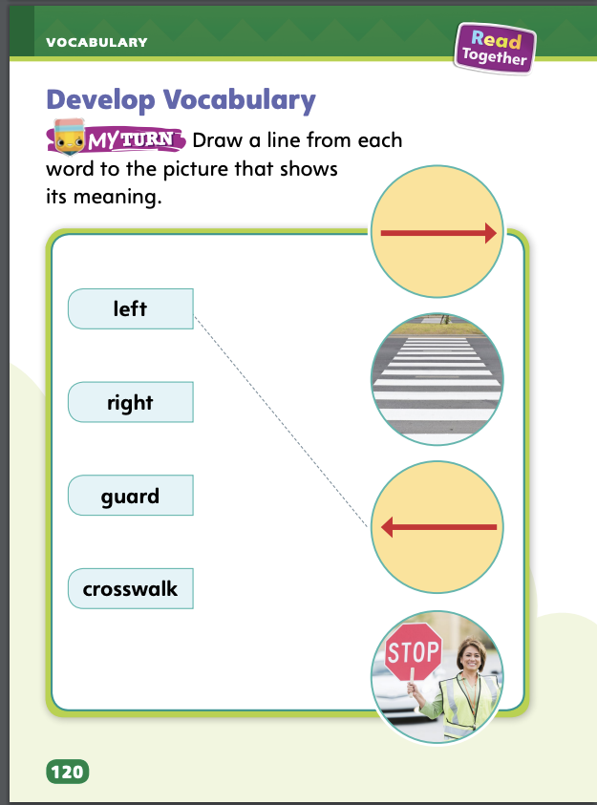
Page 120
Develop Vocabulary
Turn to page 120 in your Student Interactive and complete the activity.
Notes:
Tell students that authors choose words carefully to show ideas. The words left, right, guard, and crosswalk all tell about the main idea in Look Both Ways!
Remind yourself of the word’s meaning.
Think about how the author helps you understand a word.
Look at text details and illustrations for clues about a word’s meaning.
Have students turn to p. 120 in the Student Interactive. Read aloud the directions. Model how to complete the activity, with the word left. Then ask students to look closely at each picture. Ask: Which picture shows a crosswalk?
Have students practice developing vocabulary by completing the activity on p. 120 in the Student Interactive.

Slide 32
Page 121
Check for Understanding
How do you know this text is an informational text?
How does the author use the title Look Both Ways?
Why should you use look both ways before you cross the street? Use text evidence.
Notes:
Have students complete p. 121 in the Student Interactive.

Slide 33
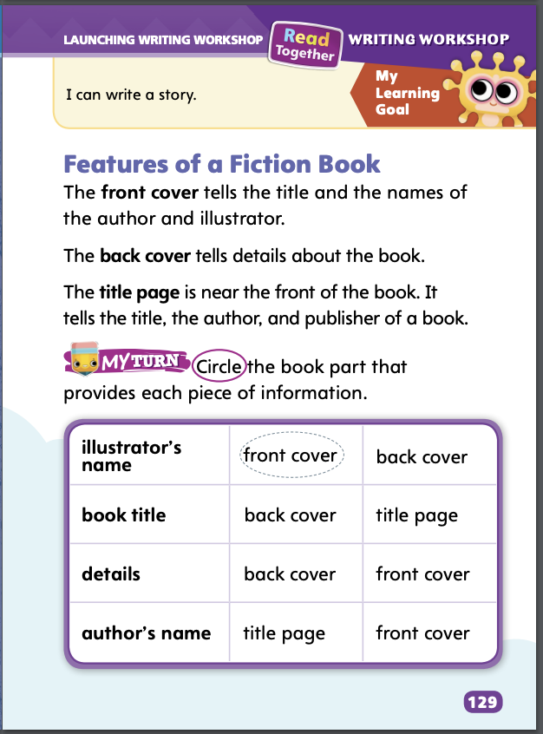
Page 129
Writing – Launching Writing Workshop
Turn to page 129 in your Student Interactive.
Notes:
The different features of a fiction book tell about that book. We can look at these features to find specific information:
front cover
back cover
title page
Hold up a book from the stack. Point to the front cover. Here is the title, author, and illustrator. Read aloud the title, author, and illustrator. The front cover of the book is where we find this information. The front cover is one feature of the fiction book. Continue to model identifying the information and features of the back cover and title page, pointing to and reading aloud the information on each.
Repeat this process with one or two more books from the stack. Display each feature, one at a time. Ask: What information is on this part of the book? What is the name of this part, or feature? How do you know that this is a fiction, or made-up, book?
Direct students to p. 129 in the Student Interactive. Read the directions and have students complete the activity. After students circle their answers, hold up another fiction book from the stack and use the book to check and confirm their answers.

Slide 34
Independent Writing
You will continue to write and draw your fiction book.
Notes:
After the minilesson, students should transition into independent writing.
Modeled Choose a stack text and do a Think Aloud to model what each feature of the book is called.
Shared Have students choose a stack text. Prompt students to talk about the names of each part of the book.
Guided Use the stack texts to provide explicit instruction on the name of each feature, where it is, and the information it contains.
If students demonstrate understanding, they should continue to draw and write their own books.
As students write, use the conference prompts in the Teacher’s Edition or Resource Download Center to provide support. Click path: Table of Contents -> Resource Download Center -+ Writing Workshop Conference Notes
Call on a few students to share the features they have drawn and written and tell the information they included.

Slide 35
Page 127
Spelling
log
top
dot
Turn to page 127 in your Student Interactive and complete the activity.
Notes:
Explain that the short o sound is spelled with the letter o. Tell students that alphabetizing means to put words in ABC order.
Write these words: log, top, dot. Model how to alphabetize the words to the first letter. Then point out the short o sound spelled o.
Have students complete the activity on p. 127 in the Student Interactive.

Slide 36
Language and Conventions
Pat goes to school.
Notes:
Point out that for a group of words to be a complete sentence, it must have a subject (the naming part) and a verb (the action part). Answer questions students may have.
Display this sentence: Pat goes to school. Read the sentence aloud. Ask: What is the subject of the sentence? (Pat) What is the verb part of the sentence? (goes to school) Cover the word Pat, and point to the words goes to school. Ask: Is this a sentence? (No.) Why not? (This group of words does not have a subject, or naming part.)
Have student pairs create oral sentences. Remind them that their sentences must have a subject and verb. Invite pairs to share their sentences with the class and to explain why each group of words is a sentence.

Slide 37
Lesson 3

Slide 38
Page 101
Phonological Awareness
Notes:
Tell students that we can listen to the beginning sound in two or more words to see if they are the same. Point to the picture of the pencil on p. 101 in the Student Interactive. Say: What sound does the word pencil begin with? Listen as I say the sound: /p/ /p/ /p/ pencil. Pencil begins with the sound /p/. Say the sound with me: /p/. Repeat with the words pumpkin and pond. Then say: What sound do pencil, pumpkin, and pond begin with? Yes, they all begin with the sound /p/.
Say the following tongue twister to model words that begin with the same sound (alliteration). Have students say which is the initial sound of the words in this sentence. Say: Peter Piper picked purple pears. Have students repeat the words. Have students try to come up with their own tongue twister using words that have the initial sound /p/.

Slide 39
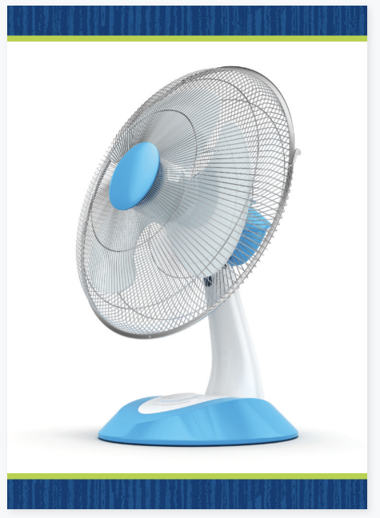
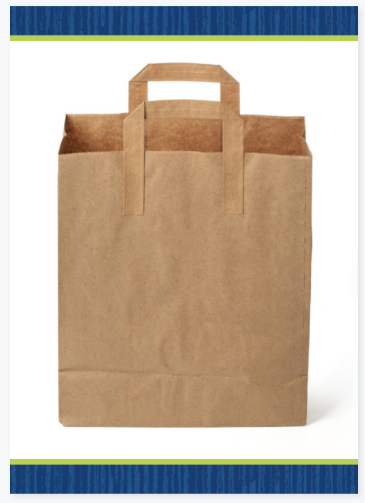
Phonics
bin
big
got
fit
Notes:
Use the fan and bag Picture Cards to introduce the sound /f/ spelled f, sound /b/ spelled b, and sound /g/ spelled g. Tell students they can decode, or read, words by using common letter sound correspondences.
Write the letters f, b, and g. Model the sound /f/ spelled f, the sound /b/ spelled b, and the sound /g/ spelled g. Display the bag Picture Card. Write the word bag. Listen as I say this word: bag. I will say the sounds in the word slowly: /b/ (pause) /a/ (pause) /g/. What beginning sound do you hear? The beginning sound /b/ in bag is spelled with the letter b. What ending sound do you hear? The ending sound /g/ in bag is spelled with the letter g. Tell students that the sounds can be spelled the same whether they begin or end a word. Repeat for the initial sound /f/ with the fan Picture Card. Then write the words bin, big, got, and fit. Ask students to decode the words. Click path -> Table of Contents -> Unit 1 Week 3 Informational Text -> Lesson 3

Slide 40
Page 101
Apply
Turn to page 101 in your Student Interactive and complete the activity.
Notes:
Have students practice blending and decoding the words on the bottom of p. 101 in the Student Interactive.

Slide 41
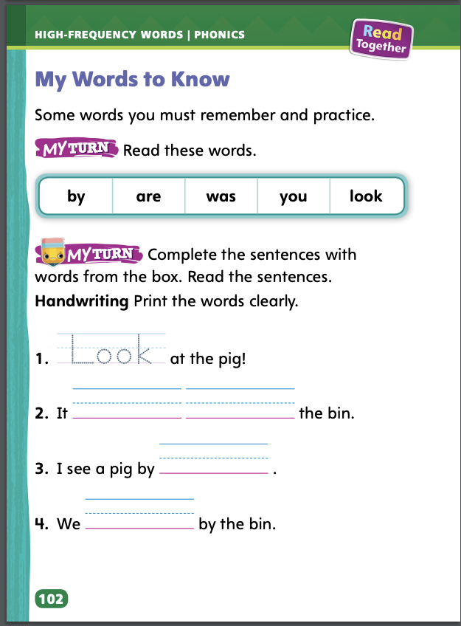
Page 102
High-Frequency Words
Turn to page 102 in your Student Interactive and complete the activity.
Notes:
Review this week’s high-frequency words: are, by, look, was, you.
Write are on the board. Say: This is the word are. There are three letters in are: a, r, e. Use the word in a sentence. Then have students say and spell the word and then use it in a sentence. Repeat with the remaining words.
Ask students to identify, read, and write high-frequency words on p. 102 in the Student Interactive.

Slide 42
Page 111
Find Text Features
Notes:
Text features help you find and understand information. One kind of text feature is a heading. A heading tells the topic of a part of a text. Another kind of text feature is a label. A label names what a picture shows.
Look through the text. Do you see headings in the text? Does the heading help you understand what that part of the text is about?
Do you see labels on pictures? How does a label help you understand a picture?
Have students turn to p. 118 in the Student Interactive and look for a heading. I see the word Safety at the top of the page. That is a heading, and it tells me what this section is about. The picture has a word on it in a white box. It says Traffic. This is a label, and it tells me what the picture shows. Tell students to go back to the Close Read notes on pp. 113 and 117 and underline the label and heading.

Slide 43
Page 112,113
Close Read – Find Text Features
Turn to page 113 in your Student Interactive.
Notes:
Have students follow the Close Read prompt on p. 113. Ask: Where is the label on page 112? (in the photo) DOK 1

Slide 44
Page 116,117
Close Read – Find Text Features
Turn to page 117 in your Student Interactive.
Notes:
Have students follow the Close Read prompt on p. 117. Ask: Where is the heading on page 116? (top of page) DOK 1

Slide 45
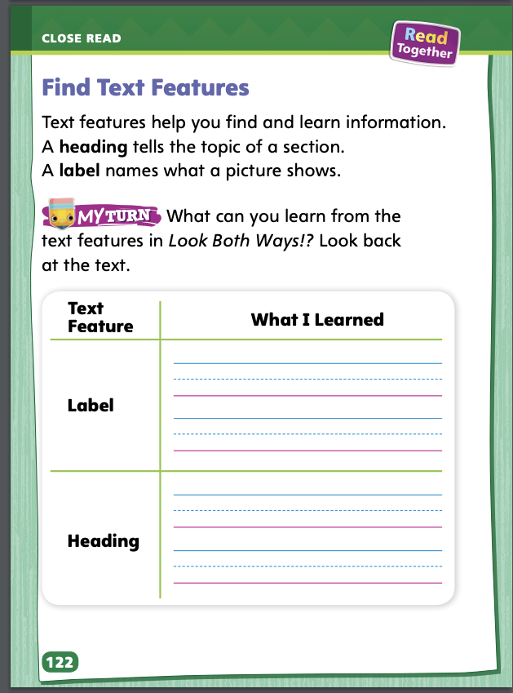
Page 122
Find Text Features
Turn to page 122 in your Student Interactive and complete the activity.
Notes:
Have students use the strategies for finding text features.
Have students complete the rest of p. 122 in the Student Interactive.

Slide 46
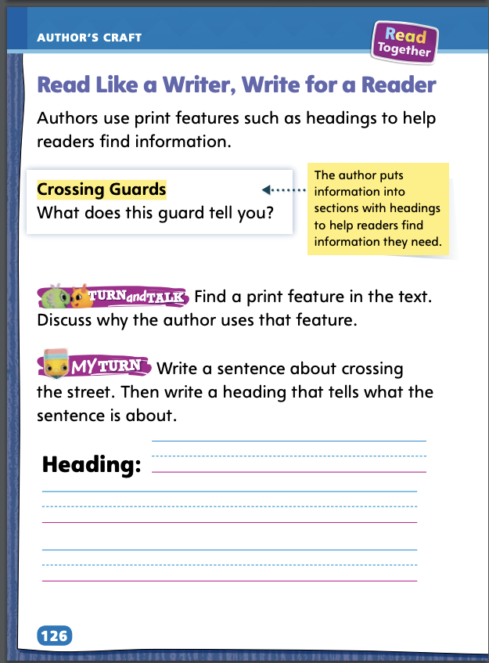
Page 126
Read Like a Writer, Write Like a Reader
Turn to page 126 in your Student Interactive and complete the activity.
Notes:
Headings are print features that help readers find information. Authors use headings to divide a text into sections, or parts. •
Read the heading, or title, of the section. The heading is above the section and tells what topic the section is about.
Display p. 114 in the Student Interactive and say: I see the heading ‘‘Crossing Guards.’’ The heading is the title of that section. This section must be about crossing guards.
Have students find a print feature and discuss its purpose.

Slide 47
Handwriting
Backward Circles
Notes:
Display a handwriting circle diagram with arrows in a counterclockwise direction.
Model tracing the displayed circle with your index finger in a counterclockwise direction. Invite volunteers to trace the circle.
Work with students to help them draw backward circles on their own lined paper. Remind them to stay within the top and bottom lines. Click path: Table of Contents -> Resource Download Center -> Handwriting Practice -> U1W3L3 Handwriting Practice

Slide 48
Writing – Launching Writing Workshop
Text features of a nonfiction book help readers location information and understand the structure of the book.
chapters or sections of the book.
topics and page numbers.
meanings of important words
Notes:
Text features of a nonfiction book help readers locate information within the book. They help the reader understand the structure of the book. Some information included in these features are
chapters or sections of the book.
topics and page numbers.
meanings of important words.
Tell students that nonfiction books are about real people, places, or events. Explain that they will examine several nonfiction books to explore the information that text features provide.
Hold up a nonfiction book from the stack. Open to the table of contents. Let’s look at the table of contents. We see the names of the chapters or sections and the page where each one begins. Point to and read the first chapter and the page where it begins. This is chapter X. If I turn to page XX, I see that this is where it begins. Turn to the page where the first chapter begins. Repeat this procedure with other text features. Point out some of the topics in the index and where they are located, and show words and their definitions in the glossary.
Explore the information in the features of more nonfiction books from your stack, following the routine above. Focus on how the features are organized.

Slide 49
Independent Writing
You will continue to write your stories.
You can put your book aside and
start a new one at any time.
Notes:
During independent writing time, students should continue writing books.
Modeled Choose a stack text and do a Think Aloud to model how to locate each feature of the nonfiction book and the information it contains.
Shared Have students choose a stack text. Prompt students to find the chapters or section names, topics and page numbers, and word meanings.
Guided Use the stack texts to provide explicit instruction on what kind of information is contained in each feature of a nonfiction book.
Remind students that they can put the book they’re writing aside and begin a new one at any time.
As students write, use the conference prompts in the Teacher’s Edition or Resource Download Center to provide support. Click path: Table of Contents -> Resource Download Center -+ Writing Workshop Conference Notes
Have a few students share information about what they would include in a table of contents of a nonfiction book they might write.

Slide 50
Spelling
top
mop
on
Notes:
Remind students that the short o sound is spelled with the letter o, and the o may be at the beginning or the middle of the word.
Write or display these words: top, mop, on. Say each word aloud and have students spell each one. Ask students to tell which letter makes the short o sound in each word.
Have students complete Spelling p. 31 from the Resource Download Center. Click path: Table of Contents -> Resource Download Center -> Spelling -> U1W1

Slide 51
Language and Conventions
_____ can ______
name
verb
Notes:
Explain to students that for a group of words to be a sentence, the group of words must have a subject, or naming part, and a verb, or action part. If the group of words is missing a subject or a verb, it is not a complete sentence.
To reinforce the concept of complete sentences, write the names of several students in a column on the board. Point to the name and ask: What can Oscar do now? Then write student responses in a second column next to that student’s name. Say: Let’s put the words together to make a complete sentence: ___ can ___. Which word is the subject? (student’s name) Which word is the verb? (verb provided) Add ending punctuation and read the sentence aloud. Then have students read it aloud. Repeat with the other names listed.

Slide 52
Lesson 4

Slide 53
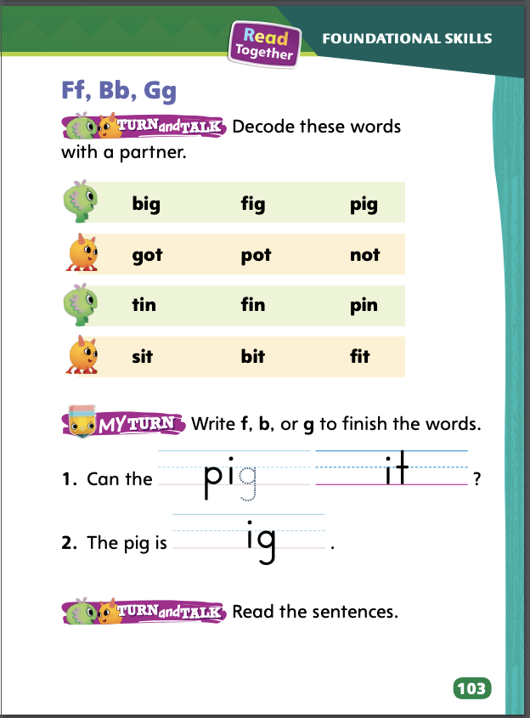
Page 103
Phonics
Decode the words with your partner.
Notes:
Review the letter names and sounds for /f/ spelled f, /b/ spelled b, and /g/ spelled g.
Model and practice how to decode words. Write the word fig. Say: Listen as I say fig slowly: /f/ (pause) /i/ (pause) /g/. Say each sound slowly so students can hear the individual sounds. How many sounds can you hear in fig? Elicit responses. Draw three empty boxes. Next, model how to write the letters for each sound. Say: What letter spells the sound /f/? Write f in the first box. What letter spells the sound /i/? Write i in the second box. What letter spells the sound /g/? Write g in the third box. Slide your finger under the boxes and read the word. Have students practice reading the word with you. Repeat with the words got and fib.
Have partners decode the words at the top of p. 103 in the Student Interactive.

Slide 54
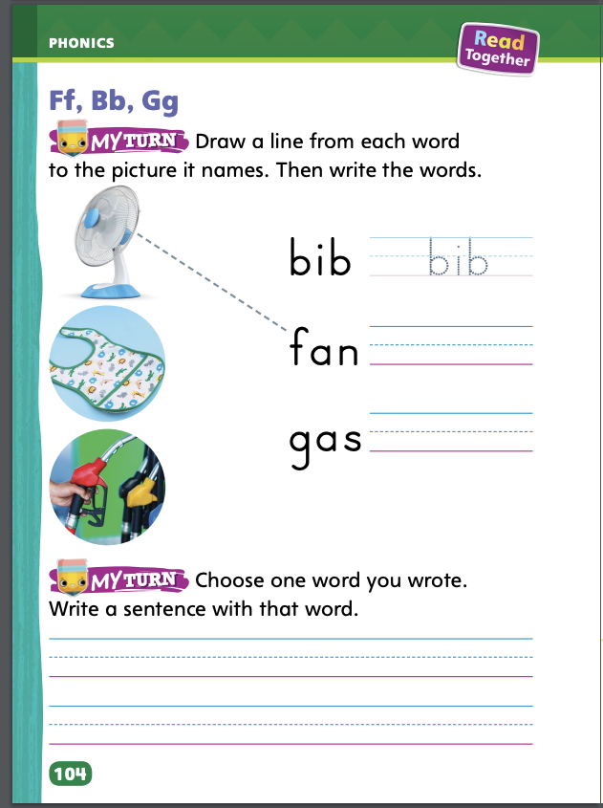
Page 103,104
Phonics
Turn to page 103 and 104 in your Student Interactive and complete the activity.
Notes:
Have students complete the rest of p. 103 and p. 104 in the Student Interactive by printing the letters. Be sure they read the words in context by reading their completed sentences.

Slide 55
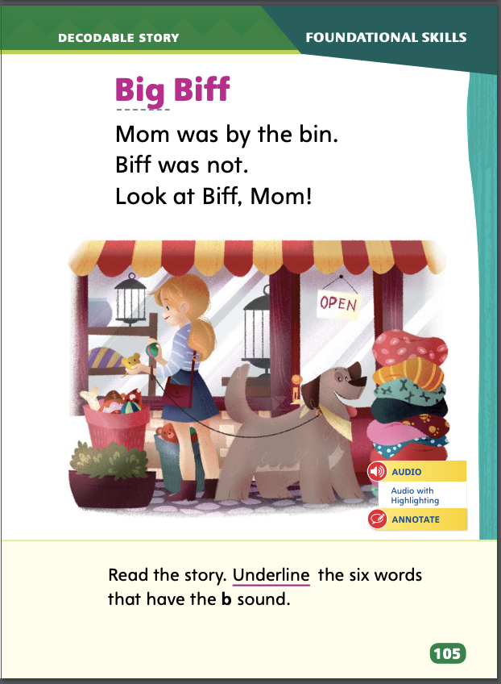
Page 105
Decodable Story
Turn to page 21 in your Student Interactive. Read “Big Biff” with your partner.
Notes:
Have students turn to p. 105 in the Student Interactive. We are going to read a story today about Biff. Point to the title of the story. The title of the story is Big Biff. I hear the sound /b/ in the word Big. What letter in Big spells the sound /b/? Right! The b spells the sound /b/. Point to the B in Big. We will read other words with the sound /b/ spelled b and words with the letters f and g in our story. We will also read words with the sound /o/ spelled o.
Before reading, review this week’s high-frequency words: are, by, look, was, you. Tell students that they will practice reading these words in the story Big Biff. Display the words. Have students read them with you. Say: When you see these words in today’s story, you will know how to read them.

Slide 56
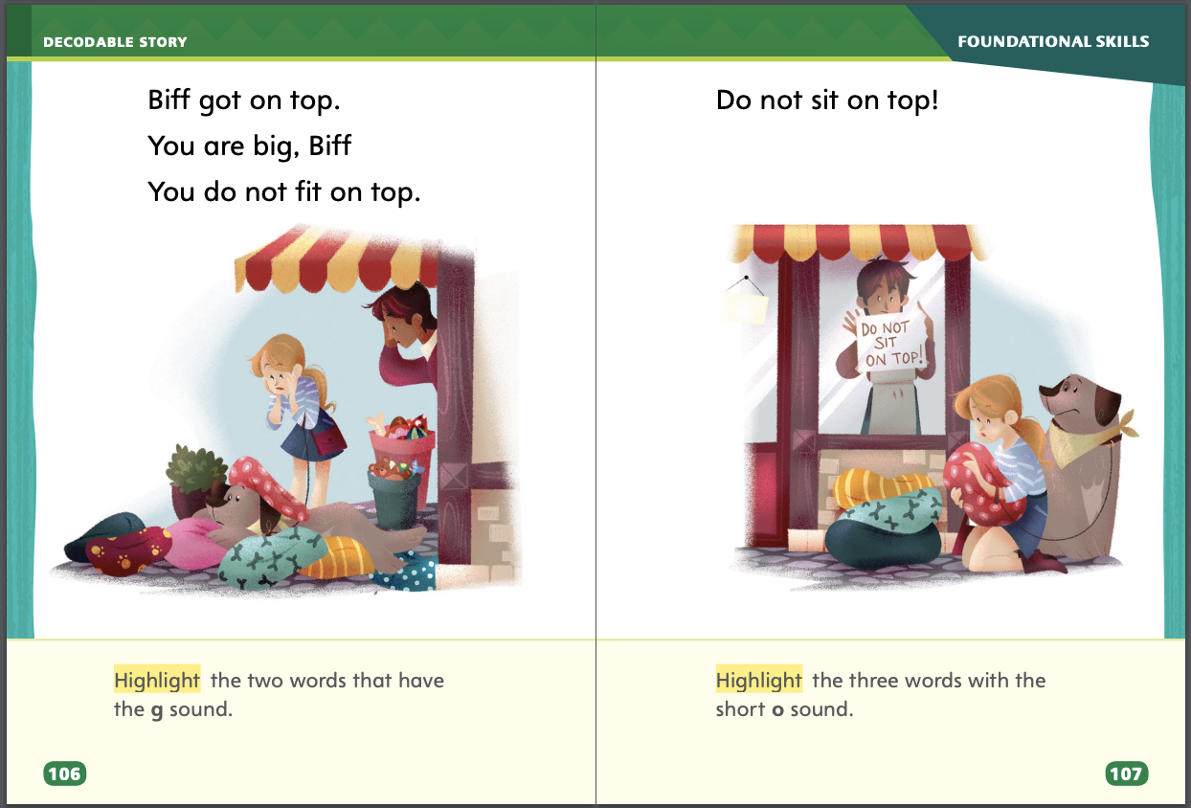
Page 106,107
Decodable Story
Notes:
Pair students for reading, and listen carefully as they use letter-sound relationships to decode. One student begins. Students read the entire story, switching readers after each page. Partners reread the story. This time the other student begins.
Call students’ attention to the title on p. 105. Say: I see the letter B in the word Biff. What sound does the letter b spell? Have students decode the word Biff. Then have them identify words with the sound /b/ spelled b on p. 105 and underline them.
Have students turn to p. 106. Say: Which words have the sound /g/? Students should supply the words got and big. Say: Which letter spells the sound /g/ in got and big? Students should say the sound /g/ is spelled with the letter g. Have them highlight the words.
Have students turn to p. 107. Say: Which words have the short sound /o/? Students should supply the words not, on, and top. Say: Which letter spells the short sound /o/ in not, on, and top? Students should say the short sound /o/ is spelled with the letter o. Have them highlight the words.

Slide 57
Page 111
Use Text Evidence
Notes:
Text evidence is the details that support what you think about a text. Good readers use text evidence to support their understanding of the text.
Refer students to pp. 118–119 in the Student Interactive. Model using text evidence to support what you think about the text and text features. Information on page 119 tells about safety. From the heading, which is a text feature, and the text on the page, I think there is a safe way to cross the street. What is the text evidence to support my response? (text evidence about looking left and looking right) Have students go back to the Close Read note on p. 115 and highlight the text evidence.

Slide 58
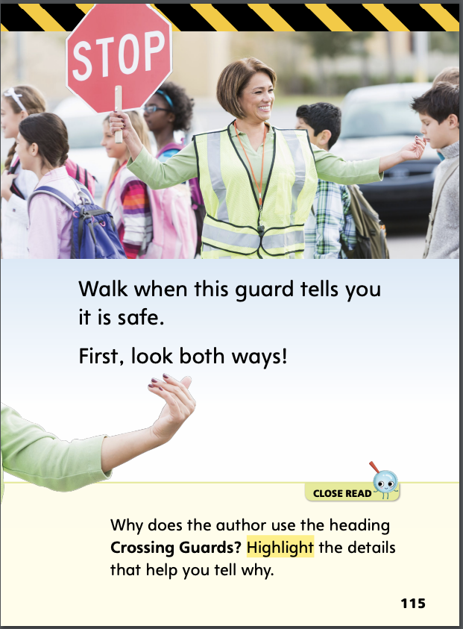
Page 115
Close Read – Use Text Evidence
Turn to page 115 in your Student Interactive.
Notes:
Ask students to answer the Close Read prompt on p. 115. (highlight: Walk when this guard tells you it is safe.) DOK 2

Slide 59
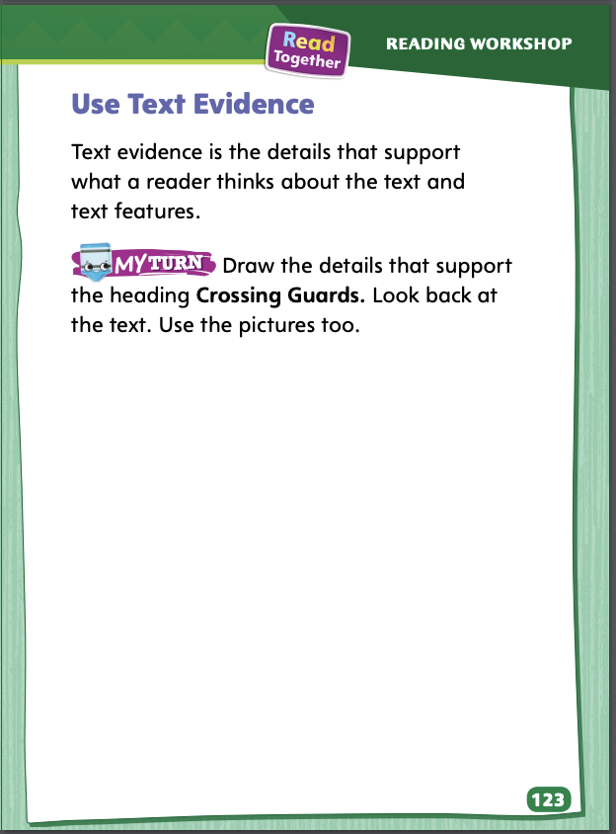
Page 123
Use Text Evidence
Turn to page 123 in your Student Interactive and complete the activity.
Notes:
Have students use the strategies for using text evidence.
Have students complete p. 123 in the Student Interactive.

Slide 60
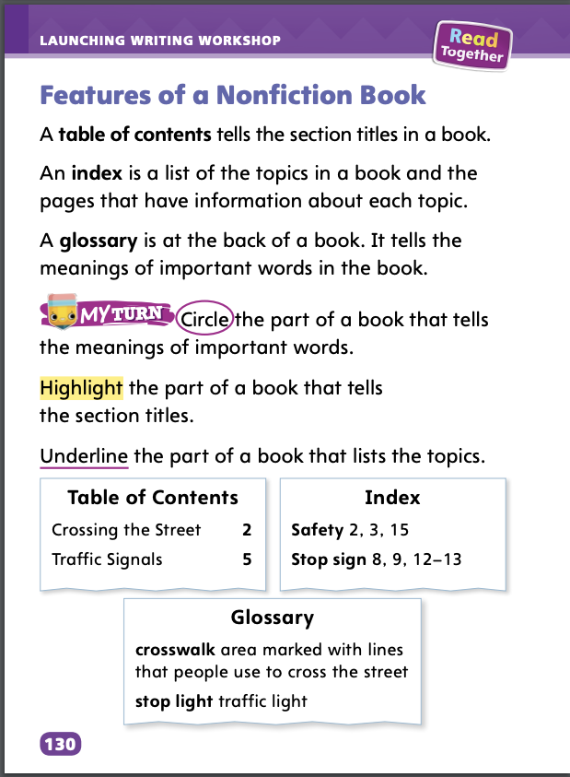
Page 130
Writing – Launching Writing Workshop
Turn to page 130 in your Student Interactive and complete the activity.
Notes:
Specific information about a nonfiction book is found in the different features. We can look at these features to locate specific information: • table of contents • index • glossary
Hold up a nonfiction book from the stack. Point to the table of contents. Here are the names of the different chapters (or sections) in this book and the pages where each section begins. Read aloud the headings and page numbers. We found this information in the Table of Contents. The Table of Contents is one feature of the nonfiction book. Continue to model locating and naming other book features, including the index and glossary, pointing to and reading aloud some of the information in each.
Hold up another book from the stack. Display each feature, one at a time. Ask: What is the name of this part, or feature? What information is on this part of the book?
Direct students to p. 130 in the Student Interactive. Read the directions and have students complete the activity. After students circle, highlight, and underline their answers, hold up another nonfiction book from the stack and use the book to check and confirm their answers.

Slide 61
Independent Writing
You will continue writing your books.
If you are writing a nonfiction book, include the features we discussed.
Notes:
After the minilesson, students should transition to independent writing.
If students are writing a nonfiction book, remind them to include the features they learned about. Modeled Do a Think Aloud to model how an author plans what to write.
Modeled Choose a stack text and do a Think Aloud to model the name of each feature presented in this minilesson.
Shared Have students choose a stack text. Prompt students to identify and talk about each feature they learned about.
Guided Use the stack texts to provide explicit instruction on the name of each feature, where it is, and the information it contains.
As students write, use the conference prompts in the Teacher’s Edition or Resource Download Center to provide support. Click path: Table of Contents -> Resource Download Center -+ Writing Workshop Conference Notes
Call on a few students to share the information they would include in various features for a nonfiction book they might write.

Slide 62
Spelling
short i
short a
c/k/
p/p/
n/n/
Notes:
Have students recall the previous spelling rule for words with the short i and short a sounds. Review the rules for spelling sounds c/k/, p/p/, and n/n/.
Read aloud the following words and have students spell them: pin, nap, pan, cap, can, nip.
Have students work in pairs to sort the words by how their medial vowel sounds are spelled. ( i/i/: pin, nip; a/a/: nap, pan, cap, can)

Slide 63
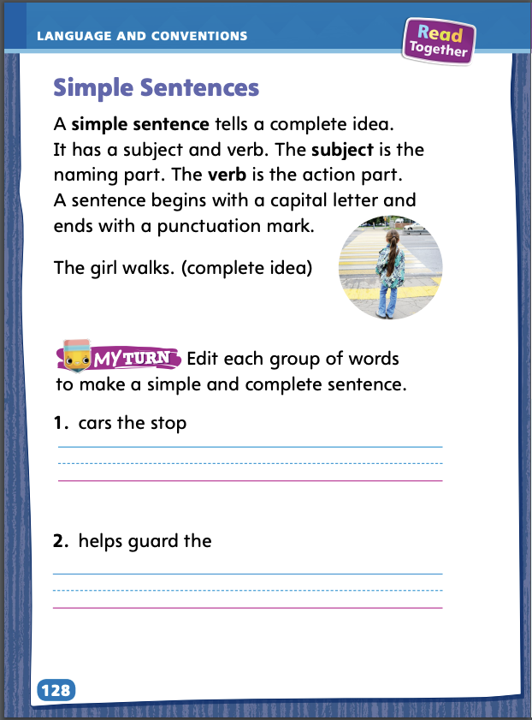
Page 128
Language and Conventions
Turn to page 128 in your Student Interactive and complete the activity.
Notes:
Have students complete the practice activity on p. 128 in the Student Interactive.

Slide 64
Lesson 5

Slide 65
Phonological Awareness
at /a/ /t/
bat /b/ /a/ /t/
in | bin
at | mat
in | fin
at | hat
Notes:
Recognizing differences in spoken words when a phoneme, or sound, is added is an important beginning reading skill. Say the word at. Listen to the sounds in the word at: /a/ /t/. Now listen to this word: bat. What sound did I add to at to make the word bat? Yes, I added the sound /b/. Say the new word with me: bat.
Have students recognize the change in each pair of words when a phoneme is added: in–bin; in–fin; at–mat; at–hat.

Slide 66
Phonics
Ii, Cc, Pp, Nn
sip
cap
pin
not
pot
cot
pan
Notes:
Write the letters Ii, Cc, Pp, and Nn. Have volunteers point to a letter and name it. Review the sound for each letter by pointing to each letter as you say the sound. Then have students point to the letter that spells the sound you say. For example, say: Listen to this sound: /k/. Which letter can spell /k/? Repeat with sounds for the other letters.
Write the words listed below. Point to each word and have students segment the sounds and then blend the sounds to read the word. Have students identify the letters i, c, p, or n in each word.

Slide 67
High-Frequency Words
are
by
look
was
you
Notes:
Write the words in a box. Then write the sentences with the blanks. Say: With your partner, complete the sentences with the words from the box. Then circle the words you already know. You can look in your notebooks to find the words. (We, like, I, see, the) Take turns reading the complete sentences.

Slide 68
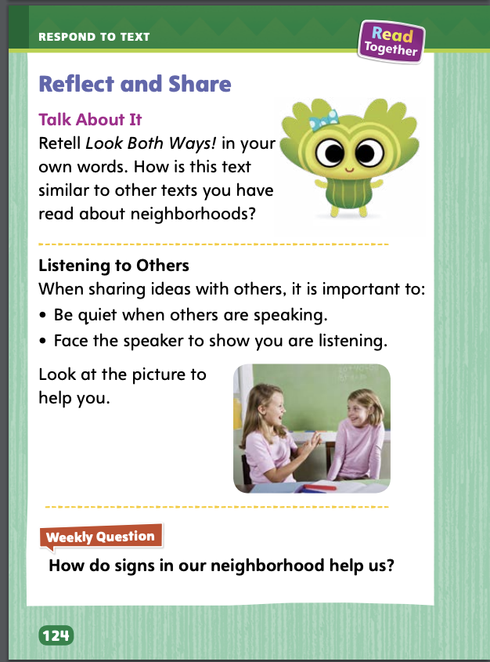
Page 124
Reflect and Share
Turn to page 124 in your Student Interactive.
Notes:
Tell students that sometimes they will read several books about the same topic and be asked to compare and discuss them. Students can get the most out of these discussions by:
retelling each text.
using examples and details from the text.
making clear connections to other texts.
thinking about what they have read and sharing information and ideas clearly at an appropriate pace.
Model sharing ideas and information about the topic under discussion, using the Talk About It prompt on p. 124 in the Student Interactive. The text Look Both Ways! is about signs in a neighborhood and how they can help us. We also read the text Henry on Wheels. In that text, Henry rides his bike around a neighborhood. So both texts are about neighborhoods. Henry on Wheels is realistic fiction. Look Both Ways! is informational text. That is one way the texts are different.
Have students use the strategies for comparing across texts.
Have students compare two texts that they have read about the same topic. If desired, distribute Speaking and Listening practice pages from the Resource Download Center to help guide discussions.

Slide 69
Page 42
Apply
How do signs in our neighborhood help us?
Notes:
Have students use evidence from the texts they have read this week to respond to the Weekly Question. Tell them to write their responses on a separate sheet of paper or discuss in small groups. Have students use the strategies for comparing across texts.
Have students compare two texts that they have read about the same topic. If desired, distribute Speaking and Listening practice pages from the Resource Download Center to help guide discussions. Click Path: Table of Contents -> Resource Download Center -> Speaking and Listening

Slide 70
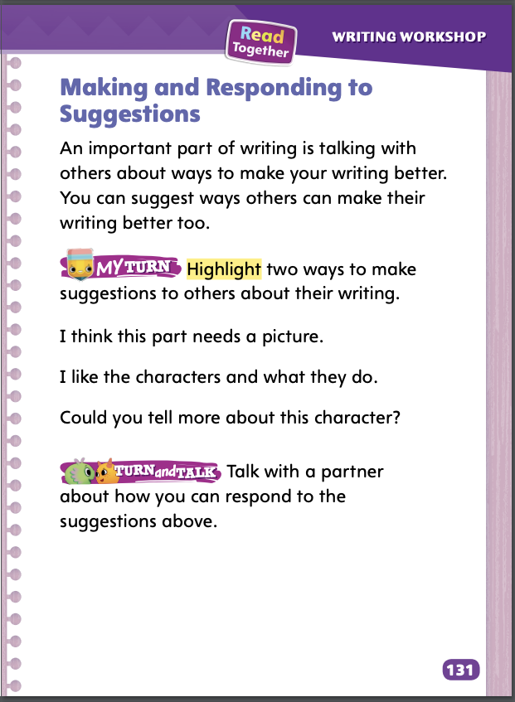
Page 131
Writing – Launching Writing Workshop
Turn to page 131 in your Student Interactive and complete the activity.
Notes:
After writing a first draft, writers find ways to make their work even better. Good writers
listen to suggestions from others about ways to improve their writing.
make suggestions to other writers about their writing.
ask and respond to questions from others about writing.
Direct students to p. 131 in the Student Interactive. Read aloud the introduction. Write the following sentence on the board: The animal is there. Explain that this sentence does not make it clear about what the writer wants the reader to know. Ask: Work with students to brainstorm questions and suggestions. Model how to make constructive recommendations. What kind of questions or suggestions could we ask or make for the writer to make this sentence better?
Direct students back to p. 131. Read aloud the directions to My Turn. Be sure students understand the difference between a suggestion and a comment. Point out that a suggestion tells the writer something he or she could do to improve the writing. A comment tells an opinion of what someone likes or does not like about the writing. Then read the choices aloud. For each one, ask:
Does this choice tell a way to improve the writing?
Does this choice tell how the reader feels about the writing?
Have students work in pairs. Give partners time to talk about how they would respond to the suggestions they highlighted if someone offered those suggestions about books they were writing

Slide 71
Spelling
I will sleep on a cot.
Our family got a dog.
Fill the pot with water.
The cat will not come.
Look at that bug.
You are a good reader.
Notes:
(Note: Move the orange boxes to cover each bold spelling word before you read aloud the words and sentences.)
Read aloud the words and sentences. Have students spell the words with initial consonant blends and the high-frequency words they have been practicing this week.
I will sleep on a cot.
Our family got a dog.
Fill the pot with water.
The cat will not come.
Look at that bug.
You are a good reader.
Reveal the spelling word and have students check their work.

Slide 72
Language and Conventions
Select the complete sentence.
You and I.
Are
They go.
We.
Notes:
Display the following groups of words, and have students select the complete sentence.
You and I.
Are
They go.
We.
Have students complete Language and Conventions p. 37 from the Resource Download Center.. Click path: Table of Contents -> Resource Download Center -> Language and Conventions -> U1 W3

Slide 73
Unit 1: Week 3
Grade 1

