Slide 1
Unit 1: Week 3
Grade 5

Slide 2
Copyright © Savvas Learning Company LLC. All Rights Reserved.
This publication is protected by copyright, and permission should be obtained from the publisher prior to any prohibited reproduction, storage in a retrieval system, or transmission in any form or by any means, electronic, mechanical, photocopying, recording, or otherwise. For information regarding permissions, request forms, and the appropriate contacts within the Savvas Learning Company Rights Management group, please send your query to:
Savvas Learning Company LLC, 15 East Midland Avenue, Paramus, NJ 07652
or
k12learningpermissions@savvas.com
myView Literacy® is an exclusive trademark of Savvas Learning Company LLC in the U.S. and/or other countries.

Slide 3
Lesson 1

Slide 4
Page
84, 85
Interact with Sources
Discuss what you would like to learn by visiting a new place.
Notes:
Remind students of the Essential Question for Unit 1: How do journeys change us? Point out the Week 3 Question: What can people learn from visiting unknown lands?
Direct students’ attention to the map on pp. 84–85 in the Student Interactive. Explain that a map can sometimes show events that occurred in different places at different times.
Use the following questions to guide discussion: • How many voyages does the map show? • Over what period of time did these voyages take place? • What does the information in the inset box in the upper left tell you?
WEEKLY QUESTION Reread the Week 3 Question: What can people learn from visiting unknown lands? Tell students they have just learned about several journeys made by European explorers to lands unknown to them. Explain that they will read more about such journeys this week.
Have students discuss with a partner what they would like to learn by visiting a new place.

Slide 5
Listening Comprehension
Henry
wondering about job
Rosa
afraid of the dark
Bertha
worried about strangers
Notes:
Tell students that the story you are going to read is historical fiction. Explain that they should listen actively, paying careful attention to the characters. Then have them listen as you read “Rosa’s Journey.” Prompt them to ask questions to clarify information and follow agreed-upon discussion rules.
Purpose Have students actively listen for elements of historical fiction.
READ the entire text aloud without stopping for Think Aloud callouts.
REREAD the text aloud, pausing to model Think Aloud strategies related to the genre and the characters in the story.
THINK ALOUD The story has a historical setting— it takes place when slavery was still practiced in the South. I’m wondering what the stars called the Drinking Gourd are. I know about a constellation called the Big Dipper, which is shaped like a giant ladle. I think that Minty may know that constellation as the Drinking Gourd, because it could resemble something she might have used to drink from. As a historical character, she could use different terms than those that modern readers use.

Slide 6
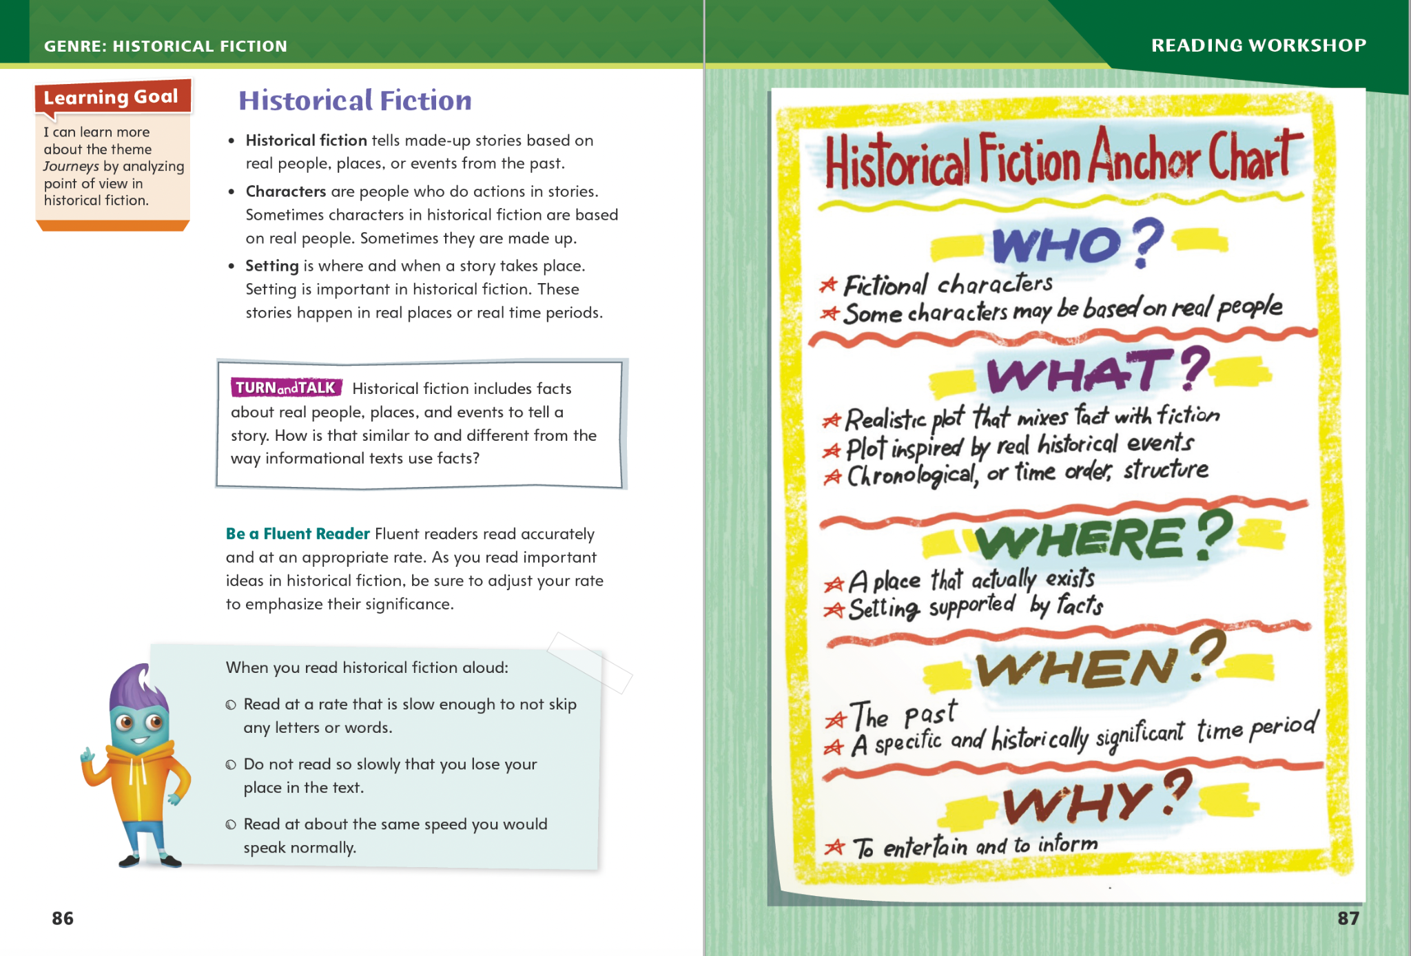
Page 86, 87
Historical Fiction
Turn to page 86 in your Student Interactive.
Notes:
An author of historical fiction may tell it in the first person from the point of view of a character who refers to himself or herself as I or me, or the author may use the third-person point of view, supplying many characters’ thoughts and feelings and referring to all of them as he or she. Ask yourself from which point of view the story is being told.
If the story is told by a character, think about how this first-person narrator reflects the times in which he or she lives.
If the author uses third-person point of view, think about which characters’ thoughts and feelings are provided.
Model using text evidence to determine point of view in historical fiction. Four characters are described in “Rosa’s Journey.” I see that none of them is telling the story using I or me. Also, the author describes the thoughts and feelings of Rosa, Henry, and Bertha. This means the story is told using third-person point of view.
Talk about how this story might have been different if told from Minty’s or Rosa’s point of view.
FLUENCY Have students practice their fluency by reading aloud a paragraph from “Rosa’s Journey” or from a historical fiction text. Emphasize accuracy and appropriate rate.
When you read accurately, you read every word without skipping or adding words. You read each word correctly, pronouncing all parts of the word, including endings, correctly.
When you read at an appropriate rate, you read at a natural pace, not too slow and not too fast. Read so that your listeners can understand you.
Read aloud a passage, then read it together as a class. Give students time to practice reading independently. Finally, have students read the passage on their own, and check their fluency, focusing on accuracy and appropriate rate. Editable Anchor Chart Click Path: Table of Contents -> Reading Anchor Charts -> Unit 1Week 3: Historical Fiction Editable Reading Anchor Chart

Slide 7
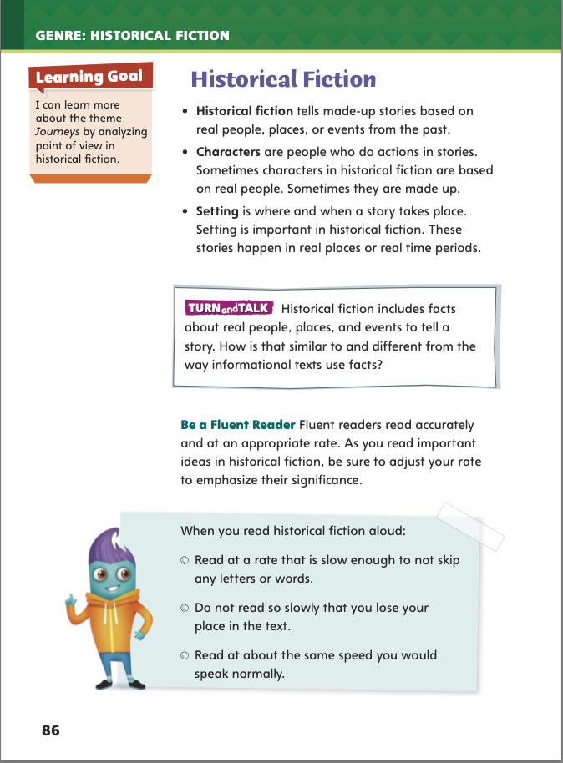
Page 86
Apply
Talk about how historical fiction is similar to and different from the way informational texts use facts.
Notes:
Have students use the strategies to identify historical fiction.
Have students work with a partner to complete the Turn and Talk activity on p. 86 in the Student Interactive. Circulate to discover whether students understand the differences and similarities in how historical fiction and informational texts use facts.

Slide 8
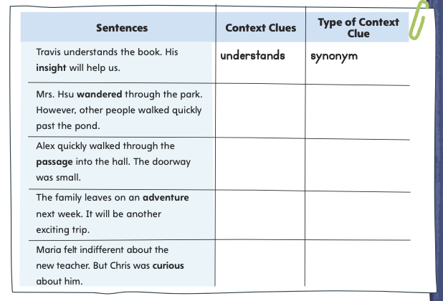
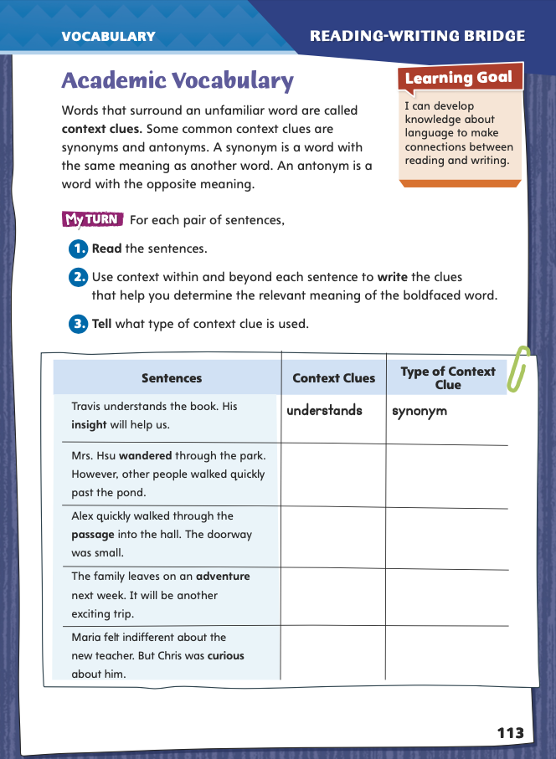
Page 113
Academic Vocabulary
Complete the chart on pg. 113 in your Student Interactive.
Notes:
Context clues are words that surround an unfamiliar word and help a reader determine its meaning.
When you come across an unfamiliar word in your reading, pay attention to the words around it.
Surrounding words can be synonyms or antonyms for an unfamiliar word. A synonym is a word that has the same meaning. An antonym is a word that has the opposite meaning.
If you are already familiar with the synonym, antonym, or other context clues, they can help you understand the meaning of the unknown word.
Model this strategy using the academic vocabulary word insight in the chart on p. 113 in the Student Interactive.
Let’s look at the first line of the chart, “Travis understands the book. His insight will help us.” If the word insight is unfamiliar to me, I can use context clues to figure it out. The first sentence states that Travis understands the book. The second indicates that because he understands it, he has insight. So I think understanding is a synonym for insight, and having insight means understanding things.
Have students apply this strategy on their own to another word from the chart. Then discuss responses and correct misunderstandings.
Have students apply this same strategy as they complete the chart on p. 113 in the Student Interactive. Remind students that they will use these academic words throughout this unit.

Slide 9
Word Study
meat
boil
I
my
pie
high
Notes:
Explain that vowel teams are two or more letters that work together to make a vowel sound. The letters can be vowels or consonants. In a digraph, two letters make a single vowel sound—the ea in meat, for example, makes a long e sound. In a diphthong, two vowels blend into a new one-syllable vowel sound—such as the oi in boil.
To demonstrate different vowel teams spelling the same vowel sound, write on the board the words I, my, pie, and high. Underline the different spellings of the long i sound—I, y, ie, and igh.

Slide 10
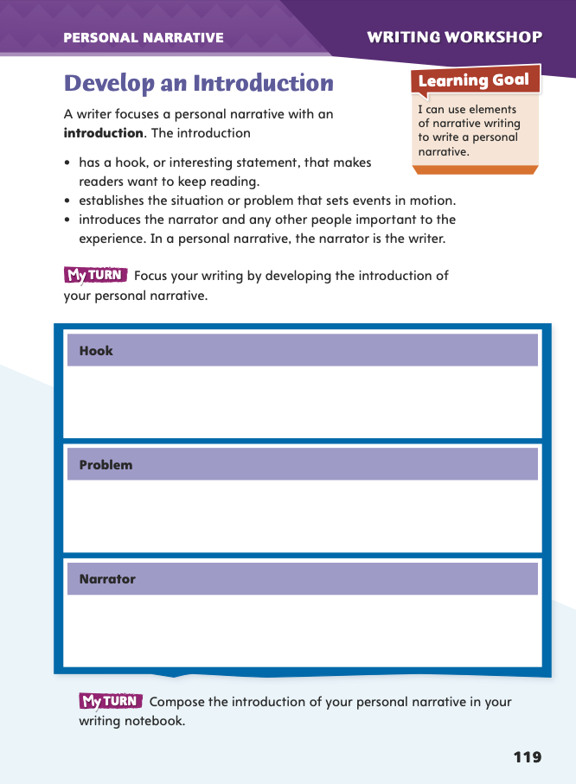
Page 119
Writing – Personal Narrative
Turn to page 119 in your Student Interactive and complete the activity.
Notes:
An effective personal narrative begins with an introduction that
has an interesting statement (called the “hook”) that makes readers want to keep reading.
focuses on a main situation or problem that sets up the whole story.
introduces the narrator (the person telling the story) and other important
people.
Tell students that the introduction of a personal narrative sets the stage for the action of the story. Read aloud two to three texts from the personal narrative stack. Pause to discuss the important parts of introductions you read. The following questions may be used to prompt discussion:
What situation or problem does the author focus on?
Who are the important people in the narrative?
Ask yourself: “What is the hook? What statements in this introduction make me want to read more?”
Direct students to p. 119 in the Student Interactive. Have them use one of the texts in the stack as an example for completing the activity.
Ask for volunteers to identify the narrators and the main situation or problem in the texts they read.

Slide 11
Independent Writing
Plan and write an introduction to your personal narrative in your writer’s notebook.
Notes:
If students need additional opportunities to develop their understanding of personal narratives, they should read additional texts from the stack. If students demonstrate understanding, they should transition to planning and writing the introduction to their personal narrative in their writer’s notebook. See the Conference Prompts on p. T214.

Slide 12
Spelling
1. You will see a lake as we approach the cabin.
2. She has a zeal for working with animals.
3. The committee will discuss plans for the school fair.
4. The treasury department handles the budget for our office.
5. After the typhoon hit, the harbor suffered heavy damages.
6. A toasted marshmallow is delicious!
7. In some counties, the government is in the hands of royalty.
8. Concealment is important to a spy.
9. You can show bravery or cowardice in a difficult situation.
10. A new drug will help fight leukemia.
Notes:
(Note: Move the orange boxes to cover each bold spelling word before you read aloud the words and sentences.)
Read aloud the words and sentences. Have students spell each word using the correct homophone.
1. You will see a lake as we approach the cabin.
2. She has a zeal for working with animals.
3. The committee will discuss plans for the school fair.
4. The treasury department handles the budget for our office.
5. After the typhoon hit, the harbor suffered heavy damages.
6. A toasted marshmallow is delicious!
7. In some countries, the government is in the hands of royalty.
8. Concealment is important to a spy.
9. You can show bravery or cowardice in a difficult situation.
10. A new drug will help fight leukemia.
2. Reveal the spelling word and have students check their work.
For students who understand the ways the spelling of vowel teams can differ, include the following Challenge Words with the spelling list. Challenge Words: scoundrel, endowment, endeavor

Slide 13
Language and Conventions
When Mike went to the store
He bought groceries.
Write a dependent clause.
Exchange clauses with your partner and add an independent clause to form a complete sentence.
Notes:
Review the language-and-conventions topic independent and dependent clauses. See pp. T138–T139.
Display the clauses When Mike went to the store and He bought groceries. Have students identify which is an independent clause and which is a dependent clause. Remind them that independent clauses can stand on their own as complete sentences; dependent clauses are incomplete and must be combined with an independent clause to form a sentence.
Then rewrite the two clauses as a complete sentence: When Mike went to the store, he bought groceries.
Have students work in pairs. Each should write a dependent clause. Then they should exchange clauses and add an independent clause to form a complete sentence.

Slide 14
Lesson 2

Slide 15
Page 88
Preview Vocabulary
tide
course
leagues
fathoms
jaunts
Notes:
Introduce the vocabulary words on p. 88 of the Student Interactive and define them as needed.
tide: the rise and fall of the ocean
course: the direction of travel
leagues: units of distance
fathoms: units of length that measure water dept
jaunts: short, enjoyable journeys
Say: These words will help you understand the plot in Pedro’s Journal. As you read, highlight the words when you see them in the text.

Slide 16
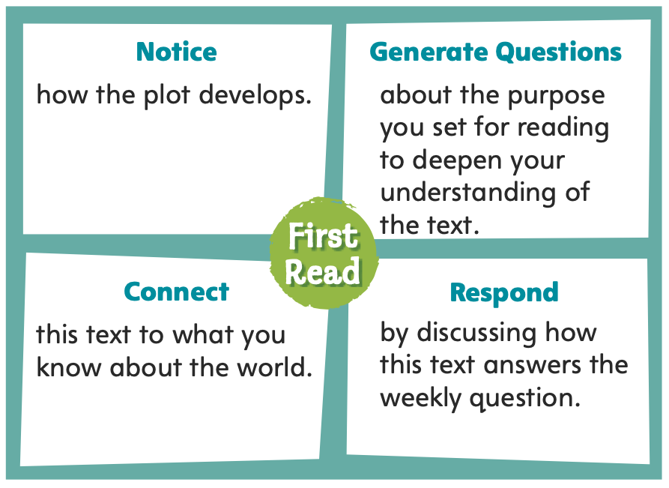
Page 88
First Read Strategies
Notes:
Discuss the First Read Strategies. Prompt students that the purpose for reading this selection is for understanding and enjoyment.
Explain the four steps of the first read.
NOTICE Remind students to notice how the plot develops.
GENERATE QUESTIONS Encourage students to jot down questions about the purpose they set for reading and to deepen their understanding of the text.
CONNECT Ask students to consider how the text connects to what they know about society and the world.
RESPOND Have students discuss how the text answers the weekly question What can people learn from visiting unknown lands?
Students may read independently, in pairs, or as a class. Use the First Read notes to help them connect with the text and guide their understanding.
Multimedia Activity After students complete the first read, have them listen to the audio version of Pedro’s Journal. Have students work together in small groups to analyze how the audio contributes to the meaning, tone, and beauty of the text. Then have groups present their analysis to the class.

Slide 17
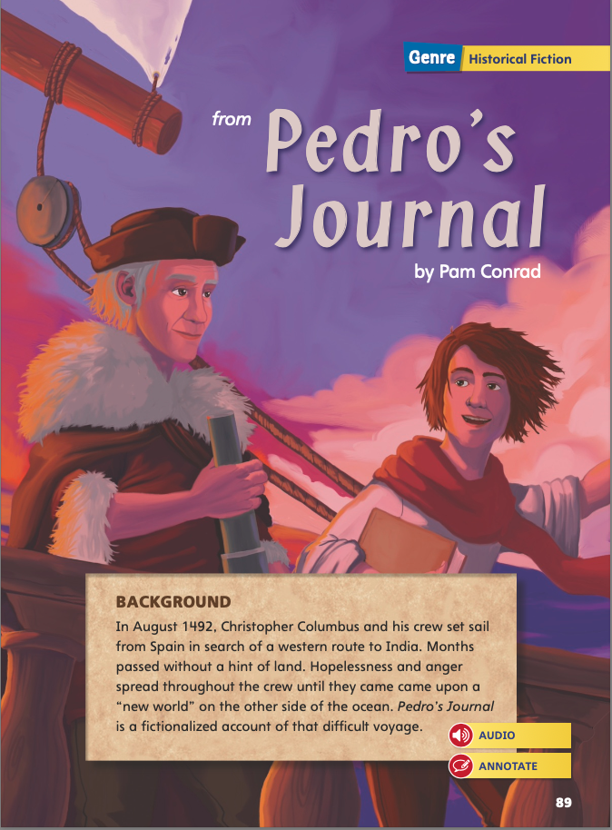
Page 90
First Read – Pedro’s Journal
Notes:
Students may read independently, in pairs, or as a class. Use the First Read notes to help them connect with the text and guide their understanding.

Slide 18
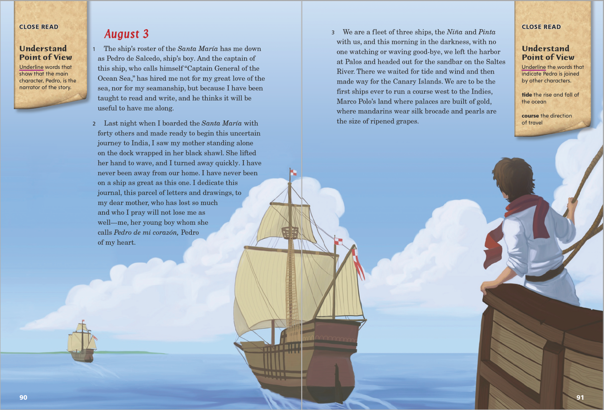
Page 91
First Read – Pedro’s Journal
Notes:
Students may read independently, in pairs, or as a class. Use the First Read notes to help them connect with the text and guide their understanding
THINK ALOUD I know that the ships will reach islands in the Caribbean, but Columbus and his men didn’t know that when they left on this journey. What would it be like to sail into the unknown? What must Pedro be thinking?
THINK ALOUD Notice that the text is in the form of a diary. It begins on August 3, and as I read, I realize that this is the first day of a voyage that a boy named Pedro is recording in his journal.

Slide 19
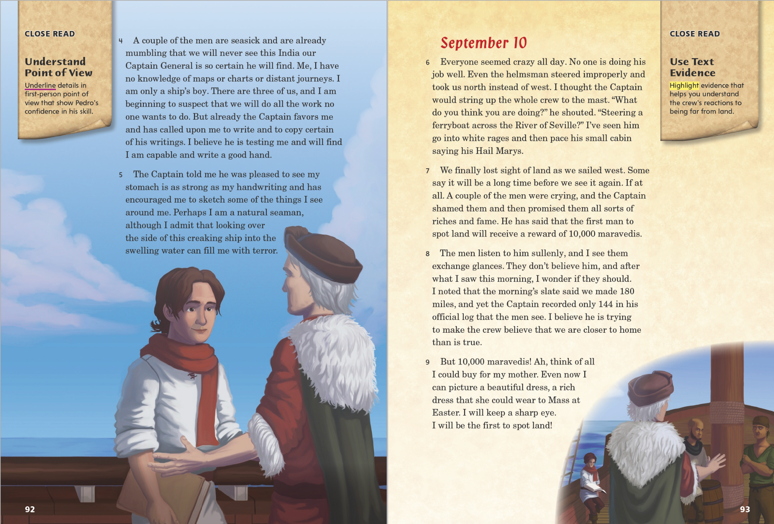
Page 92, 93
First Read – Pedro’s Journal
Notes:
Read together. Students may read independently, in pairs, or as a class. Use the First Read notes to help them connect with the text and guide their understanding
THINK ALOUD I see that many of the sailors were seasick and unhappy. I will keep this in mind as I continue to read the story.
THINK ALOUD I am surprised by the actions of Columbus. Pedro reports that Columbus became very angry and that he shamed the men who were afraid. I wonder what this says about Columbus as a leader.

Slide 20
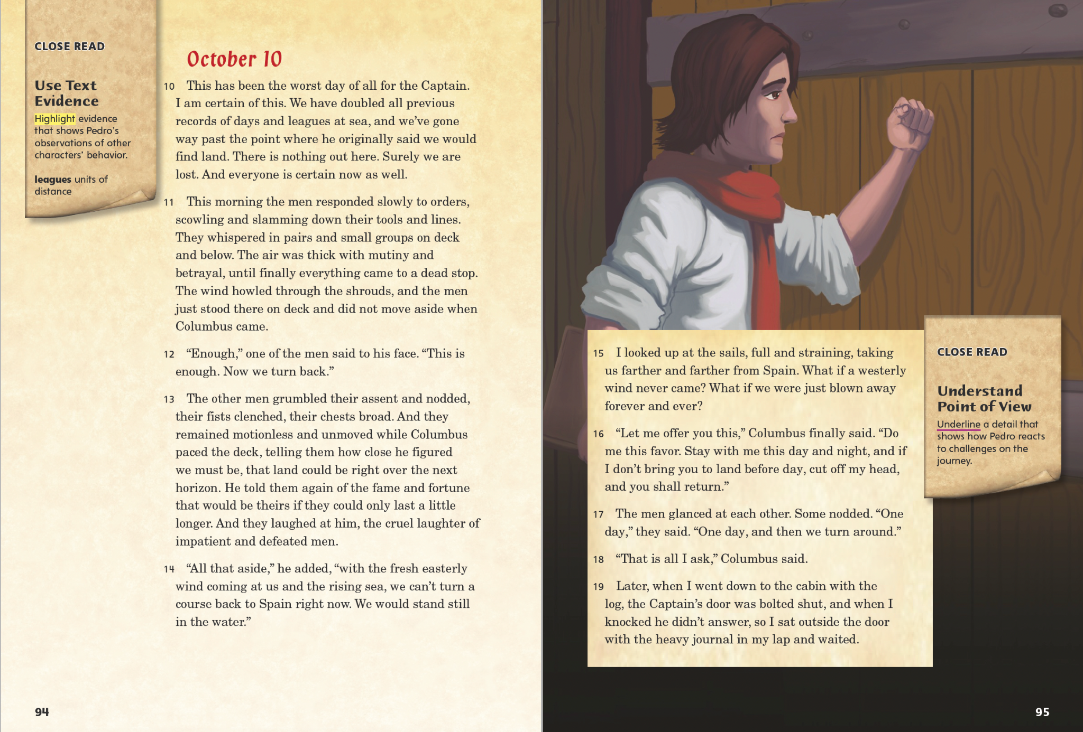
Page 94, 95
First Read – Pedro’s Journal
Notes:
Read together. Students may read independently, in pairs, or as a class. Use the First Read notes to help them connect with the text and guide their understanding.
Notice What do you notice about the words the author uses to describe the situation on October 10? Possible Response: The author uses highly descriptive words such as clenched and howled to convey the tension on deck and the angry mood of the crew.
THINK ALOUD One purpose for reading Pedro’s Journal is to learn something about Columbus’s first voyage to the Americas. But this text is historical fiction, and I wonder how many of the events actually happened. For instance, did Columbus really make a deal that members of the crew could cut off his head if no land appeared in a day, or did the author add this for drama?

Slide 21
Page 96, 97
First Read – Pedro’s Journal
Notes:
Read together. Students may read independently, in pairs, or as a class. Use the First Read notes to help them connect with the text and guide their understanding.
THINK ALOUD. From the details in paragraph 20 about floating things and birds, what question does the author seem to want readers to ask? Possible Response: Do the birds and floating things indicate that the ships are getting closer to land?
THINK ALOUD I really like this part of the story because it conveys all the excitement the men feel in spotting land. I imagine they must also be feeling nervous about what they will find there.

Slide 22
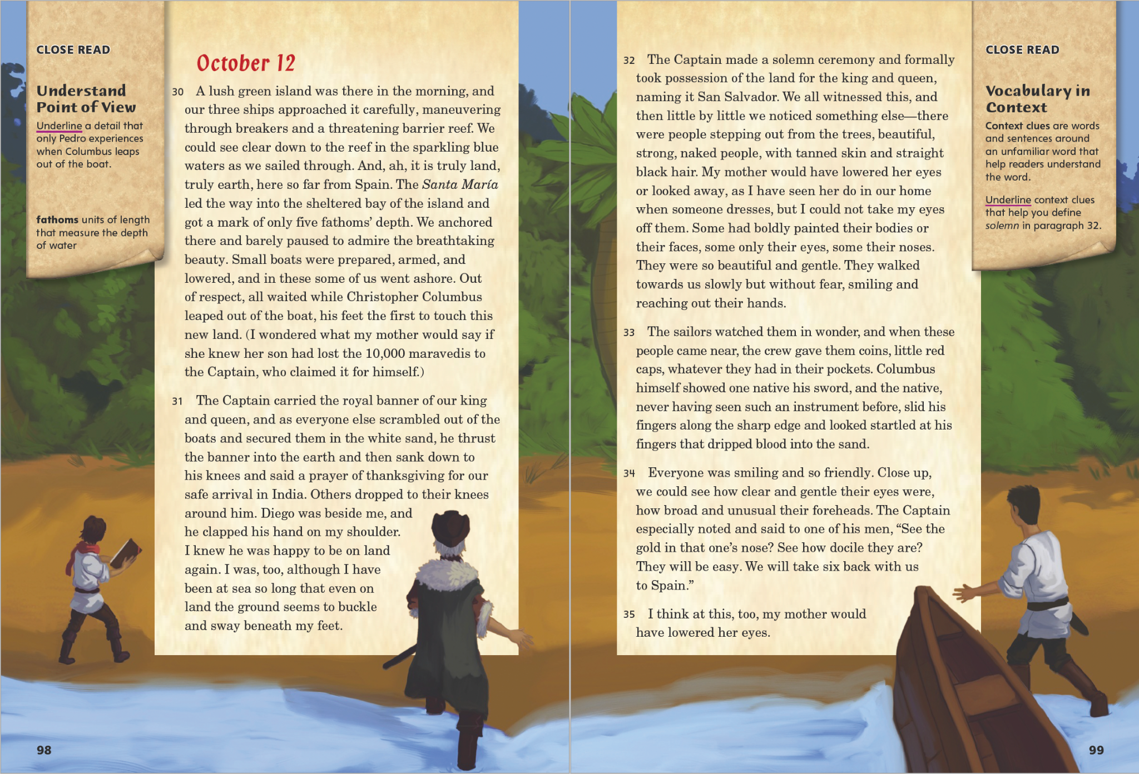
Page 98,99
First Read – Pedro’s Journal
Notes:
Read together. Students may read independently, in pairs, or as a class. Use the First Read notes to help them connect with the text and guide their understanding.
THINK ALOUD I know I’m always relieved and happy to arrive at my destination after a long journey. I can only imagine how Columbus and his crew felt!
Notice What prediction can you make about the relationship between Columbus and the native people? Possible Response: Columbus will take advantage of the good nature of the native people.

Slide 23
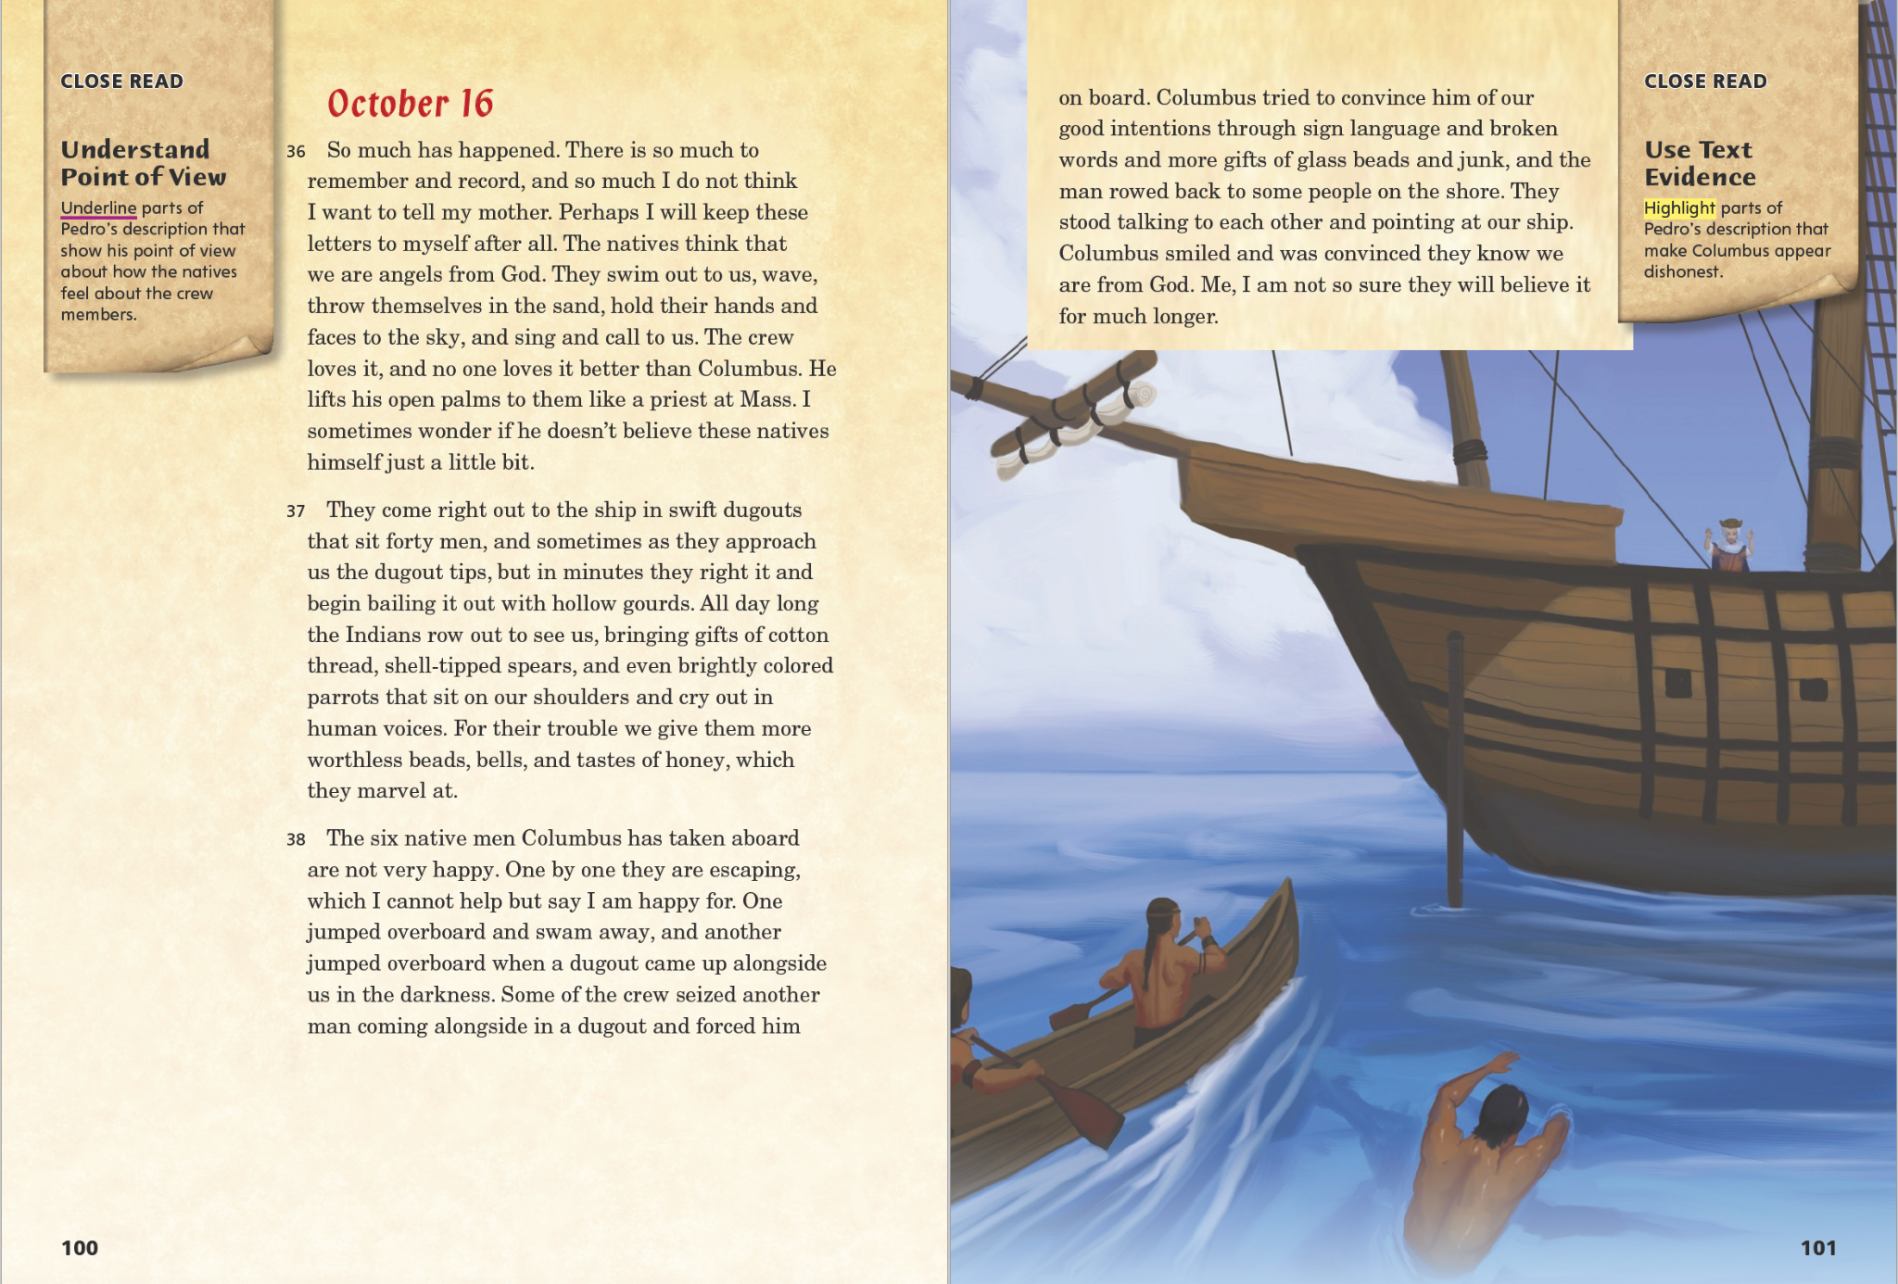
Page 100, 101
First Read – Pedro’s Journal
Notes:
Read together. Students may read independently, in pairs, or as a class. Use the First Read notes to help them connect with the text and guide their understanding.
THINK ALOUD I’m worried about what might happen to the native people at the hands of Columbus. He seems to be taking advantage of them.
THINK ALOUD I notice that the illustration on this page helps me to better understand the description of the native men approaching the ship in their dugouts. I also get an idea of what the boats of the native people and the Spanish look like. The Santa María does not look like a very large ship.

Slide 24
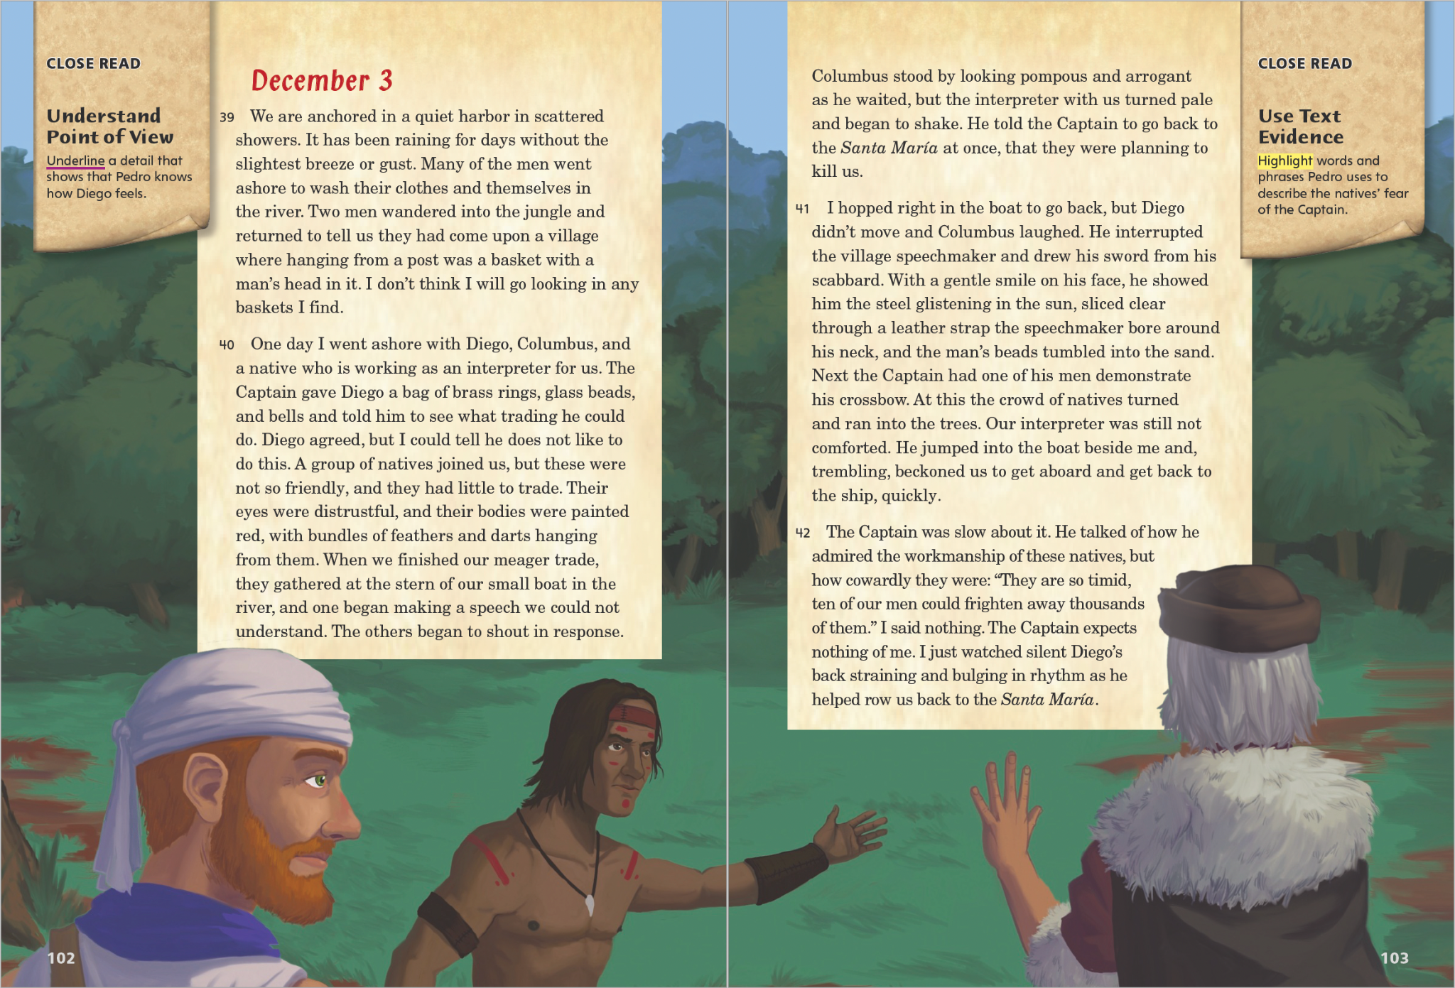
Page 102, 103
First Read – Pedro’s Journal
Notes:
Read together. Students may read independently, in pairs, or as a class. Use the First Read notes to help them connect with the text and guide their understanding.
Notice I see there are nearly two months between this entry and the last. What might have happened between October and December? Possible Response: It is likely that relations between the two groups deteriorated even more because by December, the native people want to kill Columbus and his men.
THINK ALOUD I wonder who the interpreter is more afraid of, Columbus or his own people?

Slide 25
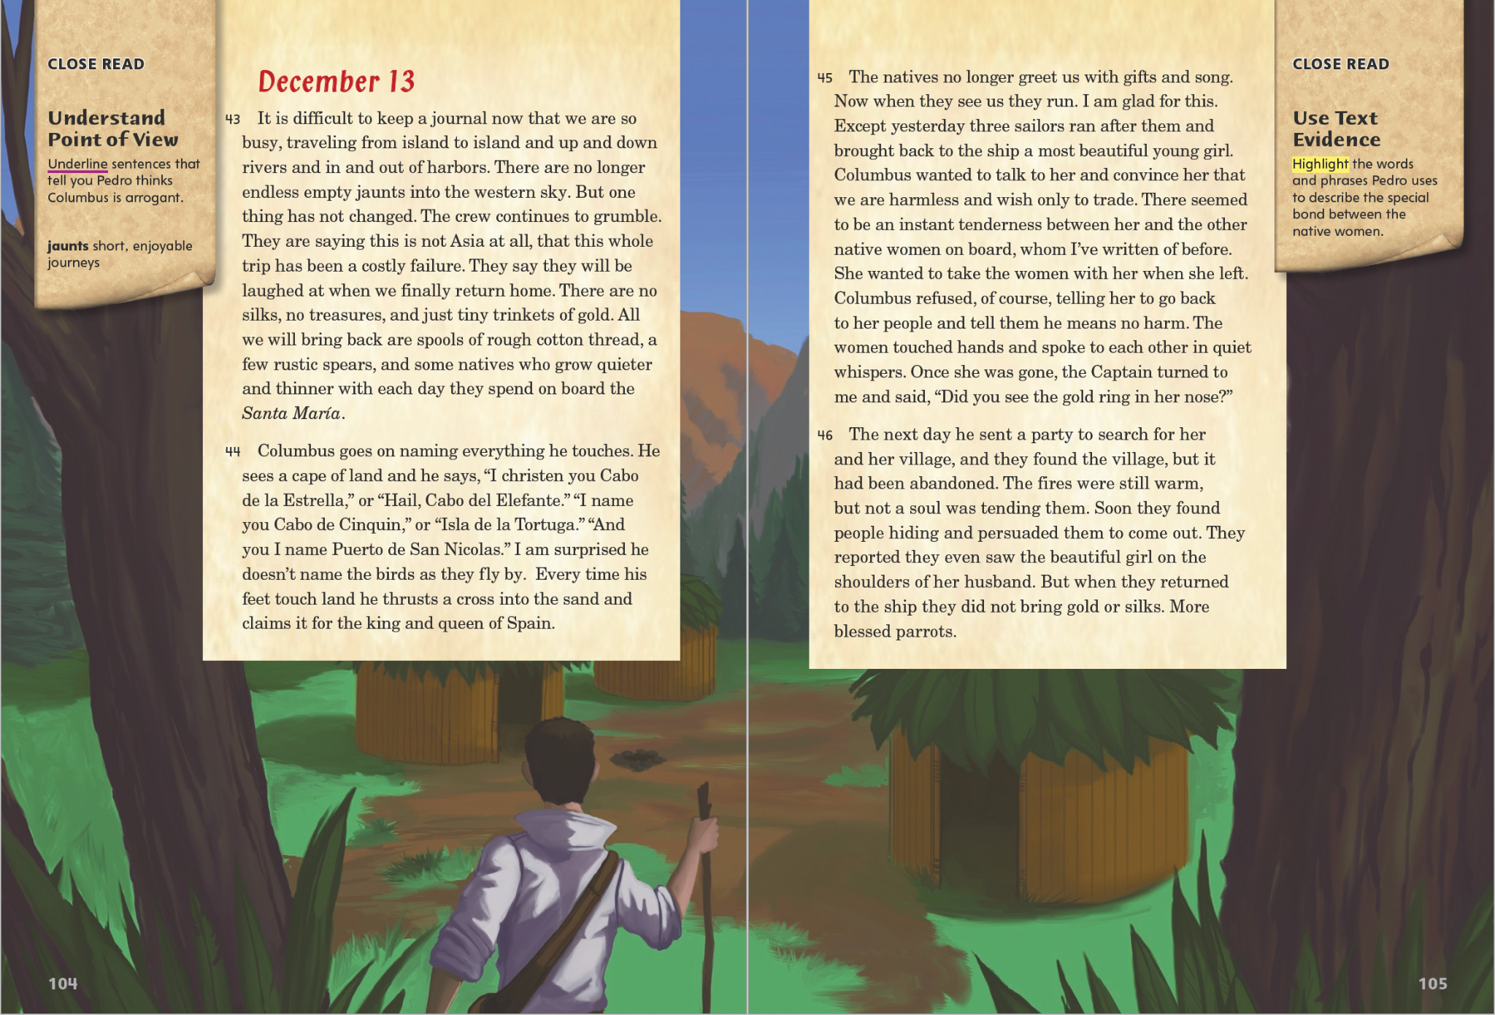
Page 104, 105
First Read – Pedro’s Journal
Notes:
Read together. Students may read independently, in pairs, or as a class. Use the First Read notes to help them connect with the text and guide their understanding.
THINK ALOUD I suppose naming places was part of claiming places. I wonder how the native people felt about the new names Columbus gave to the places where they lived.
THINK ALOUD I know from my own life how wonderful it is to be reunited with people you miss. The girl must have been very sad to leave without her friends.

Slide 26
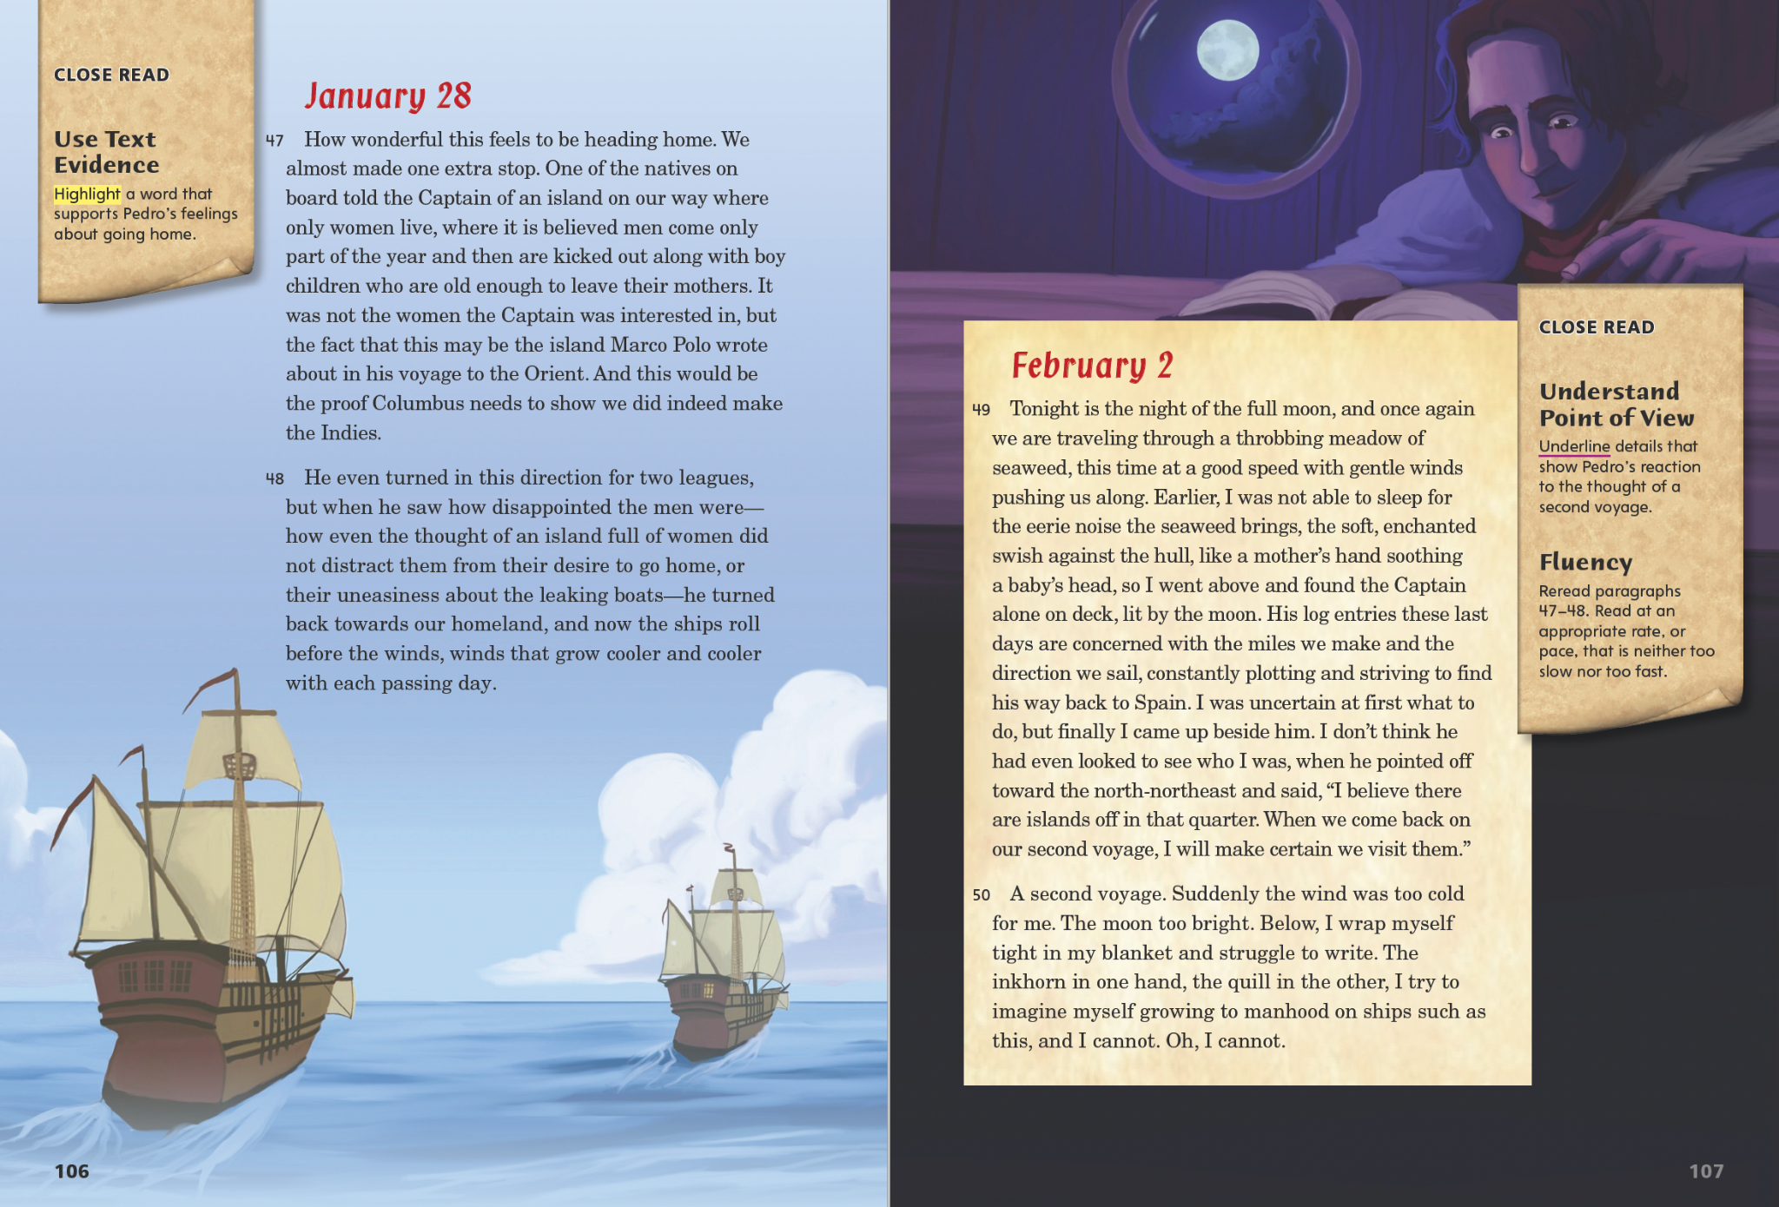
Page 106, 107
First Read – Pedro’s Journal
Notes:
Read together. Students may read independently, in pairs, or as a class. Use the First Read notes to help them connect with the text and guide their understanding.
Respond What mistake does Columbus continue to make about the lands he visited? Possible Response: He still thinks he has reached “the Orient,” or eastern Asia.
THINK ALOUD I really enjoyed the author’s description of the boat slipping through the seaweed because it helped me to imagine the scene vividly.

Slide 27
Respond and Analyze
Brainstorm: Why did the sailors grow more and more upset as they got farther away from Spain?
Freewrite: Describe the relationship between Pedro and the Captain.
Notes:
Begin by asking students “What did you think about this text?” or “What part surprised you or interested you most?” Then use these suggestions to prompt students’ initial responses to reading Pedro’s Journal.
Brainstorm Why did the sailors grow more and more upset as they got farther away from Spain?
Freewrite Briefly describe the relationship between Pedro and the Captain.

Slide 28
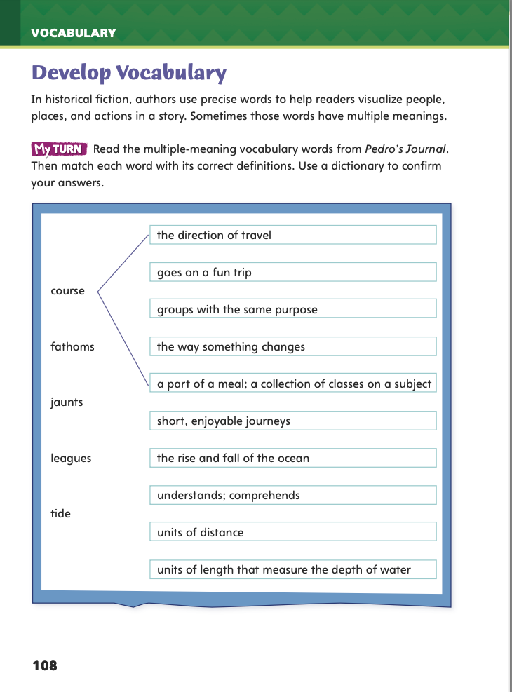
Page 108
Develop Vocabulary
Turn to page 108 in your Student Interactive and complete the activity.
Notes:
Explain that authors choose specific words to help readers visualize people, places, and actions in a text. The vocabulary words tide, course, leagues, fathoms, and jaunts all help describe the sea journey in Pedro’s Journal, but they also have other meanings.
Reread a sentence containing each word. Use text evidence to remind yourself of each word’s meaning in the story.
Use print or digital resources to determine each word’s other meaning(s).
Model completing the matching exercise on Student Interactive p. 108 using the word course.
In the story, Pedro describes their mission: “We are to be the first ships ever to run a course west to the Indies.” From this text evidence, I know that one meaning of course must be “the direction of travel.”
The dictionary tells me that course can also mean “a part of a meal” or “a collection of classes on a subject.”
Have students use the strategies for developing vocabulary.
Have students complete p. 108 of the Student Interactive.

Slide 29
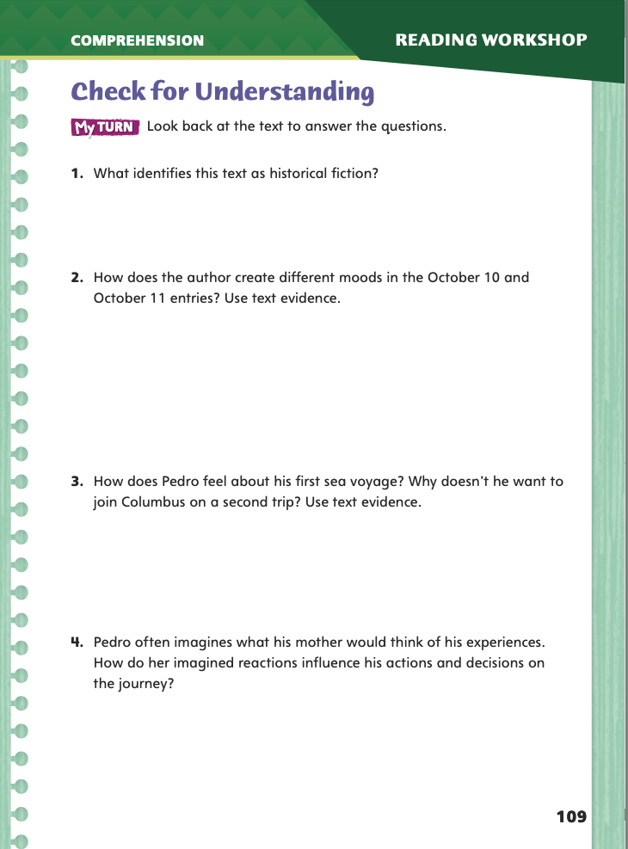
Page 109
Check for Understanding
Complete page 109 in your Student Interactive.
Notes:
Have students complete p. 109 of the Student Interactive.

Slide 30
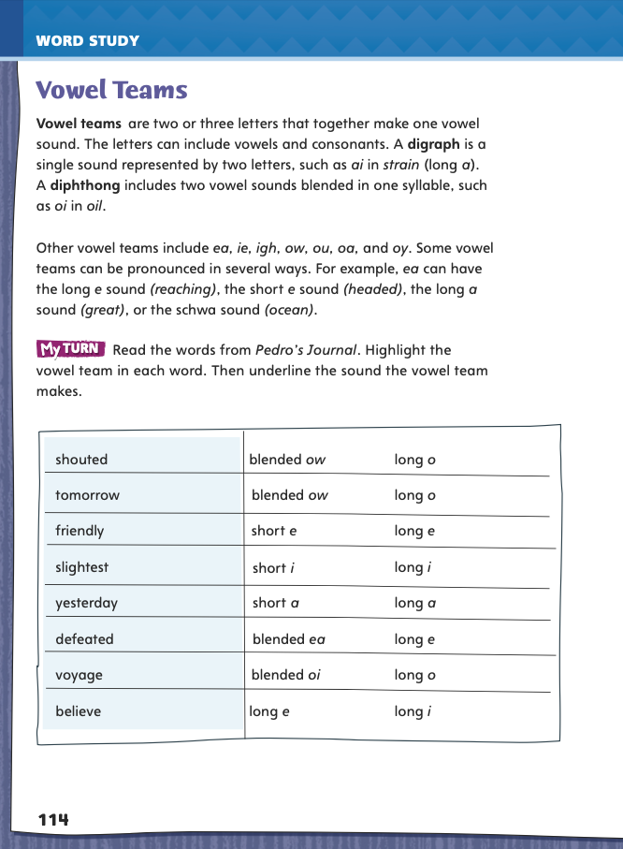
Page 114
Word Study
Complete page 114 in your Student Interactive.
Notes:
Direct students to complete the items on p. 114 in the Student Interactive.
Then have students write three sentences using three of the words from the chart.

Slide 31
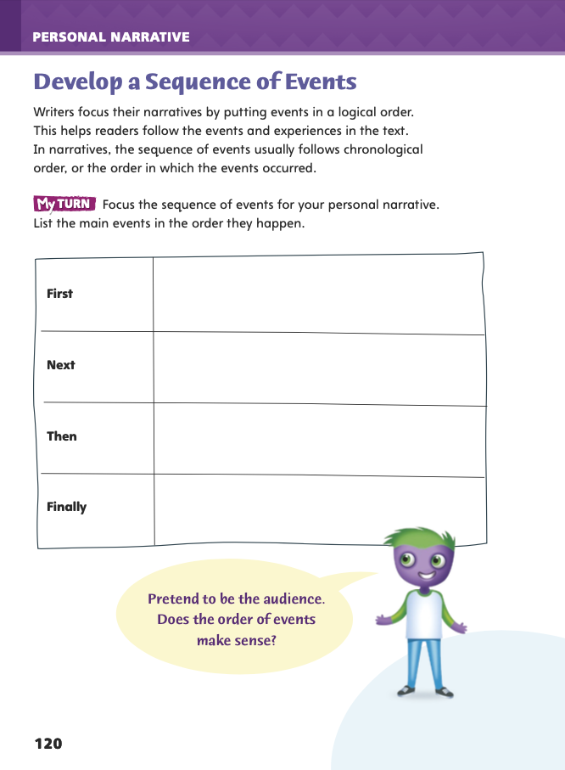
Page 120
Writing – Personal Narrative
Turn to page 120 in your Student Interactive.
Notes:
Readers want to understand when and how events occur. To make a personal narrative easier to follow, writers focus their narratives by sequencing the events in a logical order.
The sequence of events usually reflects the order in which the events occurred.
Writers use transition words such as first, next, then, and finally to show the sequence.
Review sequence of events on p. 120 in the Student Interactive. Tell students that they will be reading new texts to identify ways that writers narrate a sequence of events.
As you read together texts from your stack, ask students to identify how they know the writer is focusing on putting events in the order in which they happened. Ask: Why would an author want to tell about events in the order they happened? What words might an author use to show the sequence?
Have students choose a text the class has just read. Encourage them to use it as an example to guide them in planning their own personal narrative sequence on p. 120 of the Student Interactive.
Call on a few students to share the event sequence in one of the texts they read. Ask them which transition words and phrases describe the passage of time.

Slide 32
Independent Writing
Begin planning and writing your personal narrative in your writer’s notebook.
Notes:
If students need additional opportunities to develop their understanding of personal narratives, they should read additional texts from the stack. If students demonstrate understanding, they should begin planning and writing their personal narratives in their writer’s notebook. See the Conference Prompts on p. T214.

Slide 33
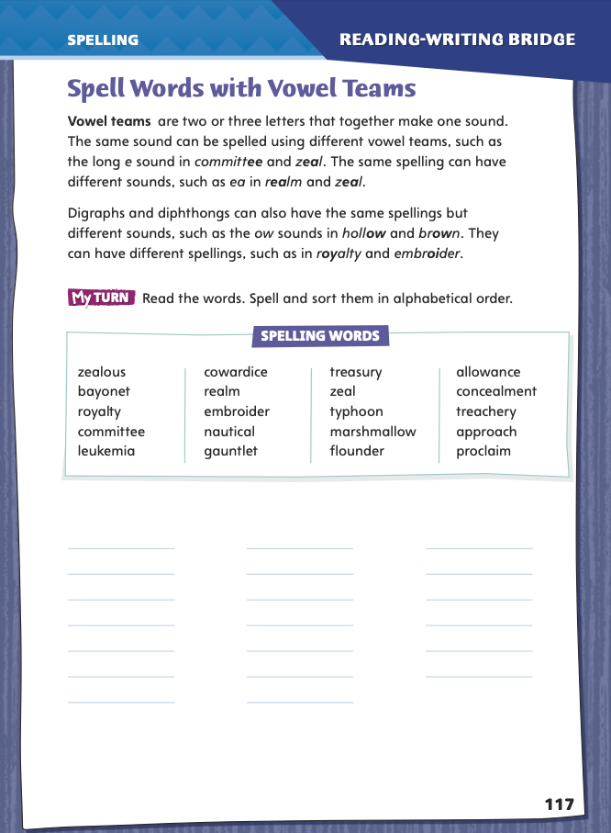
Page 117
Spelling
committee
concealment
Turn to page 117 in your Student Interactive and complete the activity.
clown
hollow
Notes:
Explain that, in a vowel team, the same sound can be spelled in different ways, and the same spelling can have different sounds.
Display and say committee/concealment. Point out the digraphs ee and ea and the two spellings for the same long e sound.
Then display and say clown/hollow. Note the diphthong ow and the two sounds spelled with the same letters ow.
Have students independently complete the activity on Student Interactive p. 117.

Slide 34
Language and Conventions
The day was sunny.
After the rain started, we ran inside.
Francesa forgot her umbrella, and we got wet!
Notes:
Explain that compound sentences include two independent clauses. Complex sentences include an independent clause and a dependent clause.
Display three sentences:
The day was sunny.
After the rain started, we ran inside.
Francesa forgot her umbrella, and we got wet!
Help students identify the simple, compound, and complex sentences.
Have them work individually to expand the simple sentence into a compound and a complex sentence by adding a clause.
Have students work in pairs to practice forming simple, compound, and complex sentences.

Slide 35
Lesson 3

Slide 36
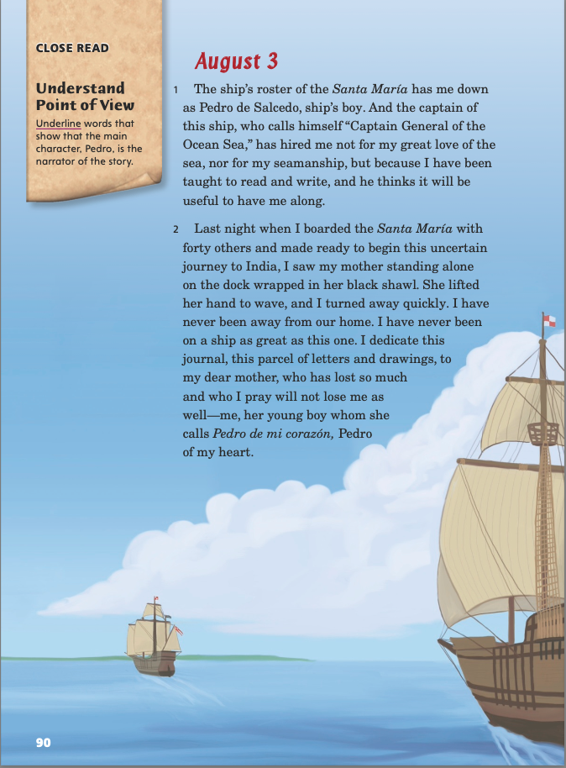
Page 90
Close Read – Understand Point of View
Turn to page 90 in your Student Interactive.
Notes:
When reading a story, one of the first things to do is identify who is telling it. That person is called the narrator. The narrator tells the story from his or her point of view. The reader sees the action and understands the characters through the narrator’s eyes. In first-person point of view, the narrator is a character in the story and refers to himself or herself with the pronouns I and me.
In third-person point of view, the narrator is not a character in the story and refers to all characters with the pronouns he and she.
Use the Close Read note on p. 90 of the Student Interactive to model how to annotate the text to identify point of view.
Which words help me identify the point of view? In the first paragraph, the writer uses the words me, I, and my. I will underline those words.
Have students find and underline other clues to point of view in the next paragraph. Then ask them if they have discovered who the narrator of the story is.

Slide 37
Page 90
Close Read – Understand Point of View
Turn to page 90 in your Student Interactive.
Notes:
When Have students scan the text on p. 90. Ask: How can I identify the narrator by using evidence in the text? Have students underline words that show that Pedro, the main character, is the narrator. See student page for possible responses.
Have students underline similar words in paragraph 2. Ask them to explain why the words they underlined show the story’s point of view. Possible Response: The words me, my, and I indicate the first-person point of view, in which the narrator is a character in the story. DOK 1

Slide 38
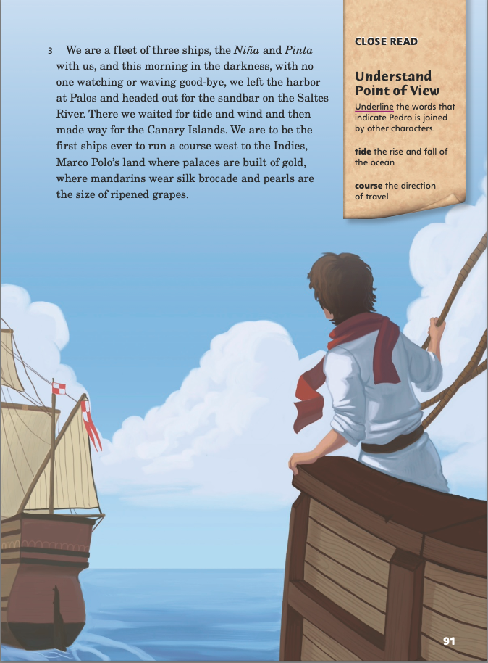
Page 91
Close Read – Understand Point of View
Turn to page 91 in your Student Interactive.
Notes:
Remind students that although Pedro tells the story from his point of view, other characters also play roles. Say: I already know that Columbus is the fleet’s captain and that Pedro and 40 sailors man the ships.
Have students scan the text on p. 91 and underline the words that indicate Pedro is joined by other characters. See student page for possible responses. DOK 1

Slide 39
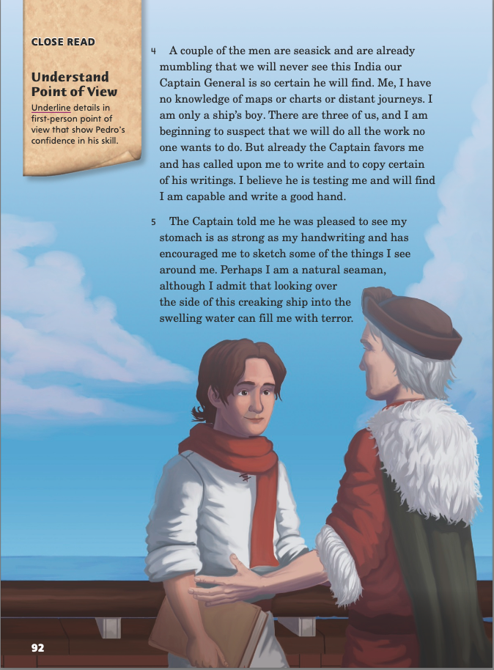
Page 92
Close Read – Understand Point of View
Turn to page 92 in your Student Interactive.
Notes:
When Explain that because the story is told from Pedro’s point of view, readers can learn a lot about how he sees the world. Have students scan the text on p. 92 and underline details in which Pedro reveals his confidence in his skill. See student page for possible responses.
Ask How does Pedro let us know his talents without bragging about them? Possible Response: Pedro reports the Captain’s behavior and praise—Columbus favoring Pedro to write and copy and saying Pedro’s stomach is as strong as his handwriting—instead of directly telling us of the skills and talents Pedro possesses. DOK 3

Slide 40
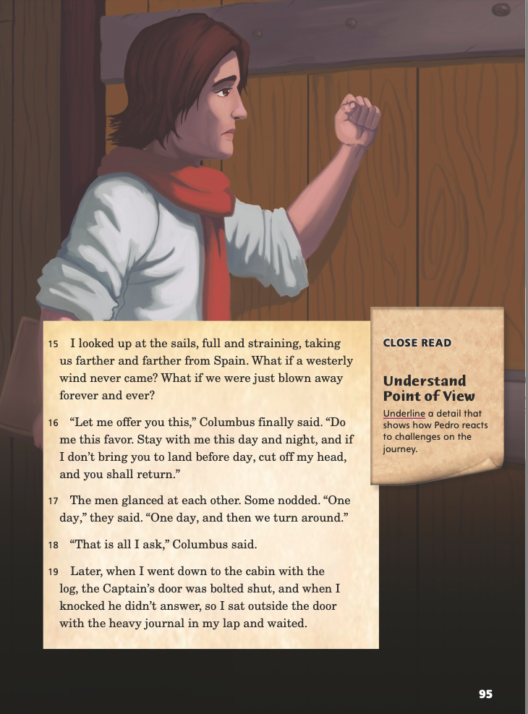
Page 95
Close Read – Understand Point of View
Turn to page 95 in your Student Interactive.
Notes:
When Have students scan the text on p. 95 and underline a detail that shows how Pedro reacts to the challenges of the journey. See student page for possible responses.
Ask students how this detail helps them better understand Pedro. Possible Response: The statement “I sat outside the door with the heavy journal in my lap and waited” shows that Pedro is patient and calm in a tense, dangerous situation. DOK 2

Slide 41
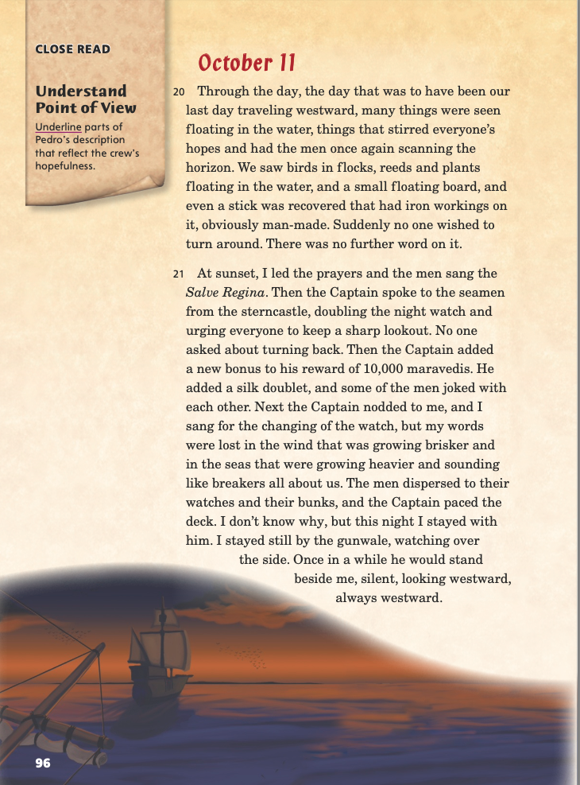
Page 96
Close Read – Understand Point of View
Turn to page 96 in your Student Interactive.
Notes:
Remind students that in works written from the first-person point of view, the reader learns the impressions of only one character, the narrator. Here, the reader learns Pedro’s impressions of the crew’s thoughts, not the actual thoughts themselves.
Have students scan the text on p. 96 and underline parts of Pedro’s description that reflect his impression of the crew’s hopefulness. See student page for possible responses. DOK 2

Slide 42
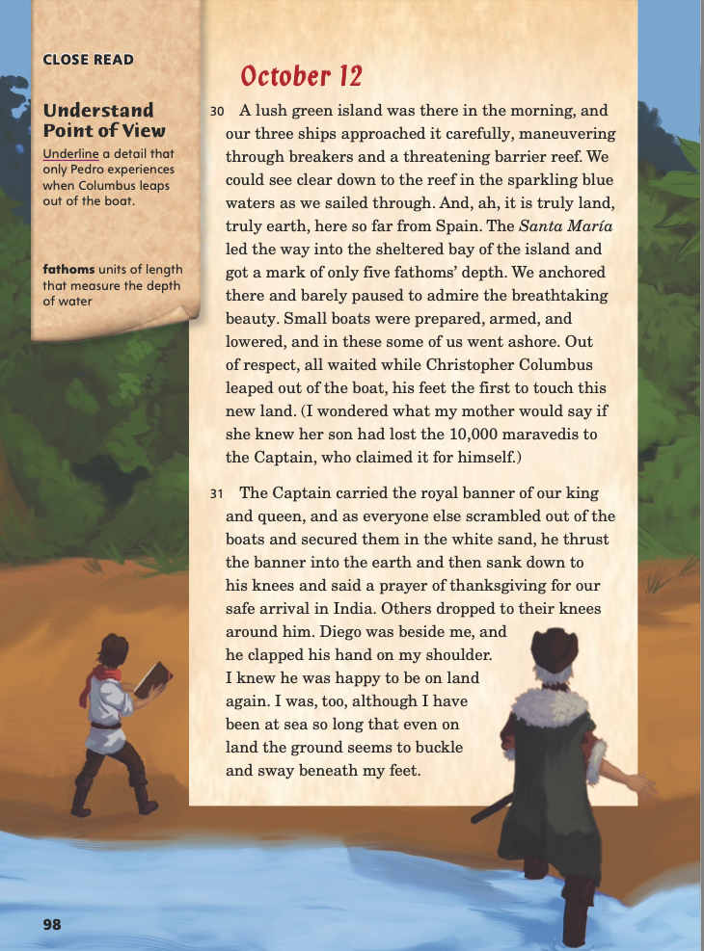
Page 98
Close Read – Understand Point of View
Turn to page 98 in your Student Interactive.
Notes:
Explain that a first-person narrator not only reports his or her observations but also reveals his or her inner thoughts.
Have students scan paragraph 30 and underline a detail that only Pedro experiences when Columbus leaps out of the boat. See student page for possible response. DOK 2

Slide 43
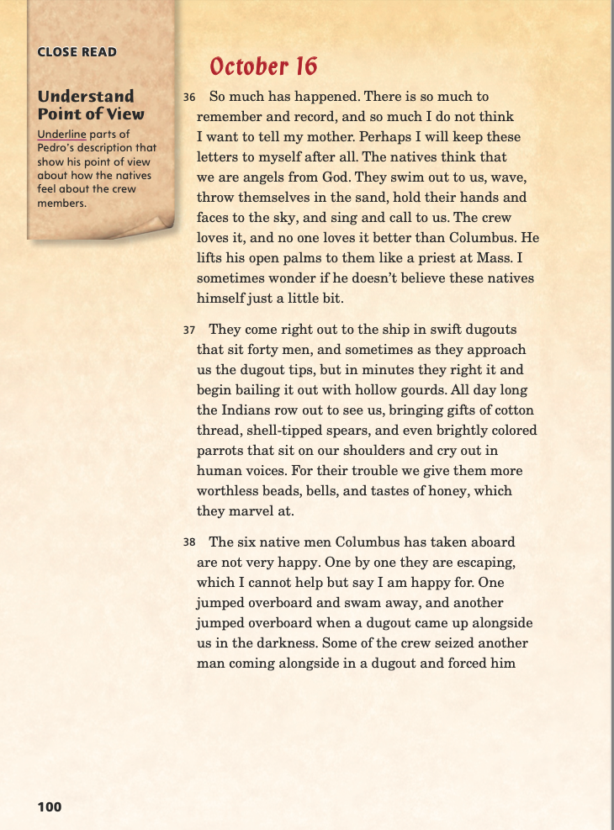
Page 100
Close Read – Understand Point of View
Turn to page 100 in your Student Interactive.
Notes:
Tell students that the author introduces new characters from the point of view of the first-person narrator. Say: We cannot know what the other characters are actually thinking and feeling; instead, we get the narrator's impression of the other characters.
Have students scan paragraph 36 and underline parts of Pedro’s description that show his impression of how the native people feel about the crew members. See student page for possible responses. DOK 2

Slide 44
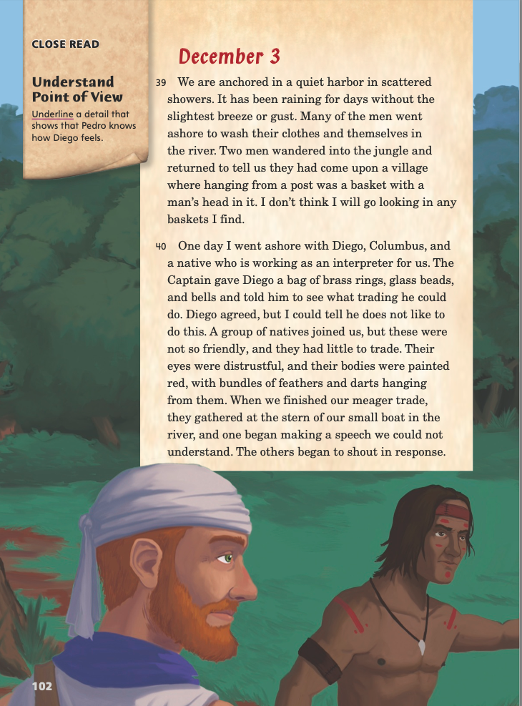
Page 102
Close Read – Understand Point of View
Turn to page 102 in your Student Interactive.
Notes:
Remind students that the text is written from Pedro’s point of view.
Have them scan paragraph 40 and underline a detail that shows that Pedro knows how Diego feels. See student page for possible responses. DOK 2

Slide 45
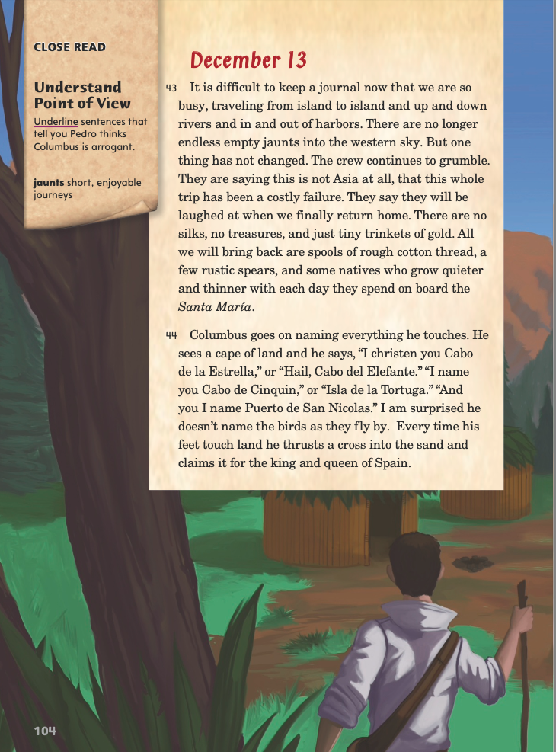
Page 104
Close Read – Understand Point of View
Turn to page 104 in your Student Interactive.
Notes:
Remind students that the impressions the reader gets of Columbus come through the eyes of the narrator, Pedro.
Have students scan paragraph 44 and underline sentences that tell them Pedro thinks Columbus is arrogant. See student page for possible responses.
Ask students why you think Pedro keeps his thoughts about Columbus’s actions to himself. Possible Response: I think Pedro does not want to make the Captain angry. DOK 2

Slide 46
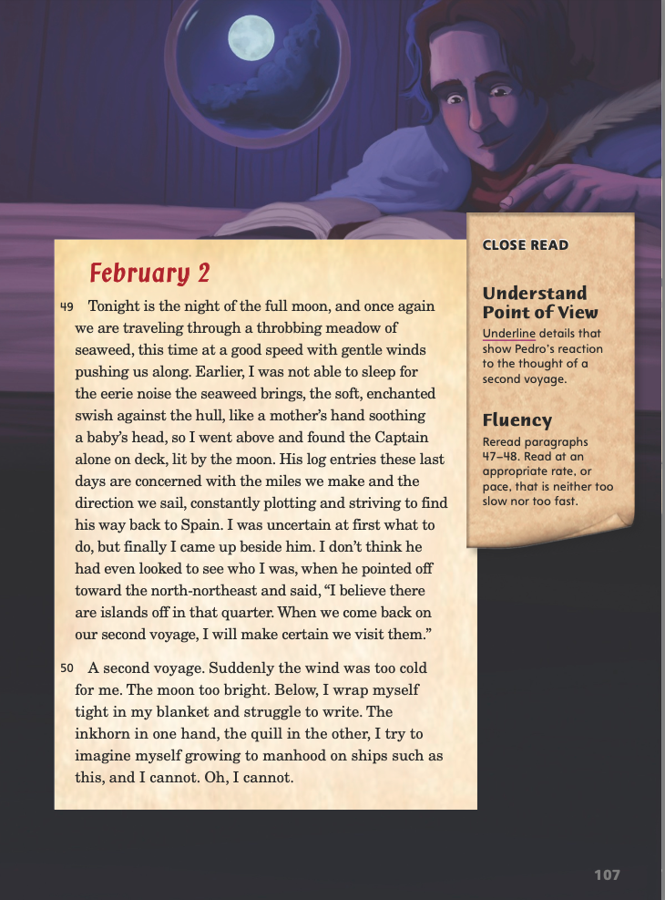
Page 107
Close Read – Understand Point of View
Turn to page 107 in your Student Interactive.
Notes:
Remind students that authors can convey point of view as much through description as through direct statement.
Have students scan paragraph 50 and underline Pedro’s physical reaction to the thought of a second voyage. See student page for possible responses.
Ask students how they think Pedro’s voyage with Columbus changed him. Possible Responses: He was able to see and report what few Europeans had ever seen. He became less admiring of Columbus and less certain that the Spanish had right on their side. DOK 3

Slide 47
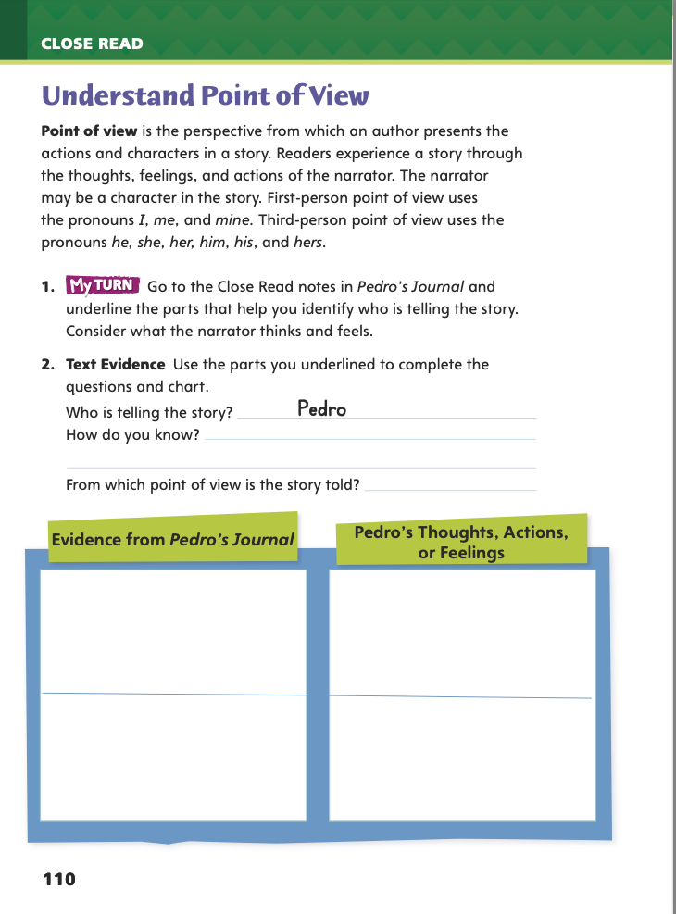
Page 110
Understand Point of View
Turn to page 110 in your Student Interactive and complete the activity.
Notes:
Have students use the strategies for understanding point of view.
Have students go to the Close Read notes in Pedro’s Journal and underline the parts that help them identify who is telling the story. Tell them to consider what the narrator thinks and feels. Then have students complete the activities on p. 110 of the Student Interactive.

Slide 48
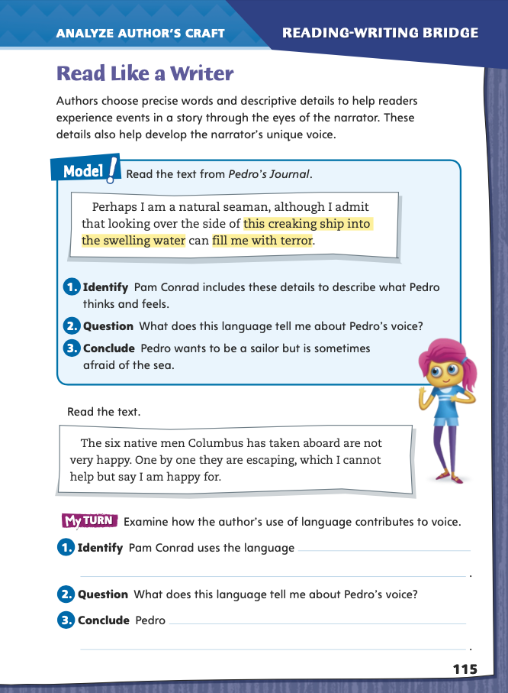
Page 115
Read Like a Writer
Circle instances of precise language in Pedro’s Journal.
Turn to page 115 in your Student Interactive and complete the activity.
Notes:
Explain that using precise words and descriptive details helps bring a story to life. Read this sentence aloud to the class: The boat moved through the water as I rowed across a lake by myself. The words do not paint a picture for readers or tell much about the narrator.
Now read this sentence: The oars broke the still surface of the water as I proudly rowed across the lake on my own. The descriptive details and precise language help the reader picture what is happening and understand how the narrator feels in that moment.
Model analyzing the author’s craft for precise language and descriptive details by directing students to p. 115 in the Student Interactive. Have them follow along as you read aloud the passage from Pedro’s Journal.
Identify the highlighted examples of precise language in the passage from the text.
Ask what the author’s use of precise language helps readers learn about Pedro and his voice. If students have difficulty understanding the concept of a character’s “voice,” explain that it is the character’s way of speaking and thinking.
Guide students to draw a conclusion about the author’s use of precise language. Point out that descriptive details help readers understand Pedro’s thoughts and feelings.
Direct students to go back to Pedro’s Journal and circle instances of precise language. Then have them focus on a specific example by completing the activity on p. 115 in the Student Interactive.

Slide 49
Word Study
ocean
great
proud
bead
seasick
joyful
heavier
seasick
pleased
spread
Notes:
Remind students that vowel teams are combinations of two or more letters that work together to form vowel sounds.
List these words with the vowel team ea: ocean, bead, heavier, pleased, great, seasick, spread.
Have students identify the digraphs with long e (bead, pleased, seasick), short e (heavier, spread), long a (great), and schwa sound (ocean). Display and have students identify diphthongs in proud and joyful.
Have students complete Word Study p. 3 from the Resource Download Center. Note that students will practice reading the words in context. Click path: Table of Contents -> Resource Download Center -> Word Study -> U4W5

Slide 50
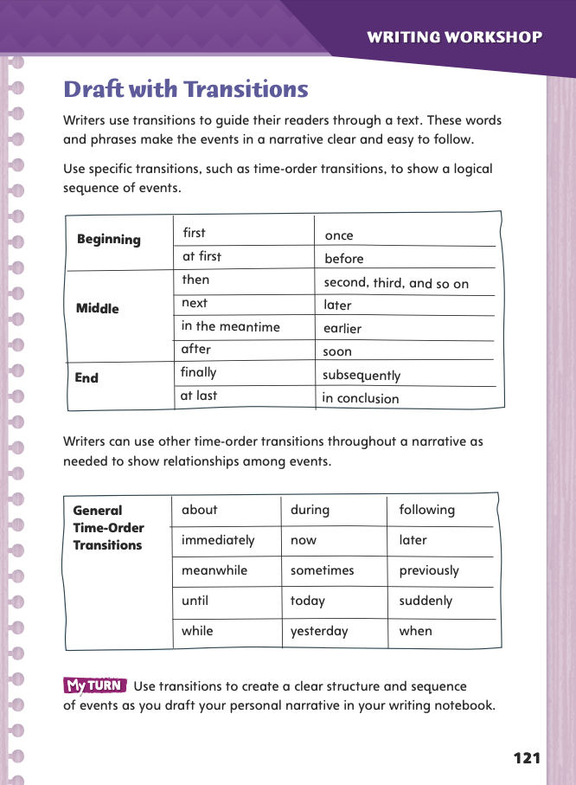
Page 121
Writing
Turn to page 121 in your Student Interactive.
Notes:
To guide readers through a text, writers use transitions that describe the order of events. Remind students that transitions
Make reading smooth and focused.
Give readers a sense of time.
Include words such as first and next to describe time order, and words such as meanwhile and suddenly to show a relationship among events.
Have a volunteer tell about something that happened this morning. Encourage the class to listen for a sequence of events and any transitions that describe what is happening.
Ask: Why is it important to tell a narrative in the order the events happened?
Explain to students that transitions, such as first, next, then, and finally, help writers narrate events in a particular order. Ask: Which transitions did you hear?
Pair students and direct them to p. 121 in the Student Interactive. Have partners tell each other a brief personal narrative from the stack or from an experience. Ask: What transition words or phrases did you hear? How did they help you understand the passage of time in the narrative?
Invite a few students to name a transition. Then have volunteers describe how transition words help the reader understand the passage of time.

Slide 51
Independent Writing
Write ideas for transitions for your narrative.
Add transitions to your personal narrative.
Notes:
Direct students to begin writing ideas for transitions in their narratives. As they write, have them refer to the stack to help generate ideas and to check for elements of personal narratives.
Alternatively, if students are ready to add transitions to their narratives, they may write in their writer’s notebooks. See the Conference Prompts on p. T214.

Slide 52
Spelling
conceal
meet
coward
hollow
Complete the sentences with a spelling word.
1. A queen is __________.
2. Something related to the sea is _________.
Notes:
In vowel teams, digraphs, and diphthongs, the same sound can have different spellings (long e in conceal/meet), and the same spelling can have different sounds (ow in hollow/coward).
Have students complete these sentences with a spelling word.
A queen is ____. (royalty)
Something related to the sea is ____. (nautical)
Have students complete Spelling p. 8 from the Resource Download Center. Click path: Table of Contents -> Resource Download Center -> Spelling -> U1W3

Slide 53
Language and Conventions
Tom bought pizza.
Tom bought pizza because he was hungry.
Tom bought a pizza, and he took it home.
Notes:
A compound sentence joins two independent clauses with a comma and a conjunction such as and, but, or, yet, or for.
A complex sentence joins an independent clause with a dependent clause. If the dependent clause appears first in a sentence, a comma follows it.
Emphasize to students the importance of avoiding comma splices. A comma splice occurs when two independent clauses are joined with a comma but no conjunction. This is incorrect and must be revised.
Display the simple sentence Tom bought pizza. Demonstrate adding clauses to create a compound and a complex sentence. Tom bought pizza because he was hungry. (complex) Tom bought a pizza, and he took it home. (compound)
Give students another simple sentence to expand into a complex sentence and into a compound sentence. Have students explain how their complex sentences use commas and conjunctions correctly.

Slide 54
Lesson 4

Slide 55
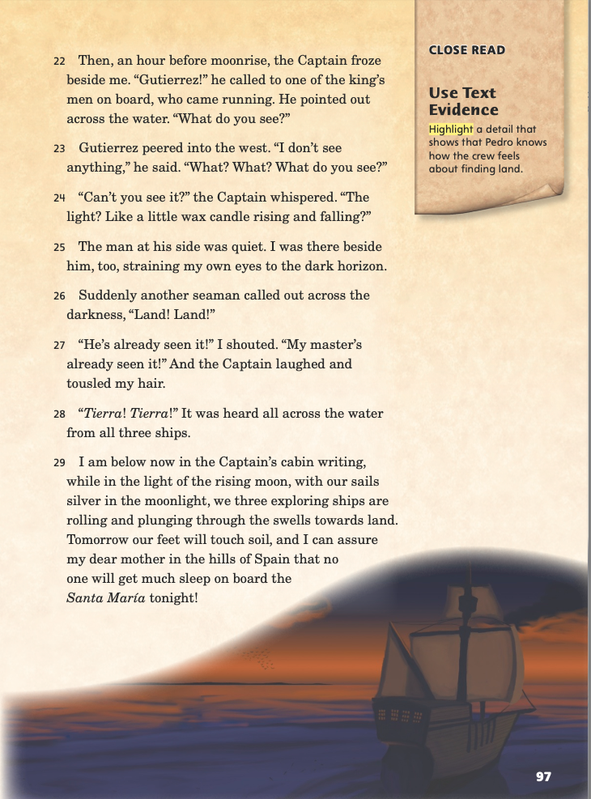
Page 97
Close Read – Use Text Evidence
Turn to page 97 in your Student Interactive.
Notes:
Readers use text evidence to understand elements in a text, including point of view, and to support an appropriate response.
Determine from what or whose point of view the story is told.
Notice how the narrator gives information about characters and events.
Use this text evidence to help understand the narrator’s point of view.
Use the Close Read note on p. 97 of the Student Interactive to model how to use text evidence to understand point of view.
How can I tell how Pedro thinks the crew will react to spotting land? In paragraph 29, he says “no one will get much sleep on board the Santa María tonight!” I am going to highlight that sentence as text evidence that he believes the crew is excited about spotting land. I think the exclamation point at the end makes his point of view particularly clear.

Slide 56
Page 97
Close Read – Use Text Evidence
Turn to page 97 in your Student Interactive.
Notes:
Explain that an author does not always state information directly in the text. Instead, he or she provides details from which the reader must make inferences about characters and events.
Have students scan paragraph 29 to find and highlight a detail that shows that Pedro knows how the crew feels about finding land. See student page for possible responses.
Discuss with students whether they think this way of conveying the crews’ excitement is effective. DOK 3

Slide 57
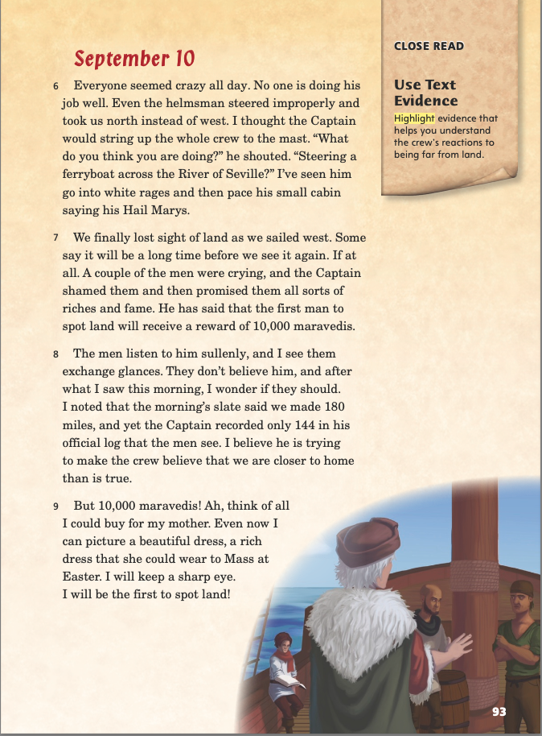
Page 93
Close Read – Use Text Evidence
Turn to page 93 in your Student Interactive.
Notes:
Readers Have students scan paragraphs 6–8 and highlight evidence that helps them understand the crew’s reactions to being far from land. See student page for possible responses.
Ask students which of the other details they highlighted are evidence of the narrator’s statement “Everyone seemed crazy all day.” Possible Responses: “No one is doing his job well”; “I’ve seen him go into white rages and then pace his small cabin”; “A couple of the men were crying.” “They don't believe him.” DOK 2

Slide 58
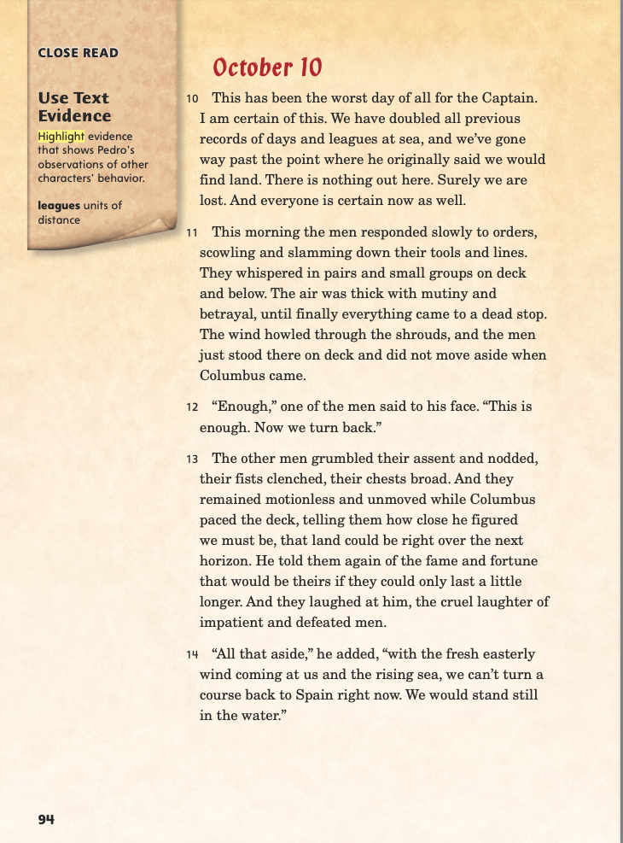
Page 94
Close Read – Use Text Evidence
Turn to page 94 in your Student Interactive.
Notes:
Remind students that they are reading Pedro’s descriptions of how others on the boat feel.
Have students scan the text on p. 94 and highlight evidence that shows the thoughts and feelings of other characters from Pedro’s point of view. See student page for possible responses.
Ask students what they can tell about Pedro from his descriptions of other characters. Possible Response: Pedro is very observant, and his observations make him feel worried. DOK 2

Slide 59
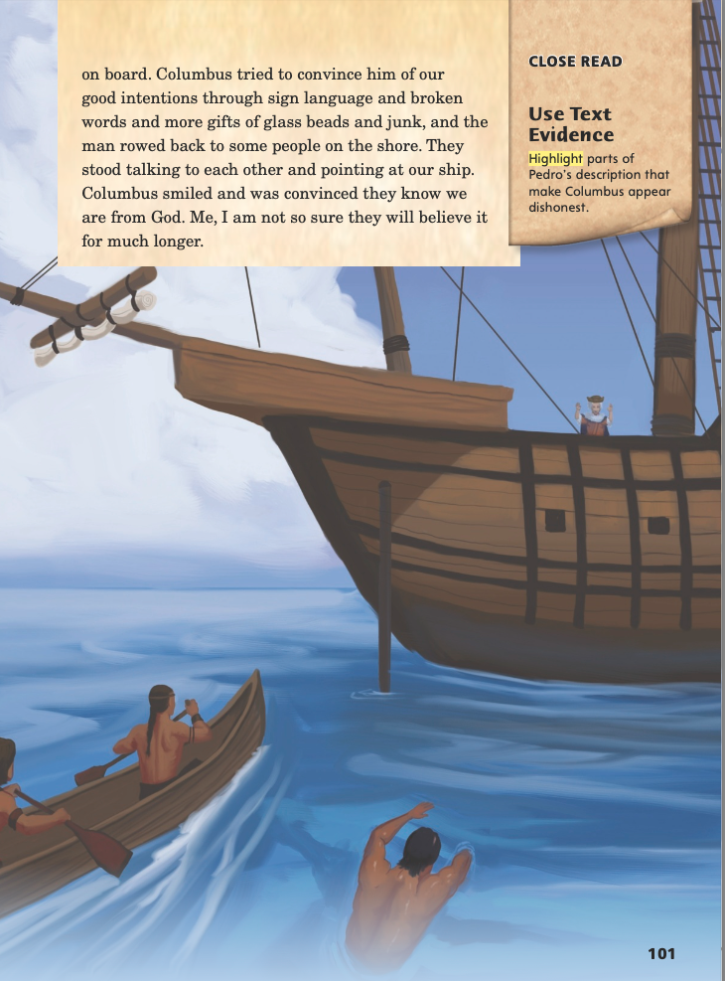
Page 101
Close Read – Use Text Evidence
Turn to page 101 in your Student Interactive.
Notes:
Remind students that they can use evidence from the text to understand characters’ thoughts and actions. Have them scan paragraph 38 and underline parts of Pedro’s description that make Columbus appear dishonest. See student page for possible response.
Ask students why they think Pedro used the word junk to describe Columbus’s gifts to the native man. Possible Response: The word junk implies that the gifts are worthless. By using it, Pedro shows his belief that Columbus is treating the native people unfairly. DOK 3

Slide 60
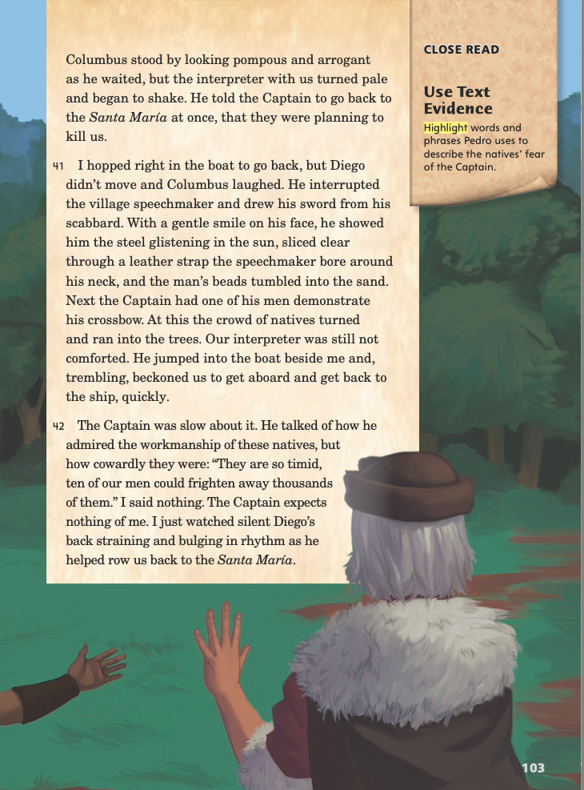
Page 103
Close Read – Use Text Evidence
Turn to page 103 in your Student Interactive.
Notes:
Readers Remind students that an author’s use of precise words and descriptive details can help the reader understand his or her meaning.
Ask students to visualize the action that takes place in paragraph 41 and then highlight words and phrases that Pedro uses to describe the native people’s fear of the Captain. See student page for possible responses. DOK 2

Slide 61
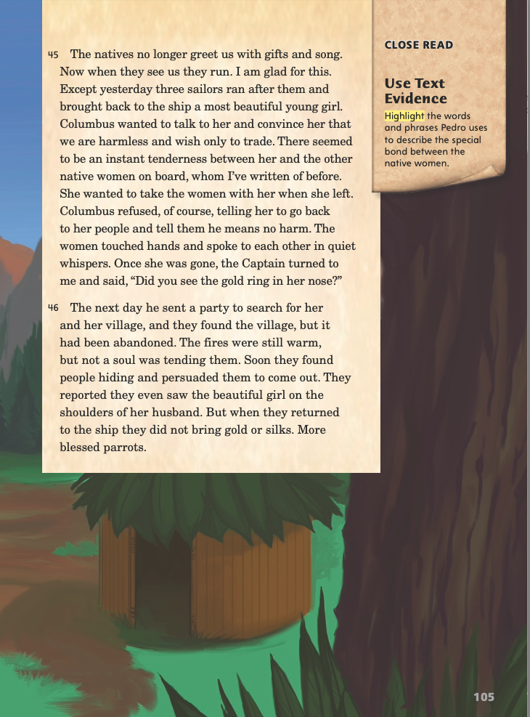
Page 105
Close Read – Use Text Evidence
Turn to page 105 in your Student Interactive.
Notes:
Remind students that they can use text evidence to understand the emotions of characters.
Have students scan paragraph 45 and highlight the words and phrases Pedro uses to describe the special bond between the native women. See student page for possible responses.
Say: Pedro’s description reveals something about the native women. Does this text evidence also reveal anything about Pedro’s attitude toward them? Possible Response: Pedro’s observations and wording reveal that he is sympathetic to the women. DOK 2

Slide 62
Page 106
Close Read – Use Text Evidence
Turn to page 106 in your Student Interactive.
Notes:
Have students scan paragraph 47 and highlight a word that provides direct evidence of Pedro’s feelings about going home. See student page for possible responses.
Point out that in most of the diary, Pedro does not state his feelings; instead, the reader infers them from Pedro’s details about what he does and says. Ask: Why do you think the author chooses to have Pedro state his feelings directly here? Possible Response: The author probably wants to show that Pedro is so overwhelmed with happiness at going home that he cannot keep from stating his feelings. DOK 2

Slide 63
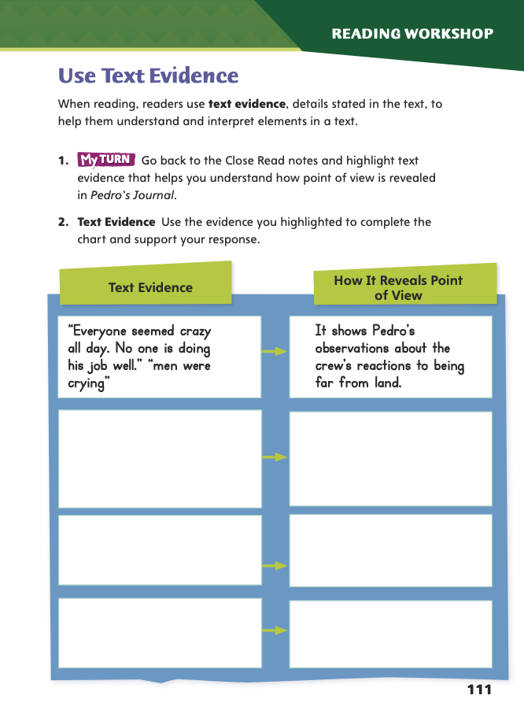
Page 111
Use Text Evidence
Complete page 111 in your Student Interactive.
Notes:
Have students use the strategies for understanding text evidence.
Have students go back to the Close Read notes and highlight text evidence in Pedro’s Journal that helps them understand Pedro’s point of view. Then have students complete the activity on Student Interactive p. 111.

Slide 64
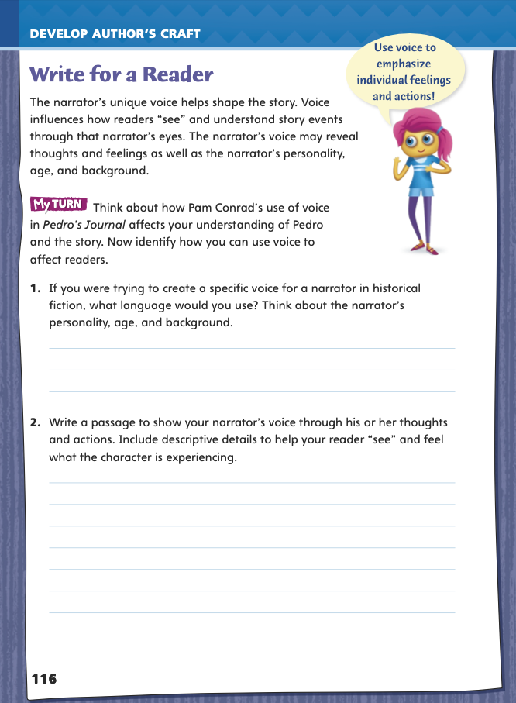
Page 116
Writing for a Reader
Turn to page 116 in your Student Interactive and complete the activity.
Notes:
Explain that a story is told through the unique voice of its narrator. Voice can be used in most fiction genres. The narrator’s voice should suit his or her background, emotions, and personality. For example, a young narrator might describe a snowstorm in an excited voice, thrilled with being able to play in it. On the other hand, an older narrator might describe a snowstorm in an irritated voice, annoyed about shoveling snow and missing work.
Discuss how students might use a similar technique in their own writing using p. 116 in the Student Interactive. Model an example.
Identify the age, background, and main personality traits of the person who will narrate the story.
Consider precise language that would help convey the narrator’s voice. Say: I want to write about a teenager who is taking a trip and is excited about it. I’ll have her describe the trip using details that show how she feels about it. I need to make the language seem natural for my narrator.
Together as a class, draft a brief paragraph with descriptive details to help craft a narrator’s voice. Have volunteers offer suggestions for ways to help readers “see” and feel what the narrator is experiencing.
Have students refer to Pam Conrad’s use of precise language to create a voice as an example for their own writing.
Then guide students to complete the activity on p. 116 in the Student Interactive. Have students keep the genre characteristics of historical fiction in mind as they craft their stories.

Slide 65
Word Study
bio
chron
meter
geo
logy
photo
Define the remaining Greek roots. List as many words as possible with these Greek roots.
Notes:
Review the strategies on pp. T130–T131 about using Greek roots to determine word meanings.
Call on a volunteer to define the Greek root bio. Discuss how knowing that bio means “life” can help readers understand words that contain this root, such biography.
Have students pair up or work independently to define the remaining Greek roots. Challenge them to list as many words as possible.
Then allow students to share and compare their definitions and word lists with others.

Slide 66
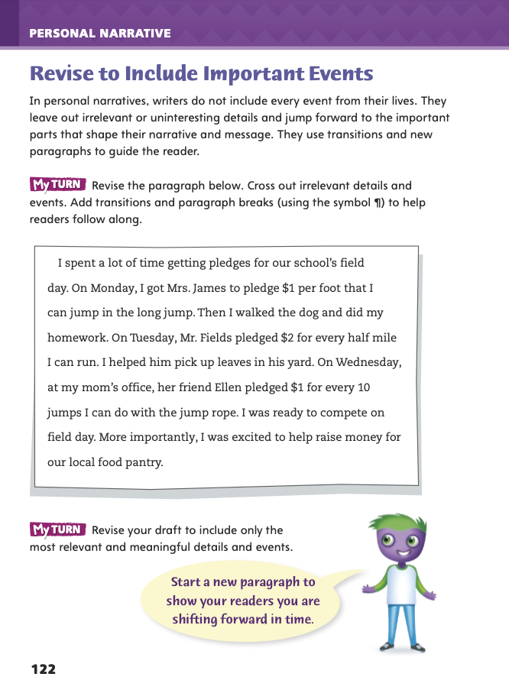
Page 122
Writing – Personal Narrative
Turn to page 122 in your Student Interactive.
Notes:
To make personal narratives effective, writers avoid irrelevant or uninteresting details and instead focus on details that best shape their narrative and help it grow. Personal narratives should be revised to
Focus on important events and details.
Include transitions to jump to different points in the sequence of events.
Use new paragraphs to help the reader move through the sequence.
Support students as they use the stack to look for paragraphs about important events. As they work, explain that good narratives supply information that supports the main focus in a paragraph. If a sentence seems out of place, it might be irrelevant or uninteresting and should be deleted. Ask: Why do you think authors leave out uninteresting details?
Direct students to p. 122 of the Student Interactive. Tell them to think about how they would revise the prompt to include only relevant details and events. If they come up with ideas they want to use in their own narratives, have them write those ideas in their writer’s notebooks.
Ask for partners to help each other find irrelevant or uninteresting details. Then invite a few volunteers to share how their partner revised to avoid them.

Slide 67
Independent Writing
Continue to develop your introduction.
Plan a sequence of events for your personal narrative.
Revise your personal narrative based on today’s lesson.
Notes:
Transition students to independent writing.
Students who are still developing an introduction and planning a sequence may use the time to work on those tasks.
If students have started their narratives, they should continue and make any modifications based on today’s minilesson.
See the Conference Prompts on p. T214.

Slide 68
Spelling
A kronic illness continues over time.
Notes:
Review See pp. T136–T137 to review spelling words with Greek roots.
Display this sentence: A kronic illness continues over time.
Call on a volunteer to correct the misspelled word.
Note that if writers know how to spell the Greek root chron, then they will know how to spell words that contain it.
Using the spelling words on p. T136, invite students to make flashcards for the words,to quiz each other on the correct spellings, or to create a word search or crossword puzzle using the words with Greek roots.

Slide 69
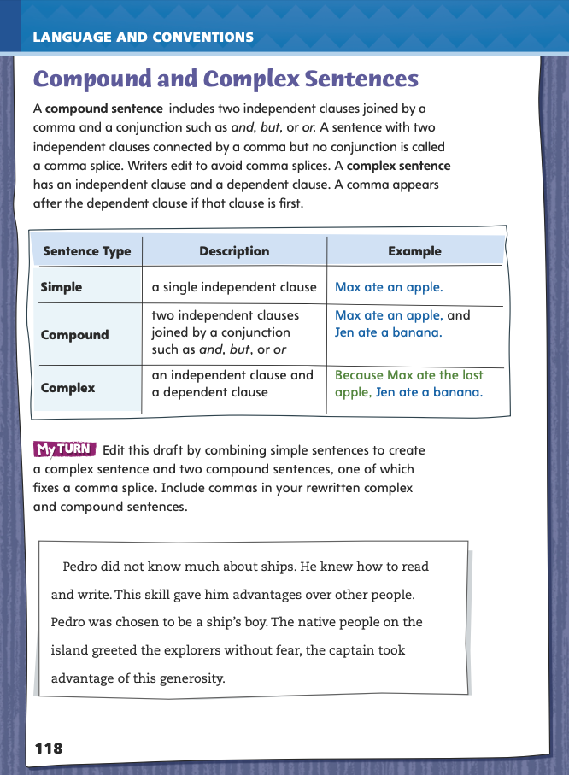
Page 118
Language and Conventions
Turn to page 118 in your Student Interactive and complete the activity.
Notes:
Have students edit the draft paragraph on Student Interactive p. 118.

Slide 70
Lesson 5

Slide 71
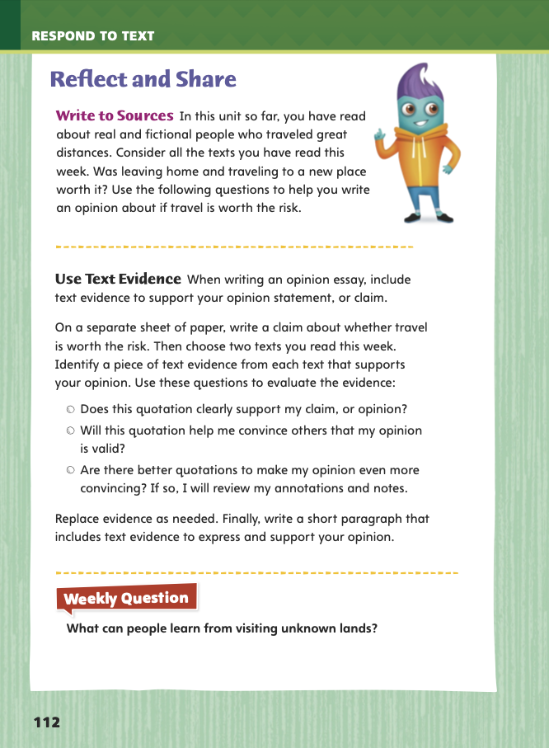
Page 112
Reflect and Share
Turn to page 112 in your Student Interactive.
Notes:
All argumentative texts share certain characteristics. An argumentative text makes a claim, or states an opinion. A claim should be supported by facts, which can be used for or against the argument. Authors carefully craft argumentative texts to persuade their intended audience, or readers.
Explain that students can use text evidence to support the opinions they express in their writing. Encourage them to compare and contrast ideas across a variety of sources.
When writing an opinion piece, use several sources to inform and support your opinion.
Make sure you select the best text evidence to support your opinion.
If you include text directly from your source, be sure to enclose it in quotation marks and tell readers where it came from.
Model supporting an opinion with text evidence using the Write to Sources prompt on p. 112 in the Student Interactive. I’m going to search through Pedro’s Journal and another book I have read to see what text evidence supports my opinion that leaving home and traveling to a new place is worth the risk. I am eager to see how I can connect this idea between texts.
Have students use the strategies for making connections between texts.
Have students craft an opinion about the pros and cons of traveling. Remind them to exhibit characteristics of argumentative texts in their paragraph.

Slide 72
Apply
What can people learn from visiting unknown lands?
Notes:
Have students use evidence from the texts they have read this week to respond to the Weekly Question. Tell them to write their response on a separate sheet of paper.

Slide 73
Word Study
Identify the vowel sound in each word and the letters that form it.
mouth
bright
teach
soil
List a word for each vowel team.
ea
ie
igh
ow
ou
Notes:
To assess students’ understanding of vowel teams, provide them with the following words: mouth, bright, teach, and soil.
Ask them to identify the vowel sound in each word and the letters that form it.
Then ask them to identify if the vowel sound is a digraph (bright, teach) or a diphthong (mouth, soil).
Have students work individually or in pairs to use their knowledge of vowel teams and vowel sounds to identify a word for each of the following vowel teams.
1. ea
2. ie
3. igh
4. ow
5. ou

Slide 74
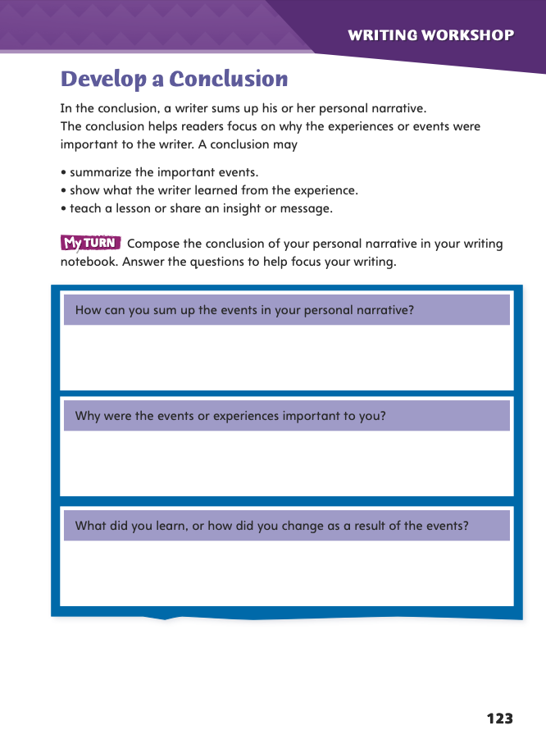
Page 123
Writing – Personal Narrative
Turn to page 123 in your Student Interactive and complete the activity.
Notes:
A writer sums up his or her personal narrative in the conclusion. A conclusion helps the reader focus on which events were most important to the writer and why. A conclusion may
summarize the beginning, middle, and end of the narrative.
show what the writer learned, including lessons or personal insight.
reveal how a writer has changed, and is now different, because of the events in the narrative.
Tell students: Authors often sum up events of a personal narrative in the conclusion. The conclusion might also answer a question or solve a problem posed in the introduction. Have students examine texts in the personal narrative stack that have strong conclusions. Ask them to compare the first and last paragraphs of the text.
Direct students to p. 123 of the Student Interactive. Tell them to use the prompts to plan out the conclusions of their personal narratives. Ask them to list in their writer’s notebooks ideas about what they want to focus on in their conclusions.
Ask for volunteers to share the reasons that their personal narratives are important to them. Invite the class to ask questions about the importance of events and suggest reasons for deleting irrelevant or uninteresting details.

Slide 75
Writing – Personal Narrative
Add transitions and shifts in time to your personal narrative.
Revise your personal narrative based on today’s lesson.
Complete a Select a Genre writing activity if your personal narrative is complete.
Notes:
Transition students to independent writing.
Students who are still working on transitions and shifts in time may use this time for those tasks.
Students who are further along in their narratives can complete a Select a Genre writing activity (see p. T221) or make modifications to their personal narratives based on today’s minilesson.
See the Conference Prompts on p. T214.

Slide 76
Spelling
1. You will see a lake as we approach the cabin.
2. She has a zeal for working with animals.
3. The committee will discuss plans for the school fair.
4. The treasury department handles the budget for our office.
5. After the typhoon hit, the harbor suffered heavy damages.
6. A toasted marshmallow is delicious!
In some counties, the government is in the hands of royalty.
Concealment is important to a spy.
9. You can show bravery or cowardice in a difficult situation.
10. A new drug will help fight leukemia.
Notes:
(Note: Move the orange boxes to cover each bold spelling word before you read aloud the words and sentences.)
Use the following sentences for the spelling test:
1. You will see a lake as we approach the cabin.
2. She has a zeal for working with animals.
3. The committee will discuss plans for the school fair.
4. The treasury department handles the budget for our office.
5. After the typhoon hit, the harbor suffered heavy damages.
6. A toasted marshmallow is delicious!
7. In some countries, the government is in the hands of royalty.
8. Concealment is important to a spy.
9. You can show bravery or cowardice in a difficult situation.
10. A new drug will help fight leukemia.

Slide 77
Language and Conventions
Before you go to school you should eat a healthy breakfast.
Which revision would correct the sentence?
Add a comma after Before.
Add a comma after eat.
Add a commas after school.
Add a commas after should.
Notes:
Review Display the sentence and have students respond independently.
Before you go to school you should eat a healthy breakfast.
Which revision would correct the sentence?
A Add a comma after Before.
B Add a comma after eat. C Add a comma after school. (correct)
D Add a comma after should.
Have students complete Language and Convention p. 13 from the Resource Download Center. Click path: Table of Contents -> Resource Download Center -> Language and Conventions -> U1 W3

Slide 78
Unit 1: Week 3
Grade 5

