Slide 1
Unit 1: Week 2
Grade 2

Slide 2
Copyright © Savvas Learning Company LLC. All Rights Reserved.
This publication is protected by copyright, and permission should be obtained from the publisher prior to any prohibited reproduction, storage in a retrieval system, or transmission in any form or by any means, electronic, mechanical, photocopying, recording, or otherwise. For information regarding permissions, request forms, and the appropriate contacts within the Savvas Learning Company Rights Management group, please send your query to:
Savvas Learning Company LLC, 15 East Midland Avenue, Paramus, NJ 07652
or
k12learningpermissions@savvas.com
myView Literacy® is an exclusive trademark of Savvas Learning Company LLC in the U.S. and/or other countries.

Slide 3
Lesson 1

Slide 4
Page 54
Phonological Awareness
Notes:
Point to the picture of the dime on SI p. 54. Tell students to listen to the vowel sound in the one-syllable word dime. Discuss that the vowel sound in dime is known as long because the vowel "says its name."
Repeat the long i sound and remind students it is a long vowel sound. Distinguish this long i sound from the short i sound in the word dim.
Conduct a similar process for the picture and word sun and the short u sound. Use the word pairs cape, cap; Pete, pet; and hope, hop to provide more instruction on distinguishing between long and short vowel sounds in one-syllable words.
Remind students that longer words also have long and short vowel sounds. Say handshake. Explain that hand has a short vowel sound and shake has a long vowel sound.
Tell students you are going to say some one-syllable words. You want them to listen to the words and tell whether the vowel sounds in the words are long or short. If the vowel sound is short, students should clap. If the vowel sound is long, students should open up their arms and hands.
Say the following words and have students distinguish between the long and short vowel sounds: home, top, such, best, place, bike, trip, mule, each.
Tell students to listen as you say longer words and clap when they hear short vowel sounds. If they hear a long vowel sound, they should keep their hands on their desks. Say these words slowly, one at a time, so students can distinguish between sounds in the syllables: lightbulb, flashlight, nightlight, flashbulb.

Slide 5
Page 54
Phonics
mat make
Underline the pictures with long vowel sounds on page 54 in your Student Interactive.
Notes:
This week students will be decoding words with the long vowel pattern CVCe. To introduce the vowel pattern, write mat, make.
Tell students: The word mat has a consonant-vowel-consonant pattern. The vowel sound in this pattern is usually short. Write CVC over the letters in mat.
Say: The word make has the long vowel sound /ā/. The letter e at the end of make doesn’t have a sound. We only hear the /ā/ sound. This pattern is called consonant-vowel-consonant-silent e. In this vowel pattern, the first vowel is usually long. Write CVCe over the letters in make.
Have partners decode and underline the pictures with long vowel sounds on p. 54 in the Student Interactive.

Slide 6
High-Frequency Words
called
long
most
Notes:
Read aloud each word and have students repeat it with you. Remind students that there are some words they need to practice so they can read them quickly.
Randomly point to the words as students say them, repeating each word several times.
Use each word in an oral sentence: I called my friend on her cell phone. The movie was long. Most students like games.

Slide 7
Page 52,53
Interact with Sources
How can people improve their neighborhoods? Draw a picture of what you could try in your neighborhood.
Notes:
Remind students of the Essential Question for Unit 1: How do different places affect us? Point out the Week 2 Question: How can people improve their neighborhoods?
Direct students’ attention to the infographic on pp. 52–53 in the Student Interactive. Explain that an infographic is a multimedia text that combines words and pictures to provide information. Have students read the infographic and discuss ways people improve their neighborhoods.
Use the following questions to guide discussion:
Which activities are things anyone can do?
How do these activities improve the neighborhood?
Why is it important to know our neighbors’ names and phone numbers?
Which activities look like the most fun?
Read the weekly question: How can people improve their neighborhoods? Tell students they just learned about different ways to improve a neighborhood and that they will learn about more ways this week.
Have students discuss their answers to the Turn and Talk questions on p. 53 with a partner. Invite them to draw a picture to illustrate ideas they could try out in their neighborhood.

Slide 8
Listening Comprehension
Troy’s Project
Characters | What Are They Like
Notes:
Tell students you are going to read a realistic fiction story aloud.
Have students listen as you read “Troy’s Project.”
Explain that students should listen actively, paying careful attention to the characters in the story as you read.
Have students describe key ideas from the read aloud.
Prompt them to ask questions to clarify information and follow agreed-upon discussion rules.
Wrap Up: Ask students: Who are the main characters in this story? What are they like? List student responses.

Slide 9
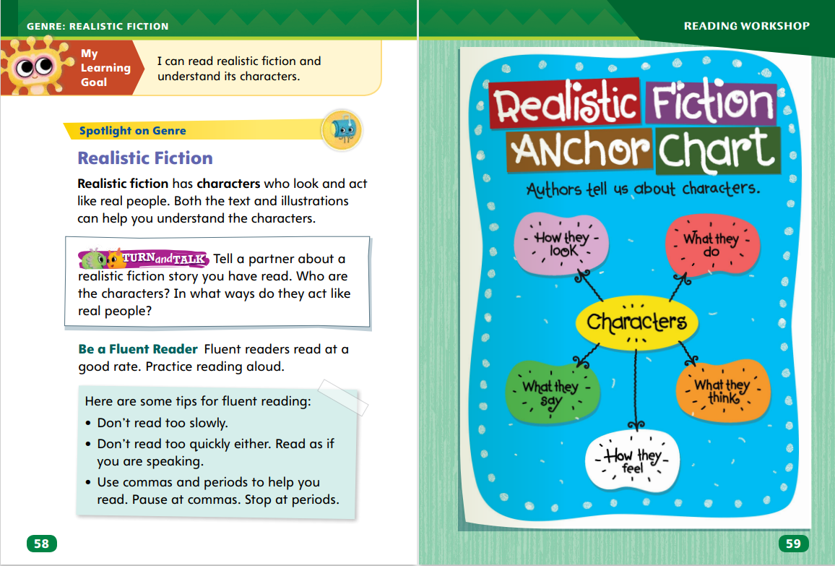
Page 58,59
Realistic Fiction Qualities
Turn to page 58 in your Student Interactive.
Notes:
Remind students that characters are the people in a story. Explain that in realistic fiction, characters think and act like real people. Tell students they can determine if characters are realistic by asking themselves these questions:
Do the characters seem real? Are they like people I know?
Do the characters talk and act like real people?
Do the characters have realistic problems to resolve? Have I ever had a similar problem?
Could I do the same things the characters in the story do?
Model how to determine if a text is realistic fiction. Say: I know that realistic fiction stories need to have characters like real people. As I think about the story “Troy’s Project,” I think about whether Troy and the other characters are like real people. The answer is yes, they are like real people. I could meet people like this, and Troy’s mom reminds me a bit of my mom. What the characters say and do is real too. I know that people often work together to clean up a neighborhood, park, or school. This is something that I have done. So, I know that this is realistic fiction with realistic characters.
Talk about other examples of characters in stories, movies, or television shows students know. Ask if they seem realistic or not. Encourage students to explain their answers.

Slide 10
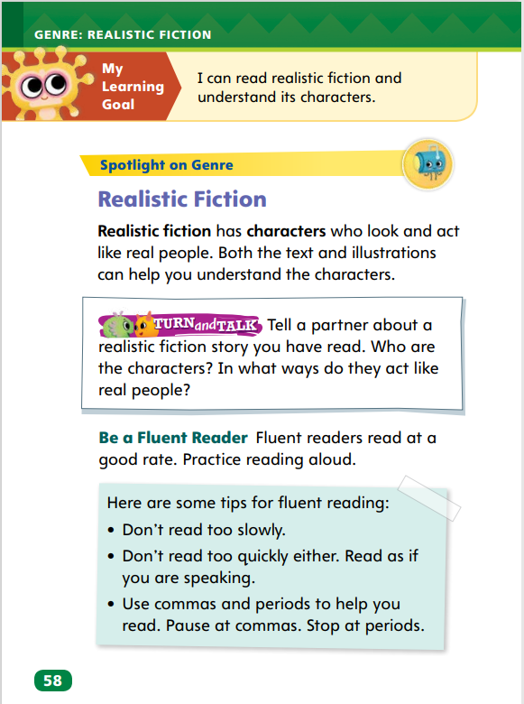
Page 58
Apply
Tell a partner about a realistic fiction story you have read.
Notes:
Have pairs complete the Turn and Talk activity on p. 58.
Observe students as they discuss characters to assess how well they understand characters and whether they are realistic or not.

Slide 11
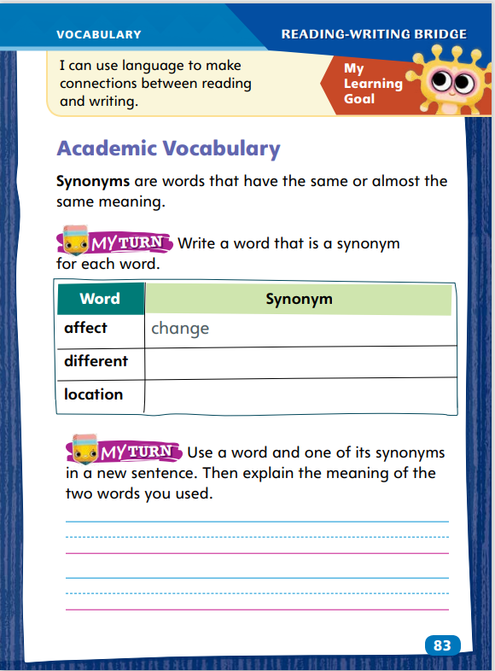
Page 83
Academic Vocabulary
Synonyms
affect = change
Notes:
Explain to students that synonyms are words that have the same or almost the same meaning. Synonyms can help readers remember the meaning of new vocabulary.
Use context clues to come up with a synonym of a new word.
Pair a familiar synonym with a new vocabulary word to help you remember the new word’s meaning.
Model this strategy by using the Academic Vocabulary in the chart on p. 83 of the Student Interactive.
First, use the word in a sentence. For example: My friend’s kind words affected me. I felt better. Then say: Let’s think about the word affect and how we can explain what it means. To affect is to make someone or something change, so we can say that a synonym of affect is change.
Use the same strategies with the class for the other Academic Vocabulary words in the chart.
Have students complete the activity on p. 83 in the Student Interactive.

Slide 12
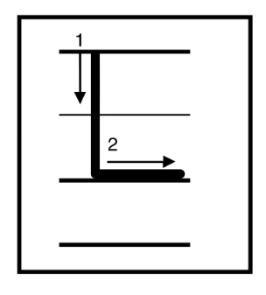
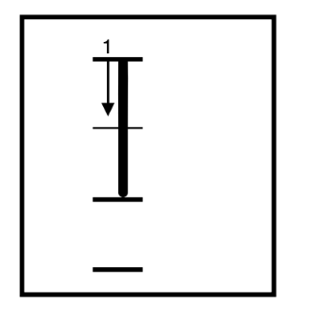
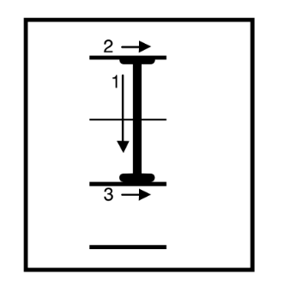
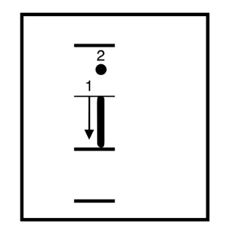
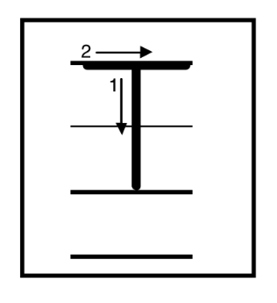
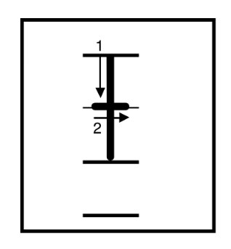
Handwriting
Notes:
Display uppercase and lowercase letters Li, Ii, and Tt.
Model writing uppercase and lowercase letters Ll, Ii, and Tt. Then write the words look, I, top, and lit, showing proper letter formation and correct letter size.
Have students use Handwriting p. 87 from the Resource Download Center to practice writing the uppercase and lowercase letters Tt. Click path: Realize -> Table of Contents -> Resource Download Center -> Handwriting Practice -> U1W2L1 Handwriting Practice

Slide 13
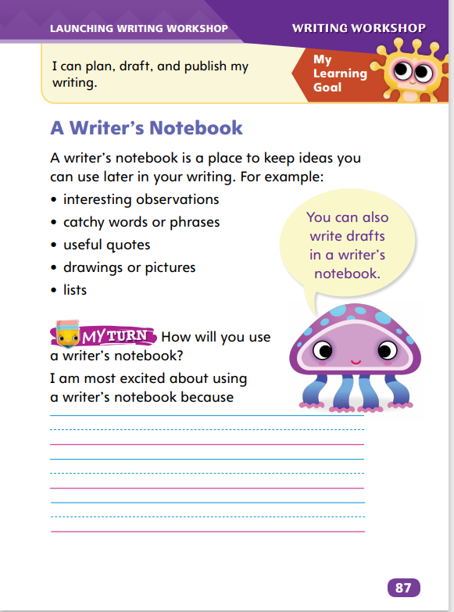
Page 87
Writing – Launch Writing Workshop
Turn to page 87 in your Student Interactive.
Notes:
A writer’s notebook provides a place to
record ideas for writing
develop first drafts
list possible topics
Say: Every piece of writing begins with an idea. Hold up a text from the stack. The author of this book had an idea and then wrote about it. Quickly review the text’s topic. Say: A writer’s notebook is where you’ll record and develop your ideas. Hold up a new notebook, such as a spiral notebook or a three-ring binder with lined paper. Direct students to p. 87 in the Student Interactive. Read aloud the bulleted list.
Tell students: Ideas come from many places. You find them in the things you see or hear every day. Maybe you notice something new, or you hear a funny story. Perhaps you really like a photo or drawing. Take this observation, story, or image and record it in your notebook. You’ll want to use as many details as you can.
Point out an interesting feature in your classroom, display a compelling image, or share a funny story. Model creating a list or description based on what you shared.
Say: You develop ideas in your notebook. First, you observe the world around you. Second, you record your observations.
Remind students that they can develop ideas into writing of any genre that they choose.

Slide 14
Independent Writing
Read a text and think about how the author got ideas.
Share your list of ideas with the class.
Write your ideas about a topic of your choice in your writer’s notebook.
Notes:
During independent writing time, students should read a stack text and think about how the author got ideas. If students have trouble, help them identify ideas in texts.
Writing Support
Modeled - Do a Think Aloud to model making and recording an observation about your classroom.
Shared - Have students share interesting anecdotes, sayings, or quotes. Record their answers.
Guided - Share an image from a book. Point out its elements. Ask guided questions to help students describe the image. Instruct them to write down their observations.
Students who complete the task should write ideas about a topic of their choice in their notebooks.
Have several students share their lists of ideas. Ask other students if those lists give them new writing ideas.

Slide 15
Spelling
We went to the lake.
Can you erase the board?
She is not home.
Mom made a sandwich.
Bring the hose to wash the dog.
Did you see the soccer game?
Mira became an artist.
We rake the yard in the fall.
My cat has a pink nose.
What time is it?
Giraffes have long necks.
Troy called his friends to help him.
Notes:
Flexible Option
(Note: Move the orange boxes to cover each bold spelling word before you read aloud the words and sentences.)
Read aloud the words and sentences. Have students spell each word with initial consonant blends and the two high-frequency words.
We went to the lake.
Can you erase the board?
She is not home.
Mom made a sandwich.
Bring the hose to wash the dog.
Did you see the soccer game?
Mira became an artist.
We rake the yard in the fall.
My cat has a pink nose.
What time is it?
Giraffes have long necks.
Troy called his friends to help him.
Reveal the spelling word and have students check their work.

Slide 16
Language and Conventions
Mira painted a bird.
The man with the paintbrushes.
We like to dance.
Played baseball in the park.
Practice identifying complete and incomplete sentences with your partners.
Notes:
Flexible Option
Review with students that a simple sentence expresses a complete thought. Remind students that a sentence begins with a capital letter and ends with an end mark.
Display the following sentences for students to identify as a simple sentence or an incomplete sentence: Mira painted a bird. The man with the paintbrushes. We like to dance. Played baseball in the park.
Have partners create their own simple sentences. Ask volunteers to share their sentences with the class.

Slide 17
Lesson 2

Slide 18
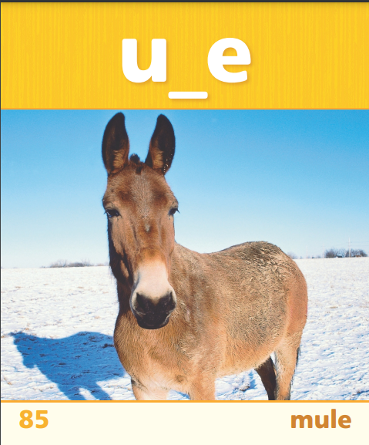
Page 55
Phonics
Notes:
Remind students that vowels can have long and short sounds.
Display Sound-Spelling Cards 84 (rope) and 85 (mule). Have students say the words, emphasizing the long vowel sounds. Point out that the words follow the CVCe pattern and the e is silent. Display Sound-Spelling Card 76. Have students decode concrete, and point out the VCe pattern in its second syllable. Click path -> Table of Contents -> Unit 1 Week 2 Realistic Fiction -> Lesson 2
Ask students to point to the picture on SI p. 55. Ask them to say game and tell what vowel sound they hear.
Point to the word bake in the first row of the chart. Ask students what sound they think the letter a has. Then decode the word with them. Repeat with the remaining words in the row. Ask partners to read the rest of the words in the chart.

Slide 19
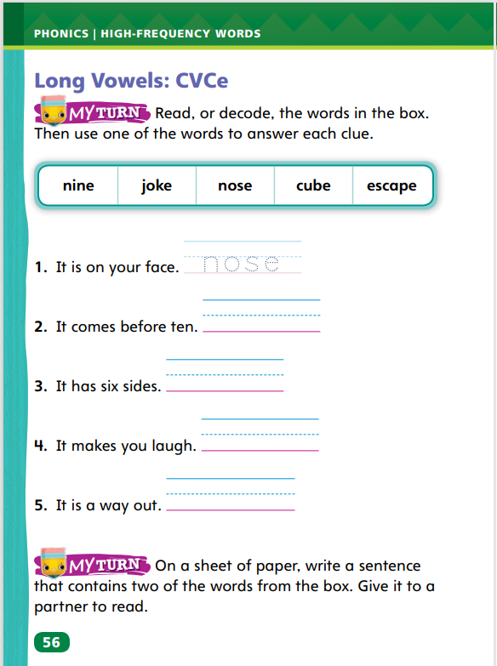
Page 55, 56
Apply
Turn to page 55 in your Student Interactive and read the words.
Read the sentences and find CVCe words with long vowels.
Turn to page 56. Read the words and use them to answer the clue.
Write another sentence that contains two words from the box.
Notes:
Have pairs complete the activity on page 55.
Have partners complete the rest of the sentences on SI p. 56.
Have students write a sentence using two of the words from the top of p. 56 in the Student Interactive.

Slide 20
High-Frequency Words
called
long
most
Notes:
Write the words called, long, and most.
Have students spell each word.
Have students use each word in a sentence.

Slide 21
Page 60
Preview Vocabulary
joy
shadows
scurried
rhythm
splattered
Notes:
Introduce the vocabulary words on page 60 in the Student Interactive. Elicit definitions from students but provide definitions if students are experiencing difficulties defining the words.
joy: a feeling of great happiness
shadows: shaded places away from light
scurried: moved quickly
rhythm: a musical pattern
splattered: splashed dots of something
Tell students: These words will help you understand the characters in Maybe Something Beautiful. Highlight the words as you see them in the text. How do they relate to the characters in the story?

Slide 22
First Read Strategies
Notes:
Discuss the First Read Strategies with students. For this first read, tell students to read for understanding and enjoyment.
Explain the four steps of the first read.
READ Remind students to read for meaning so they understand what the text is about.
LOOK Remind students that illustrations can be helpful in understanding a story. Tell them to look at the illustrations before reading the text on each page.
ASK Tell students to ask themselves questions about the text as they read. They can check their understanding and also write questions about the parts of the text they don't understand.
TALK Have students discuss the text with a partner. Encourage students to share the questions they had while reading and to help each other answer them.
Students may read the text independently, in pairs, or as a whole class. Use the First Read notes to help students connect with the text and guide their understanding.

Slide 23
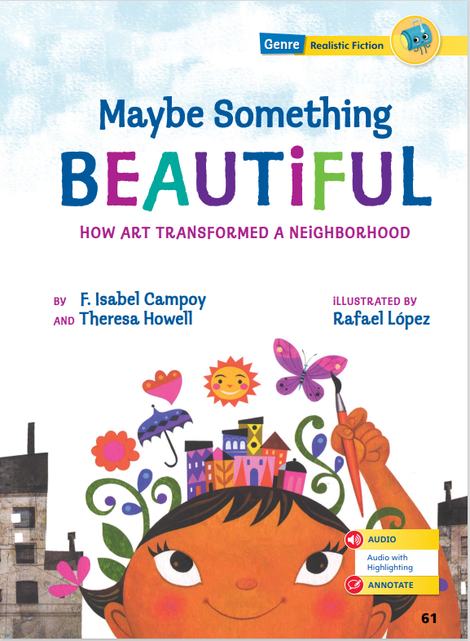
Page 61
First Read – Maybe Something Beautiful
Notes:
Read the text. Pause to discuss the First Read notes with students.

Slide 24
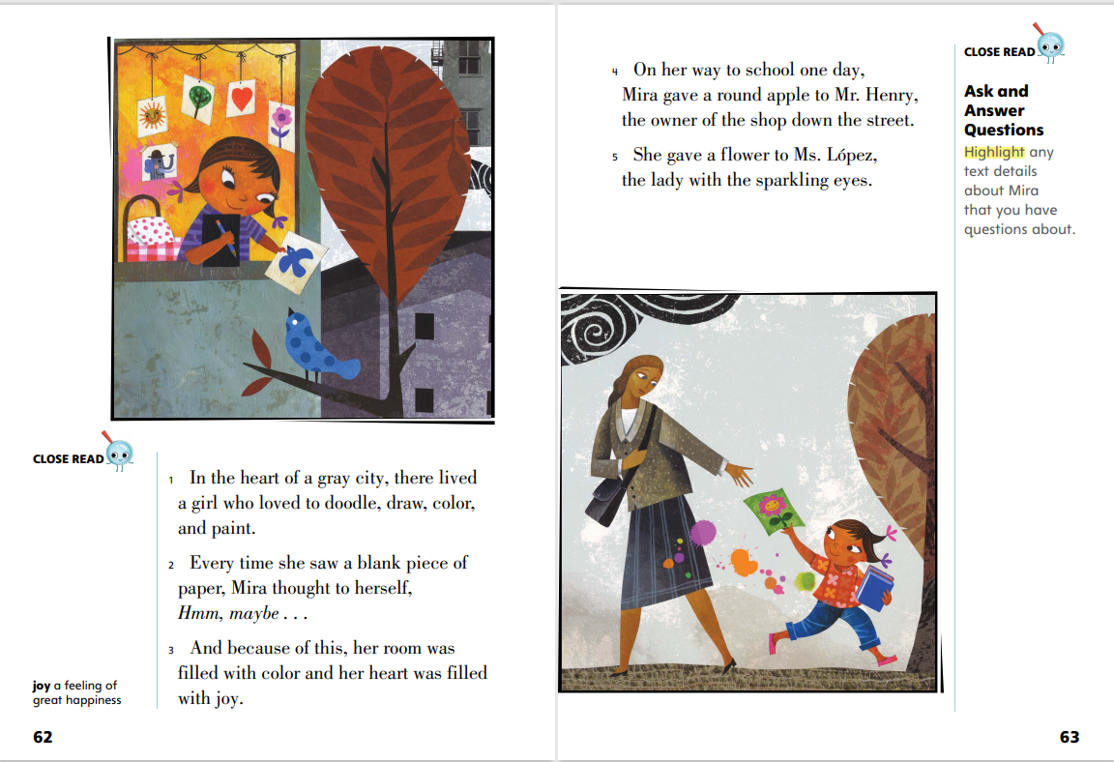
Page 62,63
First Read – Maybe Something Beautiful
Notes:
Read Together.
THINK ALOUD I look at the picture to find out information about the setting, or where the story takes place. There are tall buildings beside Mira’s building. Birds are flying by her window. This tells me that Mira lives in an apartment building high above the ground. I notice that the colors are different inside and outside. Inside Mira’s room, the colors are bright and warm. Outside, the colors look cold and gray.
THINK ALOUD I read that Mira gives a “round apple” to a shop owner and a flower to a woman with “sparkling eyes.” Is Mira giving a real apple and a real flower to these people? Why? I look at the illustration to help answer my questions. When I look at the illustration, I see that Mira is actually giving a painting to the woman. I think Mira painted an apple and a flower at home and gave drawings to people on her way to school.

Slide 25
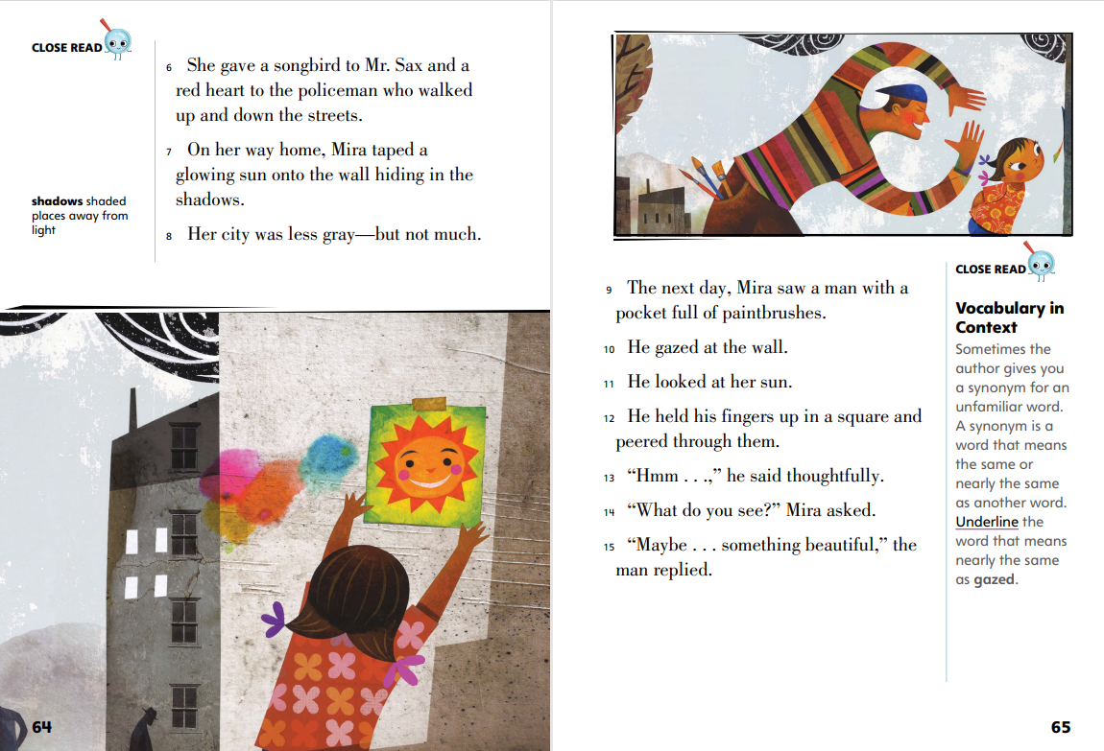
Page 64,65
First Read – Maybe Something Beautiful
Notes:
Read Together.
THINK ALOUD Mira gives colorful artwork to the people she sees as she walks to school. Mira seems cheerful and kind. She lives in a gray city, but she is trying to brighten it and bring joy to the city and the people in it. I think giving artwork away is how Mira tries to make the people around her happier. Mira will have to make a lot of colorful artwork to keep cheering people up.
THINK ALOUD The illustration on this page helps introduce the man with paintbrushes. I can see how Mira and the painter are similar. They both wear bright colors. The illustration also helps me understand what the writer meant by “he held his fingers up in a square and peered through them.”

Slide 26
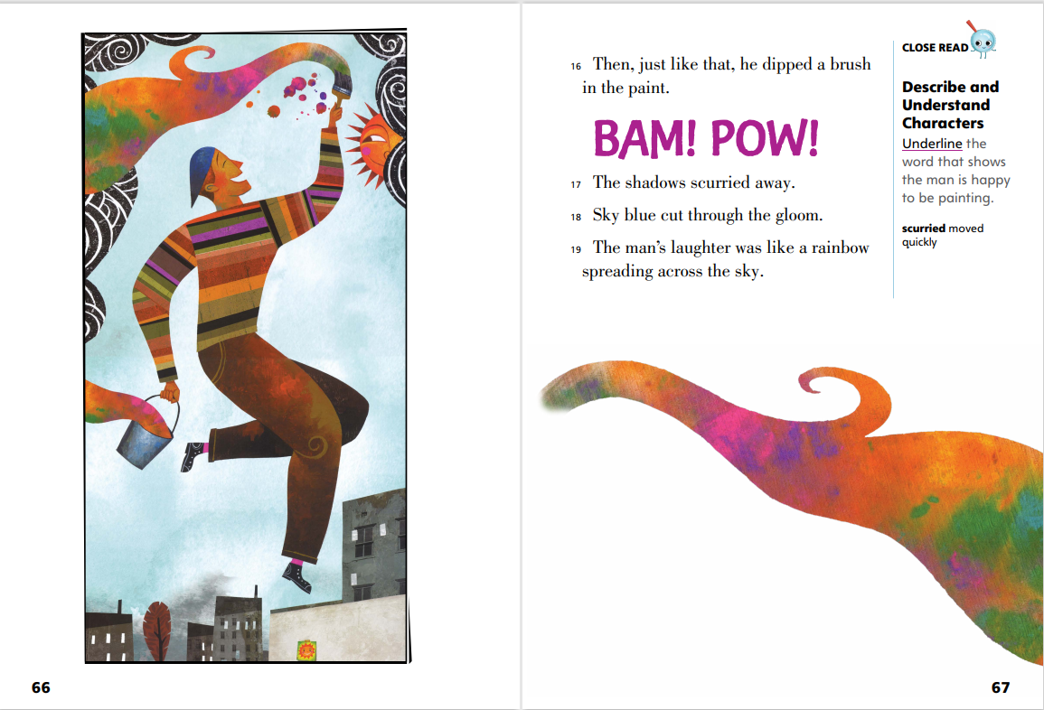
Page 66,67
First Read – Maybe Something Beautiful
Notes:
Read Together.
THINK ALOUD I know that every page in a story serves a purpose, even when the page has an illustration and no words. I want to look closely at the illustration to learn more information about the story. Here, I see that the illustrator uses a rainbow of colors to show that the painter is making the city brighter and more colorful. The painter looks cheerful and happy as he paints.
THINK ALOUD As I read the words on the page, I try to create images in my mind. Writers often try to paint a picture with their words, just like the muralist paints colors through the town. As I read the phrase “shadows scurried away,” I can imagine the paint’s bright colors chasing the dark shadows out of the city.

Slide 27
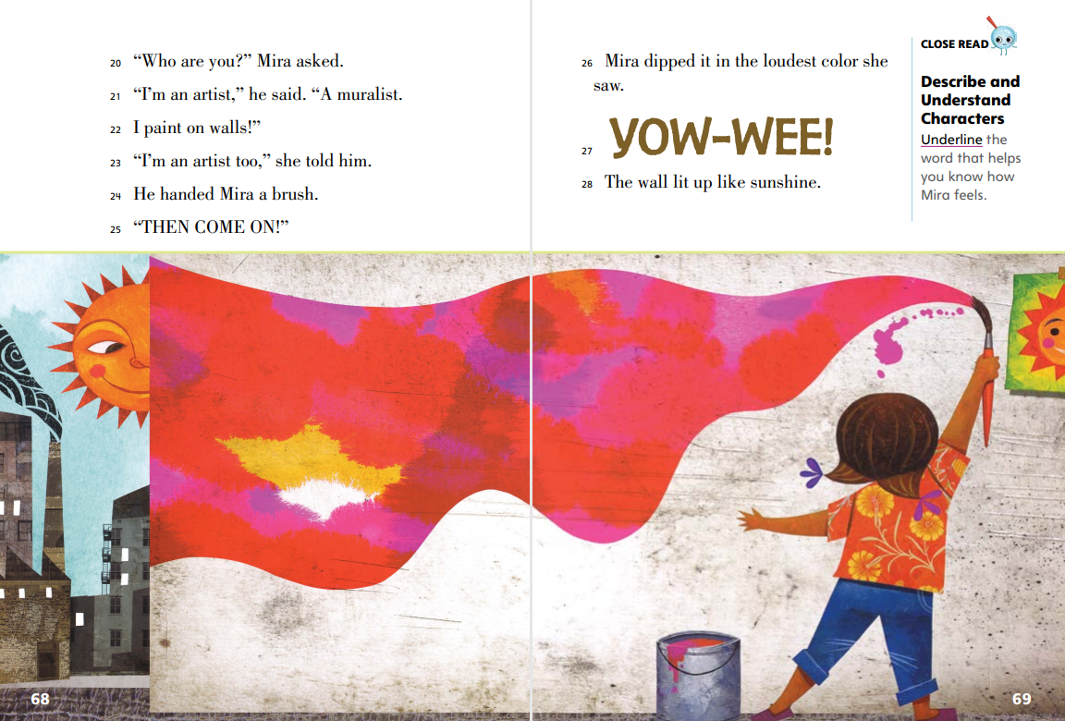
Page 68,69
First Read – Maybe Something Beautiful
Notes:
Read Together.
THINK ALOUD As I read, I write questions about words and ideas I don’t understand. As I read paragraph 21, I ask: What does the word muralist mean? I look for clues in the text to help answer my question. In the next line, the artist says, “I paint on walls!” I think a muralist must be a person who paints on walls.
Direct students to the phrase “loudest color” in paragraph 26. Ask: What does it mean to use a loud color? Guide students to understand that loud refers to a bright, intense color. In pairs, have students list loud colors and discuss which colors they think would be best for Mira to use. Have students discuss what they would paint if they were in Mira’s situation.

Slide 28
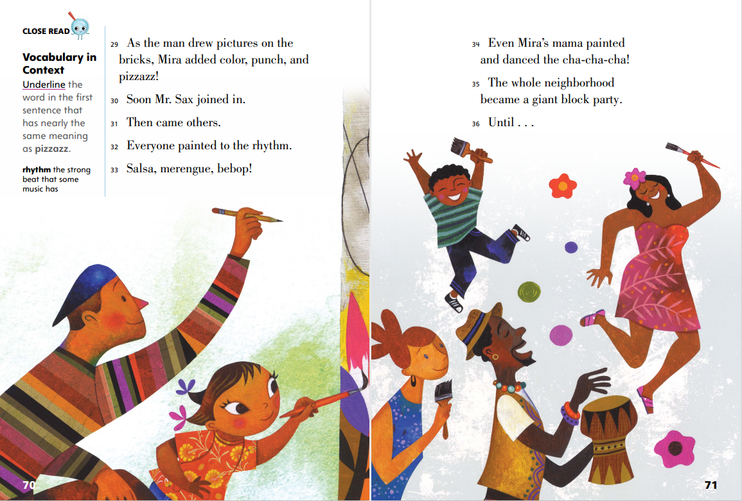
Page 70,71
First Read – Maybe Something Beautiful
Notes:
Read Together.
THINK ALOUD I read the words salsa, merengue, and bebop. I’m not sure what they mean, so I look to words around them to see if I can find clues. In paragraph 32, I see that “everyone painted to the rhythm.” The definition on p. 70 tells me that rhythm means “a musical pattern.” So, everyone is dancing and painting to a beat. I think that salsa, merengue, and bebop must be types of music.
Explain that writers can build suspense in a story by pausing before telling what happens. Point to paragraph 36. Have students discuss in pairs what they think will happen next and what feeling the last line creates.

Slide 29
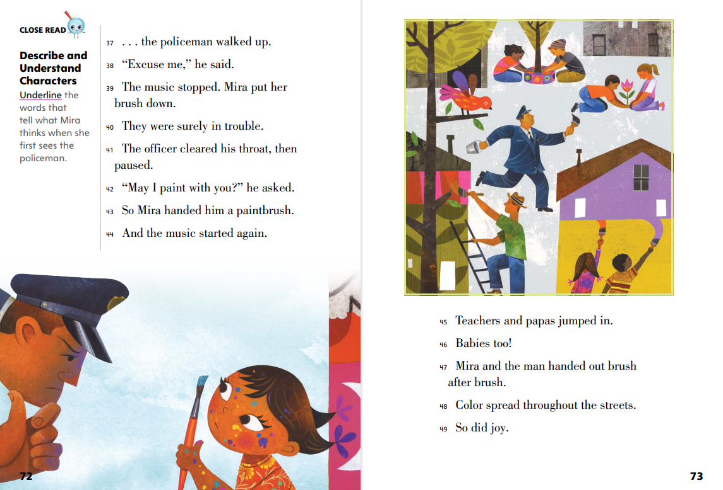
Page 72,73
First Read – Maybe Something Beautiful
Notes:
Read Together.
Point out how the action stops and starts in the passage, noting words like stopped, paused, and the use of punctuation (“. . . the policeman walked up.”) In pairs, have students reread p. 72, speaking the dialogue and acting out the characters’ actions. Remind students to show pauses in the action to create suspense. Then have pairs discuss the effect of the pauses in the passage.
THINK ALOUD The text on this page tells me that everyone in the community started to paint. When I look at the illustrations, however, they show me that even more changes have started to happen in the community. I see children planting trees and making more natural space in what used to be a gray city. The painting has led the city to become brighter in different ways.

Slide 30
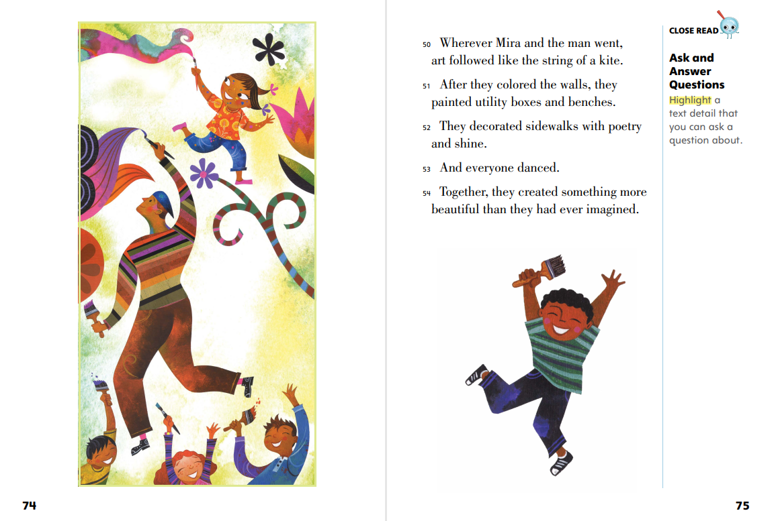
Page 74,75
First Read – Maybe Something Beautiful
Notes:
Read Together.
THINK ALOUD Looking at the illustration on this page, I notice a big change from the illustration on the first page of the story. On the first page, the city looks gray and cold. Now, the colors make the city look warm and happy, and all the characters are smiling and excited.
THINK ALOUD When I read that “They decorated sidewalks with poetry and shine,” I have to close my eyes to imagine what that looks like.

Slide 31
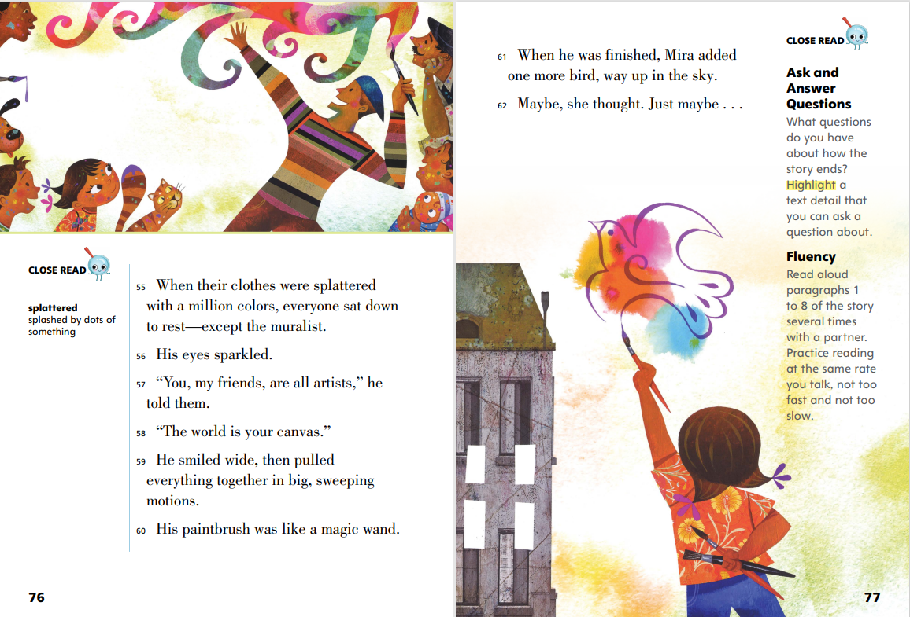
Page 76,77
First Read – Maybe Something Beautiful
Notes:
Read Together.
In pairs, have students read p. 76 aloud with each other. Then ask: What do you think the phrase “the world is your canvas” means? What does the muralist want everyone to do? Tell partners to describe times they finished artwork that they were proud of. Ask: What did the artwork mean to you? Where did you display it?
Read paragraph 62 aloud. Say: I remember Mira thought something like this on the first page, when she was looking at a blank piece of paper. Direct students to reread p. 62, then return to p. 77. Ask: What is Mira thinking about now?
Possible response: Mira is wondering what to create next and imagining what her drawing will look like in the space in front of her

Slide 32
Respond and Analyze
Brainstorm How did the muralist affect Mira and her neighbors?
Discuss Describe your experience with neighborhood block parties and other neighborhood activities.
Notes:
Use these suggestions to prompt students’ initial responses to reading Maybe Something Beautiful.
Brainstorm How did the muralist affect Mira and her neighbors?
Discuss Have students describe their experiences with block parties or other neighborhood activities. Encourage them to talk about any experiences they have had doing activities to improve a neighborhood.

Slide 33
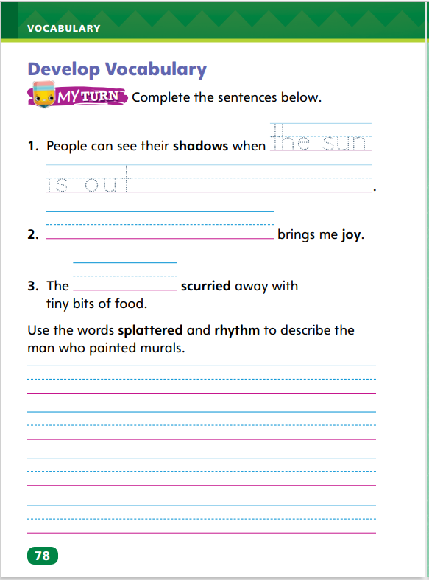
Page 78
Develop Vocabulary
Turn to page 78 in your Student Interactive and complete the activity.
Notes:
In Maybe Something Beautiful, the author uses the vocabulary words joy, rhythm, scurried, shadows, and splattered to help describe the characters’ actions and feelings.
Ask yourself how a word helps you better understand what a character is doing or how he or she is feeling.
Create word maps to help you use each new vocabulary word in a sentence.
Display the word joy. Circle the word and say: Joy is a feeling of great happiness. I’m going to write the word happiness next to the word joy and draw a line between the two words. Then I’m going to think of things that make people feel this way and write these things in the word map. Elicit ideas from students, and then write a sentence using the vocabulary word and one of the student-generated ideas, such as I feel joy when I am at the beach.
Have students use newly acquired vocabulary to complete p. 78 in the Student Interactive.

Slide 34
Page 79
Check for Understanding
What about this story could happen in real life?
How do the illustrations help you understand the story?
How is the neighborhood different at the end of the story that it was at the beginning?
Notes:
Have students complete p. 79 of the Student Interactive.

Slide 35
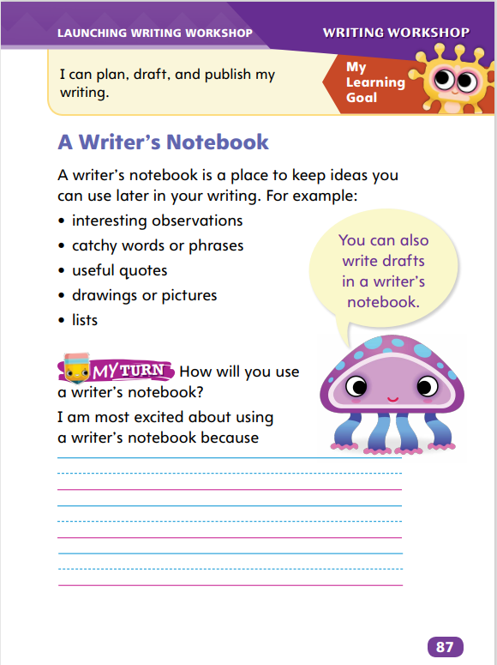
Page 87
Writing – Launch Writing Workshop
Turn to page 87 in your Student Interactive.
Notes:
Good writers develop their craft by writing and revising their work in a writing notebook.
Direct students to p. 87 in the Student Interactive. Review with students that they will fill their writer’s notebooks with ideas that come from their daily experiences.
Say: Pieces of writing grow from ideas like flowers grow from seeds. As if they were real plants, you have to take care of your writing seeds. In your writer’s notebook, you’ll feed them with facts and details. Here is where you’ll write your drafts. A draft is an unfinished piece of writing. With each change or addition, your writing becomes a new draft.
Remind students that they already have ideas and observations in their notebooks. By developing these ideas or observations with facts and details, they will begin to create drafts. Say: You might return to a draft with more information, maybe after conducting research.
Direct students to fill in the bottom of p. 87 in the Student Interactive.

Slide 36
Independent Writing
Let’s review how you will use your notebooks to develop topics and ideas.
Try to develop a first draft from an earlier idea you had.
Notes:
During independent writing time, students should continue thinking about how they will use their notebooks to develop their topics and ideas. If students have difficulty, talk with them about the value of writing ideas for later consideration. Emphasize that the notebook is for ideas and drafts, not just polished pieces.
Writing Support
Modeled - Do a Think Aloud to model how to add more description to a piece of writing.
Shared - Read students’ first drafts and ask questions that prompt them to add details.
Guided - Provide explicit instruction on how to develop an idea from a first sentence into a paragraph.
Students who show understanding may develop a first draft from an earlier idea.
Ask students to share what they’ve added to an earlier draft. Encourage students to share thoughts about how writers get ideas for future drafts.

Slide 37
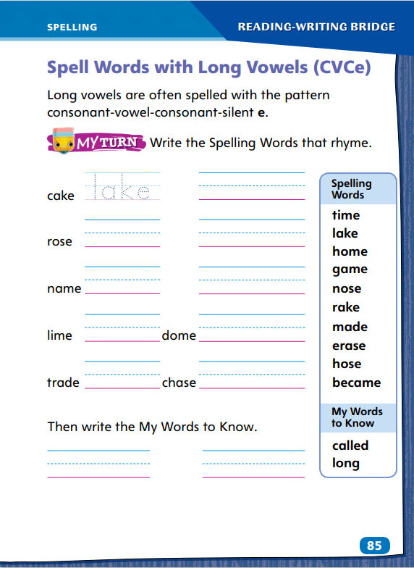
Page 85
Spelling
bite
made
cube
exhale
Turn to page 85 in your Student Interactive and complete the activity.
Notes:
Explain that in CVCe words, the e is silent and the first vowel is long.
Display: bite, made, cube, and exhale. Discuss that these are CVCe words with one VCe syllable. Say and spell bite aloud. Have students do the same for the remaining words.
Have students complete Student Interactive p. 85 to spell one-syllable and multisyllabic CVCe words with VCe syllables.

Slide 38
Language and Conventions
Mom danced the cha-cha.
They created something beautiful.
New York is a big city.
Identify the subject and predicate.
Work with your partner to make up your own sentences and identify the subjects and predicates.
Notes:
Answer any questions students have about simple sentences. Then introduce subjects and predicates. Explain that a subject tells who or what is doing something and a predicate tells what the subject is or does. A complete sentence has both a subject and a predicate.
Display these sentences: Mom danced the cha-cha. They created something beautiful. New York is a big city. Ask students to help you identify the subject and predicate.
Have students work with a partner to create oral sentences. They must be able to identify the subject and the predicate in all of their sentences. Have the partners share their sentences with the class. Have other classmates identify the subjects and predicates, and have partners confirm if their classmates are correct.

Slide 39
Lesson 3

Slide 40
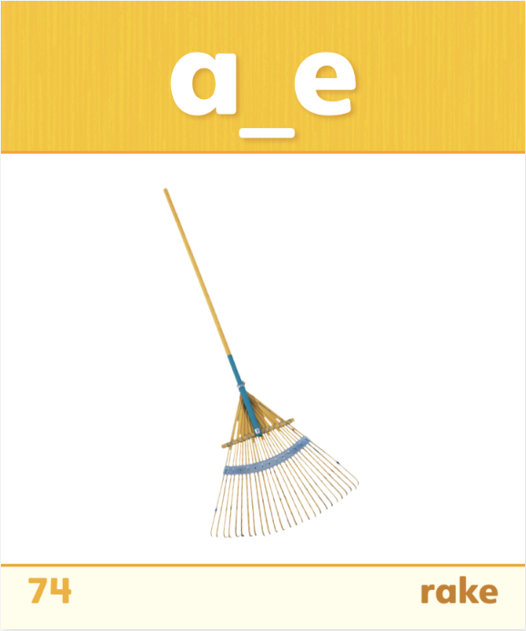
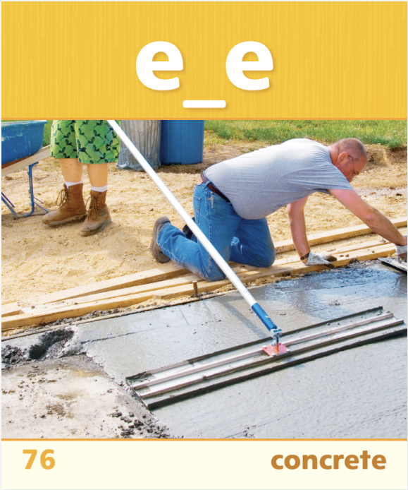
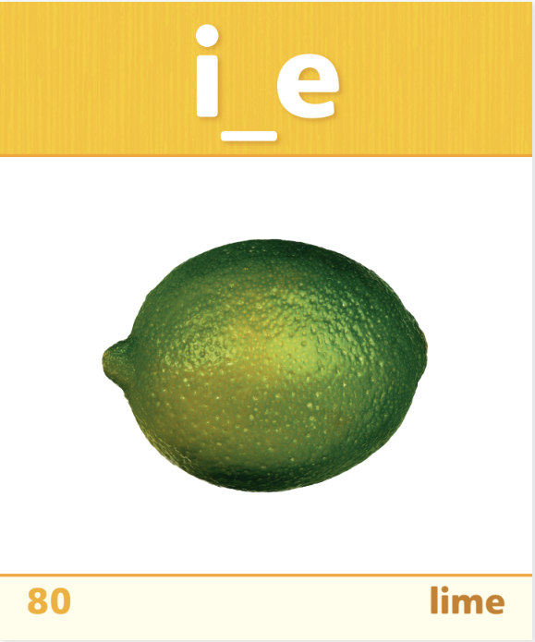
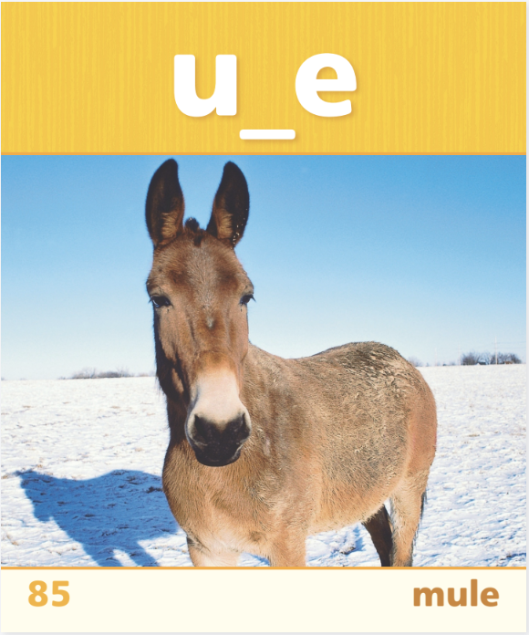
Phonics
-ake
-ine
-oke
Notes:
Display Sound-Spelling Cards 74, 76, 80, 84, and 85. Remind students that words with a consonant-vowel-consonant-e or CVCe pattern usually have a long vowel sound and a silent e. Ask students to identify the vowel sounds in the words on the cards. Then ask them to read aloud the words on the cards. Click path -> Table of Contents -> Unit 1 Week 2 Realistic Fiction-> Lesson 3
Write the following phonograms: -ake, -ine, -oke. Say: I can make new words by adding consonants to the beginning of these letters. If I add the letters s, t, and r to oke, I can make the word stroke.
Have students work in twos or threes to write lists of CVCe words they can make using the phonograms. Tell students the words must be real words. Set a time limit, such as five minutes.
Ask students to share the words they made. Write the words under the appropriate phonogram. After all students have shared their words, have them read words on the list as you point to the words.
Ask students to choose two words from the phonogram lists and write sentences using the words.

Slide 41
Page 57
High-Frequency Words
called
long
most
Turn to page 57 in your Student Interactive and correct the sentences you wrote.
Notes:
Write: called, long, and most. Remind students to practice reading these common words until they know the words by sight.
Say: To help me remember these high-frequency words, I look at each one, close my eyes, and picture the word. Then I say the word.
Help pairs of students create a note card for each word. Have one partner hold up each card while the other partner reads the word. After both students have had a turn, have them repeat the activity, this time using each word in an oral sentence.
Have partners review and correct the sentences they wrote for the previous activity, p. 57 Student Interactive.

Slide 42
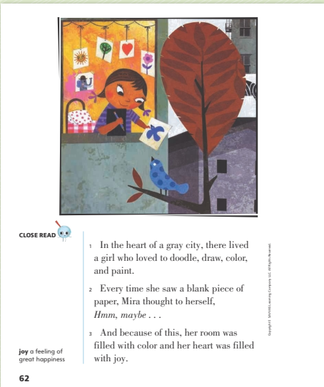
Page 62
Describe and Understand Characters
Notes:
Readers pay attention to both the external (outer) and internal (inner) traits of characters as they read a story. All of the traits together make the characters seem well-rounded and real. To describe characters’ internal and external traits:
Notice what the characters look like and what they say and do.
Notice what the characters think and feel.
Ask yourself how the characters’ thoughts and feelings affect their words and actions.
Have students look at p. 62 of the Student Interactive as you model how to find details about internal and external character traits.
Ask: How does the main character, Mira, feel about making art? What details in the text give us this information? The text says she loved to doodle, draw, color, and paint. Her room was filled with color and her heart was filled with joy. These details tell me that Mira feels happy when she does artwork. This is an internal trait. We can also use the illustration to describe some of Mira’s external traits, which include what she looks like. From the illustration, I can describe her as having short, dark hair and big, dark eyes.
Have students use relevant text details from another page of the story to describe other internal and external traits of the main character.

Slide 43
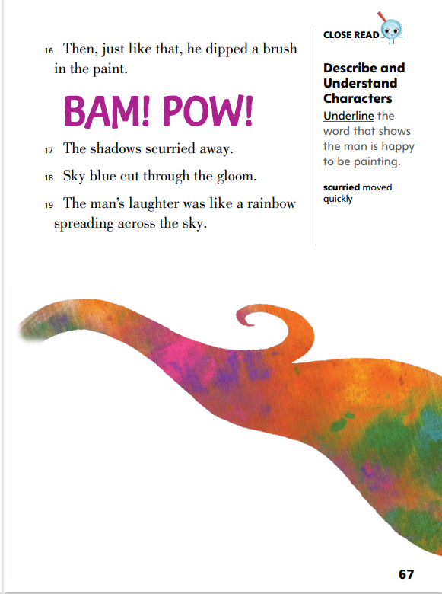
Page 67
Close Read – Describe and Understand Characters
Turn to page 67 in your Student Interactive
Notes:
Explain that writers often try to show a character’s feelings rather than telling a reader how the character feels. For example, rather than write that a character is sad, the writer might explain that the character is frowning or crying. Have students underline the word in paragraph 19 that shows the man is happy. See student page for possible response. Ask: What does the man do that shows he is happy? (He laughs.) DOK 2

Slide 44
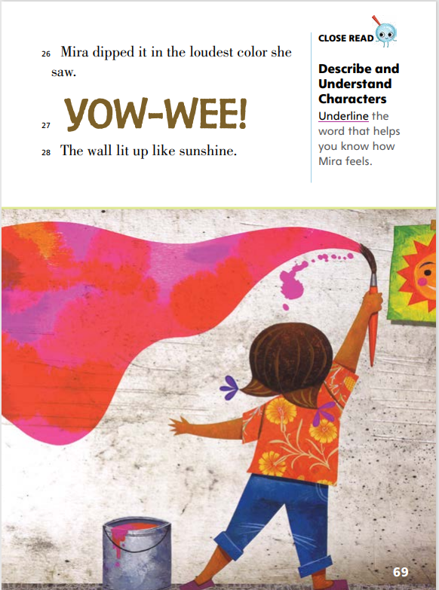
Page 69
Close Read – Describe and Understand Characters
Turn to page 69 in your Student Interactive
Notes:
Direct students to paragraph 27 and have them underline the word that describes how Mira feels. See student page for possible response.
Point out the different text size and use of all capital letters in paragraph 27. Ask: Why do you think “YOW-WEE” is written in all capitals and in big letters? How is Mira feeling as she paints the wall? How do you know? Guide students to understand the use of capital letters for emphasis and point out words such as sunshine and lit up that convey positive feelings. DOK 2

Slide 45
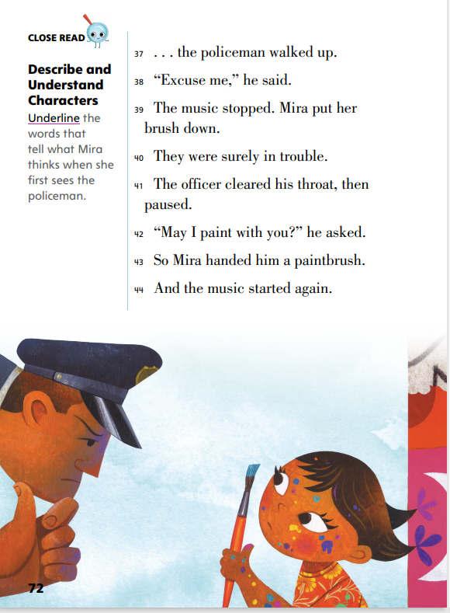
Page 72
Close Read – Describe and Understand Characters
Turn to page 72 in your Student Interactive
Notes:
Point out the actions taken by Mira and the other painters in paragraph 39. Ask: Why does the music stop? Why does Mira put her brush down? (They are afraid of getting in trouble for painting). Guide students to understand that the author describes what Mira and the other community members do so that readers can understand how they feel. Then direct students to paragraph 40 and have them underline words that tell what Mira thinks and feels when she first sees the policeman. See student page for possible response. DOK 1

Slide 46
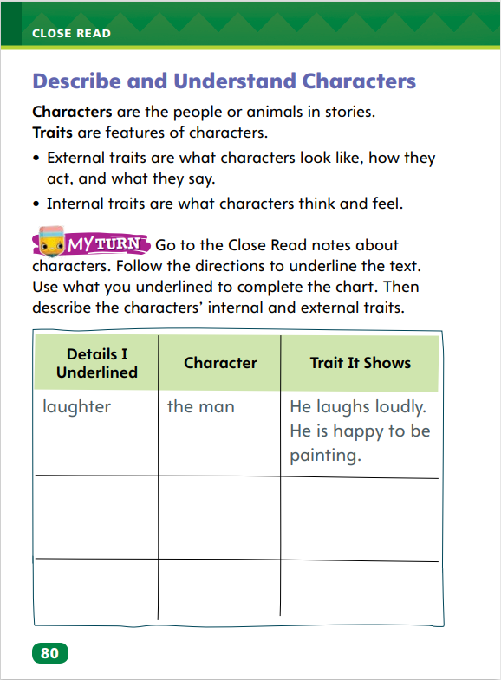
Page 80
Describe and Understand Characters
Turn to page 80 in your Student Interactive and complete the activity.
Notes:
Have students use the strategies for describing and understanding characters.
Have students use the Close Read notes on pp. 67, 69, and 72 to underline information and then complete the chart on p. 80 in the Student Interactive. Make sure students identify both internal and external traits and can identify the difference.

Slide 47
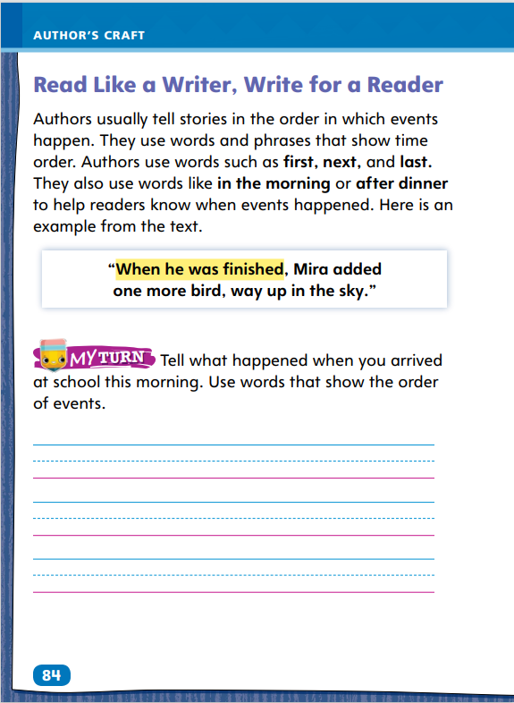
Page 84
Read Like a Writer, Write for a Reader
Turn to page 84 in your Student Interactive and complete the activity.
Notes:
Authors use certain words to show the order of events in a text. The order of events is called sequence. The words that tell the order of the events are called sequence words. These are words like first, next, then, last, and finally and phrases such as after school or later that day.
Look for sequence words to know the order of events in a story.
Use sequence words in your writing to tell when and in what order events happened.
Use the reading selection and have the class retell the story with you. Say: Think about the story Maybe Something Beautiful. We are going to retell and pay attention to the sequence words. First, Mira put a drawing of a sun on the wall. What happened next? Invite volunteers to continue the story using sequence words to signal the order of events. Continue until the story is complete.
Have students complete the activity on p. 84 in the Student Interactive.

Slide 48
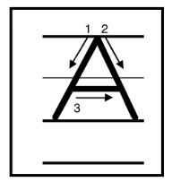
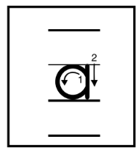
Handwriting
Notes:
Display uppercase and lowercase letters Oo, Cc, and Aa.
Model writing uppercase and lowercase letters Oo, Cc, and Aa. Then write the words Otto, onto, Cam, cut, Anna, and ant, showing proper letter formation and correct letter size.
Have students use Handwriting p. 16 in the Resource Download Center to practice writing the letters Oo, Cc, and Aa. Click path: Table of Contents -> Resource Download Center -> Handwriting Practice -> U1W2L3 Handwriting Practice

Slide 49
Page 88
Writing – Launch Writing Workshop
Turn to page 88 in your Student Interactive.
Notes:
Authors use dictionaries and thesauruses to revise their drafts by choosing the best words for their writing.
Direct students to p. 88 in the Student Interactive. Read aloud the first three paragraphs. Hold up a dictionary. Say: You can use a dictionary to find out how words are spelled. First, decide how you think the beginning of a word is spelled. Look up those letters. If you cannot find the word, consider a different spelling. Continue searching until you find the correct spelling of the word. Then check that you know the word’s definition. Model looking up a word.
Tell students: Authors can choose from many different words to describe the same thing. Hold up a thesaurus. This is a thesaurus. Thesauruses group words with similar meanings into lists. These resources help writers find the exact word they want to use.
Read a sentence with adjectives from a stack text, and point out one adjective. Ask: What is another word the author could have used to mean the same thing? I’m going to use this thesaurus to find synonyms, or similar words. Turn to the section in the thesaurus that contains the author’s word. Point out how thesaurus entries are arranged. Read the other options aloud.

Slide 50
Independent Writing
Let’s look at the dictionary and check our spelling and understanding of words.
Share the word you have looked up with its definition and spelled correctly.
Notes:
Instruct students to use dictionaries to improve their spelling and vocabulary as they work independently. If students have trouble, help them find the words they need to spell correctly.
Writing Support
Modeled - Do a Think Aloud to model how to correct a misspelled word with the aid of a dictionary.
Shared - Place students in groups. Give each group a list of words, some spelled correctly, some misspelled, and ask groups to use dictionaries to fix the incorrect words.
Guided - Identify misspelled words in students’ writing so they can consult dictionaries for help.
Students who complete the task should practice looking up unfamiliar words in dictionaries.
Have several students share words they’ve looked up, along with their spellings and definitions.

Slide 51
Spelling
cute
name
nice
bone
invite
Notes:
Flexible Option
Remind students that the final e in a CVCe word makes the first vowel long.
Display the following CVCe words: cute, name, nice, bone, and invite. Read and spell the first word aloud. Have students repeat after you. Then have students read and spell the remaining words aloud.
Have students complete Spelling p. 24 from the Resource Download Center to spell one-syllable and multisyllabic CVCe words. Click path: Table of Contents -> Resource Download Center -> Spelling -> U1W2

Slide 52
Language and Conventions
Lisa reads lots of books.
We will write two sentences.
Then we will practice finding the subject and predicate in each sentence.
Notes:
Explain to students that subjects do something. Subjects are nouns or pronouns. The predicate tells what the subject is or does. A predicate has a verb. A complete sentence has a subject and a predicate. Explain that the subject and the verb in the predicate must agree in number.
Display the following sentence: Lisa reads lots of books.
Say: Lisa is the person who is doing something. Lisa is the subject. Reads lots of books tells us what she does. Reads lots of books is the predicate.
Have students write two sentences. Invite volunteers to write their sentences on the board. Have the class identify the subject and predicate in each sentence. Then have students check the displayed sentences to make sure that the subject and the verb agree in number.

Slide 53
Lesson 4

Slide 54
Phonics
a_e | i_e | o_e | u_e
take | smile | bone | mule
Notes:
Display Sound-Spelling Cards 74, 76, 80, 84, and 85. Ask students what vowel pattern the words have. (CVCe) Call on different students to sound out and read the words on the cards.
Make a four-column CVCe chart for the vowel patterns a_e, i_e, o_e, u_e. Use the vowel patterns as column heads in the chart and record these example words in their respective columns: take, smile, bone, mule.
Ask students to brainstorm words for each vowel sound. Record the words in the appropriate columns. If students say a word with a different long vowel pattern, such as train, write it and confirm that it has a long a sound. Then ask whether it has a CVCe pattern. Tell students the word has a different vowel pattern.

Slide 55
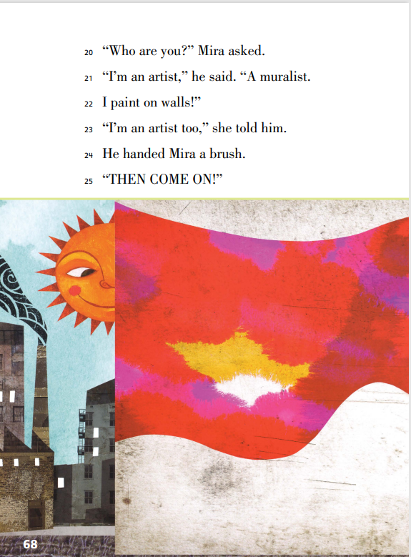
Page 68
Ask and Answer Questions
Notes:
Active readers generate questions about text before, during, and after reading to deepen their understanding and gain information.
Make predictions about the text before you read. Look at the title, cover, or illustrations to get an idea of what the text might be about.
During reading, ask what the characters are thinking and feeling about other characters and events in the story. Notice what the characters say and do. If you had to tell the story in a quick way, how would you tell it?
After reading, think about how the story ends and why it ends this way. What do you think the author is trying to say in this story?
Have students look at SI p. 68. Ask: Does Mira know the man with the paintbrushes? What does Mira think about the man? Why is he in Mira’s neighborhood? What other questions do you have about this part of the story? Elicit responses from the class and encourage students to provide details that support their answers.

Slide 56
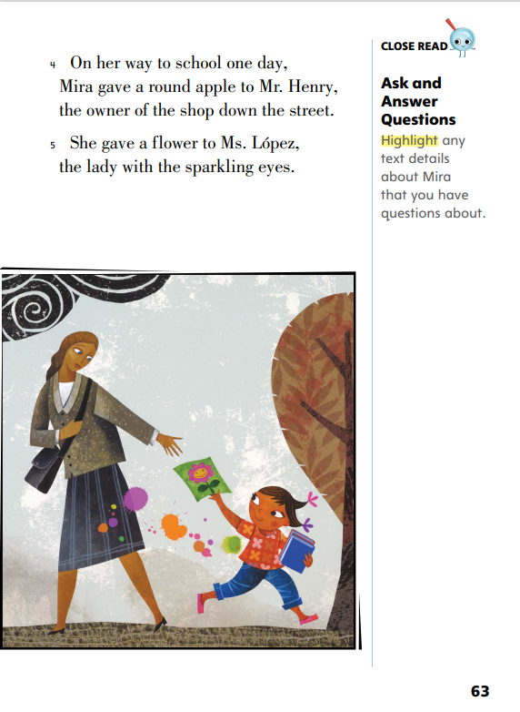
Page 63
Ask and Answer Questions
Turn to page 63 in your Student Interactive.
Notes:
Explain that students can use illustrations to help answer questions they have while reading the text. Ask: What questions do you have about the apple and the flower mentioned in the text? How can you answer these questions? What other questions do you have about Mira? Have students highlight any text details they have questions about. See student page for possible response. DOK 3

Slide 57
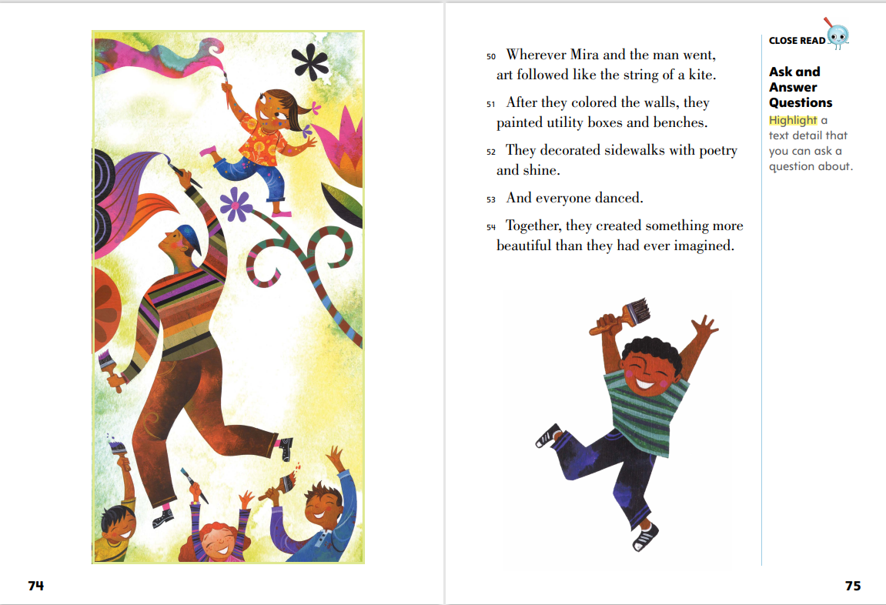
Page 75
Ask and Answer Questions
Turn to page 75 in your Student Interactive.
Notes:
Explain that sometimes, readers’ questions will be answered in the text, but other times, questions may be left unanswered. Sometimes, texts raise questions that require additional research. Direct students to paragraph 54 and have them highlight a text detail that they have a question about. See student page for possible response. DOK 3

Slide 58
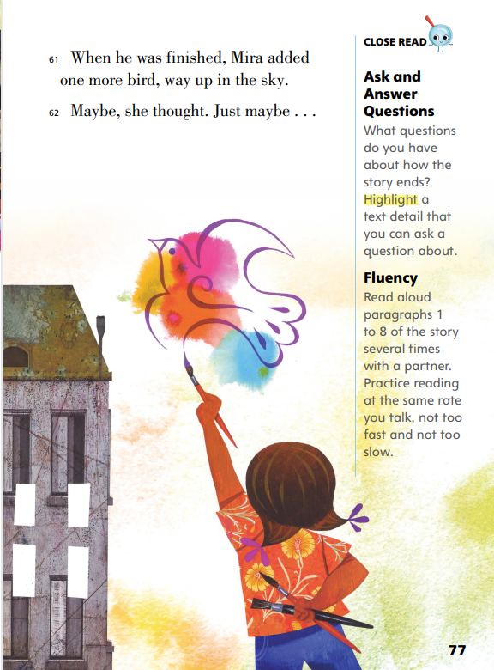
Page 77
Ask and Answer Questions
Turn to page 77 in your Student Interactive.
Notes:
Model forming a question from the text. Say: The text tells me “Mira added one more bird, way up in the sky.” In the picture, it looks like she is painting in the sky, not on a building. How was Mira able to paint in the sky? Direct students to paragraph 62 and have them highlight a text detail they can ask a question about. See student page for possible response. DOK 3

Slide 59
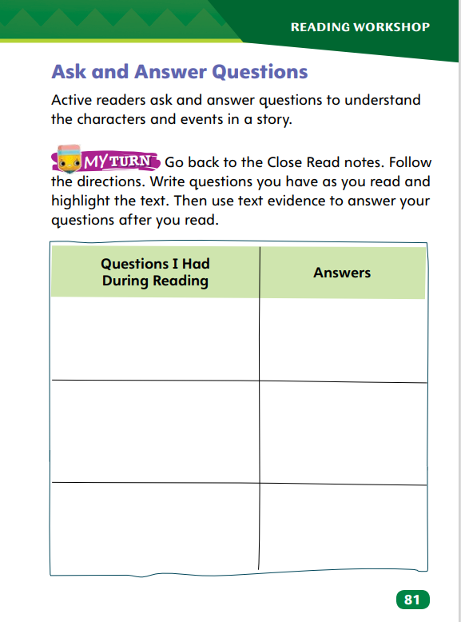
Page 81
Ask and Answer Questions
Turn to page 81 in your Student Interactive and complete the activity.
Notes:
Have students annotate the text using the Close Read notes for Ask and Answer Questions and then use their annotations to complete the chart on p. 81 in the Student Interactive

Slide 60
Page 88
Writing – Launch Writing Workshop
Turn to page 88 in your Student Interactive.
Notes:
Dictionaries and thesauruses are valuable tools for choosing words and spelling them correctly in your writing.
Return to p. 88 in the Student Interactive. Review the purpose of both a dictionary and a thesaurus. Prompt students to complete the exercise on the bottom of p. 88 in the Student Interactive.
Write the following paragraph, using it as an example of writing that needs to be checked against a dictionary and a thesaurus: I like to play in the big park. The park is very big. On Sundae, the park was very packed. I like Mondays. The park is not packed.
Tell students: Writers can use a dictionary to correct misspelled words. Can you find the misspelled word? If necessary, point out Sundae. Hmmm, this spelling doesn’t seem correct to me. Let’s look it up. Have one or more students look up both sundae and Sunday in a dictionary and read the definitions. Review the definitions, noting the correct spelling.
Reread the paragraph aloud. This paragraph repeats some words. Point out big and packed. Sometimes too many of the same words can make the text dull. An author could choose similar words to make writing more interesting.
Ask students to supply synonyms for big and packed using a thesaurus. Then, pick a sentence from a stack text and ask students to replace adjectives with synonyms.

Slide 61
Independent Writing
Use thesauruses to find synonyms for words in your draft.
Share your new and improved sentences.
Notes:
Instruct students to use thesauruses to improve their writing as they work independently. If students have trouble, help them find synonyms for several key words in their drafts.
Writing Support
Modeled- Do a Think Aloud that models how to find a synonym for a particular adjective.
Shared - Display a T-chart with a list of adjectives on the left. Direct students to use thesauruses to find synonyms for these words. Fill in their choices on the right.
Guided - Circle similar words in a student’s writing. Point them to a thesaurus entry. Ask them to consider variations of these words.
Students who complete the task should use dictionaries to look up definitions for a set of synonyms they found so that they begin to understand the slight differences among similar words.
Ask several students to share their new and improved sentences.

Slide 62
Spelling
cap
bit
tot
cut
Think of words that have short vowel sounds.
Notes:
Flexible Option
Remind students that there are short vowel sounds as well as long vowel sounds. Tell students that if we take away the final e, the vowel becomes short and we have a different word.
Display or write the following words: cap, bit, tot, cut. Say the words and have students repeat them. Then add a final e to the words, say them, and have students repeat.
Have students think of words that have short vowel sounds. Ask volunteers to write their words on the board.

Slide 63
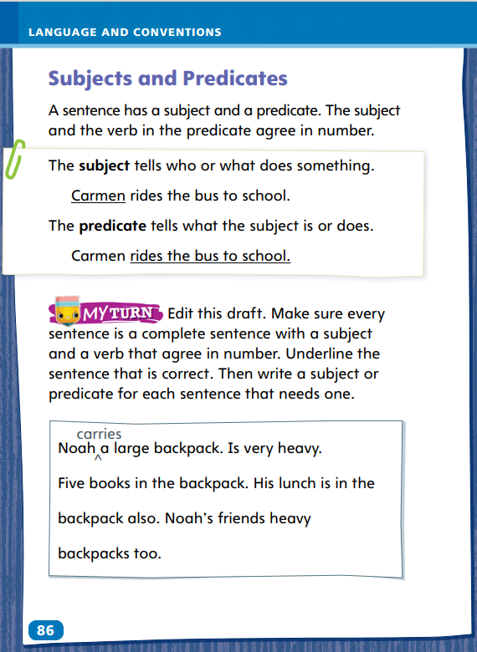
Page 86
Language and Conventions
Turn to page 86 in your Student Interactive and complete the activity.
Notes:
Have students complete the practice activity on p. 86 to edit drafts using complete sentences with subjectverb agreement. Use the leveled supports on p. T369 for ELLs.

Slide 64
Lesson 5

Slide 65
Phonics
man
pet
sit
sun
Notes:
Write the word fox. Ask students what vowel pattern the word has. (CVC) Ask what sound the vowel in a CVC word usually has. (short) Have students read the word. Repeat with these words: man, pet, sit, sun
Have small groups of students use letter tiles or word cards to make CVC words. After they make a word, they should write it down. Ask groups to share the words they made. As the groups read each word, ask listeners to identify the vowel sound.

Slide 66
High-Frequency Words
c | a | l | l | e | d
 |  | l | o | n | g
 |  | m | o | s | t
called
long
most
Notes:
Remind students that high-frequency words are words that they will hear often in conversation and see often in texts. Point out that learning to recognize these words automatically will allow them to concentrate on other, less familiar words and on the meaning of what they are reading.
Ask students to review the chart. Have them say each word and repeat after you the letters each word contains. Then ask a volunteer to use one of the words in a sentence. Another student repeats the high frequency word and spells it aloud.

Slide 67
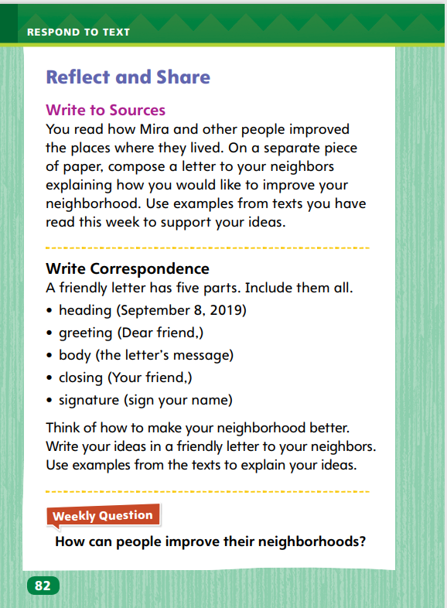
Page 82
Reflect and Share
Turn to page 82 in your Student Interactive.
Notes:
Explain how to compose correspondence, such as a friendly letter. Writing a friendly letter involves planning.
Think about the person you will write to and what you will say.
Include all five parts in your friendly letter (a heading, greeting, body, closing, and signature).
Model preparing to write a friendly letter using the Write to Sources prompt on SI p. 82 . Say: I start by writing today’s date as the heading. Then I move on to my greeting. Who will be reading this letter? My neighbors. I want my letter to be friendly, so I can choose a greeting such as Dear Friend or Dear Neighbor. As I write the body of the letter, I will write a sentence for each improvement I think should be made and give a reason I think it will help the neighborhood become a nicer place to live.

Slide 68
Page 82
Apply
How can people improve their neighborhoods?
Notes:
Have students use the strategies for making connections between texts.
Have students use evidence from the texts they have read this week to respond to the Weekly Question. Tell them to discuss responses in small groups.

Slide 69
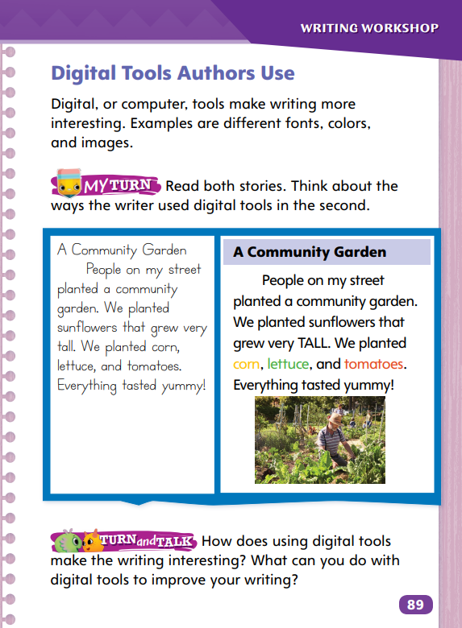
Page 89
Writing – Launch Writing Workshop
Turn to page 89 in your Student Interactive.
Notes:
Authors may use different fonts, colors, and images to make their writing more interesting to readers.
Direct students to p. 89 of the Student Interactive. Read the first paragraph aloud.
Tell students: Authors can design how they want their text to appear with the help of computer programs. They can add colors and images to the text. They can change the style of the text using fonts, which are sets of letters, numbers, and punctuation marks that are all the same size and style. With some fonts, words can appear bold, thick, thin, straight, curved, rounded, or boxy.
Hold up a text from the stack. Point out different fonts on the cover and interior pages. Identify bold and italicized words along with handwriting fonts. Tell students that the author chose certain fonts to make the text more interesting.
Point out photos and illustrations. Discuss how they connect to the content. Have students read the My Turn section on p. 89 in the Student Interactive. Guide students as they discuss how the text changed with the use of digital tools.
Have students spend a couple of minutes thinking about how they might use fonts and images to add more visual interest to their own writing. Suggest that they write ideas in their writer's notebooks.
Ask students to share their ideas for using digital tools with their own writing.

Slide 70
Spelling
I took a long walk.
This is a fun game.
They rake the leaves.
The dog ran home.
We made a mask in art class.
A firefighter uses a big hose.
I don’t have time today.
The puppy’s nose is cold.
You called your mother.
Did he erase the answer?
Dave became a doctor.
The lake is blue.
Notes:
Flexible Option
(Note: Move the orange boxes to cover each bold spelling word before you read aloud the words and sentences.)
Read aloud the words and sentences. Have students spell each word with initial consonant blends and the two high-frequency words.
I took a long walk.
This is a fun game.
They rake the leaves.
The dog ran home.
We made a mask in art class.
A firefighter uses a big hose.
I don’t have time today.
The puppy’s nose is cold.
You called your mother.
Did he erase the answer?
Dave became a doctor.
The lake is blue.
Reveal the spelling word and have students check their work.

Slide 71
Language and Conventions
My dog plays in the park.
Which words in the sentence are the predicate?
My dog
My dog plays
Plays in the park
In the park
Notes:
Display the following sentence and guide students to answer the question. (1) My dog plays in the park.
Which words in the sentence are the predicate?
my dog
my dog plays
plays in the park
in the park
Have students complete Language & Conventions p. 30 from the Resource Download Center. Click path: Table of Contents -> Resource Download Center -> Language and Conventions -> U1 W2

Slide 72
Unit 1: Week 2
Grade 2

