Slide 1
Unit 1: Week 6
Grade 1

Slide 2
Copyright © Savvas Learning Company LLC. All Rights Reserved.
This publication is protected by copyright, and permission should be obtained from the publisher prior to any prohibited reproduction, storage in a retrieval system, or transmission in any form or by any means, electronic, mechanical, photocopying, recording, or otherwise. For information regarding permissions, request forms, and the appropriate contacts within the Savvas Learning Company Rights Management group, please send your query to:
Savvas Learning Company LLC, 15 East Midland Avenue, Paramus, NJ 07652
or
k12learningpermissions@savvas.com
myView Literacy® is an exclusive trademark of Savvas Learning Company LLC in the U.S. and/or other countries.

Slide 3
Lesson 1

Slide 4
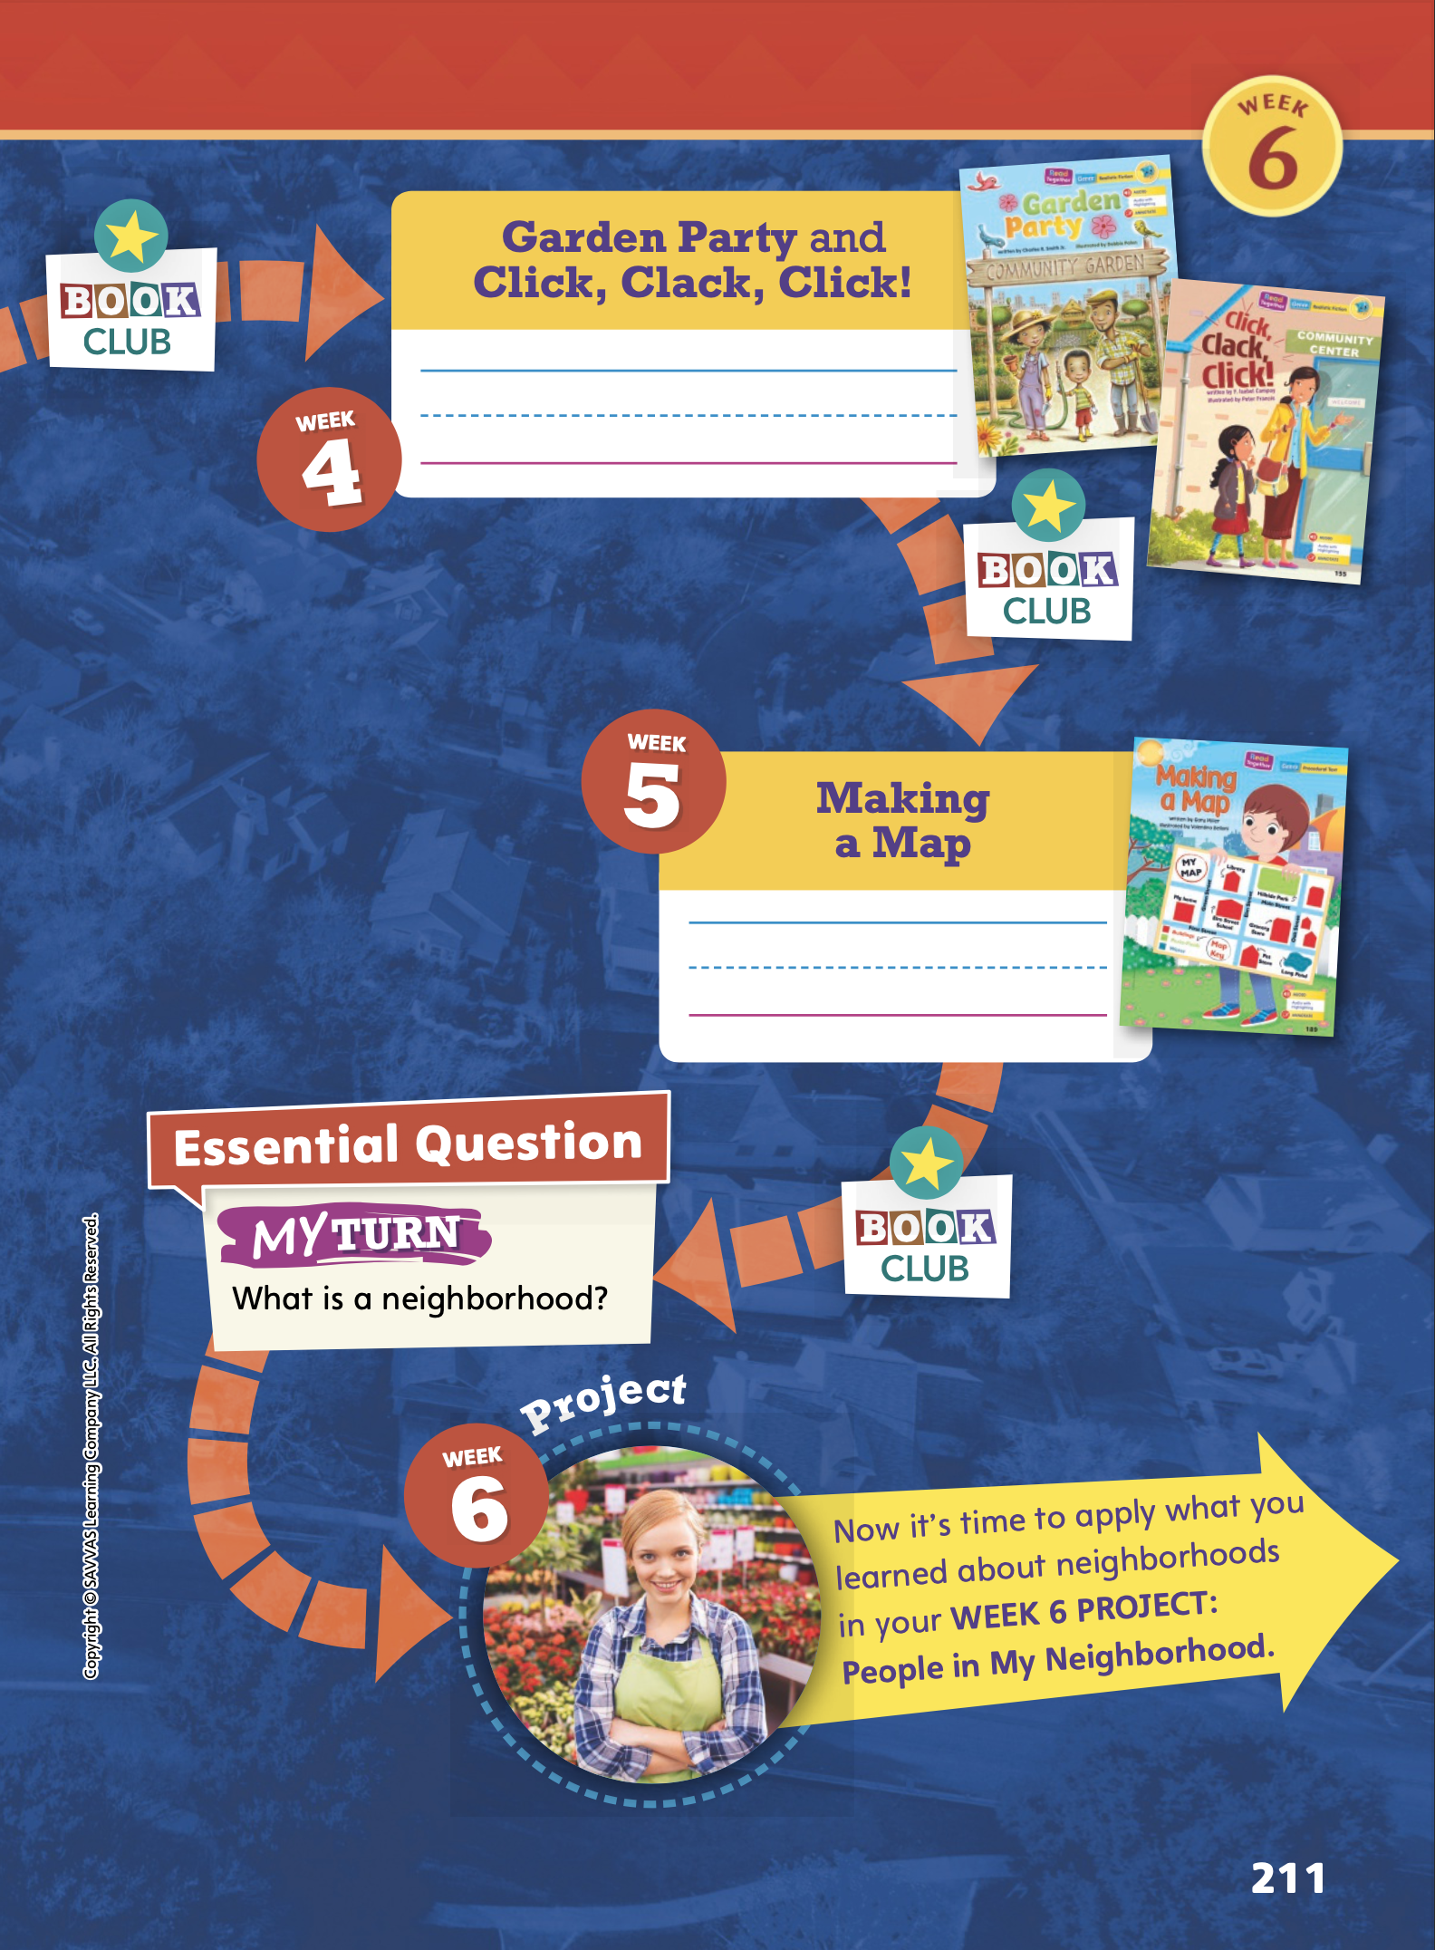
Page
210, 211
Compare Across Texts
Write a word that names something in a neighborhood for each text.
Notes:
The selections in this unit helped students learn about people, places, and things in a neighborhood. Remind students of the unit theme, My Neighborhood, and the Essential Question: What is a neighborhood?
Have student pairs revisit each selection to identify a word that names something in a neighborhood. Have students write the word below each text on pp. 210–211 in the Student Interactive.
Then have students talk with their partner about how the words can help them answer the Essential Question.

Slide 5
Page
210, 211
Compare Across Texts
Think about what makes a neighborhood.
Share your response with the class.
Notes:
Explain to students that the texts are all connected to the unit theme: My Neighborhood. Invite volunteers to briefly review each selection on the opener. Volunteers should give a short summary and tell something they liked or did not like about the selection.
Then use the prompts below to facilitate a discussion to compare characters, genres, settings, and events across texts.
Compare the characters in The Blackout and Garden Party. (Possible response: The neighbors all help each other.)
How is Making a Map different from the other selections in this unit? (Possible response: It is a procedural text. It tells how to make a map of a neighborhood.)
Tell how the setting in Henry on Wheels is different from Click, Clack, Click! (Possible response: The setting in Henry on Wheels is Henry’s neighborhood because he rides his bike around the block. The setting in Click, Clack, Click! is a community center. Amena stays in that place to meet some friends.)
Have students answer the Unit 1 Essential Question: What is a neighborhood?

Slide 6
Page
212
Phonological Awareness
Notes:
Point to the picture of a quarter on p. 212 in the Student Interactive. Have students listen closely as you say the initial sound in the word quarter. Say: This is a picture of a quarter. Quarter begins with the sound /kw/. Listen again for the beginning sound in quarter.
Say the word quarter again, and this time emphasize the sound /kw/. Ask: What sound did you hear at the beginning of the word? Yes, the sound is /kw/. Say the word with me: quarter.
Say the names of the remaining pictures and model the sound /kw/.
Then have students work with a partner and take turns saying the words quarter, queen, and question. Tell students to name the initial sound in each word (/kw/).

Slide 7
Page 212
Phonics
qu-
Quinn
Read the word on page 212 in your Student Interactive.
Notes:
Explain to students that the sound /kw/ is spelled with two letters: the letters q and u. Write the letters on the board.
Display Sound-Spelling Card 19 (quilt). Say: Here is the word quilt. Listen to the first sound as I say the word again: quilt. The letters qu spell the sound /kw/.
Write and say the name Quinn. Say the sounds in the word slowly: /kw/ /i/ /n/. What sound do you hear at the beginning of the word Quinn? The sound is /kw/. The sound /kw/ is spelled qu.
Have students read the word again with you, emphasizing the initial sound /kw/. Remind students both uppercase and lowercase combinations of those letters spell the sound /kw/.
Have students practice decoding and blending the sounds that make the word quit at the bottom of p. 212 in the Student Interactive.

Slide 8
High-Frequency Words
go
for
here
me
where
Notes:
Display the words: go, for, me, here, where.
Point to each word as you read it.
Then spell the word and read it again.
Have students spell and say the words with you.

Slide 9
Spelling
It is time to quit working.
We will be in school on Monday.
The horse bit the apple.
Can you write with a quill?
We can go to the park.
Do you know where the ball is?
Notes:
(Note: Move the orange boxes to cover each bold spelling word before you read aloud the words and sentences.)
Read aloud the words and sentences. Have students spell the words with the sound /kw/, the other spelling words, and the two high-frequency words.
It is time to quit working.
We will be in school on Monday.
The horse bit the apple.
Can you write with a quill?
We can go to the park.
Do you know where the ball is?
Reveal the spelling word and have students check their work.

Slide 10
Page
224
Inquire – Introduce the Project
Think of workers in your neighborhood.
Share your ideas with a partner and talk about what he or she does.
Notes:
This week, students will work in pairs to research neighborhood workers and then write an informational text explaining what a worker in their neighborhood does.
Read aloud the prompt on p. 224 in the Student Interactive. Activate students’ background knowledge and set a purpose for the project.
Use the rubric on p. T437 to evaluate students’ completed projects.

Slide 11
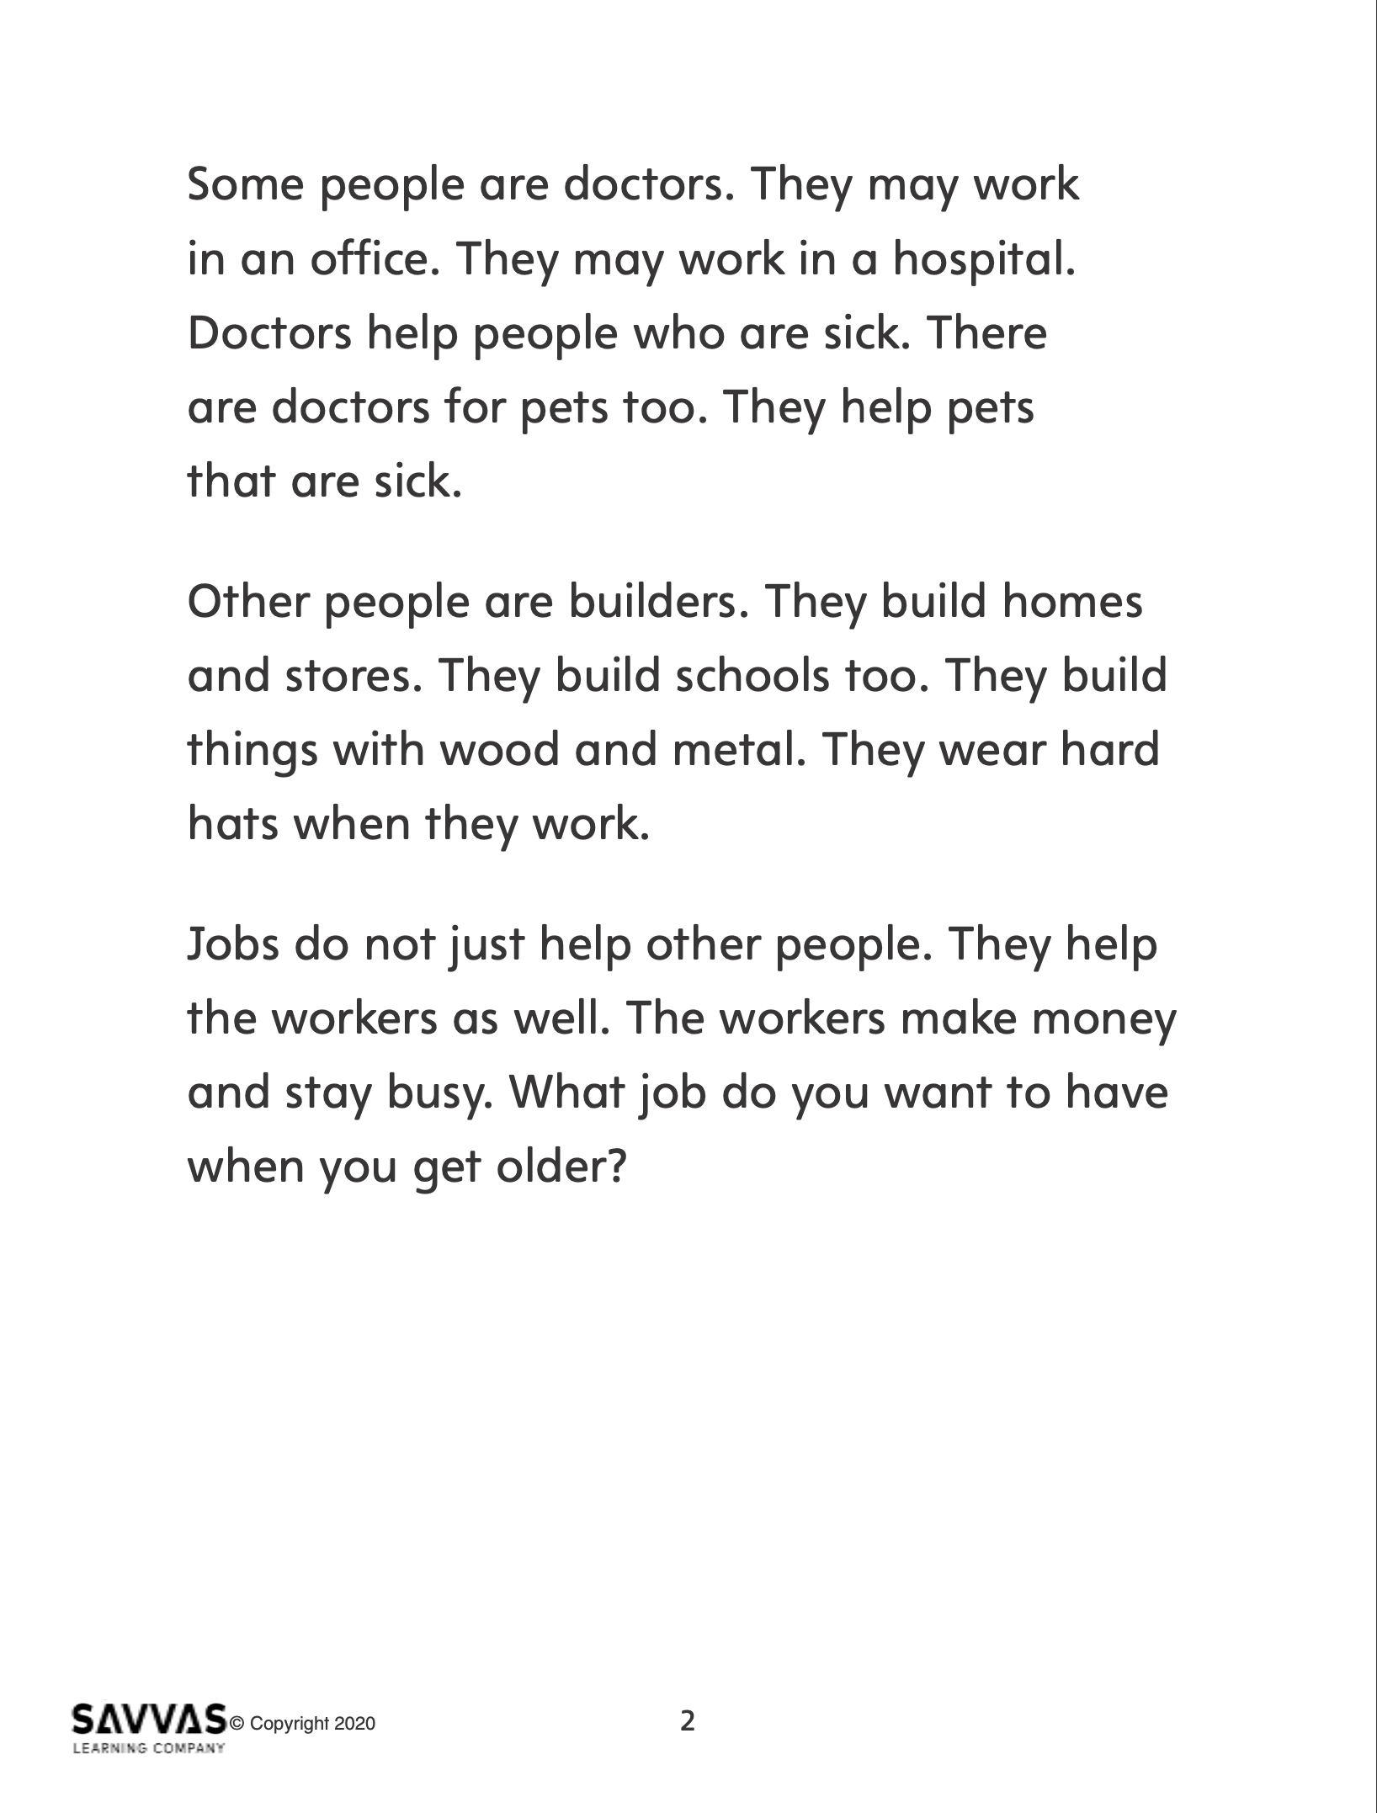
Inquire – Build Background
Read “Workers in the Neighborhood.”
Take turns reading paragraphs with a partner and make connections.
Someone I know works…
In my neighborhood, I see…
Notes:
Distribute copies of “Workers in the Neighborhood.” Click path: Table of Contents -> Unit 1: My Neighborhood -> U1 W6: Project-Based Inquiry -> U1 W6: Lesson 1
Note: This article is available at 3 different Lexile levels. The slide image is the middle range.
Use the information in the research article to support students in building background on neighborhood workers.
Have partners take turns reading aloud a paragraph and making connections to real life using these stems.
Someone I know works…
In my neighborhood, I see...

Slide 12
Page
225
Inquire – Generate Questions
With a partner, write words and draw pictures about neighborhood workers.
Write two questions about neighborhood workers.
Notes:
Have student pairs brainstorm by writing words and drawing pictures about neighborhood workers.
Tell students we generate questions for formal inquiry about words and pictures, such as Where does this person work? or How does this worker help in the neighborhood? Generating, or asking, questions helps us set a purpose for our project.
Have pairs generate and write two questions for inquiry about neighborhood workers.
To provide differentiated support:
Allow time for pairs to name neighborhood workers and tell what the workers do. Model drawing and writing what the students say. For example, You said that a firefighter is a neighborhood worker. Write firefighter. You said that firefighters put out fires. We can ask how firefighters put out fires. Draw a firefighter using a water hose to put out a small fire.
If pairs easily generate ideas and questions about neighborhood workers, have them write sentences about a neighborhood worker, such as where and how the worker does his or her job.

Slide 13
Page
224, 225
Inquire – Academic Vocabulary
Turn to pp. 224-225 in your Student Interactive.
Talk about the picture using your Academic Vocabulary.
Notes:
Review the Academic Vocabulary words settle, various, group, and type with students.
Have them use the words to tell about their neighborhoods and to talk about the image on pp. 224–225 in the Student Interactive using their newly acquired Academic Vocabulary.
Remind students that they will follow a research plan in order to complete the project in one week.
Read aloud the Neighborhood Worker Research Plan on p. 225 in the Student Interactive and have students follow along.
At the end of this lesson, students should have completed the first step by choosing a neighborhood worker and writing two questions for research.

Slide 14
Lesson 2

Slide 15
Page 213
Phonics
Qu | qu
quit
quill
Quinn
quiz
My hamster’s name is ______.
Long ago, people wrote with a ______.
It is time to take a math ______.
I love playing soccer, so I will now ______.
Notes:
Write the letters Qu and qu on the board and point to each pair of letters as you say the sound /kw/. Tell students that the sound /kw/ is spelled with the pattern qu.
Reinforce the phonics skill by writing the following words on the board: quit, quill, Quinn, quiz.
Point to and say the word quit. Have students repeat the word. Ask: What sound do you hear at the beginning of quit? (/kw/) What letters spell the sound /kw/? (qu)
Invite a volunteer to underline the letters qu. Continue with the other words.
Next, read aloud the following sentences and have students fill in the blank with one of the qu words on the board.
My hamster’s name is _____. (Quinn)
Long ago, people wrote with a _____. (quill)
It is time to take a math _____. (quiz)
I love playing soccer, so I will not _____. (quit)
Have partners read the sentences at the top of p. 213 in the Student Interactive.

Slide 16
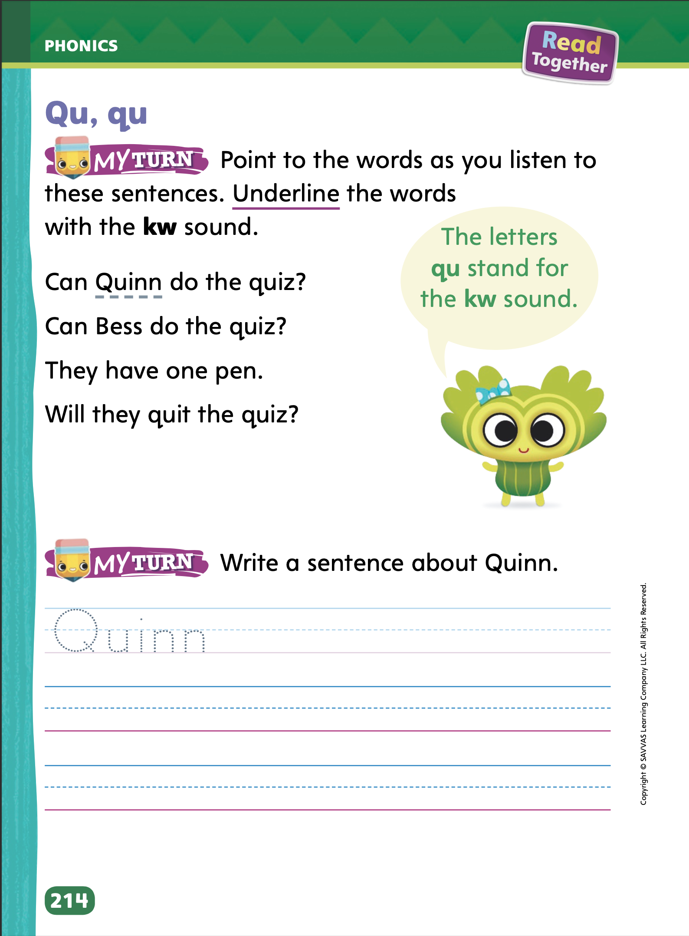
Page 213, 214
Apply
Turn to page 213 in your Student Interactive and read the words.
Say the picture names and write the words.
Tell your partner a sentence with a qu- word.
Turn to page 214. Listen to the sentences and underline the words with the kw sound.
Write a sentence about Quinn.
Notes:
Have students complete the rest of p. 213 and p. 214 in the Student Interactive.

Slide 17
High-Frequency Words
go
for
here
me
where
Notes:
Display and then read aloud the high-frequency words: for, go, here, me, where.
Dictate each word, and have students spell them aloud.
Then cover the words, and dictate them again.
Have students write the words as you dictate each one.

Slide 18
Page 215
Spelling
quit
quill
Turn to page 215 in your Student Interactive and complete the activity.
Notes:
Tell students that the sound /kw/ follows a spelling pattern. The sound /kw/ is spelled qu.
Write or display the words quit and quill.
Read each word aloud, emphasizing the sound /kw/. Point to the qu in each word as you say the sound. Point out the spelling of the other words.
Have students complete the activity on p. 215 in the Student Interactive.

Slide 19
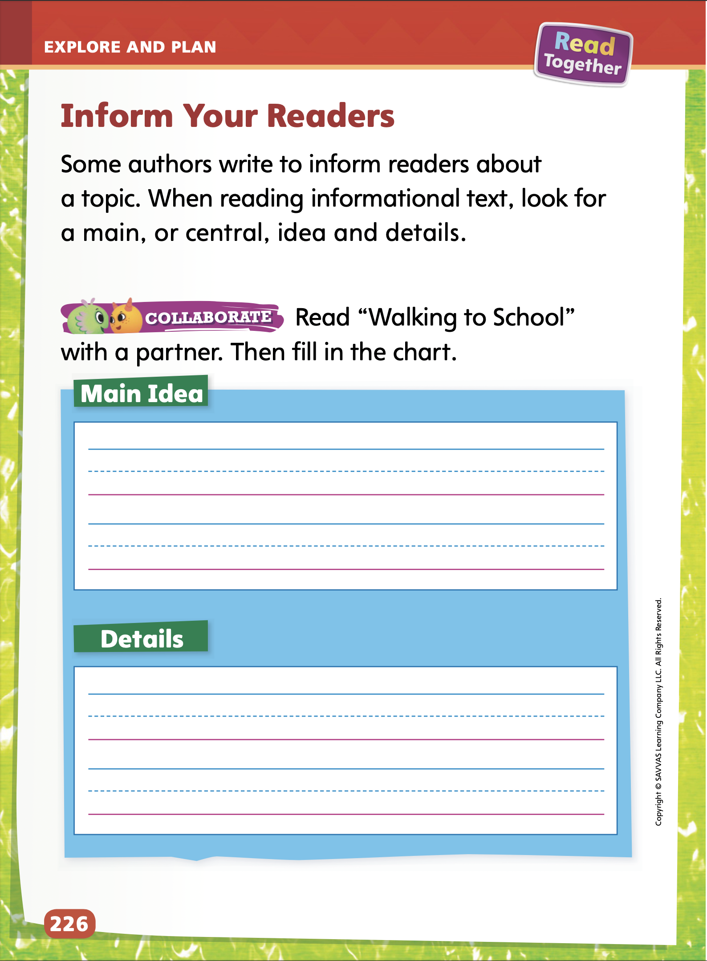
Page
226
Explore and Plan – Informational Text
Turn to p. 226 in your Student Interactive.
Notes:
Read aloud the paragraph on p. 226 in the Student Interactive.
Tell students that an informational text explains information about a topic. An informational text has a main, or central, idea and details. The main idea is what the text is mostly about. Details give more information about the main idea.
Tell students that before they write their informational texts, they should state their central idea clearly and include only details that tell more about the central idea.
Remind students that their audience is their classmates. As they plan and write their informational texts, students should consider what their classmates want to know about a neighborhood worker. Help students write for an audience by asking questions, such as What might your classmates already know about your neighborhood worker? and What do you think is most important for them to learn about your neighborhood worker?

Slide 20
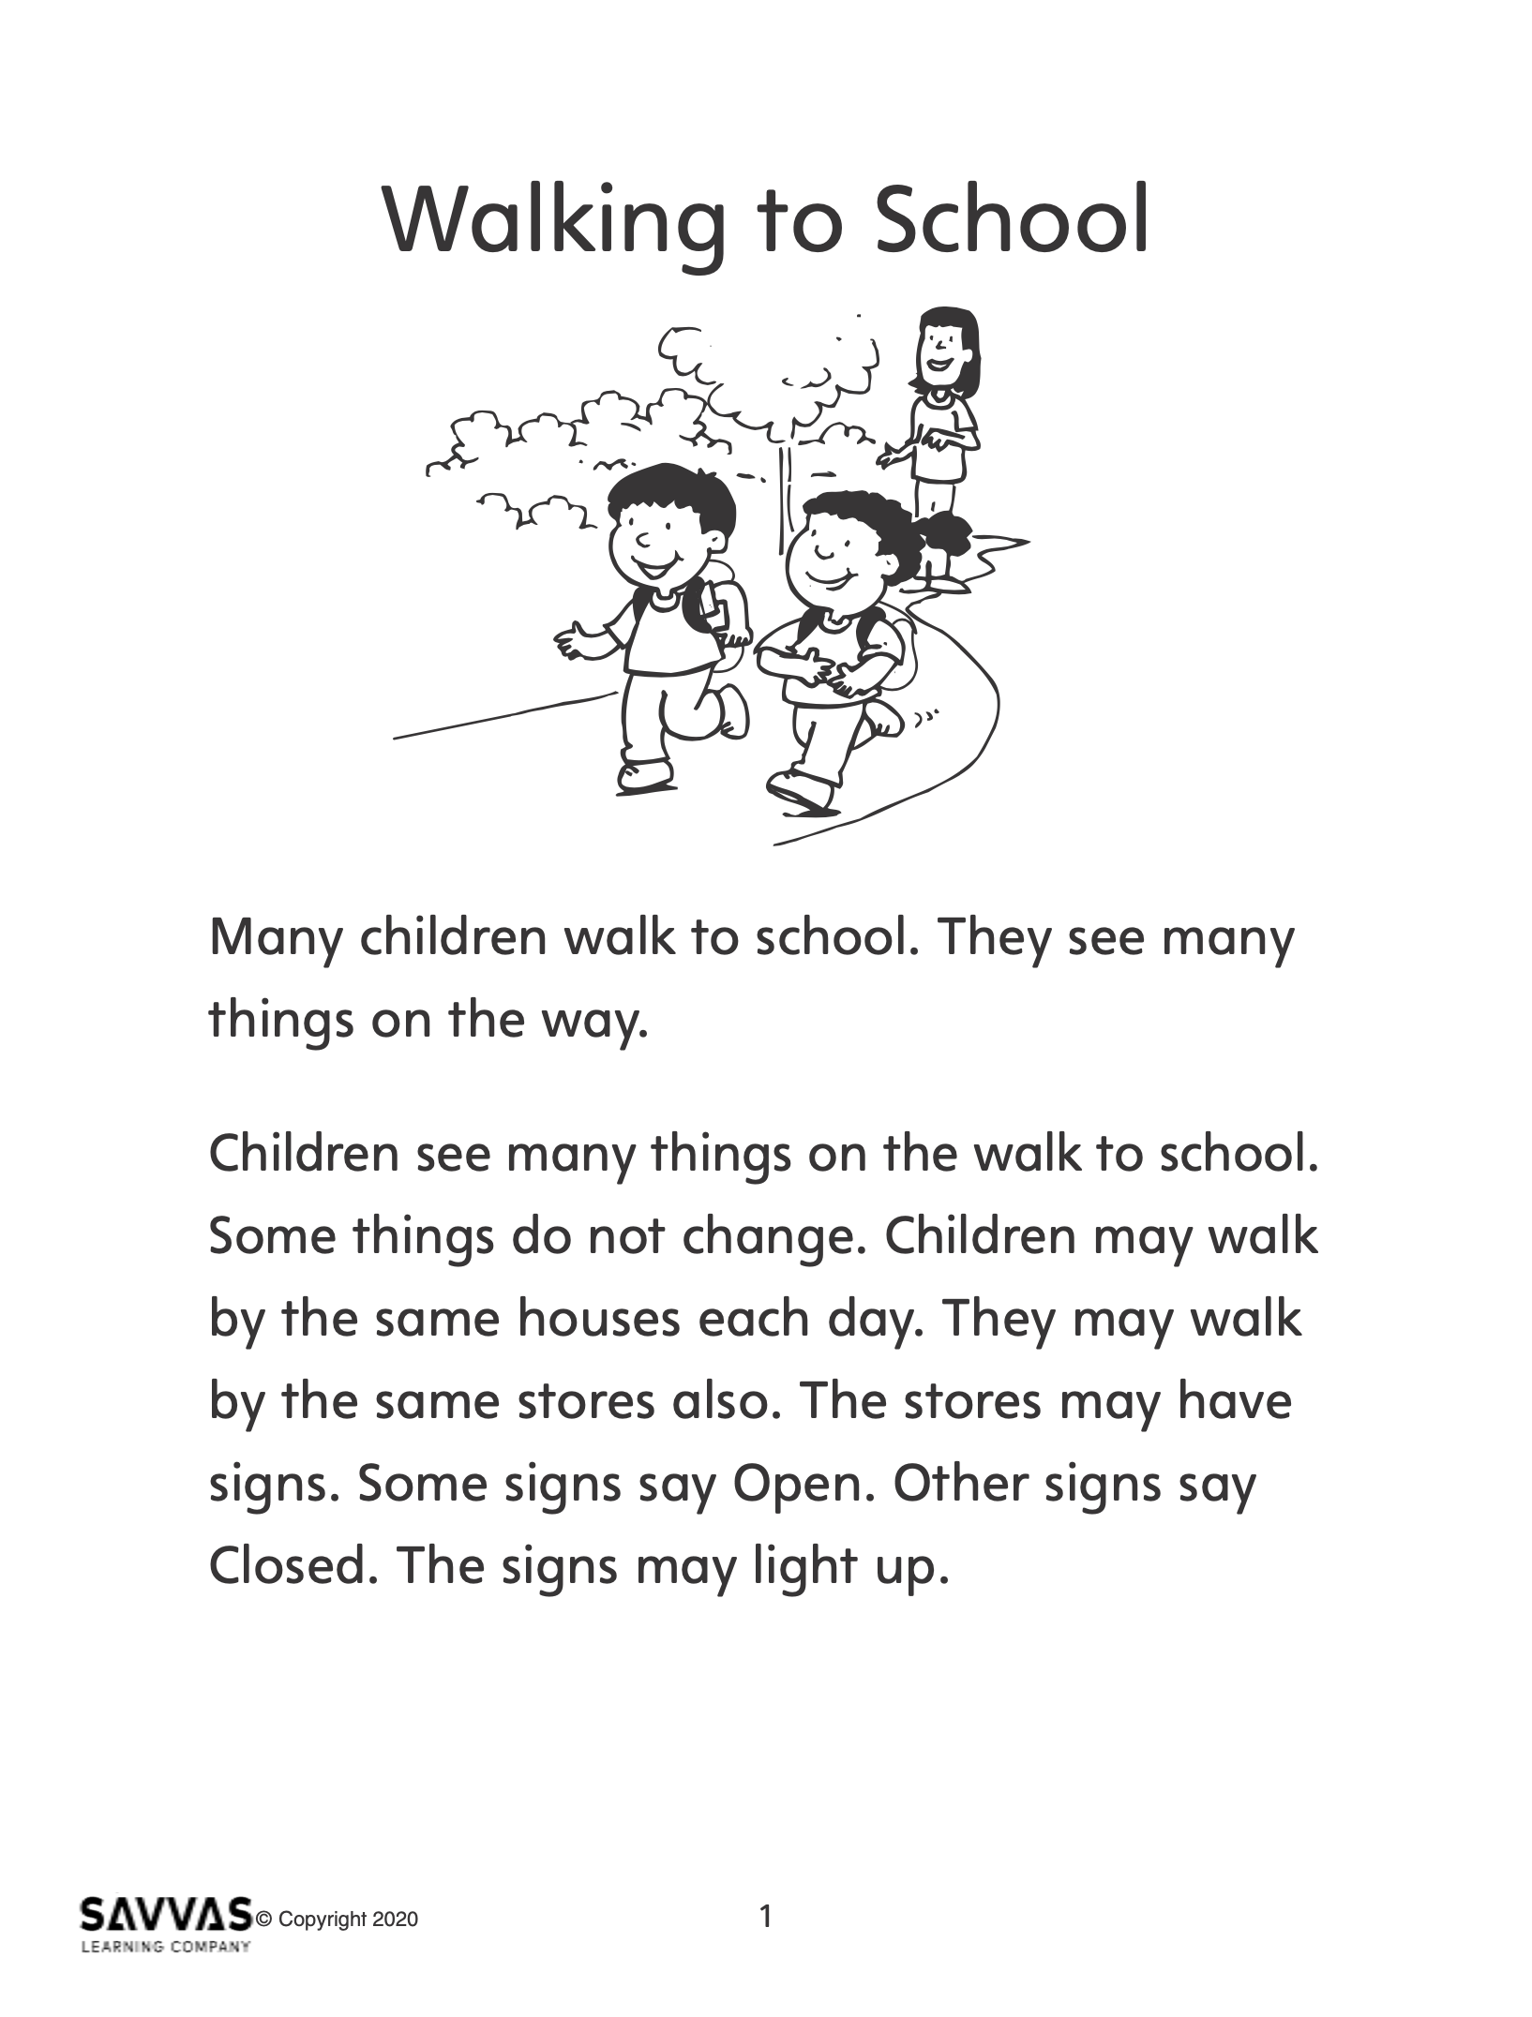
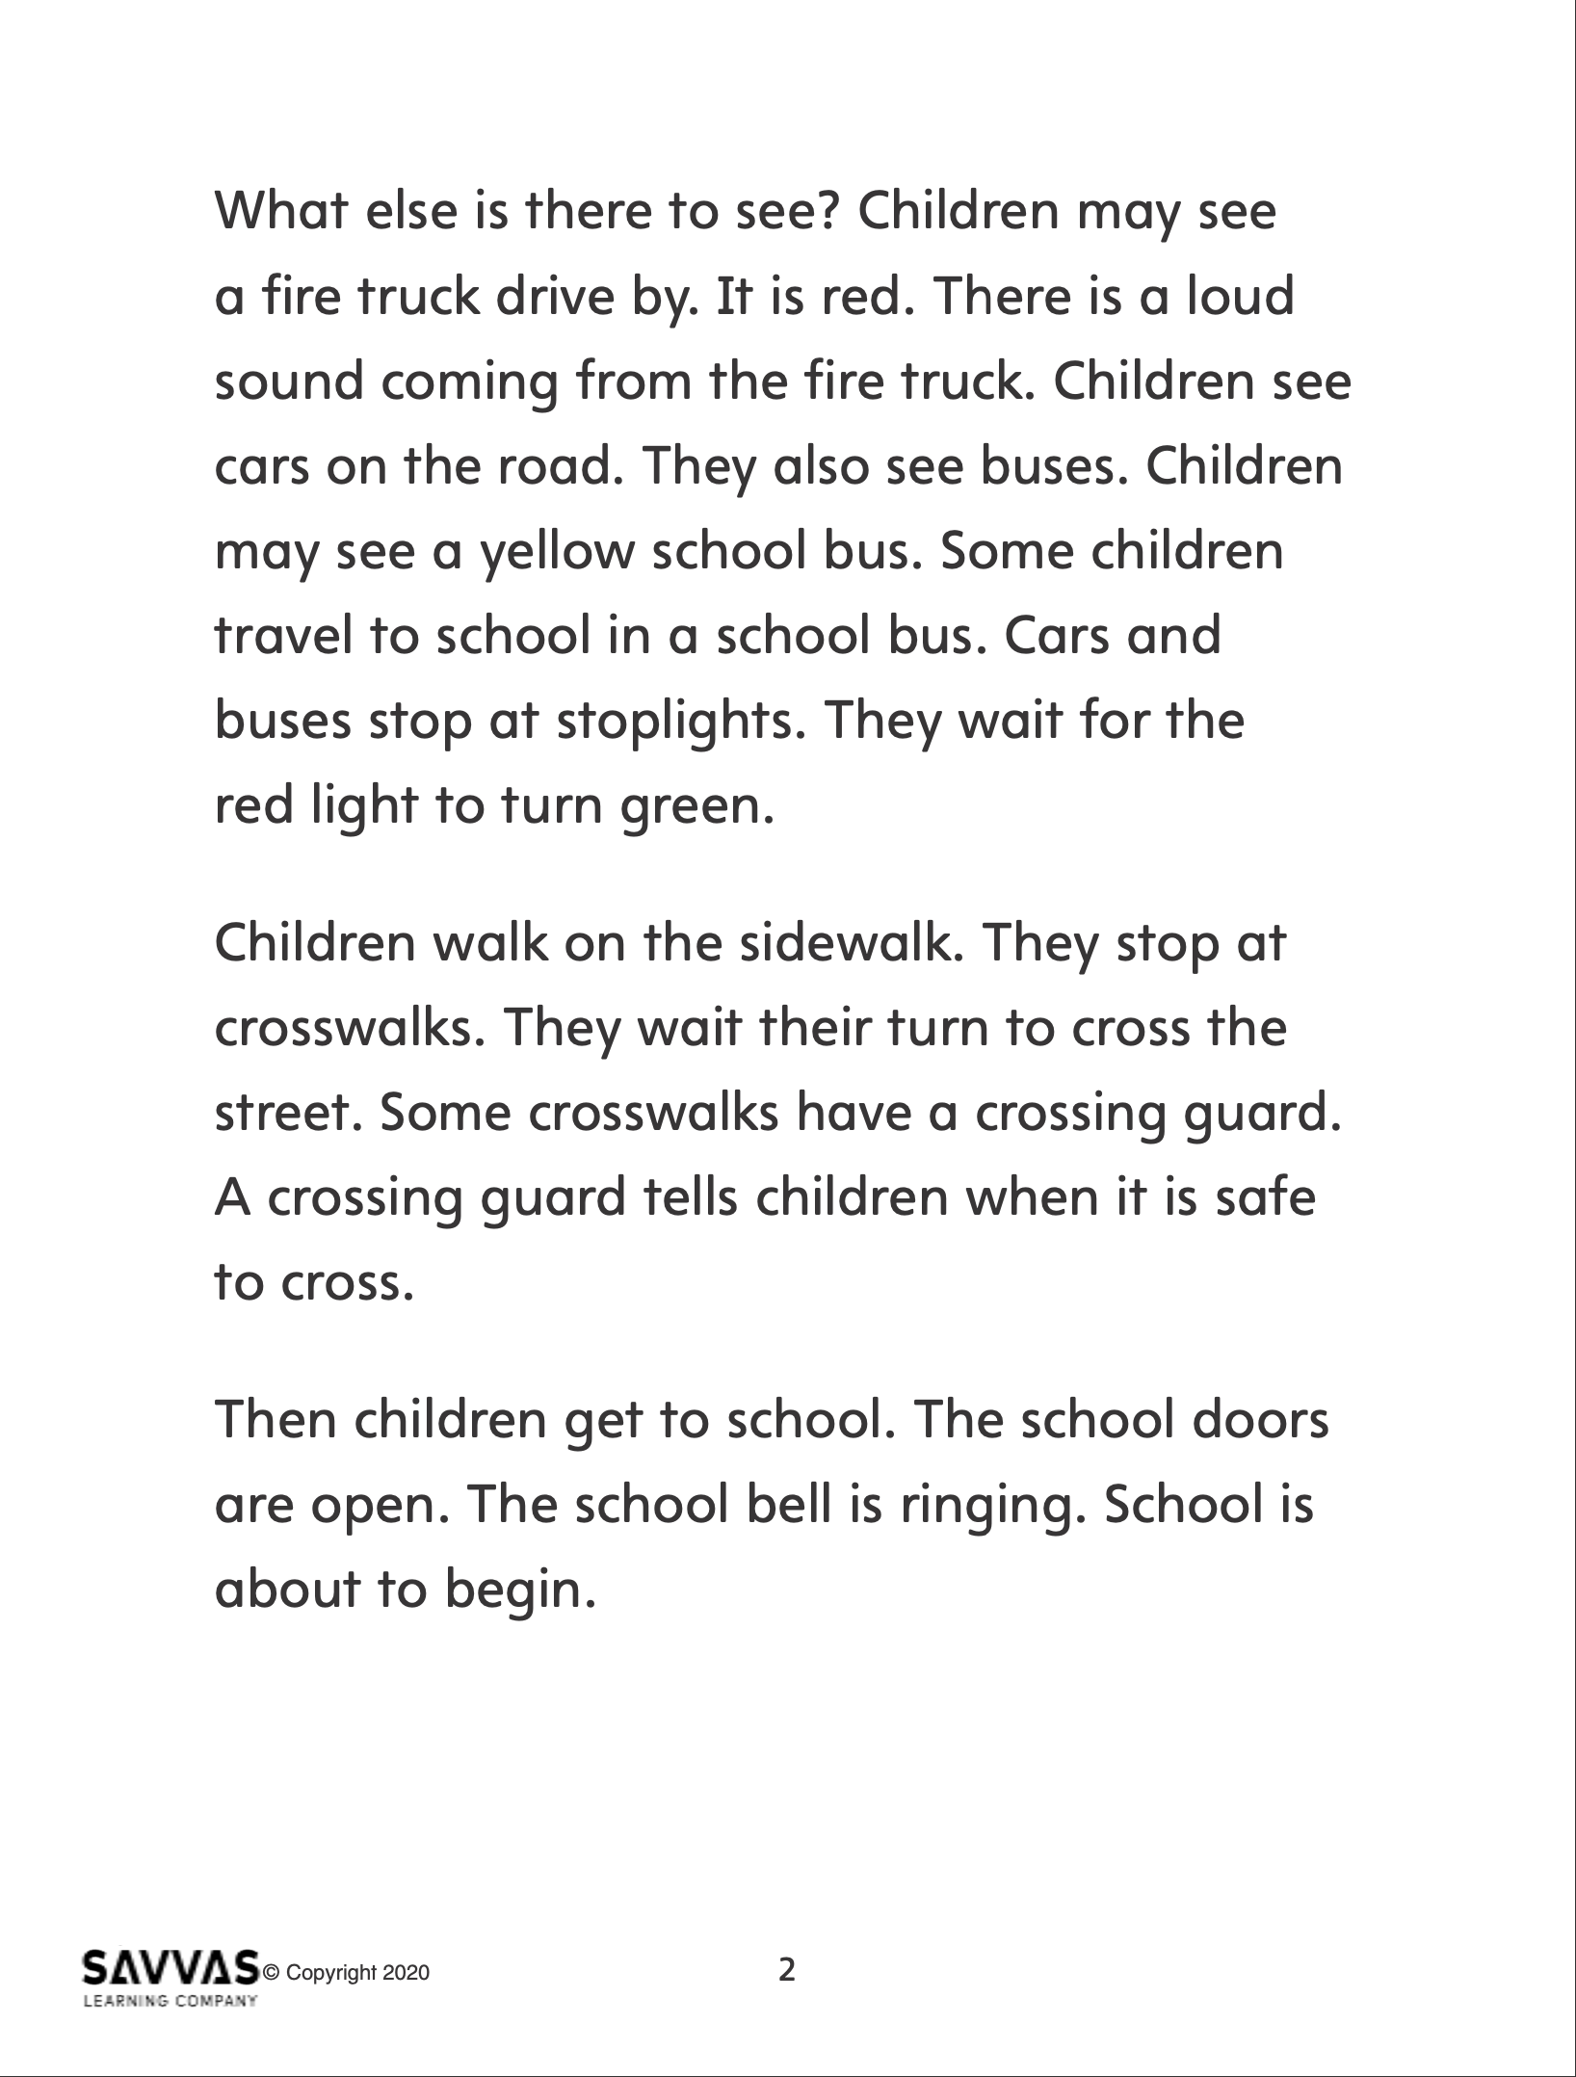
Explore and Plan – Informational Text
Listen to “Walking to School.”
Find the following:
The main, or central, idea.
Details that tell about the main idea.
Notes:
Use the article “Walking to School” to help students identify characteristics of informational texts.
Distribute copies of “Walking to School.” Click path: Table of Contents -> Unit 1: My Neighborhood -> U1 W6: Project-Based Inquiry -> U1 W6: Lesson 2
Note: This article is available at 3 different Lexile levels. The slide image is the middle range.
Explain to students that reading critically involves understanding why an author wrote a text. Read aloud “Walking to School” one paragraph at a time. Have students look for characteristics of informational texts. Write the following tasks on the board. Find the following: • the main, or central, idea • details that tell about the main idea

Slide 21
Page
226
Apply
Turn to p. 226 in your Student Interactive and complete the activity with a partner.
Notes:
After reading “Walking to School,” have students work with a partner to fill in the chart on p. 226 in the Student Interactive.
Ask students to find the main idea of the article and details that tell more about the main idea.

Slide 22
Check For Understanding
In your notebook, write or draw the main idea of your informational text with your partner.
Notes:
Check students’ understanding of informational texts by asking them to write or draw the main idea of their text before they continue with the Conduct Research page.
Explain to students that they should look back at this picture or statement to guide their research.

Slide 23
Page
227
Conduct Research
With your partner, discuss how you will use your source to gather information.
Notes:
Help students conduct research by providing articles, books, magazines, or other accessible print sources from the school library. Use the Model and Practice on print sources to help students identify and gather relevant information to answer their questions about a neighborhood worker. Remind students to use their questions to guide their research.
Use a relevant informational text to model the process for using print sources to answer inquiry questions. See the example below.
Say: Let’s learn about firefighters. First, I ask a question to focus my research: How do you become a firefighter?
Display an appropriate book or article about neighborhood workers. Say: This looks like a relevant source because the title (or cover picture) tells me that it has information about firefighters.
Use text features, such as a table of contents, an index, photographs, or headings, to find a page with details about firefighters. Say: I will quickly look for key words, such as firefighter and job.
Point to a sentence containing a fact about firefighters and read it aloud. Say: Here is a fact about firefighters: Firefighters have to take a test before they can become a firefighter. This fact answers my research question.
Have student pairs turn to p. 227 in the Student Interactive and circle the source where they will look for information to answer their questions about their neighborhood worker.
Ask pairs to work collaboratively to discuss how they can use the source to gather information.
Tell students to follow the rules for discussion, including listening to each other, speaking when recognized, and making appropriate contributions.

Slide 24
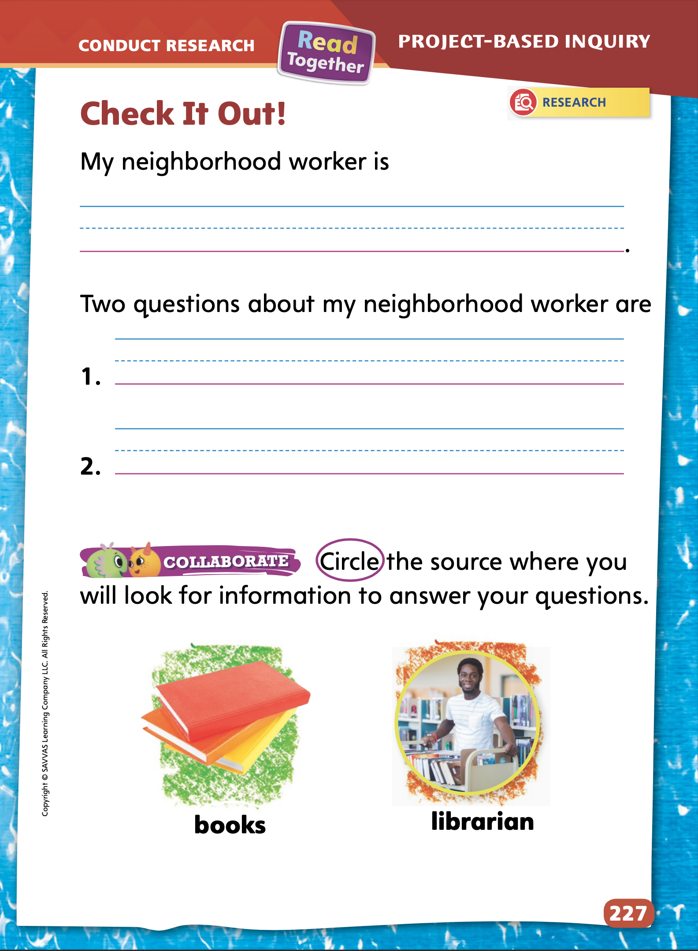
Page
227
Conduct Research
Turn to p. 227 in your Student Interactive.
Write which neighborhood worker you will write about.
Identify two questions you will ask in your research.
Notes:
Ask students to write the name of their neighborhood worker and their two questions before they begin researching.
Remind them that as they research, they should look only for information that answers their questions about their neighborhood worker.
Support students in using text features and scanning for key words as they research.
To provide differentiated support:
If students struggle to ask questions about a worker, have them create a T-chart in their notebooks. Have them label the left column “Know” and the right column “Don't Know.” Have students list facts they already know about their neighborhood worker in the left column and things they do not know in the right column. Have students reread the right column and select two items to use as questions for research.
Have students use a word web or a chart to organize information that they gather about their neighborhood worker.

Slide 25
Lesson 3

Slide 26
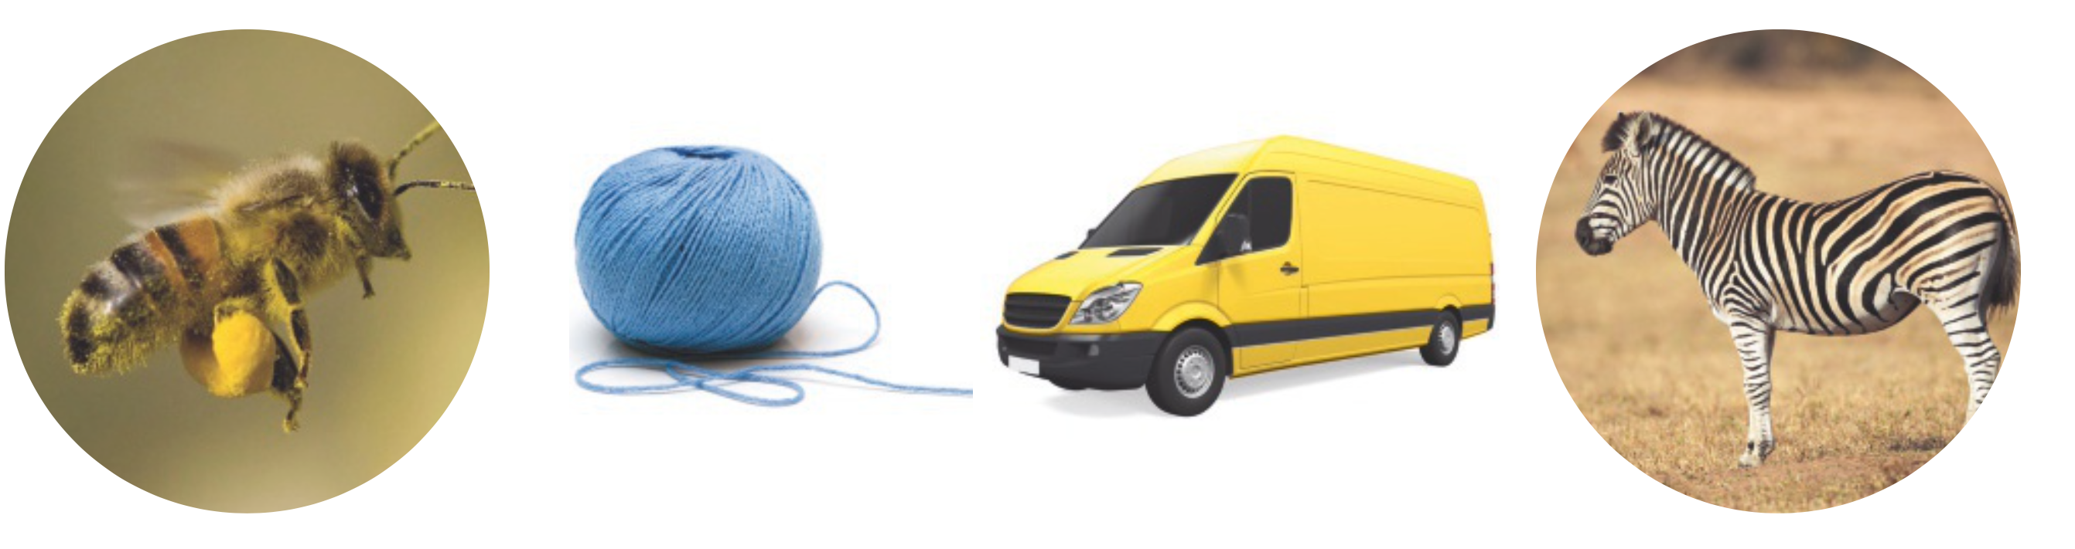
Page 216
Phonological Awareness
Notes:
Point to the picture of a bee on p. 216 in the Student Interactive. Say: The bee goes buzz. Listen closely to the sounds in the word buzz: /b/ /u/ /z/. What sound do you hear at the end of the word buzz? (/z/)
Point to the ball of yarn and have students name what they see. Ask students to identify the initial sound in the word yarn (/y/).
Repeat with the words van (/v/) and zebra (/z/).
Tell students that you will say a word and that they should give a thumbs-up if the word ends with the sound /z/. Say words such as quiz, yam, bell, fizz, snow, fuzz, and jazz.
Next say words that begin with the sounds /y/, /v/, and /z/ and ask students to name the initial sound in each word. Say words such as yip, vowel, zoo, voice, zipper, and yellow.

Slide 27
Page 216
Phonics
vet
yak
zip
Turn to page 216 in your Student Interactive and complete the activity.
Notes:
Write the letters Vv, Yy, and Zz on the board. Point to each letter and explain to students that the sound /v/ is spelled v, the sound /y/ is spelled y, and the sound /z/ can be spelled z.
Use Sound-Spelling Cards 25 (volcano), 28 (yo-yo), and 29 (zebra) to show students the letter sounds.
Point to the volcano and say: What sound does volcano begin with? What letter spells that sound? Repeat with y/y/ and z/z/.
Write or display the following words: vet, yak, zip. For each word, have students identify the first letter and then say the word.
Have students practice blending and decoding the words at the bottom of p. 216 in the Student Interactive.

Slide 28
Page 217
High-Frequency Words
for
go
here
me
where
Turn to page 217 in your Student Interactive and complete the activity.
Notes:
Write or display the high-frequency words for the week: for, go, here, me, where.
Write the word for on the board. Say: This is the word for. The letters in for are f, o, and r.
Ask students to say the word and spell it. Then continue with the remaining high-frequency words.
Then have students turn to p. 217 in the Student Interactive and identify and read the words at the top of the page.
Have students use this week’s high-frequency words to complete the sentences on p. 217 in the Student Interactive.

Slide 29
Spelling
b
i
l
l
q
t
u
w
Notes:
Help students recall that the sound /kw/ is spelled qu.
Distribute eight index cards to each student. Have students write the following letters on separate index cards: b, i, l, l, q, t, u, w.
Next have students work in pairs to arrange the letters to spell each spelling word.
Have students complete Spelling p. 34 from the Resource Download Center. Click path: Table of Contents -> Resource Download Center -> Spelling -> U1W6

Slide 30
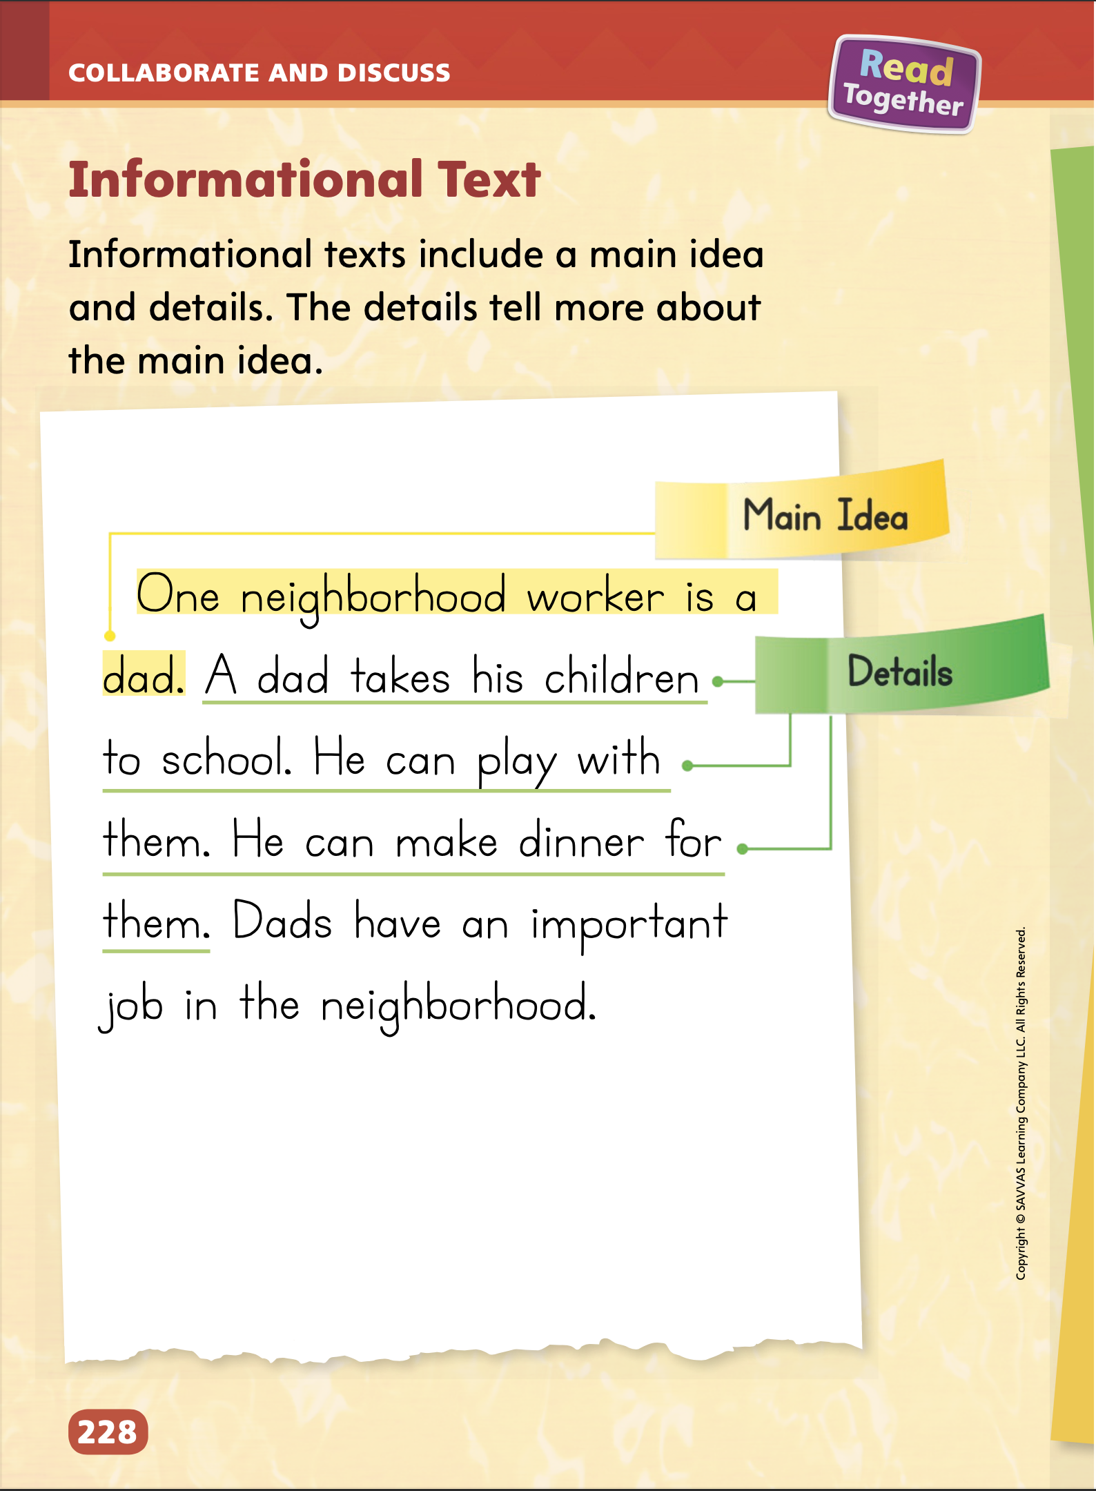
Page
228
Collaborate and Discuss
Turn to p. 228 in your Student Interactive.
Notes:
Explain that the student model has the characteristics of an informational text. Point out the structure of the student model: the main, or central, idea is stated first, and the sentences that follow are details supporting the main idea.
Use the student model on p. 228 in the Student Interactive to model the characteristics of informational text. Say: The main, or central, idea is the first sentence of the text. The author tells which neighborhood worker he or she will write about. Then the author tells details about the main idea in the following sentences. What is another detail you could add that tells more about the main idea?
Invite students to tell additional details that relate to the main idea.

Slide 31
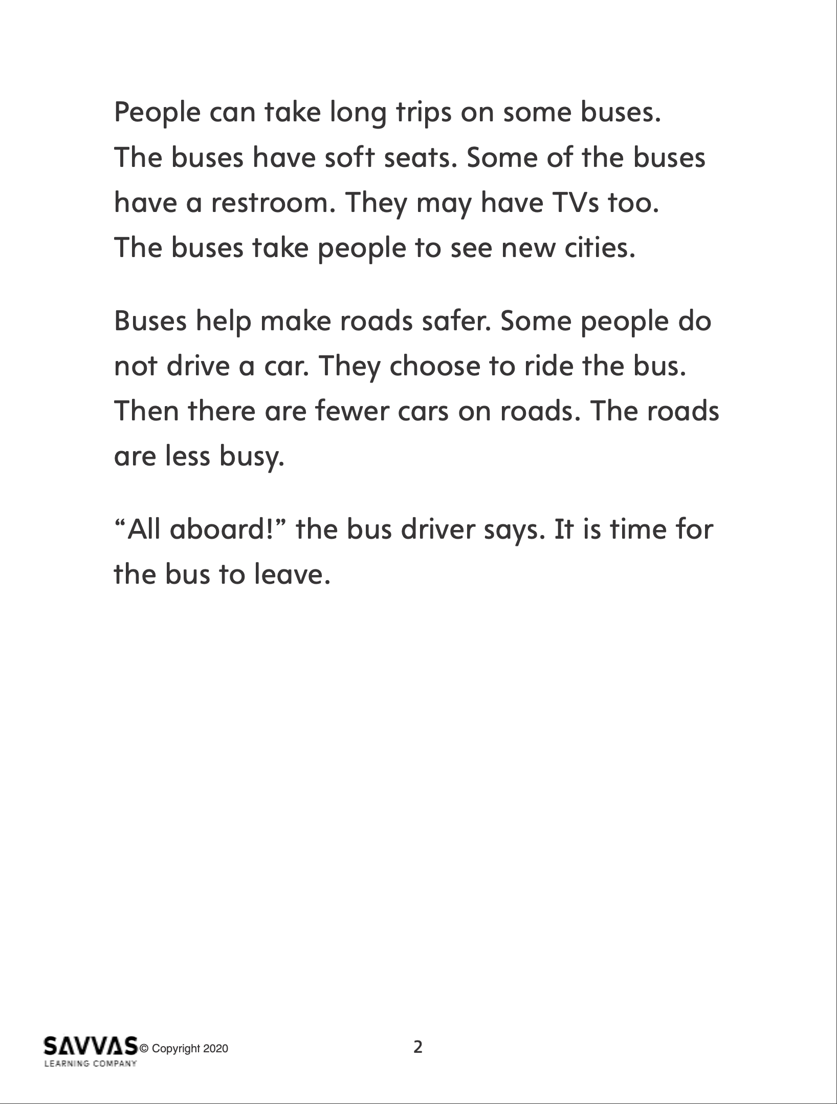
Collaborate and Discuss – Author’s Purpose
Read “All Aboard the Bus” with a partner.
Share something interesting you learned.
Explain whether you agree with the author’s opinion.
Notes:
Distribute copies of “All Aboard the Bus.” Click path: Table of Contents -> Unit 1: My Neighborhood -> U1 W6: Project-Based Inquiry -> U1 W6: Lesson 3
Note: This article is available at 3 different Lexile levels. The slide image is the middle range.
Use the research article to help students discuss the reasons why authors write.
Have pairs take turns orally reading a paragraph at a time. Students should pause to determine why the author wrote this article. Have them take notes on clues about the author’s purpose.
Write the following tasks on the board. Have students complete the tasks as they discuss the author’s purpose.
Share something interesting you learned.
Explain whether you agree with the author’s opinion.
Encourage students to use the information in their articles.

Slide 32
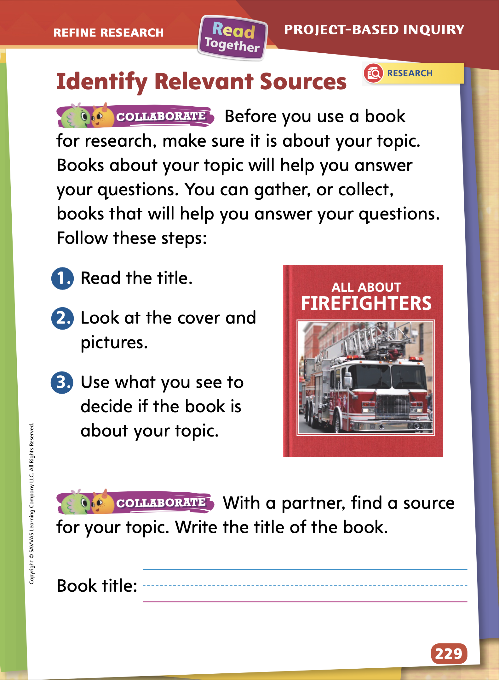
Page
229
Refine Research
Turn to p. 229 in your Student Interactive and complete the activity.
Begin writing your informational text. Be sure to start with your main idea.
Notes:
Before students start writing their informational texts, assist them by modeling how to identify and gather, or collect, relevant sources to answer the questions they have about their topic.
Select a book about a neighborhood worker. Read aloud the title and tell what you see on the cover. Flip through the book and tell what the pictures show. \Explain whether the title and pictures relate to your topic.
Then ask partners to gather, or collect, books or magazines from the class library and identify a source that is relevant to their topic. If they can use the source to answer their questions, have them write the title of the book on p. 229 in the Student Interactive. Provide assistance as needed.
Check in with student pairs as they write their informational texts. Offer support if students are struggling.
Point out that the main, or central, idea should guide the body of the text. Model stating a main idea and one or two supporting details, such as Firefighters are important neighborhood workers. They keep the neighborhood safe. They help put out fires. They help if there is an accident.

Slide 33
Lesson 4

Slide 34
Page 218
Phonics
v
y
z
z a p
_ u m
_ e t
qu i _
_ e s
Turn to page 218 in your Student Interactive.
Notes:
Write the letters v, y, and z on the board. Review the sounds each letter spells by pointing to the letter and saying its sound.
Help students practice the sound-spelling correspondences of /v/ spelled v, /y/ spelled y, and /z/ spelled z by using the following grid.
Point to and read the word zap. Have students repeat the word.
Point to the blank space in _um. Ask: What letter could go in the blank to make the word you say when you eat food that tastes really good? (y) Write y on the line and say the word yum, emphasizing the sound /y/.
Ask students to say the word with you. Then continue by asking students to write the letters on the lines to create new words to answer the following questions:
Who can help my pet when it is sick? (vet)
What is something you study for? (quiz) What is the opposite of no? (yes)
Have partners practice blending and reading the words at the top of p. 218 in the Student Interactive.

Slide 35
Page 218, 219
Apply
Turn to pp. 218-219 in your Student Interactive and complete the activities.
Notes:
Have students complete the rest of pp. 218–219 in the Student Interactive.

Slide 36
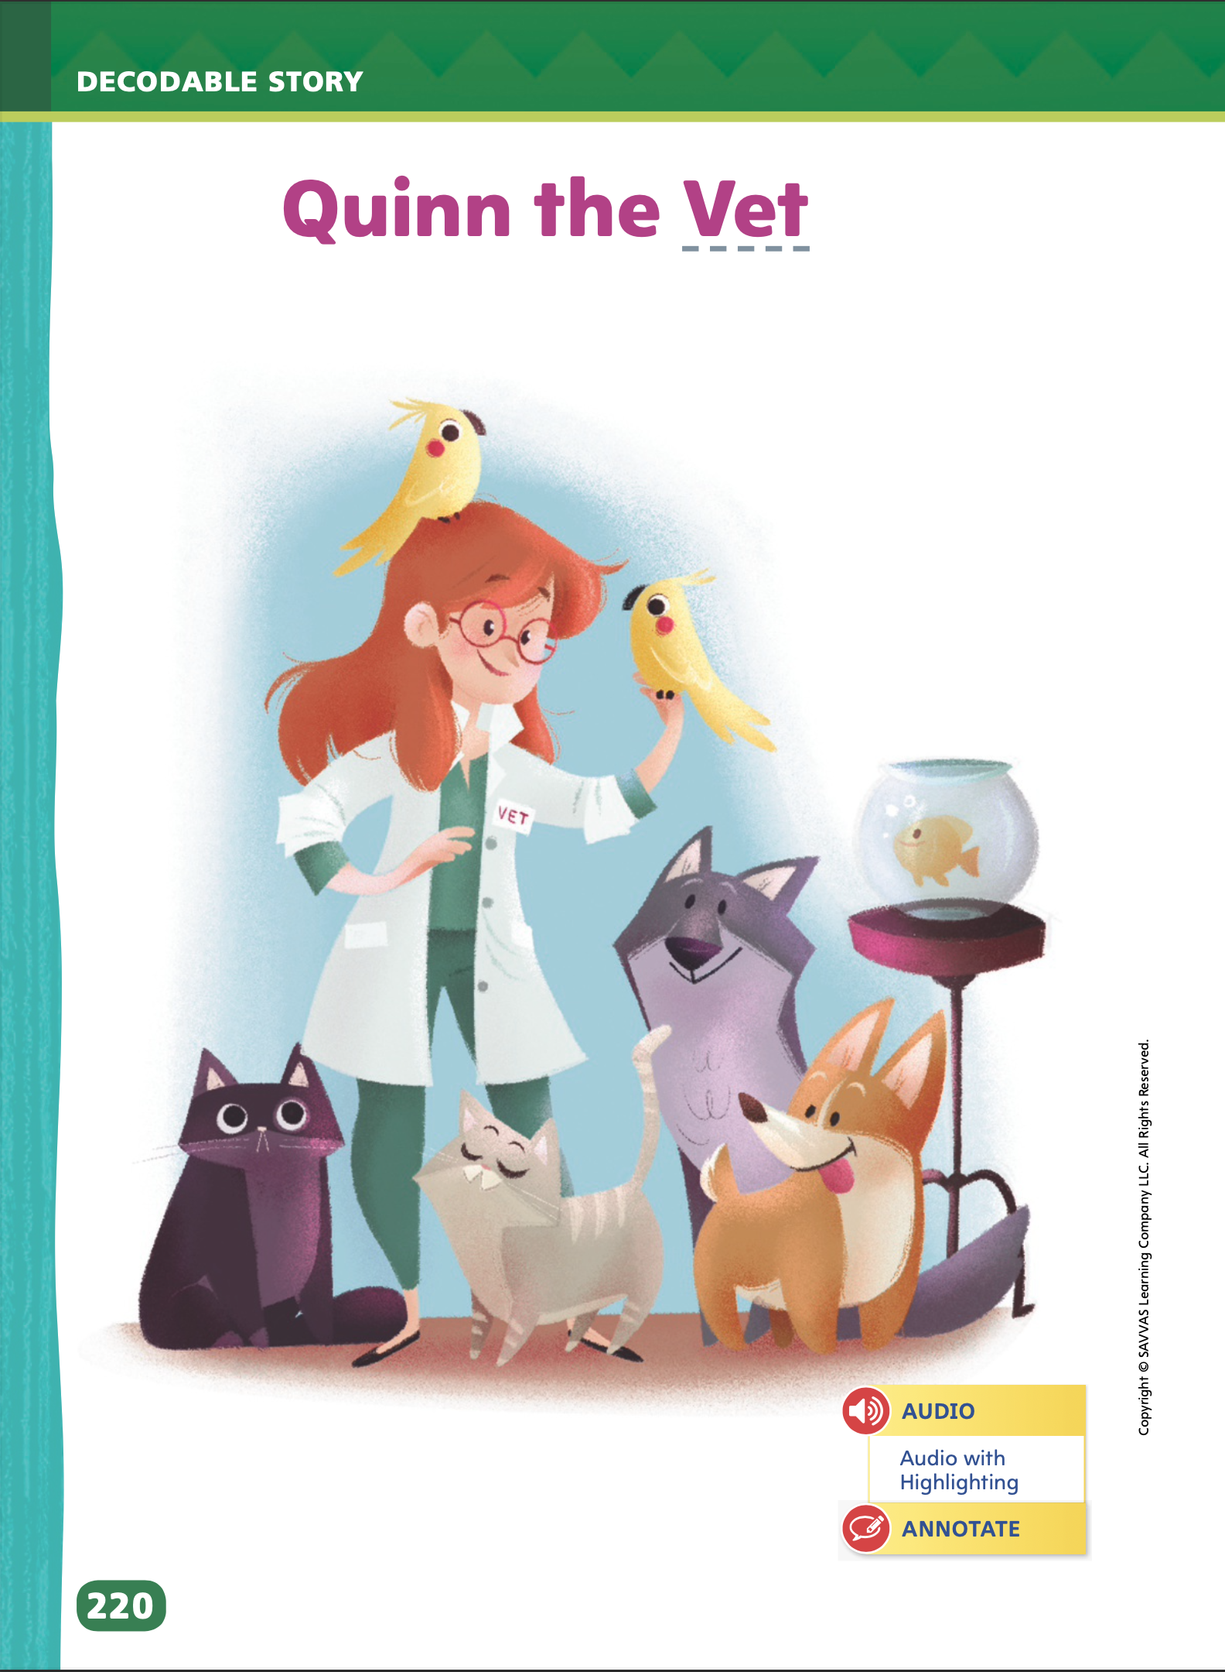
Page 220
Decodable Story
Turn to page 220 in your Student Interactive. Read “Quinn the Vet” with your partner.
Notes:
Have students turn to p. 220 in the Student Interactive. Say: We are going to read a story today about a vet named Quinn. A vet takes care of animals.
Point to the title of the story. Say: The title of the story is Quinn the Vet. I hear the sound /kw/ in the word Quinn. What letters in Quinn spell the sound /kw/? Right! The letters qu spell the sound /kw/. We will read other words with the sound /kw/ spelled qu, the sound /v/ spelled v, and words that begin with the letter z in our story.
Before reading, review this week’s high-frequency words: for, go, here, me, where.
Tell students that they will practice reading these words in the story Quinn the Vet. Display the words. Have students read them with you. Say: When you see these words in today's story, you will know how to read them.
Call students’ attention to the title on p. 220. Say: I see the letter v in the word Vet. What sound does the letter v make? Students should say the sound /v/ is spelled with the letter v. Have students decode the word Vet.
Pair students for reading and listen carefully as they use letter-sound relationships to decode. One student begins. Students read the entire story, switching readers after each page. Partners reread the story. This time the other student begins.

Slide 37
Page 221
Decodable Story
Turn to page 221 in your Student Interactive. Read “Quinn the Vet” with your partner.
Notes:
Then have them identify the two words with the sound /v/ on p. 221 and underline the three words on these two pages that start with the letter v.
Students may also underline the word Vet in the illustration.

Slide 38
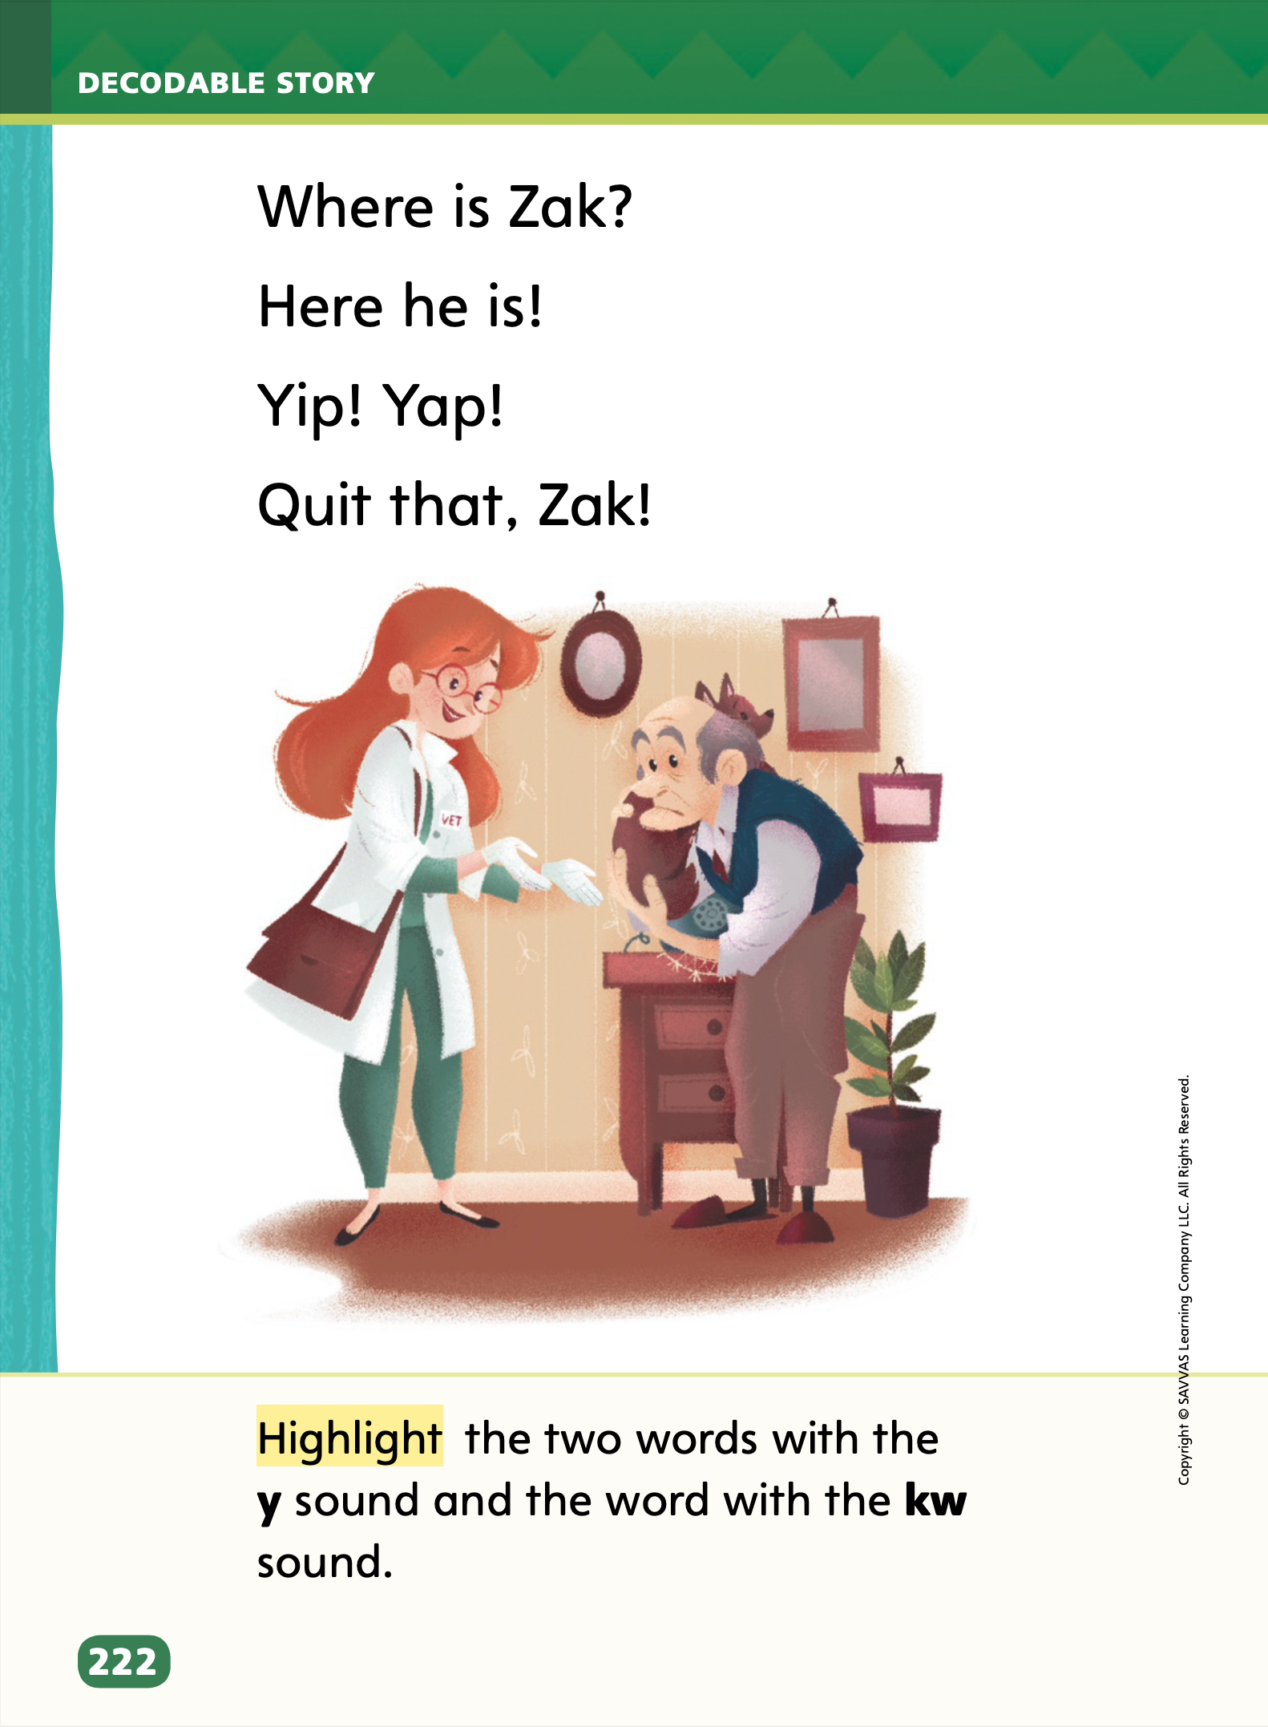
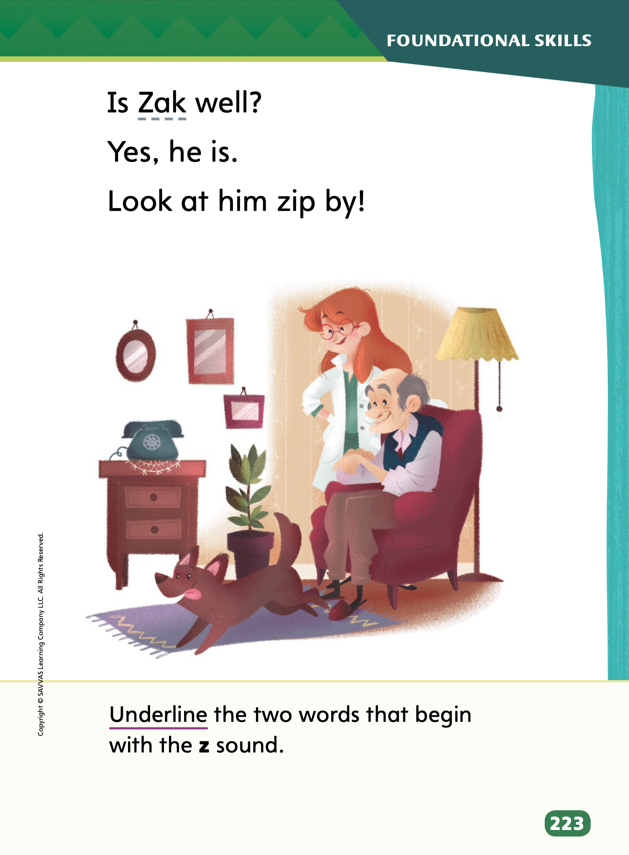
Page 222, 223
Decodable Story
Turn to pp. 222-223 in your Student Interactive. Read “Quinn the Vet” with your partner.
Notes:
Have students turn to p. 222. Ask: Which words have the sound /y/? Students should supply the words Yip and Yap.
Say: What letter spells the sound /y/ in Yip and Yap? Students should say the sound /y/ is spelled with the letter y.
Ask: Which letters spell the sound /kw/ in quit? Students should say the sound /kw/ is spelled with the letters qu.
Have them highlight the words with the sound /y/ and sound /kw/.
Have students turn to p. 223. Ask: Which words begin with the sound /z/? Students should supply the words Zak and zip.
Ask: Which letter spells the sound /z/ in Zak and zip? Students should say the sound /z/ is spelled with the letter z.
Have them underline the words with the sound /z/.

Slide 39
Spelling
rug
fun
nut
sun
but
hug
cup
pup
Work with a partner to match the words that rhyme.
Notes:
Review the previous spelling skill: short u spelled u
On the board, write these words with short u: rug, fun, nut, sun, but, hug, cup, pup. Have students read them aloud.
Pair students and have them work together to match the words that rhyme. (rug/hug, fun/sun, nut/but, cup/pup)
As students proofread their writing, remind them to check their spelling, including spelling words with short u.

Slide 40
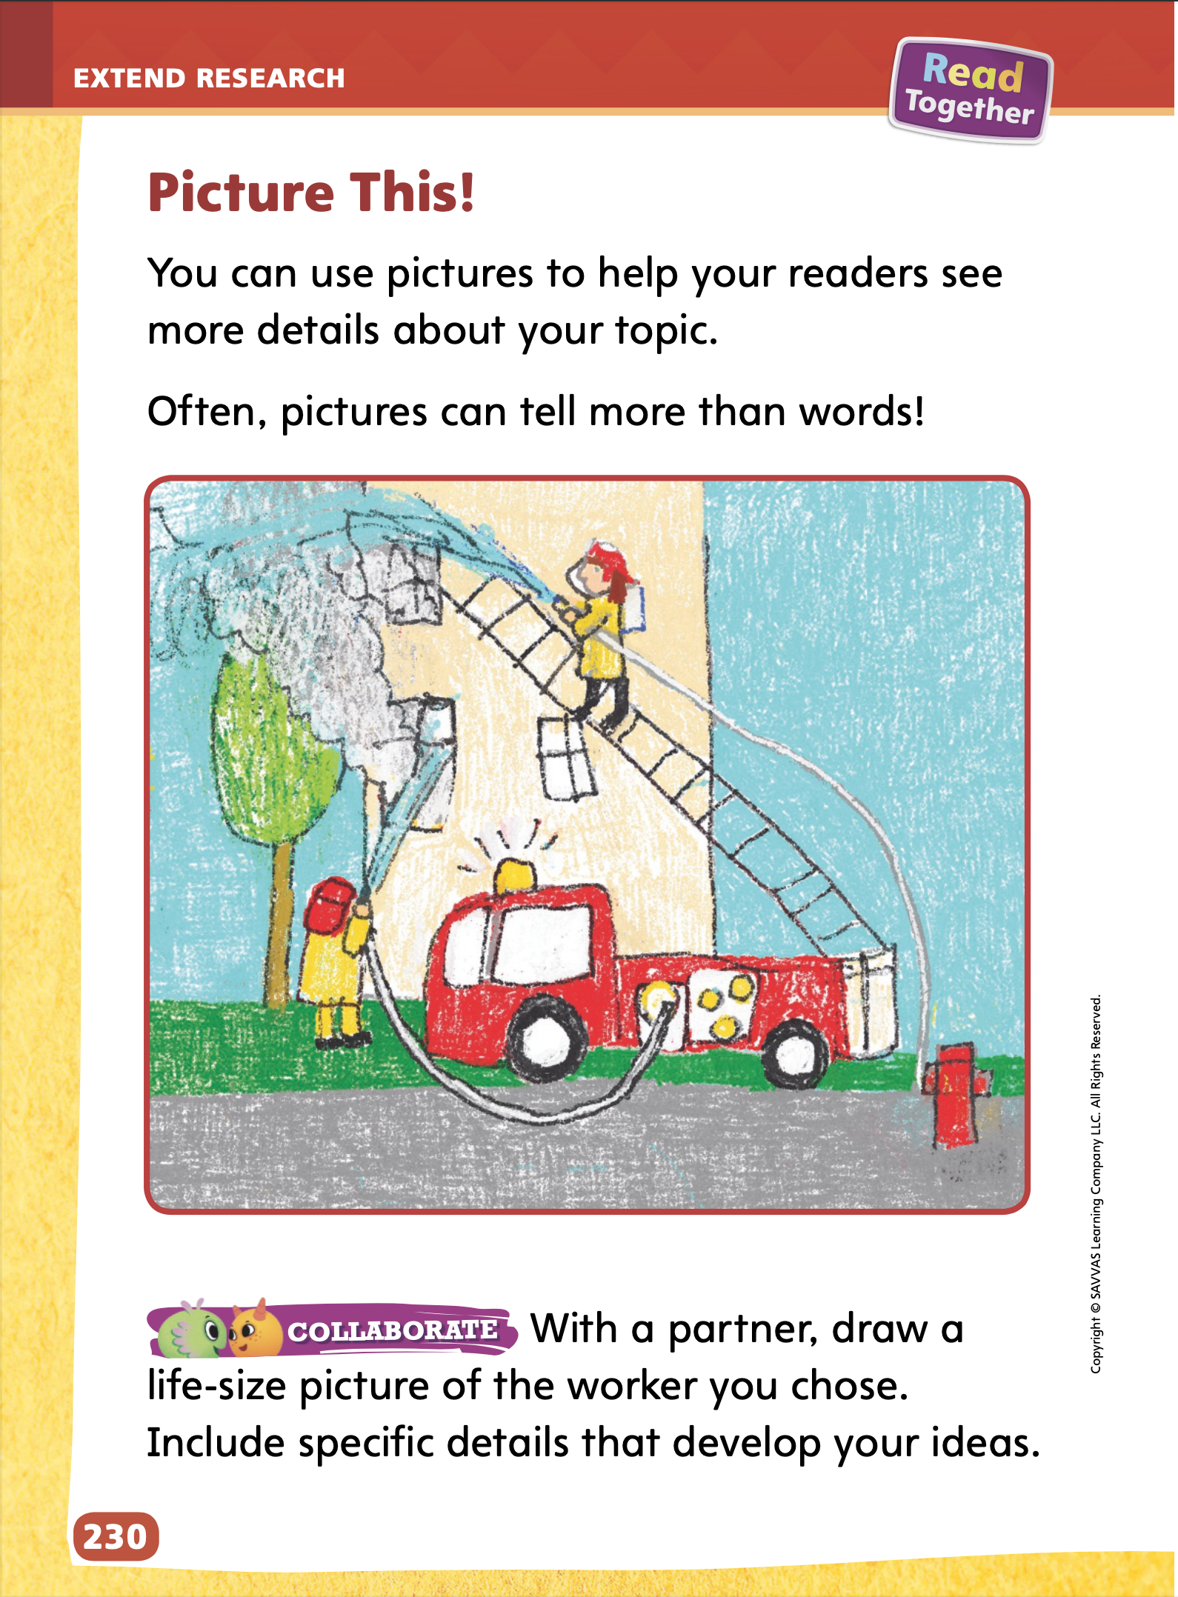
Page
230
Extend Research – Incorporate Media
Turn to p. 230 in your Student Interactive and complete the activity.
Notes:
Before students revise and edit their texts, have them draw a life-size version of their worker. Provide butcher paper and crayons or markers for students to draw their life-size pictures. They will share the picture with the class when they read their informational texts aloud.
Encourage students to add specific and relevant details from their research, such as tools used or uniforms worn by the worker.
If students struggle to begin a drawing, guide them in finding an appropriate photograph from a book or magazine to use as inspiration.

Slide 41
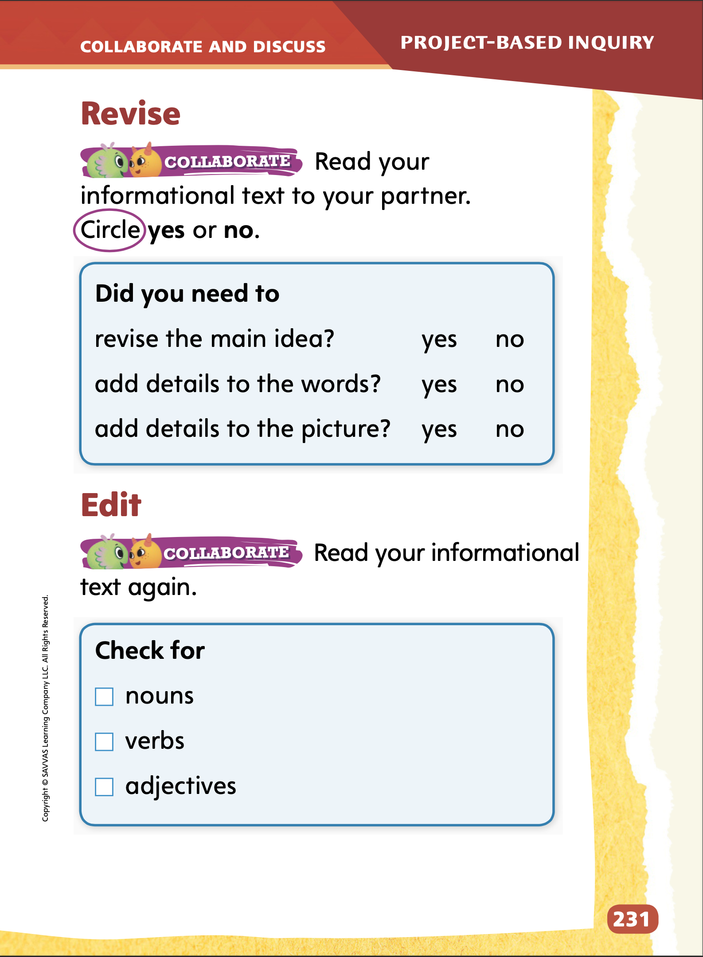
Page
231
Collaborate and Discuss
Turn to p. 231 in your Student Interactive and complete the activity with a partner.
Notes:
Set aside time for students to read their informational text aloud to a partner.
Explain that this is the time for them to review their drafts and make any revisions, or changes. Have students use the checklists on p. 231 in their Student Interactive to evaluate their informational texts and share feedback. They should circle “yes” or “no” to respond to each item. If students responded “no” to any items on the checklist, they should work together to revise their drafts by adding details in the picture or words.

Slide 42
Apply
Edit your informational text by adding details to sentences like nouns, verbs, and adjectives.
Write a clean, edited, final copy of your informational text.
Notes:
Students will edit their texts by adding details to sentences.
Write sentences from the student model on the board. Add details, such as adjectives, or replace words with more descriptive nouns or verbs.
Model each edit and explain how and why you are adding details or replacing nouns and verbs.
Then have student pairs edit their informational texts.
As students revise and edit their informational texts, remind them to add details that will engage the audience and help the audience understand the topic. Students should evaluate their facts and details by asking questions, such as Do readers need to know this fact to understand my main, or central, idea? Is this detail interesting?
To provide differentiated support:
If students struggle to revise their informational texts, have them annotate their texts using the checklist. Ask students to circle their main idea. Then have students underline and number each detail. Ask: Do you have a clear main, or central, idea? Does the first detail tell more about the main idea? Continue questioning students in this manner until students answer “no.” Then support students in fixing the sentence that needs revision.
Students who can easily revise and edit their informational texts can extend their project by adding more facts and descriptive details. Encourage students to use additional facts and details or incorporate new vocabulary words in their project.
Remind students that they should finish dictating or writing their informational texts so they can present their texts to the class the next day. If students finish early, have them take turns practicing reading their informational texts aloud to a partner.

Slide 43
Lesson 5

Slide 44
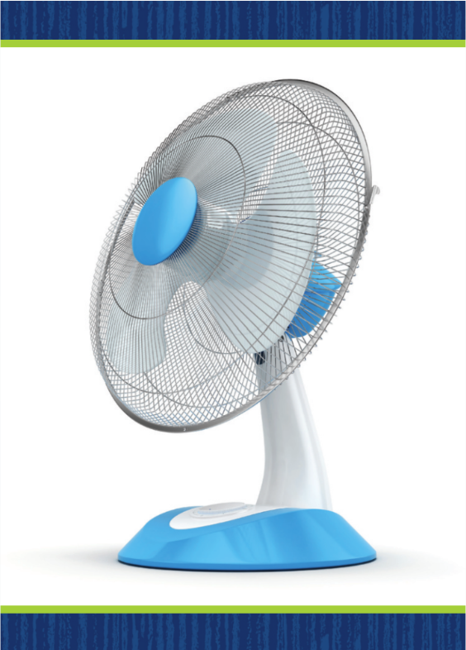
Phonological Awareness
Notes:
Display the fan Picture Card. Model changing the initial phoneme from /f/ to /p/ to make the word pan.
Model adding the phoneme /t/ to the end of pan to make the word pant.
Then model removing the phoneme /p/ from pant to make the word ant.
Display the Picture Card cap. Say: Change the middle sound from /a/ to /ā/. What new word do you have? Students should reply cape.
Say: Remove the first sound from cape. What new word do you have? Students should reply ape.
Say: Now, add the sound /t/ to the beginning of ape. What new word do you have? Students should reply tape.
Continue the activity, having students add, delete, and change phonemes. Use the words net (night, kite, kit); man (mane, rain, train); and cat (rat, rate, crate).

Slide 45
Phonics
Rr
Ww
Jj
Kk
rag
jam
kit
win
jet
rug
Kent
wet
Notes:
Write the letters Rr, Ww, Jj, and Kk on the board.
Point to Rr and tell students that this letter spells the sound /r/. Read words that begin with the sound /r/, such as run, rip, and rat.
Have students read each word and identify which letter spells the sound /r/.
Then review the sound for the following letters as you point to them: /w/ spelled w, /j/ spelled j, and /k/ spelled k. Remind students that the letters make the same sound whether the letter is lowercase or uppercase.
Write the following words: rag, jam, kit, win, jet, rug, Ken, wet. Have students read each word, identify the initial sound, and name the letter that spells it. Tell students to sort the words by their initial sound.
Have students think of other words that begin with the sounds /r/, /w/, /j/, or /k/. Ask them to make a list of as many words as they can.
Then ask for volunteers to share their words and create a master list on the board.
Have students spell each word that is added to the list.

Slide 46
High-Frequency Words
for
go
here
me
where
Notes:
Explain that high-frequency words are words that students will hear and see over and over in texts.
Write the words for, go, here, me, and where.
Have students work with a partner.
One student spells a word.
The other student says the word.
Repeat.

Slide 47
Spelling
I do not want to quit now.
Who will come to our party?
The carrot crunched when I bit it.
They signed the paper with a quill.
The cars go fast on the road.
Please tell me where my dog is.
Notes:
(Note: Move the orange boxes to cover each bold spelling word before you read aloud the words and sentences.)
Read aloud the words and sentences. Have students spell the words with the sound /kw/, the other spelling words, and the two high-frequency words.
I do not want to quit now.
Who will come to our party?
The carrot crunched when I bit it.
They signed the paper with a quill?
The cars go fast on the road.
Please tell me where my dog is.
Reveal the spelling word and have students check their work.

Slide 48
Page
232
Celebrate and Reflect
Turn to p. 232 in your Student Interactive.
Present your informational text to your classmates as you follow the rules for speaking and listening.
Notes:
Explain to the class that student pairs will share their informational texts. Discuss appropriate modes of delivery, such as reading aloud or presenting the writing digitally.
Suggest that pairs take turns reading one sentence at a time as they present their text.
Point to the rules for speaking and listening on p. 232 in the Student Interactive. Tell students that they will listen actively as other students present. Say: I listen actively by looking at the speaker and paying attention until the speaker is finished. I stay quiet as the speaker talks.
Remind students that they should wait to ask questions until after the presentation is finished. When they ask and answer questions in a collaborative group setting, students should follow agreed-upon rules for discussion, including speaking when recognized and making appropriate comments. Say: When I have a comment or question, I raise my hand and wait until it is my turn to speak. I make sure the comment or question I have is appropriate, or on topic.
Explain that students should speak clearly at an appropriate pace. Say: When we present our informational texts, we speak clearly by pronouncing words correctly and emphasizing words or phrases that are important. We do not speak too fast or too slow. We want to make sure everyone can understand us.
Have students share their informational texts. Tell them to speak clearly at an appropriate pace when sharing ideas and information.
Have students draw pictures that they can share to help explain their thoughts in their writing.

Slide 49
Page
232
Celebrate and Reflect
Turn to p. 232 in your Student Interactive and complete the activity.
Notes:
Guide students to complete the sentences at the bottom of p. 232 in the Student Interactive.
Model answering the questions. Say: The source that helped me most is the book about firefighters. The hardest part of research is finding a just-right book.
Give students time to think about both their successes and struggles during their research activities. Prompt them with questions, such as Where did you find information for your project? or Which was easier: finding information, or writing about it?
Then have students write their responses.

Slide 50
Page
233
Reflect on the Unit
Turn to p. 233 in your Student Interactive and complete the activities.
Notes:
With students, review the Unit Goals page at the beginning of the unit. Have students reflect on their reading and writing skills. Direct students to rate themselves again to assess their progress.
Invite students to return to the Compare Across Texts section on pp. 210–211 in the Student Interactive to reflect on the unit’s reading.
Ask volunteers to briefly summarize each text. Ask other volunteers to tell how the text challenged them, such as This text had a lot of diagrams or There were a lot of words I did not know in this text.
Help students recount the writing they did in this unit. Ask students to reflect on their writing with prompts, such as Which type of writing did you most enjoy? Which writing from this unit was easiest for you to do? What do you like about writing stories? What do you like about writing informational texts?

Slide 51
Unit 1: Week 6
Grade 1

