Slide 1
Unit 1: Week 5
Grade 3

Slide 2
Copyright © Savvas Learning Company LLC. All Rights Reserved.
This publication is protected by copyright, and permission should be obtained from the publisher prior to any prohibited reproduction, storage in a retrieval system, or transmission in any form or by any means, electronic, mechanical, photocopying, recording, or otherwise. For information regarding permissions, request forms, and the appropriate contacts within the Savvas Learning Company Rights Management group, please send your query to:
Savvas Learning Company LLC, 15 East Midland Avenue, Paramus, NJ 07652
or
k12learningpermissions@savvas.com
myView Literacy® is an exclusive trademark of Savvas Learning Company LLC in the U.S. and/or other countries.

Slide 3
Lesson 1

Slide 4
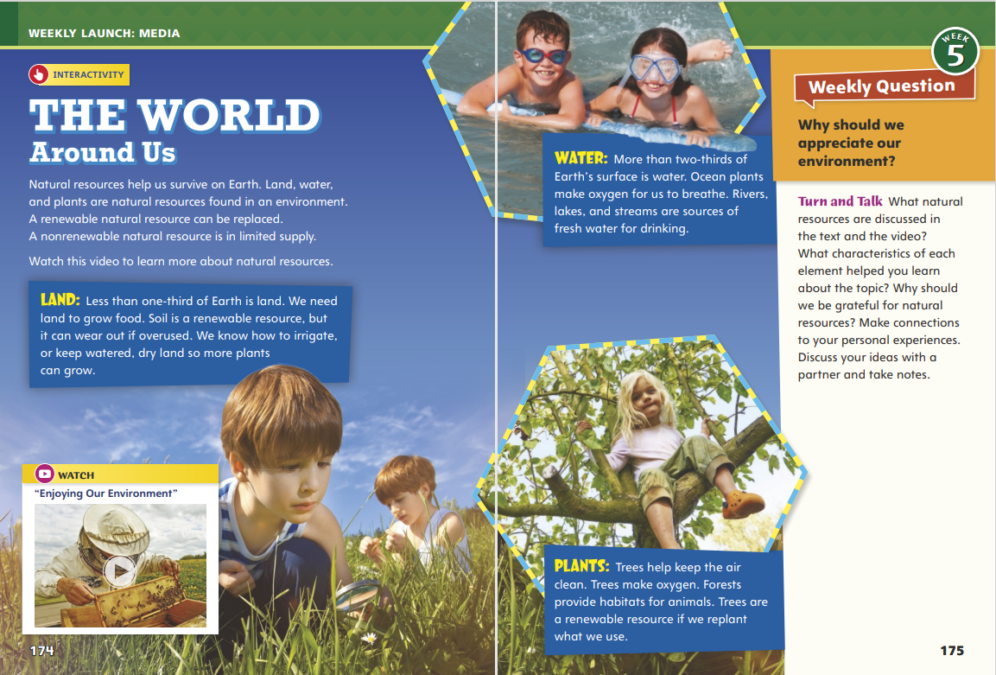
Page 174, 176
Interact with Sources
Discuss with a partner:
What natural resources are discussed in the text and the video?
What characteristics of each element helped you learn about the topic?
Why should we be grateful for natural resources?
Notes:
Remind students of the Essential Question for Unit 1: How does our environment affect us? Point out the Week 5 Question: Why should we appreciate our environment?
Direct students' attention to the images on pp. 174–175 in the Student Interactive. Explain that media such as still images and videos provides additional information for the text. Have students read the text that goes with each image to learn about natural resources. Point out the differences between renewable and nonrenewable resources.
Use the following questions to guide discussion:
Why do some natural resources seem more valuable than others?
Which facts point to our responsibility to protect our natural resources?
What do the images suggest about appreciation of our natural resources?
Reread the Week 5 Question: Why should we appreciate our environment? Explain to students that they learned some reasons why they should appreciate their natural resources. Tell them that they will read about even more reasons to value resources this week.
Have students discuss the Turn and Talk question on Student Interactive p. 175 with a partner and then share their responses with the class.

Slide 5
Listening Comprehension
The Beaded Necklace
Cause | Effect
Ruby Bridges
Notes:
Tell students you are going to read an origin myth aloud. Have students listen as you read “The Beaded Necklace” aloud. Explain that students should listen actively, paying careful attention to the characters, plot, and purpose of the tale as you read, as well as to the descriptive language used. Prompt them to ask relevant questions to clarify information and to make pertinent comments.
Have students actively listen for elements of origin myths.
Read the entire text aloud without stopping for Think Aloud callouts.
Reread the myth aloud, pausing to model Think Aloud strategies related to the genre and the descriptive language in the myth.
Use the T-chart to follow Artemis and her actions. Ask: What caused Artemis to lie to Demeter? What was the effect of her lie? What caused Artemis to yank the necklace off Demeter? What was the effect? Use the chart to record student responses

Slide 6
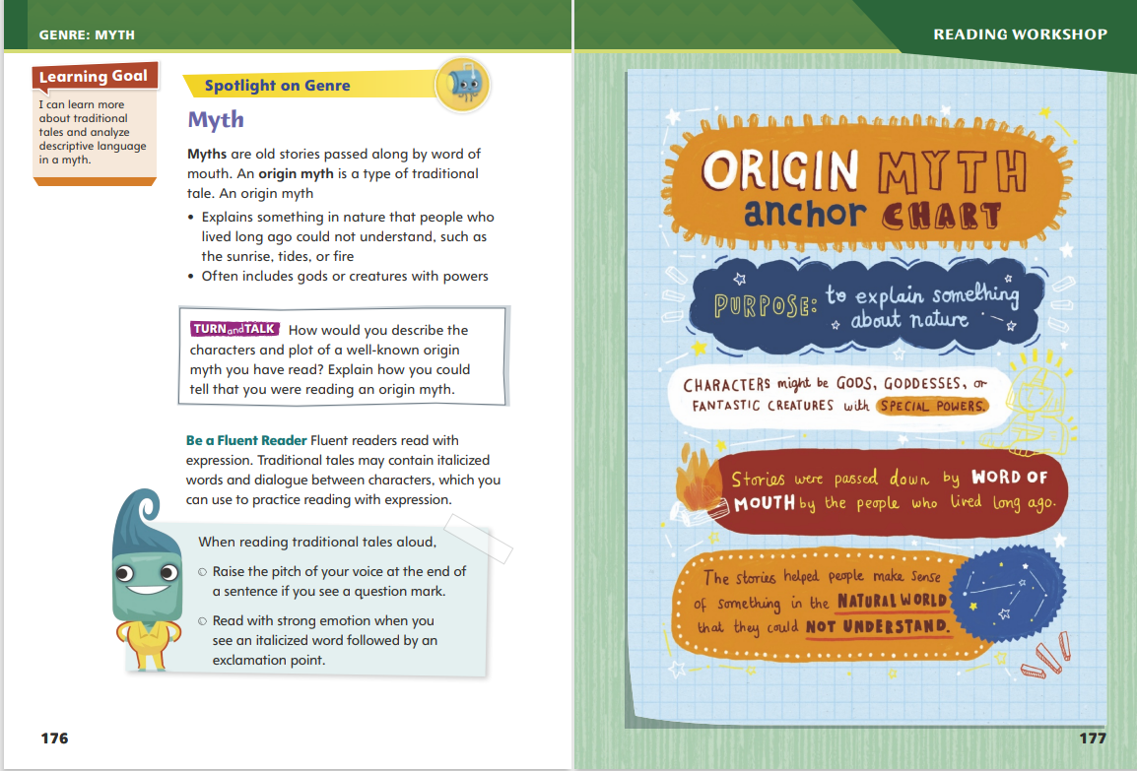
Page 176, 177
Origin Myth
Turn to page 176 in your Student Interactive.
Notes:
Myths are told and retold many times, so there can be different versions of the same story. Origin myths are usually set in an ancient time, but without many details to describe the exact time and place.
Look for tales that explain something in the natural world, such as weather patterns, animal behavior, or how land formations such as rivers and mountains came to be.
The characters in origin myths are often gods, goddesses, or other characters with powers greater than those of humans.
Look for places where the characters speak, and practice reading their dialogue with expression.
Identifying the key characteristics and details in a myth will help you determine the central message.
Model determining whether a story is a myth: In “The Beaded Necklace,” you have a clue in the first sentence. First you read that this story tells about gods and goddesses of Ancient Greece. Could these characters possibly be the kind written for an origin myth? Yes, they could. Does Ancient Greece sound like a setting for a myth? Yes, it does. As you read on, does the story explain the origin of anything? Yes, it is a tale explaining the origin of olive trees on Earth.
Inquire about other myths the students may have read. Ask students to point out the characteristics of the myths that illustrate the genre. Then discuss how the characteristics relate to the central message of the myths.
Demonstrate how to speak dialogue in “The Beaded Necklace” to reveal the character’s intended meaning. Ask students what they think Artemis was feeling when she said this: “If I could capture Demeter’s necklace and wear it around my own neck, I would be the graceful one.” Ask students, “If Artemis were feeling jealous, how would she sound?” Let students try using appropriate expression for the dialogue. Model the expression that makes sense for each line, and ask students to echo your example. Explain that reading with fluency helps make meaning clear.

Slide 7
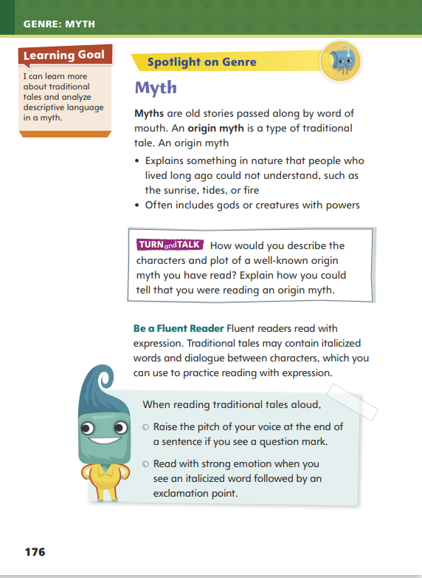
Page 176
Apply
Discuss How would you describe the characters and plot of a well-known origin myth you have read?
Notes:
Have students work with a partner to complete the Turn and Talk activity on p. 96 of the Student Interactive.
Circulate to discover if students can determine similarities and differences between realistic fiction stories and traditional tales. Editable Anchor Chart Click Path: Table of Contents -> Reading Anchor Charts -> Unit 1 Week 5: Origin Myth Anchor Chart

Slide 8
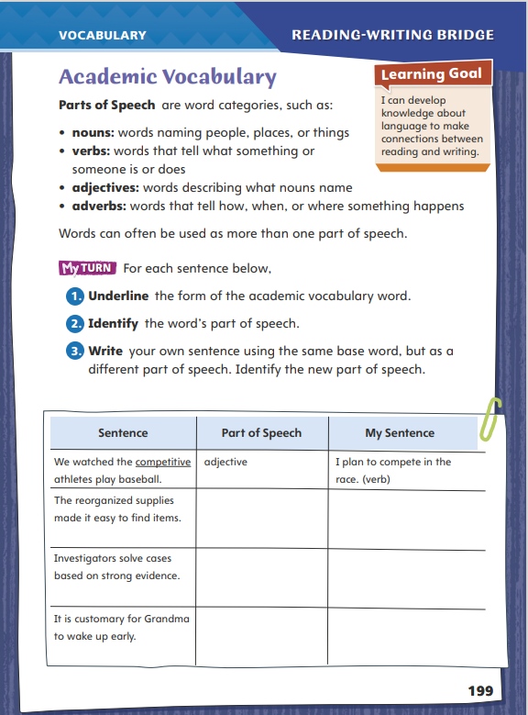
Page 199
Academic Vocabulary
Turn to page 199 in your Student Interactive and complete the activity.
Notes:
A word’s part of speech is the role the word plays in a sentence. Verbs, for example, can tell what someone or something is doing. Often, the same root word can be used as different parts of speech. Think about what a word does in a sentence to figure out its part of speech.
Model this strategy using the Academic Vocabulary word solve.
You solve math problems all the time. That’s an action, so solve is a verb. The answer you find is a solution. A solution is a thing, a noun. But what if a problem is unsolved? What part of speech is that? Unsolved describes problem. Problem is a noun, so unsolved is an adjective. We just used the same root word, solve, as three different parts of speech: a verb (solve), a noun (solution), and an adjective (unsolved).
Have students search for other root words on Student Interactive page 199 and use them as different parts of speech (connect, athlete, play, supply, investigate).
Have students follow the same strategy as they complete the chart on p. 199 of the Student Interactive. Remind students that they have studied the same Academic Vocabulary words throughout this unit.

Slide 9
Word Study
powder
toy
Notes:
Students learned last week that the letters ow can spell the sound /ō/. These letters can also spell the sound /ou/, as in the word power. The letters ou can spell the sound /ou/ too, as in the word mousetrap. The letters oi and oy can spell the sound /oi/. The sounds /ou/ and /oi/ are diphthongs. When a vowel sound begins as one sound and moves toward another, it is a diphthong.
Write the words powder and toy on the board. Point out the ow and oi diphthongs in each word.
Guide students to use knowledge of these diphthongs to decode the words town and destroy.

Slide 10
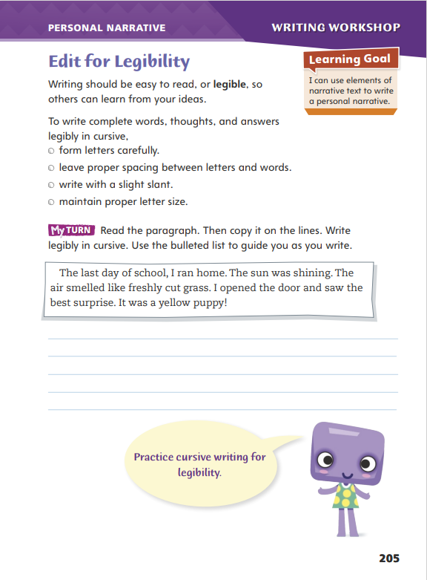
Page 205
Writing – Personal Narrative
Turn to page 205 in your Student Interactive.
Notes:
Writers want their readers to understand what they have written. For this reason, writers need to write complete words and thoughts. Their writing should also be legible, or clear and easy for someone to read.
Handwriting should be clear and legible.
The space between each word should be about the same size.
Letters should be aligned on the line.
Review the guidelines to writing legibly. Explain to students that sometimes they will not have access to a computer or other technology for the writing they do. Tell students that if their handwriting is not legible on a standardized test, their work cannot be scored.
Ask: When you write, do you leave enough space between each word? Try using a pencil to gauge the spacing between words.
Make sure all your letters are the same size.
Direct students to p. 205 in the Student Interactive. Have them write the paragraph and evaluate their own handwriting. Have students circle letters that are too large or too small.

Slide 11
Independent Writing
Write your final draft of your personal narrative.
Show your completed paragraph to the class.
Are there any letters that need improvement or spaces that need adjusting?
Notes:
After the minilesson, students should start writing the final drafts of their personal narratives. If students need additional practice, they should focus on letters that are giving them trouble and practice writing those letters on lined paper.
Writing Support
Modeled - Model writing the student paragraph in cursive on the board. Show students how to form each letter and say how your hand moves as you form the letters.
Shared - Have students identify letters they are having difficulty writing. Write the letters and have students trace them. When ready, students can write the letters on their own.
Guided - Have students practice writing their names in cursive. Focus on any letters that seem difficult. Look for consistency in letter size.
Students who have written rough drafts should make adjustments based on today’s minilesson.
Invite volunteers to show their completed paragraph to the class. Ask the class whether there are any letters that need improvement or spaces that need adjusting.

Slide 12
Spelling
1. Our car does not have enough power to get up that hill.
2. A thousand ants covered the table.
3. I try to avoid things that scare me.
4. Kira is proud of her high score.
5. The dogs enjoy a good run.
6. Chewing sounds annoy me.
7. The water in the shower is cold.
8. The coach will appoint the team captain.
9. The ball may bounce over the wall.
10. The fountain sprayed water into the air.
Notes:
(Note: Move the orange boxes to cover each bold spelling word before you read aloud the words and sentences.)
Read aloud the words and sentences. Have students spell each word with initial consonant blends and the two high-frequency words.
Our car does not have enough power to get up that hill.
A thousand ants covered the table.
I try to avoid things that scare me.
Kira is proud of her high score.
The dogs enjoy a good run.
Chewing sounds annoy me.
The water in the shower is cold.
The coach will appoint the team captain.
The ball may bounce over the wall.
The fountain sprayed water into the air.
Reveal the spelling word and have students check their work.

Slide 13
Language and Conventions
The mothers and fathers washed and swept the floors.
Identify the compound subject and compound predicate.
Write one sentence with a compound subject and one with a compound predicate.
Exchange with a partner.
Notes:
Flexible Option
Review the language and conventions topic compound subjects and predicates. See p. 168 in Unit 1 of the Student Interactive.
Display the following sentence: The mothers and fathers washed and swept the floors. Help students to identify the compound subject (The mothers and fathers) and the compound predicate (washed and swept) of the sentence. Then have students discuss how both subjects are completing both actions.
Have students write one sentence with a compound subject and one sentence with a compound predicate. Have them exchange sentences with a partner. Have partners circle the compound subjects and underline the compound predicates

Slide 14
Lesson 2

Slide 15
Page 178
Preview Vocabulary
pouch
globe
murmuring
mountainside
footpath
Notes:
Introduce the vocabulary words on p. 178 in the Student Interactive and define them as needed.
pouch: a small bag that closes with a piece of string
globe: an object shaped like a ball
murmuring: a soft, continuous sound
mountainside: the sloping side of a mountain
footpath: a narrow walking path for people
Tell students: These words will help you imagine the events in The Golden Flower and better understand the story. As you read, highlight the words when you see them in the text. Try to picture in your mind what is being described.

Slide 16
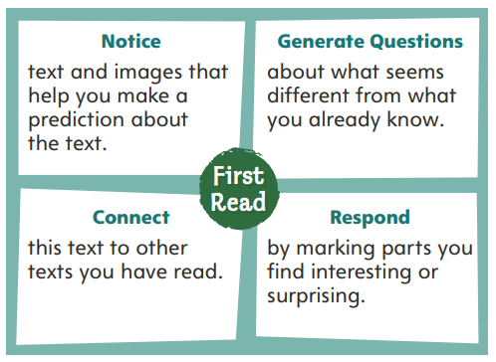
First Read Strategies
Notes:
Discuss the First Read Strategies. Prompt students to use text features to make predictions about this original myth.
Explain the four steps of the first read.
NOTICE Ask students to look for text and text features such as picture clues to predict what will happen next.
GENERATE QUESTIONS Have students write down questions about details that seem different from what they already know. Ask students to generate questions about the title and cover art before reading and about the text itself during and after reading.
CONNECT Ask students to consider how the same things in nature have been described or explained in stories from other cultures.
RESPOND Have students use sticky notes to mark the parts of the text that they find interesting or exciting.
Students may read the text independently, in pairs, or as a whole class. Use the First Read notes to help students connect with the text and guide their understanding.

Slide 17
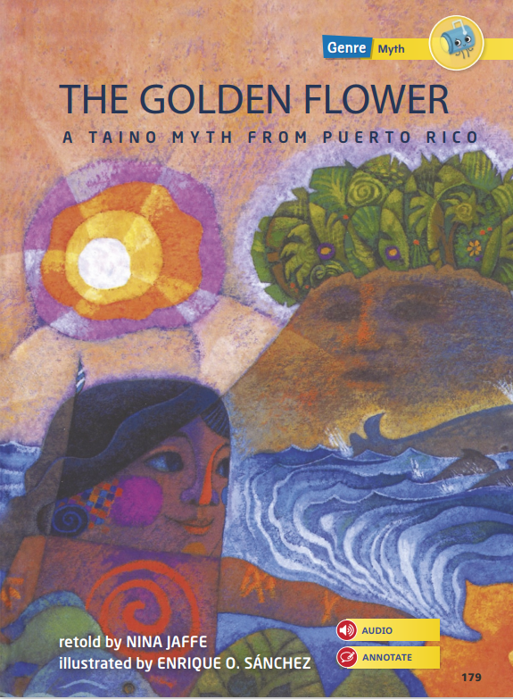
Page 179
First Read – The Golden Flower
Notes:
Students may read the text independently, in pairs, or as a whole class. Use the First Read notes to help students connect with the text and guide their understanding.

Slide 18
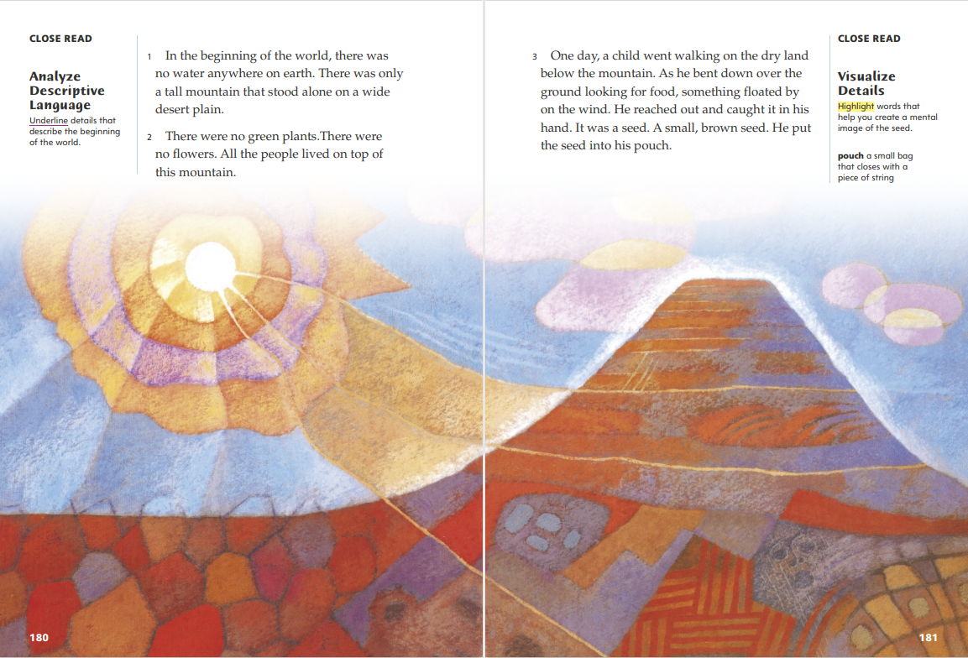
Page 180, 181
First Read – The Golden Flower
Notes:
Students may read the text independently, in pairs, or as a whole class.
THINK ALOUD The “beginning of the world” in this myth is a time when there was no water on earth and no living things except for people. This is interesting because The Golden Flower is a Taino myth from Puerto Rico, an island. I think this myth will explain where water came from and how it formed the island.
THINK ALOUD The illustration on this page matches my mental image of the mountain. But how can he find a seed if there are no plants? Is this a hint that he will soon meet a god or creature with the power to make seeds out of nothing? I am going to visualize the seed next and see if that helps me understand the story. As I read, I am also going to write down my questions to help me check my understanding of what I already learned from the story. This will help me recognize how the Taino saw things in nature differently than I do, too.

Slide 19
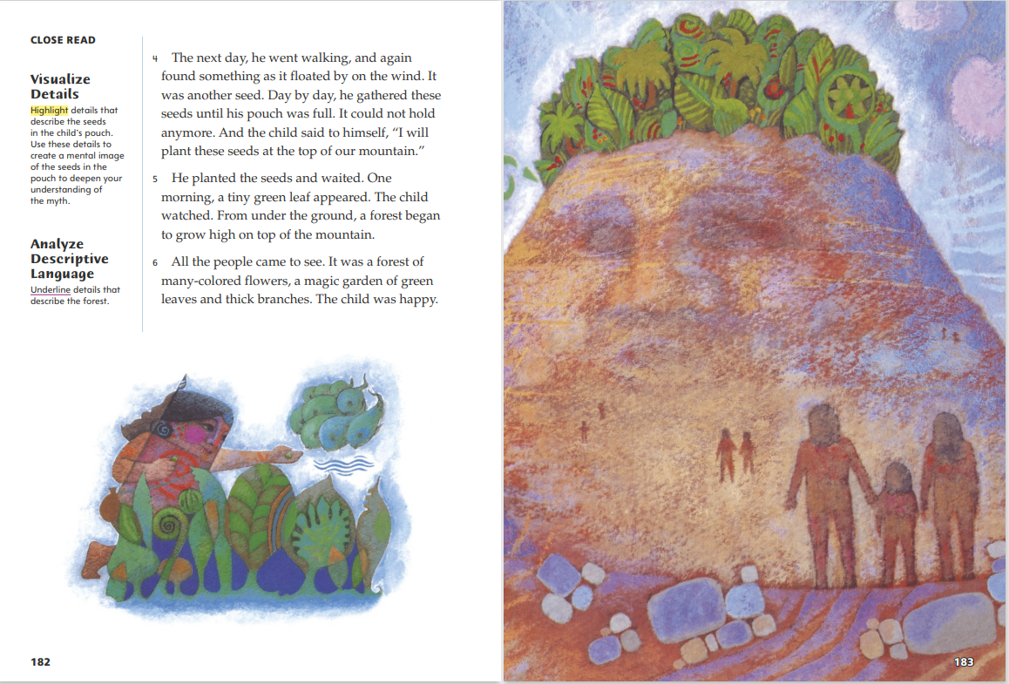
Page 182, 183
First Read – The Golden Flower
Notes:
Students may read the text independently, in pairs, or as a whole class.
THINK ALOUD The phrases “day by day,” “until his pouch was full,” and “one morning” make me wonder how much time is going by. I know that authors will sometimes skip ahead in time or summarize events to keep the plot moving. But in this story, the forest must grow so quickly because it is magical. The child is still a child when it appears.
THINK ALOUD Have students study the illustration. Say: The forest in this illustration does look magical. It looks like a tropical forest to me, with palm trees and tall, wide-leafed plants, and red and orange flowers. I have never seen a forest like that growing on a mountaintop. It is also surprising that I can see a face on the mountain, since the text does not mention that detail. Now the forest looks like the mountain’s hair. I wonder if the mountain will turn out to be a god and start talking.

Slide 20
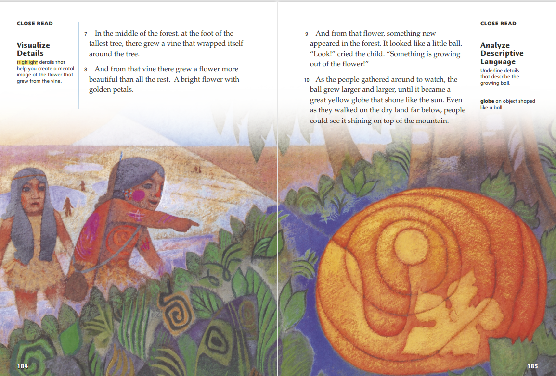
Page 184, 185
First Read – The Golden Flower
Notes:
Students may read the text independently, in pairs, or as a whole class.
THINK ALOUD When I visualize the vine described in paragraph 7, I start with one image in my mind and change it to match all the text details. First, I picture a very tall tree. My eyes move down its trunk to focus on the part where the tree comes out of the ground. Then I see a green vine growing up against the tree trunk and imagine it curling all the way around the trunk, like a snake. To visualize the golden flower from the title, my starting image can be the flower in the illustration.
THINK ALOUD After reading paragraph 10, say: The illustration shows how big the ball is. But the detail that the people “on the dry land” below the mountain can see the ball reminds me of my prediction about water. Will water be the next thing that magically appears in the forest? In real life, trees and plants and flowers need water, but so do people. Are the people in the myth magical, like the forest? I’m writing these questions down so I do not forget them.

Slide 21
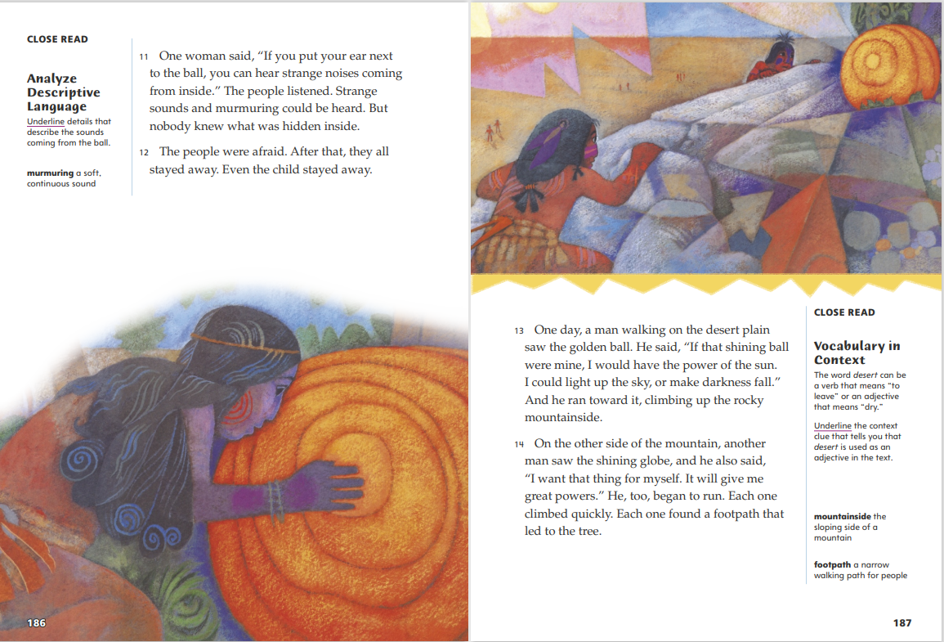
Page 186, 187
First Read – The Golden Flower
Notes:
Students may read the text independently, in pairs, or as a whole class.
THINK ALOUD The strange sounds coming from inside the ball seem like a clue that something bad is going to happen soon. The woman in the illustration also looks scared and worried at the same time. I predict that whatever is making the sounds will come out of the ball, but I don’t know what that will be yet.
THINK ALOUD Reading about how these men want the ball for themselves makes me wonder if this myth will teach a lesson about how people should act, like a fable, as well as explain something about nature. Or, their race for the ball could just be a way to move the plot forward, so we can find out what’s inside the ball.

Slide 22
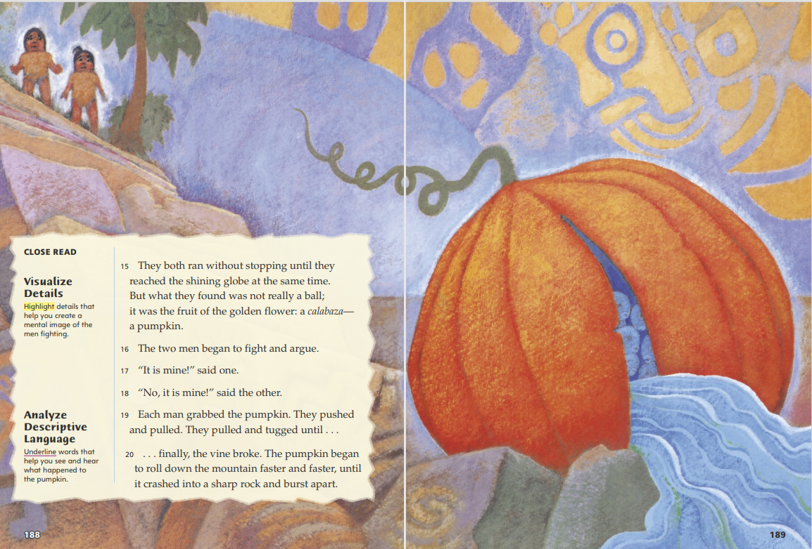
Page 188, 189
First Read – The Golden Flower
Notes:
Students may read the text independently, in pairs, or as a whole class.
THINK ALOUD After reading paragraph 15, say: The ball did turn into a fruit, just like I thought it might! In real life, flowers turn into fruit in order to spread the seeds inside the fruit, so a pumpkin is a fruit. Now that I think about it, there is something magical about how plants do this. Since this myth is from Puerto Rico, pumpkin plants probably grow there naturally.
THINK ALOUD Have students study the illustration. Say: The illustration shows that the pumpkin is filled with water! But if the people long ago had pumpkins, they would know that they are not filled with water. Why would they explain where water comes from in this way, when they could prove that the myth was not true? Is the main purpose of this myth to explain something else? I am going to write these questions down and keep reading for answers.

Slide 23
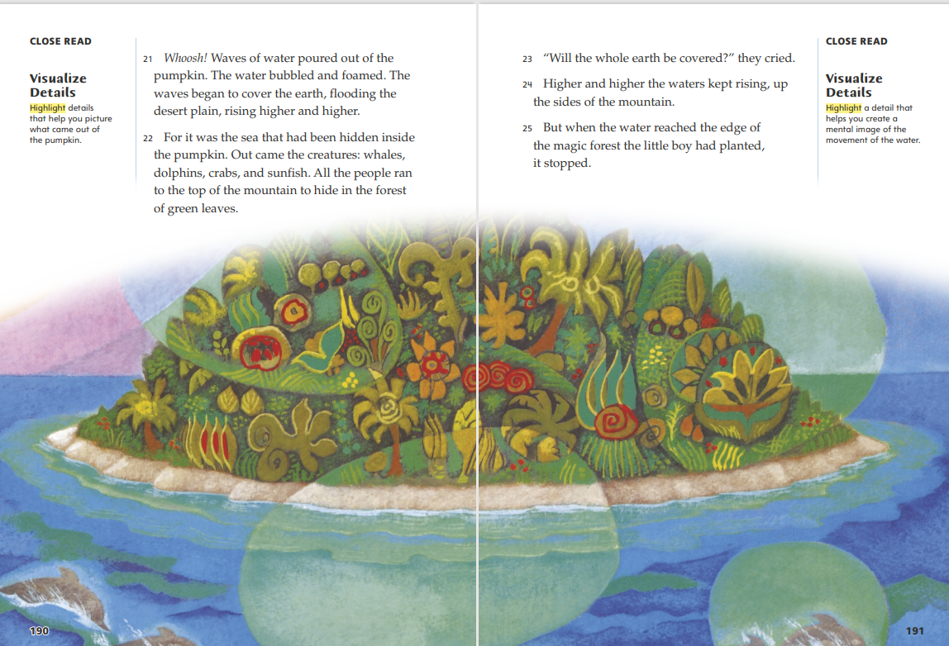
Page 190, 191
First Read – The Golden Flower
Notes:
Students may read the text independently, in pairs, or as a whole class.
THINK ALOUD Now I see that it is not just water coming from the pumpkin. The entire sea was “hidden inside the pumpkin,” so I think all the sea animals came out along with the water, not just the ones the author mentions. No wonder the people heard those strange sounds! They may have heard the sounds of the animals forming and trying to get out.
THINK ALOUD Paragraph 25 answers the question the people asked: the whole earth does not get covered. But I am not sure why the illustration shows bubbles with lighter-colored areas of the sea, the beach, and parts of the forest. These bubbles may represent the bubbling water described in the text. I think they also suggest that some magical changes are still happening all over the place, particularly in the forest, while the sea is forming in the plain.

Slide 24
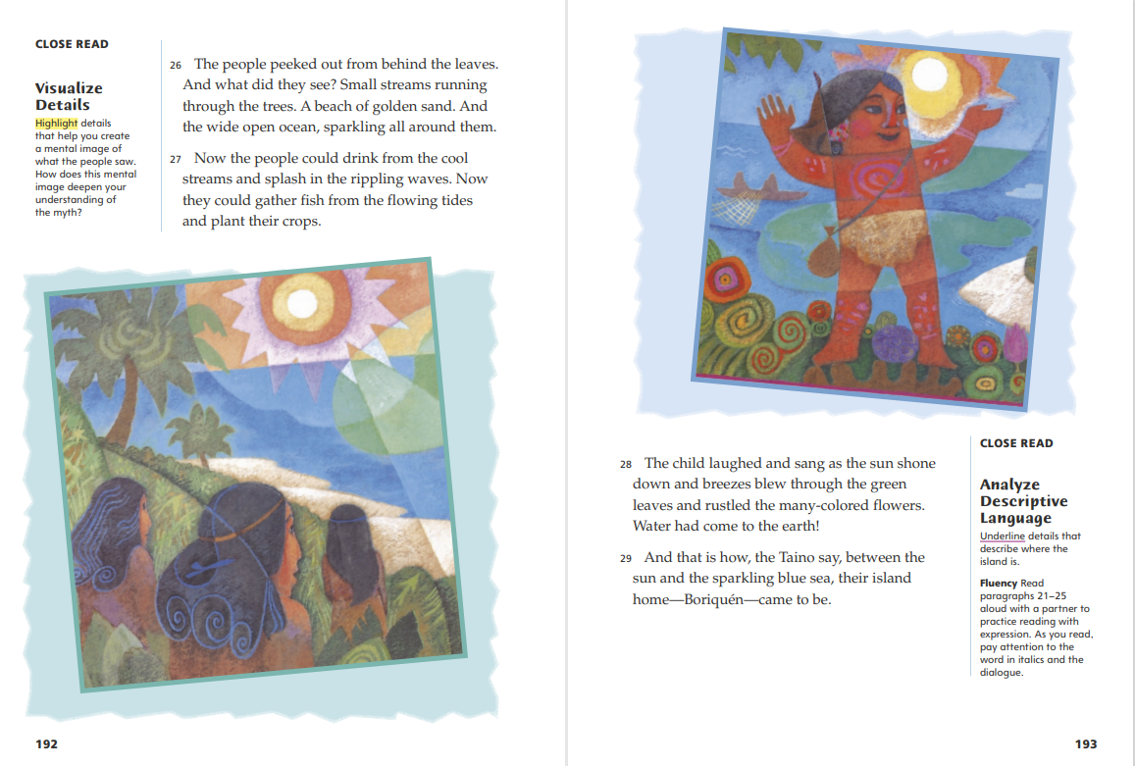
Page 192, 193
First Read – The Golden Flower
Notes:
Students may read the text independently, in pairs, or as a whole class.
THINK ALOUD The environment described on this page is much more like the environment of Puerto Rico today. Many of the other origin myths I have read also begin with something missing from nature. That thing or event becomes a part of nature as the myth explains how it was created or came to be.
After reading paragraph 28, say: This myth explains where the water on earth came from. But is water the only thing that was added to the earth in this story? What else came about as a result of the seeds the boy planted?
Possible Response: The seeds also caused the forest of trees, plants, flowers, and food like pumpkins to form. The water came with the creatures that live in the sea and changed the mountain into an island

Slide 25
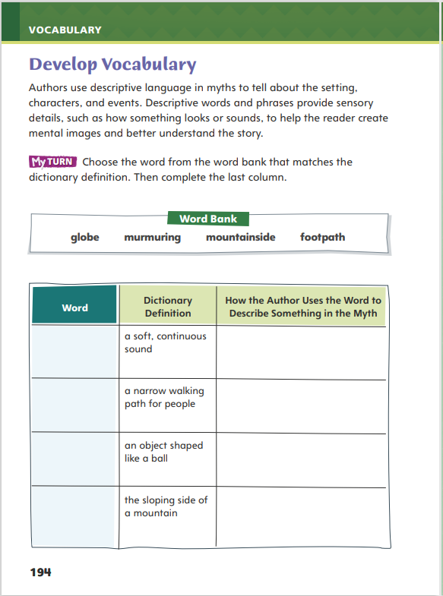
Page 194
Develop Vocabulary
Turn to page 194 in your Student Interactive and complete the activity.
Notes:
Tell students that authors use descriptive words to give sensory details about the setting, characters, and events in a myth. The vocabulary words pouch, globe, murmuring, mountainside, and footpath describe what people see, hear, and use, as well as where they live, in The Golden Flower.
Remind yourself of the word's meaning.
Ask yourself how the author uses the word to describe what characters sense and experience.
Model filling out the chart on p. 194 using the word murmuring:
The author says that when the people found the pumpkin, “Strange sounds and murmuring could be heard.” The author is trying to describe what the insides of the pumpkin sound like so that readers can imagine what the people hear.
Have students respond using newly acquired vocabulary as they complete p. 194 of the Student Interactive. They should use text evidence in their answers.

Slide 26
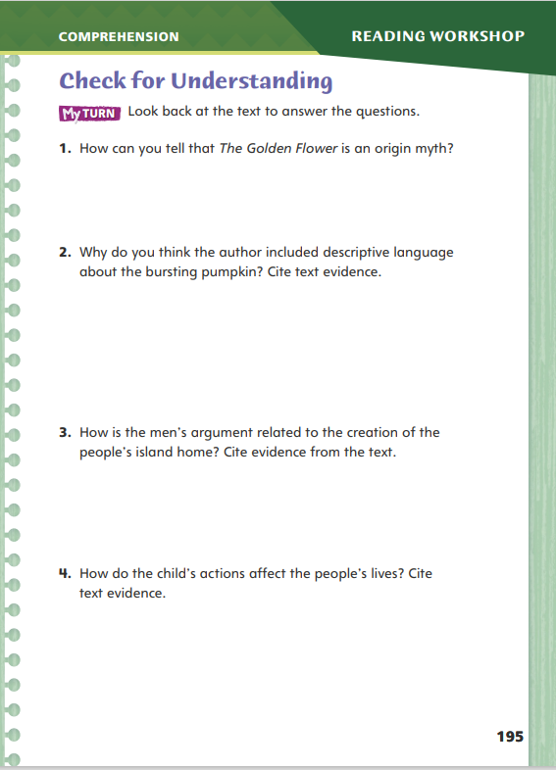
Page 195
Check for Understanding
Turn to page 195 in your Student Interactive and complete the activity.
Notes:
Have students complete p. 195 of the Student Interactive.

Slide 27
Page 200
Word Study
ou
ow
oi
oy
Notes:
Direct students to complete the activity on p. 200 of the Student Interactive.
High-frequency words are words that appear often in texts. Many of them do not follow regular sound-spelling patterns. Have students demonstrate their knowledge of high-frequency words, and apply that knowledge, to find, identify, and read the words unit and figure in various texts.

Slide 28
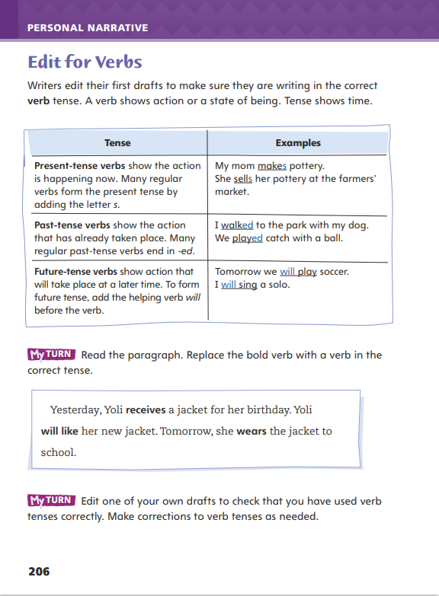
Page 206
Writing – Personal Narrative
Turn to page 206 in your Student Interactive.
Fill in the chart.
Notes:
A critical part of creating a final draft is editing for verb tense. Most personal narratives are told in the past tense. The writer should use the past tense consistently throughout the narrative. An exception is in quoted text, or dialogue, which is usually written in the present tense.
Past tense shows what has occurred.
Present tense shows what is occurring now.
Future tense shows what will occur in the future.
Remind students that there are many elements to examine when they revise a rough draft. To edit for verb tense, they will look at the ending of each verb. Review the endings of regular present and past tense verbs. Say: My personal narrative is about an event that happened in the past. I want to make sure all my verbs are in past tense. They should end in -d or -ed.
Write a few regular verbs on the board and have students conjugate them to the past tense; for example, talk, pull, listen. Then write use and dance on the board. Remind students that these verbs end in -e, so only -d is added to form past tense.
Direct students to p. 206 in the Student Interactive and have them complete the first My Turn activity.

Slide 29
Independent Writing
Edit your personal narrative for correct verb tense.
Share sentences from your drafts.
Explain why you made changes to your verbs.
Notes:
After the minilesson, students should transition to editing their own drafts for correct verb tense. Remind students that most of their verbs should be in past tense. For students who need help with editing verb tense, have them highlight all of the verbs in their drafts. Then work with them to make sure the tense is consistent.
Writing Support
Modeled - Write a few simple sentences with verb tense errors on the board to model how to edit for verb tense.
Shared - Have students describe an event. Transcribe their sentences, and then read them back. Prompt students to identify any errors in verb tense.
Guided - As they edit, ask students to look for words that show action. Have students say whether the verb is in present or past tense.
If students demonstrate understanding, have them make corrections and begin writing a final draft.
Call on students to share a few sentences from their narratives. Ask them to explain why they made any changes to their verbs.

Slide 30
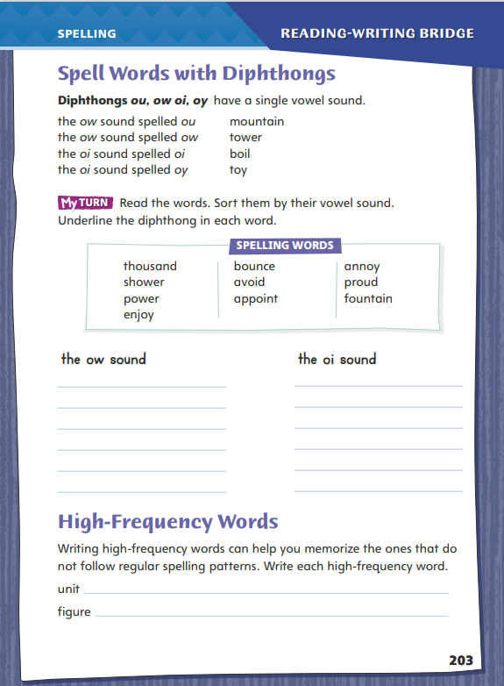
Page 203
Spelling
round
growl
south
house
count
moist
enjoy
Turn to page 203 in your Student Interactive and complete the activity.
Notes:
Remind students that the four diphthongs ou, ow, oi, and oy are pronounced two different ways: ow as in cow, or oy as in boy.
Write or display the words round, growl, south, house, count, moist, and enjoy. Say each word aloud, emphasizing the single vowel sound of each spelling. Have students repeat the words after you.
Have students complete the activity on p. 203 of the Student Interactive independently.

Slide 31
Language and Conventions
My sister and her friends met Mayor Alice Smith at a parade in July.
Identify the common nouns and proper nouns.
With your partner write sentences that have common and proper nouns.
Notes:
Flexible Option
Describe the difference between common and proper nouns. Provide oral examples of some common nouns (building, state) and their proper noun counterparts (Empire State Building, Ohio). Remind students that the proper nouns begin with a capital letter.
Write the following sentence on the board: My sister and her friends met Mayor Alice Smith at a parade in July. Have volunteers identify the common nouns (sister, friends, parade) and proper nouns (Mayor Alice Smith, July).
Have students work with partners or in small groups to compose sentences that include both common and proper nouns. Have partners or groups exchange their sentences and identify the common and proper nouns.

Slide 32
Lesson 3

Slide 33
Page 179
Introduce Analyze Descriptive Language
Notes:
Readers learn about the descriptive language authors use to appeal to the senses and help them imagine characters, settings, and events. • Notice descriptive language that helps you imagine an event.
Ask yourself which senses the author’s language uses.
Underline and describe details that help you imagine an event in the story.
Use the Close Read note on p. 180 of the Student Interactive to model how to annotate the text to analyze descriptive language:
Which details tell about the beginning of the world? In the first paragraph, the author says there was "no water" at the beginning of the world. I'm going to underline those words. Then I'm going to write dry in the margin.
Have pairs find and underline another detail in the paragraph. Then have them write in the margin a description of what they imagine when they think of this detail.

Slide 34
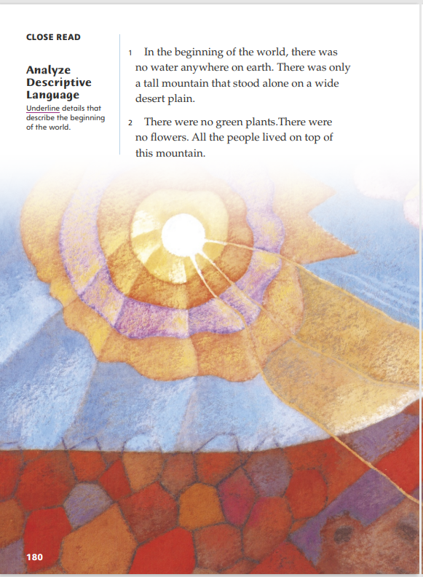
Page 180
Close Read – Analyze Descriptive Language
Turn to page 180 in your Student Interactive.
Notes:
Have students scan paragraphs 1 and 2 and underline details that describe the beginning of the world. See student page for possible responses.
Tell students that descriptive language makes the things being described seem more real to readers. Remind students that imagery is descriptive language that helps readers imagine what things look, smell, taste, sound, or feel like. Ask: How does the description of the mountain help you to imagine it?
Possible Response: It helps me see what the mountain looks like and where it is. I picture a “tall mountain” with no other mountains nearby, since it “stood alone.” The detail that it is “on a wide desert plain” makes me see bare, flat ground around the mountain. Since there are no plants, the mountain is bare too. DOK 2

Slide 35
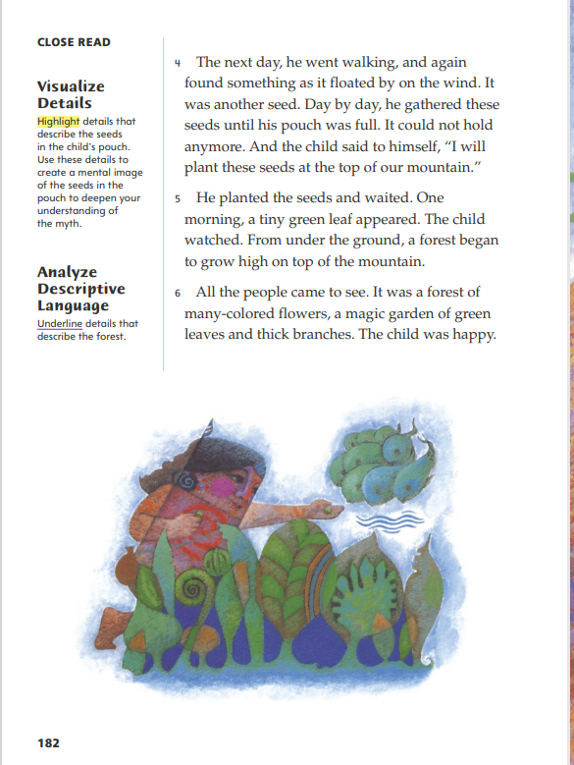
Page 182
Close Read – Analyze Descriptive Language
Turn to page 182 in your Student Interactive.
Notes:
Have students scan paragraphs 5 and 6 and underline details that describe the forest. See student page for possible responses.
Ask: How do the details in the text support the idea that there is something special about this forest?
Possible Response: The forest is “high on top of the mountain” but still has “many colored flowers,” which is unusual. Most forests on mountaintops are made up of evergreen trees that don’t grow flowers. The description of the forest as a “garden of green leaves” also shows that it must have a variety of plants. The word “magic” tells me that the forest probably seems amazing to the people looking at it too. DOK 2

Slide 36
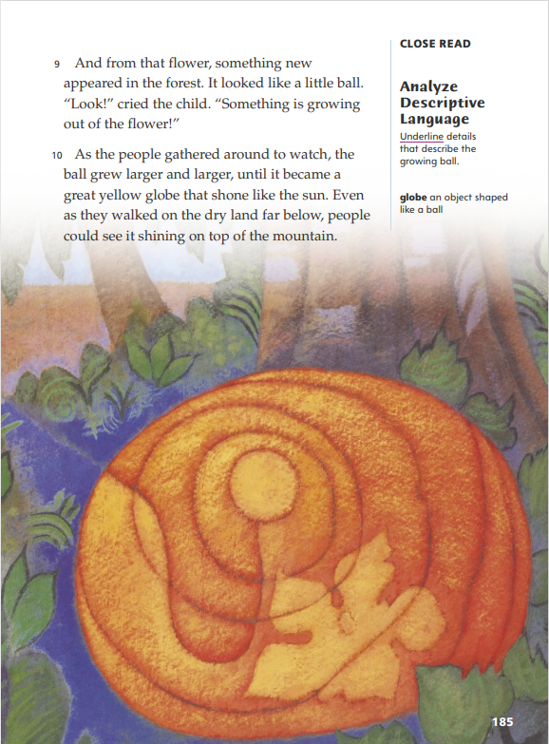
Page 185
Close Read – Analyze Descriptive Language
Turn to page 185 in your Student Interactive.
Notes:
Have students scan paragraph 10 and underline details that describe the ball that is growing out of the flower. See student page for possible responses.
Tell students that descriptive language often includes comparisons that call attention to certain details and add interest. Remind students that a simile is a comparison of two unlike things that uses words such as like or as, and ask them to identify the simile in paragraph 10.
Ask: How does comparing the “great yellow globe” to the sun help you understand the story?
Possible Response: Knowing that it “shone like the sun” tells me that it was shining so brightly, there was a glow or light coming from it. This helps explain why the people far below the mountain could see it. DOK 2

Slide 37
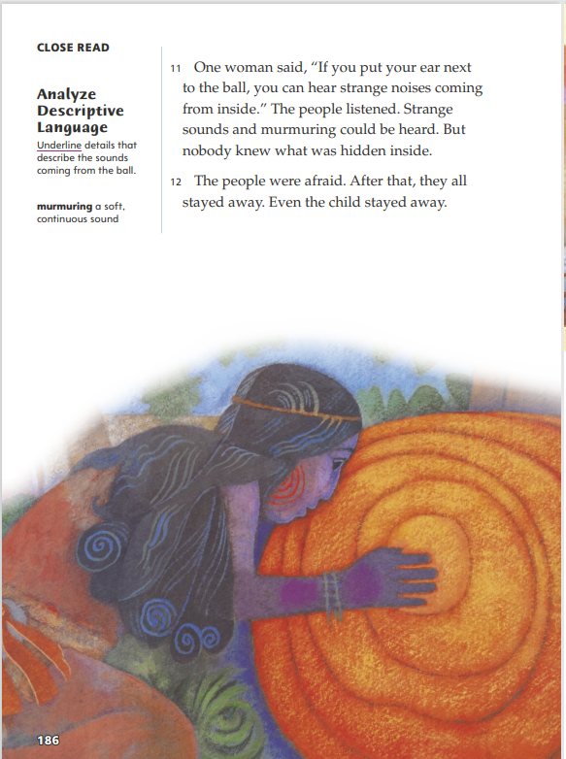
Page 186
Close Read – Analyze Descriptive Language
Turn to page 186 in your Student Interactive.
Notes:
Have students scan paragraph 11 and underline the details that describe the sounds coming from the ball. See student page for possible responses.
Remind students that descriptive language provides sensory details that help readers see, hear, smell, taste, touch, or feel what is happening. Ask: How do your underlined details help you understand why the people are afraid of the ball?
Possible Response: The adjective strange means odd or unusual, so the people don’t recognize the noises or know what’s making them. The repeated s sounds in “strange sounds” also make me think of a hissing snake, and since some snakes are poisonous, I would be afraid if I heard that. A murmuring sound is mysterious too, because there are many things that could make a sound like that. DOK 2

Slide 38
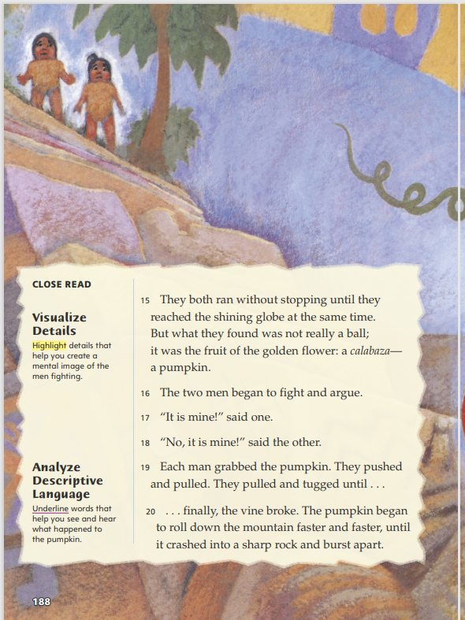
Page 188
Close Read – Analyze Descriptive Language
Turn to page 188 in your Student Interactive.
Notes:
Have students scan paragraph 20 and underline the words that help them see and hear what happened to the pumpkin. See student page for possible responses.
Ask: How would replacing “crashed” and “burst apart” with different words change the sounds that you hear in your head?
Possible Response: The sounds would change completely. The word “crashed” makes me hear a loud, high-pitched “thwack!” If the pumpkin “bumped” into a sharp rock instead, that would make a low-pitched “thud” or “fump” sound. “Burst apart” makes me hear a sound like an explosion, like a loud “pow!” and then “splat” as bits of pumpkin fall to the ground. If the pumpkin just “split apart,” I would only hear a “crack.” DOK 2

Slide 39
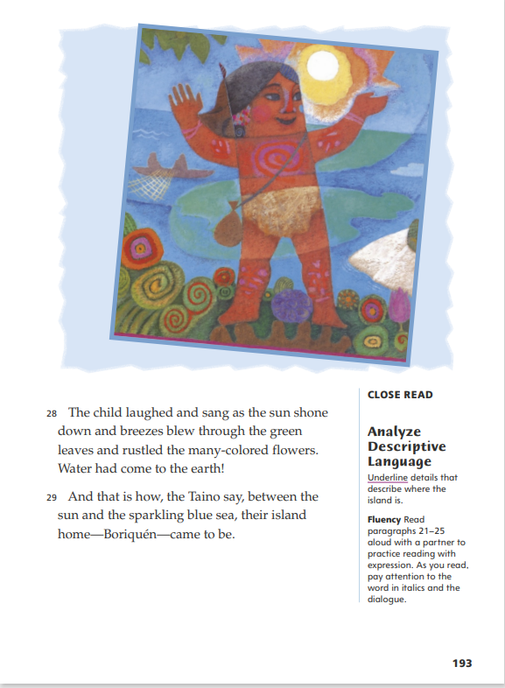
Page 193
Close Read – Analyze Descriptive Language
Turn to page 193 in your Student Interactive.
Notes:
Have students scan paragraph 29 and underline details that describe where the island is. See student page for possible responses.
Ask: Based on the description of what the Taino say and what you read, how would you explain the purpose of this myth?
Possible Response: The myth’s purpose is to explain how Borinquén formed. The phrase “between the sun and the sparkling blue sea” shows that explaining how their home became an island is one main point of the myth. But I think the phrase “their island home” shows that another main point is to explain how the island became a good home. DOK 3

Slide 40
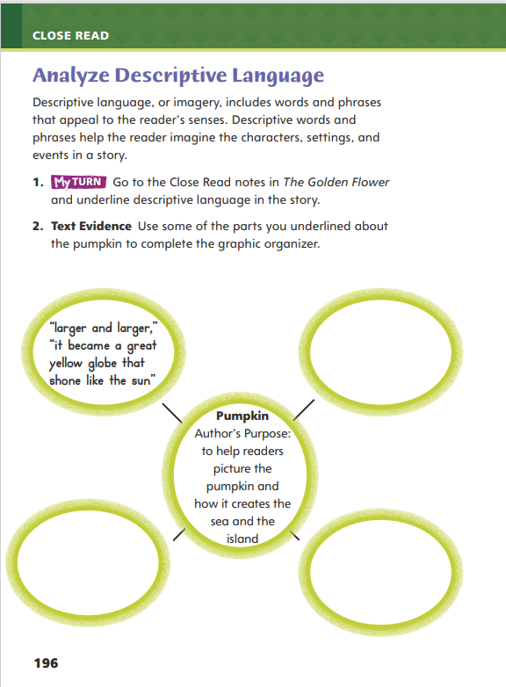
Page 196
Analyze Descriptive Language
Turn to page 196 in your Student Interactive and complete the activity.
Notes:
Have students annotate the text using the other Close Read notes for Analyze Descriptive Language and then use the text evidence from their annotations to complete the web on p. 196 in the Student Interactive.

Slide 41
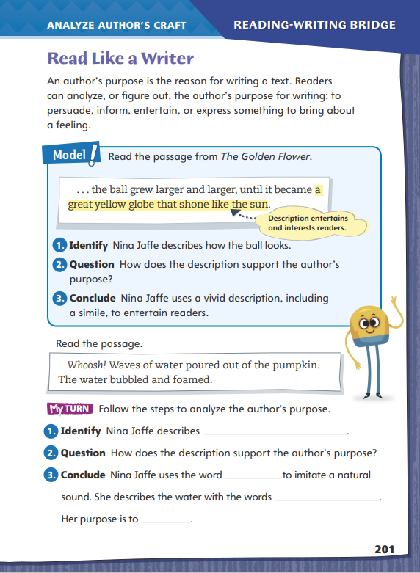
Page 201
Read Like a Writer
Turn to page 201 in your Student Interactive and complete activity.
Notes:
Authors have a purpose, or reason, for writing. To figure out a writer’s purpose, a reader can think about the effect the writing has on its audience. The writer may want to
persuade, or change the reader’s mind about a topic.
inform readers, or share important information with them. • entertain readers by providing them with a new experience.
bring about certain feelings in readers.
To model analyzing the author’s purpose, direct students to the list on p. 201 of the Student Interactive. Have students follow along as you complete the steps.
Identify the passage that the author, Nina Jaffe, wrote to describe the ball in The Golden Flower.
Ask students to find the words and phrases that form vivid images, such as larger and larger, great yellow globe, and shone like the sun. Help students relate these words and phrases to the thought bubble beside the passage that explains their effect.
Help students understand that the author’s purpose may be to entertain and interest the reader by using colorful and descriptive language to describe this ball. Point out the simile Jaffe uses to suggest that the ball looks like something they know.
Direct students to go back to The Golden Flower to identify different examples of writing that show the author’s purpose. Have them define whether the author is trying to persuade, inform, entertain, or express ideas or feelings. Then have them focus on analyzing author’s purpose by completing the activities on p. 201 of the Student Interactive.

Slide 42
Word Study
house
clown
recoil
oyster
Notes:
Flexible Option
Remind students that trying out the different sounds that diphthongs can spell will help them read words correctly.
Display the words house and clown. Underline the ou and ow and indicate that, in each word, both vowel teams spell the same sound: /ou/. Show students the words recoil and oyster. Guide students to identify the letters that are pronounced as a single vowel sound. Have students say the words and emphasize the sound /oi/ in both words
Have students complete Word Study p. 5 from the Resource Download Center.

Slide 43
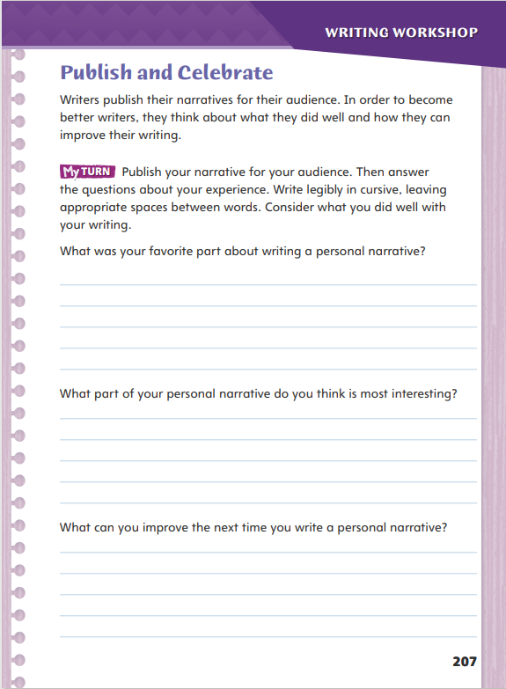
Page 207
Writing – Personal Narrative
Turn to page 207 in your Student Interactive.
Notes:
Authors write to be published. After weeks of hard work, it is now time for your students to present their final drafts to their peers.
Students may share some or all of their personal narratives.
Students may share what they learned about writing personal narratives, commenting on what they liked best.
Students may ask each other questions and discuss the writing process as they share their work.
Look at a published book and point out some of the features, including title, byline, and illustrations. If students wish to have their work published and displayed in the classroom, allow students time to add these features to their personal narratives. Ask students to review the things they learned during this process:
What was the first step you took when writing a personal narrative?
What was it like to decide on a topic and focus on one special moment?
Would you like to write another personal narrative?
Is there someone else you would like to share your narrative with?
Should we invite other teachers or school staff to listen to your stories?
Direct students to complete the first My Turn on p. 207 in the Student Interactive. Remind students to write in cursive as they reflect about writing personal narratives.

Slide 44
Independent Writing
Write a reflection about your experience writing a personal narrative.
Share your reflection with the class.
What element of your work do you feel is the best?
Notes:
After the minilesson, direct students to begin writing about their experience writing personal narratives. Students should refer to their writing notebooks to look at some of their prewriting notes, revisions, and rough drafts to help them remember the process.
Writing Support
Modeled - Use your own writing to model how to prepare a rough draft for publishing.
Shared - Record skills students think they mastered in this unit. Prompt students to contribute ideas on how they could have improved their writing.
Guided - Have students add details that explain their reflections on writing.
Ask for volunteers to share their reflections about writing personal narratives. Ask students to discuss the elements of their work that they feel are the best. Invite students to read those sections of their personal narratives.

Slide 45
Spelling
choice
sprout
Notes:
Flexible Option
Remind students to say each spelling word aloud to decide which diphthong to use. Point out that words like tow or four have ow or ou spellings but don’t sound like ow or oy diphthongs.
Write or display the following words. Have pairs pronounce and spell the words, emphasizing the diphthongs.
choice
sprout
Have students complete Spelling p. 10 from the Resource Download Center. Click path: Table of Contents -> Resource Download Center -> Spelling

Slide 46
Language and Conventions
The doctor works at a hospital in a city.
His mother came to visit last month from her country.
Change the common nouns to proper nouns.
Notes:
Explain that common and proper nouns can refer to the same thing. Book is a common noun. The Golden Flower is the title of a book and a proper noun. Note that you can have a teacher and his name can be Mr. Jones, which is a proper noun. Point out that all proper nouns begin with capital letters.
Provide the following sentences: The doctor works at a hospital in a city. His mother came to visit last month from her country. Have volunteers help you change the common nouns in the sentences to proper nouns. (Dr. Ortiz works at Mercy Hospital in Austin. Imelda Ortiz came to visit in July from Costa Rica.

Slide 47
Lesson 4

Slide 48
Page 179
Visualize Details
Notes:
Readers use descriptive details to help them visualize, or picture in their minds, characters, settings, and events.
Pay attention to the details the author uses to describe characters, the setting, and events in the story.
Highlight details that help you to form a mental image of the character, setting, or event.
Write in the margins a description of the picture in your mind.
Use the Close Read note on p. 181 of the Student Interactive to model how to annotate the text to help visualize details:
Which details help to create an image of the seed? In the third paragraph, the author says that something "floated by on the wind." I'm going to highlight those words. Then I'm going to write light in the margin because I already know that something that floats in the air is probably light.
Have pairs find, highlight, and describe another detail in the paragraph.

Slide 49
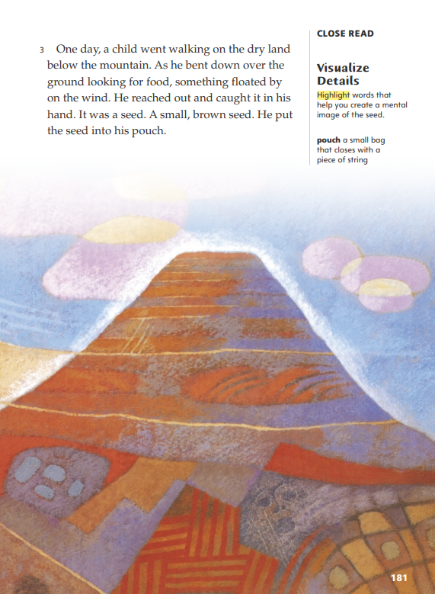
Page 181
Close Read – Visualize Details
Turn to page 181 in your Student Interactive.
Notes:
Tell students that authors choose specific nouns, verbs, and descriptive words, or adjectives and adverbs, to help readers visualize what they are describing.
Have students scan paragraph 3 and highlight words that help them visualize the seed. See student page for possible responses.
Ask: How do these details help you form a mental image of the seed while reading? Use text evidence to support your description.
Possible Response: When I read that “something floated by on the wind,” I imagined something light and small being carried along by the wind, like a feather. The detail that it was a seed made me think of seeds that have wings, like maple seeds. But when I read that it was just a “small, brown seed,” I changed my image to a brown watermelon seed, because those are small and light. DOK 3

Slide 50
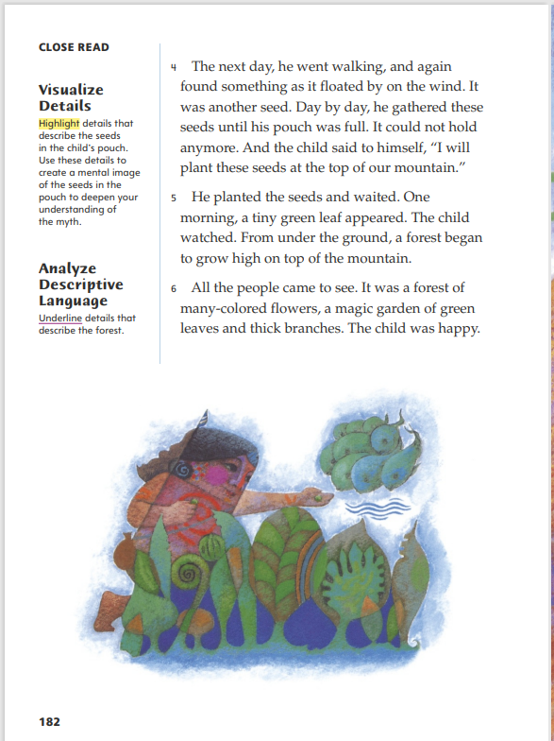
Page 182
Close Read – Visualize Details
Turn to page 182 in your Student Interactive.
Notes:
Have students read the first Close Read note and scan paragraph 4 to locate and highlight details about the seeds in the pouch. See student page for possible responses.
Remind students to use what they already know to help them visualize these details. Prompt them to close their eyes and picture the seeds and pouch. Ask: What does your mental image suggest about how much time has gone by in the story? Use evidence to explain your response.
Possible Response: I think the boy has been collecting seeds for a long time. Since the pouch “could not hold any more,” I pictured a small bag stuffed so full, it was shaped like a softball. The seeds are small, so there could be hundreds of them inside the pouch. If he collects one seed each day, it would take hundreds of days to fill the pouch, or maybe even a couple of years. DOK 2

Slide 51
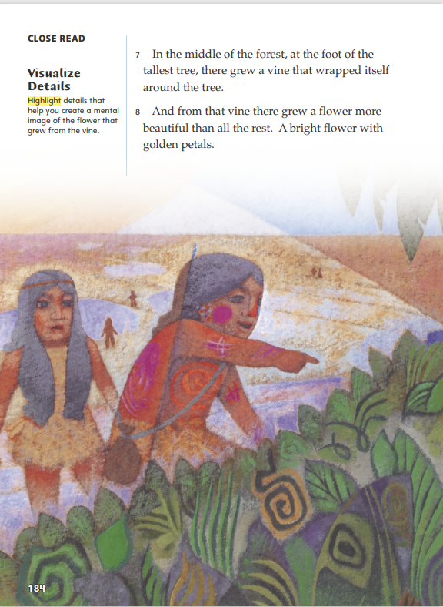
Page 184
Close Read – Visualize Details
Turn to page 184 in your Student Interactive.
Notes:
Have students scan paragraph 8 and highlight details that help them create a mental image of the flower that grew from the vine. See student page for possible responses.
Ask: What do you picture in your mind when you read this description of the flower?
Possible Response: I think the flower in the illustration is kind of shaped like a lily, so I picture a golden lily growing on a vine instead of a stem. Since it’s “more beautiful than all the rest,” I imagine it is fully bloomed and has perfectly-shaped, big petals. To make it “bright,” I make it glow a little bit. The detail that it has “golden petals” makes me change its color from orange to the golden yellow of gold jewelry, since that also glows. DOK 2

Slide 52
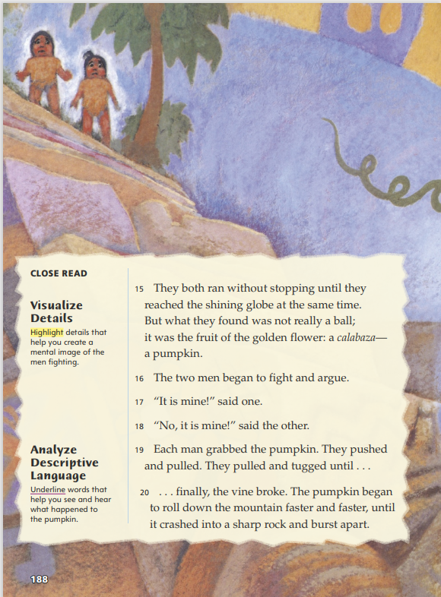
Page 188
Close Read – Visualize Details
Turn to page 188 in your Student Interactive.
Notes:
Have students scan paragraphs 16–19 and highlight details that help them create a mental image of the men fighting. See student page for possible responses.
Ask: How do the verbs the author chose help you visualize the men’s fight?
Possible Response: When you “push,” you shove something away, and when you “pull,” you bring it toward you. These opposite words help me picture both the pumpkin and the men moving one way and then the other, because neither man is letting go of the pumpkin. Repeating “pulled” tells me that they move back and forth more than once, so I imagine them struggling for the pumpkin for a while. DOK 2

Slide 53
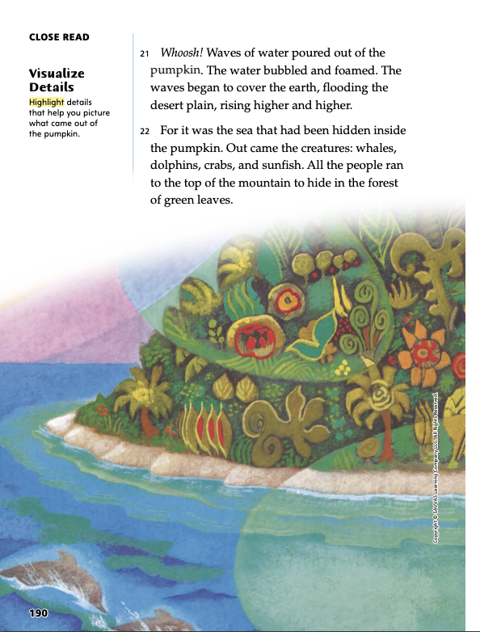
Page 190
Close Read – Visualize Details
Turn to page 190 in your Student Interactive.
Notes:
Have students scan paragraphs 21 and 22 and highlight details that help them picture what came out of the pumpkin. See student page for possible responses.
Have students close their eyes while you reread the paragraphs aloud. Then say: Describe how you visualize the sea coming out of the pumpkin. What details helped you?
Possible Response: First, I see the “waves of water” gushing out of the pumpkin like it has a giant drinking fountain spout inside it, because “the water bubbled and foamed.” The water streams down the side of the mountain and across the plain in sheets that “cover the earth.” The plain fills like a bathtub, with the water “rising higher and higher.” Since the sea is “hidden inside the pumpkin,” I see the creatures popping out from under the surface of the waves in the water that pours down and collects. DOK 2

Slide 54
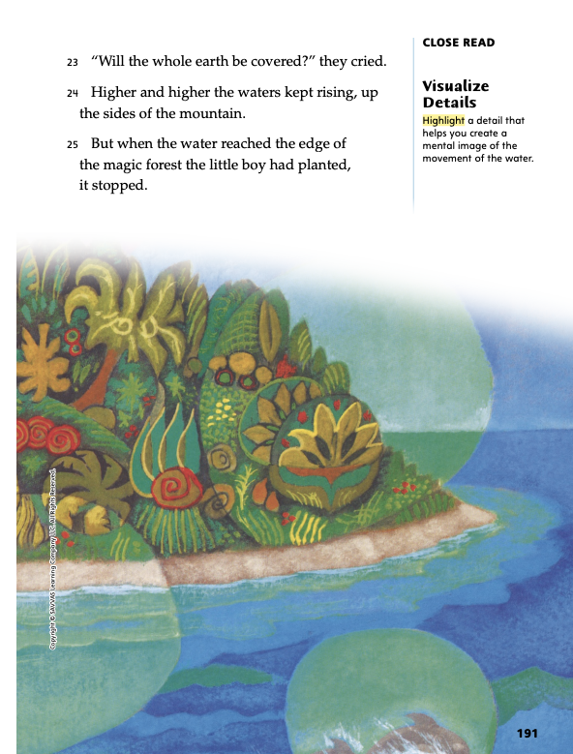
Page 191
Close Read – Visualize Details
Turn to page 191 in your Student Interactive.
Notes:
Have students scan paragraphs 24 and 25 and highlight a detail that helps them imagine the movement of the water, or create a mental image of it. See student page for possible responses.
Ask: How does visualizing the movement of the water help you understand what is happening to the mountain?
Possible Response: When I picture the water rising up the sides of the mountain, I also see that the part of the mountain that is still above the water is shrinking. When the water stops at the edge of the forest, the rest of the mountain below the forest is completely underwater. DOK 2

Slide 55
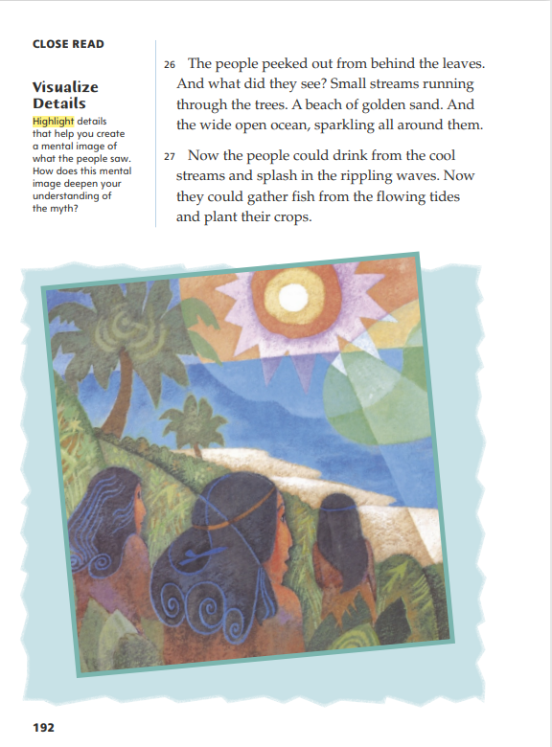
Page 192
Close Read – Visualize Details
Turn to page 192 in your Student Interactive.
Notes:
Have students scan paragraphs 26 and 27 and highlight details that help them create a mental image of what the people saw. See student page for possible responses.
Ask students to consider the type of information this page provides about the changes that took place. Then ask: How does your mental image of what the people saw deepen your understanding of the myth?
Possible Response: Visualizing what the people saw helps me understand that the forest is now their home and their lives are greatly improved by the new environment. When I picture the streams in the forest and people drinking and watering crops from them, I realize that not all the water from the pumpkin ended up in the sea or was saltwater. A beach of “golden sand” looks more enjoyable than a wide desert plain, especially when people are splashing and catching fish in the sea. DOK 2

Slide 56
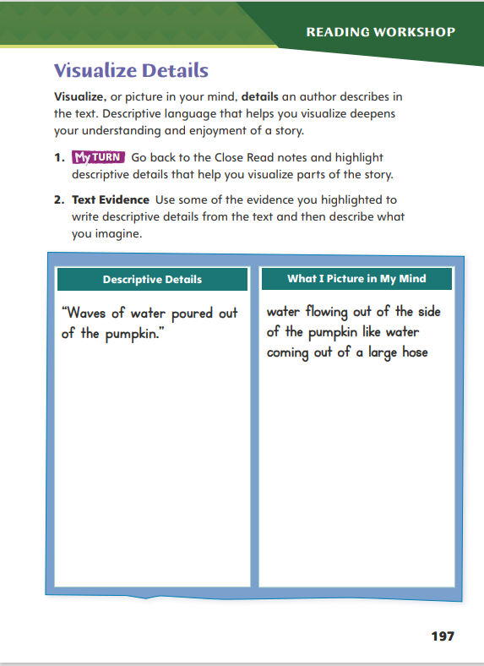
Page 197
Visualize Details
Turn to page 197 in your Student Interactive and complete the activity.
Notes:
Have students annotate the text using the other Close Read notes for Visualize Details and then use the text evidence from their annotations to complete the chart on Student Interactive p. 197.

Slide 57
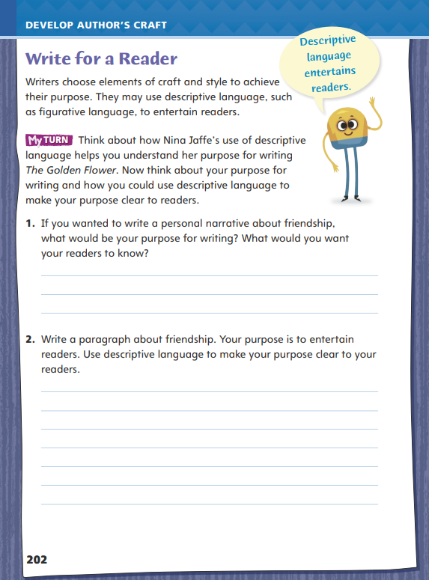
Page 202
Write for a Reader
Turn to page 202 in your Student Interactive.
Notes:
Many authors write to entertain or inform their readers. Word choice and language structures help them achieve that purpose. For example, text that entertains relies on descriptive and figurative language.
Part of a writer’s style is the way he or she writes descriptions. Strong, vivid descriptions create clear pictures in the reader’s mind.
Figurative language compares a thing to something else that is familiar to the reader. Writers use the words like and as to create similes, which are a form of figurative language.
Discuss how students might use a similar technique in their own writing using p. 202 of the Student Interactive.
Ask volunteers to give an example of something they might like to write about that would entertain their readers.
Think aloud as you plan. Provide a model. I want to describe a waterfall I saw in a state park. My purpose is to entertain my readers. I will describe the path to the waterfall as steep, slippery, and thick with fallen leaves. I will compare the sound of the falls in the distance to the roar of a monster.
Have students compare Nina Jaffe’s purpose for writing to their own purposes for writing. Then guide students to complete the activity on p. 202 of the Student Interactive. Have students set a specific purpose for their writing. As they write, remind them to use vivid language in their stories from the Writing Workshop. During conferences, support students’ writing by helping them add descriptive words, including similes, to their writing.

Slide 58
Word Study
beet
reach
rain
tray
flow
roam
Notes:
Flexible Option
Review the strategies of pronouncing the two vowels together as one long vowel sound.
Write the following words on the board: beet, reach, rain, tray, flow, and roam. Have volunteers pronounce the vowel combinations in each word. Demonstrate how the vowel digraphs ee and ea can form the long e sound, while the digraphs ai and ay form the long a sound and the digraphs ow and oa form the long o sound.
Have students work independently to find vowel digraph words in their textbooks. To demonstrate correct pronunciation, have students think of another word that rhymes with each word they found.

Slide 59
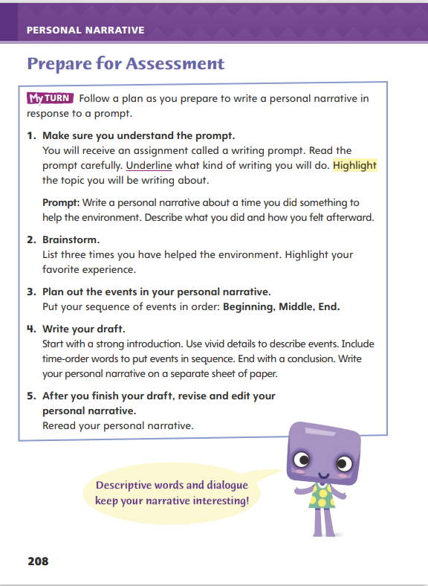
Page 208
Writing – Personal Narrative
Turn to page 208 in your Student Interactive.
Notes:
Brainstorming ideas that can be turned into a composition is essential when taking a writing test. Key strategies include
Understanding the prompt
Organizing ideas before writing
Inform students that in each unit, they will review several ways to prepare for writing tests. They will review strategies they learned in this unit that will help them organize ideas and write a successful composition.
Direct students to p. 208 in the Student Interactive. Read each strategy aloud. Say: Understanding the prompt is the first step to a successful composition. Do not be afraid to underline the kind of writing you are expected to do and highlight key ideas.
Remind students that prewriting is key. Say: Before you begin writing, remember to brainstorm ideas. Use circles and lines to help you see how you can connect your ideas. The next step is organization. Remember, personal narratives are usually in time order.
Explain that students should use these notes as a guide to writing a draft. Remind them that they should write legibly. After they write their drafts, students have one last strategy. Say: Do not forget to reread your work and look for errors in grammar and spelling.

Slide 60
Independent Writing
Brainstorm and plan a personal narrative based on one of the prompts from page 208.
Share ideas you are going to include.
How can you begin and end your narrative?
Notes:
After the minilesson, students should begin to brainstorm and plan a personal narrative based on the prompt on p. 208 in the Student Interactive. Students may use the entire independent writing time to work on this.
Writing Support
Modeled - Write a different prompt to model how to identify objectives in the prompt.
Shared - Transcribe student ideas that they have brainstormed for this prompt. Invite students to say how to organize the ideas.
Guided - As students brainstorm ideas for the prompt, remind them to organize their ideas in order and use temporal words and phrases.
Ask students to share ideas they are going to include in their personal narratives. Have several students talk about ways they can begin and end their narratives and get feedback on these ideas from the class.

Slide 61
Spelling
meet
fear
train
slay
blow
boat
Notes:
Flexible Option
Review the spelling rules about these digraphs. The vowel digraphs ee and ea form a long e sound. Digraphs ai and ay form a long a sound. Digraphs ow and oo form a long o sound.
Display the following words: meet, fear, train, slay, blow, and boat. Have volunteers pronounce the words and have listeners say what vowel sound they heard. Students should say the letters of the sounds to help them spell the words.
APPLY Have students write sentences using the spelling words from the previous week. Have students quiz each other on how to spell the words. Make sure students pronounce the words correctly and use the proper digraph.

Slide 62
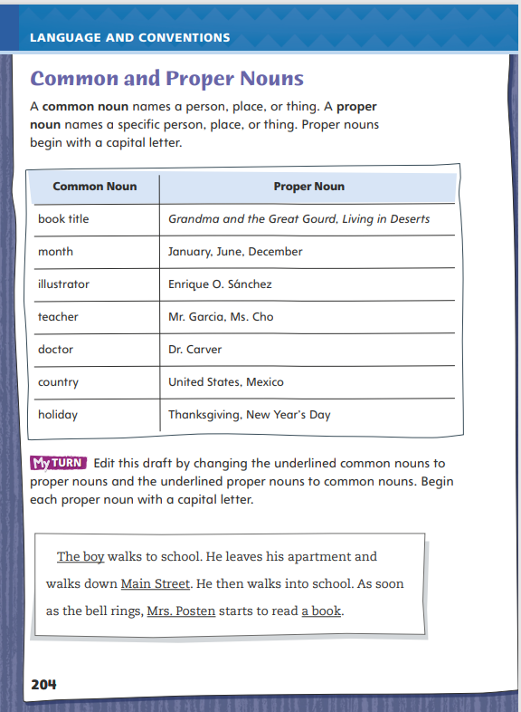
Page 204
Language and Conventions
Turn to page 204 in your Student Interactive and complete the activity.
Notes:
Have students edit the draft paragraph on Student Interactive p. 204

Slide 63
Lesson 5

Slide 64
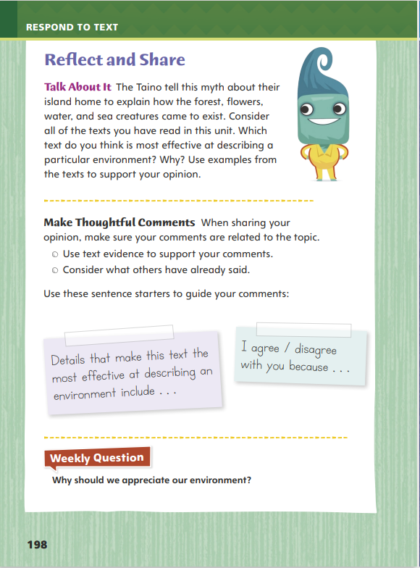
Page 198
Reflect and Share
Turn to page 198 in your Student Interactive.
Notes:
Explain to students that when they participate in discussions with other readers, they should make pertinent comments, or remarks that are related to what others have said about a topic or text.
Before making a comment, ask yourself whether it is on-topic and related to the discussion that is happening now.
Build on the things that other people say to stay on topic and to deepen the conversation. Use language such as, I agree/disagree with you because to help connect your ideas with those of others.
Model making pertinent comments using the Talk About It prompt on p. 198 in the Student Interactive: If my discussion partner talked about the water coming out of the pumpkin on p. 189 and said, “I think the details about the water help to explain oceans arriving on the earth,” I could reply with the pertinent comment, “I disagree with you because a pumpkin can't hold enough water to cover two thirds of the world.”
Ask students to reply to your last statement with a pertinent, on-topic comment

Slide 65
Page 198
Apply
Why should we appreciate our environment?
Notes:
Have students use evidence from the texts they have read this week to respond to the Weekly Question. Tell them to write their responses on separate sheets of paper.

Slide 66
Word Study
flour
plow
soil
coy
Notes:
Flexible Option
To assess students’ understanding of the proper pronunciation of diphthongs, provide them with the following words:
flour
plow
soil
coy
Have students use their knowledge of the pronunciation of this lesson’s diphthongs to read these words fluently.

Slide 67
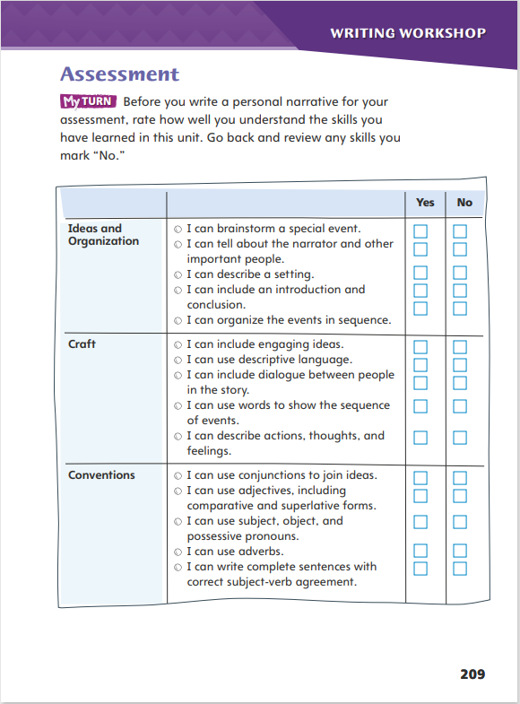
Page 209
Writing – Personal Narrative
Turn to page 209 in your Student Interactive.
Notes:
Before they take the writing assessment, this page will offer students a reminder of the skills they learned about writing personal narratives. Key elements include
Writing about a personal event.
Organizing ideas by writing a clear introduction, sequence of events, and conclusion.
Using descriptive words and dialogue that reveal thoughts and feelings.
Review the elements of personal narratives in the Student Interactive p. 209. Say: There are three main areas in the chart: Ideas and Organization, Craft, and Conventions. The skills listed on this page are an overview of what we learned about writing personal narratives. Now is the time for each of you to review any skills that you need to improve.
Allow time for students to complete the evaluation. Form small groups for students who have marked “No” and review the skills with those students. You may have students participate in peer teaching as well, matching students who need help with those who have mastered the skill.

Slide 68
Writing Assessment
It takes a friend to be a friend.
Write about a time when you met a new person.
Describe how you met and how your friendship grew.
Notes:
Provide students the assessment prompt below. The prompt may be displayed for students to respond to on a separate sheet of paper. Alternatively, the prompt may be printed from SavvasRealize.com.
READ the information in the box below.
It takes a friend to be a friend.
THINK about the different ways we start new friendships.
WRITE about a time when you met a new person. Describe how you met and how your friendship grew. Be sure to
Write about your own personal experience.
Organize the events in sequence.
Include descriptive words and dialogue.
Use correct spelling, punctuation, and grammar

Slide 69
Spelling
1. Our car does not have enough power to get up that hill.
2. A thousand ants covered the table.
3. I try to avoid things that scare me.
4. Kira is proud of her high score.
5. The dogs enjoy a good run.
6. Chewing sounds annoy me.
7. The water in the shower is cold.
8. The coach will appoint the team captain.
9. The ball may bounce over the wall.
10. The fountain sprayed water into the air.
Notes:
(Note: Move the orange boxes to cover each bold spelling word before you read aloud the words and sentences.)
Read aloud the words and sentences. Have students spell each word with initial consonant blends and the two high-frequency words.
Our car does not have enough power to get up that hill.
A thousand ants covered the table.
I try to avoid things that scare me.
Kira is proud of her high score.
The dogs enjoy a good run.
Chewing sounds annoy me.
The water in the shower is cold.
The coach will appoint the team captain.
The ball may bounce over the wall.
The fountain sprayed water into the air.
Reveal the spelling word and have students check their work.

Slide 70
Language and Conventions
Uncle Ben will come with our grandparents to our house on thanksgiving.
Which revision uses common and proper nouns correctly?
Change Uncle Ben to uncle ben.
Change grandparents to Grandparents.
Change house to House.
Change thanksgiving to Thanksgiving.
Notes:
Flexible Option
Display these sentences and have students respond independently.
Uncle Ben will come with our grandparents to our house on thanksgiving.
Which revision uses common and proper nouns correctly?
Change Uncle Ben to uncle Ben.
Change grandparents to Grandparents
Change house to House.
Change thanksgiving to Thanksgiving.
Have students complete Language and Conventions p. 14 from the Resource Download Center

Slide 71
Unit 1: Week 5
Grade 3

