Slide 1
Unit 1: Week 6
Grade 3

Slide 2
Copyright © Savvas Learning Company LLC. All Rights Reserved.
This publication is protected by copyright, and permission should be obtained from the publisher prior to any prohibited reproduction, storage in a retrieval system, or transmission in any form or by any means, electronic, mechanical, photocopying, recording, or otherwise. For information regarding permissions, request forms, and the appropriate contacts within the Savvas Learning Company Rights Management group, please send your query to:
Savvas Learning Company LLC, 15 East Midland Avenue, Paramus, NJ 07652
or
k12learningpermissions@savvas.com
myView Literacy® is an exclusive trademark of Savvas Learning Company LLC in the U.S. and/or other countries.

Slide 3
Lesson 1

Slide 4
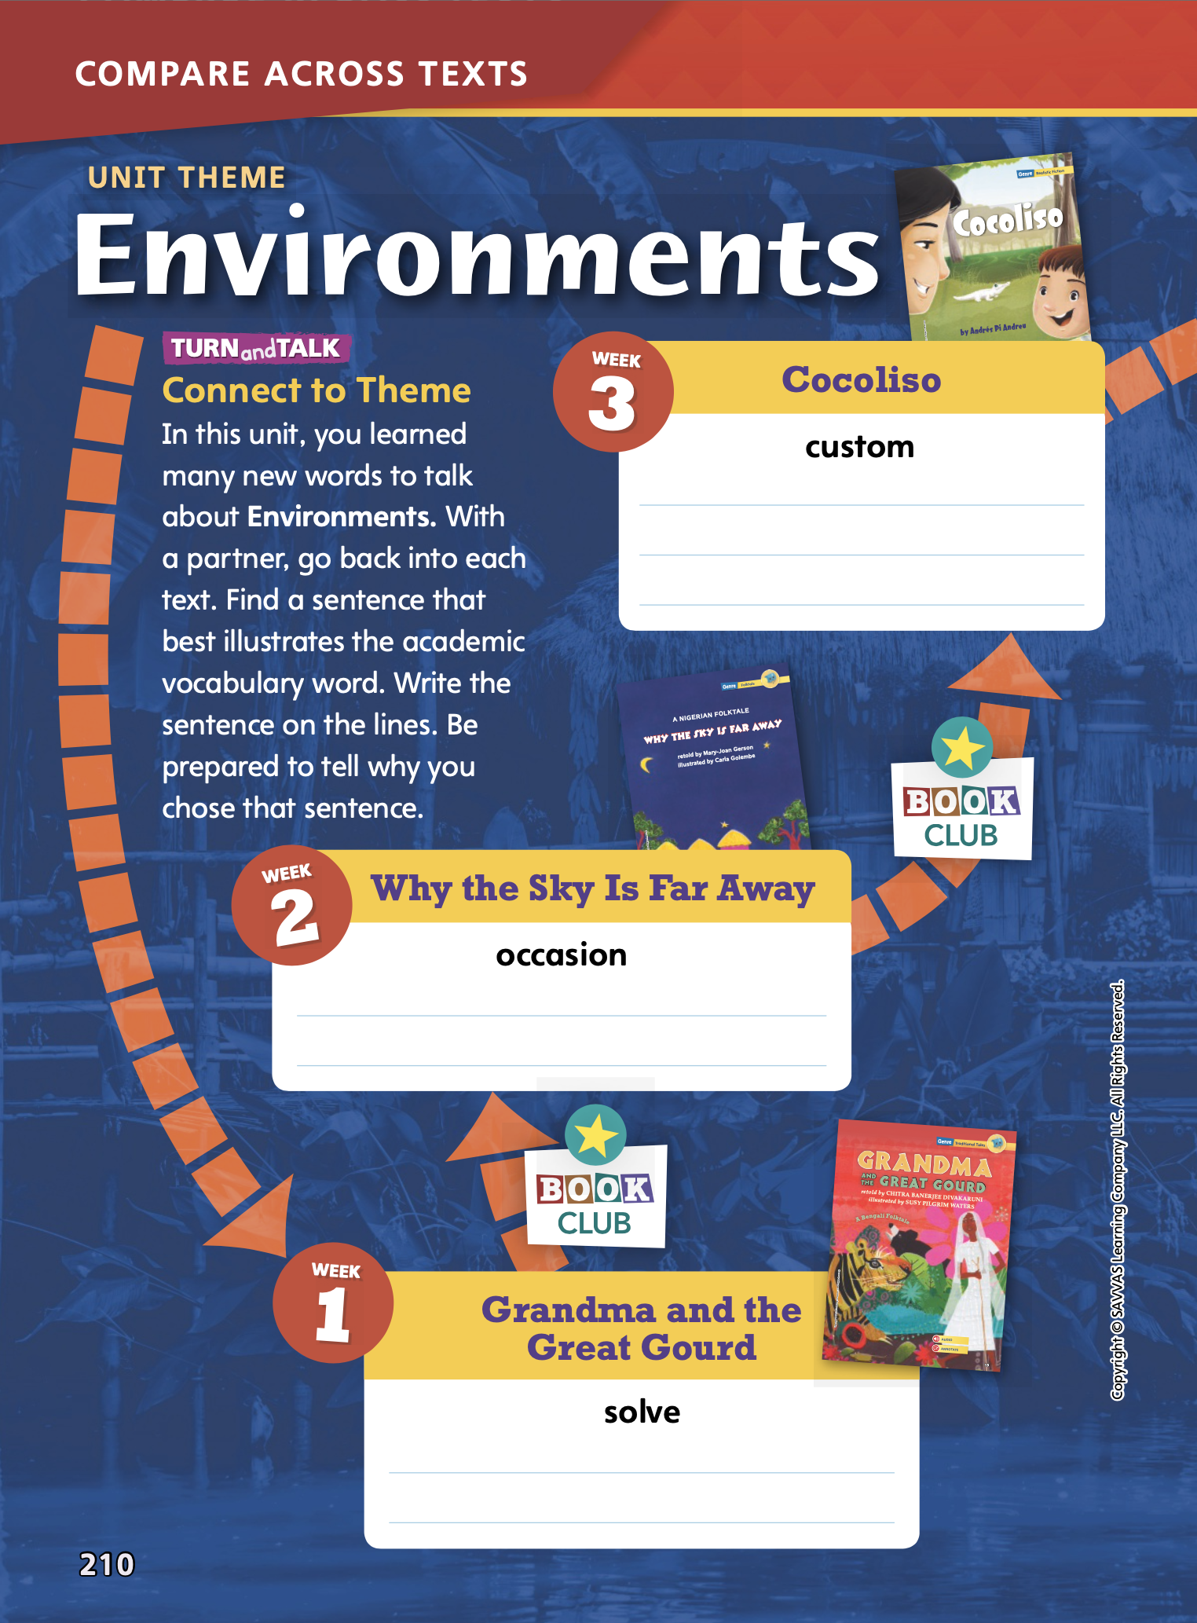
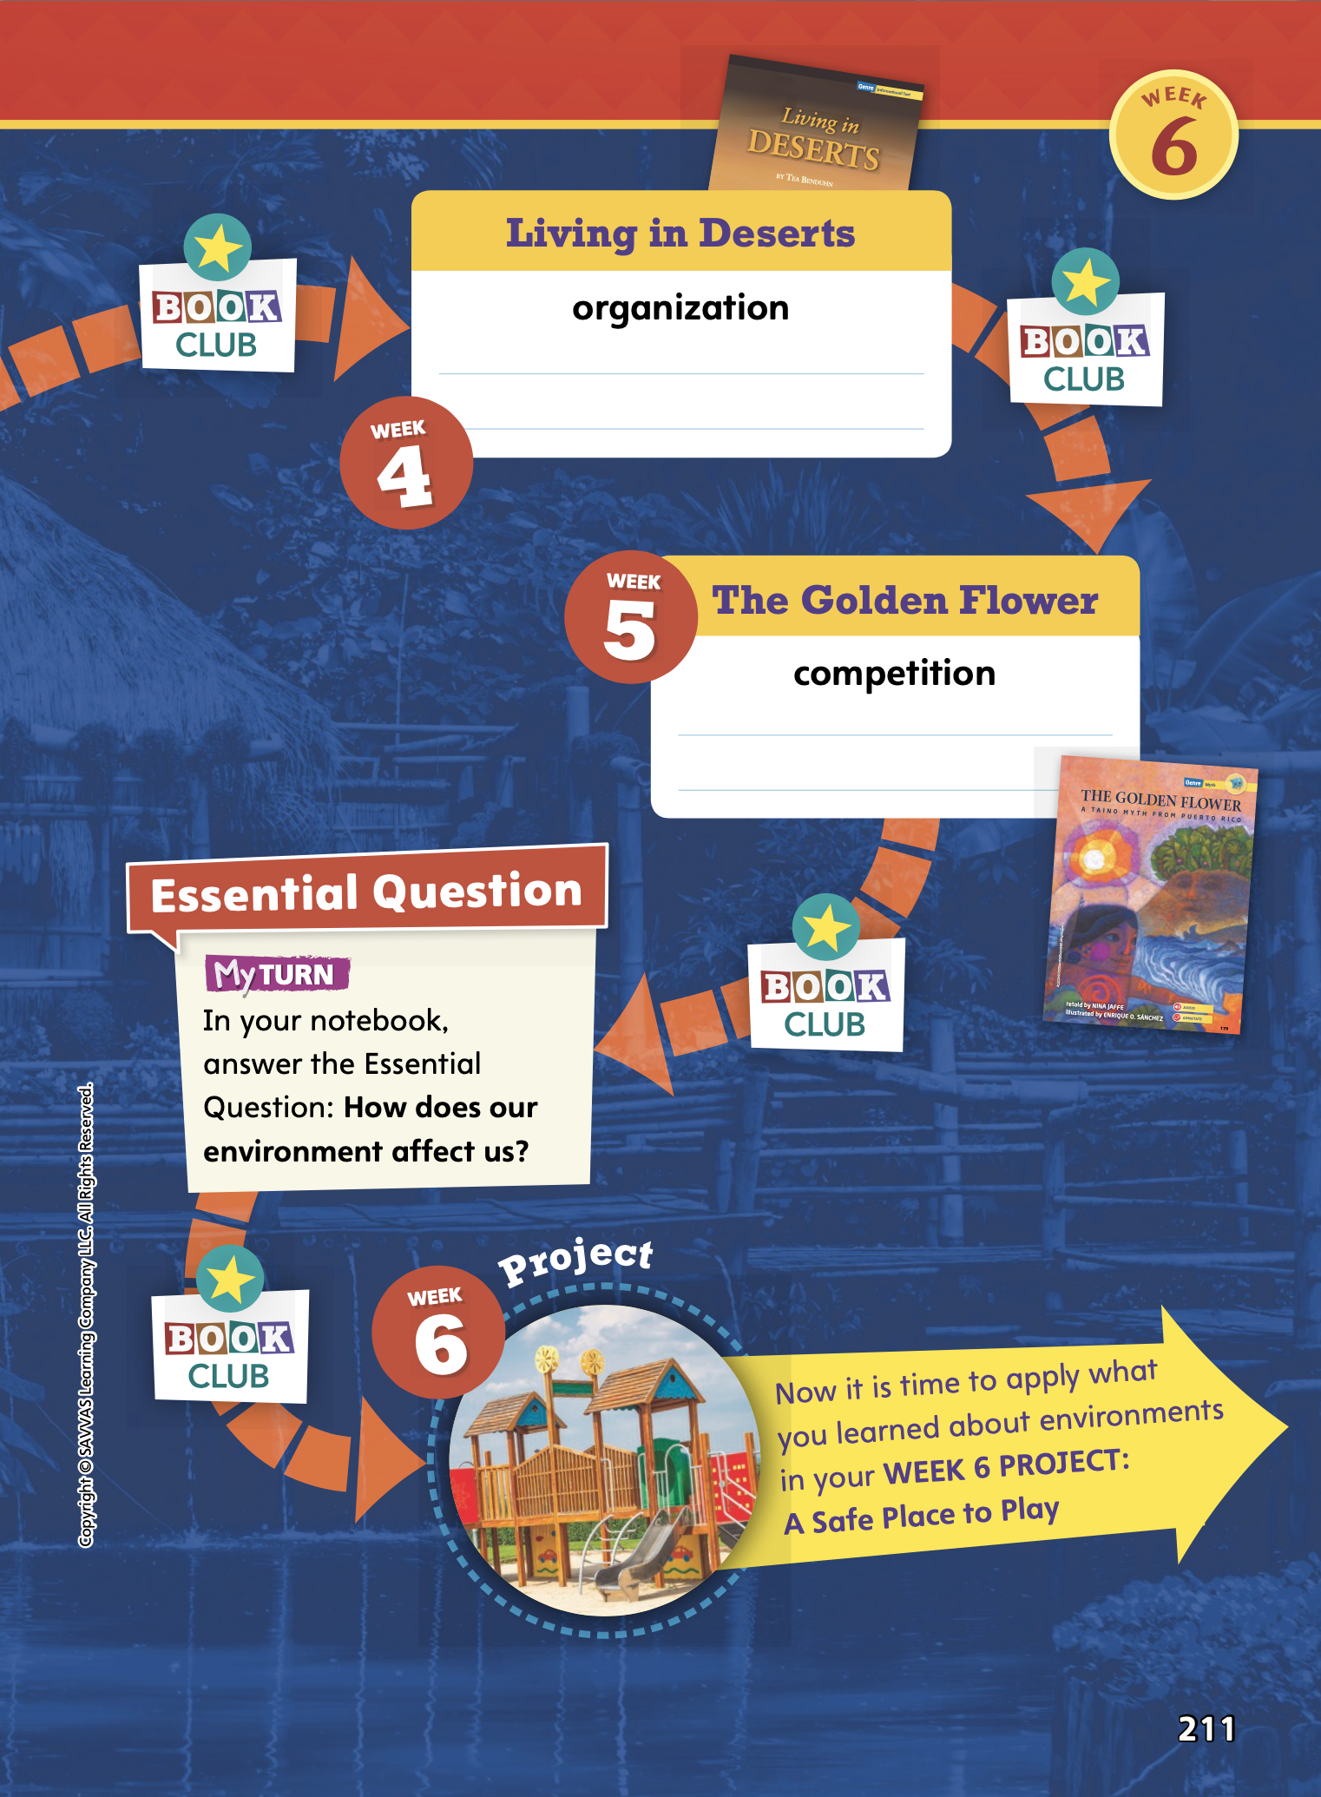
Page
210, 211
Compare Across Texts
Write a sentence that best illustrates the vocabulary word with each text.
Notes:
In this unit, students explored the theme of Environments. This unit of study should help students gain an understanding of the diverse environments on Earth and how environments affect people’s lives.
Connect to Theme-- Have students look back at each text and write a sentence that best illustrates the Academic Vocabulary word listed with each title.
Use Grandma and the Great Gourd: A Bengali Folktale to model how to complete the activity. Say: The Academic Vocabulary word listed with Grandma and the Great Gourd is solve. I’ll go back into the text of Grandma and the Great Gourd to find a sentence that illustrates this word. In paragraph 28, I find a sentence that tells how Grandma and her daughter will solve a problem: “We’ll come up with a plan!” This sentence illustrates the word solve, so I’ll write it in the Week 1 box at the bottom of page 210.

Slide 5
Page
210, 211
Compare Across Texts
Think about how our environments affect us.
Write your response in your notebook.
Notes:
Have students consider what they learned about the theme of Environments by reading the texts in this unit. Use the questions below to guide students in synthesizing information from several texts to create a new understanding of the unit theme.
How are the environments, or the specific settings, of the folktales important to these stories? (Possible response: In all of the folktales, the environment is important to the plot and conflict of each story: Grandma uses a gourd to escape animals in the jungle; the Oba and his people must farm the land because they wasted the sky’s gifts; and Earth was transformed by the child’s seeds into a forest and island.)
How do people adapt to their environments in Cocoliso and Living in Deserts? (Possible response: Alejandro and his family learn how to live and stay safe in the swamp. Desert people have clothing, homes, and ways of finding water and food that help them survive.)
Remind students of the Unit 1 Essential Question: How does our environment affect us? Have students answer the question in their notebooks.
If they struggle to answer, you can do the following:
• Place students in pairs or small groups, and have each group review and answer the Weekly Questions for each text.
• Then have students make connections to ideas in other texts and the larger community.

Slide 6
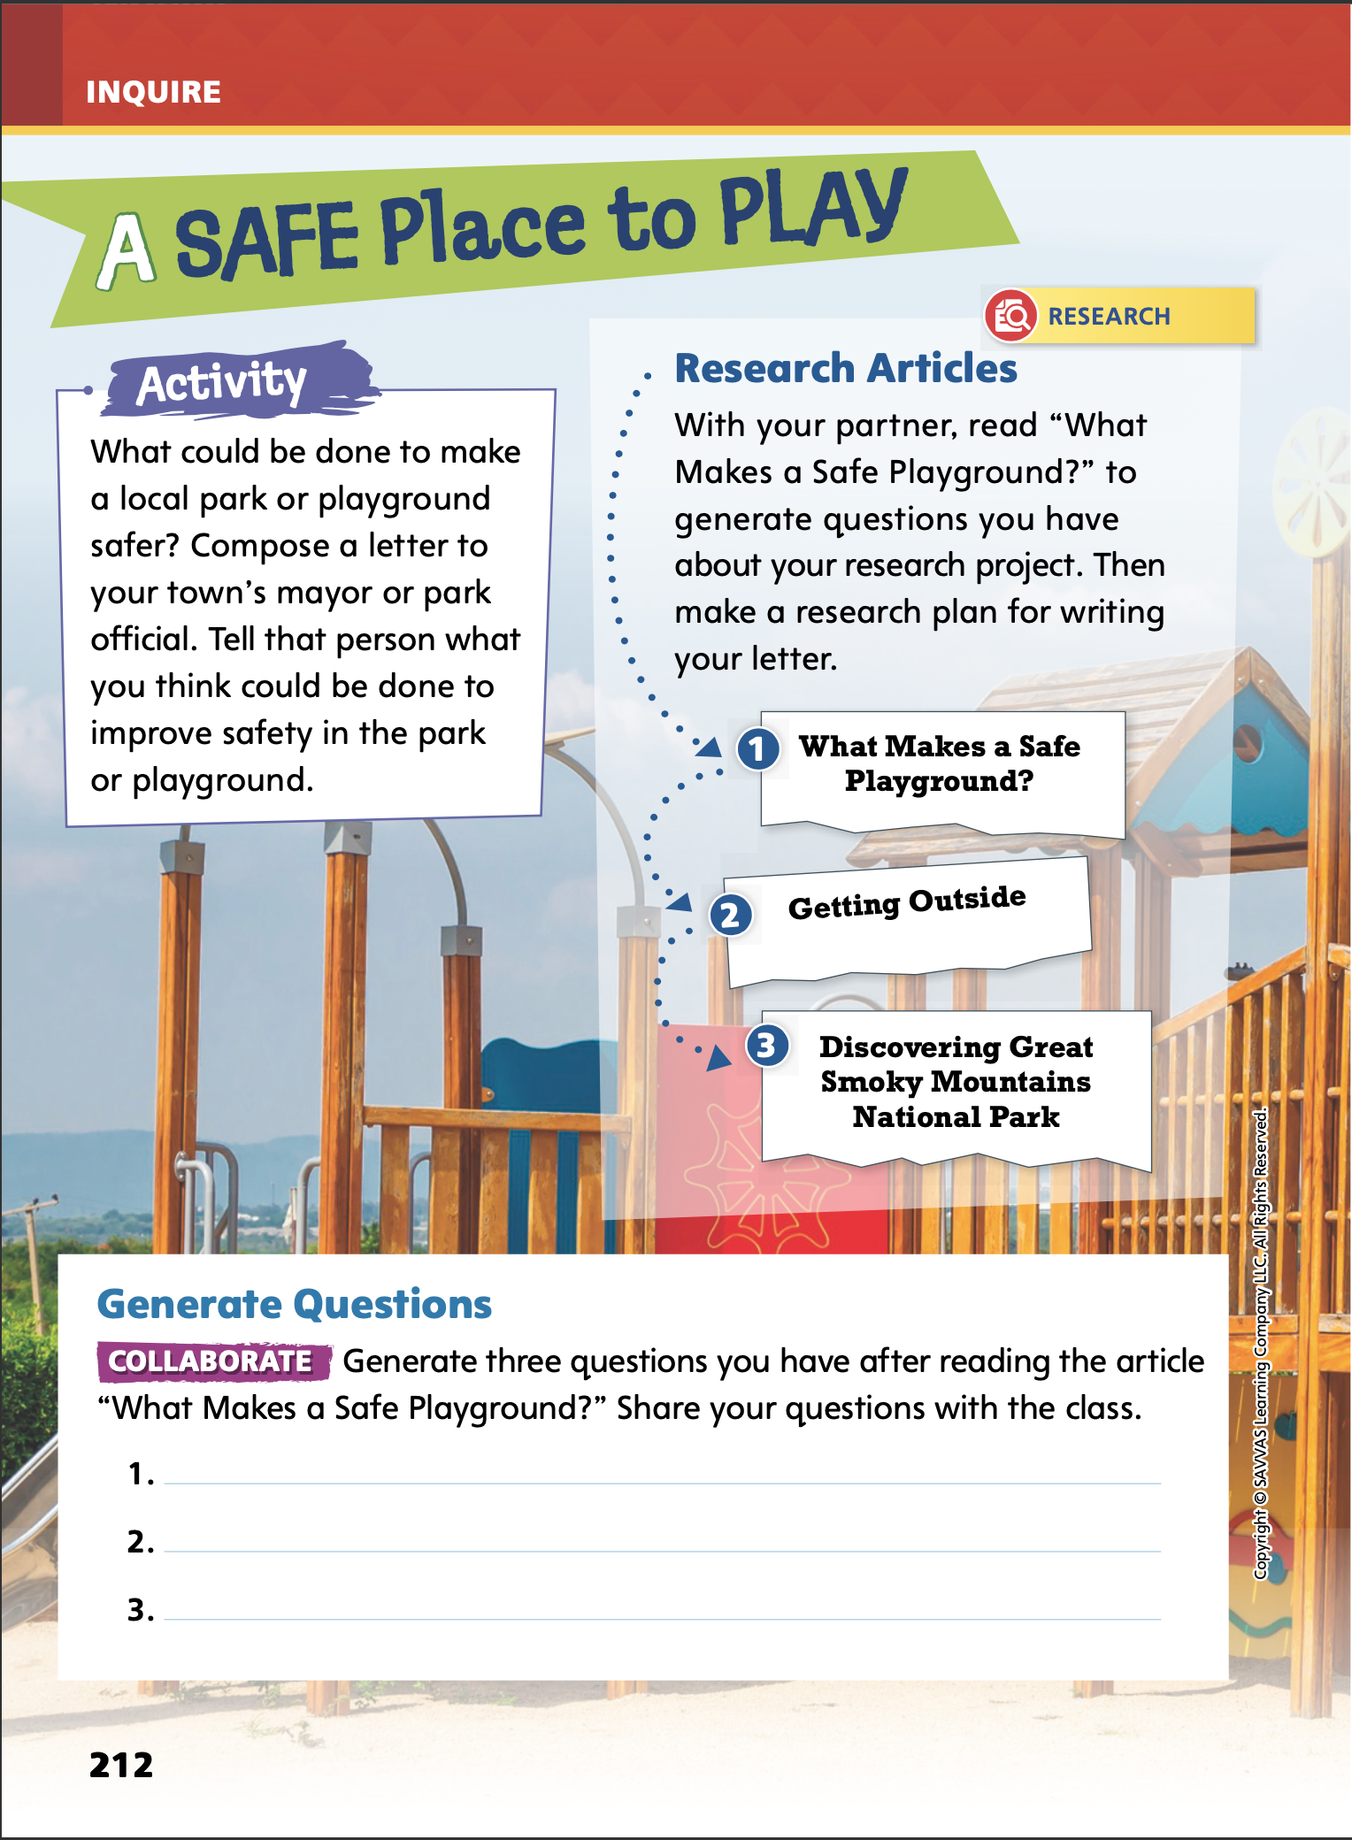
Page
212
Inquire – Introduce the Project
Discuss what it means to “improve” something.
Share your ideas about how safety could be improved in a park. Why is it important for children?
Notes:
This week students will address themes related to environments by collaboratively researching and writing an opinion letter to the students’ town mayor or a park official, telling what could be done to improve safety in a local park or playground. Before assigning the research article, motivate students by activating background knowledge and setting a purpose for the project.
Begin by reading aloud the Activity prompt on p. 212 of the Student Interactive. Have students identify the word improve in the Activity prompt.
Discuss the prompt and activate prior knowledge by asking students to share their ideas about how safety could be improved in a park or playground and why it is important for children.

Slide 7
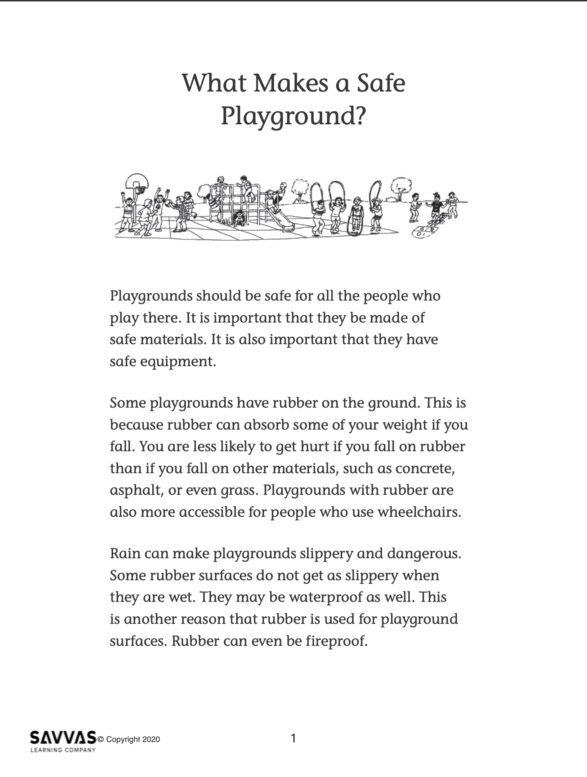
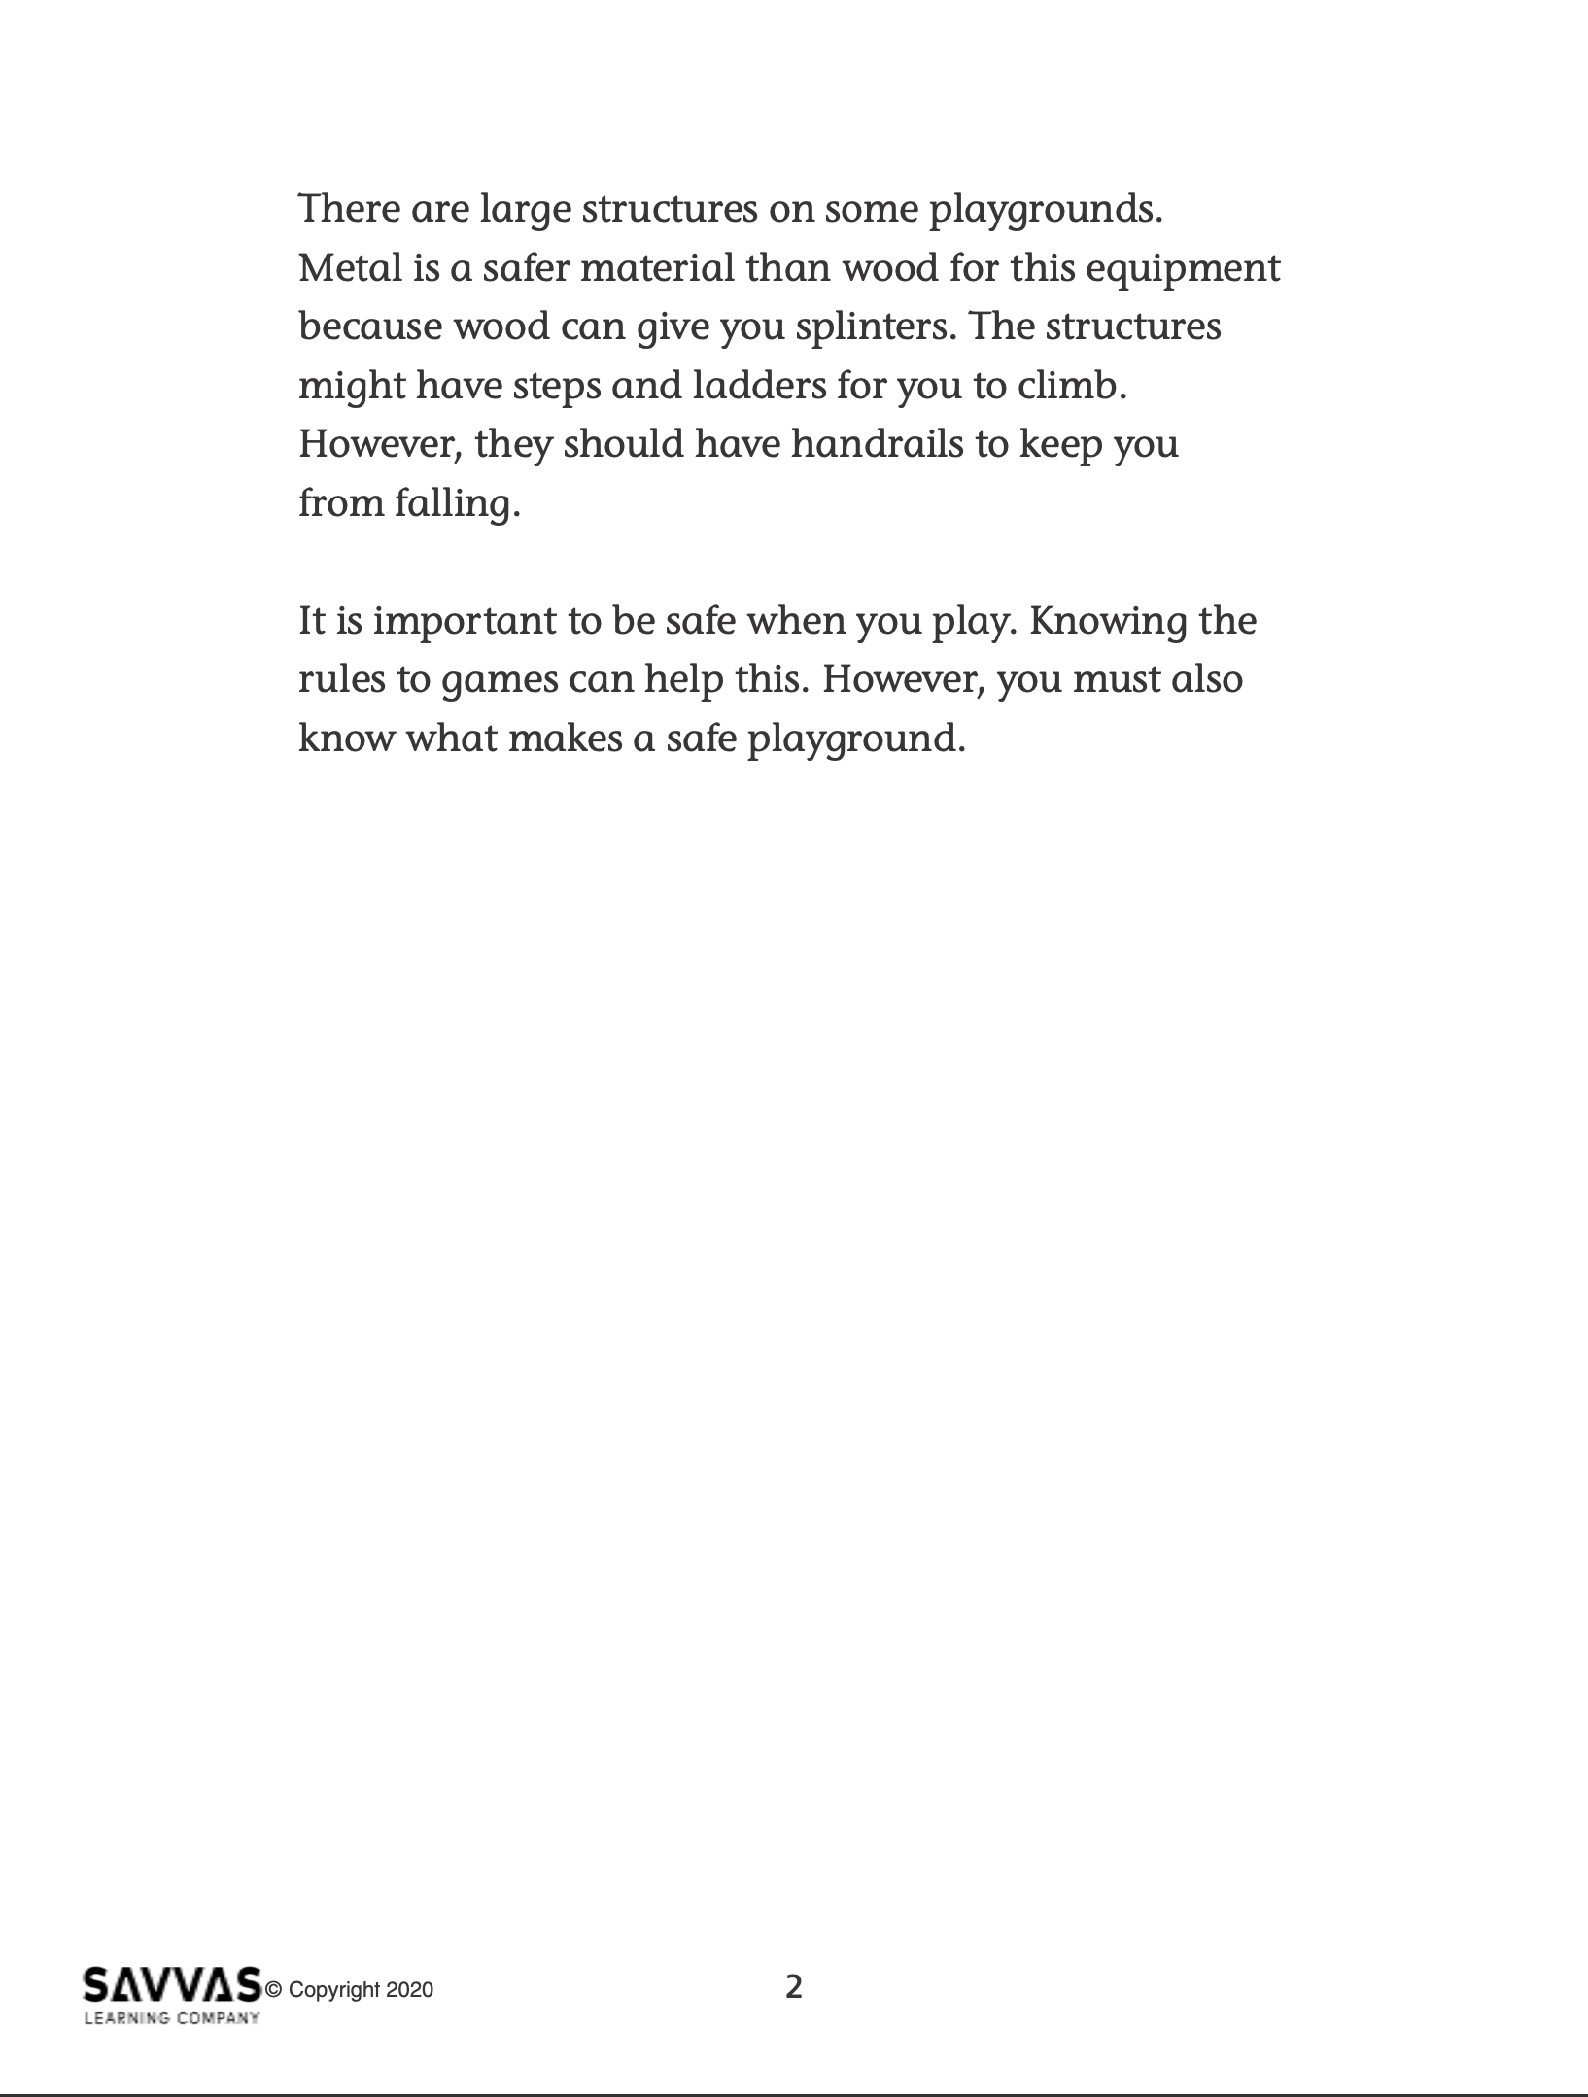
Inquire – Build Background
Read and annotate “What Makes a Safe Playground?”
Underline details about why playground safety is important.
Circle text that you find confusing or do not understand.
Highlight words and phrases that describe how the author feels about the topic.
Notes:
Read-Pause-Annotate: Distribute copies of “What Makes a Safe Playground?” Click path: Table of Contents -> Unit 1: Environments -> U1 W6: Project-Based Inquiry -> U1 W6: Lesson 1
Note: This article is available at 3 different Lexile levels. The slide image is the middle range.
Use the research article to help students build background and generate questions for formal inquiry.
Write the bulleted items below on the board and have partners take turns reading the article aloud. Tell students to pause periodically to annotate the following:
Underline details about why playground safety is important.
Circle text that you find confusing or do not understand.
Highlight words and phrases that describe how the author feels about the topic.
After reading, have students discuss their annotations with the class.

Slide 8
Page
212
Inquire – Generate Questions
Turn to p. 212 in your Student Interactive and complete the activity.
Notes:
Have students work together to generate questions they have about park or playground safety. Have them write them on p. 212 of the Student Interactive.
Tell students that they will work to answer their questions when they conduct research.
If students struggle to generate questions for research, prompt pairs to reread the article and underline words and phrases that they don’t understand. Then ask them to infer the meaning of each based on the article, photo, and Activity prompt.
If students show understanding, have them brainstorm a list of local parks or playgrounds and a feature of each that could be improved. Prompt students to debate which park or playground would be the best one to improve, providing reasons that support their opinions.

Slide 9
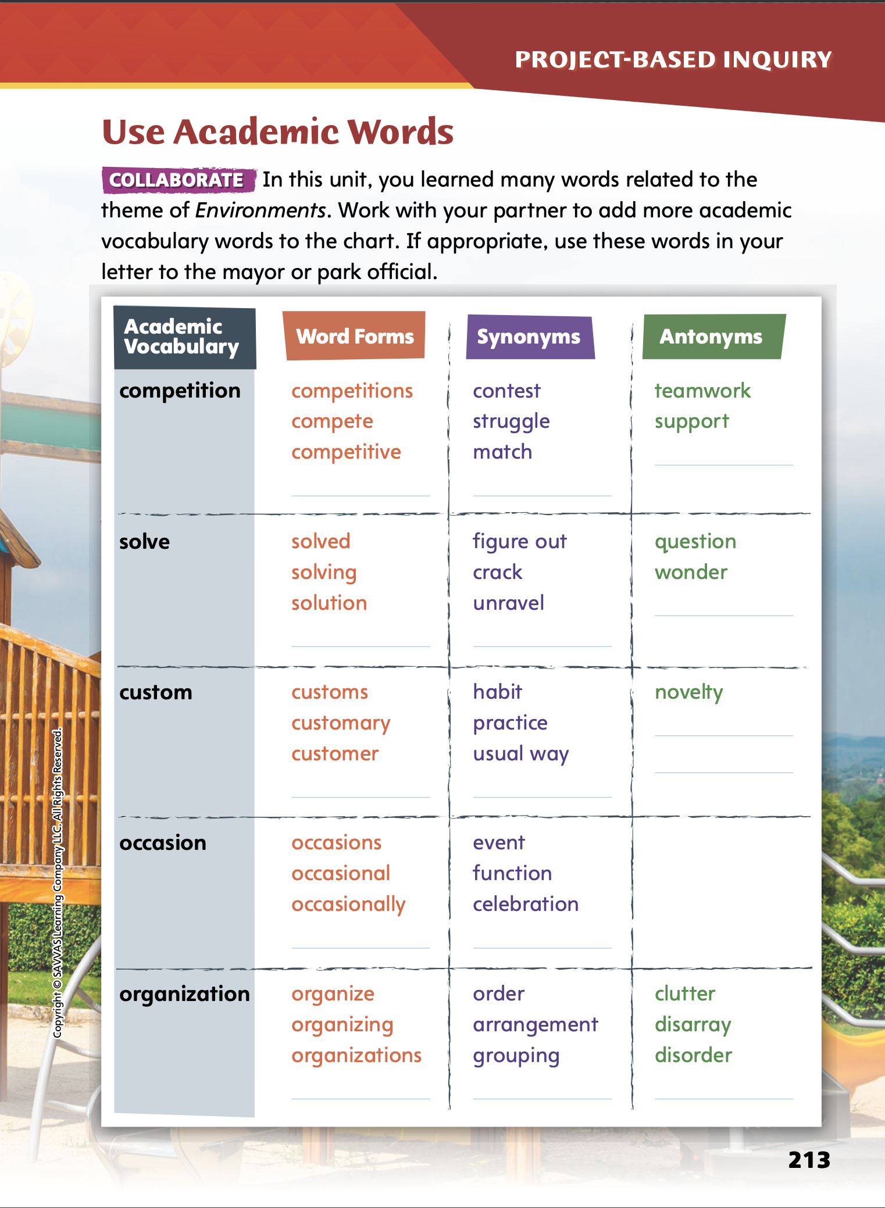
Page
213
Inquire – Academic Vocabulary
Turn to page 213 in your Student Interactive and complete the activity with a partner.
Share your ideas with your classmates.
Notes:
Have students complete the activity on p. 213 of the Student Interactive.
Ask volunteers to share the words they added to the chart with the class.
Tell students that they should try to use some of these academic vocabulary words in their letter to the mayor or park official.

Slide 10
Lesson 2

Slide 11
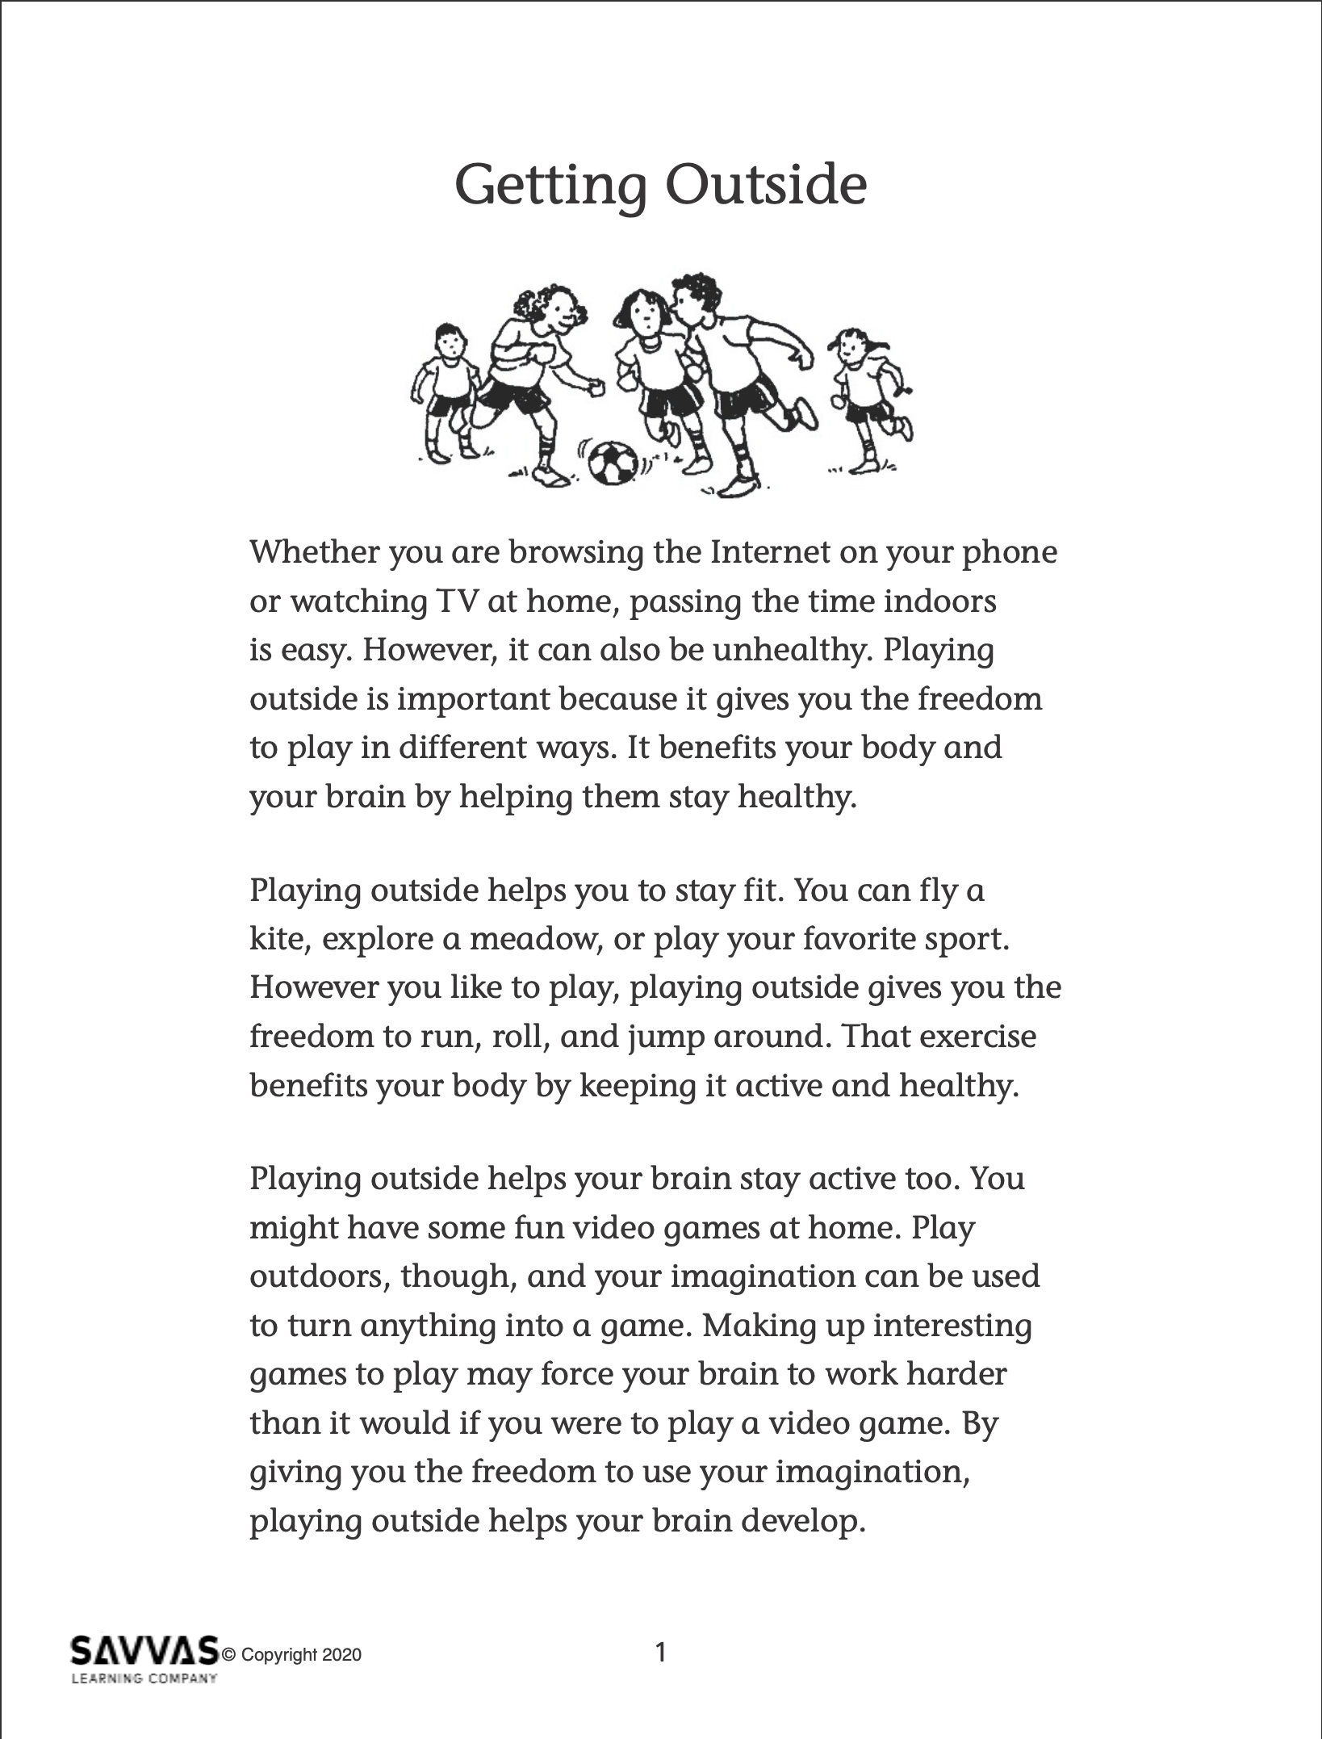
Explore and Plan – Argumentative Writing
Read and analyze “Getting Outside.”
Identify the following:
The topic of the text.
The author’s opinion about the topic.
Reasons that support the author’s opinion.
The intended audience of the text.
Notes:
Use the opinion article, “Getting Outside,” to help students recognize the characteristics and structures of argumentative texts.
Distribute copies of “Getting Outside.” Click path: Table of Contents -> Unit 1: Environments -> U1 W6: Project-Based Inquiry -> U1 W6: Lesson 2
Note: This article is available at 3 different Lexile levels. The slide image is the middle range.
Use the research article to teach the characteristics and structures of argumentative text and critical reading skills.
Explain to students that reading critically is about analyzing the text to better understand the topic, the author’s craft, and the author’s purpose for writing. To critically read an argumentative text, readers should analyze the text to help them identify and understand
The topic of the text.
The author’s opinion about the topic.
Reasons that support the author’s opinion.
The intended audience of the text.

Slide 12
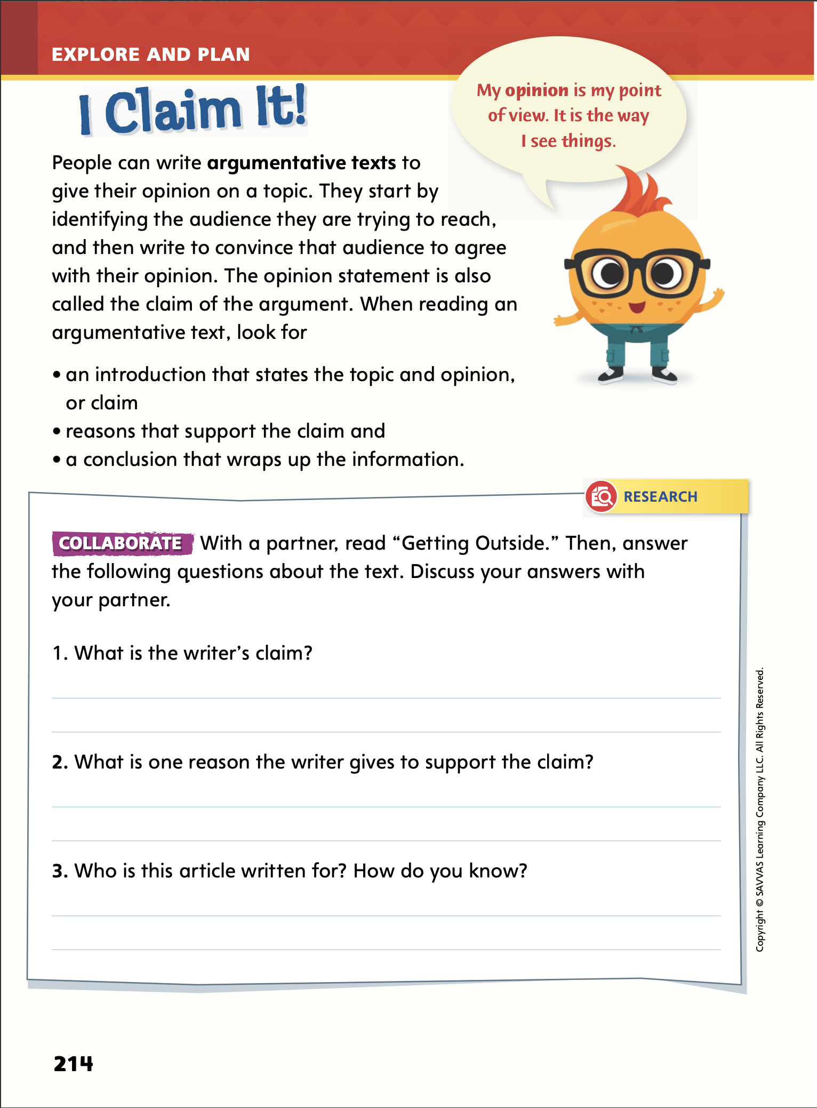
Page
214
Explore and Plan – Argumentative Writing
Turn to p. 214 in your Student Interactive and complete the activity with a partner.
Notes:
After students have read “Getting Outside,” lead them in a discussion about the article. Guide students in critically understanding the article using the following questions.
What is the topic of the article?
What words and phrases reveal the author’s opinion about the topic?
Do you think the author’s reasons support the author’s opinion? Explain why or why not.
Then have students complete p. 214 in the Student Interactive.

Slide 13
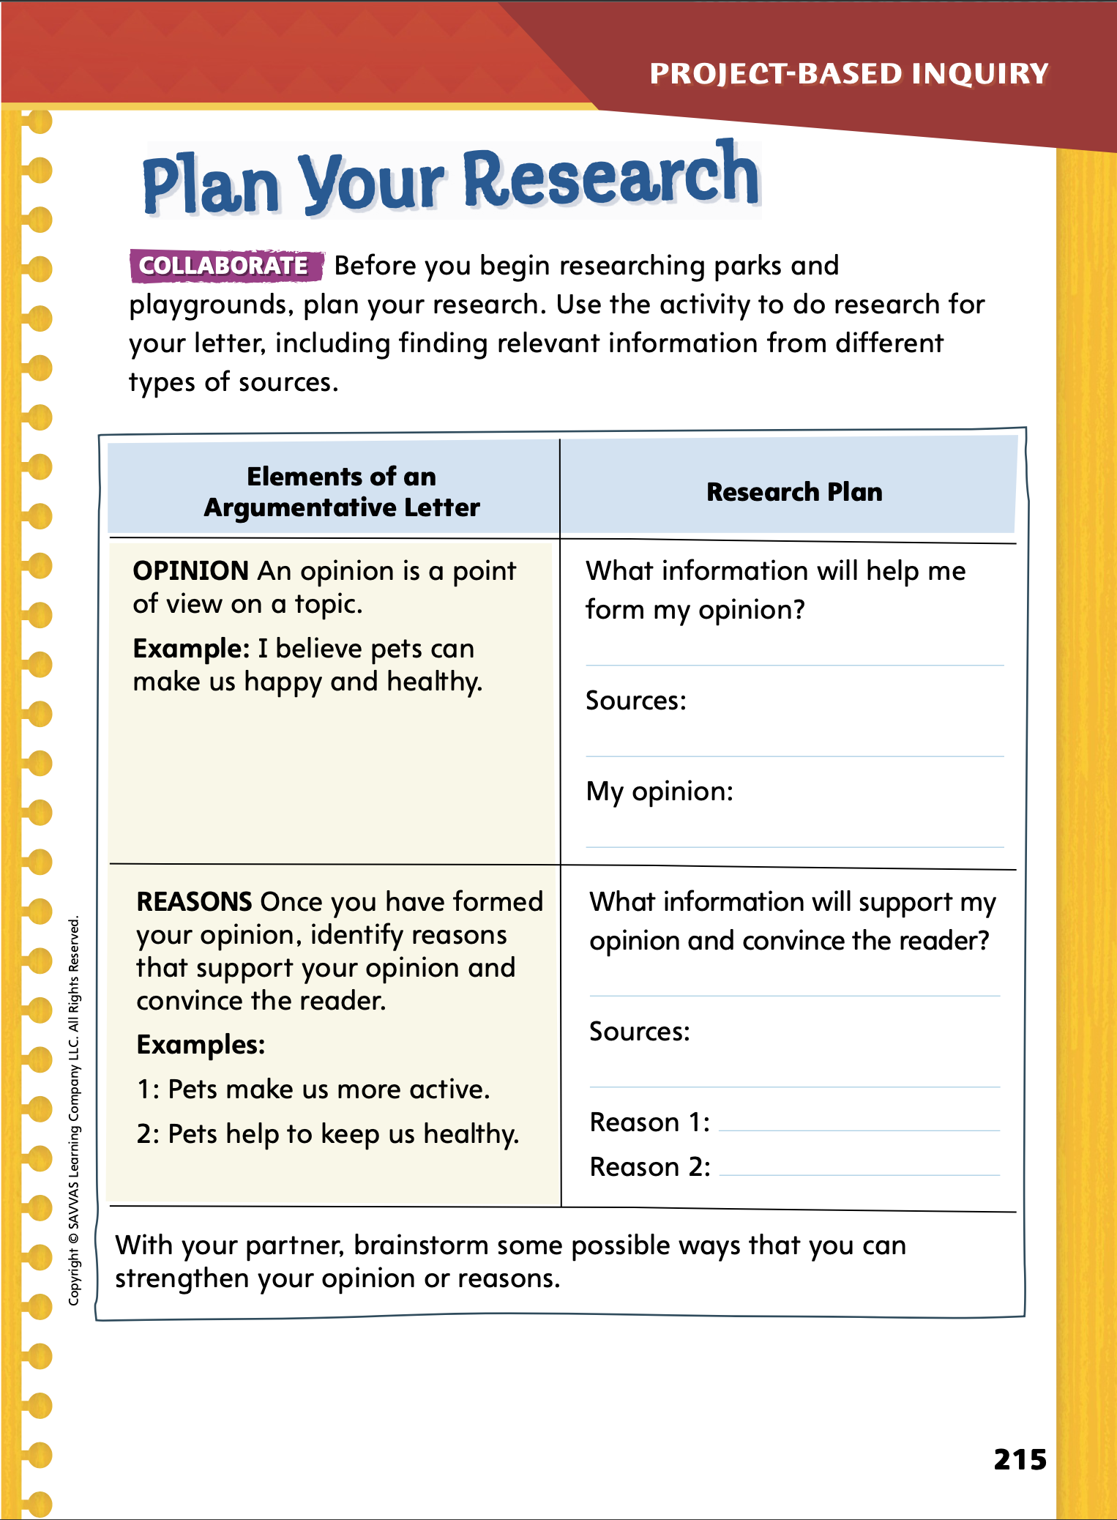
Page
215
Explore and Plan – Argumentative Writing
Turn to p. 215 in your Student Interactive and complete the activity with a partner.
Notes:
Have student pairs use the Plan Your Research activity on p. 215 to help them form an opinion about park or playground safety and develop a research plan with adult assistance. A research plan includes generating questions for formal inquiry, conducting research about the topic, writing the project, revising and editing the project, and presenting. Ask students to consider how they can strengthen their opinions and reasons.
Once students have completed the activity, initiate a class discussion of students’ opinions, research plans, and ideas for strengthening their opinion and supporting reasons.
Allow time for student pairs to revise their research-plan charts based on the information shared during the discussion.

Slide 14
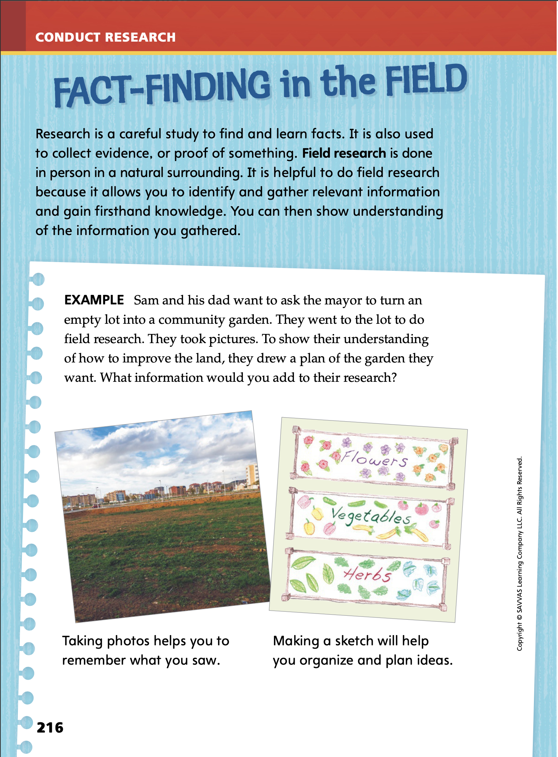
Page
216
Conduct Research
Discuss what information you would add to Sam and his dad’s research.
Notes:
Tell students that field research is conducted in a natural surrounding. Explain that researchers conduct field research when they go to a location to collect data. Tell students that information collected during field research is a primary source because it is gathered firsthand.
Explain that there is a variety of information at a site that can be identified and gathered. Tell students to look at the whole site, but then identify all the different sources of relevant, or meaningful, information that can be gathered to help with their project. They need to understand the information they gather and why it is helpful for their project.
Use the example on p. 216 of the Student Interactive to help students understand how field research can be conducted.
Say: Sam and his dad need to conduct field research on the empty lot to support their argument for turning it into a community garden. They go to the lot to study the area and collect information. They take photos and measurements. They use their field research to draw a plan for the community garden.
Have students discuss their ideas for identifying and gathering information from different sources at the site. Have student teams discuss the information and why the information will be important to their project.

Slide 15
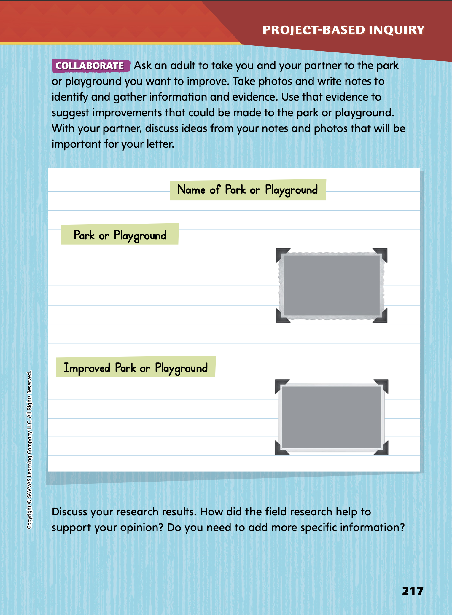
Page
217
Conduct Research
Record your field research on p. 217 of your Student Interactive.
With your partner, discuss ideas from your notes and photos that will be important for your letter.
Notes:
Send a letter home with students explaining the project and encouraging parents and guardians to visit a park or playground with students. For students who are unable to visit a park or playground, have them develop a field research plan about the information they would want to collect.
Have students write notes to identify and gather relevant information and evidence from a variety of sources. Tell them to record their field research on p. 217 of the Student Interactive.
Have students show understanding of the information gathered by discussing with their team why it is important to their project.
For differentiated support:
For struggling students, provide support by creating a K-W-L chart on the board with the following headings: What I Know About the Park/Playground, What I Want to Know, What I Learned Through My Field Research. Complete the chart together with students.
For students that are showing understanding, have them collect additional information to support their argument by conducting field research at a park or playground that has already been improved or by researching park and playground improvements online. Provide an opportunity for students to share their research findings with the class.
Once students have collected information on the park or playground they want to improve, they should be ready to begin a first draft of their letters. As students begin writing, they should demonstrate understanding of the information gathered. Be sure that they can identify their topic, opinion, reasons and evidence that support the opinion, and who their intended audience is. In the following activity, students will learn how to write their letters.

Slide 16
Lesson 3

Slide 17
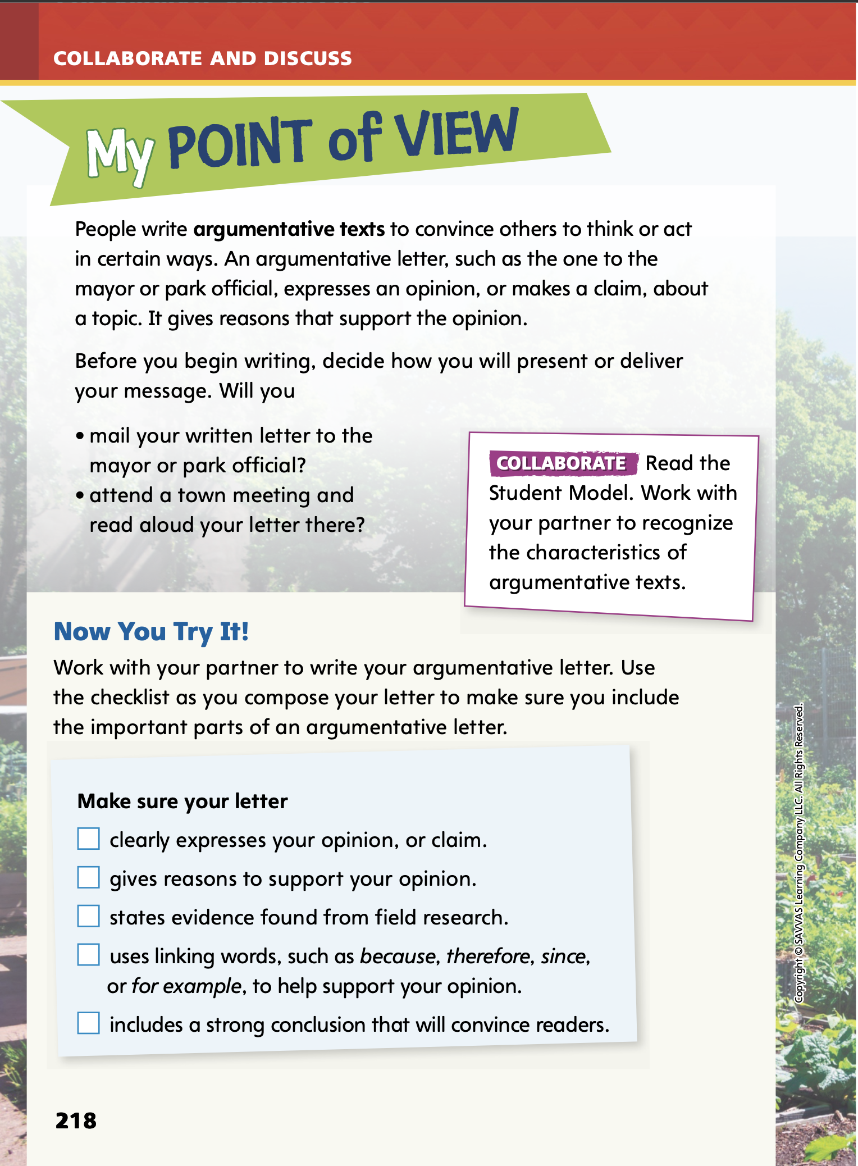
Page
218, 219
Collaborate and Discuss
Read the Student Model on p. 219 of your Student Interactive. Work with your partner to recognize the characteristics of argumentative texts.
Notes:
Remind students that the student model is about creating a community garden, but their writing task is about improving a park or playground. Use the student model to review some of the characteristics of argumentative texts, as well as the formatting and organization of a formal letter addressed to the mayor or a park official.
Use the letter on p. 219 of the Student Interactive to model the characteristics and structures of an argumentative letter. Say: When writing an argumentative letter, it is important to include the name of the person to whom you are writing the letter. Be sure to identify the topic about which you are writing, and clearly state your opinion. The letter should also include reasons that support the opinion and a conclusion that restates your opinion and helps to convince the reader to agree with your opinion. Let’s look at the parts of an argumentative letter using this letter written by Gracie and Dylan. Who is the intended audience for their letter? What parts of this letter help to convince the reader to agree with their opinion?
Ask student volunteers to share their thoughts and responses. Use the callouts to teach students the characteristics of an argumentative text.

Slide 18
Page
218, 219
Apply
Use the checklist on p. 218 of your Student Interactive as you write the first draft of your letter.
Notes:
Direct student pairs to read p. 218 of the Student Interactive and use the checklist as they write a complete first draft of their letter to the mayor or a park official.
Remind students to look for opportunities to use some of their newly acquired academic vocabulary as they work on their drafts.
Remind students to consider their intended audience while they are writing. For their letters, students should use formal English and address the mayor or park official. Display the name of the mayor or the director of the local park service for students. Then offer examples of formal English and have volunteers offer examples of their own. Remind students that formal English should have a serious tone and include complete sentences, and should not contain contractions.

Slide 19
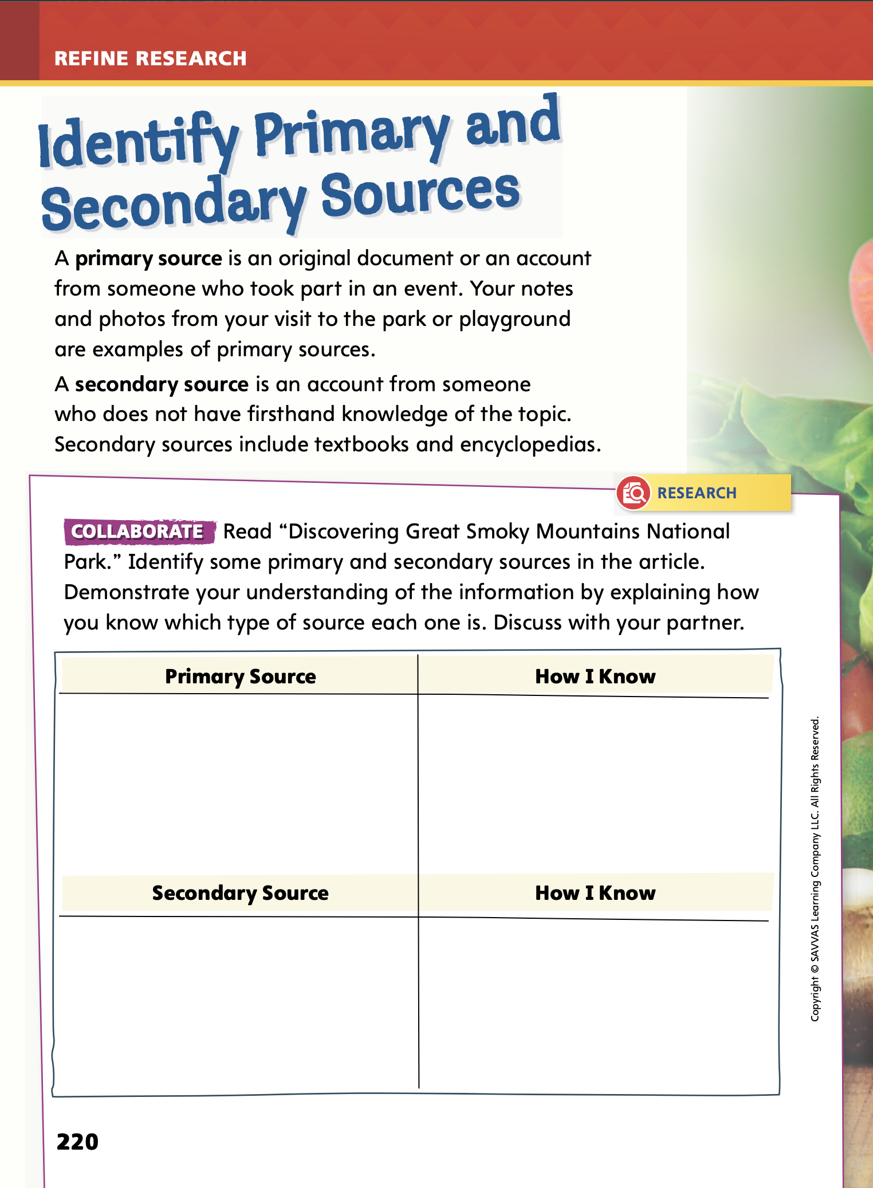
Page
220
Refine Research
Turn to p. 220 in your Student Interactive.
Notes:
Tell students that researchers must evaluate the sources of information they use. All of the sources can be classified as either primary or secondary sources.
Model how to identify primary and secondary sources. Say: To determine if a source is a primary or secondary source, I need to think about the genre and characteristics of the source. For example, I find a speech I want to use. It includes the exact words that someone said to a group of people. The speech provides firsthand evidence of what was said, so this speech is a primary source. If I’m reviewing a magazine article that I want to use in my research, I might notice that the author provides opinions on the topic. The magazine article is a secondary source because it does not provide a firsthand account or direct evidence about the topic.

Slide 20
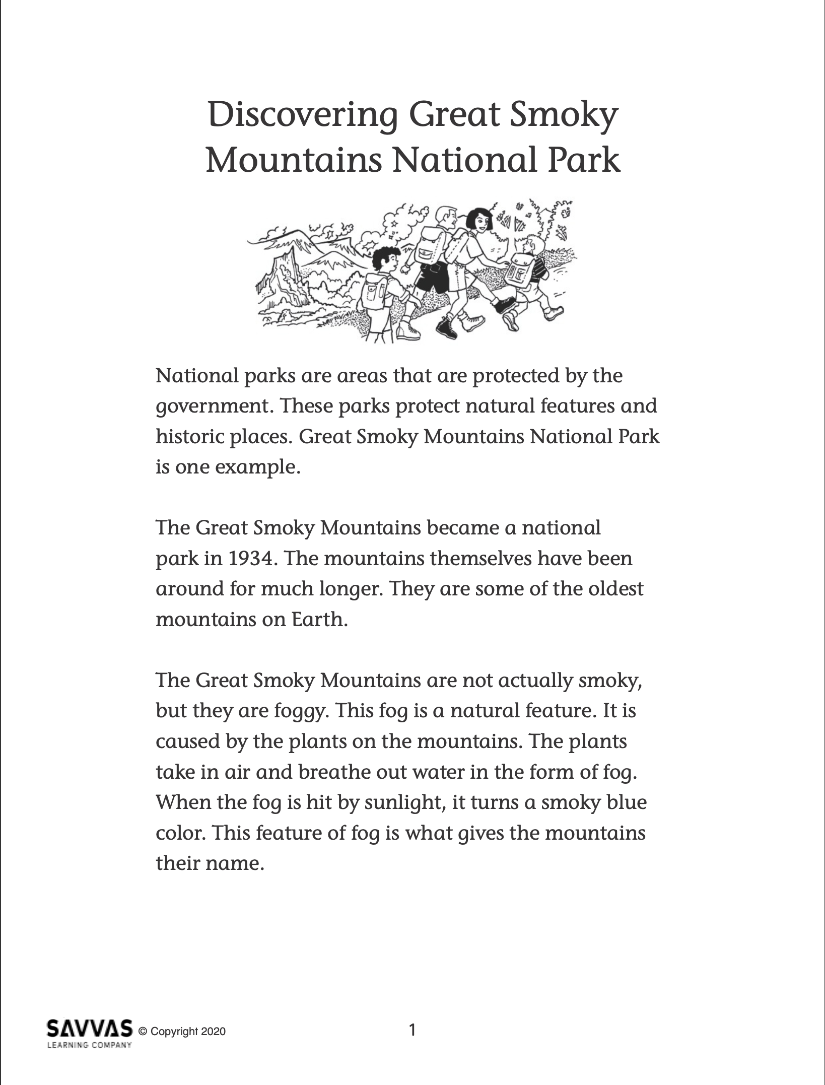
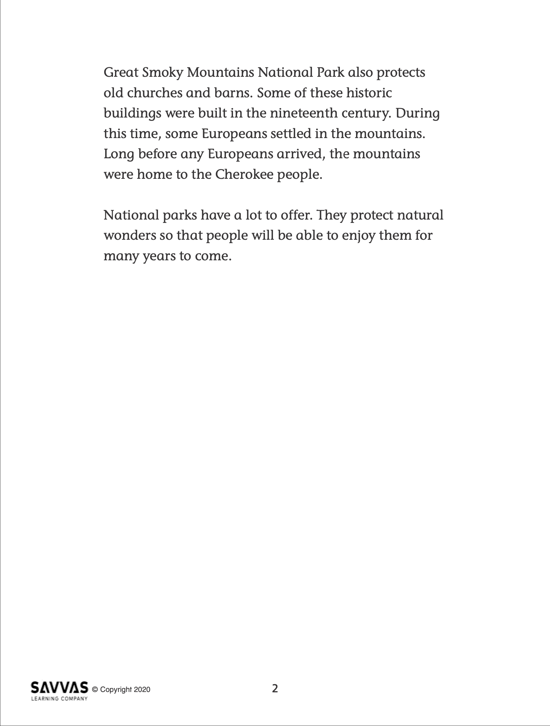
Refine Research
Read “Discovering Great Smoky Mountains National Park.”
A primary source provides direct or firsthand evidence about an event, object, or person.
A secondary source is made by someone using primary source info or someone else’s research.
Notes:
Distribute copies of “Discovering Great Smoky Mountain National Park.” Click path: Table of Contents -> Unit 1: Environments -> U1 W6: Project-Based Inquiry -> U1 W6: Lesson 3
Note: This article is available at 3 different Lexile levels. The slide image is the middle range.
Use the research article to provide practice in identifying primary and secondary sources.
As students analyze the sources in the article, display the following bullet points to further assist students in identifying primary and secondary sources.
A primary source provides direct or firsthand evidence about an event, object, or person.
A secondary source is a source made by someone using primary source information or someone else’s research. Secondary sources do not provide direct or firsthand evidence about the topic.

Slide 21
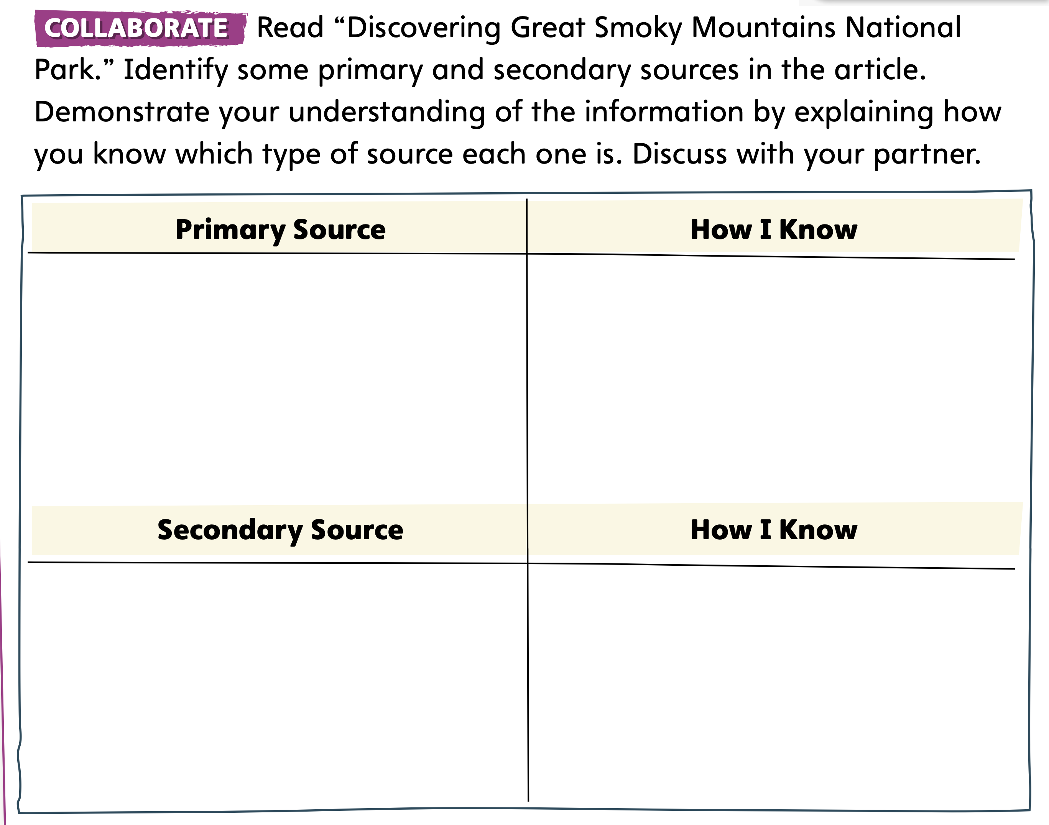
Page
220
Refine Research
Identify which sources are primary and which sources are secondary.
Turn to p. 220 in your Student Interactive and complete the activity.
Notes:
Give students time to complete the chart on p. 220 of the Student Interactive independently.
Have them identify primary and secondary sources in the article. Follow up by having students demonstrate understanding of the information gathered by explaining how they were able to identify each of the sources.
For additional practice, use additional primary sources. Click path: Table of Contents -> Unit 1: Environments -> U1 W6: Project-Based Inquiry -> U1 W6: Primary Sources

Slide 22
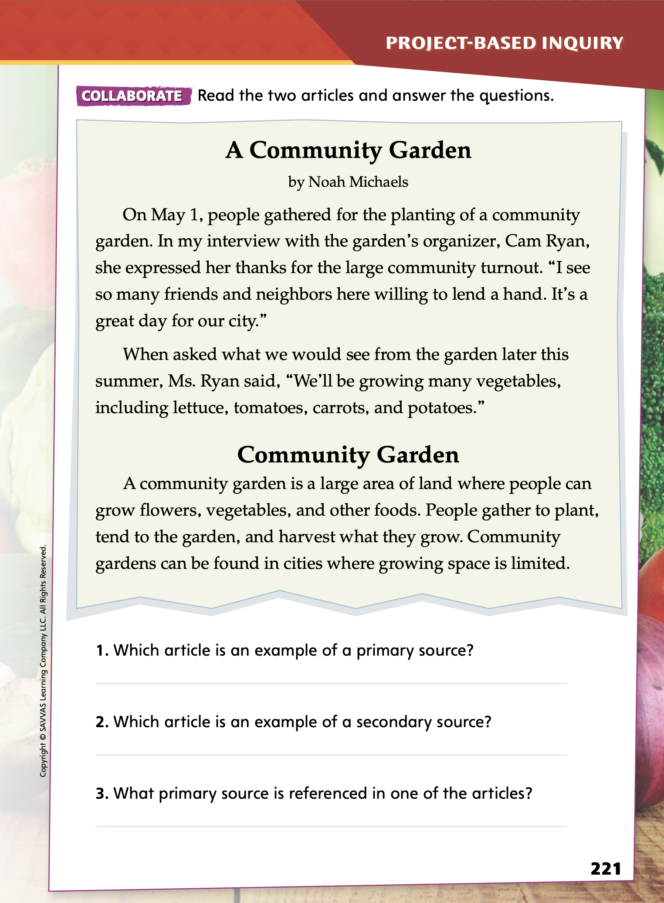
Page
221
Refine Research
Turn to p. 221 in your Student Interactive and complete the activity with a partner.
Notes:
Next, have students practice identifying primary and secondary sources by completing the activity on p. 221 of the Student Interactive.
For differentiated support:
For struggling students, provide them with additional practice in identifying primary and secondary sources. Provide a list of sources that could include information about playgrounds, such as an encyclopedia, a magazine article, a speech from a park official, and the results of an experiment conducted at a playground. Ask students to identify each source as a primary or secondary source and discuss how they can tell.
Have students who fully comprehend the distinction between primary and secondary sources identify a primary and secondary source related to their research topic. Have students use information from the sources to further support their opinion in their argumentative letter.
Have students look at their drafts for opportunities to include primary and secondary sources in their research.

Slide 23
Lesson 4

Slide 24
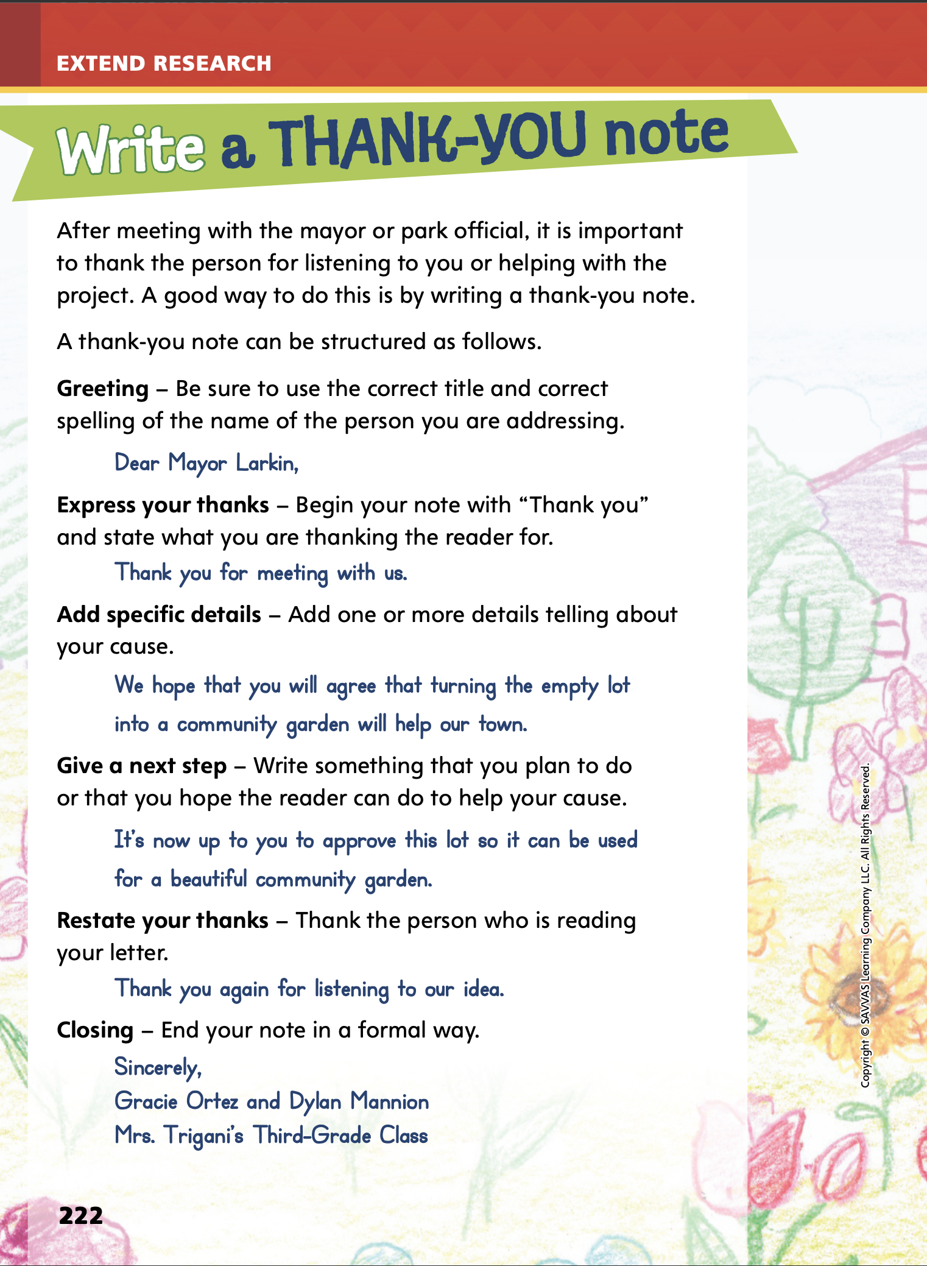
Page
222
Extend Research – A Thank You Note
Turn to p. 222 in your Student Interactive.
Notes:
Tell students that a thank you note is a way to acknowledge and express gratitude, or thankfulness, for something nice that someone has done.
Use the thank you note on p. 222 of the Student Interactive to identify and evaluate the structure of a thank you letter.
Say: After Gracie and Dylan met with the mayor, they wrote a note to thank the mayor for his or her time and help. This thank you note is a formal letter because it is for someone who holds a government job and title. It should use formal English. Remember to use complete sentences and a serious tone and avoid using contractions.
Say: Thank you notes include a greeting, an expression of thanks, specific details about why you are thankful, and a closing. The thank you note from Gracie and Dylan also includes a next step that reminds the mayor about their cause. The students also restated their thanks. Why do you think each part of the thank you note is important? Why is it important to follow up with a thank you note?
Provide an opportunity for students to respond and then review the structure of the thank you note together as a class.

Slide 25
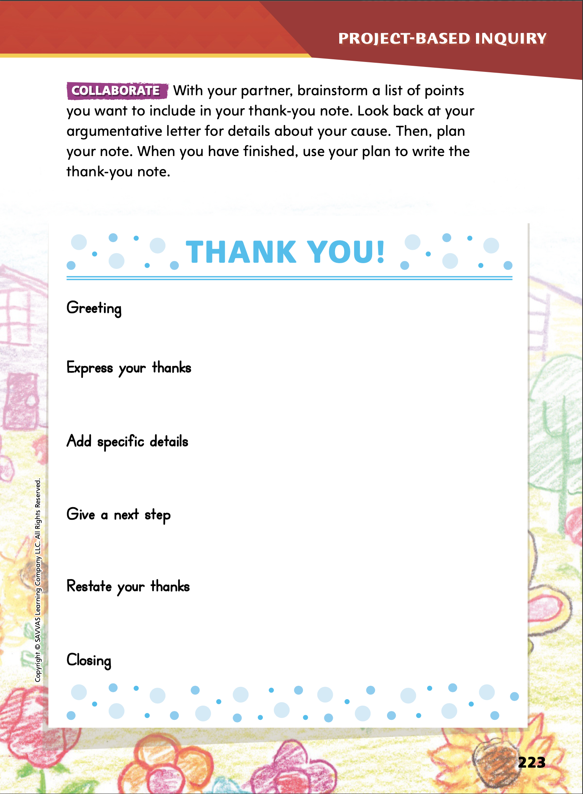
Page
223
Extend Research – A Thank You Note
Turn to p. 223 in your Student Interactive and complete the activity with a partner.
Notes:
Direct student pairs to plan their thank you note using p. 223 of the Student Interactive.
Then have them use the plan to compose a thank you note.
Allow time for students to discuss their preferences for delivering notes to the mayor or park official.

Slide 26
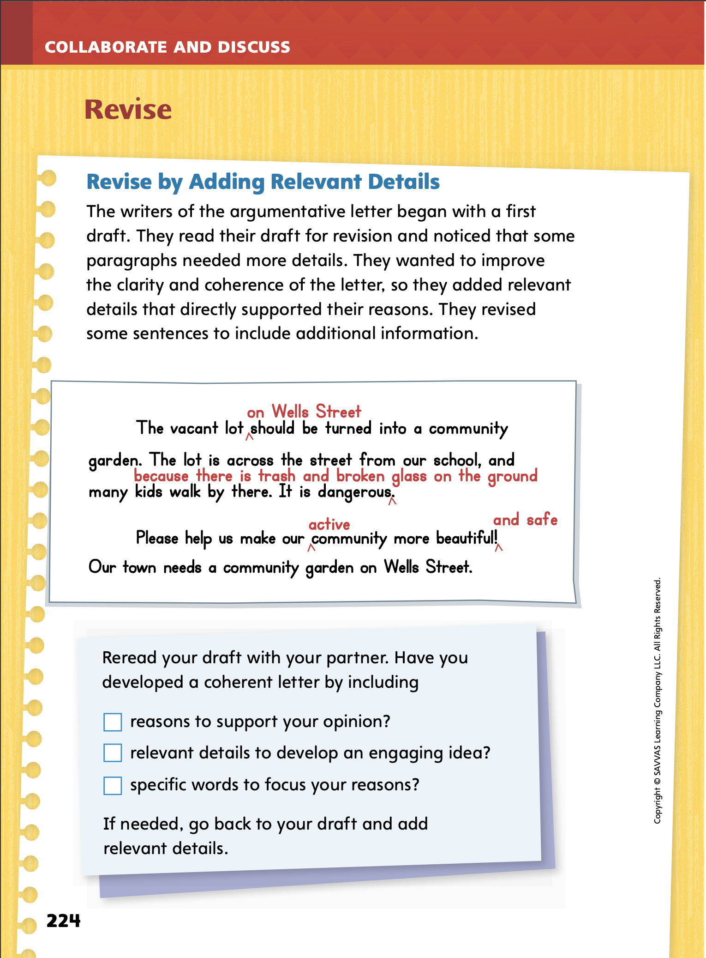
Page
224
Collaborate and Discuss
Turn to p. 224 in your Student Interactive.
Discuss how adding “active” and “safe” strengthen their reasons and support their opinion.
Notes:
Tell students that writers analyze their own writing to determine how they can make their ideas clearer and well organized. When writers review their writing, they should check their verbs to make sure that they used the past, present, and future verb tenses correctly.
Model how writers add details on p. 224 of the Student Interactive, referring back to the Student Model on p. 219. Say: When Gracie and Dylan analyzed a draft of their letter, they noticed that they did not use enough details to make their argument strong. In the first paragraph, they know where the lot is and why the lot is dangerous, but they realized they didn’t explain that to the reader. So they revised their writing by adding the location and the reason why it was dangerous. This revision makes it clearer and adds strength to their opinion.
Ask students to explain how adding “active” and “and safe” strengthened their reasons and supported their opinion. Offer corrective feedback as needed.

Slide 27
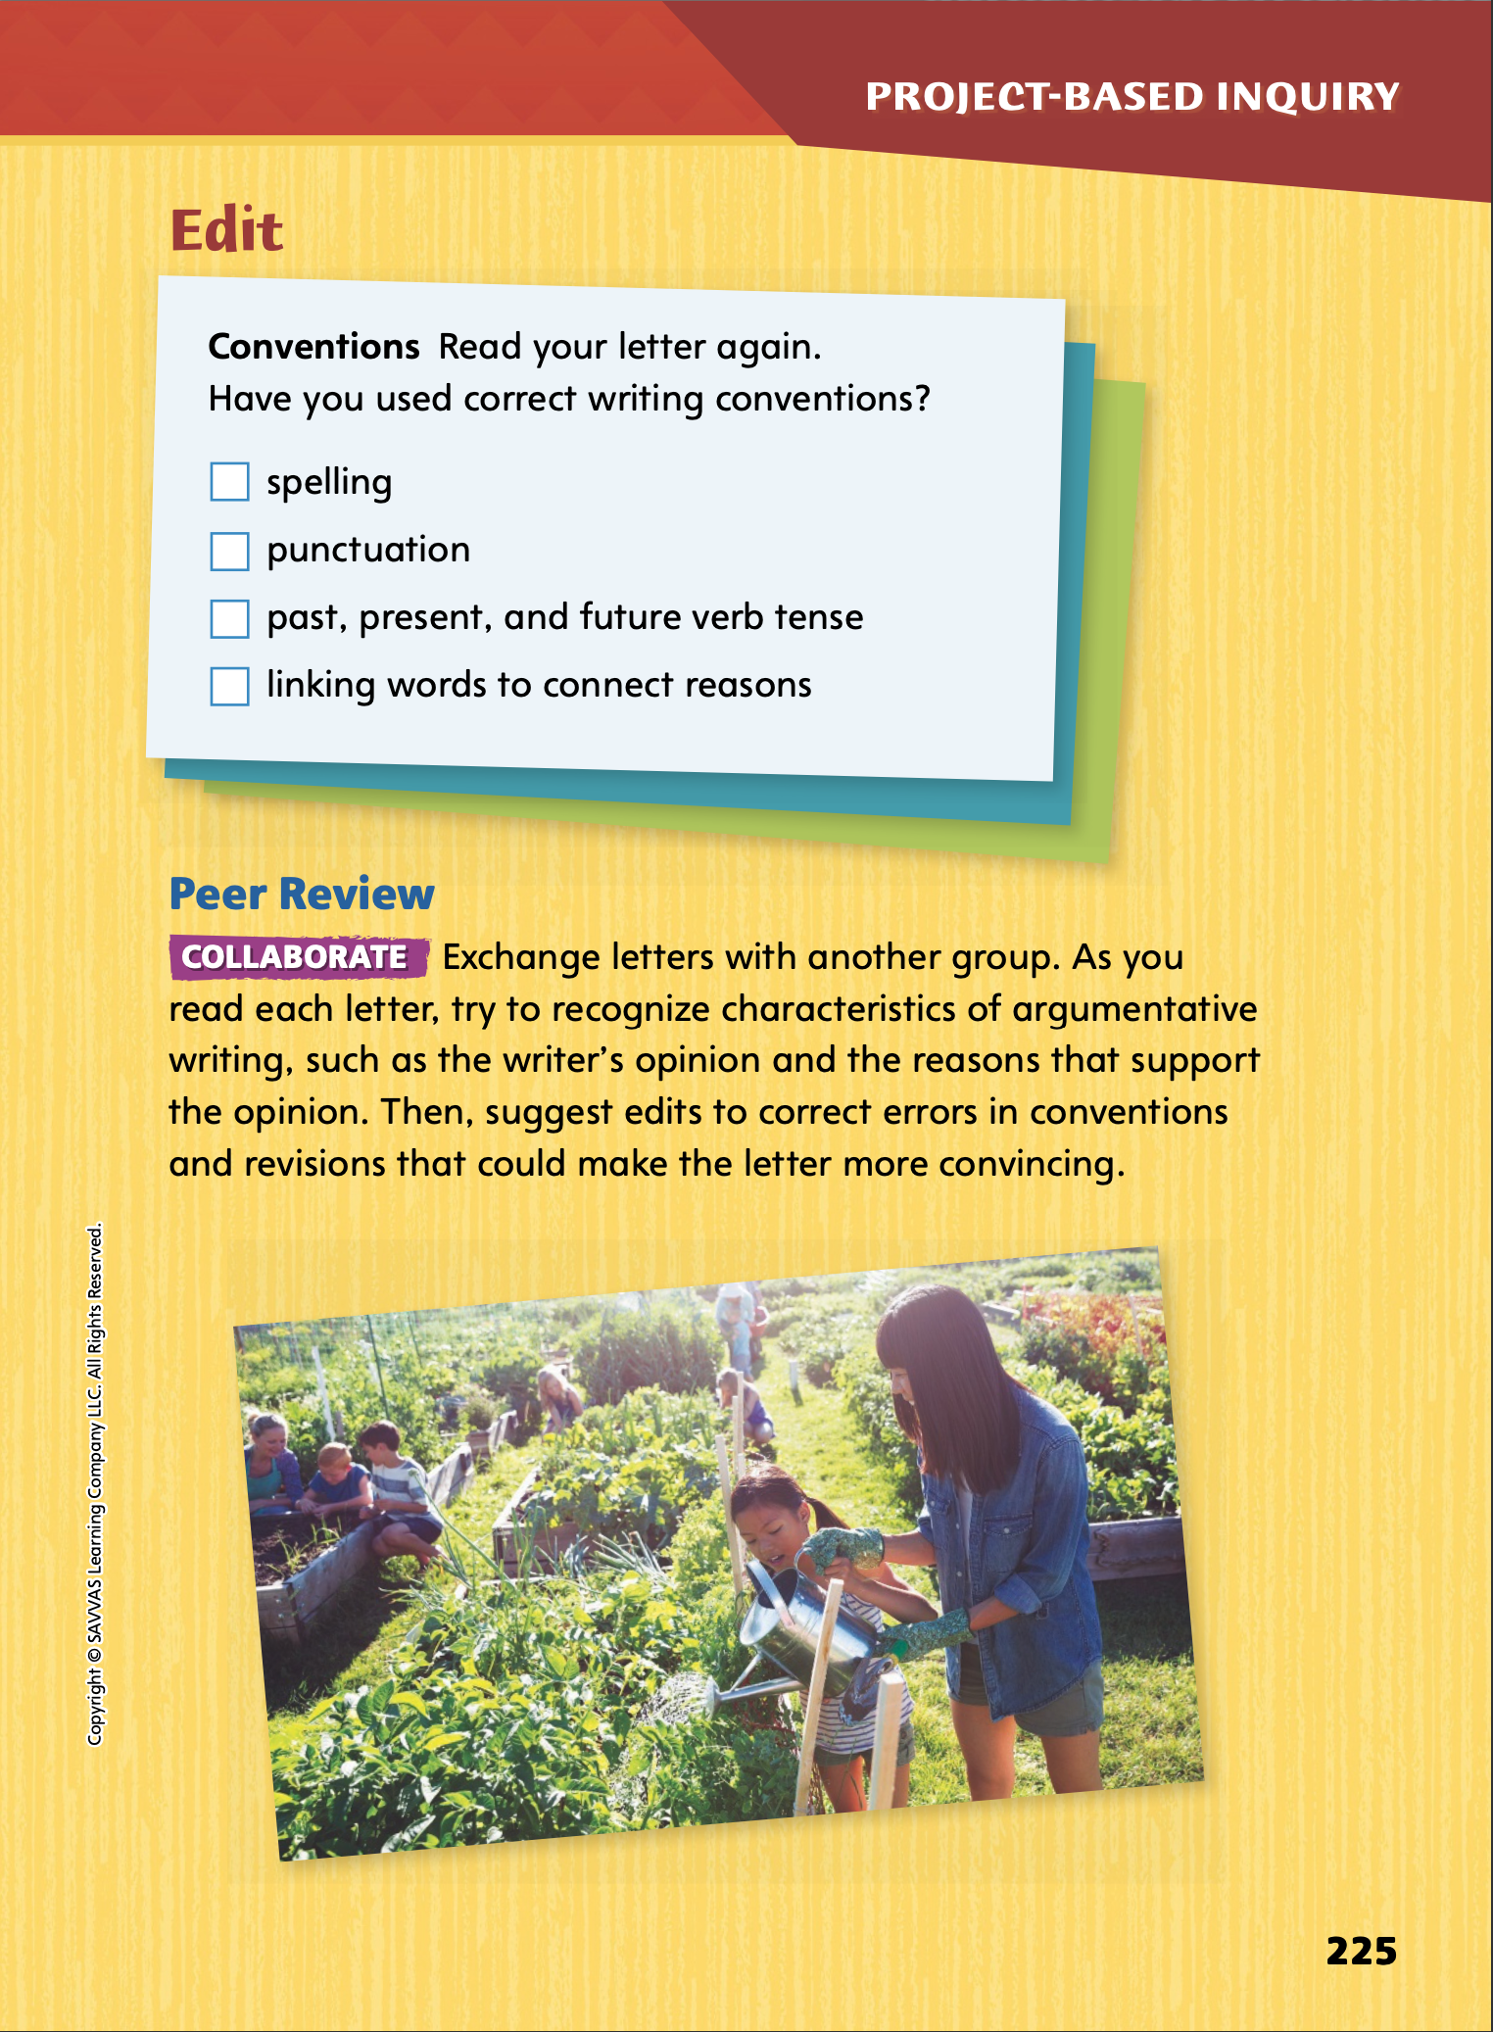
Page
224, 225
Apply
Revise and edit your letter using the checklists.
Exchange with another group.
Notes:
Have student pairs exchange letters and review each other’s writing. Remind students to be respectful as they review and comment upon one another’s writing.
Have student pairs reread their letters using the Revise checklist on p. 224. Tell them to ask questions, such as: Were my reasons strong enough to support my opinion? Is my opinion clearly stated and well supported with research? What details could make my letter clearer and my opinion more convincing? Have students mark specific places where they can add examples and reasons and specific words to make their letter more persuasive.
Next, have partners use the Edit checklist on p. 225 to make sure they used correct writing conventions. Direct students to use a dictionary to check the spelling of any unfamiliar words. Also have students purposely vary the structure of their sentences. For example, they can use short sentences for important points and longer sentences for reasons or evidence.
To provide differentiated support:
Support struggling students by outlining steps that they can follow to review and improve their letters. Explain that students first critically read their letters to identify errors or ways their letters can be improved, then revise them by making changes that improve or correct their text, and finally edit their letters by rereading the text and using the Edit checklist to correct any remaining errors, such as spelling and punctuation errors.
Have students who show understanding review the checklist of p. 224 of the Student Interactive to evaluate their letters. Ask students to identify ways they can revise their letters to clarify their opinion statement and/or strengthen the reasons and evidence that they are using to support their opinion.

Slide 28
Apply
Talk about the edits your peers suggested.
Write a clean, edited, final copy of your letter to the mayor or park official.
Notes:
Once students have revised and edited their letters, have them write a clean, final copy of their letters to the mayor or park official.

Slide 29
Lesson 5

Slide 30
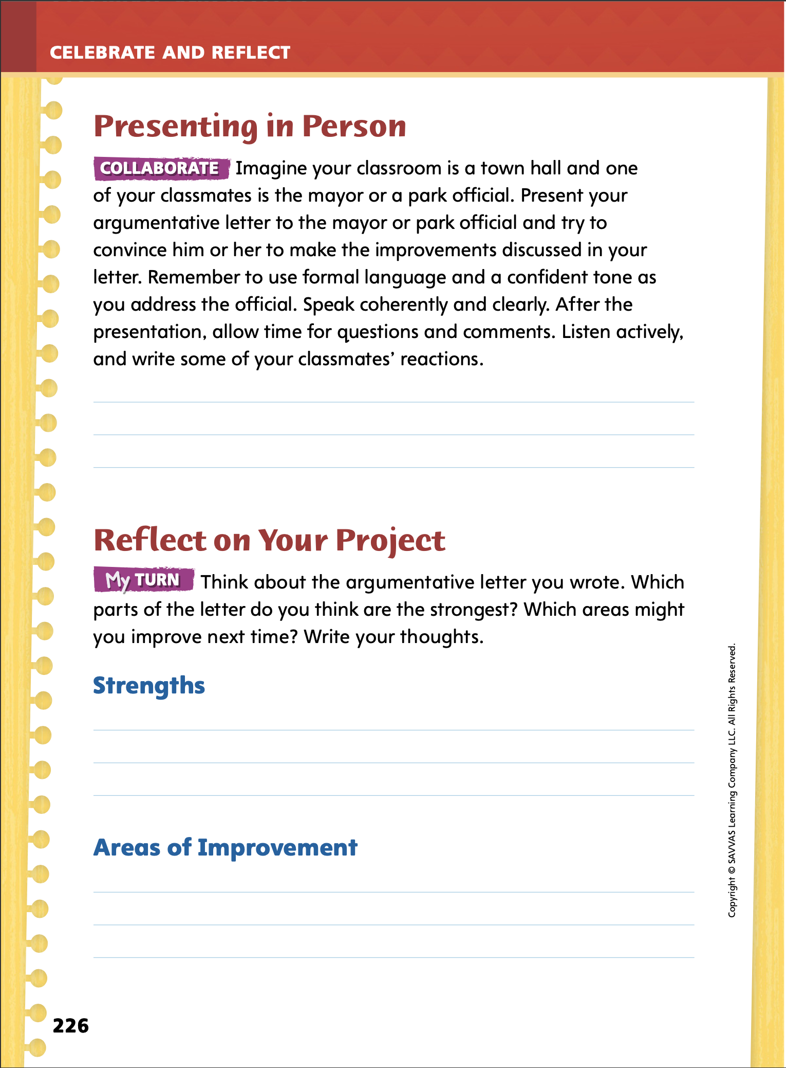
Page
226
Celebrate and Reflect
Present your letter to your classmates.
Turn to p. 226 in your Student Interactive and write your classmates’ reactions.
Notes:
Before final publication, have student pairs present their letters orally. Have students decide with their partners who will present each part of the letter and then practice their presentations.
Use the Student Model on p. 219 of the Student Interactive to model how to present a written letter orally. Before you begin, identify traits of effective speech.
Say: When I present the letter, I make eye contact with the audience. I do not keep my eyes directed downward at my paper. Instead, I look up at the people who are listening to me from time to time during my presentation.
Say: As I speak, I make sure that the volume of my voice is loud enough that everyone can hear what I am saying.
Say: As I present the letter, I pronounce each of my words clearly and correctly.
Say: I do not rush through my presentation, but speak slowly and at a rate that is steady and natural.
After you model reading aloud the letter, tell students that although they are speaking to an audience, they are presenting something that is written on paper. Ask students to observe the differences between spoken and written English as they listen to the letters read aloud.
Engage students further by creating a classroom town hall and having students take turns in the role of mayor or park official as each pair of students present their letters. Have students in the audience listen actively, ask questions to clarify information, and make pertinent comments following each presentation.
When students are finished presenting, ask them to identify how the tone, structure, and formality of written English differs from spoken English.
After completing their presentations, have students work with their partners to write their classmate’s reactions to their presentation on p. 226 of the Student Interactive.

Slide 31
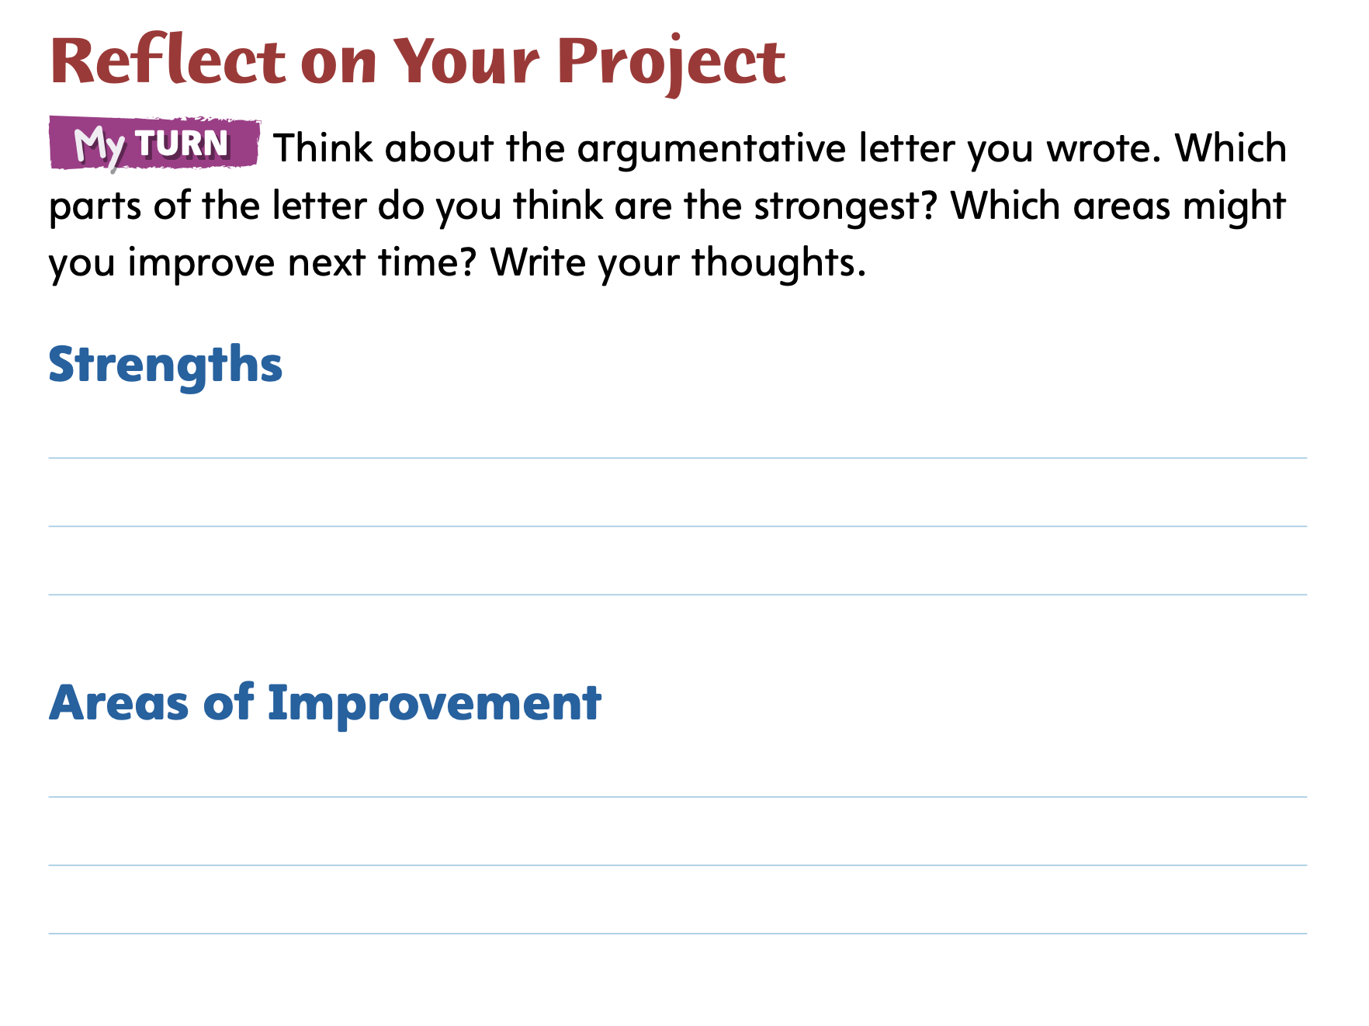
Page
226
Celebrate and Reflect
Turn to p. 226 in your Student Interactive and complete the activity.
Notes:
Students should work independently or with their partners to evaluate the argumentative letter that they wrote.
Have them identify the strengths of their writing as well as ways their letters could be improved.

Slide 32
Page
227
Reflect on the Unit
Turn to p. 227 in your Student Interactive and complete the activities.
Notes:
Have students revisit the unit goals on p. 12 of the Student Interactive. Remind them to use a different color to re-rate how well they think they have met the goals.
Tell students that readers reflect on what they read to better understand the texts in a broader context. Use Why the Sky Is Far Away and Cocoliso to model reflecting on reading. Say: The texts Why the Sky Is Far Away and Cocoliso relate to my life because they make me think about and appreciate the plants, animals, and resources in the natural world and the environment in which I live.
Then have students answer the Reflect on Your Reading question on p. 227 of the Student Interactive.
Tell students that writers reflect on the challenges and successes they experience so that they can continue to improve their writing. They use an appropriate mode of expression, such as a written or oral reflection, to present their thoughts.
Have students consider the writing they have done in this unit’s Writing Workshop and consider what they enjoyed most about the experience of writing a personal narrative.
Then have students answer the Reflect on Your Writing question.

Slide 33
Unit 1: Week 6
Grade 3

