Slide 1
Unit 1: Week 6
Grade 5

Slide 2
Copyright © Savvas Learning Company LLC. All Rights Reserved.
This publication is protected by copyright, and permission should be obtained from the publisher prior to any prohibited reproduction, storage in a retrieval system, or transmission in any form or by any means, electronic, mechanical, photocopying, recording, or otherwise. For information regarding permissions, request forms, and the appropriate contacts within the Savvas Learning Company Rights Management group, please send your query to:
Savvas Learning Company LLC, 15 East Midland Avenue, Paramus, NJ 07652
or
k12learningpermissions@savvas.com
myView Literacy® is an exclusive trademark of Savvas Learning Company LLC in the U.S. and/or other countries.

Slide 3
Lesson 1

Slide 4
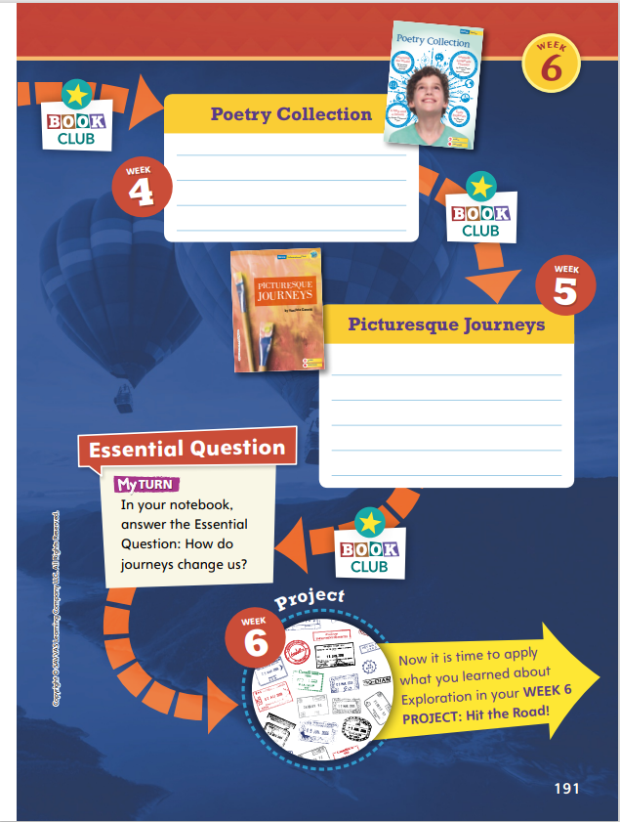
Page
190, 191
Compare Across Texts
Go back to each selection and find a sentence that best illustrates the meaning of an academic vocabulary word. Explain why that word fits that quotation.
Notes:
In this unit, students explored different forms of Journeys. This unit of study should help students understand there are many ways to explore the world around them. Point out that the infographic on the student pages resembles a path or journey they are going to explore with a partner
Connect to Theme-- Have students look back at each selection to choose a sentence that best illustrates the Academic Vocabulary words they learned. Encourage students to discuss their choices with their partners. Use the model for “The Path to Paper Son” to demonstrate.
Tell students: I think a good sentence for the word adventure would be “He had traveled alone on a journey that took nearly a month to cross the Pacific Ocean.” I know a passage is a long trip, and this sentence makes me feel how long and difficult that passage across the ocean must have been.

Slide 5
Page
190, 191
Compare Across Texts
Answer the question:
How do journeys change us?
Write your response in your notebook.
Notes:
Have a student volunteer point to each selection on the opener and identify which genre the unit covers (informational text, historical fiction, and poetry). Then, use the questions below to help students compare across texts.
How are the journeys in “The Path to Paper Son” and the poem “Latitude Longitude Dreams” similar? (Possible response: Both are related to taking a long trip across the sea or ocean.)
Could the main character in Pedro’s Journal also be the narrator of the poem “Early Explorers”? Why or why not? (Possible response: No. Although both selections are written in first-person point of view, Pedro’s Journal is historical fiction. The poem is writing about past explorers in modern day times.
Remind students of the Unit 1 Essential Question: How do journeys change us? Have students answer the question in their notebooks.
If they struggle to answer, you can do the following:
• Place students in pairs or small groups, and have each group review and answer the Weekly Questions for each text.
• Then have students make connections to ideas in other texts and the larger community.

Slide 6
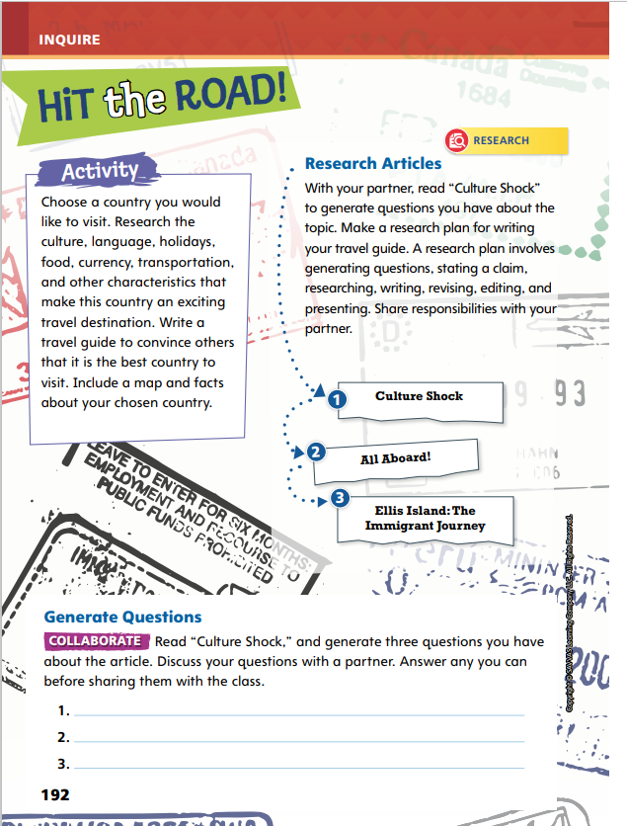
Page
192
Inquire – Introduce the Project
Choose a country that you would like to visit.
Let’s brainstorm what a travel guide is.
What kinds of information will you find in a travel guide?
Notes:
This week students will address the theme of Journeys by researching collaboratively and writing a travel guide about a country they would like to visit. Before assigning the travel guide, engage and energize students by activating background knowledge and setting a purpose for the project.
Begin by reading aloud the Activity prompt on Student Interactive p. 192. Then, ask students to identify countries they have heard or read about.
Brainstorm with students what a travel guide is, providing collected samples of realia. Then model outlining a research plan that will guide students through generating questions, researching, writing, revising, and editing.

Slide 7
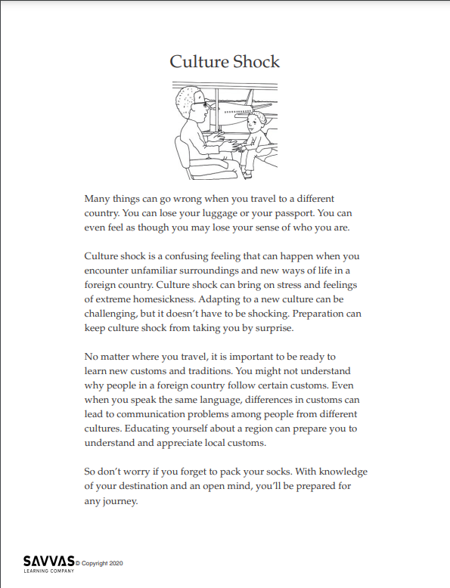
Inquire – Build Background
Read and annotate “Culture Shock.”
Underline what you find interesting.
Circle what is confusing.
Highlight words that describe the place the author discusses.
Generate questions you may have.
Notes:
Read-Pause-Annotate: Distribute copies of “Culture Shock.” Click path: Table of Contents -> Unit 1: Journeys -> U1 W6: Project-Based Inquiry -> U1 W6: Lesson 1
Note: This article is available at 3 different Lexile levels. The slide image is the middle range.
Use the article to help students build background and generate questions for research.
Write the bulleted items below on the board and have partners take turns reading the article aloud. Tell students to pause periodically to annotate the following:
Underline what you find interesting. Circle what is confusing.
Highlight words that describe the place the author discusses.
Generate, or create, questions.

Slide 8
Page
192
Inquire – Generate Questions
Turn to p. 192 in your Student Interactive and complete the activity.
Notes:
Have students work together to generate three questions they would like to have answered about a country they want to visit. Tell students they will work together to develop a research plan as well as answer their questions when they conduct research.
For differentiated support:
If students struggle to underline, circle, and highlight the text per the bulleted list, prompt pairs to reread the article, looking for each bulleted item separately. For example, for the first read, they would focus on underlining facts and details they find interesting. Then, for the second read, they would circle information that was confusing, and so on.
If students show understanding, have them compile a list of more than three questions they have for their research. Encourage them to highlight key words and phrases they can employ when researching online.

Slide 9
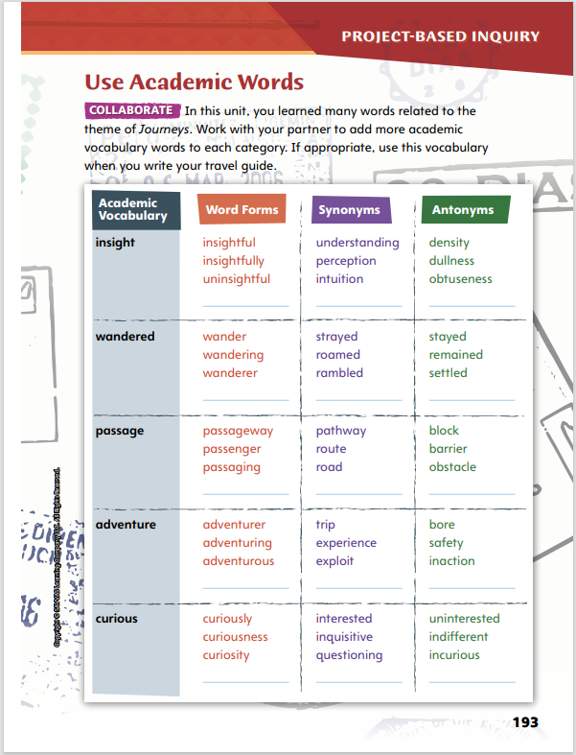
Page
193
Inquire – Academic Vocabulary
Turn to page 193 in your Student Interactive and complete the activity with a partner.
Share the words you added with your classmates.
Notes:
Have students complete the activity on p. 193.
Ask volunteers to share the words they added to the chart with the class.
Tell students that they should try to use some of these Academic Vocabulary words in their travel guide

Slide 10
Lesson 2

Slide 11
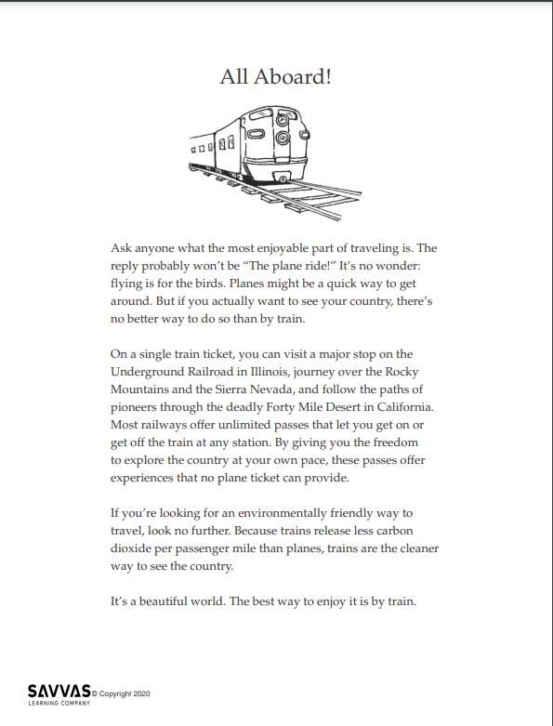
Explore and Plan – Argumentative Writing
Read and analyze “All Aboard!”
When reading critically, we do the following:
Consider the author’s claim.
Think about reasons the author uses to support the claim.
Identify evidence that supports the claim.
Notes:
Use the travelogue “All Aboard!” and the Plan Your Research chart to help students follow their research plans and recognize the characteristics and structures of argumentative texts.
Distribute copies of “All Aboard!” Click path: Table of Contents -> Unit 1: Journeys-> U1 W6: Project-Based Inquiry -> U1 W6: Lesson 2
Note: This article is available at 3 different Lexile levels. The slide image is the middle range.
Use the travelogue to teach the characteristics and structure of a travel guide and argumentative text.
Tell students that reading critically is about understanding why an author wrote about a particular topic from a particular perspective. When reading critically, we:
consider the author’s claim, or what the author wants the reader to believe.
think about the reasons the author includes to support the claim.
identify the evidence, including facts and examples, that best support the claim.

Slide 12
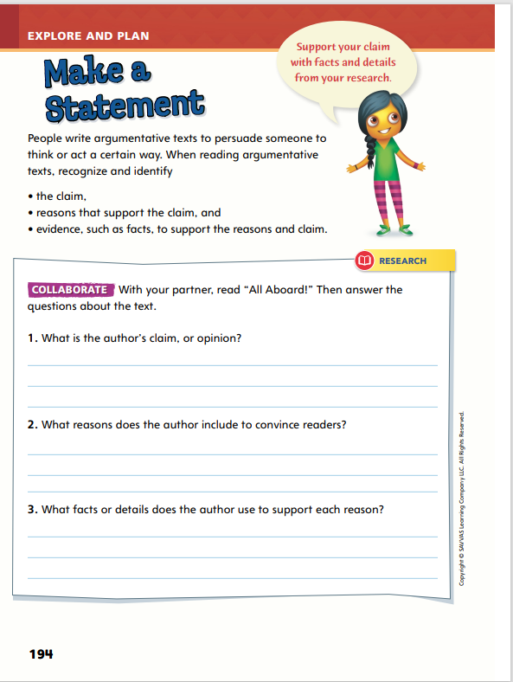
Page
194
Explore and Plan – Argumentative Writing
Turn to p. 194 in your Student Interactive and complete the activity with a partner.
Notes:
After students have read “All Aboard!,” lead them in a discussion about the article. Ask the following questions to facilitate critical understanding.
What are some of the places you can visit on a train ride?
What do trains offer that planes do not?
What makes trains a more environmentally friendly way to travel?
Then have students complete p. 194 in the Student Interactive.

Slide 13
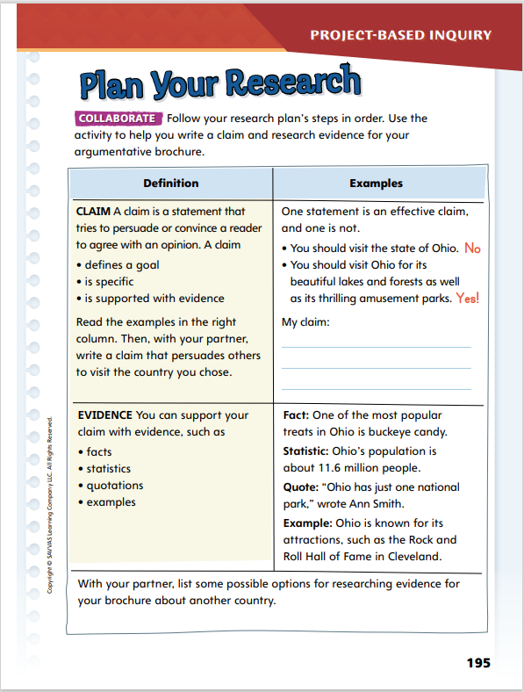
Page
195
Explore and Plan – Argumentative Writing
Turn to p. 195 in your Student Interactive and complete the activity with a partner.
Notes:
Have student pairs use the Plan Your Research activity on p. 195 in the Student Interactive to help them identify a claim for their argumentative travel guide and to brainstorm types of evidence they might use to support their claim.
Check students’ claims against the bulleted list in the first column.
Remind them to follow the steps of their research plan in order.

Slide 14
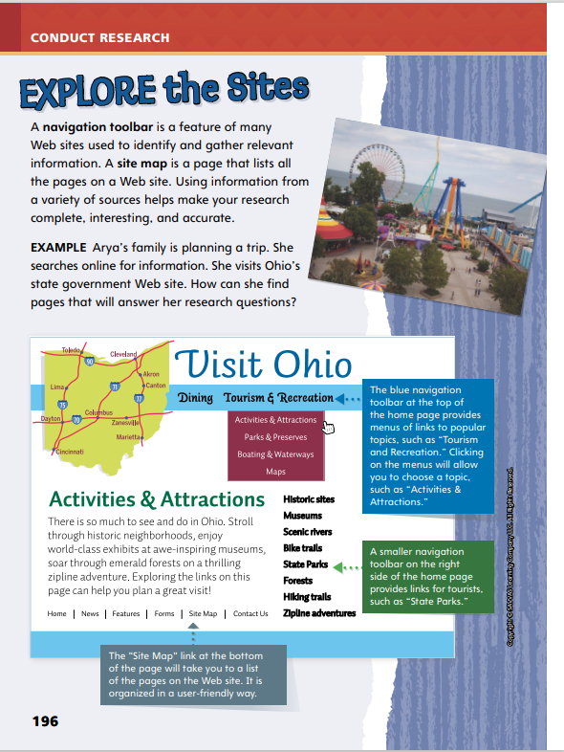
Page
196
Conduct Research
Discuss what information you would add to a travel brochure such as currency and food.
Notes:
Tell students: Navigation toolbars and site maps help visitors identify and gather information on a Web site. Knowing how to use these tools makes researching online easier and more efficient. Researchers then determine which links will best support their writing. Including research from a variety of sources makes writing more accurate and credible.
Use the example on p. 196 in the Student Interactive to model using navigation toolbars and site maps.
Say: The “Visit Ohio” Web site has a lot of information. The blue navigation toolbar has information about dining, as well as tourism and recreation. By clicking on that section, Anya can then see additional menu items, including activities and attractions. Had the page not had a link called “Activities & Attractions,” Anya could click on “Site Map” to see a list of all the pages on the Web site. That may lead her to pages related to things her family could do as well. If Anya were to check out another Ohio Web site, the navigational toolbars might look different, so it’s important to scan the Home Page before clicking on links. And I know this information is credible because the Web site is published and maintained by the state government in Ohio.
Tell students that as they research countries to visit, they will find many navigation toolbars with many links. Encourage them to look for information on a variety of topics related to their travel guide, such as currency, transportation, culture, language, and food.

Slide 15
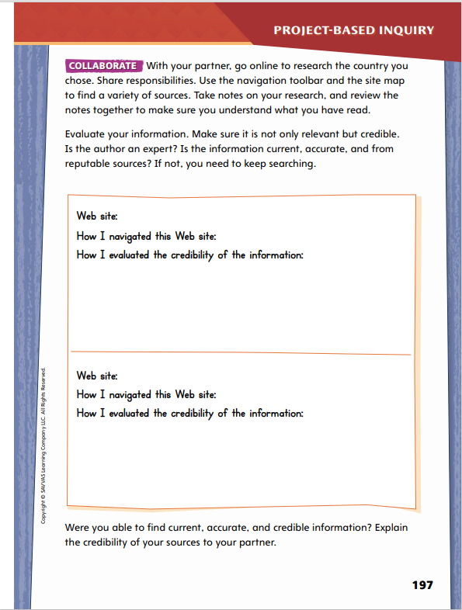
Page
197
Conduct Research
Conduct research and take notes on p. 197 of your Student Interactive.
With your partner, go online and research the country you chose.
Notes:
Have students share responsibilities as they conduct research and take notes on p. 197.
Remind students to be sure they record information accurately in their notes. Encourage them to refer to
p. 196 as they work.
Help students find and analyze the credibility of government Web sites for their countries and identify the navigational toolbars on the Web sites, since they will look different from site to site. Remind them to scan the Home Page or use the site map as needed to find a variety of sources to demonstrate their understanding of their topic.
For differentiated support:
Intervention: Provide struggling students with examples that show the different ways navigation toolbars and site maps are represented online. Explain: Navigation toolbars look different on different Web sites. The type of information may vary too. Work with students to identify the toolbars in the examples and their similarities before they research their topic.
Extend: Have students write or share their own explanation of navigation toolbars and site maps with other students. Encourage them to reference the Web sites they use for research as examples of how these tools are represented online.
5. Have students demonstrate understanding of information gathered on their chosen country by beginning a first draft of their travel guides. As students begin writing, be sure they can identify which country they chose, give details related to culture, such as language and food, and tell how they might organize the guide. Next, students will learn how to appeal to their audience.

Slide 16
Lesson 3

Slide 17
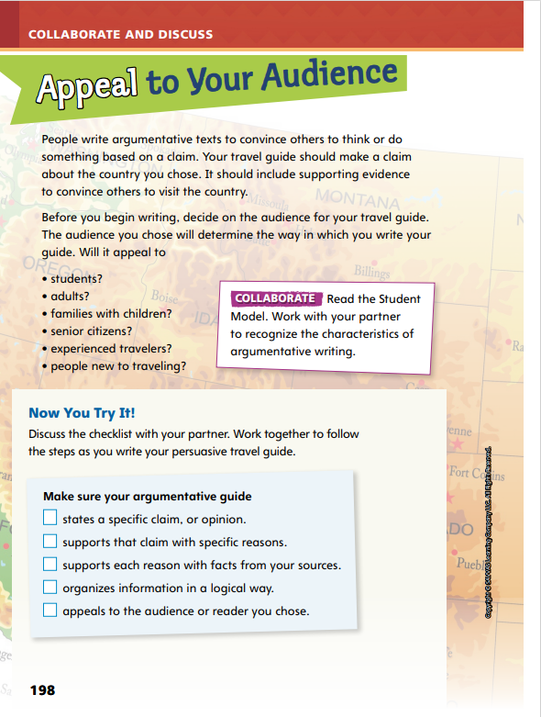
Page
198, 199
Collaborate and Discuss
Read the Student Model on p. 199 of your Student Interactive. Work with your partner to recognize the characteristics of argumentative writing.
Notes:
Remind students that the student model is about visiting Ohio, but their writing task will be about a country (not state) they want to visit. Use the student model to review some of the characteristics of a travel guide, such as the writer’s claim, best places to visit, fun facts about the place, and the organization or format of the guide. Point out that the students’ travel guides do not have to match this format; they can use the travel guide on p. 199 of the Student Interactive to model the parts of a travel guide.
Use the letter on p. 199 of the Student Interactive to model the parts of a travel guide.
Say: When writing a travel guide, it is important that your message is clear, organized, and formatted well. A travel guide usually includes the name of the place and an opinion, or claim, about why you should visit. That claim should be supported by facts and details about the place. The types of details provided will depend on the audience that the author is trying to reach. Read the first sentence and think about who the intended audience is.
Allow students to respond. Then have a student volunteer read the introductory paragraph. Use the callouts to teach the characteristics of an argumentative text, such as reasons and details that support the main claim. For example, discuss how providing specific details about state parks supports the claim that Ohio is interesting to visit.

Slide 18
Page
198, 199
Apply
Use the checklist on p. 198 of your Student Interactive as you write the first draft of your travel guide.
Notes:
Direct partners to discuss the items in the checklist on p. 198 as they craft a complete draft of their travel guide. Have them use the checklist as they work.
Remind students they must consider their intended audience when writing. For their travel guides, students should include details about culture, language, transportation, and locations that are appropriate for their audience.
Display “families with children.” Discuss with students the types of details they would include if that were their audience. Then display “students.” Compare and contrast the information they would include for that audience.
Remind students to include details that will most appeal to the audience for whom they are writing.

Slide 19
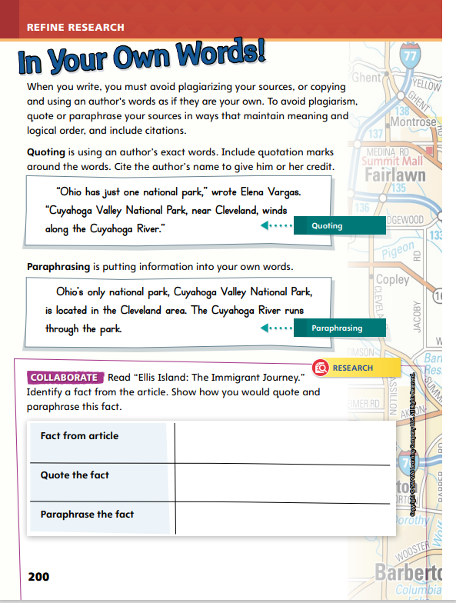
Page
200
Refine Research
Turn to p. 200 in your Student Interactive.
Notes:
Researchers must understand the difference between using their own words and using the words they find in their sources. To avoid plagiarism, writers quote and paraphrase the information they find.
Model how to quote and paraphrase.
Read a sentence, paragraph, or passage.
Is there a statement that you find particularly interesting? You can use that statement as a quote. Write the statement as it was in the source with quotation marks around the material that is directly from the source. Be sure to include information about the source and the page the quote is on.
Alternatively, which words or phrases capture the author’s point of view? Restate the information using your own words. Be sure to keep the meaning of the original writing. Focus on what the writer says.

Slide 20
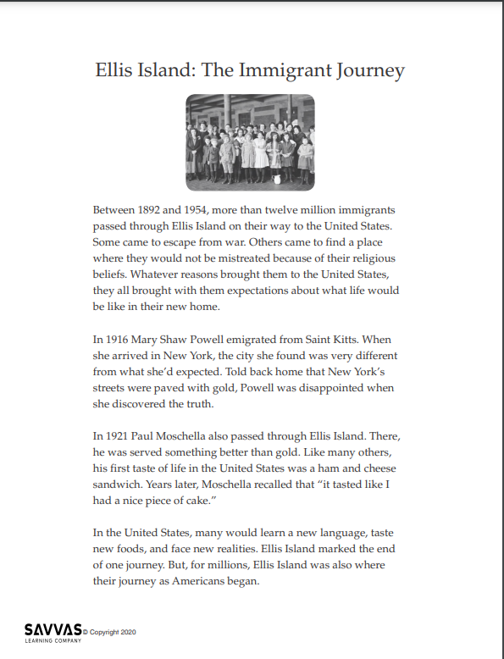
Refine Research
Read “Ellis Island: The Immigrant Journey.”
Let’s discuss the difference between quoting and paraphrasing.
Underline any facts as you read. What is the difference between a fact and an opinion?
Notes:
Distribute copies of “Ellis Island: The Immigrant Journey.” Click path: Table of Contents -> Unit 1: Journeys -> U1 W6: Project-Based Inquiry -> U1 W6: Lesson 3
Note: This article is available at 3 different Lexile levels. The slide image is the middle range.
Use the research article to teach the difference between quoting and paraphrasing. Tell students to underline any facts as they read. Review the difference between facts and opinions.

Slide 21
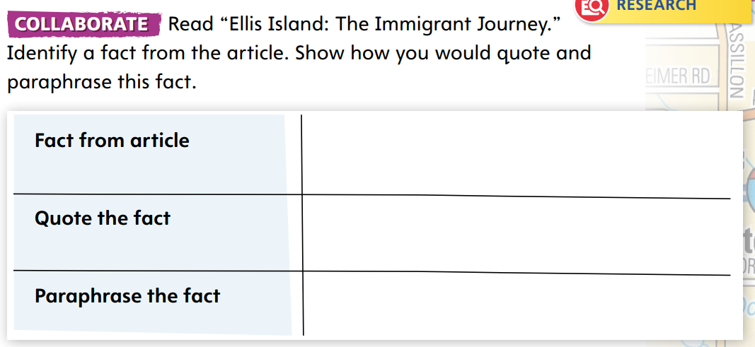
Page
200
Refine Research
Turn to p. 200 in your Student Interactive and complete the activity.
Notes:
Give student pairs time to complete the chart on p. 200 in the Student Interactive.
Have them underline the most interesting facts from the text. Then, have them practice quoting and paraphrasing each fact.
Finally, have students check the quote and the paraphrasing by asking:
Did I include all of the words from the article in the quote? Did I place quotation marks around the text?
Did I use my own words for the paraphrasing? Did I keep the author’s meaning?

Slide 22
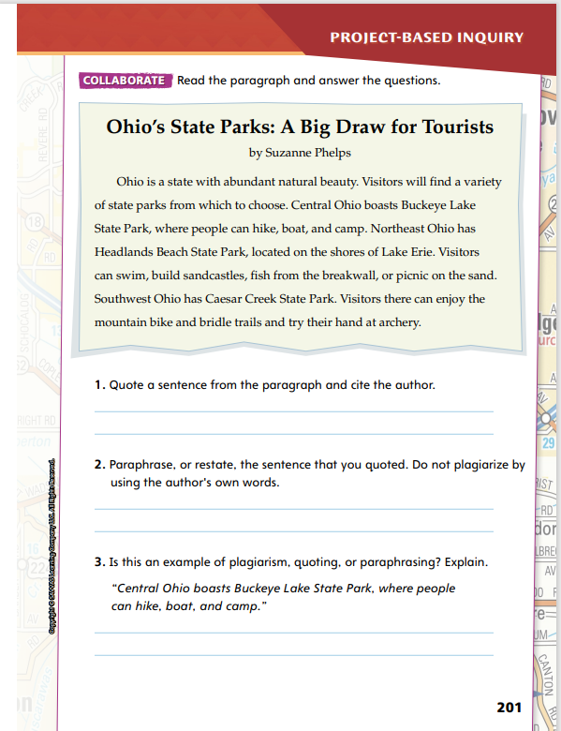
Page
201
Refine Research
Turn to p. 201 in your Student Interactive and complete the activity with a partner.
Notes:
Next, have students identify differences between plagiarizing, quoting, and paraphrasing by completing the activity on p. 201.
For differentiated support:
Support struggling students in additional practice with quoting and paraphrasing text. Using one of the research articles, provide either quoted or paraphrased content from the source. Ask students to identify whether the statement is a quote or paraphrased. Prompt other students to explain how they can tell.
Have students who have grasped the concepts of quoting and paraphrasing material practice using the techniques to develop original sentences for the activity. Monitor their work as they transfer the knowledge to their own writing and research. Guide them as they make connections to the reasons and evidence in their writing.
Have students look at their drafts for opportunities to quote and paraphrase from information in their research of argumentative travel guides. Have them demonstrate understanding of their gathered information.

Slide 23
Lesson 4

Slide 24
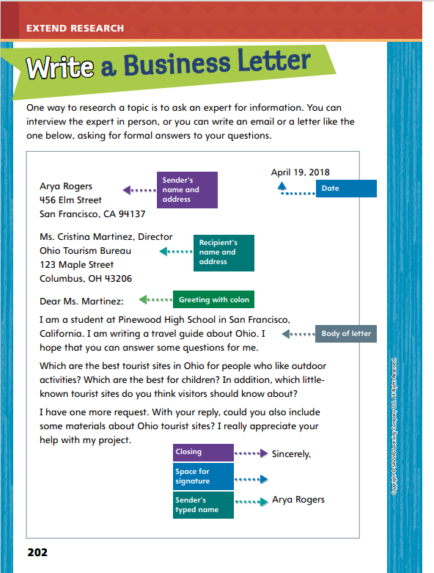
Page
202
Extend Research – A Business Letter
Turn to p. 202 in your Student Interactive.
Notes:
Writers can strengthen their writing and research by asking an expert for information. Writers can meet with the person for a face-to-face interview, or they can write a business letter to the person.
Use the sample business letter on p. 202 of the Student Interactive to discuss the different parts of a business letter. Say:
All business letters include the date in the upper right-hand corner. This is the date on which the letter is being written. Be sure to spell out the month, and include a comma between the date and year.
The sender’s and recipient’s name and address is placed on the upper lefthand corner. The sender is you and the recipient is the person reading the letter. Be sure to include full names and not nicknames, even if you know the person. Write the name of the business under the recipient’s name. Use proper formatting for the address, including using a comma between the city and state.
Begin your business letter with a greeting and a colon, not a comma like in other letters. The body of the letter should include an introduction of yourself, the questions you have, and any request for additional information or materials. Be clear and concise with your writing in the body. Take time before writing to generate questions. Reread your text and clarify the questions if they should be clearer.
All business letters end with a closing such as Sincerely, Best, or Thank you. Then it is followed by your signature. Be sure to leave some space between the closing and your name!

Slide 25
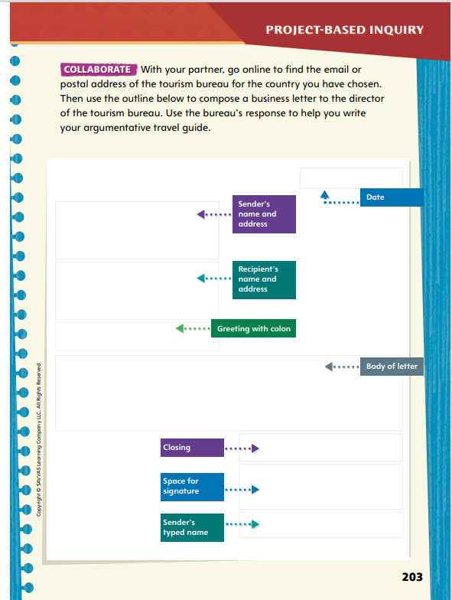
Page
203
Extend Research – A Business Letter
Turn to p. 203 in your Student Interactive and complete the activity with a partner.
Notes:
Discuss specific reasons students might want to write a business letter for their research. Point out that business letters can be sent through the mail, delivered in person, or sent as an e-mail.
Have pairs use p. 203 to generate and clarify questions for a business letter they would like to write for their own research.
Consider the following questions:
Who is an expert in my topic?
What questions would I like them to answer?
What materials would I like them to include in their response?
Remind students that business letters should always be formal and professional.

Slide 26
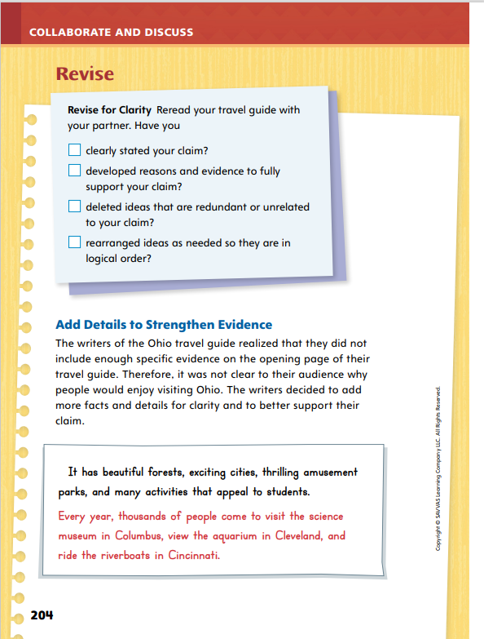
Page
204
Collaborate and Discuss
Turn to p. 204 in your Student Interactive.
Which details did the writer add to provide more evidence that Ohio is a fun and worthwhile place to visit?
Notes:
Remind students writers analyze their own writing to see how they can make their ideas more convincing and interesting to their audience. Remind students that they should organize their information in a creative and engaging way to convince their audience to visit the country they chose to research.
Use the model on p. 204 of the Student Interactive to show how writers add details to strengthen their evidence, referring back to the Student Model on p. 199 as needed.
Say: In this example, the writer has mentioned that there are many activities in Ohio that appeal to students. However, the writer does not include those activities. Thinking back to the business letter, I see that the writer asked about outdoor activities and activities for children. Based on that research, I see the writer can add specific details and examples of places to go and things to do in Cleveland, Columbus, and Cincinnati.
Ask students which details the writer added to provide more evidence that Ohio is a fun and worthwhile place to visit. Then encourage students to determine whether the author paraphrased or quoted research they had conducted. Offer corrective feedback as needed.

Slide 27
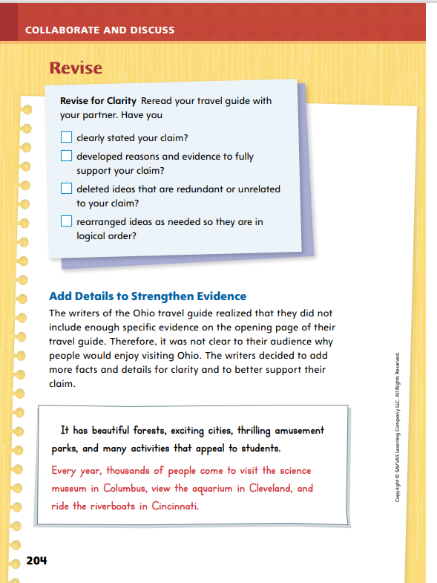
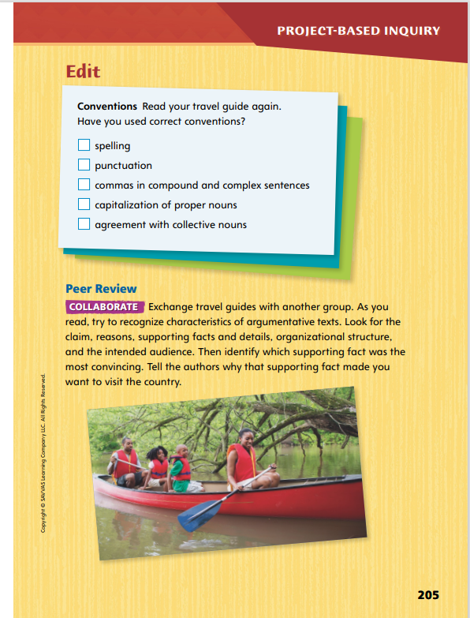
Page
204, 205
Apply
Revise and edit your travel guide using the checklist.
Exchange with another group.
Notes:
Have pairs exchange travel brochures and review each other’s writing. Remind students to be respectful in their comments, focusing on the writing and not the writer.
Have pairs reread their travel brochures using the Revise checklist on p. 204. Encourage students to ask questions, such as How can I make my writing clearer? Can I add or delete details that would make the writing easier to understand? Could I move information around to make it more convincing? Can I add more details or evidence to support my claim?
Have students mark specific places where they can make their writing clearer or more convincing.
Next, have pairs use the Edit checklist on p. 205 to make sure they used correct conventions. Encourage students to consult a dictionary to check the spelling of any unfamiliar words.
Point out that students should purposefully vary sentence structure and sentence beginnings. For example, encourage them to make sure all of their sentences do not begin with the name of the country.
To provide differentiated support:
Support struggling students as they complete the Revise and Edit checklists. Have them scan their travel guides for each item on the checklist one at a time. Offer questions to help guide them, such as Did I clearly state my claim? Did I include developed reasons and evidence?
Encourage students who show understanding of supporting a claim with evidence to demonstrate understanding of the proper use of commas in compound and complex sentences. Have them explain why commas are used in these instances.

Slide 28
Apply
Talk about the edits your peers suggested.
Write a clean, edited, final copy of your travel guide.
Notes:
Once students have revised and edited their travel guide, have students write or type clean, final copies of their travel guides.

Slide 29
Lesson 5

Slide 30
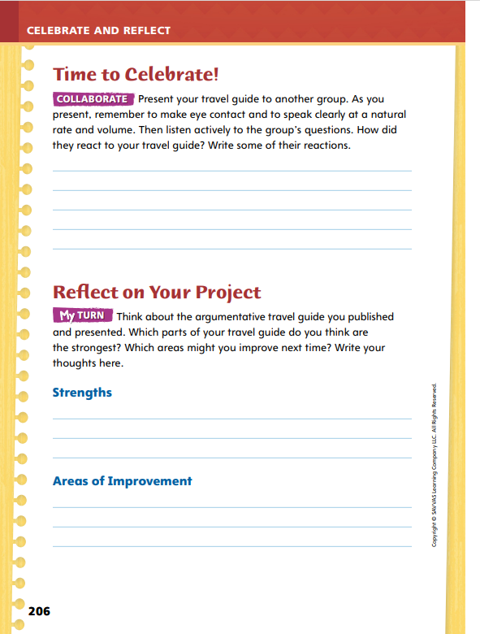
Page
206
Celebrate and Reflect
Present your travel guide to your classmates.
Turn to p. 206 in your Student Interactive and write your classmates’ reactions.
Notes:
Before final publication, have student pairs present their travel brochures orally to another team. If students have included any media with their brochures, they should be prepared to share that with their audience.
Use the Student Model on p. 199 of the Student Interactive to model effectively sharing this project with others. When you finish, point out the traits of effective speech.
When I shared my travel brochure, I did not look down at my paper the entire time. Every so often, I looked at my audience and made eye contact or smiled.
I took my time and did not rush. I spoke slowly enough and paused to point to the pictures or other things I wanted to highlight in my travel brochure.
I did not skip any information or words in my writing. I pronounced all of the words correctly. After you model reading aloud the letter, tell students that although they are speaking to an audience, they are presenting something that is written on paper. Ask students to observe the differences between spoken and written English as they listen to the letters read aloud.
Allow students to practice their oral delivery, speaking clearly at a correct rate and volume, and make adjustments based on the reactions of their peers. Have them write down suggestions from their classmates on p. 206 in the Student Interactive.

Slide 31
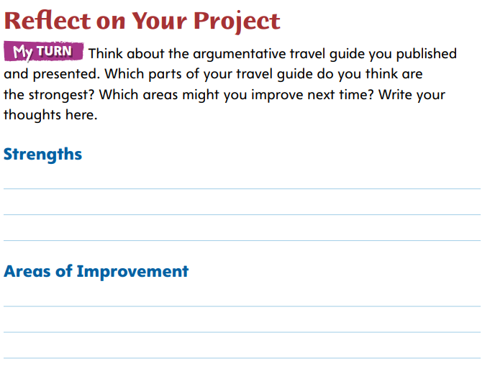
Page
206
Celebrate and Reflect
Turn to p. 206 in your Student Interactive and complete the activity.
Notes:
Students should work independently or with their partners to evaluate their work, using the rubric on p. T449.
Encourage them to consider what worked well, what surprised them, which aspects were the most challenging, and what they might try differently next time.

Slide 32
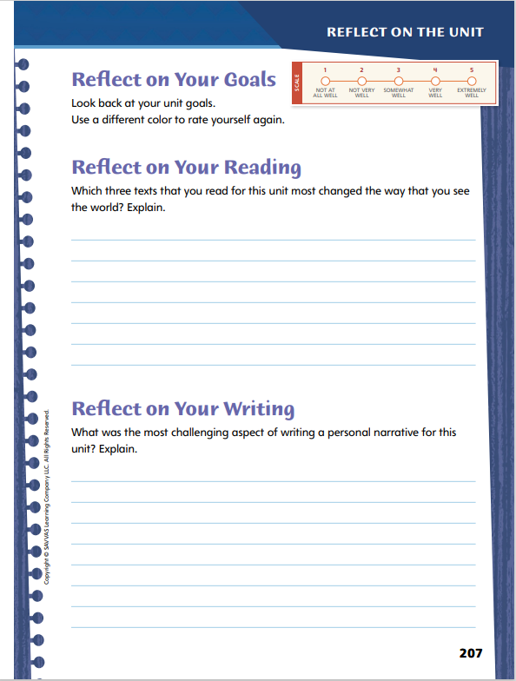
Page
207
Reflect on the Unit
Turn to p. 207 in your Student Interactive and complete the activities.
Notes:
Have students revisit their goals on p. 12 of the Student Interactive. Remind them to use a different color to re-rate how well they think they have met the goals.
Readers reflect on what they read to better understand the text in a broader context. Use Pedro’s Journal to model reflecting on reading. Say: In Pedro’s Journal, I read about the difficult passage across the ocean. I was surprised that although the trip was challenging, it was still an adventure and exciting. It made me think about traveling to a new place and how it can be challenging and scary at times, but exciting, too.
Have students answer the Reflect on Your Reading question.
Writers reflect on the challenges and success they experience so that they can continue to improve their writing. Use the edits to the Student Model on p. 199 to model reflecting on writing. Say: The writing was definitely better after the writer added more details about specific places to visit in Ohio. Without those details, I wasn’t sure or convinced that Ohio would be worth my time. Adding those details and facts made the writing clearer.
Have students answer the Reflect on Your Writing question.

Slide 33
Unit 1: Week 6
Grade 5

