Slide 1
Unit 1: Week 2
Grade 3

Slide 2
Copyright © Savvas Learning Company LLC. All Rights Reserved.
This publication is protected by copyright, and permission should be obtained from the publisher prior to any prohibited reproduction, storage in a retrieval system, or transmission in any form or by any means, electronic, mechanical, photocopying, recording, or otherwise. For information regarding permissions, request forms, and the appropriate contacts within the Savvas Learning Company Rights Management group, please send your query to:
Savvas Learning Company LLC, 15 East Midland Avenue, Paramus, NJ 07652
or
k12learningpermissions@savvas.com
myView Literacy® is an exclusive trademark of Savvas Learning Company LLC in the U.S. and/or other countries.

Slide 3
Lesson 1

Slide 4
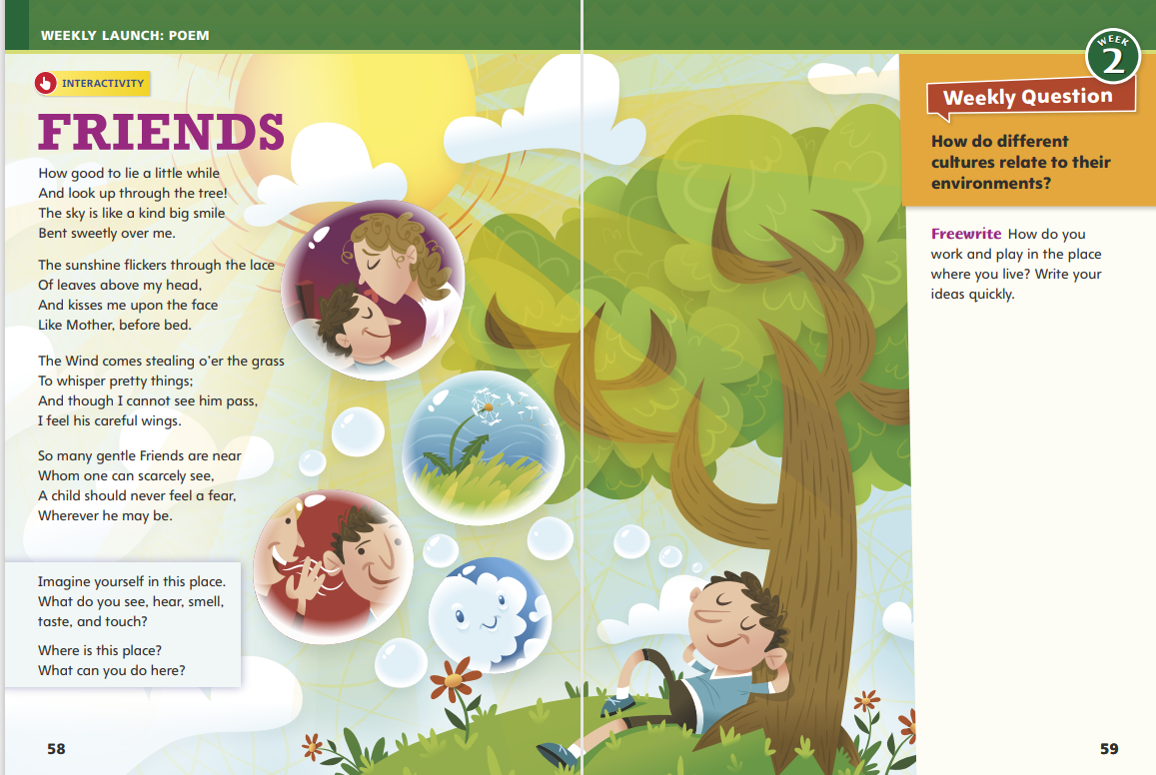
Page 58, 59
Interact with Sources
How do you work and play in the place where you live?
Write your ideas quickly.
Notes:
Remind students of the Essential Question for Unit 1: How does our environment affect us? Point out the Week 2 Question: How do different cultures relate to their environments?
Direct students’ attention to the illustration on pp. 58–59 in the Student Interactive. Explain that this illustration attempts to show some of the ideas presented in the poem. Have students look over the illustration and discuss how the artist used visual images to represent ideas from the poem.
Use the following questions to guide discussion:
Which lines from the poem are illustrated in the artwork?
Why are the smaller pictures shown inside bubbles?
How does the poem match the illustration in general?
Reread the Week 2 question: How do different cultures relate to their environments? Tell students that through the illustration they can see how one person relates to his environment. Explain that they will soon read about other ways to relate to different environments.
Have students freewrite to answer the question on p. 59 and then share their responses.

Slide 5
Listening Comprehension
Environments
Problem | Solution
Ruby Bridges
Notes:
Tell students you are going to read a folktale aloud. Have students listen as you read “A Gift Horse.” Explain that students should actively listen and try to focus on the characters as you read. Prompt them to ask relevant questions about problems characters face and to make pertinent comments.
Read aloud routine
Purpose Have students actively listen for elements of a folktale.
Read the entire text aloud without stopping for Think Aloud callouts.
Reread the text aloud, pausing to model Think Aloud strategies related to the genre, the characters, and the problems in the story.
Analyze Plot: Use the “Problem and Solution” chart to help students understand the plot.

Slide 6
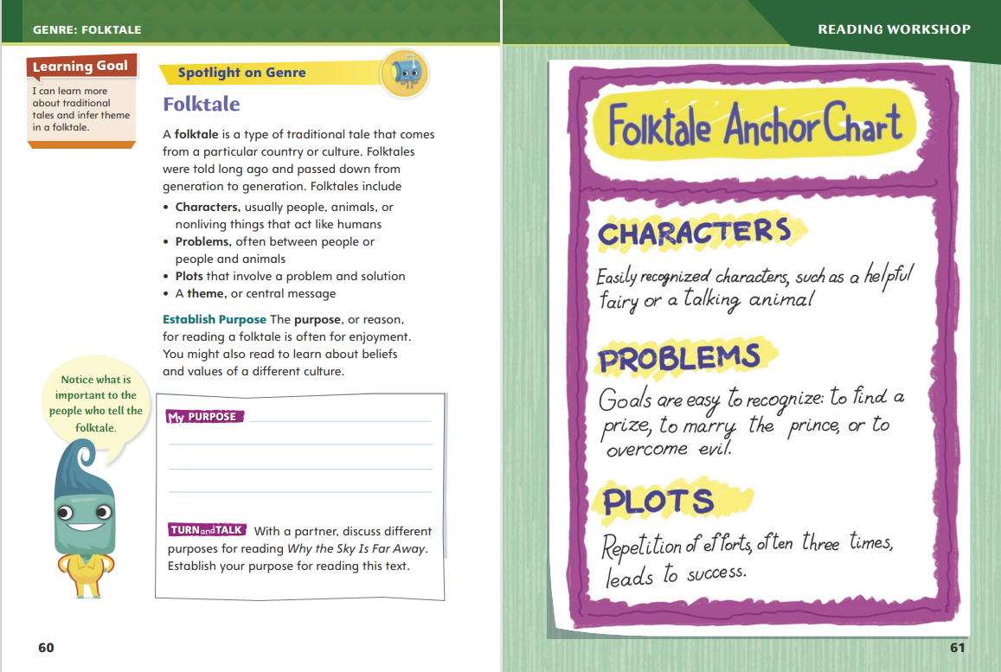
Page 60,61
Traditional Tales
Turn to page 60 in your Student Interactive.
Notes:
Remind students that folktales are often told orally for generations before they are written down. Explain that these types of stories are entertaining and teach a lesson. This lesson is most often the theme of the folktale. Folktales have distinguishing characteristics. They include:
Relatable characters that the reader understands.
Familiar plots with which the reader identifies.
Problems with a twist or surprise that provides an unexpected solution.
A theme that teaches a lesson. Sometimes the theme can be inferred.
Model how to determine whether a story is a traditional tale: The farmer cannot afford a horse and has to plow his field by himself. Needing a horse to plow tells me that this is an old tale. The farmer explains that his belief in the goodness of people will bring him the horse he needs. I also see that his wife reveals her character by doubting his plan. I infer that the problem is their differing beliefs. Is the problem solved? Yes, because although the landowner appears to trick the farmer, the farmer becomes rich. The tale teaches the lesson that being generous will pay off in the end. I realize this is the theme of the folktale.
Talk about other folktales students may have heard before. Have them discuss the characters, problems, solutions, and settings.
Have students work with a partner to complete the Turn and Talk activity on p. 60 of the Student Interactive. Walk around the room to determine whether students understand the characteristics of a folktale.

Slide 7
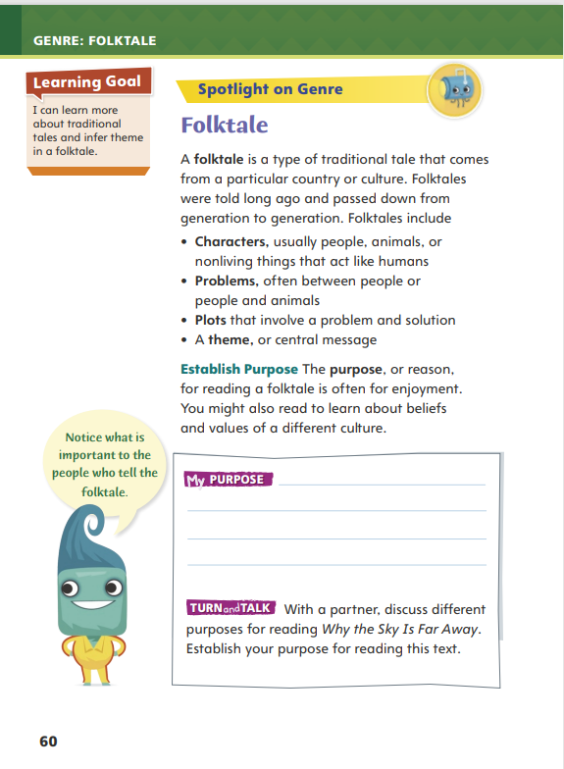
Page 60
Apply
Discuss different purposes for reading Why the Sky Is Far Away.
Notes:
Have students work with a partner to complete the Turn and Talk activity on p. 16 of the Student Interactive.
Observe student interactions to determine whether they understand the characteristics of a traditional tale. Editable Anchor Chart Click Path: Table of Contents -> Reading Anchor Charts -> Unit 1 Week 2: Folktale Anchor Chart

Slide 8
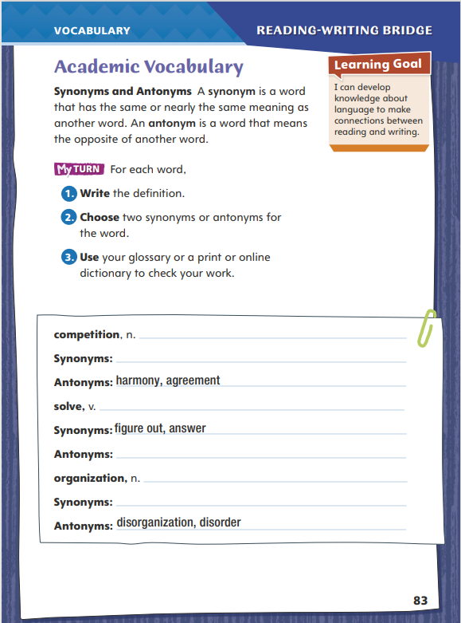
Page 83
Academic Vocabulary
Turn to page 83 in your Student Interactive and complete the activity.
Notes:
Synonyms are words with similar meanings, and antonyms are words with meanings that are opposite or nearly opposite. Identifying synonyms and antonyms helps readers make connections, build vocabulary, and learn the nuances between the meanings of similar words.
Use print or digital resources to determine the meaning of an unfamiliar word encountered in text.
To identify synonyms and antonyms, brainstorm and list words that have meanings similar to and opposite of the unfamiliar word.
Use print or digital resources to confirm these synonyms and antonyms.
Model this strategy using the Academic Vocabulary word custom. If I encountered the word custom in a text, I could find its meaning in the glossary or in a print or online dictionary. Then I would brainstorm all the words I know with similar or opposite meanings. Using an online or print dictionary or thesaurus, I would compare and contrast the meanings of these words to the meaning of custom to confirm or correct my understanding of the synonyms and antonyms I listed.
Have students apply this strategy to another word. Discuss students’ words and the synonyms and antonyms they identified.
Have students follow this same strategy as they complete the chart on p. 83 of the Student Interactive. Remind students that they will use these Academic Vocabulary words throughout this unit.

Slide 9
Word Study
street
streets
class
classes
country
countries
Notes:
Inflected endings are added to nouns, verbs, and adjectives. In this lesson, the inflected endings -s, -es, and -ies are added to nouns to change singular nouns to their plural forms.
Explain that the letters at the end of a singular noun determine which inflected ending will change the noun to its plural form.
Direct students’ attention to the chart on p. 84 in the Student Interactive. Review the examples, pointing out the ending letters of each singular noun. Help students identify that the last letters of the singular noun tell them what to do to change the noun to its plural form.
Guide students in using the information in the first column to change the singular nouns street, class, and country to their plural forms. (streets, classes, countries.

Slide 10
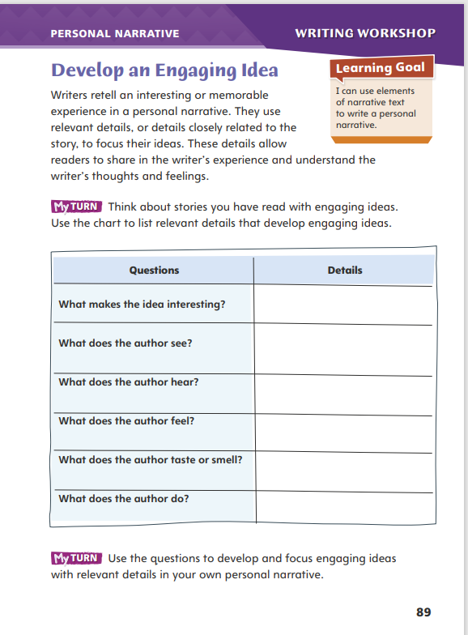
Page 89
Writing – Personal Narrative
Turn to page 89 in your Student Interactive.
Notes:
An engaging idea keeps readers interested in a text. Authors can develop an engaging idea for a personal narrative by
Thinking of a unique topic
Using strong details
Connecting with readers’ experiences or feelings
Inform students that developing an engaging idea is the first step in writing a strong personal narrative. An engaging idea will make the rest of the writing process easier and more successful. Read aloud two to three personal narratives from the stack. Pause to discuss what makes the narratives engaging.
What makes the topic of the personal narrative interesting to a reader?
How do the details help keep the reader interested in the narrative?
How does the author connect with the readers’ experiences and feelings?
Direct students to p. 89 in the Student Interactive. Have them complete the activity using a personal narrative the class has just read.

Slide 11
Independent Writing
Brainstorm ways to make your topic more engaging.
Share the idea you have chosen for your personal narrative.
Notes:
After the minilesson, students should transition into independent writing. If students need to choose a topic for their personal narrative, they may use this time to brainstorm ideas and choose the most engaging one.
Writing Support
Modeled - Brainstorm events from your own life and think aloud why each could be an engaging idea.
Shared - As you discuss a student’s writing, ask questions that prompt the student to add details to engage readers.
Guided - Prompt students to make specific points in their narrative more engaging for readers.
If students have already chosen a topic or started their personal narrative, they can brainstorm ways to make their topic or draft more engaging.
Call on a few students to describe the idea they have chosen for their personal narrative. Have the class point out why each idea sounds engaging.

Slide 12
Spelling
1. My glasses help me to see clearly.
2. They was the dishes after dinner.
3. Many families came to the school event.
4. My pencil is six inches long.
5. We have enough pennies to buy an eraser.
6. The office received two faxes.
7. Many people live in big cities.
8. My brother eats fries with his sandwich.
9. The baseball player throws three pitches to strike out the batter.
10. The soldiers will make excellent spies.
Notes:
(Note: Move the orange boxes to cover each bold spelling word before you read aloud the words and sentences.)
Read aloud the words and sentences. Have students spell each word with initial consonant blends and the two high-frequency words.
My glasses help me to see clearly.
They wash the dishes after dinner.
Many families came to the school event.
My pencil is six inches long.
We have enough pennies to buy an eraser.
The office received two faxes.
Many people live in big cities.
My brother eats fries with his sandwich.
The baseball player throws three pitches to strike out the batter.
The soldiers will make excellent spies.
Reveal the spelling word and have students check their work.

Slide 13
Language and Conventions
I walk my dog.
Identify the subject and predicate used in the sentence.
Identify the capital letter that begins the sentence.
Identify the punctuation that ends the sentence.
Notes:
Flexible Option
Review the language and conventions topic simple sentences by sharing examples of two-word sentences, such as We laughed. Olivia ate. Marcus cheered. Point out that in these sentences, a one-word subject and a one-word predicate combine to form one complete thought. See p. T361
Share this sentence with students: I walk my dog. Explain that this is a simple sentence that expresses one complete thought. As a class, identify the subject, or who or what the sentence is about. (I) Then identify the predicate, the part of the sentence that tells what the subject does or is. (walk my dog) Have volunteers identify the capital letter that begins the sentence and the punctuation that ends the sentence.
Have students compose their own simple sentences. Ask students to share their sentences with a partner and to identify the subjects and predicates in their sentences.

Slide 14
Lesson 2

Slide 15
Page 62
Preview Vocabulary
preparations
magnificent
brooded
rejoicing
satisfied
Notes:
Introduce the vocabulary words on p. 62 of the Student Interactive and define them as needed.
preparations: activities to get ready for something
magnificent: very wonderful or beautiful
brooded: worried or fretted
rejoicing: actions and feelings of great happiness
satisfied: happy or pleased
Tell students: These words will help you understand a festival and the actions of the characters in Why the Sky Is Far Away. As you read, highlight the words when you see them in the text. Ask yourself what they tell you about the characters.

Slide 16
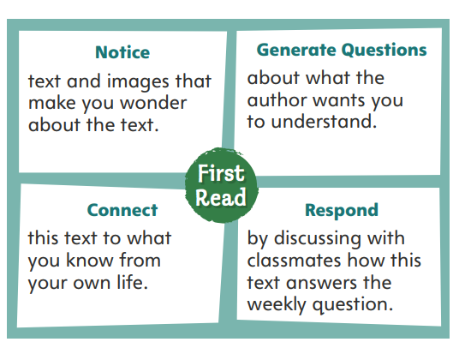
First Read Strategies
Notes:
Discuss the First Read Strategies. Before the first read, prompt students to consider what the title and illustrations suggest this traditional tale will be about. Point out that the selection is a folktale.
Explain the four steps of the first read.
NOTICE Remind students that both the text and images will help them make predictions as they read.
GENERATE QUESTIONS Ask students to jot down questions they think the author will answer in the story.
CONNECT Ask students to think about how the lessons learned in this folktale are applicable in their own lives.
RESPOND Have students discuss with classmates how this text contributes to the idea that different cultures interact with their environment in unique ways
Students may read the text independently, in pairs, or as a whole class. Use the First Read notes to help students connect with the text and guide their understanding.

Slide 17
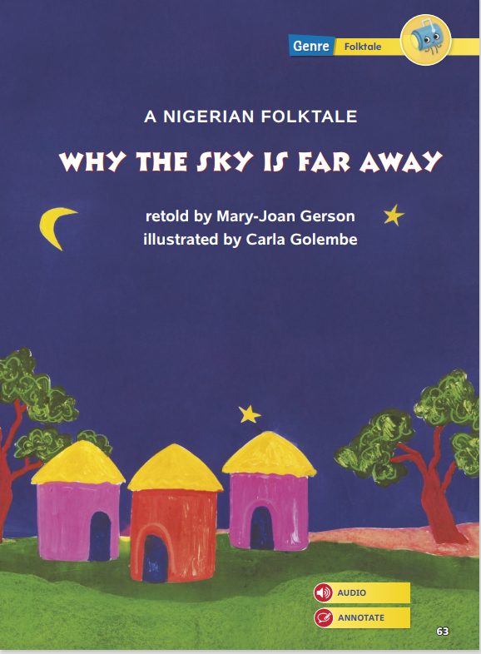
Page 63
First Read – Why the Sky is Far Away
Notes:
Students may read the text independently, in pairs, or as a whole class. Use the First Read notes to help students connect with the text and guide their understanding.

Slide 18
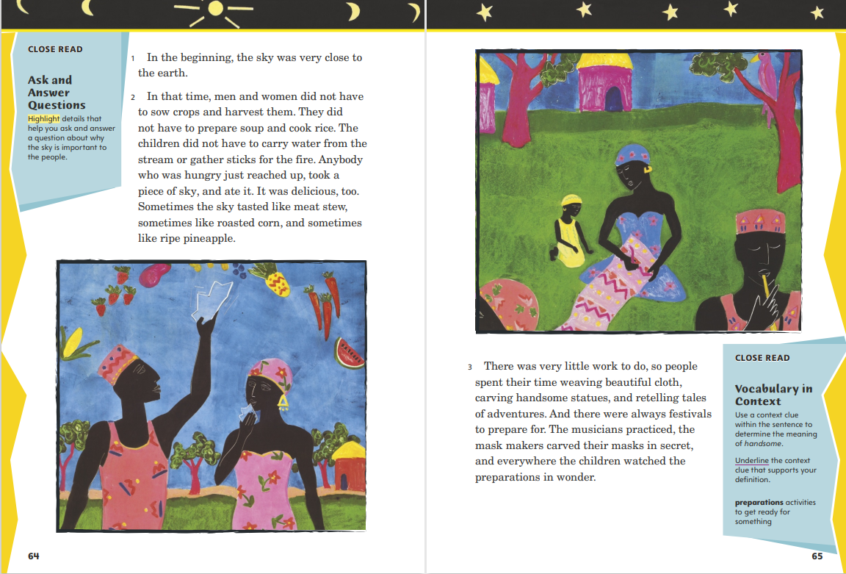
Page 64, 65
First Read – Why the Sky is Far Away
Notes:
Students may read the text independently, in pairs, or as a whole class
THINK ALOUD The first sentence of the story introduces the setting. “In the beginning” tells me this folktale is set long, long ago, in an unknown time in the past. The story takes place on the earth, but it is a different earth from the one I know because the sky is close to it.
THINK ALOUD It is interesting to me that the author writes, “the children watched the preparations in wonder.” I think about times when a festival or carnival was coming to town. I would watch things happening and get very excited. It was something that didn’t happen all the time, and it was going to be fun.

Slide 19
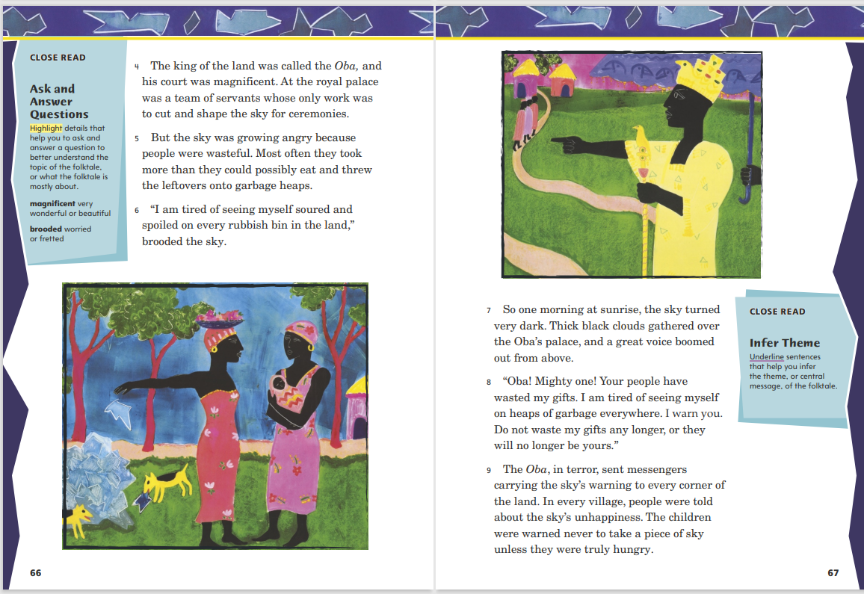
Page 66, 67
First Read – Why the Sky is Far Away
Notes:
Students may read the text independently, in pairs, or as a whole class.
THINK ALOUD As I read, I have questions about the text. Right now, I know the sky is unhappy because it is tired of being wasted and thrown into rubbish bins. I will circle paragraph 6 to remind myself to look for what the sky decides to do.
THINK ALOUD The sky warns the people that it will keep its gifts if they do not change. I know there are times that a warning makes a person want to do something or behave in a certain way. Sometimes a warning can get people to change.

Slide 20
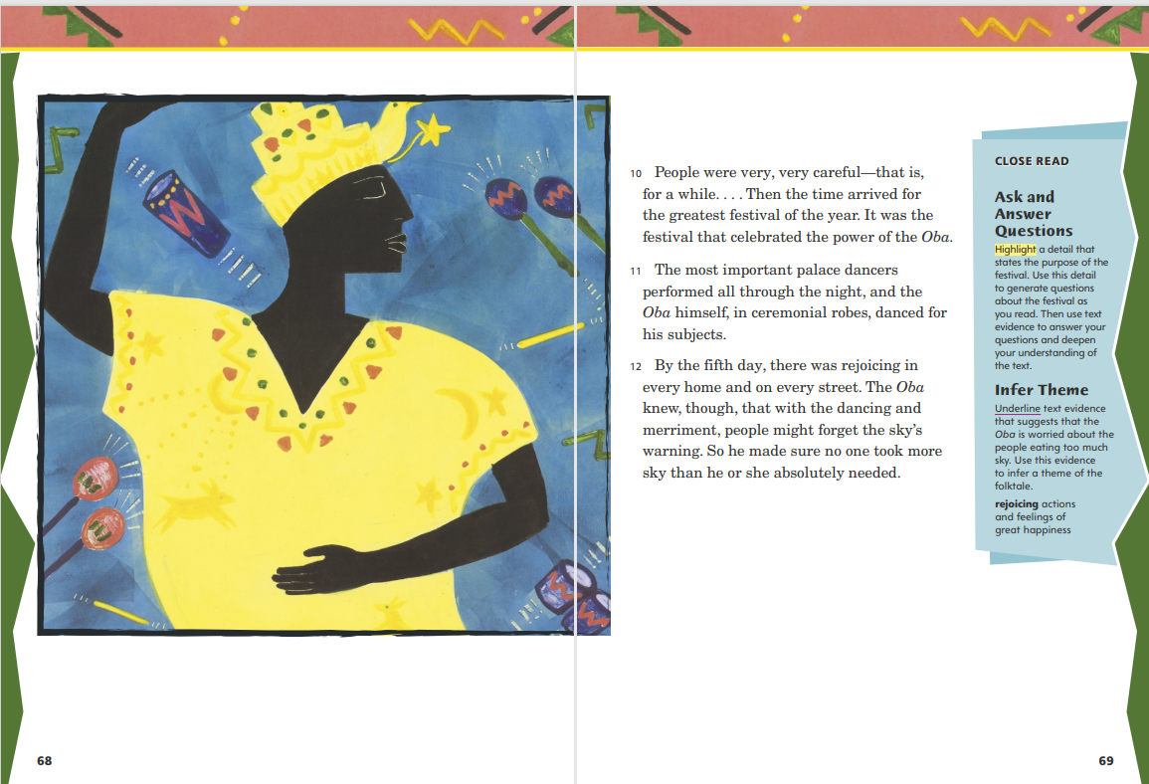
Page 68, 69
First Read – Why the Sky is Far Away
Notes:
Students may read the text independently, in pairs, or as a whole class.
THINK ALOUD The illustration of the Oba dancing helps me understand the festival that is going on. It also helps me gain a better understanding of the Nigerian culture. The images of noisemakers, castanets, and drums help me imagine the joyful sounds. I have seen some wonderful celebrations. This illustration helps me understand a little bit more about this celebration.
THINK ALOUD Time has passed since the sky’s warning, but I notice that the Oba is still very much aware of the warning. Even during the festival, he makes sure the people don’t take more sky than they need. I wonder what will happen. Maybe someone will take more sky than he or she can eat.

Slide 21
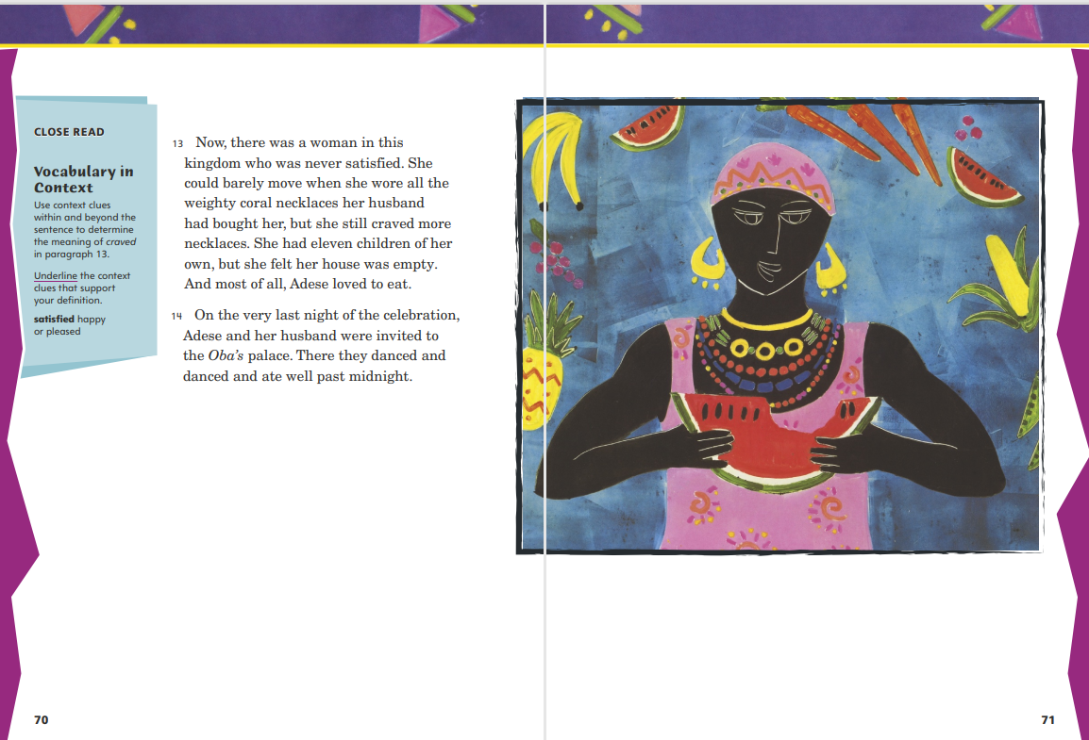
Page 70, 71
First Read – Why the Sky is Far Away
Notes:
Students may read the text independently, in pairs, or as a whole class.
THINK ALOUD The story has been about the people and the Oba. Now the author changes the story to focus on one woman, Adese. I read that Adese loves to eat. Will Adese waste the sky? Will she be the cause of the sky being far away? I’ll keep reading to answer my questions.
THINK ALOUD When I combine what I just read with the illustration on this page, I begin to understand who Adese is. What are weighty coral necklaces? Why does the author mention them? The illustration shows me what those necklaces looked like. The text mentions that Adese can barely move when she wears them. I see how the text and illustrations work together to help me understand.

Slide 22
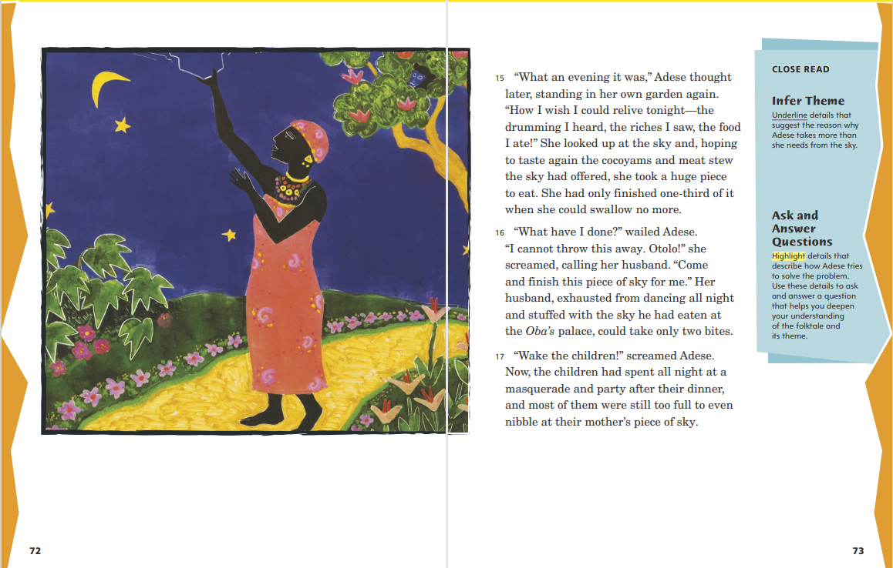
Page 72, 73
First Read – Why the Sky is Far Away
Notes:
Students may read the text independently, in pairs, or as a whole class.
THINK ALOUD As I look at the illustration, it looks like Adese is taking a large piece of the sky. I am afraid that something is going to happen, and it probably won’t be good. I will continue reading to confirm if I am right.
THINK ALOUD I see from the illustration that Adese is taking from the sky. Then, as I read, I understand that she is in trouble. When she says, “What have I done?” I know that Adese is upset, and she frantically searches for someone to help eat the piece of sky. I, too, would be desperate to figure out what to do, because I wouldn’t want to be the cause of the sky carrying out its threat.

Slide 23
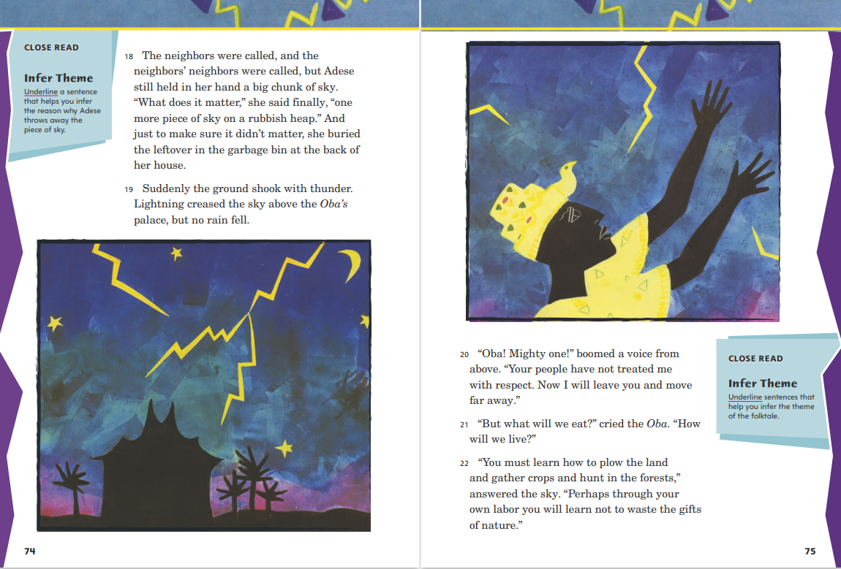
Page 74, 75
First Read – Why the Sky is Far Away
Notes:
Students may read the text independently, in pairs, or as a whole class.
THINK ALOUD Adese cannot find anyone to finish eating her piece of the sky, and she buries it in the rubbish heap. I wonder what the sky’s punishment will be.
THINK ALOUD The sky carried through with its warning. No longer will the people be able to just reach up and take a piece of the sky. The sky taught the people a lesson. I think it wasn’t right that everyone should have been punished for Adese’s actions. Now everyone will have to learn to grow and gather crops and hunt the land. So maybe it is a good thing after all.

Slide 24
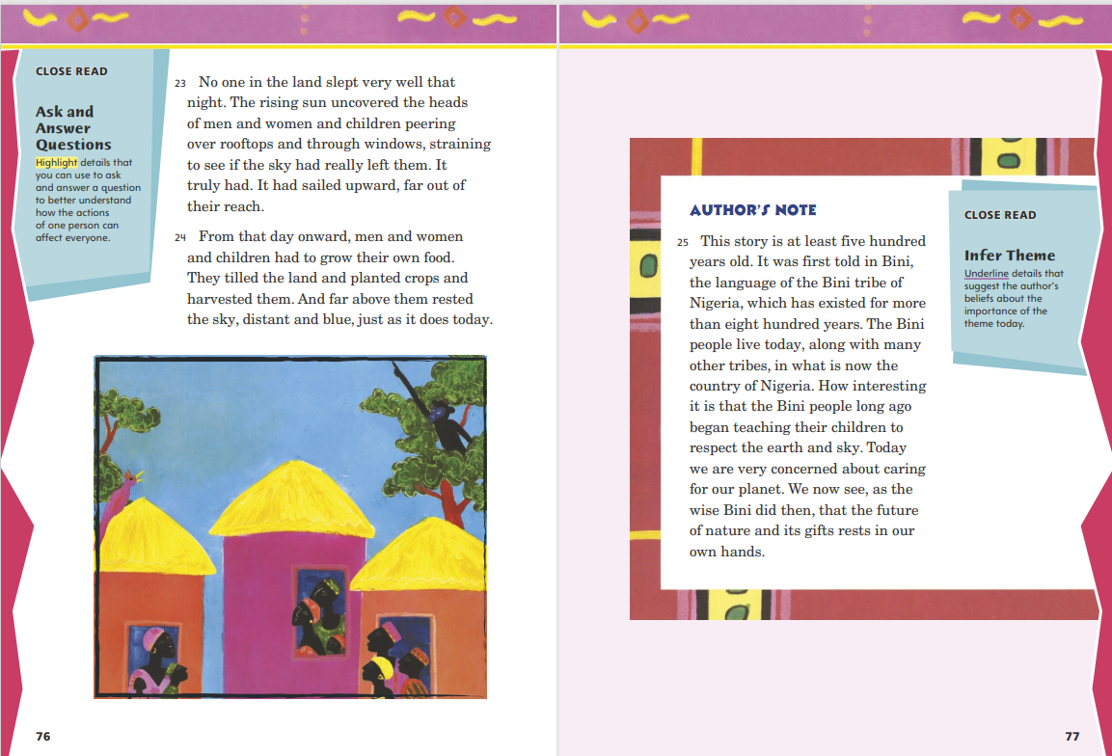
Page 76, 77
First Read – Why the Sky is Far Away
Notes:
Students may read the text independently, in pairs, or as a whole class.
Tell students: I have been thinking about the question of how different cultures relate to their environments. I see now how the sky forces the people to relate to their environment by making them farm in the fields and hunt in the forests. What other questions do you have about what you just read? Possible response: What does the sky still provide for the people?
THINK ALOUD I think the Bini people were right in teaching their children to respect the earth and sky. It’s important to be responsible for our natural world, and we should treat the earth wisely and carefully. That is why I try to be aware of caring for our natural resources.

Slide 25
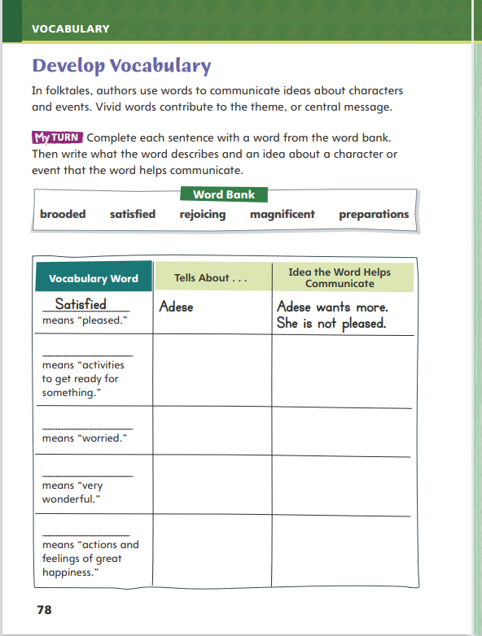
Page 78
Develop Vocabulary
Turn to page 78 in your Student Interactive and complete the activity.
Notes:
Tell students that in folktales, authors choose certain words to convey information about characters and events. The vocabulary words preparations, satisfied, rejoicing, magnificent, and brooded tell about the characters and events in Why the Sky Is Far Away.
Remind yourself of the word’s meaning.
Ask what the author is trying to convey about a character or event.
Model filling out the chart on page 78 of the Student Interactive using the word satisfied. The author says Adese is never satisfied. She always wants more jewelry, children, and food. If she were satisfied, she would feel that she had enough of everything. The word helps to communicate that Adese always wants more. She is not pleased.
Have students use newly acquired vocabulary in their own original sentences using p. 78 of the Student Interactive.

Slide 26
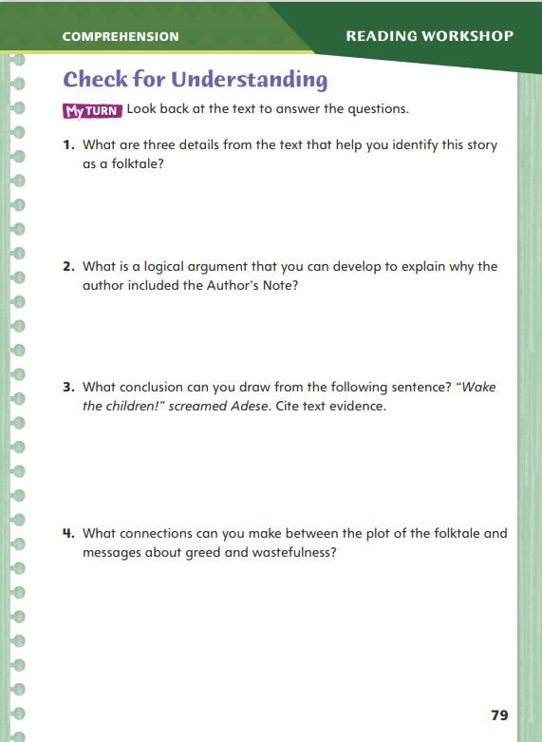
Page 79
Check for Understanding
Turn to page 79 in your Student Interactive and complete the activity.
Notes:
Have students complete p. 79 of the Student Interactive.

Slide 27
Word Study
wish
fox
watch
glass
strawberry
baby
Notes:
Direct students to complete the activity on p. 84 in the Student Interactive.
Have students write the plural forms of nouns and use the plural forms in sentences.
Explain that high-frequency words appear often in texts but do not always follow regular word study patterns, so students need to practice reading them.

Slide 28
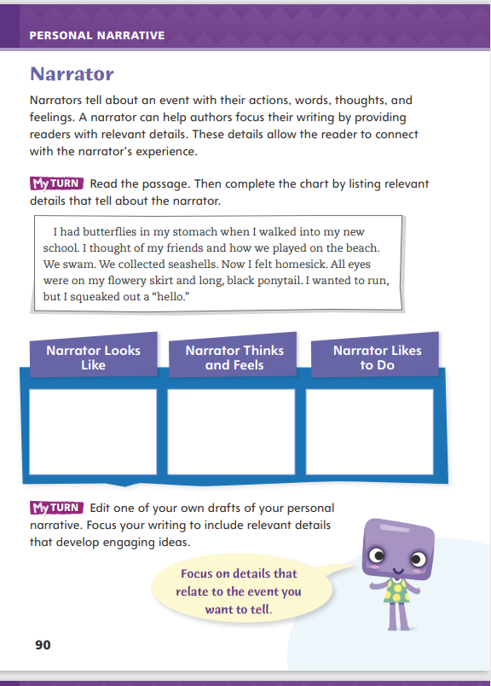
Page 90
Writing – Personal Narrative
Turn to page 90 in your Student Interactive.
Fill in the chart.
Notes:
In a personal narrative, the writer is also the narrator. The role of the narrator includes the following:
Using relevant details to describe a life event
Expressing actions, thoughts, and feelings in a way that engages readers
Writing in the first person, using words such as I, me, and my
Remind students that when they tell their family and friends what happened at school or home, they are narrating the stories. Sometimes personal narratives have a casual tone, like these everyday stories. Other times, they might have a different tone.
Read a story from the personal narrative stack. Say: Describe the narrator of this story. What details in the story tell more about the narrator?
Then direct students to p. 90 in the Student Interactive and have them complete the first My Turn.

Slide 29
Independent Writing
Edit one of your own drafts of your personal narrative.
Include relevant details that develop engaging ideas.
Share your personal narrative. What does it reveal about your likes, feelings, and personality?
Notes:
After students have completed the top part of the Student Interactive page, they should transition into independent writing. If students need to increase their understanding of the narrator’s role in a personal narrative, they should read and analyze more examples from the stack.
Writing Support
Modeled - Using an event from your life, model how to create a narrative voice that fits the tone and topic.
Shared - As you discuss a student’s writing, ask questions that bring out his or her personality.
Guided - Remind students that their personal narrative must show events through the narrator’s eyes, thoughts, and feelings.
If students have a solid understanding of the narrator’s role, they can work on the second My Turn on p. 90 in the Student Interactive.
Ask a few students to share their personal narrative draft. Discuss with the class what each draft reveals about the narrator’s likes, feelings, and personality

Slide 30
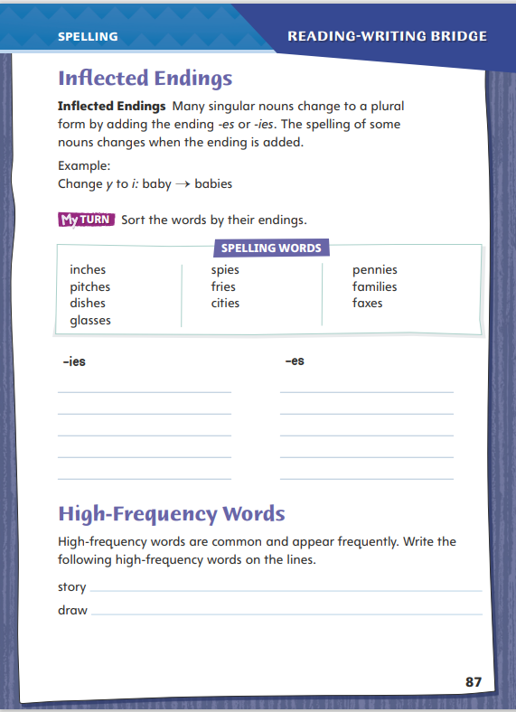
Page 87
Spelling
spies
fries
Turn to page 87 in your Student Interactive and complete the activity.
Notes:
Remind students that they can add the inflected endings -s, -es, or -ies to change some singular nouns to their plural forms.
Say and then spell the words spies and fries. Point out that these words have the ending -ies. Explain that these words are plural forms of base words that end with a consonant + y: spy and fry. Discuss the spelling of words with the inflected endings -s, -es, or –ies.
Have students complete the activity on p. 87 of the Student Interactive independently.

Slide 31
Language and Conventions
My friend and I play soccer.
Our team plays our first game this Saturday.
Identify the subject and the predicate.
Work with your partner. Identify the subject and the predicate in the sentences your partner has written.
Notes:
Flexible Option
Begin the discussion of subjects and predicates by providing oral examples of simple sentences, such as: My friend and I play soccer. Our team plays our first game this Saturday. Remind students that the subject of a sentence is whom or what the sentence is about, and the predicate tells what the subject is or does.
Using the oral sentences you provided, guide students in identifying the subjects of each sentence. (My friend and I, Our team) Then ask students to identify the predicates. (play soccer, plays our first game this Saturday)
Have students work with a partner to compose their own oral sentences. Ask students to identify the subjects and predicates in their partner’s sentences.

Slide 32
Lesson 3

Slide 33
Page 63
Infer Theme
Notes:
Readers infer the theme of a work by noticing the lessons characters learn in a story.
Think about how the characters behaved at the beginning of the story.
Notice the consequences of the characters’ actions.
Ask yourself how the characters change their behavior at the end and what actions show that they have learned a lesson.
Use the Close Read note on p. 67 of the Student Interactive to model how to annotate the text to infer theme. The theme is the central message of the story. Which sentences tell about the theme of the folktale? I am going to underline these sentences that Sky says, “Your people have wasted my gifts. I am tired of seeing myself on heaps of garbage everywhere.” I am also going to underline “Do not waste my gifts any longer, or they will no longer be yours.” I am going to write theme: don’t be wasteful in the margin.
Have pairs find and underline another sentence in the passage that helps them infer the same theme. Students can write what that sentence helps them infer about the theme in the margin.

Slide 34
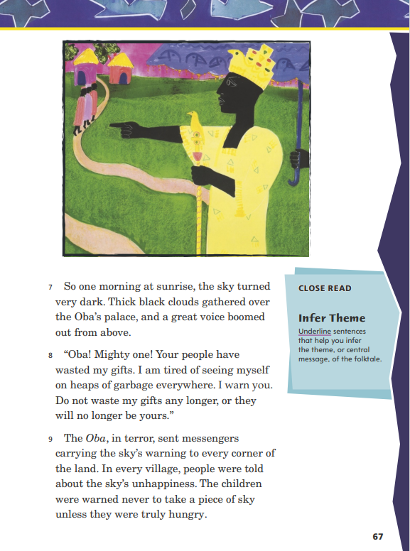
Page 67
Close Read – Infer Theme
Turn to page 67 in your Student Interactive.
Notes:
Explain that most folktales have a theme, or a central message. The theme may not be summed up in a single sentence. Readers have to infer or figure it out for themselves.
Have students scan paragraph 8. Ask: What feelings does the sky express? What warning does the sky make? Have students find and underline the sentences that help them infer the theme. See student page for possible responses.
Ask students to explain how these details help them understand the theme.
Possible Response: The sky is angry about being wasted, and the warning is not to be wasteful of the things that have been given to you. DOK 2

Slide 35
Page 68, 69
Close Read – Infer Theme
Turn to page 69 in your Student Interactive.
Notes:
Remind students that the theme of a story is usually not stated and readers must use clues from the story and their own knowledge to infer it.
Have students scan paragraph 12 and underline text evidence that will help them infer the theme of the folktale. See student page for possible responses. DOK 2

Slide 36
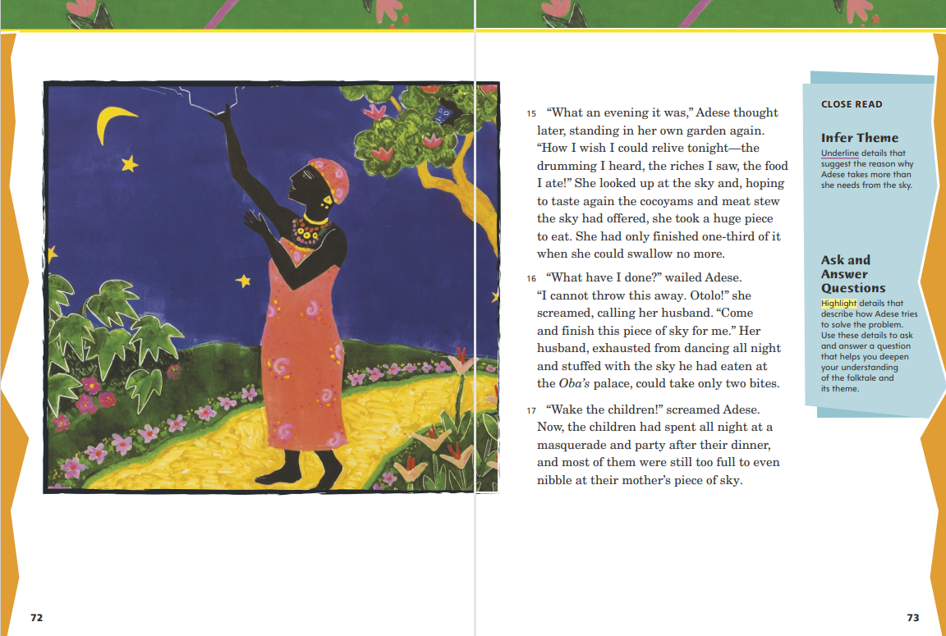
Page 72, 73
Close Read – Infer Theme
Turn to page 73 in your Student Interactive.
Notes:
Remind students that as they are reading they should be looking for clues in the text that help them infer the theme of the folktale.
Have students scan paragraph 15 and underline details that suggest the reasons why Adese takes more from the sky. See student page for possible responses. DOK 2

Slide 37
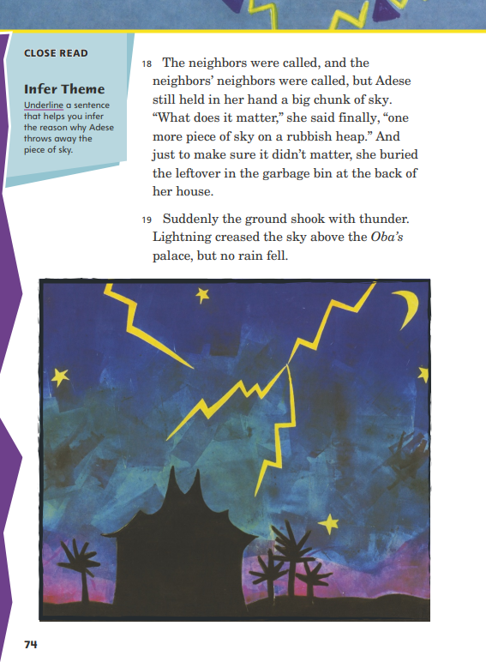
Page 74
Close Read – Infer Theme
Turn to page 74 in your Student Interactive.
Notes:
Remind students that the theme is the central message of this story and that events in the story can help them infer the theme. Have students scan paragraph 18. Ask: Why does Adese throw away the piece of sky? Underline the sentence as students point it out. See student page for possible responses.
Ask students to explain how this detail helps them understand the theme.
Possible Response: Adese has taken too much sky but doesn’t think it will matter if she throws away just one more piece. She doesn’t think being wasteful will matter this time. DOK 2

Slide 38
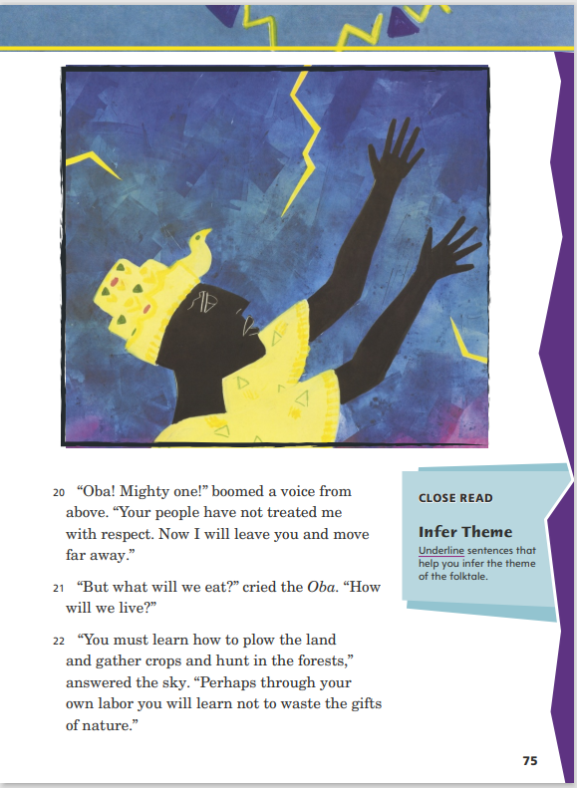
Page 75
Close Read – Infer Theme
Turn to page 75 in your Student Interactive.
Notes:
Students should be thinking about what the theme of this folktale is. By now they realize it involves respect for nature and not wasting natural resources. Have students scan paragraphs 20 and 22 for sentences that will help them infer the theme. Underline sentences as students point them out. See student page for possible responses. DOK 2

Slide 39
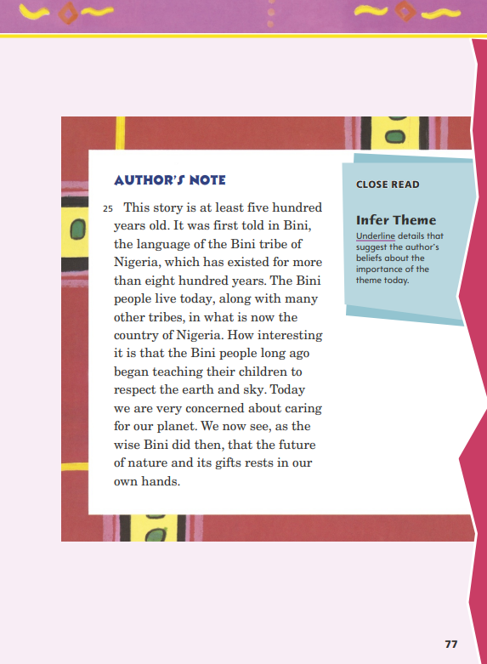
Page 77
Close Read – Infer Theme
Turn to page 77 in your Student Interactive.
Notes:
Remind students that authors generally write with a theme, or central message, in mind. Have students scan paragraph 25. Ask: What does the author of this story believe about the importance of caring for our world? Underline the sentences as students point them out. See student page for possible responses.
Ask students for examples of how we can care for our world.
Possible Response: recycling at home and at school; not wasting things; cleaning up air and water pollution DOK 2

Slide 40
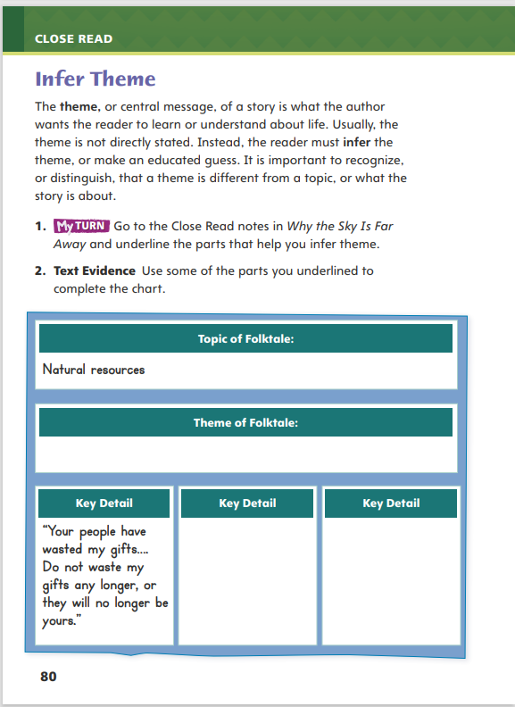
Page 80
Infer Theme
Turn to page 80 in your Student Interactive and complete the activity.
Notes:
Have students annotate the text using the other Close Read notes for Infer Theme and then use the text evidence from their annotations to complete the chart on p. 80 of the Student Interactive.

Slide 41
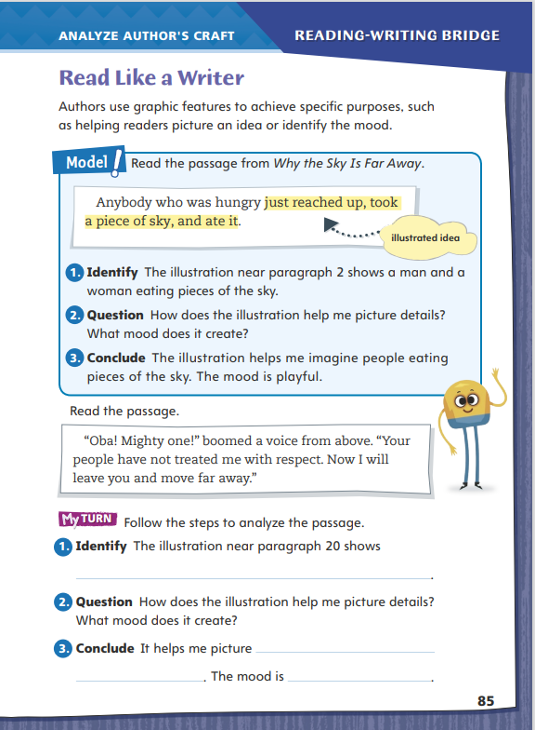
Page 85
Read Like a Writer
Turn to page 85 in your Student Interactive and complete the activity.
Notes:
Authors may use graphic features to help readers visualize the characters and events in a text or to convey mood.
To analyze how an author uses graphic features, note what the graphic feature shows, the details it includes, and the style and colors that are used.
Think about how the graphic features support the text. How do they help the reader understand the text?
Then explain how the author uses graphic features to achieve specific purposes in the text.
Explain that students will analyze how author Mary-Joan Gerson uses illustrations to achieve specific purposes in Why the Sky Is Far Away. Model analyzing graphic features using p. 85 of the Student Interactive.
Read the passage from the text. Then have students examine the details in the illustration on p. 64 of the Student Interactive.
Guide students in connecting details in the text with details shown in the illustration.
Help students describe Mary-Joan Gerson’s specific purposes for using this illustration in Why the Sky Is Far Away.
Direct students back to Why the Sky Is Far Away and complete the activity on p. 85 of the Student Interactive.

Slide 42
Word Study
worry
worries
copy
copies
house
houses
speech
speechs
Notes:
Flexible Option
Remind students that the inflected endings -s, -es, and -ies can be added to singular nouns to change singular nouns to their plural forms.
The word worry is a noun that ends with a consonant + y. To change this noun to its plural form, change the y to i and add -es. Have students change the nouns copy, house, and speech to their plural forms and read each word aloud. (copies, houses, and speeches.
Have students complete Word Study p. 1 from the Resource Download Center.

Slide 43
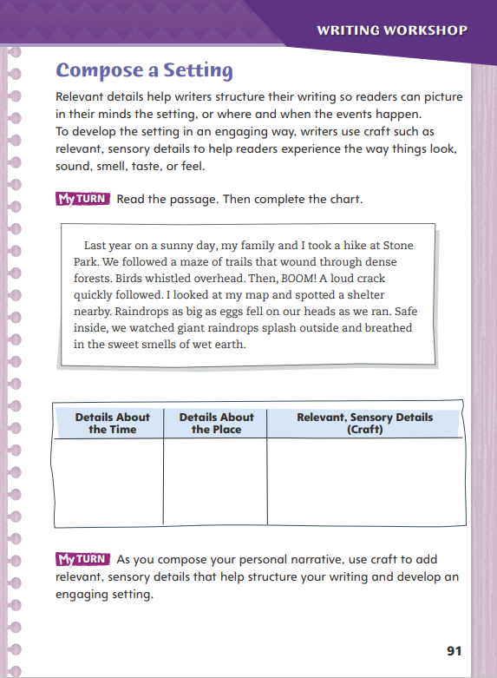
Page 91
Writing – Personal Narrative
Turn to page 91 in your Student Interactive.
Notes:
The event in a personal narrative should happen in a specific place and at a specific time. A writer can develop the setting in a personal narrative by
Using words that indicate when an event happens (e.g., yesterday, when I was five).
Using words that indicate where an event happens (e.g., at the park, in Houston).
Using sensory details to describe the setting.
Have students help you choose a personal narrative from the stack.
Ask students to close their eyes as you read the text. Then ask: What did you picture in your mind as you heard this personal narrative?
Then have students listen carefully to the words as you read the text a second time. Ask: Where and when does this personal narrative take place? Which words and details helped you to form a picture in your mind during the first reading?
Direct students to p. 91 in the Student Interactive. Have them read the first paragraph and complete the first My Turn.

Slide 44
Independent Writing
Read your personal narrative draft.
What words and details did you hear about the setting?
Ask questions to help identify other ways to develop the setting.
Notes:
After students have completed the first My Turn on the Student Interactive page, they should transition into independent writing. If students are just beginning their personal narrative draft, have them make notes about their setting in their writer’s notebook to use as they write their draft.
Writing Support
Modeled - Use an idea web to develop details for a setting.
Shared - While transcribing, ask the students questions that elicit further information about sensory details they could use to help describe the setting.
Guided - Prompt students to add two details about setting to their draft—one about time and one about place.
If students have already completed a draft, have them complete the second My Turn on p. 91 of the Student Interactive.
Have a few students read their personal narrative draft. Discuss with the class what words and details they heard about the setting. Then have them ask questions to help identify other ways in which the setting might be developed.

Slide 45
Spelling
sky
bus
lunch
candy
dress
wish
Notes:
Flexible Option
Remind students that the spelling of some nouns changes when an inflected ending is added. For a noun ending in a consonant + y, the y will change to i in the plural form.
Display the following words: sky, lunch, dress, bus, candy, and wish. Have students spell the plural forms of these nouns. Then discuss the inflected endings that students used.
Have students complete Spelling p. 7 from the Resource Download Center. Click path: Table of Contents -> Resource Download Center -> Spelling

Slide 46
Language and Conventions
The small child plays with a ball.
Identify the complete subject and the complete predicate.
Notes:
Explain to students that a complete subject and complete predicate include all the words in the subject and all the words in the predicate of a sentence.
Provide the following sentence: The small child plays with a ball. Identify the complete subject of the sentence (The small child) and the complete predicate (plays with a ball). Say: I can tell the subject and verb of this sentence agree because the noun in the subject, child, agrees with the singular verb, plays, in the predicate.
Have students work in pairs to generate simple sentences with clear subjects and predicates. Tell partners to read each sentence aloud pausing between the subject and the predicate. Then have students state the noun and the verb pointing out agreement. Ask partners to explain subjects and predicates verbally in order to monitor their understanding.

Slide 47
Lesson 4

Slide 48
Page 63
Ask and Answer Questions
Notes:
Readers ask and answer questions before, during, and after reading to gain information and deepen their understanding of the text.
Before reading, look through the story and use the title and illustrations to generate questions and ideas about the plot.
During reading, pause several times to think about whether your questions have been answered. If you do not understand the text, ask questions about what you do not understand and then reread to gain information.
After reading, think about the answers to the questions you had before and during reading. Add any additional questions you might have about theme to deepen your understanding.
Use the Close Read note on Student Interactive p. 64 to model asking and answering questions while reading. When I read, I monitor my understanding and ask questions to help clarify the text, such as Why is the sky important? I will highlight details that help me answer that question. In paragraph 2, I will highlight “Anybody who was hungry just reached up, took a piece of sky, and ate it.” This detail helps me understand that it was their source of food.
Remind students that when they read their self-selected texts, they should ask questions before, during, and after to gain knowledge and deepen their understanding,.

Slide 49
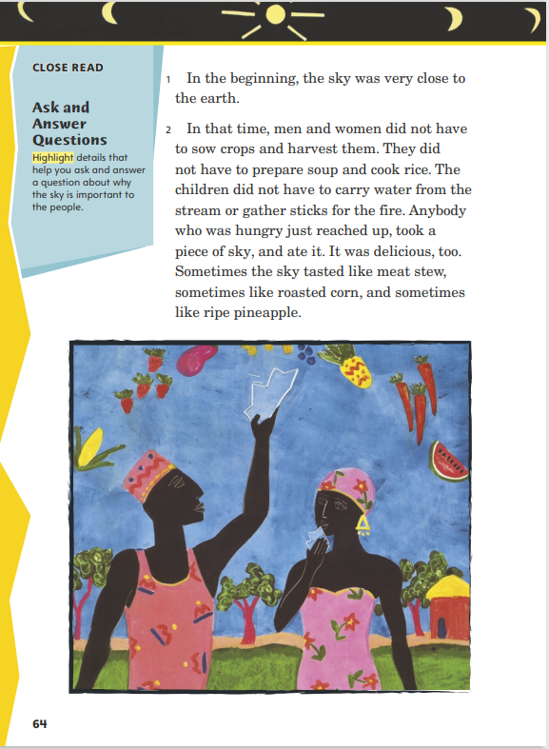
Page 64
Close Read – Ask and Answer Questions
Turn to page 64 in your Student Interactive.
Notes:
Have students scan paragraph 2. Ask: Why is the sky important to the people? What details provide a clue to the answer? Highlight details that help to answer the questions as students point them out. See student page for possible responses.
Ask students how they know the food that the sky provided was not all the same. Have them use text evidence to support their understanding.
Possible Response: The last sentence tells me that the sky had different tastes. DOK 2

Slide 50
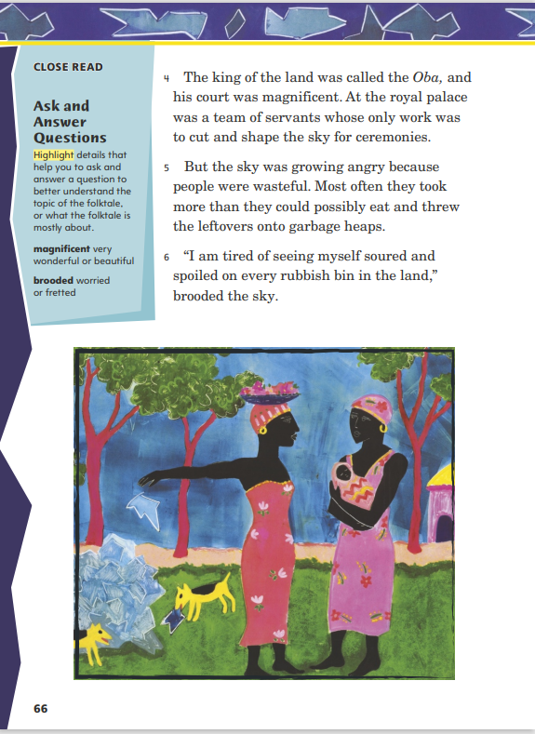
Page 66
Close Read – Ask and Answer Questions
Turn to page 66 in your Student Interactive.
Notes:
Tell students that while they are reading they should generate or ask themselves questions to deepen their understanding of the text.
Have students scan paragraph 5 and highlight details that would help them to ask and answer a question to understand the topic of the folktale. See student page for possible responses. DOK 2

Slide 51
Page 68, 69
Close Read – Ask and Answer Questions
Turn to page 69 in your Student Interactive.
Notes:
Ask: What is the purpose for the festival? Have students scan paragraph 10 and highlight a detail that states the purpose. See student page for possible responses.
Have students use the detail to generate questions about the festival during their reading. Remind them to use text evidence to answer their questions and to support understanding. DOK 1

Slide 52
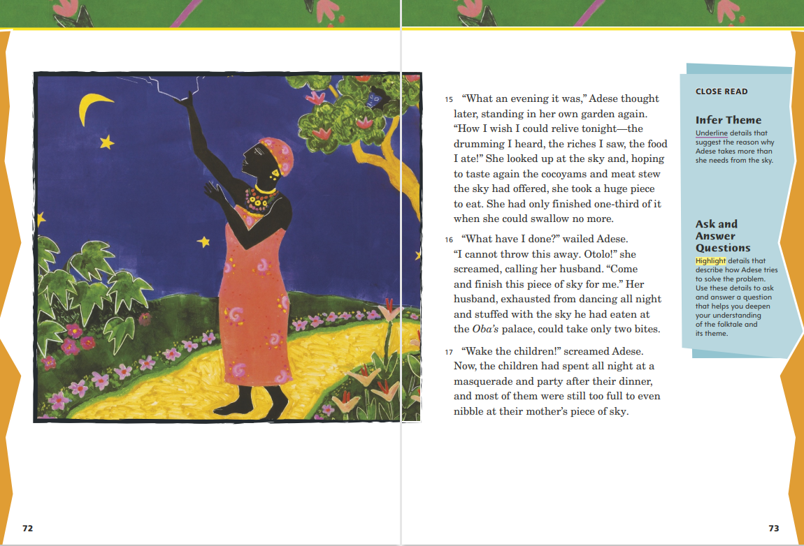
Page 72, 73
Close Read – Ask and Answer Questions
Turn to page 73 in your Student Interactive.
Notes:
Have students scan paragraphs 16 and 17. Say: Adese’s problem is that she must finish eating the piece of sky she took. How does she try to solve her problem? Highlight details that describe how she tries to solve the problem as students point them out. See student page for possible responses.
Then have students use these details to generate and answer a question that helps them deepen their understanding of the plot and the theme. DOK 2

Slide 53
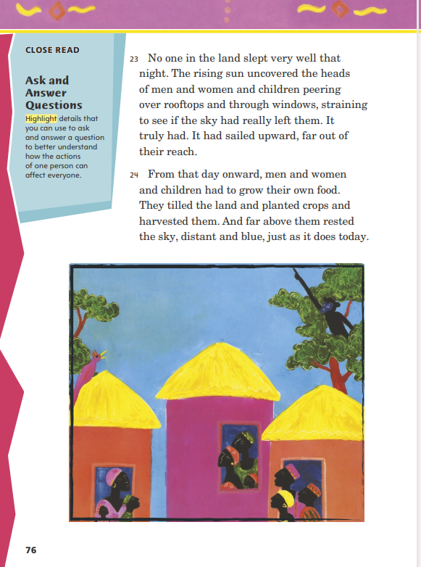
Page 76
Close Read – Ask and Answer Questions
Turn to page 76 in your Student Interactive.
Notes:
This folktale’s plot moved from telling about all the people to telling about Adese to telling about all the people again. Ask: How did the actions of one person, Adese, affect everyone? Have students scan paragraph 24 for details about how everyone is affected. See student page for possible responses.
Ask students to give some real-life examples of how one person’s actions affect many other people.
Possible Response: Students might refer to examples in the classroom, school, or government. DOK 3

Slide 54
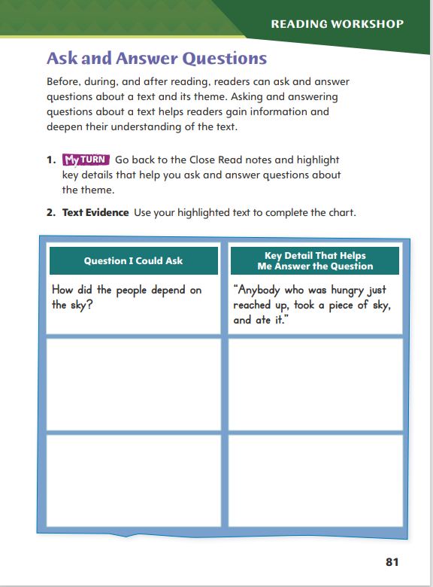
Page 81
Ask and Answer Questions
Turn to page 81 in your Student Interactive and complete the activity.
Notes:
Have students annotate the text using the other Close Read notes for Ask and Answer Questions and then use their annotations to complete Student Interactive p. 81

Slide 55
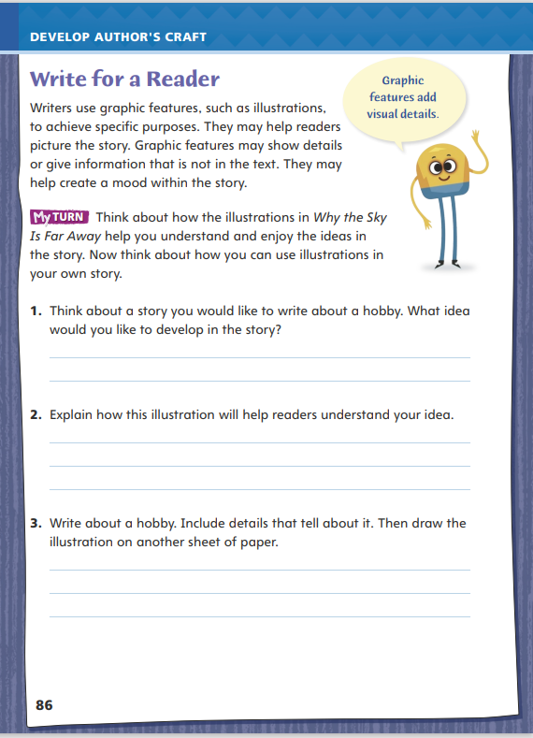
Page 86
Write for a Reader
Turn to page 86 in your Student Interactive and complete the activity.
Notes:
Remind students that authors use graphic features to achieve specific purposes in their writing. Together review how author Mary-Joan Gerson uses illustrations to convey mood and help readers visualize characters and events in Why the Sky Is Far Away.
Authors consider how adding graphic features could help them achieve specific purposes. Could visuals help readers better understand the text? Could visuals help convey the mood of the text?
Authors identify the specific purposes for using graphic features and then determine what type of graphic features, such as illustrations or photos, would best achieve these purposes.
Discuss how students might use graphic features for specific purposes in their own writing, using p. 86 of the Student Interactive. Model an example: Hiking is a hobby I enjoy. If I wrote a story about my family’s hiking trip to the state park, I might include graphic features to help readers picture my family and our hiking experience in the park. I think using an illustration or photo would best achieve these purposes. So in my text, I will include an illustration of my family as we hiked along the trails of the state park.
Have students refer to author Mary-Joan Gerson’s use of graphic features as an example of how to use graphic features in their own writing. Then guide students to complete the activity on p. 86 of the Student Interactive.

Slide 56
Word Study
happen
problem
puppet
trumpet
Notes:
Flexible Option
Review the strategies from the previous week to use the syllable pattern VC/CV to decode words.
Call on a volunteer to describe the syllable pattern of the word supper. Discuss how identifying the VC/CV syllable pattern helps readers understand how to read and pronounce unfamiliar words. Remind students to divide a VC/CV word between two consonants, as in lesson: les/son.
Have students work independently or in pairs to use what they have learned about the VC/CV syllable pattern to decode the following words: happen, problem, puppet, and trumpet. Ask students to discuss and compare how they used the VC/CV syllable pattern to read and pronounce the words.

Slide 57
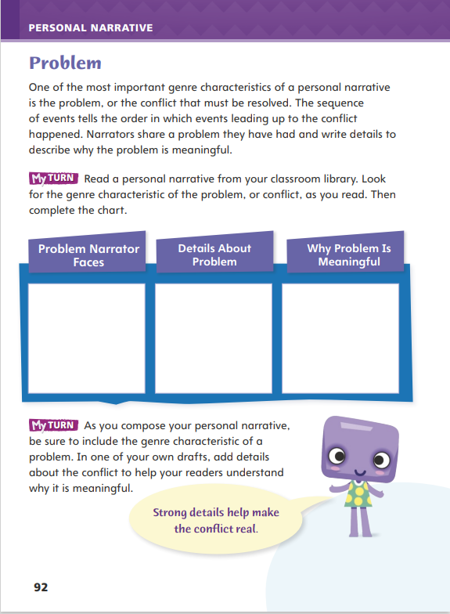
Page 92
Writing – Personal Narrative
Turn to page 92 in your Student Interactive.
Notes:
A personal narrative tells a true story from the writer’s life, so like most stories, it has a beginning, middle, and end.
In the beginning, the writer introduces a problem he or she had and explains why it is meaningful.
The middle contains a sequence of events that happened because of the problem.
By the end, the writer explains how the problem was resolved.
Read the first part of one of the personal narratives from the stack. Ask: What problem did the narrator have? What did he or she tell you about the problem? Why was it meaningful to the narrator? Mention that meaningful problems can be big or small, serious or funny, and long-term or short-term.
If students understand how a personal narrative includes a problem, have them choose a new personal narrative from the stack. If they need more support, have them choose the one you just shared. Then direct students to p. 92 of the Student Interactive. Have them read the introductory paragraph and complete the first My Turn using the text they have chosen.

Slide 58
Page 92
Independent Writing
Now you will begin to fully develop the problem in your personal narrative.
Share the part of your draft where the problem is described.
Identify the problem, give details about it and ask for additional information about it.
Notes:
Prompt students to begin fully developing the problem in their personal narrative. Students who are still unsure can brainstorm problems they have personally had and record them in their writer’s notebook. They can then identify which problems might be engaging ideas for a personal narrative.
Writing Support
Modeled - Do a Think Aloud to model coming up with a problem that could be engaging to a reader.
Shared - As you discuss the problem, ask students what about the problem makes it meaningful and engaging to a reader.
Guided - Use a web organizer to brainstorm a list of details that students could include to tell more about the problem.
Students who are drafting or have finished their draft can complete the second My Turn on p. 92 of the Student Interactive.
Select a few student volunteers who have completed a draft of their personal narrative. Have them share the beginning of their draft in which the problem is described. Ask the class to identify the problem, give details about it, and ask for additional information about it.

Slide 59
Spelling
rabbit
member
zipper
Notes:
Flexible Option
Review the spelling rule from the previous week about the VC/CV syllable pattern.
Present the following words to students: rabbit, member, and zipper. Call on volunteers to use the VC/CV syllable pattern to pronounce and spell the words. Remind students that the VC/CV syllable pattern appears in words that have two consonants after a short vowel sound.
Using the Spelling Words from the previous week, invite students to create flashcards for the words, to quiz each other on the correct spellings, or to create a word search or crossword puzzle using the words with a VC/CV syllable pattern.

Slide 60
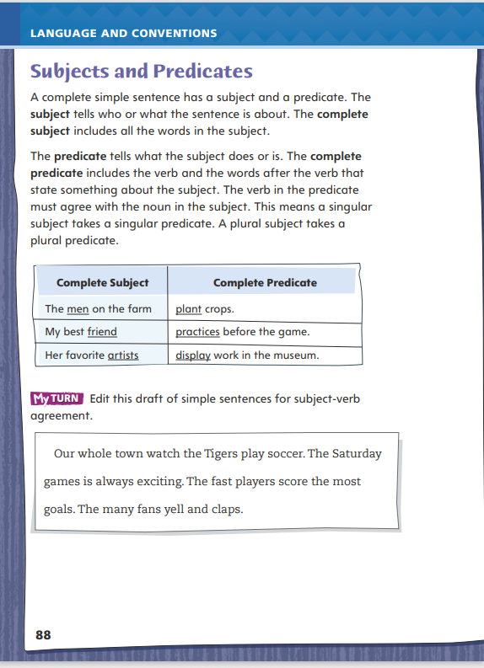
Page 88
Language and Conventions
Turn to page 88 in your Student Interactive and complete the activity.
Notes:
Have students edit the draft paragraph on Student Interactive p. 88.

Slide 61
Lesson 5

Slide 62
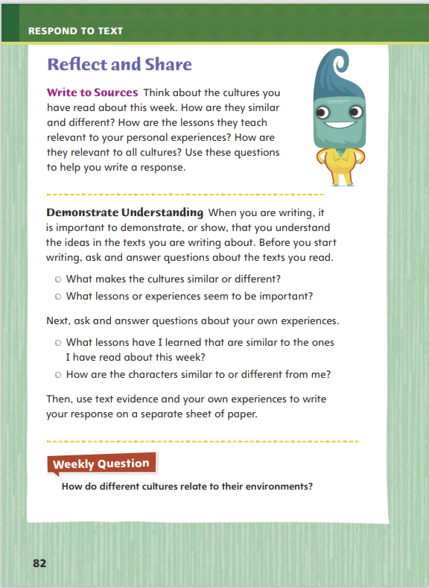
Page 82
Reflect and Share
Turn to page 82 in your Student Interactive.
Notes:
Explain to students that before writing about a text, they should ask and answer questions about the text. This practice will focus their writing and increase their comprehension of the text.
Ask students to focus on other texts and identify how the cultures are similar and different, what lessons were learned, and what connections can be made among the texts.
Then ask and answer questions about the lessons that were learned and how students can make connections between themselves or others and the characters in the text.
Model self-checking for understanding before beginning to write about the Write to Sources prompt on Student Interactive p. 82. Before I write, I am going to make sure I know enough about the theme of Why the Sky Is Far Away. I ask myself, What was the story mostly about? I remember that the story was mostly about how the people wasted what they had. I think the theme is don’t be wasteful.
Have students use evidence from this week’s text to discuss how the culture in Why the Sky Is Far Away views the environment.

Slide 63
Page 46
Apply
How do different cultures relate to their environment?
Notes:
Have students use evidence from the texts they have read this week to respond to the Weekly Question. Tell them to write their responses on a separate sheet of paper or discuss in small groups.

Slide 64
Word Study
sky
crop
class
dish
match
box
Notes:
Flexible Option
To assess students’ understanding of inflected endings, provide them with the following words: sky, crop, class, dish, match, and box.
Have students use their knowledge of the inflected endings -s, -es, and -ies to change each singular noun to its plural form.
Provide students with an example by showing them how to change the y to an i and add -es when changing sky to skies. Then have them complete the activity for the other five words. (crops, classes, dishes, matches, boxes

Slide 65
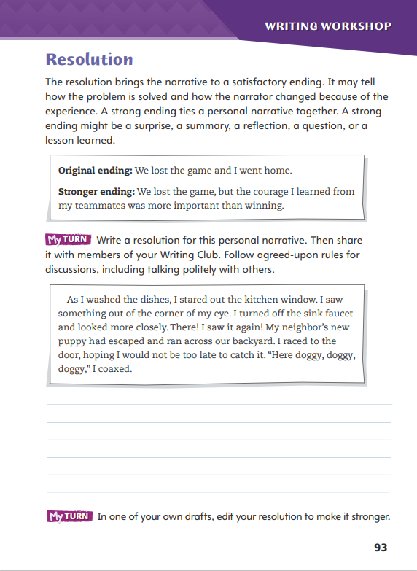
Page 93
Writing – Personal Narrative
Turn to page 93 in your Student Interactive.
Notes:
A personal narrative’s resolution follows naturally from the beginning and middle. It solves the problem, although it may do so in an unexpected way. A strong resolution is more than just an ending; it may also do one or more of the following:
Show how the narrator changed through the experience
Give readers a deeper understanding of their own lives
Create an emotional response from readers
Together read the introductory paragraph and example on p. 93 of the Student Interactive. Emphasize the different types of strong endings mentioned in the last sentence of the paragraph.
Next, read some personal narratives from the stack from beginning to end. As you finish each text, ask: How is this personal narrative resolved? What makes the ending strong? Have students explain why each resolution is purposeful and meaningful.
Provide students time to complete the Student Interactive page. Ask students to think of ways to create a resolution that is meaningful for the reader.

Slide 66
Independent Writing
Share the current draft of your personal narrative.
Identify each resolution’s strength and give suggestions to make it stronger.
Notes:
In this week’s Writing Club, students will share the current draft of their personal narrative. As students continue to work with their Writing Club group, they should spend the first five to ten minutes discussing the following:
The importance of discussing the writing, not the writer
How to appropriately praise a piece of writing
How to gently make suggestions for a piece of writing
Before sharing their work, students should review the topics covered in this week’s minilessons. Have them each choose an element of personal narratives that they would like help with in today’s Writing Club. Before they begin reading their draft, students should inform their Writing Club of the element to focus on. The discussion after each reading will be guided by the way the writer presents this element in the personal narrative.
Have students share the resolutions they wrote in the first My Turn on p. 93 of the Student Interactive. Ask the class to identify each resolution’s strength and to give suggestions for making it stronger.

Slide 67
Spelling
1. My glasses help me to see clearly.
2. They was the dishes after dinner.
3. Many families came to the school event.
4. My pencil is six inches long.
5. We have enough pennies to buy an eraser.
6. The office received two faxes.
7. Many people live in big cities.
8. My brother eats fries with his sandwich.
9. The baseball player throws three pitches to strike out the batter.
10. The soldiers will make excellent spies.
Notes:
(Note: Move the orange boxes to cover each bold spelling word before you read aloud the words and sentences.)
Read aloud the words and sentences. Have students spell each word with initial consonant blends and the two high-frequency words.
My glasses help me to see clearly.
They wash the dishes after dinner.
Many families came to the school event.
My pencil is six inches long.
We have enough pennies to buy an eraser.
The office received two faxes.
Many people live in big cities.
My brother eats fries with his sandwich.
The baseball player throws three pitches to strike out the batter.
The soldiers will make excellent spies.
Reveal the spelling word and have students check their work.

Slide 68
Language and Conventions
My dad bakes a cake for my sister.
Which of the following identifies the complete predicate of the sentence?
My Dad
dad
bakes
bakes a cake for my sister.
Notes:
Flexible Option
Display the sentence and have students respond independently.
My dad bakes a cake for my sister.
Which of the following identifies the complete predicate of the sentence?
My Dad
dad
bakes
bakes a cake for my sister.
Have students complete Language and Conventions p. 12 from the Resource Download Center. Click path: Table of Contents -> Resource Download Center -> Language and Conventions -> U3 W2

Slide 69
Unit 1: Week 2
Grade 3

