Slide 1
Unit 1: Week 6
Grade 4

Slide 2
Copyright © Savvas Learning Company LLC. All Rights Reserved.
This publication is protected by copyright, and permission should be obtained from the publisher prior to any prohibited reproduction, storage in a retrieval system, or transmission in any form or by any means, electronic, mechanical, photocopying, recording, or otherwise. For information regarding permissions, request forms, and the appropriate contacts within the Savvas Learning Company Rights Management group, please send your query to:
Savvas Learning Company LLC, 15 East Midland Avenue, Paramus, NJ 07652
or
k12learningpermissions@savvas.com
myView Literacy® is an exclusive trademark of Savvas Learning Company LLC in the U.S. and/or other countries.

Slide 3
Lesson 1

Slide 4
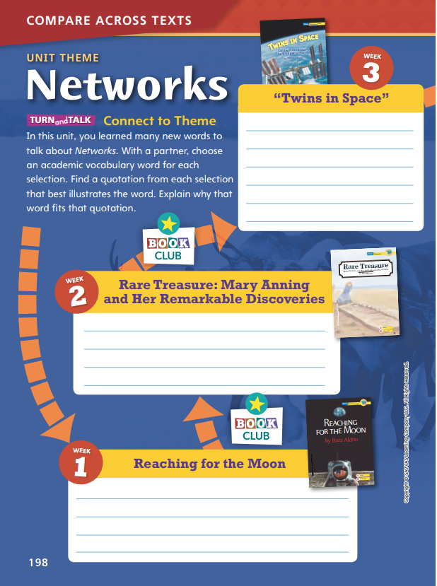
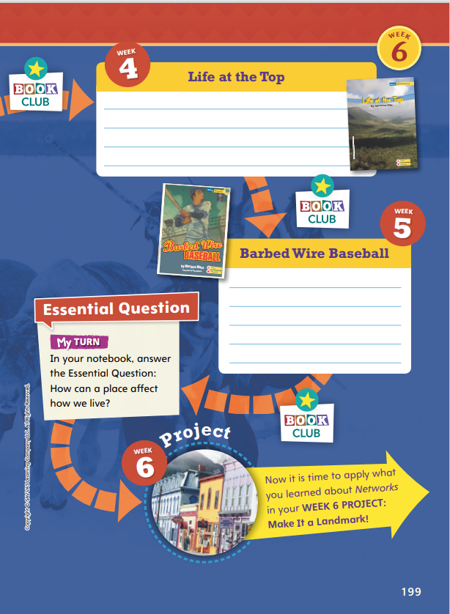
Page
198, 199
Compare Across Texts
Choose a vocabulary word for each text.
Write a quotation from that text that demonstrates its meaning.
Notes:
In this unit, students investigated the role and importance of social networks. This unit of study should help students understand that connections are essential, and that students not only rely on others, but that others, in turn, rely on them.
Have students look back at each selection to find examples of how people benefited from their networks and learned from each other, worked together, or relied on one another for assistance. Encourage students to discuss Networks by choosing an academic vocabulary word and a quotation from the text that demonstrates its meaning.
Use the model about Mary Anning to demonstrate. Say: Mary Anning is a good example of someone who contributed, or helped others, and who was helped by others in return. The text says, “Mary shared her ideas with the finest scientists. They prized the thoughts of the remarkable young woman who had left school when she was eleven.”

Slide 5
Page
198, 199
Compare Across Texts
How can a place affect how we live?
Write your response in your notebook.
Notes:
Have volunteers identify the setting of each selection listed in the opener. Then use questions like the one below to help students compare across texts.
In what ways are the settings of “Twins in Space” and Reaching for the Moon alike? In what ways are they different? How do the settings of each shape the experiences of the characters? (Possible response: Both texts include settings in space. Buzz Aldrin describes landing on the surface of the Moon. “Twins in Space” describes living on the International Space Station.
Remind students of the Unit 1 Essential Question: How can a place affect how we live? Have students answer the question in their notebooks.
If they have difficulty answering:
Place students in pairs or small groups, and have each group review the Weekly Question for each selection.
Then have students make connections to ideas in other texts and to the larger community or the world.

Slide 6
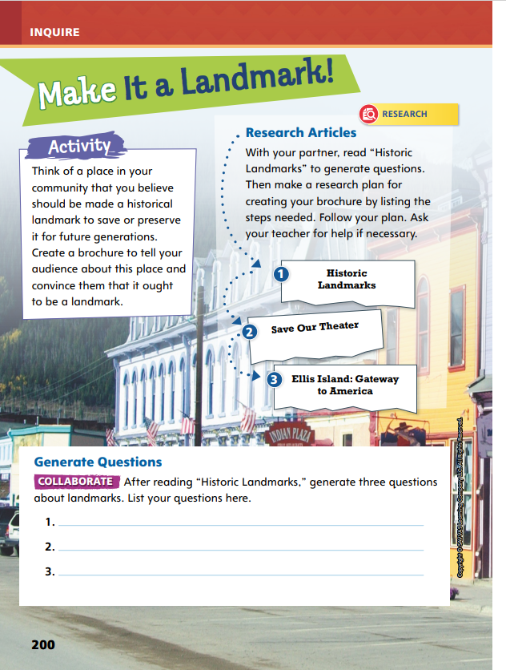
Page
200
Inquire – Introduce the Project
Discuss places you know that might be of historic value.
Share your ideas about the building or area and why you think it is of historic interest.
Notes:
This week students will address the theme of Networks by developing and conducting a research plan to write a brochure designed to convince readers that a particular place in their community should be designated a historic landmark. Before assigning the research article, motivate students by activating prior knowledge and setting a purpose for the project.
Read aloud the Activity prompt on Student Interactive p. 200.
Discuss the prompt and have students work in pairs or trios to discuss places they know that might be of historic value. Ask groups to share their ideas with the rest of the class. Have students tell what they know about the building or area they thought of and why they think it might be of historic interest.

Slide 7
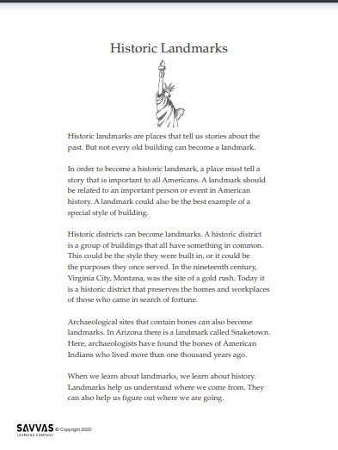
Inquire – Build Background
Read and annotate “Historic Landmarks.”
Underline unfamiliar words or phrases and write what you think the meanings might be.
Circle sections of the article you think are most interesting or important.
Put stars next to sections of the article that make you think of further questions about landmarks.
Notes:
Read-Pause-Annotate: Distribute copies of “Historic Landmarks.” Click path: Table of Contents -> Unit 1: Networks -> U1 W6: Project-Based Inquiry -> U1 W6: Lesson 1
Note: This article is available at 3 different Lexile levels. The slide image is the middle range.
Use the article to help students understand what landmarks are and why they exist, in addition to building background and helping students generate and clarify questions about landmarks.
Write the bulleted items below on the board and have partners take turns reading the article aloud. Tell students to pause periodically to annotate the following:
Underline unfamiliar words or phrases, and write what you think the meanings might be in context.
Circle sections of the article you think are most interesting or important.
Put stars next to sections of the article that make you think of further questions about landmarks.
After reading, have students discuss their annotations with the class.

Slide 8
Page
200
Inquire – Generate Questions
Turn to p. 200 in your Student Interactive and complete the activity.
Notes:
Have students work in pairs or trios to generate and clarify questions they would like to have answered about landmarks and write their questions on page 200.
Tell students that these questions can likely be answered through the research they will be doing in the project. Remind them to develop and follow a research plan as they complete their brochures.
For differentiated support:
If students have difficulty generating questions for research, have them make a T-chart with the headings What We Know and What We Don’t Know (Yet). Guide them to fill in the chart by asking questions about landmarks and the process of creating historic landmarks. Then help students rewrite their notes in the second column into question form.
If students show strong understanding of the article, have them rank their questions from easiest to answer to hardest to answer. Have them explain why they think the questions fall into this ranking. Then have them revisit the questions and answers at the end of the project to assess the accuracy of their predictions.

Slide 9
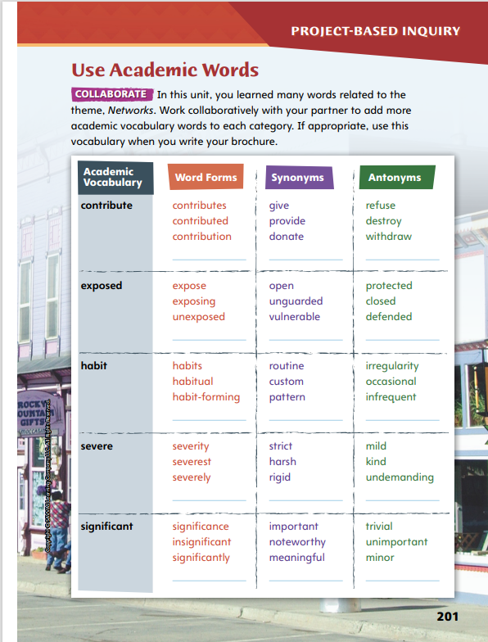
Page
201
Inquire – Academic Vocabulary
Turn to page 201 in your Student Interactive and complete the activity with a partner.
Share your ideas with your classmates.
Notes:
Have students complete the activity on p. 201.
Ask volunteers to share any words they added to the chart, such as contributor for another form of contribute or stern as a synonym for severe.
Tell students to try to use these academic vocabulary words in their brochures.

Slide 10
Lesson 2

Slide 11
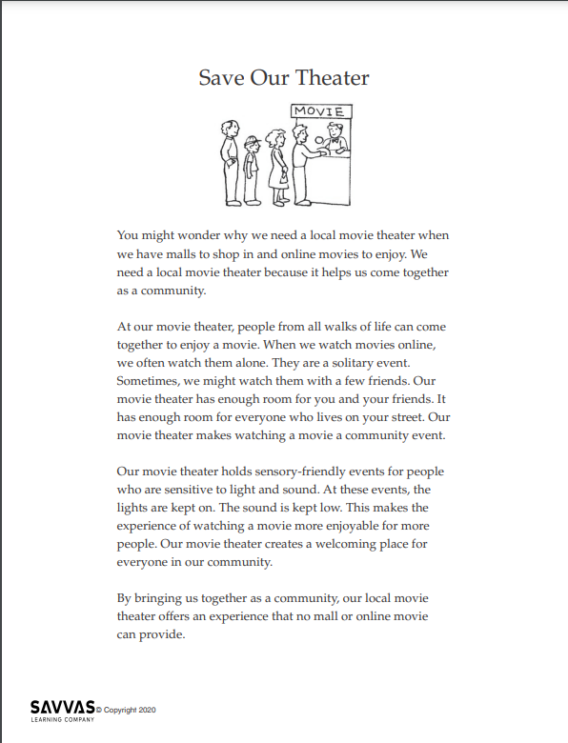
Explore and Plan – Argumentative Writing
Read and analyze “Save Our Theater.”
Identify the following:
The intended audience of the text.
What the author wants the audience to believe or do.
Reasons the author uses to back up the claim.
Notes:
Use the opinion article “Save Our Theater” and the Plan Your Research chart to help students recognize the characteristics of argumentative texts, including claims, facts, and evidence.
Distribute copies of “Save Our Theater.” Click path: Table of Contents -> Unit 1: Networks -> U1 W6: Project-Based Inquiry -> U1 W6: Lesson 2
Note: This article is available at 3 different Lexile levels. The slide image is the middle range.
Use the article to help students understand the characteristics and structures of argumentative writing. Tell students that every argumentative text makes a claim, and that identifying the claim is the first step in understanding the text.
Explain that identifying the author’s purpose in writing the text can go a long way toward finding and understanding the claim. Tell students that they can
determine the intended audience for the text
think about what the author wants his or her audience to believe or do
explore the reasons the author uses to back up the claim.

Slide 12
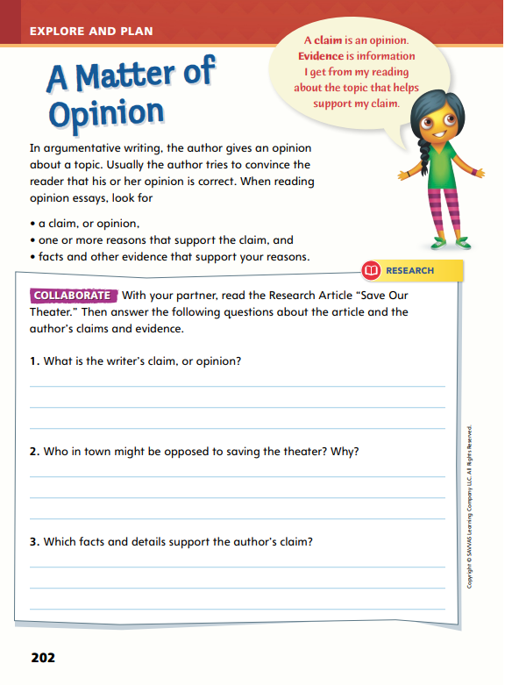
Page
202
Explore and Plan – Argumentative Writing
Turn to p. 202 in your Student Interactive and complete the activity with a partner.
Notes:
After students have read “Save Our Theater,” lead them in a discussion about the article. To help students read and think critically about the text, ask the following questions.
What claim is the author making?
What is the author’s purpose in writing this article?
What arguments against the article’s claims might there be?
In what way do the author’s facts support the claim?
Then have students complete p. 202 in the Student Interactive.

Slide 13
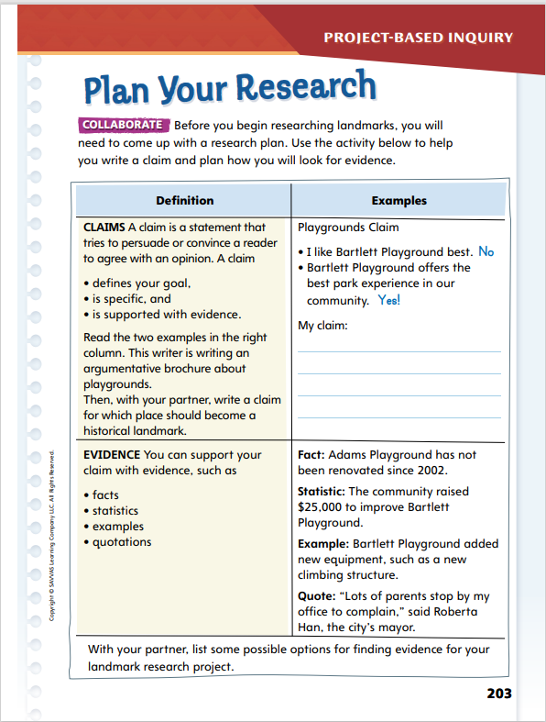
Page
203
Explore and Plan – Argumentative Writing
Turn to p. 203 in your Student Interactive and complete the activity with a partner.
Notes:
Have pairs or trios use the characteristics and structures of argumentative text and the Plan Your Research activity on p. 203 to help them identify a claim they would like to make for their historic landmark brochures.
Have them check their proposed claims against the information in the chart to ensure it makes sense and is actually a claim.
Then have students use the chart to identify types of evidence they might use to support their claims and where they might find those facts.

Slide 14
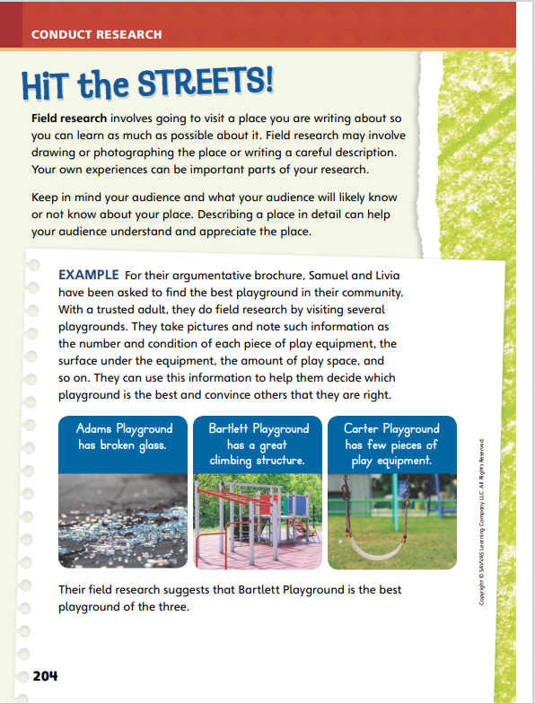
Page
204
Conduct Research
Discuss what why it was important that Samuel and Livia do their own field research.
Notes:
Field research may not always be possible, but it is a wonderful way to give students firsthand experience with the landmarks they are writing about. If at all possible, have students visit the places they would like to see given landmark status and let them experience the place through their own senses.
Use the example on p. 204 to model field research.
Say: Samuel and Livia could have relied on other people’s descriptions to evaluate the three playgrounds in their community, but they decided to go and visit the playgrounds themselves. That’s field research, and it was a good idea for several reasons. They could see firsthand how much glass there was at Adams Playground—so much glass that they could not recommend that anyone play there. In the same way, they could see for themselves how much fun children were having on the Bartlett Playground climbing structure and how little play equipment there was at Carter Playground. They took pictures and made notes to help them remember what they saw. Without doing the field research, they might have come to a different conclusion about which playground was best.
Tell students that when they conduct their field research, they need to record their observations in some way because they can be very easy to forget. They can make detailed notes about the landmark, for example, or they can take photographs and make drawings. The more information they can get, the better.

Slide 15
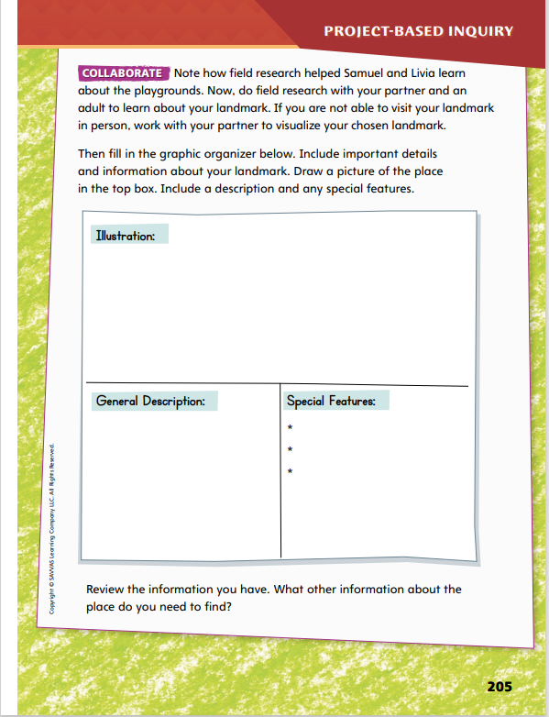
Page
205
Conduct Research
Record your field research on p. 205 of your Student Interactive.
With your partner, discuss ideas from your notes and photos that will be important for your brochure.
Notes:
Have students record their results on p. 205, whether they are able to conduct field research or not. (If they are unable to, have them visualize the landmark or use photos if available.)
Have them refer to the description of field research on p. 204 as they work. Tell students that their goal is to describe the place so well that anyone who has seen it will know which place they are talking about.
For differentiated support:
If students struggle to describe the landmark from their field research, ask a series of questions designed to activate their knowledge. For example, ask: What is it used for? What material was used to build it? Are there stairs? Guide students to turn their answers into complete sentences, such as The outside walls are made of red brick.
If students understand the assignment thoroughly and carry it out with ease, have them go further by writing words that tell about the landmark and sorting them into nouns, adjectives, and other parts of speech. Challenge students to make lists as long as possible while still describing the place appropriately.
Once students have gathered information about their chosen landmarks, they can begin to write a first draft of their brochure. Remind students that they are writing to persuade, which is the function of an argumentative text. Review that they need a clear topic and a strong and easily understood claim as well as a purpose for writing. In the following activity, students will learn about the various parts of a brochure.

Slide 16
Lesson 3

Slide 17
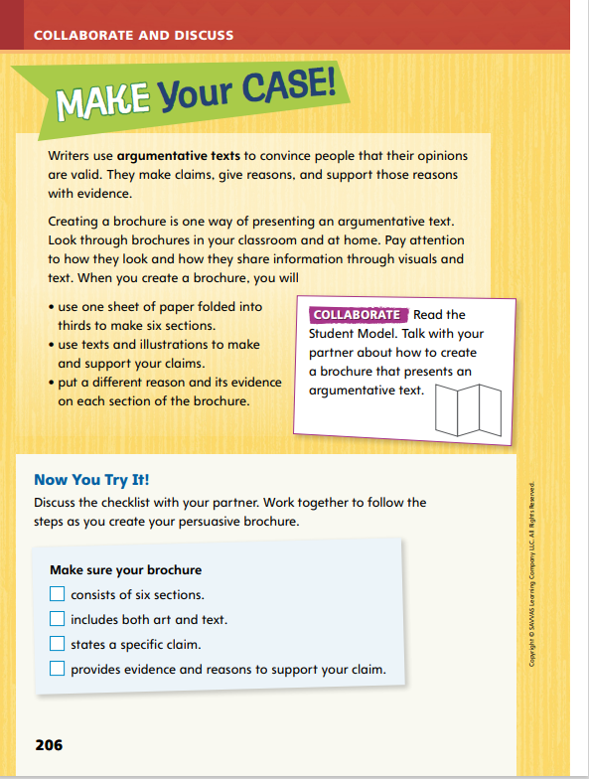
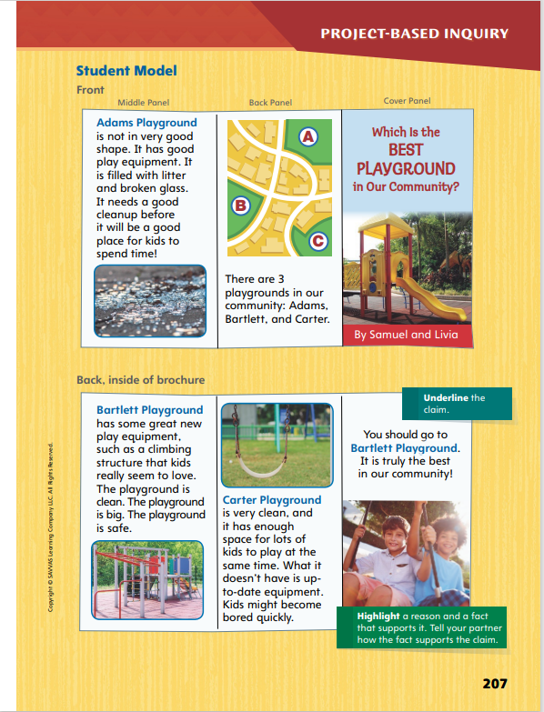
Page
206, 207
Collaborate and Discuss
Read the Student Model on p. 207 of your Student Interactive. Work with your partner to recognize the characteristics of argumentative texts.
Notes:
Review with students that their final projects are about landmarks, but point out that the student model of a brochure compares playgrounds. Use the student model to review some of the characteristics of argumentative or opinion writing, such as claims and evidence. In addition, use the model to point out some of the most important features of a brochure, notably the six sections and the use of art and other visuals.
Use the brochure about playgrounds on p. 207 to model the parts of a brochure. Say: When you are creating a brochure, you need to think about presentation as well as content. You need to make the brochure look appealing; notice how the student model uses photos and a map to add visual interest. You also need to give each of the six sections of the brochure its own specific focus. Notice how the model describes three playgrounds—each one in a different section. Finally, keep in mind the writing genre. Include a claim and reasons to support your opinions. What do you notice about the brochure—how is it set up and how does it work as an argumentative text?
Ask a volunteer to use characteristics and structures of argumentative text to identify the claim. Call on volunteers to read each section aloud and then describe in their own words what the section is mainly about. Use the callouts to teach students about claims and reasons and to show how they can be included in a brochure.

Slide 18
Page
206, 207
Apply
Use the checklist on p. 206 of your Student Interactive as you write the first draft of your brochure.
Notes:
Have student pairs use the checklist on p. 206 to help them as they write a first draft of their brochures.
Direct pairs to read and discuss the checklist to make sure they understand it.
Briefly review the academic vocabulary students have learned and remind them that they should look for ways to include these terms in their brochures.
Explain that brochures are typically offered free of charge, and they are often handed out to people who may not be interested in the brochure’s topic. Tell students that this makes the audience for brochures different from the audience for letters, books, and newspapers. Authors of brochures must engage the audience very quickly to ensure that their brochures are read rather than immediately recycled. Talk with students about using descriptive, detailed language and providing interesting visuals to capture the attention of the audience.

Slide 19
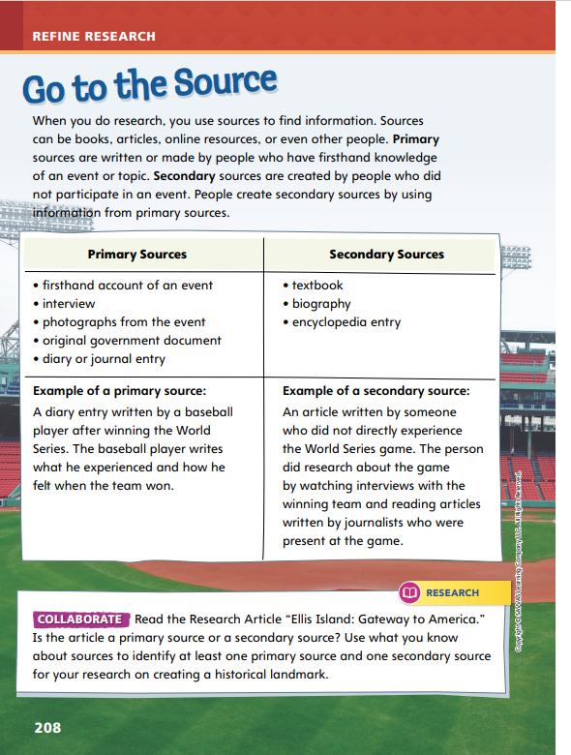
Page
208
Refine Research
Turn to p. 208 in your Student Interactive.
Notes:
Help students compare and contrast primary and secondary sources.
Use the bullet points to model how to distinguish primary and secondary sources.
A primary source is written or made by a person who has firsthand knowledge of an event or topic. This type of source might include a diary entry from a historical figure or an original government document.
A secondary source is created by someone who did not participate in an event. The author of a secondary source uses information from primary sources.
Help students understand that both primary and secondary sources may be reliable or unreliable and that all sources must be evaluated.

Slide 20
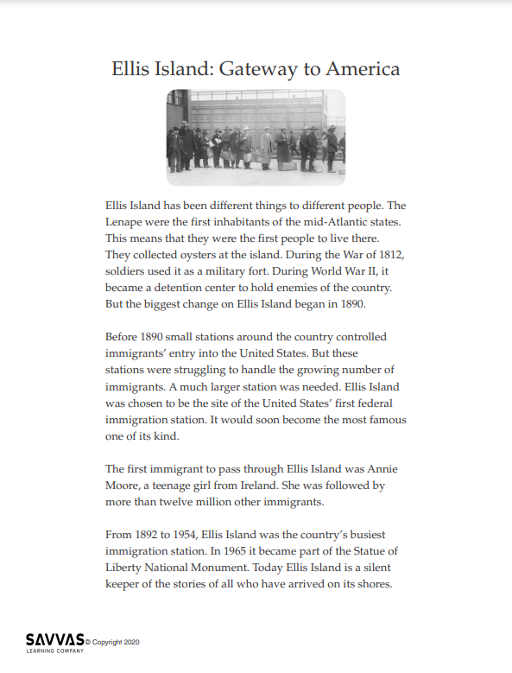
Refine Research
Read “Ellis Island: Gateway to America.”
Circle information that comes directly from people who worked or came through Ellis Island.
Write the author’s purpose at the bottom of the article.
Discuss how the article would be different if people at Ellis Island were left out.
Notes:
Distribute copies of “Ellis Island: Gateway to America.” Click path: Table of Contents -> Unit 1: Networks -> U1 W6: Project-Based Inquiry -> U1 W6: Lesson 3
Note: This article is available at 3 different Lexile levels. The slide image is the middle range.
Use the research article to provide practice in identifying primary and secondary sources.
As students analyze the sources in the article, display the following bullet points for students to consider:
Circle information that comes directly from people who worked at or went through Ellis Island.
Write the author’s purpose at the bottom of the article.
With your partner, consider how the article would have been different if the experiences of people who were at Ellis Island had been left out of the text.

Slide 21
Page
208
Refine Research
Identify: Is this article a primary or secondary source?
Turn to p. 208 in your Student Interactive and complete the activity.
Notes:
Have student pairs complete the activity on p. 208.
Have them identify primary and secondary sources in the article. Follow up by having students demonstrate understanding of the information gathered by explaining how they were able to identify each of the sources.
For additional practice, use additional primary sources. Click path: Table of Contents -> Unit 1: Networks -> U1 W6: Project-Based Inquiry -> U1 W6: Primary Sources

Slide 22
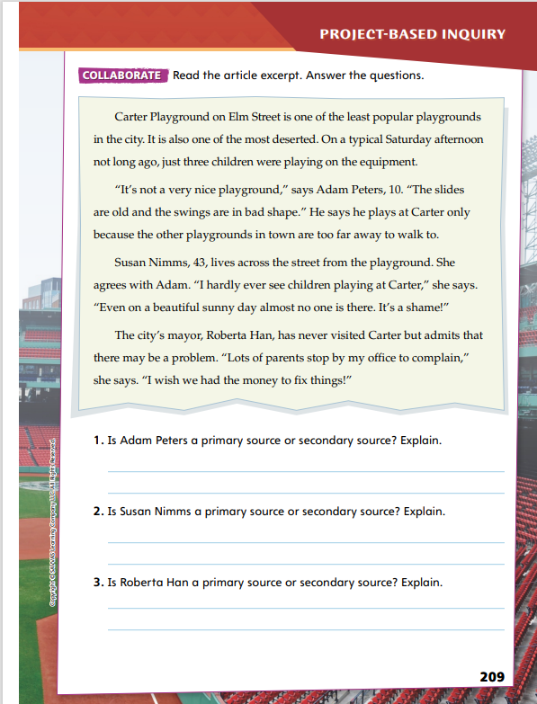
Page
209
Refine Research
Turn to p. 209 in your Student Interactive and complete the activity with a partner.
Notes:
Have students read the article on p. 209 and write the answers to the questions. Have students identify which people interviewed in the newspaper article have direct experience with the playgrounds and which are passing on information from elsewhere. Point out that the first group consists of primary sources and the second group consists of secondary sources.
Differentiated Instruction
Help students who are struggling to understand the difference between primary and secondary sources by discussing the roots of the two terms. Explain that primary means “first.” Then point out the base word in secondary. Explain that the first people to experience an event are the primary sources and that secondary sources learn about the event second, or following the first.
Students who quickly understand the distinction between primary and secondary sources should write their own primary source account of an event they experienced. They can switch papers with another student and write a brief secondary source document summarizing the event from the perspective of someone who did not experience it directly.
Have students look at their drafts. With a partner, have them find examples of primary and secondary sources and tell each other how they know which is which.

Slide 23
Lesson 4

Slide 24
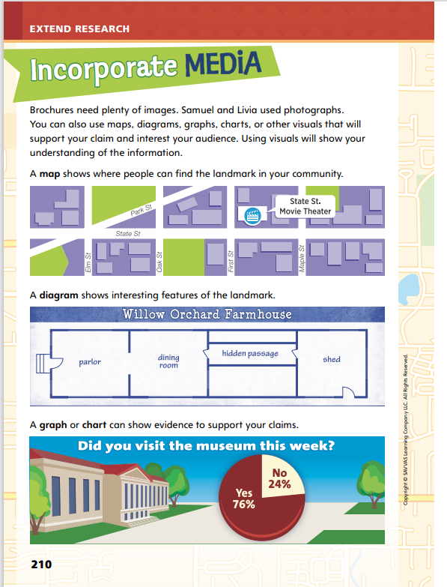
Page
210
Extend Research – Incorporate Media
Turn to p. 210 in your Student Interactive.
Notes:
Tell students authors can better support their claims and make their evidence easier to understand if they incorporate visual images and other types of media into their work. This is especially true for items such as brochures, which are designed to be eye-catching. Using visuals also allows authors to demonstrate their understanding of a topic and their research about that topic.
Use the media examples on p. 210 to model how to include a variety of images in their projects.
Say: A map tells readers where a landmark is and how they can get there. A map can be very detailed, but it does not have to be; it just needs to give the reader an idea of where to find the landmark. Maps should include labels for nearby streets, familiar places such as parks and community buildings, and an arrow to indicate the location of the landmark.
Say: Graphs and charts can be excellent visuals in brochures because they show information that may be difficult to clearly express in words. Statistics and other mathematical data are easier for readers to interpret when presented visually.

Slide 25
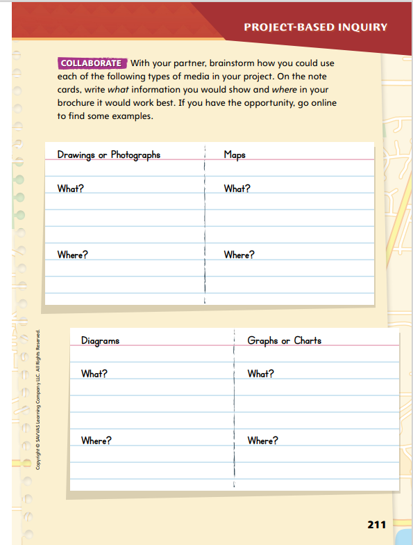
Page
211
Extend Research – Incorporate Media
Turn to p. 211 in your Student Interactive and complete the activity with a partner.
Notes:
Discuss specific visuals that students might find helpful to include in their brochures.
Have students explain why they would want to include the images they chose.
Have pairs use the information on p. 211 to help them brainstorm ideas for their brochures.
Ask them to consider these questions: How would this image help you convince a reader that your place should be a landmark? How does the image make your place seem interesting or unusual?
Emphasize that the visuals must relate to the topic and support the claims in the brochure; they should not be present just for decoration.

Slide 26
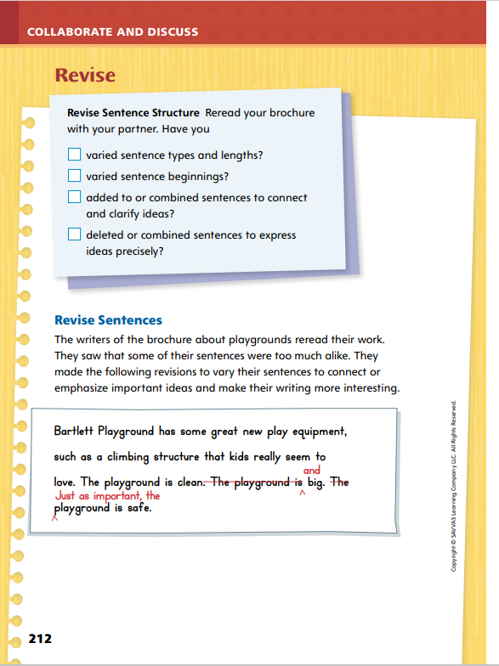
Page
212
Collaborate and Discuss
Turn to p. 212 in your Student Interactive.
Describe the differences after the sentences have been revised.
Notes:
Point out that authors always look over their work at least once before declaring it complete. They need to check that they have said everything they want to say, but they also need to be sure that they have used language that will appeal to their intended audience. In particular, they want to be sure that their sentence structures are interesting and appropriate for an argumentative text.
Model how writers review their sentence structures on p. 212, and refer back to the Student Model as necessary. Say: One goal for sentence structure is to vary your sentences so they do not all sound exactly alike. You can see that Samuel and Livia decided that some of their sentences were too much alike. They solved this problem by combining two of the sentences and by adding some words to the beginning of the third sentence.
Read the original sentences beginning with “The playground is clean”; then read the revision. Ask students to describe the differences. Elicit that the sentences no longer sound similar and repetitive, and the writing has become less choppy.

Slide 27
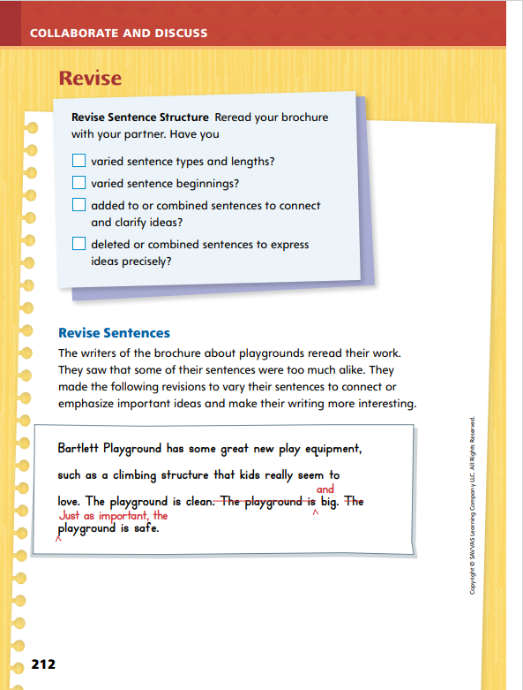
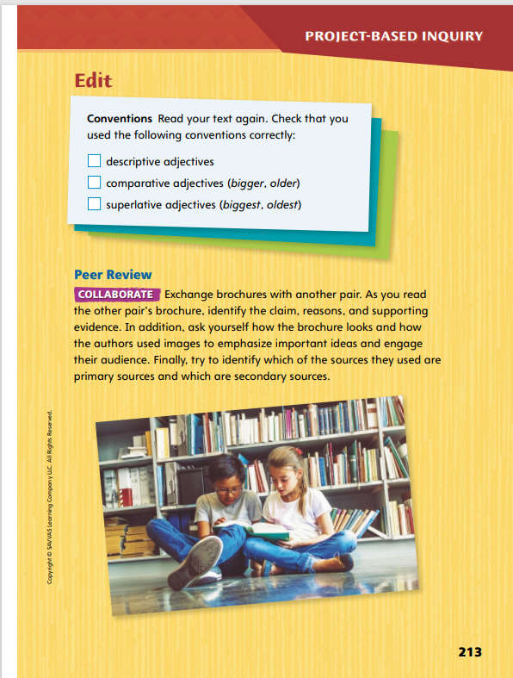
Page
212, 213
Apply
Revise and edit your brochure using the checklists.
Exchange with another group.
Notes:
Have pairs exchange their brochures and read each other’s work. Review with students that their feedback should be respectful in tone and immediately applicable to the writer’s draft.
Have pairs reread their brochures. Remind students that they should use the checklist on p. 212 of the Student Interactive to guide them in making changes to sentence structure. Have them ask questions such as How many simple, declarative sentences did I write? How many of my sentences are compound? Which transition words have I used to combine ideas? Tell students that they should be able to check off each box when they have finished revisions.
Next, have students use the checklist on p. 213 to review their use of conventions, especially comparative and superlative adjectives. Have them ask questions such as Is this the best word for what I want to say? and Does this adjective support my claim? Help students understand the distinctions between comparative and superlative forms of adjectives and when each might be used.
To provide differentiated support:
Reread the Student Model with students to demonstrate what similar sentences sound like and what varied sentences sound like. Then have students read their brochures aloud one sentence at a time. Have them listen for repetition in wording and sentence format. Show them explicitly how to make changes by combining sentences, adding or deleting words, or changing the word order.
Students who show good understanding of sentence structure can be asked to find three different ways of expressing a given idea in their brochures. Encourage them to rank their sentences based on how clearly they communicate the necessary information. Then have them share their lists with a partner and discuss what makes each sentence effective or ineffective.

Slide 28
Apply
Talk about the edits your peers suggested.
Write a clean, edited, final copy of your brochure for your target audience.
Notes:
Once students have revised and edited their brochures, have students produce a clean, revised, and final copy.

Slide 29
Lesson 5

Slide 30
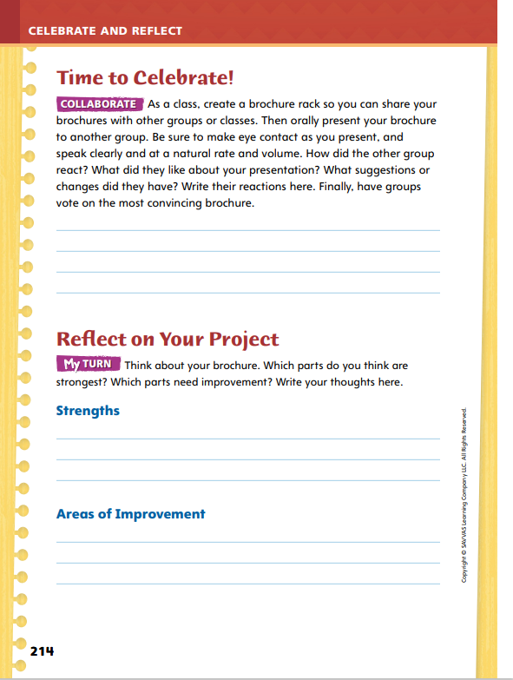
Page
214
Celebrate and Reflect
Present your brochure to your classmates.
Turn to p. 214 in your Student Interactive and write your classmates’ reactions.
Notes:
Before final publication, have students present their brochures to an authentic audience. Allow presenters to choose a method for displaying their brochures while giving their presentations so that audience members can clearly see the visual components.
Use the information on p. 214 of the Student Interactive to show students what characteristics define a good presentation. Say the following:
You need to make eye contact with members of your audience. If you look at your brochure the whole time, listeners will think you are not prepared or that you are not interested in their reactions. You do not need to stare at people, but look audience members in the eye from time to time.
Speaking at a natural rate means talking at a normal speed. If-I-read-mybrochure-very-quickly, no one will understand it. If…I…read…too…slowly, my audience will get bored.
The word volume refers to how loudly or quietly you are speaking. If you speak too loudly or too softly, your audience will have difficulty understanding what you are saying.
Guide students to provide appropriate, useful feedback to their peers about brochure presentations.
Model comments that are actionable and respectful, such as I was able to hear you because you spoke clearly at a reasonable volume. I could have understood you better if you spoke a little more slowly or Your presentation was very convincing because when you made eye contact with me I knew you were talking directly to me.

Slide 31
Page
214
Celebrate and Reflect
Turn to p. 214 in your Student Interactive and complete the activity.
Notes:
Have students work independently to evaluation their own brochures, using the rubric on p. T457 and consulting with their partners as needed.
Remind them to think about what worked well and what they would change for next time. Encourage students to be honest in their assessments.

Slide 32
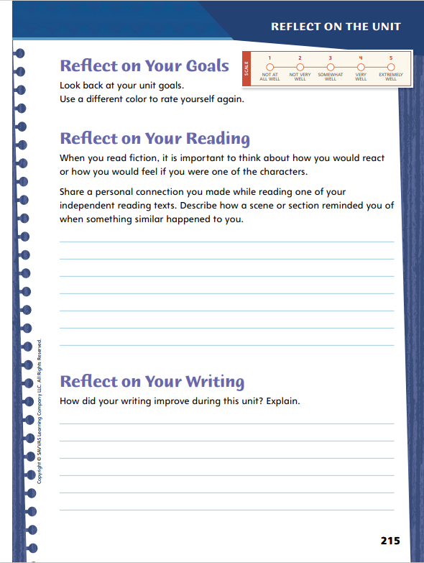
Page
215
Reflect on the Unit
Turn to p. 215 in your Student Interactive and complete the activities.
Notes:
Have students revisit the Unit Goals on p. 12. Have them re-rate themselves in each category. How close did you come to achieving each goal?
As they are reading self-selected texts including fiction, readers make personal connections by thinking about how they would react or how they would feel if they were a character in the story. Ask: Which fictional events reminded you of something that has happened in your life? How did you react? Was your reaction similar to or different from the fictional character's reaction?
Have students describe their personal connections to self-selected texts by answering the Reflect on Your Reading question.
Writers reflect on what they found easy and what they found difficult. Remind students that noticing challenges and successes can help them build awareness of their strengths as writers. Discuss with students how they can know that they are making progress as writers. Ask: What will tell you that your writing is improving? What will you look for in the future to know that your writing is getting even better?
Have students answer the Reflect on Your Writing question.

Slide 33
Unit 1: Week 6
Grade 4

