Slide 1
Unit 1: Week 2
Grade 5

Slide 2
Copyright © Savvas Learning Company LLC. All Rights Reserved.
This publication is protected by copyright, and permission should be obtained from the publisher prior to any prohibited reproduction, storage in a retrieval system, or transmission in any form or by any means, electronic, mechanical, photocopying, recording, or otherwise. For information regarding permissions, request forms, and the appropriate contacts within the Savvas Learning Company Rights Management group, please send your query to:
Savvas Learning Company LLC, 15 East Midland Avenue, Paramus, NJ 07652
or
k12learningpermissions@savvas.com
myView Literacy® is an exclusive trademark of Savvas Learning Company LLC in the U.S. and/or other countries.

Slide 3
Lesson 1

Slide 4
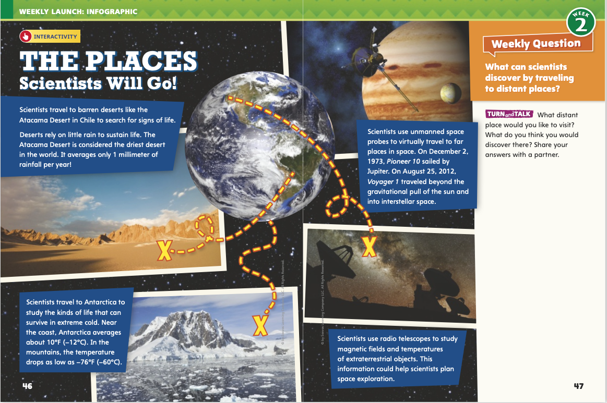
Page 46, 47
Interact with Sources
Discuss the different places scientists will go to find evidence of life.
Freewrite your ideas.
Notes:
Remind students of the Essential Question for Unit 1: How do journeys change us?
Point out the Week 2 Question: What can scientists discover by traveling to distant places?
Read and Discuss Direct students’ attention to the infographic on pp. 46–47 in the Student Interactive. Explain that an infographic combines words and pictures to provide information. Have students read the infographic and discuss the very different places scientists will go to find evidence of life
Use the following questions to guide discussion:
Of the places scientists search for life, which one was most surprising to you?
What do you think scientists will find as they explore space?
What do these places suggest about how people persevere, or keep trying
to do something? Why?
WEEKLY QUESTION Reread the Week 2 question: What can scientists discover by traveling to distant places? Tell students that they just learned about some ways in which scientists have discovered life in distant places. Explain that they will read about more ways this week.
Have students answer the questions on p. 47 and then discuss their answers with a partner.

Slide 5
Listening Comprehension
Question | Answer
Notes:
Tell students you are going to read an informational text aloud. Have students listen as you read “Searching for Life Under the Sea.” Explain that students should listen actively, paying careful attention to the given facts, technical vocabulary, and text structure as you read. Prompt them to ask questions to clarify information and follow agreed-upon discussion rules.
Have students actively listen for elements of informational text. READ the entire text aloud without stopping for the Think Aloud callouts.
REREAD the text aloud, pausing to model Think Aloud strategies related to the genre.
THINK ALOUD Analyze Informational Text I notice that the author uses several technical terms, including tectonic plates. I think it means “part of Earth’s crust that moves slowly.” Submersible is another technical term. It sounds like it means “submarine.” I will use a dictionary to check my definitions. Technical vocabulary is important in informational text. I’m going to look closely at other technical terms to help me understand the topic.
THINK ALOUD After I finished reading, I went back and looked at the text structure. The first paragraph tells about places where scientists have looked for signs of life. The last sentence of the paragraph is “But what about several kilometers down?” The rest of the selection answers that question. I think that the structure of this text is question and answer.
Use a T-chart to help students identify the question and answer in this text.

Slide 6
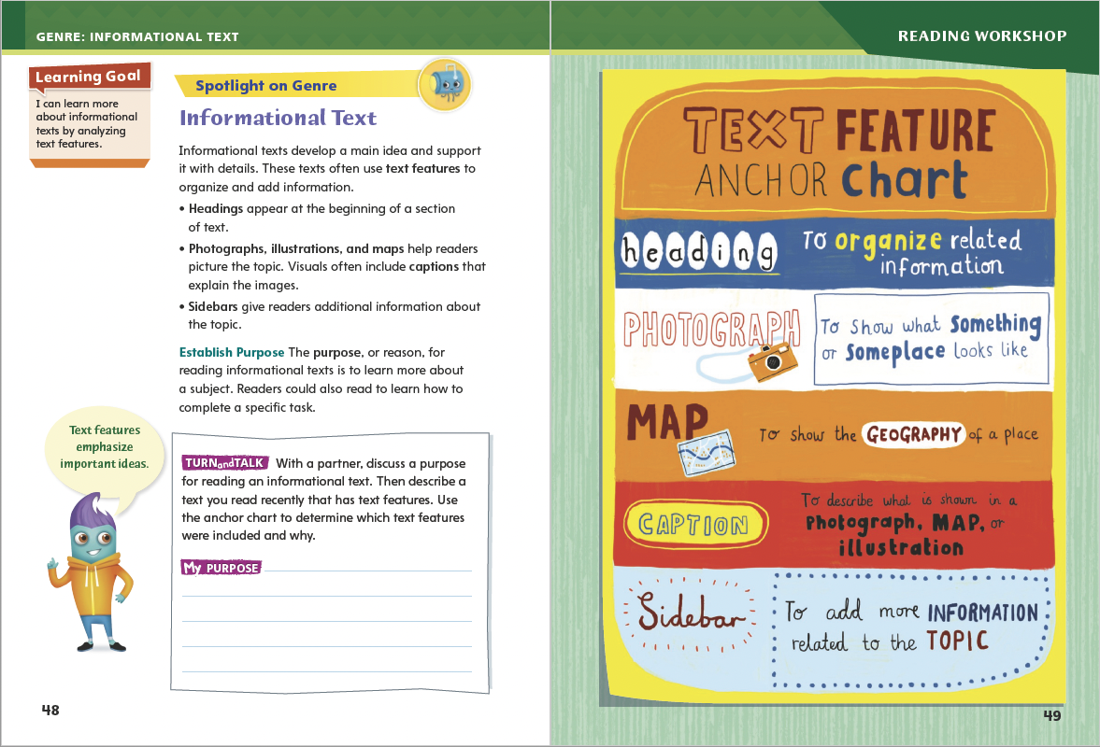
Page 48,49
Text Features
Turn to page 48 in your Student Interactive.
Notes:
The purpose of informational text is to give information about the real world. It is nonfiction. It contains facts. Often, authors of informational text use text features to help communicate information.
Point out that when students read informational text, they should look for text features to help them better understand it.
Explain the purposes of text features: insets, timelines, sidebars, photographs, maps, diagrams, titles, headings, and captions.
Ask: If a text discusses a part of the world with which you are unfamiliar, which text feature would aid your understanding?
Model determining which text features would add to a text: In “Searching for Life Under the Sea,” there are no text features. I ask myself, “Which text features would help me better understand this text?” I reread the text. I see that it discusses the Galapagos Rift and the discovery of geothermal vents and new organisms. A map would help me understand the location of the rift. Photographs of the vents and the organisms would show me their appearance.
Show students examples of text features in several informational texts. Explain how the features help readers better understand the text.
Have students use the strategies to identify informational text.
Use the Anchor Chart Have students use the strategies to identify elements of informational text. Editable Anchor Chart Click Path: Table of Contents -> Reading Anchor Charts -> Unit 1 Week 2: Text Feature Editable Reading Anchor Chart

Slide 7
Page 48
Apply
Discuss a purpose for reading an informational text. Describe a text you read recently that has text features.
Notes:
Have students complete the Turn and Talk activity on p. 48 of the Student Interactive. Call on volunteers to share their purpose with the class.

Slide 8
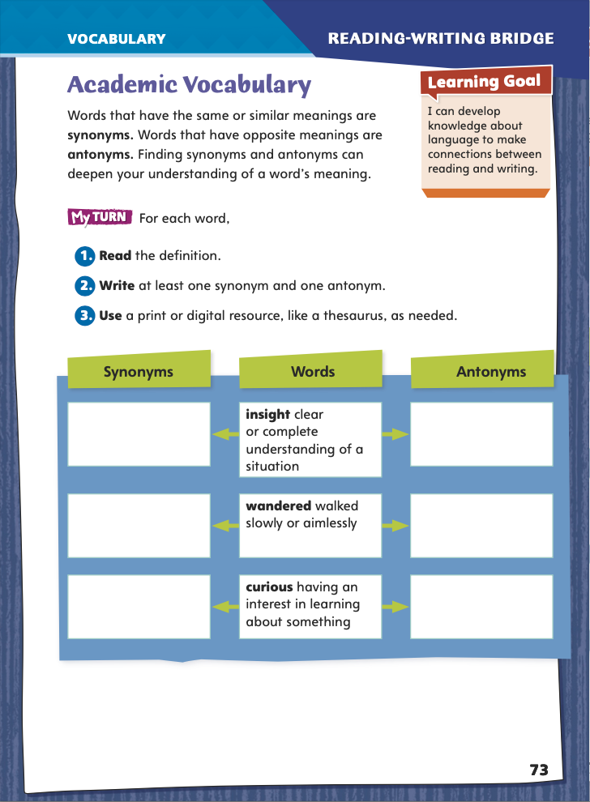
Page 73
Academic Vocabulary
Complete the graphic organizer on pg. 73 in your Student Interactive.
Notes:
Words with similar meanings, such as awareness and knowledge, are called synonyms. Words with opposite meanings, such as hurried and lagged, are called antonyms. It is often possible to figure out an unfamiliar word’s meaning by recognizing a familiar synonym or antonym in its context, or surroundings.
When you find an unfamiliar word in your reading, try to find a nearby synonym or antonym whose meaning you do know.
Use the familiar synonym or antonym to figure out the unfamiliar word’s meaning. For example, if you know that awareness means “understanding” and you see it used as a synonym for insight, you can figure out that insight means “understanding,” too.
Model this strategy using the Academic Vocabulary word wandered from the graphic organizer on p. 73 in the Student Interactive.
Let’s say I don’t know what the word wandered means and read this sentence: She wandered around until she heard the monster, but then she ran for her life. I can tell from the context that ran is an antonym for wandered. I know that ran means “moved quickly,” so wandered must mean “moved slowly.”
Have students apply this strategy on their own to another word in the graphic organizer. Then discuss responses and correct misunderstandings.
Have students follow the same strategy as they complete the graphic organizer on p. 73 in the Student Interactive. Remind them that they will use these academic words throughout the unit.

Slide 9
Word Study
chron-
chronological
chronology
chronic
Notes:
Many English words (and words from Romance languages such as Spanish, French, and Italian) contain Greek roots such as meter (“measure”) and chron (“time”).
To demonstrate how to use roots’ meanings to figure out words’ meanings, use the root definitions on p. 74 of the Student Interactive for chron and chronological. Remind students that the meaning of the root chron is “time.” So chronological means “in time order.”
Guide students to list other English words that contain chron (chronology, chronic). Have students guess the meanings of the words they list and check them in a dictionary.

Slide 10
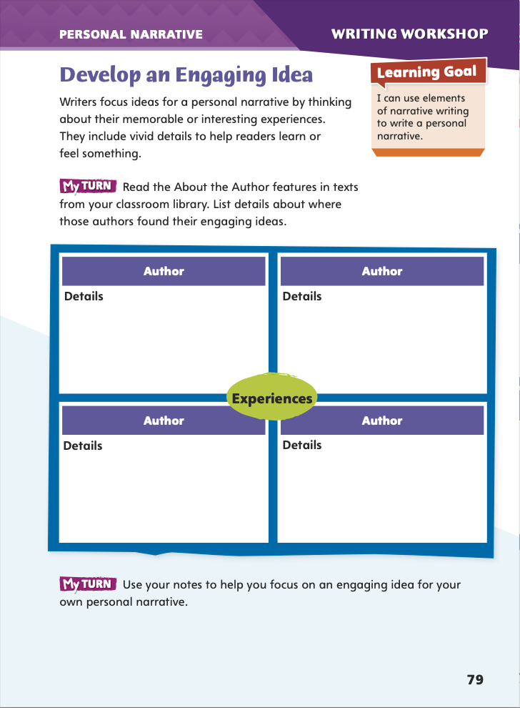
Page 79
Writing – Personal Narrative
Turn to page 79 in your Student Interactive.
Use your notes to focus on an idea for your own narrative.
Notes:
To help students create narratives that capture readers’ attention and are fun to write, encourage them to sift through their memories for an engaging idea. These ideas usually:
center on a memorable or interesting experience.
feel significant to the person who experienced them.
can be expanded to include specific facts, details, and dialogue.
Explain that over the next week or so, students will craft a personal narrative—a real-life story that happened to them. Remind them that their mentor stack includes examples of personal narratives.
Invite a volunteer to read the first paragraph under “Develop an Engaging Idea” in Student Interactive p. 79. Elicit the qualities that make an effective personal narrative: memorable or interesting experience, vivid details, readers learn or feel something.
Complete the activity on p. 79 with students. Discuss where the authors found their ideas. Ask: Which details stand out, and why? Do the narratives include dialogue? If so, how does that dialogue help you visualize what is happening?
Direct students to the bottom of p. 79. Remind students to use the notes they have just taken to help them focus on an idea for their own narratives.

Slide 11
Independent Writing
Freewrite your ideas for your own personal narrative.
Review your ideas and circle two or three that most interest you .
Notes:
Direct students to freewrite for three minutes about ideas for their own personal narrative. When the three minutes have passed, have them review their ideas and circle the two or three that most interest them. See the Conference Prompts on p. T142.
Invite volunteers to share their ideas for personal narratives and explain why the experience was memorable or interesting.

Slide 12
Spelling
Stanley studied meteorology and works as a weatherman at a local TV station.
2. Please make a photocopy of this test to take home.
3. My favorite geometric shape is a square.
4. Texting and passing notes in class are outside the parameters of our school rules.
5. When you study geography you usually use a lot of maps.
6. Nobody’s face has perfect symmetry, with one side exactly the same
as the other.
7. List the events in chronological order starting in 1776.
Nadiri studied geology and now teaches classes about Earth’s physical
structure.
9. Chronic pain is horrible because it keeps coming back.
10. Dad checked the speedometer to see how fast he was driving.
Notes:
(Note: Move the orange boxes to cover each bold spelling word before you read aloud the words and sentences.)
Read aloud the words and sentences. Have students spell each word to assess their prior knowledge of Greek Roots.
1. Stanley studied meteorology and works as a weatherman at a local TV station.
2. Please make a photocopy of this test to take home.
3. My favorite geometric shape is a square.
4. Texting and passing notes in class are outside the parameters of our school rules.
5. When you study geography you usually use a lot of maps.
6. Nobody’s face has perfect symmetry, with one side exactly the same as the other.
7. List the events in chronological order starting in 1776.
8. Nadiri studied geology and now teaches classes about Earth’s physical structure.
9. Chronic pain is horrible because it keeps coming back.
10. Dad checked the speedometer to see how fast he was driving.
Reveal the spelling word and have students check their work.
For students who understand how to spell these Greek Roots, include the following Challenge Words with the spelling list. Challenge Words: psychology, photosynthesis, anachronism

Slide 13
Language and Conventions
1. Stop barking, Hollie!
2. Why are you barking?
3. I can’t stand listening to non-stop barking!
4. Hollie barks at strangers.
Write one declarative, one interrogative, one exclamatory, and one imperative sentence. You can use the same topic for all four.
Notes:
Review with students what a simple sentence is, and go over the four kinds of simple sentences—declarative, interrogative, exclamatory, and imperative. See pp. T68–T69.
Share these sentences:
Stop barking, Hollie!
Why are you barking?
I can’t stand listening to non-stop barking!
Hollie barks at strangers.
For each, have a volunteer identify the sentence type. (1. imperative; 2. interrogative; 3. exclamatory; 4. declarative)
Have students write one declarative, one interrogative, one exclamatory, and one imperative sentence; they can use the same topic for all four.

Slide 14
Lesson 2

Slide 15
Page 50
Preview Vocabulary
astrobiologists
microbes
colony
sensors
radiation
rovers
Notes:
Introduce the vocabulary words on p. 50 in the Student Interactive and define them as needed.
astrobiologists: scientists who study life in the universe
microbes: the smallest living things
colony: a group of animals living in one place
sensors: devices that detect changes in light, moisture, or other physical conditions
radiation: dangerous energy rays that cannot be seen
rovers: vehicles used to explore a planet’s surface
Have students tell what they know about the words. Ask them to guess what the selection will be about, based on the words.
Say: These words will help you understand the work of the scientists described in Life on Earth—and Beyond. As you read, highlight the words when you see them in the text.

Slide 16
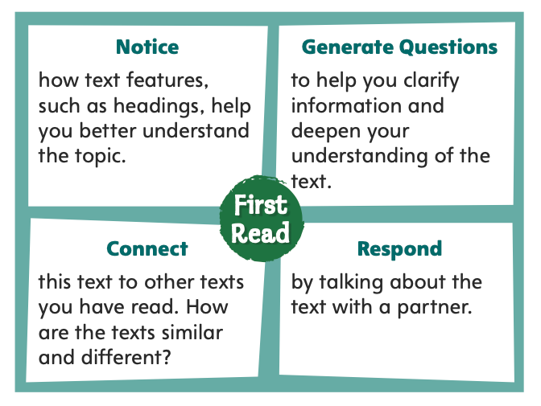
Page 50
First Read Strategies
Notes:
Discuss the First Read Strategies. Prompt students to establish that the purpose for reading this selection is to learn about a topic.
NOTICE Remind students to recognize and notice how text features, such as headings, help them better understand the topic.
GENERATE QUESTIONS Encourage students to jot down questions before, during, and after reading to help them clarify information and deepen their understanding of the text. Tell them to mark anything they find confusing.
CONNECT Ask students to consider how the text is similar to and different from other texts they have read.
RESPOND Have students discuss the text with a partner.

Slide 17
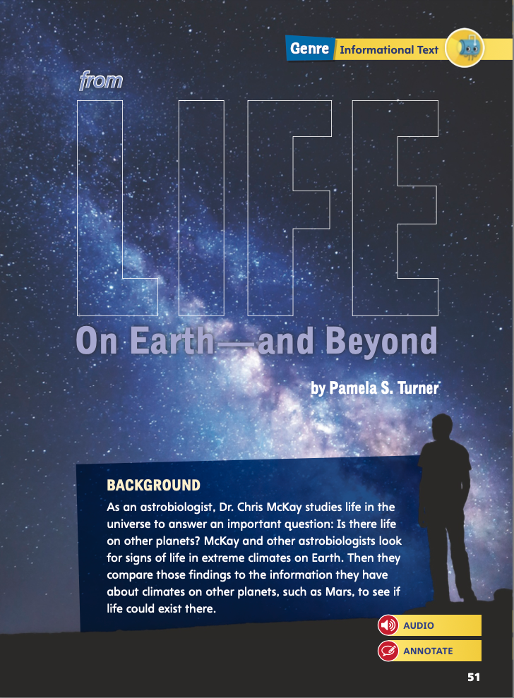
Page 51
First Read – Life on Earth – and Beyond
Notes:
Students may read independently, in pairs, or as a whole class. Use the First Read notes to help them connect with the text and guide their understanding.

Slide 18
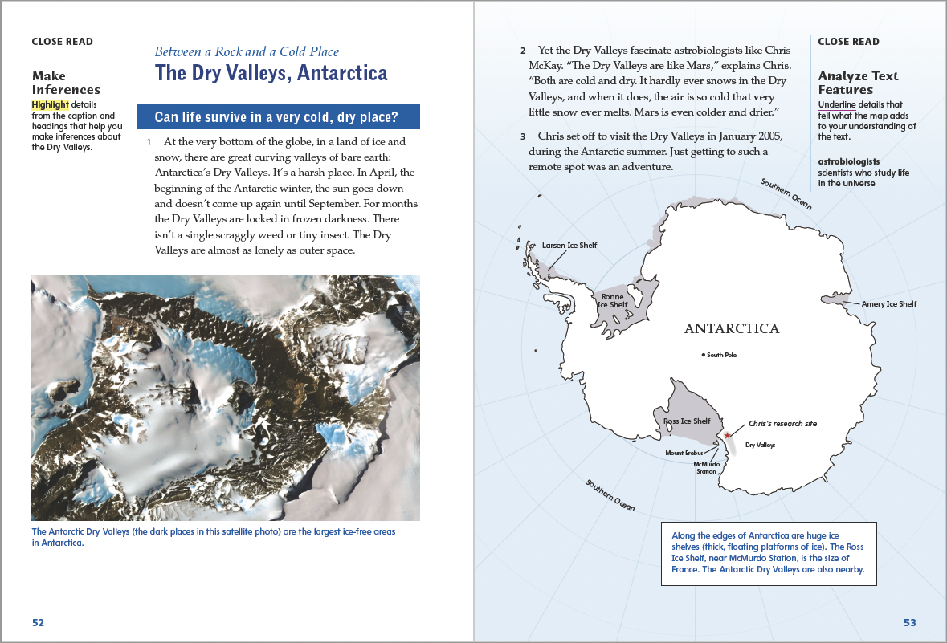
Page 52,53
First Read – Life on Earth – and Beyond
Notes:
Students may read independently, in pairs, or as a whole class. Use the First Read notes to help them connect with the text and guide their understanding.
THINK ALOUD At the beginning of the text, the author describes Antarctica’s Dry Valleys. She uses language that shows readers the harshness of the environment. The photo of the area makes it look harsh. The author ends the first paragraph by comparing the Dry Valleys to outer space. As I read, I will pay attention to see if there are more reasons for this comparison.
THINK ALOUD This map is really interesting. Most maps just show Antarctica as a blob at the bottom of the world. This one shows details. I can see that parts are ice shelves—based on the caption, that’s just ice with no land underneath. The ice shelves are really big—the caption says the Ross Ice Shelf is as big as France! I see that Chris McKay’s research station is near the Ross Ice Shelf. I wonder if he ever explores it.

Slide 19
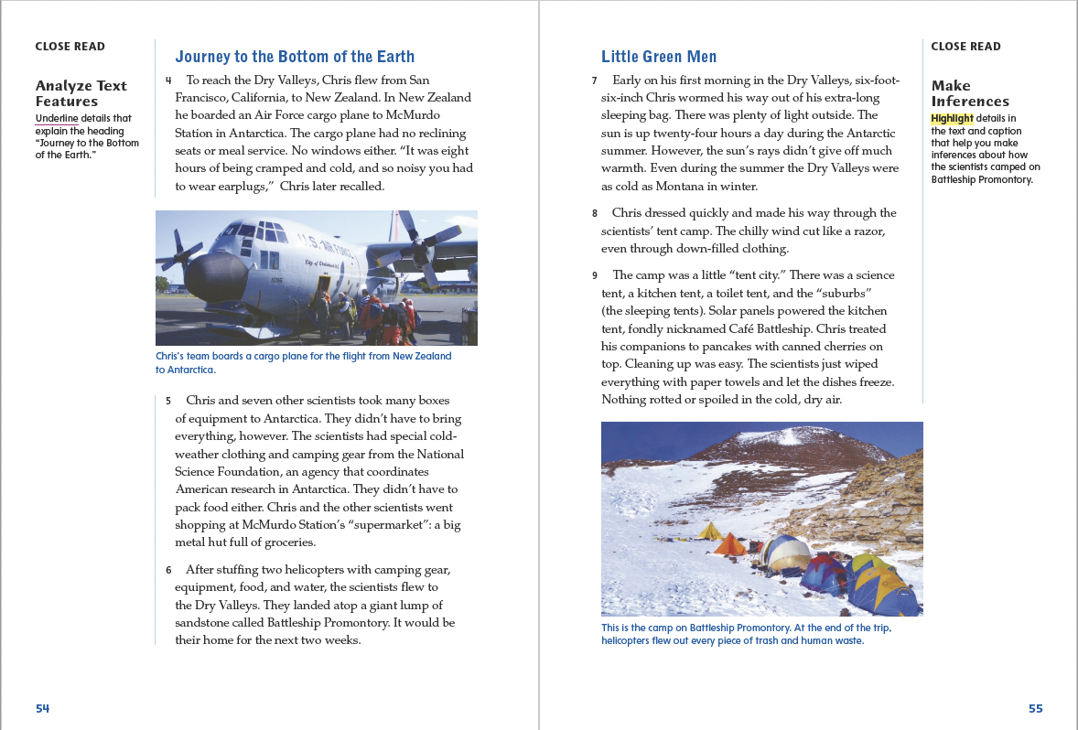
Page 54, 55
First Read – Life on Earth – and Beyond
Notes:
Students may read independently, in pairs, or as a whole class. Use the First Read notes to help them connect with the text and guide their understanding.
THINK ALOUD When the author describes how difficult Chris McKay’s journey to Antarctica was, I thought about another text we read, “Louie Share Kim, Paper Son.” Share Kim had to travel from China to San Francisco, California, across the Pacific Ocean, and the trip took a month. Chris McKay’s trip did not take a month, but he did cover long distances—from San Francisco to New Zealand and then to Antarctica.
THINK ALOUD As I read, I will think of questions I have about the text. I will circle paragraph 7 because I have questions about why “the sun is up twenty-four hours a day during the Antarctic summer.” I want to know more about that.

Slide 20
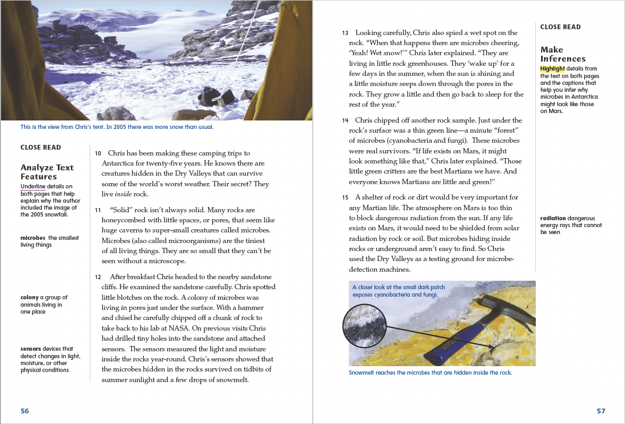
Page 56, 57
First Read – Life on Earth – and Beyond
Notes:
Students may read independently, in pairs, or as a whole class. Use the First Read notes to help them connect with the text and guide their understanding.
THINK ALOUD The first item on this page is a photograph of the view from Chris’s tent. The photo’s caption explains that “in 2005, there was more snow than usual.” I wonder why the author included this detail. I will read the text closely to see if I can find an answer.
THINK ALOUD As I read, I am going to think of questions I have about the text. I am going to circle paragraph 14 because I have questions about how the microbes in Antarctica might be similar to microbes on Mars. I want to know more about that.

Slide 21
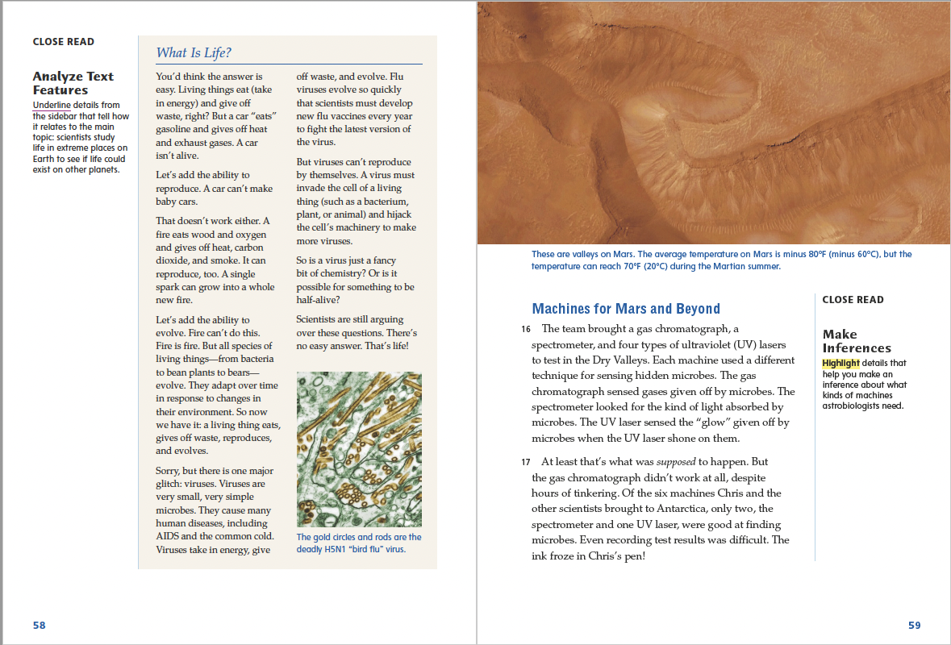
Page 58, 59
First Read – Life on Earth – and Beyond
Notes:
Students may read independently, in pairs, or as a whole class. Use the First Read notes to help them connect with the text and guide their understanding.
THINK ALOUD This part of the informational text looks different than other parts. It is in a box with a shaded background, and it has a title that looks different from the other subheads in the text. This must be a text feature.
THINK ALOUD When the author describes how some of the scientists’ tools did not work, I thought about another text we read, “Louie Share Kim, Paper Son,” and how the Chinese immigrants made books of information so that “paper sons” could practice their answers before they were interviewed by immigration officials. Sometimes, those books didn’t work. Louie Share Kim had a “twin” paper brother who had studied his book but was still deported.

Slide 22
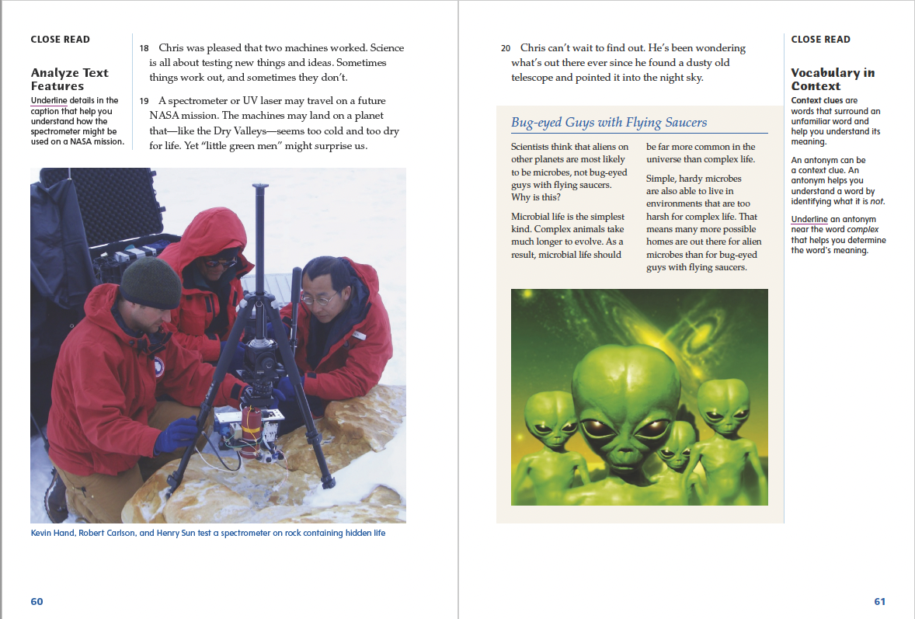
Page 60, 61
First Read – Life on Earth – and Beyond
Notes:
Students may read independently, in pairs, or as a whole class. Use the First Read notes to help them connect with the text and guide their understanding.
THINK ALOUD The text talks about a spectrometer and the photo on this page shows scientists using one. I think the author included this photo so the reader can see what a spectrometer looks like and how it is used.
THINK ALOUD The first paragraph of the sidebar explains that scientists do not think aliens on other planets are “bug-eyed guys with flying saucers.” In all the movies I’ve ever seen about aliens, they did look like that. I was surprised when the text explained that “aliens” are more likely to be microbes.

Slide 23
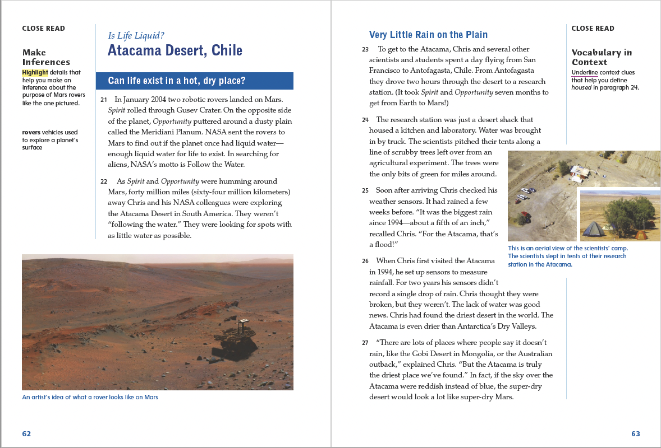
Page 62, 63
First Read – Life on Earth – and Beyond
Notes:
Students may read independently, in pairs, or as a whole class. Use the First Read notes to help them connect with the text and guide their understanding.
THINK ALOUD As I read, I mark parts I find interesting or surprising. I marked the sentences, “They weren’t ‘following the water.’ They were looking for spots with as little water as possible.” I was surprised because I thought that because living things need water, scientists looking for life would look for water.
THINK ALOUD Ask students to read the text on this page, mark parts they find confusing, and share those parts. For example: I marked the weather sensors in paragraph 25. I am confused about how Chris McKay used them to measure rainfall. I would like to know more about them.

Slide 24
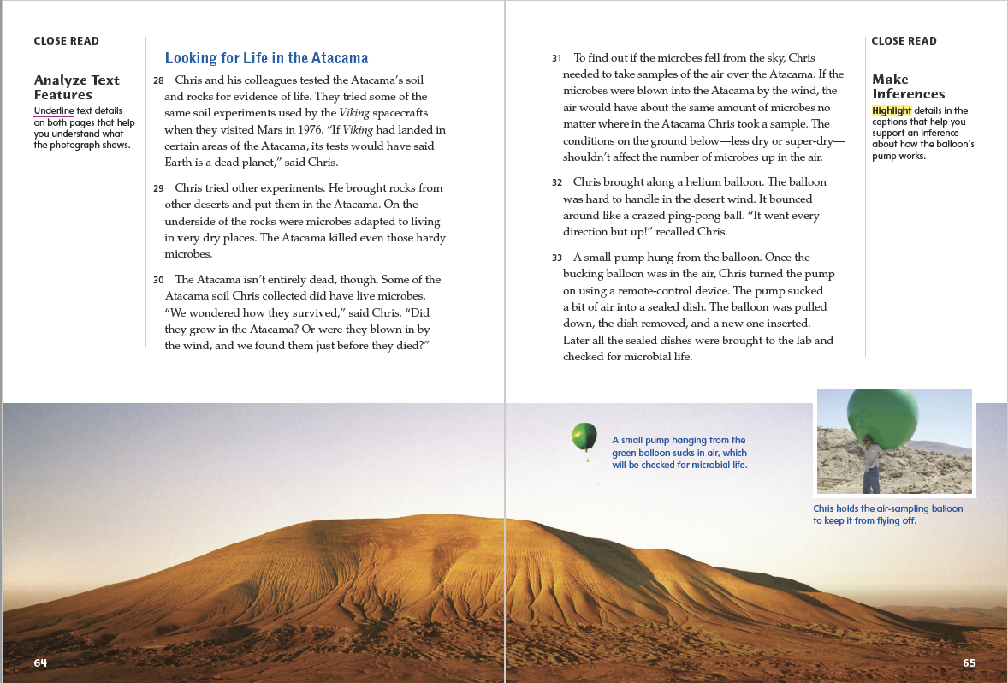
Page 64, 65
First Read – Life on Earth – and Beyond
Notes:
Students may read independently, in pairs, or as a whole class. Use the First Read notes to help them connect with the text and guide their understanding.
THINK ALOUD As I read the text on this page, I feel very surprised. It is hard to imagine a place like the Atacama Desert, where nothing but a few microbes can live (and then only in some parts of the desert).
THINK ALOUD If I were going to summarize the text on page 65, I would say that Chris McKay wanted to find out whether the microbes in the soil of the Atacama Desert grew there or were blown in by the wind. He used a helium balloon to collect samples of the air over different parts of the desert. He reasoned that if the wind carried the microbes, the air in all parts of the desert would have roughly the same number of them.

Slide 25
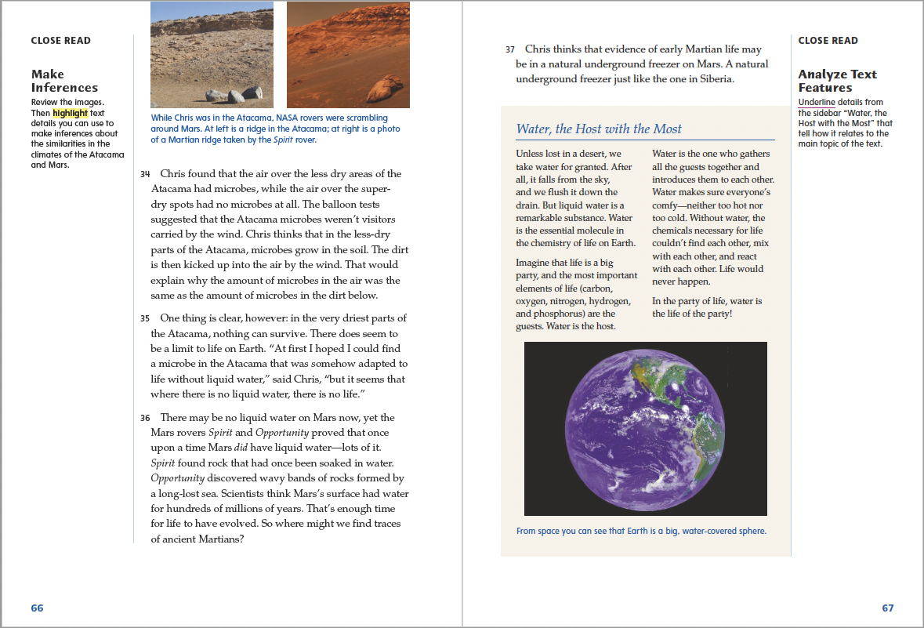
Page 66, 67
First Read – Life on Earth – and Beyond
Notes:
Students may read independently, in pairs, or as a whole class. Use the First Read notes to help them connect with the text and guide their understanding.
THINK ALOUD As I read paragraph 35, I found I had a question about Chris McKay’s statement that “where there is no liquid water, there is no life.” My question is: What if there is frozen water? Could frozen water support life?
THINK ALOUD I noticed that the sidebar contains important information about why the presence of water is so essential to life. That helps me understand the scientists’ purpose for studying these very dry areas.

Slide 26
Respond and Analyze
Brainstorm: In what other places on Earth could Chris McKay look for life in inhospitable conditions?
Discuss: Do you think Chris McKay’s research will ultimately be helpful to the space program? Why or why not?
Notes:
Use these suggestions to prompt students’ initial response to reading Life on Earth—and Beyond.
Brainstorm In what other places on Earth could Chris McKay look for life in inhospitable conditions?
Discuss Do you think Chris McKay’s research will ultimately be helpful to the space program? Why or why not?

Slide 27
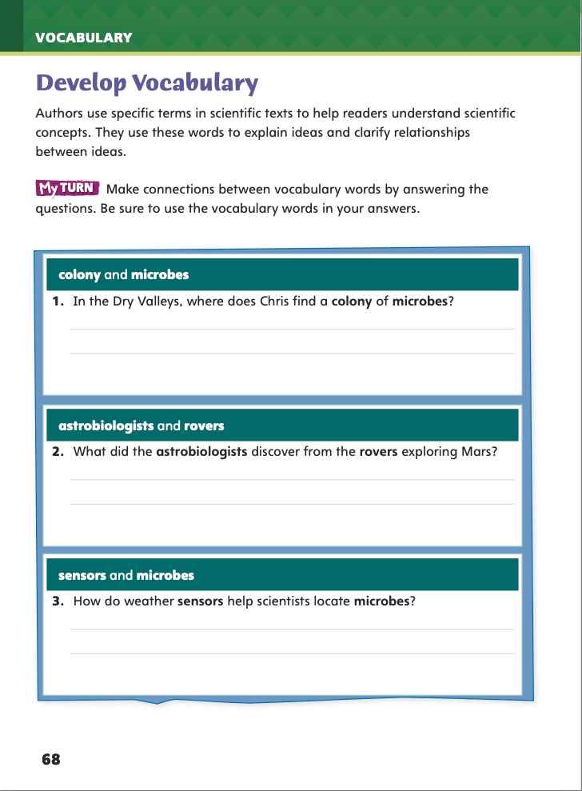
Page 68
Develop Vocabulary
Turn to page 68 in your Student Interactive and complete the activity.
Notes:
Have students use the strategies for developing vocabulary.
Have students respond using newly acquired vocabulary as they complete p. 68 of the Student Interactive. They should make connections between the words.

Slide 28
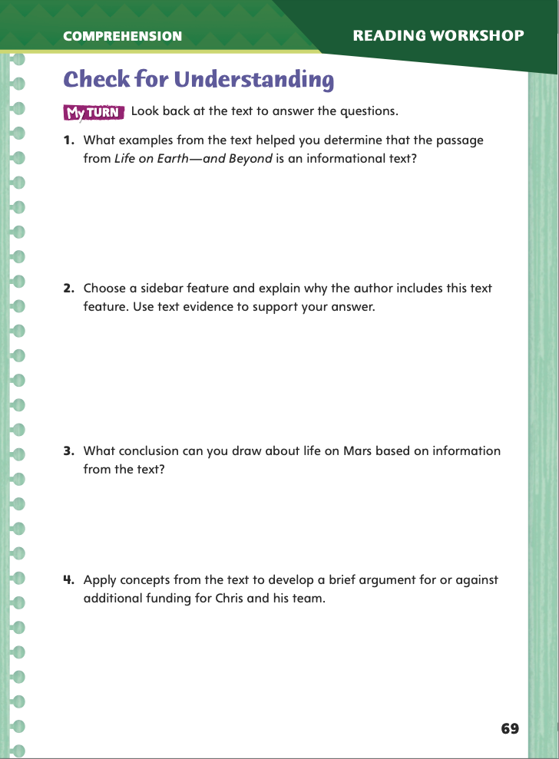
Page 69
Check for Understanding
Complete page 69 in your Student Interactive.
Notes:
Have students complete p. 69 of the Student Interactive.

Slide 29
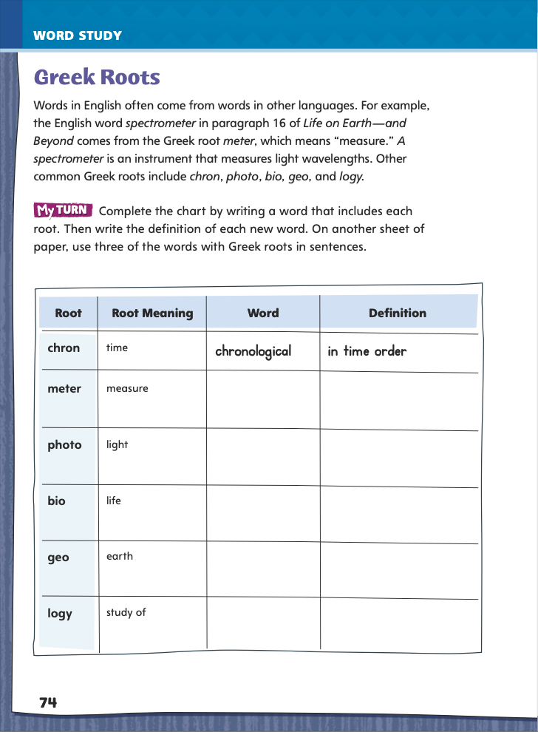
Page 74
Word Study
geology
mythology
barometer
Notes:
Direct students to complete the chart on p. 74 of the Student Interactive.
Then have students guess the meanings of these words, check them in a dictionary, and write a strong context sentence for each: geology, mythology, barometer.
Have students use their own paper to write sentences that include three of the words.

Slide 30
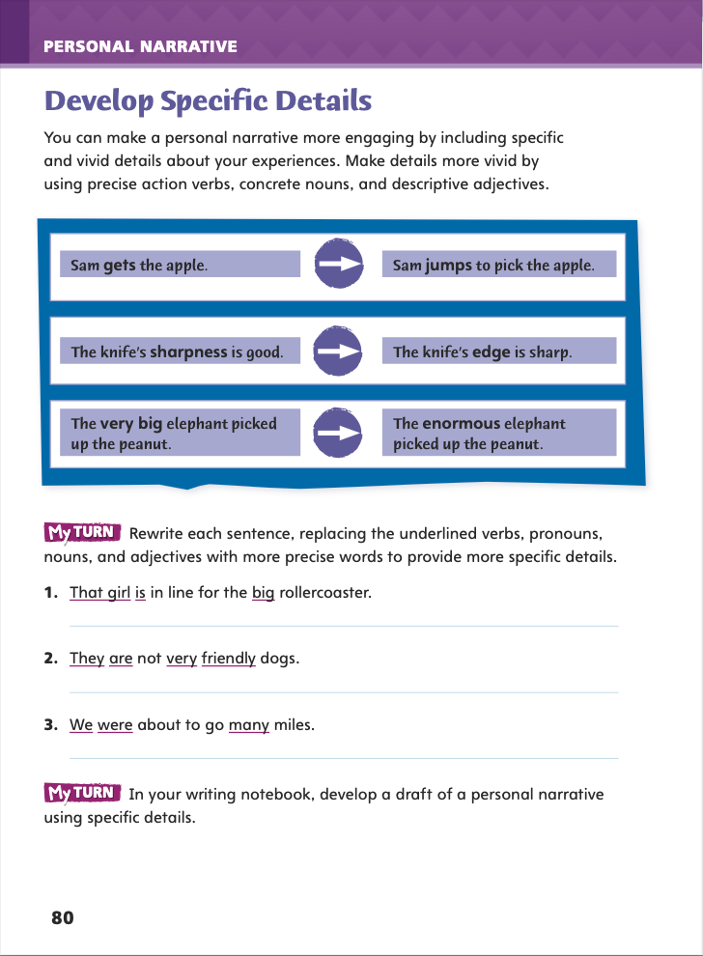
Page 80
Writing – Personal Narative
Turn to page 80 in your Student Interactive.
Notes:
Stress that specific details can make personal narratives most effective. Explain that effective details usually use:
vivid language, producing clear images in a reader’s mind.
precise action verbs (zoomed is more specific than went), concrete nouns (macaroni and cheese is more specific than food), and descriptive adjectives (booming is more specific than loud).
Invite a volunteer to read aloud the first paragraph of p. 80 of the Student Interactive.
Read aloud the first example on p. 80. Point out that jumps is a more vivid action verb than reaching for because it is easier to picture.
Have a volunteer read aloud the second example. Talk about why the second version of the sentence is more vivid—it uses the concrete noun edge instead of speaking about the entire knife and uses the descriptive adjective sharp instead of the vague, overused adjective good.
Discuss why very big in the third example is less vivid than enormous, eliciting that very and big are used so often that they have little impact.
Pair students, and have each pair rewrite sentences 1 through 3 on p. 80. Then have students begin drafting a personal narrative that includes specific, vivid details.

Slide 31
Independent Writing
the first time I cooked by myself
Create word webs for your personal narrative.
Notes:
Model creating a word web with an engaging idea in the central circle (“the first time I cooked by myself”) and specific, vivid details around it (raw, burned, gasped, kept at it, and proud). Then have students create word webs for the personal narratives they plan to write. See the Conference Prompts on p. T142.
Encourage volunteers to share their word webs. As a class, choose the details that you believe are the most vivid and specific. Emphasize that specific, vivid details make a personal narrative more fun to write and more rewarding to read.

Slide 32
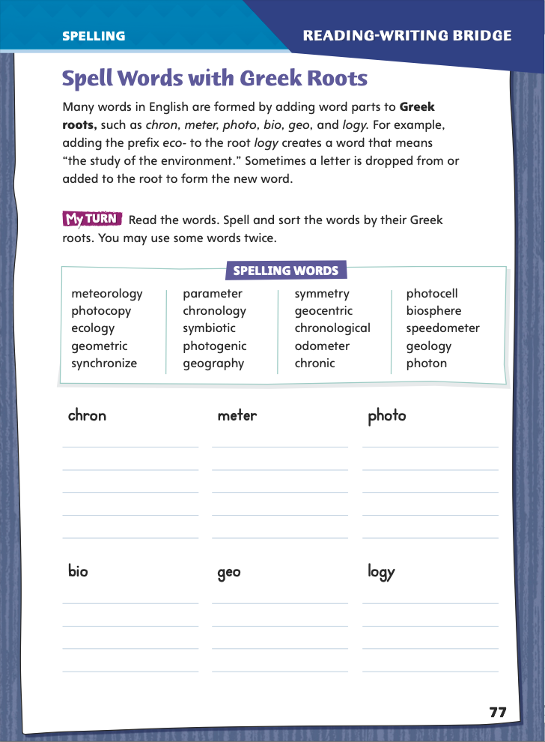
Page 77
Spelling
ch
chron
Turn to page 77 in your Student Interactive and complete the activity.
Notes:
Point out that English words with Greek roots sometimes have unusual spellings for their sounds.
Write ch and say the ch sound.
Then write the Greek root chron, and explain that the ch in this root is pronounced with a k sound.
Have students demonstrate and apply their spelling knowledge by identifying and writing words that illustrate this root’s spelling.
Have students demonstrate their spelling knowledge by completing the activity on p. 77 of the Student Interactive.

Slide 33
Language and Conventions
Independent and Dependent Clauses
Because I never/always______,
I never/always __________.
Write two complex sentences.
Notes:
Introduce dependent and independent clauses by “tailing off” in the middle of a complex sentence: Though I like plain vanilla ice cream . . . and then waiting until students seem impatient for you to go on. Then complete your sentence: I love coffee ice cream with bits of chocolate in it!
Give students a frame such as Because I never/always _____, I never/always _____. Guide students to complete the frame orally.
Have students work in pairs to write two complex sentences. Ask partners to share their sentences with another pair, who should identify the dependent and independent clauses.

Slide 34
Lesson 3

Slide 35
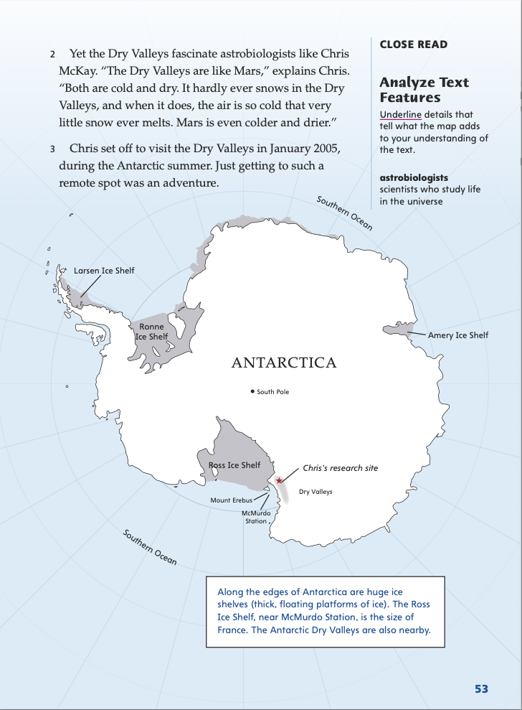
Page 53
Close Read – Analyze Text Features
Turn to page 53 in your Student Interactive.
Notes:
Authors use text features for different purposes. Some text features help readers navigate or locate information in a text. Other text features highlight or clarify important facts.
Identify the type of text feature.
Determine the information to which it draws your attention.
Think about why the author used it in that spot in the text.
Use the Close Read note on p. 53 of the Student Interactive to model how to analyze a text feature.
In the map’s caption, I learn “The Ross Ice Shelf, near McMurdo State, is the size of France. The Antarctic Dry Valleys are also nearby.” That is new information. I will underline it and write “additional information.”
Have student pairs underline another detail from the map that adds to their understanding of the text.

Slide 36
Page 53
Close Read – Analyze Text Features
Turn to page 53 in your Student Interactive.
Notes:
Have students study the map and read its labels and caption. Ask: What features on this page show that this is informational text? Underline relevant details that show what the map adds to your understanding of the text. See student page for possible responses.
Ask students to explain what the map, its labels, and its caption help them understand about the text. Possible Response: The labels help me understand where the ice shelves and McMurdo Station are located. The last two sentences in the caption help me understand the size of the ice shelves and how close McMurdo Station is to one of them. DOK 2

Slide 37
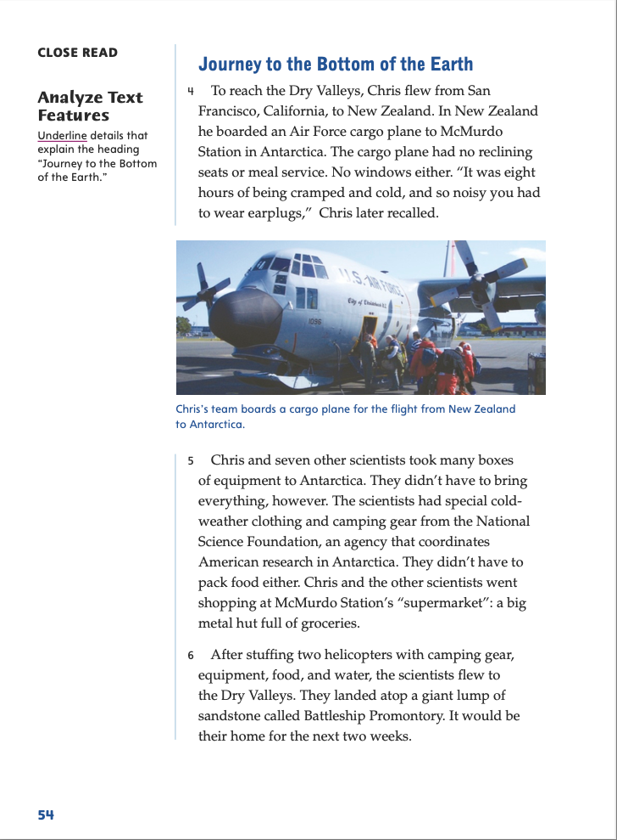
Page 54
Close Read – Analyze Text Features
Turn to page 54 in your Student Interactive.
Notes:
Tell students that when they are scanning a text to find details that explain a heading, they should look for words related to the topic in the heading.
Have students scan paragraphs 4–6 to find and underline relevant details that tell about Chris McKay’s “Journey to the Bottom of the Earth.” Tell students to look for words about his journey and where he went when he arrived. See student page for possible responses.
Ask: Which words tell about where McKay’s plane landed? Possible Response: “They landed atop a giant lump of sandstone called Battleship Promontory.”
DOK 1

Slide 38
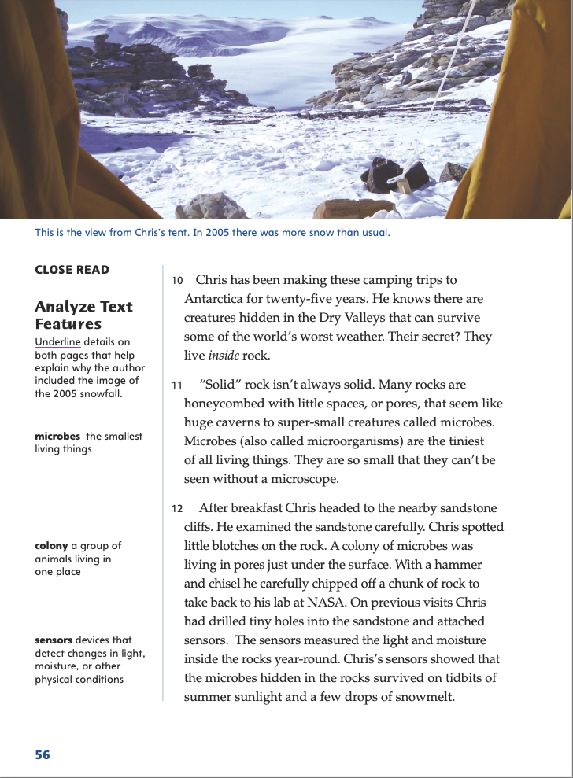
Page 56
Close Read – Analyze Text Features
Turn to page 56 in your Student Interactive.
Notes:
Remind students to scan the text for clue words when they are trying to find a connection between the topic of a text feature and the text. Ask: What is the topic of the photo—that is, what does it show? Which details in the text help explain why the author included the photo? Have students scan paragraphs 12 and 13 and underline details that explain why the author included the photo. See student page for possible responses. Possible Responses: The photo shows the snow in Antarctica. The detail “the microbes hidden in the rocks survived on tidbits of summer sunlight and a few drops of snowmelt” helps explain why the author included the photo—to show that the snow will eventually melt. DOK 2

Slide 39
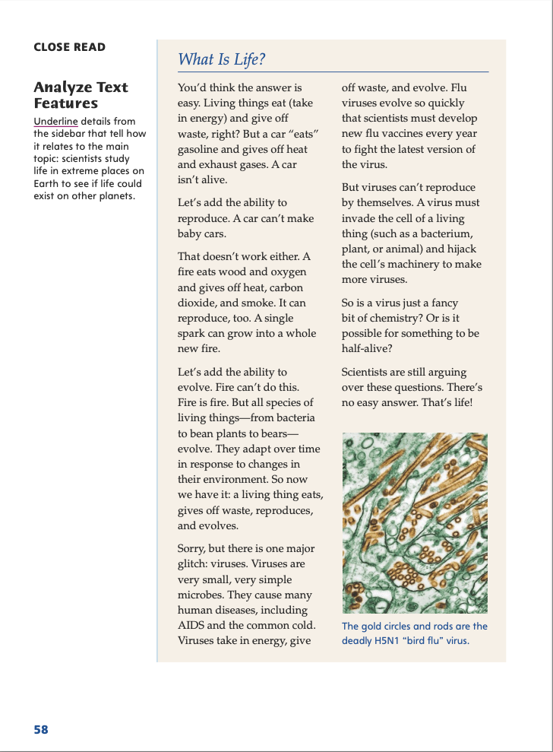
Page 58
Close Read – Analyze Text Features
Turn to page 58 in your Student Interactive.
Notes:
Tell students that the text feature called a sidebar is a short piece of text that accompanies a longer one. A sidebar contains information that adds to or further explains information in the longer text.
Have students read the sidebar and underline details that show how it relates to and helps them better understand the main topic of Life on Earth—and Beyond. See student page for possible responses.
Ask: Why did the author include a sidebar that explains what life is? Possible Response: She included it because the longer text is about scientists studying life in remote places on Earth in the hopes of learning what life on other planets might be like. DOK 3

Slide 40
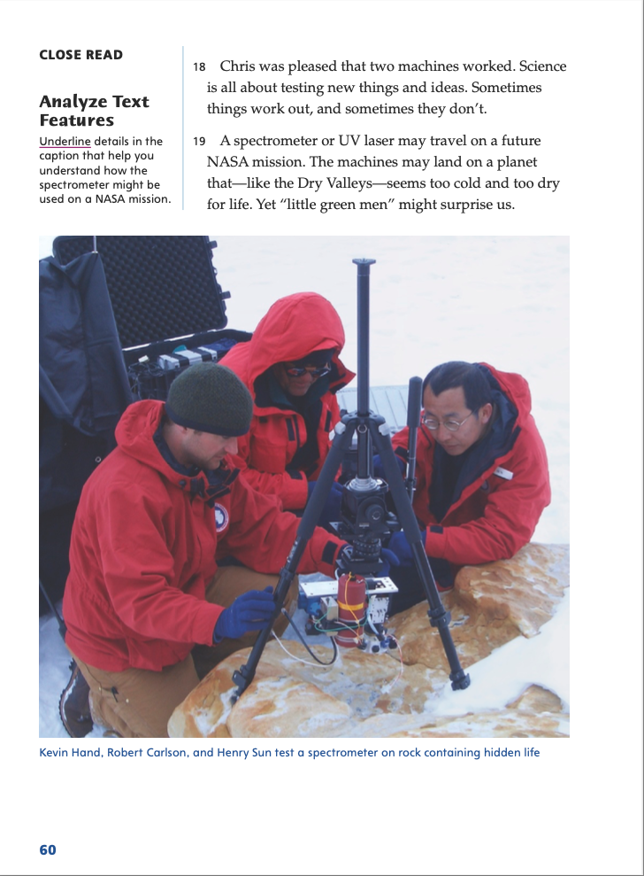
Page 60
Close Read – Analyze Text Features
Turn to page 60 in your Student Interactive.
Notes:
Point out the photo of the scientists using the spectrometer. Have students scan the photo caption. Ask: What do you find out about spectrometers in this text? Have students underline details in the photo caption that help them understand what the spectrometer is and how it might be used on a future NASA mission. See student page for possible responses. Possible Response: I found out that people can use a spectrometer to scan rocks and discover whether there are living things inside. That information could help scientists who study whether life exists on other planets. DOK 2

Slide 41
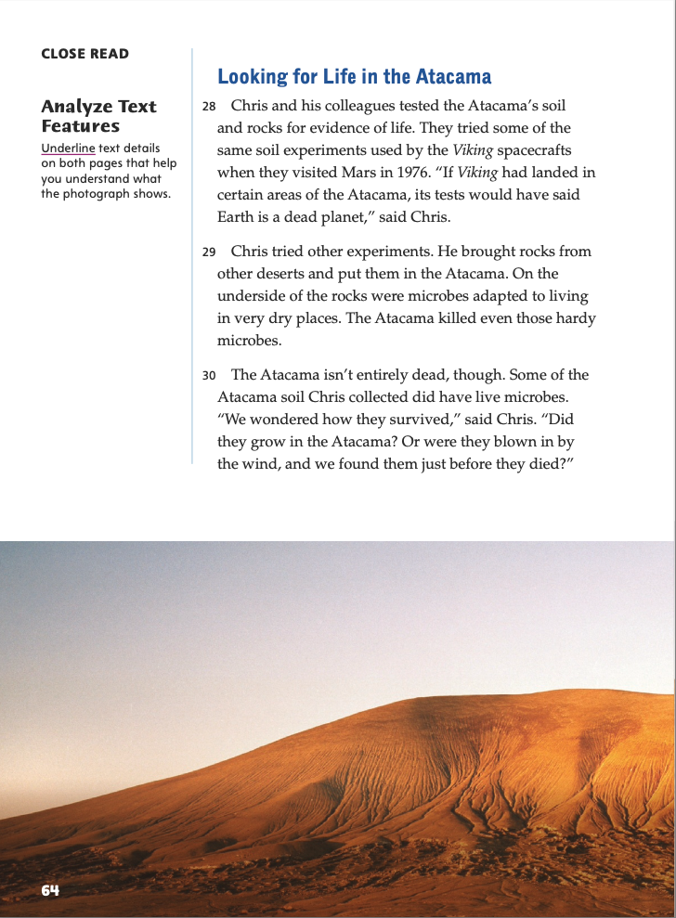
Page 64
Close Read – Analyze Text Features
Turn to page 64 in your Student Interactive.
Notes:
Have students study the photographs and scan the text on pp. 64–65. Say: Describe what you see in the main photo and the inset photo.
Have students underline text that helps them understand what the photographs show. See student page for possible responses. Possible Responses: I see a desert landscape with a green balloon floating over it. I do not see anything alive. The inset photo shows Chris McKay holding the balloon. DOK 1

Slide 42
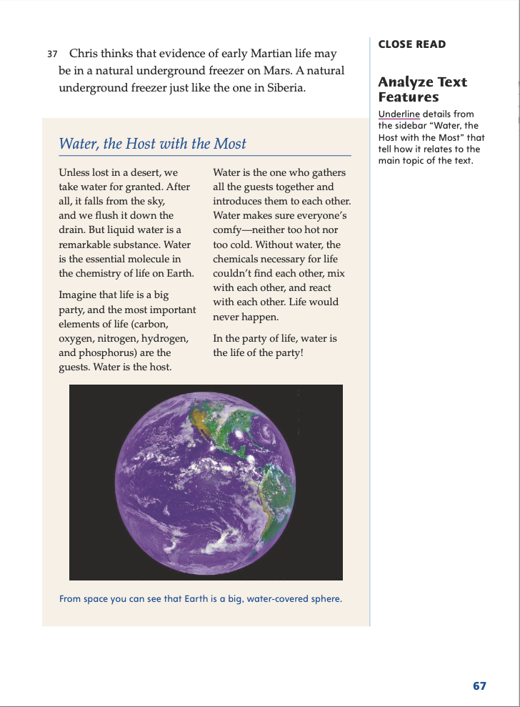
Page 67
Close Read – Analyze Text Features
Turn to page 67 in your Student Interactive.
Notes:
Remind students that a sidebar contains information that adds to or further explains information in the longer text. Have students read the sidebar and underline details that tell them how it relates to the main topic of Life on Earth—and Beyond. See student page for possible responses.
Ask: Why did the author include a sidebar that explains why water is necessary for life on Earth? Possible Response: She included the sidebar because, on p. 66, she quotes Chris McKay as saying, “. . . where there is no liquid water, there is no life.” The author wants to explain why that is so. DOK 3

Slide 43
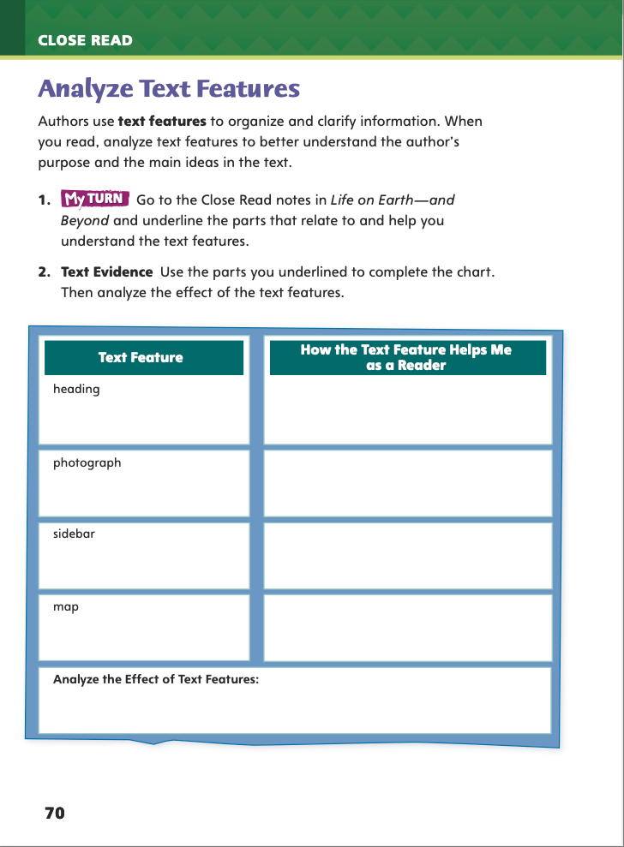
Page 70
Analyze Text Features
Turn to page 70 in your Student Interactive and complete the activity.
Notes:
Have students use the strategies for analyzing text features.
Have students annotate the text using the other Close Read notes for Analyze Text Features and then use the text evidence from their annotations to complete the chart on p. 70 of the Student Interactive.

Slide 44
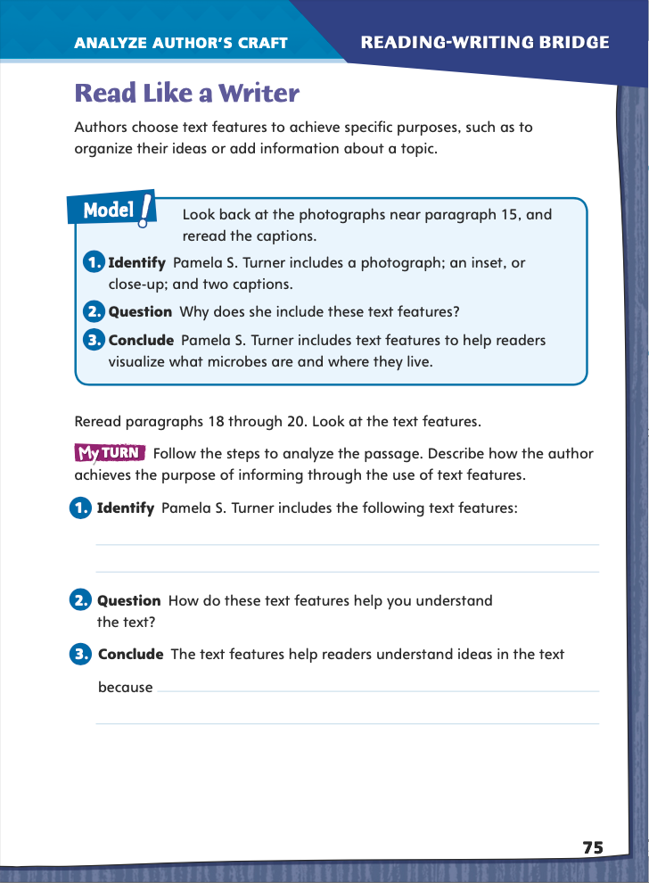
Page 75
Read Like a Writer,
Turn to page 75 in your Student Interactive.
Notes:
Many authors, especially those who write informational text, use text features to organize their ideas and to provide extra information. Text features include charts, diagrams, tables, graphs, photos and other illustrations, headings, subheadings, captions, sidebars, and close-ups or insets.
While you are reading a text—especially an informational text—identify the text features it includes.
Ask yourself why the author included each feature.
Draw conclusions about how the feature works and how it helps you understand and remember ideas in the text.
Model identifying and using text features by directing students to the box on p. 75 of the Student Interactive.
Identify, near paragraph 15 in Life on Earth—and Beyond, a photograph with a caption and an inset or close-up with another caption.
Ask why Pamela S. Turner includes these text features.
Guide students to reach a conclusion that she includes them to help readers visualize how microbes look and where they live and to provide more details about them.
Have students reread paragraphs 18–20 of Life on Earth—and Beyond and complete the activity on p. 75 in the Student Interactive.

Slide 45
Word Study
chronological
thermometer
geology
Notes:
Remind students that many English words, such as chronological, thermometer, and geology, contain Greek roots. Knowing the meanings of these roots can help students figure out the meanings of unfamiliar words that contain those roots.
Share these examples: A chronic illness is one that continues for a long time. A barometer is a device that measures air pressure and helps meteorologists—those who study weather—to make predictions.
APPLY Have students complete Word Study p. 2 from the Resource Download Center. Click path: Table of Contents -> Resource Download Center -> Word Study -> U1W2

Slide 46
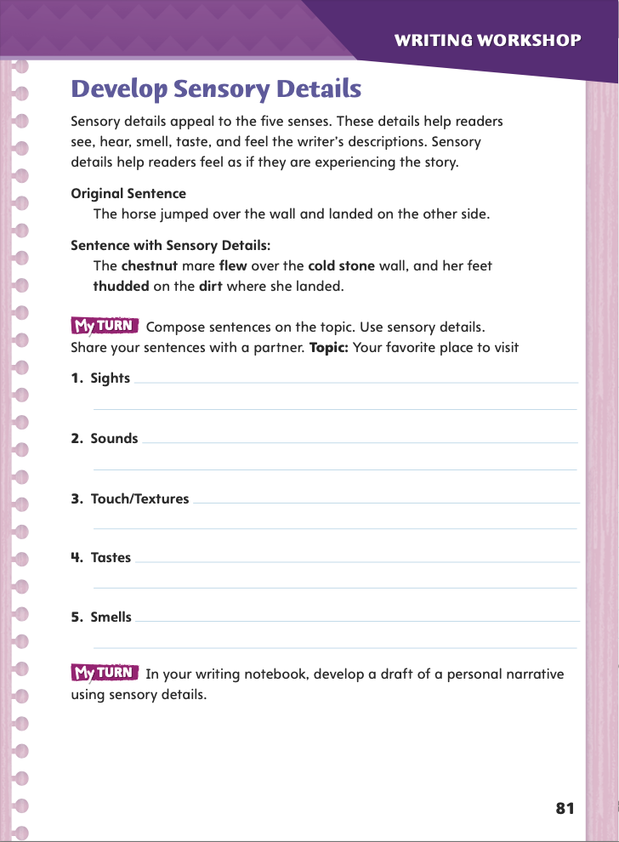
Page 81
Writing – Personal Narrative
Turn to page 81 in your Student Interactive.
Notes:
Ask students: Have you ever told a friend about something that happened to you, and your friend could not wait to hear more? Explain that sensory details can cause this reaction in a reader. These details:
appeal to one or more of the five senses—sight, sound, smell, taste, and touch.
make readers feel as if they are right there with the writer, seeing what the writer sees and hearing what he or she hears.
Note that details about sight are usually most common, but effective personal narratives usually include details about other senses as well.
Have students silently read the first paragraph on p. 81 of the Student Interactive and the two sample sentences that follow. Use these ideas to prompt discussion:
Which sentence do you think is more interesting? Why?
To which senses does the second sentence appeal?
Direct students to complete the exercise on p. 81. Challenge them to include more than one detail for each of the five senses.

Slide 47
Independent Writing
Use the list on page 81 if you’re writing about a place you have visited.
If you want to write about another topic, freewrite about an idea you have.
Focus on sensory details.
Notes:
Students should transition into independent writing in their writer’s notebooks. If they want to write a about a place they have visited, then the exercise on p. 81 is an excellent start. If they want to write about another topic, encourage them to freewrite about an idea they have, focusing on sensory details. See the Conference Prompts on p. T142.
Encourage students to share passages from their drafts or freewriting. Praise those who include many sensory details, especially if those details are related to a sense other than sight.

Slide 48
Spelling
photo
Identify and write the spelling words that illustrate this root’s spelling.
Notes:
Remind students that some Greek roots have unusual spellings. For example, the root chron uses a ch spelling for the k sound.
Display the Greek root photo. Explain that this root uses the letters ph to spell the f sound. Have students identify and write the spelling words that illustrate this root’s spelling (photocopy, photogenic, photocell, photon). Ask which other spelling word also illustrates this spelling (geography).
Have students complete Spelling p. 7 from the Resource Download Center. Click path: Table of Contents -> Resource Download Center -> Spelling -> U1W2

Slide 49
Language and Conventions
Notes:
Say that a clause has a noun and a verb. An independent clause can stand on its own, but a dependent clause cannot. A complex sentence consists of one independent and one dependent clause. Example: Because we have four furry animals at home, we must vacuum often.
Point out that a dependent clause often begins with a subordinating conjunction such as after, if, since, until, when, though, although, or because.
Use the top box on p. 78 of the Student Interactive to model determining which clause is dependent: If I say, “When Clara went outside” and then stop, you probably would ask, “What happened when she went outside?” That is how you can tell that this clause is dependent. But if I say, “She noticed the rainbow,” it is a complete thought—it is an independent clause that can stand on its own.

Slide 50
Lesson 4

Slide 51
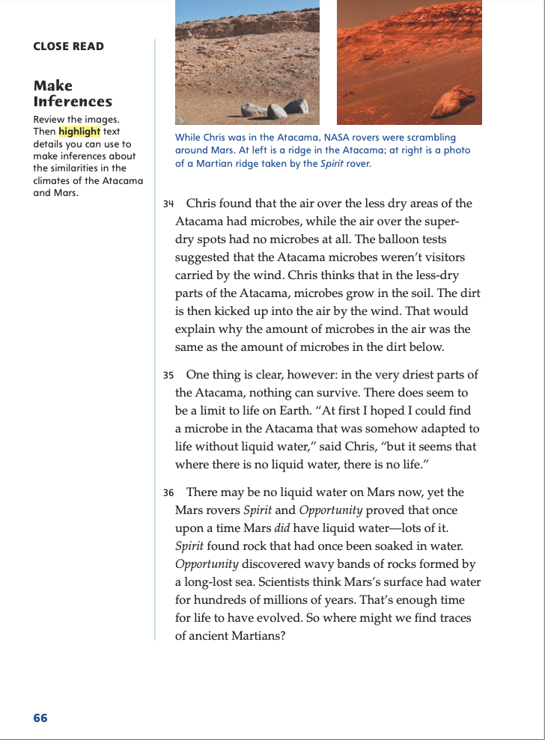
Page 66
Close Read – Make Inferences
Turn to page 66 in your Student Interactive.
Notes:
Text features provide additional information that can help readers better understand the text. Readers can use text features to help them make inferences.
Think about your prior knowledge about the topic of the text feature.
Read and/or view the information provided by the text feature.
Read the text surrounding the text feature.
Find evidence that supports your understanding.
Make an inference about the text feature and/or the related information in the main body of the text.
Use the Close Read note on p. 66 of the Student Interactive to model how to analyze a text feature. How can I analyze these two photographs? First, I think about what I know about deserts—they are usually hot and don’t have much water. Next, I study the text feature. The photos of the Atacama Desert and Mars look very similar, with bare, red, rocky ground and no plants. Next, I read the text under the feature. I highlight “in the very driest parts of the Atacama, nothing can survive,” “where there is no liquid water, there is no life,” and “no liquid water on Mars now.” Last, I make an inference from the text feature and the text: Neither the Atacama nor Mars have any water, so nothing can live in those places.

Slide 52
Page 66
Close Read – Make Inferences
Turn to page 66 in your Student Interactive.
Notes:
Tell students that photographs can often illuminate important information better than text does. Have students study the photos and scan the text on p. 66. Then have students highlight text details that they can use to make inferences about the similarities in the climates of the Atacama Desert and Mars. See student page for possible responses.
Ask: What can you infer about the climates of the Atacama Desert and Mars? Possible Response: The climate of both places is extremely dry. DOK 1

Slide 53
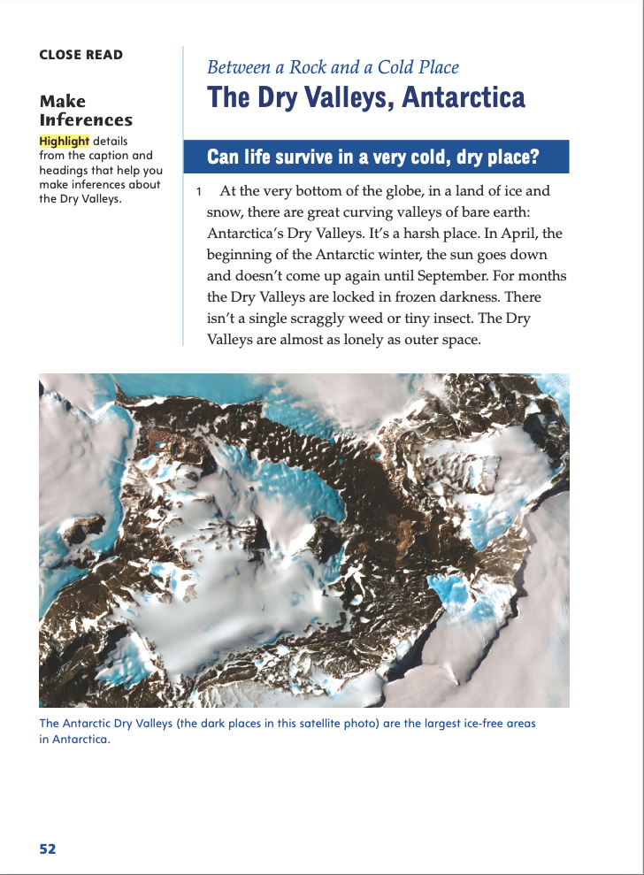
Page 52
Close Read – Make Inferences
Turn to page 52 in your Student Interactive.
Notes:
Ask: Where are the headings and photo caption? Have students point them out and read them. Ask: What can the reader tell about the Dry Valleys based on the words in the headings and photo caption? Have students highlight details. See student page for possible responses.
Ask students to explain how these details help them understand what the Dry Valleys are like. Possible Response: The words “very cold, dry place” in one of the headings show what the Dry Valleys are like. DOK 2

Slide 54
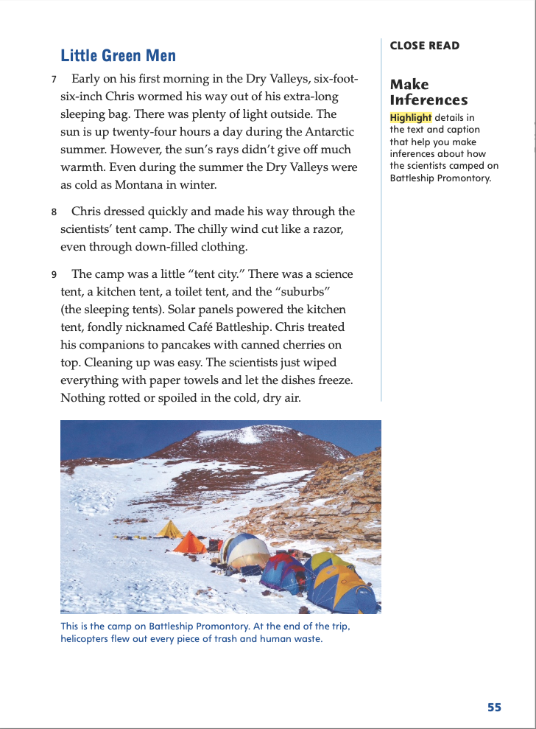
Page 55
Close Read – Make Inferences
Turn to page 55 in your Student Interactive.
Notes:
Remind students that when they are making inferences, they can use this equation to help them:
What I Know + Text Clues = Inference
Have students scan paragraph 9 and highlight details that help them make inferences about how the scientists lived on Battleship Promontory. See student page for possible responses.
Ask: Why do you think the scientists had different tents for different activities? Possible Response: Different tents probably made it easier to keep things organized and also probably made things safer and more sanitary. DOK 2

Slide 55
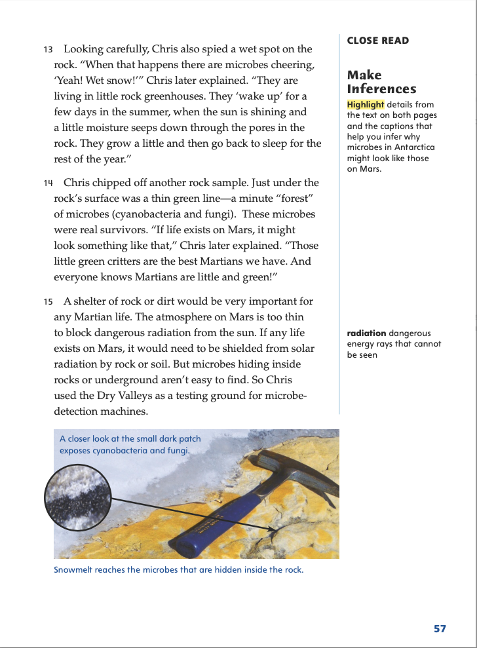
Page 57
Close Read – Make Inferences
Turn to page 57 in your Student Interactive.
Notes:
Have students scan paragraphs 10–14 and the caption of the image with the inset photo to find and highlight details that help them infer why microbes in Antarctica might look like those on Mars. See student page for possible responses.
Ask: What details help explain the possible connection between microbes in Antarctica and microbes on Mars? Possible Response: The caption of the image with the inset photo is “Snowmelt reaches the microbes that are hidden inside the rock.” The first sentence in paragraph 15 is “A shelter of rock or dirt would be very important for any Martian life.” I infer that the microbes in both places might look alike because they live inside rocks. DOK 2

Slide 56
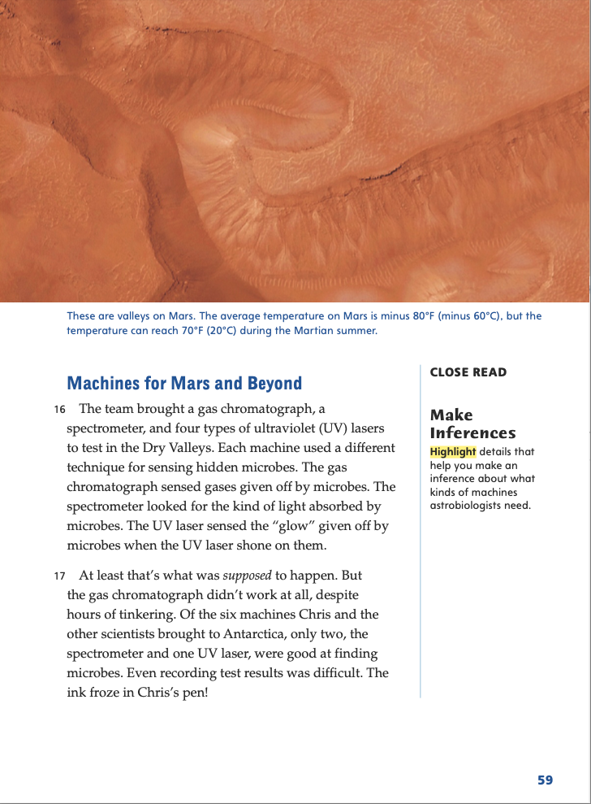
Page 59
Close Read – Make Inferences
Turn to page 59 in your Student Interactive.
Notes:
Have students scan paragraphs 16 and 17 and highlight details that help them make inferences about astrobiologists’ machines. Remind students that they should combine their prior knowledge with information in the text in order to make an inference. See student page for possible responses.
Ask: Why would astrobiologists need machines to find microbes? Possible Response: Microbes are microscopic. You can’t see them with your eyes only. DOK 2

Slide 57
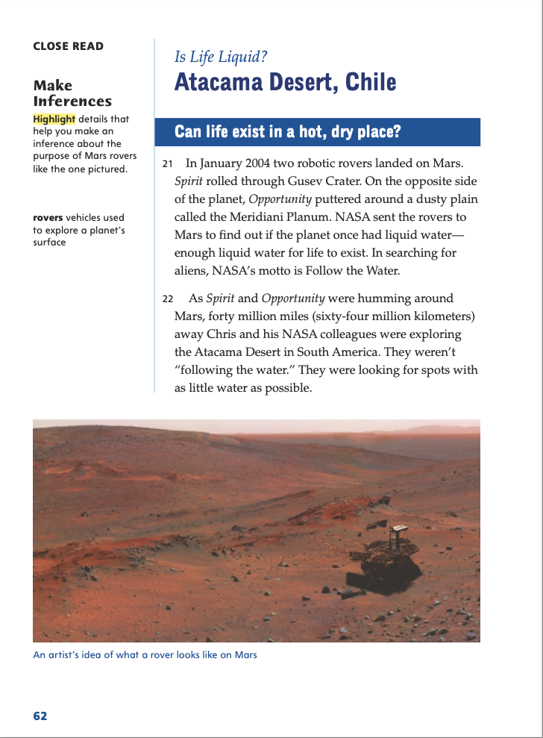
Page 62
Close Read – Make Inferences
Turn to page 62 in your Student Interactive.
Notes:
Have students look at the photo, scan paragraph 21, and highlight details that help them make an inference about how Mars rovers are designed to carry out a specific purpose. Ask: What details from the text discuss the purpose of the rovers? Remind students that they should combine their prior knowledge with information in the text in order to make an inference. See student page for possible responses. Possible Response: This detail discusses the purpose of the rovers: “. . . to find out if the planet once had liquid water—enough liquid water for life to exist.” DOK 2

Slide 58
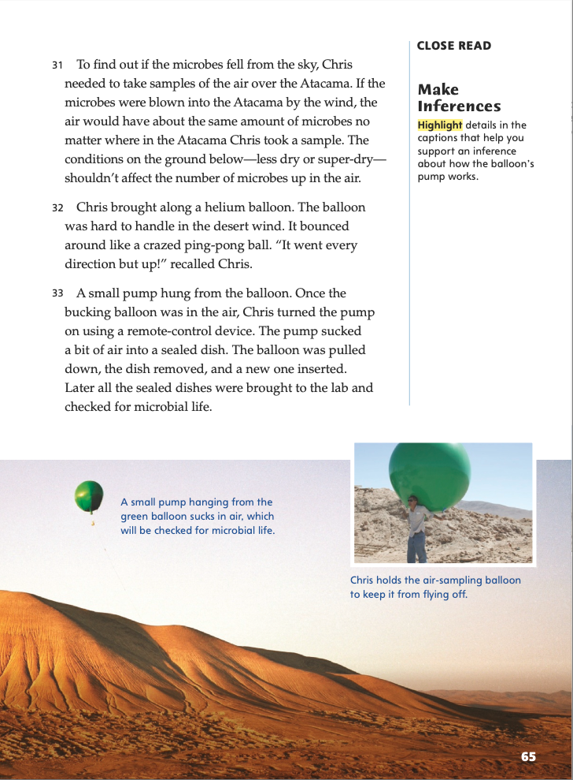
Page 65
Close Read – Make Inferences
Turn to page 65 in your Student Interactive.
Notes:
Have students describe different kinds of pumps with which they are familiar.
Then have them scan the captions of the photos on p. 65 and highlight details that help them support an inference about how the balloon’s pump works. See student page for possible responses.
Remind students that making inferences involves adding their prior knowledge to information in the text.
Ask: How does your prior knowledge of pumps help you understand the pump Chris McKay used? Possible Response: I have used a pump to blow air into my bicycle’s tires. I have to push down on a handle to pump the air. I understand that the pump Chris McKay used must have a part that moves in order to draw in the air sample. DOK 2

Slide 59
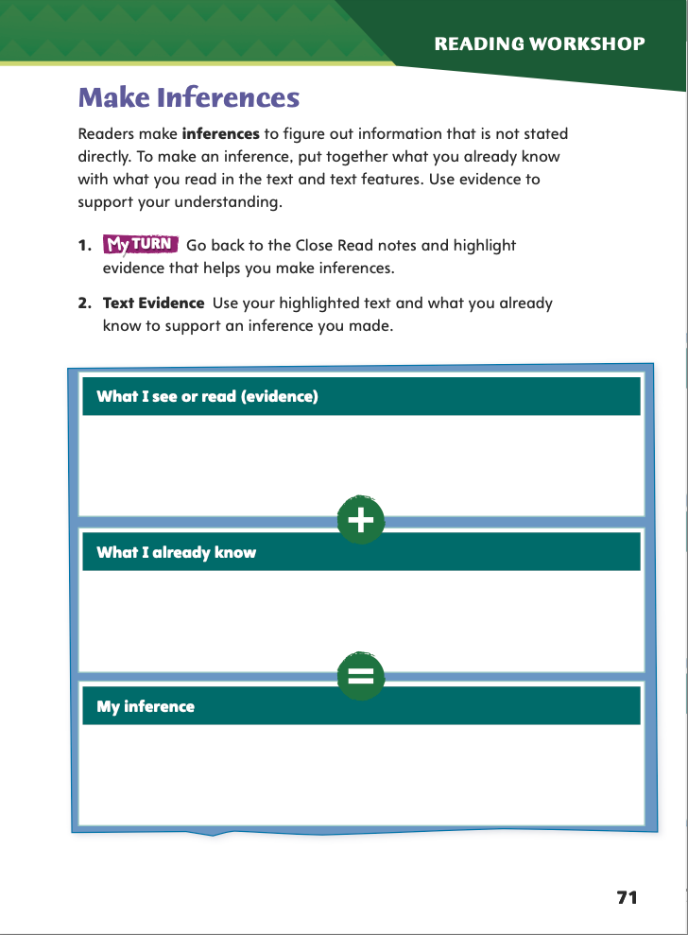
Page 71
Close Read – Make Inferences
Turn to page 71 in your Student Interactive and complete the activity.
Notes:
Have students use the strategies for making inferences.
Have students annotate the text using the other Close Read notes for Make Inferences and then use the text evidence from their annotations to complete the graphic organizer on student Interactive p. 71.

Slide 60
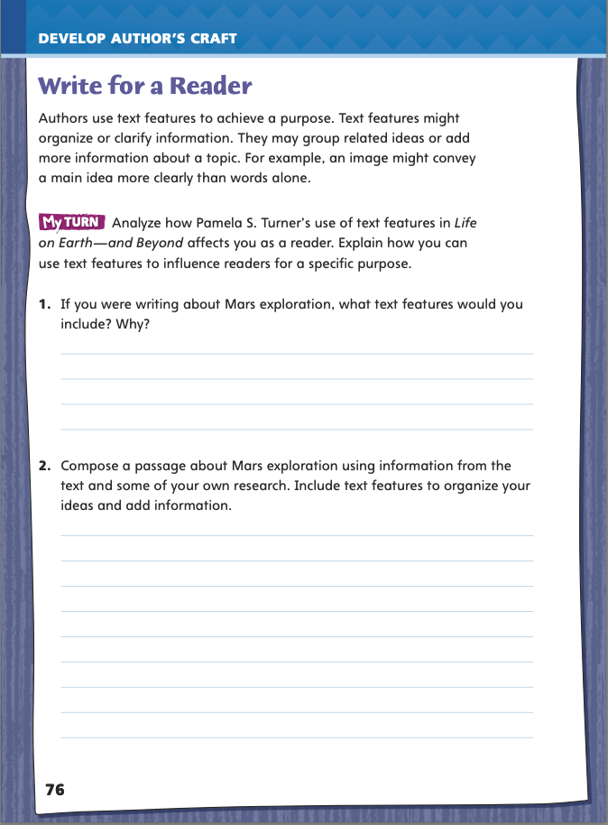
Page 76
Writing for a Reader
Turn to page 76 in your Student Interactive and complete the activity.
Notes:
Text features help readers to understand and remember information. These features, including photos and illustrations, captions, headings, subheadings, maps, charts, diagrams, graphs, and sidebars, also make informational texts livelier and more interesting to read.
Remind students that they just identified and analyzed some text features that Pamela S. Turner uses in Life on Earth—and Beyond.
Discuss how students might use text features in their own writing using p. 76 of the Student Interactive.
Model finding, identifying, and analyzing more text features: On page 52 there’s an aerial photo with a caption. It shows what Antarctica’s Dry Valleys look like from a satellite in space. On page 53 there’s a map of Antarctica that shows exactly where on that continent the Dry Valleys are located and where the scientists’ research site is. The caption under the map gives readers a “fun fact” about the Ross Ice Shelf—that area is as big as France!
Use students’ suggestions to list other text features in Life on Earth— and Beyond, including headings, subheadings, sidebars, and a two- page photo on pp. 64–65 with an inset photo in the upper right corner. For each suggestion, ask how the feature helps readers.
Guide students to complete the writing activity on p. 76 of the Student Interactive. Remind them to include text features such as photos, captions, headings, and subheadings.

Slide 61
Word Study – Greek Roots
history historic
tour tourism
narrate narrative
Add –ic, -ism, or –ive to acid, critic, and mass.
Notes:
Review the strategies on pp. T60–T61 about adding the suffixes -ic, -ism, or -ive to base words. This process changes the base word’s meaning, usually changes its part of speech, and sometimes changes its spelling. For example, adding -ic to the noun athlete changes it to an adjective, athletic, in which the final e has been dropped.
Display the following pairs: history/ historic; tour/tourism; and narrate/narrative. For each pair, ask a volunteer to point out each word’s meaning and part of speech. Also have students point out the spelling changes in history/historic and narrate/ narrative.
Have students work independently or in pairs to add -ic, -ism, or -ive to acid, critic, or mass. Have students guess the meanings of the new words and check their spellings and meanings in a dictionary.

Slide 62
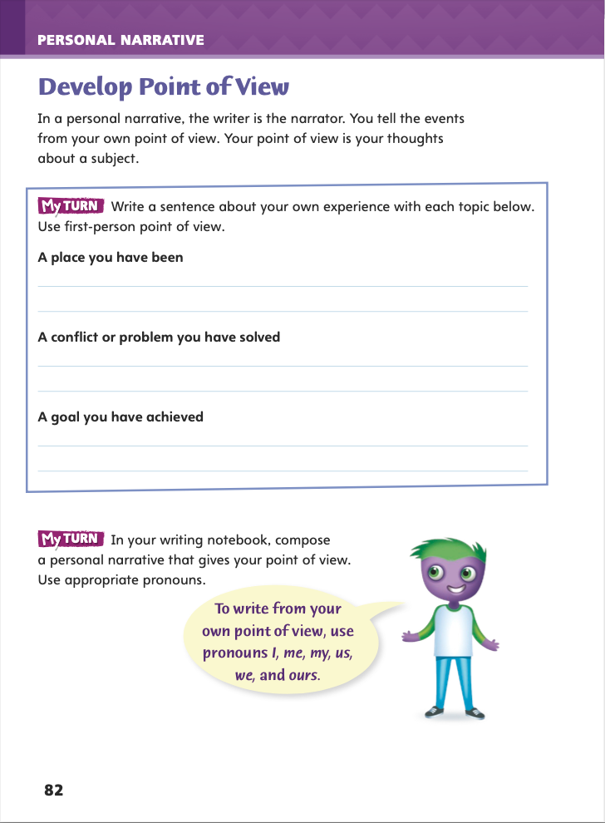
Page 82
Writing – Personal Narrative
Turn to page 82 in your Student Interactive.
Notes:
One genre characteristic of personal narratives is that they are written from first-person point of view. Point of view is one tool writers use to craft their narratives. Clarify that point of view here means the writer's opinions and thoughts on a subject. Note that it:
comes from the writer, not the reader or listener.
is often expressed using the pronouns I, me, and my and verbs such as think, seem, feel, want, and believe.
can make writing more effective by focusing on the writer’s views and emotions and making the reader care about them.
Read aloud the first paragraph on p. 82 of the Student Interactive. Note the first item students must complete, “A place you have been,” and model how not to describe it from the student’s point of view: “Lincolnville is a big city” or “Maria loves Lincolnville.” Then model how students could describe it from their point of view: “I felt scared when I first went to Lincolnville because it seemed huge and crowded."
Direct students to complete the exercise on p. 82. Then have partners check each other’s work and circle any instances of the words I, me, my, and forms of think, feel, seem, want, or believe.
Invite students to share examples of text that reflect an individual’s point of view. If they have begun their personal narratives, have volunteers read parts aloud to illustrate their points of view.

Slide 63
Independent Writing
Use the prompts on p. 82 to spark ideas for your own personal narrative.
Remember to craft your narrative from first-person point of view.
Notes:
Transition students to independent writing. Tell them that the prompts on p. 82 may spark ideas for their own personal narrative, but it would also be fine to write on an entirely different topic. Remind students that their narrative should exhibit the genre characteristic and craft of being written in first-person point of view. See the Conference Prompts on p. T142.

Slide 64
Spelling
-ic
-ism
-ive
active
myth
execute
narrate
history
relate
Notes:
See pp. T66–T67 to review spelling words with suffixes -ic, -ism and -ive.
Model adding the suffix -ic to the base word athlete: Drop the final silent e in athlete before adding -ic: athlete + -ic = athletic.
Write or display the words active, athlete, execute, history, myth, narrate, relate. Guide students as they change each word’s spelling before adding -ic, -ism, or -ive.
active + -ism = activism history + -ic = historic relate + -ive = relative
Invite students to create a word search using the spelling words on p. T66.

Slide 65
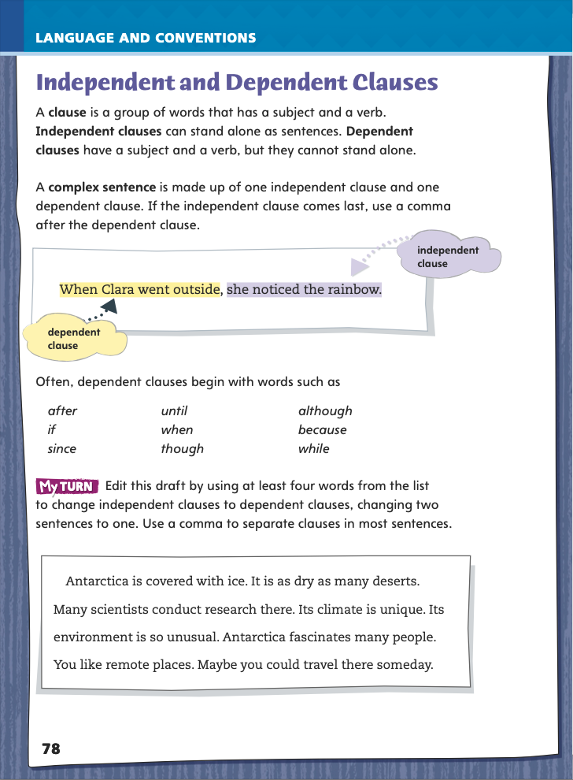
Page 78
Language and Conventions
Turn to page 78 in your Student Interactive and complete the activity.
Notes:
Have students edit the draft paragraph on Student Interactive p. 78.

Slide 66
Lesson 5

Slide 67
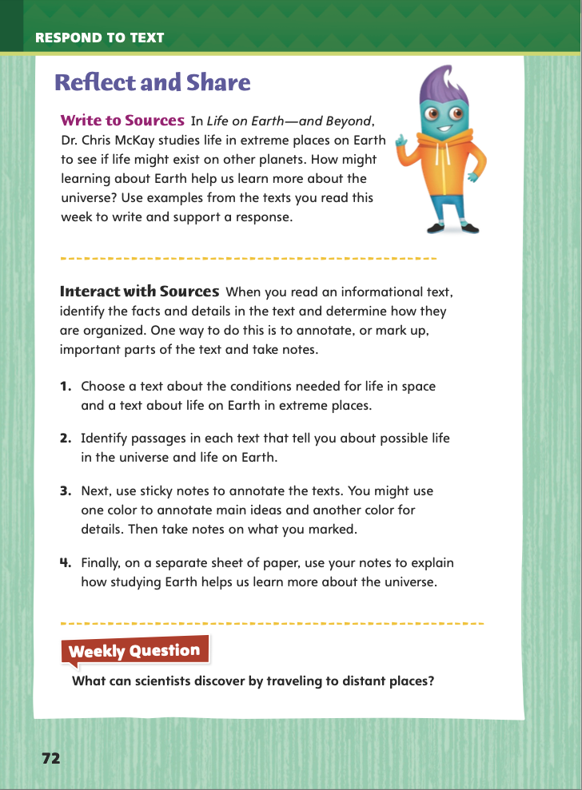
Page 72
Reflect and Share
Turn to page 72 in your Student Interactive.
Notes:
Explain to students that when they read an informational text, they should annotate it, identifying facts and details and determining how they are organized. Their annotations will help them better understand the text and easily find text evidence.
Underline parts of the text and write notes in the margins (if you own the text).
Use sticky notes to mark parts of the text and write your ideas (if you do not own the text).
Choose a leveled reader or another text. Model annotating using the underline/write method or the sticky notes method. In the text I chose, there are two sentences that explain how learning about Earth might help us learn more about the universe. I will underline those sentences. I see that the text uses a problem/solution structure. I will write “problem/solution” in the margin.
Have students choose a leveled reader or a text they are reading independently. Ask them to annotate the text using the underline/write method or the sticky notes method, whichever is appropriate.
Have students use the strategies for making connections between texts.
Have students use evidence from this week’s texts to write about how learning about Earth can help us learn more about the universe.

Slide 68
Apply
What can scientists discover by traveling to distant places?
Notes:
Have students use evidence from this week's texts to respond to the Weekly Question. Have them write their responses or discuss in small groups.

Slide 69
Word Study – Greek Roots
antibiotics
speedometer
archeology
Notes:
To assess students’ understanding of the Greek roots in this lesson, provide them with the following words: antibiotics, speedometer, and archeology. Offer context sentences:
Dr. Lo prescribed antibiotics to heal his patient’s infection.
The driver checked the speedometer to see how fast he was going.
Archeology students helped their professor dig up an ancient Zuni dwelling in New Mexico.
Have students use their knowledge of Greek roots to define each word. (Possible responses: antibiotics—medicines that attack living infections in the body; speedometer—instrument for measuring speed; archeology— the study of ancient human cultures)
Then have students use each word in a new sentence.

Slide 70
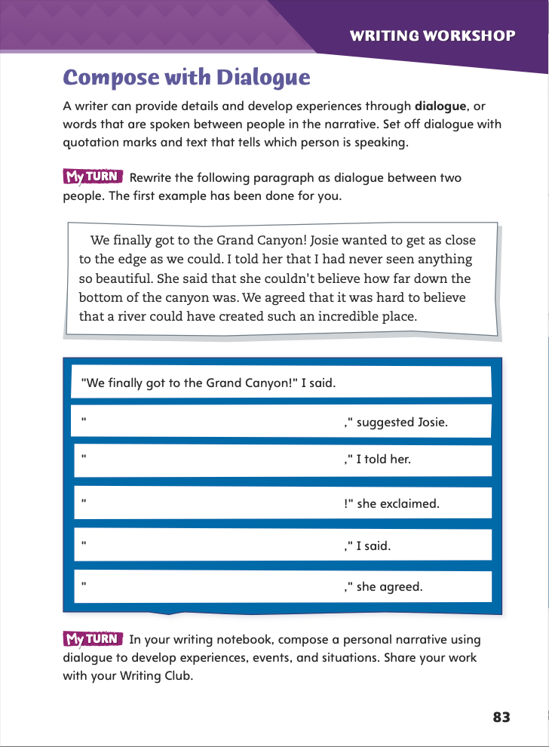
Page 83
Writing – Personal Narrative
Turn to page 83 in your Student Interactive.
Notes:
Personal narratives often include the genre characteristic of dialogue. Explain that dialogue:
is the words that people speak to each other within a narrative.
must be set off within quotation marks.
must include text that identifies who is speaking so that the reader does not get confused.
Explain that writers carefully craft dialogue to make characters or people in a narrative come alive for the reader. Dialogue makes narratives more exciting.
Ask a volunteer to read aloud the first paragraph on p. 83 of the Student Interactive. Then read aloud the text about the Grand Canyon. Model two examples of dialogue to complete the first fill-in item in the exercise:
“I guess we should sit here,” suggested Josie.
“Let's get closer to the edge,” suggested Josie.
Elicit that the second example is more effective because it conveys more interesting information and shows more about Josie’s personality. Then have students complete the exercise in pairs or small groups.
Ask students to begin crafting dialogue for their personal narrative. If they have difficulty, encourage them to use stack text as models.
Ask volunteers to share passages of dialogue from their narrative drafts. Discuss whether it is possible for the reader or listener to tell who is speaking.

Slide 71
Independent Writing – Writing Club
Discuss
Why did you choose _____ to write about?
What makes that topic engaging to you?
Where do you plan to include dialogue?
Which details in your narrative do you think are most specific and vivid?
To how many senses did you appeal in your narrative?
How do you think your narrative will end?
Notes:
This week’s Writing Club gives students a chance to share their ideas and drafts for their personal narratives.
Because students are still getting used to being in Writing Club groups, have them spend the first 5-10 minutes in their groups answering these questions:
What do we expect of a club member who is describing an idea or reading aloud a draft?
What do we expect of club members who are listening to someone else describe or read?
What rules should we make about kindness and politeness when responding to other club members?
Before students share their narratives or narrative ideas, they should identify the element of their personal narratives on which they would like feedback in today’s Writing Club—specific details, for example, or dialogue. Explain that doing this will help Writing Club members maintain their focus.

Slide 72
Spelling
Stanley studied meteorology and works as a weatherman at a local TV station.
2. Please make a photocopy of this test to take home.
3. My favorite geometric shape is a square.
4. Texting and passing notes in class are outside the parameters of our school rules.
5. When you study geography you usually use a lot of maps.
6. Nobody’s face has perfect symmetry, with one side exactly the same as the other.
7. List the events in chronological order starting in 1776.
8. Nadiri studied geology and now teaches classes about Earth’s physical structure.
9. Chronic pain is horrible because it keeps coming back.
10. Dad checked the speedometer to see how fast he was driving.
Notes:
(Note: Move the orange boxes to cover each bold spelling word before you read aloud the words and sentences.)
1. Use the following sentences for the spelling test:
1. Stanley studied meteorology and works as a weatherman at a local TV station.
2. Please make a photocopy of this test to take home.
3. My favorite geometric shape is a square.
4. Texting and passing notes in class are outside the parameters of our school rules.
5. When you study geography you usually use a lot of maps.
6. Nobody’s face has perfect symmetry, with one side exactly the same as the other.
7. List the events in chronological order starting in 1776.
8. Nadiri studied geology and now teaches classes about Earth’s physical structure.
9. Chronic pain is horrible because it keeps coming back.
10. Dad checked the speedometer to see how fast he was driving.
Challenge Words with the spelling list. Challenge Words: psychology, photosynthesis, anachronism

Slide 73
Language and Conventions
1. Until next summer vacation.
2. I will start reading the story.
3. I am going to concentrate on finishing my
projects.
4. While I wait for Mom.
Which two clauses are dependent?
A 1 and 2 are dependent. B 1 and 3 are dependent. C 1 and 4 are dependent.
D 2 and 3 are dependent.
Notes:
Display the clauses and have students respond independently.
Until next summer vacation.
I will start reading the story.
I am going to concentrate on finishing my projects.
While I wait for Mom.
Which two clauses are dependent?
A 1 and 2 are dependent. B 1 and 3 are dependent. C 1 and 4 are dependent.
D 2 and 3 are dependent.
Have students complete Language and Conventions p. 12 from the Resource Download Center. Click path: Table of Contents -> Resource Download Center -> Language and Conventions -> U1 W2

Slide 74
Unit 1: Week 2
Grade 5

