Slide 1
Unit 3: Week 1
Grade 2

Slide 2
Copyright © Savvas Learning Company LLC. All Rights Reserved.
This publication is protected by copyright, and permission should be obtained from the publisher prior to any prohibited reproduction, storage in a retrieval system, or transmission in any form or by any means, electronic, mechanical, photocopying, recording, or otherwise. For information regarding permissions, request forms, and the appropriate contacts within the Savvas Learning Company Rights Management group, please send your query to:
Savvas Learning Company LLC, 15 East Midland Avenue, Paramus, NJ 07652
or
k12learningpermissions@savvas.com
myView Literacy® is an exclusive trademark of Savvas Learning Company LLC in the U.S. and/or other countries.

Slide 3
Page 10
Introduce the Unit
Essential Question: What makes a
tradition?
What did you notice about the families that you saw?
How might food and storytelling be connected to traditions?
Notes:
Introduce the Essential Question for Unit 3: What makes a tradition? Tell students they will read many texts about the traditions of people from around the world. Explain that reading texts in a variety of genres helps students build their vocabulary and strengthen their reading skills.
Watch the Unit Video – Say: You will watch a video about families and their traditions. Pay attention to the celebrations shown in the video. Click Path: Table of Contents -> Unit 3: Our Traditions -> Unit 3: Introduction -> Unit 3 Video: Our Traditions
Have partners discuss the content of the video. Use these questions to guide discussion:
What did you notice about the families that you saw?
How might food and storytelling be connected to traditions?

Slide 4
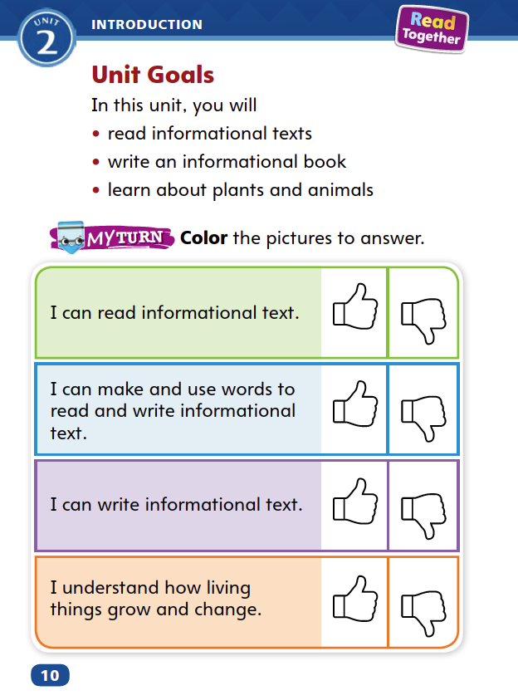
Page 14
Unit Goals
Turn to page 14 in your Student Interactive.
Color the “Thumbs Up” or the “Thumbs Down” for each goal.
Notes:
Read aloud the Unit Goals on p. 14 in the Student Interactive
Have students color the “thumbs up” if they feel they have already accomplished the Unit Goals, or the “thumbs down” if they think they have more to learn. Students will revisit this page in Week 6.

Slide 5
Page 15
Academic Vocabulary
culture
belief
purpose
communication
maintain
We use __________________ when we speak to one another.
The school will _____________ its practice of school assemblies.
Notes:
Explain that as students talk about living things growing and changing, they will respond in meaningful ways by using the newly acquired Academic Vocabulary words. They will learn new words that are connected to these words.
Read aloud the paragraph on page 11 in the Student Interactive.
Then use the EXPAND and ASK questions for each word. Have students respond, or say something in reply to someone else, using the newly acquired Academic Vocabulary as appropriate.
Have students use the Academic Vocabulary words as they talk about the picture in the Student Interactive with a partner.

Slide 6
Lesson 1

Slide 7
Page 18
Phonics
Work with a partner to read the sentences on the bottom of page 18 in your Student Interactive.
Underline the long i spelling in each word.
Notes:
Remind students that a sound can be represented by different spellings. Tell them that this week they will learn different spellings for the long i sound.
Display Sound-Spelling Card 80 (lime). Say: You have practiced the vowel pattern CVCe and know that the final e is silent and the first vowel is long. The word lime has a CVCe pattern.
Display Sound-Spelling Cards 70 (pie), 71 (lightbulb), 78 (hi), 79 (child), and 81 (sky). Point out the spelling pattern for long i in each word. Have students read the words with you.
Point out the word hi on Sound-Spelling Card 78. Explain that in a consonant-vowel pattern, the final vowel is usually long, as in the word hi. Tell students that the CVCe pattern for long i is the most common spelling of long i.
Display Sound-Spelling Card 71 again. Say: In the word lightbulb, three letters make the long i sound: i, g, h. When three letters make a single sound, they are called a trigraph.
Use the chart on p. 18 of the Student Interactive to model how you read the first word. Say: When I see a vowel in a word, I think about what I have learned about vowel patterns to help me decide if the vowel is long or short. For example, when I see the word wild, I notice that the letter i is followed by two consonants, not one, so it isn’t a CVC word. I know that in words like child, wild, and mind, where the vowel is followed by two consonants, the vowel can stand for a long vowel sound.
Have students orally read the words in the chart, naming the vowel pattern that represents the long i sound in each word. When students have finished, ask: Which of these vowel patterns is a trigraph?
Guide students to identify igh. Ask: What sound does the trigraph igh represent?
Have students work with a partner to read the sentences at the bottom of p. 18 and underline the long i spelling in each word.

Slide 8
High-Frequency Words
eyes
earth
thought
Notes:
Remind students that some common words cannot be sounded out. To read fluently, students will need to recognize these words quickly.
Write eyes. Say: To help me remember high-frequency words, I look at them closely. The word eyes isn’t spelled the way it sounds. The letter e has a long i sound. It will help me remember the word if I practice writing and reading it aloud.
Ask students to write eyes, earth, and thought and read them aloud to a partner.
Have students identify, read, and write the words on p. 20.
Have pairs use each clue to identify the word it describes.

Slide 9
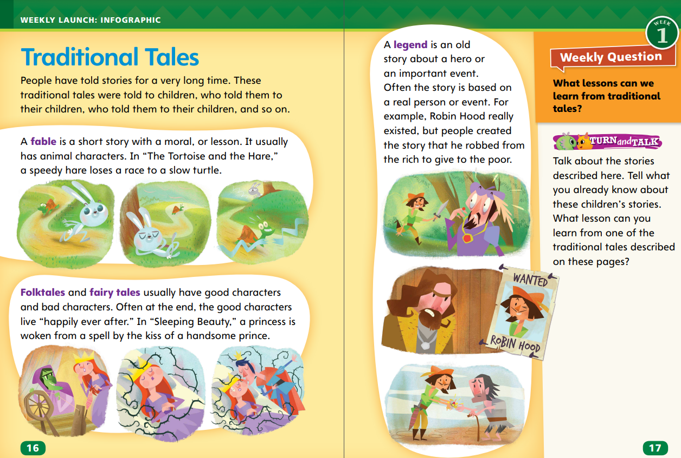
Page 16, 17
Interact with Sources
What lessons can you learn about the tales? Underline the names you are familiar with.
Notes:
Remind students of the Essential Question for Unit 3: What makes a tradition? Point out the Week 1 Question: What lessons can we learn from traditional tales?
Have students follow along as you read aloud “Traditional Tales” on pp. 16–17 in the Student Interactive. As you read, have students underline the names of characters they are familiar with.
Then organize students into small groups and have them discuss the distinguishing characteristics of the different types of traditional tales. During the group discussions, encourage students to ask questions to make connections to the topic of the infographic.
Use the following questions to guide the group discussions:
Why do you think fables, folktales, and legends have survived so long?
What characters do you know from folktales and fairy tales? What do they have in common?
Do you think Robin Hood really stole from the rich to give to the poor? Why might people tell this story?
Which one of these stories is your favorite? Why?
Read the Week 1 question: What lessons can we learn from traditional tales?
Tell students they just learned about a few characteristics of traditional tales. Traditional tales often teach a lesson.
Explain that they will learn another lesson reading a traditional tale this week.
Have students discuss with a partner what they already know about the tales and the lessons that can be learned from them. Encourage students to name more familiar traditional tales that teach lessons.

Slide 10
Listening Comprehension
Characteristics of Fables | Included in this Story?
Begins with “Long ago” or “One day”
Has animals as the main characters
The animals talk
has a moral or lesson
is short
Notes:
Tell students you are going to read a fable aloud. Have students listen as you read “The Lion and the Mouse.”
Explain that students should listen actively, paying careful attention to features of a fable as you read.
Prompt them to ask questions to clarify information and to follow agreed-upon discussion rules. Then have students describe key details from the fable.
Read the whole passage aloud without stopping.
Reread the text aloud a second time. This time stop to model Think Aloud strategies related to the genre and the characters in the story.
Say: I notice that the main characters are animals. The mouse talks to the lion. I know that fables often have talking animals. I will look for other features of fables as I continue reading.
Say: As I read the second half of the story, I’m thinking about the lesson that the lion learned from the mouse’s actions. I think the author wants me to understand that, not only did the mouse keep her promise, but she also was able to help the lion even though she was so small. Fables end with a moral, or lesson. Lion learns that someone’s size should not be used to judge his or her strength or abilities.
Use a Characteristics of Fables chart to help students determine whether the characteristics of a fable are present in this story.

Slide 11
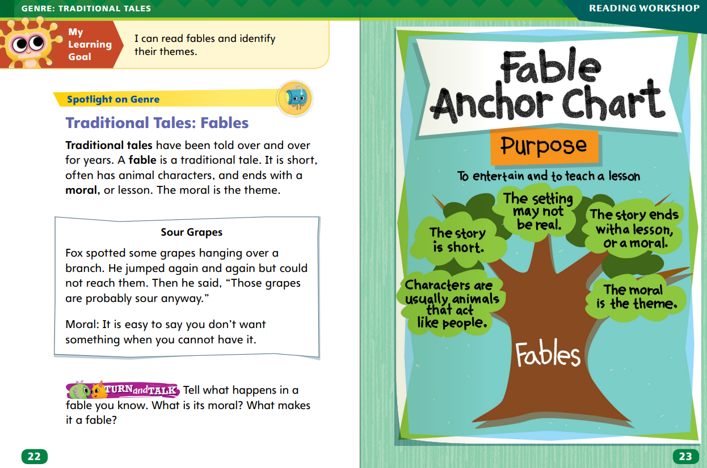
Page 22, 23
Traditional Tales: Fables
Turn to page 22 in your Student Interactive.
Notes:
Explain that traditional tales are made-up stories that were originally oral stories. These stories have been passed down from generation to generation.
Tell students that a fable is an example of a traditional tale. Students can identify a fable by asking these questions:
Does the story have animal characters that speak and act like humans?
Do the characters have to solve some kind of problem?
Does the story provide a lesson or moral at the end?
Explain that the moral of a fable is the lesson that the author teaches readers through the words and actions of the characters. In fables, the moral is also known as the theme of the story.
Model determining that a story is a fable based on the story elements. Say: To tell whether “The Lion and the Mouse” is a fable, I ask myself questions. Does the story have animal characters that talk? The answer is yes. Do the characters have to solve some kind of problem? Yes, they do. Is there a moral or lesson in the story? Yes. Even though the mouse is much smaller than the lion, she is able to help the lion. The lion misjudged the mouse because of her size. I believe “The Lion and the Mouse” is an example of a fable.
Read the Anchor Chart on page. 23 in the Student Interactive together.

Slide 12
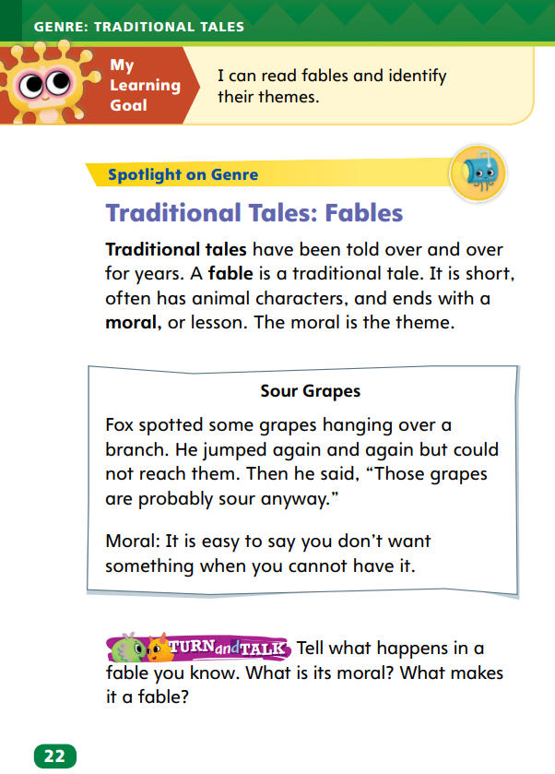
Page 22
Apply
Identify the moral in other fables you have read.
Notes:
Have students work with a partner to complete the activity on p. 22 of the Student Interactive.
Observe students as they talk to assess whether they can identify the moral in other fables they have read.

Slide 13
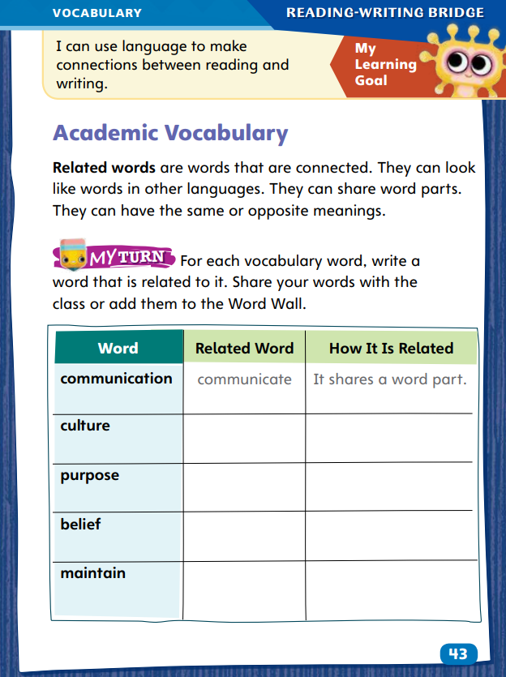
Page 43
Academic Vocabulary
communication
Notes:
Related words often have a connection in meaning. Help students recognize related words to learn new vocabulary:
When you come across an unfamiliar word, notice its word parts.
Ask yourself if the word part looks like part of a word you know the meaning of.
Is the meaning of the new word part similar to or different from the meaning of the word you know?
Words parts can help you understand the meaning. For example, if you know the word like, you know dislike means the opposite.
Model this strategy using the academic vocabulary in the sentences on p. 43 in the Student Interactive. Say: If I saw the word communication in a text, I might realize that I already know the word communicate. I can use this information to figure out that communication is related to communicate and means “an exchange of information.”
Have students apply this strategy to another word from the chart on their own.
Have students complete the activity on p. 43 in the Student Interactive.

Slide 14
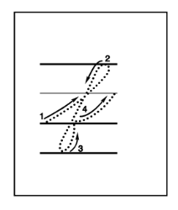
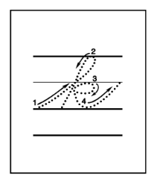
Handwriting
Notes:
Display the cursive letters f and k.
Tell students to think of a roller coaster that loops up and travels back down. Have students begin to form the letter f with the pencil on the bottom line, slide it up at a slight slant and curve around to form a loop. Like a roller coaster, their pencil will curve down. Tell them to do the same below the bottom line, forming another loop.
Model doing similar movements to form the letter k, with a loop in the top of the letter.
Have students use Handwriting p. 137 from the Resource Download Center to practice writing cursive letters f and k. Click path: Realize -> Table of Contents -> Resource Download Center -> Handwriting Practice -> U3W1L1 Handwriting Practice

Slide 15
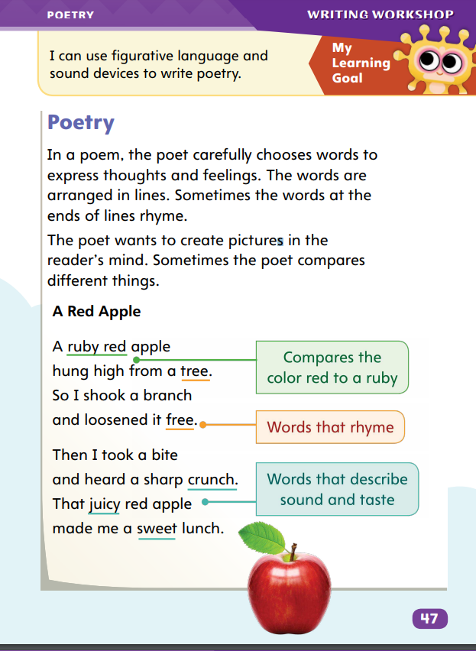
Page 47
Writing – Poetry
Turn to page 47 in your Student Interactive.
Notes:
Poetry is a form of writing that contains thoughts and feelings in lines. Poems are typically filled with descriptive language. Sometimes, they contain rhyming words at the ends of lines.
Direct students to p. 47 of the Student Interactive. Point out the poem. Say: This is a poem about an apple. We know this is a poem because of how the words are arranged into lines rather than sentences. Some words rhyme, and some words don’t.
Read aloud “A Red Apple.” Say: In each line, the poet chose words to describe the apple. What words does the poet use to describe the apple? (red, ruby red, hung high, crunch, juicy, sweet) Where does the speaker find the apple? What does the speaker do with it? Discuss how the speaker finds it in a tree, shakes it down, and then eats it. Ask: Which words rhyme in the poem? (tree, free, crunch, lunch).
Hold up a poem from the stack. Read the title and point out the lines.
Read the poem as a class, and model finding the subject of the poem, words that describe the subject, and rhyming words.

Slide 16
Independent Writing
Look through other poems and identify lines and rhyming words.
Share the poems you have read or written with the class.
Notes:
Students should explore poems during independent writing time. If students have trouble identifying structural elements of poetry, pick specific poems for them and identify lines and rhyming words. If students struggle, choose one of the following options to provide further support.
Modeled – Choose a stack text. Do a Think Aloud to model how a poet describes a subject.
Shared – Have students choose poems from the stack. Prompt them to identify descriptive words about the subject of each poem.
Guided – Provide explicit instruction on how to identify descriptive words about a subject.
Students who are ready should begin working on their own poems, making sure to focus on topics that interest them and include descriptive words.
At the end of writing time, have several students share the poems they have read or written.
Ask other students to identify the elements of poetry in the work.

Slide 17
Spelling
1. I would like to try to play a new game.
2. He tried his best in the race.
3. They wanted to spy on the other team.
4. She spied the cookies on the table.
5. We are going to a movie tonight.
6. He needed two dimes and a nickel.
7. A lightning strike caused the fire.
8. There is a spider on my desk!
9. The pirate wore an eye patch.
10. It was a delight to see them.
11. The plant grew out of the earth.
12. She thought the puppy was cute.
Notes:
(Note: Move the orange boxes to cover each bold spelling word before you read aloud the words and sentences.)
Read aloud the sentences. Have students spell each word with the long i sound and the two high frequency words.
I would like to try to play a new game.
He tried his best in the race.
They wanted to spy on the other team.
She spied the cookies on the table.
We are going to a movie tonight.
He needed two dimes and a nickel.
A lightning strike caused the fire.
There is a spider on my desk!
The pirate wore an eye patch.
It was a delight to see them.
The plant grew out of the earth.
She thought the puppy was cute.
Reveal the spelling word and have students check their work.

Slide 18
Language and Conventions
The team has a winning record.
Create a list collective nouns for people with your partners. Write sentences for each noun.
Notes:
Review with students that a collective noun names a group of persons or things. Emphasize that it is singular even thought it names a group of more than one.
Display this sentence: The team has a winning record.
Have students read the sentence aloud. Then ask students to name the collective noun (team).
Ask: Is the collective noun team singular or plural? (singular)
Have partners create a list of collective nouns and then write sentences for each noun. Challenge them to name collective nouns for people (class, crowd, audience) and animals (herd, flock, group).

Slide 19
Lesson 2

Slide 20
Page 19
Phonics
Notes:
Use Sound-Spelling Cards 70, 71, 78, 79, and 81 to review the spelling for the long i sound. Point out that the vowel team ie is a digraph because it is made of two letters. Tell students that igh is called a trigraph because it is made of three letters.
Point to and name the picture of the iron at the top of p.19 in the Student Interactive.
Read each of the words below the picture: ever, open, and iron.
Model how you choose the correct word. Say: The picture is an iron. I hear long i in the word iron. As I read each of the words, I listen for the long i. This helps me make sure I select the correct word.
Ask students to underline the word that says iron and then write the word under the picture. Then ask students to name the next picture and identify the vowel sound.
Have them underline the word that says bike. Ask them what vowel pattern stands for the long i sound. Repeat with the picture of the light.
Ask students to complete the rest of the activity at the top of p. 19 independently. Circulate and provide support where needed.

Slide 21
Page 19
Apply
Write a sentence that contains two of the words you wrote on the top page 19.
Notes:
Have students complete the activity at the bottom of p. 19.

Slide 22
High-Frequency Words
eyes
earth
thought
Notes:
Display the high-frequency words eyes, earth, and thought.
Point to the words and ask students to read them.
Assign one of the words to each pair of students.
Ask them to write a sentence using the word.
Have partners share their sentences with the class

Slide 23
Page 24
Preview Vocabulary
contentment
rage
hopes
disappointment
alarmed
Notes:
Introduce the vocabulary words on p. 24 in the Student Interactive and define them as needed.
contentment: feeling of happiness
rage: strong anger
hopes: things wanted in the future
disappointments: feelings of not getting what you wanted
alarmed: felt fearful of danger
Say: These words will help you understand the characters in Fables by Arnold Lobel. As you read, highlight the words when you see them in the text. Ask yourself what they tell you about each character.

Slide 24
First Read Strategies
Notes:
Discuss the First Read Strategies. Prompt students to establish that the purpose for reading this selection is for understanding and enjoyment.
Explain the four steps of the first read.
READ Help students to connect their own lives and lessons that they have learned to what they are reading as a way to better understand the fable.
LOOK Direct students’ attention to the illustrations to help them understand the fable
ASK Help students generate questions about confusing parts.
TALK Encourage students to talk about the fable with a partner.
Students may read the text independently, in pairs, or as a whole class.
Use the First Read notes to help students connect with the text and guide their understanding.

Slide 25
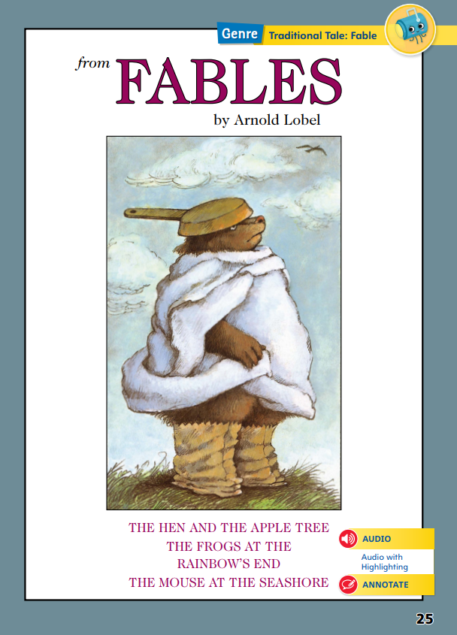
Page 25
First Read – Fables
Notes:
Read Together.

Slide 26
Page 26,27
First Read – Fables
Notes:
Read Together.
THINK ALOUD By looking at the picture on this page, I know that the characters in this story are animals. I see a hen looking out the window of a house. Outside, I see legs, ears, and a mouth with sharp teeth coming out of an apple tree. It looks like a scary animal is hiding in an apple tree.
THINK ALOUD As I read, I try to understand what is happening in the story. I’m a little confused about why the tree is talking. I know animals can talk in fables, but I’m not sure about trees. Is the tree actually talking? Or is an animal hiding in the tree? Why would an animal pretend to be a tree? I’ll keep reading to find out if my questions are answered.

Slide 27
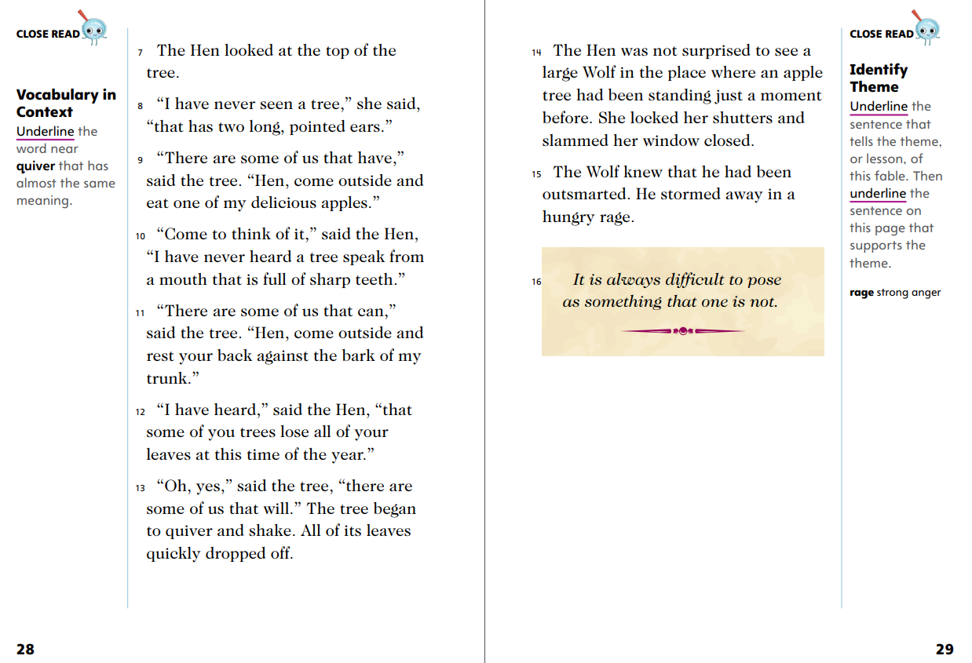
Page 28, 29
First Read – Fables
Notes:
Read Together.
THINK ALOUD I see that the hen is noting unusual things about the tree. As I read, I pay attention to the ways the tree in the story is different from a normal tree. The tree in the story has “long, pointed ears” and “a mouth full of sharp teeth.” I remember seeing the ears and the teeth in the picture at the beginning of the story. I think there is an animal with long ears and sharp teeth hiding in the tree.
THINK ALOUD I know that fables are written to teach a lesson. At the end of the story, I learn that the animal hiding in the tree was a wolf. He was trying to disguise himself as a tree to trick Hen into leaving her house. In the end, though, his disguise didn’t work. I think the story is trying to tell me that I shouldn’t try to pretend to be someone I’m not. I can talk with a partner about the fable to see what he or she thinks about it.

Slide 28
Page 31, 32
First Read – Fables
Notes:
Read Together.
THINK ALOUD By looking at the picture on this page, I get an idea about the characters in the story and what they might do. I see three frogs that look like they are chasing a rainbow. I will read on to find out what they are doing.
THINK ALOUD As I read, I pay attention to who the characters are and what they say and do. So far, I know there are two frogs in the story. They both have heard a rumor, or a story, about gold at the end of the rainbow. They both want to follow the rainbow. In the picture, there are three frogs. I wonder if they’ll meet another frog who will join them. I’ll read to find out.

Slide 29
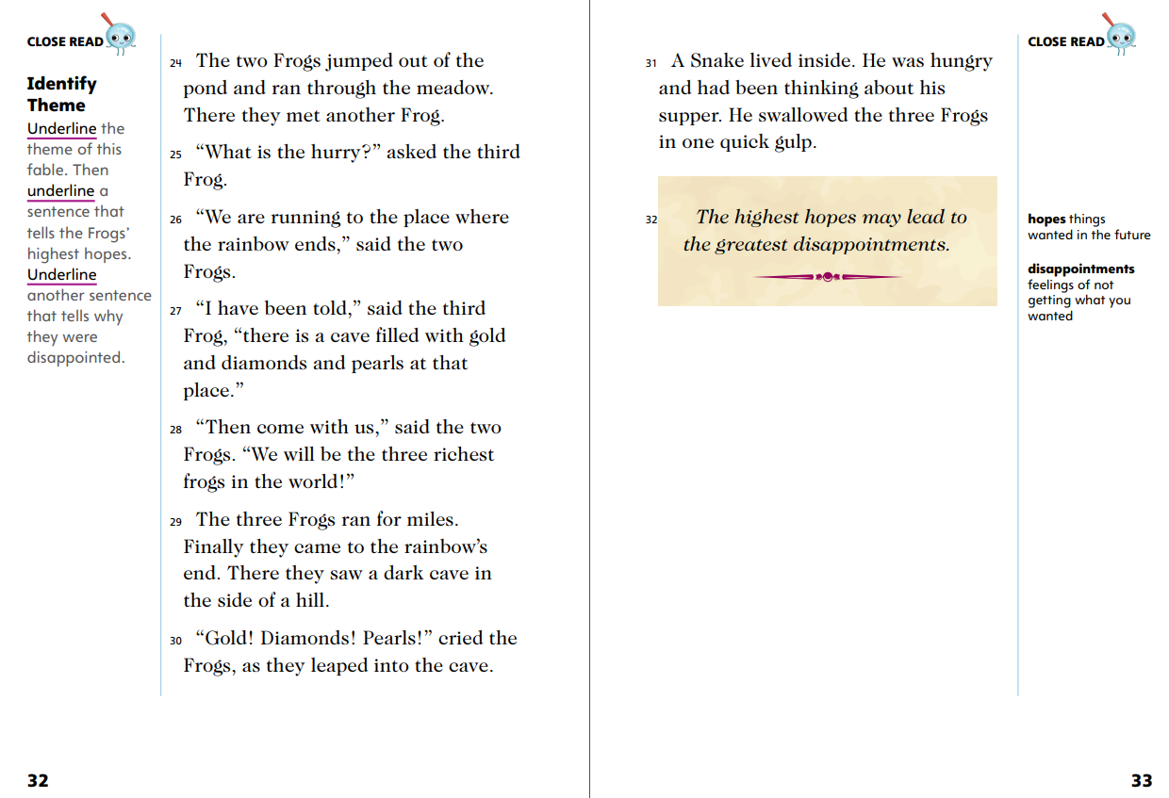
Page 32,33
First Read – Fables
Notes:
Read Together.
THINK ALOUD As I read, I ask questions to help me understand the story. I notice that each frog has heard a slightly different story. The first frog thinks there is gold in the cave. The second frog adds diamonds to the list and the third frog adds pearls. Why have the frogs all heard slightly different versions of the story? Where did the story come from? Is the story true?
THINK ALOUD The lesson I learn at the end of the story is that great hopes might lead to great disappointments. I think the writer doesn’t mean that being hopeful, or wanting something to happen, will always lead to disappointment. Looking back at the story can help me interpret, or understand, the lesson. The frogs weren’t careful. They were greedy and just wanted to be the richest frogs, without thinking through their plan. I think the writer wants me to know that if I am excited or hopeful about something happening, I should make sure I am careful and think through my plan so I am not disappointed. I can share my reactions with a partner and learn what he or she thinks of the fable.

Slide 30
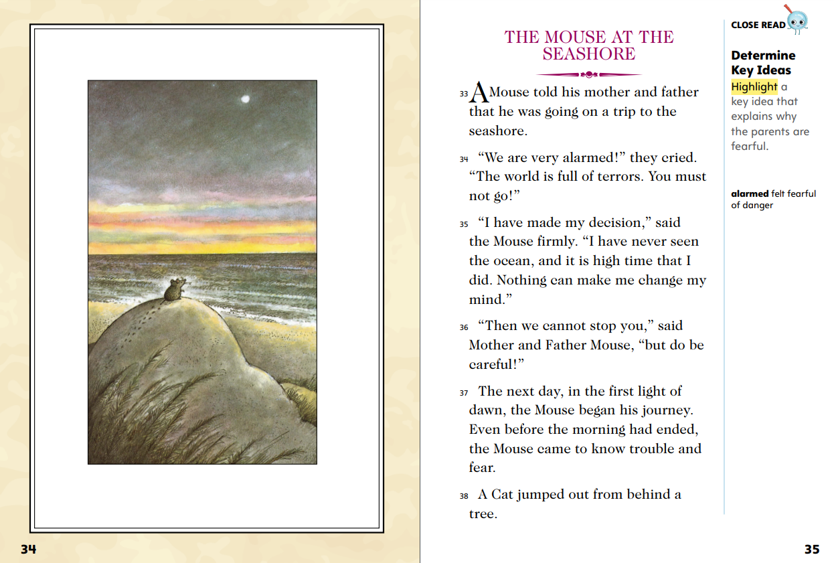
Page 34,35
First Read – Fables
Notes:
Read Together.
THINK ALOUD I’ll look at the illustration to help me predict what the setting of the story will be. I see a mouse sitting by itself on a sand dune looking out onto the water. I can see footprints. Maybe the mouse had to climb up to get to the top of the hill. This shows me that the setting will be at the seashore.
THINK ALOUD When I read, I try to understand the characters’ thoughts and feelings. This helps me understand why they act how they do. I read that Mouse’s parents are “alarmed” when he wants to go to the seashore and talk about “terrors.” I wonder why the seashore would be dangerous for a mouse. As I read, I look for details that tell me why a trip to the seashore would be dangerous.

Slide 31
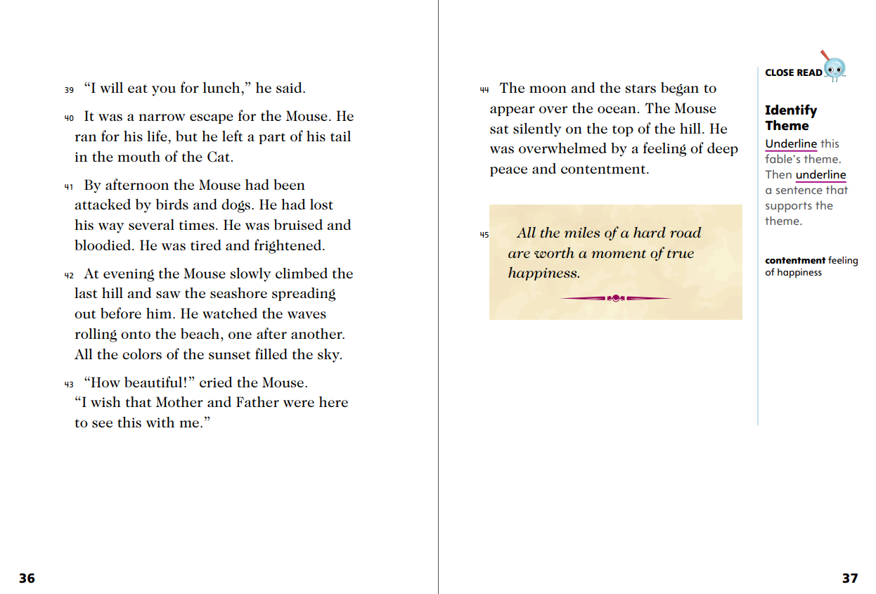
Page 36,37
First Read – Fables
Notes:
Read Together.
THINK ALOUD As I read, I ask myself “What happens?” and “Why does it happen?” After I read page 36, I ask: What happened to the Mouse? I read that he escaped a cat and was attacked by birds and dogs, but he made it to the seashore. Why did Mouse want to go to the seashore? I see some clues in the text. He says the seashore is “beautiful” and he likes watching the waves. Mouse went to the seashore because he wanted to see the beauty of the ocean.
Direct students to the lesson at the end of the fable. Ask: When was a time you did something very difficult? What made it difficult or challenging? How did you feel after you did it?
Have students discuss their experiences with a partner.

Slide 32
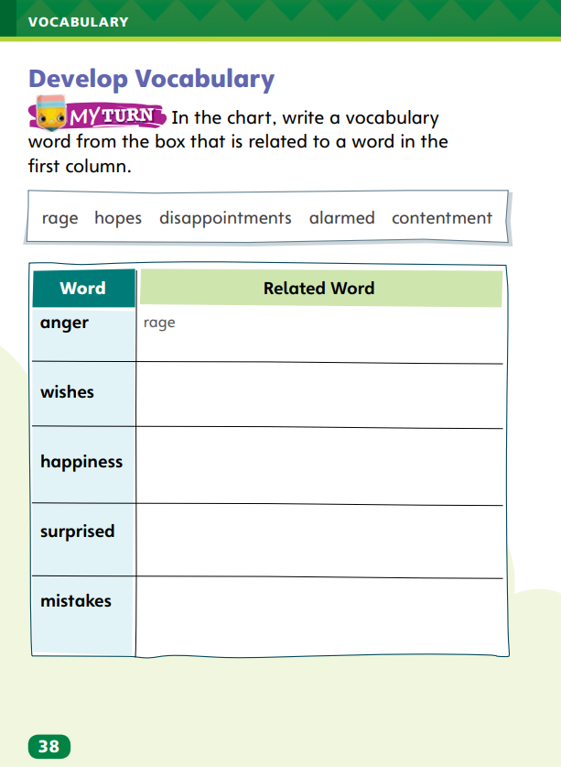
Page 38
Develop Vocabulary
Turn to page 38 in your Student Interactive and complete the activity.
Notes:
My View - Use these suggestions to prompt students’ initial responses to reading Fables.
Brainstorm What did you think about the theme of each fable?
Discuss Why do you think each fable has animals for characters?
Tell students that authors choose words to convey information. The vocabulary words rage, hopes, contentment, alarmed, and disappointments tell us about the characters’ feelings in the stories from Fables.
Remind yourself that words can have related meanings.
Ask yourself which words you already know that could help you understand the vocabulary words.
Model filling out the chart on SI p. 38 using the word rage.
Say: I begin by looking at each word in the box. I ask myself which of these five words has a meaning closest to anger. I know that rage means “very strong anger,” so I write it down.
Have students respond using newly acquired vocabulary as they complete p. 38 of the Student Interactive. They should determine which vocabulary word is related to each word in the chart.

Slide 33
Page 39
Check for Understanding
What makes these stories fables?
Why did the author include the sentence in italics at the end of each fable?
How are the Frogs in “The Frogs at the Rainbow’s End” and the Mouse in “The Mouse at the Seashore” alike? How are they different?
Notes:
Have students complete p. 39 of the Student Interactive.

Slide 34
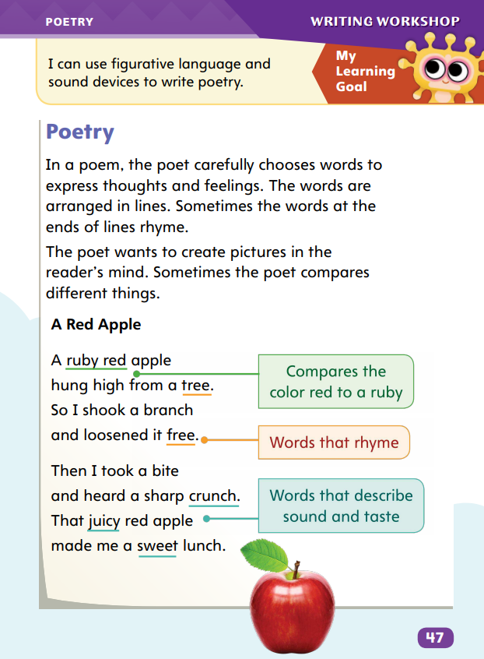
Page 47
Writing – Poetry
Turn to page 47 in your Student Interactive.
Notes:
Poets use words that make specific sounds when read aloud. They do this by choosing words that:
rhyme with other words
sound like what they describe
help create a beat, or rhythm
Direct students to the poem on p. 47 in the Student Interactive. Say: The poet chose words based on their sounds as well as their meanings. The poet used rhyming words and created a pattern of sounds called a rhythm.
Ask students to identify the rhyming words in the first stanza. Say: Here the poet rhymes tree and free. The poet could have written: A ruby red apple hung high from a tree, so I shook a branch and the apple fell off. The rhyming lines sound much better!
Next, have students identify the rhyming words in the second stanza. Say: Crunch and lunch rhyme. They share the same sound and create a rhythm.
Point out the phrase “heard a sharp crunch.” Say: The poet also chose descriptive words to express the sound that the apple makes. What sound does the apple make? It crunches.
Read more poems from the stack aloud together. Have students identify rhyming words and other interesting sounds in the poems.

Slide 35
Independent Writing
Let’s review what we learning about rhyming words and talk with our partners.
You will continue writing your own poetry that includes rhyming words.
Notes:
During independent writing time, students should continue to read poetry from the stack, looking for rhyming
words as they go along. If students have difficulty, read poems aloud to them and emphasize the words that rhyme.
If students struggle, choose one of the following options to provide further support.
Modeled – Do a Think Aloud to model identifying rhyming sounds using a poem from a stack text.
Shared – Have students choose several poems from the stack and work together to identify rhyming words.
Guided – Provide explicit instruction on how to locate rhyming words by sight and sound
Students with a strong understanding should write poetry that includes rhyming words.
At the end of writing time, ask a few students to share examples of rhyming poetry from poems they have read or written.

Slide 36
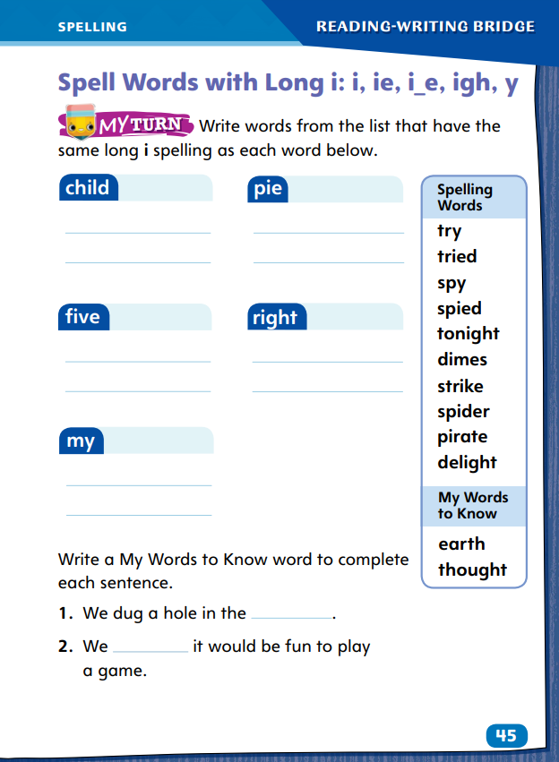
Page 45
Spelling
like
right
try
pie
hi
Turn to page 45 in your Student Interactive and complete the activity.
Notes:
Explain that long i sound words are usually spelled with the single letters i and y and the letter teams ie, i_e, and igh.
Write the words: like, right, try, pie, and hi.
Emphasize how the long i sound is made. Discuss the one-syllable words with open syllables.
Point out the one-syllable word with the VCe syllable. Have students spell those words.
Have students complete SI p. 45.

Slide 37
Language and Conventions
The boy walks to the store with his sister.
The horse runs.
Work with your partner to create oral sentences that use present-tense verbs.
She sings.
A cloud passes overhead.
Notes:
Answer any questions students have about present tense verbs. Then explain to the class what a verb is: a word that can tell when actions happen. Say: A present-tense verb tells what happens now.
Display this sentence: The boy walks to the store with his sister. Ask: What is the present-tense verb? (walks) What does the present-tense verb do? (tells us what the boy is doing now).
Point out that when a noun or pronoun is singular, the present tense verb usually ends with an -s or -es.
Write: The horse runs. She sings. A cloud passes overhead.
Have students identify the present-tense verbs. Ask students for more examples.
Have partners create oral sentences that use present-tense verbs.
Have partners share their sentences with the class, identifying the present-tense verbs and the singular or plural nouns or pronouns that the verbs match.

Slide 38
Lesson 3

Slide 39
Phonics
hi
child
pie
lime
lightbulb
sky
Notes:
Remind students that a sound can have more than one spelling. Review with students the spellings they have learned that represent the long i sound: i, ie, i_e, igh, and y.
Write the following words: hi, child, pie, lime, lightbulb, and sky. Read each word with students.
Call on students to underline the vowel pattern in each word that stands for the long i sound.
Say: When I read words, I look carefully at the vowel patterns to help me decode the words correctly.
Write the following vowel patterns on cards and place them in a pocket chart or write them on chart paper and lay it on the floor: i, ie, i_e, igh, and y.
Write the following words on cards: tribe, wide, spike, rise, stripe, quite, die, pie, fried, tried, flies, kind, mind, grind, wild, by, dry, pry, sky, high, flight, tight, might, and right. Mix up the cards.
Have students take turns drawing a card, reading the word, and placing it under the correct vowel pattern.
Ask other students to notice if the word is placed correctly.

Slide 40
Page 20
High-Frequency Words
eyes
earth
thought
Turn to page 20 in your Student Interactive and complete the activity.
Notes:
Remind students that some common words cannot be sounded out. To read fluently, students will need to recognize these words quickly.
Write eyes. Say: To help me remember high-frequency words, I look at them closely. The word eyes isn’t spelled the way it sounds. The letter e has a long i sound. It will help me remember the word if I practice writing and reading it aloud.
Ask students to write eyes, earth, and thought and read them aloud to a partner.
Have students identify, read, and write the words on p. 20.
Have pairs use each clue to identify the word it describes.

Slide 41
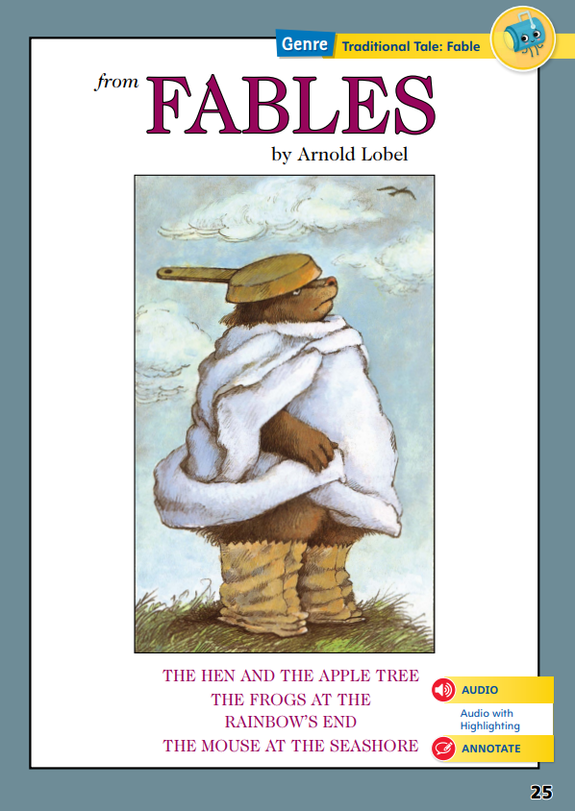
Page 25
Identify Theme
Notes:
Readers learn about theme by noticing text evidence and how characters respond to different situations. This can give readers clues about the theme of a fable.
Pay attention to how the characters react to problems.
Think about important decisions the characters have to make.
Consider how the characters grow and change in the story.
Use the Close Read notes of the Student Interactive to model how to identify the theme of a fable.
Tell students that you will provide assistance as they determine the theme.
Say: Which sentences support the theme of the fable? In “The Hen and the Apple Tree,” I am going to underline “The Wolf knew that he had been outsmarted” and write this in the chart. This shows what the Wolf learned after posing as a tree. I am going to write “The Wolf knows he is not able to pose as something he is not: a tree” because this is how it helped me identify the theme.
Have pairs of students find and underline text that supports the themes of the remaining two fables. Provide assistance as needed.
Then have them write how the text helps them identify the theme.

Slide 42
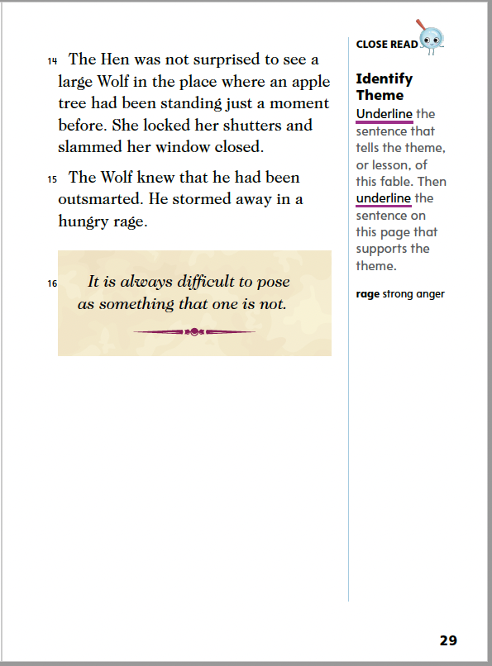
Page 29
Close Read – Identify Theme
Turn to page 29 in your Student Interactive.
Notes:
Have students use the strategies for identifying theme.
Remind students that fables often have a theme, or lesson. This can also be called the moral. Discuss how authors include a theme for readers to learn.
Have students read paragraphs 15 and 16 and underline the sentence that states the theme and another that supports the theme. See student page for possible responses.
Ask students to restate the theme, or lesson, of the story in their own words. Possible responses: Don’t pretend to be something you are not. DOK 2

Slide 43
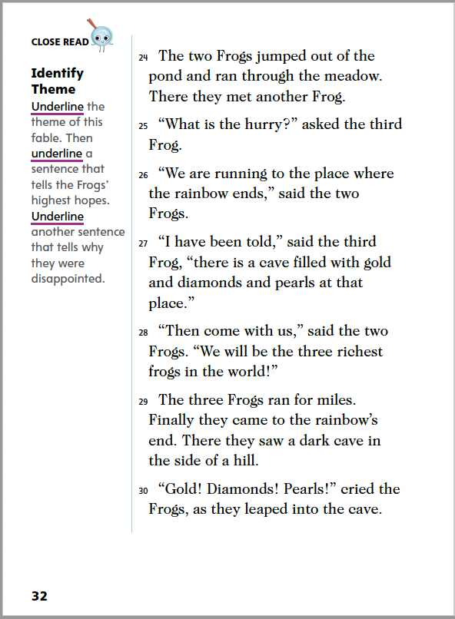
Page 32
Close Read – Identify Theme
Turn to page 32 in your Student Interactive.
Notes:
Have students use the strategies for identifying theme.
Remind students that the theme or moral in a fable is the lesson the writer wants to teach. Explain that the moral is usually written at the end of a fable. Explain that the lesson always connects to the characters’ actions in the story. Direct students’ attention to paragraphs 30, 31, and 32, and have them complete the Close Read activity on p. 32. See student pages for possible responses.
Ask: What were the Frogs’ highest hopes, and why didn’t they achieve their goals? Possible Response: The Frogs’ highest hopes were to find gold, diamonds, and pearls. They followed the rainbow to find their highest hopes, but were swallowed up by a Snake. The Frogs did not think of anything but what they wanted, so they were not careful. Because they were not careful, they did not achieve their goals, and were disappointed instead. DOK 2

Slide 44
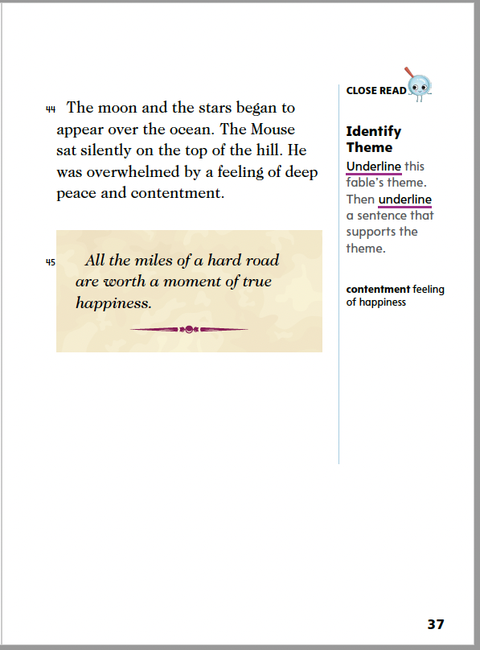
Page 37
Close Read – Identify Theme
Turn to page 37 in your Student Interactive.
Notes:
Have students use the strategies for identifying theme.
The theme is the lesson that readers learn in a fable. Help students with challenging and figurative language in the theme. Explain that the phrase “miles of a hard road” can relate not just to traveling, but to any type of challenge. Explain that the theme always relates to characters’ actions in the text. Point out that contentment is a synonym for happiness. Have students complete the Close Read activity on p. 37.
See student page for possible responses. DOK 2

Slide 45
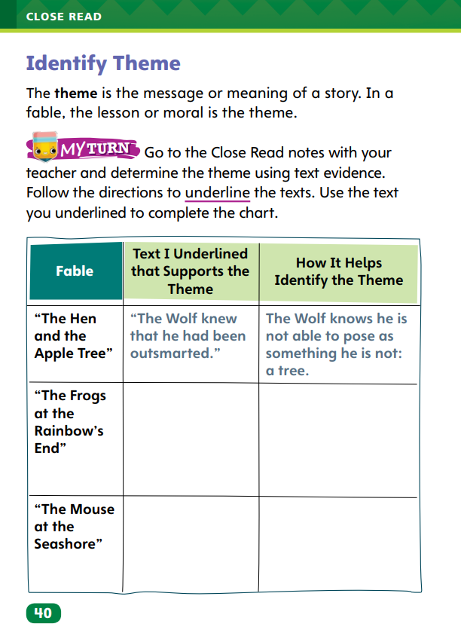
Page 40
Identify Theme
Turn to page 40 in your Student Interactive and complete the activity.
Notes:
Have students annotate the text using the other Close Read notes for Identify Theme.
Have students use the text evidence from their annotations to complete the chart on p. 40.

Slide 46
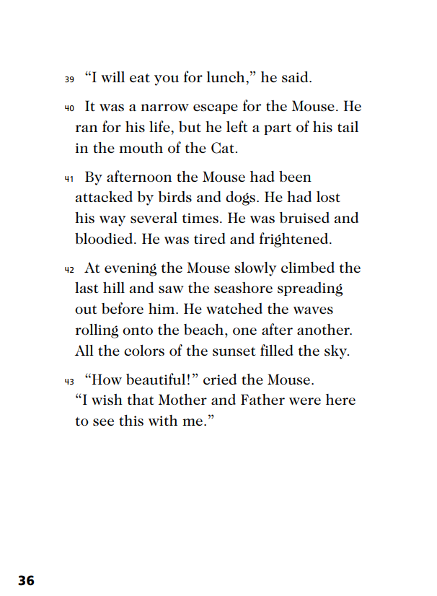
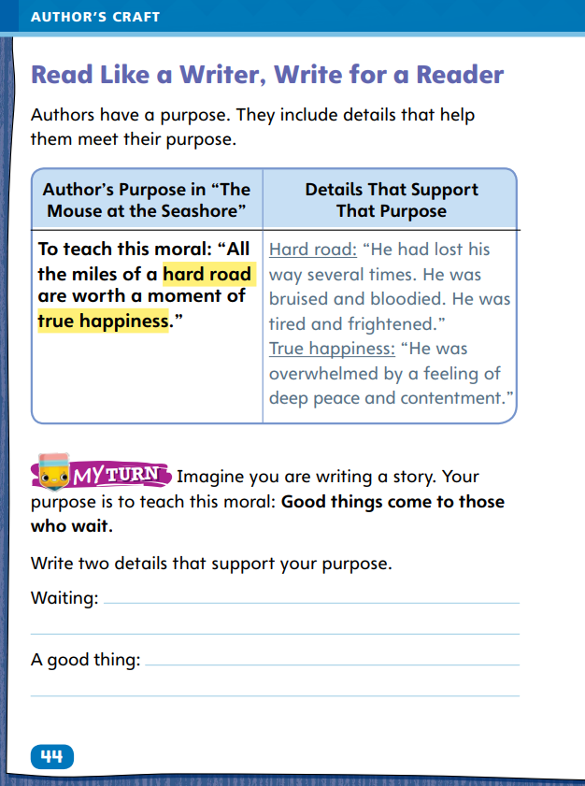
Page 44
Read Like a Writer, Write Like a Reader
Turn to page 44 in your Student Interactive.
Notes:
Authors have many different reasons for writing. Their purpose can be to teach, entertain, or inform.
Authors include details in the text that help them meet their purpose.
Authors choose words carefully for their purpose.
Model using the example on p. 44 in the Student Interactive to show students how writers use details to support a purpose.
Remind students that a moral is a lesson, and then read the moral on p. 44. Emphasize the phrases “hard road” and “true happiness.”
Then say: In the sentences “He had lost his way several times. He was bruised and bloodied. He was tired and frightened,” the author uses details to describe the hard road that Mouse had to travel. This helps us understand that Mouse had a difficult journey. Read the sentences that support true happiness and point out how the words peace and contentment support this idea.
Have students complete the activity on p. 44 in the Student Interactive.

Slide 47
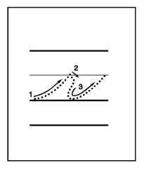
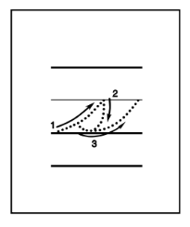
Handwriting
Notes:
Display the cursive letters r and s.
Remind students to sit upright in their chair with both feet flat on the floor.
Tell students that the lowercase r and s are written without lifting the pencil. Both begin on the bottom line and travel up to the middle. The lowercase r dips down then out, then travels back down to the bottom line. The lowercase s curves out as the pencil travels down, making a partial circle before it reaches the bottom line.
Have students practice both letters.
Have students use Handwriting p. 138 from the Resource Download Center to practice writing cursive letters r and s. Click path: Table of Contents -> Resource Download Center -> Handwriting Practice -> U3W1L3 Handwriting Practice

Slide 48
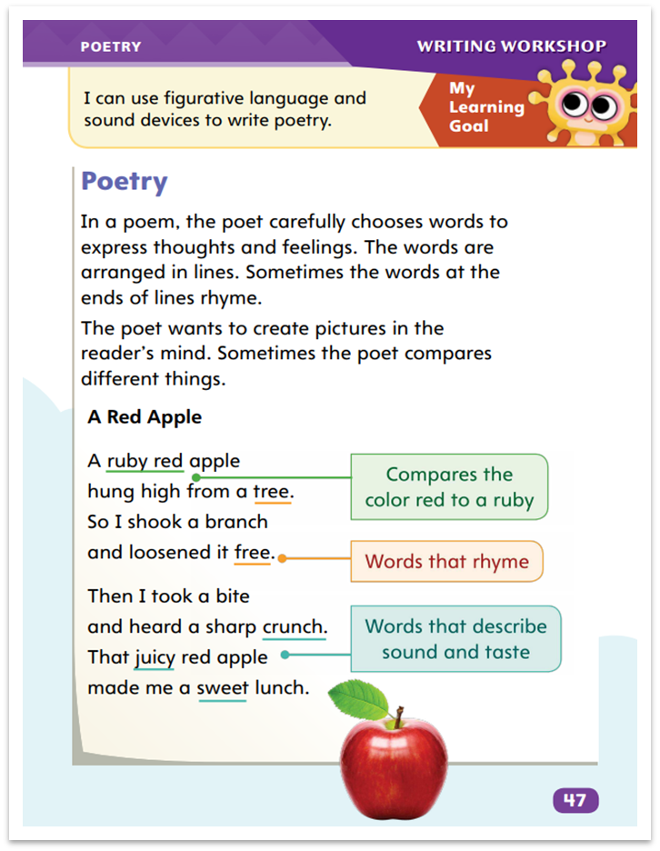
Page 47
Writing – Poetry
Turn to page 47 in your Student Interactive.
Notes:
Poets arrange words into lines rather than sentences. The poet carefully chooses which words appear on each line.
Return to p. 47 in the Student Interactive. Point to the poem and count its lines. Say: This poem has eight lines. The lines are all about the same length and have a similar number of syllables. This keeps the poem’s rhythm consistent. Lines of a poem are different from regular sentences—they don’t always have punctuation.
Poets think about how words look and sound together in each line. Point to lines 1 and 2. Here the poet starts with: A ruby red apple. I can almost see this apple. In the next line, I see the apple is hanging high in the tree. Point to lines 2 and 4. The poet ended these lines with words that rhyme.
Read lines 5 through 8. Ask: What happens in each line? Explain how the poet ends lines 6 and 8. (Point out crunch and lunch.)
Read aloud and display another poem from the stack. Discuss the number of lines and the content of each line.

Slide 49
Independent Writing
Let’s look at some of the lines from our poems and talk with our table about what we notice in each line.
You will continue to work on your poems in your journals. Practice using different lines lengths.
Notes:
Students should continue to work on their poems, focusing on what they want to describe in each line. If students have difficulty, read poems from the stack with them, explaining how poets decide to end lines.
If students struggle, choose one of the following options to provide further support.
Modeled – Do a Think Aloud to model identifying how each line of a poem relates to the subject.
Shared – Read a poem aloud. Prompt students to share what each line describes.
Guided – Discuss with students options for deciding how to end a line of poetry.
Students who show understanding should experiment with different line lengths.
At the end of writing time call on a few students to share lines from their poems.
Ask them to explain their choices in writing them.

Slide 50
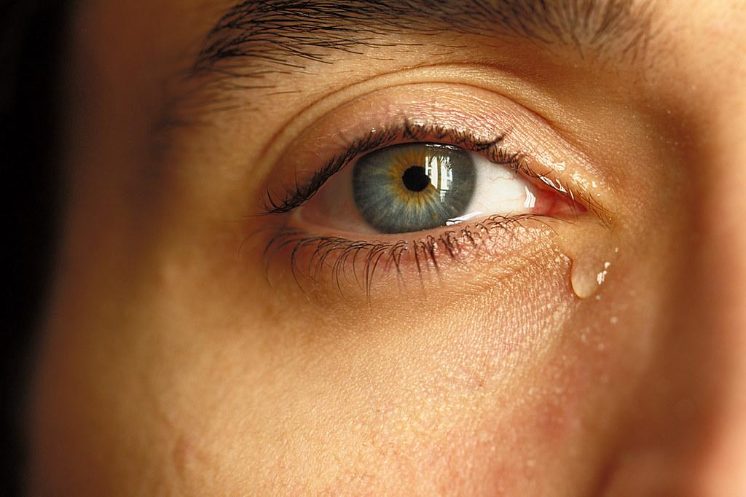
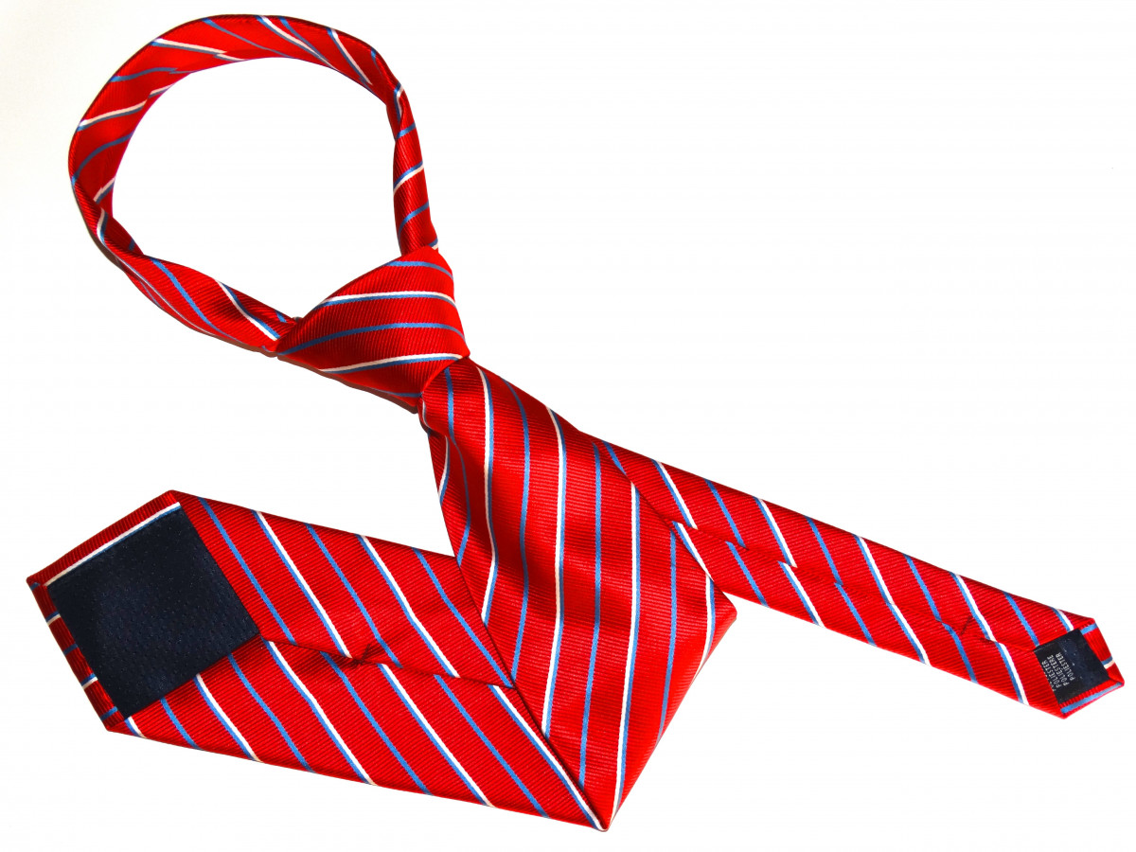
Spelling
Notes:
Remind students that words with long i sounds are formed by i, ie, i_e, igh, and y, and that some one-syllable words with these sounds, such as try and spy, have open syllables.
Have students spell these words and underline each long i spelling pattern: site, light, cry, hi, tie.
Then have them circle the words with open syllables.
Finally, have students spell the one-syllable word with a VCe syllable, nine, and these one-syllable words with open syllables: fly, lie, sigh.
Have students complete Spelling p. 147 from the Resource Download Center. Click path: Table of Contents -> Resource Download Center -> Spelling -> U3W1

Slide 51
Language and Conventions
We will write some simple sentences that include actions and use present-tense verbs with singular and plural nouns.
Then we will practice creating sentences with present-tense verbs that do not show action.
Notes:
Explain that present-tense verbs tell what happens now. They can be used with singular or plural nouns and pronouns.
Review that if a verb is used with a singular noun or the pronouns he, she, or it, the verb ends in -s or -es. If used with a plural noun, it does not end in -s or -es.
Review action verbs and forms of be (am, is, are). Point out that these present-tense verbs do not show action.
To reinforce present-tense verbs, name different types of actions.
Ask students to provide examples of sentences that include those actions and use present-tense verbs with singular and plural nouns.
Then ask students to create sentences using am, is, and are to demonstrate present-tense verbs that do not show action. For example, say: I am a teacher. What are you?

Slide 52
Lesson 4

Slide 53
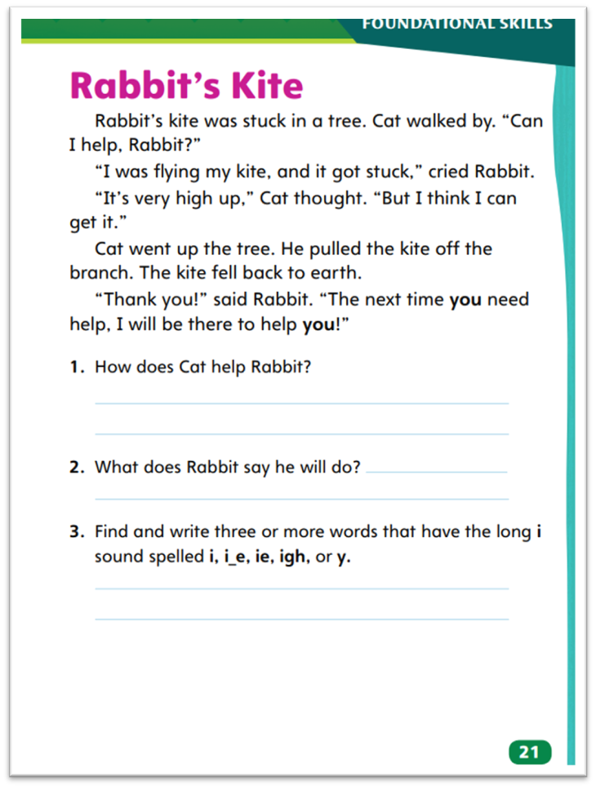
Page 21
Decodable Text
Turn to page 21 in your Student Interactive. Read “Rabbit’s Kite” with your partner.
Notes:
Have students turn to p. 21 in the Student Interactive. Say: We are going to read a story today about a rabbit who is having trouble flying his kite. In this story, you will read some words with the long i sound spelled in different ways. How do you think the rabbit might solve his problem?
Tell students that as they read, they should stop and check their understanding of what they read. Say: As you read, think about what you are reading and whether it makes sense. You might have to go back and reread a sentence, just to make sure you understand the story.
Have students choral read the whole story with a partner. Then have them reread the story, this time with one student reading the part of the cat and the other the part of the rabbit.
Call students’ attention to the first sentence in the story. Ask if they can find a word with the long i sound.
Have them circle the word kite and tell what vowel pattern stands for the long i sound.
Review with students that the sound /ī/ can be spelled using different vowel patterns. Say: Which word in the second sentence has the sound /ī/ spelled y? (by)
Have students underline the word. Have partners work together to identify words with long i in the rest of the story. They should read the words together and then circle the vowel pattern.
When students are finished, call on one or more sets of partners to read the words they found.

Slide 54
Page 25
Determine Key Ideas
Think about descriptions of characters or places.
Notice how the author lets the reader know what the character is thinking and feeling.
Think about the story’s main message to evaluate which details reveal key ideas.
Notes:
The important ideas in a text are known as key ideas. When evaluating the text, the reader works to understand how key ideas are related and how well those ideas explain a topic.
Think about descriptions of characters or places.
Notice how the author lets the reader know what the character is thinking and feeling.
Think about the story’s main message to evaluate which details reveal key ideas.
Use the Close Read note on SI p. 27 to model how to find and evaluate details that relate to the key ideas.
Say: What words does the author use to describe the tree? In paragraph 5, the Hen says: “I have never seen a tree that has ten furry toes.” I know that the Hen was looking out her window at the apple tree. I can use this detail about the tree to understand that the tree is actually an animal posing as a tree. That seems to be a key idea in this story, and that tells me that the detail is important. I will write it in the chart.
Have students reread “The Hen and the Apple Tree” and find another detail. Then help them determine how the two details are related and evaluate the two details to determine a key idea.

Slide 55
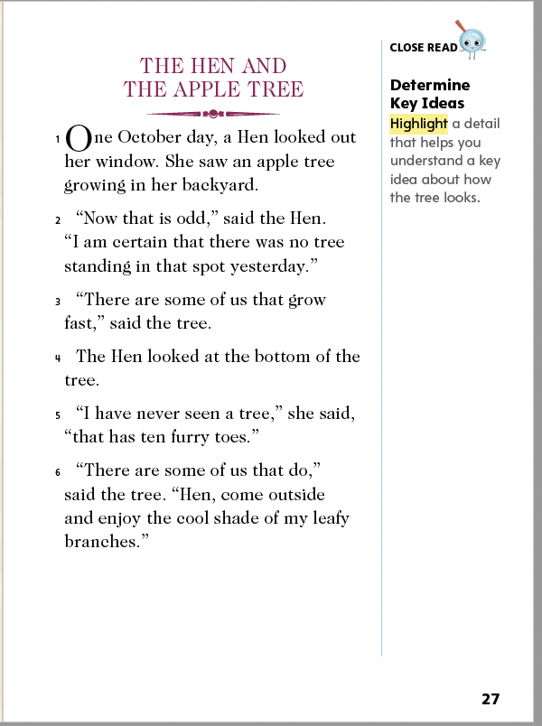
Page 27
Close Read – Determine Key Ideas
Turn to page 27 in your Student Interactive.
Notes:
Have students annotate the text using the Close Read notes for Determine Key Ideas and then use their annotations to complete SI p. 41.
Explain that students should look for descriptive words that help them understand more about the character and setting in a story. Remind students that descriptions can be found in dialogue, or what characters say. Direct students’ attention to paragraph 5. Ask: What words on the page tell how the tree looks? See student page for possible responses. DOK 1

Slide 56
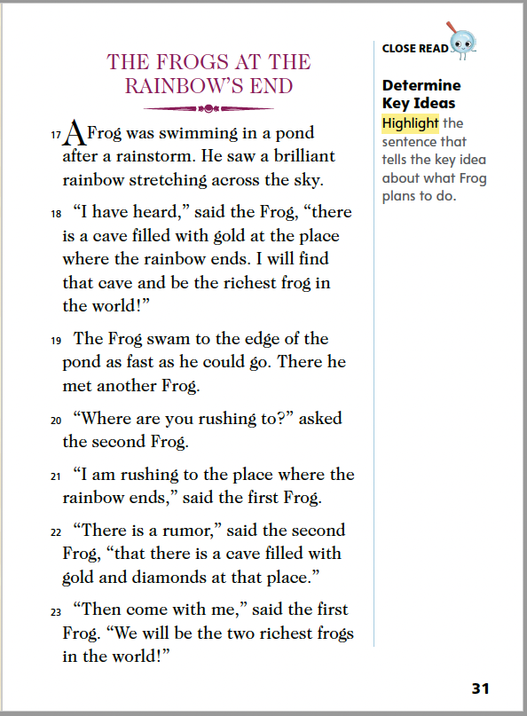
Page 31
Close Read – Determine Key Ideas
Turn to page 31 in your Student Interactive.
Notes:
Have students annotate the text using the Close Read notes for Determine Key Ideas and then use their annotations to complete SI p. 41.
Direct students’ attention to paragraph 18. Have students highlight the sentence that tells the key idea about what Frog is planning to do. See student page for possible responses.
Ask: Why does the frog want to find the cave? How does he plan to do it? Possible Response: An example clue is “I will find that cave and be the richest frog in the world.” Just before this, the Frog remembered that he heard there was a cave filled with gold at the place where the rainbow ends. He plans to follow the rainbow to find the cave filled with gold. DOK 2

Slide 57
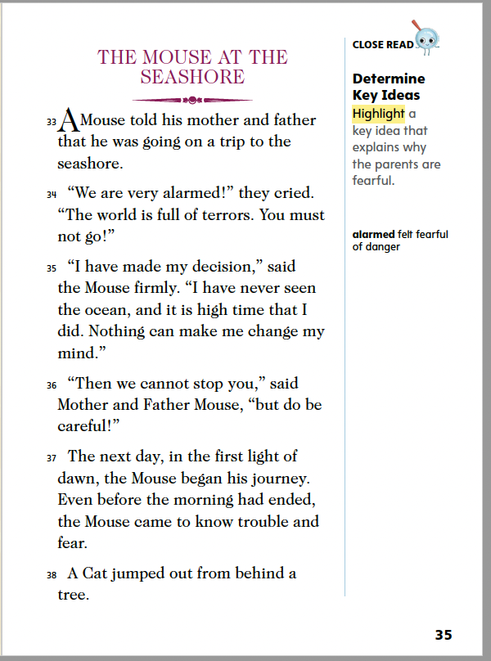
Page 35
Close Read – Determine Key Ideas
Turn to page 35 in your Student Interactive.
Notes:
Have students annotate the text using the Close Read notes for Determine Key Ideas and then use their annotations to complete SI p. 41.
Key ideas help readers determine what is important in a story. Direct students’ attention to paragraph 34 and guide them to find details that explain why Mouse’s parents are fearful of his trip to the seashore. Ask: Where do you see words that relate to fear or danger on the page? Have students complete the Close Read activity on p. 35. See student page for possible responses. DOK 2

Slide 58
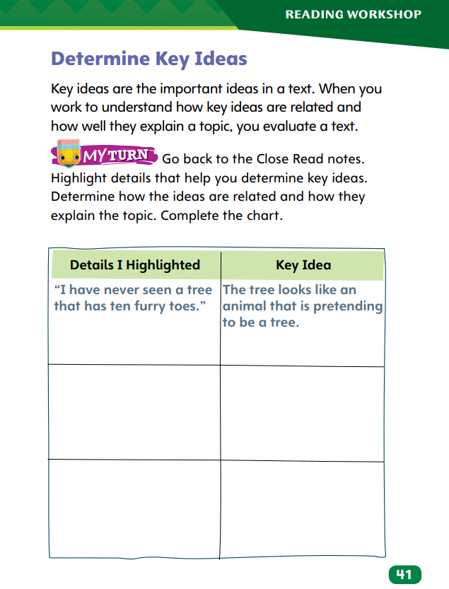
Page 41
Determine Key Ideas
Turn to page 41 in your Student Interactive and complete the activity.
Notes:
Have students complete p. 41 in the Student Interactive.

Slide 59
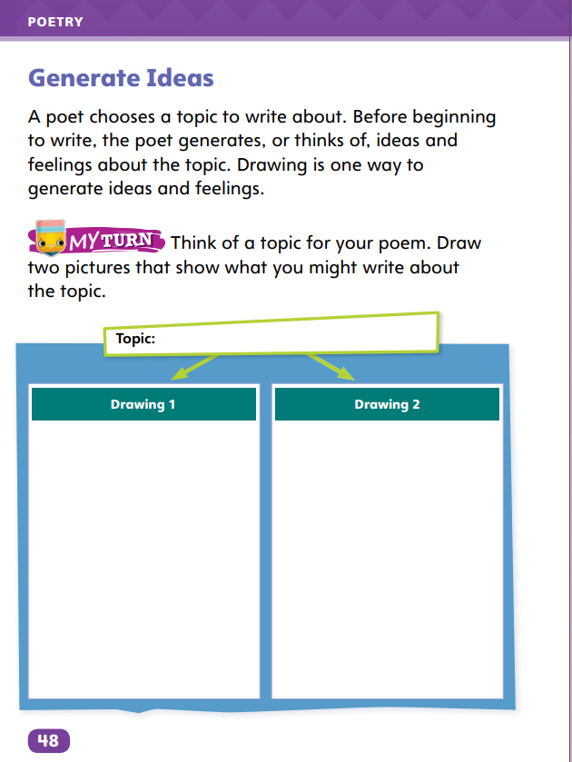
Page 48
Writing – Poetry
Turn to page 48 in your Student Interactive.
Notes:
A poem starts with a topic. Before writing, a poet generates ideas and feelings about a topic. Drawing is one method a poet might use to brainstorm ideas and feelings.
Hold up a poem from the stack. Read its title and state its topic, then read the poem. Say: This poet chose to write about ____. Before the poet began to write, he or she brainstormed ideas and feelings about the topic. Drawings can represent feelings and ideas.
Model doing a simple drawing based on the poem’s topic. Discuss how it relates to the topic.
Call on a few students to share some topic ideas. Choose one of the ideas and draw a sketch about it. Have students identify ideas and feelings the drawing evokes.
Direct students to p. 48 of the Student Interactive. Have students complete the exercise.
When finished, have pairs of students talk about their topics and drawings together.

Slide 60
Independent Writing
Now you will generate ideas for your poems by drawing.
List ideas and feelings you get from your drawings. Share your drawings and describe them.
Notes:
During their independent writing time, students should generate ideas for their poems by drawing. If students have trouble, ask them to describe what they want to draw, then draw it for them.
For students who need additional support with brainstorming, partner students to discuss possible ideas. Use the following options for additional support:
Modeled – Do a Think Aloud to model drawing an idea or feeling based on a topic.
Shared – Provide sample topics to students. Have them complete drawings based on the topic.
Guided – Ask students questions about their drawings to help them come up with related ideas and feelings.
If students complete the task, ask them to list ideas and feelings they get from their drawings.
At the end of writing time, ask students to share their drawings and describe them. Instruct other students to share ideas and feelings that they get from the drawings.

Slide 61
Spelling
load
bowl
only
Let’s review the spelling words with the long o sound.
Notes:
Review how to spell words with the long o sound. Point out the spelling patterns o, oa, and ow.
Read aloud the words load, bowl, and only and have students categorize them by their pattern (oa, ow, and o).
Underline the pattern in each word and read the words with students.
Read additional words for students to write in each category: float, throw, mow, coach, go, below, load, and open.

Slide 62
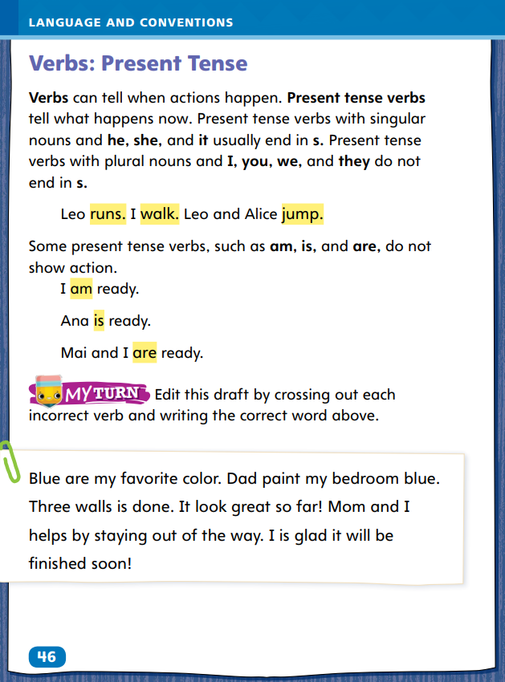
Page 46
Language and Conventions
Turn to page 46 in your Student Interactive and complete the activity.
Notes:
Have students complete the practice activity on p. 46 to edit drafts using present-tense verbs.

Slide 63
Lesson 5

Slide 64
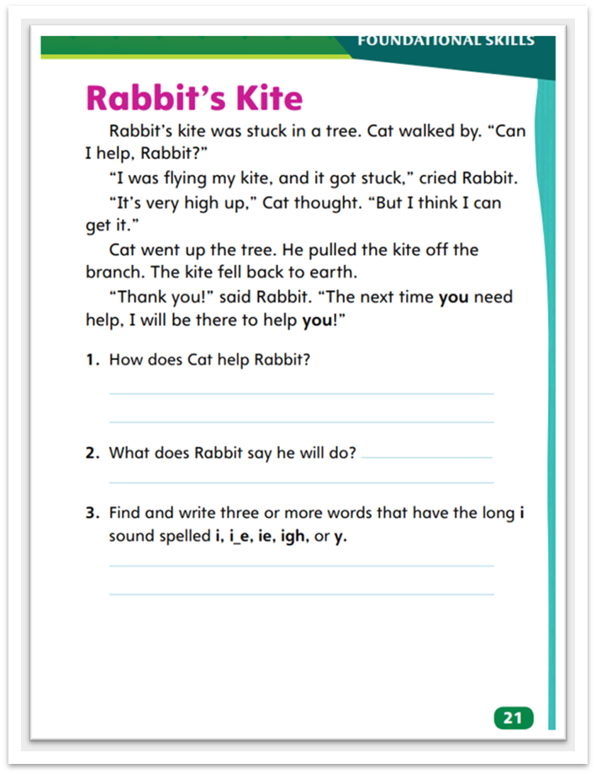
Page 21
Decodable Text
Turn to page 21 in your Student Interactive.
Notes:
Tell students that learning about letters and sounds helps them read a story fluently and understand it.
Ask students what the story Rabbit’s Kite is mostly about. Ask: What is Rabbit’s problem at the beginning of this story?
Have students point out and read aloud the sentence that tells Rabbit’s problem (sentence 1).
Point to and read the first question under the story. Have students answer the question and read aloud the sentences that contain the answer (paragraph 4). Continue with question 2.
Remind students that they learned how to decode words with the long i sound. Challenge them to apply their phonetic knowledge by finding and decoding these words, including the one with the trigraph igh, in the story.
Then say: earth, eyes, thought. Have students identify and read the high frequency word that appears in the story.
Have student pairs retell Rabbit’s Kite to each other.

Slide 65
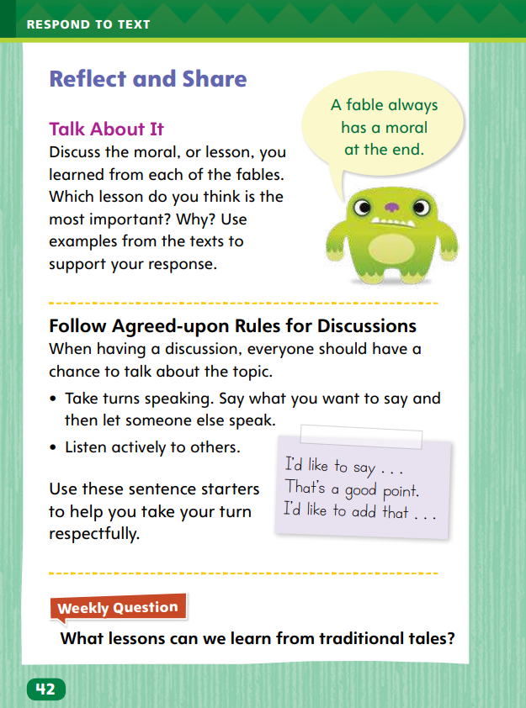
Page 42
Reflect and Share
Turn to page 42 in your Student Interactive.
Notes:
Remind students that when they participate in discussions, they should make pertinent comments, or remarks that build on what others say, in order to have meaningful conversations.
Before making a comment, ask yourself whether it is on-topic and related to the discussion.
Identify examples from the text to support your comment.
Build on others’ comments. Use language such as “I am glad you said that because” or “I agree, and also think” to help connect ideas.
Listen closely to others’ comments and take turns making comments, ensuring that everyone has a chance to join the discussion.
Model making pertinent comments using the Talk About It prompt on p. 42 in the Student Interactive.
Say: The most important lesson I learned is from “The Mouse at the Seashore.” It is worthwhile to work hard for a goal. Mouse survived his long journey despite the danger. He kept going and reached his goal. He was very happy to reach the seashore, and succeeding through hard work made him even happier. I think this is important for everyone.
Have students use the strategies for comparing information and ideas across texts.
Use the Shared Read Have students use text evidence from this week’s texts to make comparisons to how animals grow and change.
If desired, distribute Speaking and Listening tips from the Resource Download Center. Click Path: Table of Contents -> Resource Download Center -> Speaking and Listening

Slide 66
Page 42
Apply
Use evidence from the texts they have read this week to respond.
Write their response on a separate sheet of paper.
Notes:
Have students use the theme of each fable to talk about lessons they learn in life.
Have students use evidence from the texts they have read this week to respond to the Weekly Question.
Tell them to write their response on a separate sheet of paper.
If desired, distribute Collaborative Conversations tips from the Resource Download Center to help guide discussions. Click Path: Table of Contents -> Resource Download Center -> Speaking and Listening

Slide 67
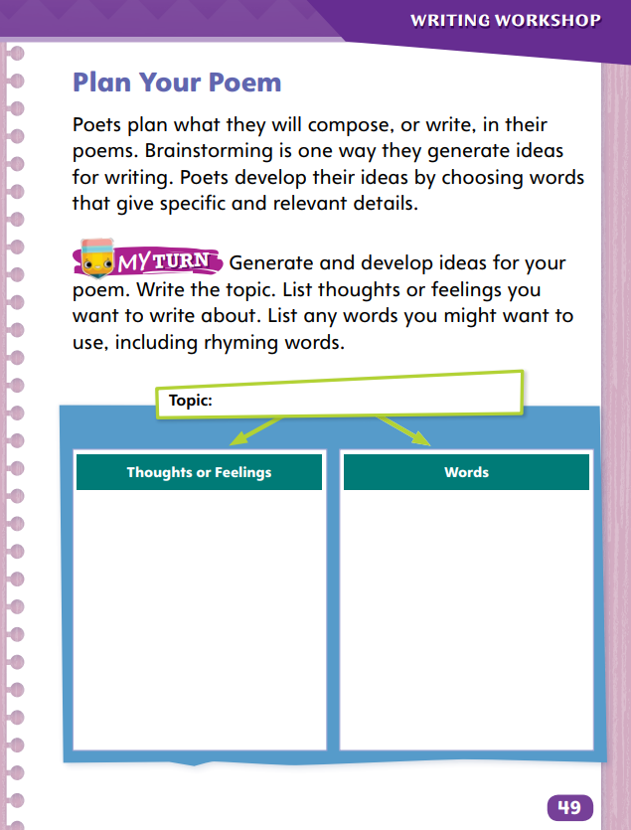
Page 49
Writing – Poetry
Turn to page 49 in your Student Interactive and complete the activity.
Notes:
Before poets start writing, they plan what they will write about. They brainstorm ideas and develop these ideas with specific and relevant details.
Hold up a poem from the stack. Say: Before writing, this poet planned what to include in the poem. Let’s see what this poem is about.
Read the poem and review its topic. Call on students to name ideas and feelings about which the poet wrote. List the ideas and feelings.
Then review the poem for specific words and details that connect to those ideas and feelings. List these words and details for students to see.
Direct students to p. 49 in the Student Interactive. Have them complete the activity on the page, first filling in a topic, then brainstorming thoughts and feelings about it, and finally listing words that relate to those thoughts and feelings. Encourage them to think about words that rhyme
Call on students to share a topic idea, a thought or feeling about it, and some related words. Instruct other students to add more related words if they can.

Slide 68
Spelling
1. The pirate was searching for treasure.
2. He wanted to try to do the puzzle.
3. She found two dimes on the sidewalk.
4. He did not want to strike out.
5. We tried to bake a cake.
6. Do you think she is a spy?
7. He was afraid of the spider.
8. I’d like to eat some ice cream tonight.
9. It was such a delight to join the team!
10. They spied their friends outside.
11. We thought about going swimming.
12. Look at the footprint on the earth.
Notes:
(Note: Move the orange boxes to cover each bold spelling word before you read aloud the words and sentences.)
Read aloud the bold words, and then read the sentences. Have students listen for words with long i sounds and the high-frequency words. Then read each sentence again. Repeat each word and allow time for students to spell it.
The pirate was searching for treasure.
He wanted to try to do the puzzle.
She found two dimes on the sidewalk.
He did not want to strike out.
We tried to bake a cake.
Do you think she is a spy?
He was afraid of the spider.
I’d like to eat some ice cream tonight.
It was such a delight to join the team!
They spied their friends outside.
We thought about going swimming.
Look at the footprint on the earth.
Reveal the spelling word and have students check their work.

Slide 69
Language and Conventions
The cat runs away from the squirrel.
Which word in the sentence is a present-tense verb?
cat
away
squirrel
runs
Notes:
Display the following sentence and guide students to answer the question.
The cat runs away from the squirrel.
Which word in the sentence is a present-tense verb?
A cat
B away
C squirrel
D runs
Have students complete Language & Conventions p. 153 from the Resource Download Center. Click path: Table of Contents -> Resource Download Center -> Language and Conventions -> U3 W1

Slide 70
Unit 3: Week 1
Grade 2

