Slide 1
Unit 1: Week 1
Grade 3

Slide 2
Copyright © Savvas Learning Company LLC. All Rights Reserved.
This publication is protected by copyright, and permission should be obtained from the publisher prior to any prohibited reproduction, storage in a retrieval system, or transmission in any form or by any means, electronic, mechanical, photocopying, recording, or otherwise. For information regarding permissions, request forms, and the appropriate contacts within the Savvas Learning Company Rights Management group, please send your query to:
Savvas Learning Company LLC, 15 East Midland Avenue, Paramus, NJ 07652
or
k12learningpermissions@savvas.com
myView Literacy® is an exclusive trademark of Savvas Learning Company LLC in the U.S. and/or other countries.

Slide 3
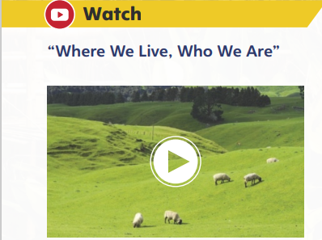
Page 8
Introduce the Unit
Essential Question: How does our environment affect us?
What did you learn about the different environments and their effect on different life forms?
What did you learn by looking at the images in the video?
Notes:
Introduce the Unit 1 Essential Question, How does our environment affect us? Tell students they will read several texts to learn about how different cultures adapt to and appreciate their environments. Explain that they will read a variety of genres to see how each author approaches the theme.
Watch the Unit Video Tell students that a video is a multimodal text because it combines sound and pictures. Have students watch “Where We Live, Who We Are” and take notes about the different environments and their effect on life forms. Click Path: Table of Contents -> Unit 1: Environments-> Unit 1: Introduction
Encourage partners to discuss what they learned about different environments by watching the video. Use the following questions to guide their discussions.
What did you learn about the different environments and their effect on different life forms?
What did you learn by looking at the images in the video?

Slide 4
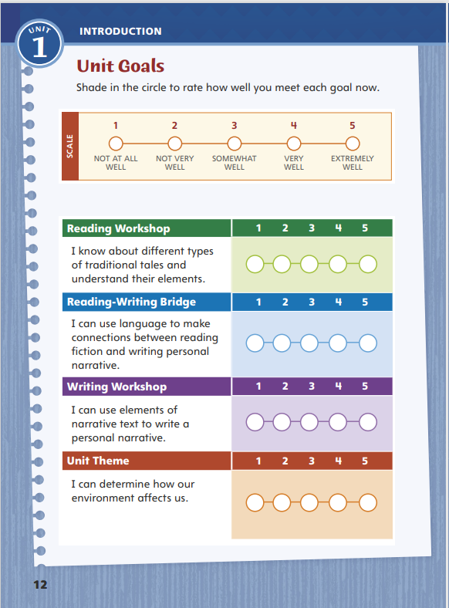
Page 12
Unit Goals
Turn to page 12 in your Student Interactive.
Shade in the circle to rate how well you meet each goal now.
Notes:
Review the Unit Goals on p. 12 of the Student Interactive.
Have students rate how well they think they already meet the unit goals. Have them adjust their ratings to reflect on how well they are meeting their personal learning goals during the unit. Students will revisit their ratings in Week 6.

Slide 5
Page 13
Academic Vocabulary
Expand: I entered the competition to win the race.
Ask: What kind of competitions do we have at school?
Expand: A detective uses clues to solve a mystery.
Ask: What do you to do when you cannot solve a problem in math class?
Expand: In some countries it is a custom to remove your shoes before you enter a house.
Ask: What is a custom you do at home that you would like to share?
Expand: We sometimes dress up to celebrate a special occasion.
Ask: What kind of foods do you eat on a special occasion?
Expand: The organization of products at grocery stores makes shopping easy.
Ask: How can you use organization when you write a composition?
Notes:
Academic vocabulary is language used to discuss ideas. As students work through the unit, they will use these words to discuss different environments.
Read each word's definition.
Have students respond to the Expand and Ask questions using the newly acquired academic vocabulary as appropriate

Slide 6
Lesson 1

Slide 7
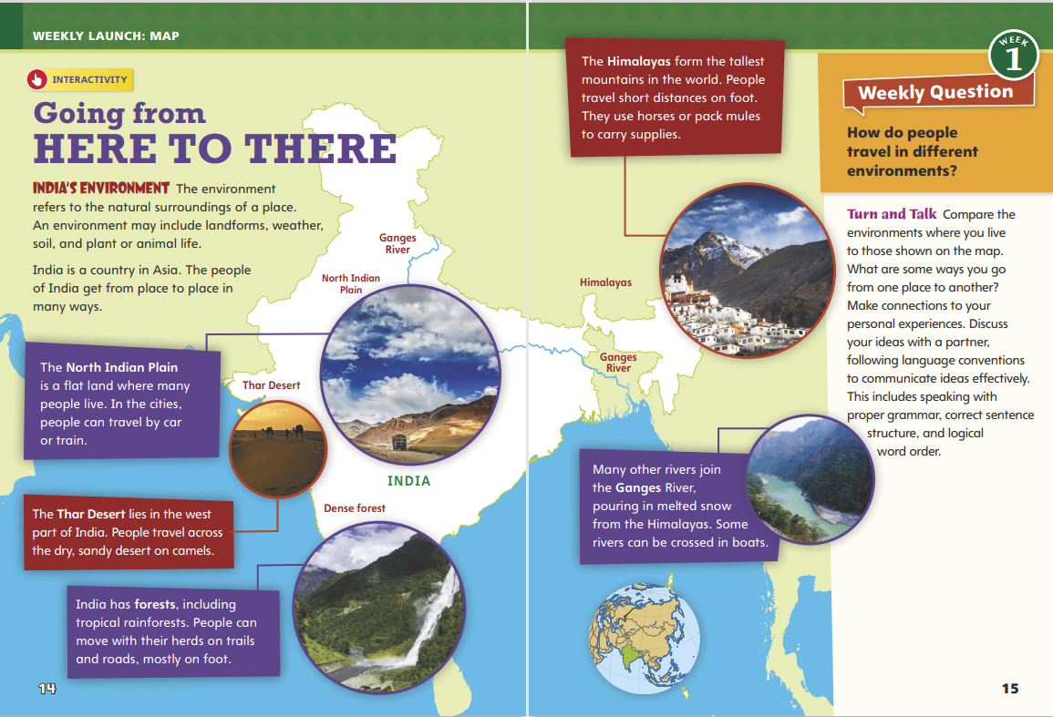
Page 14, 15
Interact with Sources
Read the text. Discuss which method of travel you use most often.
Answer the Talk and Turn question with a partner.
Notes:
Remind students of the Essential Question for Unit 1: How does our environment affect us? Point out the Week 1 Question: How do people travel in different environments?
Direct students’ attention to the map on pp. 14–15 in the Student Interactive. Explain that the map illustrates four different environments in India, including mountains, plains, forests, and deserts. Point out that each environment has different physical characteristics that require different travel solutions.
Explain to students that when they discuss a topic, it is important for them to make eye contact with classmates and speak at a rate, or speed, that allows them to communicate their ideas effectively. They should speak loudly and clearly enough for others to hear what they say. Tell students they should use correct conventions of language.
Use the following questions to guide discussion:
What surprised you about the ways people travel in India?
Which physical environment do you think is the most difficult to travel through and why?
What do these travel solutions tell you about what it is like to live in each environment?
Reread the Week 1 Question: How do people travel in different environments? Tell students they just learned about some of the ways people travel in different environments. Explain that this week they will read more about how different environments affect the ways people live and move.
Have partners choose which method of travel they use most often and then share their answer with the class.

Slide 8
Listening Comprehension
Environment
Cause | Effect
Ruby Bridges
Notes:
Tell students that you are going to read a traditional tale. Ask students to listen as you read “The Boy’s Advice” aloud. Encourage students to listen actively by paying attention to the setting and plot elements in the story as you read. After listening, have students report on the topic or text using appropriate facts and relevant details. Remind them to include the main idea and descriptive language. If students have trouble summarizing, encourage them to ask relevant questions to clarify information and follow up with pertinent comments.
Have students listen actively for elements of traditional tales.
Read the entire text aloud without stopping for the Think Aloud callouts.
Reread the text aloud, pausing to model Think Aloud strategies related to the genre.
Analyze Plot: Use the “Cause and Effect” chart to help students understand the consequences of the man’s actions.

Slide 9
Page 16,17
Traditional Tales
Turn to page 16 in your Student Interactive.
Notes:
Remind students that traditional tales include folktales, fables, fairy tales, legends, and myths. These fictional stories were told and retold in oral form by many people many times. Some characteristics are consistent for these tales:
Characters usually have strong and sometimes unique traits. Sometimes the characters are people, but often animals are used.
Plots have simple conflicts. There may be a happy ending, or a character may learn a particular lesson.
Plots use repetition to move the action forward. Often there is a pattern of three.
The setting is usually a familiar scene on which the plot is constructed.
Model determining whether a story is a traditional tale: In “The Boy’s Advice,” the man gathering coconuts does not use a modern device to tell time, and this tells me that the setting could be long ago. Now I notice that the plot also uses repetition. The story describes the man piling coconuts in his cart three times, and they even fall out of his cart with a “clunk clunk clunk.” The story also teaches a lesson. This type of traditional tale is a fable.
Lead a class discussion on familiar traditional tales. Remind students to express their ideas clearly, stay on topic, and build on the remarks of others. Challenge students to identify the common characteristics of at least one familiar traditional tale.

Slide 10
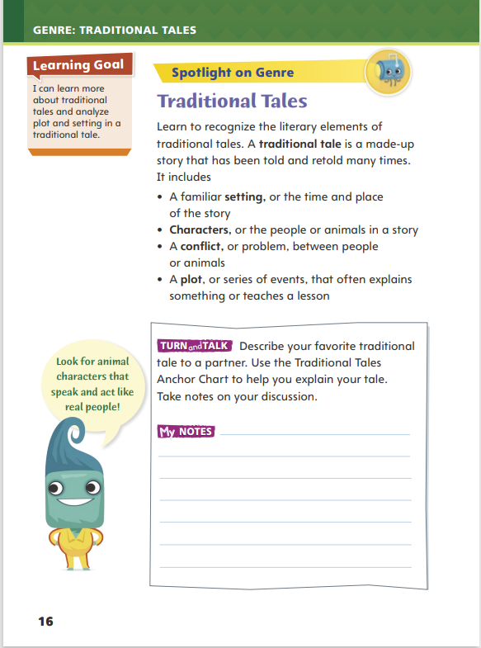
Page 16
Apply
Discuss your favorite traditional tale.
Use the Traditional Tales Anchor Chart to explain your tale.
Take notes on your discussion.
Notes:
Have students work with a partner to complete the Turn and Talk activity on p. 16 of the Student Interactive.
Observe student interactions to determine whether they understand the characteristics of a traditional tale. Editable Anchor Chart Click Path: Table of Contents -> Reading Anchor Charts -> Unit 1 Week 1: Traditional Tale Anchor Chart

Slide 11
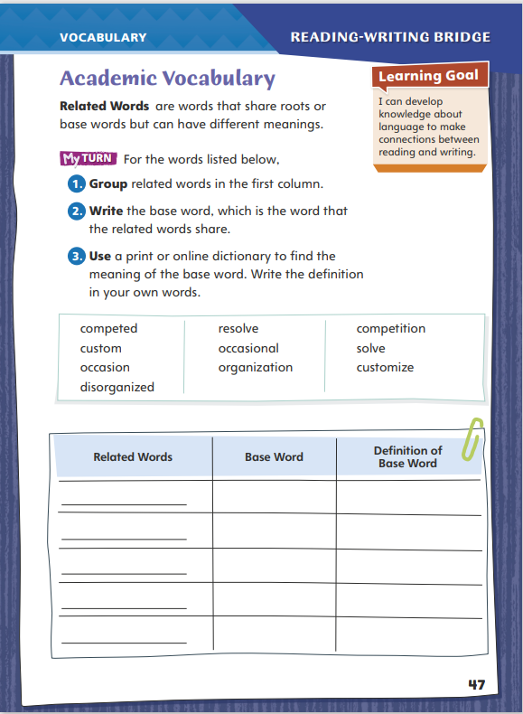
Page 47
Academic Vocabulary
Turn to page 47 in your Student Interactive.
Notes:
Related words are words that share the same roots or base words. Their meanings are related but may differ based on the part of speech, the affix used, or how the word is used. Knowing related words can help you determine the meaning of unfamiliar words.
Model this strategy using the Academic Vocabulary words competed and competition in the chart on p. 47 in the Student Interactive.
Tell students: If I encountered the words competed and competition in a text, I would notice that these two words look similar, which means they are probably related words. I could identify that they have the same base word: compete. I know that compete means “to fight for or try to win something.” I would then recognize that the suffix -ed added to compete would make the word past tense. The suffix -tion would make the word a noun.
Have students apply this strategy to another word from the chart. Then discuss responses and correct misunderstandings.
Have students follow the same strategy as they complete the chart on p. 47 of the Student Interactive. Remind students that they will use Academic Vocabulary throughout this unit.

Slide 12
Word Study
winter
summer
cactus
costume
basket
Notes:
In a word with a VC/CV syllable pattern, syllables are divided between the consonants. A syllable is closed when it ends in a consonant sound. Knowing this syllable pattern can help students decode, or read, words correctly.
Write the words winter and summer on the board. Guide students to identify the VC/CV pattern in each word. Then have students use their knowledge of syllable patterns and closed syllables to read each word. Repeat with the words cactus, costume, and basket.

Slide 13
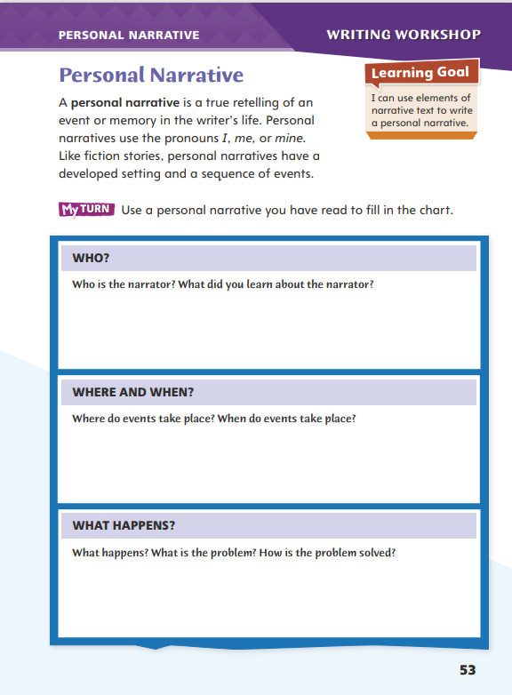
Page 53
Writing – Personal Narrative
Turn to page 53 in your Student Interactive.
Notes:
Authors write personal narratives to share personal experiences or events that were important to them. Like fiction, a personal narrative tells a story. The story is told from the narrator's point of view, includes a setting, and describes a problem. A personal narrative includes
The narrator or voice that tells the story.
A setting with relevant details.
A problem that may lead the narrator to reflection or a lesson.
Inform students that they will be exploring multiple personal narratives over the next two days to prepare them to write their own. Today, they will focus on techniques authors use to describe themselves, the setting, and a problem. They will also focus on why a particular experience was memorable to the narrator.
Read aloud two to three personal narratives from the stack. Pause to discuss what makes the settings and events memorable. Discuss the narrator's reaction to the problem. The following may be used to prompt discussion:
What words does the author use to help you picture the setting?
What problem does the narrator share that is similar to what we might have experienced in our lives?
What does the narrator learn from his or her experience?
Direct students to p. 53 in the Student Interactive. Have them use one of the personal narratives you have just read together to complete the activity.

Slide 14
Independent Writing
Write your personal narrative in your writer’s notebook.
Share details about the narrator, setting, and problem you have written down from your personal narrative.
Notes:
After the minilesson, students should transition into independent writing.
If students need additional opportunities to develop their understanding of personal narratives, they should read additional books from the stack.
Writing Support
Modeled - Choose a stack text and do a Think Aloud to model identifying elements of a personal narrative..
Shared - Have students choose a stack text. Prompt students to identify details about the narrator.
Guided - Use the stack texts to provide explicit instruction on why the narrator chose to write about the experience.
If students demonstrate understanding, they should transition to writing their own personal narratives in their writer’s notebook.
Call on a few students to share details about the narrator, setting, and problem that they have written down from the personal narratives.

Slide 15
Spelling
1. We put the fruit in the basket.
2. Reading is my favorite subject.
3. I learned my lesson when I locked myself out of my room.
4. There is a lot of traffic on Main Street.
5. I like to put mustard on my sandwich.
6. The small room is very compact.
7. She is absent today because she went to the doctor.
8. The cosmic rays were dangerous.
9. He shook his head in disgust at what he saw.
10. The salad tasted fantastic.
Notes:
(Note: Move the orange boxes to cover each bold spelling word before you read aloud the words and sentences.)
Read aloud the words and sentences. Have students spell each word with initial consonant blends and the two high-frequency words.
We put the fruit in the basket.
Reading is my favorite subject.
I learned my lesson when I locked myself out of my room.
There is a lot of traffic on Main Street.
I like to put mustard on my sandwich.
The small room is very compact.
She is absent today because she went to the doctor.
The cosmic rays were dangerous.
He shook his head in disgust at what he saw.
The salad tasted fantastic.
Reveal the spelling word and have students check their work.

Slide 16
Language and Conventions
The musician plays the piano.
Identify the nouns and verb used in the sentence.
Write a simple sentence.
Have your partner circle the subject and underline the predicate.
Notes:
Flexible Option
Review the language and conventions topic simple sentences.
Display the following sentence: The musician plays the piano. Help students to identify the subject (The musician) and the predicate (plays the piano) of the sentence. Then have students identify the nouns and verb used in the sentence.
Have students write a simple sentence. Have them exchange sentences with a partner. Have the partner read the sentence, circle the subject, and underline the predicate.

Slide 17
Lesson 2

Slide 18
Page 18
Preview Vocabulary
fierce
baring
flexing
crouching
swipe
Notes:
Introduce the vocabulary words on p. 18 in the Student Interactive. Have students share what they know about the words. Define them as needed.
fierce: wild or dangerous
baring: showing
flexing: curling
crouching: bending down to not be seen
swipe: hit
Tell students: These words will help you understand the setting and action in Grandma and the Great Gourd. Highlight each word in the text. Ask yourself how that word describes where the tale takes place or what is happening.

Slide 19
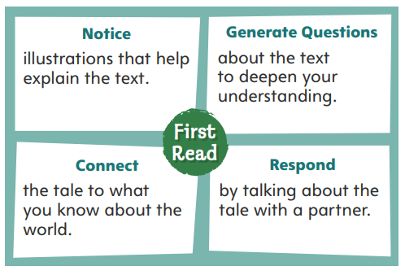
First Read Strategies
Notes:
Discuss the First Read Strategies. Before the first read, prompt students to consider what the title and illustrations suggest this traditional tale will be about. Point out that the selection is a folktale.
Explain the four steps of the first read.
NOTICE Remind students to look at the illustrations to help them understand the text.
GENERATE QUESTIONS Ask students to mark parts of the text containing information that seems different from what they already know. Encourage students to generate, or ask, questions about these differences to deepen their understanding of the tale.
CONNECT Ask students to connect the tale to what they know about other places in the world, the lives of people from other cultures, and other folktales they have read.
RESPOND Have students talk to a partner about the tale.
Students may read the text independently, in pairs, or as a whole class.
Use the First Read notes to help students connect with the text and guide their understanding.

Slide 20
Page 19
First Read – Grandma and the Great Gourd
Notes:
Students may read the text independently, in pairs, or as a whole class. Use the First Read notes to help students connect with the text and guide their understanding.

Slide 21
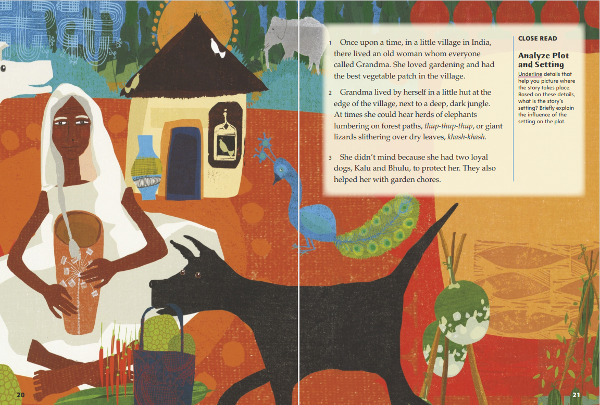
Page 20, 21
First Read – Grandma and the Great Gourd
Notes:
Students may read the text independently, in pairs, or as a whole class.
THINK ALOUD Before you begin reading, say: I am going to look at this first illustration and see if I have any questions about what it shows. Since the title of the story is Grandma and the Great Gourd, I think that this woman with the gray hair is probably Grandma. But where is the great gourd mentioned in the title? Does the illustration show two dogs because they are important to the story? Why is there an elephant behind the house? Where does Grandma live? Now I really want to read the story and discover the answers to these questions.
THINK ALOUD The story begins by introducing the setting and Grandma. I can look at the illustration again to help me understand these details. I see that Grandma’s hut is a simple building just big enough for one person. The illustration also shows that living at the edge of the village means there are no other huts nearby. In addition to the animals the author mentions, there is also a peacock near her hut. I wonder what other animals live here!

Slide 22
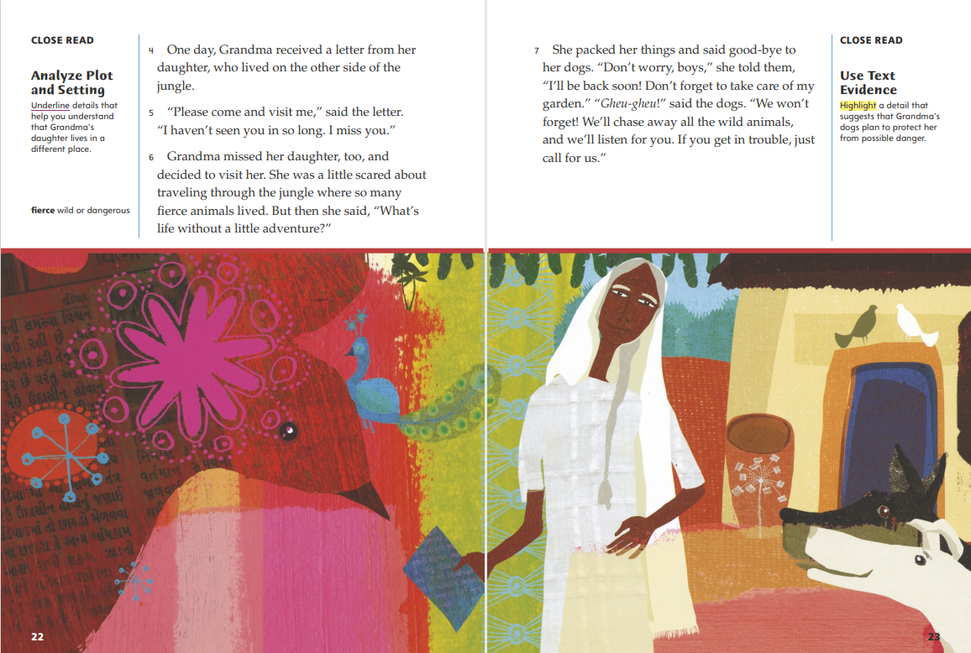
Page 22, 23
First Read – Grandma and the Great Gourd
Notes:
Students may read the text independently, in pairs, or as a whole class.
THINK ALOUD “The other side of the jungle” is far enough away that Grandma and her daughter communicate through letters instead of talking face-to-face. If this story took place in the present, they could talk on the phone instead of writing letters. The part of the letter that says, “I haven’t seen you in so long” makes me think of people who see relatives only on holidays because traveling to their homes is too difficult to do often.
THINK ALOUD Grandma’s dogs are smarter than I thought they were. In paragraph 3, I learned that they are loyal and helpful, like most dogs. Now I know that they also can talk and think ahead like people do. They remind me of the talking animals in other traditional tales, such as “The Three Little Pigs” and “Little Red Riding Hood”.

Slide 23
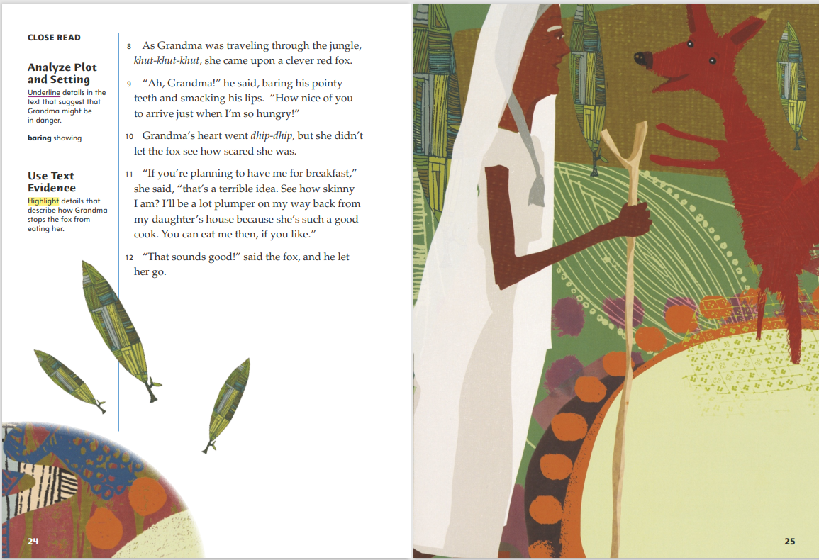
Page 24, 25
First Read – Grandma and the Great Gourd
Notes:
Students may read the text independently, in pairs, or as a whole class.
THINK ALOUD Paragraph 9 shows that the fox can talk, like Grandma’s dogs. The illustration shows that the fox also can stand upright, like a person. But I still have questions about the fox’s behavior. For example, is he like real foxes in every other way? Are real foxes dangerous to people? I am going to circle this paragraph and keep reading to see if there are “rules” for how animals act in this tale.
Remind students that the illustrations provide information that helps explain details in the text. Say: The illustration shows that Grandma is using a stick to help her walk through the jungle. What detail in the text does this illustration help explain?
Possible Response: The stick helps to explain the khut-khut-khut sound. The stick may go khut every time Grandma puts the end of it down on the ground to steady herself. The fact that Grandma uses a walking stick also tells me that she may have difficulty walking, so khut-khut-khut could be the sound of her shuffling or dragging her feet.

Slide 24
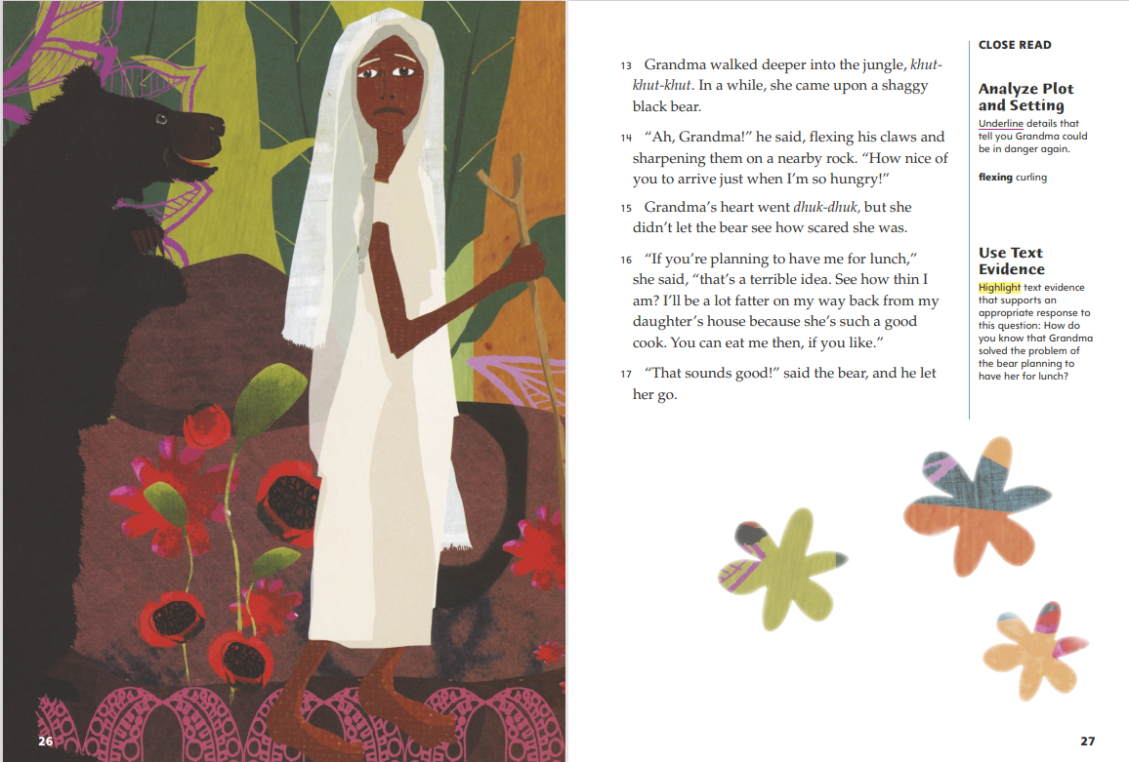
Page 26, 27
First Read – Grandma and the Great Gourd
Notes:
Students may read the text independently, in pairs, or as a whole class.
Have students look at the illustration. Say: This illustration of Grandma and a bear looks very similar to the one of her with the fox. Based on what I already know, I have several questions about what this illustration may be showing. What questions do you have about the situation shown here?
Possible Response: What is the bear saying to Grandma? Does he want to eat Grandma too? Why does Grandma look unhappy?
THINK ALOUD After reading paragraph 14, I see a pattern forming. This black bear talks, just like the other animals. Like the fox, he calls Grandma “Grandma,” so he knows who she is. He also wants the same thing that the fox wanted! I am going to keep reading to find answers to my other questions about this situation.

Slide 25
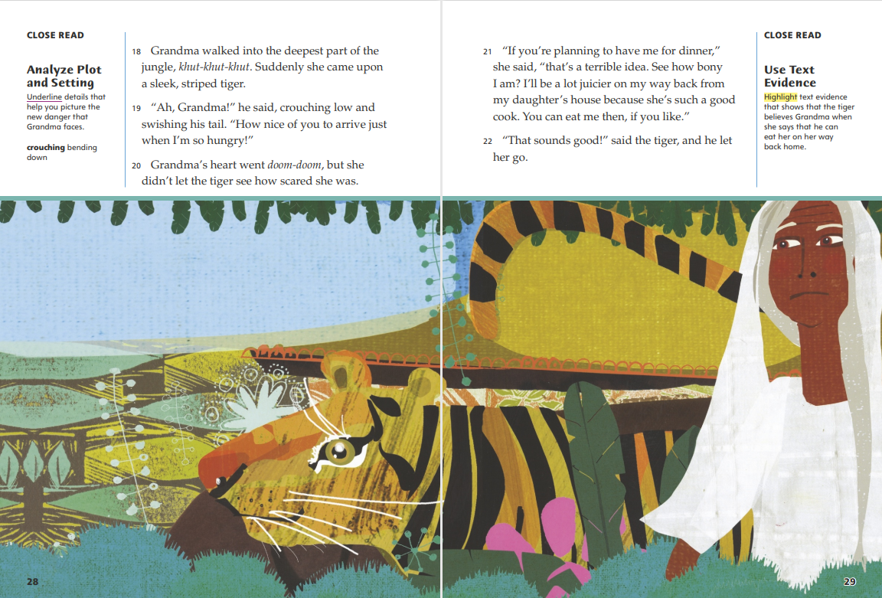
Page 28, 29
First Read – Grandma and the Great Gourd
Notes:
Students may read the text independently, in pairs, or as a whole class.
Have students look at the illustration and say: The illustration and paragraph 18 show that the next animal Grandma meets is a tiger. From what you have seen or read about tigers, do you think they are as dangerous as foxes and black bears or more dangerous?
Possible Response: The tigers at the zoo are big, strong animals that move quickly, so I think they are more dangerous than foxes. They probably are more dangerous than bears, too. Bears eat a variety of things, but tigers are predators who eat only other animals.
THINK ALOUD After you read paragraph 21, say: This is Grandma’s third encounter with an animal. In other traditional tales I have read, like “Goldilocks and the Three Bears” and “The Three Little Pigs,” there are three main events, and the third event ends differently than the other two. I wonder if this tale will follow the same pattern, or if Grandma’s response will work with the tiger.

Slide 26
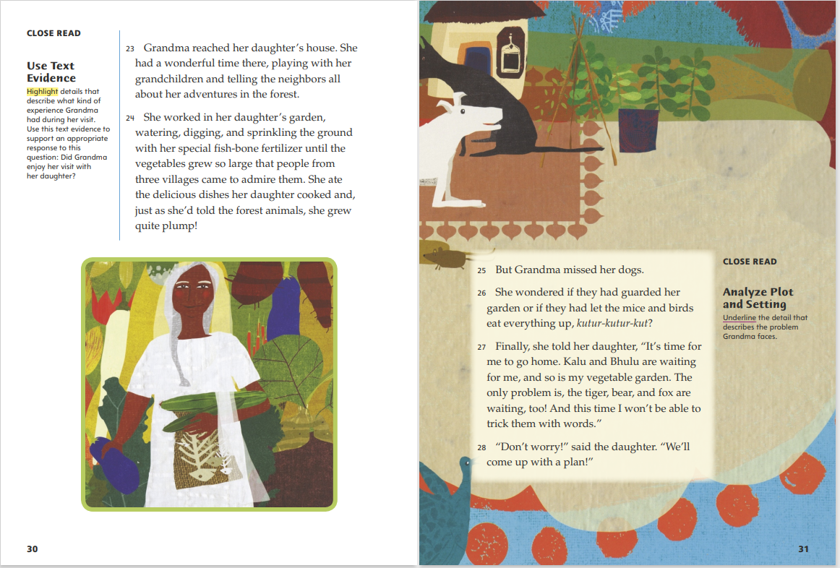
Page 30, 31
First Read – Grandma and the Great Gourd
Notes:
Students may read the text independently, in pairs, or as a whole class.
THINK ALOUD In paragraph 23, I learn that Grandma arrives safely at her daughter’s house and has a good time with her grandchildren and the neighbors. The illustration does not show these activities, but it does show Grandma smiling. Other parts of her visit must have been enjoyable too. I will read paragraph 24 to learn what those activities are and then compare the details to the illustration.
THINK ALOUD The first sentence on this page makes me think that Grandma’s wonderful time is about to end. She misses her dogs and worries about her garden, and she seems anxious to go back home. She also has not forgotten about the tiger, bear, and fox. Her trip back through the jungle will not be easy!

Slide 27
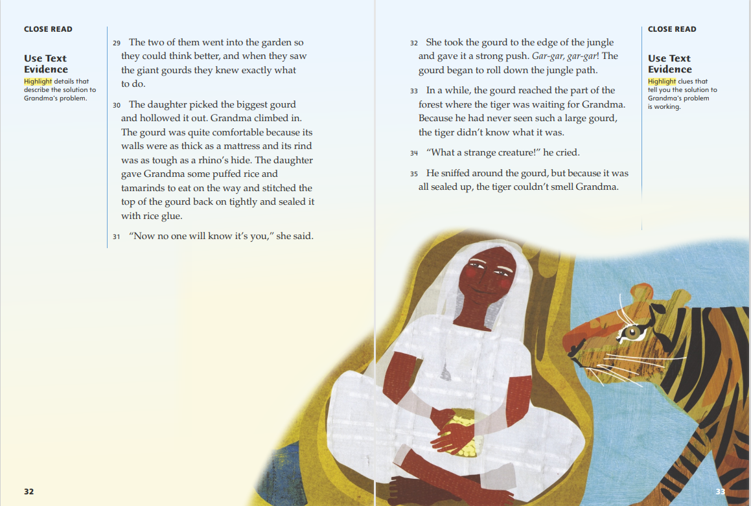
Page 32, 33
First Read – Grandma and the Great Gourd
Notes:
Students may read the text independently, in pairs, or as a whole class.
Tell Students: Paragraph 29 is the first time that the text mentions the giant gourd from the title. After reading paragraph 31, I know why it is in the title—it is a key part of Grandma’s solution to her problem. What does the illustration reveal about the size of the biggest gourd?
Possible Response: The illustration shows that the gourd is big enough for Grandma to sit in, but not tall enough for her to stand up inside.
THINK ALOUD As I read, I am going to circle details that make me think of questions. The tiger’s surprise in paragraph 33 makes me wonder how real tigers react when they see unfamiliar things. It will be interesting to compare that information to the tiger’s response to the large gourd in this story.

Slide 28
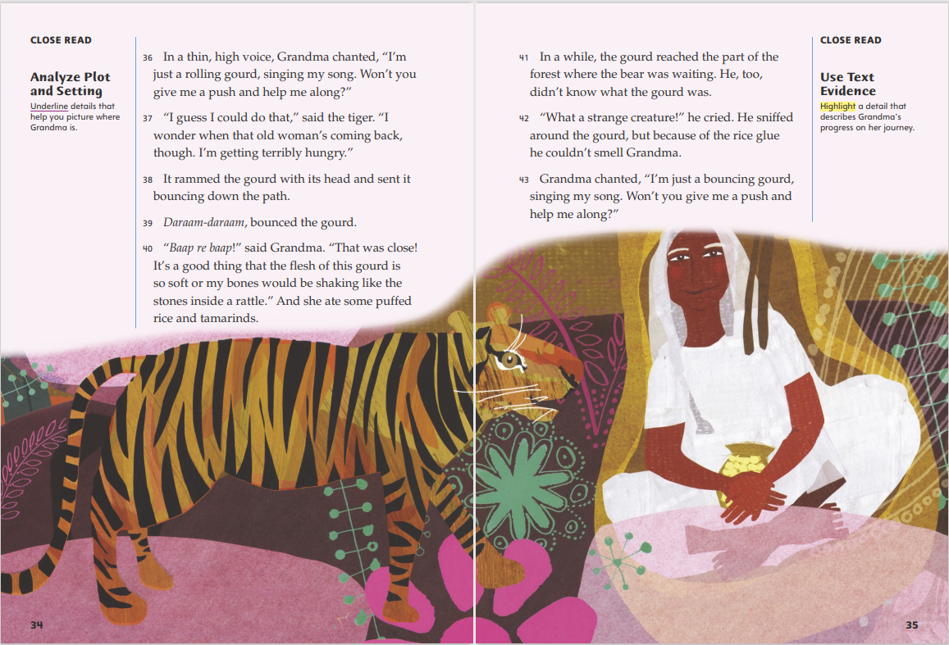
Page 34, 35
First Read – Grandma and the Great Gourd
Notes:
Students may read the text independently, in pairs, or as a whole class.
THINK ALOUD If I were Grandma, I am not sure I would be brave enough to ask the tiger for a push down the path. She must worry that he might recognize her voice, because she uses a different voice when she asks for help. But it seems like the gourd disguise has fooled the tiger.
THINK ALOUD When I read that the bear also could not smell Grandma “because of the rice glue,” I thought about how careful you need to be with food when camping. My family locks all our food in the car, even food in unopened packages, because bears might smell the food inside sealed wrappers. I have to remind myself that traditional tales are not realistic. This one also follows a pattern. Since the tiger could not smell Grandma, it makes sense that the bear would not either.

Slide 29
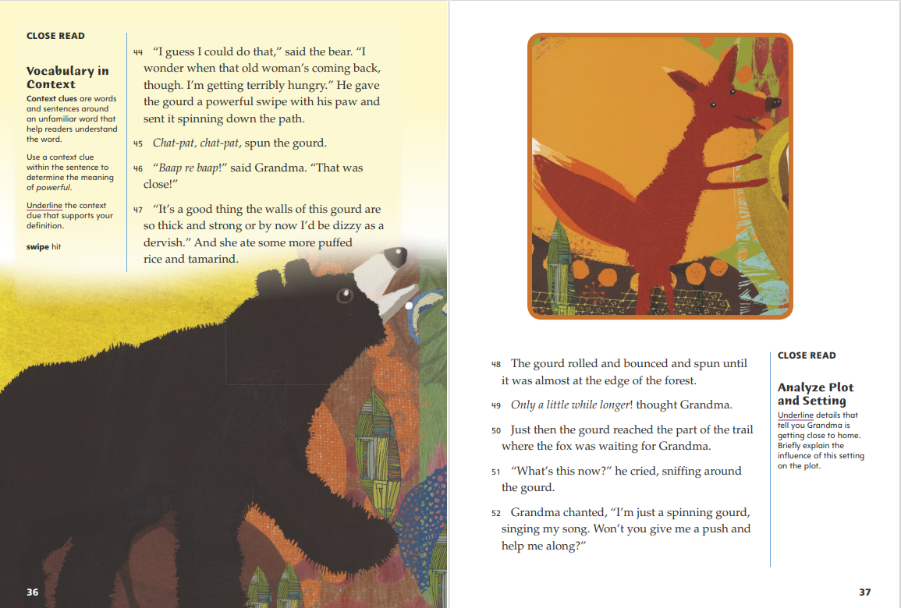
Page 36, 37
First Read – Grandma and the Great Gourd
Notes:
Students may read the text independently, in pairs, or as a whole class.
THINK ALOUD The bear answers Grandma’s question using the same words as the tiger. He also helps move her gourd along, but instead of ramming it with his head like the tiger did, he does it in a way that is more natural for him. The illustration helps to explain what a swipe is.
THINK ALOUD In the first sentence, the gourd is described as moving differently than it moved before. It “rolled and bounced and spun,” combining all of the movements since it left Grandma’s daughter’s house. This change makes me think that this next encounter will be different from the earlier ones. The illustration reminds me that the fox is the last animal Grandma must fool, so let’s see if he can be fooled like the other animals.

Slide 30
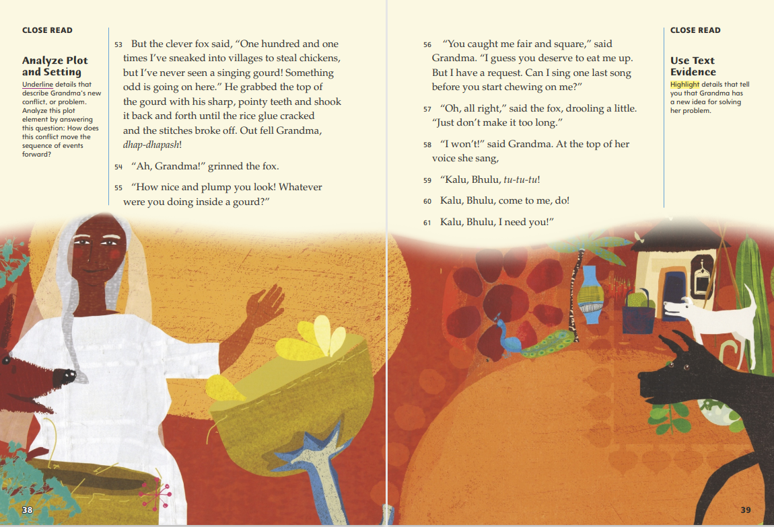
Page 38, 39
First Read – Grandma and the Great Gourd
Notes:
Students may read the text independently, in pairs, or as a whole class.
THINK ALOUD After you read the first paragraph, say: The fox’s small size made me think he was the least dangerous animal. But he is the only animal who recognizes what the gourd is and knows that gourds normally do not sing. Now I know that his cleverness and sharp, pointy teeth are all he needs to be dangerous.
THINK ALOUD The first time Grandma sang, “Kalu, Bhulu,” I was not sure what she was saying. When she sings, “come to me, do!” I remember that the words Kalu and Bhulu are the names of her dogs. The illustration shows Grandma’s dogs back at her hut. They are both listening to her as she calls to them, just like they promised.

Slide 31
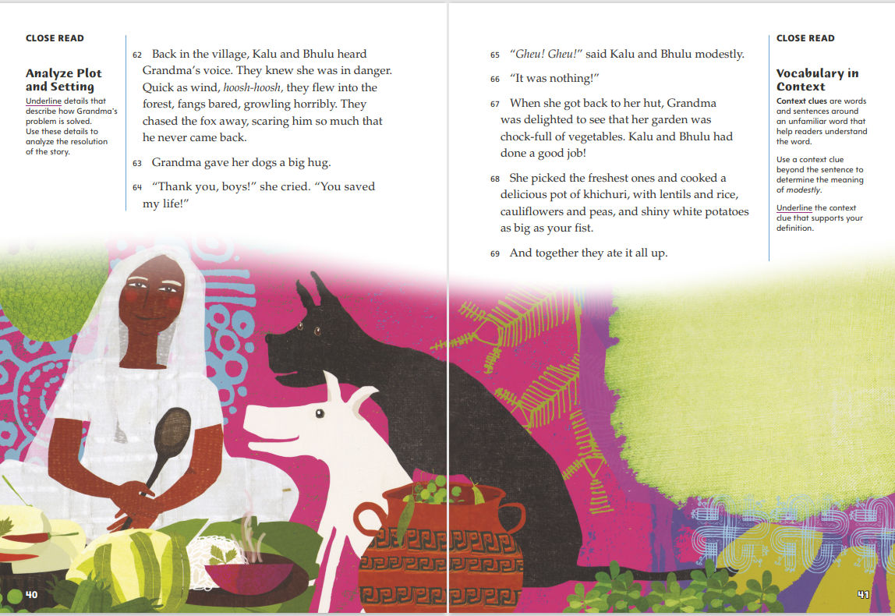
Page 40, 41
First Read – Grandma and the Great Gourd
Notes:
Students may read the text independently, in pairs, or as a whole class.
THINK ALOUD Reading about how Grandma’s dogs rescue her from the fox reminds me of why dogs are called “man’s best friend.” They are loyal pets and protectors. Kalu and Bhulu are also important characters in this story, even though we do not spend much time with them.
THINK ALOUD After reading paragraph 67, say: At her daughter’s house, Grandma was worried about her garden. Now I see that she had no reason to worry, because her dogs could be trusted to do everything they said they would. The illustration shows Grandma cooking the delicious khichuri described in the text. I am going to look at the illustration to help me understand what this vegetable dish is like.

Slide 32
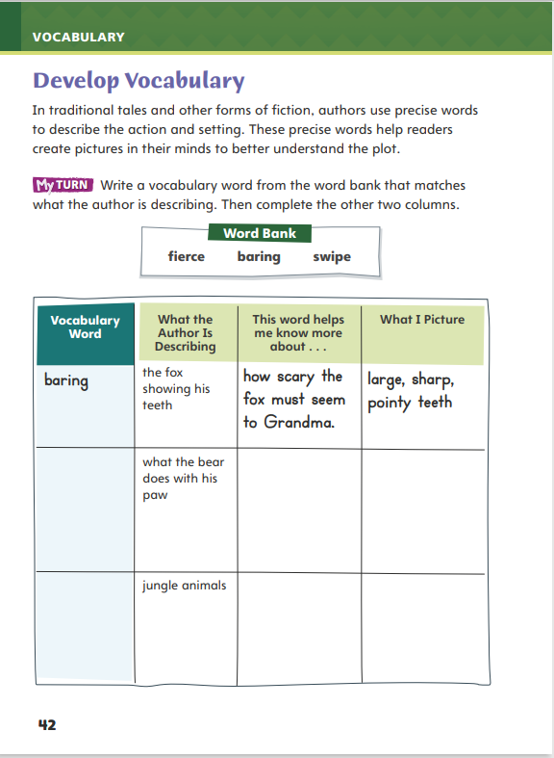
Page 42
Develop Vocabulary
Turn to page 42 in your Student Interactive and complete the activity.
Notes:
Tell students that authors use vivid words to describe characters and their actions. The vocabulary words fierce, baring, flexing, crouching, and swipe tell us what the animals in Grandma and the Great Gourd are like and what they do. The words help you “see” the animals in your mind.
Remind yourself of the word’s meaning.
Ask yourself how this word helps you see what the animal is doing or what it is like.
Model filling out the chart on p. 42 using the word baring.
In the story, the fox bares his teeth. How do you think he looks when he bares his teeth?
How do you think the fox baring his teeth affects Grandma? What does Grandma see as she looks at the fox?
Have students respond using the newly acquired vocabulary as they complete p. 42 of the Student Interactive. They should use text evidence in their answers.

Slide 33
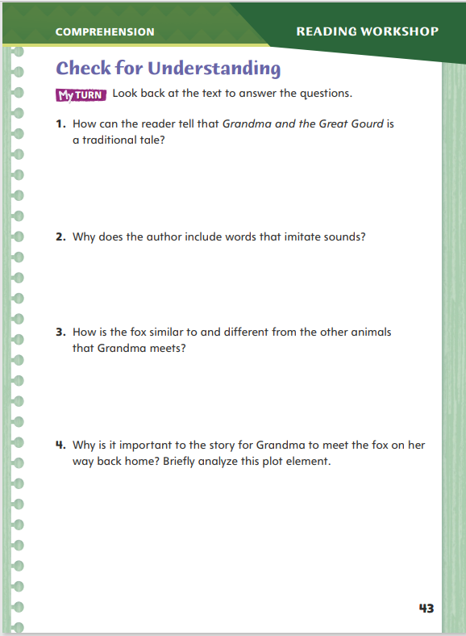
Page 43
Check for Understanding
Turn to page 43 in your Student Interactive and complete the activity.
Notes:
Have students complete p. 43 of the Student Interactive.

Slide 34
Word Study
lumber
garden
forget
comfort
Notes:
Direct students to complete the activity on p. 48 of the Student Interactive.
Explain that since high-frequency words are ones that appear often in texts but do not follow regular word study patterns, students need to practice reading them.

Slide 35
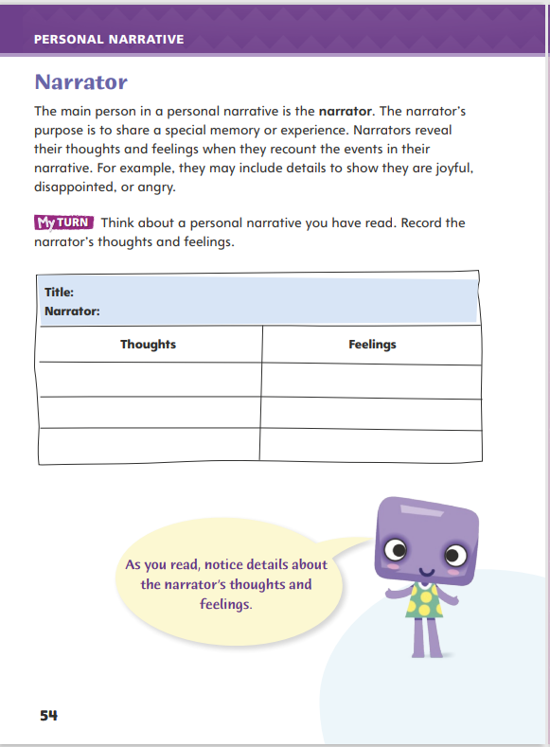
Page 54
Writing – Personal Narrative
Turn to page 54 in your Student Interactive.
Fill in the chart.
Notes:
The narrator is the main person in a personal narrative. He or she tells a story of a personal experience.
Narrators reveal thoughts they have about the experience.
Narrators share their feelings about the experience.
Remind students that as they explore various personal narratives over the next few days, they can prepare to write their own. Today, they will focus on how narrators include descriptions of their thoughts and feelings related to the event. As you read stories from your stack together, ask students to identify personal feelings. Ask: What feelings does this narrator have about the experience?
Direct students to p. 54 in the Student Interactive. Have them choose a personal narrative the class has just read to complete the activity.

Slide 36
Independent Writing
Write your personal narrative in your writer’s notebook.
Describe the personal thoughts and feelings of the narrator in the personal narratives you read.
How did this help you better understand the text?
Notes:
After the mini lesson, students should transition into independent writing. If students need additional opportunities to develop their understanding of personal narratives, they should read additional books from the stack.
Writing Support
Modeled - Choose a stack text and do a Think Aloud to model identifying the narrator's thoughts and feelings in the story.
Shared - Have students choose a stack text. Prompt students to identify what the narrator thinks and feels from the story.
Guided - Use the stack texts to provide explicit instruction on how the narrator's thoughts and feelings are directly tied to the experience.
If students demonstrate understanding, they should transition to writing their personal narratives in their writer's notebook.
Invite a few students to describe some of the narrator's thoughts and feelings they found in the personal narratives they read. Ask them how the descriptions of these feelings helped them to better understand the text

Slide 37
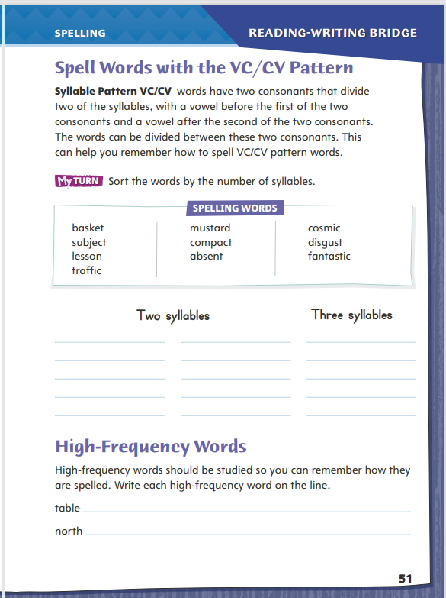
Page 51
Spelling
basket
lesson
mustard
absent
Turn to page 51 in your Student Interactive and complete the activity.
Notes:
Explain that students can use their knowledge of syllable patterns to spell multisyllabic words with the VC/CV pattern. If they know how to divide a word with this pattern, and that a syllable that ends in a consonant sound is closed, it can help them learn to spell the word correctly.
Say the following words aloud, and guide students to use their knowledge of syllable division of words with the VC/CV pattern to spell them: basket, lesson, mustard, absent.
Have students complete the activity on p. 51 of the Student Interactive.

Slide 38
Language and Conventions
The sandwich taste great.
Do the subject and verb agree?
Work with your partner. One partner forms a sentence and the other identifies the subject and the predicate.
Notes:
Flexible Option
Say that simple sentences are sentences that express a complete thought. Simple sentences contain a subject and a predicate. The subject is who or what the sentence is about. The predicate contains a verb and tells what the subject is or is doing. The subject and the verb must agree. Both must be singular, or both must be plural.
Write the following sentence on the board: The sandwich taste great. Have a volunteer identify the subject and the predicate. Then have the volunteer tell whether the subject and the verb agree. (no) If necessary, have the student edit the sentence. (The sandwich tastes great.)
Have students work in pairs. Have each student write a sentence. Have the partner read the sentence and identify the subject and the predicate. Then have the student confirm whether the subject and the verb agree. Have students edit the sentences as necessary.

Slide 39
Lesson 3

Slide 40
Page 19
Introduce Analyze Plot and Setting
Notes:
Readers learn about the plot of a story (the events that happen), the setting of the story (where and when it takes place), and how the setting affects the plot.
Think about the setting—where and when the story takes place.
Think about the plot—the events that happen in the story.
Ask yourself if the setting is important. Would the story be different if it happened in another place in the world or in a different time period?
Use the Close Read note on p. 21 of the Student Interactive to model how to determine the setting of a story. Say: Setting is where and when the story takes place. In paragraph 1, I learn that this story takes place in a village in India. I’ll underline that detail.
Have pairs find and underline details in paragraph 2 that give more details about the setting. Then have them discuss what might happen in the story because of where it takes place

Slide 41
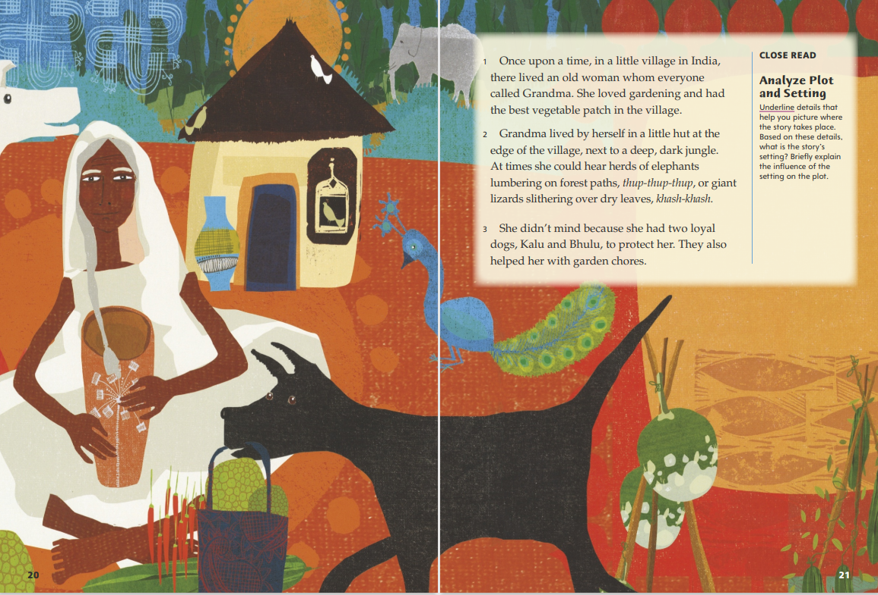
Page 21
Close Read – Analyze Plot and Setting
Notes:
Have students scan paragraphs 1–2 and underline details that help them picture where the story takes place. See student page for possible responses.
Ask: Based on these details, how would you describe the setting?
Possible Response: The setting is the countryside in a tropical area of India a long time ago.
Ask: How does the story’s setting influence, or help to shape, the plot?
Possible Response: Since Grandma lives right next to the jungle, it makes sense that she has to travel through it to visit her daughter. Also, people living a long time ago probably walked most places. The time period makes it more likely that Grandma would walk through the jungle, meet the wild animals living there, and have a hard time protecting herself from them. DOK 2

Slide 42
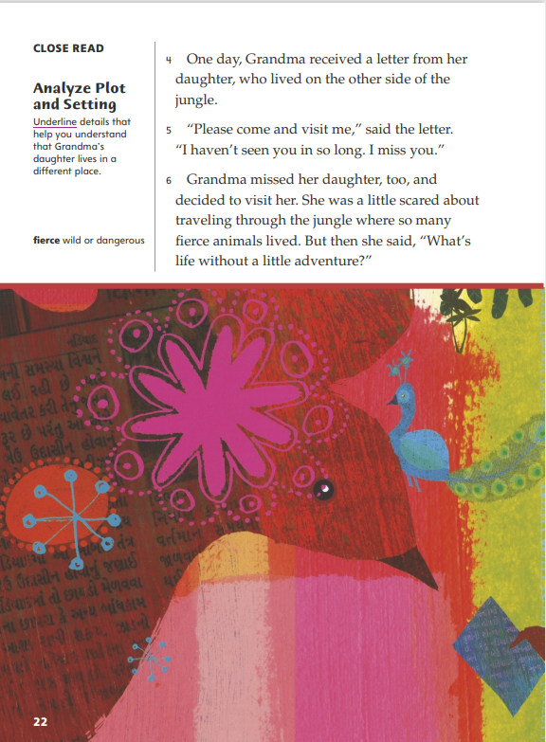
Page 22
Close Read – Analyze Plot and Setting
Turn to page 22 in your Student Interactive.
Notes:
Ask students to read the Close Read note and scan paragraphs 4–5. Prompt them to underline details that explain where the daughter lives as well as how this situation has affected her. See student page for possible responses.
Remind students that a story’s plot is the sequence of events that happen throughout the story. Ask: How does the location of the daughter’s home help to move the plot toward the next event?
Possible Response: In her letter, the daughter asks Grandma to “Please come and visit me” because they live on opposite sides of the jungle and have not seen each other for a long time. Since they both miss each other, Grandma decides to make the dangerous trip. DOK 2

Slide 43
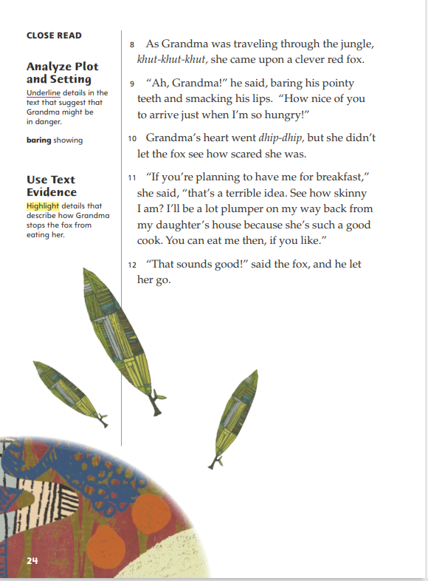
Page 24
Close Read – Analyze Plot and Setting
Turn to page 24 in your Student Interactive.
Notes:
Ask students to scan paragraphs 9 and 10 and underline details that make them think that Grandma might be in danger. See student page for possible responses.
Ask: How does Grandma’s encounter, or meeting, with the fox develop the plot of the story?
Possible Response: The fox’s behavior and statement of “I’m so hungry” create a problem for Grandma. The “dhip-dhip” sound shows that she is so scared that the fox will eat her that her heart jumps, but she hides her fear because she knows she must do something to protect herself. The next event in the plot will be what she does to respond to the problem. DOK 2

Slide 44
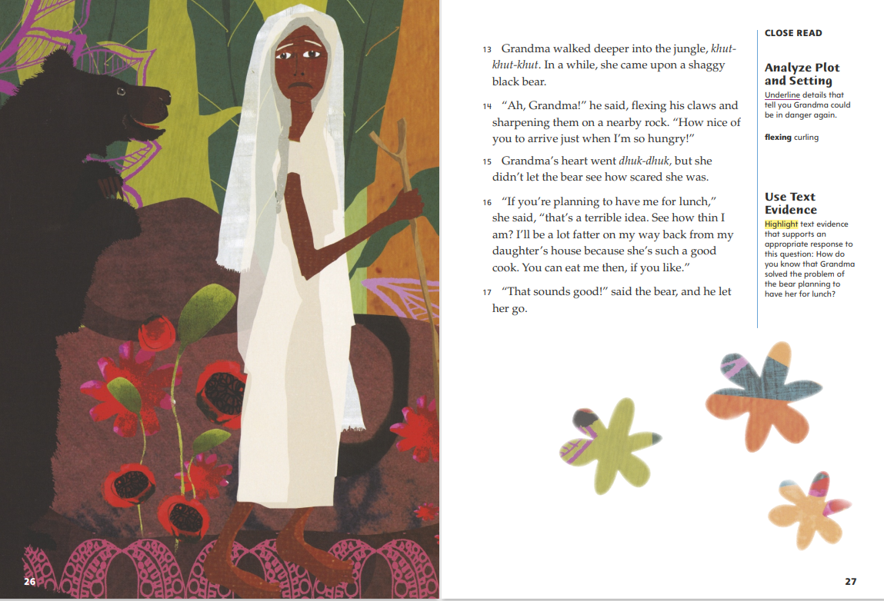
Page 26, 27
Close Read – Analyze Plot and Setting
Notes:
Ask students to scan paragraphs 13–15 and underline details that suggest Grandma could be in danger again. See student page for possible responses.
Ask: How would you compare Grandma’s encounter with the black bear to the one she had with the fox?
Possible Response: The two events are very similar. The detail about the bear “flexing his claws and sharpening them” shows that he wants to eat Grandma. The fox was doing the same thing when he bared his teeth and smacked his lips. They both tell Grandma that they are happy to see her and say, “I’m so hungry!” DOK 2

Slide 45
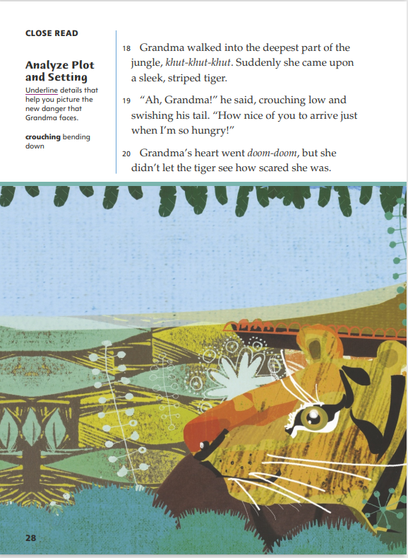
Page 28
Close Read – Analyze Plot and Setting
Turn to page 28 in your Student Interactive.
Notes:
Have students scan paragraphs 18–19 and underline details that help them picture the new danger that Grandma faces. See student page for possible responses.
Ask: How do these details help show that the tiger is dangerous?
Possible Response: The tiger “crouching low” suggests that he is ready to pounce.
Ask: How does the setting make the tiger’s actions seem extra threatening?
Possible Response: It will be harder for Grandma to run away from the tiger in "the deepest part of the jungle." DOK 2, 3

Slide 46
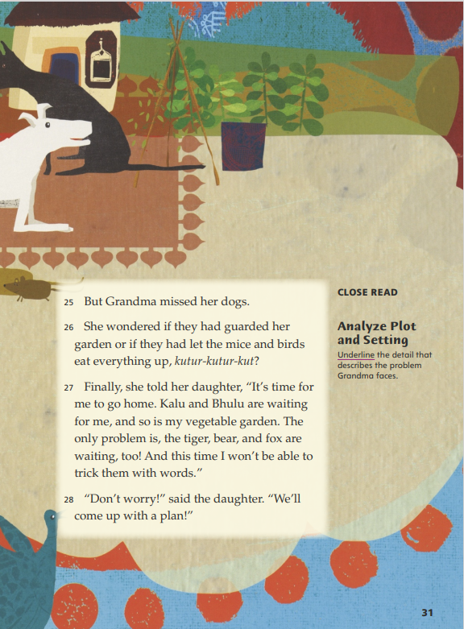
Page 31
Close Read – Analyze Plot and Setting
Turn to page 31 in your Student Interactive.
Notes:
Have students scan paragraph 27 and underline the detail that describes the problem Grandma faces in this part of the story. Remind students that sometimes specific text evidence can be located by looking for clue words. See student page for possible responses.
Ask: How would you contrast the problem Grandma has now with her earlier problems? Use text evidence to support your response.
Possible Response: Grandma knows she must outsmart the animals that are hungrily waiting for her. She says, “And this time I won’t be able to trick them with words,” so she also knows that the animals will be more difficult to fool now. DOK 2

Slide 47
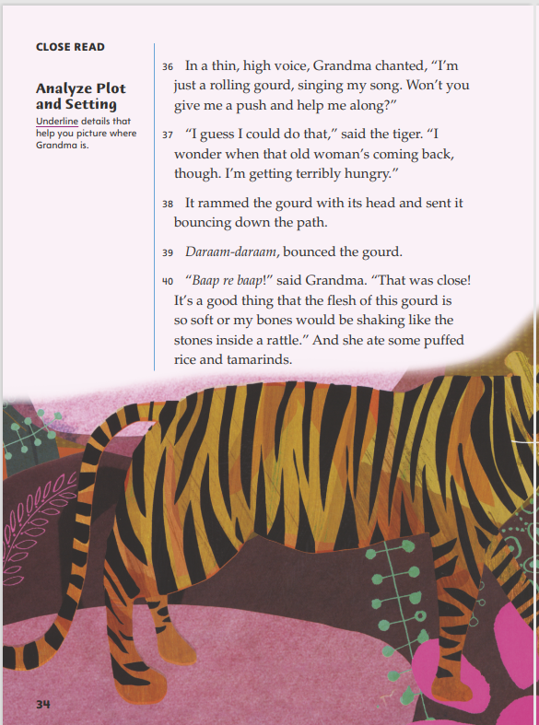
Page 34
Close Read – Analyze Plot and Setting
Turn to page 34 in your Student Interactive.
Notes:
Have students scan paragraphs 36–40 and underline details that help them picture where Grandma is. See student page for possible responses.
Remind students that the plot of a story is influenced by the setting as well as the characters’ choices and actions. Ask: What can you infer about the moment that Grandma chooses to speak in her normal voice again?
Possible Response: Grandma did not speak in her own voice until after the tiger gave her gourd a push and she bounced some distance down the path. I think Grandma waited until she was sure that she was no longer in danger, because one of the first things she said was, “That was close!” If the tiger had heard her real voice coming from the gourd, the encounter may have ended differently. DOK 2

Slide 48
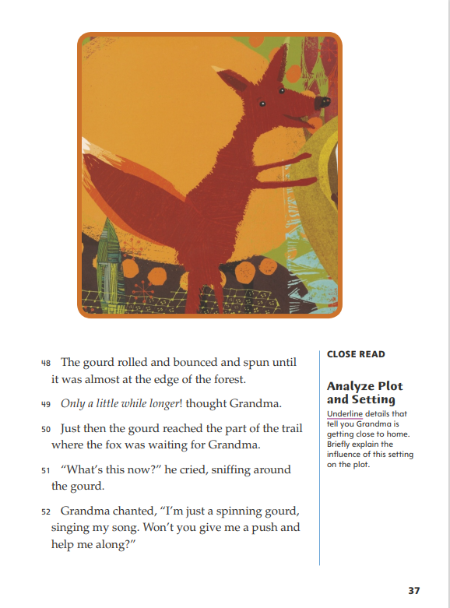
Page 37
Close Read – Analyze Plot and Setting
Turn to page 37 in your Student Interactive.
Notes:
Ask students to scan paragraphs 48–50 and underline the details that tell them Grandma is getting close to home. See student page for possible responses.
Ask: How does the setting for this part of the story influence the plot?
Possible Response: The detail that the fox says, “What’s this now?” when he sees the gourd, instead of what the bear and tiger said, is a hint that he will not be fooled like they were. The setting is one reason for this change in the pattern of events. Grandma is “almost at the edge of the forest” where she started her journey and back to the place where she left the fox. The fox has been waiting the longest to eat her, because he was the first to be fooled and the last one she sees on her return trip. These two things combined probably make him the hungriest and hardest to fool. DOK 2

Slide 49
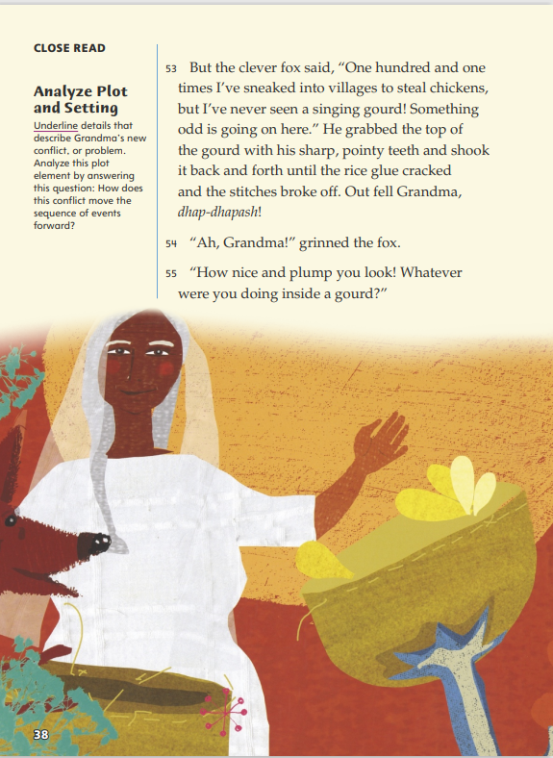
Page 38
Close Read – Analyze Plot and Setting
Turn to page 38 in your Student Interactive.
Notes:
Ask students to read the Close Read note. Prompt them to scan paragraph 53 and underline the details that tell them what the new problem is. See student page for possible responses.
Ask: How does this problem move the sequence of events forward?
Possible Response: When the fox breaks the top off the gourd, Grandma falls out and the fox can see her. Now she must quickly think of another way to stop him from eating her. DOK 2

Slide 50
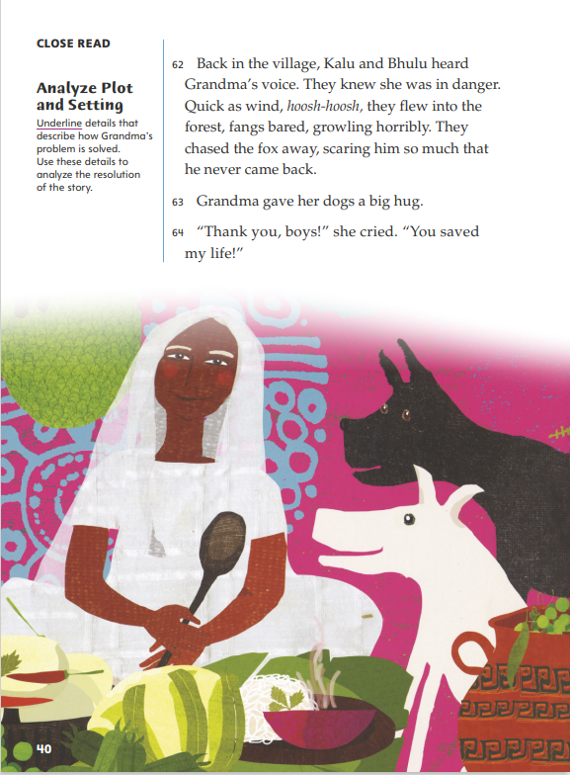
Page 40
Close Read – Analyze Plot and Setting
Turn to page 40 in your Student Interactive.
Notes:
Ask students to scan paragraph 62 and underline the details that describe how Grandma’s problem is solved. See student page for possible responses.
Remind students that a story’s resolution is the part in which the main character solves the main problem. Have them use their underlined details to analyze the resolution.
Ask: How does the resolution of the story relate to the events at the beginning of the story?
Possible Response: Grandma solves her problem with the help of her dogs, who “flew into the forest” and “chased the fox away, scaring him so much that he never came back.” This is what the dogs promised Grandma they would do, at the beginning of the story. They made a plan and remembered it. DOK 2

Slide 51
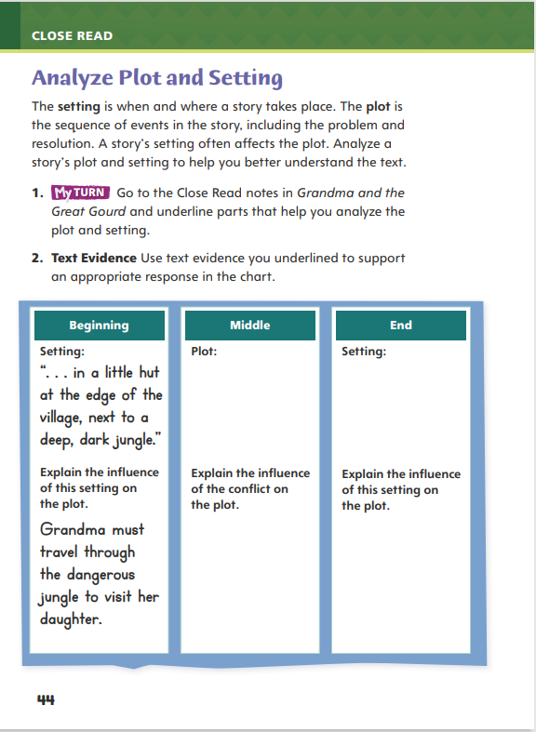
Page 44
Analyze Plot and Setting
Turn to page 44 in your Student Interactive and complete the activity.
Notes:
Have students annotate the text using the Close Read notes for Analyze Plot and Setting and then use the text evidence from their annotations to complete the chart on p. 44 of the Student Interactive.

Slide 52
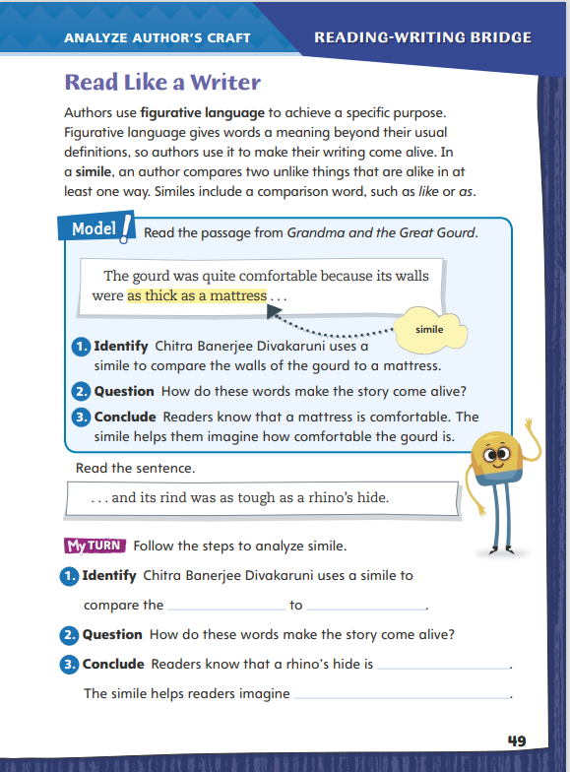
Page 49
Read Like a Writer
Turn to page 49 in your Student Interactive.
Notes:
Figurative language includes descriptive words and comparisons that can help readers visualize, or picture in their minds, people, places, or things that an author is describing.
Similes are one type of figurative language.
A simile compares two unlike things using the word like or as.
Similes are one way authors use figurative language to help readers visualize what they are writing about.
Model analyzing the author’s use of figurative language by directing students to the top of p. 49 of the Student Interactive. Complete the following steps.
Identify that the author uses a simile to describe the gourd.
Ask students how the simile helps readers create a mental picture of how comfortable the gourd is.
Guide students to understand that the simile helps the author achieve her purpose of describing the gourd in a way readers can understand by comparing the gourd to something they know.
Direct students to go back to Grandma and the Great Gourd and circle instances where similes appear. Help guide their search by having them look for the words like and as. Then have them focus on specific examples of similes by completing the activities on p. 49 of the Student Interactive.

Slide 53
Word Study
napkin
absent
Notes:
Flexible Option
Remind students that using knowledge of syllable division, such as VC/CV, can help them read words correctly. In words with the VC/CV pattern, the syllables are closed because they end in consonant sounds.
Show students the words napkin and absent. Guide students to identify the syllable break in each word. (nap -kin; ab -sent) Then have them use this knowledge to decode each word.
Have students complete Word Study p. 1 from the Resource Download Center.

Slide 54
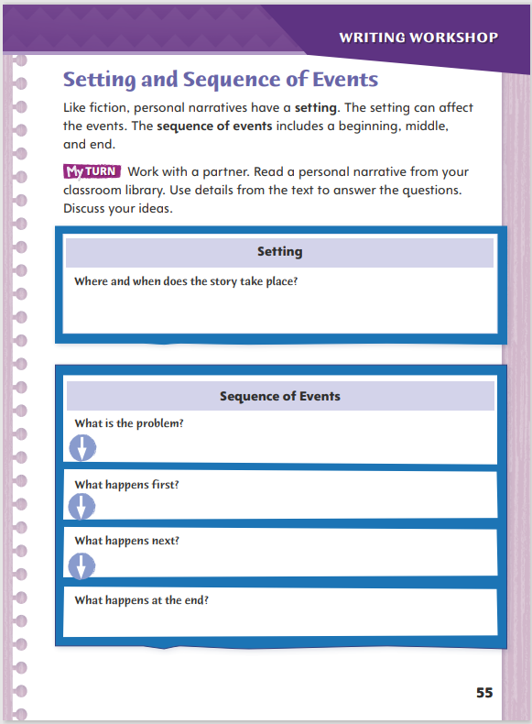
Page 55
Writing – Personal Narrative
Turn to page 55 in your Student Interactive.
Notes:
Like fiction, the details in personal narratives make the story come alive. Narrators provide key details about
The setting
The sequence of events
Review the personal narratives that you have read from the stack. Have students think about an experience a narrator described. Use the following questions to prompt discussion:
Where and when does the story take place? What details about the setting does the narrator include? How do these details help you picture the setting?
What problem does the narrator have? What events lead to the narrator's problem?
What happens as a result of the problem? What lesson does the narrator learn, or how does the narrator view the problem now?
Direct students to p. 55 in the Student Interactive. Have them work with a partner to find a personal narrative from the classroom library that they have both read. Have them use the personal narrative to complete the activity

Slide 55
Independent Writing
Write your ideas for your personal narrative.
Make a list of ideas and include notes about where and when the event takes place.
Notes:
After the minilesson, direct students to begin writing their ideas for their personal narratives. They should be thinking about an experience they would like to share. Students should begin making lists of ideas and include notes about the setting: when and where the event takes place. Students may also write phrases or sentences about the sequence of events. Later, they can come back and put them in time order.
Writing Support
Modeled - Choose a stack text and do a Think Aloud to model identifying the setting and the sequence of events from a personal narrative.
Shared - Have students choose a stack text. Prompt students to identify the setting and the sequence of events from a personal narrative. Write responses on the Student Interactive.
Guided - Use a stack text to provide explicit instruction on setting. Discuss how the setting is an important part of the plot and frames the sequence of events.
If students know what they want to write about and are ready to begin, they may write in their writer's notebooks.
Ask for volunteers to share text evidence of details relating to the setting found in the personal narratives they reviewed. Call on a few students to identify important events from a personal narrative they have read.

Slide 56
Spelling
cosmic
traffic
Notes:
Flexible Option
Remind students that knowing how to divide words into syllables can help them spell words correctly. Review the syllable pattern VC/CV with the words disgust (dis -gust) and compact (com -pact)
Say the following words aloud: cosmic, traffic. Have students spell the words and use a slash (/) to divide each word into syllables using knowledge of syllable pattern VC/CV.
Have students complete Spelling p. 6 from the Resource Download Center. Click path: Table of Contents -> Resource Download Center -> Spelling

Slide 57
Language and Conventions
The player kicks the ball. Goes in the goal.
The parents claps their hands.
Notes:
Say that a simple sentence contains a subject and a predicate. A simple sentence expresses a complete thought. The subject and the verb of the sentence must agree for the sentence to be correct.
Display the following sentences: The player kicks the ball. Goes in the goal. The parents claps their hands. Have volunteers help you edit the sentences so that they all have a subject and a predicate and all subjects agree with the verbs. (The player kicks the ball. It goes in the goal. The parents clap their hands.)

Slide 58
Lesson 4

Slide 59
Page 19
Introduce Use Text Evidence
Notes:
Readers use what they read in a text to help them understand the characters and what may happen later in the plot. What readers learn and the inferences they make must be supported by the text.
Look for details that are given in the text.
Focus on what characters say and do for clues about how the characters will act or what they will do later in the story.
Think about what those details suggest about what may happen later.
Use the Close Read note on Student Interactive p. 23 of Grandma and the Great Gourd to model how to use text evidence to support understanding of characters and the plot.
How do I know that the dogs plan to protect Grandma from danger? I can tell they think she might run into trouble, because they say they will listen, and if she gets into trouble, she should just call them. That is text evidence showing they are ready to help her if she gets into trouble. I think they will come to rescue her if she calls.

Slide 60
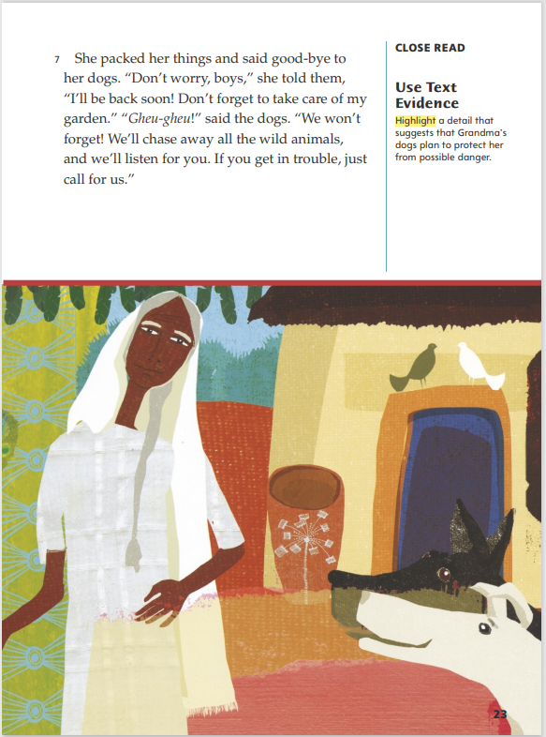
Page 23
Close Read – Use Text Evidence
Turn to page 23 in your Student Interactive.
Notes:
Remind students that pointing to specific details can help them explain observations and opinions about a text. Tell students that these pieces of text evidence explain why they believe a certain idea is true.
Have students scan paragraph 7 and highlight a detail that suggests that Grandma’s dogs plan to protect her from danger. See student page for possible responses.
Ask: Why do Grandma’s dogs tell her how they will protect her? Use your highlighted text evidence to support your answer.
Possible Response: The dogs need Grandma to let them know that she needs help. They explain, “If you get in trouble, just call for us.” DOK 2

Slide 61
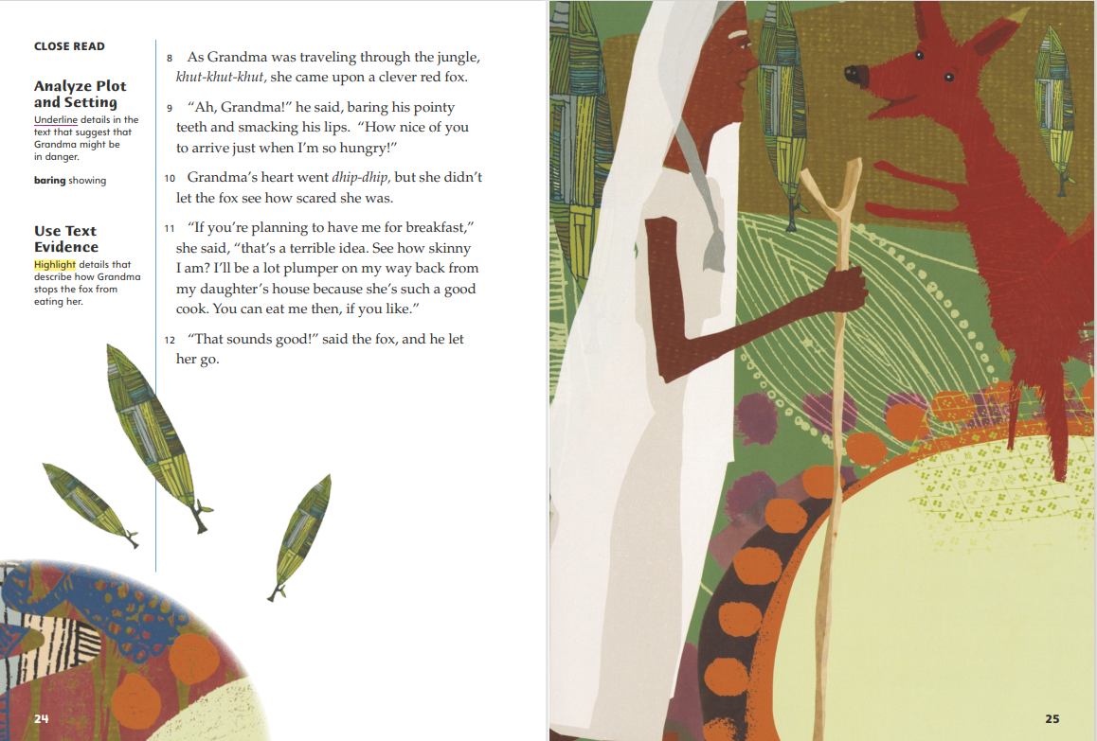
Page 24
Close Read – Use Text Evidence
Notes:
Ask students to read the second Close Read note on p. 24. Prompt them to scan paragraph 11 and highlight details that describe how Grandma stops the fox from eating her. See student page for possible responses.
Ask: Is Grandma’s solution to her problem with the fox a good one? Use text evidence to support your opinion.
Possible Response: Telling the fox “I’ll be a lot plumper on my way back,” and “You can eat me then,” tells him to look for her when she returns home. I think she will face the same problem with the fox later, so her solution is not the best. DOK 2

Slide 62
Page 27
Close Read – Use Text Evidence
Notes:
Ask students to scan paragraph 17 and highlight evidence that helps them identify how Grandma solved the problem of the bear planning to have her for lunch. See student page for possible responses.
Ask: What does this detail tell you about both the bear and Grandma?
Possible Response: The detail shows that the bear is easily fooled and that Grandma is very clever. DOK 2

Slide 63
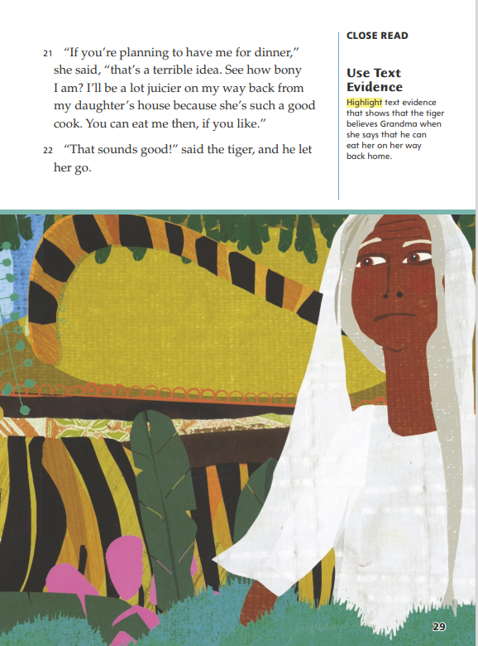
Page 29
Close Read – Use Text Evidence
Turn to page 29 in your Student Interactive.
Notes:
Have students scan paragraph 22 and highlight text evidence that shows that the tiger believes Grandma when she says that he can eat her on her way back home. See student page for possible response.
Ask: What text evidence supports the idea that Grandma has solved her problem with the tiger?
Possible Response: The tiger says, “That sounds good!” and then he “let her go” without trying to eat her.
Ask: What text evidence supports the prediction that the tiger is the last animal Grandma will meet today?
Possible Response: The tiger is the third animal she meets and folktales often use a pattern of three. DOK 2, 3

Slide 64
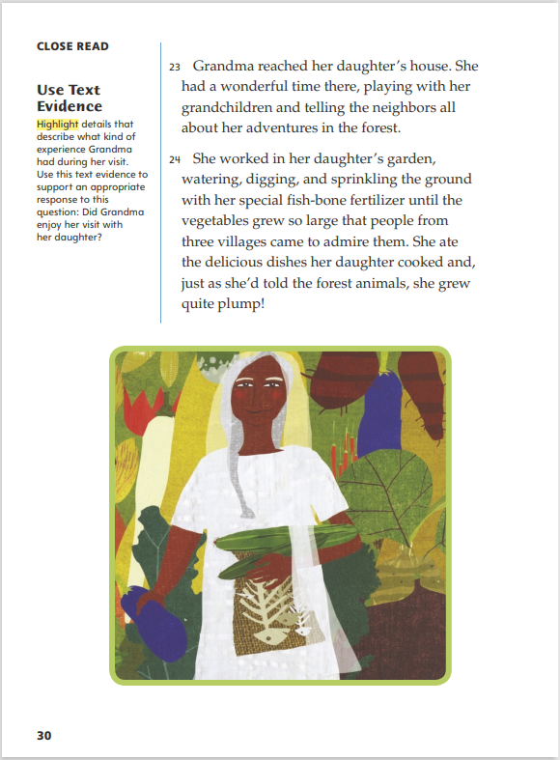
Page 30
Close Read – Use Text Evidence
Turn to page 30 in your Student Interactive.
Notes:
Ask students to read the Close Read note. Prompt students to scan and highlight any details in paragraphs 23–24 that provide evidence of Grandma’s enjoyable experiences at her daughter’s house. See student page for possible responses.
Ask: Did Grandma enjoy her visit? Use text evidence to support your response.
Possible Response: The detail that “She had a wonderful time there” tells me that Grandma did enjoy her visit. The text also says that “she ate the delicious dishes her daughter cooked” and “grew quite plump,” so she enjoyed her daughter’s cooking. DOK 2

Slide 65
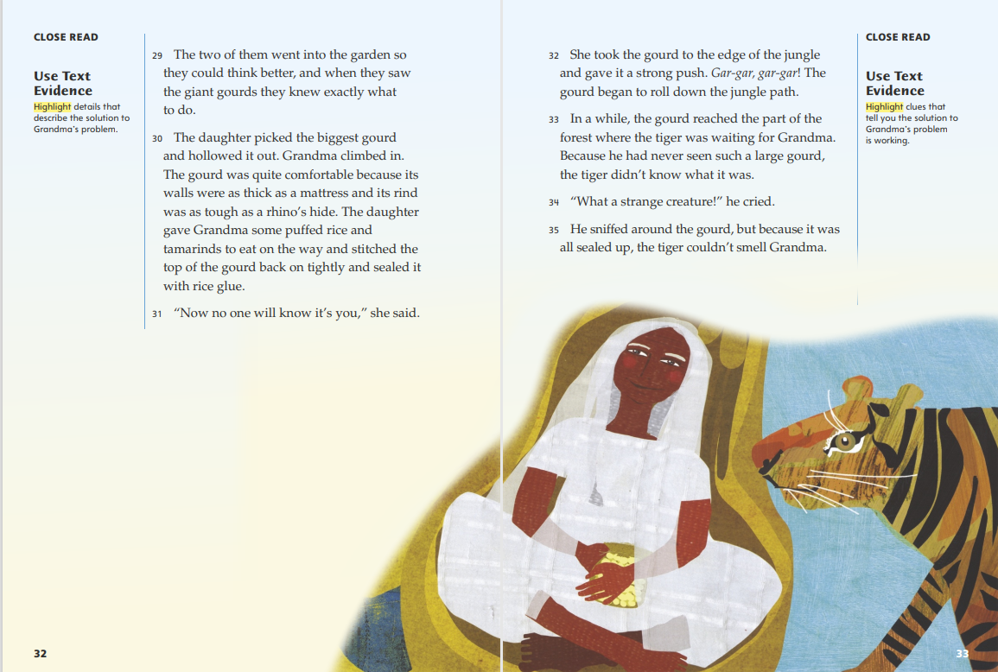
Page 32, 33
Close Read – Use Text Evidence
Notes:
Have students scan paragraphs 29–31 and highlight details that describe the solution to Grandma’s problem. See student page for possible responses.
Ask: How can you summarize Grandma’s solution? Use text evidence to support your response.
Possible Response: Grandma’s solution is to disguise or hide herself, since she “climbed in” the gourd and her daughter says, “Now no one will know it’s you.”
Ask: What detail could you use to support the idea that this plan might not work in real life?
Possible Response: The detail that the daughter “stitched the top of the gourd back on tightly and sealed it with rice glue” suggests that there is no way for air to get into the gourd. In real life, Grandma would need an air hole so she could breathe. DOK 2, 3
Ask students to scan paragraphs 33–35 and highlight clues that show that the solution to Grandma’s problem is working. See student page for possible responses.
Ask: What conclusion can you draw about the way the tiger inspects the large gourd? Use text evidence to support your response.
Possible Response: The tiger is using his animal senses to try to figure out what the gourd is. The detail that “he had never seen such a large gourd, the tiger didn’t know what it was” proves that the tiger tries using his eyesight first. Then the details that “He sniffed around the gourd” and “the tiger couldn’t smell Grandma” shows that he uses his sense of smell, too. DOK 2

Slide 66
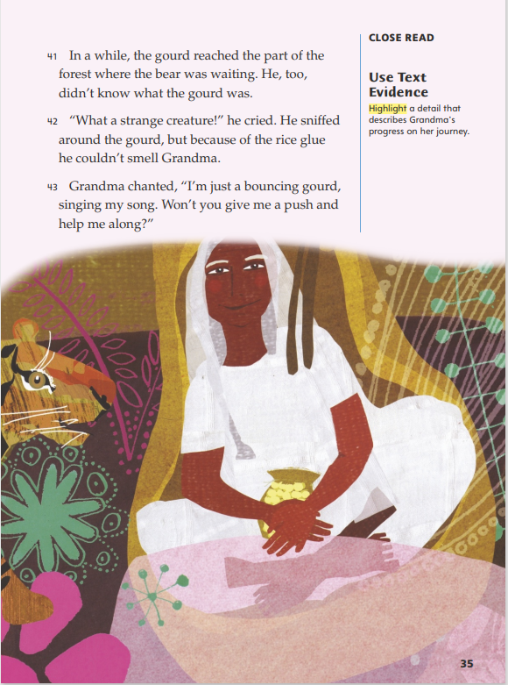
Page 35
Close Read – Use Text Evidence
Turn to page 35 in your Student Interactive.
Notes:
Have volunteers identify the main plot events of the story up to this point. Then ask students to scan paragraph 41 and highlight a detail that describes Grandma’s progress on her journey.
Ask: How does the setting show that the plot has moved on? Use text evidence.
Possible Response: The phrase “In a while” shows the story is jumping ahead in time. The detail that “the gourd reached the part of the forest where the bear was waiting,” reminds readers that Grandma will meet each animal again.
Say: Explain how Grandma changes her gourd song for each animal that she meets. Use text evidence.
Possible Response: Grandma changes how she describes herself to match how her gourd is moving when the animal sees it. DOK 2

Slide 67
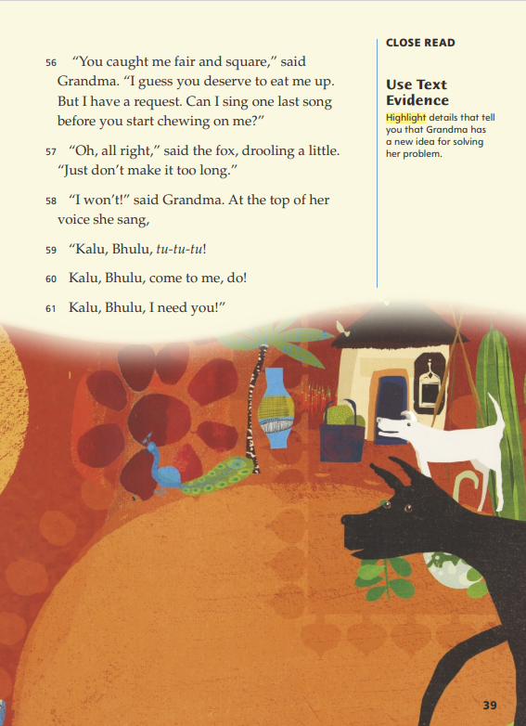
Page 39
Close Read – Use Text Evidence
Turn to page 39 in your Student Interactive.
Notes:
Ask students to scan paragraph 56 and highlight details that tell them that Grandma has a new idea for solving her problem. See student page for possible responses.
Ask: How does this information tell you that Grandma has thought of a new solution? Use your text evidence to support your response.
Possible Response: Grandma tells the fox that she has a request “before you start chewing on me.” This detail tells me that she will ask the fox something that she hopes will stop him from eating her. Since her request is that he let her “sing one last song,” I know that the song is part of her solution. DOK 2

Slide 68
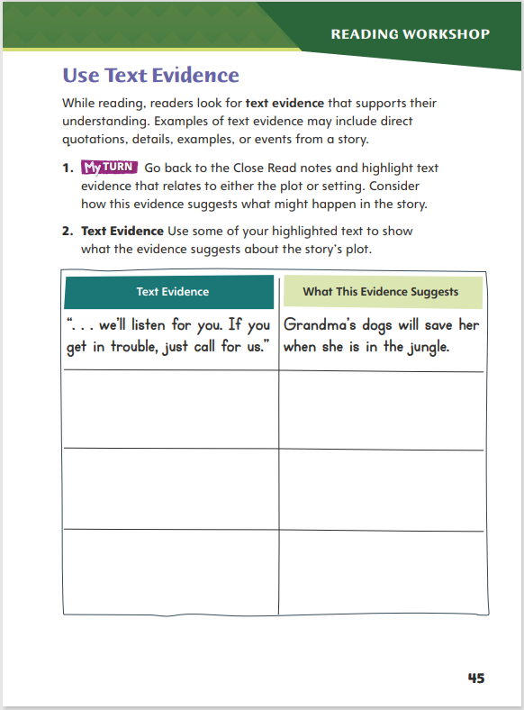
Page 45
Use Text Evidence
Turn to page 45 in your Student Interactive and complete the activity.
Notes:
Have students annotate the text using other Close Read notes for Use Text Evidence and then their annotations to complete p. 45 of the Student Interactive

Slide 69
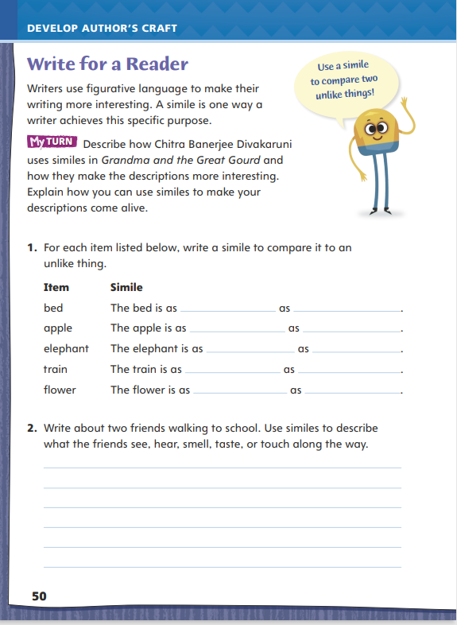
Page 50
Write for a Reader
Turn to page 50 in your Student Interactive.
Notes:
Writers use figurative language to describe settings, characters, and events and make their writing more interesting.
Figurative language helps readers visualize ordinary things in new and interesting ways to capture the readers’ interest.
Figurative language includes similes, which compare two unlike things using the words like and as.
Discuss how students might use a similar technique in their own writing using p. 50 of the Student Interactive. Model creating a simile by comparing two things. I have a messy desk. I want readers to understand just how messy it is. I will do this by comparing it to a more interesting object. I will compare it to a garbage dump. My desk is as messy as a garbage dump.
Have students brainstorm objects that can be compared to the desk’s size, color, or shape.
Have students refer to Chitra Banerjee Divakaruni's use of figurative language as an example for their own writing. Then guide students to complete the activity on p. 50 of the Student Interactive.

Slide 70
Word Study
subject
zigzag
cannon
object
Notes:
Flexible Option
Review the strategies about using the syllable pattern VC/CV to decode words.
Write the following words on the board: subject, zigzag, cannon, and object. Have volunteers identify the VC/CV syllable pattern in each word and show how to use it to divide the word into syllables.
Have students work independently to find VC/CV words in a story they recently read. Have students write the words and divide them into syllables using the VC/CV syllable pattern.

Slide 71
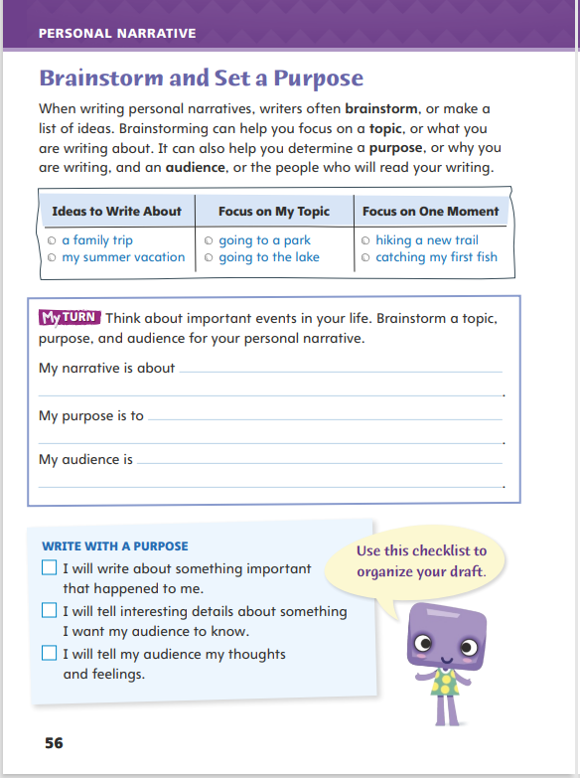
Page 56
Writing – Personal Narrative
Turn to page 56 in your Student Interactive.
Notes:
Brainstorming is a strategy writers use to generate ideas and help them decide which ideas are the best. When brainstorming ideas for a personal narrative, have students
Think about experiences or events that are memorable to them.
Limit the experience to one specific event.
Focus on one special moment of the experience
Explain that students will begin brainstorming topics for their personal narratives. Read one or two personal narratives from the stack to show the types of experiences people share. Ask: What are some of the experiences shared in these texts? What is it about the experiences that make them interesting? What experiences would you like to write about?
Explain to students that knowing the purpose and audience of their narratives will help them decide on what details to include as they develop their narratives. Say: Once you choose a topic, think about the purpose. What do you want your audience to know? Do you want them to know how it made you feel? Do you want to share a lesson you learned? Thinking about your purpose will help you write your draft.
Direct students to p. 56 in the Student Interactive. Tell them to use the examples and prompts to help them brainstorm a particular topic, purpose, and audience for their personal narratives. If they come up with ideas, have them write them in their notebooks.

Slide 72
Independent Writing
Now you will take the memorable moment that you have chosen and work in your writer’s notebook.
Share your ideas and have your classmates suggest which experience is most interesting.
Notes:
After the minilesson, students should transition into independent writing. Ask students who need to choose a topic to focus on a single memorable moment. If they need more support, help them understand how a stack text is about a specific topic.
Writing Support
Modeled Do a Think Aloud to model focusing on a topic and choosing a specific moment.
Shared Have students choose a topic idea from the Student Interactive. Prompt students to identify what the purpose would be and the most likely audience.
Guided Use a web organizer to brainstorm a list of memorable firsts, such as a carnival ride, a first pet, or a first trip.
If students have started their personal narratives, have them make any changes based on today’s minilesson. Point out that a personal narrative focuses on one moment.
Ask for volunteers to share the ideas they are considering writing about. Have the class suggest which experiences they would find the most interesting.

Slide 73
Spelling
hidden
yellow
bandit
picnic
Notes:
Flexible Option
Review the spelling rule about splitting words with the VC/CV spelling pattern between the consonants.
Display the following words: hidden, yellow, bandit, and picnic. Have volunteers divide the words into syllables using the VC/CV pattern. Have them sound out the syllables and use the pattern to help them spell the words.
Have students create flash cards of the spelling words from this week. Have students quiz each other on how to spell the words. As they spell the words, have them say the words aloud, emphasizing the syllables, before spelling the word

Slide 74
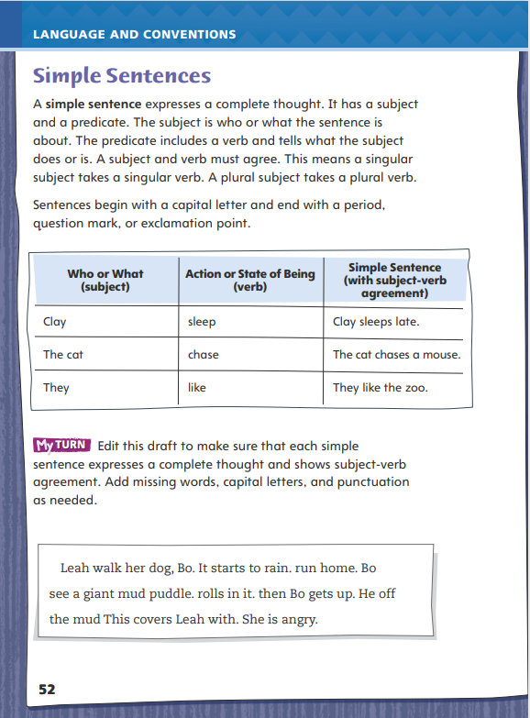
Page 52
Language and Conventions
Turn to page 52 in your Student Interactive and complete the activity.
Notes:
Have students edit the draft paragraph on Student Interactive p. 52

Slide 75
Lesson 5

Slide 76
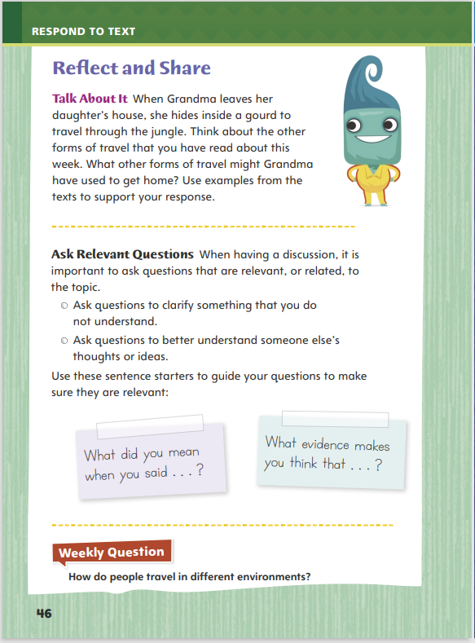
Page 46
Reflect and Share
Turn to page 46 in your Student Interactive.
Notes:
Explain to students that if they don’t understand something that has been said in a discussion, it is important to ask questions to find out what the other person means. They can also ask questions to find out more about what the other person thinks. Their questions must be related to the topic being discussed.
Listen and try to understand what others say.
Ask questions to learn more about someone else’s ideas.
Make sure that your questions are about the topic being discussed.
Model asking relevant questions while discussing the Talk About It prompt on Student Interactive p. 46.
Say: If I didn’t understand why my discussion partner gave an idea about a form of travel that Grandma could use, I would ask, “What do you mean by that? Why did you say that?” I would not start talking about travel in the latest movie I have seen, because that is not relevant to what we are discussing.

Slide 77
Page 46
Apply
Use evidence from the text you have read this week to answer the question.
Write your answers on a separate sheet of paper.
Notes:
Have students use evidence from the texts they have read this week to respond to the Weekly Question. Tell them to write their responses on a separate sheet of paper or discuss in small groups.

Slide 78
Word Study
campus
matter
mishap
capture
Notes:
Flexible Option
To assess students’ understanding of the syllable pattern VC/CV, provide them with the following words:
Campus
Matter
Mishap
capture
Have students use their knowledge of the spelling of the syllable pattern VC/CV to divide each word in syllables and then decode the words

Slide 79
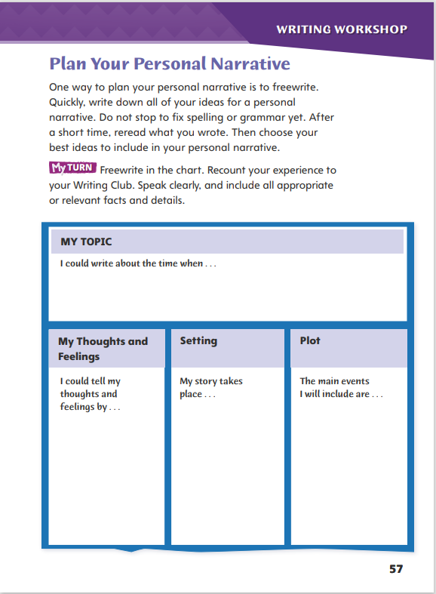
Page 57
Writing – Personal Narrative
Turn to page 57 in your Student Interactive.
Notes:
Freewriting before drafting allows writers to get all their ideas down without worrying about organization, grammar, and spelling. As students use the strategy of freewriting, have them include ideas about
Thoughts and feelings: How did they feel? What thoughts do they want to share? How can they tell about their thoughts and feelings?
Setting: Where and when did the experience occur?
Plot: What happened? How did this experience affect them?
Have students choose a personal narrative from the personal narrative stack. Ask: What ideas do you think the writer first remembered? What do you think the writer first wrote about the setting? What thoughts and feelings do you think the writer included in freewriting?
Inform students that today they will use freewriting to plan a first draft for their personal narratives. Direct them to p. 57 in the Student Interactive. Tell students that before writing they should recount an experience to a partner. Remind them to include all appropriate facts and relevant, descriptive details. Tell students to speak clearly at an understandable pace. Have students then use the chart to help guide them in planning their personal narratives. As students freewrite, remind them to let their ideas flow freely and not to worry about spelling or grammar at this time.

Slide 80
Independent Writing
Determine what element you would like feedback on from your writing group.
Share your ideas and freewriting notes.
Notes:
In this week’s Writing Club, students will share their ideas and freewriting notes for their personal narratives. As students are in new Writing Club groups, they should spend the first 5–10 minutes in their groups discussing the following:
Role of audience when someone is reading aloud a draft
Polite ways to ask questions
Respecting others’ ideas
Prior to sharing their personal narrative ideas, students should determine what element of their personal narrative they would like feedback on in today’s Writing Club. Students should inform their Writing Club of the element before they begin reading their narratives. This will help direct the group’s focus as students are sharing their writing.
Have partners share their freewriting notes. Have them converse politely as they help each other think about which ideas to include or exclude. Invite volunteers to share their freewriting as others listen actively. Allow time for students to ask questions to clarify information and to make pertinent comments

Slide 81
Spelling
1. We put the fruit in the basket.
2. Reading is my favorite subject.
3. I learned my lesson when I locked myself out of my room.
4. There is a lot of traffic on Main Street.
5. I like to put mustard on my sandwich.
6. The small room is very compact.
7. She is absent today because she went to the doctor.
8. The cosmic rays were dangerous.
9. He shook his head in disgust at what he saw.
10. The salad tasted fantastic.
Notes:
(Note: Move the orange boxes to cover each bold spelling word before you read aloud the words and sentences.)
Read aloud the words and sentences. Have students spell each word with initial consonant blends and the two high-frequency words.
We put the fruit in the basket.
Reading is my favorite subject.
I learned my lesson when I locked myself out of my room.
There is a lot of traffic on Main Street.
I like to put mustard on my sandwich.
The small room is very compact.
She is absent today because she went to the doctor.
The cosmic rays were dangerous.
He shook his head in disgust at what he saw.
The salad tasted fantastic.
Reveal the spelling word and have students check their work.

Slide 82
Language and Conventions
The sun shine brightly in the morning.
Which revision makes the subject and verb agree?
Change The to A
Change shine to shines
Change brightly to brightest
Change morning to evening
Notes:
Flexible Option
Display the sentence and have students respond independently.
The sun shine brightly in the morning.
Which revision makes the subject and verb agree?
Change The to A.
Change shine to shines.
Change brightly to brightest.
Change morning to evening
Have students complete Language and Conventions p. 11 from the Resource Download Center. Click path: Table of Contents -> Resource Download Center -> Language and Conventions -> U3 W1

Slide 83
Unit 1: Week 1
Grade 3

