Slide 1
Unit 5: Week 1
Grade 5

Slide 2
Copyright © Savvas Learning Company LLC. All Rights Reserved.
This publication is protected by copyright, and permission should be obtained from the publisher prior to any prohibited reproduction, storage in a retrieval system, or transmission in any form or by any means, electronic, mechanical, photocopying, recording, or otherwise. For information regarding permissions, request forms, and the appropriate contacts within the Savvas Learning Company Rights Management group, please send your query to:
Savvas Learning Company LLC, 15 East Midland Avenue, Paramus, NJ 07652
or
k12learningpermissions@savvas.com
myView Literacy® is an exclusive trademark of Savvas Learning Company LLC in the U.S. and/or other countries.

Slide 3
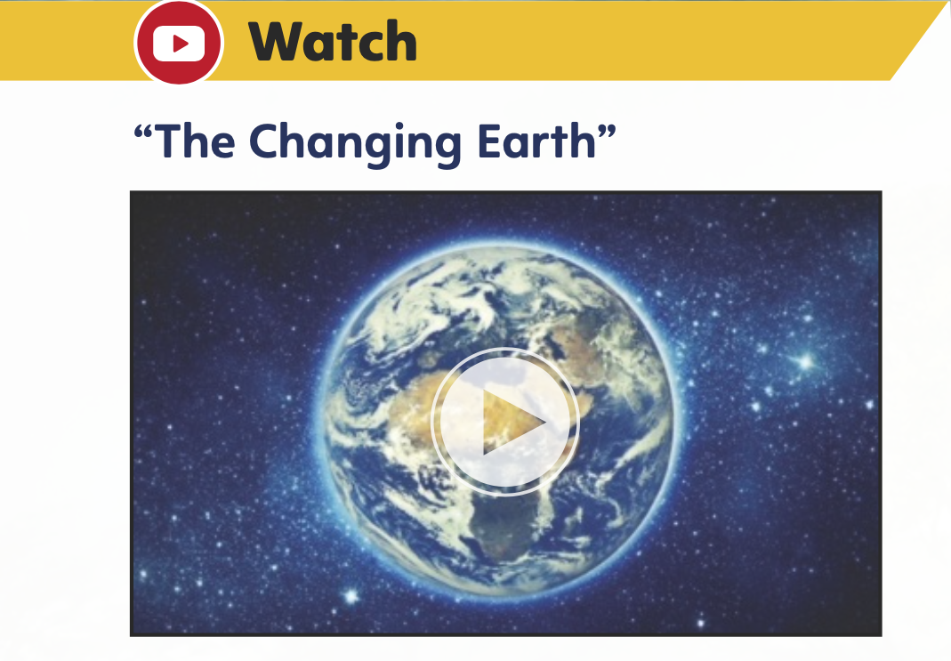
Page 420
Introduce the Unit - Systems
Essential Question: How do elements of systems change?
What changes do you see on earth?
What did you learn from the pictures?
Notes:
Introduce the Essential Question for Unit 5: How do elements of systems change? Tell students they will read many texts to explore how natural systems change.
Explain that reading a variety of genres about a similar topic provides students with different perspectives from authors and helps to broaden students’ understanding of the topic.
Watch the Unit Video – Have students watch the Unit 5 video, "The Changing Earth," and take notes on the types of systems shown in the video. Click Path: Table of Contents -> Unit 5: Systems> Unit 5: Introduction
Encourage partners to discuss what changes they see on Earth. Use the following questions to guide their discussions.
What images in the video did you find most memorable?
What did you learn from the audio that you did not learn from the images?

Slide 4
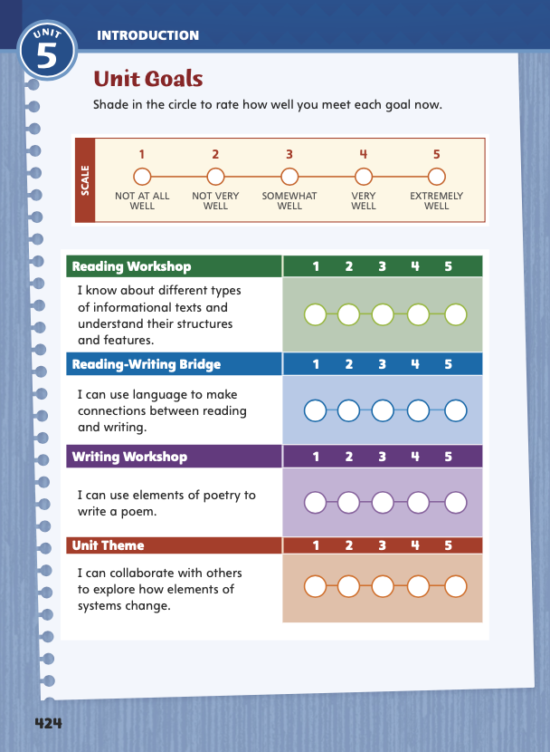
Page 424
Unit Goals
Turn to page 424 in your
Student Interactive.
Rate how well you think you already meet the unit goals.
Notes:
1. Review the Unit Goals on p. 424 of the Student Interactive.
Have students rate how well they think they already meet the unit goals.
Have them use their ratings to reflect on how well they are meeting their personal learning goals during the unit.
2. Students will revisit their ratings in Week 6.

Slide 5
Academic Vocabulary
Expand: A person who disturbs you interrupts what you are doing.
Ask: When is it appropriate to disturb someone who is busy?
Expand: A cycle repeats the same process in the same order.
Ask: What cycles in nature have you read about?
Expand: A bicycle helmet protects your head from the impact of a fall.
Ask: What invention has had a great impact on communication?
Expand: A powerful play is composed of many dramatic elements..
Ask: What is water composed of?
Expand: A software engineer plans and builds computer programs.
Ask: What other things do different engineers build?
Notes:
Academic vocabulary is language used to discuss ideas. As students work through the unit, they will use these words to discuss systems.
Read each word's definition.
Have students respond to the Expand and Ask questions using the newly acquired academic vocabulary as appropriate.

Slide 6
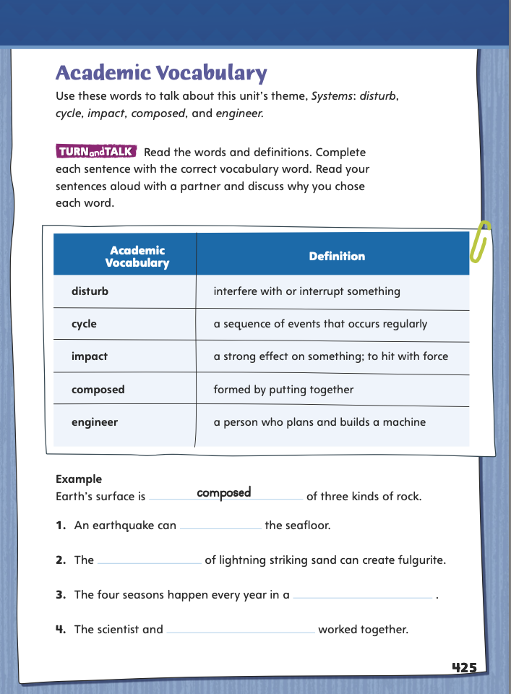
Page 425
Academic Vocabulary
Complete the sentences on page 424 in your Student Interactive.
Notes:
Have students use the Academic Vocabulary to complete the sentences on p. 425.
Have partners share their answers.

Slide 7
Lesson 1

Slide 8
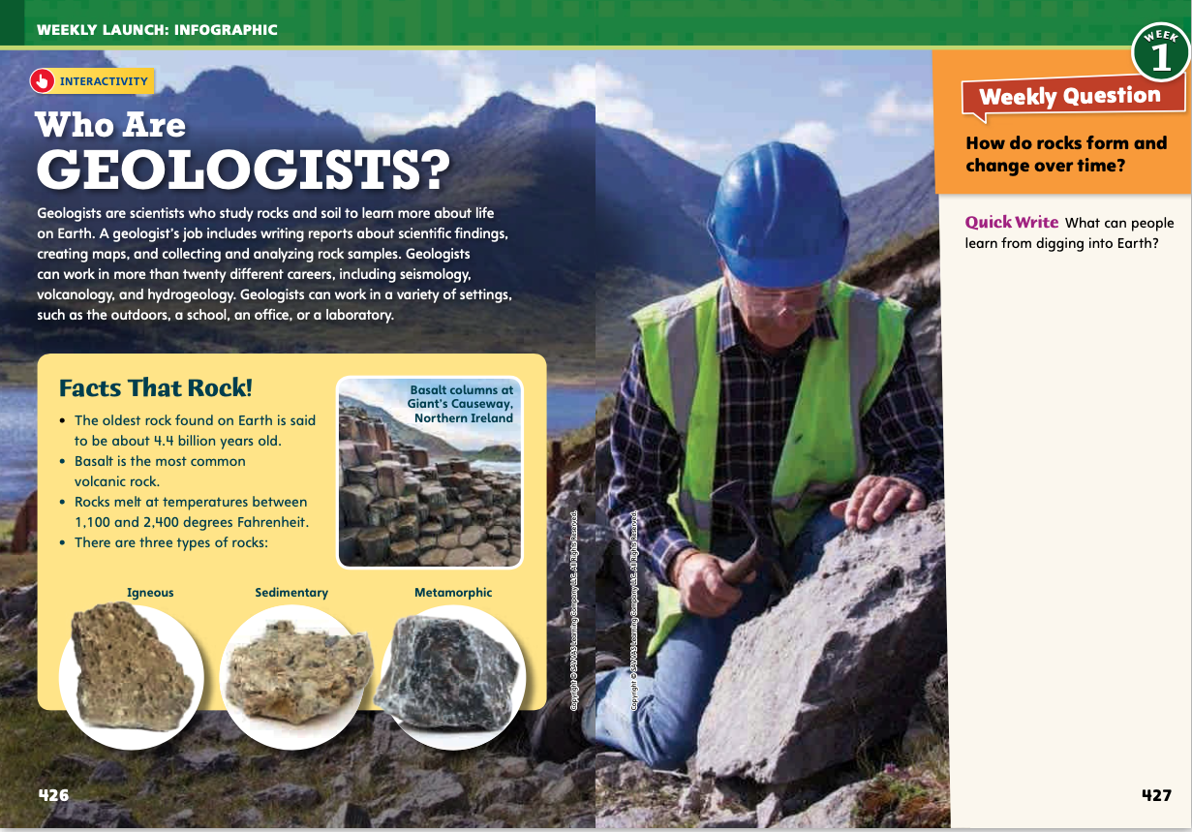
Page 426,427
Interact with Sources
Answer the Quick Write question.
Notes:
Remind students of the Essential Question for Unit 5: How do elements of systems change? Point out the Week 1 Question: How do rocks form and change over time?
Direct students’ attention to the infographic on pp. 426–427 in the Student Interactive.
Have students read the infographic and discuss the different ways that geologists study rocks.
As you lead students in their discussion, guide them to build on the ideas of others and to express their own ideas clearly.
What facts about geologists surprised you?
Which detail about rocks did you find most interesting?
What is one inference you can make from the infographic? Name at least one piece of evidence that supports that inference.
Reread the Week 1 Question: How do rocks form and change over time? Tell students that they just learned about a few different kinds of rocks and the scientists who study them. Explain that they will read more about rocks and geologists this week.
Have students freewrite their answer to the Quick Write question on p. 427 and then share their responses.

Slide 9
Listening Comprehension
What Do Geologists Study?
Notes:
Tell students you will read aloud an informational text. Have them listen as you read “Geologists at Work”.
Remind students to listen actively as you read and note any characteristics that help them identify the text as informational. Prompt students to ask relevant questions and make pertinent comments. Have students report on what they heard by summarizing the text. They should include the passage’s text features, topic, key details, and organization
Read-Aloud Routine
Purpose: Have students actively listen for elements of informational text.
READ the entire text aloud without stopping for Think Aloud callouts.
REREAD the text aloud, pausing to model Think Aloud strategies related to the genre and informational text features.
THINK ALOUD: The first thing I notice as I start to read is the title, “Geologists at Work.” The title and first paragraph show me that the topic is geology, a kind of science. The first paragraph also has a fact about when geology was established. This tells me I’m probably reading an informational text about geology.
THINK ALOUD: As I continue reading, I notice three headings in the text. When I see text features like headings, I know I’m probably reading an informational text. Authors use headings to organize and highlight important information. Headings also tell me where I can find information I’m looking for.
Use a word web to help students list things and processes that geologists study.

Slide 10
Page 428,429
Informational Text
Turn to page 428 in your Student Interactive.
Notes:
Informational texts contain facts, details, and domain-specific language that inform readers about a topic. Authors use headings and subheadings to organize and clarify information. Bold or italic print help readers quickly identify important terms and details. Text features, such as insets and sidebars, point out additional information and enhance the text. Graphics, such as diagrams, graphs, maps, and photos, help to make information clearer.
Think about how the information is structured. What text features and formatting are used to organize and clarify details?
Ask yourself how these characteristics and structures help you understand information in the text.
Model analyzing informational text. Say: In “Geologists at Work,” I notice that the author structures the text with headings. Each heading lists what the section is about. I ask myself, “How do these features help me understand the text?” They help me identify the main ideas, which tell what geologists study and why their work is important.
Discuss other examples of informational text that students have read.
Have students use the strategies to identify informational text.
Read the Anchor Chart on page. 429 in the Student Interactive together. Editable Anchor Chart Click Path: Table of Contents -> Reading Anchor Charts -> Unit 5 Week 1: Informational Text Editable Reading Anchor Chart

Slide 11
Page 428
Apply
Describe an informational text you have read. What elements does it include?
Notes:
Have students use the strategies to identify informational text.
Have students work with a partner to complete the Turn and Talk on p. 428 of the Student Interactive. Circulate to discover whether students can recognize features of informational text.

Slide 12
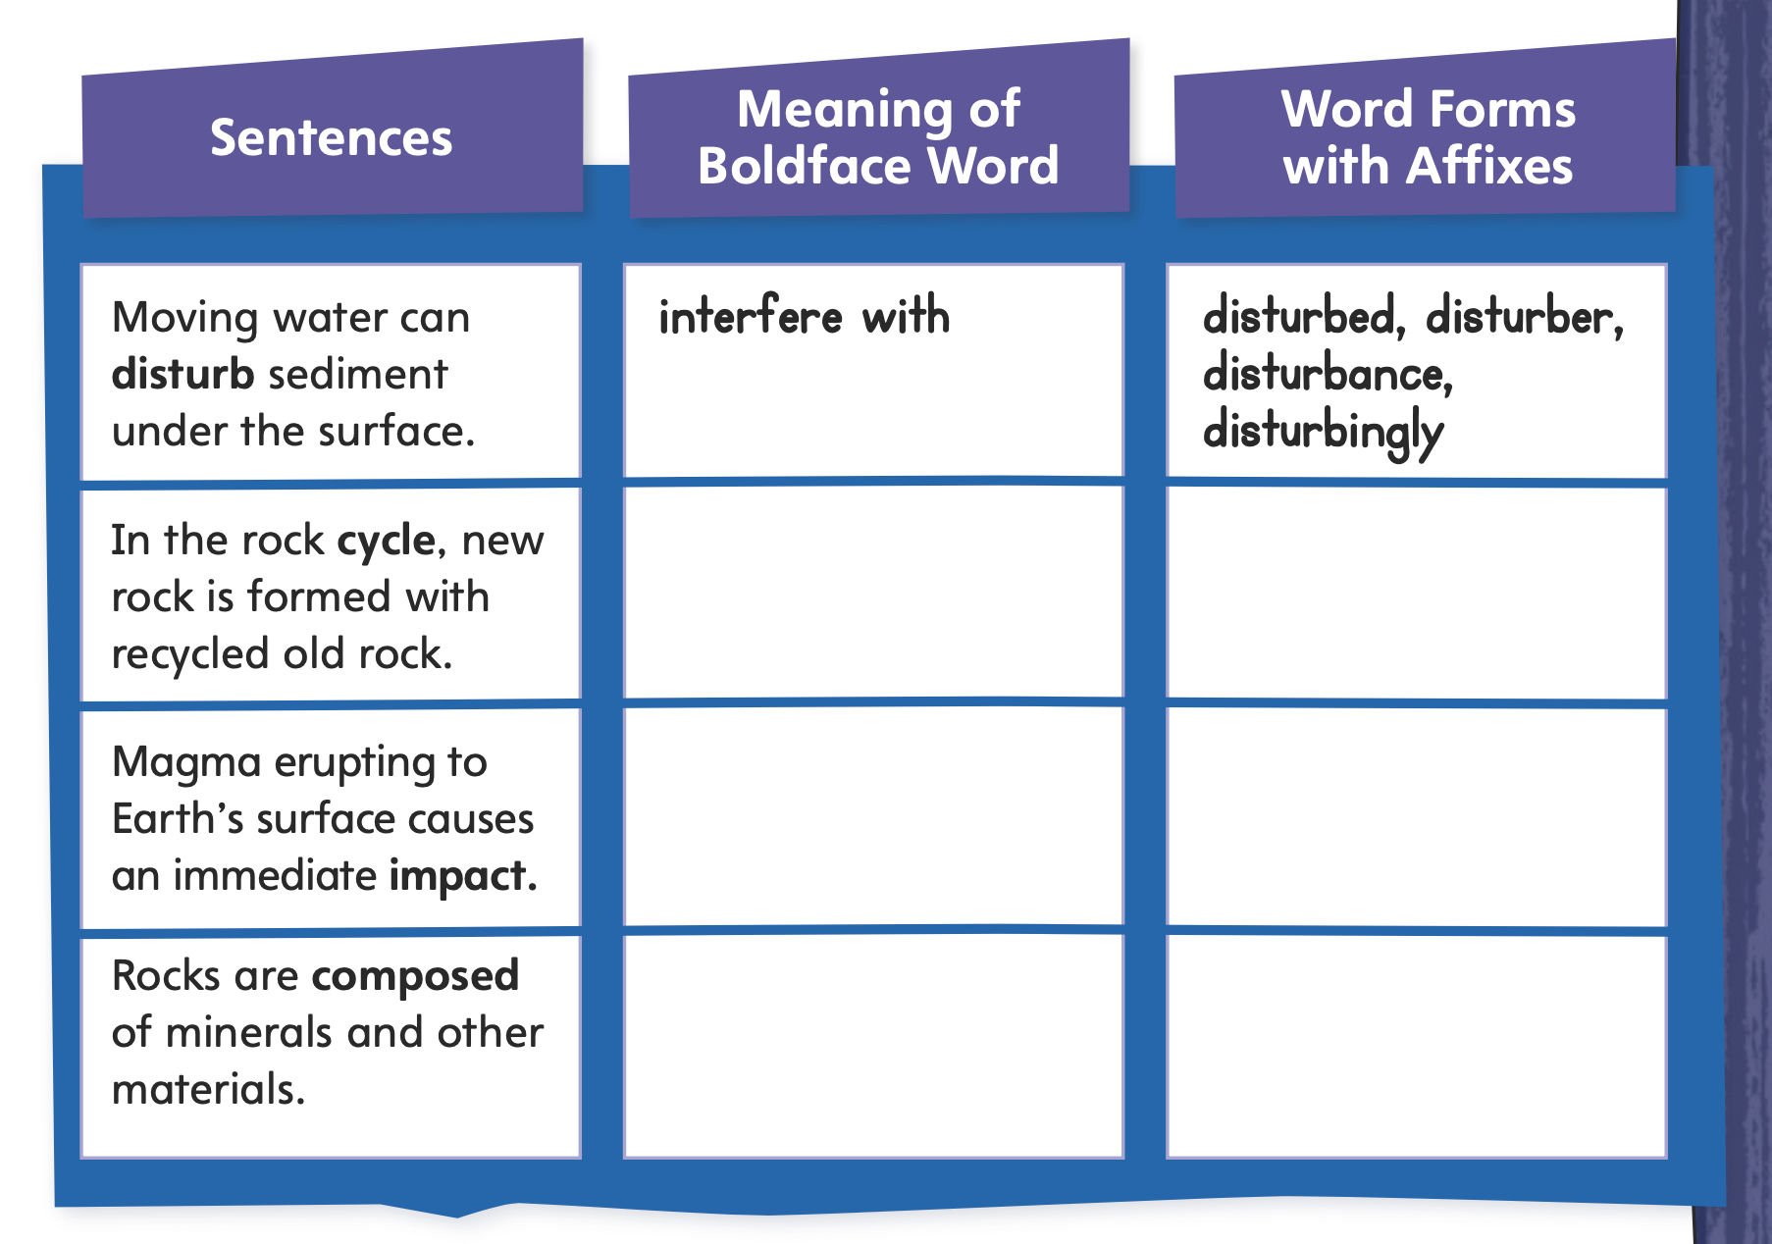
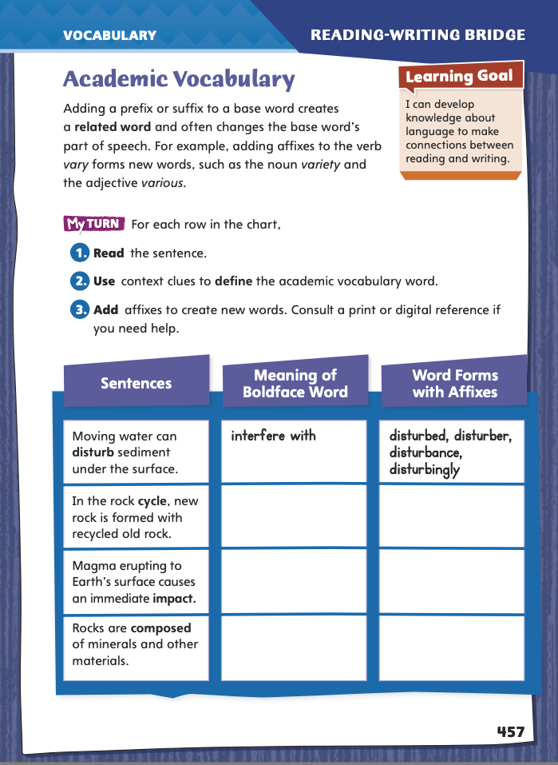
Page 457
Academic Vocabulary
Complete the chart on pg. 457 in your Student Interactive.
Notes:
Explain that related words share the same root or base word. Their meanings are related but differ based on their affixes (prefixes and suffixes). Adding an affix often also changes the part of speech. Tell students:
Look for a word that has the same word part or is spelled similarly.
When you come across an unfamiliar word, study its context for clues to its meaning.
Add affixes to create related words with the same root or base word.
Make a guess about the meanings and parts of speech of the related words, and check your guesses in a print or digital dictionary.
Model this strategy using the Academic Vocabulary word disturb. Say: From the sentence “Moving water might disturb the sediments,” I might guess that disturb means “interfere with.” That would give me an idea of the meaning of the related words undisturbed and disturbance, because I know that the prefix un- means “not” and the suffix -ance usually forms nouns. So I would guess that undisturbed means “not interfered with” and a disturbance is “something that interferes with.”
Have students work on their own to apply the strategy to another word from the chart.
Discuss responses and correct misunderstandings.
Have students follow the same strategy as they complete the chart on p. 457. Remind students that they will use these academic words throughout this unit.

Slide 13
Word Study
select
selection
rotate
rotation
Notes:
Explain that consonant sounds sometimes change when suffixes are added, even when the spelling still uses the same consonant.
Point to the word select and have students say it, pronouncing the final /t/ sound. Then point to selection and have students say that. Point out that the /t/ sound has changed to the /sh/ sound even though selection is still spelled with a t.
Repeat the process with the words rotate and rotation and instruct and instruction, noting that rotate ends with a t in this case followed by a silent e, that instruct ends with a final /t/ sound, and that in both cases the sound becomes /sh/ when the suffix is added.
Guide students to think of related words with similar consonant changes. Encourage them to check pronunciations in print or digital dictionaries, if needed.

Slide 14
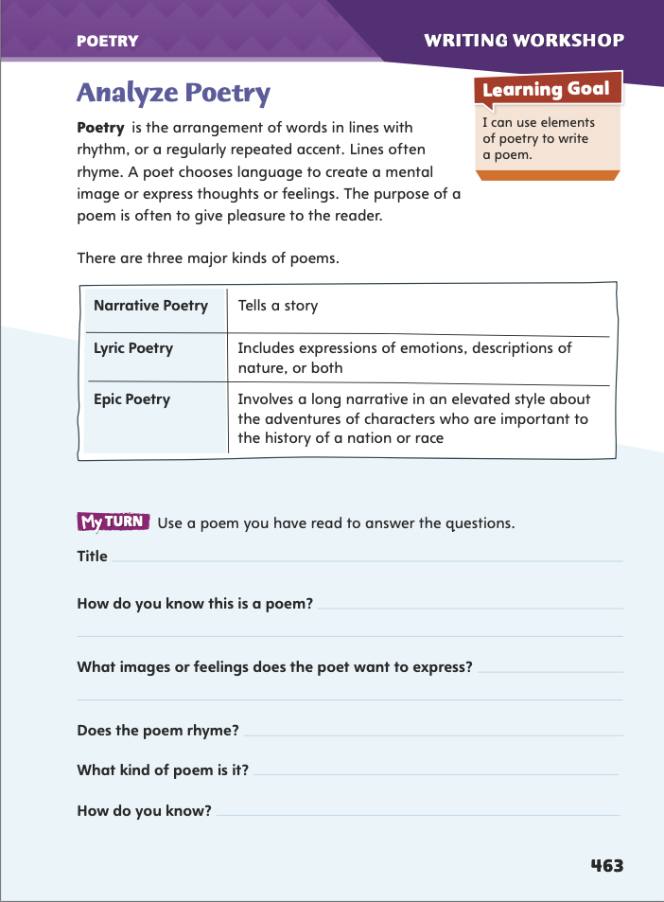
Page 463
Writing – Poetry
Turn to page 463 in your Student Interactive.
Use poems from the stack to answer the questions.
Notes:
1. Poets use language to paint a picture or create a feeling. They usually arrange carefully chosen words in lines. Poets
Choose the type of poem to best achieve their purpose.
Use language in unique, memorable ways to provoke certain feelings or images in the reader.
Use rhythm and rhyme to create a musical quality. \
Tell students that they will be exploring many different kinds of poems over the next few days in preparation for writing their own poems.
2. Read aloud a poem’s title from the stack and ask students what they think the poem will be about. Then read aloud and discuss.
Have students identify the poet’s intention or purpose. Is the poet telling a story, expressing emotions, giving a description, or recounting in elevated style a long narrative of a heroic adventure?
Have students name memorable descriptive language or images from the poem.
Invite students to name other features of the poem, such as use of stanzas, rhythm, or rhyme.
3. Direct students to p. 463 in the Student Interactive. Have them use other poems from the stack to complete the activity.

Slide 15
Independent Writing
Choose a poem from the stack. Identify the type of poem and the poetic features.
Write in your writing notebook the type of poem you would like to write and the features to include in it.
Notes:
After the minilesson, students should transition into independent writing.
If students need additional opportunities to develop their understanding of poetry, they should read more poems from the stack.
Modeled Choose a poem from the stack and do a Think Aloud to model identifying the poet’s purpose. Note memorable or descriptive language and comment on the form.
Shared Have students choose a poem from the stack. Prompt them to identify the type of poem and the poetic features.
Guided Use poems from the stack to provide explicit instruction on the poem’s defining qualities (purpose, language, and form).
If students demonstrate understanding, they should transition to identifying in their writing notebooks the type of poem they would like to write and the features to include in it. See the Conference Prompts on p. T332.
Call on students to share how poetry is different from other genres. Invite them to name qualities poems have in terms of purpose, language, content, and form.

Slide 16
Spelling
I would not want to live in complete isolation.
Will you select a song to play?
He is a fine musician.
If you hesitate to swing the bat, you may miss the ball.
I could see a look of frustration on his face.
We will elect a new class president.
Is she a scientist or a mathematician?
I did not get a shot at the clinic.
A politician might run for governor or mayor.
Having a good coordination helps you dance.
Notes:
(Note: Move the orange boxes to cover each bold spelling word before you read aloud the words and sentences.)
Use the sentences from Lesson 5 Spelling, p. T352 to assess students’ prior knowledge of consonant changes.
I would not want to live in complete isolation.
Will you select a song to play?
He is a fine musician.
f you hesitate to swing the bat, you may miss the ball.
I could see a look of frustration on his face.
We will elect a new class president.
s she a scientist or a mathematician?
I did not get a shot at the clinic.
A politician might run for governor or mayor.
Having good coordination helps you dance.
For students who understand rules for consonant changes, include the following Challenge Words with the spelling list.
Challenge Words: esthetics, esthetician, diagnostician

Slide 17
Language and Conventions
Since last year, dr. h. Sharp has worked at the clinic inside the vfw building.
Create your own sentences using capitalization of abbreviations, initials, acronyms, and organizations.
Notes:
Review rules and strategies for capitalization.
Tell students to look closely at this sentence for capitalization mistakes: Since last year, dr. h. Sharp has worked at the clinic inside the vfw building
Capitalize VFW as you explain that it is an abbreviation that stands for Veterans of Foreign Wars
Guide students to specify other abbreviations and initials that need to be capitalized, such as Dr. and H.
As a class, brainstorm a list of abbreviations, initials, acronyms, and organizations that need capitalization.
Have students create sentences of their own, using correct capitalization of abbreviations, initials, acronyms, and organizations.

Slide 18
Lesson 2

Slide 19
Page 430
Preview Vocabulary
minerals
particles
deposits
erosion
principles
Notes:
Introduce the vocabulary words on p. 430 in the Student Interactive and define them as needed.
minerals: solid substances made of one or more simple chemicals
particles: very small pieces of matter
deposits: amounts of something left in one place by a natural process
erosion: a slow process of being worn away
principles: general theories or facts
Say: These words will help you understand what you read and see in Rocks and Fossils. What do you already know about them? What can you predict about the text based on what you know about them? As you read, highlight the words and ask yourself how they connect to main ideas and details.

Slide 20
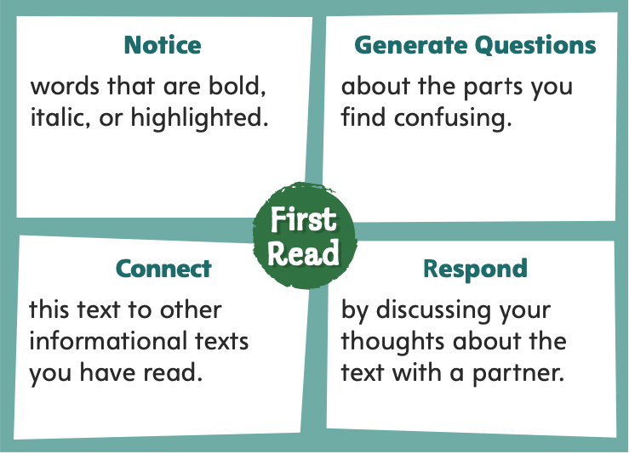
Page 430
First Read Strategies
Notes:
Discuss the First Read Strategies with students.
Prompt students to establish that the purpose for reading this text is to learn and understand information.
Explain the four steps of the first read.
NOTICE Tell students to focus on words the author emphasizes through the use of bold print, italics, or highlighting.
GENERATE QUESTIONS Encourage students to ask questions about words, sentences, and features they find confusing.
CONNECT Have students connect this text to other informational texts they have read.
RESPOND Have students respond to the text by sharing their thoughts about the text with a partner.
Students may read independently, in pairs, or as a class. Use the First Read notes to help them connect with the text and guide their understanding.

Slide 21
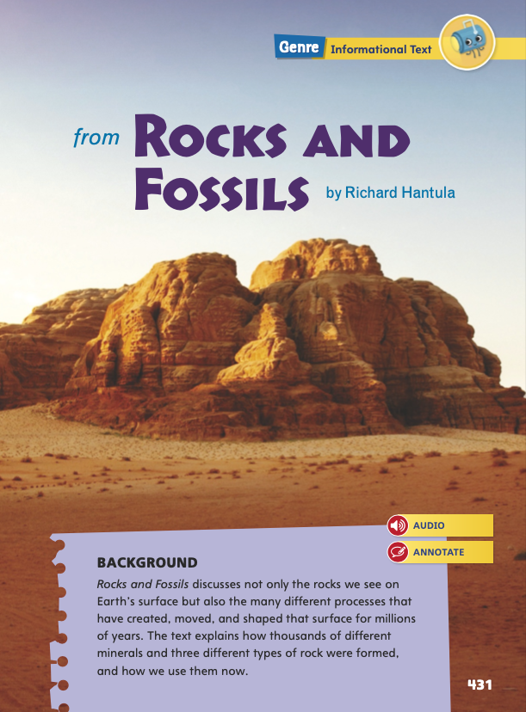
Page 431
First Read – Rocks and Fossils
Notes:
Students may read independently, in pairs, or as a class. Use the First Read notes to help them connect with the text and guide their understanding.

Slide 22
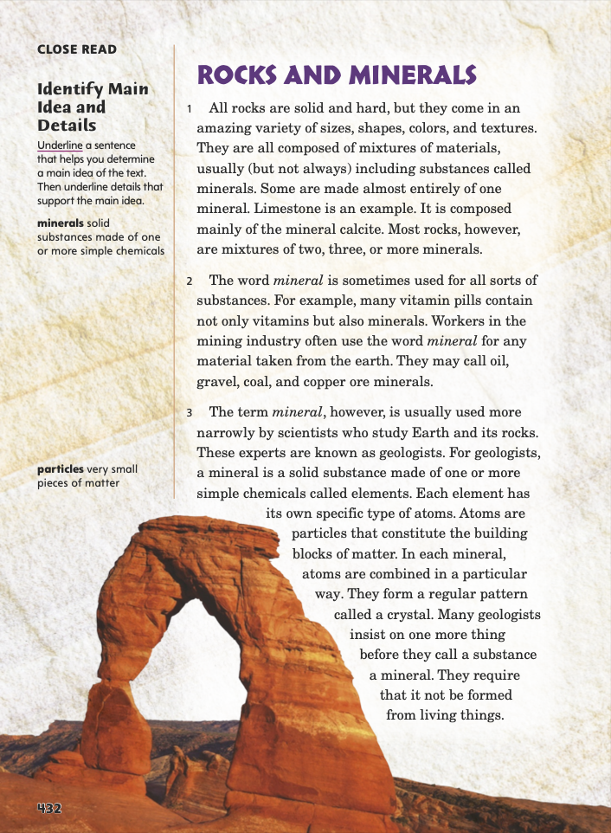
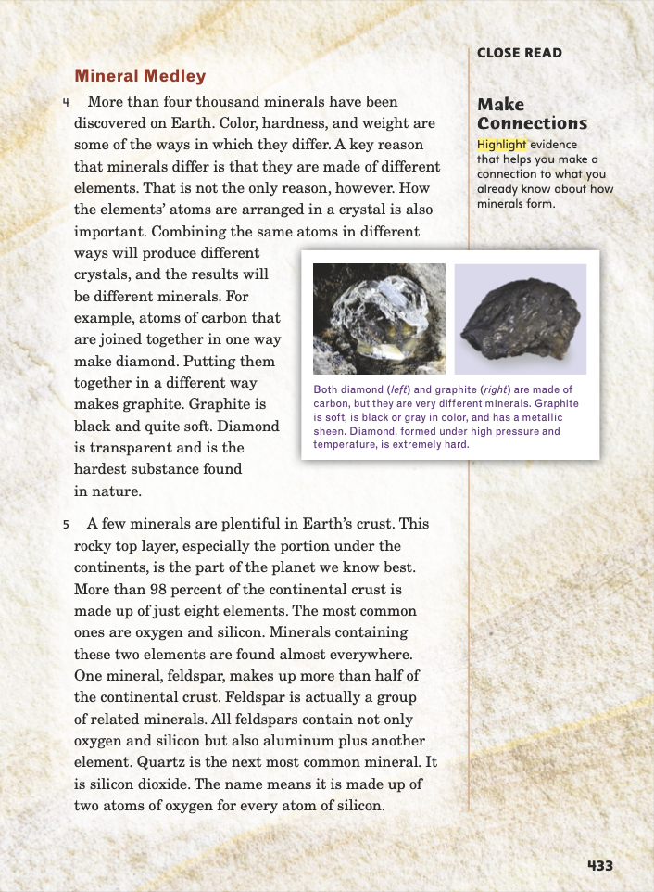
Page 432, 433
First Read – Rocks and Fossils
Notes:
Read Together.
THINK ALOUD: I notice that the word mineral in paragraph 2 is in italics. This tells me that the author is explaining what the word means and how it is used. Italics usually signal a key term that tells about an important idea in the text.
THINK ALOUD: Most of this information is new to me, so I have a lot of questions. For example, I wonder how many minerals are in Earth’s crust. How many of Earth’s 4,000 minerals can be found in Earth's crust?

Slide 23
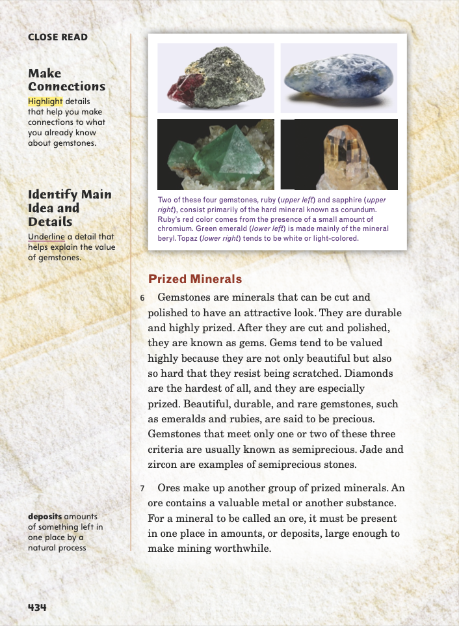
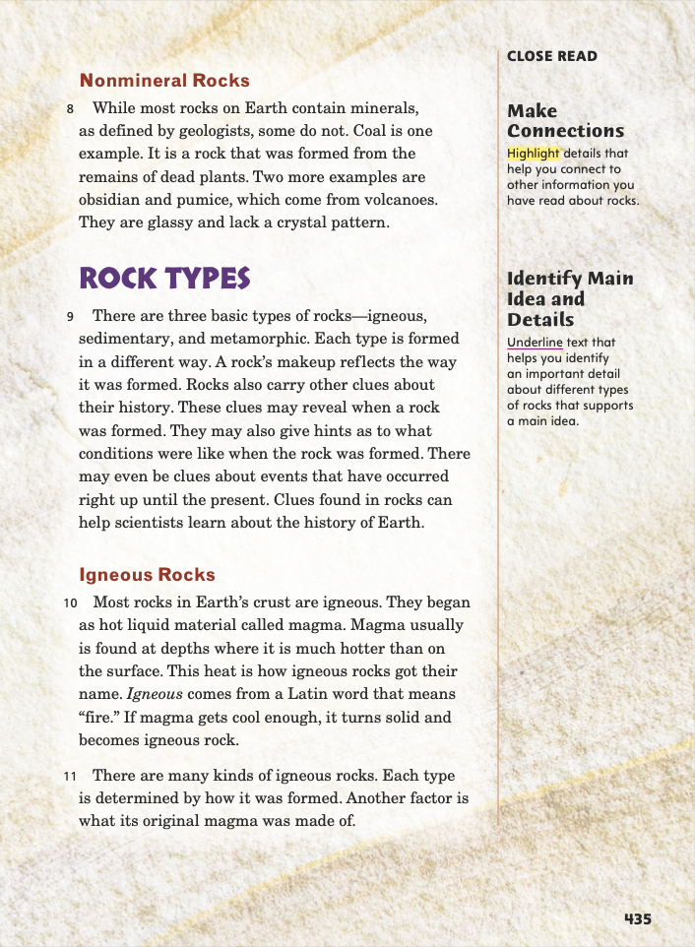
Page 434, 435
First Read – Rocks and Fossils
Notes:
Read Together.
RESPOND: Have pairs discuss paragraphs 6 and 7.
Ask: What did you already know about gems? What did you learn about them from the text?
Possible Response: I already knew that diamonds are valuable gems. I learned from the text that gems are called gems only after they are cut and polished. Before that, they are called gemstones.
THINK ALOUD: I notice that the term igneous in paragraph 10 is in italics, which tells me I should pay attention to the term because it is important to the main ideas of the text.

Slide 24
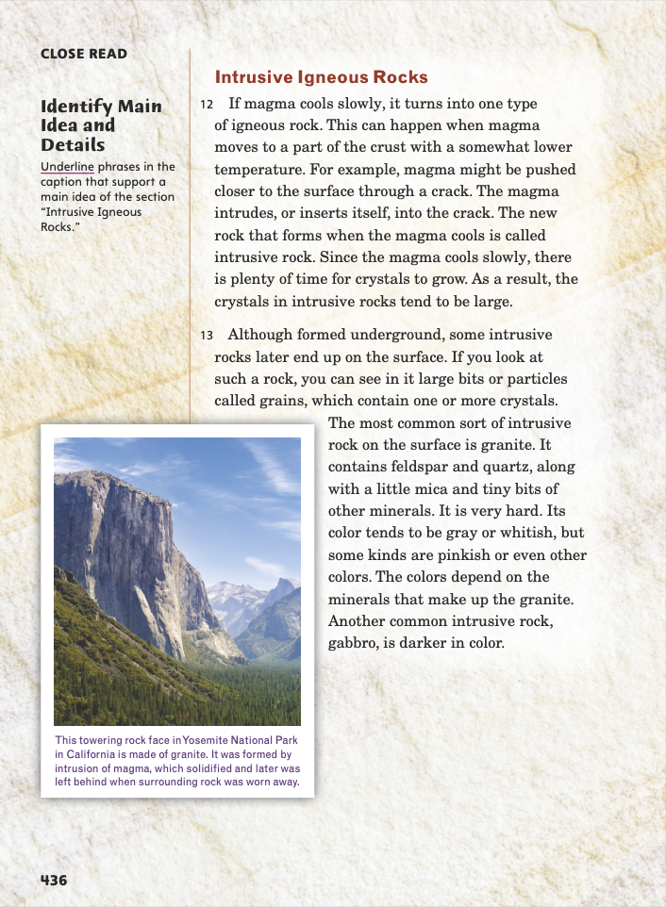
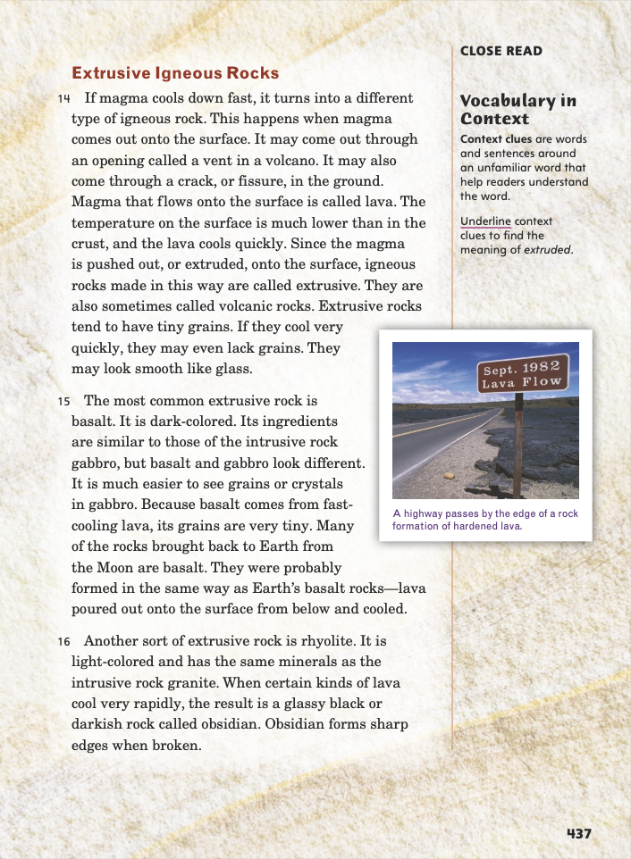
Page 436,437
First Read – Rocks and Fossils
Notes:
Read Together.
THINK ALOUD: I wonder what determines whether magma cools slowly or quickly. Also, if intrusive rocks form underground, how do they end up on the surface? I’ll keep reading to see whether my questions are answered.
THINK ALOUD: I notice that paragraph 15 talks about a kind of rock called basalt. It indicates that basalt is the most common extrusive igneous rock. The infographic on pages 426 and 427 also talks about basalt. It says that basalt is the most common volcanic rock. That connects with the information here, since volcanic rocks are igneous rocks.

Slide 25
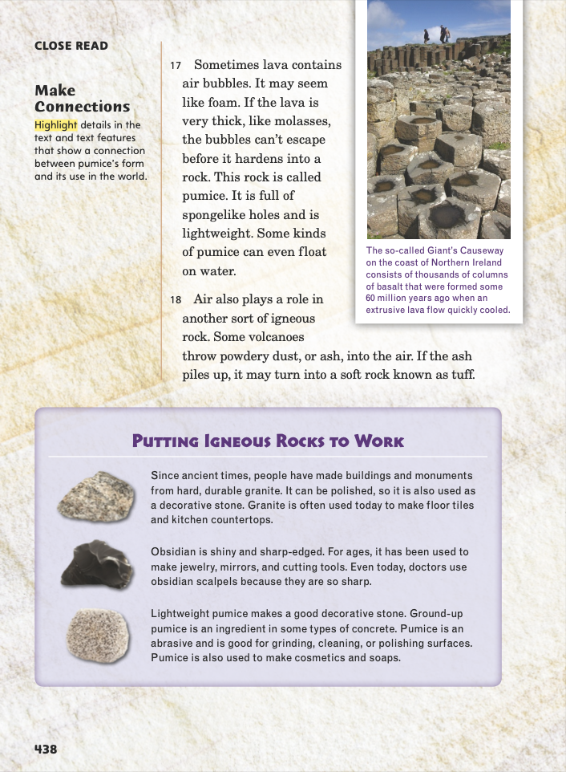
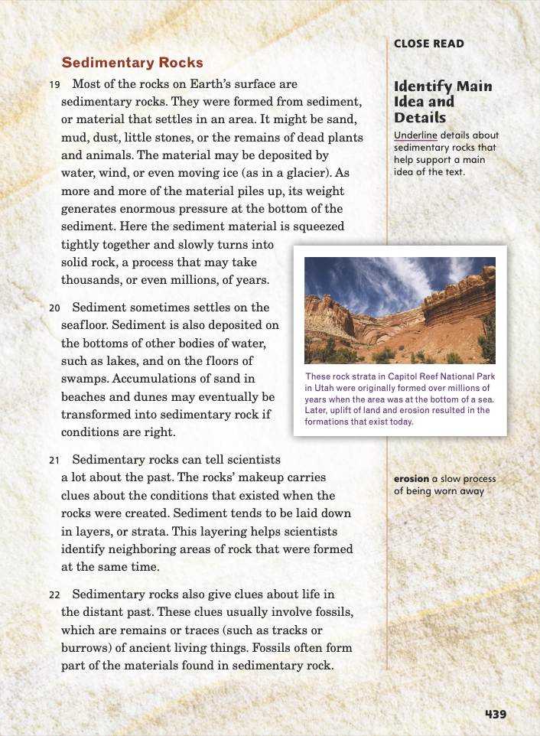
Page 438,439
First Read – Rocks and Fossils
Notes:
Read Together.
RESPOND: Have partners discuss the use of text features and graphics on p. 438. Ask: What is one detail in the text that is supported by the inset at the bottom of the page? What is one thing you learn from the inset that the text does not tell you?
Possible Responses: The detail that pumice is “full of spongelike holes” is supported by the inset. One new detail in the inset is how people use granite, obsidian, and pumice.
THINK ALOUD: I was surprised to see in paragraph 22 that fossils often form some of the materials found in sedimentary rock. This confuses me because I thought fossils were rocks. I wonder how rocks are different from fossils?

Slide 26
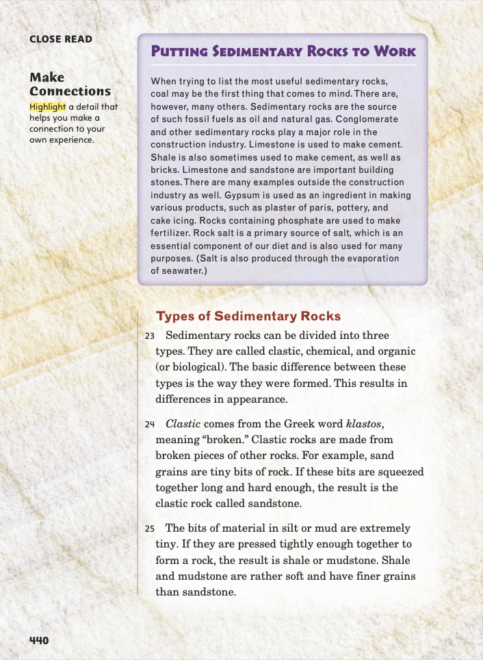
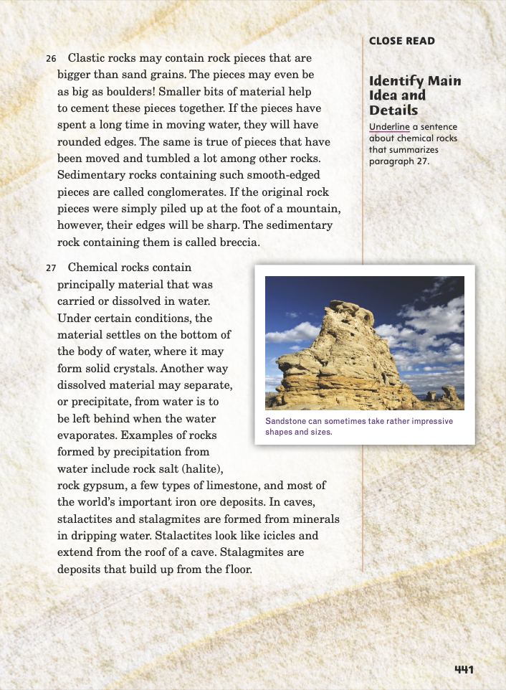
Page 440,441
First Read – Rocks and Fossils
Notes:
Read Together.
THINK ALOUD: In paragraph 24, I see two more italicized words, clastic and klastos. Klastos is the Greek origin of clastic, so klastos is in italics simply because it is a foreign word. But the italics for clastic show me that the term is important.
RESPOND: Have pairs compare and contrast igneous and sedimentary rocks. Ask: How are igneous rocks different from sedimentary rocks? What do the two types of rocks have in common?

Slide 27
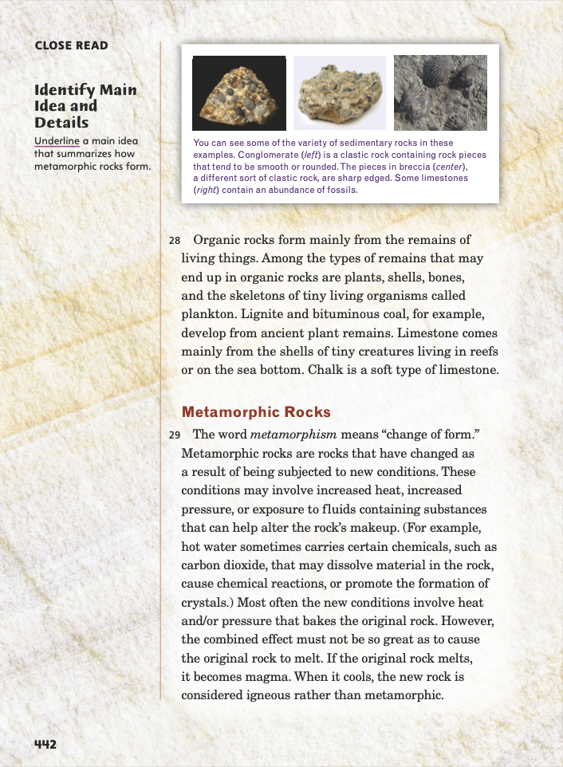
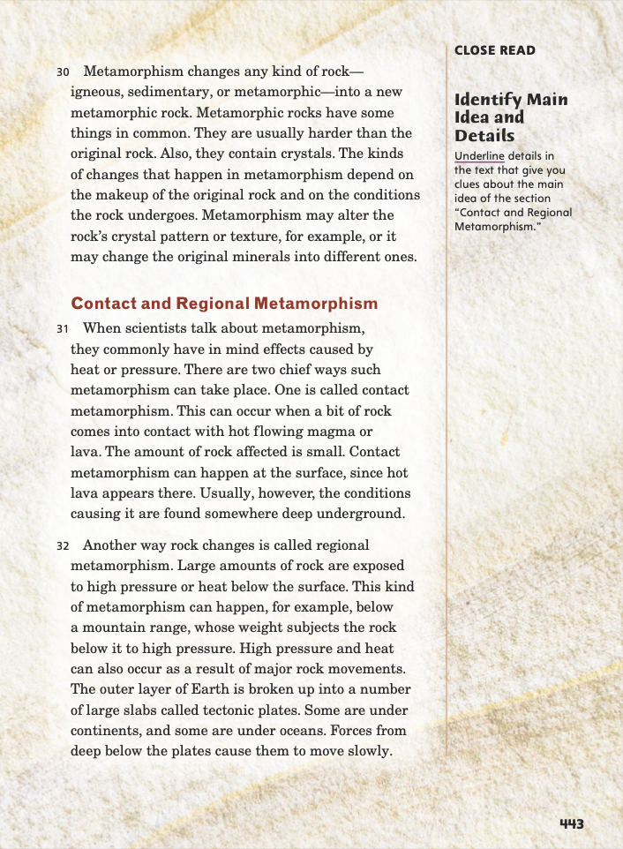
Page 442, 443
First Read – Rocks and Fossils
Notes:
Read Together.
THINK ALOUD: I see that paragraph 29 says heat can cause rocks to melt. This connects with the information I read in the infographic on pages 426 and 427. The infographic told me at what temperatures rocks melt.
THINK ALOUD: I’m a little confused about metamorphic rocks. When is a rock still in its original form, and when is it considered a metamorphic rock? How can scientists tell when metamorphism is complete? How can a metamorphic rock change into a new metamorphic rock?

Slide 28
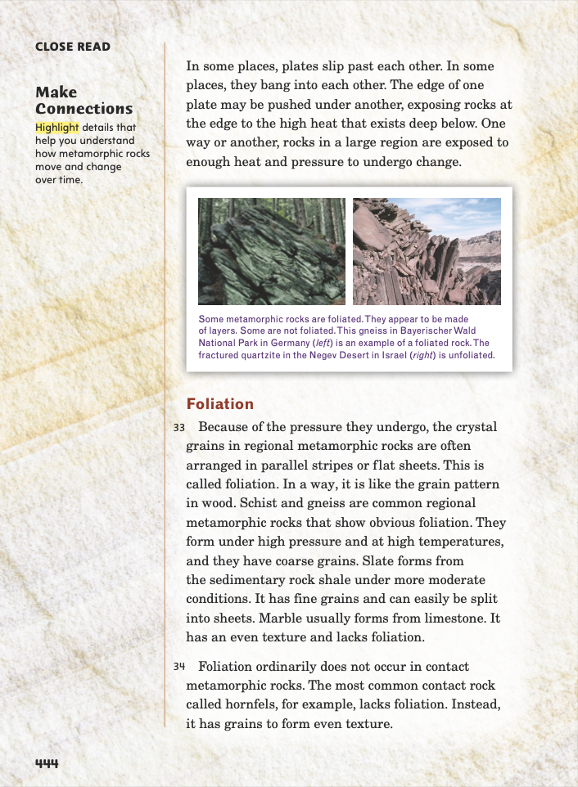
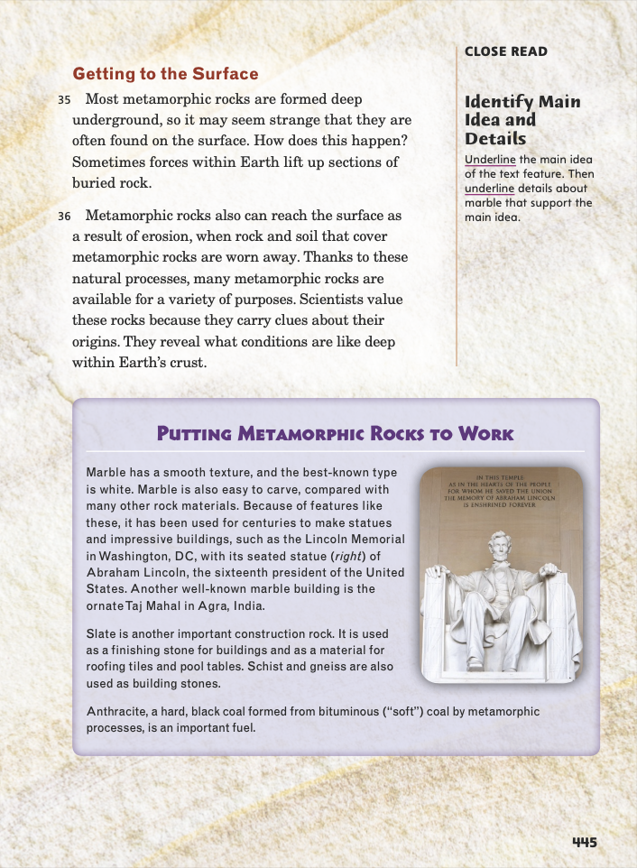
Page 444, 445
First Read – Rocks and Fossils
Notes:
Read Together.
RESPOND: Have partners discuss these questions:
What have you learned about rocks so far?
What facts do you find the most surprising or interesting, and why?
Possible Response: I’ve learned that there are three kinds of rocks, and they are identified based on how they form. The fact that rocks can change from one form to another surprised me because I didn’t know that rocks could change that much.
THINK ALOUD: I see that paragraph 36 on page 445 explains why scientists value metamorphic rocks. I remember that “Geologists at Work” also discussed why geologists value rocks and other materials found underground. I think it said that studying these materials can reveal a lot about Earth’s past, such as how it formed and how it has changed over time.

Slide 29
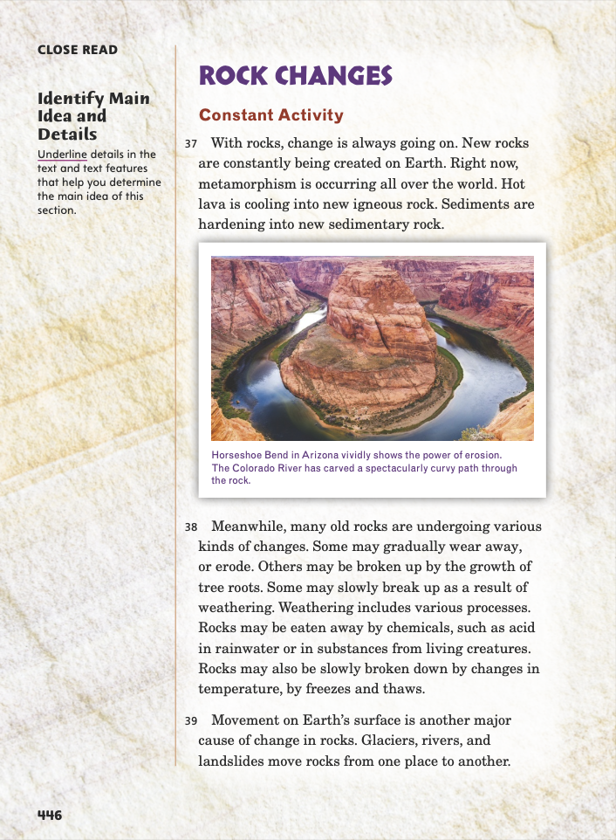
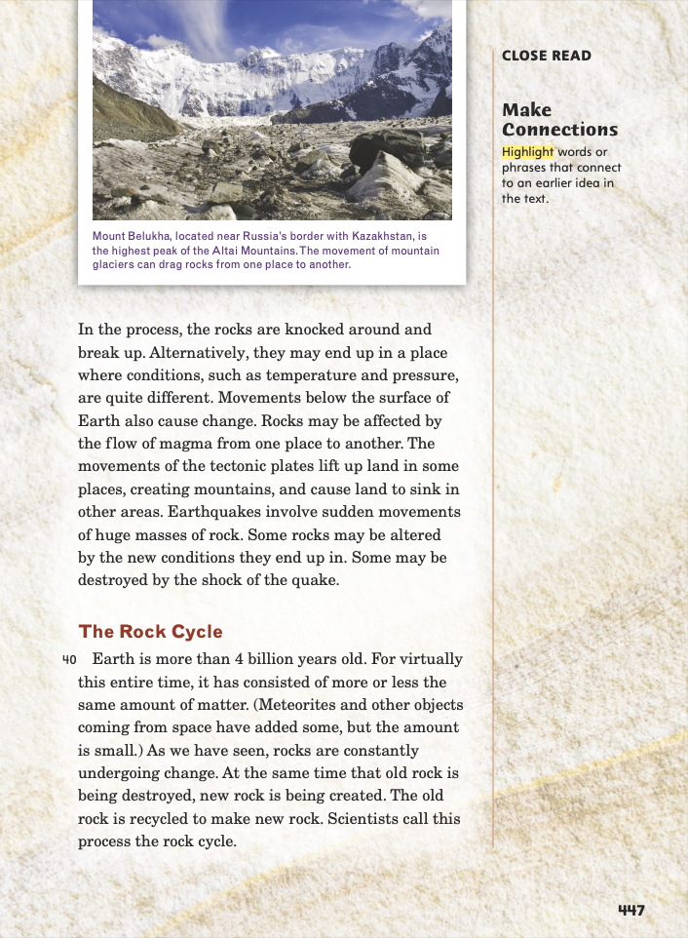
Page 446, 447
First Read – Rocks and Fossils
Notes:
Read Together.
RESPOND: How do the heading and subheadings help you understand the information on these pages?
Possible Response: The headings help organize the information into a main topic, “Rock Changes,” and two subtopics.
The subheadings also help me identify the section’s main idea. For example, the subheading “Constant Activity” helps me recognize that the main idea of the first section is that rocks are constantly changing.
THINK ALOUD: “Geologists at Work” also talked about earthquakes as one of Earth’s processes. It said it’s important for geologists to study earthquakes because the more geologists learn, the more they can help people prepare for earthquakes.”

Slide 30
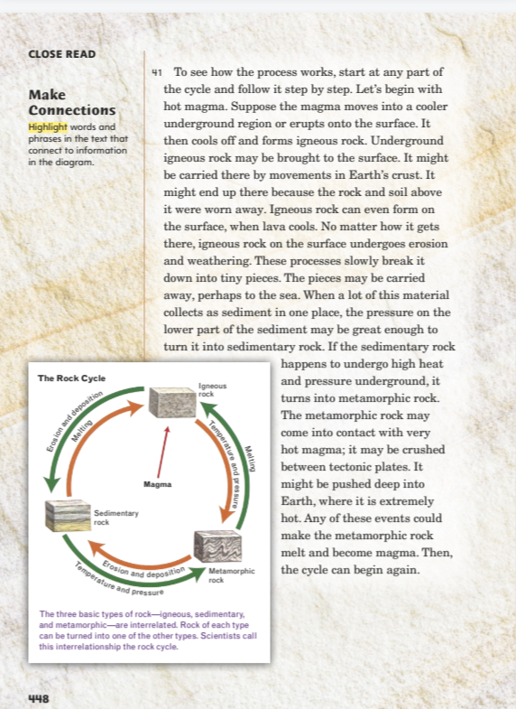
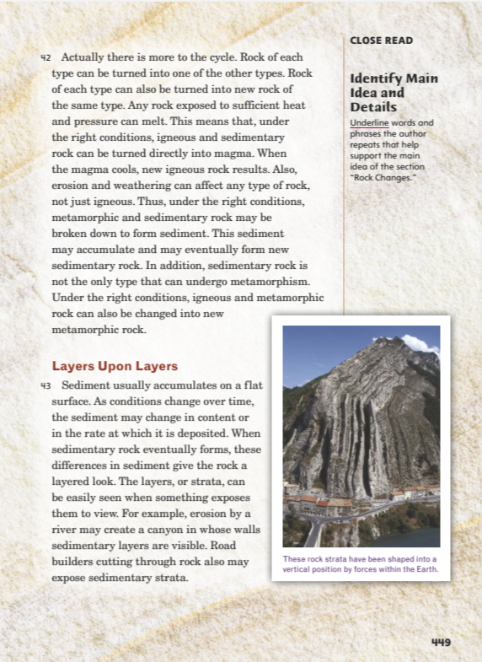
Page 448, 449
First Read – Rocks and Fossils
Notes:
Read Together.
RESPOND: Have pairs discuss the rock cycle.
Ask: What did you learn about the rock cycle? What text features did the author use to help you understand it? Did you connect the rock cycle with any other cycles you know about?
Possible Response: I learned that one type of rock can turn into another. The diagram helped me see how that happens. It reminds me of other cycles in nature, like the water cycle, in which water changes its state from liquid to gas when it evaporates.
THINK ALOUD: I see that the author repeats the phrase “under the right conditions” a few times. I wonder why he does that. What are the “right conditions”? Are they the same for each of the changes the author describes?

Slide 31
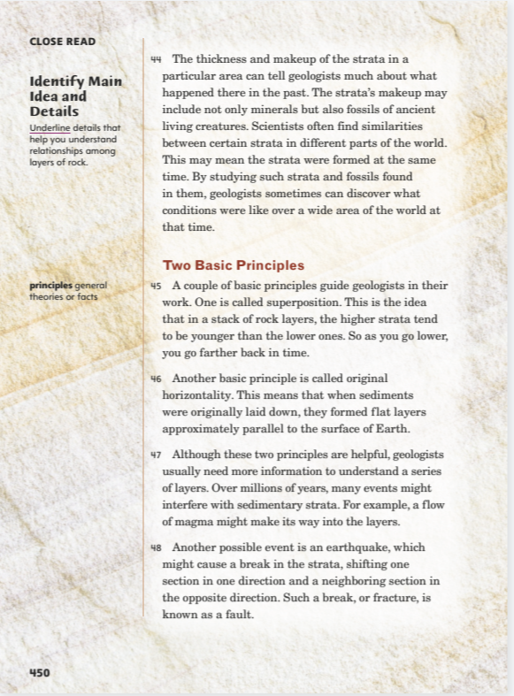
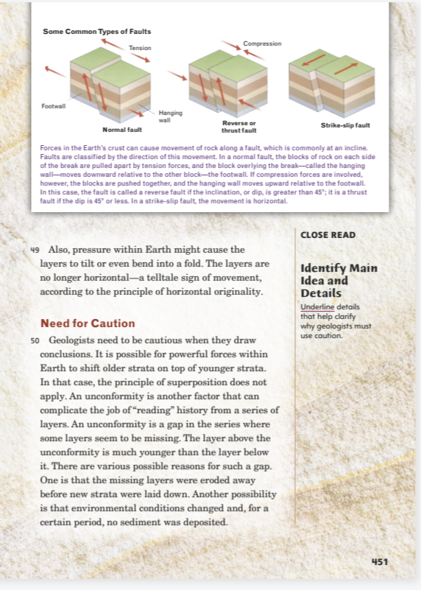
Page 450, 451
First Read – Rocks and Fossils
Notes:
Read Together.
THINK ALOUD: I think I understand how studying strata can give scientists clues about land shifts and other big events in the past. But what about fossils? Do fossils show something about what happened to the creatures who left them?
RESPOND: Have pairs discuss these questions: What parts did you like? What parts confused you? What facts did you learn?
4. Possible Response: I liked the part about gemstones and gems because those are my favorite kinds of rocks. I was a little confused by the parts about fossils. I learned how the rock cycle works and that rocks are constantly changing.
5. Then have students compare this text to another text they read this week.

Slide 32
Respond and Analyze
Brainstorm: What are some facts you learned about how rocks form and change over time?
Discuss: How did reading Rocks and Fossils interest you in geology?
Notes:
Use these questions to prompt students’ initial response to reading Rocks and Fossils.
Brainstorm: What are some facts you learned about how rocks form and change over time?
Discuss: How did reading Rocks and Fossils interest you in geology?

Slide 33
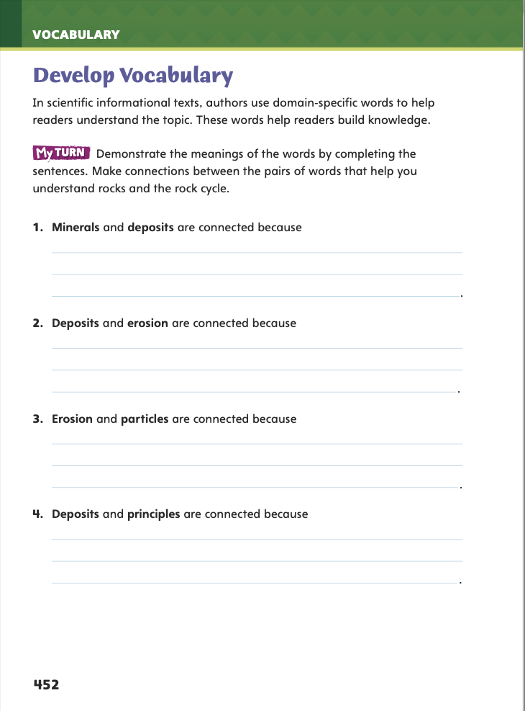
Page 452
Develop Vocabulary
Turn to page 452 in your Student Interactive and complete the sentences.
Notes:
Tell students that authors of informational texts often use domain-specific words to inform readers about their topics. The vocabulary words minerals, particles, deposits, erosion, and principles are all used in the domain, or field, of geology.
Remind yourself of each word’s meaning.
Ask yourself what the author is trying to tell you about geology.
Model making connections between domain- specific words: The text explains that mineral can have different meanings in different contexts. In this text it will refer to “a solid substance made of one or more... elements.” Later in the text, I find that a deposit is an amount of something left somewhere by a natural process. This is important because the amount of a mineral in one place, or the size of the mineral deposit, determines whether it is an ore that can be mined.
Have students use the strategies for developing vocabulary.
Have students respond using newly acquired vocabulary as they complete p. 452 of the Student Interactive.

Slide 34
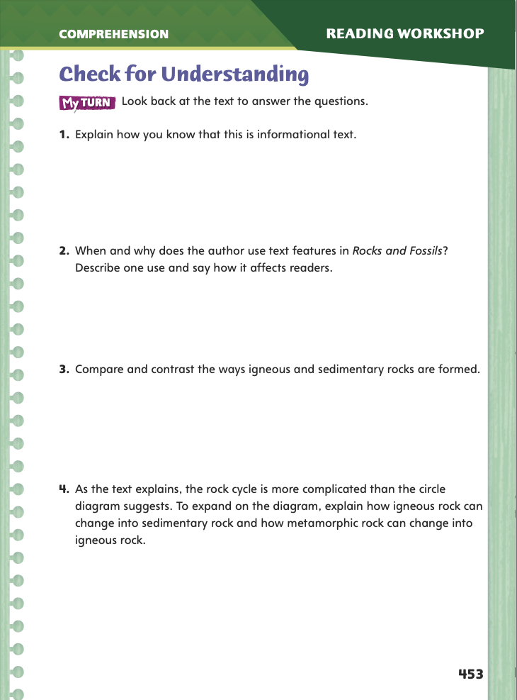
Page 453
Check for Understanding
Complete page 453 in your Student Interactive.
Look back at the text to answer the questions.
Notes:
Have students complete p. 453 of the Student Interactive.

Slide 35
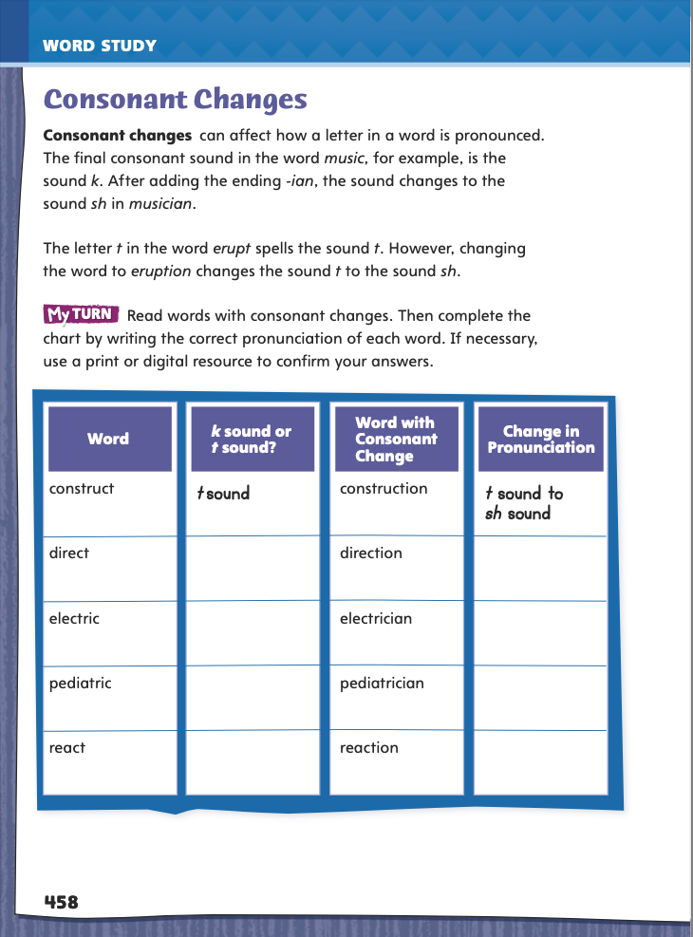
Page 458
Word Study – Consonant Changes
music
Turn to page 453 in your Student Interactive.
erupt
musician
eruption
Notes:
Discuss Student Interactive p. 458 with students.
Model consonant changes by displaying the words music and erupt. Have students decode and say the words, pronouncing the final /k/ and /t/ sounds.
Then write musician and eruption, and have students decode and say the words. Point out that both the /k/ and /t/ sounds changed to the /sh/ sound even though music and erupt are still spelled with a c and t respectively.
Direct students to complete the chart on p. 458. Then have students use a print or digital resource to confirm their answers.

Slide 36
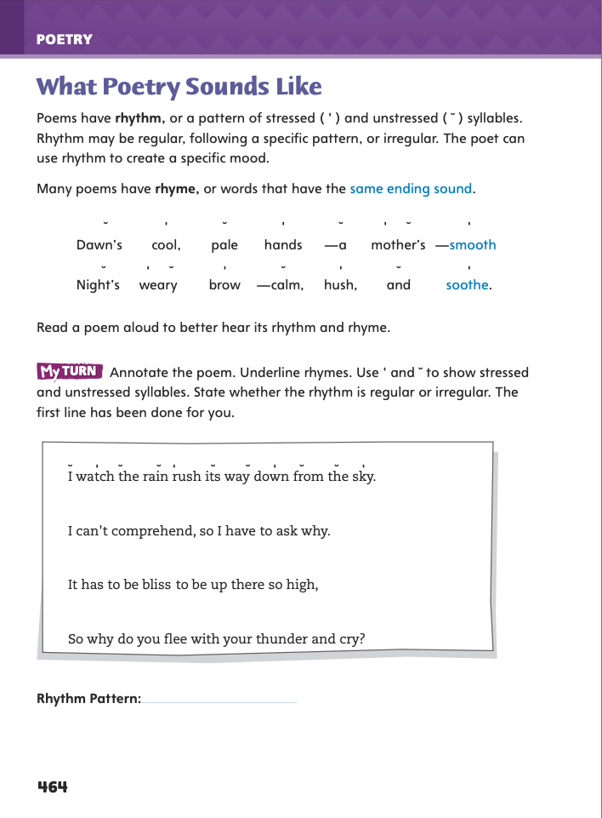
Page 464
Writing – Poetry
Turn to page 464 in your Student Interactive.
Notes:
Poets choose their words not only for their meaning but also for their sound. To make a poem sound musical, poets use rhythm and rhyme. Rhythm and rhyme also contribute to the mood, or overall feeling, of a poem. Poets focus on sound by:
creating a rhythm with stressed and unstressed syllables that may follow a regular pattern or no pattern.
using rhyming words, or words with the same ending sound, such as bite and bright.
Read aloud the two lines of poetry near the top of p. 464, emphasizing the rhyming words and the rhythm.
Read them again, inviting students to clap or tap on the stressed syllables to demonstrate the rhythm.
Point out the symbols used to mark stressed and unstressed syllables. Say: Poetry is often meant to be read aloud so that the rhythm and rhyme can be enjoyed. The sound can also evoke a mood or feeling. What mood is created by the rhythm and rhyme in this poem?
Use this process as needed with other poems from the stack until students demonstrate understanding of the contribution of rhythm and rhyme to a poem’s mood and music.
Direct students to the activity on p. 464 of the Student Interactive. Have them annotate the poem by marking the stressed and unstressed syllables and underlining the rhyming words at the ends of lines.

Slide 37
Independent Writing
Let’s review what we’re learning about poems.
Continue writing your own
poems using rhythm and rhyme.
Notes:
After the minilesson, students should transition into independent writing.
If students need additional opportunities, they should read other poems from the stack, identify any rhymes at the ends of lines, and tap out the rhythms with partners.
Modeled Choose a poem from the stack to read aloud and tap or clap to the stressed syllables to demonstrate rhythm.
Shared Have students choose a poem from the stack. Ask them to read the poem aloud and clap or tap to emphasize the rhythm.
Guided Use a poem from the stack to provide explicit instruction on identifying rhythm, rhyme, and the mood the sound evokes.
If students demonstrate understanding, they should transition to drafting in their notebooks lines of poetry using rhythm and rhyme. See the Conference Prompts on p. T332.
Invite a volunteer to demonstrate the rhythm of the poem on p. 464 of the Student Interactive by reading it aloud and tapping out the stressed syllables.

Slide 38
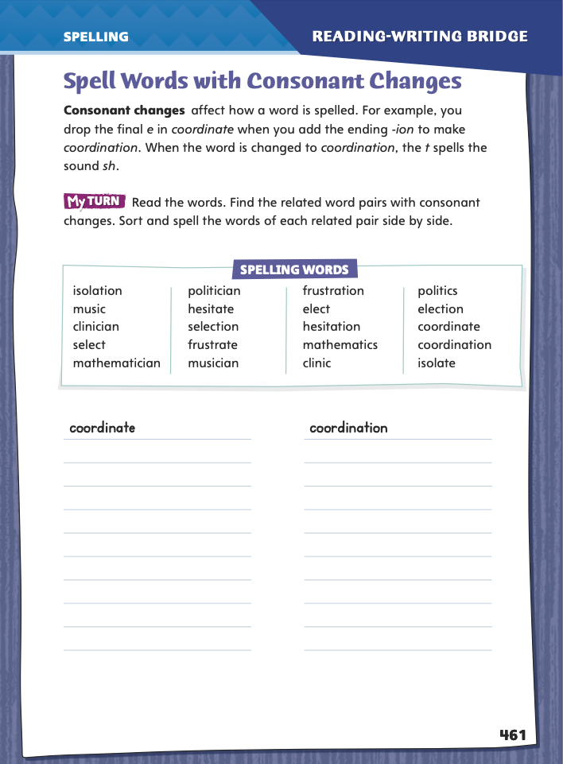
Page 461
Spelling – Consonant Changes
frustrate
frustration
elect
election
Turn to page 461 in your Student Interactive.
Read the words and find the related word pairs with consonant changes.
Sort and spell the words of each related pair side by side.
Notes:
Explain that adding suffixes can change the way some consonants are pronounced.
Display the words frustrate, frustration; elect, election.
Say each word aloud and point out the pronunciation changes.
Explain that frustration and election are still spelled with the consonant t even though their sounds changed from /t/ to /sh/ when the endings were added.
Have students complete the activity on p. 461 of the Student Interactive independently.

Slide 39
Language and Conventions
The contestants included Elena, a doctor; Manny, a teacher; and the champion.
The box of supplies contains pencils, both gray and red, crayons, some of them worn, and several markers.
Notes:
Remind students that a list of three or more items usually uses commas to separate each item. However, when one or more of the items already contains a comma, semicolons need to be used between the items instead.
Model commas and semicolons in a series with this sentence on the board: The contestants included Elena, a doctor; Manny, a teacher; and the champion.
Ask what happens if commas are used instead of semicolons between the three items (in this case, people) in this series. Elicit that the series becomes very confusing—you can no longer tell that there are just three contestants. Lead students to understand that to avoid confusion, semicolons should be used between items that already have commas.
Have students correctly punctuate this sentence: The box of supplies contains pencils, both gray and red, crayons, some of them worn, and several markers. (The box of supplies contains pencils, both gray and red; crayons, some of them worn; and several markers.)

Slide 40
Lesson 3

Slide 41
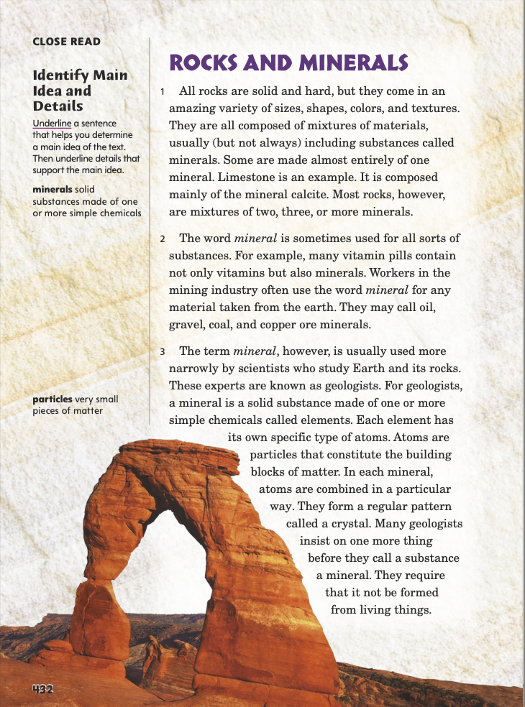
Page 432
Identify Main Idea and Details
Turn to page 432 in your Student Interactive.
Notes:
1. The main idea is the author’s most important idea about the topic of a text. Longer works may have more than one main idea. Authors may state a main idea directly and support it with details. Other times readers must use the supporting details to infer, or determine, a main idea. Have students follow these steps.
First, identify the topic of the text.
Pay attention to the details. Ask yourself, “What do the details say about the topic?”
Ask yourself, “What big idea is revealed by the details?” Synthesize, or pull together, supporting details to infer a main idea.
Look for more supporting details as you continue reading.
Use supporting details to determine whether there is more than one main idea in the text.
2. Use the Close Read note on p. 432 of the Student Interactive to model identifying a topic and main idea. Say:
The Background Note and the heading on p. 432 tell me that the topic is rocks and how they form and change.
Next, I look at the introduction to see if the author states a main idea directly. I’m also going to look for facts and other details about rocks for clues about a main idea.
In the very first sentence, the author explains that a variety of rocks exist. Then the author provides details about what different rocks are made from. This sentence seems like an important idea in the text, so I will underline it.
3. Have students continue finding facts and details related to the topic. Then help them use those facts and details to determine a main idea in the text.

Slide 42
Page 432
Close Read – Identify Main Idea and Details
Turn to page 432 in your Student Interactive.
Notes:
1. Have students scan paragraphs 1–2 and underline a sentence that helps them determine a main idea of the text. See student page for possible responses.
2. Ask students to use the sentence to tell the main idea in their own words. Possible Response: There are many different kinds of rocks.

Slide 43
Page 434
Close Read – Identify Main Idea and Details
Turn to page 434 in your Student Interactive.
Notes:
1. Have students underline a supporting detail in paragraphs 6–7 that helps explain the value of gemstones. See student page for possible responses.
2. Ask students to explain the difference between precious and semiprecious gemstones and to include examples.

Slide 44
Page 435
Close Read – Identify Main Idea and Details
Turn to page 435 in your Student Interactive.
Notes:
1. Have students scan paragraphs 8–11 and underline text that helps them identify an important detail that supports the main idea. See student page for possible responses.
2. Have students explain how the text they marked supports the main idea. Possible Response: It supports the main idea by explaining how igneous rocks, one of the three basic types of rocks, form.

Slide 45
Page 436
Close Read – Identify Main Idea and Details
Turn to page 436 in your Student Interactive.
Notes:
1. Ask: How does the subheading at the top of page 436 help point to the main idea on the page? Possible Response: The subheading shows that the main idea will be about one type of igneous rock—intrusive igneous rocks.
2. Have students scan the caption and underline phrases that support a main idea of the section “Intrusive Igneous Rocks.” See student page for possible responses.
3. Ask students what idea is supported by the phrases they underlined. Possible Response: The phrases support the idea of what intrusive igneous rocks are and how they form.

Slide 46
Page 439
Close Read – Identify Main Idea and Details
Turn to page 439 in your Student Interactive.
Notes:
1. Have students scan paragraphs 19–22 and underline details about sedimentary rocks that help explain a main idea of the text. See student page for possible responses.
2. Have students explain how the details they marked support a main idea of the text. Possible Response: They explain what sedimentary rocks are and how they form.

Slide 47
Page 441
Close Read – Identify Main Idea and Details
Turn to page 441 in your Student Interactive.
Notes:
1. Have students scan paragraph 27 and underline a sentence about chemical rocks that summarizes the paragraph. See student page for possible responses.
2. Ask students to state the main idea of paragraph 27. Possible Response: The main idea of paragraph 27 is what chemical rocks are made of and how they form. DOK 2

Slide 48
Page 442
Close Read – Identify Main Idea and Details
Turn to page 442 in your Student Interactive.
Notes:
1. Have students scan paragraph 29 and underline the main idea about how metamorphic rocks form. See student page for possible responses.
2. Have students state the main idea about metamorphic rocks. Possible Response: Metamorphic rocks are rocks that have changed form because of new conditions.

Slide 49
Page 443
Close Read – Identify Main Idea and Details
Turn to page 443 in your Student Interactive.
Notes:
1. Continue helping students find details that support main ideas in the text.
2. Have students scan paragraphs 31–32 and underline clues about the main idea of “Contact and Regional Metamorphism.” See student page for possible responses.
3. Ask students what the supporting details they underlined tell them about the main idea of this section. Possible Response: The details tell me what contact metamorphism is, which is this section’s main idea. DOK 2

Slide 50
Page 445
Close Read – Identify Main Idea and Details
Turn to page 445 in your Student Interactive.
Notes:
1. Have students scan the text feature at the bottom of p. 445 and underline its main idea and details that support it. See student page for possible responses.
2. Ask students how the details they underlined support the main idea they marked. Possible Response: The detail “it has been used for centuries to make statues and impressive buildings” supports the main idea of “putting metamorphic rocks to work” by explaining how people use marble, which is a kind of metamorphic rock. DOK 1

Slide 51
Page 446
Close Read – Identify Main Idea and Details
Turn to page 446 in your Student Interactive.
Notes:
1. Have students scan the text feature and paragraphs 37–39 and underline details that help them determine the main idea of this section. See student page for possible responses.
2. Ask students what the details they underlined tell them about the main idea of “Constant Activity.” Possible Response: The details tell me that the main idea is that old and new rocks are always changing. DOK 2

Slide 52
Page 449
Close Read – Identify Main Idea and Details
Turn to page 449 in your Student Interactive.
Notes:
1. Tell students that authors sometimes emphasize important ideas and details through repetition. Remind students to ask themselves, “What do these repeated words and phrases tell me about the main idea?”
2. Have students scan paragraph 42 and underline words and phrases the author repeats that help support the main idea. See student page for possible responses.
3. Ask students to explain how the words and phrases they marked support the main idea of this section. Possible Response: The details support the main idea of “Rock Changes” by explaining that one type of rock can change into another as long as the conditions are right for that kind of change.
DOK 2

Slide 53
Page 450
Close Read – Identify Main Idea and Details
Turn to page 450 in your Student Interactive.
Notes:
1. Have students scan paragraphs 45–48 and underline two supporting details that reveal relationships among rock strata. See student page for possible responses.
2. Ask students to explain what the details they marked reveal about how geologists interpret strata in their work. Possible Response: The detail “so as you go lower, you go farther back in time” tells me that lower strata of rock are older than higher strata. DOK 2

Slide 54
Page 451
Close Read – Identify Main Idea and Details
Turn to page 451 in your Student Interactive.
Notes:
1. Have students scan paragraph 50 and underline supporting details that help clarify important ideas in this section. See student page for possible responses.
2. Ask students how the supporting evidence they marked helps them understand geologists’ need for caution. Possible Response: The detail “complicate the job of ‘reading’ history from a series of layers” helps me understand that geologists have a tough job in studying rock layers because there are many factors that can cause the layers to shift or disappear. DOK 2

Slide 55
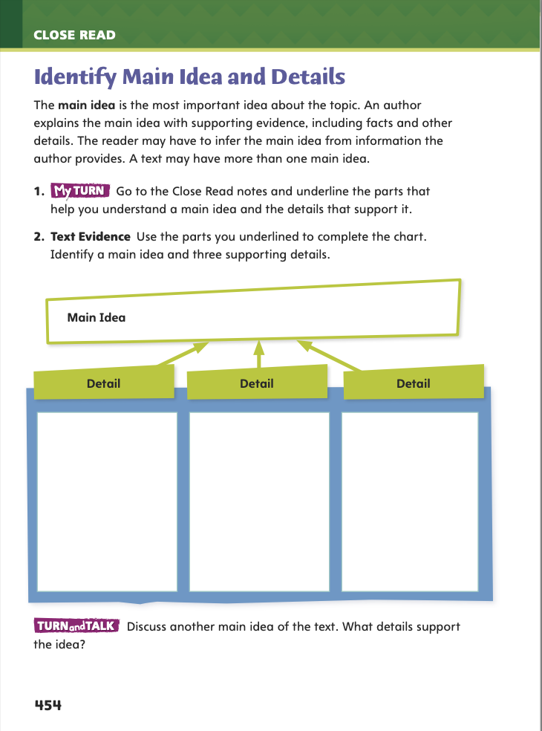
Page 454
Identify Main Idea and Details
Turn to page 454 in your Student Interactive and complete the activity.
Notes:
1. Have students use the strategies for identifying main ideas and details.
2. Have students annotate the text using the Close Read notes for Identify Main Idea and Details and then use their annotations to complete the chart on p. 454.

Slide 56
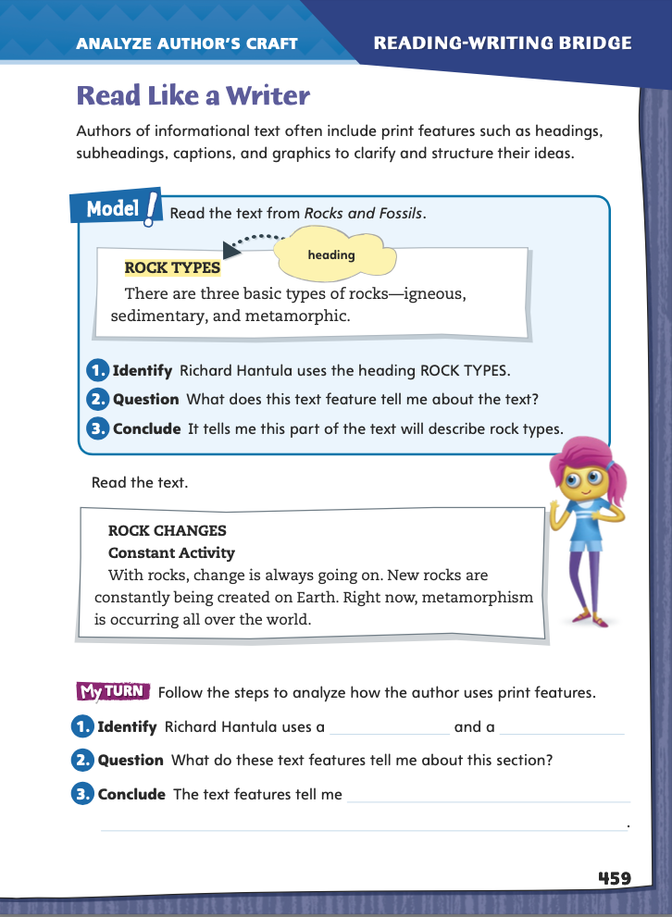
Page 459
Read Like a Writer
Turn to page 459 in your Student Interactive.
Follow the steps to analyze how the author uses print features.
Notes:
1. Explain that most authors of informational text include text features, such as headings, subheadings, captions, insets, and graphics. Text features help clarify and organize the information. Offer these strategies for using text features:
Notice any headings and visual elements in the text. These are all text features.
Ask yourself how each text feature helps you understand what you read.
2. Model analyzing an author’s use of text features by directing students to the top of p. 459 of the Student Interactive. Have students follow along as you complete the steps.
Identify that author Richard Hantula uses the heading ROCK TYPES at the top of the text.
Ask students what this text feature tells the reader.
Guide students to draw a conclusion about the reason the author used this text feature. Elicit that the heading helps organize the text, shows the topic of the section, and indicates that the information about rock types is important.
3. Direct students to go back to Rocks and Fossils and flag some of the text features. Then have them focus on specific text features by answering the questions on p. 459.

Slide 57
Word Study
electric
electricity
An electrician is someone who works with electricity.
Notes:
1. Remind students that words can change their consonant sounds when suffixes are added.
2. Write and say the word electric. Point out that its final consonant sound is /k/, spelled with a c.
3. Write and say: An electrician is someone who works with electricity. Elicit or explain that in electrician, the /k/ sound in electric has changed to a /sh/ sound, even though electrician is still spelled with a c.
4. Point out that in electricity, the /k/ sound changes to an /s/ sound.
5. Have students complete Word Study p. 177 from the Resource Download Center. Click path: Table of Contents -> Resource Download Center -> Word Study-> U5 W1

Slide 58
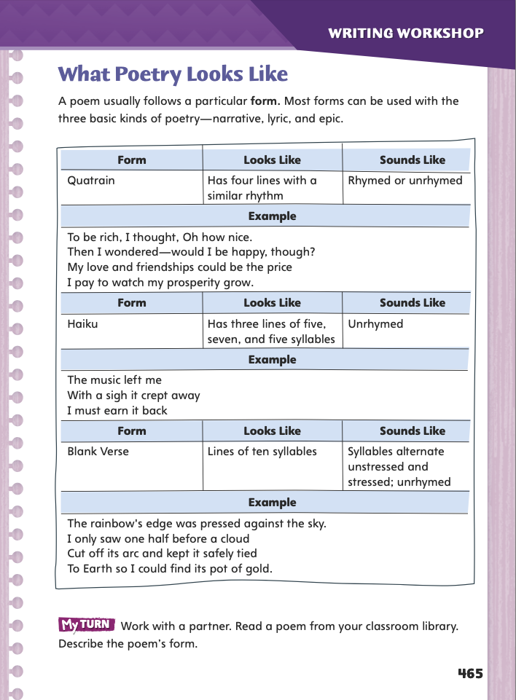
Page 465
Writing – Poetry
Turn to page 465 in your Student Interactive.
Notes:
1. Narrative, lyric, and epic poetry may use one of these forms:
quatrain: four lines that follow a similar pattern of rhythm and sometimes rhyme; a poem may be one quatrain long or may be organized into many quatrains.
haiku: three unrhymed lines of five, seven, and five syllables.
blank verse: unrhymed lines of ten syllables in which a stressed syllable follows an unstressed syllable (da-DUM da-DUM da-DUM da-DUM da-DUM).
2. Ask students: From the poems we have read, how would you describe what poetry looks like?
3. Have students look through the stack to help them answer the question. Invite them to share their observations.
4. Direct students’ attention to the chart on Student Interactive p. 465. For each listing, read the form, the description of its appearance and sound, and the example.
For the quatrain, point out the use of rhyme and have students mark the stressed and unstressed syllables that establish the rhythm.
For the haiku, have students count the syllables in each line.
For the blank verse, note the absence of rhyme and have students mark the stressed and unstressed syllables.

Slide 59
Independent Writing
Choose a poem, read it aloud, and identify which form on page 465 the poem is.
You will continue working on your poem in your notebooks. Explore rhythm, rhyme, and different forms.
Notes:
Direct students to begin writing their ideas for a poem. Students should refer to the stack to help generate ideas and to identify the type of poem they want to write (narrative, lyric, or epic).
Choose a poem from the stack to read aloud and identify its form by noting what it looks and sounds like.
Have students choose a poem from the stack, read it aloud, and identify which form on p. 465 they think the poem is.
Using a poem from the stack, provide explicit instruction on using rhyme, rhythm, and syllables.
Using a poem from the stack, provide explicit instruction on using rhyme, rhythm, and syllables.
If students have chosen a type of poem, they may want to work on what it sounds and looks like by exploring rhythm, rhyme, and different forms in their writing notebooks. See conference Prompts on p. T332.
As partners to read the stack poem they chose and share its form. Have them explain how they knew what form it was.

Slide 60
Spelling
Anika likes to ____________ things with wood. She might like a career in ____________.
In __________ class, we learned about geometry. A famous __________ discovered the laws of geometry.
Notes:
The word boxes at the bottom can be moved into the correct blank in the sentences above.
When a suffix is added to a base word, the pronunciation of some consonants may change.
Model spelling words with consonant sound changes.
Anika likes to _______ things with wood. (construct)
She might like a career in _______. (construction)
In _______ class, we learned about geometry. (mathematics)
A famous _______ discovered the laws of geometry. (mathematician)
Have students complete Spelling p. 182 from the Resource Download Center. Click path: Table of Contents -> Resource Download Center -> Spelling -> U5W1

Slide 61
Language and Conventions
Commas and Semicolons
,
;
Notes:
1. Tell students to separate items in a series with commas. If the items already contain commas, then use semicolons to separate the items.
2. To reinforce the instruction, show students examples of comma and semicolon usage in books in the classroom library. Have a few examples ready to write on the board.
3. Ask students to read those sentences with appropriate phrasing. Guide them to practice fluency as they read by pausing naturally as they see commas or semicolons.
4. As a group, work together to write sentences modeled after the examples on the board.

Slide 62
Lesson 4

Slide 63
Page 440
Make Connections
Turn to page 440 in your Student Interactive.
Notes:
1. Good readers connect the texts they read to their own experiences, other texts they have read, and society at large. Making connections helps readers enhance and deepen their understanding of both the text and the world.
2. MODEL AND PRACTICE: Use the Close Read note on p. 440 of the Student Interactive to model how to annotate the text to make a connection to a personal experience:
• Say: In the insert on page 440, one detail says, “Rock salt is a primary source of salt, which is an essential component of our diet and is also used for many purposes.” I can connect this detail to my own experience, so I’m going to write it in the chart under “Text Evidence.”
Next, I’m going to explain how this detail connects to my personal experience. Before I read Rocks and Fossils, I already knew that we eat salt on our food. I’m going to write that connection in the chart.
Have students continue filling out the chart by making text-to-text connections and text-to-world connections.

Slide 64
Page 440
Close Read – Make Connections
Turn to page 440 in your Student Interactive.
Notes:
1. Have students read the inset “Putting Sedimentary Rocks to Work” and highlight a detail that helps them make a connection to their own experience. See student page for possible responses.
2. Be sure to tell students that the rock salt discussed in the text is sodium chloride, or halite, which is edible. It is not calcium chloride, often called rock salt and used to melt ice and snow, which is not edible.
3. Ask students to explain the connection between the detail they marked and their own experience.
4. Possible Response: The detail connects to my previous knowledge about salt. I knew it is a necessary part of our diet and also has other purposes. I did not realize it could come from rock, though.

Slide 65
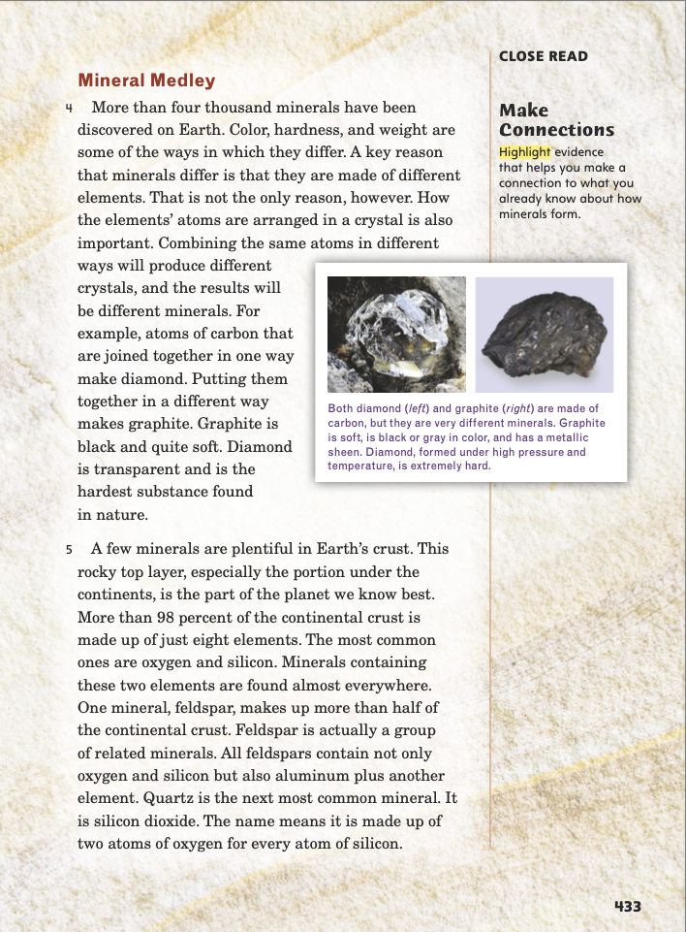
Page 433
Close Read – Make Connections
Turn to page 433 in your Student Interactive.
Notes:
1. Have students scan paragraph 4 and highlight details that help them make a connection to what they read earlier about how minerals form.
2. Have students explain how the evidence they highlighted helps them understand the ways minerals form.
3. Possible Response: The detail connects with the earlier facts that minerals are made of different elements and elements are made of atoms arranged in different ways. Together, these details help me understand that the same element can form different minerals when its atoms are arranged in different ways.
4. Have students study the photos and caption in the inset on p. 433.
5. Ask: How does the inset help clarify how minerals form?
6. Possible Response: The inset illustrates the general idea by showing two minerals, graphite and diamonds, formed from the same element, carbon, with its atoms arranged in two different ways.

Slide 66
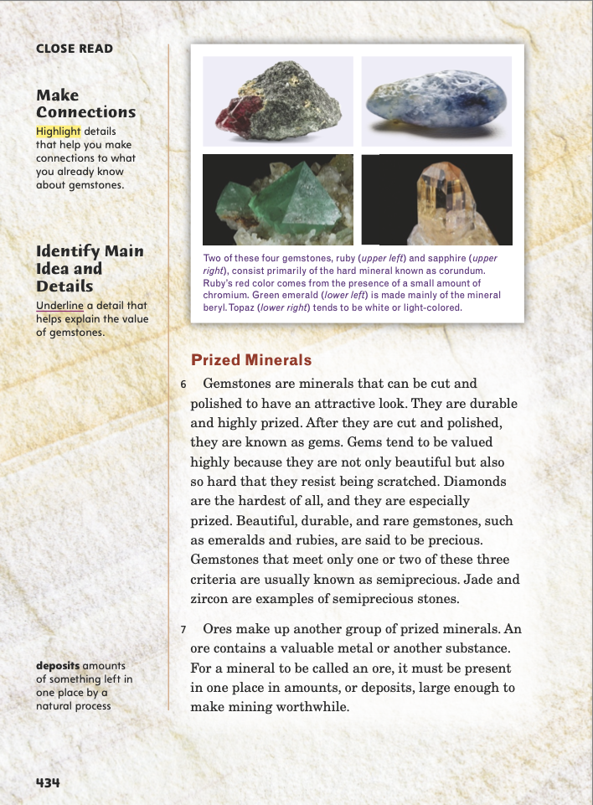
Page 434
Close Read – Make Connections
Turn to page 434 in your Student Interactive.
Notes:
1. Have students scan paragraphs 6–7 and highlight details that help them make connections to what they already know about gemstones. See student page for possible responses.

Slide 67
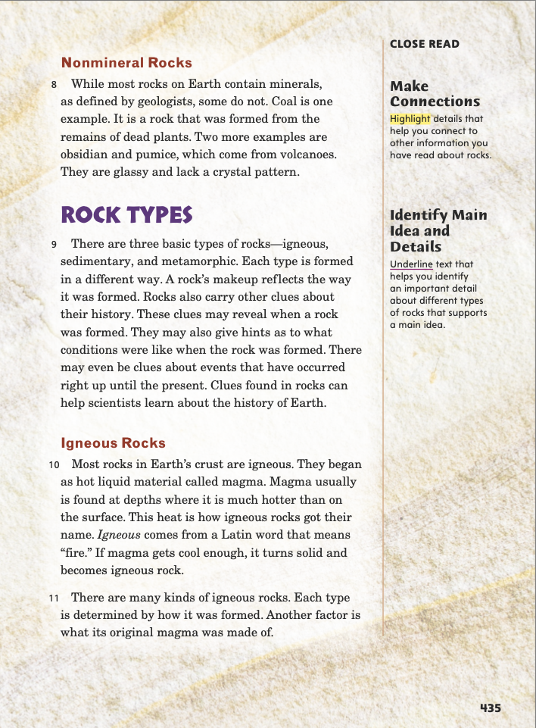
Page 435
Close Read – Make Connections
Turn to page 435 in your Student Interactive.
Notes:
1. Have students highlight details that help them make connections to other information they have read about rocks. See student page for possible responses.

Slide 68
Page 438
Close Read – Make Connections
Turn to page 438 in your Student Interactive.
Notes:
1. Remind students that text features are an important source of details that can help them make connections.
2. Explain that the word abrasive, used in the inset at the bottom of p. 438, means “something rough or scratchy that can be used to polish or rub objects clean.”
3. Have students scan paragraphs 17–18 and the inset and highlight details that show a connection between pumice’s form and pumice’s use in the world.
4. Have students explain the connection between pumice’s form and use. Possible Response: Since pumice has spongelike holes, is lightweight, and is an abrasive, it can be used “for grinding, cleaning, or polishing surfaces.”

Slide 69
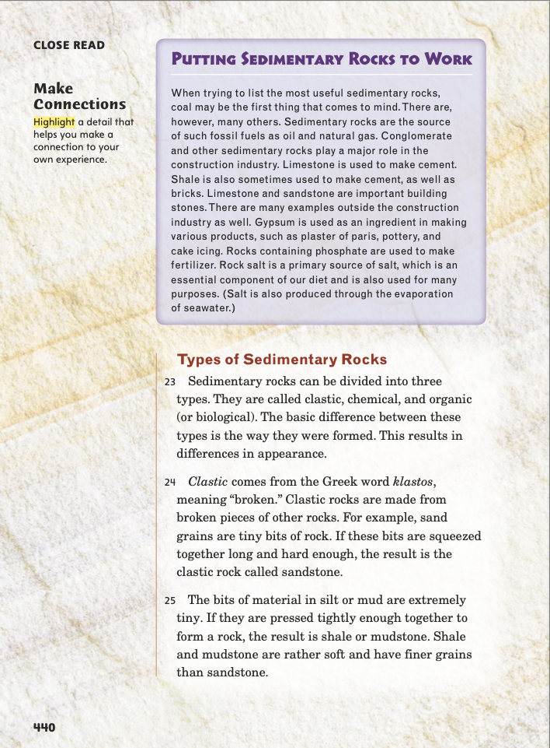
Page 440
Close Read – Make Connections
Turn to page 440 in your Student Interactive.
Notes:
1. Have students read the inset “Putting Sedimentary Rocks to Work” and highlight a detail that helps them make a connection to their own experience
2. Be sure to tell students that the rock salt discussed in the text is sodium chloride, or halite, which is edible. It is not calcium chloride, often called rock salt and used to melt ice and snow, which is not edible.
3. Ask students to explain the connection between the detail they marked and their own experience. Possible Response: The detail connects to my previous knowledge about salt. I knew it is a necessary part of our diet and also has other purposes. I did not realize it could come from rock, though.

Slide 70
Page 444
Close Read – Make Connections
Turn to page 444 in your Student Interactive.
Notes:
1. Have students scan pp. 444–445 and highlight details that indicate where they personally might find metamorphic rocks in their everyday life.
2. Discuss places where students might have seen marble, such as a statue or public building in your area or an important building or monument students may know.
3. Explain that the use of slate as a writing surface (usually with chalk) is the origin of terms such as “a clean slate.”

Slide 71
Page 447
Close Read – Make Connections
Turn to page 447 in your Student Interactive.
Notes:
1. Point out that one way to connect with a text is to connect two or more different ideas in it.
2. Have students scan paragraph 40 and highlight an idea that connects to an earlier idea in the text.
3. Ask students to explain the connection between the idea they marked and the earlier idea. Possible Response: The sentence “As we have seen, rocks are constantly undergoing change” connects to an earlier idea in the section “Constant Activity” by reminding us that rocks are always changing.

Slide 72
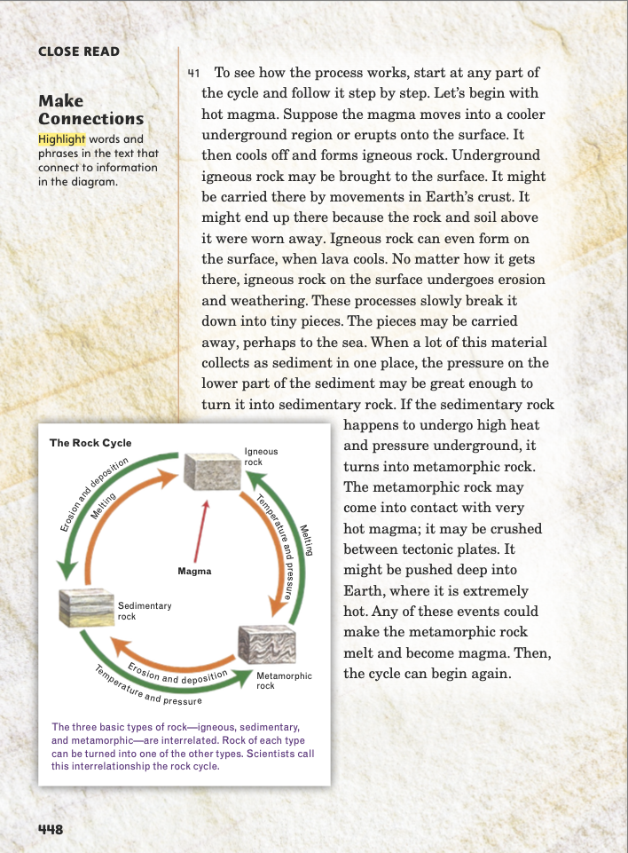
Page 448
Close Read – Make Connections
Turn to page 448 in your Student Interactive.
Notes:
1. Have students scan paragraph 41 and highlight words and phrases that connect to information in the diagram.
2. Ask students to explain the connections between the details they marked and the diagram. Possible Response: The detail “high heat and pressure underground” connects to the part of the diagram that shows how sedimentary rock becomes metamorphic rock through temperature and pressure. The detail “events could make the metamorphic rock melt and become magma” connects to the part of the diagram that shows how metamorphic rock melts and becomes igneous rock. DOK 3

Slide 73
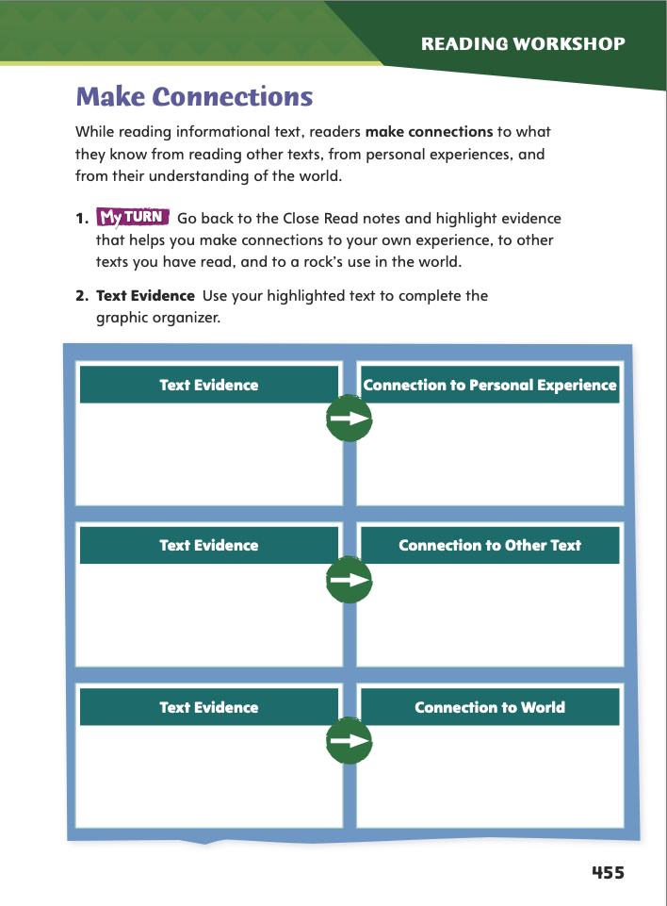
Page 455
Make Connections
Complete the chart on page 455 in your Student Interactive.
Notes:
1. Have students use the strategies for making connections.
2. Have students annotate the text using the other Close Read notes for Make Connections. Then have them use the text evidence from their annotations to complete p. 455.

Slide 74
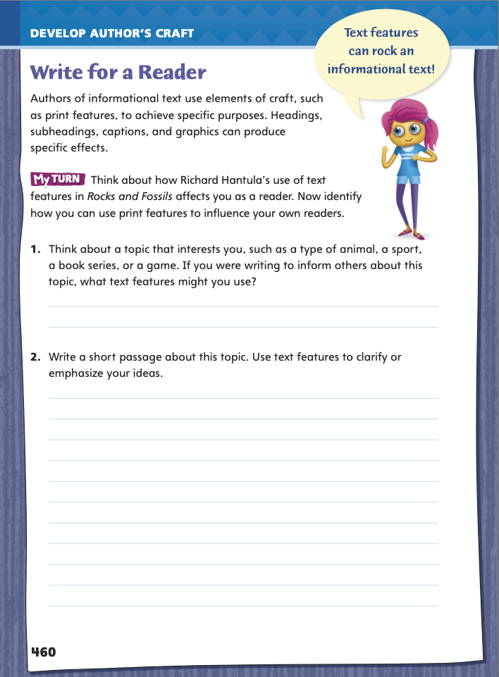
Page 460
Write for a Reader
Turn to page 460 in your Student Interactive.
Notes:
1. Remind students that in Rocks and Fossils, author Richard Hantula used text features such as headings, subheadings, insets, and graphics to clarify, support, and structure important information in the main body of text.
2. Use p. 460 of the Student Interactive to explore how students might similarly use text features in their own writing. Model an example.
Using a previously written passage or a shared writing text, identify a place in the text that needs visual support, such as a list of numbers or a description in need of a diagram. Transcribe the passage onto the board or chart paper.
Say: As I write, I will use details or descriptions. However, these may be difficult for the reader to grasp. So, rather than just tell about details, I will show them in a text feature.
Using the passage or text, briefly draw or sketch a text feature that supports it, such as a diagram, chart, graph, or image. Highlight or underline the parts in the text that match the text feature. Have volunteers suggest other ideas and explain their thinking.
3. Have students refer to Richard Hantula’s use of text features as an example for their own writing. Then guide students to complete the activity on p. 460 in the Student Interactive.

Slide 75
Word Study – Latin Roots
audi
scrib
rupt
spec
Notes:
1. Review strategies about using Latin roots audi, rupt, scrib, and spec to determine word meanings.
2. Call on a volunteer to define the Latin root audi. Discuss how knowing that audi means “hear” can help students understand words that contain this root, such as audible (“able to be heard”) and auditorium (“a place where music, drama, and speeches are heard”).
3. Have students pair up or work independently to define the remaining Latin roots. Then challenge them to use print or digital resources to find words that contain each of the four roots.
4. Have students pick one word with each root and define it, explaining how knowledge of the root helps them define the word.
5. Encourage students to share and compare their words and definitions.

Slide 76
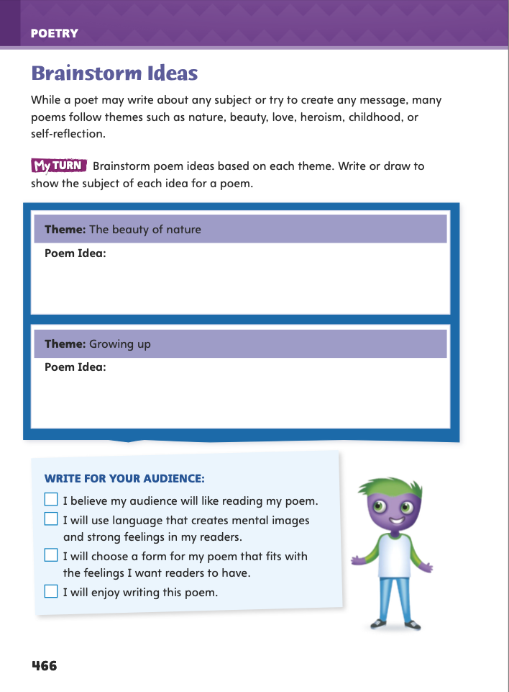
Page 466
Writing – Poetry
Turn to page 466 in your Student Interactive.
Notes:
1. Brainstorming helps writers come up with interesting ideas that they want to explore. In brainstorming for poetry, tell students to
focus on a theme to explore, such as love, family, or adventure.
consider topics that they find interesting and want to explore.
think of how they want the poem to affect their audience.
consider features and forms of poetry and which topics may best suit them.
2. After brainstorming, writers choose the topic that they feel most strongly about and that they will enjoy exploring through writing.
3. Tell students that they will brainstorm topics for a poem. Invite them to share the topics of poems from the stack that they have enjoyed reading. Note the topics on the board.
4. Discuss what made the poems enjoyable.
5. Direct students to the activity on p. 466 in the Student Interactive.
To help students get started, have the class brainstorm ideas for a particular theme, such as heroism or friendship.
Then have students independently complete the chart on p. 466.

Slide 77
Page 466
Independent Writing
Think of topics you could use for your poem. Use the checklist on p. 466.
Share your topic ideas and identify the form that would best match that topic.
Notes:
1. Transition students to independent writing. Students who still need to finalize a topic may use this time to do so.
2. Do a Think Aloud to model how to generate ideas for a theme.
3. Have students share their topics and then use the checklist on p. 466.
4. Suggest several themes that may interest students, and then have them use a mind map to explore ideas for each theme using the checklist on p. 466 as a guide.
5. If students have started their poems, they should use today’s brainstorming session to include any other ideas they generated. Ask them also to complete the checklist on p. 466 to ensure that they are writing with their audience in mind and have selected a topic that motivates them. See the Conference Prompts on p. T332.
6. Invite small groups to discuss the poem ideas they listed for the themes on p. 466. Then have them share topic ideas for their independent writing. They may also want to share the forms they think would best match their topics.

Slide 78
Spelling – Latin Roots
My teacher told me not to skribble.
Notes:
1. Review the spelling of words with the Latin roots audi, rupt, scrib, and spec.
2. Display this sentence: My teacher told me not to skribble.
3. Call on a volunteer to correct the misspelled word.
4. Explain that if students know how to spell the root scrib, then they can correctly spell English words that contain it, such as scribble.
5. Use the Spelling Words from the previous week. Invite students to make flashcards to quiz each other on the correct spellings of the words or to create a word search or crossword puzzle using the words.

Slide 79
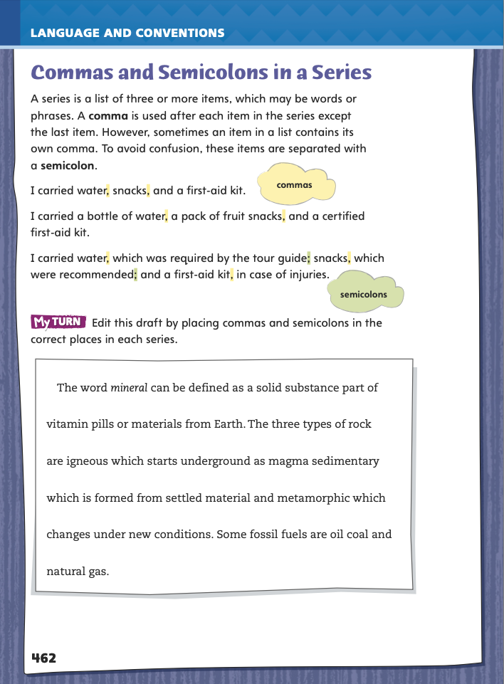
Page 462
Language and Conventions
Turn to page 462 in your Student Interactive.
Edit this draft by placing commas and semicolons in the correct places in each series.
Notes:
1. Have students edit the draft paragraph on Student Interactive p. 462.

Slide 80
Lesson 5

Slide 81
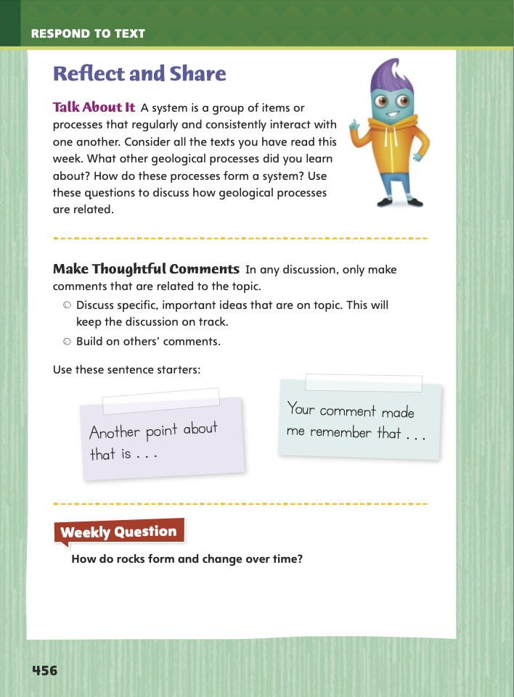
Page 456
Reflect and Share
Turn to page 456 in your Student Interactive.
Notes:
1. Explain to students that group discussions are productive when participants stay on topic. Remind them to make sure their comments are pertinent, or related, to the discussion topic. Tell them:
Listen closely when someone speaks. Pay attention so that you can make pertinent comments about what he or she said.
Before making a comment, be sure it is related to the topic being discussed.
Make comments that build on the comments of others.
Pronounce each word clearly, and speak at a moderate rate, or pace.
2. Model making pertinent comments using the Talk About It prompt on p. 456 of the Student Interactive: If we were talking about geological processes and another student said, “Sometimes land gets lifted up to create mountains,” I could say, “Yes, the movement of tectonic plates is what does that. And the movement of tectonic plates also causes earthquakes.”
3. Have students continue discussing the text, making sure they talk about specific ideas that are important to the text’s meaning. Encourage them to listen actively to each other and make pertinent comments to keep the discussion going.
4. Have students use the strategies for making pertinent comments when they discuss or compare texts.
5. Use the Shared Read. Have students complete the rest of p. 456 in the Student Interactive.

Slide 82
Apply
How do rocks form and change over time?
Notes:
1. Have students use evidence from the texts they have read this week to respond to the Weekly Question. Tell them to write their responses on separate sheets of paper.

Slide 83
Word Study – Consonant Changes
If you leave trash at the lake, it will pollute the water.
Water pollution can harm plants and animals that live near the lake.
I learned about fractions in the mathematics lesson.
My math teacher says math students are learning to be mathematicians.
Notes:
1. Have students say the sentences aloud, carefully pronouncing the words.
2. Tell them to use their knowledge of consonant changes to pronounce the words pollute and pollution, mathematics and mathematician.
3. Then have them explain the change in the consonant sound and pronounce each word aloud. Click path: Table of Contents -> Language Awareness Handbook -> p.53

Slide 84
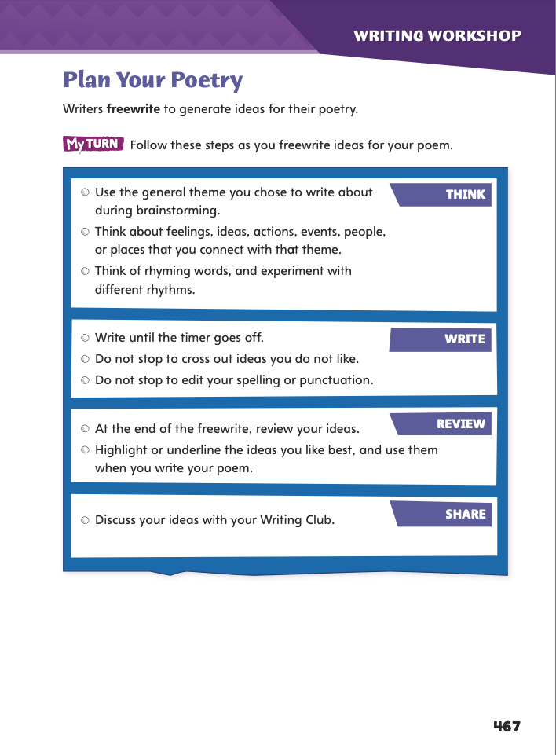
Page 467
Writing – Poetry
Turn to page 467 in your Student Interactive.
Notes:
1. Poems take a specific form and have a specific purpose. Use these questions to help decide what type of poem to write and what to include:
Do you want to tell a story, express emotions, or give a description?
Do you have a message you want to convey to the audience?
What poetic features do you enjoy and want to include in your poem?
2. Emphasize that students do not need to have answers to all these questions before they begin writing but that it will be helpful to know the goals they want to achieve.
3. Have students choose a favorite poem from the stack. Say: Read the poem and reflect on what you particularly enjoy about it. Is it the theme or topic? Do you like the rhythm or form?
4. Tell students that today they will plan their poems. Say: Before planning, you will freewrite to generate ideas. Freewriting is a way to explore your thoughts, feelings, and even images or descriptions as you think about your poem.
Read through the directions on Student Interactive p. 467.
Begin the timed freewriting.
Have students highlight the ideas they like best. Encourage them to mark language that is particularly descriptive or evocative of an image. Have them circle any ideas they want to explore further and underline words that they may want to use to establish rhythm or rhyme.
5. Have partners share ideas from their freewriting. Encourage students to focus on sharing topic ideas and language they want to use.

Slide 85
Spelling
I would not want to live in complete isolation.
Will you select a song to play?
He is a fine musician.
If you hesitate to swing the bat, you may miss the ball.
I could see a look of frustration on his face.
We will elect a new class president.
Is she a scientist or a mathematician?
I did not get a shot at the clinic.
A politician might run for governor or mayor.
Having a good coordination helps you dance.
Notes:
(Note: Move the orange boxes to cover each bold spelling word before you read aloud the words and sentences.)
Use the following sentences for a spelling test.
I would not want to live in complete isolation.
Will you select a song to play?
He is a fine musician.
f you hesitate to swing the bat, you may miss the ball.
I could see a look of frustration on his face.
We will elect a new class president.
s she a scientist or a mathematician?
I did not get a shot at the clinic.
A politician might run for governor or mayor.
Having good coordination helps you dance.

Slide 86
Language and Conventions
Events that interfere with sedimentary strata include a flow of magma, which comes from a volcano, earthquakes, and the passage of time.
Which revision is correct?
A. Change comma after volcano to semicolon.
B. Change commas after magma and earthquakes to
semicolons.
C. Change commas after volcano and earthquakes to
semicolons.
Notes:
1. Events that interfere with sedimentary strata include a flow of magma, which comes from a volcano, earthquakes, and the passage of time.
Answer: C is the correct revision: Change commas after volcano and earthquakes to semicolons.
2. Have students complete Language & Conventions p. 187 from the Resource Download Center. Click path: Table of Contents -> Resource Download Center -> Language and Conventions -> U5 W1

Slide 87
Unit 5: Week 1
Grade 5

