Slide 1
Unit 1: Week 3
Grade 3

Slide 2
Copyright © Savvas Learning Company LLC. All Rights Reserved.
This publication is protected by copyright, and permission should be obtained from the publisher prior to any prohibited reproduction, storage in a retrieval system, or transmission in any form or by any means, electronic, mechanical, photocopying, recording, or otherwise. For information regarding permissions, request forms, and the appropriate contacts within the Savvas Learning Company Rights Management group, please send your query to:
Savvas Learning Company LLC, 15 East Midland Avenue, Paramus, NJ 07652
or
k12learningpermissions@savvas.com
myView Literacy® is an exclusive trademark of Savvas Learning Company LLC in the U.S. and/or other countries.

Slide 3
Lesson 1

Slide 4
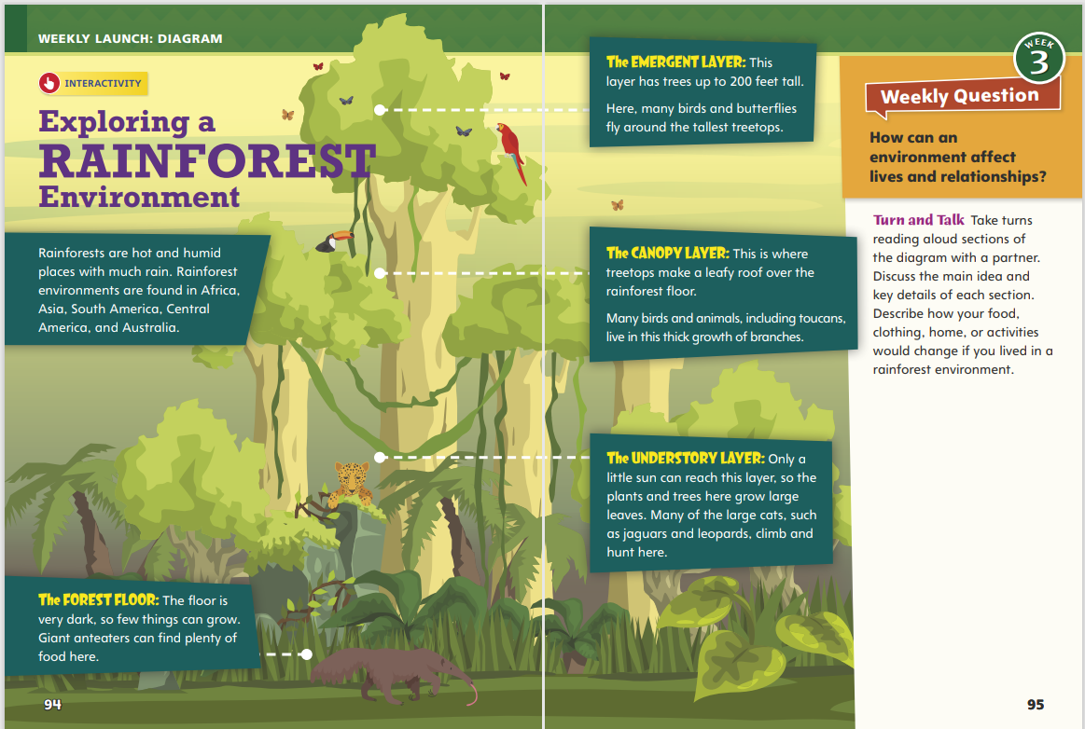
Page 94, 95
Interact with Sources
Describe how your food, clothing, home, or activities would change if you lived in a rainforest environment
Notes:
Remind students of the Essential Question for Unit 1: How does our environment affect us? Point out the Week 3 Question: How can an environment affect lives and relationships?
Direct students' attention to the diagram on pp. 94–95 in the Student Interactive. Explain that a diagram combines words and pictures to provide information. Have students read the diagram and discuss how a rainforest environment might affect the ways that people live, including the types of shelter they build, the clothing they wear, and the foods they eat.
Use the following questions to guide discussion:
Which facts about these environments surprised you?
Why do you think people living in different environments have different types of shelter, food, and clothing?
What do these facts suggest about the importance of adapting to one's environment?
Reread the Week 3 Question: How can an environment affect lives and relationships? Tell students they just learned a few ways that people adapt to living in different environments. Explain that they will read about more ways this week.
Have students participate in the Turn and Talk activity on Student Interactive p. 95

Slide 5
Listening Comprehension
Dara’s Feelings
Start of Recess | End of Recess
Ruby Bridges
Notes:
Tell students you are going to read a realistic fiction story aloud. Have students listen as you read “Feeling the Cold.” Explain that students should listen actively, paying careful attention to the characters in the story as you read. Prompt them to ask relevant questions to clarify information and to make pertinent comments.
Read aloud routine
Purpose Have students actively listen for elements of realistic fiction.
Read the entire text aloud without stopping for Think Aloud callouts.
Reread the text aloud, pausing to model Think Aloud strategies related to the genre and the characters in the story.
Use a T-chart to help students note how Dara's feelings about her environment change.

Slide 6
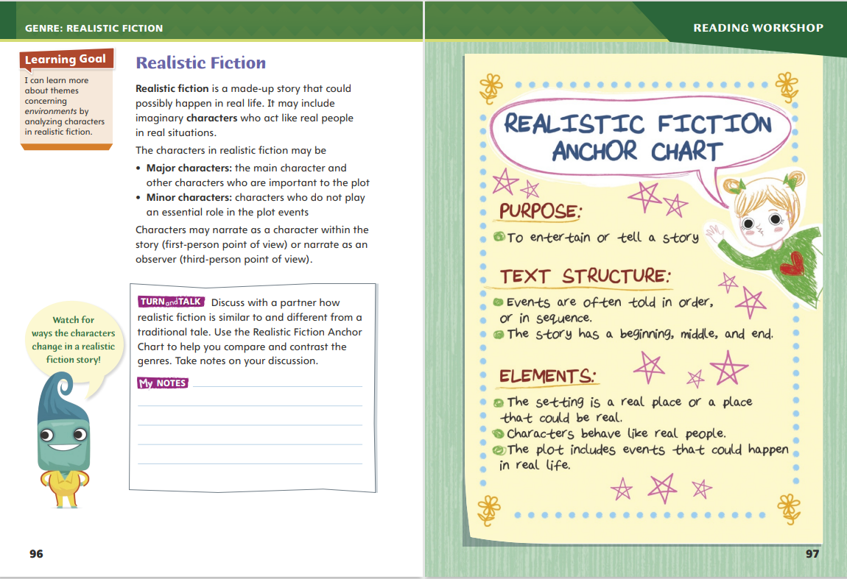
Page 96, 97
Realistic Fiction
Turn to page 96 in your Student Interactive.
Notes:
Major characters in realistic fiction interact and undergo changes like real people. They also face problems that are often resolved by the end of the story. Sometimes the setting’s environment affects the way the major and minor characters respond and behave.
Do the major and minor characters seem like real people? Do they interact with each other in a realistic way? How do you know?
Think about the problem the main character is facing. How would you feel or react in that situation?
Look for details that tell whether the setting is in a realistic location and whether the plot describes realistic events. Does the story happen in a real time? Does the setting affect the story in a realistic way?
Model determining that a story is realistic. In "Feeling the Cold," the main character, Dara, moved from Miami to Chicago, both real cities. Does the setting seem real? Yes, it does. A school and a playground at recess are realistic settings. I also notice that the cold weather and being at a new school are hard for Dara. I ask myself, could this happen in real life? Yes, it could. People who move from a warm environment to a cold environment take a while to adapt. It is also hard to be in a new environment without knowing anyone. I decide that "Feeling the Cold" is an example of realistic fiction.
Talk about familiar fictional stories. Discuss the characters, settings, and plots in the stories and whether the stories seem realistic.

Slide 7
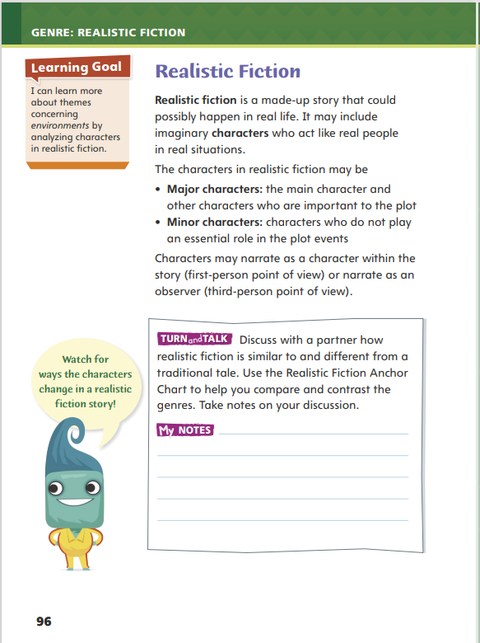
Page 96
Apply
Discuss how realistic fiction is similar to and different from a traditional tale.
Notes:
Have students work with a partner to complete the Turn and Talk activity on p. 96 of the Student Interactive.
Circulate to discover if students can determine similarities and differences between realistic fiction stories and traditional tales. Editable Anchor Chart Click Path: Table of Contents -> Reading Anchor Charts -> Unit 1 Week 3: Realistic Fiction Anchor Chart

Slide 8
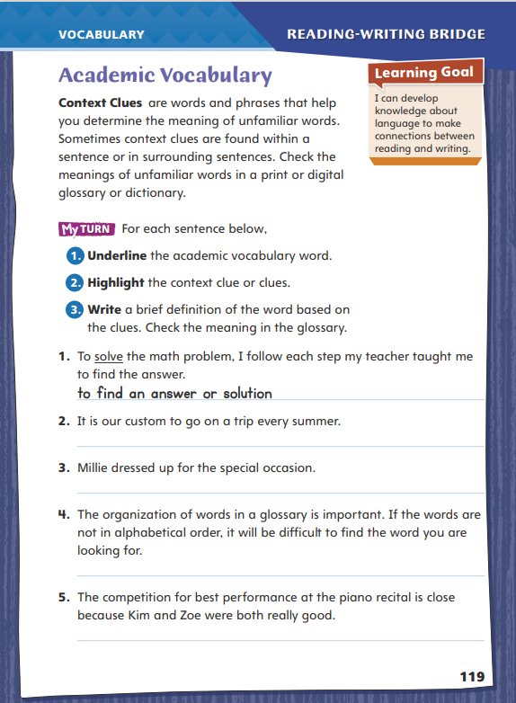
Page 119
Academic Vocabulary
Turn to page 119 in your Student Interactive and complete the activity.
Notes:
Readers often encounter unfamiliar words or phrases in their reading. They may have seen an unfamiliar word before but are unsure of its meaning in a particular phrase or sentence. Other words or phrases within a sentence or a section of text can provide clues to the meanings of words that are unfamiliar or that have multiple meanings.
When you come across an unfamiliar phrase or a word with more than one meaning, look for clues to its meaning in the same sentence or nearby sentences.
Use these context clues to determine the meaning of the unfamiliar phrase or a word with more than one meaning.
Check the word’s meaning in a glossary or dictionary to be sure.
Model this strategy using the Academic Vocabulary word competition. •
When I see the word competition in my reading, I’m not sure I know its exact meaning. I could look it up in a dictionary or glossary, but instead I’m going to look for clues that might help me figure out its meaning. For example, the words the Olympic games are in the same sentence. I know that in the Olympics, athletes struggle to win first place and become a champion of their sport. This is a clue that a competition is an event in which two or more people work against each other to win a contest.
Have students work with a partner to apply this strategy to another word. As a group, discuss the definitions that students produce.
Have students follow this same strategy as they complete the chart on p. 119 of the Student Interactive. Remind students that they will use these Academic Vocabulary words throughout this unit.

Slide 9
Word Study
bake, baked, baking
carry, carried, carrying
big, bigger, biggest
Notes:
A base word is the simplest form of a word. Endings can be added to base words to create new words with related, but different, meanings. If the ending -ed is added to a verb, it shows that the action happened in the past. If the ending -ing is added to a verb, it shows the action is happening now. The endings -er and -est can be added to adjectives, such as sadder and saddest, when comparing things.
Display the following words: bake, baked, baking; carry, carried, carrying; hop, hopped, hopping; big, bigger, biggest. Have students demonstrate their knowledge of suffixes by reading each word. Then guide students’ discussion about how each base word changed when the suffix was added and how the suffix changes the word’s meaning.

Slide 10
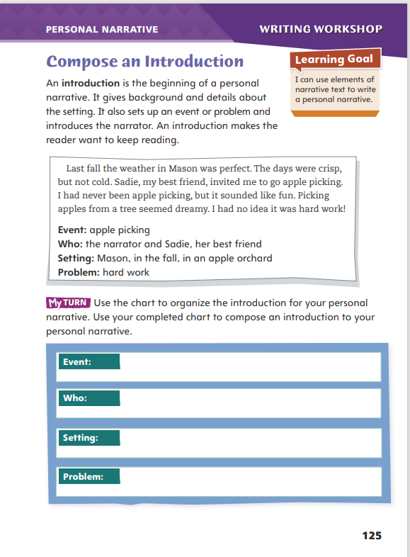
Page 125
Writing – Personal Narrative
Turn to page 125 in your Student Interactive.
Notes:
A strong introduction grabs the reader’s attention. To frame the narrative, an introduction for a personal narrative includes
The setting—putting the narrator in a time and place
The situation—setting up the event or problem
The problem—providing a clue about the narrator’s conflict
Inform students that today they will be writing the beginning for their personal narratives. Read aloud the introduction from one of the personal narrative texts in the stack. Use these questions to aid discussion after reading.
What do you learn about the narrator in this introduction?
What details do you find most interesting?
Are you interested in finding out what happens to the narrator?
Explain to students that there are many ways to begin a personal narrative. Say: Your introduction might begin with a description. Using descriptive details can help to set the scene. You might also choose to begin your personal narrative in other ways. You could start with dialogue, ask a question, or put the reader right in the middle of the action.
Direct students to p. 125 of the Student Interactive. Have pairs work together to discuss ideas as they complete the graphic organizer.

Slide 11
Independent Writing
Write your introduction.
Share your introduction with the class.
Listen for descriptions of setting and characters.
Notes:
Direct students to use their graphic organizers to begin writing their introductions. If students are unsure how to put their notes into writing, they should follow the model.
Writing Support
Modeled - Do a Think Aloud for your own personal narrative to model how to fill out the organizer.
Shared - Have students think about the setting of their narratives. Prompt students to create a list of adjectives to use as they describe the setting.
Guided - Focus on how to include a hook in the introduction that grabs the reader’s attention.
For students who have already written introductions, they should make adjustments based on today’s minilesson.
Ask volunteers to read their introductions to the class. Have the class listen for descriptions of setting and characters and identify the event and problem.

Slide 12
Spelling
1. The horses carried our suitcases.
2. As the game went on, the crowd got noisier.
3. Mother begged us to turn off the movie.
4. The baby is dragging his bear around by one leg.
5. We are moving the statue to the backyard.
6. The snow is beginning to melt and disappear.
7. You should be using a pot holder to carry a hot pan.
8. The angriest hornet came after me.
9. The room emptied out after the speaker left.
10. That hill is easier to climb that the first one we climbed.
Notes:
(Note: Move the orange boxes to cover each bold spelling word before you read aloud the words and sentences.)
Read aloud the words and sentences. Have students spell each word with initial consonant blends and the two high-frequency words.
The horses carried our suitcases.
As the game went on, the crowd got noisier.
Mother begged us to turn off the movie.
The baby is dragging his bear around by one leg.
We are moving the statue to the backyard.
The snow is beginning to melt and disappear.
You should be using a pot holder to carry a hot pan.
The angriest hornet came after me.
The room emptied out after the speaker left.
That hill is easier to climb than the first one we climbed
Reveal the spelling word and have students check their work.

Slide 13
Language and Conventions
My dad bakes a chocolate cake for my sister. My sister does not like chocolate.
Which of the following conjunctions properly creates a compound sentence?
and
but
or
Notes:
Flexible Option
Display these sentences and have students respond independently.
My dad bakes a chocolate cake for my sister. My sister does not like chocolate.
Which of the following conjunctions properly creates a compound sentence with these two sentences?
And
But
Or
Have students complete Language and Conventions p. 13 from the Resource Download Center

Slide 14
Lesson 2

Slide 15
Page 98
Preview Vocabulary
dreams
amazing
bored
discovery
proud
Notes:
Introduce the vocabulary words on p. 98 in the Student Interactive. Have students share what they already know about the words, and define them as needed.
dreams: has a desired goal or purpose
amazing: causing great wonder or surprise
bored: not interested in something
discovery: something found for the first time
proud: feeling good about yourself or something
Tell students: These words will help you understand the characters and plot of Cocoliso. As you read, highlight the words when you see them in the text. Ask yourself what each word reveals about the character.

Slide 16
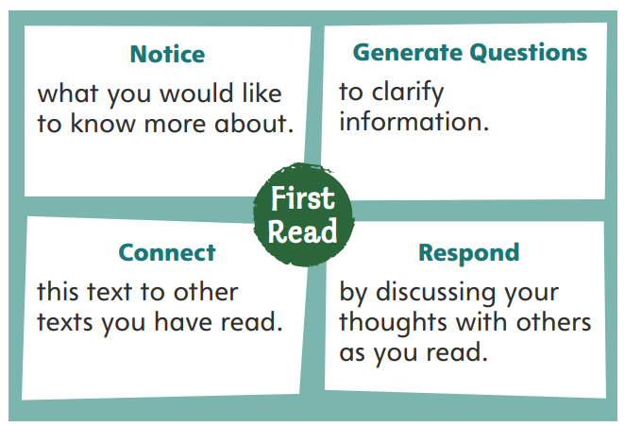
First Read Strategies
Notes:
Discuss the First Read Strategies. Tell students that when reading realistic fiction for the first time, they will better understand and enjoy the story if they take an active interest in the characters and what happens to them. Prompt students to establish a purpose for this first reading, such as finding out what the selection title means.
Explain the four steps of the first read.
NOTICE Encourage students to mark any parts of the text that they would like to know more about.
GENERATE QUESTIONS Remind students to write down questions that they can use to help them clarify information. Have students generate questions about the text before, during, and after reading.
CONNECT Ask students to connect this text to other texts they have read. Encourage students to consider how the text connects to other realistic fiction stories as well as what they have learned from informational texts.
RESPOND Have students discuss their thoughts about the selection with others as they read.
Students may read the text independently, in pairs, or as a whole class. Use the First Read notes to help students connect with the text and guide their understanding.

Slide 17
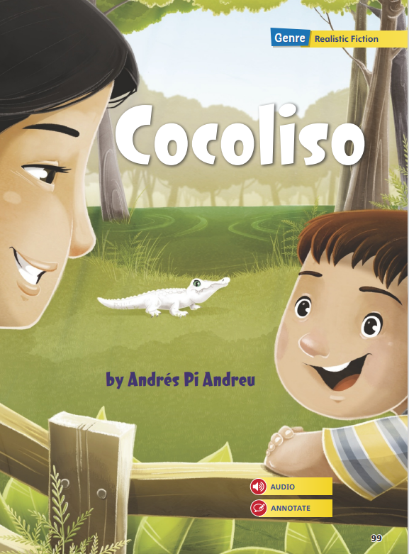
Page 99
First Read – Cocoliso
Notes:
Students may read the text independently, in pairs, or as a whole class. Use the First Read notes to help students connect with the text and guide their understanding.

Slide 18
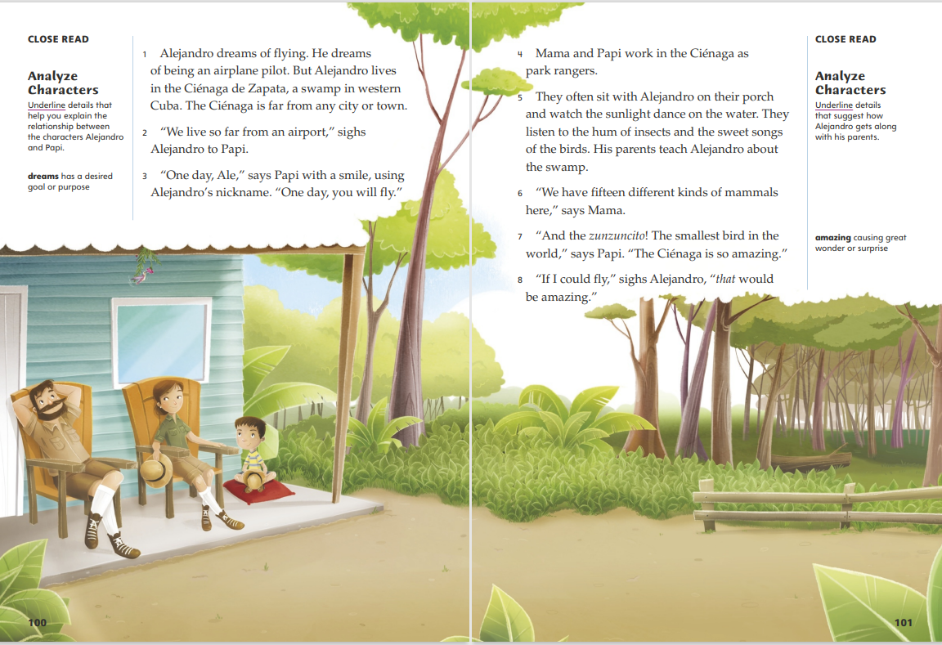
Page 100, 101
First Read – Cocoliso
Notes:
Students may read the text independently, in pairs, or as a whole class
THINK ALOUD The story begins by introducing Alejandro and his dream of being an airplane pilot, so Alejandro is probably the main character. I think Papi is his father, based on what he says to Alejandro and the family shown in the illustration. Alejandro and Papi’s conversation makes me wonder if the title, Cocoliso, is the name of an airport or an airplane.
THINK ALOUD Paragraph 4 introduces Mama by telling readers that she and Papi are park rangers. Mama must be Alejandro’s mother, but then is “Papi” another word for “father,” like “papa” or “dad”? I thought “Papi” was Alejandro’s father’s name. As I read, I am going to jot down my questions about information in the text and check my understanding. For example, in paragraph 5 we learn that Alejandro’s parents often sit with him on the porch. The illustration shows the family sitting on the porch. This must be one of the times the author describes.

Slide 19
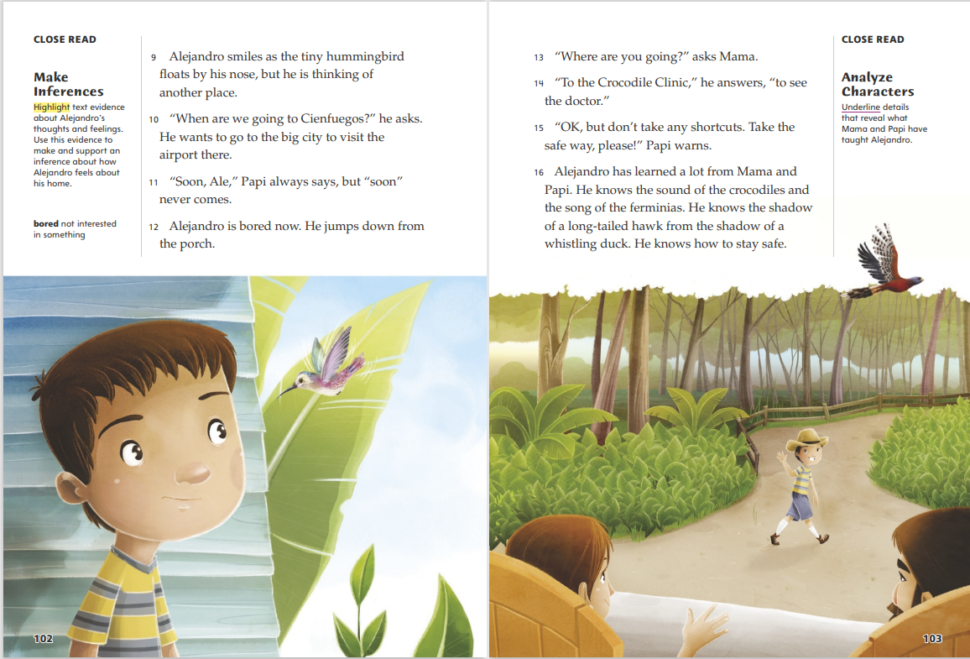
Page 102, 103
First Read – Cocoliso
Notes:
Students may read the text independently, in pairs, or as a whole class.
THINK ALOUD After reading paragraph 12, say: In the other realistic fiction stories I have read, the main character feels differently about something at the end of the story than he or she felt at the beginning. I think Alejandro’s feelings about his home might change in this story.
THINK ALOUD I am not sure why Alejandro is going to see a doctor at the Crocodile Clinic, but I can infer that he goes there often. His parents do not seem surprised, and they let him go alone. The illustration shows that Alejandro is walking on a path through the swamp, so maybe the “safe way” to the clinic is to just stay on the path.

Slide 20
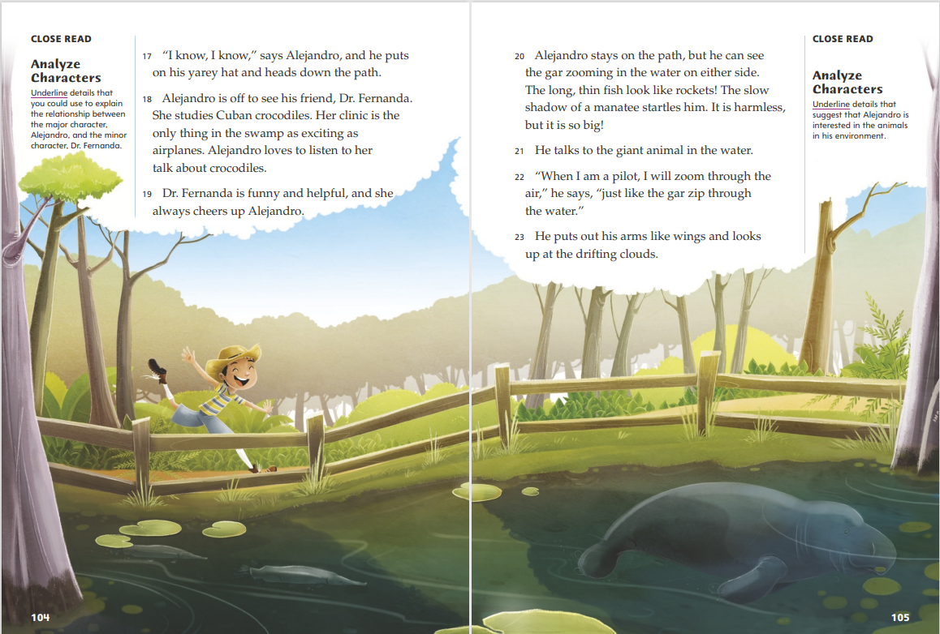
Page 104, 105
First Read – Cocoliso
Notes:
Students may read the text independently, in pairs, or as a whole class.
THINK ALOUD After reading paragraph 18, say: Now I understand why Alejandro wants to go to the Crocodile Clinic. His relationship with Dr. Fernanda reminds me of my own friendships and the ones I’ve read about in other stories. Friends are interested in many of the same things, so they enjoy talking about and exploring these interests together.
THINK ALOUD When I read that “Alejandro stays on the path,” I remember that he needs to be safe in the swamp and I’m glad I do not have to worry about him. He is paying attention to what is around him, and this helps him to notice many interesting things. The descriptions make me want to see these animals for myself, so I am glad that I can see them in the illustration.

Slide 21
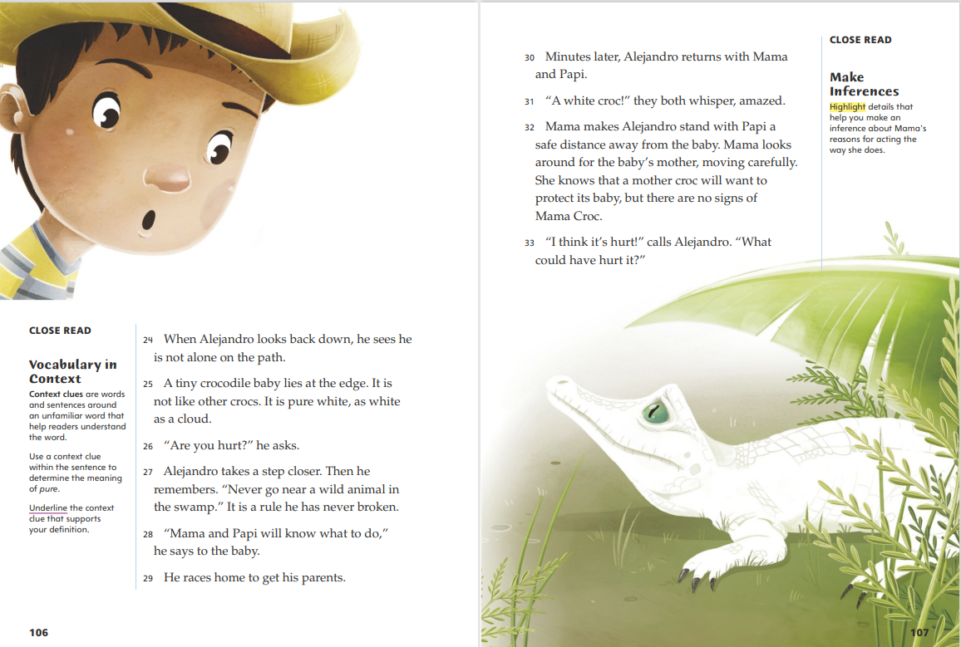
Page 106, 107
First Read – Cocoliso
Notes:
Students may read the text independently, in pairs, or as a whole class.
THINK ALOUD After reading paragraph 27, say: When Alejandro sees the crocodile baby, he asks it if it’s hurt. I’m not sure if he thinks it’s hurt because it’s an unusual color, or because baby crocodiles don’t normally come near the path, or for some other reason. I also wonder how dangerous a baby crocodile can be, especially if it is tiny. Now I want to learn more about crocodiles.
THINK ALOUD If Alejandro’s parents are amazed, I know that this crocodile is something special. As park rangers, they probably know about most of the animals in the swamp. They also know how you should act around them. Paragraph 32 is an instance where the rule Alejandro remembered about not going near a wild animal, even if it’s a baby, applies. Mama or Papi probably taught Alejandro this rule to help him stay safe.

Slide 22
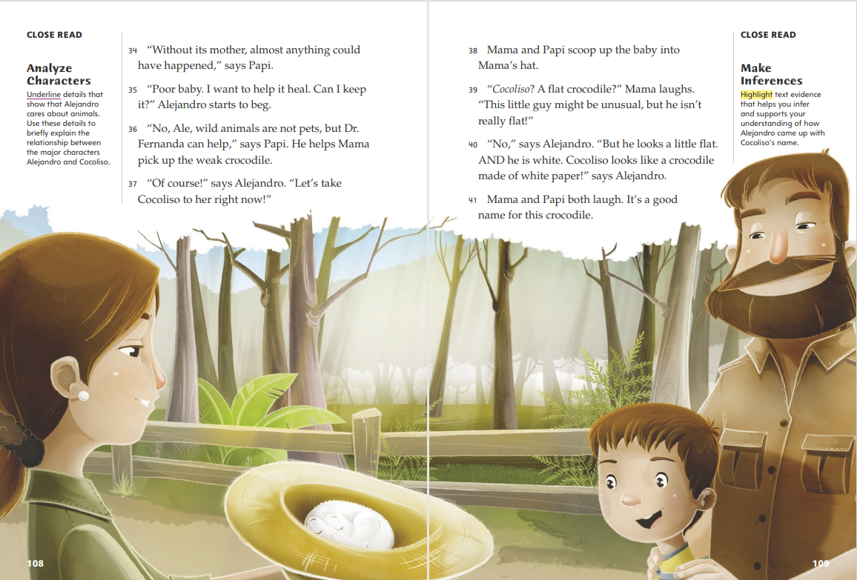
Page 108, 109
First Read – Cocoliso
Notes:
Students may read the text independently, in pairs, or as a whole class.
THINK ALOUD I can understand why Papi says wild animals are not pets. I’ve read stories about wild animals that suffer when they are taken from their homes. This detail suggests that Papi is a good park ranger. He cares about what is best for wild animals, not just what humans may want.
THINK ALOUD Since the title of this text is Cocoliso, I want to understand this character’s name better. I am not sure whether Cocoliso is a real word or one that Alejandro made up. Does one part of the name mean “flat” and the other part “crocodile”? In Spanish, doesn’t coco mean “coconut”? I am going to write my questions down, so I remember to find out the answers.

Slide 23
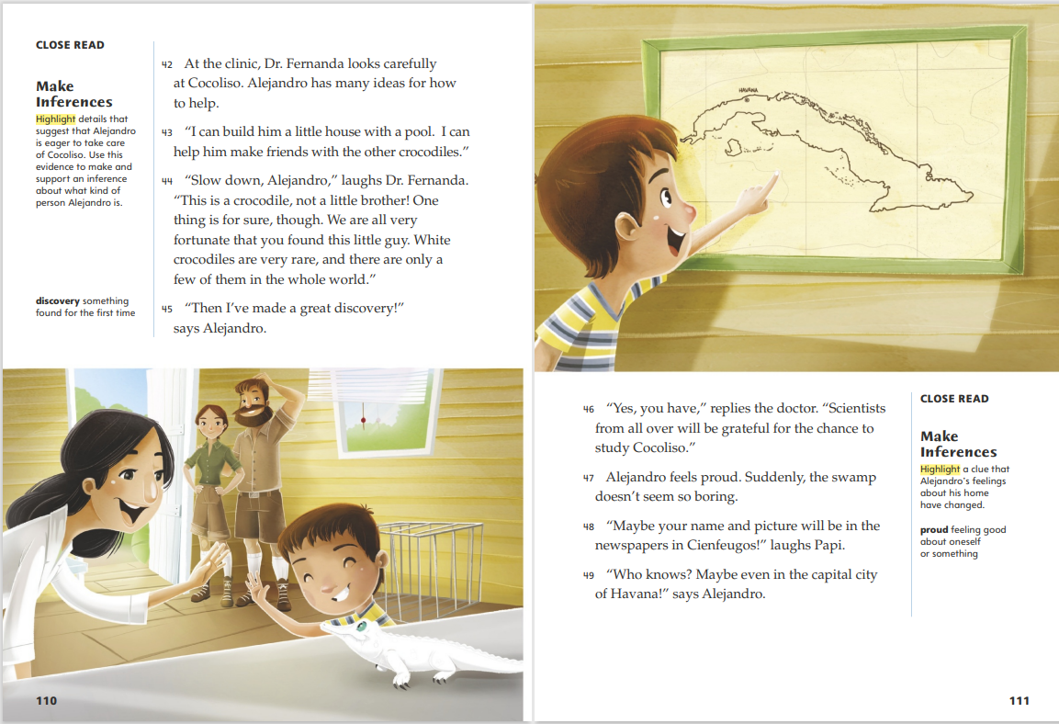
Page 110, 111
First Read – Cocoliso
Notes:
Students may read the text independently, in pairs, or as a whole class.
THINK ALOUD It makes me happy to read that Alejandro is so excited and happy. I have really grown to care about this character, which is one reason that I love reading realistic fiction. I’m glad that he found something that he cares about as much as airplanes and flying.
THINK ALOUD When Dr. Fernanda says that scientists from all over will want to study Cocoliso, it makes me wonder how scientists study wild animals in real life. I’m going to try to find out more about this kind of research later. I also want to find out why white crocodiles are so rare.

Slide 24
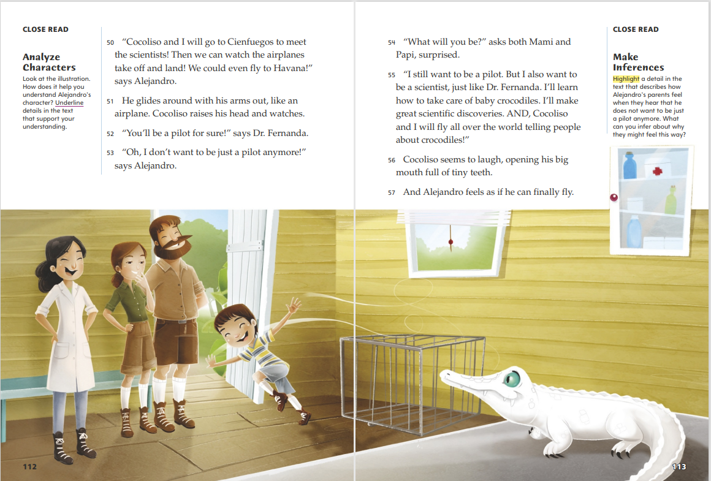
Page 112, 113
First Read – Cocoliso
Notes:
Students may read the text independently, in pairs, or as a whole class.
After reading paragraph 53, ask: What do you think Alejandro means when he says he doesn’t want to be “just a pilot” anymore? What caused his dream to change?
Possible Response: Alejandro still wants to be a pilot, but he wants to be something else too. His dream changed because he found Cocoliso and he interests Alejandro.
After finishing the story, say: Alejandro’s dreams have multiplied! Now he wants to be a pilot and a scientist and combine these two jobs to help Cocoliso, other crocodiles, and other people in a number of ways. How do you think Alejandro feels about this change in his life?
Possible Response: Since Alejandro “feels as if he can finally fly,” I think he has never been more excited.

Slide 25
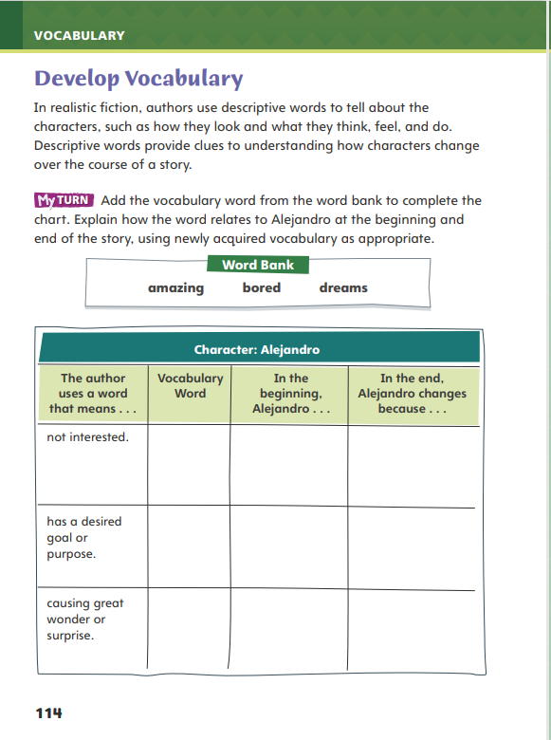
Page 114
Develop Vocabulary
Turn to page 114 in your Student Interactive and complete the activity.
Notes:
Tell students that authors choose words carefully to describe characters and show how those characters change. The vocabulary words amazing, bored, and dreams are used to describe Alejandro’s thoughts and feelings in Cocoliso.
Remind yourself of the word’s meaning.
Ask yourself what the author is describing about Alejandro.
Think about how the word can be used to describe how Alejandro changes.
Model filling out the chart on p. 114 of the Student Interactive using the word bored.
I need to figure out which of the vocabulary words means “not interested.” When someone is bored, that person is not interested in what is going on. I’ll write bored in the second column.
Now I need to think about when Alejandro was bored. In the beginning of the story, Alejandro was bored by the nature around him. All he wanted to do was get away to the city. But after he found the white crocodile, his feelings changed. He was no longer bored because he was interested in Cocoliso.
Have students respond using newly acquired vocabulary as they complete p. 114 of the Student Interactive. They should use text evidence in their answers.

Slide 26
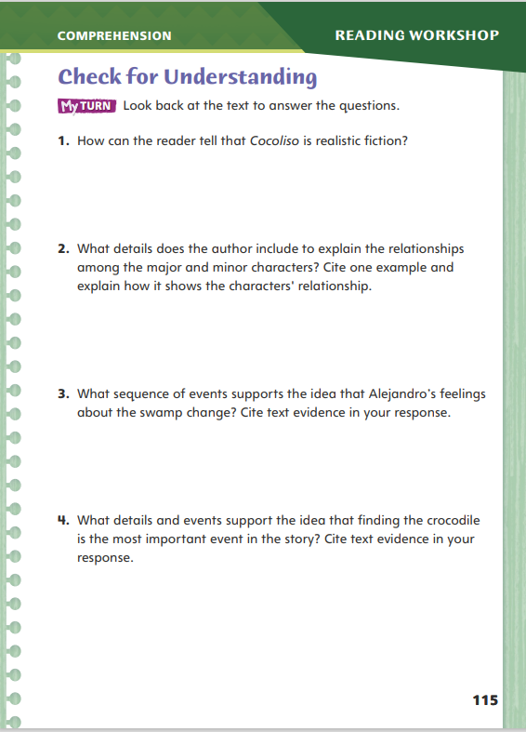
Page 115
Check for Understanding
Turn to page 115 in your Student Interactive and complete the activity.
Notes:
Have students complete p. 115 of the Student Interactive.

Slide 27
Word Study
-ed
-ing
-er
-est
Notes:
Direct students to complete the activity on p. 120 of the Student Interactive.
Have students write the words formed with these endings and use them in sentences.
Explain that because high-frequency words are words that appear often in speech and in written language, their forms and usage should already be familiar.

Slide 28
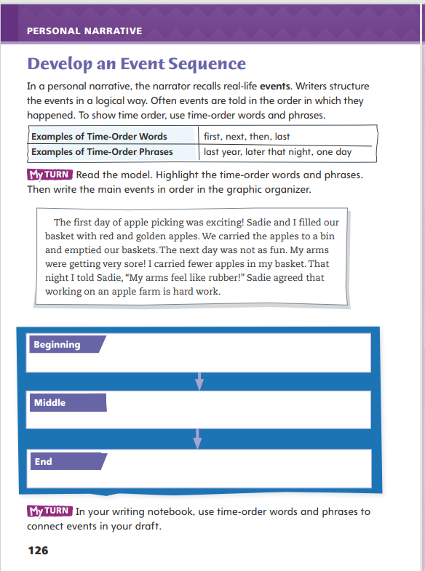
Page 126
Writing – Personal Narrative
Turn to page 126 in your Student Interactive.
Fill in the chart.
Notes:
A personal narrative tells a story about real-life events. The writer often uses chronological order. To organize their ideas, writers use:
Sequence of events
Temporal words and phrases
Remind students that a personal narrative tells a story about real-life events. To help readers understand how one event leads to another, readers need a story map. Say: To help readers understand the sequence of events, writers use temporal words or phrases. Words and phrases such as next, one time, and finally are examples of temporal words and phrases. These words and phrases show time order and help the reader understand how the events are connected.
Select one of the personal narratives from the stack to read aloud. As you read, emphasize the temporal words and phrases that show a passage of time and help to sequence the events. Pause to discuss how the words and phrases make the writing sound more natural. Then guide students in restating the main events of the text.
Direct students to p. 126 of the Student Interactive. Have them highlight words and phrases that show the passage of time. Then, have students use the graphic organizer to list the events in chronological order.

Slide 29
Independent Writing
Add temporal words and phrases to your personal narrative.
Read a paragraph to the class.
Did you understand the passage of time in the paragraph that was read?
Notes:
After the minilesson, students should transition into independent writing. If students need additional support in adding temporal words or phrases, have them look at places where they have switched time but have not let the reader know. Have students refer back to their Student Interactive for words or phrases to use.
Writing Support
Modeled - Use a few sentences to model how adding temporal words and phrases makes the writing sound more natural.
Shared - Have students choose two or three temporal words or phrases from the worksheet. Prompt students to locate sentences in their narratives where they could add the words.
Guided - Remind students that transition words can be used between paragraphs as well, allowing the events to flow more smoothly.
If students demonstrate understanding, they should add temporal words and phrases to their personal narratives.
Invite students who feel they have mastered temporal words and phrases to connect events to read a paragraph to the class. Have the class say if they understood the passage of time.

Slide 30
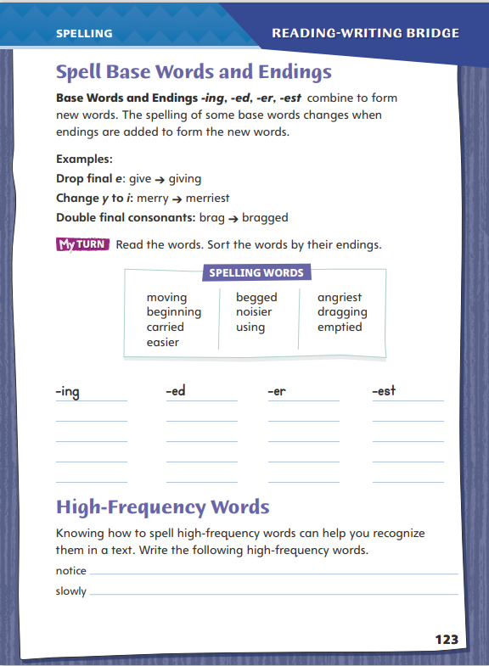
Page 123
Spelling
moving
easier
Turn to page 123 in your Student Interactive and complete the activity.
Notes:
Remind students that they can add the endings -ed and -ing to base verbs to show when the action occurred.
Say and then spell the words moving and easier. Point out that these words have the endings -ing and -er. Explain that the base word of moving is move, and show how the final -e is dropped to add the -ing ending.
Have students complete the activity on p. 123 of the Student Interactive independently.

Slide 31
Language and Conventions
My friend and I play soccer.
We haven’t played on a team yet.
The cat jumped out of the basket.
The dog chased her.
Work with your partner. Compose sentence and join them with conjunctions.
Notes:
Flexible Option
Begin the discussion of compound sentences by providing examples, such as: My friend and I play soccer. We haven’t played on a team yet. Explain to students that these sentences can make sense together. Put the word but between them and explain how it unites the sentences’ contrasting ideas.
Share these sentences with students: The cat jumped out of the basket. The dog chased her. Point out that these sentences are related and it would make sense to join them. Show how the conjunction and can join them in a compound sentence. (The cat jumped out of the basket, and the dog chased her.) Make sure that students see the comma before and. Explain that it shows that there are two complete sentences joined into one larger sentence.
Have pairs compose their own oral sentences. Have students join related sentences with conjunctions.

Slide 32
Lesson 3

Slide 33
Page 99
Analyze Characters
Notes:
Readers learn about a character’s traits by analyzing his or her relationships, motivations, and feelings. Readers also analyze illustrations to better understand a character’s thoughts and feelings. They use this information to explain how the characters’ actions affect the sequence of events in the story.
Think about what characters say and how they treat each other.
Look for what motivates the characters.
Identify how the characters feel about events or other characters.
Use the Close Read note on p. 100 of the Student Interactive to model how to annotate the text to analyze characters.
Which details help me understand Alejandro and Papi? The text says that Alejandro “sighs” as he talks to Papi about living far from the airport. We learn that Alejandro is frustrated. Papi replies by smiling and encouraging Alejandro. These details show me that Papi loves Alejandro and wants to encourage him.
Ask students to describe Alejandro in more detail. Tell them to include his motivations and feelings. Elicit that the illustrations also help reveal Alejandro’s character. Discuss with students how Alejandro’s feelings and personality traits influence his actions. Explain how those actions contribute to the sequence of events.

Slide 34
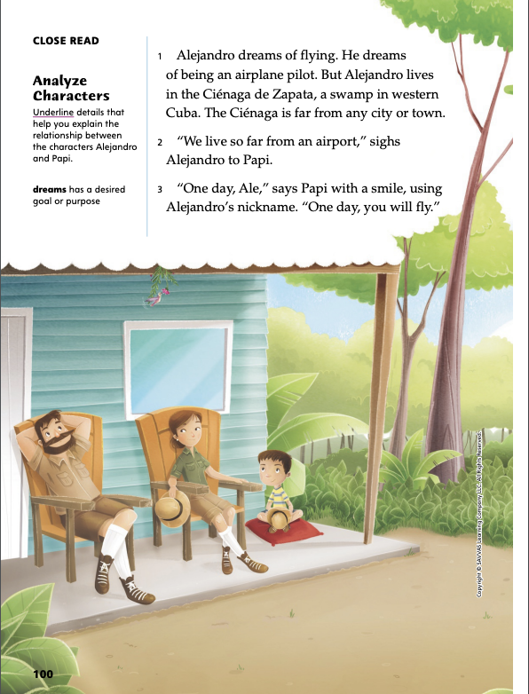
Page 100
Close Read – Analyze Characters
Turn to page 100 in your Student Interactive.
Notes:
Tell students that what characters say to each other and how they treat one another are clues about the kind of relationship they have.
Ask: What kind of relationship do Alejandro and Papi have? Have students scan paragraphs 2 and 3 and underline details that they can use to explain this relationship. See the student page for possible responses.
Ask students to explain how these details help them explain the relationship.
Possible Response: Alejandro and Papi have a close, caring relationship. When Alejandro tells Papi “We live so far from the airport,” he is sharing what troubles him. Papi tries to make him feel better by saying, “One day, you will fly.” Calling Alejandro by his nickname, Ale, also shows that Papi is affectionate toward him. DOK 2

Slide 35
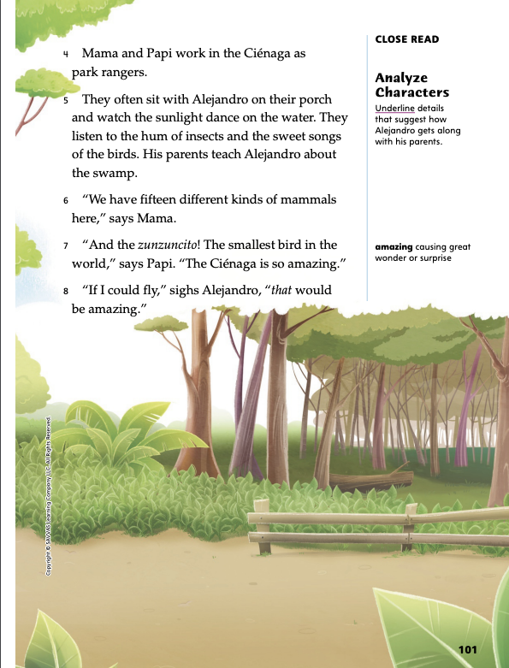
Page 101
Close Read – Analyze Characters
Turn to page 101 in your Student Interactive.
Notes:
Tell students that information about what characters do together can suggest how well they get along or interact with each other. Then have students reread paragraph 5 and underline details that suggest how Alejandro gets along with his parents. See the student page for possible responses. Ask: What can you tell about the family from the things that they do together?
Possible Response: The detail that Mami and Papi “often sit with Alejandro on their porch” tells me that the family spends time together, so they probably get along well with each other. Since the parents “teach Alejandro about the swamp” and have him “watch the sunlight dance” and listen to insects and birds with them, I think they want him to like these things. DOK 2

Slide 36
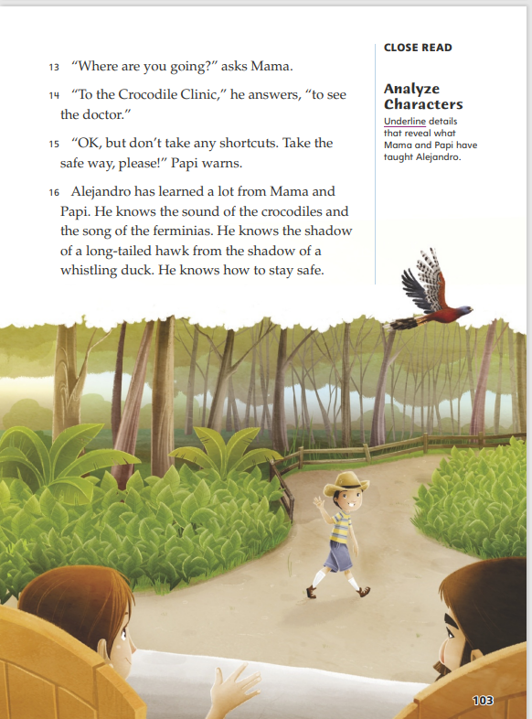
Page 103
Close Read – Analyze Characters
Turn to page 103 in your Student Interactive.
Notes:
Have students scan paragraph 16 and underline details that reveal what Mama and Papi have taught Alejandro. See the student page for possible responses.
Ask: How do these details help you explain the relationship between Alejandro and his parents?
Possible Response: His parents taught him many things to keep him safe and to share their knowledge with him. These details show a close relationship. DOK 2
Ask: What can you infer about Alejandro’s relationship with his parents from the detail that they let him go to the Crocodile Clinic alone?
Possible Response: Mama and Papi know that Alejandro remembers everything they taught him, and they trust him to do what they say. DOK 2

Slide 37
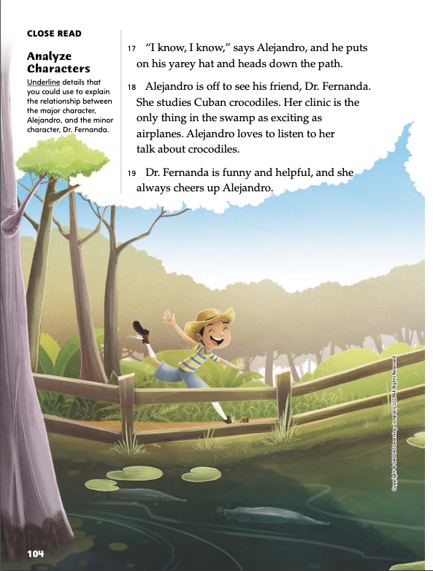
Page 104
Close Read – Analyze Characters
Turn to page 104 in your Student Interactive.
Notes:
Tell students that how a main character feels about other characters can reveal their importance to the story. Have students scan paragraph 18 and underline details that they can use to explain the relationship between Alejandro and Dr. Fernanda. See the student page for possible responses.
Ask: What conclusion can you draw about Dr. Fernanda’s importance to Alejandro?
Possible Response: Dr. Fernanda is an important friend in Alejandro’s life for many reasons. The detail that he “loves to listen to her talk about crocodiles” shows that they share this interest. Since her clinic “is the only thing in the swamp as exciting as airplanes” and “she always cheers up Alejandro,” I think Alejandro would be more bored and unhappy living in the swamp if she was not around. The detail that she is “helpful” also makes me think that she will help Alejandro later in the story. DOK 3

Slide 38
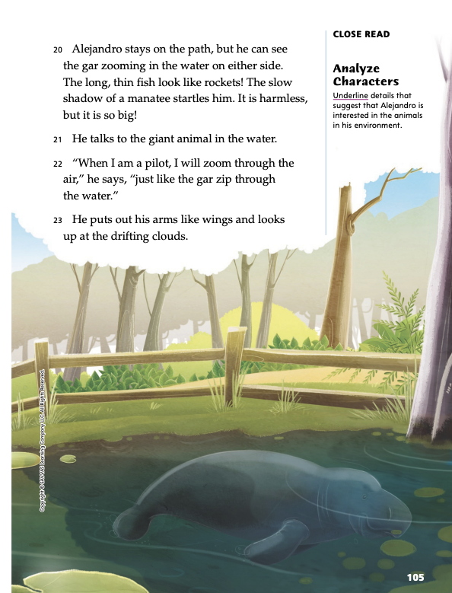
Page 105
Close Read – Analyze Characters
Turn to page 105 in your Student Interactive.
Notes:
Point out to students that Alejandro does not seem to have pets, but he seems to be very interested in animals. Discuss how people behave when they are interested in something. Then have students scan paragraphs 20–22 and underline details that indicate that Alejandro is interested in the animals in his environment.
Ask: How does Alejandro’s relationship with the wild animals show interest?
Possible Response: Alejandro acts like he feels close to the animals. He tells the manatee what he is thinking, and confides in him like a friend. DOK 2

Slide 39
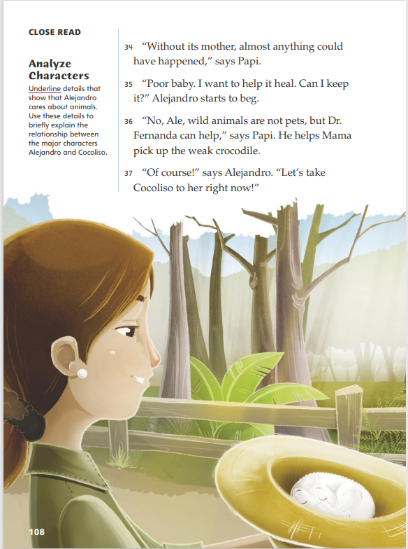
Page 108
Close Read – Analyze Characters
Turn to page 108 in your Student Interactive.
Notes:
Have students scan paragraphs 35–37 and underline details that show that Alejandro cares about animals. See the student page for possible responses.
Ask: How would you explain the relationship between Alejandro and Cocoliso? Use your text evidence to support your answer.
Possible Response: Alejandro likes Cocoliso so much, he begs to keep it as a pet. He shows that he cares about Cocoliso by calling the crocodile “poor baby” and saying, “I want to help it heal.” The detail that he wants to take it to Dr. Fernanda “right now” also makes me think that he feels protective of Cocoliso. DOK 2

Slide 40
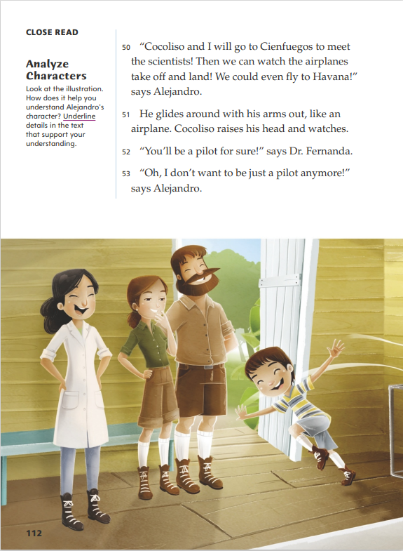
Page 112
Close Read – Analyze Characters
Turn to page 112 in your Student Interactive.
Notes:
Remind students that in realistic fiction, we can learn a lot about characters from illustrations and the text.
Have students scan paragraphs 50–53 and underline details that reveal characteristics of Alejandro's personality. See the student page for possible responses.
Ask: How has Alejandro's relationship with Cocoliso changed Alejandro? Use text evidence to support your response.
Possible Response: Before Alejandro found Cocoliso, his dream was to be an airplane pilot and he wanted to go to Cienfuegos to visit the airport. Now, he is excited to “go to Cienfuegos to meet the scientists” instead. DOK 2

Slide 41
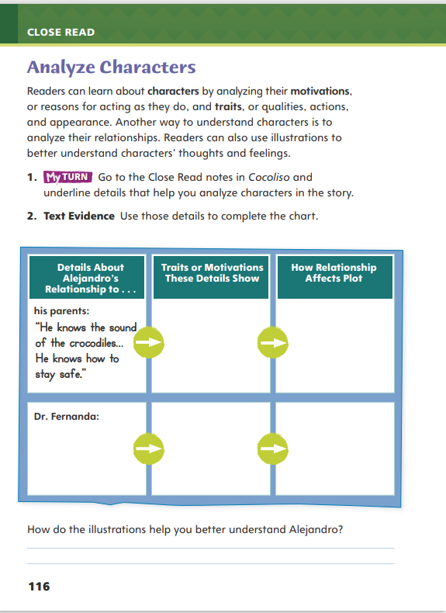
Page 116
Analyze Characters
Turn to page 116 in your Student Interactive and complete the activity.
Notes:
Have students annotate the text using the other Close Read notes for Analyze Characters and then use the text evidence from their annotations to complete the chart on p. 116 of the Student Interactive.

Slide 42
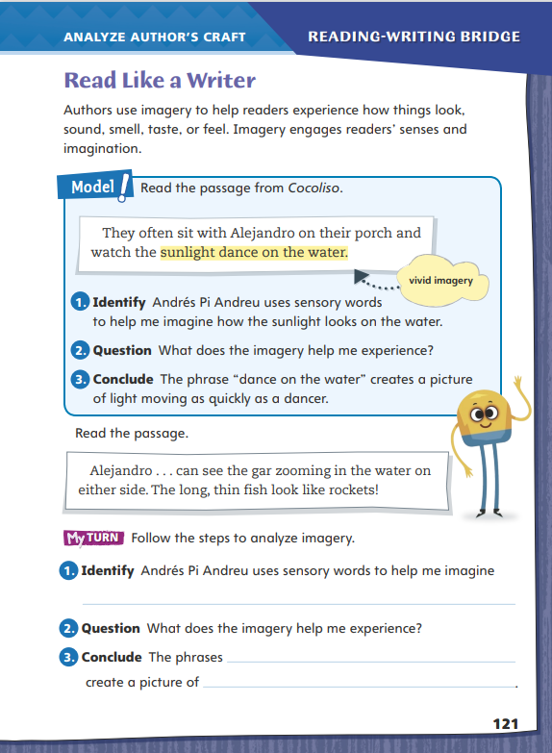
Page 121
Read Like a Writer
Turn to page 121 in your Student Interactive and complete the activity.
Notes:
Imagery is descriptive language that helps readers picture in their minds the characters, settings, and events of a story.
Think about the words that authors use to create imagery. For example, an author might use flaming instead of red to describe a sunset.
When writers describe something in a unique way, readers can form a picture in their mind. For example, an author might write, The leaves jumped up into a tornado instead of The leaves blew around.
Explain that students will analyze how author Andrés Pi Andreu uses imagery to provide moving descriptions in Cocoliso. Model analyzing imagery on p. 121 of the Student Interactive.
Read the passage from the text. Then have students examine the language of the imagery used on p.121 of the Student Interactive.
Guide students in drawing a connection between the imagery described in the text and the pictures they see in their minds as they read.
Discuss students’ responses to the questions and guide them in discussing what the author achieves by using imagery in Cocoliso.
Direct students back to Cocoliso to find the author’s specific use of imagery. Students should then complete the activity on p. 121 of the Student Interactive to help determine their understanding of the skill.

Slide 43
Word Study
live
lived, living
pretty
prettier, prettiest
loose
looser, loosest
blue
bluer, bluest
Notes:
Flexible Option
Remind students that the endings -ed and -ing can be added to verbs to show when the action occurred, and that -er and -est can be added to adjectives when comparing things. Sometimes, the spelling of the base word changes when one of these suffixes is added.
Explain that when adding -ed or -ing to the word live, you drop the final -e. (lived, living) Then have students add -er or -est to the adjectives pretty, loose, and blue and read each word aloud. (prettier, prettiest; looser, loosest; bluer, bluest)
Have students complete Word Study p. 3 from the Resource Download Center.

Slide 44
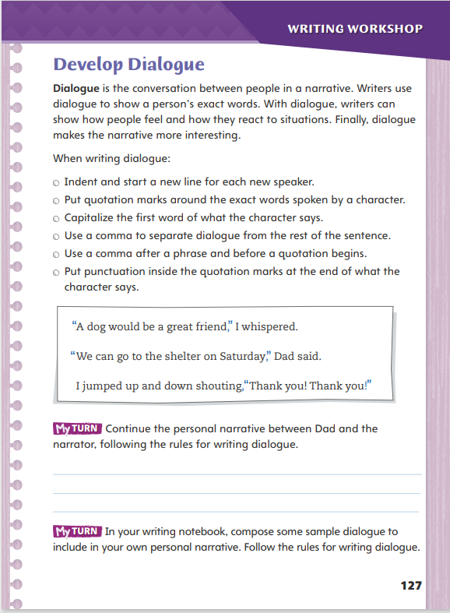
Page 127
Writing – Personal Narrative
Turn to page 127 in your Student Interactive.
Notes:
Writers use dialogue to bring characters to life. Dialogue is used to
Reveal character through thoughts and feelings.
Move the action along.
Make the story more realistic and interesting.
Explain to students that even though they are writing about themselves, they can include dialogue in their narratives. Say: Dialogue is the conversation between people in a narrative. It adds life to the narrator and other characters. When you use dialogue, you show the reader how characters feel and how they react to situations.
Group students into pairs and have them choose a book from the stack that contains dialogue. Say: Together read a section of the story that is dialogue. Remember that the dialogue should sound like regular conversation. As you read, think about how the characters relate to one another.
Direct students to p. 127 of the Student Interactive. Review the rules of dialogue together. Next have students write the dialogue and then share their writing with a partner. Have students compare how the dialogue can affect actions and reveal qualities of a character. Ask partners to check each other’s dialogue for correct punctuation.

Slide 45
Independent Writing
Write dialogue for your own personal narrative.
Review your punctuation and make edits.
Share the dialogue you included in your personal narrative.
Notes:
Direct students to write sample dialogue to include in their own personal narratives. They should refer to the stack for models of dialogue as they are writing. Remind students that there should be a reason for the conversation.
Writing Support
Modeled - Create a dialogue between a narrator and a character to model correct punctuation and dialogue tags.
Shared - Have the class provide a situation between two characters and create a short dialogue. Prompt students to create tension between the characters.
Guided - Use a stack text to highlight the rules for writing dialogue
If students already have included dialogue in their narratives, have them review punctuation and make any necessary edits.
Call on a few students to share the dialogue they included in their personal narratives. Have the class say what they found interesting about the dialogue. Encourage students to talk about problems they had with punctuation.

Slide 46
Spelling
beginning
carried
begged
noisier
using
angriest
Notes:
Flexible Option
Remind students that the spelling of some verbs and some adjectives changes when an ending is added. A final vowel such as a -y or an -e may be dropped or a final consonant may be added.
Write the following words: beginning, carried, begged, noisier, using, and angriest. Have students work in pairs to spell the base word of each word and then write a new word with the same added ending each word had.
Have students complete Spelling p. 8 from the Resource Download Center. Click path: Table of Contents -> Resource Download Center -> Spelling

Slide 47
Language and Conventions
Our family will go to the beach.
We will visit the city instead.
Use conjunctions to join the sentences in a way that makes sense.
Notes:
Explain to students that the conjunction used to create compound sentences must relate to the ideas of the sentences.
Provide the following sentences: Our family will go to the beach. We will visit the city instead. Show that joining them with either and or but doesn’t make sense. Say: Only the conjunction or works here. Or shows alternatives. Adding and shows an additional thought. Adding but shows a contrasting idea.
Have students add and or but between the sentences to form a compound sentence so they can hear how wrong it sounds. Then have them add or to hear how it sounds. Point out that each part of the compound sentence has subject-verb agreement. Encourage students to create other sentences that use all these conjunctions, preceded by a comma.

Slide 48
Lesson 4

Slide 49
Page 99
Make Inferences
Notes:
Making inferences means figuring out details that are not directly stated in the text. Readers often make inferences about what characters think and feel based on what they say and do.
Read the text closely and think about what the character says and does. Notice different character traits.
Use knowledge from your own life to help you make inferences about the character’s motivations, feelings, and thoughts.
Use the Close Read note on p. 102 of the Student Interactive to model how to annotate the text to make inferences about Alejandro’s thoughts and feelings.
What are Alejandro’s thoughts and feelings on page 102? The text says that “he is thinking of another place.” I’ll have to read on to see where he is thinking about.
In the next paragraph, the text says, “He wants to go to the big city.” I know when I am bored, I sometimes daydream about being someplace else.
When I read on, I see that the text says Alejandro is bored. By using this text evidence, I can infer that Alejandro must be bored living where he lives.

Slide 50
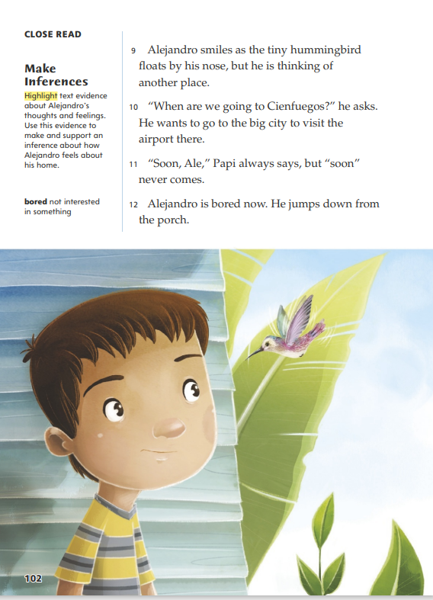
Page 102
Close Read – Make Inferences
Turn to page 102 in your Student Interactive.
Notes:
Have students scan paragraphs 9–12 and highlight text evidence, or details, about Alejandro’s thoughts and feelings. See the student page for possible responses.
Remind students that an inference is an idea that they form from text evidence and what they already know. Ask: Based on this evidence, what can you infer about how Alejandro feels about his home? Cite evidence to support your inference.
Possible Response: The detail that Alejandro’s “thinking of another place” makes me think that he sees things like hummingbirds all the time and is bored at home. I think he would rather live in Cienfuegos, the place he is thinking about, because “he wants to go to the big city to visit the airport.” If there was an airport near his home, Alejandro would probably like it more. DOK 2

Slide 51
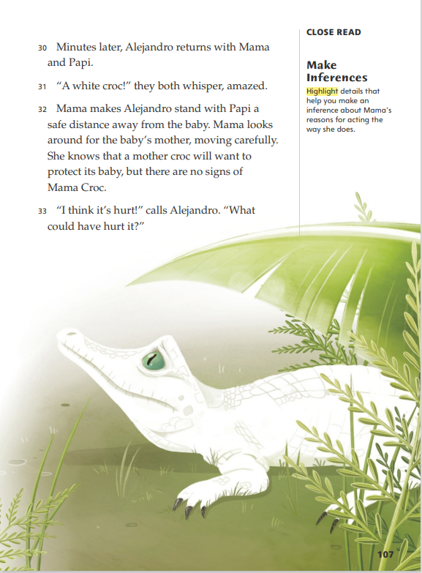
Page 107
Close Read – Make Inferences
Turn to page 107 in your Student Interactive.
Notes:
Have students scan paragraph 32 and highlight details that help them infer why Mama is acting nervous. See the student page for possible responses.
Ask: How does your evidence support the inference that Mama is afraid that the children could get hurt?
Possible Response: The detail that Mama “makes Alejandro stand with Papi a safe distance away” shows that she is scared of the crocodile. The details that “Mama looks around for the baby’s mother” because it “will want to protect its baby” tell me that Mama is aware of danger and understands a mother crocodile's behavior. She is responding to that. DOK 2

Slide 52
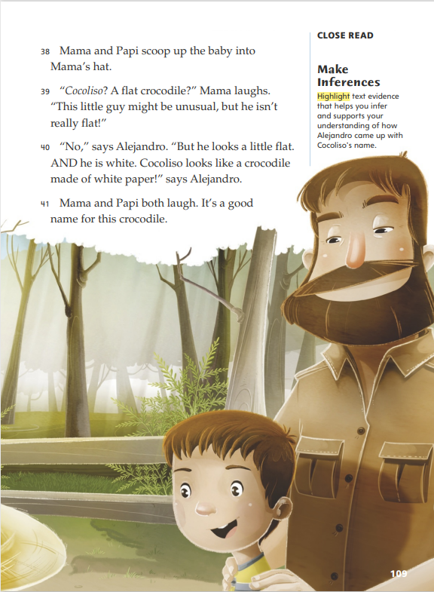
Page 109
Close Read – Make Inferences
Turn to page 109 in your Student Interactive.
Notes:
Have students scan paragraphs 39 and 40 and highlight details that help them infer how Alejandro came up with Cocoliso’s name. See the student page for possible responses.
Ask: What can you infer about Alejandro from the way he names Cocoliso? Use text evidence to support your inference.
Possible Response: Alejandro’s explanation that “he looks a little flat. AND he is white” shows that he names Cocoliso carefully and thoughtfully. I can infer that Alejandro wanted to name Cocoliso because he is the person who found him, and he thinks of the crocodile as his friend. DOK 1

Slide 53
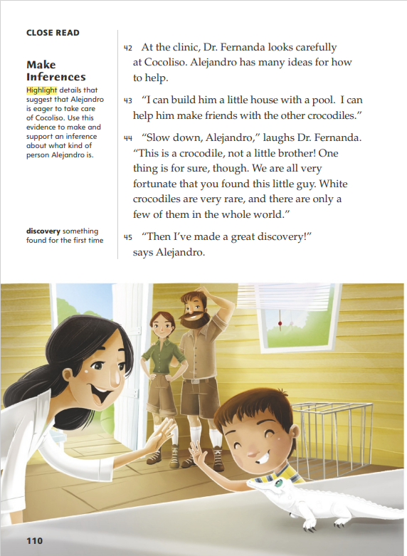
Page 110
Close Read – Make Inferences
Turn to page 110 in your Student Interactive.
Notes:
Have students scan paragraphs 42 and 43 and highlight details that suggest that Alejandro is eager to take care of Cocoliso. See the student page for possible responses.
Ask: Based on these details, what inference can you make about the kind of person Alejandro is? Use text evidence to support your response.
Possible Response: I can infer that Alejandro is a helpful and thoughtful person, since he “has many ideas for how to help” and offers to “help him make friends with the other crocodiles.” Alejandro also is not a lazy person, because he offers to “build him a little house with a pool.” He will do whatever he can to help Cocoliso. DOK 2

Slide 54
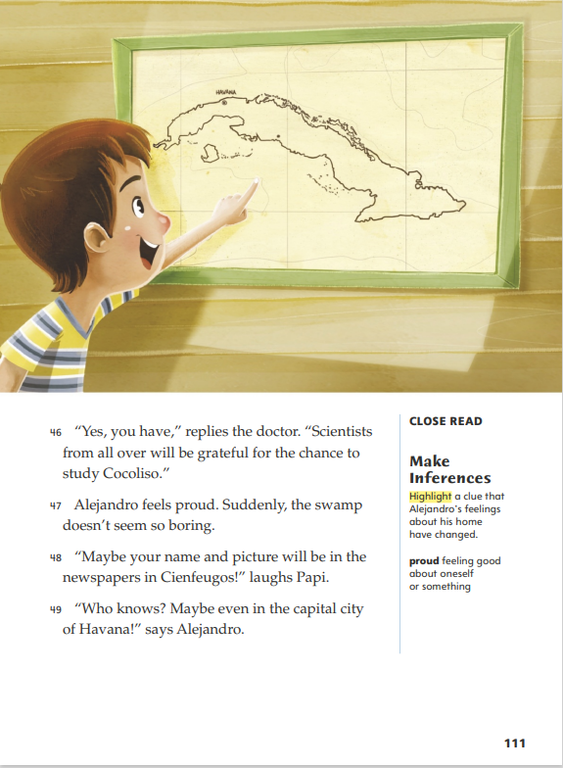
Page 111
Close Read – Make Inferences
Turn to page 111 in your Student Interactive.
Notes:
Have students scan paragraphs 47–49 and highlight a clue that Alejandro’s feelings about his home have changed. See the student page for possible responses.
Ask: How are Alejandro’s feelings about his home different from the way he felt at the beginning of the story? Use text evidence to support your response.
Possible Response: The detail that “Suddenly, the swamp does not seem so boring” shows that Alejandro is more interested in his home now. I think he also may not feel that airports are the only things that make a place important anymore. At the beginning of the story, he only wanted to go to the airport in Cienfuegos. But when Papi mentions the newspapers in Cienfuegos, Alejandro suggests that papers in “the capital city of Havana” would be even better. DOK 2

Slide 55
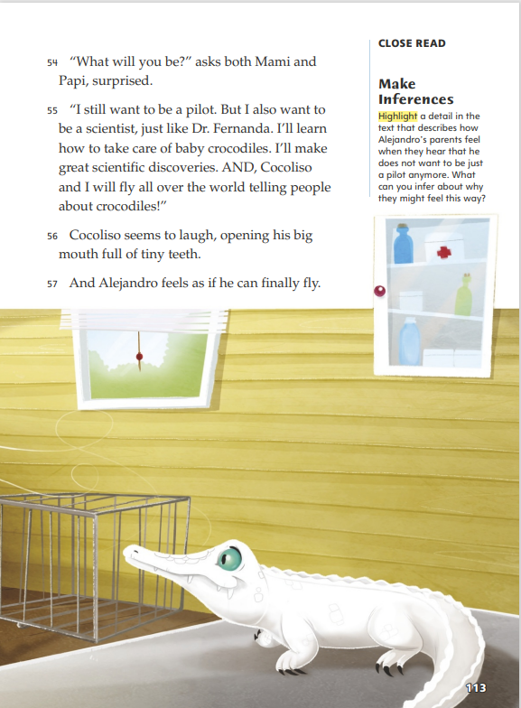
Page 113
Close Read – Make Inferences
Turn to page 113 in your Student Interactive.
Notes:
Have students highlight a detail in paragraph 54 that describes how Alejandro's parents feel when they hear that he does not want to be just a pilot anymore. See the student page for possible responses.
Ask: What can you infer is the reason Alejandro’s parents feel this way?
Possible Response: Alejandro’s parents knew that his dream was to be a pilot. In the story, he complained about living so far from an airport, asked to go to the airport in Cienfuegos, and told them how it would be amazing to fly. He probably did all of these things more often than the author mentioned, because they are a close family and he did not hide his dream. So Mama and Papi are surprised now because this is the first time he has let them know that his dream has changed. DOK 3

Slide 56
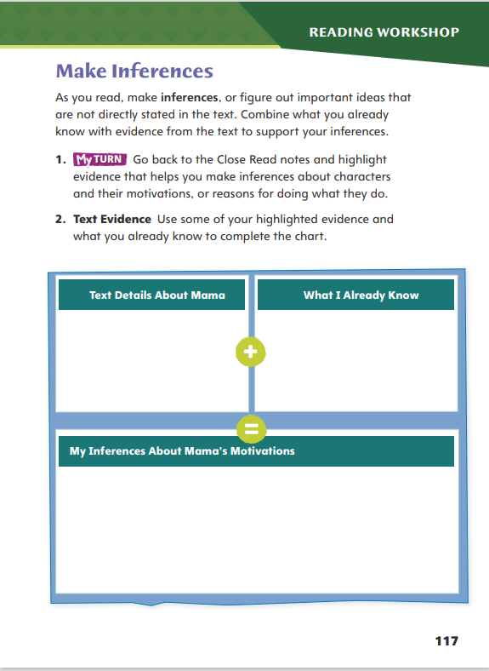
Page 117
Make Inferences
Turn to page 117 in your Student Interactive and complete the activity.
Notes:
Have students annotate the text using the other Close Read notes for Make Inferences and then use the text evidence from their annotations to complete p. 117 of the Student Interactive.

Slide 57
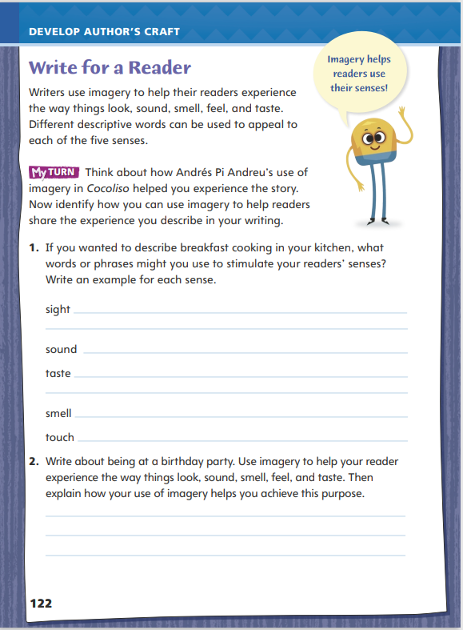
Page 122
Write for a Reader
Turn to page 122 in your Student Interactive and complete the activity.
Notes:
Explain to students that writers want readers to be able to picture in their minds the characters, settings, and events of their stories. To do this, they use descriptive words that call upon the readers’ five senses and make their stories come alive.
Remind students that they identified how author Andrés Pi Andreu uses imagery to bring alive the setting, characters, and events in Cocoliso. Review some of the words the author uses to create images.
Discuss how students might use imagery to bring their own writing to life. Model an example: I like to write about the city. When I ride the subway, I describe imagery in my notebook. I write that the train sounds thunderous. I describe a man’s face as having lines that mark every smile. I capture the feeling I get when I see a rat on the tracks as a sharp tingling that travels up my spine.
Have students describe sunshine, eggs, orange juice in their own words. Ask students to verbally share their ideas. (Possible responses: beams spreading across the sky; eggs dancing in the pan; orange juice with pulp as thick as crushed ice)
Ask students to use imagery to write a description of a party or a scene from their neighborhood.
Have students review Andrés Pi Andreu’s use of imagery and use it an example for their own writing. Then guide students to complete the activity on p. 122 of the Student Interactive.

Slide 58
Word Study
bike
glass
city
Notes:
Flexible Option
Review the strategies from the previous week to use the inflected endings -s, -es, and -ies to create plural nouns.
Display different words that require spelling changes with the addition of inflected endings, such as bike, glass, and city. Ask volunteers to spell these words correctly and note any changes in spelling: bikes, glasses, and cities. Remind students that the final letters in a word determine which ending to use and if letters need to be dropped or changed.
Have students pair up or work independently to apply what they have learned about adding inflected endings to nouns to create plurals. Then allow students to share what they have learned by forming plurals with nouns they collect

Slide 59
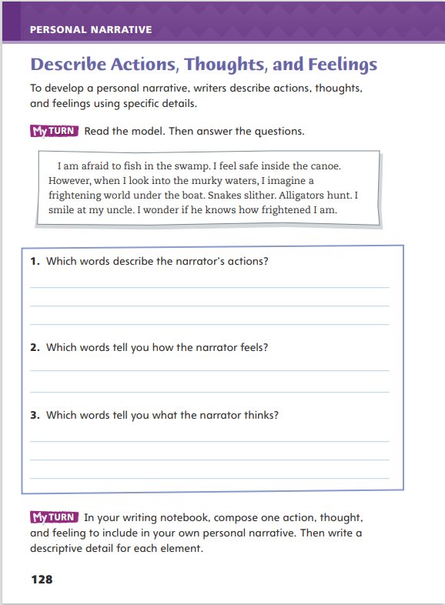
Page 128
Writing – Personal Narrative
Turn to page 128 in your Student Interactive.
Notes:
To allow the reader to feel as though he or she is experiencing the event alongside of the narrator, writers of personal narratives develop engaging ideas with details. Writers elaborate on
Details that convey and heighten action.
Descriptions of their thoughts and feelings.
Remind students that action and specific details make writing more interesting. Descriptive details allow readers to visualize the experience. Say: Interesting stories include details about the action. If I am writing about riding a roller coaster, I want to include details about how I felt when I got into the car, looked down at all the people, and zipped around curves. I would also include details to describe my feelings: I might be nervous, scared, or excited.
Read aloud an example from one of the personal narratives from the stack. Ask: Which words tell you how the narrator is feeling? Which words describe the narrator’s actions?
Direct students to p. 128 of the Student Interactive. Have them find words and phrases from the model that describe the narrator’s actions, thoughts, and feelings.

Slide 60
Independent Writing
Write sentences for an action, though and feeling and related to your personal experience.
Read a section of your personal narrative where you added details.
How do details make a story more interesting?
Notes:
After the minilesson, students should transition into independent writing. Have students begin writing sentences for an action, thought, and feeling related to a personal experience. Have students use a web cluster to recall specific details.
Writing Support
Modeled - Write sentences and model adding details about thoughts and feelings.
Shared - Have students provide three simple sentences.
Guided - Use a stack text to show how authors share thoughts and feelings in personal narratives
If students have written sentences, they should add details that are relevant.
Invite volunteers to read a section of their personal narrative where they added descriptive details. Begin a discussion about how details make stories more interesting.

Slide 61
Spelling
inches
spies
families
Notes:
Flexible Option
Review the spelling rule from the previous week about forming plural nouns by adding the inflected endings -s, -es, or -ies.
Present the following words to students: inches, spies, and families. Call on volunteers to identify the base word and inflected ending (-s, -es, -ies) that has been added to each word.
Using the Spelling Words from the previous week, invite students to make flashcards for the words, quiz each other on the words’ correct spellings or create a word search or crossword puzzle using the words.

Slide 62
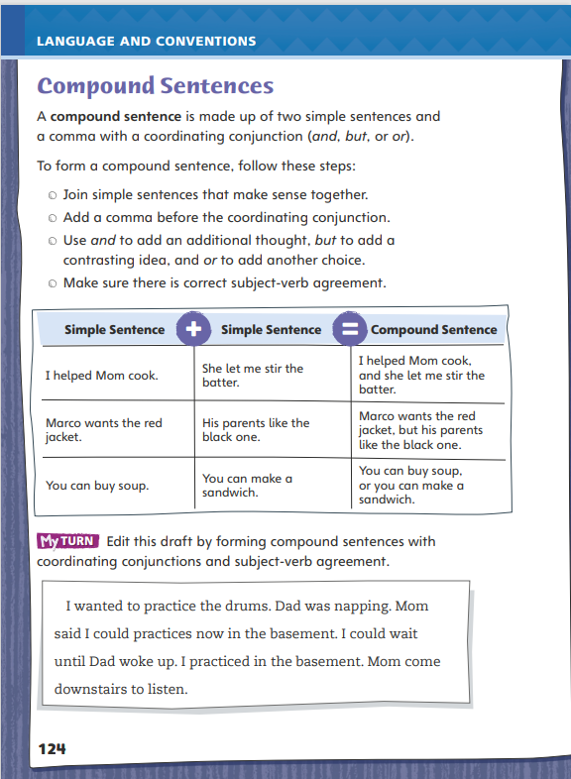
Page 124
Language and Conventions
Turn to page 124 in your Student Interactive and complete the activity.
Notes:
Have students edit the draft paragraph on p. 124 of the Student Interactive.

Slide 63
Lesson 5

Slide 64
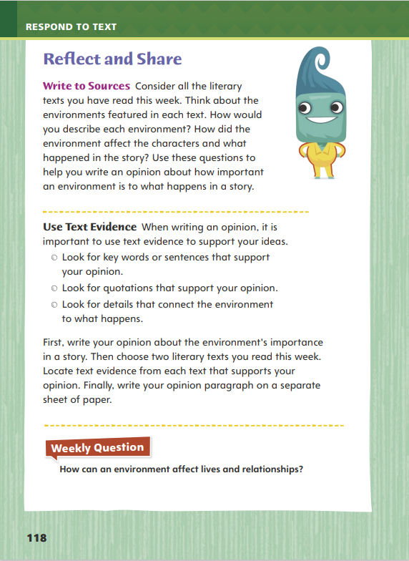
Page 118
Reflect and Share
Turn to page 118 in your Student Interactive.
Notes:
Explain to students that when they are writing an opinion, it is important for them to use text evidence to support their ideas.
Look for details that support your opinion.
Look for direct quotations from the text that support your opinion.
Make connections between ideas to support your opinion.
Model making pertinent comments using the Write to Sources prompt on p. 118 in the Student Interactive.
In Cocoliso, the story takes place in a swamp. The text says that it was “far away from any city or town.” This is very important to the story, because Alejandro thinks it is boring to live in the swamp. Then Alejandro sees a baby white crocodile. The text says “white crocodiles are very rare.” If this story took place in the city, Alejandro most likely would have never seen the white crocodile.

Slide 65
Page 118
Apply
How can an environment affect lives and relationships?
Notes:
Have students use evidence from the texts they have read this week to respond to the Weekly Question. Tell them to write their responses on separate sheets of paper.

Slide 66
Word Study
buried
hurried
pinning
cozier
coziest
Notes:
Flexible Option
To assess students’ understanding of base words and endings, provide them with the following words: buried, hurried, pinning, cozier, coziest
Have students use their knowledge of base words and endings to read each word. Then have them explain the spelling and meaning change for each word.

Slide 67
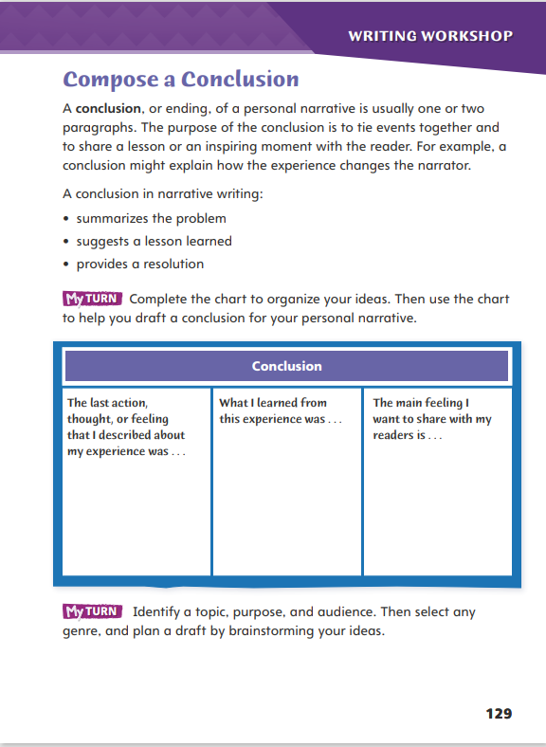
Page 129
Writing – Personal Narrative
Turn to page 129 in your Student Interactive.
Notes:
A conclusion ties the ideas of the personal narrative together. It is the final event which brings the experience to a close. A conclusion in narrative writing:
Summarizes the problem
Suggests a lesson learned from the experience
Provides a resolution to the conflict
Discuss the elements to a strong conclusion on p. 129 of the Student Interactive. Then read the conclusions of two narratives from the stack, choosing narratives students are familiar with. As you read, have students notice how the ending ties into the beginning of the narrative. Ask: What words help you understand how the narrator feels about the experience? What did the narrator learn from the experience? How did the story end? How would you make it better? Remind students that a strong conclusion shows how the events were meaningful to the narrator. Encourage students to be creative and reflective.
Direct students to p. 129 of the Student Interactive. Have them organize their ideas for conclusions to their personal narratives and then compose a strong conclusion.

Slide 68
Independent Writing
Write the conclusion to your personal narrative.
Share your conclusion with the class.
Notes:
Use the instruction on p. T415 to guide students on how to plan a first draft by selecting a genre for a particular topic, purpose, and audience. Alternatively, students may continue writing their personal narratives.
Ask students who have written their conclusions based on their notes to share them with the class. Invite the class to say if they feel the conclusion provides a resolution or reflection and offer ideas on how it could be improved.

Slide 69
Spelling
1. The horses carried our suitcases.
2. As the game went on, the crowd got noisier.
3. Mother begged us to turn off the movie.
4. The baby is dragging his bear around by one leg.
5. We are moving the statue to the backyard.
6. The snow is beginning to melt and disappear.
7. You should be using a pot holder to carry a hot pan.
8. The angriest hornet came after me.
9. The room emptied out after the speaker left.
10. That hill is easier to climb that the first one we climbed.
Notes:
(Note: Move the orange boxes to cover each bold spelling word before you read aloud the words and sentences.)
Read aloud the words and sentences. Have students spell each word with initial consonant blends and the two high-frequency words.
The horses carried our suitcases.
As the game went on, the crowd got noisier.
Mother begged us to turn off the movie.
The baby is dragging his bear around by one leg.
We are moving the statue to the backyard.
The snow is beginning to melt and disappear.
You should be using a pot holder to carry a hot pan.
The angriest hornet came after me.
The room emptied out after the speaker left.
That hill is easier to climb than the first one we climbed
Reveal the spelling word and have students check their work.

Slide 70
Language and Conventions
My dad bakes a chocolate cake for my sister. My sister does not like chocolate.
Which of the following conjunctions properly creates a compound sentence?
and
but
or
Notes:
Flexible Option
Display these sentences and have students respond independently.
My dad bakes a chocolate cake for my sister. My sister does not like chocolate.
Which of the following conjunctions properly creates a compound sentence with these two sentences?
And
But
or
Have students complete Language and Conventions p. 13 from the Resource Download Center. Click path: Table of Contents -> Resource Download Center -> Language and Conventions -> U3 W3

Slide 71
Unit 1: Week 3
Grade 3

