Slide 1
Unit 1: Week 5
Grade 1

Slide 2
Copyright © Savvas Learning Company LLC. All Rights Reserved.
This publication is protected by copyright, and permission should be obtained from the publisher prior to any prohibited reproduction, storage in a retrieval system, or transmission in any form or by any means, electronic, mechanical, photocopying, recording, or otherwise. For information regarding permissions, request forms, and the appropriate contacts within the Savvas Learning Company Rights Management group, please send your query to:
Savvas Learning Company LLC, 15 East Midland Avenue, Paramus, NJ 07652
or
k12learningpermissions@savvas.com
myView Literacy® is an exclusive trademark of Savvas Learning Company LLC in the U.S. and/or other countries.

Slide 3
Lesson 1

Slide 4
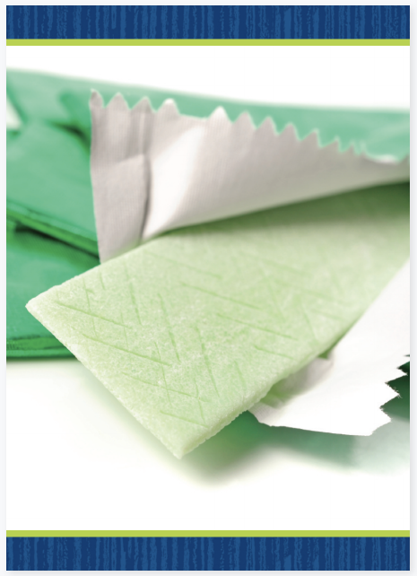
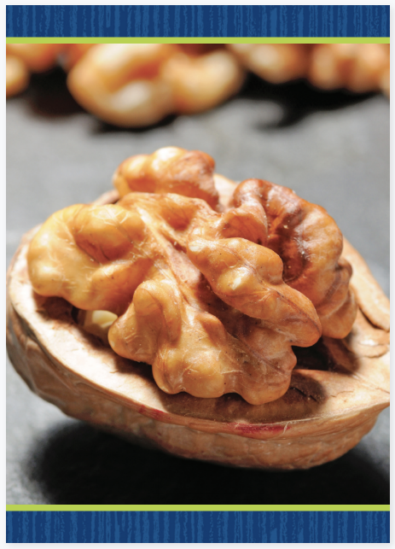
Phonological Awareness
Notes:
Display the gum and nut Picture Cards for further practice with the medial sound /u/. First say the sounds in each word and then have students repeat the sounds. Click path -> Table of Contents -> Unit 1 Week 5 Procedural Text -> Lesson 1

Slide 5
Page 176
Phonological Awareness
Notes:
Point to the picture of the cup on p. 176 in the Student Interactive. Tell students to listen to each sound as you say the word cup: /k/ /u/ /p/. Say: I hear the sounds /k/ /u/ /p/ in the word cup. What sound do you hear in the middle of cup? Pause for responses. Yes, the sound /u/ is in the middle of the word cup. Have students repeat with the pictures for bug and sun. Then ask them what sound is in the middle of all three picture names.

Slide 6
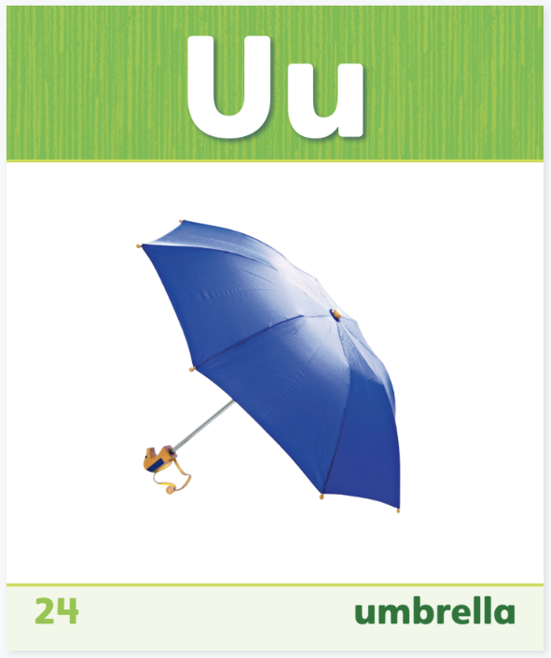
Page 176
Phonics
Read the words on page 176 in your Student Interactive.
Notes:
Use Sound-Spelling Card 24 (umbrella) to introduce how to spell the short u sound.
Say: This is a picture of an umbrella. Umbrella begins with the sound /u/ (pause) /u/ (pause) /u/ (pause) umbrella. Say the sound with me. Have students say the sound several times, then ask: What sound does umbrella begin with? Elicit responses. Point to the Uu at the top of the card. The sound /u/ is called the short u sound and is spelled u. What letter spells the sound /u/? That’s right, the letter u. Click path -> Table of Contents -> Week 5 Procedural Text -> Lesson 1
Direct students to the bottom of p. 176. Have them practice saying each sound in the words. Then have them blend the sounds to decode the short u words.

Slide 7
High-Frequency Words
as
three
he
with
to
Notes:
Write the high-frequency words as, he, to, three, and with. Display the words. Tell students to practice and remember these words.
Point to each word as you read it.
Then spell the word and read it again.
Have students spell and say the words with you.
Have students write the words in their notebooks.

Slide 8
Page 132,133
Interact with Sources
How are the kinds of neighborhoods different from one another? Are neighborhoods alike in any way.
What kind of neighborhood would you want to live in?
Notes:
Remind students of the Essential Question for Unit 1: What is a neighborhood? Point out the question for Week 5: What does a neighborhood look like? Ask students to turn to pp. 174–175 in the Student Interactive. Review the infographic with students. Have students work with a partner to talk about the different types of neighborhoods they see in the infographic. Ask students to use their prior knowledge and experiences to help them discuss the three kinds of neighborhoods. During the discussion, have students think about the following questions:
How are the kinds of neighborhoods different from one another? Are the neighborhoods alike in any way?
Which kind of neighborhood would you want to live in?
After the discussion, ask: What do you notice by looking at the different kinds of neighborhoods? Prompt students to look at the pictures in the infographic to help them answer the question.
Have students review the infographic. Then ask them to work with a partner to identify and discuss the kind of neighborhood they live in.
Talk about the Weekly Question: What does a neighborhood look like? Explain that even neighborhoods that look different can have many things that are the same. Students will learn more about what neighborhoods look like this week.

Slide 9
Listening Comprehension
Steps
First
Next
Then
Last
Notes:
Tell students that you are going to read aloud a procedural text. Have them listen while you read “How to Describe Your Neighborhood.” Ask students to listen actively as you read to help them better understand the text.
Purpose Have students listen actively for characteristics of procedural text.
READ the text aloud without stopping for the Think Aloud callouts.
REREAD the text aloud a second time. This time, pause to model the Think Aloud strategies related to the genre.
Ask students: What are some steps to describe a neighborhood? Use a sequence chart to record student responses.

Slide 10
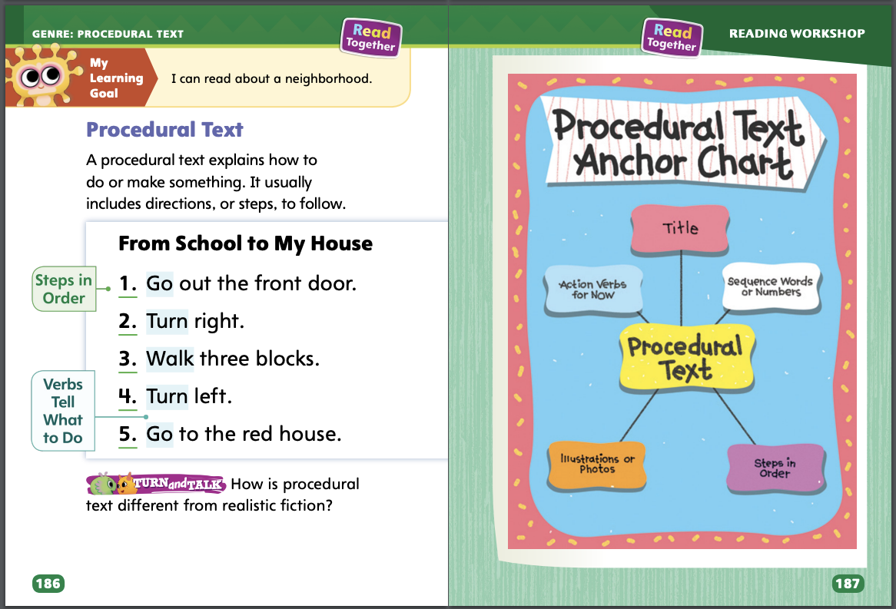
Page 186,187
Procedural Text
Turn to page 187 in your Student Interactive.
Notes:
A procedural text uses directions, or steps, to explain how to do or make something.
What does the text explain how to do or make?
Look for sequence words or numbers. How do they help you understand what you will do or make?
Look at the words at the start of each step. How do they help you understand what you’re supposed to do in that step?
Read aloud the model “From School to My House” on p. 186 in the Student Interactive. Then talk about how it is a procedural text: “From School to My House” is the title. I think the text will tell us how the person will get from school to home. There are also numbers to keep the steps in order. The action words go, turn, and walk help explain what I am supposed to do to follow the steps. Have students restate the instructions. Then review the anchor chart on p. 187 in the Student Interactive together. Point out that a procedural text includes a title, sequence words for numbers, action words, illustrations or photographs, and steps in order. Editable Anchor Chart Click Path: Table of Contents -> Reading Anchor Charts -> Unit 1 Week 5: Procedural Text Editable Reading Anchor Chart

Slide 11
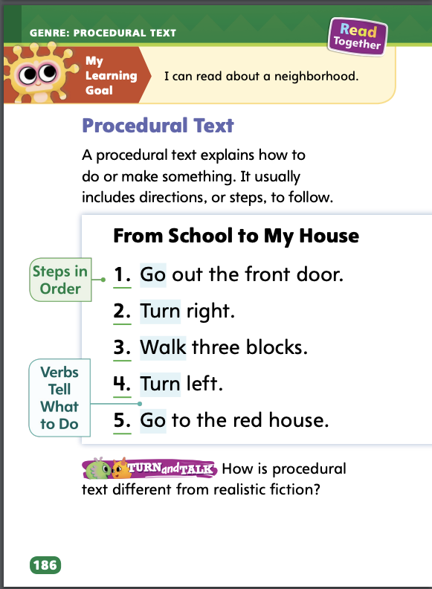
Page 186
Apply
How is procedural text different from realistic fiction?
Notes:
Have students use the strategies to identify procedural text.
Have students turn to a partner to discuss how procedural text is different from realistic fiction.

Slide 12
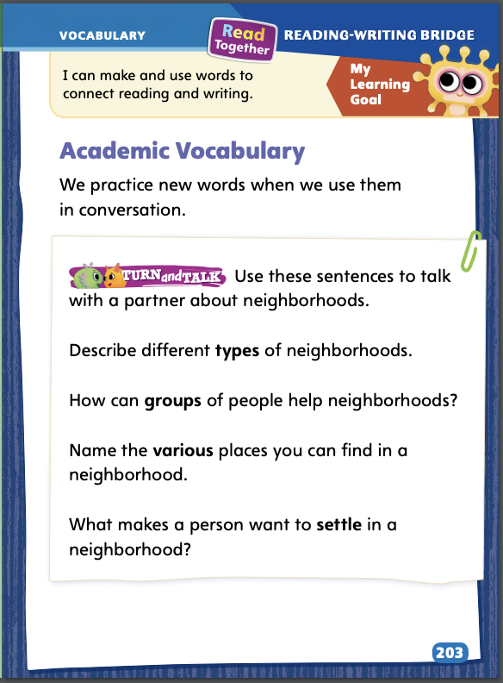
Page 203
Academic Vocabulary
Turn to page 203 in your Student Interactive and complete the activity.
Notes:
Remind students of the Academic Vocabulary for this unit: type, group, various, settle. Tell students that using new words in conversation is a good way to become more familiar with them.
Choose one of the Academic Vocabulary words in this unit.
Recall the meaning of the word and how it is used in a sentence.
Now say a sentence of your own with that new word. You can use it to ask a question or tell about something.
Model an example. We learned the word type. I remember reading that there are many different types of neighborhoods. One type of neighborhood is an urban, or city, neighborhood. Another type of neighborhood is rural, or country. I think type means “kind” or “category.” I can use that word to ask someone, “What type of neighborhood do you live in?”
Have students practice using Academic Vocabulary by completing the activity on p. 203 in the Student Interactive.

Slide 13
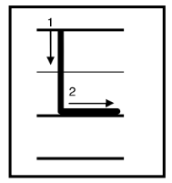
Handwriting
Notes:
Display uppercase L and lowercase I.
Model how to write uppercase L using correct letter formation and slant. Have students practice writing the letter in the air with their fingers. Then repeat with lowercase l.
Have students use Handwriting p. 27 in the Resource Download Center to practice writing the uppercase and lowercase Ll. Click path: Table of Contents -> Resource Download Center -> Handwriting Practice -> U1W4L3 Handwriting Practice

Slide 14
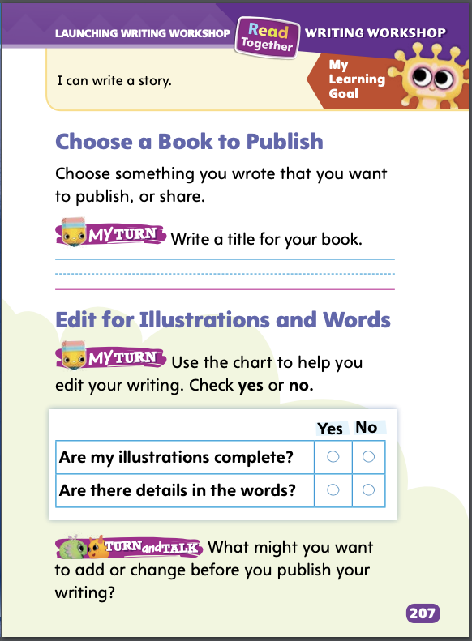
Page 207
Writing – Launching Writing Workshop
Turn to page 207 in your Student Interactive and complete the writing activity.
Notes:
Choosing a book to publish means deciding on which writing you will get ready to share with readers. Ask yourself
What should I do to decide which writing to publish?
How do I know my writing is ready to be published?
Which ideas do I want to share with my readers?
Read aloud a book from the stack. When finished, say: Let’s think about why the author decided to publish this book. Guide students to identify how the author may have made publishing decisions. Ask and discuss answers to the following questions:
How do you think the author knew this book was ready to be published?
What ideas did the author want to share with readers?
How did the author publish this writing?
Encourage students to read another stack book to decide why the book was ready to be published and what ideas the author wanted to share. Say: Authors make sure their writing is clear, complete, and without mistakes before they publish it.
Have students look through their own writings from this unit and choose one work to publish. Point out that they will need to be sure the writing is mistake-free before they publish it. Explain that they will do this later. Today they are just choosing what they will get ready to publish. Then direct students to the top half of p. 207 in the Student Interactive. Have them complete the activity by writing their title.

Slide 15
Independent Writing
You will finish writing the book you have
decided to publish .
Once you book is finished, edit and
revise you book. Add details and
clarify information.
Notes:
During independent writing time, students should spend time finishing the book they’ve decided to publish.
Modeled Choose a stack text and do a Think Aloud to model why that book was ready to publish.
Shared Have students choose a stack text. Prompt students to take turns talking about the ideas the author wanted to share with readers.
Guided Use the stack texts to provide explicit instruction on the specific things students should look for when choosing a book to publish.
If students have completed their book already, they should edit and revise, finding places to add details and clarify information.
As students write, use the conference prompts in the Teacher’s Edition or Resource Download Center to provide support. Click path: Table of Contents -> Resource Download Center -> Writing Workshop Conference Notes
Call on a few students to explain why they chose their piece of writing to publish.

Slide 16
Spelling
I like to hug my dog.
A fly is a type of bug.
I pull up weeds with a tug.
My brother dug a big hole.
I like to play ball.
Come with me to the park.
Notes:
(Note: Move the orange boxes to cover each bold spelling word before you read aloud the words and sentences.)
Read aloud the words and sentences. Have students spell each word with initial consonant blends and the two high-frequency words.
I like to hug my dog.
A fly is a type of bug.
I pull up weeds with a tug.
My brother dug a big hole.
I like to play ball.
Come with me to th4e park.
Reveal the spelling word and have students check their work.

Slide 17
Language and Conventions
Put ____ pen on the desk.
Notes:
Remind students that articles are the words a, an, and the. Adjectives are words that describe a person, animal, or thing, such as tall or short. The article the is used for a specific noun. A and an are used before any noun.
Show students the following sentence: Put _____ pen on the desk. Have students say which article could go in the blank. Have them explain why. Then invite students to suggest adjectives to describe the pen and desk in the sentence.
Have small groups of students select a common noun. Have them work together to list as many adjectives as they can to describe the noun. Then ask each student to write a sentence using the noun, an adjective from their list, and an article

Slide 18
Lesson 2

Slide 19
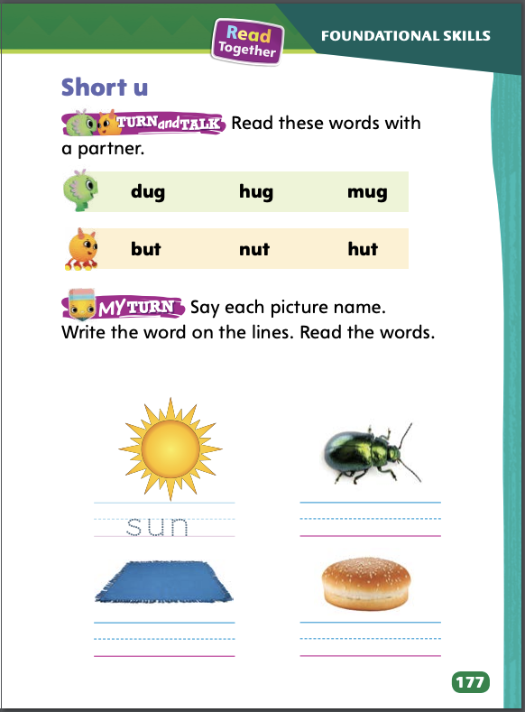
Page 177
Phonics
With a partner, decode the words on page 177 in your Student Interactive
Notes:
Review that the short u sound is spelled u.
Write the letter u on the board. Say: This is the letter u. It can spell the sound /u/. Let’s write words that have the sound /u/ spelled u. Write the letter h. Point to the h and say /h/. Ask students to say the sound /h/ with you as you point to the letter and say it again. Write the letter u. Point to the u and say /u/. Now have students say the sound /u/ with you as you point to the u. Then slowly slide your finger (from left to right) below the two letters and blend and say the sounds (/hu/). Then have students blend the sounds with you as you say them again.
Next write t. Point to the t and say /t/. Have students say the sound /t/ with you as you point to the t. Slowly slide your finger below all three letters to blend the sounds and pronounce the word hut. Then have students blend the letters on their own and say the word. Say: How many sounds are in the word hut? Let’s clap for each sound: /h/ (clap) /u/ (clap) /t/ (clap). How many times did we clap? Right, three times! Look at the letters in hut. What letters spell the word hut? Yes, the letters are h, u, t. So, in the word hut, there are three sounds and three letters.
For additional practice, model using the words bug, sun, and cut.
Have partners decode the words at the top of p. 177 in the Student Interactive.

Slide 20
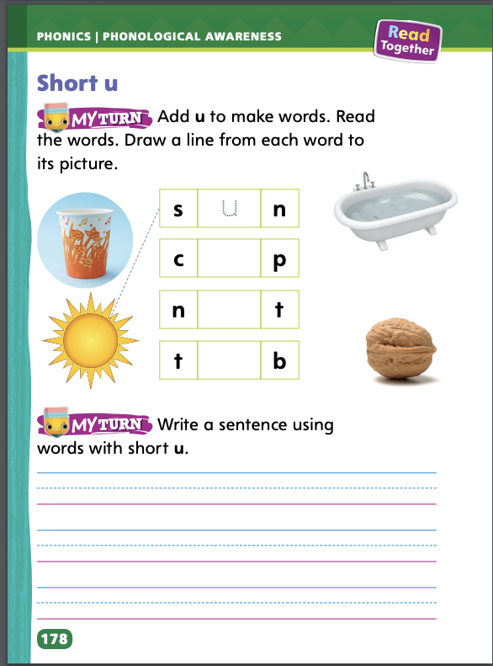
Page 178
Apply
Turn to page 177 and 178 in your Student Interactive and complete the activity.
Notes:
Have students complete the rest of p. 177 and p. 178 in the Student Interactive.

Slide 21
High-Frequency Words
as
he
to
three
with
Notes:
Write the words as, he, to, three, with on the board. Say and spell each word and then have students repeat.
Cover the words on the board and then dictate each word.
Students write the words from memory.
Display the words and have students check their spellings.

Slide 22
Page 188
Preview Vocabulary
stores
school
library
buildings
Notes:
Introduce the words stores, school, library, and buildings from p. 188 in the Student Interactive.
Ask students to talk about what they already know about these words. Ask questions such as: What can you find in a library? Why do people go to stores? What can be inside buildings? What do you do at school?
Provide definitions of these words as needed. Definitions appear on the selection pages that follow. These words will help us as we read the text Making a Map.

Slide 23
First Read Strategies
Notes:
Discuss the First Read Strategies with students. Explain that when you make a prediction, you guess what the text will be about or what might happen next. Thinking about the characteristics of the genre can help a reader make a prediction. For example, procedural texts tell how to do or make something, so a reader can make a prediction about what the text will tell how to do or make. For this first read, tell students to read for understanding and enjoyment.
PREDICT Have students use what they know about the characteristics of the genre of procedural text to make a prediction. Provide assistance as needed.
READ Tell students to read or listen as you read the text. Tell them they are reading to understand the text.
ASK Have students ask themselves questions about the steps as they listen to or read the text. Explain that asking questions can help them gain information.
TALK Have students talk to a partner about the text and how it connects to the Weekly Question: What does a neighborhood look like?
Students may read the text independently, in pairs, or as a whole class. Use the First Read notes to help students connect with the text and guide their understanding.

Slide 24
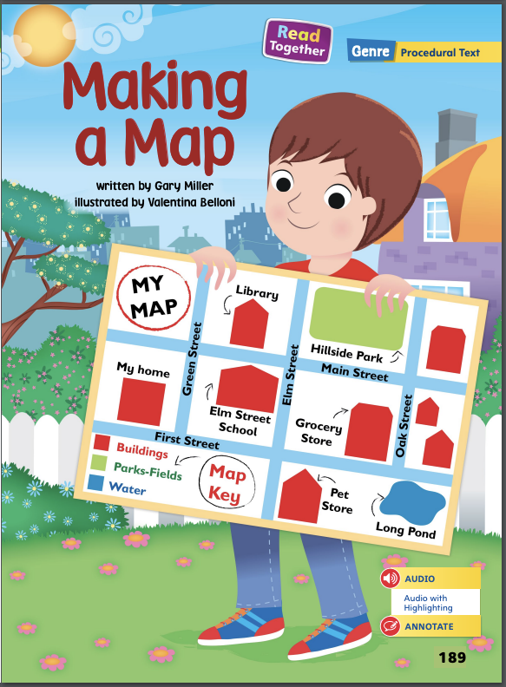
Page 189
First Read – Making a Map
Notes:
Read together.

Slide 25
Page 190,191
First Read – Making a Map
Notes:
Read together.
THINK ALOUD As I begin to read, I’m wondering exactly what a map is. I’m going to go look at the text to see whether I can find any clues. I read that maps help people find their way. What does the phrase find their way mean? What questions can I ask and then answer about this phrase to help me figure out what it means? Discuss possible questions and answers with students.

Slide 26
Page 192,193
First Read – Making a Map
Notes:
Read together.

Slide 27
Page 194,195
First Read – Making a Map
Notes:
Read together.
THINK ALOUD The text says I should add stores to my map. I’m not sure what kinds of stores to draw. I will ask myself what kinds of stores I should draw on my map. I will look at the pictures for clues. I see a grocery store and a pet store. I have those in my neighborhood, too!

Slide 28
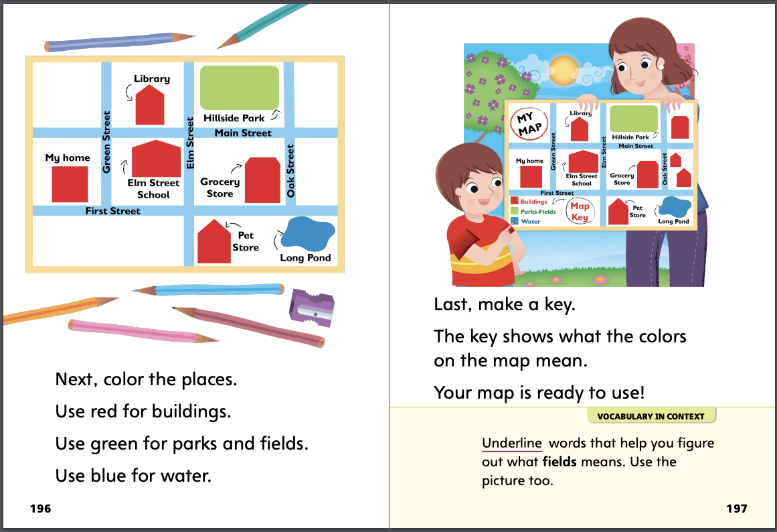
Page 196,197
First Read – Making a Map
Notes:
Read together.

Slide 29
Respond and Analyze
Predict Work with a partner to discuss what you both predicted before you read the text. Were your predictions similar? In what way?
Instructions Work with a partner to give and then restate the sequence of instructions for making a map.
Notes:
Use these suggestions to prompt students’ initial responses to reading Making a Map. Begin by asking what part of the text interested them the most.
Predict Work with a partner to discuss what you both predicted before you read the text. Were your predictions similar? In what way?
Instructions Work with a partner to give and then restate the sequence of instructions for making a map.

Slide 30
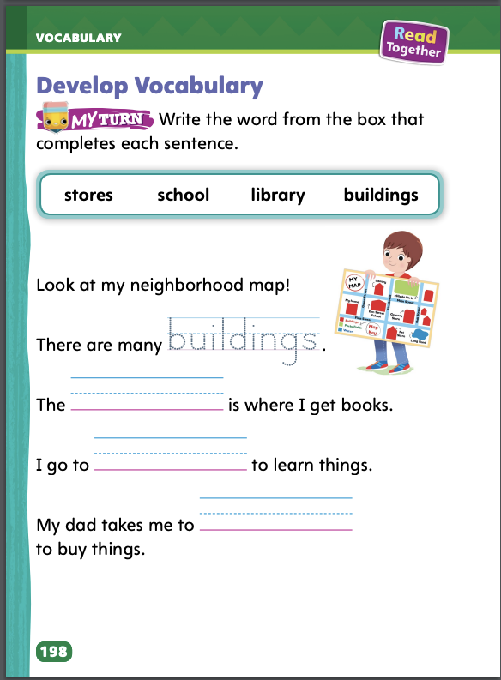
Page 198
Develop Vocabulary
Turn to page 198 in your Student Interactive and complete the activity.
Notes:
Discuss the words the author chose to use in the text. The words buildings, stores, school, and library were chosen because they describe features that can be added to a map. Tell students:
Remind yourself what these words mean.
Are there any clues in the illustrations that help you understand what the words mean?
How does knowing these words help you understand the text better?
Ask students to turn to p. 198 in the Student Interactive. Read aloud the directions and then the first sentence. Model how to decide which word fits in the next sentence: I want to choose a word that tells about more than one. The word many is a clue. Can I see many buildings on a map? Yes. I will write the word buildings.
Have students work on their vocabulary by completing the activity on p. 198 in the Student Interactive.

Slide 31
Page 199
Check for Understanding
What makes a text a procedural text?
Why do you think the author labels the pictures?
Why are there steps to making a map? Use text evidence.
Notes:
Ask students to complete the activity on p. 199 in the Student Interactive.

Slide 32
Page 207
Writing – Launching Writing Workshop
Turn to page 207 in your Student Interactive and complete the chart.
Notes:
When authors edit, they fix mistakes and make improvements in their writing. Good writers check for
information that can be added.
writing that should be changed.
illustrations that can be improved.
Select a book from the stack and read it aloud. When finished, say: When I read this book, I noticed the illustrations helped to add information about what I was reading. I also noticed there were no mistakes in the words. Let’s read another book together. See whether the illustrations are helpful. Look for any mistakes in the words. Have students help you choose another book from the stack. Read that book aloud. Then ask:
How did the illustrations help you understand the ideas?
Did you see or hear any mistakes in the words?
Then direct students to the bottom of p. 207 in the Student Interactive. Have them look at the writing they chose to publish and then complete the chart.

Slide 33
Independent Writing
You will check the illustrations and the words in the book you have chosen to publish.
Make any additions or changes before you publish your book.
Notes:
Have students review the book they have chosen to publish, checking to be sure the illustrations are detailed and there are no mistakes in the words.
Modeled Use a Think Aloud to model how you might edit the title of a book.
Shared Prompt students to share their writing from last week and talk about how they might edit the illustration or words.
Guided Provide explicit instruction on specific illustrations and words that students could edit in their own writing.
Have students make any additions or changes to their writing now before they publish it.
As students write, use the conference prompts in the Teacher’s Edition or Resource Download Center to provide support. Click path: Table of Contents -> Resource Download Center -> Writing Workshop Conference Notes
Invite a few students to share the edits they made to get their work ready to publish.

Slide 34
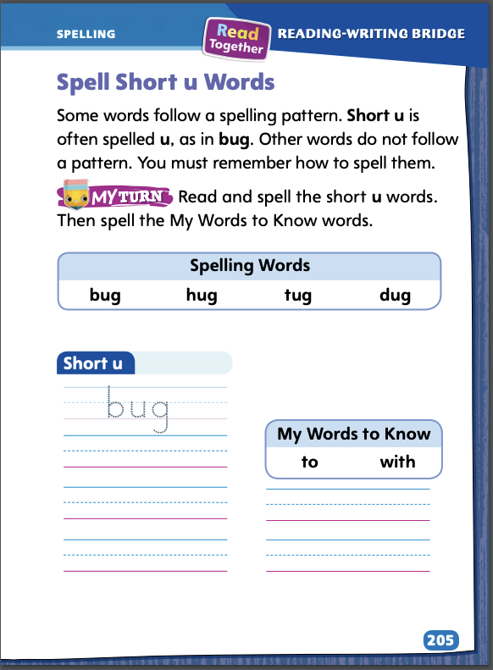
Page 205
Spelling
tub
gum
bus
Turn to page 205 in your Student Interactive and complete the activity.
Notes:
Some words follow a sound-spelling pattern. Words with the sound /u/ are spelled with the letter u. Other words students have to remember how to spell.
Show students an example of a word with a short u like hug. Say the word out loud and point out the u. Ask what sound that letter makes. Tell students that the letter u spells the sound /u/ in hug.
Have students use sound-spelling patterns to complete the activity on p. 205 in the Student Interactive independently.

Slide 35
Language and Conventions
John walks down the busy street.
Notes:
Tell students that sentences may contain nouns, verbs, and adjectives to tell a complete idea. Nouns name people, animals, or things. Verbs show action. Adjectives describe nouns.
Display and read aloud this sentence for students: John walks down the busy street. Ask students: Does this sentence have a noun? (yes) What are the nouns? (John, street) What word tells what John is doing? (walks) What word describes the street? (busy)
Have students work in pairs to create their own oral sentences with nouns, verbs, and adjectives. Ask them to share their sentences with the class, taking time to point out the nouns, verbs, and adjectives.

Slide 36
Lesson 3

Slide 37
Page 179
Phonological Awareness
Notes:
Point to the picture of the rock on p. 179 in the Student Interactive. Say: This is a picture of a rock. Listen as I say the beginning sound in the word rock: /r/ (pause) /r/ (pause) /r/ (pause) rock. Rock begins with the sound /r/. Say the sound with me: /r/. What sound does rock begin with? (/r/) Repeat with the pictures for web, jug, and kite.
Have each child draw a happy face on a piece of paper. Say: I’m going to say a word. If the word begins with the sound /r/, raise your happy face. The first word is rule. If rule begins with the sound /r/, raise your happy face now. Wait for responses. Assess and model as needed. Say: The next word is bug. Wait for responses. Continue with the word ribbon. Then repeat for the sounds /w/, /j/, and /k/ using the words walk, wet, new; just, row, jump; kitten, get, Kim.

Slide 38
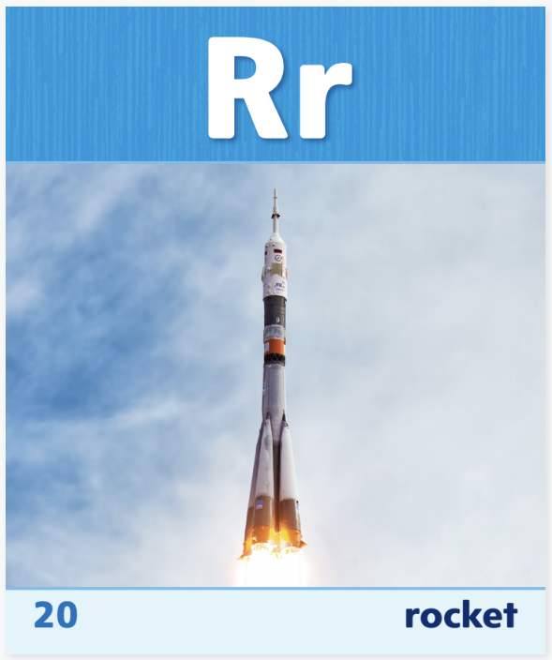
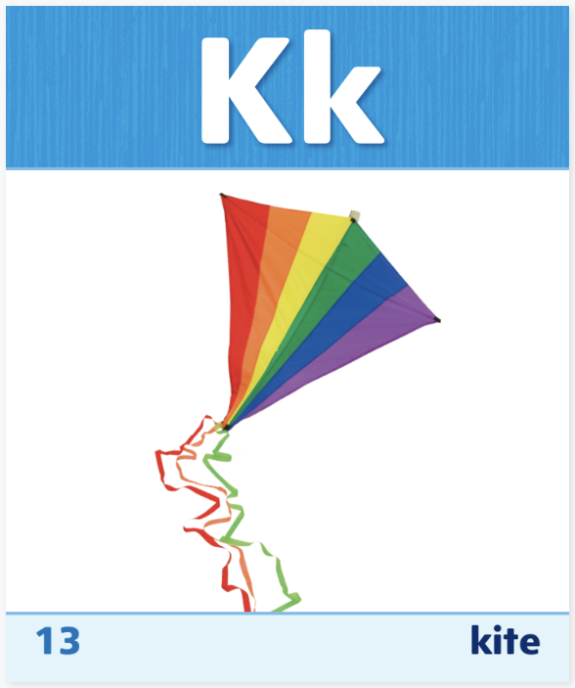
Phonics
red, run, we, will, jump
Jan, king, kid
Notes:
Use Sound-Spelling Cards to model the sound /r/ spelled r, the sound /w/ spelled w, the sound /j/ spelled j, and the sound /k/ spelled k.
Display Sound-Spelling Card 20 (rocket) and point to the r. Say: This is a picture of a rocket. Rocket begins with the sound /r/. Listen carefully: /r/ (pause) rocket. The sound /r/ is spelled with the letter r. Continue modeling with Sound-Spelling Cards 26 (waterfall), 12 (jacket), and 13 (kite). Then have students practice recognizing initial sounds with these words: red, run, we, will, jump, Jan, king, kid. Click path -> Table of Contents -> Unit 1 Week 5 Informational Text -> Lesson 3

Slide 39
Page 179
Phonics
Turn to page 179 in your Student Interactive.
Notes:
Have students practice blending and decoding the words on the bottom of p. 179 in the Student Interactive.

Slide 40
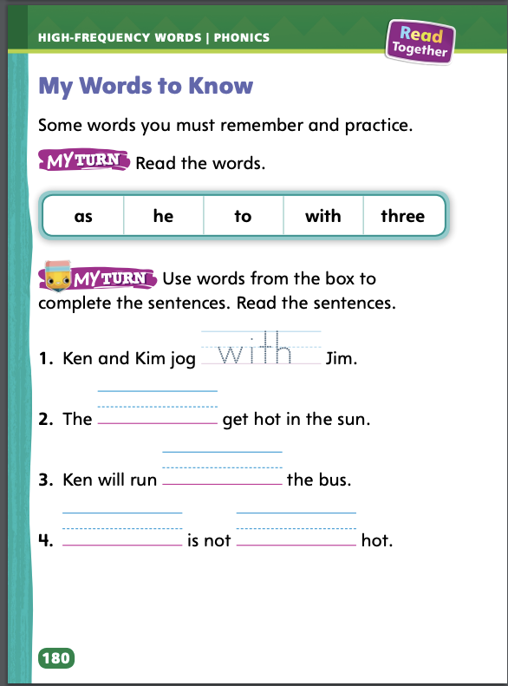
Page 180
High-Frequency Words
Turn to page 180 in your Student Interactive and complete the activity.
Notes:
Review the high-frequency words for the week. Write or display the high-frequency words: as, he, to, three, with.
Write as on the board. This is the word as. It has two letters: a, s. Have students say and spell the word. Then model using the word in a sentence. Repeat with the other words. Then have students turn to p. 180 in the Student Interactive and identify and read the words in the box.
Have students identify, read, and write the high-frequency words on p. 180 in the Student Interactive.

Slide 41
Page 189
Find Graphics
Notes:
Simple graphics, such as pictures, help readers find and gain information. Graphics can tell readers more information about the topic and important ideas.
Use graphics to help you follow steps in procedural text.
Look at graphics to learn topic details that may not be written in words.
Use graphics to help you understand important ideas in a text.
Have students turn to p. 192 in the Student Interactive. Say: I see that this page has a graphic, or picture. I wonder what I can learn from this graphic. Let’s read the text. It says to draw the streets near your home. When I look at the graphic, I notice that there are blue lines. Those are the streets. This graphic helps me learn information about making a map. Guide students to share other things they can learn from this graphic. Then have them go back to the Close Read notes on pp. 193 and 195, and underline the words that name what is in the graphic.

Slide 42
Page 192,193
Close Read – Find Graphics
Turn to page 192 and 193 in your Student Interactive.
Notes:
Tell students that graphics help readers find information. Have them follow the prompt on p. 193. DOK 1

Slide 43
Page 194,195
Close Read – Describe Characters
Turn to page 194 and 195 in your Student Interactive.
Notes:
Have students complete the Close Read activity on p. 195. Ask: How do these words help you learn information about the map? (They tell names of places.) DOK 1

Slide 44
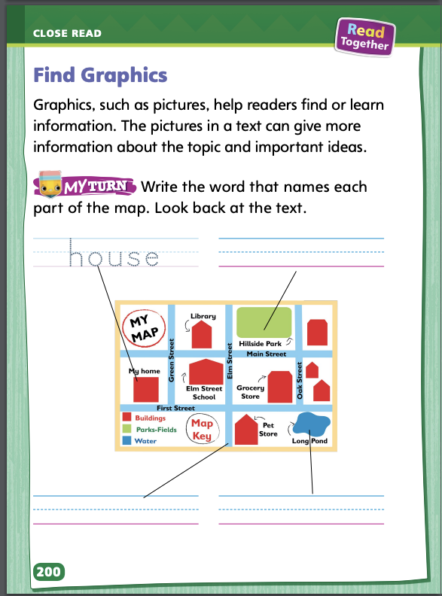
Page 200
Find Graphics
Turn to page 200 in your Student Interactive and complete the activity.
Notes:
Have students use the strategies for finding and using simple graphics to understand a text.
Have students complete p. 200 in the Student Interactive.

Slide 45
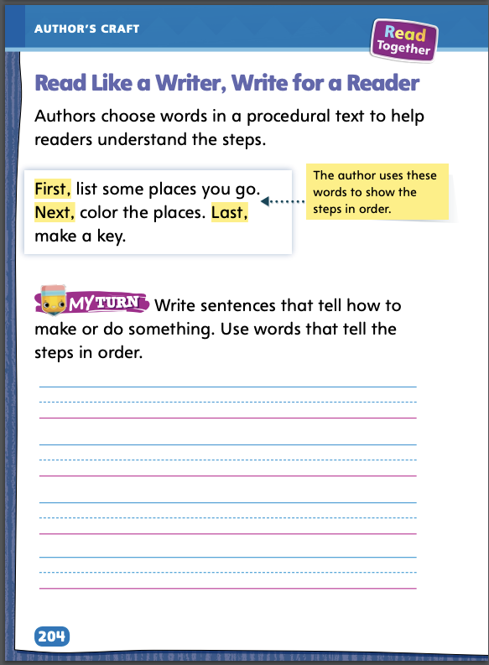
Page 204
Read Like a Writer, Write Like a Reader
Turn to page 204 in your Student Interactive and complete the activity.
Notes:
When authors write a procedure, they use words that help readers understand how to do steps in the right order.
Words like first, next, then, and last help the reader follow the steps.
Use the example from Making a Map on p. 204 in the Student Interactive to show students how authors choose words to show the order of steps. Say: These sentences tell how to follow a procedure. The sentence, First, list some places you go, tells you how to start. The word first is a clue that tells you how to begin. Read the other two sentences and ask students to identify the words that give the reader clues about when to do each step. Have students tell the steps in a procedure that they know how to do. Remind them to produce complete sentences.
Have students complete the exercise at the bottom of p. 204 in the Student Interactive to create a procedural text.

Slide 46
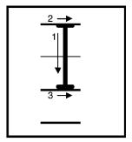
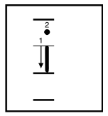
Handwriting
Notes:
Display uppercase I and lowercase i.
Model how to write uppercase I using correct letter formation and slant. Have students practice writing the letter in the air with their fingers. Then repeat with lowercase i.
Have students use Handwriting p. 28 in the Resource Download Center to practice writing uppercase and lowercase Ii. Click path: Table of Contents -> Resource Download Center -> Handwriting Practice -> U1W4L3 Handwriting Practice

Slide 47
Writing – Launching Writing Workshop
Let’s prepare celebration
Choose your best writing.
Edit illustrations and words to make it the best it can be.
Decide how you want to present the final copy.
Presentation Brainstorm:
Notes:
Authors prepare for the celebration of their work by getting their writing ready to share. They decide how to present their final product. Then they gather materials for their presentation.
Say: There are several steps to follow to prepare your writing for celebration.
Choose your best writing.
Edit illustrations and words to make it the best it can be.
Decide how you want to present the final copy.
Review where students are in the publishing process. So far they have chosen the writing they will publish and have edited the words and illustrations. Say: Now let’s talk about ways to present your writing. Hold up a stack text. Ask: How did the author present this text? What do you think had to be done to get the writing into book form? Do you think digital tools were used?
Next, have students brainstorm ways they could present their writing. List the ways on a chart or board. Suggestions may include:
oral presentation
printing it out from a computer
making it into a book
creating a poster

Slide 48
Independent Writing
With a partner, discuss what you need to celebrate your writing.
Prepare you book for publication based on the suggestion you chose.
Notes:
Student partners can discuss with each other what they would need to do to celebrate their writing in each of the different ways listed.
Modeled Choose a stack text and do a Think Aloud to identify one thing the author had to do to prepare for publishing the writing in book form.
Shared Prompt students to ask each other questions about how they will prepare to celebrate.
Guided Provide explicit instruction on how to prepare to celebrate using one of the ways listed on the board.
Once they have decided on the way they’d like to present their book, students should prepare it for publication.
As students write, use the conference prompts in the Teacher’s Edition or Resource Download Center to provide support. Click path: Table of Contents -> Resource Download Center -> Writing Workshop Conference Notes
Choose a few students to say what they must do to prepare to share and celebrate their writing.

Slide 49
Spelling
tug /t/ /u/ /g/
dug /d/ /u/ /g/
bug /b/ /u/ /g/
hug /h/ /u/ /g/
Notes:
Remind students that the letter u can spell the sound /u/ in words.
Have students spell the following words as you isolate each phoneme: tug, /t/ /u/ /g/; dug, /d/ /u/ /g/; bug, /b/ /u/ /g/; hug, /h/ /u/ /g/.
Have students complete Spelling p. 33 from the Resource Download Center. Click path: Table of Contents -> Resource Download Center -> Spelling -> U1W5

Slide 50
Language and Conventions
Tim jogs to school on a hot day.
Notes:
Explain to students that sentences tell complete ideas. They have nouns, verbs, and sometimes they have adjectives. Nouns name people, animals, or things. Verbs show action. Adjectives describe nouns.
Write the following sentence on the board: Tim jogs to school on a hot day. Identify and underline the nouns (Tim, school, day), verb (jogs), and adjective (hot).
Ask students to pair up and create their own simple sentences with at least one noun, verb, and adjective. Have them underline the nouns, verbs, and adjectives.

Slide 51
Lesson 4

Slide 52
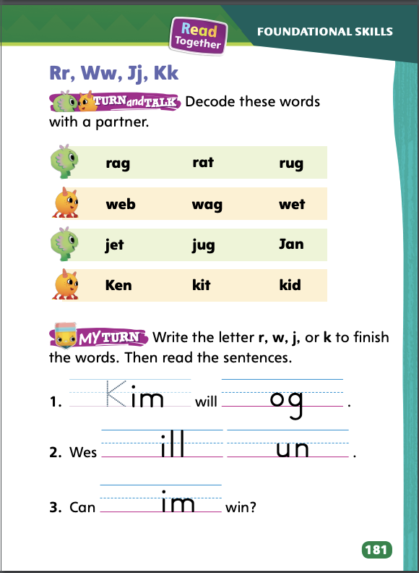
Page 181
Phonics
r
w
j
k
Decode the words with your partner.
Notes:
Write the letters r, w, j, and k on the board. Review the sound-spellings for /r/ spelled r, /w/ spelled w, /j/ spelled j, and /k/ spelled k.
Write the word wag. Say: Listen as I say the sounds slowly: /w/ (pause) /a/ (pause) /g/. How many sounds can you hear in wag? Yes, we hear three sounds. Draw three empty boxes. Next, model how to write the letters for each sound. Say: What letter spells the sound /w/? Write w in the first box. Continue with the a and g. Then say: How many letters did we write? Correct, three letters, three sounds, three boxes. Now slowly slide your finger under the boxes and blend the sounds to read the word. Then say the word more quickly. Have students practice blending and reading the word with you. Repeat with the words rug, jet, and kid.
Have partners decode the words at the top of p. 181 in the Student Interactive.

Slide 53
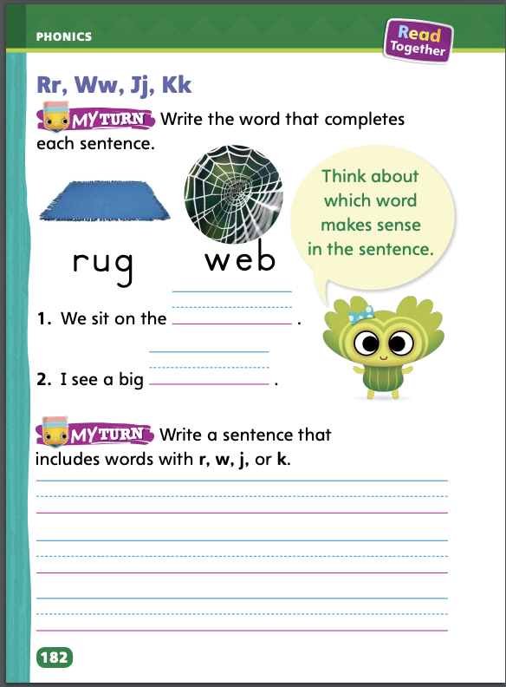
Page 181,182
Phonics
Turn to page 181 and 182 in your Student Interactive and complete the activity.
Notes:
Have students complete the rest of p. 181 and p. 182 in the Student Interactive

Slide 54
Page 183
Decodable Story
Turn to page 183 in your Student Interactive. Read “Three Will Run” with your partner.
Notes:
Have students turn to p. 183 in the Student Interactive. We are going to read a story about three people named Ken, Kim, and Jeff. What sounds do you hear at the beginning of those names? Yes, /k/ and /j/. We will also read words with the sound /u/ and letters r and w in our story.
Before reading, review this week’s high-frequency words: as, he, three, to, with. Tell students that they will practice reading these words in the story Three Will Run.

Slide 55
Page 184,185
Decodable Story
Notes:
Pair students for reading and listen carefully as they use letter-sound relationships to decode. One student begins. Students read the entire story, switching readers after each page. Partners reread the story. This time the other student begins.
Call students’ attention to the title on p. 183. I see the letter r in the word Run. What sound does the letter r spell? (/r/) Have students decode the word Run. Then have them identify words with the sound /k/ spelled k on p. 183 and highlight them. Next, have students identify words with the sound /j/ spelled j and underline them.
Have students turn to p. 184. Which words have the sound /w/? Students should supply the words will and wet. Which letter spells the sound /w/ in will and wet? Students should say the sound /w/ is spelled with the letter w. Have them highlight the words.
Have students turn to p. 185. Which words have the sound /u/? Students should supply the words but and fun. Which letter spells the sound /u/ in but and fun? Students should say the short u sound is spelled with the letter u. Have them underline the words.

Slide 56
Page 189
Correct and Confirm Predictions
Notes:
Readers make predictions about a text using text features and what they already know. Readers can use text features to correct, or adjust, their predictions. When they confirm a prediction, they decide if their prediction matches the text features.
Look at the text features as you read.
Think about whether you need to change or confirm your prediction based on the text features.
Use the selection Look Both Ways! on pp. 111–119 in the Student Interactive. Say: When I first read this title, I predicted that the text would be about looking at things around you. As I started reading, I corrected, or changed, my prediction using text features. The pictures made me think the text is about crossing the street. Once I finished the text, I could confirm that my corrected prediction matched the text features. This text is about crossing the street safely. Have students complete the Close Read note on p. 191 in the Student Interactive. Assist students with correcting or confirming the prediction they made.

Slide 57
Page 190,191
Close Read – Correct and Confirm Predictions
Turn to page 190 and 191 in your Student Interactive.
Notes:
Tell students a prediction tells what they think will happen next. Assist them as they follow the prompt on p. 191. DOK 2

Slide 58
Page 201
Correct and Confirm Predictions
Turn to page 201 in your Student Interactive and complete the activity.
Notes:
Have students use the strategies for correcting and confirming predictions.
Have students complete the activity on p. 201 in the Student Interactive.

Slide 59
Page 208
Writing – Launching Writing Workshop
Turn to page208 in your Student Interactive and complete the activity.
Notes:
Explain that social communication is important when celebrating and sharing experiences. Social communication is how you talk and act with others. It’s important to introduce yourself and listen to others as they tell about their experiences. Today students will celebrate by speaking about their writing. They will share their writing experience with the class. Students will follow rules to celebrate.
Say: I am going to tell you about myself and my own writing experience in two different ways. Listen to each way and then tell me which way is better and why. Say the following abruptly: My name is _____. I wrote about fish. Ask students to tell you how your introduction made them feel. Then say the following in a more excited tone: Hello, students! I am your teacher. My name is _____. I want to share a story with you about a time I went to the lake with my family. It was beautiful and it was fun and the story involves a fish! Talk with students about which way sounds better and why. Elicit from them that it is better to give more information to get your audience interested.
Invite a couple of students to the front of the classroom. Have them introduce themselves and relate an experience to their classmates. Help them to express their feelings as they tell their stories.
Direct students to p. 208 in the Student Interactive. Read aloud the rules together with students. Discuss each rule with students. Have listeners respond in a positive way to the students who have shared their experiences.

Slide 60
Independent Writing
Let’s celebrate our writing by sharing it with the class.
Notes:
Students should celebrate their writing by sharing it with the class.
Modeled Use a Think Aloud to model a rule on p. 208 in the Student Interactive and demonstrate how to follow it.
Shared Have students share ways to introduce each other.
Guided Give explicit instructions on how to follow the rules when introducing yourself and talking about writing experiences.

Slide 61
Spelling
pet
Short e | Short a | Short i
sat
tin
Notes:
Remind students about the previous week’s spelling rules for words with short e, short a, and short i.
Read the following words and have the students spell them: pet, sat, tin.
Have pairs draw three columns in their notebooks labeled “Short e,” “Short a,” and “Short i.” Have them write at least two CVC pattern words with the sounds /e/ spelled e, /a/ spelled a, or /i/ spelled i in the appropriate columns.

Slide 62
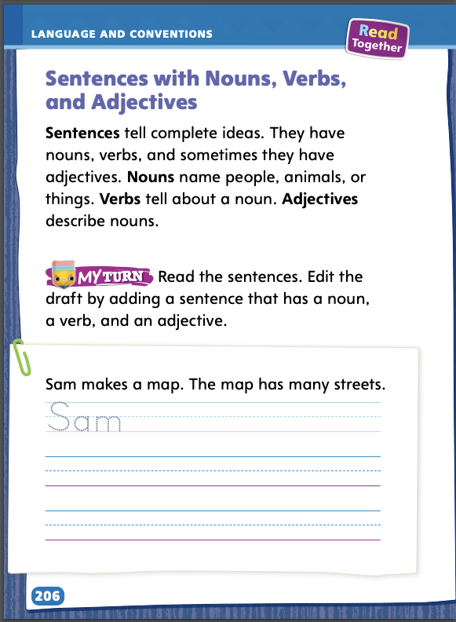
Page 206
Language and Conventions
Turn to page 206 in your Student Interactive and complete the activity.
Notes:
Have students complete the activity on p. 206 in the Student Interactive

Slide 63
Lesson 5

Slide 64
Phonological Awareness
tub /t/ /u/ /b/
jet /j/ /e/ /t/
rat
Ken
win
Notes:
Display the tub Picture Card. Say: This is a picture of a tub: /t/ /u/ /b/. What is the middle sound in tub? It is the sound /u/, right? Now I will say a word, and you will say each sound in the word. Ready? Display the jet Picture Card. This is a picture of a jet. Call on a student volunteer to say the sounds in jet. Yes, the sounds in jet are /j/ /e/ /t/. What sound does jet begin with? (/j/) Correct and model as needed.
Say the following words and have students segment and blend the phonemes: rat, Ken, win. Ask students what sound they hear at the beginning of each word. Then ask them to identify the medial and final sounds in each word. Click path -> Table of Contents -> Unit 1 Week 5 Informational Text> Lesson 5

Slide 65
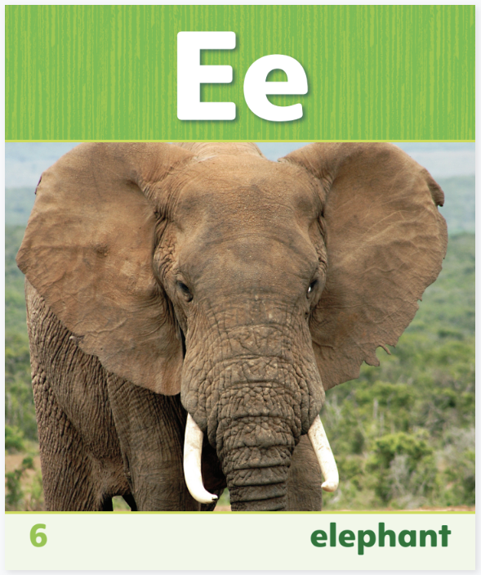
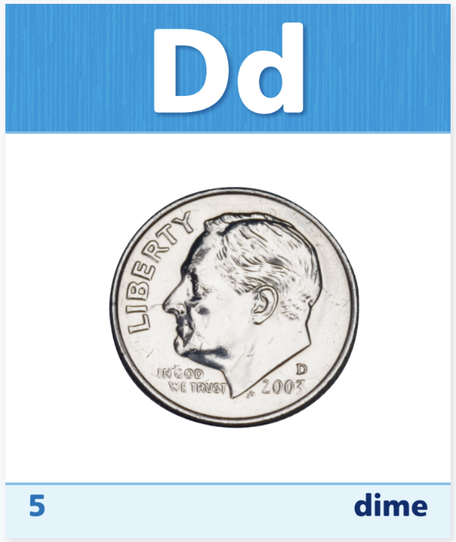
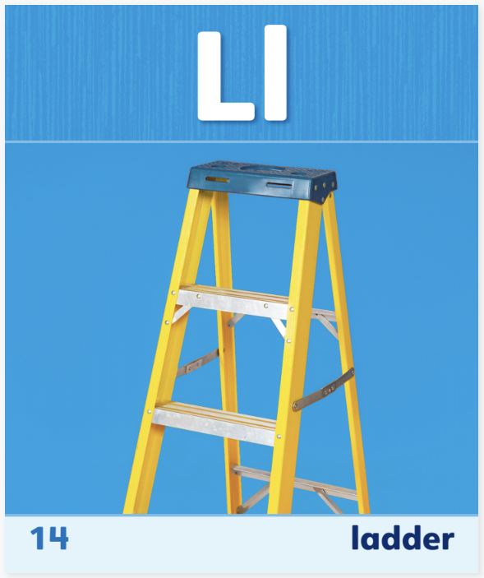
Phonics
bed
kit
rip
jet
wet
dug
hug
Notes:
Display the Sound-Spelling Cards 6 (elephant), 5 (dime), 14 (ladder), and 10 (helicopter) for Ee, Dd, Ll, and Hh. Have students name each letter as you point to it. Then review the sound for each letter by pointing to each letter as you say the sound. Ask: What is the picture name on the card? What letter spells the first sound in the picture name? Continue with each card.
Write each of the words listed below. Point to a word and have students read it. Provide clues about words and ask students to read or point to the words that answer the clue. For example, ask: Which word begins with the same sound as rug? Click path -> Table of Contents -> Unit 1 Week 5 Informational Text> Lesson 5
bed kit rip jet wet dug hug

Slide 66
High-Frequency Words
as
he
to
with
three
Notes:
Give students a list of this week’s high-frequency words: as, he, to, with, three. Have students work with a partner.
One student spells a word.
The other student says the word.
The first student uses the word in a sentence.
Students then switch order and repeat for each word.

Slide 67
Page 202
Reflect and Share
Turn to page 202 in your Student Interactive.
Notes:
Tell students that writing brief, or short, comments about texts can help them organize their thoughts and ideas about what they have read. When writing brief comments, they should
use examples and details from the text.
make connections to other texts.
think about what they have read and share their thoughts in their own words.
Model writing comments about sources using the Write to Sources prompt on p. 202 in the Student Interactive. I see that I will be comparing two sources. First, I should make sure I have read both sources, or texts. Next, I’ll take notes. I will want to write my ideas as I go. I’ll record ways the sources are the same and ways they are different. I can already see one way these texts are alike. They both tell information about neighborhoods. I will start my writing with that brief, or short, comment: Both informational texts tell about neighborhoods.
Have students use the strategies for writing comments to compare texts.
Have students use text evidence from the two texts in the prompt to write about similarities and differences.

Slide 68
Page 166
Apply
What does a neighborhood look like?
Notes:
Have students use the examples from the texts they have read this week to respond to the Weekly Question. Have them talk about it in small groups. Click Path: Table of Contents -> Resource Download Center -> Speaking and Listening

Slide 69
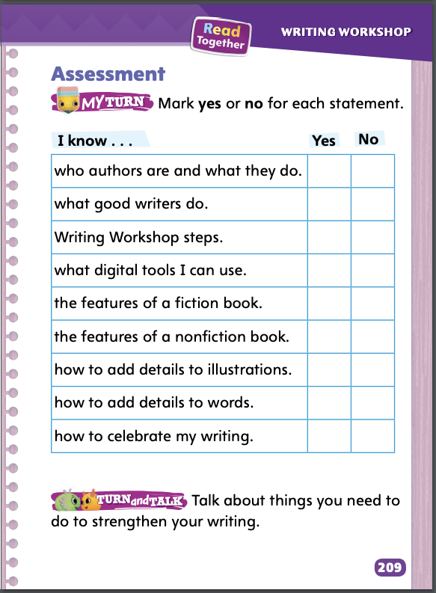
Page 209
Writing – Launching Writing Workshop
Turn to page 209 in your Student Interactive.
Notes:
Assessments tell students how much they have learned and how well they can use what they have learned. Students can self-assess their understanding of all skills and strategies they learned in this unit.
Direct students to p. 209 in the Student Interactive. Read aloud the skills together with students one at a time. For the first skill, model how to decide which column to check. For example: I know authors are writers, and they write all kinds of genres, so I can check Yes next to this rule. Continue reading aloud each rule, pausing to give students time to check the correct box in the chart.
Read aloud Turn and Talk. Have partners complete the activity. Encourage students to help each other review any skills they did not know. Have them write what they learned from each other about that skill.

Slide 70
Writing – Assessment
PROMPT Write a book of your choice.
Be sure to
use your best idea.
use the features of the type of book you are writing.
add details to the words.
add details using pictures.
Notes:
Inform students that they are going to take a writing assessment. They will be given a prompt that asks them to write something. Using the skills they have learned in this unit, they should respond to the prompt. Another form of assessment is to score students’ published writing using the rubric on p. T431.
Provide students the assessment prompt below. The prompt may be displayed for students to respond to on a separate sheet of paper. Alternatively, the prompt may be printed from SavvasRealize.com.
PROMPT Write a book of your choice.
Be sure to
use your best idea.
use the features of the type of book you are writing.
add details to the words.
add details using pictures.

Slide 71
Spelling
What kind of bug is that?
The pup likes to tug on the rope.
We dug a hole in the sand.
I like to hug my dad when I’m sad.
I like visiting with my grandma.
I always bring a snack to school.
Notes:
(Note: Move the orange boxes to cover each bold spelling word before you read aloud the words and sentences.)
Read aloud the words and sentences. Have students spell the words with initial consonant blends and the high-frequency words they have been practicing this week.
What kind of bug is that?
The pup likes to tug on the rope.
We dug a hole in the sand.
I like to hug my dad when I’m sad.
I like visiting with my grandma.
I always bring a snack to school.
Reveal the spelling word and have students check their work.

Slide 72
Language and Conventions
The big dog barks at me.
Which word is an adjective?
dog
The
barks
big
Notes:
Display the following sentence and guide students to answer the question.
The big dog barks at me.
Which word is an adjective
dog
The
barks
big
Have students complete Language and Conventions p. 39 from the Resource Download Center.. Click path: Table of Contents -> Resource Download Center -> Language and Conventions -> U1 W5

Slide 73
Unit 1: Week 5
Grade 1

