Slide 1
Unit 1: Week 3
Grade 4

Slide 2
Copyright © Savvas Learning Company LLC. All Rights Reserved.
This publication is protected by copyright, and permission should be obtained from the publisher prior to any prohibited reproduction, storage in a retrieval system, or transmission in any form or by any means, electronic, mechanical, photocopying, recording, or otherwise. For information regarding permissions, request forms, and the appropriate contacts within the Savvas Learning Company Rights Management group, please send your query to:
Savvas Learning Company LLC, 15 East Midland Avenue, Paramus, NJ 07652
or
k12learningpermissions@savvas.com
myView Literacy® is an exclusive trademark of Savvas Learning Company LLC in the U.S. and/or other countries.

Slide 3
Lesson 1

Slide 4
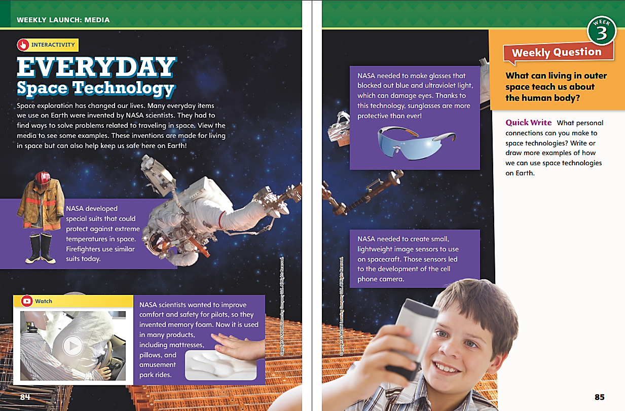
Page 84, 85
Interact with Sources
Write or draw more examples of how we can use space technologies on Earth.
Notes:
Remind students of the Essential Question for Unit 1: How can a place affect how we live? Point out the Week 3 Question: What can living in outer space teach us about the human body?
Direct students’ attention to pp. 84–85. Have students read the text, view the images, and discuss how a place, including outer space, affects how humans live. Then have students view the video and share how it relates to the other media.
Use the following questions to guide discussion:
Do any of the facts about what humans need to travel in outer space surprise you?
Why do you think scientists needed to develop new technologies for humans to use in outer space?
What do the technologies developed in outer space tell you about how humans live today?
How does the video add to your understanding of the way people adapt technology to serve more than one purpose?
WEEKLY QUESTION | Reread the Week 3 Question: What can living in outer space teach us about the human body? Tell students they have learned a few things that living in outer space has taught us about the human body. Explain that they will read about more this week.
QUICK WRITE | Direct students to answer the Quick Write on p. 85 to share their connections to personal experiences with space technology, such as products they use. Then, as a group, have students share their responses.

Slide 5
Listening Comprehension
PLANETS
Earth | Mars
Notes:
Tell students you are going to read a magazine article aloud. Have students listen as you read “Exploring Mars.” Explain that students should listen actively, paying careful attention to the details in the article as you read. Prompt them to ask questions to clarify information and follow agreed-upon discussion rules.
READ-ALOUD ROUTINE | Purpose - Have students actively listen for elements of a magazine article.
READ | the entire text aloud without stopping for the Think Aloud callouts.
REREAD | the text aloud, pausing to model Think Aloud strategies related to the genre and key details in the article.
THINK ALOUD | Analyze Magazine Articles | Say: I notice that this article is organized into sections. Each section has a heading that asks a question. This tells me that after I read the question, I should be looking for information that answers the question in that same section.
THINK ALOUD | Analyze Magazine Articles | Say: I know the central idea of this article is that humans are researching Mars, but why? I see in the last section that part of the research includes how humans could one day live there. So, in addition to looking for current life on Mars, a reason for exploration is to find out how to make the planet livable for humans.
WRAP-UP | Use a T-chart to help students understand differences between Earth and Mars and why humans currently only live on Earth.

Slide 6
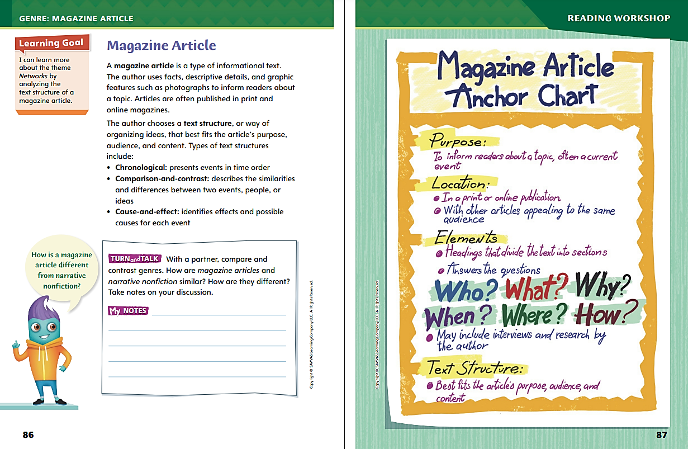
Page 86, 87
Magazine Article
Turn to page 86 in your Student Interactive.
Notes:
Explain to students that a magazine article is a type of informational text. An article appears in a print or online publication and uses facts, details, and graphics to inform readers about a topic.
Ask yourself what the text is mostly about. Does the author support the main idea with details?
Identify how the text is organized. How does the structure of the text help you understand the main idea?
Look for answers to the following questions: Who? What? When? Where? Why? and How?
Model determining that a text fits the features of a magazine article. Say: The author begins “Exploring Mars” by asking if the reader has ever wondered about what it would be like to visit Mars. This tells me that the text is nonfiction, since Mars is a real place. The author gives facts about Mars for the rest of the text. The facts tell what Mars is like and what humans are doing to explore it. The text answers Who? (scientists at NASA) What? (exploring Mars) When? (since the 1960s up to today and into the 2030s) Where? (in space) Why? (to learn about its conditions) and How? (with special equipment).
Ask students if they have read any magazine articles recently, either in class or at home. Discuss the features magazine articles can have.

Slide 7
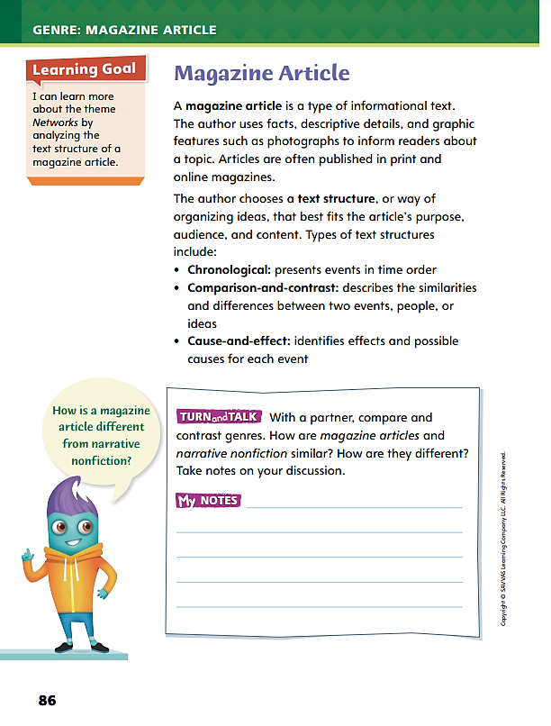
Page 86
Apply
Turn to page 86 in your Student Interactive and complete the activity with a partner.
Notes:
Have students use the strategies to identify magazine articles.
Have students work with a partner to complete the Turn and Talk activity on p. 86 of the Student Interactive.
Circulate to discover if students can determine how magazine articles are similar to and different from narrative nonfiction.

Slide 8
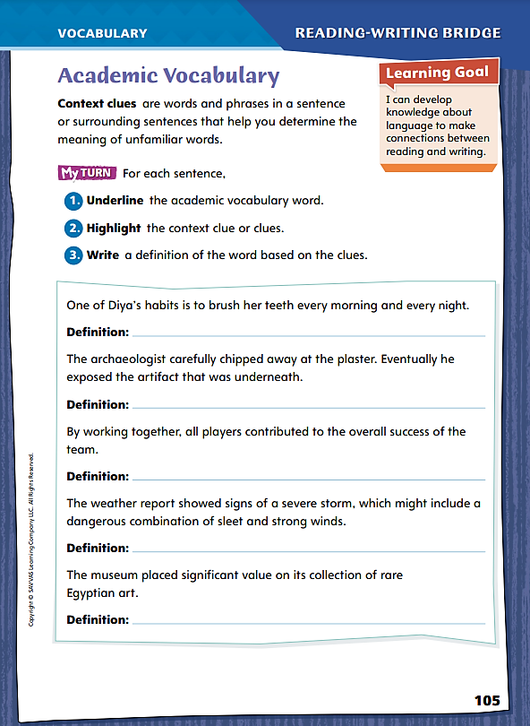
Page 105
Academic Vocabulary
Turn to page 105 in your Student Interactive.
Notes:
Explain to students that using context clues can help readers understand unfamiliar words or phrases in a text. Context clues are hints an author provides to help readers infer the meaning of an unfamiliar word. In some cases, context clues restate or contrast with the unknown word within the same sentence. In other cases, readers can infer the meaning of an unfamiliar word by paying attention to how it is used in the sentence.
When you encounter an unfamiliar word, notice its function in the sentence. Is it being used as a noun, a verb, or a modifier, or does it have some other function?
Look for synonyms or contrasting words. Authors sometimes restate the meaning of the word within the same sentence.
Try out your definition of the word in the sentence. If it seems to make sense, it is probably correct.
Model this strategy using the academic vocabulary word habits. Then have students apply the strategy on p. 105.
Say: If I encounter an unfamiliar word in a text, I first look for a synonym within the sentence. For example, listen to this sentence: Marsha has many good habits, or regular routines, that she carries out every day. The word habits is defined within the sentence as “regular routines.” I also notice that habits is used as a noun; habits are actions that Marsha carries out. Finally, I use the context clues to make up a definition for habits, “normal actions,” and try it in the sentence: Marsha has many normal actions that she carries out every day. This definition makes sense so it is likely to be correct.

Slide 9
Page 105
Apply
Turn to page 105 in your Student Interactive and complete the activity.
Notes:
Have students try out the strategy on p. 105 to write possible definitions for each of the academic words.

Slide 10
Word Study
tap, tape
rip, ripe
hop, hope
rat, rate
Read each word and pronounce them out loud.
Notes:
Explain to students that the vowel-consonant-e (VCe) sequence is one of the most common patterns in English, with the silent e conferring a long sound on the vowel that precedes it. Write tap and tape on the board and read the words aloud. Without the silent e, the a in tap gets a short sound. When a silent e is attached, tape now gets a long a sound.
Write the following pairs of words and have students pronounce them out loud.
rip and ripe
hop and hope
rat and rate
Ask students to list other words that fit the VCe pattern.

Slide 11
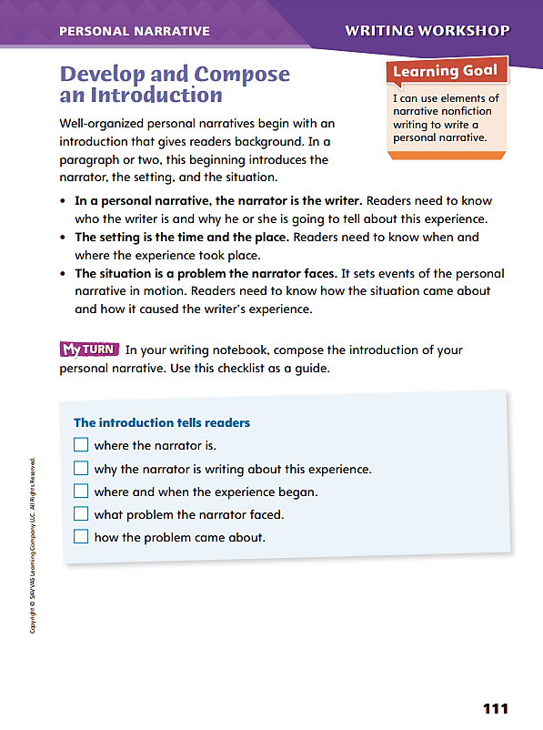
Page 111
Writing – Personal Narrative
Turn to page 111 in your Student Interactive.
Notes:
Explain to students that authors of well-structured personal narratives use an introduction, or beginning, that gives readers the background they need to understand events. It includes
Key facts about the narrator.
Information about the setting in which the experience occurs.
Presentation of the situation the narrator faces as events begin.
Tell students that the introduction of a personal narrative sets the stage for the action of the story. Read aloud the introduction of a personal narrative in the classroom stack. Help students analyze it by discussing
What readers learn about the narrator before events begin.
What readers learn about the situation, or problem, that confronts the narrator.
What helps readers know that the introduction has come to an end.
Direct students to p. 111 and review the bulleted items. Answer any questions students have about the explanations. Then ask students to review the checklist as they develop structured introductions.

Slide 12
Independent Writing
In your writing notebook, compose the introduction of your personal narrative.
Use the checklist on p. 111 as a guide.
Describe to the class the process you used to decide what to put in your introduction.
Notes:
After the minilesson, students should transition into independent writing. If students need further opportunities to explore what goes into the introduction of a well-structured personal narrative, guide them to examples in the stack. .
If students struggle, choose one of the following options to provide further support.
Modeled – Model deciding what readers need to know before you begin to describe an experience.
Shared – Have students summarize the experience they will relate in their narratives, and then discuss what information to give readers as background.
Guided – Use a stack text to provide explicit instruction about what goes into an introduction.
If students demonstrate understanding, have them continue drafting personal narratives in their writing notebooks. See the Conference Prompts on p. T384.
At the end of writing time, ask a volunteer to describe the process he or she used to decide what to put in his or her introduction.

Slide 13
Spelling
Roger likes to imitate the way his dog Jenny barks.
To be a good citizen, you should contribute to the community.
I saw the first episode of the show.
A lizard can survive cold conditions by slowing down.
Many businesses now advertise only on the Internet.
Janna will be able to participate in three different sports.
A country cannot impose its laws on other nations.
I can recognize Zara just by the way she walks.
If you leave your bike outside, it will begin to corrode.
The inner workings of the government fascinate Rina.
Notes:
(Note: Move the orange boxes to cover each bold spelling word before you read aloud the words and sentences.)
Use the sentences from Lesson 5, p. T404, to assess students’ prior knowledge of spelling patterns.
Roger likes to imitate the way his dog Jenny barks.
To be a good citizen, you should contribute to the community.
I saw the first episode of the show.
A lizard can survive cold conditions by slowing down.
Many businesses now advertise only on the Internet.
Janna will be able to participate in three different sports.
A country cannot impose its laws on other nations.
I can recognize Zara just by the way she walks.
If you leave your bike outside, it will begin to corrode.
The inner workings of the government fascinate Rina.
Reveal the spelling word and have students check their work.
For students who seem proficient in spelling, provide the following words for a challenge. Challenge Words: meteorite, accumulate, retaliate

Slide 14
Language and Conventions
Will and Tara walked to the park and played volleyball.
Identify the compound subject and the compound predicate.
Notes:
Review compound subjects and predicates. See p. T369.
Write the following sentence and have students identify the compound subject and the compound predicate: Will and Tara walked to the park and played volleyball. Confirm that the compound subject is Will and Tara and the compound predicate is walked to the park and played volleyball.
Ask students to write sentences with compound subjects only, compound predicates only, and both compound subjects and predicates. Then have students identify the subjects and the predicates in each of their sentences.

Slide 15
Lesson 2

Slide 16
Preview Vocabulary
identical
radiation
duplicate
comparison
DNA
chromosomes
Notes:
Introduce the vocabulary words on p. 88 in the Student Interactive and define them as needed.
identical: appearing to be exactly the same
radiation: energy that travels in the form of waves outward from a source, such as the sun
duplicate: exactly the same as another
comparison: examination of things to see how they are similar
DNA: the substance in cells that determines the characteristics of a living thing
chromosomes: parts of DNA in cells that contain the genes
Say: These words will help you understand the information in “Twins in Space.” Think about what you already know about these words and what they might tell you about the selection before you begin reading. As you read, highlight the words when you see them in the text.

Slide 17
Page 88
First Read Strategies
Notes:
Discuss the First Read Strategies. Prompt students to establish that the purpose for reading this selection is for understanding and enjoyment.
NOTICE - Remind students to pay attention to the facts and descriptive details that inform them about the article’s topic.
GENERATE QUESTIONS - Encourage students to write down questions before, during, and after reading and to mark anything they find confusing.
CONNECT - Ask students to connect ideas within the text by marking transition words and phrases
RESPOND - Have students mark any parts of the text they find interesting, surprising, or significant.
Students may read independently, in pairs, or as a class. Use the First Read notes to help them connect with the text and guide their understanding.

Slide 18
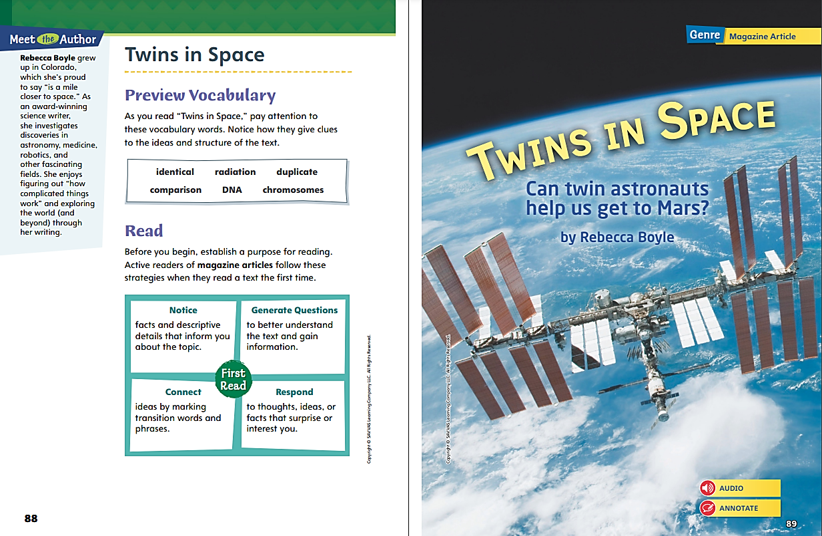
Page 88, 89
First Read – Twins in Space
Notes:
Read the text. Pause to discuss the First Read notes with students.

Slide 19
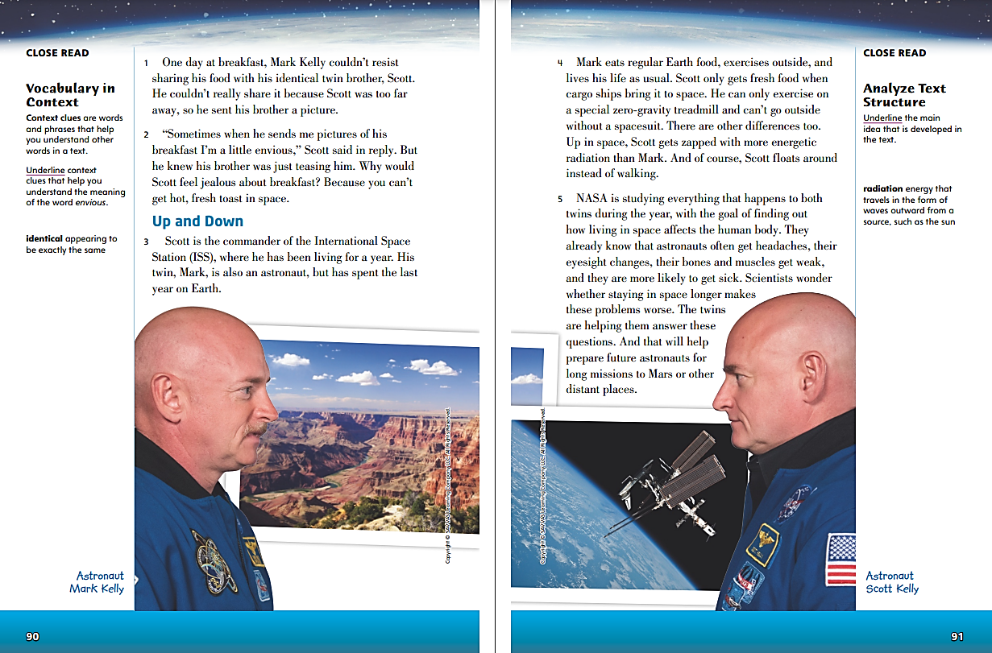
Page 90, 91
First Read – Twins in Space
Notes:
Read the text. Pause to discuss the First Read notes with students.
Say: After reading the first two paragraphs of the magazine article, I see that one twin is on Earth and the other is in outer space. I wonder why only one twin is in outer space, when the title is “Twins in Space”—is only one of them an astronaut? I’ll keep reading to find out.
Say: Reading about the differences between Mark’s and Scott’s daily lives is very surprising. Mark lives just like the rest of us do, but Scott can’t go outside or eat fresh food. I would feel trapped if I couldn’t go outside. Scott must have a good reason for living in the International Space Station.

Slide 20
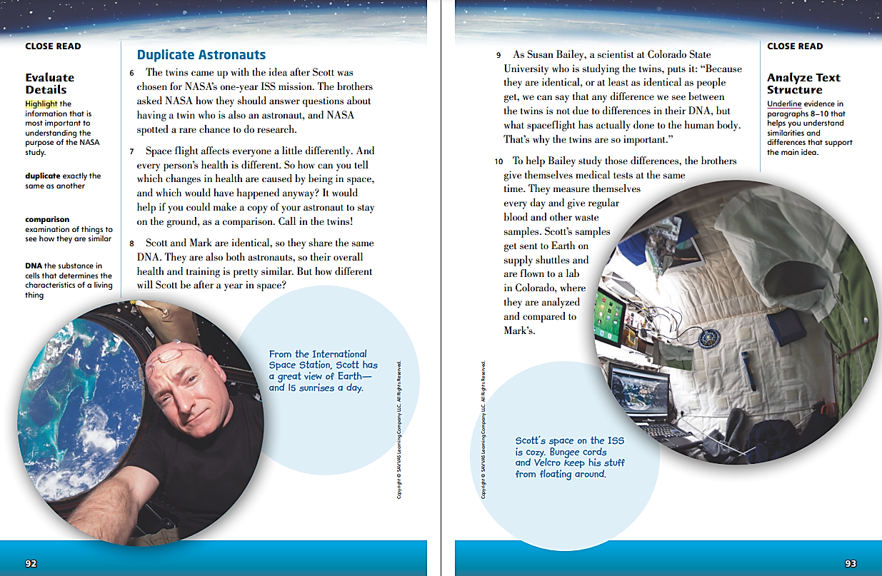
Page 92, 93
First Read – Twins in Space
Notes:
Read the text. Pause to discuss the First Read notes with students.
Say: Now I know why one twin is on Earth and the other is in outer space. Because they are identical twins, NASA can see how Scott’s body responds to being in space versus how Mark’s body is on Earth. This information tells NASA how spaceflight affects the human body.
Say: When I read about how both twins measure themselves every day and give themselves medical tests at the same time, I think about how much work that must be for both of them. I know when I go to the doctor, I’d rather not have all those tests. The twins must be very committed to helping NASA see how spaceflight affects the human body.

Slide 21
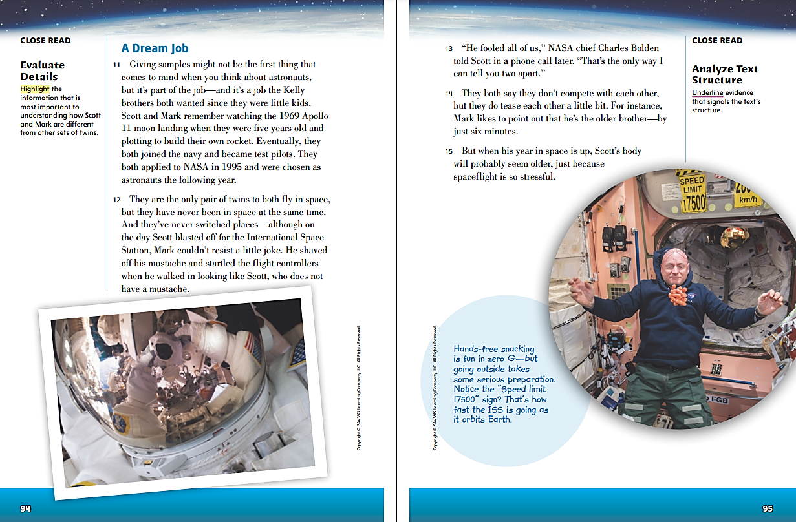
Page 94, 95
First Read – Twins in Space
Notes:
Read the text. Pause to discuss the First Read notes with students.
Say: It’s surprising that Mark and Scott are twins, but they’ve never switched places and they’re not competitive. All the stories I’ve read about twins have them switching places or competing with one another, so Mark and Scott must be very different from most twins.
Say: The author says that even though Mark is older, Scott’s body will probably seem older after a year in space. This is confusing, since the entire point of the mission is that the twins are exactly the same. In what ways will Scott’s body be different? I’ll mark that sentence and keep reading to find out.

Slide 22
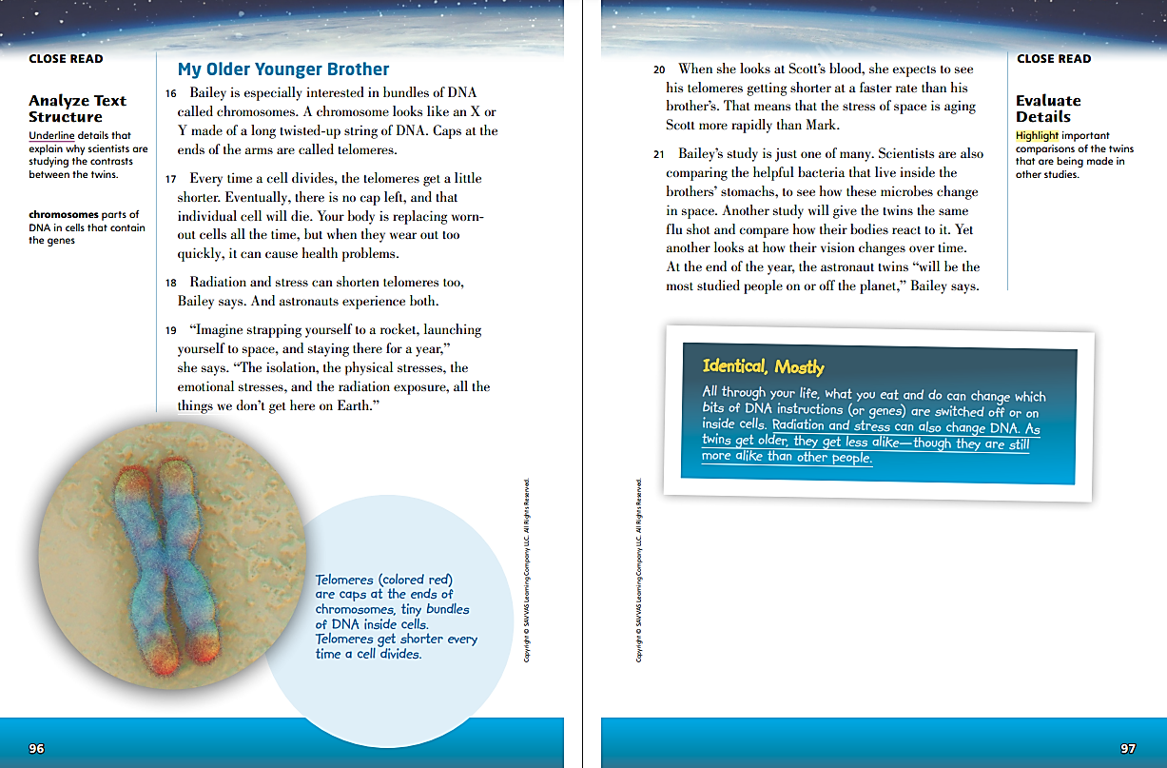
Page 96, 97
First Read – Twins in Space
Notes:
Read the text. Pause to discuss the First Read notes with students.
Say: These paragraphs are about what happens to chromosomes, which are made up of DNA. Earlier in the text, the author mentioned that because Mark and Scott are identical twins, they have the same DNA. This part of the text must be important in explaining how Mark and Scott will be different because of Scott’s time in space.
Say: Paragraphs 20 and 21 list a lot of different ways the twins are being tested and compared. I have never thought about how vision could change in space, or that people might react to a flu shot differently. Being in space for a year must be damaging to Scott’s body.

Slide 23
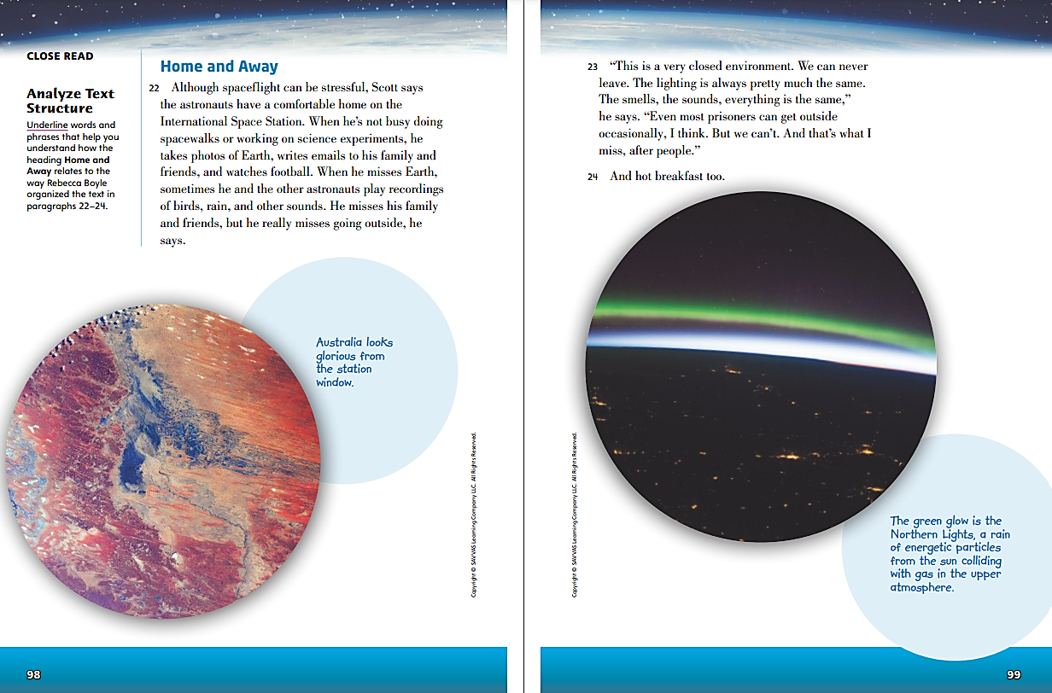
Page 98, 99
First Read – Twins in Space
Notes:
Read the text. Pause to discuss the First Read notes with students.
Say: When I read Scott’s descriptions of how he spends his time, such as watching football, doing science experiments, and writing emails, it seems like his life is not that much different from that of an astronaut who lives on Earth. But then the paragraph transitions to the things that Scott misses about Earth, which must be hard for him.
Say: Scott talks about how much he misses going outside, and that even prisoners are allowed to go outside once in a while. This is surprising to think about, since Scott volunteered to be part of this mission. He must really care about his job and want NASA to have accurate information about how flight affects the human body.

Slide 24
Respond and Analyze
Discuss: What did you think about “Twins in Space”?
Brainstorm: How did analyzing the structure and evaluating the details in “Twins in Space” help you better understand the topic?
Notes:
Use these suggestions to prompt students’ initial responses to reading “Twins in Space.”
Discuss - What did you think about “Twins in Space”?
Brainstorm - How did analyzing the structure and evaluating the details in “Twins in Space” help you better understand the topic?

Slide 25
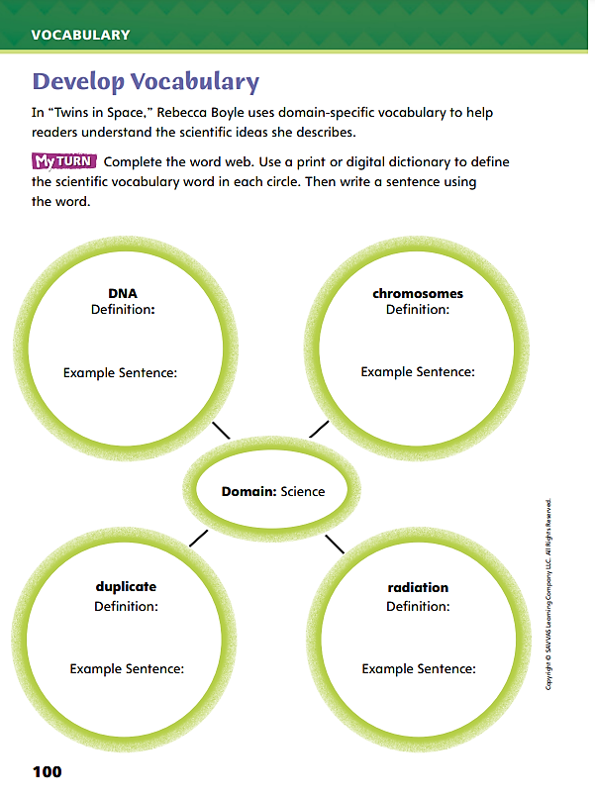
Page 100
Develop Vocabulary
Turn to page 100 in your Student Interactive.
Notes:
Tell students that understanding scientific terms in “Twins in Space” will help them understand the meaning of the text. DNA, chromosomes, duplicate, and radiation are domain-specific terms related to the main idea of “Twins in Space.”
Remind yourself of the word’s meaning.
Ask yourself why the word is central to your understanding of ideas in the text.
Model responding to a prompt using newly acquired vocabulary as appropriate. Use DNA to fill out the web on p. 100 of the Student Interactive.
Say: I can find in a dictionary that DNA is a substance in cells that determines a living thing’s characteristics.
Say: I will demonstrate my word knowledge by writing a sentence explaining that the Kelly brothers have the same DNA.
Have students use the process you modeled to write a definition and example sentence for chromosomes in the web on p. 100.

Slide 26
Page 100
Apply
Turn to page 100 in your Student Interactive and complete the activity.
Notes:
Have students use the strategies for developing vocabulary.
Have students respond using newly acquired vocabulary as they complete p. 100 of the Student Interactive.

Slide 27
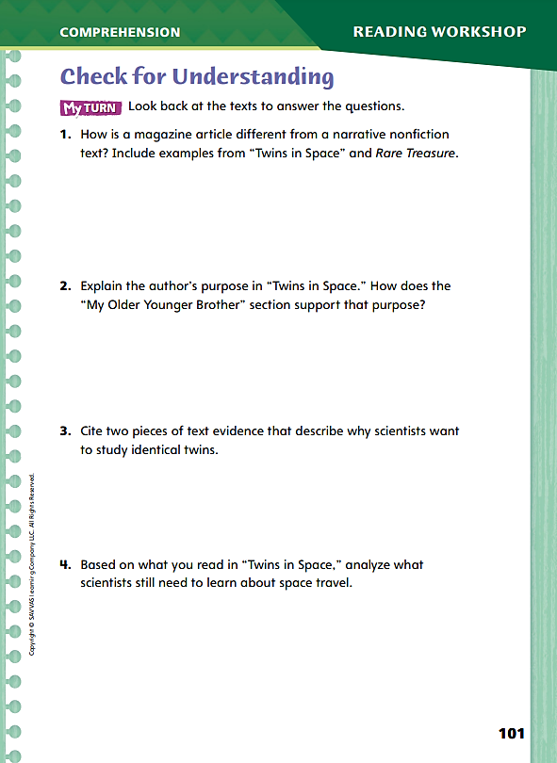
Page 101
Check for Understanding
Turn to page 101 in your Student Interactive and complete the activity.
Notes:
Have students complete p. 101 of the Student Interactive.

Slide 28
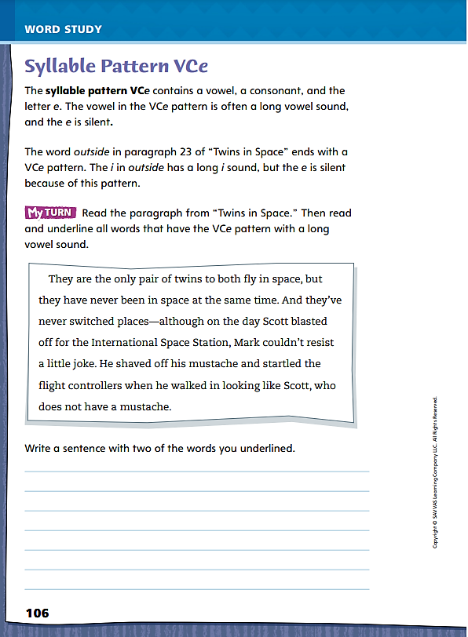
Page 106
Word Study
Turn to page 106 in your Student Interactive and complete the activity.
Notes:
Instruct students to complete the “Twins in Space” exercise on p. 106 in the Student Interactive. Have students read the VCe words in context and then underline each one.
Students should pronounce each word orally. Then ask students to write three additional sentences using words that they identified.

Slide 29
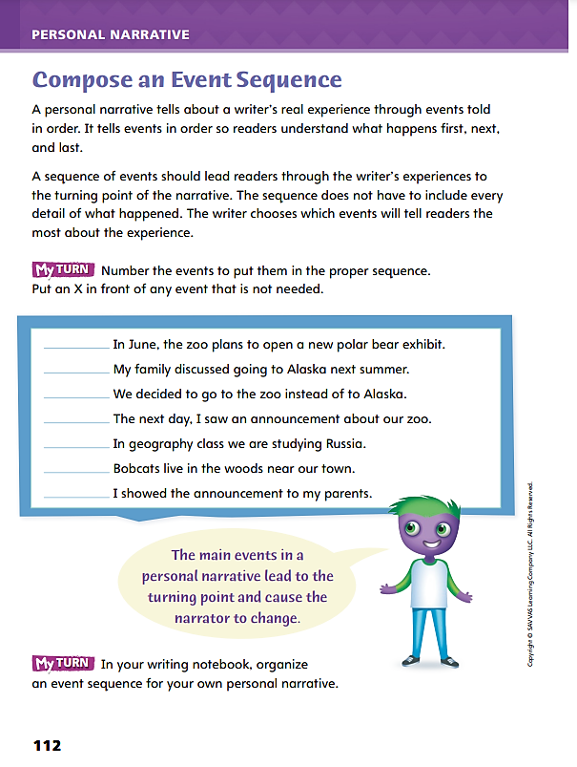
Page 112
Writing – Personal Narrative
Turn to page 112 in your Student Interactive.
Notes:
Explain to students that composing an event sequence requires making choices. From a reader’s perspective, some events may seem irrelevant, even though they really happened. Readers do not need to know about them to appreciate the personal narrative. To compose an event sequence, writers may
List every event, in order, that seems important to the experience.
Highlight the event that is the turning point.
Review the list to decide which events will most help readers appreciate the personal narrative.
Direct students to p. 112 of the Student Interactive. Explain that a student wants to write about a family’s decision to stay home instead of taking a trip.
Have students scan the list of statements in the My Turn box. Ask: Do readers need to know about all of these events? Which event do you think is the turning point of the narrative?
After students respond, have them complete the activity. Then discuss how they chose how to order events and what events to leave out.

Slide 30
Independent Writing
In your writing notebook, put in order the key events you have identified for your narratives.
Use this time to list and evaluate events from the perspective of a potential reader.
Explain to the class how you decided to leave an event out of your narratives.
Notes:
After the minilesson, students should transition into independent writing. If students have identified key events for their narratives, they may use this time to put them in order.
If students struggle, choose one of the following options to provide further support.
Modeled – Do a Think Aloud that identifies the turning point in an experience, and then model deciding on events that must come before the turning point.
Shared – To help students decide which events are most important in their narratives, help them fill in a sequence organizer with a limited number of spaces for events.
Guided – Challenge students to identify the main events in a stack text and explain their choices. Then direct them to apply this evaluation to their own writing.
If students need more time to decide which events to include, they can use this time to list and evaluate events from the perspective of a potential reader. See the Conference Prompts on p. T384.
At the end of writing time, call on a few students to explain how they decided to leave an event out of their narratives.

Slide 31
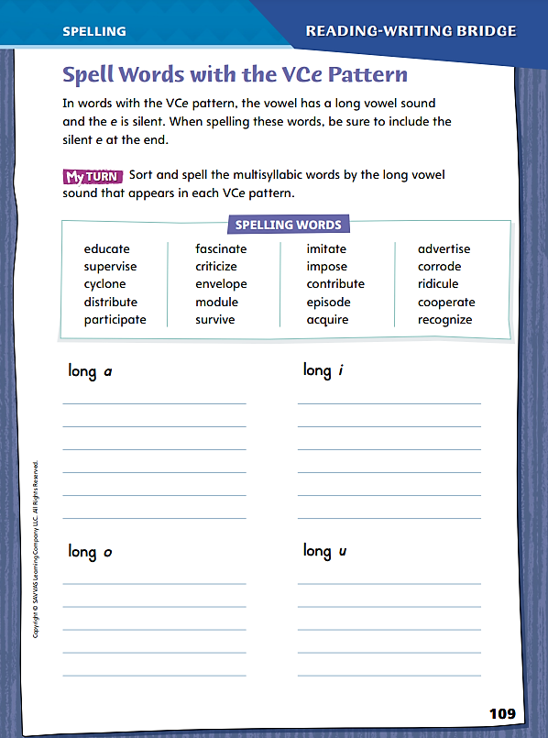
Page 109
Spelling
imitate
Turn to page 109 in your Student Interactive and complete the activity.
Notes:
Review the VCe spelling pattern in which a vowel is followed by a consonant and then a silent letter e that confers a long sound on the vowel that precedes it.
Say the word imitate and ask, Which syllable has a long sound? Point out that the a has a long sound because it fits the VCe pattern.
Ask students to complete the activity on Student Interactive p. 109.

Slide 32
Language and Conventions
Rocky runs.
Annie, smart and kind.
Nadia, my cousin, loves dogs.
Identify the subject and the predicate and tell whether each is a complete sentence or a fragment.
Notes:
Explain to students that a complete sentence must have a subject and a predicate, and it must express a complete idea. A sentence fragment is a group of words that is missing a subject or a predicate.
Write the following examples. Have students identify the subject and the predicate and tell whether each is a complete sentence or a fragment.
Rocky runs. Subject: Rocky, predicate: runs, complete sentence
Annie, smart and kind. Subject: Annie, predicate: none, fragment
Nadia, my cousin, loves dogs. Subject: Nadia, predicate: loves dogs, complete sentence
Have students write complete sentences, then exchange papers with a partner. For each item, partners should identify the subject and the predicate. If the sentence is incomplete, have students edit the sentence to make it complete.

Slide 33
Lesson 3

Slide 34
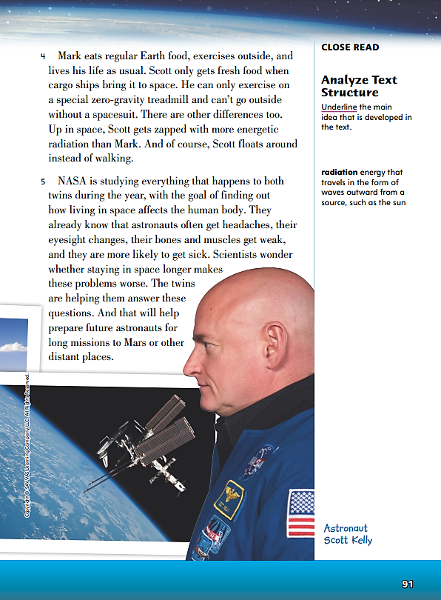
Page 91
Close Read – Analyze Text Structure
Turn to page 91 in your Student Interactive.
Notes:
Remind students that One characteristic of informational text is the main idea. Once readers have determined the main idea of a text, analyzing informational text structure can help readers understand how key details support the main idea.
Think about what the text is telling you, or the main idea.
Look for any details that reveal similarities and differences related to the main idea.
Pay attention to features that show you the text’s organizational pattern or structure, such as headings.
Think about how the author structures the text by grouping details and why the author might have chosen that organizational pattern.
Use the Close Read note on p. 91 of the Student Interactive to model how to annotate the text to analyze text structure.
Say: What is the main idea of this text? The text starts off by describing how one twin who lives on Earth is sending a picture of his breakfast to his twin in space. The text talks about how differently the twins live their lives. Paragraph 5 begins by saying how and why NASA is studying the twins. The author is writing the text to inform us about this study. I will underline the first sentence of paragraph 5, because it tells me the main idea.
Have pairs use informational text structure and characteristics to find and underline evidence that supports this main idea. Then have them discuss how different pieces of evidence relate to one another and to the main idea.

Slide 35
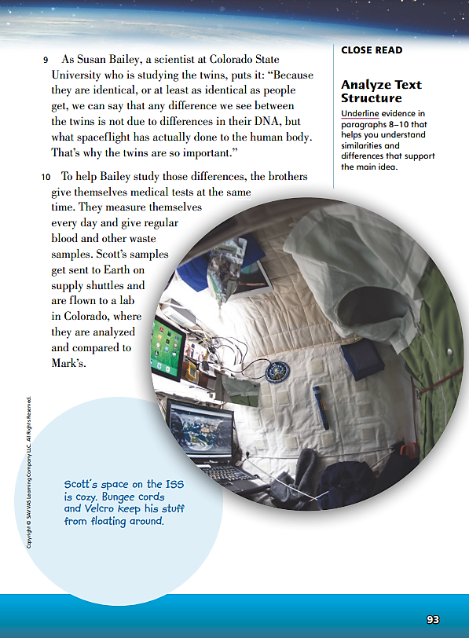
Page 93
Close Read – Analyze Text Structure
Turn to page 93 in your Student Interactive.
Notes:
Tell students that as they read a magazine article, they should notice how the author organizes, or structures, details that support the main idea.
Have students scan paragraphs 8–10 to look for comparisons or contrasts of the twins that support the main idea. See student pages for possible responses. DOK 2

Slide 36
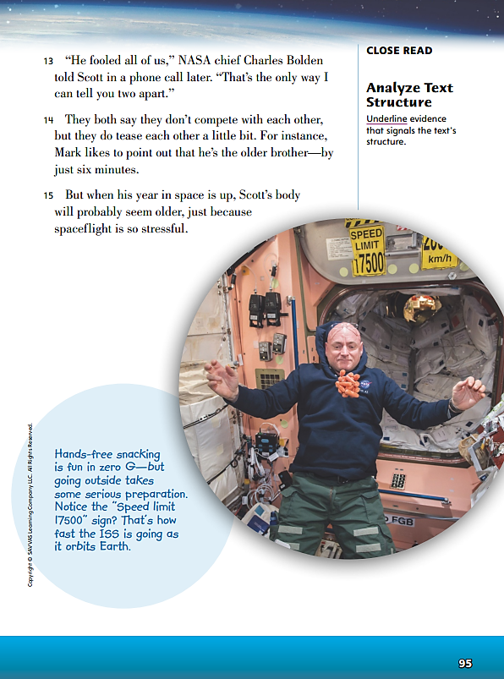
Page 95
Close Read – Analyze Text Structure
Turn to page 95 in your Student Interactive.
Notes:
Remind students that they can use what they know about the characteristics and structures of informational text to look for transition words and phrases that indicate a text’s structure or organizational pattern.
Have students scan paragraphs 13–15 to underline transitions that signal the text’s structure. See student page for possible responses. DOK 2

Slide 37
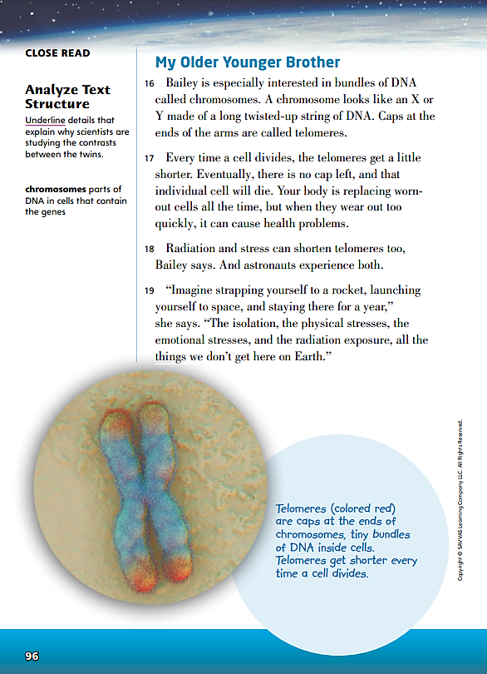
Page 96
Close Read – Analyze Text Structure
Turn to page 96 in your Student Interactive.
Notes:
Remind students that, in magazine articles, text features are part of the text structure. Ask students for examples of text features they have seen before. Point out that “My Older Younger Brother” is a text feature called a heading. Discuss what is unusual about the statement in the heading.
Have students scan paragraphs 16–19 and the text feature below paragraph 21 and underline details about differences in chromosomes. See student page for possible responses. DOK 2

Slide 38
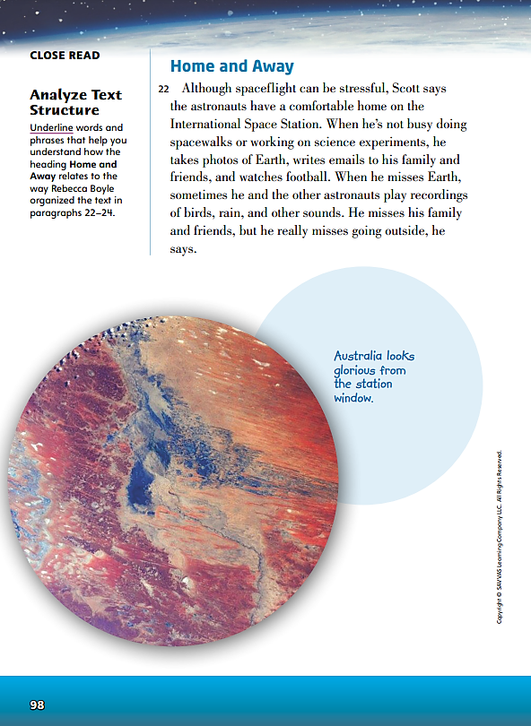
Page 98
Close Read – Analyze Text Structure
Turn to page 98 in your Student Interactive.
Notes:
Direct attention to the heading on page 98. Explain that headings can give a clue as to how a text is structured. Encourage students to underline words and phrases on these pages that show how the heading relates to the text structure. See student page for possible responses.
Ask: What text structure do the paragraphs and the heading suggest? What evidence supports your choice?
Possible response: The text and the heading suggest a compare-and-contrast structure. The text begins with Scott referring to the space station as “home.” Then the text turns to what Scott misses about home on Earth. This contrast is set up by the heading because the space station is both home, but away from home, and Earth is his home, but he is away from the Earth. DOK 2

Slide 39
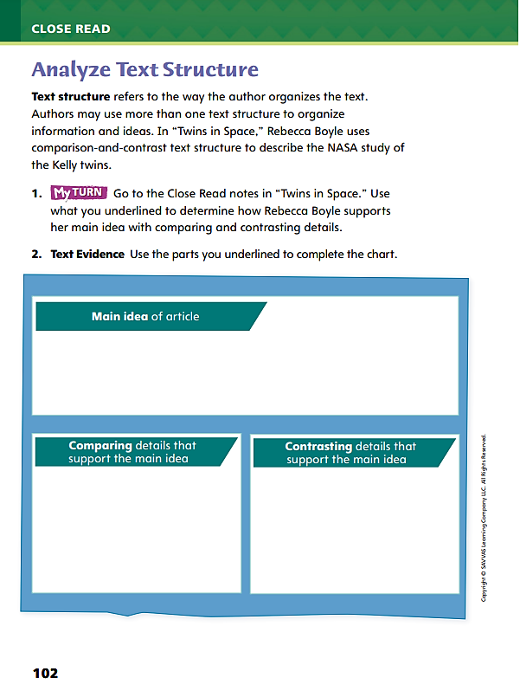
Page 102
Apply
Turn to page 102 in your Student Interactive and complete the activity.
Notes:
Have students use the strategies for analyzing text structure.
Have students annotate the text using the other Close Read notes for Analyze Text Structure and then use their annotations to complete the chart on p. 102.

Slide 40
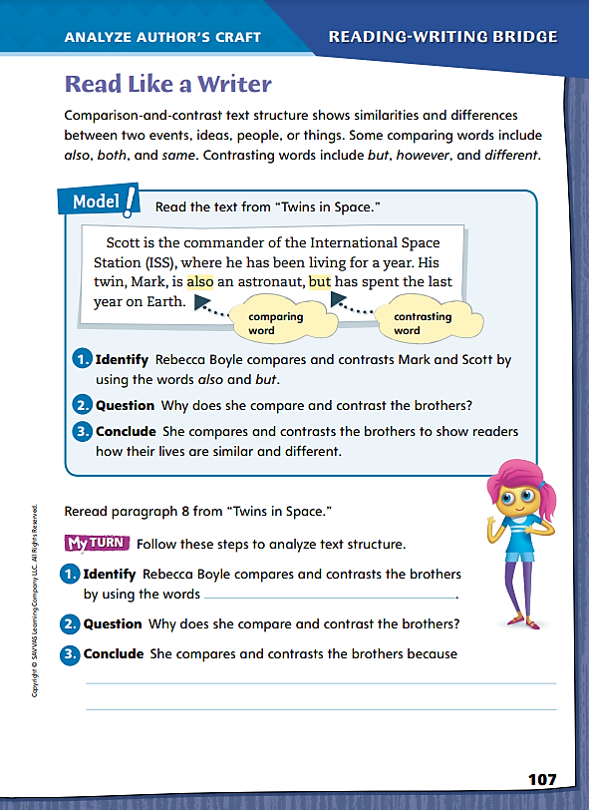
Page 107
Read Like a Writer
Turn to page 107 in your Student Interactive.
Notes:
Explain to students that when authors compare and contrast, they show how items are the same or different. Signal words such as also and both are used in comparisons to show how items are similar. To contrast, or show how items are different, authors use signal words that include however and but. Rebecca Boyle uses several signal words to compare and contrast in “Twins in Space.”
Eventually, they both joined the navy and became test pilots.
They are the only pair of twins to both fly in space, but they have never been in space at the same time.
The first sentence uses both to compare the two brothers and show how they are similar. The second sentence uses but to contrast the brothers and show how they are different.
MODEL AND PRACTICE | Model the skill by referring to Student Interactive p. 107 and paragraph 3 of “Twins in Space.”
How does the word also show a comparison?
How does the word but show a contrast?
Discuss how comparison and contrast helps the reader get an accurate view of the people, things, or ideas being discussed.
Help students use the process you modeled to locate and explain another instance of comparison-and-contrast text structure in “Twins in Space.”

Slide 41
Page 107
Apply
Turn to page 107 in your Student Interactive and complete the activity.
Notes:
Direct students to find examples of compare and contrast that Rebecca Boyle uses in “Twins in Space.”
Then have students complete My Turn on p. 107 of the Student Interactive.

Slide 42
Word Study
like
likely
unlikely
place
replace
replacement
fuse
refuse
Identify each VCe sequence and pronounce the word aloud.
Notes:
Point out that the VCe sequence can appear at the beginning, the middle, or at the end of a word.
Write the following words. Have students identify each VCe sequence and pronounce the word aloud.
like
likely
unlikely
place
replace
replacement
fuse
refuse
Have students complete Word Study p. 3 from the Resource Download Center. Click path: Table of Contents -> Resource Download Center -> Word Study -> U1W3 Word Study

Slide 43
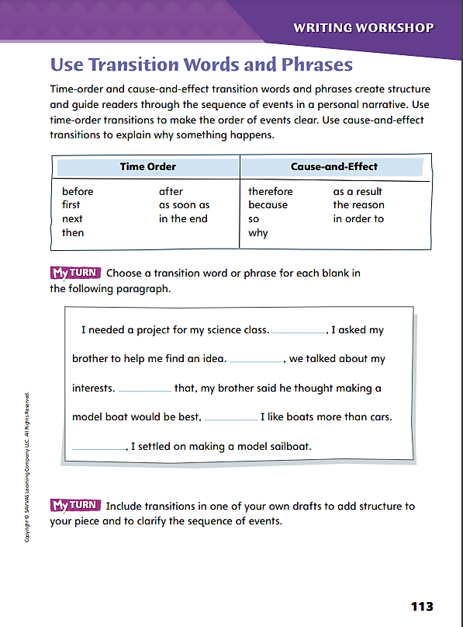
Page 113
Writing – Personal Narrative
Turn to page 113 in your Student Interactive.
Notes:
Explain to students that transitions are words and phrases that give structure to a text and help readers move from one event or idea to another. They are also called linking words and phrases. Writers choose transitions to help readers follow their narratives.
Time-order transitions clarify the order of events.
Cause-effect transitions clarify why events occur and what happens as a result of events.
Review the difference between a word and a phrase. Give an example: Afterward is a word, as you know. A phrase that can say the same thing might be “After the phone rang.” Another transition word is therefore. A phrase that can say the same thing might be “As a result of the contest.” When you choose transition words and phrases, decide how much detail readers need to understand what is happening.
Review common transition words and phrases with students using the lists on Student Interactive p. 113. Invite students to use each example in a sentence. Then have students complete the activity.

Slide 44
Independent Writing
Let’s work on our own writing projects.
Include transitions in one of your own drafts to add structure to your piece and to clarify the sequence of events.
Share transitions you added to your personal narratives.
Notes:
After the minilesson, students should transition into independent writing. If students struggle to add structure and clarify sequence of events by linking ideas with transitions, suggest that they choose stack texts and identify transition words and phrases the authors use.
If students struggle, choose one of the following options to provide further support.
Modeled - Use transition words to describe a short sequence of activities such as checking the time.
Shared - Use a sequence graphic organizer to inspire students to add transition words and phrases to their planned order of events.
Guided - Have students use stack texts as models for adding useful transition words and phrases to their own drafts.
If students have developed a sequence of events in their personal narratives, encourage them to experiment with transitions as they complete and revise their drafts. See the Conference Prompts on p. T384.
Have a few volunteers share transitions they added to their personal narratives.

Slide 45
Spelling
g_ _ _
s_ _ _ r_ _ _
r_ _ _ _ _
e_ _ _ g _ _ _ n_
c_ _ _ _ s_
e_ _ r_ _ _
Spell each word and identify the VCe syllable pattern.
Notes:
Remind students that the VCe pattern has a vowel-consonant-e pattern in which the e is silent and gives the preceding vowel a long sound.
Read the following words aloud: gate, surprise, relate, engagement, compose, extreme. Have students spell each word and identify the VCe syllable pattern.
Have students complete Spelling p. 8 from the Resource Do wnload Center. Click path: Table of Contents -> Resource Download Center -> Spelling -> U1 W3 Spelling

Slide 46
Language and Conventions
Mo has a good forehand, his backhand is weak, he’s got a great serve.
The cat with white feet.
The president sings.
Remembers most of her past.
Notes:
Remind students that a complete sentence has a subject and a predicate. A sentence fragment is missing either a subject or a predicate. A run-on sentence contains more than one complete thought that should be broken into separate simple or compound sentences.
Have students tell whether each item is a complete sentence, a fragment, or a run-on sentence. Have students correct each fragment or run-on to make it a complete simple or compound sentence.
Mo has a good forehand, his backhand is weak, he’s got a great serve. run-on; Mo has a good forehand. His backhand is weak, but he’s got a great serve.
The cat with white feet. fragment; Boots is the cat with white feet.
The president sings. complete sentence
Remembers most of her past. fragment; Johanna remembers most of her past.

Slide 47
Lesson 4

Slide 48
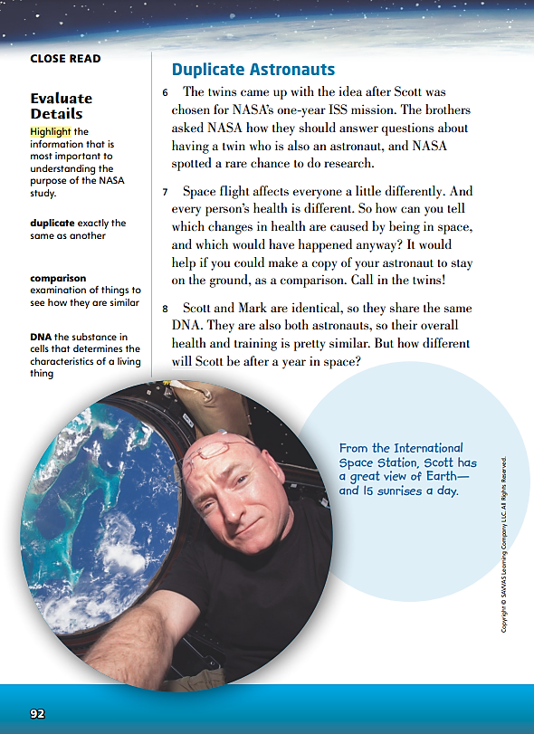
Page 92
Close Read – Evaluate Details
Turn to page 92 in your Student Interactive.
Notes:
Explain that readers can use genre characteristics and structures, such as main idea and details, to help them understand what a text is mostly about. Readers evaluate details to better understand ideas in a text, such as a magazine article.
Notice each detail that is related to the main idea of the text.
Think about the evidence the author gives to support that detail, and decide how important the detail is.
Connect the most important details to the main idea.
Use the Close Read note on p. 92 of the Student Interactive to model how to annotate the text to evaluate details.
Say: The text so far has talked about how NASA is studying any changes in the twins’ health. What information exactly is NASA looking for? In paragraph 7, I see the question, “So how can you tell which changes in health are caused by being in space, and which would have happened anyway?” This is the question that NASA wants to answer, so I will highlight the question. This detail tells why one twin is on Earth and the other is in space.
Have students use genre characteristics and structures to look for other details that are important to the main idea.

Slide 49
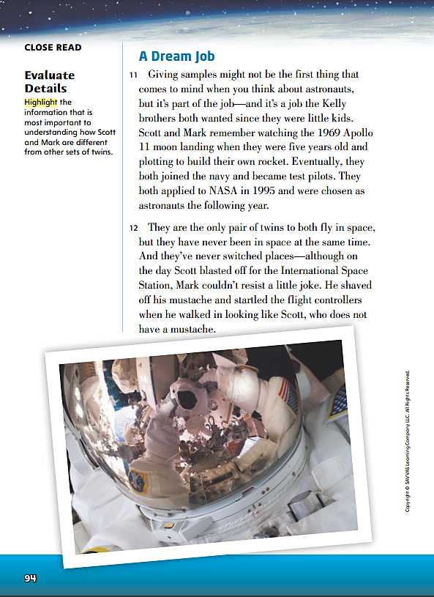
Page 94
Close Read – Evaluate Details
Turn to page 94 in your Student Interactive.
Notes:
Explain that when an article contains surprising information, it is probably important to the central idea.
Have students scan paragraphs 11–15 to highlight details that show how different Mark and Scott are from many other sets of twins. See student page for possible responses. DOK 2

Slide 50
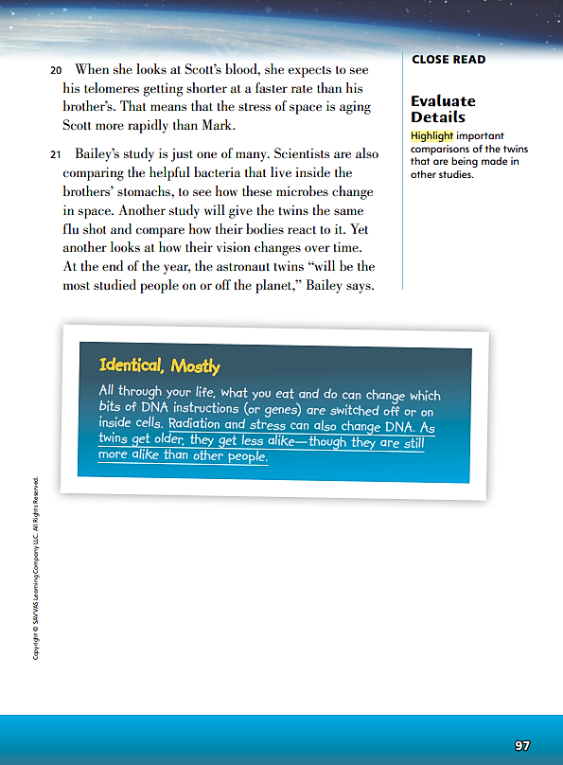
Page 97
Close Read – Evaluate Details
Turn to page 97 in your Student Interactive.
Notes:
Ask students to state the central idea again, and explain that they will look for key details that support the central idea.
Have students review paragraphs 20 and 21 to highlight the reasons for various studies of the twins. See student page for possible responses. DOK 2

Slide 51
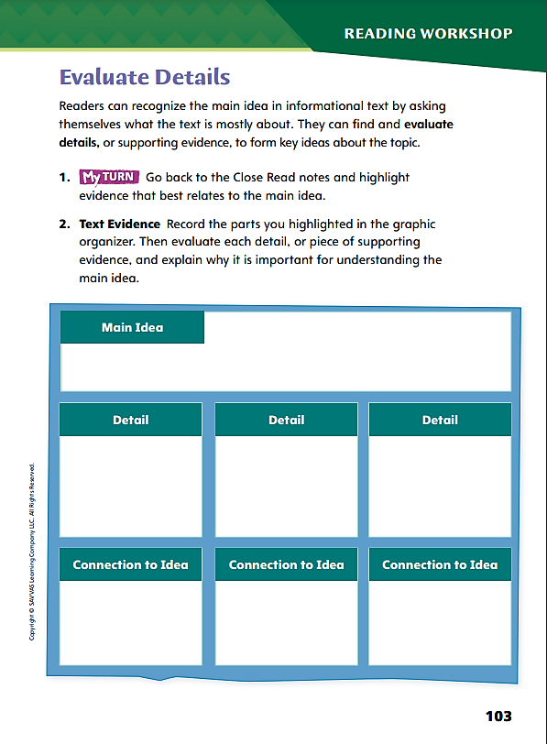
Page 103
Apply
Use the text
evidence from your annotations to complete p. 103.
Notes:
Have students use the strategies for evaluating details in a text.
Have students annotate the text using the other Close Read notes for Evaluate Details, and then use the text evidence from their annotations to complete p. 103.

Slide 52
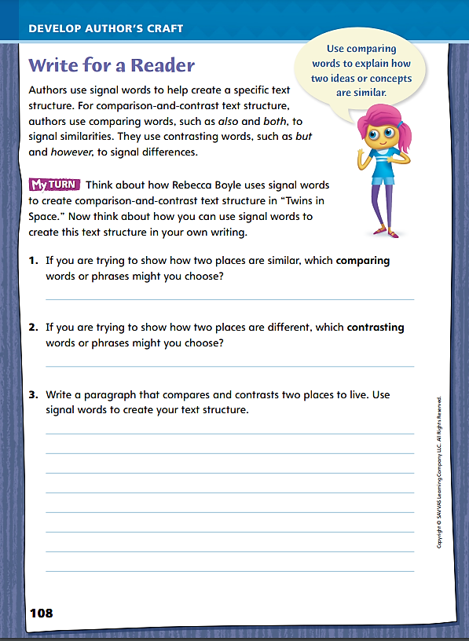
Page 108
Write for a Reader
Turn to page 108 in your Student Interactive.
Notes:
Review the signal words for comparison and contrast that students noted in “Twins in Space.” Point out that many words and phrases can be used to compare and contrast, such as share, as well as, same, differs, and contrasts.
Discuss how students might compare and contrast in their own writing using p. 108 in the Student Interactive. Model an example.
Identify two items that you want to show to be similar or different.
What kind of signal words might be useful for making a comparison? For showing contrast? Explain: I might use same, similar, identical, and alike for comparison, and differs, varies, and disagrees with for contrast.
With the whole class, collaboratively write a paragraph that compares and contrasts two people, places, ideas, or things. Stress that the purpose of the comparison is to engage the reader and to make the items easy to visualize.

Slide 53
Page 108
Apply
Turn to page 108 in your Student Interactive and complete the activity.
Notes:
Ask students to make a list of comparisons and contrasts in “Twins in Space.”
Then have students complete My Turn on p. 108 of the Student Interactive.

Slide 54
Word Study
active
activity
Work together to identify the suffix and how it changes the meaning of the base word.
athlete
athletic
enjoy
enjoyment
loyal
loyalty
Notes:
Review the use of suffixes and how they change the meanings of words.
Write the words active and activity. Ask students to describe how the suffix -ity changes the meaning of the base word active. Students should recognize that the suffix turns active, a word that describes, into activity, a word that names an action.
Display the following word pairs: athlete and athletic, enjoy and enjoyment, loyal and loyalty. Have student pairs work together to identify the suffix and how it changes the meaning of the base word.

Slide 55
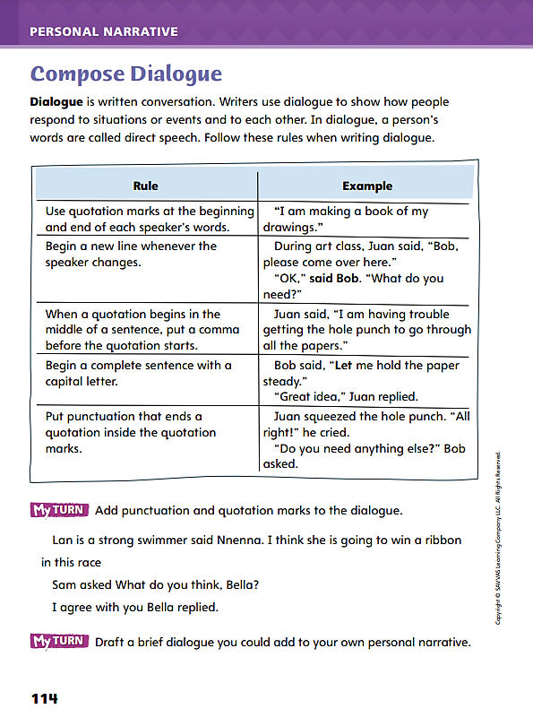
Page 114
Writing – Personal Narrative
Turn to page 114 in your Student Interactive and complete the activity.
Notes:
Explain to students that dialogue expresses thoughts and feelings through words, intonations, and facial expressions. Writing a conversation requires
Showing the words each person says.
Telling how the person sounds when he or she says the words.
Reporting on any facial expressions or gestures the person makes as he or she speaks.
Tell the class to listen as you and a student you select carry on a short conversation about the difference between the subject and predicate of a sentence. Then ask: How would you write that conversation? Would you write down more than the words we said? Give me an example. After students respond, guide them to say they would also identify each speaker by name and use punctuation.
Direct students to the chart of rules on Student Interactive p. 114. Ask: How can we apply these rules to the conversation you just heard? Have students give a response for each rule, and write their responses as dialogue on the board. Say: To observe each rule, you might have to revise something you wrote earlier. Finally, have students complete the activity.

Slide 56
Independent Writing
Continue working on your personal narratives.
Draft a brief dialogue you could add to your own personal narrative.
Share short dialogues from your personal narratives.
Notes:
After the minilesson, students should transition into independent writing. If students need more examples of how writers use dialogue, have them find and evaluate dialogue in texts from the classroom stack..
If students struggle, choose one of the following options to provide further support.
Modeled - Model deciding to replace a description in a narrative with dialogue.
Shared - Discuss with students ways to describe a speaker’s tone of voice, facial expression, and gestures during a conversation, and transcribe concrete words students suggest.
Guided - Use a stack text to support explicit instruction on writing speech tags in dialogue.
If students have already included some dialogue in their drafts, have them add more or check that their dialogue follows all the rules in the Student Interactive. See the Conference Prompts on p. T384.
After writing time is over, have two sets of partners read short dialogues from their personal narratives.

Slide 57
Spelling
creative
base
able
festive
loyal
pay
Notes:
Review how suffixes change the spelling of a base word.
Display the base word creative. Ask students to indicate how the word will change after the suffix -ity is attached to form creativity. Have students write creativity and describe the change: The final e in creative was deleted before adding the suffix.
Repeat the process with other words from last week: base, able, festive, loyal, pay

Slide 58
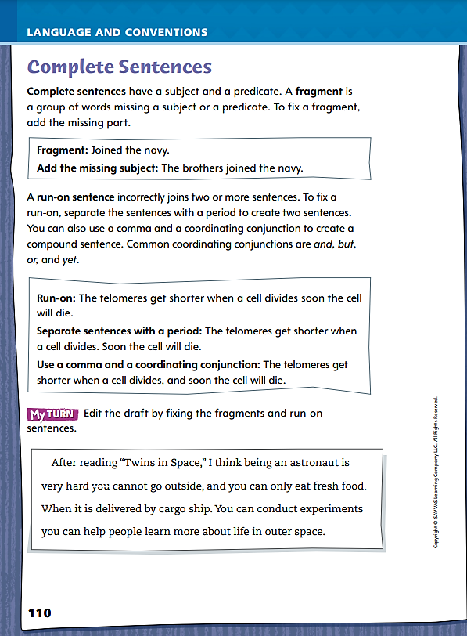
Page 110
Language and Conventions
Turn to page 110 in your Student Interactive and complete the activity.
Notes:
Have students complete the My Turn on Student Interactive p. 110.

Slide 59
Lesson 5

Slide 60
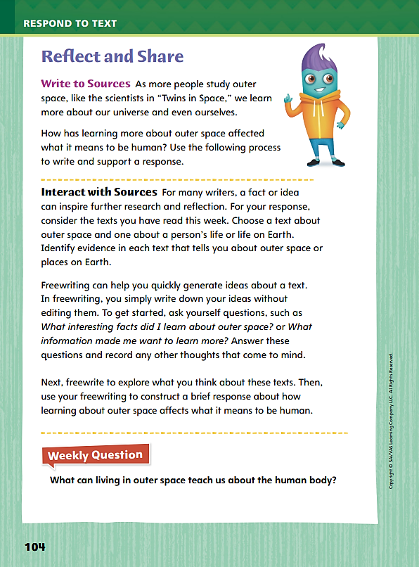
Page 104
Reflect and Share
Turn to page 104 in your Student Interactive.
Notes:
Explain that freewriting in response to a text is one way readers meaningfully interact with sources. It is an opportunity for reflection and can lead to ideas and questions for research. Tell students that freewriting is a lot like brainstorming. They will quickly jot down any questions, answers, thoughts, or ideas that the text brings up in their minds. They will not pause to analyze or edit their writing.
Model your thinking using the Write to Sources prompt on p. 104 in the Student Interactive. Write on the board: I didn’t know why humans couldn’t live on another planet. In “Exploring Mars,” I heard about the extreme temperatures and lower gravity. These are important. In “Twins in Space,” I read about how space affects the human body and why we study the effects. Are scientists doing other studies? Will humans be able to live in outer space for longer periods of time?
Say: I’ll use these thoughts to write a short paragraph about what it means to be human.
Suggest one or two sources and give students three to five minutes to freewrite in response.

Slide 61
Page 104
Apply
What can living in outer space teach us about the human body?
Notes:
Have students use the strategies for making connections between texts.
Use the Shared Read Have students interact with the texts in meaningful ways by using evidence from this week’s texts to discuss how learning about outer space affects what it means to be human. Encourage them to compare across multiple texts, including the infographic.
WEEKLY QUESTION | Have students use evidence from the texts they have read this week to respond to the Weekly Question. Tell them to write their response on a separate sheet of paper.

Slide 62
Word Study
Spell the word you hear and indicate whether each vowel is pronounced with a long sound or a short sound.
Make a running list of VCe words that you encounter in the reading.
Notes:
To evaluate how well students have mastered the VCe construction, read the following words orally: can, not, cane, note, bite, reduce, bit disgraceful
Ask students to spell them and indicate whether each vowel is pronounced with a long sound or a short sound.
Invite students to make a running list of VCe words that they encounter in the reading.

Slide 63
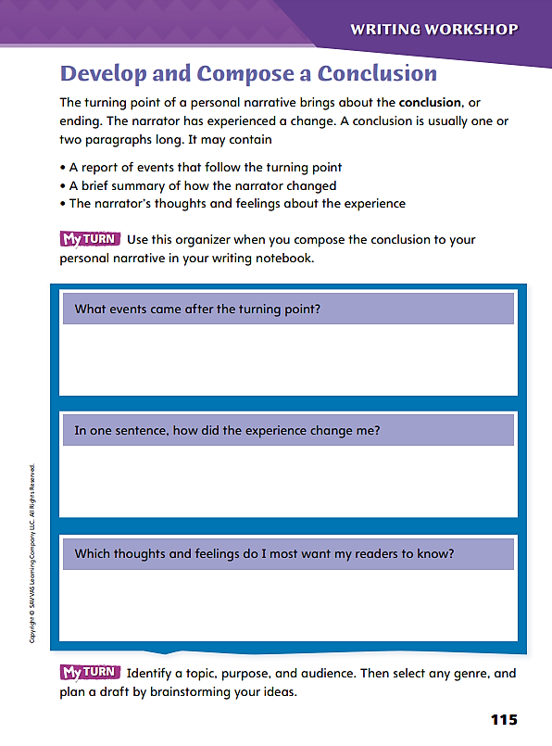
Page 115
Writing – Personal Narrative
Turn to page 115 in your Student Interactive.
Notes:
Explain to students that a conclusion wraps up a personal narrative by
• Reporting any meaningful events that occurred after the turning point.
• Offering a perspective on the narrator’s experience.
Remind students that a personal narrative tells about a real experience. Hand out several stack texts with which students are familiar. Have the student holding each text tell why its narrator chose to share that experience with readers. Then lead a class discussion using prompts such as the following:
What comes after the turning point in this narrative?
Does the narrator tell you how the experience changed him or her? If so, where?
Would the same experience affect other people in the same way?
After reading this narrative, do you have any questions for the narrator?
Wrap up the discussion by pointing out that the conclusion of a personal narrative is a place to find the narrator’s reason for writing. Then have students review p. 115 of the Student Interactive. Encourage students to consider using the organizer when they draft a conclusion to their own personal narratives.

Slide 64
Independent Writing
In your writing notebook, identify a topic, purpose, and audience.
Then select any genre, and plan a draft by brainstorming your ideas.
Share what you put in the conclusions of your personal narratives.
Notes:
Students may transition to independent writing and continue working on their personal narratives. If students are progressing steadily on their drafts, you may wish to offer them the opportunity to select a genre on p. T403. See the Conference Prompts on p. T384.
Select a Genre | Topic - Ask students to brainstorm additional topics for personal narratives, or have them refer to the topics they brainstormed earlier. Have them record their ideas in their writing notebooks. Use these prompts to help students isolate three or four experiences about which they could write.
Which experience involves learning about a new place or a new object?
Which experience would probably affect many people the same way?
Which experience involves unusually wise or powerful characters?
Which experience would make a good short story or informational text?
Students should highlight the experience they would like to write about as a topic.
Purpose - Tell students that determining the purpose of their writing will help them select a genre in which to write. Have students decide whether they want to
Entertain readers with a good story.
Inform readers about a significant issue.
Convince readers to share a feeling or opinion about an event.
Students should record their purpose in their writing notebooks.
Audience - As a class, brainstorm potential reading audiences. Write down the ideas and read them back. Have each student choose an audience and write it in his or her writing notebook.
Genre of Choice - Direct students to look at their topic, purpose, and audience and then select a new genre in which to write. Remind them that there are three main genres— narrative, informational text, and argument—as well as the genre of poetry and subgenres in each of the broad categories.
Have students record the genre they choose in their writing notebooks and start writing a draft.
After writing time is over, call on two or three students to share what they put in the conclusions of their personal narratives.

Slide 65
Spelling
Roger likes to imitate the way his dog Jenny barks.
To be a good citizen, you should contribute to the community.
I saw the first episode of the show.
A lizard can survive cold conditions by slowing down.
Many businesses now advertise only on the Internet.
Janna will be able to participate in three different sports.
A country cannot impose its laws on other nations.
I can recognize Zara just by the way she walks.
If you leave your bike outside, it will begin to corrode.
The inner workings of the government fascinate Rina.
Notes:
(Note: Move the orange boxes to cover each bold spelling word before you read aloud the words and sentences.)
Have students spell the bold words in the following sentences.
Roger likes to imitate the way his dog Jenny barks.
To be a good citizen, you should contribute to the community.
I saw the first episode of the show.
A lizard can survive cold conditions by slowing down.
Many businesses now advertise only on the Internet.
Janna will be able to participate in three different sports.
A country cannot impose its laws on other nations.
I can recognize Zara just by the way she walks.
If you leave your bike outside, it will begin to corrode.
The inner workings of the government fascinate Rina.

Slide 66
Language and Conventions
Select the best revision.
Wendy’s best friend Una, who speaks French, Chinese, and English.
Wendy’s best friend Una. Who speaks French, Chinese, and English.
Wendy’s best friend Una, who speaks French, Chinese, and English, spoke at graduation.
Wendy’s best friend Una, she speaks French, Chinese, and English.
Complete sentence; no revision necessary.
Notes:
Write the following and have students select the best revision.
Wendy’s best friend Una, who speaks French, Chinese, and English.
Wendy’s best friend Una. Who speaks French, Chinese, and English.
Wendy’s best friend Una, who speaks French, Chinese, and English, spoke at graduation.
Wendy’s best friend Una, she speaks French, Chinese, and English.
Complete sentence; no revision necessary.
Have students complete Language and Conventions p. 13 from the Resource Download Center. Click path: Table of Contents -> Resource Download Center -> Language and Conventions -> U1 W3

Slide 67
Unit 1: Week 3
Grade 4

