Slide 1
Unit 1: Week 5
Grade 5

Slide 2
Copyright © Savvas Learning Company LLC. All Rights Reserved.
This publication is protected by copyright, and permission should be obtained from the publisher prior to any prohibited reproduction, storage in a retrieval system, or transmission in any form or by any means, electronic, mechanical, photocopying, recording, or otherwise. For information regarding permissions, request forms, and the appropriate contacts within the Savvas Learning Company Rights Management group, please send your query to:
Savvas Learning Company LLC, 15 East Midland Avenue, Paramus, NJ 07652
or
k12learningpermissions@savvas.com
myView Literacy® is an exclusive trademark of Savvas Learning Company LLC in the U.S. and/or other countries.

Slide 3
Lesson 1

Slide 4
Page
154, 155
Interact with Sources
Discuss how new places change the way a person sees the world.
Freewrite your ideas about how a character from literature changed from visiting a new place.
Notes:
Remind students of the Essential Question for Unit 1: How do journeys change us?
Point out the Week 5 Question: How can new places change the way a person sees the world?
Direct students’ attention to the series of images on pp. 154–155 in the Student Interactive. Explain that these historic illustrations depict a variety of locations and transportation methods. Have students read the text, study the images, and discuss how travel affects people in different ways, including shaping their point of view.
Use the following questions to guide discussion:
Which illustrations show unusual or risky locations?
Why might travelers visit these locations? How might they feel, and what might they learn?
Why do you think it is important to visit new places?
Reread the Week 5 Question: How can new places change the way a person sees the world? Tell students they just learned about the ways travel can influence people and their points of view. Explain that they will read more about this concept this week.
Have students freewrite to answer the Quick Write question on p. 155 in the Student Interactive and then share their responses.

Slide 5
Listening Comprehension
Event 1
Event 2
Event 3
Notes:
Tell students you are going to read an informational text aloud. Have students listen as you read “Life in Black and White.” Explain that students should listen actively, paying careful attention to the facts and details in the text as you read. Prompt them to ask questions to clarify information and follow agreed-upon rules for discussion.
Read Aloud Routine
Purpose Have students actively listen for elements of informational text.
READ the entire text aloud without stopping for Think Aloud callouts.
REREAD the text aloud, pausing to model Think Aloud strategies related to the genre of the article.
THINK ALOUD I notice that the article is about a famous photographer who took pictures during the Great Depression, an important event in U.S. history. I also notice a lot of dates and words like later and when. These clues help me keep track of when events happen so I can follow along.
THINK ALOUD As I reread this last page of the article, I’m thinking about how Lange used her photography to record how people lived in different places during tough times. I think this is a key idea about her work. The details about her most famous photograph help me understand why Lange’s work was important.
Use a sequence chart to help students note three important events from the article.

Slide 6
Page 156, 157
Informational Text
Turn to page 156 in your Student Interactive.
Notes:
In informational texts, authors organize details in patterns that help readers best understand the text. The structure the author chooses depends on the topic and the relationship between the key ideas. For example, a text about a historical event is often in chronological order or problem-and-solution order. A text about an invention may be in problem-and-solution order.
Transition words and phrases can provide clues about the structure of a text. Ask yourself:
What transition words and phrases does the author include?
What relationship between ideas do these words point out?
Model determining the structure of an informational text: In “Life in Black and White,” the author tells about the life and career of Dorothea Lange. The text follows her life from childhood to adulthood. The author includes dates and the transition words later, then, as a child, and today. Keeping all of this in mind, I think the structure of this text is chronological. The author tells when important events happened in Lange’s life and her legacy today.
To help students establish a purpose for reading, provide them with copies of a short newspaper or magazine article. Have them work with a partner to identify transition words and phrases and determine the structure of the text. Editable Anchor Chart Click Path: Table of Contents -> Reading Anchor Charts -> Unit 4 Week 5: Drama Editable Reading Anchor Chart

Slide 7
Page 156
Apply
Talk about a book you read recently.
Notes:
Have students use the strategies to identify the structure of an informational text.
Have students work with a partner to complete the Turn and Talk activity on p. 156 of the Student Interactive. Circulate to discover if students can determine the text structure of a book.

Slide 8
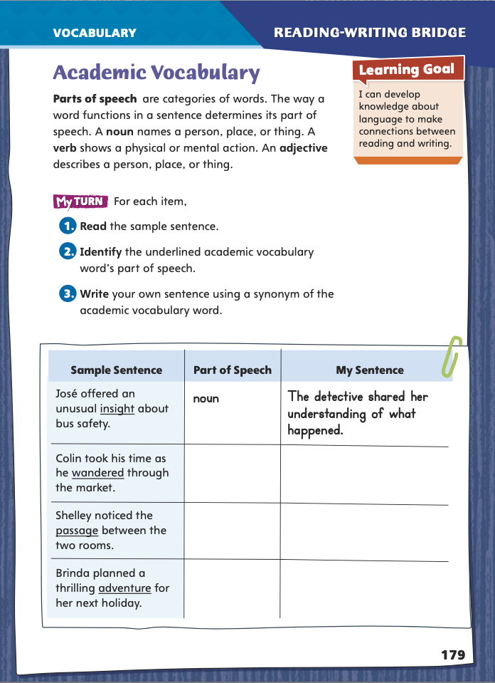
Page 179
Academic Vocabulary
Complete the chart on page 179 in your Student Interactive.
Notes:
Tell students: If we’re going to talk about our reading and writing, it’s important to learn the names of the different parts of speech. Knowing those names makes it easier for you to examine what you’re reading and to strengthen your writing.
Explain that there are many parts of speech, but today the class will focus on three of the most important ones:
Nouns, which are people, places, and things.
Verbs, which show actions or thoughts.
Adjectives, which describe nouns.
Ask students to suggest examples of each of these parts of speech. Work with students to assemble some examples into a sentence.
Invite a volunteer to read aloud the paragraph near the top of p. 179 in the Student Interactive.
Then have three more volunteers each read aloud a step in the list of numbered steps.
Say: Step 3 asks you to give a synonym. In your own words, what is a synonym? (Possible response: a word with the same meaning as or a very similar meaning to another word)
As a class, complete the first blank row in the table.
Once you have confirmed that students understand the assignment, have groups complete the rest of the table on p. 179 in the Student Interactive. Invite them to share their results. Remind students that they will use these academic words throughout this unit, and encourage them to use the words when they are completing writing assignments for other subject areas.

Slide 9
Word Study
same
blame
aflame
Notes:
Ask students to explain the difference between a vowel and a consonant. (Possible response: Vowels are a, e, i, o, u, and sometimes y. All other letters are consonants.)
Explain that when a word has a vowel, a consonant, and the letter e at the end, the first vowel has a long sound and the e is silent. Tell students that knowing this will help them to pronounce unfamiliar words.
Follow these steps to be certain that students understand the concept.
Ask students to say all the long vowel sounds.
On the board, write these words: same, blame, aflame.
Guide them as they pronounce each word. Explain that spotting the VCe pattern can help students figure out how to pronounce the word aflame even if they have seen it before.

Slide 10
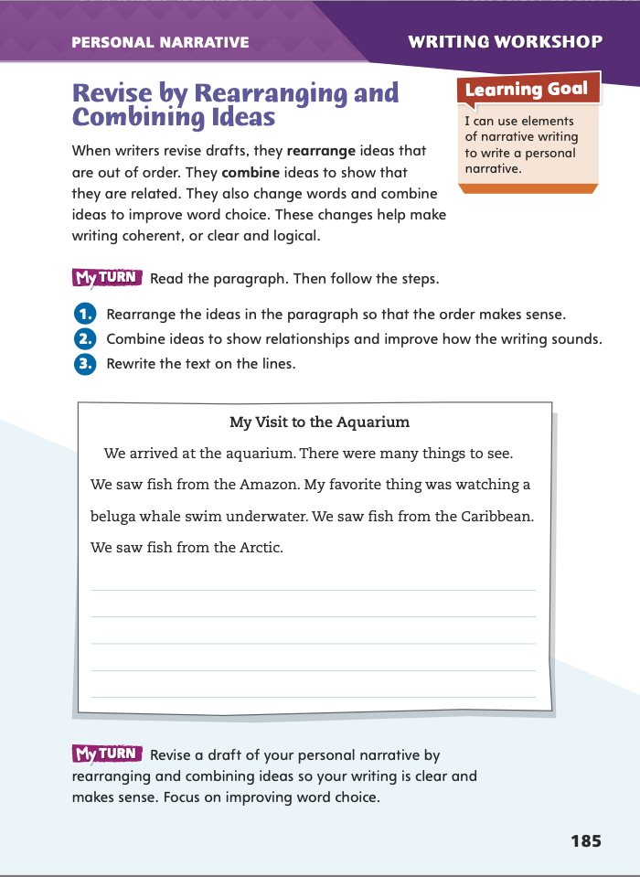
Page 185
Writing – Personal Narrative
Turn to page 185 in your Student Interactive.
Notes:
Authors make revisions to improve the way their writing sounds and to help make the writing more coherent. They
Rearrange the ideas so that the order makes sense.
Combine ideas to show how ideas are related.
Improve word choice to make the writing clear.
Review the strategies authors use to clearly convey ideas. Then read a few example paragraphs from one of the narratives from the stack. Ask:
How does the author arrange the ideas in these paragraphs?
How does the author combine ideas to show how the ideas are related?
Direct students to p. 185 in the Student Interactive. Have pairs work together to revise the paragraph. Students should rearrange the ideas so the order makes sense and should combine related ideas. If they suggest different revisions, have them discuss which revision most improves the coherence of the writing and how the writing sounds.
Ask a few students to share how they revised their personal narratives. Have them explain how their changes made their narratives easier for the reader to understand.

Slide 11
Independent Writing
Read your partner’s personal narrative.
Determine whether the order of events and the word choice make sense and whether ideas presented clearly.
Suggest ways to rearrange and combine ideas for clarity.
Notes:
Group students into pairs and have them read each other’s personal narrative. Ask students to determine whether the order of events and the word choice make sense and whether ideas are clearly presented. Encourage them to suggest ways to rearrange and combine ideas for clarity. If students need additional assistance, they should refer to the stack as they are reviewing to see how the authors combine and order ideas. If students demonstrate understanding, they should transition to revising their own personal narratives, keeping in mind the revisions suggested by their peers. See the Conference Prompts on p. T344.
Ask a few students to share how they revised their personal narratives. Have them explain how their changes made their narratives easier for the reader to understand.

Slide 12
Spelling
1. Is this software up to date or obsolete?
2. Braden was nervous before the big game, but I felt serene.
3. If you provoke that snapping turtle, you might get hurt!
4. I didn’t prepare a speech, so I had to improvise.
5. The smell of Dad’s spaghetti sauce always increases my appetite.
6. I hope the free concert will coincide with our school’s vacation
week.
7. When my little brother gets on that roller coaster, his confidence will evaporate.
8. Our coach decided to schedule two soccer games on one day.
9. Without enough evidence, a lawyer cannot prosecute.
10. Will you please delete those old files from my computer?
Notes:
(Note: Move the orange boxes to cover each bold spelling word before you read aloud the words and sentences.)
Read aloud the words and sentences. Have students spell each word using the correct homophone.
1. Is this software up to date or obsolete?
2. Braden was nervous before the big game, but I felt serene.
3. If you provoke that snapping turtle, you might get hurt!
4. I didn’t prepare a speech, so I had to improvise.
5. The smell of Dad’s spaghetti sauce always increases my appetite.
6. I hope the free concert will coincide with our school’s vacation week.
7. When my little brother gets on that roller coaster, his confidence will evaporate.
8. Our coach decided to schedule two soccer games on one day.
9. Without enough evidence, a lawyer cannot prosecute.
10. Will you please delete those old files from my computer?
Reveal the spelling word and have students check their work.
For students who understand how to spell these homophones, include the following Challenge Words with the spelling list. Challenge Words: accumulate, eradicate, advertisement

Slide 13
Language and Conventions
The musician performed at the location for the entire staff.
Create a radio commercials to advertise a movie, concert, or sporting event using common nouns.
Create a second advertisement for the same event with proper nouns.
Notes:
Review the differences between common, proper, and collective nouns. See pp. T272–T273.
Write this sentence on the board: The musician performed at the location for the entire staff. Ask students to identify the collective noun. (staff)
Explain that proper nouns often make writing more interesting and specific. Then challenge the class to replace the two common nouns (musician and location) with more specific proper nouns.
Have groups create two radio commercials each. The first should advertise a movie, concert, or sporting event and use common nouns. The second should advertise the same event but with proper nouns. Ask students to include at least one collective noun (such as cast, band, or team) per commercial. Then have volunteers read aloud the commercials. Discuss why the ones with proper nouns are more effective.

Slide 14
Lesson 2

Slide 15
Page 158
Preview Vocabulary
inspired
express
exhibit
imitated
compositions
Notes:
Introduce the vocabulary words on p. 158 in the Student Interactive and define them as needed.
inspired: caused something to be created
express: show or tell thoughts and feelings
exhibit: a group of artworks put on display
imitated: tried to do the same thing others did
compositions: works of art
These words will help you understand the main ideas in Picturesque Journeys. As you read, highlight the words when you see them. Ask yourself what ideas they help you understand in the text.

Slide 16
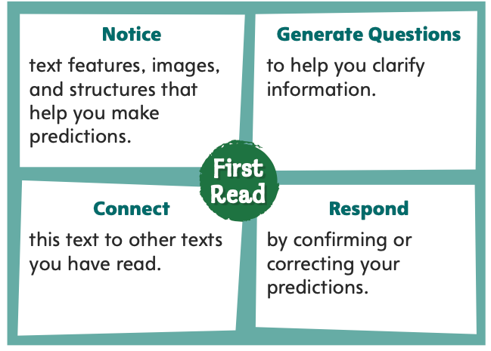
Page 158
First Read Strategies
Notes:
Discuss the First Read Strategies. Prompt students to establish that the purpose for reading this selection is to learn about a topic. To make predictions, have students preview the text, looking for details that show the structure and genre. Have them make predictions about the text structure and record them in the chart on p. 177 of the Student Interactive.
First Read Strategies
NOTICE Remind students to focus on the text features, images, and text structure as they read and make predictions.
GENERATE QUESTIONS Encourage students to list questions before, during, and after reading to clarify information.
CONNECT Ask students to consider how the text connects to other texts they have read.
RESPOND Have students mark any parts of the text that help them confirm or correct their predictions.
Students may read independently, in pairs, or as a class. Use the First Read notes to help them connect with the text and guide their understanding.

Slide 17
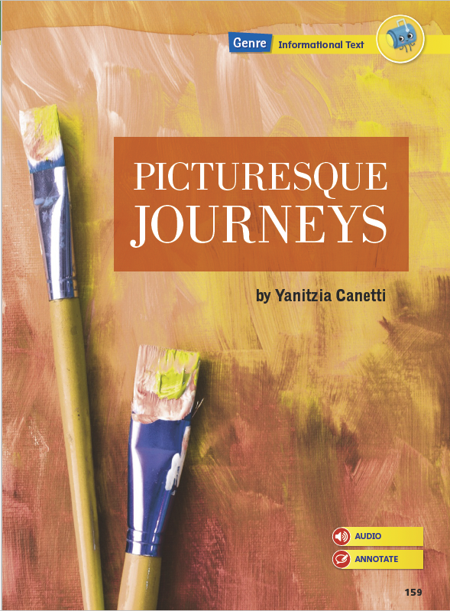
Page 160
First Read – Picturesque Journeys
Notes:
Students may read independently, in pairs, or as a class. Use the First Read notes to help them connect with the text and guide their understanding.

Slide 18
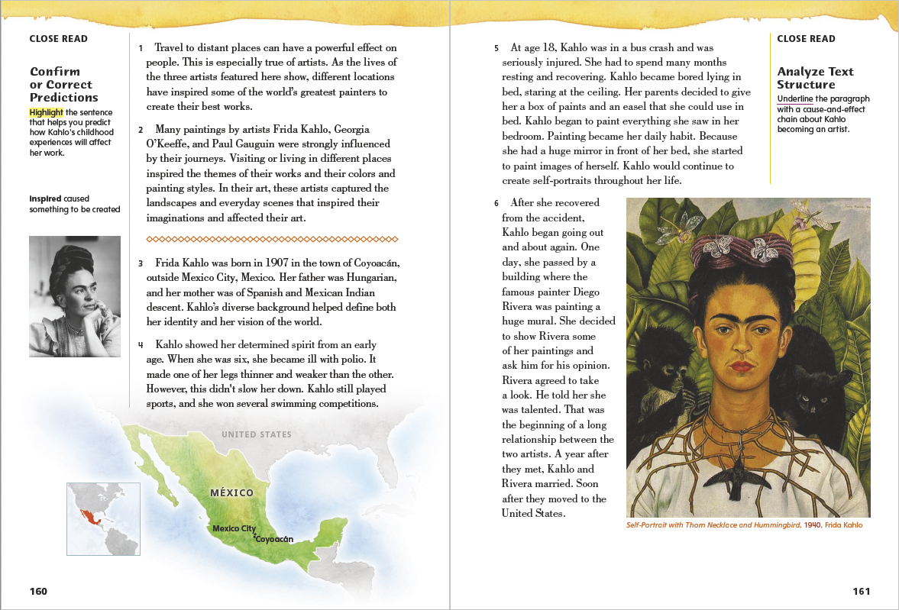
Page 161
First Read – Picturesque Journeys
Notes:
Students may read independently, in pairs, or as a class. Use the First Read notes to help them connect with the text and guide their understanding.
THINK ALOUD By previewing these first two pages, I notice three text features right away. A map shows me where this artist lived. A photograph shows me what she looked like. Finally, another image shows me one of her paintings. These text features help me understand some of the key facts in the selection.
THINK ALOUD The author explains that Kahlo's parents gave her paints and an easel to paint in bed. I wonder if Kahlo drew or painted before her accident.

Slide 19
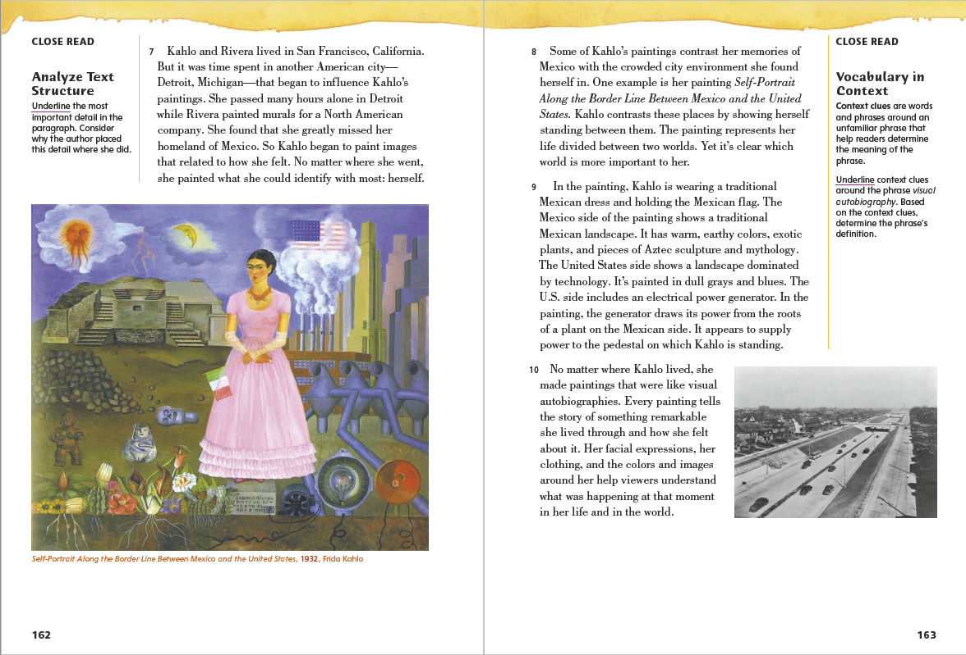
Page 162, 163
First Read – Picturesque Journeys
Notes:
Students may read independently, in pairs, or as a class. Use the First Read notes to help them connect with the text and guide their understanding.
THINK ALOUD Frida Kahlo often included herself as a subject in her paintings. Her works reflected how she felt about herself and the world around her. This confirms a prediction I made that her paintings are like a diary.
THINK ALOUD As I read, I am going to think of questions I have about the text. I will circle paragraph 9 because I have questions about Kahlo’s painting Self-Portrait Along the Border Line Between Mexico and the United States. I want to know more about this piece of art and why she chose the other symbols she did.

Slide 20
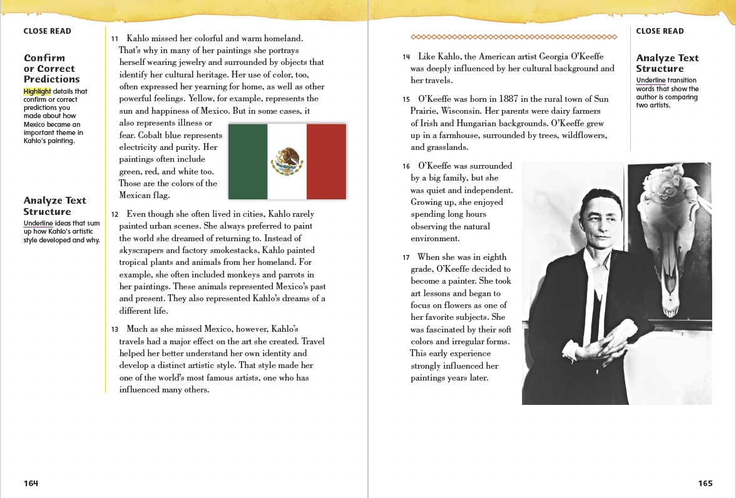
Page 164, 165
First Read – Picturesque Journeys
Notes:
Students may read independently, in pairs, or as a class. Use the First Read notes to help them connect with the text and guide their understanding.
THINK ALOUD Most of Kahlo’s paintings show Mexico, her homeland. I know where I was born and raised is important to me. Leaving such a place can be hard. It helps to have reminders of it, just as Pedro remembered his mother on the long voyage with Columbus. So I can understand why Kahlo wanted to show her homeland in her art after she moved to the United States
THINK ALOUD. Ask: How did Georgia O’Keeffe’s early paintings compare to Frida Kahlo’s? Possible Response: Frida Kahlo’s early paintings were mostly of the things she saw in her bedroom as she recovered from her accident. This included a number of self- portraits using a mirror. Georgia O’Keeffe’s early paintings were mostly of flowers. She appreciated their colors and forms.

Slide 21
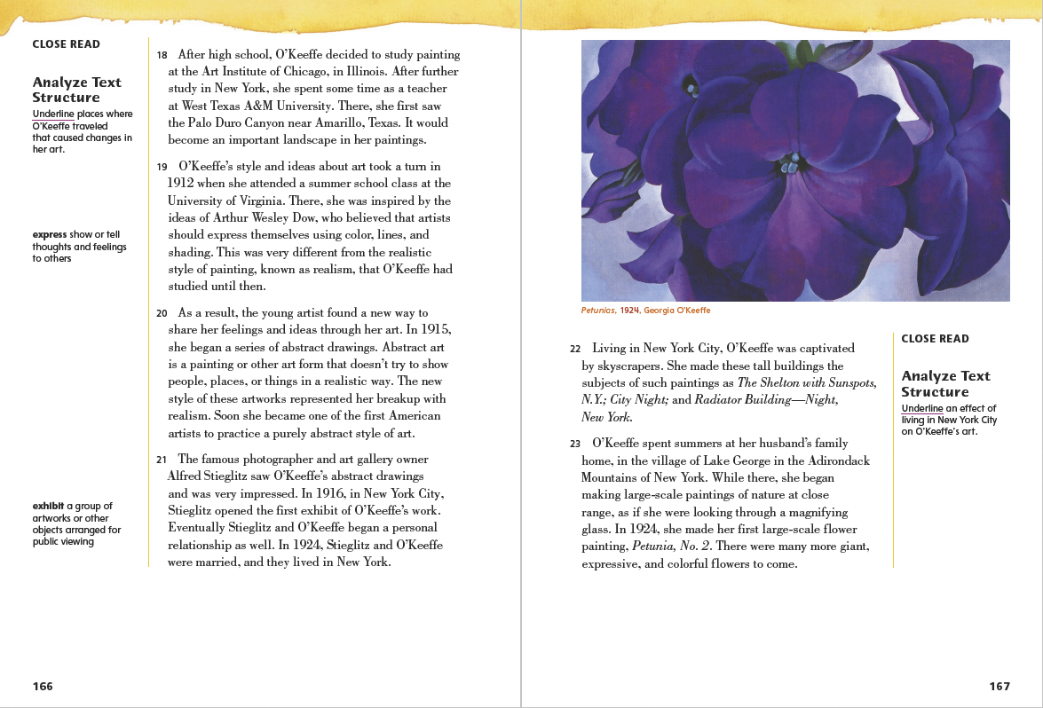
Page 166, 167
First Read – Picturesque Journeys
Notes:
Students may read independently, in pairs, or as a class. Use the First Read notes to help them connect with the text and guide their understanding.
THINK ALOUD Paragraph 18 states that Georgia O’Keeffe painted the Palo Duro Canyon while she was living in Texas. I want to know more about how her artwork changed over the course of her life. As I read the next two pages, I will write down any questions I have about her paintings. For example, what other kinds of subjects did she paint?
THINK ALOUD The text says that Georgia O’Keeffe began to create paintings of giant, expressive, and colorful flowers. The image on this page shows a very detailed painting of an enormous purple flower. I know O’Keeffe had been painting skyscrapers before she began painting giant flowers. Why did she paint such large flowers? Did she want to show flowers as a large structure, kind of like a tall building, made up of different parts?

Slide 22
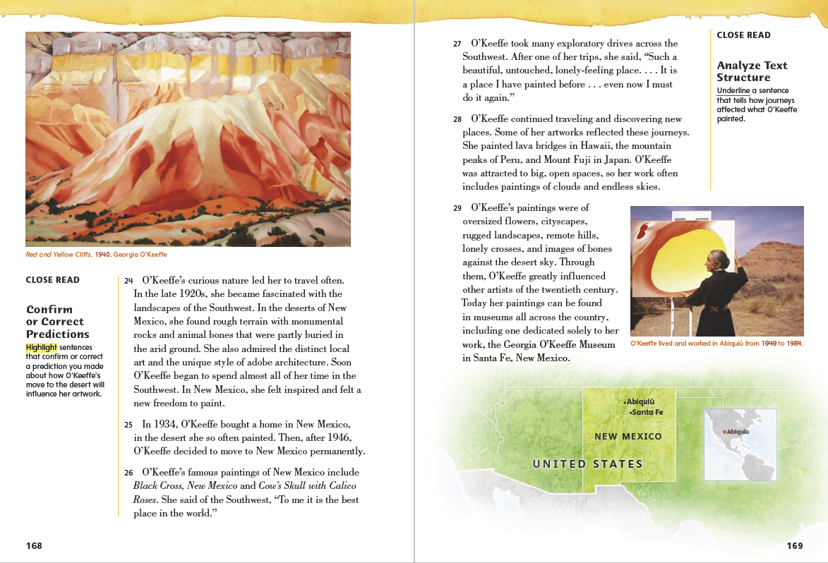
Page 168, 169
First Read – Picturesque Journeys
Notes:
Students may read independently, in pairs, or as a class. Use the First Read notes to help them connect with the text and guide their understanding.
Respond. Ask: Why do you think O’Keeffe called the Southwest “the best place in the world”? Possible Response: While she was living in the Southwest, she came to admire the local art and architecture. She also felt a new freedom to paint while living there. It’s for those reasons that I think O’Keeffe saw the Southwest as “the best place in the world.”
THINK ALOUD Georgia O’Keeffe seemed to be inspired by being in nature. She enjoyed painting flowers, desert landscapes, and other parts of the natural world. Where she lived greatly influenced her work. This reminds me of the section about Frida Kahlo and how her surroundings impacted her art.

Slide 23
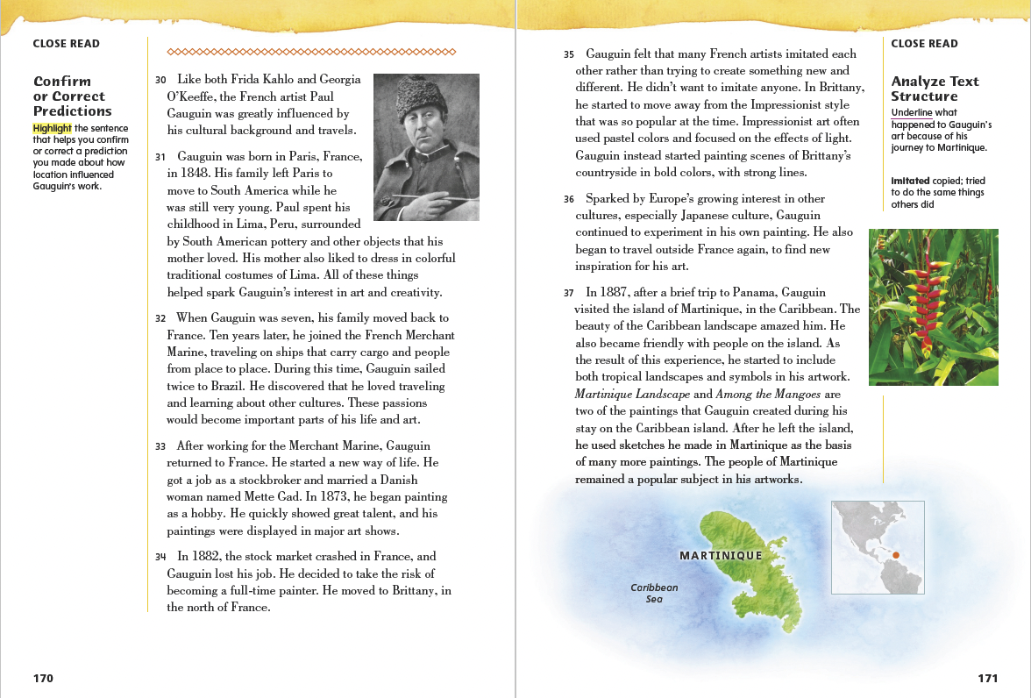
Page 170, 171
First Read – Picturesque Journeys
Notes:
Students may read independently, in pairs, or as a class. Use the First Read notes to help them connect with the text and guide their understanding.
THINK ALOUD Paragraph 34 states that Paul Gauguin moved to the north of France. I want to know more about his life there and how it affected his work. As I read the next page, I will write down any questions I have about his life in Brittany. For example, what did he learn about art at this time?
Respond Have partners discuss the following question: Why did Gauguin decide to create a new kind of art? Possible Response: He believed artists copied each other too often. He thought they should try to create something new instead.

Slide 24
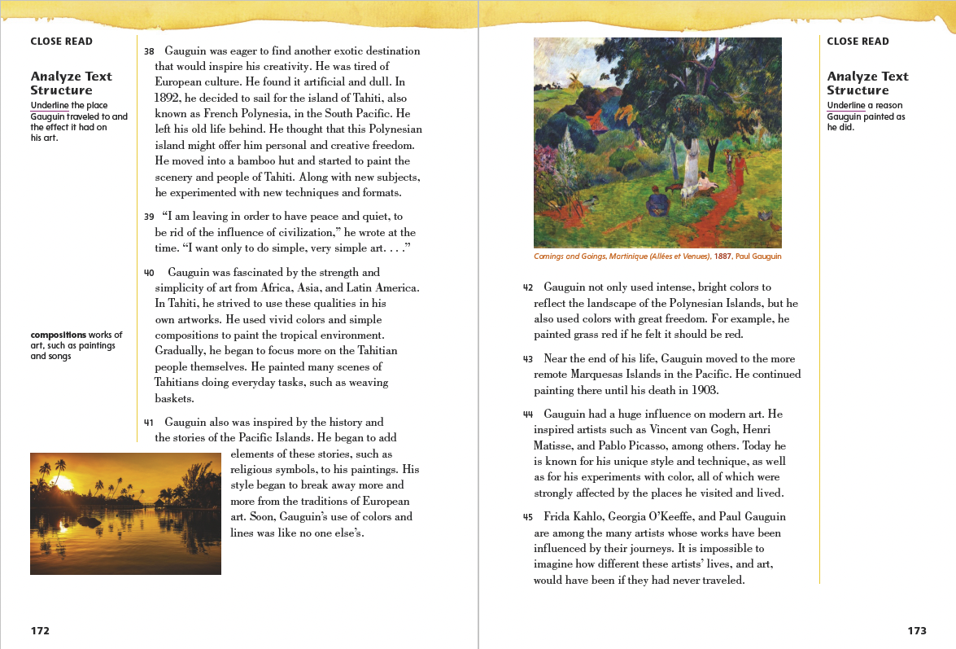
Page 172, 173
First Read – Picturesque Journeys
Notes:
Students may read independently, in pairs, or as a class. Use the First Read notes to help them connect with the text and guide their understanding.
Remind students to write questions they have about key details. Provide an example for students. Ask: How did the history of the Pacific Islands inspire Gauguin? Possible Response: He decided to use elements from stories about life in this area in his paintings. For example, he began to include religious symbols related to the Pacific Islands.
THINK ALOUD This page wraps up the article and includes a summary at the end. These details help me confirm or correct predictions I made about the text before I read. It reminds readers that Frida Kahlo, Georgia O’Keeffe, and Paul Gauguin were painters who created memorable works of art. Their artwork was very different. Kahlo painted self-portraits and images of Mexico. O’Keeffe painted city areas and desert landscapes. Gauguin painted lush, tropical areas. What they had in common was that they were all inspired by their journeys. What they saw and experienced on their travels greatly shaped their art.

Slide 25
Respond and Analyze
Brainstorm: What interested you the most about this text?
Discuss: Use the images in Picturesque Journeys to summarize the information presented.
Notes:
Use these suggestions to prompt students’ initial response to reading Picturesque Journeys.
Brainstorm What interested you the most about this text?
Discuss Have students use the various images used in Picturesque Journeys to summarize information presented in the text.

Slide 26
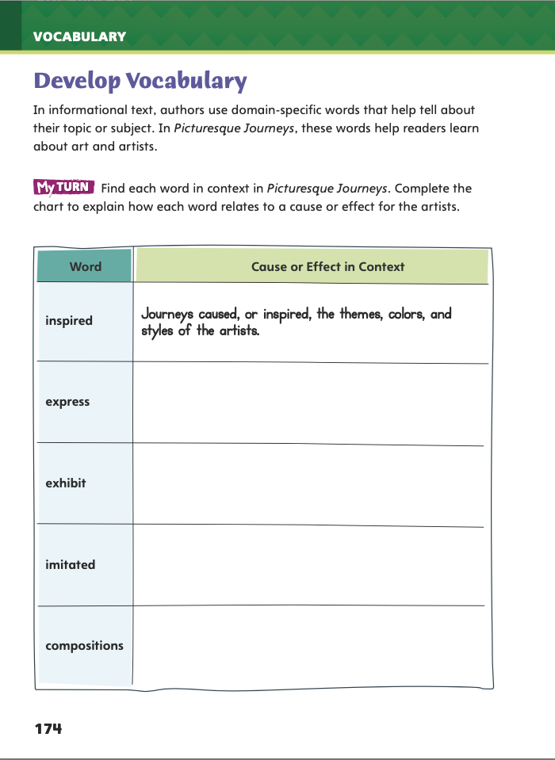
Page 174
Develop Vocabulary
Turn to page 174 in your Student.
Notes:
Tell students that authors of informational texts use specific words related to their topic. These terms are known as domain- specific words. The domain-specific words inspired, express, exhibit, imitated, and compositions tell readers about and art.
Remind yourself of the word’s meaning.
Ask yourself how the word helps readers understand the topic.
Model filling out the chart on Student Interactive p. 174 using the word inspired: In the article, the author explains how journeys influenced the work of three painters. The artists’ journeys shaped the themes, colors, and styles of their paintings. For example, when Georgia O’Keeffe moved to the Southwest, she began to paint desert landscapes. The environment of this area inspired her. Her paintings began to include rough terrain and animal bones.
Have students use the strategies for developing vocabulary.
Have students respond using newly acquired vocabulary as they complete p. 174 of the Student Interactive. They should use text evidence in their answers.

Slide 27
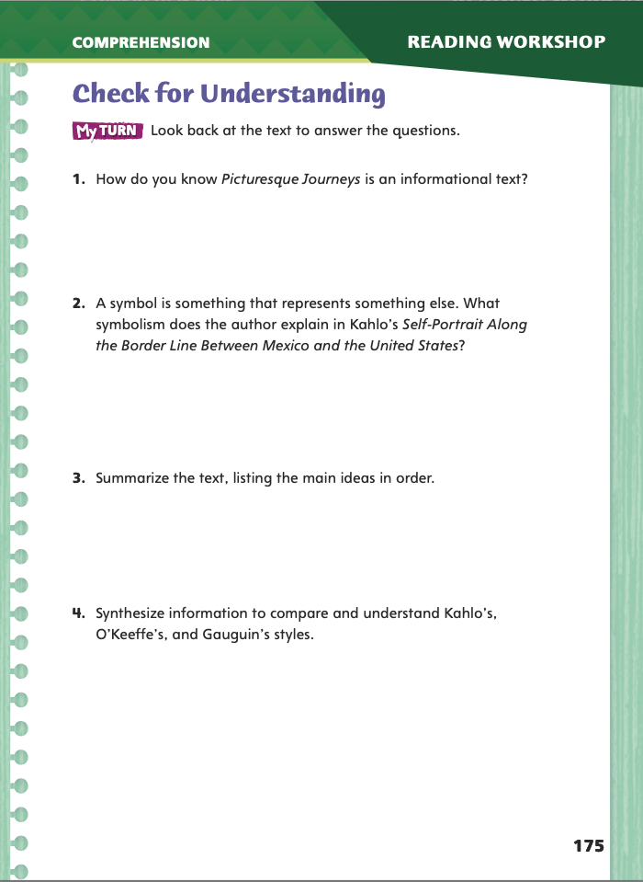
Page 175
Check for Understanding
Complete page 175 in your Student Interactive.
Notes:
Have students complete p. 175 of the Student Interactive.

Slide 28
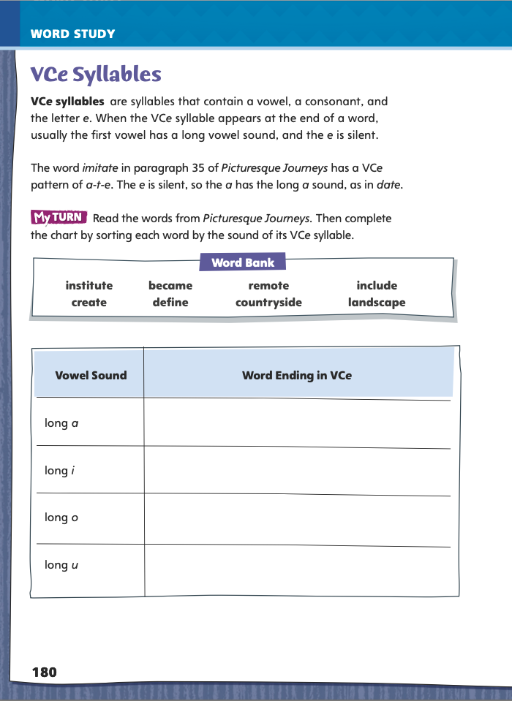
Page 180
Word Study –
Complete the chart on page 180 in your Student Interactive.
Write three sentences that each use as many of the Word Bank words as possible.
Notes:
Ask students to work independently to complete the chart on p. 180 of the Student Interactive.
Then challenge students to write three sentences that each use as many of the Word Bank words as possible.

Slide 29
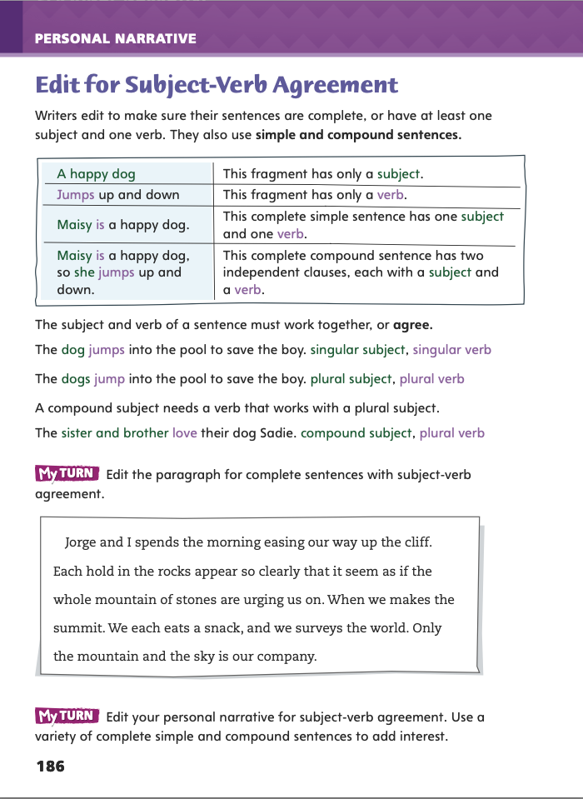
Page 186
Writing – Personal Narrative
Turn to page 186 in your Student Interactive.
Notes:
A complete sentence must have at least one subject and at least one verb. An incomplete thought without a subject or a verb is called a fragment. Writers edit to avoid fragments. The subject and verb in a sentence must work together, or agree. Remind students that
A sentence with a singular subject must have a verb that works with a singular subject.
A sentence with a plural subject must have a verb that works with a plural subject.
When two subjects are combined to form a compound subject, the verb must change to work with the plural subject.
Remind students that they need to use complete sentences, or sentences that have at least one subject and one verb, in their writing. The subject and verb of each sentence must agree.
Read several example sentences from the stack, modifying a few examples so that the subject and verb do not agree. Ask: Does this sentence contain a singular subject or a plural subject? Which type of verb do we use for this type of subject? Do the subject and verb agree?
Pair students, and have each pair edit the paragraph on p. 186 of the Student Interactive for subject-verb agreement and complete sentences.

Slide 30
Independent Writing
Review your personal narrative and make revisions so sentences have subject-verb agreement.
Notes:
Ask students to review their personal narratives and make revisions based on today’s minilesson. If students need additional opportunities to develop their understanding of complete sentences with subject-verb agreement, they should refer to the stack as they are writing. If students demonstrate understanding, they should transition to revising their personal narratives. See the Conference Prompts on p. T344.
Have volunteers share examples of subject-verb agreement from their own personal narratives. Encourage students to share examples of revisions they had to make.

Slide 31
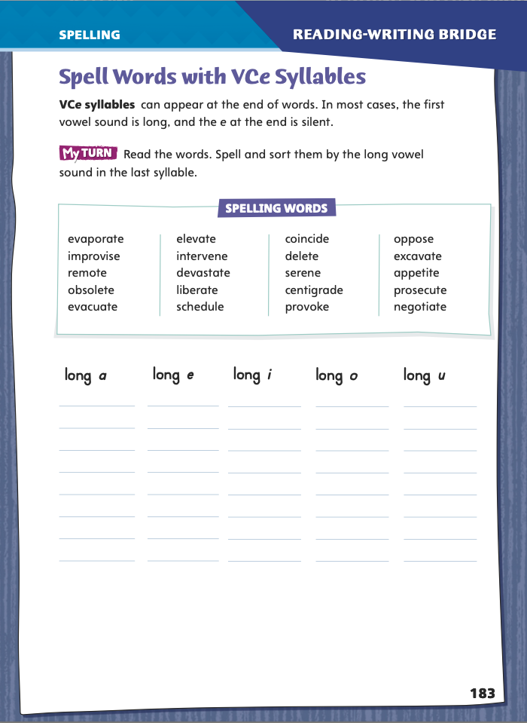
Page 183
Spelling – Words with VCe Syllables
remote
evacuate
excavate
Turn to page 183 in your Student Interactive and complete the activity.
Notes:
Explain that many words that combine vowel-consonant-silent e are multisyllabic, and a multisyllabic word has more than one beat in it.
Explain that when students spot this VCe pattern, they know that the final e is likely to be silent, and the last vowel sound will probably be long.
Read aloud these words, modeling correct spelling and pronunciation: remote, evacuate, excavate. Have students invent a sentence using these words.
Have students complete the activity on p. 183 of the Student Interactive.

Slide 32
Language and Conventions
person, place thing, idea
people, place, things, ideas
Notes:
Write the words person, place, thing, and idea, and remind students that a noun names one of these. Say that a plural noun names at least two of these, and then write the words people, places, things, and ideas underneath the first line. Challenge students to find the irregular plural noun.
Ask students to tell you other irregular plural nouns they know. Supply one with irregular spelling, such as man and men, and one that has the same spelling in the singular and the plural, such as moose and moose.
Have pairs create an oral sentence that uses the same word in singular and irregular plural forms. Then direct each pair to share its sentence with another pair, who should identify whether the irregular plural has an irregular spelling or the same spelling as the singular form.

Slide 33
Lesson 3

Slide 34
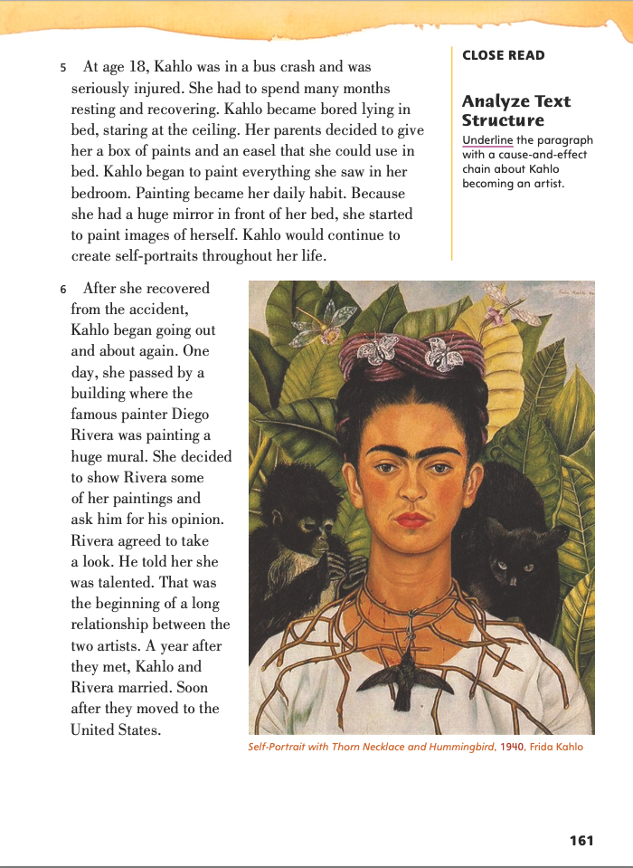
Page 161
Close Read Analyze Text Structure
Turn to page 161 in your Student Interactive.
Notes:
Text structure is the way a text has been organized. Identifying the text structure can help readers better understand the topic, connect ideas, and figure out what the author wants readers to learn.
Think about what the text is mostly about.
Identify transitions to see how the author connects ideas.
Determine which structure best fits the ideas and transitions in the text.
Use the Close Read note on p. 161 of the Student Interactive to model how to annotate the text to analyze the structure: I can look for transition words and phrases as I read to better understand the text structure. I know the structure of this text is cause and effect. Some transitions that appear in cause-and-effect texts include as a result, so, and because. I see the word because in paragraph 5. This part of the text also explains the reason why Kahlo began to paint and what happened as a result. The reason is the cause, and the result is the effect.

Slide 35
Page 161
Close Read Analyze Text Structure
Turn to page 161 in your Student Interactive.
Notes:
Remind students that text structures are ways of organizing an informational text. Have them scan paragraphs 5 and 6. Tell them that they need to identify which paragraph includes a cause-and-effect chain about how Kahlo began her career as an artist. Have them identify the paragraph that contains transitions that signal cause-and- effect order and underline the paragraph. See student page for possible responses.
Ask: How did you decide on your response? Possible Response: Paragraph 5 includes a cause-and-effect chain about Kahlo becoming an artist. It describes how a bus crash led to her beginning to paint. The transition word because helped me identify the text structure. DOK 2

Slide 36
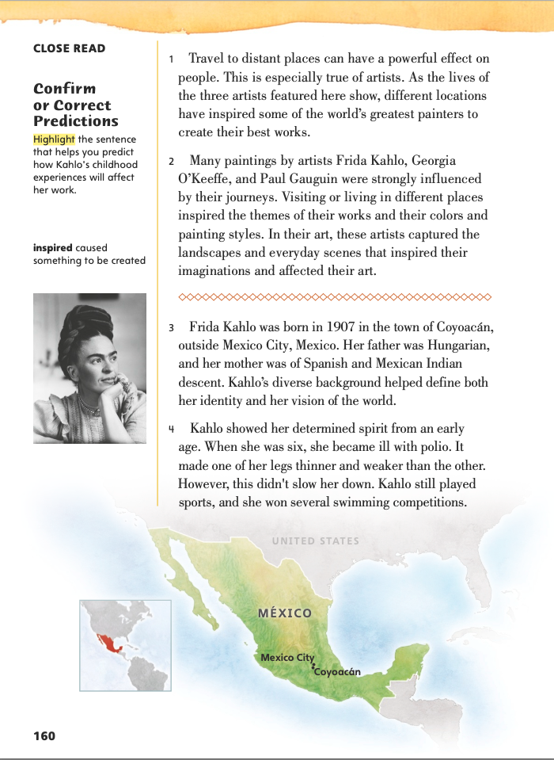
Page 160
Close Read Analyze Text Structure
Turn to page 160 in your Student Interactive.
Notes:
Have students identify a cause and effect in paragraph 4 on p. 160. The cause is Kahlo contracted polio, and the effect is the disease made one of her legs thinner and weaker than the other.

Slide 37
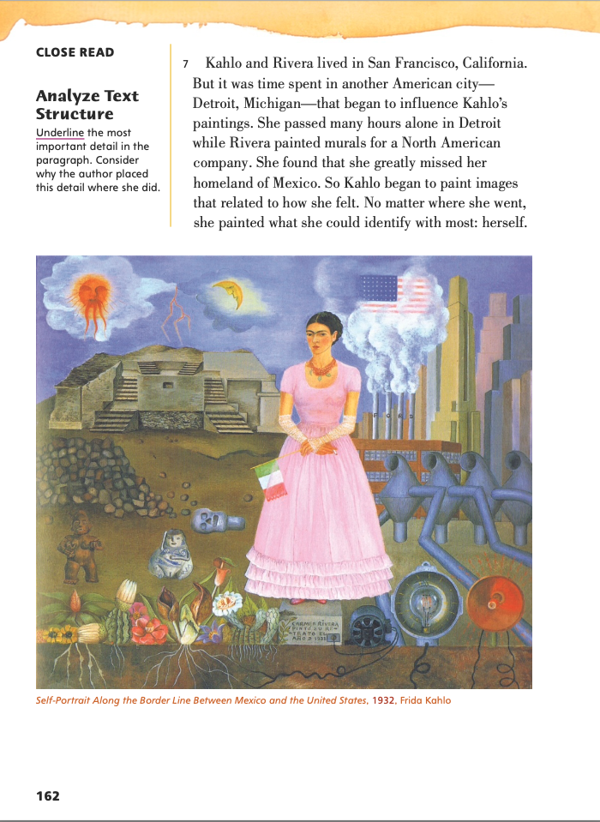
Page 162
Close Read Analyze Text Structure
Turn to page 162 in your Student Interactive.
Notes:
Explain that, to focus readers, an author may begin a paragraph with the most important detail. To leave an impact on readers, an author may choose to end a paragraph with this detail.
Have students scan paragraph 7 to identify and underline the most important detail. See student page for possible responses.
Ask: Why do you think the author placed the detail at the end? Possible Response: Placing the most important detail at the end helps connect and conclude the other details in this paragraph. It also makes a greater impact on the reader. DOK 2

Slide 38
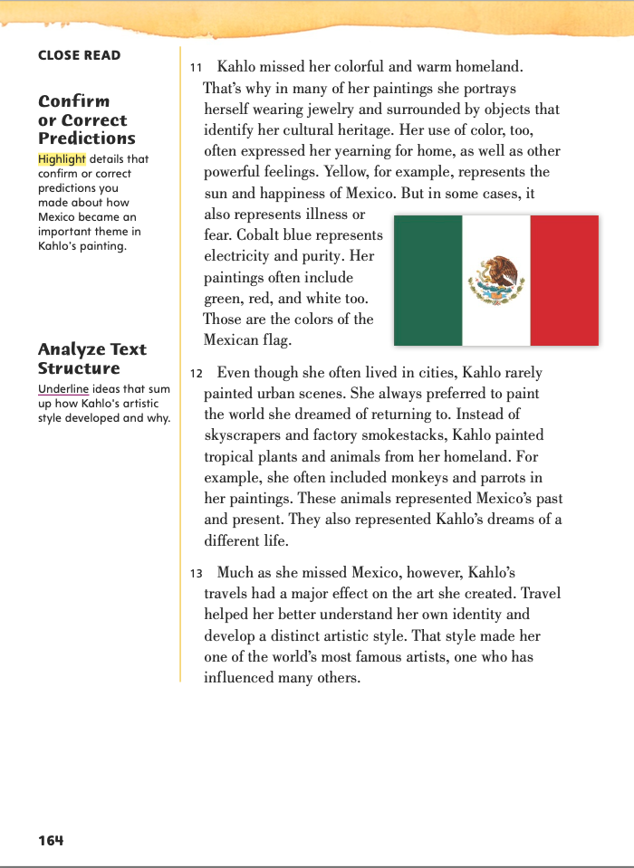
Page 164
Close Read Analyze Text Structure
Turn to page 164 in your Student Interactive.
Notes:
Have students scan paragraphs 12 and 13 underline how Kahlo’s style developed and why. See student page for possible responses.
Ask: How did you decide on your response? Possible Response: Kahlo’s travels affected her art and helped her better understand her identity. This helped her develop a style different from any other artist. DOK 2

Slide 39
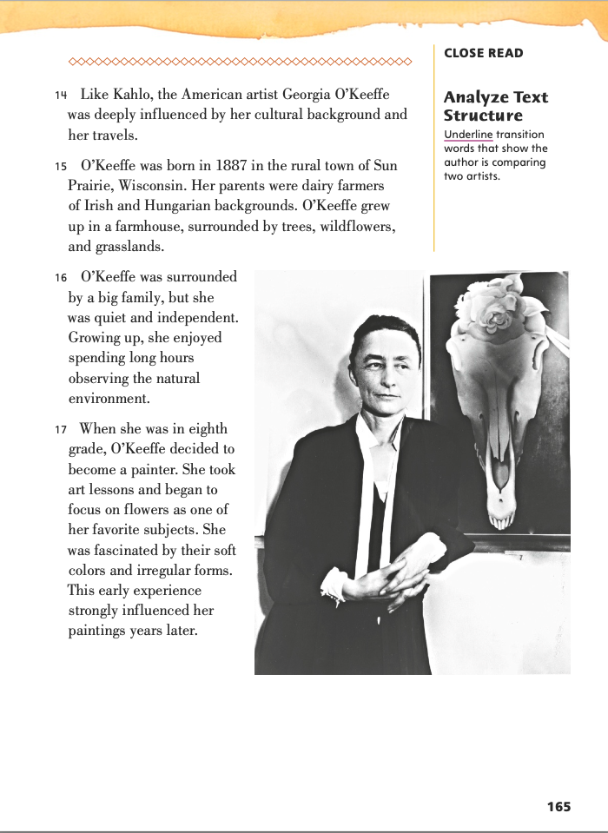
Page 165
Close Read Analyze Text Structure
Turn to page 165 in your Student Interactive.
Notes:
Have students scan paragraph 14. Ask: Which transition word or words show you that the author is comparing Kahlo and O’Keeffe? See student page for possible responses.
Ask: What other transition words would help the author show comparison and contrast? Possible Response: The author could have used transition words, such as likewise, similarly, or also, to show comparison. She could have used however, in contrast, or but to show contrast. DOK 2

Slide 40
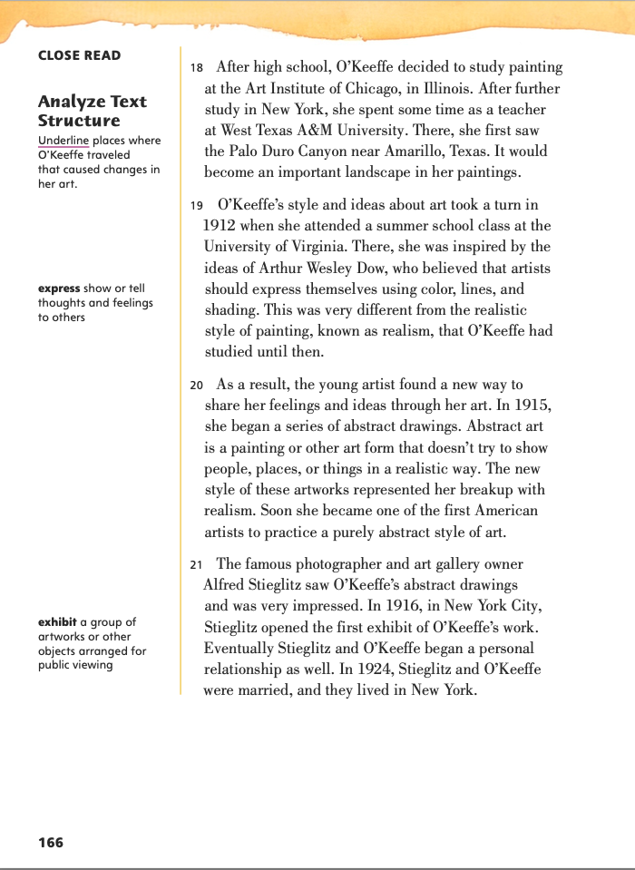
Page 166
Close Read Analyze Text Structure
Turn to page 166 in your Student Interactive.
Notes:
Have students scan paragraphs 18 and 19 to identify the places where O’Keeffe traveled. These locations are where her artwork changed. Guide students to underline their answers. See student page for possible responses. DOK 2

Slide 41
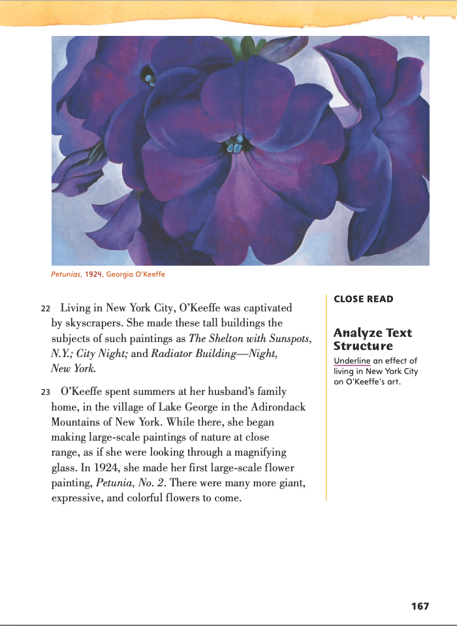
Page 167
Close Read Analyze Text Structure
Turn to page 167 in your Student Interactive.
Notes:
Have students scan paragraphs 22 and 23 to identify an effect of living in New York City on O’Keeffe’s paintings. Have them underline what happened to her work as result of being in the city. See student page for possible responses.
Ask: How did you decide on your response? Possible Response: The text states that O’Keeffe was captivated by skyscrapers. I think living in New York and seeing tall buildings every day made her want to paint them. DOK 2

Slide 42
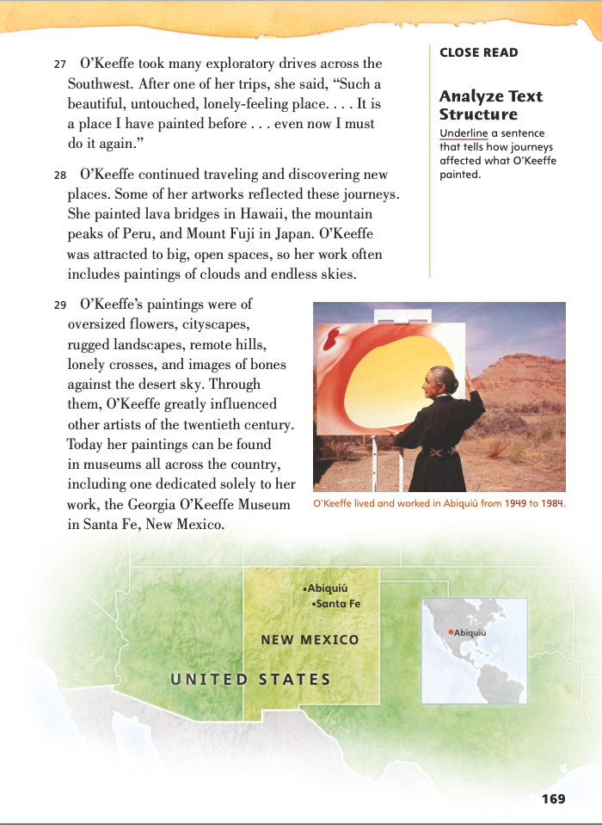
Page 169
Close Read Analyze Text Structure
Turn to page 169 in your Student Interactive.
Notes:
Have students scan paragraphs 27 and 28 to identify how journeys affected O’Keeffe’s paintings. Have them underline the result. See student page for possible responses.
Ask: How did you decide on your response? Possible Response: The text describes what O’Keeffe painted as she went to different places. The artwork she created was the result of her travels.
DOK 2

Slide 43
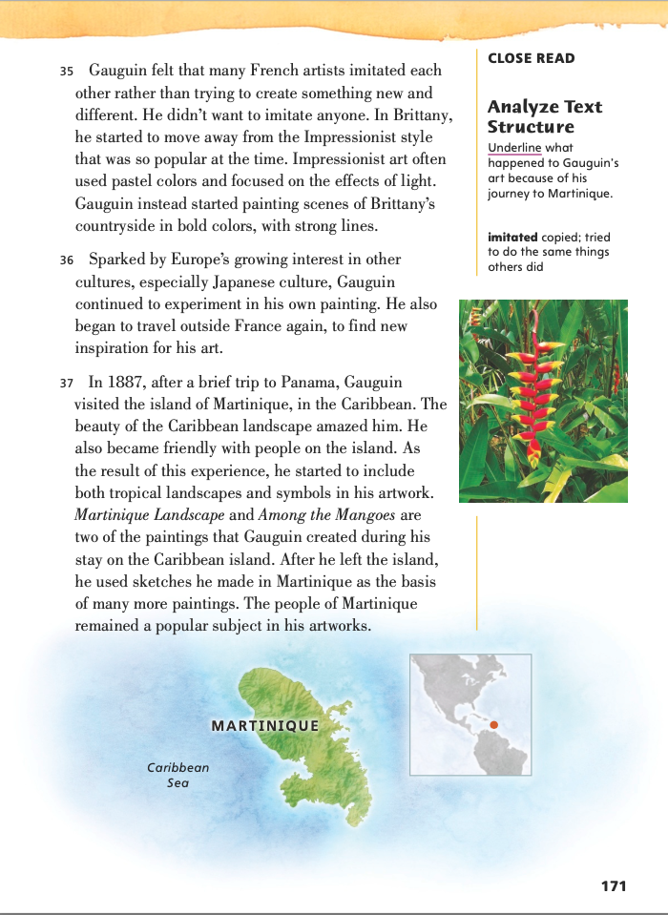
Page 171
Close Read Analyze Text Structure
Turn to page 171 in your Student Interactive.
Notes:
Have students scan paragraph 37 to identify what happened to Gauguin’s art when he traveled to Martinique. Have them underline the result. See student page for possible responses.
Ask: How did you decide on your response? Possible Response: The text describes how Gauguin’s artwork changed after he moved to Martinique. For example, he began to use tropical landscapes and symbols in his paintings. This was the result of moving onto the island. DOK 2

Slide 44
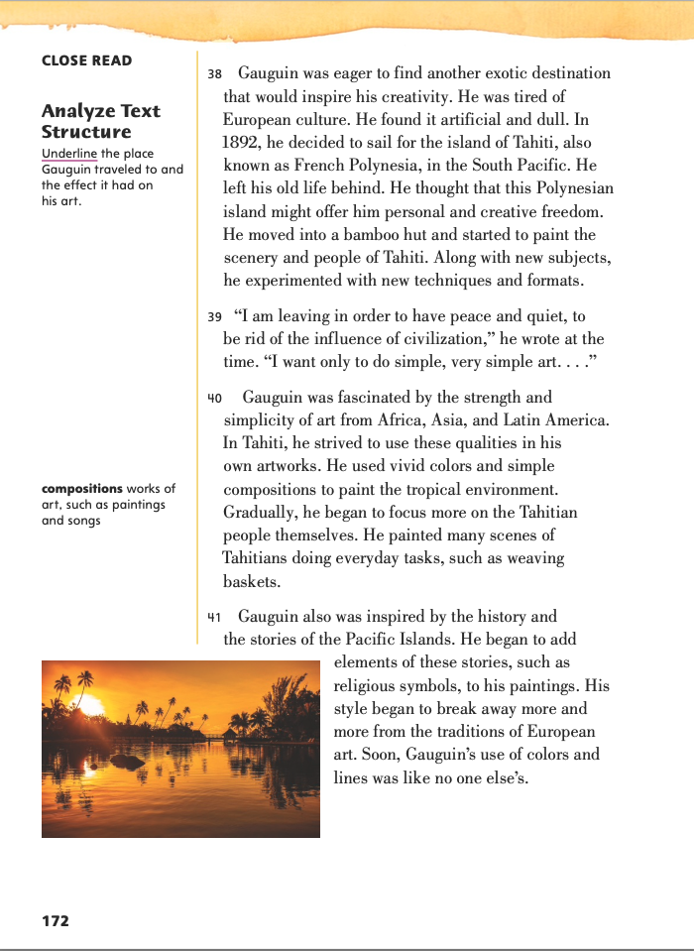
Page 172
Close Read Analyze Text Structure
Turn to page 172 in your Student Interactive.
Notes:
Have students scan paragraphs 38–40 to identify and underline where Gauguin traveled and how his art changed as a result. See student page for possible responses. DOK 2

Slide 45
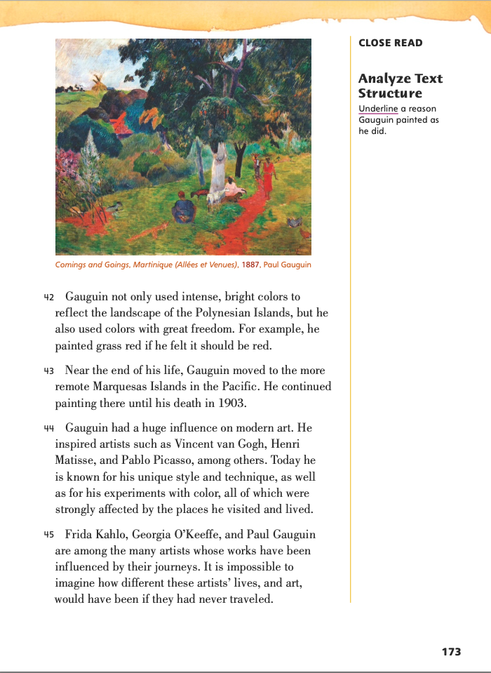
Page 173
Close Read Analyze Text Structure
Turn to page 173 in your Student Interactive.
Notes:
Have students scan paragraphs 42 and 43 to identify a reason why Gauguin painted the way he did. Have them underline the cause. See student page for possible responses. DOK 2

Slide 46
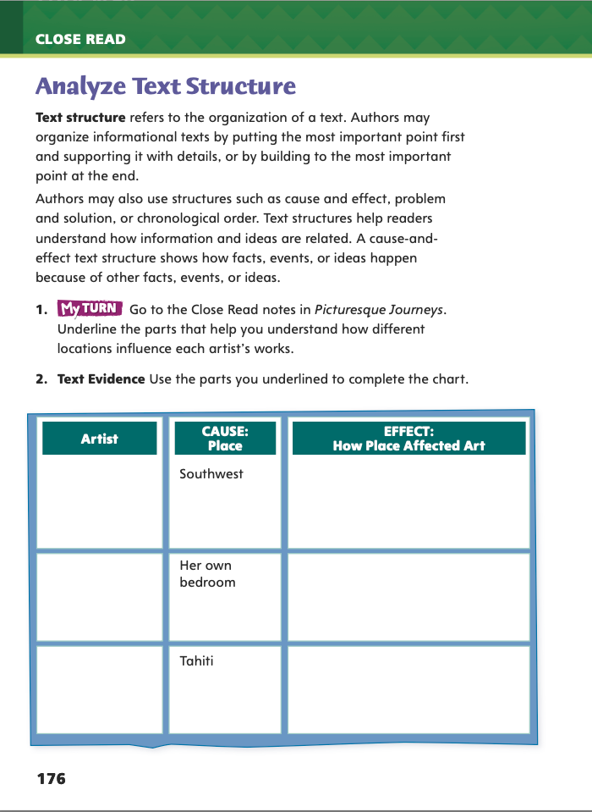
Page 176
Analyze Text Structure
Turn to page 176 in your Student Interactive and complete the chart.
Notes:
Have students use the strategies for analyzing text structure.
Have students annotate the text using the other Close Read notes for Analyze Text Structure and then use the text evidence from their annotations to complete the chart on p. 176.

Slide 47
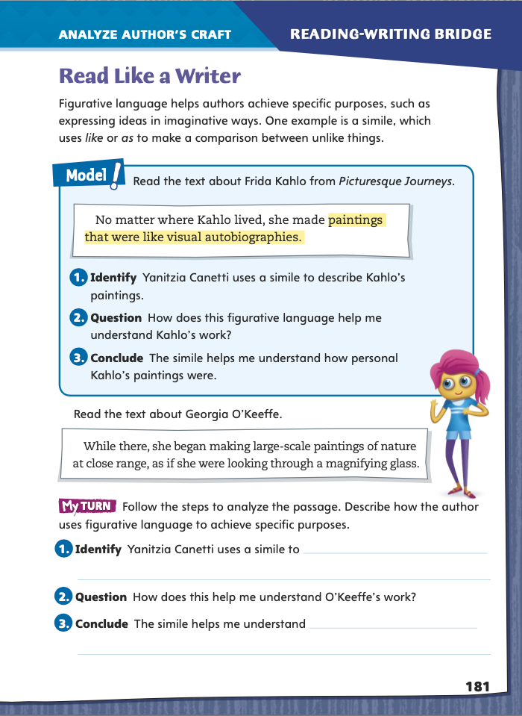
Page 181
Read Like a Writer
Turn to page 181 in your Student Interactive.
Notes:
“Your room looks like a tornado hit it!” is just one example of the figurative language that students may hear every day. Writers use literal language (descriptions that are actually true) so that readers understand the truth. In contrast, writers use figurative language (descriptions that differ from the actual, literal meaning of the words) to make their writing lively and vivid. A common type of figurative language is the simile, a comparison using like or as.
Model analyzing figurative language by leading students through the information in the Model box on p. 181 of the Student Interactive. Explain that students will be using this “identify, question, conclude” approach when they complete the exercise at the bottom of the page.
Invite students to rephrase the sentence about Frida Kahlo so it has the same meaning but does not use figurative language. (Possible response: “No matter where Kahlo lived, she made paintings that were very autobiographical.”)
Discuss why a writer might choose to include similes or other types of figurative language. (Possible responses: to keep the reader interested, to express something in a new way)
Ask students to return to Picturesque Journeys and write similes based on the images of the artists and their work.
Then monitor students as they complete the exercise on p. 181 of the Student Interactive, working individually or in small groups.
Discuss whether adding figurative language might improve Picturesque Journeys, and if so, how.

Slide 48
Word Study
became
adventure
define
insight
countryside
Notes:
Tell students that they may be able to pronounce a word that they have not seen before by breaking it into smaller parts and looking for patterns such as VCe.
Discuss the VCe words became, define, and countryside. Ask: How can breaking those words into smaller parts make them easier to pronounce?
Have students use this strategy for the words adventure (contains venture) and insight (sight).
Have students complete Word Study p. 5 from the Resource Download Center. Tell students to consult a reference, as needed, to spell words correctly. Click path: Table of Contents -> Resource Download Center -> Word Study -> U1W5

Slide 49
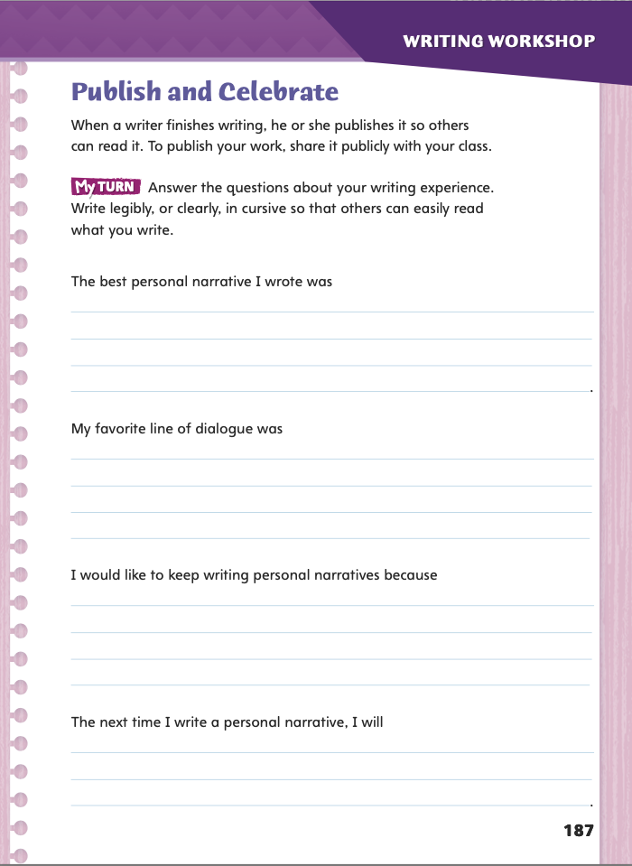
Page 187
Writing – Personal Narrative
Turn to page 187 in your Student Interactive.
Notes:
An author publishes his or her finished writing so others can read it. A student can publish his or her work by sharing it with the class, a teacher, or another appropriate audience.
Inform students that they will be sharing their personal narratives with the class. Ask: Which of your personal narratives would you like to share with the class? Why?
Direct students to p. 187 in the Student Interactive. Have them use texts from the stack if they need assistance identifying something they will do differently the next time they write a personal narrative.

Slide 50
Independent Writing
Finalize your personal narrative revisions. Finish the final draft of your personal narrative. Write legibly. When you finish the final draft, you may illustrate it.
Identify your best personal narrative and be ready to share with the class.
Notes:
Students should finish writing the final draft of their personal narratives. Remind students to write legibly, or clearly, in cursive. For students who need to finalize revisions, they may use this time to work on this. They may refer to the stack if they need additional help clarifying ideas. If students have completed their final drafts, they may also illustrate or type their personal narratives. See the Conference Prompts on p. T344.
After students have identified their best personal narrative, invite several volunteers to share their written works with the class.

Slide 51
Spelling
Notes:
Multisyllabic words with VCe patterns can confuse even confident spellers. The more often students use these spelling words, the more self-assured they will be as they write and say them.
This spelling list contains many rhyming words. Invite students to use these words in a poem or rap. Ask volunteers to read aloud their compositions. (Possible response: Our team will devastate / The game we’ll elevate / After we dominate / You may have to excavate ).
Have students complete Spelling p. 10 from the Resource Download Center. Click path: Table of Contents -> Resource Download Center -> Spelling -> U1W5

Slide 52
Language and Conventions
leaf
rope
scarf
potato
grass
Notes:
Tell students that to form a regular plural noun, all they have to do is add -s or -es to the end of the word.
To form an irregular plural noun, they may need to use the same word for the singular and the plural form, or they may need to change the spelling in a way that does not use -s or -es.
To reinforce the instruction of correctly spelling regular and irregular plural nouns, provide a list of singular words. Some words should have regular plurals. Other words should have irregular plurals. (For example, you might list leaf, rope, scarf, potato, and grass.) Invite students to supply the plural form of each word. Review answers with the class, pointing out any errors.

Slide 53
Lesson 4

Slide 54
Page 160
Close Read – Confirm or Correct Predictions
Turn to page 160 in your Student Interactive.
Notes:
Readers can preview a text to make predictions about what will happen or what the text will reveal. Readers can use clues from the text’s structure, including headings, sidebars, and captions, and clues based on the genre, such as the main idea and details.
Look for structure and genre clues in the text as you preview it.
Consider any prior knowledge you have about the topic.
Make a guess about what the text will reveal.
Read the text to confirm or correct your prediction.
If your prediction is incorrect, update the prediction you made.
Use the Close Read note on p. 160 of the Student Interactive to model how to annotate the text to make and confirm or correct predictions:
As I read, I notice many details about different places. I see that Kahlo has a diverse background. Her father was Hungarian, and her mother was Spanish and Mexican Indian. Her background shaped her perspective. I think having a diverse background will lead Kahlo to paint about a variety of subjects and show how they relate to her life. That’s my guess, or prediction, based on the text. As I read the text, I will highlight details that confirm or correct my prediction. If my prediction is incorrect, I will update the prediction based on new information I read.

Slide 55
Page 160
Close Read – Confirm or Correct Predictions
Turn to page 160 in your Student Interactive.
Notes:
Explain that to understand a text, it is helpful to make predictions as you read. Remind students that when you make a prediction, you make a guess about what will happen next based on what you have already read.
Have students scan paragraphs 3 and 4. Ask: Which sentence can help the reader make a prediction about how childhood experiences will affect Kahlo’s work? Have students highlight the text. See student page for possible responses.
Ask: How did you decide on your response? Possible Response: The sentence “Kahlo’s diverse background helped define both her identity and her vision of the world” helps me predict that Kahlo’s experiences will shape her work.
Say: As you continue reading, look for text evidence that confirms or corrects your prediction. DOK 2

Slide 56
Page 161
Close Read – Confirm or Correct Predictions
Turn to page 161 in your Student Interactive.
Notes:
Have students preview the text on p. 161 and make a prediction about how the bus crash might have affected Kahlo. Then have them continue reading to confirm or correct their prediction.

Slide 57
Page 164
Close Read – Confirm or Correct Predictions
Turn to page 164 in your Student Interactive.
Notes:
Have students scan paragraph 11 and highlight details that help them confirm or correct predictions they made about the importance of Mexico as a theme in Kahlo's work. See student page for possible responses.

Slide 58
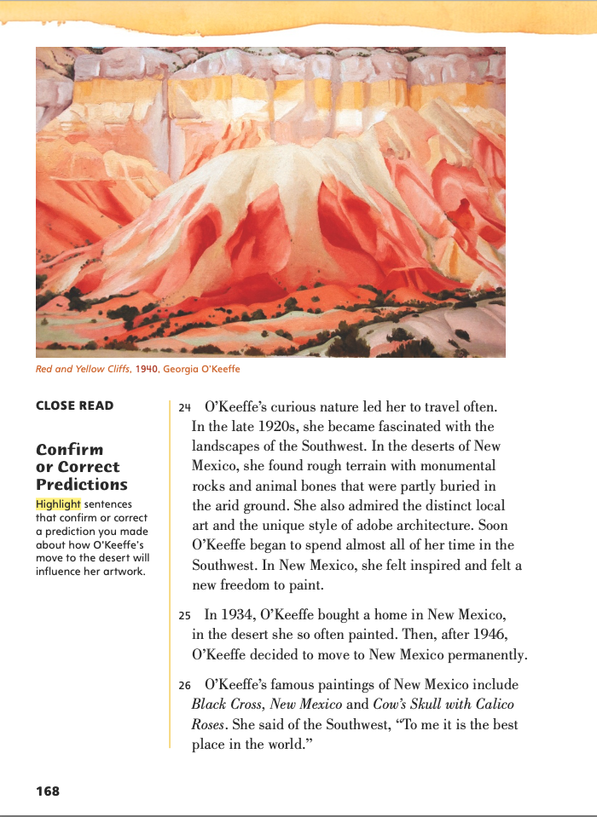
Page 168
Close Read – Confirm or Correct Predictions
Turn to page 168 in your Student Interactive.
Notes:
Have students scan paragraph 24. Ask: Which sentences in the text can help a reader predict how living in the desert influenced O’Keeffe’s work? Have students highlight the text. See student page for possible responses.
Ask: How did you decide on your response? Possible Response: Details about the rocky terrain, local art, and adobe architecture show what inspired O’Keeffe and how the desert influenced her work. DOK 2

Slide 59
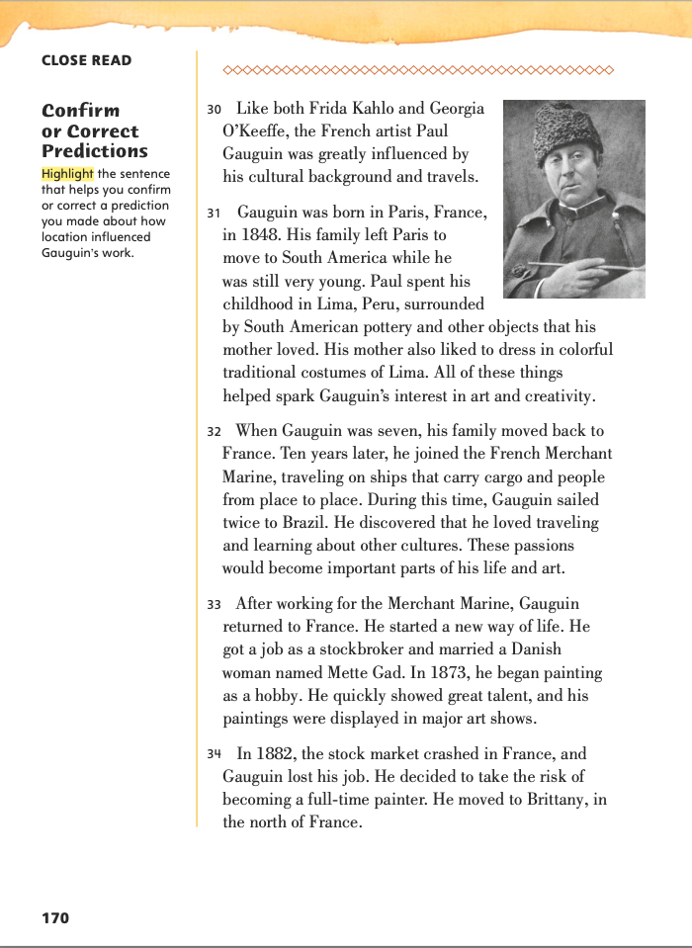
Page 170
Close Read – Confirm or Correct Predictions
Turn to page 170 in your Student Interactive.
Notes:
Have students scan paragraphs 30 and 31. Ask: Which sentence from the text can help the reader predict how location influenced Gauguin’s work? Have students highlight the text. See student page for possible responses. DOK 2

Slide 60
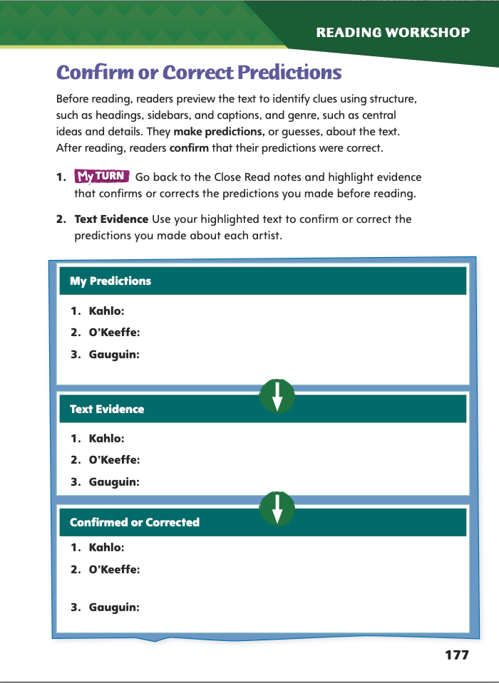
Page 177
Close Read – Confirm or Correct Predictions
Complete page 177 in your Student Interactive.
Notes:
Have students use the strategies for confirming or correcting predictions.
Have students annotate the text using the other Close Read notes for Confirm or Correct Predictions and then use the text evidence from their annotations to complete the chart on p. 177.

Slide 61
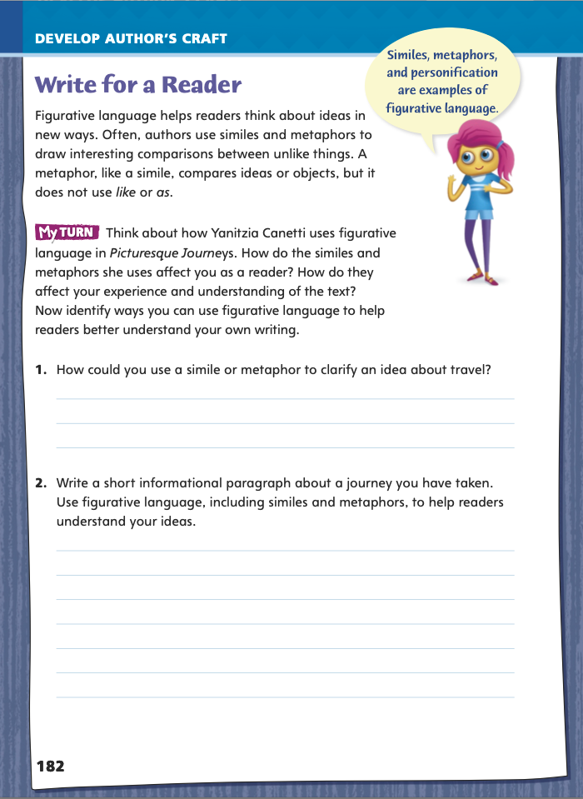
Page 182
Write for a Reader
Turn to page 182 in your Student Interactive and complete the activity.
Notes:
Another type of figurative language is the simile—a comparison that does not include the word like or as. For instance, explain that the expression “I have a frog in my throat” does not mean that the person has swallowed an amphibian. Instead, it means the person has a voice like a croaking frog. Writers use metaphors to enrich their writing and to keep their readers’ attention.
Invite students to go back to Picturesque Journeys and write metaphors based on the images and the text.
For example, instead of writing “Frida Kahlo felt sad,” students could write “Frida Kahlo was a weeping willow.” (You may need to tell students that a weeping willow is a type of tree that has drooping branches.)
Explain that many people would describe Georgia O’Keeffe’s love of independence as “being a lone wolf.”
Have students complete the activity on p.182 of the Student Interactive. Explain that students may be sharing their informational paragraphs with the class, so the paragraphs should not contain information that the students consider personal.

Slide 62
Word Study
definable
Think of as many –able and –ible words as you can.
Check the spelling in the dictionary. Write the words on sticky notes.
Notes:
Review the strategies on pp. T264–T265 on the meaning and use of the suffixes -able and -ible.
Write the word definable on the board and challenge students to pronounce it and guess what it means.
Explain to students that when they are adding -able or -ible to a word that ends with a silent e, they will usually need to remove the silent e before adding the suffix.
Group students, and provide each group with a dictionary. Ask them to think of as many -able and -ible words as they can, check the spellings in the dictionary, and write the words on sticky notes. Use the notes to create a word wall, and discuss which words came up in more than one group.

Slide 63
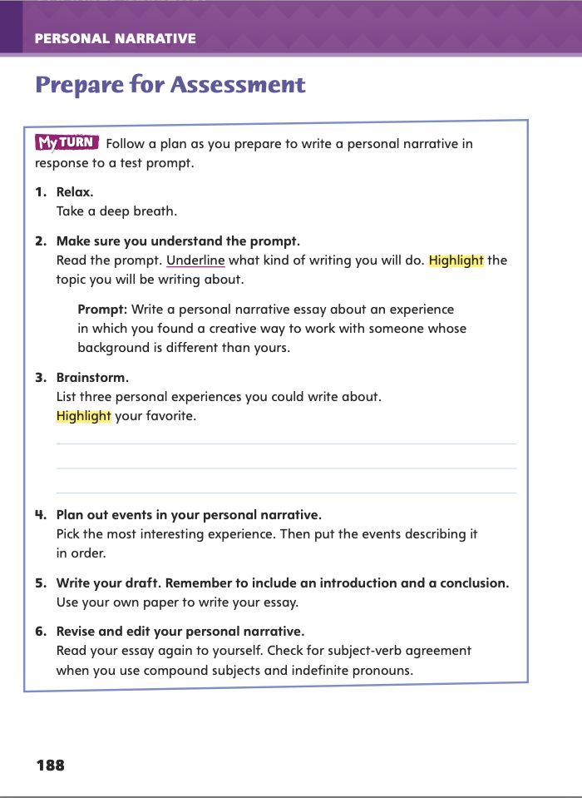
Page 188
Writing – Personal Narrative
Turn to page 188 in your Student Interactive.
Notes:
A personal narrative tells a story, either real or made up, that engages the reader. A narrative
Uses dialogue and description to develop experiences and events.
Is organized so that the order of ideas makes sense.
Includes an introduction and a conclusion.
Review the instructions on p. 188 in the Student Interactive. Tell students they will be writing a personal narrative essay about an experience in which they found a creative way to work with someone whose background is different from theirs. Say: When I think about an experience to write about, I write my ideas on a sheet of paper. Then I choose the most interesting experience, and I write the events describing that experience in order. Next I add details. When I am finished, I read my essay again and make revisions.
Direct students to p. 188 in the Student Interactive. Have them complete the activity to brainstorm a topic for their assessment essay.

Slide 64
Independent Writing
Write your personal narrative about an experience in which you found a creative way to work with someone whose background was different from yours.
Notes:
After completing the brainstorming activity, students should transition into independent writing. If students need additional assistance brainstorming a topic, they may refer to books from the stack. If students demonstrate understanding, they should transition to writing their personal narrative on a separate sheet of paper. See the Conference Prompts on p. T344.
Call on a few students to share which part of the practice assessment they found most difficult. Ask how they worked through any difficulties to complete the practice assessment.

Slide 65
Spelling
Unlike chimpanzees, humans have ________ thumbs. That means we can touch our thumbs to the other fingers on the same hand.
That file is ________. You can drag it into the trash instead of saving it to your desktop.
Notes:
See pp. T270–T271 to review the spelling rules about the word parts -able and -ible.
Write or display these sentences. Ask pairs to fill in the blanks with the correct word from this week’s spelling list plus the suffix -able or -ible. Allow students to check spellings in a dictionary.
1. Unlike chimpanzees, humans have _________ thumbs. That means we can touch our thumbs to the other fingers on the same hand. (opposable)
2. That file is _______. You can drag it into the trash instead of saving it to your desktop. (deletable)
Using spelling words on p. T270, create a game show competition in which volunteers have 30 seconds to spell each word.

Slide 66
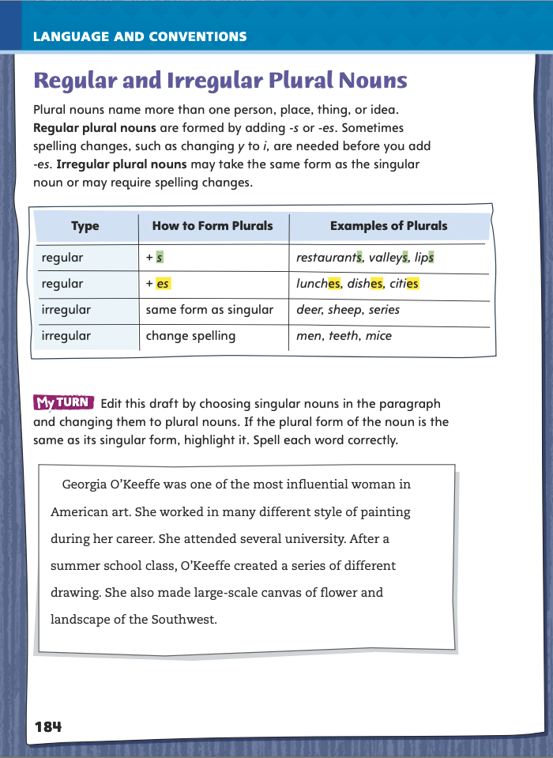
Page 184
Language and Conventions
Turn to page 184 in your Student Interactive and complete the activity.
Notes:
Have students edit the draft paragraph on Student Interactive p. 184 of the Student Interactive.

Slide 67
Lesson 5

Slide 68
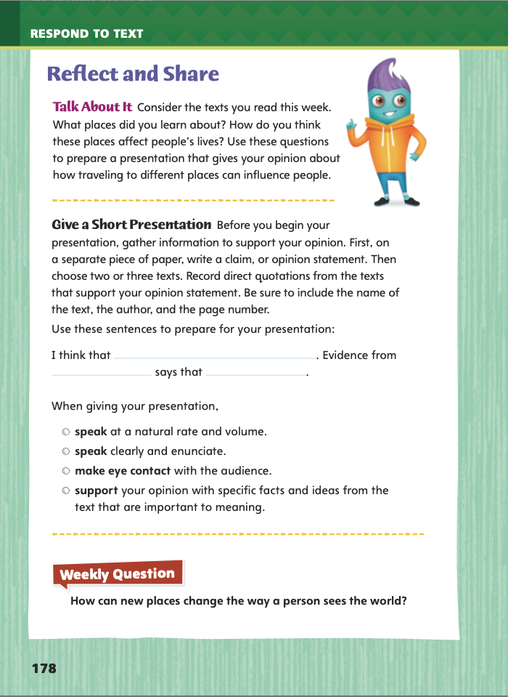
Page 178
Reflect and Share
Turn to page 178 in your Student Interactive.
Notes:
Explain to students that when they write or express an opinion, it is important to gather information to support it. Supporting an opinion with facts and details can help convince others that what you think or believe is right.
Write a claim, or statement that expresses your opinion.
Choose two or three texts.
Record details from the texts that support your opinion.
Make sure to note the name of the text, the author, and the page number for each quotation or piece of information you write down.
Model how to gather information to support a claim: I believe the Grand Canyon is one of the best places to visit in the United States. To support this idea, I need to find out more information. So, I will check books or Web sites about the Grand Canyon. I will try to find out what people can see and do when they visit this area and how it has affected their lives. I will also look for quotes from people who have traveled there and enjoyed it.
Have students use the strategies for making connections between texts.
Have students use evidence from this week’s texts to give a short presentation about how location affects people’s lives. Have students use eye contact to communicate their ideas effectively.

Slide 69
Apply
How can new places change the way a person sees the world?
Notes:
Have students use evidence from the texts they have read this week to respond to the Weekly Question. Tell them write their response on a separate sheet of paper.

Slide 70
Word Study
declare
inspire
It did not take long for Angela to declare her opinion: “Wow!”
“Angela, you inspire me to keep working,” I told her.
Notes:
To assess students’ understanding of VCe words, provide them with the following words: declare and inspire. Write sample sentences on the board:
It did not take long for Angela to declare her opinion: “Wow!”
“Angela, you inspire me to keep working,” I told her.
Have students use their knowledge of the VCe pattern to pronounce each word.

Slide 71
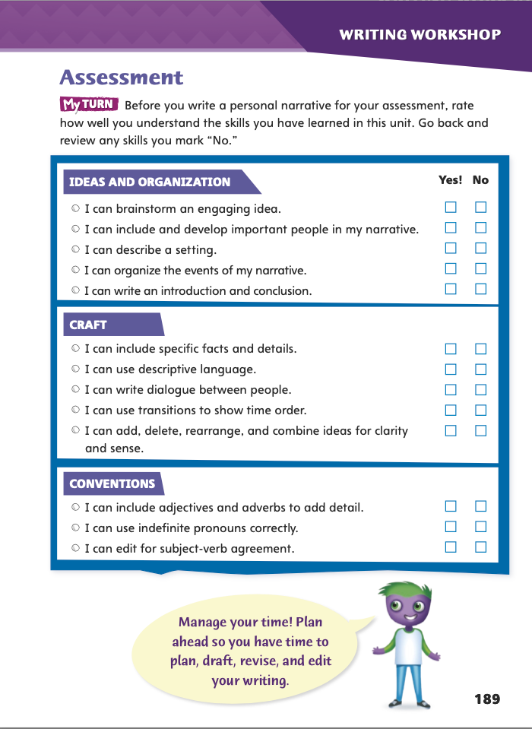
Page 189
Writing - Assessment
Turn to page 189 in your Student Interactive.
Rate how well you understand the skills.
Notes:
Throughout the week students have learned a variety of skills in order to write and revise their personal narratives. Students should be able to
Organize events in their narratives to present ideas clearly.
Add, delete, rearrange, and combine ideas for clarity and sense.
Edit for subject-verb agreement.
Review the skills students should understand before writing their assessment essays. Say: When I do not understand a skill we have learned, I can read texts from the stack or review my work in the Student Interactive.
Direct students to p. 189 in the Student Interactive. Have them complete the checklist to assess their understanding of the skills they have learned in this unit. Allow time for students to review any skills they do not understand.

Slide 72
Writing - Assessment
Notes:
Inform students that they are going to take a writing assessment. Using the skills they have learned in this unit, they should respond to the prompt. If students answer the prompt on a separate sheet of paper, provide a line limit so the assessment emulates other writing assessments students will take. Alternatively, students’ published writing from earlier in the week may be used as the assessment.

Slide 73
Spelling
1. Is this software up to date or obsolete?
2. Braden was nervous before the big game, but I felt serene.
3. If you provoke that snapping turtle, you might get hurt!
4. I didn’t prepare a speech, so I had to improvise.
5. The smell of Dad’s spaghetti sauce always increases my appetite.
6. I hope the free concert will coincide with our school’s vacation
week.
7. When my little brother gets on that roller coaster, his confidence will
evaporate.
8. Our coach decided to schedule two soccer games on one day.
9. Without enough evidence, a lawyer cannot prosecute.
10. Will you please delete those old files from my computer?
Notes:
(Note: Move the orange boxes to cover each bold spelling word before you read aloud the words and sentences.)
Use the following sentences for the spelling test:
1. Is this software up to date or obsolete?
2. Braden was nervous before the big game, but I felt serene.
3. If you provoke that snapping turtle, you might get hurt!
4. I didn’t prepare a speech, so I had to improvise.
5. The smell of Dad’s spaghetti sauce always increases my appetite.
6. I hope the free concert will coincide with our school’s vacation week.
7. When my little brother gets on that roller coaster, his confidence will evaporate.
8. Our coach decided to schedule two soccer games on one day.
9. Without enough evidence, a lawyer cannot prosecute.
10. Will you please delete those old files from my computer?

Slide 74
Language and Conventions
All five of the goose honked angrily at the two wolves.
Which revision correctly uses an irregular plural noun?
Change goose to gooses.
Change goose to geese.
Change wolves to wolfes.
Change wolves to wolf.
Notes:
Display the sentence and have students respond independently.
All five of the goose honked angrily at the two wolves.
Which revision correctly uses an irregular plural noun?
A Change goose to gooses.
B Change goose to geese. (correct)
C Change wolves to wolfes.
D Change wolves to wolf.
APPLY Have students complete Language and Conventions p. 15 from the Resource Download Center. Click path: Table of Contents -> Resource Download Center -> Language and Conventions -> U4 W5

Slide 75
Unit 1: Week 5
Grade 5

