Slide 1
Unit 1: Week 4
Grade 1

Slide 2
Copyright © Savvas Learning Company LLC. All Rights Reserved.
This publication is protected by copyright, and permission should be obtained from the publisher prior to any prohibited reproduction, storage in a retrieval system, or transmission in any form or by any means, electronic, mechanical, photocopying, recording, or otherwise. For information regarding permissions, request forms, and the appropriate contacts within the Savvas Learning Company Rights Management group, please send your query to:
Savvas Learning Company LLC, 15 East Midland Avenue, Paramus, NJ 07652
or
k12learningpermissions@savvas.com
myView Literacy® is an exclusive trademark of Savvas Learning Company LLC in the U.S. and/or other countries.

Slide 3
Lesson 1

Slide 4
Page 134
Phonological Awareness
Notes:
Hold up the bed Picture Card. Tell students to listen to each sound as you say the word bed. Repeat the sounds in the word bed several times: /b/ /e/ /d/. Then point to the picture of the ten on p. 134 in the Student Interactive. Have students repeat the activity with the pictures for ten, net, and pen.
Display the jet Picture Card. Say: Listen carefully as I say the sounds in the word jet: /j/ /e/ /t/. Now repeat the sounds in jet with me: /j/ e/ /t/. What sound do you hear in the middle of the word jet? Yes, that is the sound /e/. Display the hen and red Picture Cards to further practice the medial sound /e/. First say the sounds in each word and then have students repeat the sounds. Click path -> Table of Contents -> Unit 1 Week 4 Realistic Fiction -> Lesson 1

Slide 5
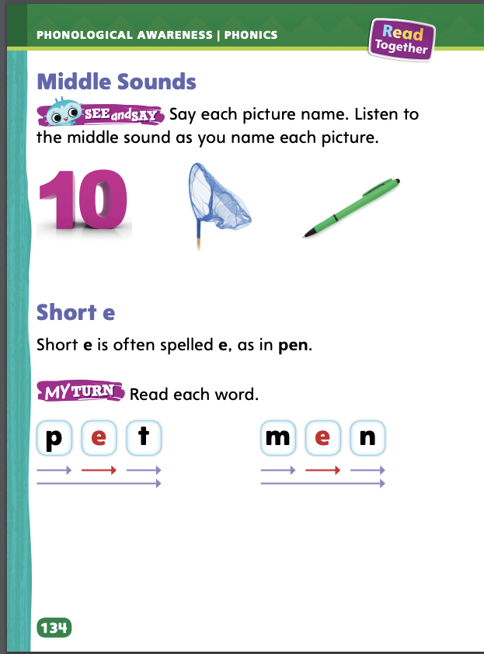
Page 134
Apply
Read the words on page 134 in your Student Interactive.
Notes:
Use Sound-Spelling Card 6 (elephant) to introduce how to spell the sound short e.
Say: This is a picture of an elephant. Elephant begins with the sound /e/, which sounds like this: /e/ (pause) /e/ (pause) /e/ (pause) elephant. Say the sound with me. Have students say the sound several times. Then ask: What sound does elephant begin with? Elicit responses. Point to the Ee at the top of the card. The sound /e/ is called the short e sound and is spelled with the letter e. What letter makes the short e sound? Yes, the letter e. Write the words get and set and have students decode them. Click path -> Table of Contents -> Unit 1 Week 4 Realistic Fiction -> Lesson 1
Direct students to the bottom of p. 134 in the Student Interactive. Have them practice saying each sound in the words by following the short arrows. Then have students blend phonemes (long arrow) to decode the short e words pet and men.

Slide 6
High-Frequency Words
have
two
that
up
they
Notes:
Write the high-frequency words have, that, they, two, up. Display the words. Tell students to practice and remember these words.
Point to each word as you read it.
Then spell the word and read it again.
Have students spell and say the words with you.

Slide 7
Page 132,133
Interact with Sources
Neighbors get together to make their neighborhood a better place.
Neighbors get together to have fun.
Notes:
Revisit the Essential Question for Unit 1: What is a neighborhood? Then read aloud the Week 4 Question: How can I get to know my neighbors?
Direct students’ attention to pp. 132–133 in the Student Interactive. Have students follow along as you read aloud “Neighborhood Activities.” Then place students into small groups. Ask them to use the pictures and words from the infographic to talk about how people get to know their neighbors. As they engage in group discussion, prompt students to ask questions about the infographic.
Write the following sentences on the board as talking points to support group discussion:
Neighbors get together to make their neighborhood a better place.
Neighbors get together to have fun.
Ask: What would you do if you could plan a neighborhood activity? Which activity would you choose? Why? Give each group time to agree on an activity. Ask a volunteer from each group to share the group’s response with the class.
Prompt students to discuss, in pairs, what activities their neighborhoods have. Tell them that when they share their ideas, they should speak clearly.
Remind students of the Weekly Question: How can I get to know my neighbors? Tell them that block parties, yard sales, and planting trees are different ways that people can get to know their neighbors. Explain that there are other ways people get to know their neighbors, and students will learn more about them this week.

Slide 8
Listening Comprehension
Alike | Different
Notes:
Tell students that you are going to read aloud a realistic fiction text. Have students listen as you read the text, “Welcome to the Neighborhood.” Ask them to be active listeners by looking at you and thinking about what you are reading.
Purpose Have students listen actively for elements of realistic fiction.
READ the entire text aloud without stopping for the Think Aloud callouts.
REREAD the text aloud, pausing to model Think Aloud strategies related to the genre.
Ask students: How are Jack and Lola alike and different? Use the chart to record student responses.

Slide 9
Page 144,145
Realistic Fiction
Turn to page 145 in your Student Interactive.
Notes:
Realistic fiction has characters. Characters are the people in realistic fiction. The words and pictures in the story tell what characters say, do, and feel.
Examine the character details that are in the words and pictures. What do they tell about the characters?
Think about the characters in the text. Are they like people in real life?
Model how to identify realistic fiction by discussing the characters in the Read Aloud “Welcome to the Neighborhood” on pp. T198–T199. “Welcome to the Neighborhood” has made-up people, or characters. The text tells me what these characters say, do, and feel. These details make the characters seem like people in real life. I think this is realistic fiction. Then read the Anchor Chart on p. 145 together. Editable Anchor Chart Click Path: Table of Contents -> Reading Anchor Charts -> Unit 1 Week 4: Realistic Fiction Editable Reading Anchor Chart

Slide 10
Page 144
Apply
Discuss the purpose of reading realistic fiction.
Notes:
Have students use the strategies to identify realistic fiction.
Prompt students to review The Blackout. Then have them complete the Turn and Talk activity on p. 144.
Review the Set a Purpose section on p. 144 in the Student Interactive. Discuss a purpose for reading realistic fiction.

Slide 11
Page 167
Academic Vocabulary
Turn to page 167 in your Student Interactive and complete the activity.
Notes:
Remind students of the Academic Vocabulary for the unit: settle, various, group, and type. Explain that word parts are groups of letters that can be added to some words to make new words with different meanings.
Determine the meaning of the word part.
Recognize where the word part can be added to a root (beginning or end).
Use the definition of the word part to figure out the meaning of the new word.
Look at p. 167 in the Student Interactive to model an example: I know that I can add the word part re- to some words. So, when I add re- to the beginning of the word group, the word becomes regroup. The new word, regroup, has a different meaning. I read that the word part re- means “again.” So, regroup must mean “to group again.”
Have students complete the activity on p. 167 in the Student Interactive to show how the word part re- changes word meanings.

Slide 12
Handwriting
Notes:
Show examples of slanted lines to help develop students’ handwriting.
Model writing slanted lines on the board. Draw handwriting lines on the board (solid line, dotted line, solid line).
Start at the bottom handwriting line and draw a line up and right (diagonally) to the top.
Draw another line, moving up and left (diagonally) to the top.
Repeat the process, this time starting from the top.
Have students use Handwriting p. 25 from the Resource Download Center to practice drawing slanted lines. Click path: Realize -> Table of Contents -> Resource Download Center -> Handwriting Practice -> U1W3L1 Handwriting Practice

Slide 13
Writing – Launching Writing Workshop
Illustrations help readers better understand
characters
objects
events
setting
Notes:
Authors include illustrations to help readers. Details in illustrations add information about a topic. Details might help readers better understand
characters
objects
events
setting
Tell students that illustrations are pictures included in books to help readers enjoy and understand a book. Show the cover of a stack book that has an illustration and title. Read aloud the title. Let’s look at this picture. It has many parts, or details. Those details help us better understand what this book is about. They add to what the title tells us.
Guide students in identifying details in the illustration that add to their understanding.
Discuss whether the illustration shows where the text takes place, who the text is about, and what might happen in the text.

Slide 14
Independent Writing
You will continue writing your books.
Include details in your illustrations.
Notes:
During independent writing time, students should continue writing their books. Remind students to include details in their illustrations.
Modeled Choose a stack text and do a Think Aloud to model how to identify details in an illustration.
Shared Have students choose a stack text. Prompt students to take turns seeing how many details they see in the cover illustrations.
Guided Use the stack texts to give explicit instruction on the details of a cover illustration and what information they provide about the book.
As students write, use the conference prompts in the Teacher’s Edition or Resource Download Center to provide support. Click path: Table of Contents -> Resource Download Center -+ Writing Workshop Conference Notes
Call on a few students with whom you conferred and have them show an illustration from their book. They should describe a detail they included.

Slide 15
Spelling
I set the phone down.
I met my friend today.
He likes to pet the dog.
The bug is in the net.
I have a cat.
They left the house.
Notes:
(Note: Move the orange boxes to cover each bold spelling word before you read aloud the words and sentences.)
Read aloud the words and sentences. Have students spell each word with initial consonant blends and the two high-frequency words.
I set the phone down.
I met my friend today.
He likes to pet the dog.
The bug is in the net.
I have a cat.
They left the house.
Reveal the spelling word and have students check their work.

Slide 16
Language and Conventions
man runs the
Notes:
Review simple sentences with students. Explain that a simple sentence tells a complete idea. It has a subject and verb.
Display the following jumbled sentence: man runs the. Place the words in the proper order to form a simple sentence. (The man runs.) Ask: Which is the naming part? (man) Which is the action part? (runs) Remind students that the naming part is the subject and the action part is the verb. Give students this additional jumbled sentence to rewrite as a simple sentence: jumps girl the. (The girl jumps.)
Have partners create their own simple sentences that tell complete ideas. Prompt them to underline the subjects and circle the verbs.

Slide 17
Lesson 2

Slide 18
Page 135
Phonics
With a partner, decode the words on page 135 in your Student Interactive
Notes:
Review with students that the sound short e is spelled e.
Write the letter m. Point to the m and say /m/. Ask students to say the sound /m/ with you as you point to the letter and say it again. Write the letter e. Point to the e and say /e/. Now have students say the sound /e/ with you as you point to the e. Then slowly slide your finger (from left to right) below the two letters and blend and say the sounds (/m/ /e/).
Next, have students blend the sounds with you as you say them again. Write the letter t. Point to the t and say /t/. Have students say the sound /t/ with you as you point to the t. Slowly slide your finger below all three letters to blend the sounds and pronounce the word met. Then have students blend the letters on their own and say the word. Ask for volunteers to use the word in a sentence. For additional practice, use the words pen, men, beg, and pet.

Slide 19
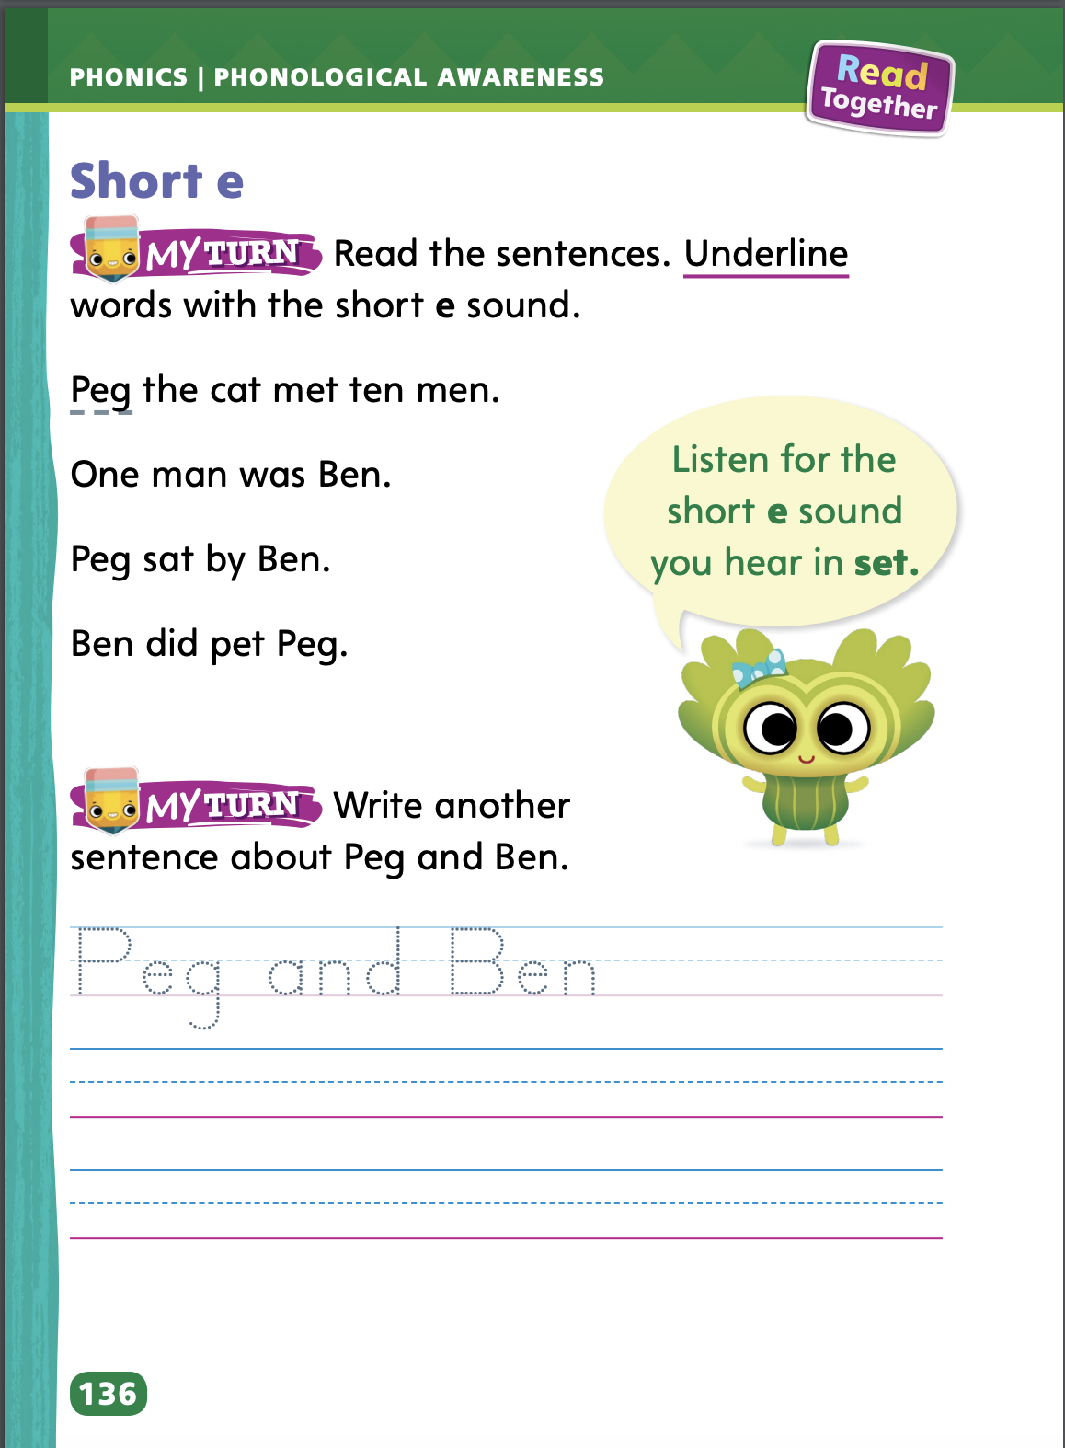
Page 136
Apply
Turn to page 135 and 136 in your Student Interactive and complete the activity.
Notes:
Have students complete the rest of p. 135 and p. 136 in the Student Interactive by printing the letters

Slide 20
High-Frequency Words
have
two
that
up
they
Notes:
Write the words have, that, they, two, up. Divide students into teams and ask them to choose one of the words to write on a poster board. Have each team write their word multiple times on the poster with different colored crayons or markers. When everyone is done, have students write their names under their “special” word with a pencil or pen. Hang the posters in the classroom.

Slide 21
Page 146
Preview Vocabulary
plant
help
Notes:
Introduce the words plant and help from p. 146 in the Student Interactive.
Have students act out each word to show what they already know about the selection vocabulary words. They can, for example, mimic a gardener planting seeds.
Define the vocabulary words as needed. Definitions appear on the selection pages that follow. Say: These words will help us understand what characters do in the story Garden Party.

Slide 22
First Read Strategies
Notes:
Discuss the First Read Strategies with students. Guide students to develop their own purpose, or reason, for reading Garden Party
THINK Prompt students to develop their own reasons for reading the text.
READ Have students focus on the purpose they established as they read or listen to the text.
LOOK Remind students to look at the words and pictures to help them understand the characters and the characters’ actions in the text.
ASK Have students generate, or ask, questions about the characters to deepen their understanding.
COMPARE Remind students that they will be comparing this text to Click, Clack, Click! at a later time.
Students may read the text independently, in pairs, or as a whole class. Use the First Read notes to help students connect with the text and guide their understanding

Slide 23
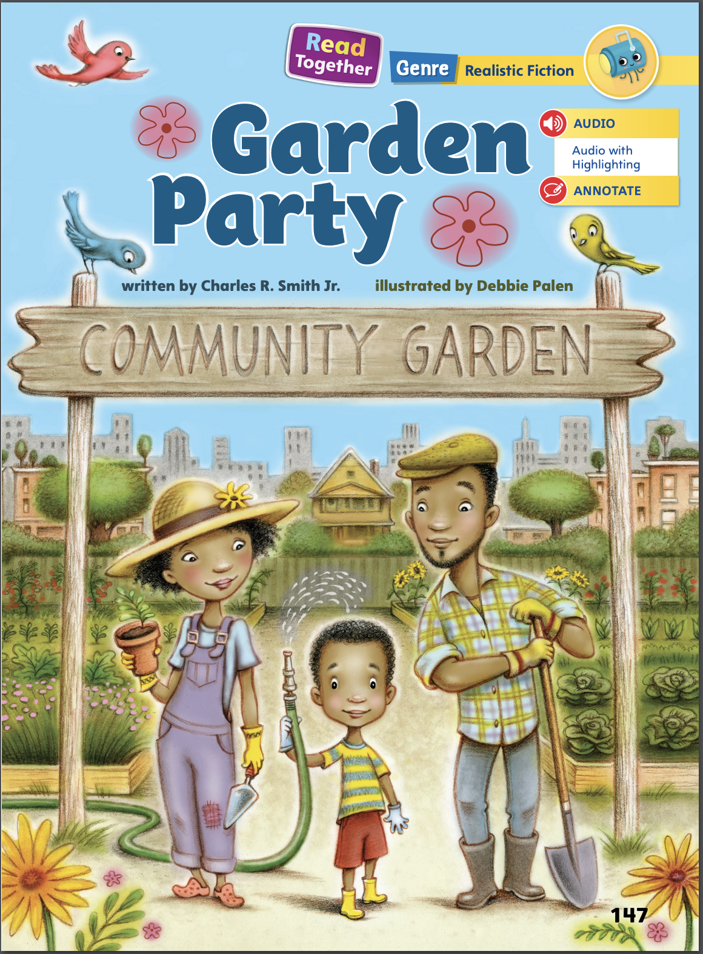
Page 147
First Read – Garden Party
Notes:
Read together.
THINK ALOUD I ask myself why I am reading Garden Party. I could read to learn about the characters. I could read to find out what a “garden party” is. But I want to learn how people can get to know their neighbors. Now I can start reading to find text evidence about the ways people become friendly neighbors.

Slide 24
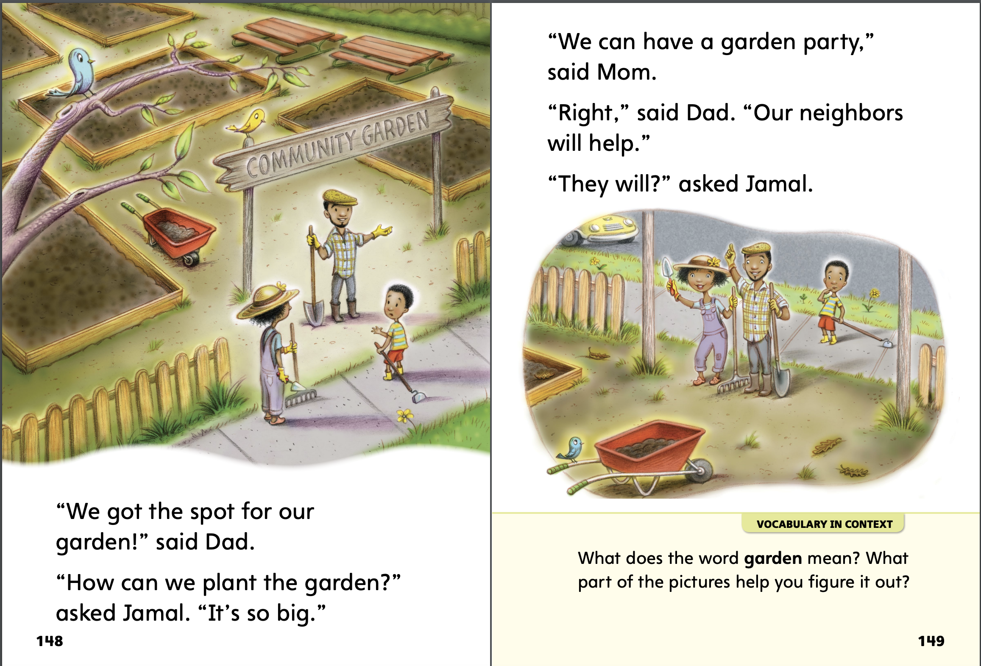
Page 148,149
First Read – Garden Party
Notes:
Read together.

Slide 25
Page 150,151
First Read – Garden Party
Notes:
Read together.
THINK ALOUD I’m reading Garden Party to learn how people can get to know their neighbors. Jamal gets to know his neighbors in this story. He asks his neighbors to help plant the garden. The “garden party” brings the people, or characters, together. So, that’s one way people can get to know their neighbors.

Slide 26
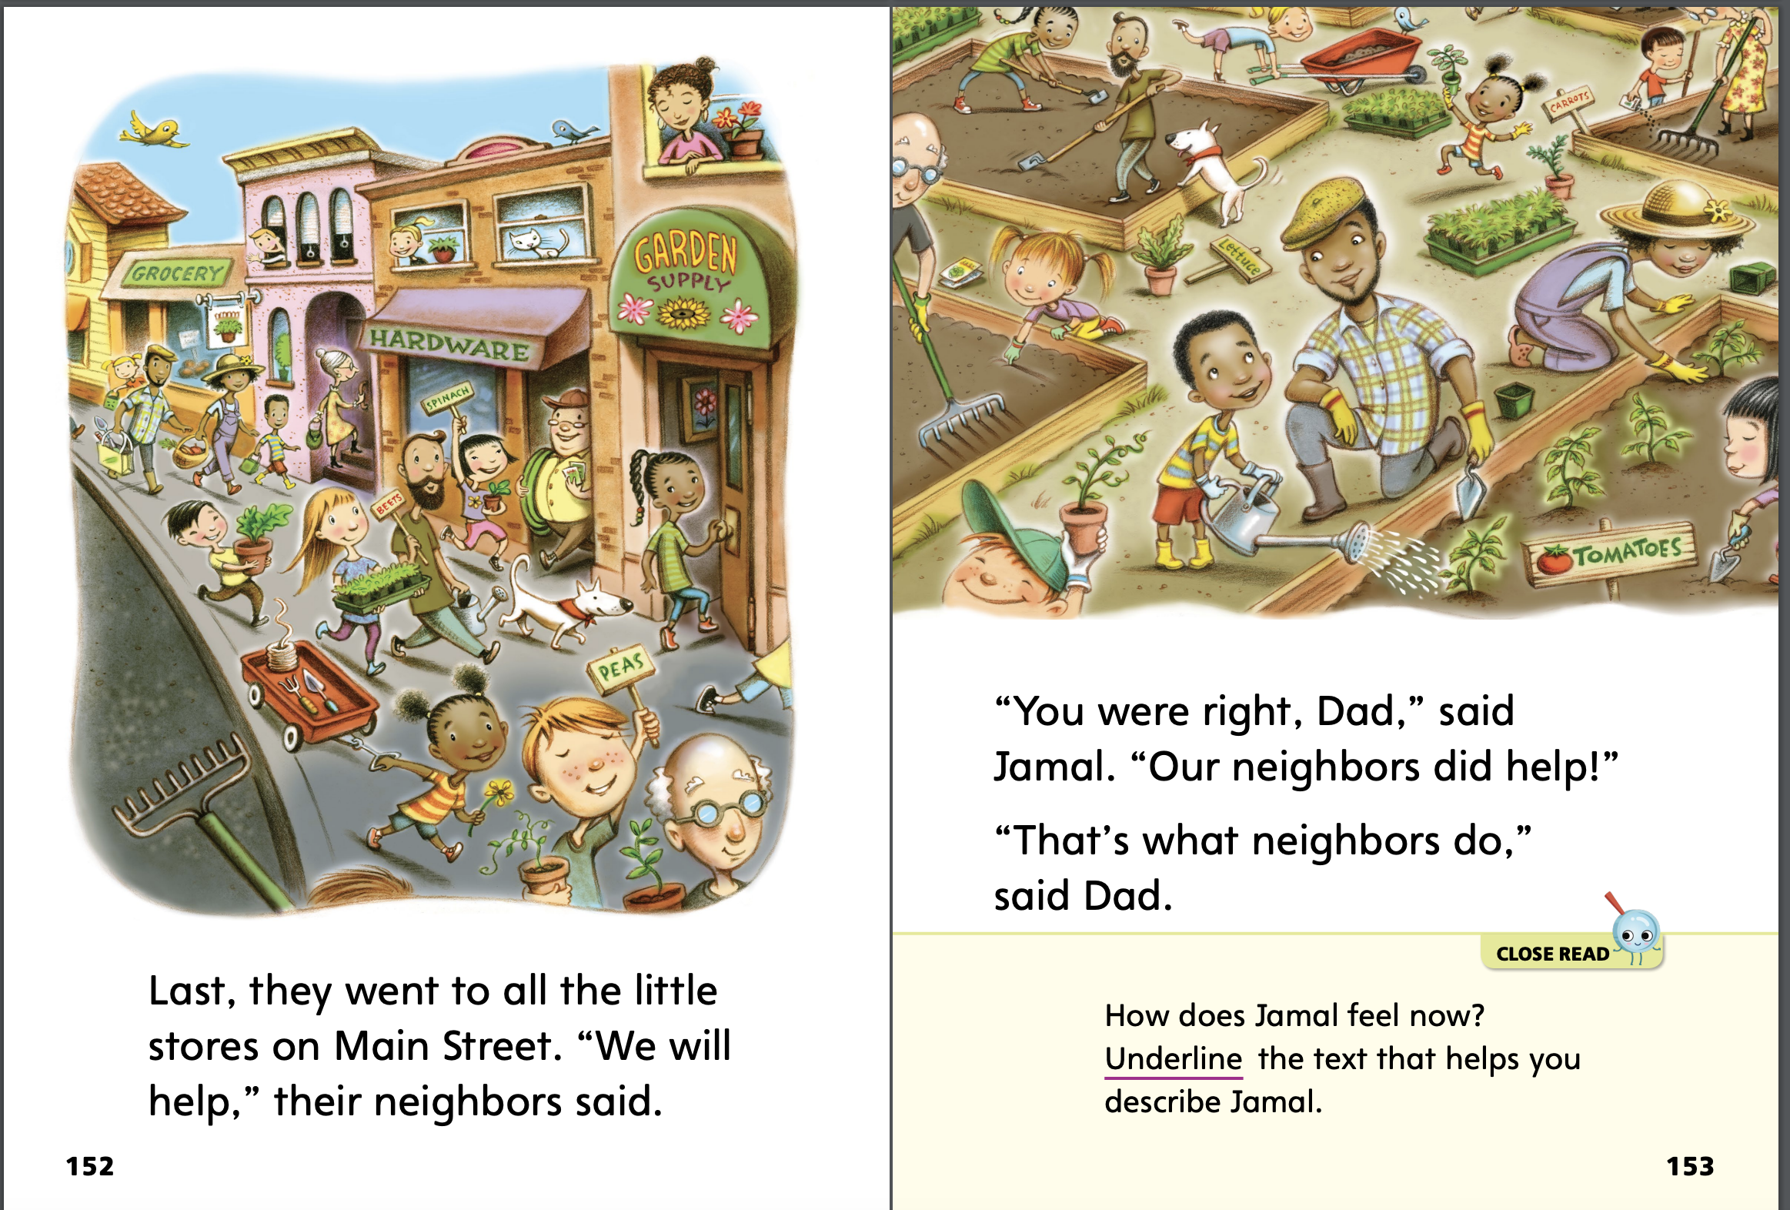
Page 152,153
First Read – Garden Party
Notes:
Read together.

Slide 27
Page 154
Preview Vocabulary
meet
join
Notes:
Introduce the words meet and join from p. 154 in the Student Interactive. Prompt students to find out what they already know about these words. Ask: What does it mean to meet someone? Did you ever want to join a club or team?
Define the vocabulary words as needed. Definitions appear on the selection pages that follow. Say: These words will help us understand what characters do in the text Click, Clack, Click!

Slide 28
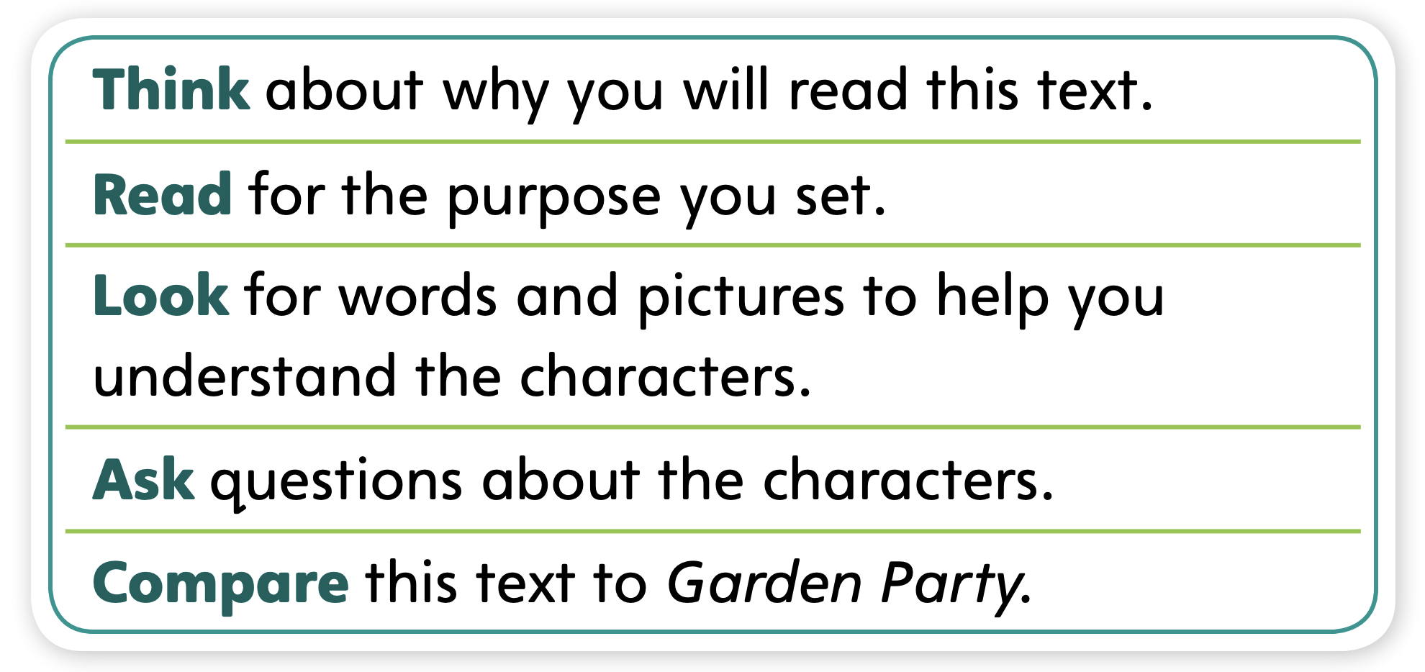
First Read Strategies
Notes:
Prepare students to compare and contrast ideas across texts. We just finished reading Garden Party. As we read Click, Clack, Click!, look for similarities and differences between the two texts. Discuss the First Read Strategies with students. Guide students to develop their own purpose, or reason, for reading Click, Clack, Click!
THINK Prompt students to develop their own reasons for reading the text.
READ Have students focus on the purpose they established as they read or listen to the text.
LOOK Remind students to look at the words and pictures to help them understand the characters and the characters’ actions in the text.
ASK Have students generate, or ask, questions about the characters to deepen their understanding.
COMPARE Guide students to compare the text to Click, Clack, Click! Ask them to focus on the similarities and differences between Jamal (from Garden Party) and Amena (from Click, Clack, Click!).
Students may read the text independently, in pairs, or as a whole class. Use the First Read notes to help students connect with the text and guide their understanding.

Slide 29
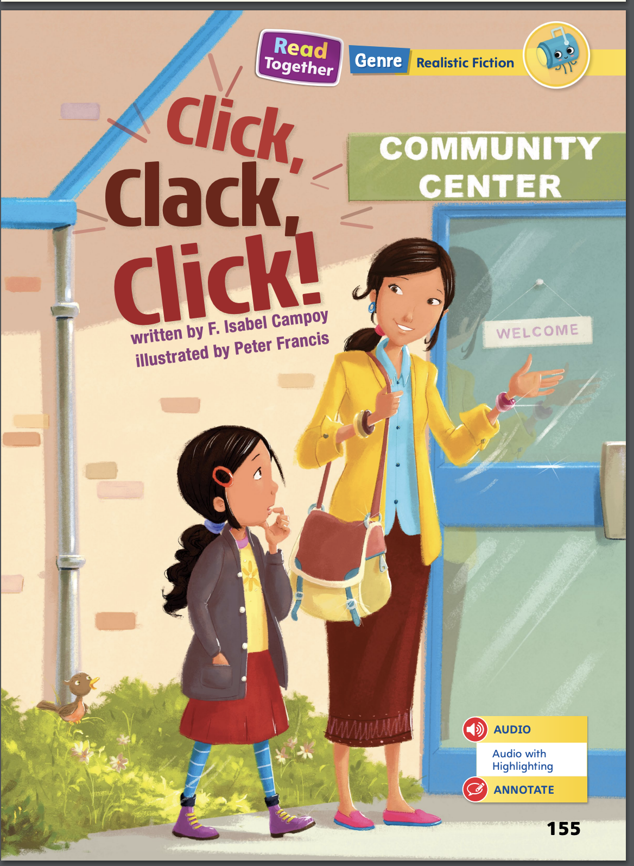
Page 155
First Read – Click, Clack, Click
Notes:
Read together.
THINK ALOUD I see the title page shows a girl with an adult. This picture gives me a clue about how the girl feels. The adult looks like she is taking the girl someplace, but the girl looks like she isn’t sure she wants to go. I ask myself why the girl looks worried. I will read on to find the answer to my question.

Slide 30
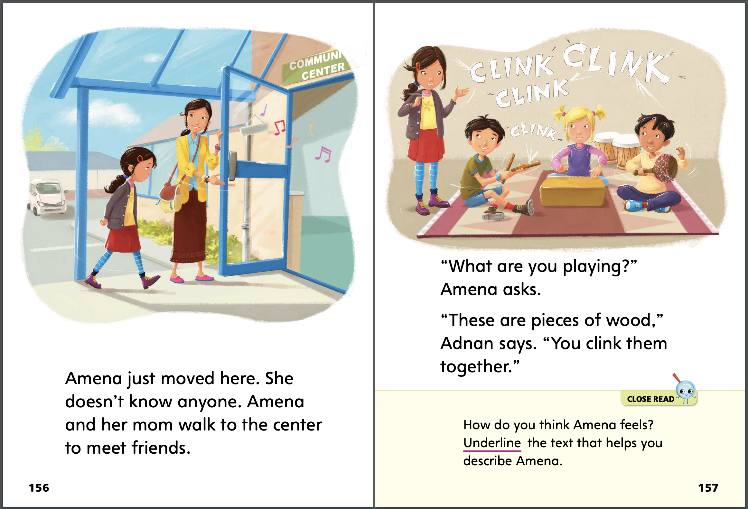
Page 156,157
First Read – Click, Clack, Click
Notes:
Read together.

Slide 31
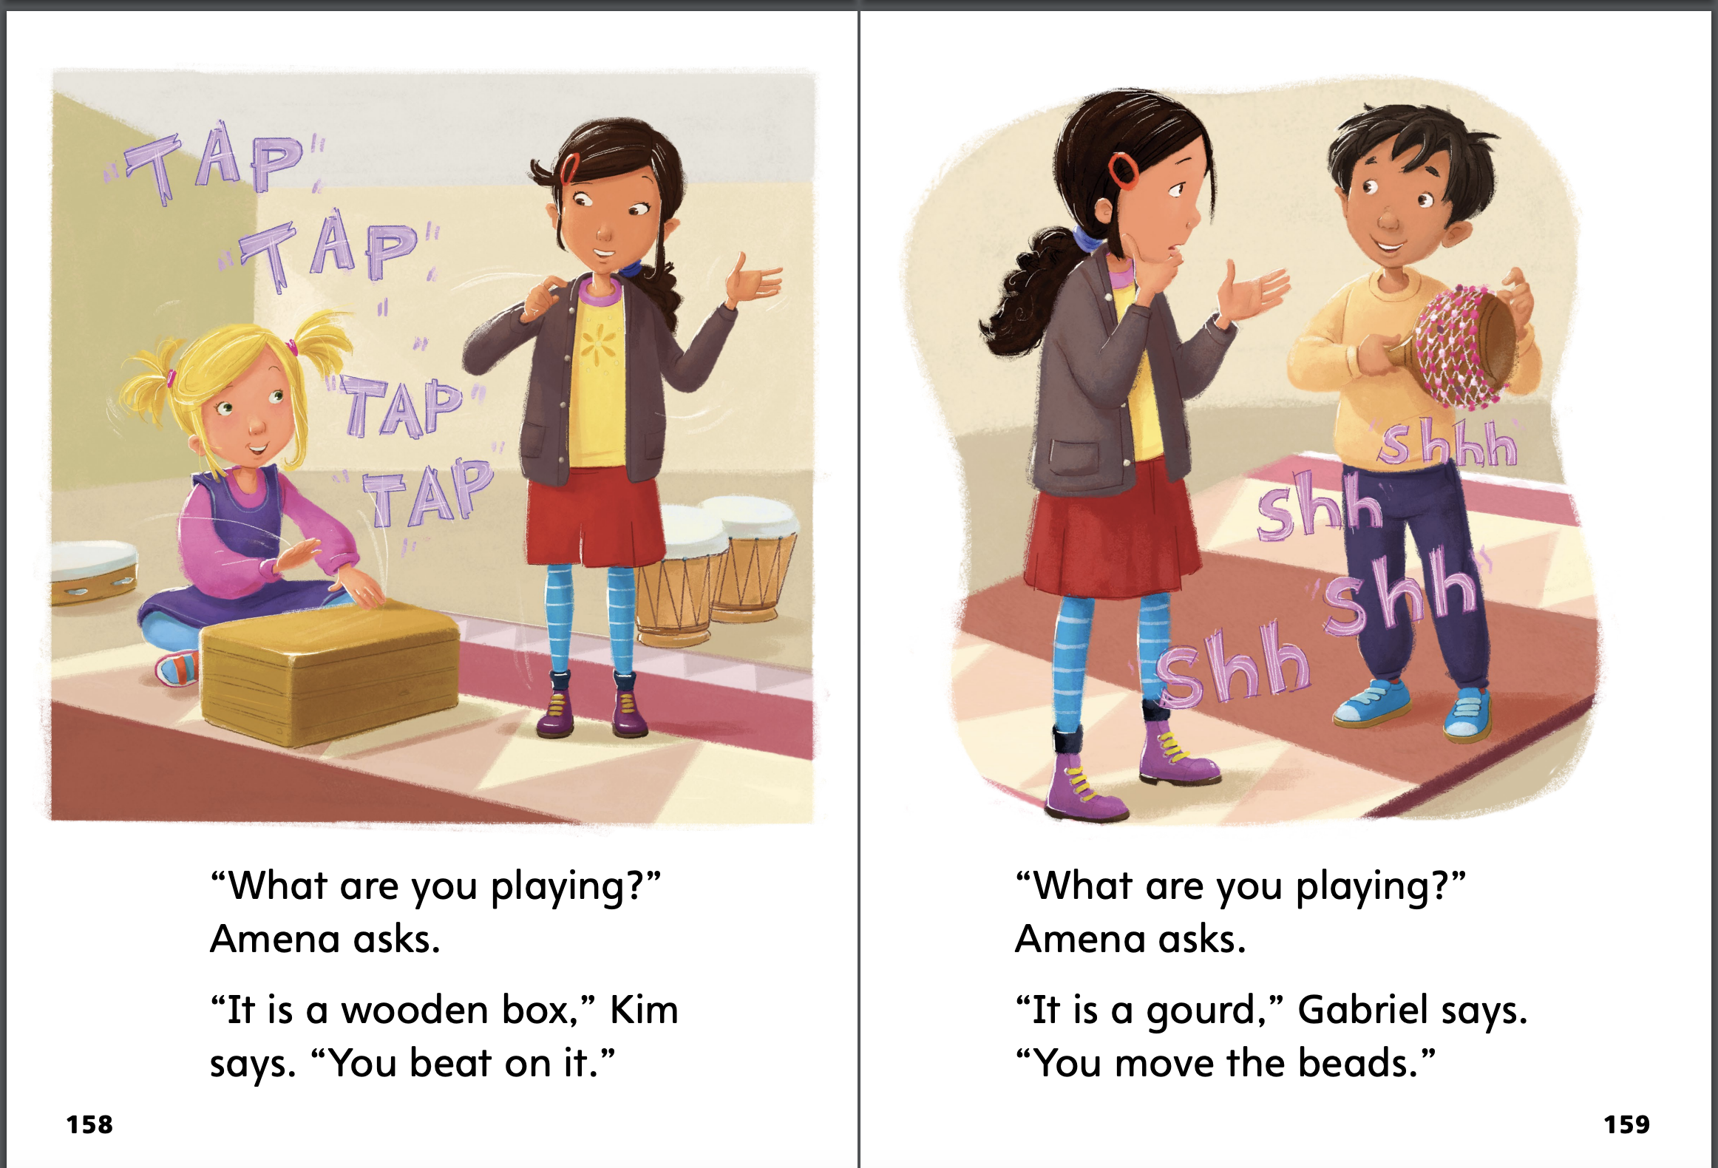
Page 158,159
First Read – Click, Clack, Click
Notes:
Read together.
THINK ALOUD I do not know who the boy on page 159 is. I should look at the words and pictures. The picture on this page shows Amena and a boy. The details from the text tell me that Amena is talking with a boy named Gabriel. So the boy in the picture must be Gabriel.

Slide 32
Page 160,161
First Read – Click, Clack, Click
Notes:
Read together.

Slide 33
Respond and Analyze
Retell Tell a partner about the part of each text that interested you the most. Why was it interesting?
Share Share a personal experience that relates to one or both of
the texts.
Notes:
Use these suggestions to prompt students’ initial responses to reading Look Both Ways!
Retell Tell a partner about the part of the text that shows something you have seen before. Where did you see this thing?
Illustrate Details Have students draw a picture of a traffic light or walk and wait signals. Then have partners discuss the meaning of each signal and what they should do when they see it.

Slide 34
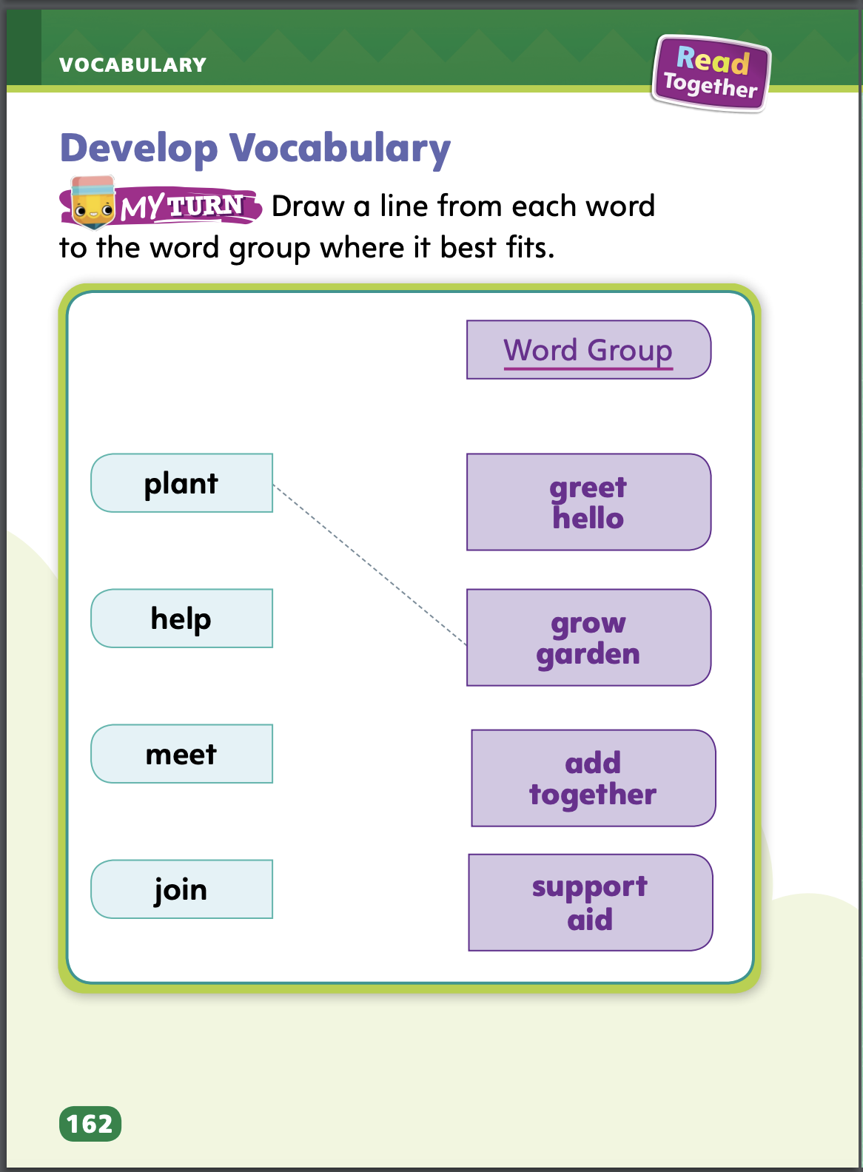
Page 162
Develop Vocabulary
Turn to page 162 in your Student Interactive and complete the activity.
Notes:
Tell students that authors choose words carefully. The vocabulary words plant, help, meet, and join can be used to talk about the actions of characters in Garden Party and Click, Clack, Click!
Remind yourself of the word’s meaning.
Think about why the author chose to use this word. What information is the author trying to give the reader?
Have students turn to p. 162 in the Student Interactive. Model how to complete the activity using the word plant. Read the directions aloud and ask students to look at the word groups. In which word group does plant fit best?
Have students use the strategies for developing vocabulary.
Have students respond by using the vocabulary words to complete p. 162 in the Student Interactive.

Slide 35
Page 163
Check for Understanding
What makes both texts realistic fiction?
What words do the authors use to describe things? Why do the use these words?
How are the texts alike? Use text evidence.
Notes:
Have students complete p. 163 in the Student Interactive.

Slide 36
Page 171
Writing – Launching Writing Workshop
Turn to page 171 in your Student Interactive.
Notes:
Authors revise their drafts by adding details in pictures. Different kinds of books contain different kinds of illustrations and details. Fiction books usually contain illustrations with details that show
what a character is doing
what a character looks like
where a character is
Nonfiction books usually contain illustrations with details that show
different parts of an object
what real places look like
what real people do
Hold up a fiction book from the stack. Read aloud the title. Look at this illustration. What details help you know more about the book? How could the illustrator have revised his or her draft to add details in pictures that would give even more information?
Hold up another fiction book and model for students how you would revise the text to add details. Then hold up another book and ask the class to offer details they would add. Repeat the procedure with some nonfiction books.
Direct students to p. 171 in the Student Interactive. Read the introduction and directions and have students revise the illustration by adding details.

Slide 37
Independent Writing
Revisit your stories and add details to your pictures.
Continue writing your stories.
Notes:
During independent writing time, students should revise their drafts by adding details to their own pictures. Then they should continue writing.
Modeled Do a Think Aloud to model drawing a character and adding details.
Shared Have partners work together to draw an object and talk about details they can add.
Guided Provide explicit instruction on details students can add to their pictures to help readers.
As students write, use the conference prompts in the Teacher’s Edition or Resource Download Center to provide support. Click path: Table of Contents -> Resource Download Center -+ Writing Workshop Conference Notes
Call on several students with whom you conferred to share the pictures they drew, identify the details, and tell why they included them.

Slide 38
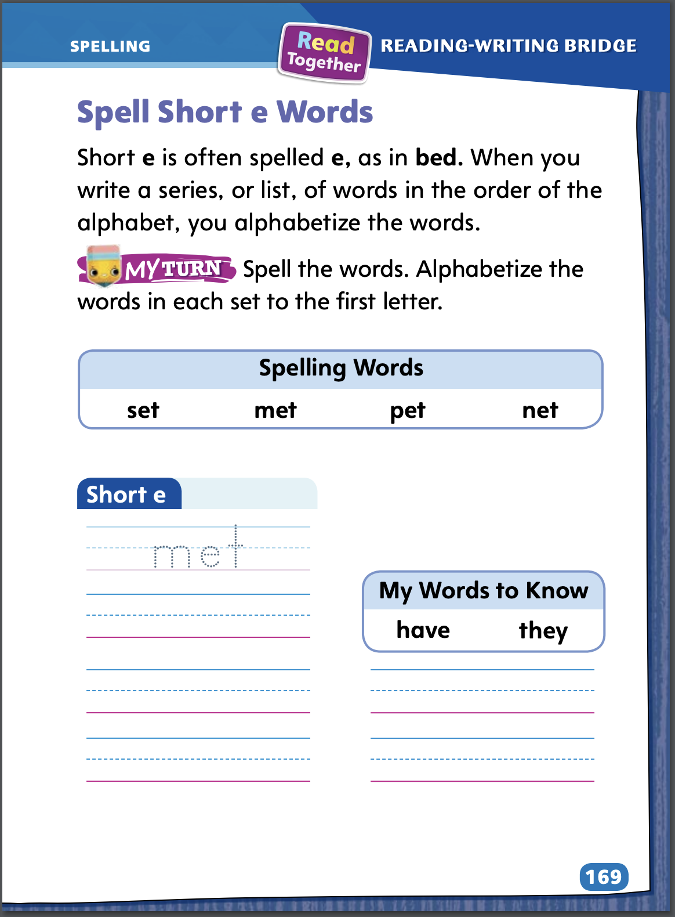
Page 169
Spelling
ten
men
pen
Turn to page 169 in your Student Interactive and complete the activity.
Notes:
Explain that in some words, the letter e is pronounced /e/ as in net.
Display the following words: ten, men, pen. Read each word and point out that the letter e makes the short e sound. Then circle the first letters in each word. Model alphabetizing the three words to the first letter. (men, pen, ten)
Have students complete the activity on p. 169 in the Student Interactive.

Slide 39
Language and Conventions
The girl has a small plant.
Notes:
Introduce adjectives and articles to students. Explain that an adjective is a word that describes a noun. Articles a and an tell about any person, place, or thing. The article the tells about a specific person, place, or thing.
Present this sentence: The girl has a small plant. Ask: Which word describes plant? (small) Small describes plant, so small is an adjective. Does the article the tell about a specific girl or any girl? (specific) Does the article a tell about a specific plant or any plant? (any)
Have partners practice using adjectives and articles by making their own oral sentences. Tell them to include at least one adjective and one article. They will then share their sentences with the class, explaining which word is the adjective and which is the article.

Slide 40
Lesson 3

Slide 41
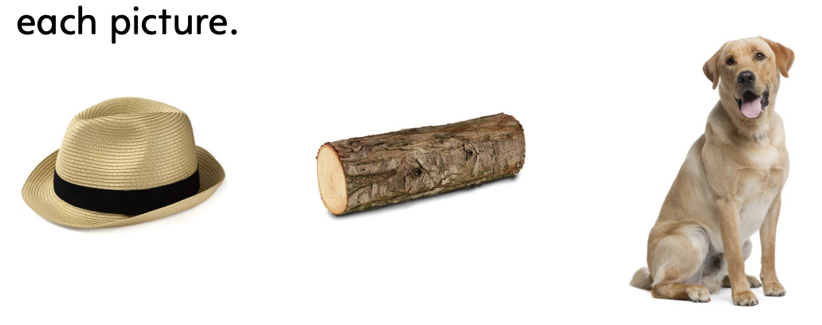
Page 137
Phonological Awareness
Notes:
Point to the picture of the hat on p. 137 in the Student Interactive. Tell students to listen for the beginning sound as you say the word hat. Then say: What sound does hat begin with? Listen as I say the sound: /h/ /h/ /h/ hat. Hat begins with the sound /h/. Say the sound with me: /h/. Repeat the sounds in the word hat several times and stress the beginning sound: /h/ /a/ /t/. Then have students repeat this activity with the pictures for log and dog.
Say the following words and have students segment and blend the phonemes: lot, /l/ /o/ /t/; hen, /h/ /e/ /n/; Dan, /d/ /a/ /n/. Ask students what sound they hear at the beginning of each word.

Slide 42
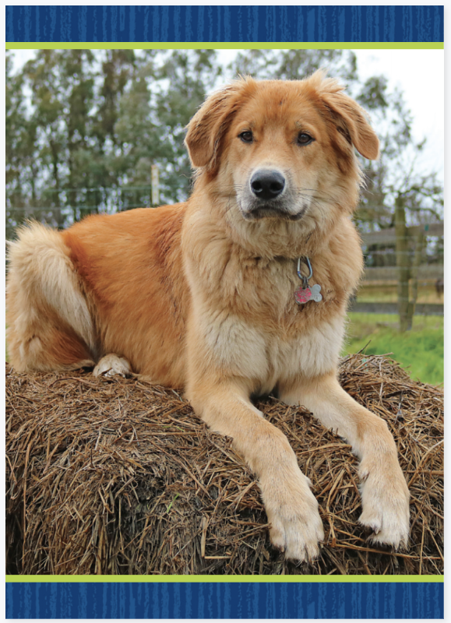
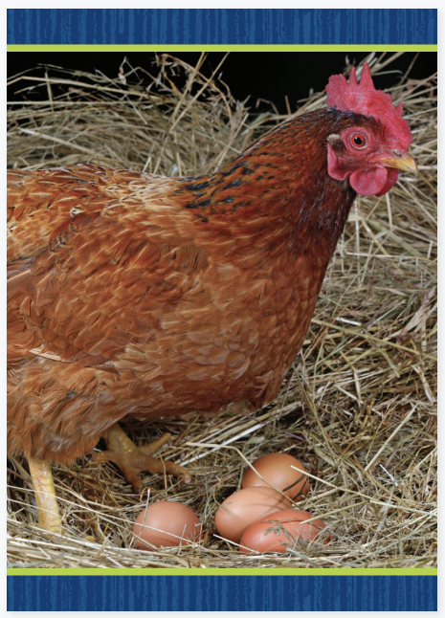
Phonics
dog
lamp
hen
dot
dip
dig
lip
lot
leg
ham
hit
hog
Notes:
Use the dog, lamp, and hen Picture Cards to introduce the sound /d/ spelled d, sound /l/ spelled l, and sound /h/ spelled h.
Write the letters d, l, and h. Model the sound /d/ spelled d, sound /l/ spelled l, and sound /h/ spelled h. Display the dog Picture Card. Write the word dog. Listen as I say this word: dog. I will say the sounds in the word slowly: /d/ (pause) /o/ (pause) /g/. What beginning sound do you hear? Listen carefully as I say the sounds in dog again: /d/ (pause) /o/ (pause) /g/. The beginning sound in dog is the sound /d/. The sound /d/ is spelled with the letter d. Point to the letter d. Practice other initial d words: dot, dip, dig. Repeat for the initial sound /l/ with the lamp Picture Card and the initial sound /h/ with the hen Picture Card. Model and practice initial sounds for words beginning with l and h: lip, lot, leg; hem, hit, hog. Click path -> Table of Contents -> Unit 1 Week 4 Realistic Fiction-> Lesson 3

Slide 43
Page 137
Phonics
Turn to page 137 in your Student Interactive.
Notes:
Have students practice blending and decoding the words on the bottom of p. 137 in the Student Interactive.

Slide 44
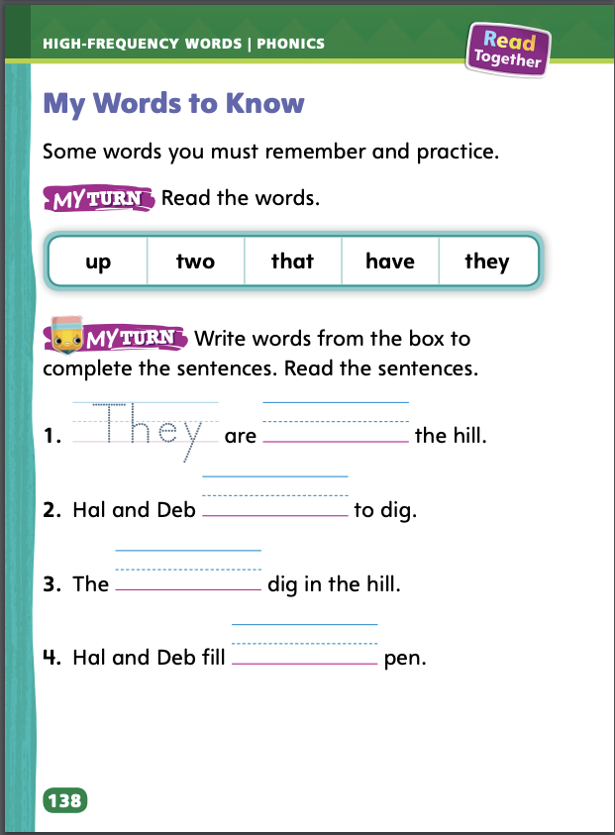
Page 138
High-Frequency Words
Turn to page 138 in your Student Interactive and complete the activity.
Notes:
Review the high-frequency words for the week: have, that, they, two, up. Explain that these are words we must remember and practice.
Write have on the board. Say: This is the word have. What are the letters in have? Yes, the letters are h, a, v, e. Ask students to use have in a sentence. Repeat with the remaining words.
Have students identify, read, and write high-frequency words on p. 138 in the Student Interactive.

Slide 45
Page 147,155
Describe Characters
Notes:
Characters are the people or animals in a story. Readers can describe characters by noticing what they say and do. When you read more than one text, you can compare and contrast characters’ actions.
Examine the text. Are there words or pictures that might help you describe the main characters and the reasons for their actions?
Focus on words that tell what the characters say, do, and feel.
Direct students’ attention to the Close Read note on p. 153 of Garden Party in the Student Interactive.
To describe how Jamal feels, I need to read the text. Then I should find Jamal in the picture and think about how he looks. Does he look happy, sad, or mad? Then I can describe how Jamal feels. Read aloud the text to students. Then ask: How does Jamal feel? Guide students to describe Jamal.
Compare Texts Now have students go back to the Close Read notes on pp. 157 and 161 in the Student Interactive and underline the text that helps them describe how Amena feels in Click, Clack, Click! Lead a discussion that compares and contrasts the two characters.

Slide 46
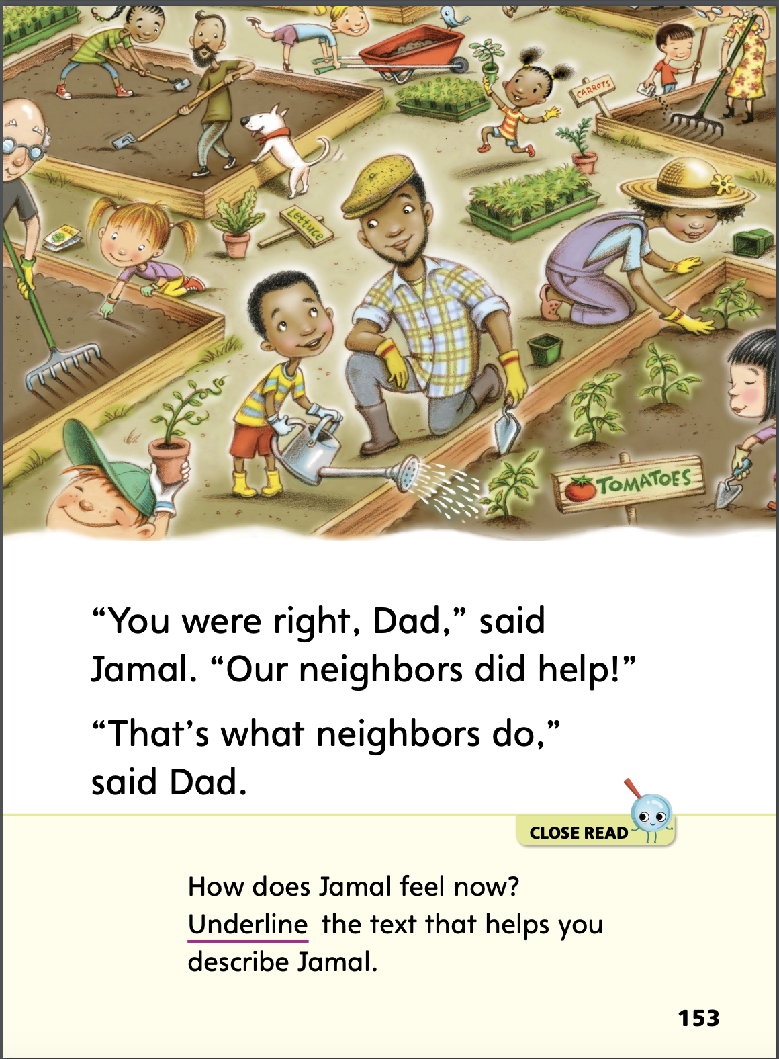
Page 153
Close Read – Describe Characters
Turn to page 153 in your Student Interactive.
Notes:
Have students follow the Close Read prompt on p. 153. Ask: How does Jamal feel? (possible response: happy) DOK 1

Slide 47
Page 156,157
Close Read – Describe Characters
Turn to page 156 and 157 in your Student Interactive.
Notes:
Have students read the Close Read note. Ask: How does Amena feel? (Possible response: sad) Then prompt them to underline details in the text that help them describe how Amena is feeling at the start of the story. DOK 2

Slide 48
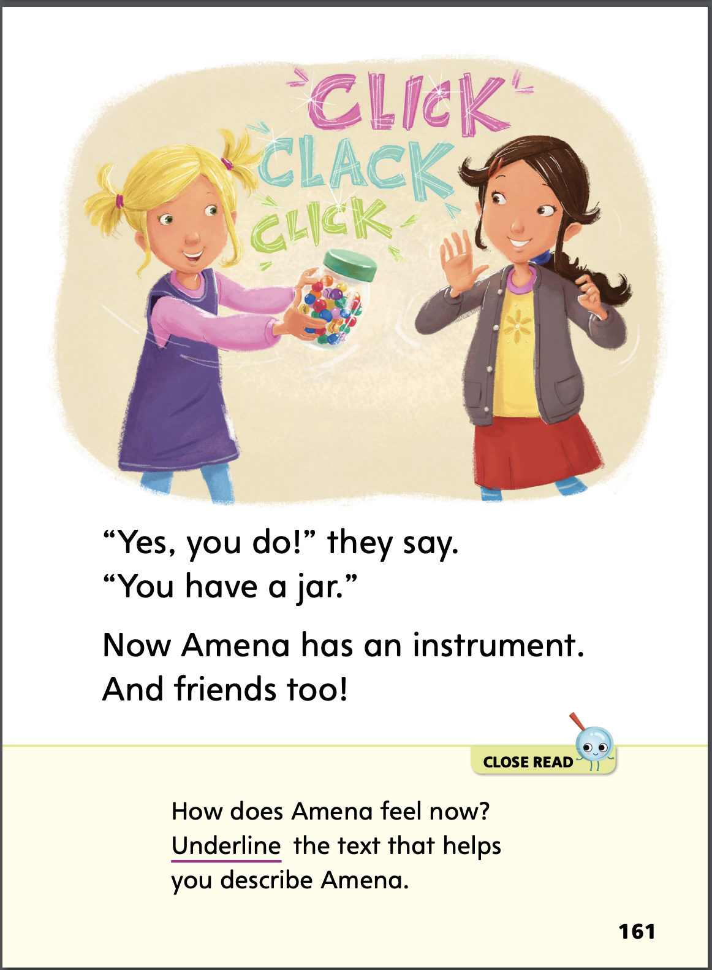
Page 161
Close Read – Describe Characters
Turn to page 161 in your Student Interactive.
Notes:
Ask students to read the Close Read note on p. 161. Guide them to use clues from the picture to help them understand how Amena feels. Then prompt students to underline details in the text that tell why she is feeling that way. Ask students to explain why Amena's character changes over the course of the story. (Possible response: She makes friends.) DOK 3

Slide 49
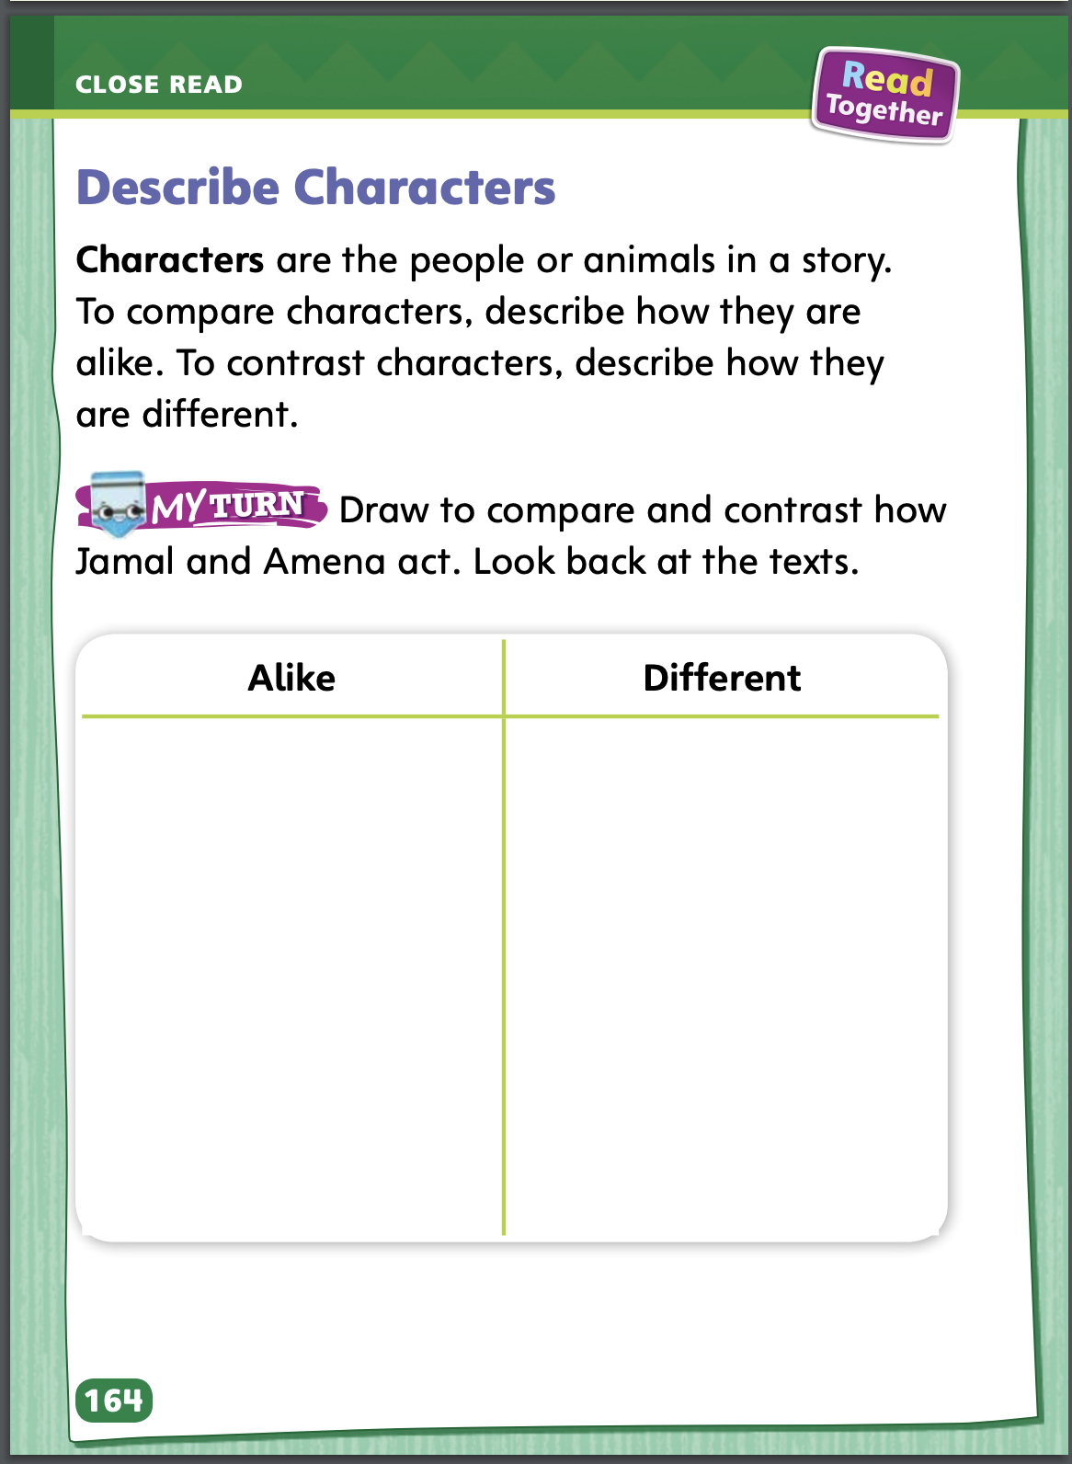
Page 164
Describe Characters
Turn to page 164 in your Student Interactive and complete the activity.
Notes:
Have students use the strategies for describing characters.
Have students compare characters by completing the chart on p. 164 in the Student Interactive.

Slide 50
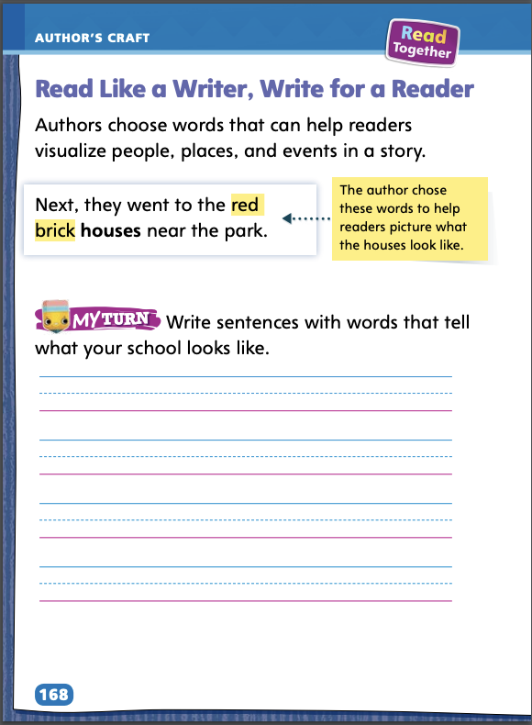
Page 168
Read Like a Writer, Write Like a Reader
Turn to page 168 in your Student Interactive and complete the activity.
Notes:
Authors choose precise and vivid words to help readers see and understand what they are describing in a text.
Descriptive words can help you picture people, places, and events.
Pay attention to descriptive words.
We can make connections between words and what we think about those words.
Use the text on p. 168 in the Student Interactive to discuss with students how authors use words to describe people, places, and events in detail. In the sentence, “Next, they went to the red brick houses near the park,” the author uses words to paint a picture. The words red brick help us picture, or visualize, what the houses look like. Point to an object in the room, such as a chair. Ask students to make connections between the chair and real life. They might express they have a chair at home that is comfortable. Ask students to suggest words to help someone picture what it looks like.
Have students use the bottom of p. 168 in the Student Interactive to write sentences with descriptive words that tell what their school looks like.

Slide 51
Handwriting
Forward Circles
Notes:
When students draw forward circles, they draw circles in a clockwise motion.
Model drawing forward circles on the board. Draw a large circle in a clockwise motion. Draw arrows pointing clockwise around the circle to show the direction students should draw forward circles.
Have students use Handwriting p. 26 from the Resource Download Center to practice drawing forward circles. Click path: Table of Contents -> Resource Download Center -> Handwriting Practice -> U1W4L3 Handwriting Practice

Slide 52
Writing – Launching Writing Workshop
Authors use specific words to expand sentences and add details
fluffy or fuzzy, to describe a noun like dog
kind or smart, to describe a noun like girl
slowly or quickly, to describe a verb like walking
Notes:
After writing a first draft, authors look back and revise their writing to improve it. They often use specific words to expand sentences and add details. Some examples of these specific words are
fluffy or fuzzy, to describe a noun like dog.
kind or smart, to describe a noun like girl.
slowly or quickly, to describe a verb like walking.
Tell students that they will be looking at several books to see just how writers use words to add details to their writing.
Hold up a book from the stack. Read the title. Let’s look at some of the details the author writes about this topic. Read a sentence that uses detail words. Ask: What is this sentence about? Does this sentence tell us what ___ is like? Which word adds the detail to the sentence?
Repeat these questions while discussing details included in both fiction and nonfiction books from the stack. Point out adjectives and adverbs, focusing on how the specific words help make the writing clearer and more informative.

Slide 53
Independent Writing
You will continue to write your books.
Add details to your books by including adjectives in your sentences.
Notes:
During independent writing time, students should continue writing their books.
Remind students to add details to their books by including adjectives in their sentences.
Modeled Choose a stack text and do a Think Aloud to identify a detail and information that was added.
Shared Have students choose a stack text. Prompt students to find and discuss one detail and share what else they would like to know.
Guided Use the stack texts to provide explicit instruction on identifying a detail, the additional information given, and what other information could be added using adjectives or descriptive words.
As students write, use the conference prompts in the Teacher’s Edition or Resource Download Center to provide support. Click path: Table of Contents -> Resource Download Center -+ Writing Workshop Conference Notes
Call on a few students with whom you conferred to share a sentence from their book and explain what details they included or added.

Slide 54
Spelling
Deb
Ben
Peg
Notes:
Tell students that in some words the short e sound is spelled with the letter e.
Prompt students to spell these short e names: Deb, Ben, Peg. Say each word aloud and point out that the letter e in the middle of the three names spells the short e sound.
Have students complete Spelling p. 32 from the Resource Download Center. Click path: Table of Contents -> Resource Download Center -> Spelling -> U1W4

Slide 55
Language and Conventions
A big dog runs to the tall tree.
Max needs_____ shirt.
He wants to paint_____ picture.
Notes:
Review adjectives and articles with students. Remind students that an adjective describes something. Articles a and an tell about any person, place, or thing. The article the tells about a specific person, place, or thing.
Display this sentence: A big dog runs to the tall tree. Guide students to identify the adjectives (big, tall) and articles (A, the) in the sentence. Have students explain what the adjectives describe (big tells about dog, tall tells about tree). Then prompt them to determine if the articles tell about any thing (A) or a specific thing (the).
Display these sentence frames: Max needs ____ shirt. (an old) He wants to paint ____ picture. (a large) Ask students to edit for adjectives and articles.

Slide 56
Lesson 4

Slide 57
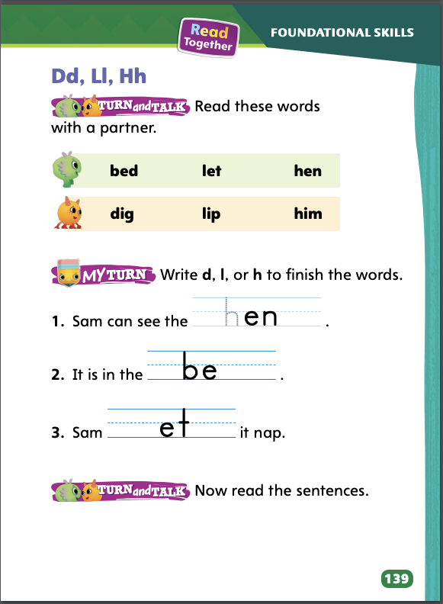
Page 139
Phonics
Decode the words with your partner.
Notes:
Review the letter names and sounds for /d/ spelled d, /l/ spelled l, and /h/ spelled h.
Write the word let. Say: Listen as I say the word let slowly: /l/ (pause) /e/ (pause) /t/. Say each sound slowly so students can hear the individual sounds. Say the sounds in let again and have students repeat. How many sounds can you hear in let? Elicit responses. Draw three empty boxes. Next, model how to write the letters for each sound. Say: What letter spells the sound /l/? Write l in the first box. Continue with the e and t. Then slide your finger under the boxes and read the word. Have students practice reading the word with you. Repeat with the words ham and den.
Have partners decode the words at the top of p. 139 in the Student Interactive.

Slide 58
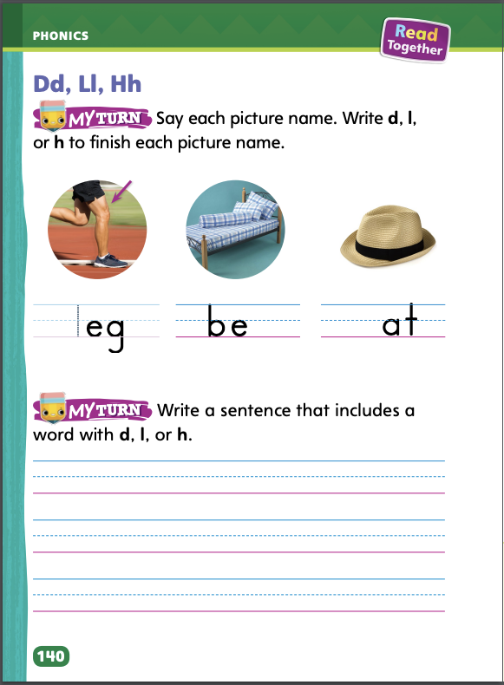
Page 139,140
Phonics
Turn to page 139 and 140 in your Student Interactive and complete the activity.
Notes:
Have students complete the rest of p. 139 and p. 140 in the Student Interactive. Be sure they read the words in context by reading their completed sentences.

Slide 59
High-Frequency Words
have
two
that
up
they
Notes:
Before reading the Decodable Story, review this week’s high-frequency words: have, that, they, two, up. Tell students that they will practice reading these words in the story Fill the Pen. Display the words. Have students read them with you. When you see these words in today’s story, you will know how to read them.

Slide 60
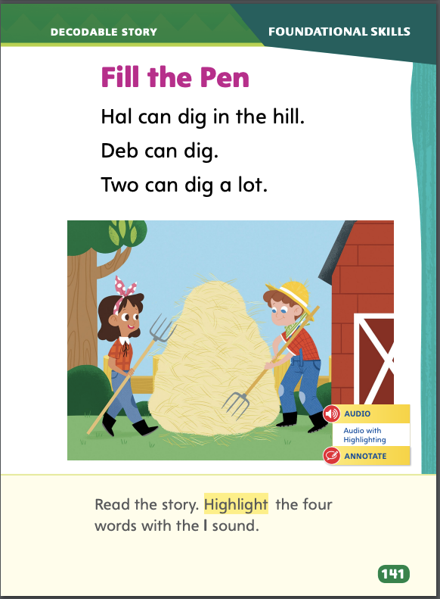
Page 141
Decodable Story
Turn to page 141 in your Student Interactive. Read “Fill the Pan” with your partner.
Notes:
Have students turn to p. 141 in the Student Interactive. We are going to read a story today about Hal, Deb, and a pen. Point to the title of the story. The title of the story is Fill the Pen. I hear the short e sound in the word Pen. What letter in Pen spells the sound /e/? Right! The letter e spells the sound /e/. Point to the e in Pen. We will read other words with the short e sound spelled e, and words with the letters d and h and l in our story.
Before reading, review this week’s high-frequency words: have, that, they, two, up. Tell students that they will practice reading these words in the story Fill the Pen. Display the words. Have students read them with you. When you see these words in today’s story, you will know how to read them.

Slide 61
Page 142,143
Decodable Story
Notes:
Pair students for reading and listen carefully as they use letter-sound relationships to decode. One student begins. Students read the entire story, switching readers after each page. Partners reread the story. This time the other student begins.
Call students’ attention to the title on p. 141. I see the letters ll in the word Fill. What sound does the letter l make? Then have them identify words with the /l/ sound spelled l and ll on p. 141 and highlight them.
Have students turn to p. 142. Which words have the sound /h/? (Hal, hill, have) Which letter spells the sound /h/ in Hal, hill, and have? (h) Have them underline the words. Then ask: Which words have the sound /d/? (Deb, dig) Which letter spells the sound /d/ in Deb and dig? (d). Have students highlight the words. Repeat with the sound /h/ spelled h.
Have students turn to p. 143. Which words have the sound /e/? (get, pen) Which letter spells the short e sound in get and pen? (e) Have students highlight the words.

Slide 62
Page 147,155
Visualize Details About Characters
Notes:
The details in a story can help readers create mental images to deepen their understanding about the characters and events in two or more texts.
Find details in both texts that tell about the characters and events.
Use these details to visualize what happens in the story.
How does creating pictures in your mind help you understand the characters and events in the texts?
Revisit p. 151 of Garden Party in the Student Interactive. Have students examine the Close Read note.
I can visualize, or picture in my mind, details that tell me about the neighbors. These details might be what the neighbors do or say. When I read these details, I think about what they tell me about the neighbors. Are they nice or mean? Then I can visualize the neighbors.
Have students highlight the details on pp. 150–151 that help them visualize the neighbors in Garden Party.

Slide 63
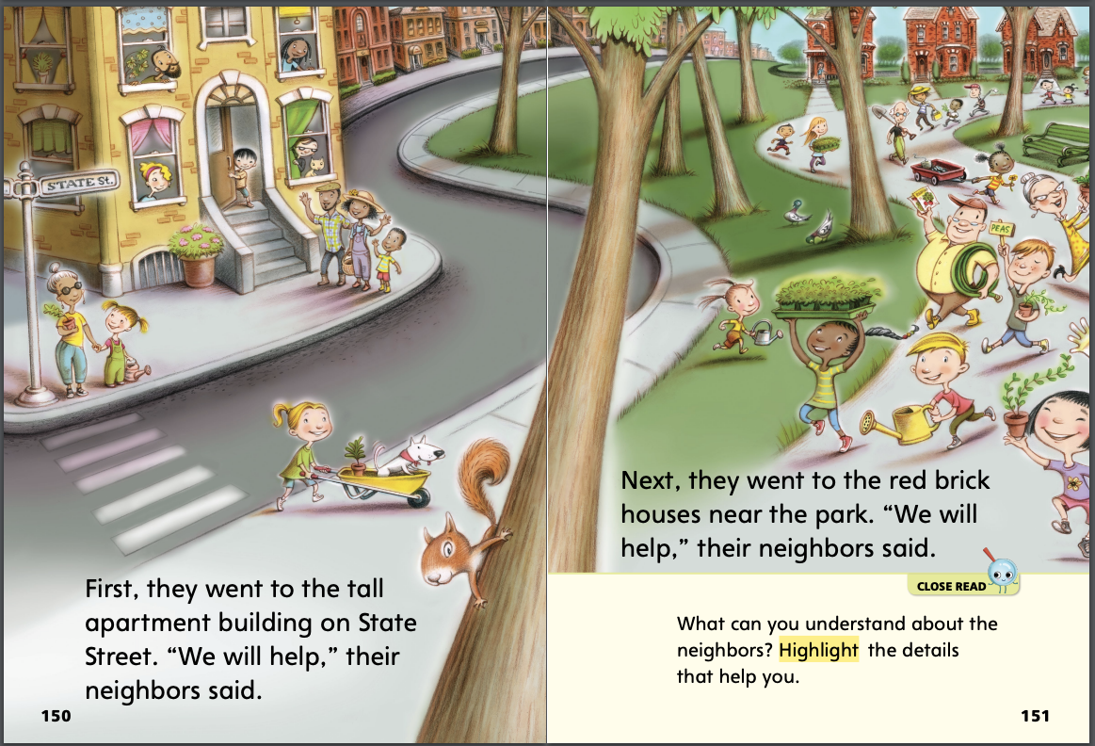
Page 150,151
Close Read – Visualize Details
Turn to page 150 and 151 in your Student Interactive.
Notes:
Have students follow the Close Read prompt on p. 151. Ask: How do you visualize the neighbors? (possible response: as happy, kind people) DOK 2

Slide 64
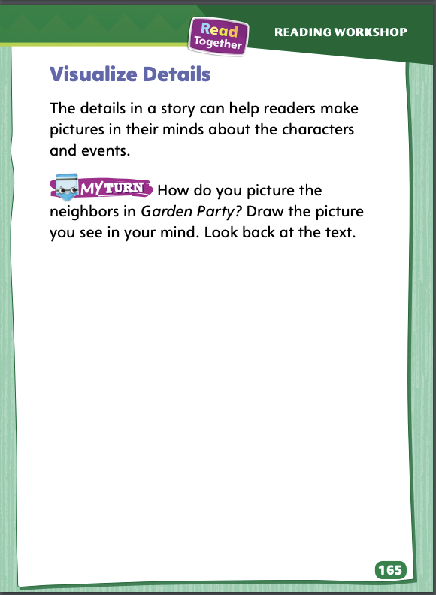
Page 165
Visualize Details
Turn to page 165 in your Student Interactive and complete the activity.
Notes:
Have students use the strategies for visualizing details about characters.
Have students complete p. 165 in the Student Interactive.

Slide 65
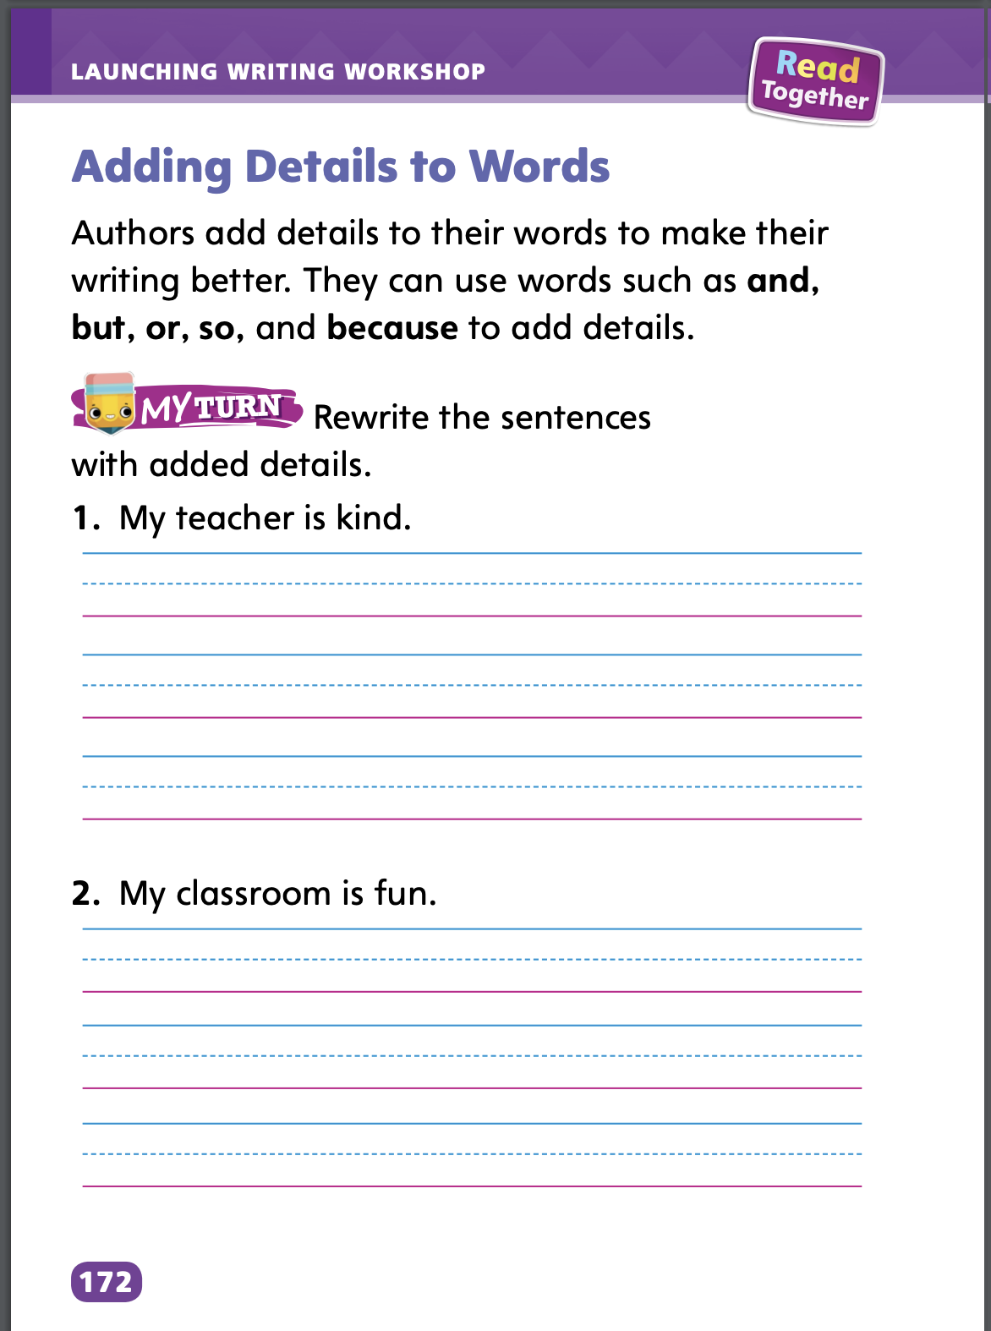
Page 172
Writing – Launching Writing Workshop
Turn to page 172 in your Student Interactive and complete the activity.
Notes:
Authors add different kinds of details for different reasons. They add details that
describe more about a character or place.
tell how characters or events are different.
Direct students to p. 172 in the Student Interactive. Read aloud the directions and the first sentence. Model how to revise a draft by adding a detail. Say: Today I’m going to teach you how to revise a sentence by adding more details. Let’s read this sentence. It says: My teacher is kind. In this sentence, I read one detail about my teacher: she is kind. I want to add another detail. I can use the word and to add another detail. I can say, “My teacher is kind and funny.”
Repeat by modeling how to add details to the second sentence. For example, say: My classroom is fun because my friends are here.
Have students complete the activity on p. 172 in the Student Interactive. Have students share their answers with the class.

Slide 66
Independent Writing
You will continue writing your books.
Reread the books you have written and find places to add details.
Notes:
After the minilesson, students should transition to independent writing.
Students should reread the books they have written in this unit and find places to add details.
Modeled Use a Think Aloud to model how to add a detail to a simple sentence using a descriptive word.
Shared Have student pairs write a sentence about something they both like. Prompt students to add details about why they like it using descriptive words.
Guided Use several simple sentences to provide explicit instruction on how to add details using each of the words listed on p. 172 in the Student Interactive.
As students write, use the conference prompts in the Teacher’s Edition or Resource Download Center to provide support. Click path: Table of Contents -> Resource Download Center -> Writing Workshop Conference Notes
Call on a few students to share their sentences and show how they added details.

Slide 67
Spelling
not
top
got
on
pot
fog
mop
bob
Notes:
Have students recall last week’s spelling rules for words with the short o sound spelled o and f/f/, b/b/, and g/g/.
Read these short o words and have students spell them: not, got, pot, mop, top, on, fog, bob.
In pairs, have students write a sentence with at least one short o word

Slide 68
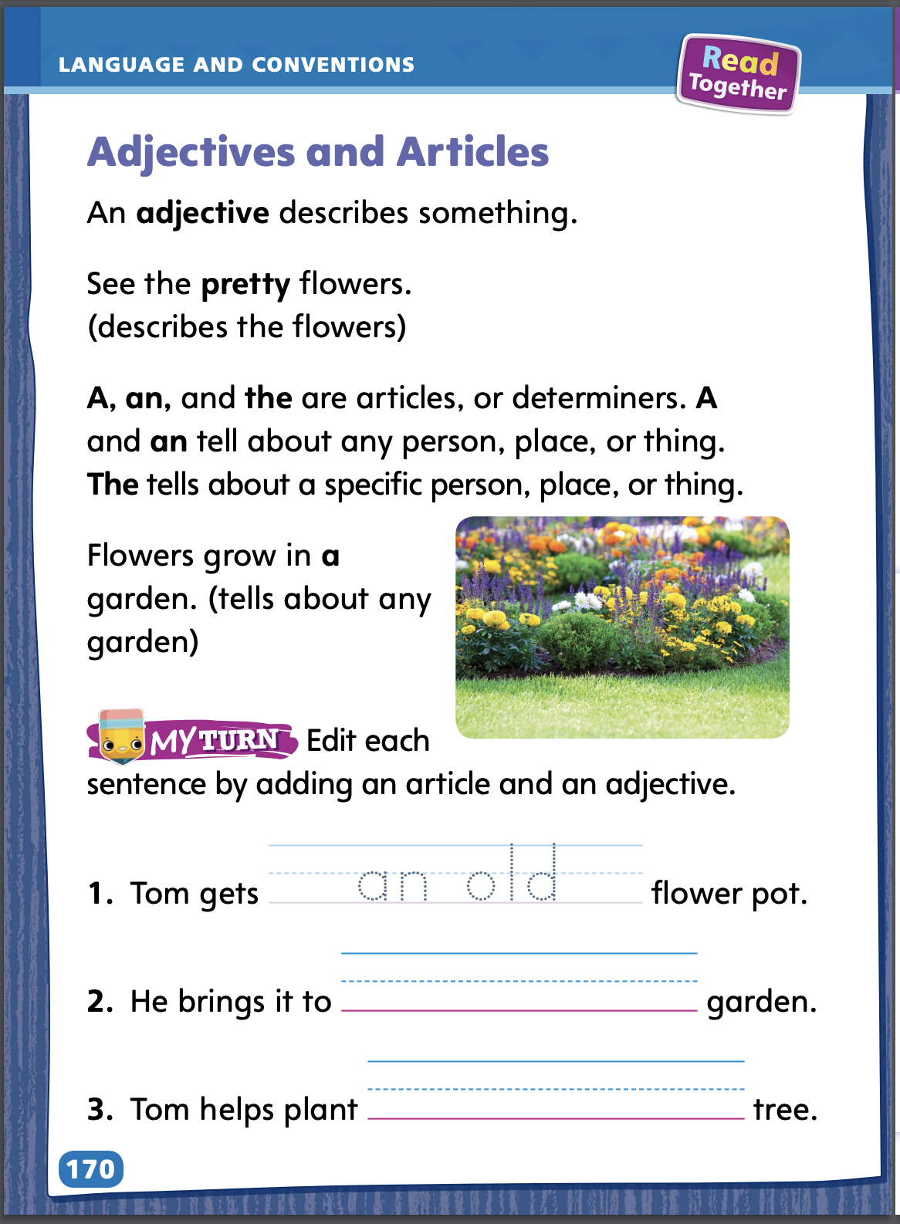
Page 170
Language and Conventions
Turn to page 170 in your Student Interactive and complete the activity.
Notes:
Have students edit the sentences on p. 170 in the Student Interactive.

Slide 69
Lesson 5

Slide 70
Phonological Awareness
pen /p/ /e/ /n/
leg
Deb
hen
Notes:
Students need to develop the ability to blend, or combine, individual sounds within words, as well as to segment, or break down, words into individual sounds.
Display the pen Picture Card. Write the word pen. Say: Let’s take apart the word pen. Repeat the word pen slowly, elongating the sound /e/. Then ask: What’s the beginning sound? Yes, /p/. What’s the middle sound? That’s right, /e/. What’s the ending sound? Yes, /n/. Repeat the segmented sounds and ask the students to repeat them after you. Then say: Let’s blend the sounds to say the word. Have students repeat the word pen several times.
Say the following words and have students segment and blend the phonemes: leg, Deb, hen. Ask students what sound they hear at the beginning of each word. Then ask them to identify the medial and final sounds in each word. Click path -> Table of Contents -> Unit 1 Week 4 Realistic Fiction-> Lesson 4

Slide 71
Phonics
Oo, Ff, Bb, Gg
big
dot
get
fan
top
bib
got
Notes:
Write the letters Oo, Ff, Bb, and Gg. Have students name each letter as you point to it. Then review the sound for each letter by pointing to each letter as you say the sound. Say: The sound /b/ can be spelled b. Repeat with the other letters.
Write each of the words listed below. Point to each word and have students read it. Have students point out the letters o, f, b, and g in each word.

Slide 72
High-Frequency Words
have
two
that
up
they
Notes:
Tell students that the words they studied this week are in many of the books they will read. Recognizing those words will help them read more accurately. Give students a bag of letter tiles and have them spell out as many of the high-frequency words as they can remember.

Slide 73
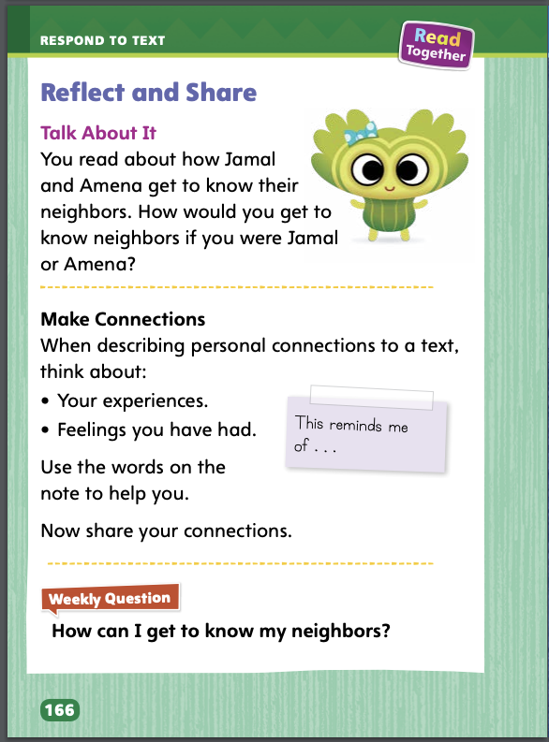
Page 166
Reflect and Share
Turn to page 166 in your Student Interactive.
Notes:
Tell students that discussing the connections they make as they read across texts will increase their understanding and enjoyment of reading. Students should
follow along with the discussion by listening actively.
think about personal experiences that are related to the text or topic under discussion.
describe their connections to personal experiences.
speak clearly and at an appropriate pace.
use the conventions of language.
ask relevant questions about others’ personal experiences to clarify information.
answer questions about their personal experiences using multi-word responses.
Model describing personal connections to the topic under discussion using the Talk About It prompt on p. 166 in the Student Interactive. In my life, I have gotten to know neighbors by going to a block party. I can share this personal experience in a discussion about how I would get to know neighbors if I were Jamal or Amena.

Slide 74
Page 166
Apply
How can I get to know my neighbors?
Notes:
Have students talk about their personal connections to the texts they read this week. They should focus on relating to the ways characters in these texts get to know their neighbors.
Have students respond by drawing or writing to answer the Weekly Question. Tell them to include information about their own experiences with neighbors. Click Path: Table of Contents -> Resource Download Center -> Speaking and Listening

Slide 75
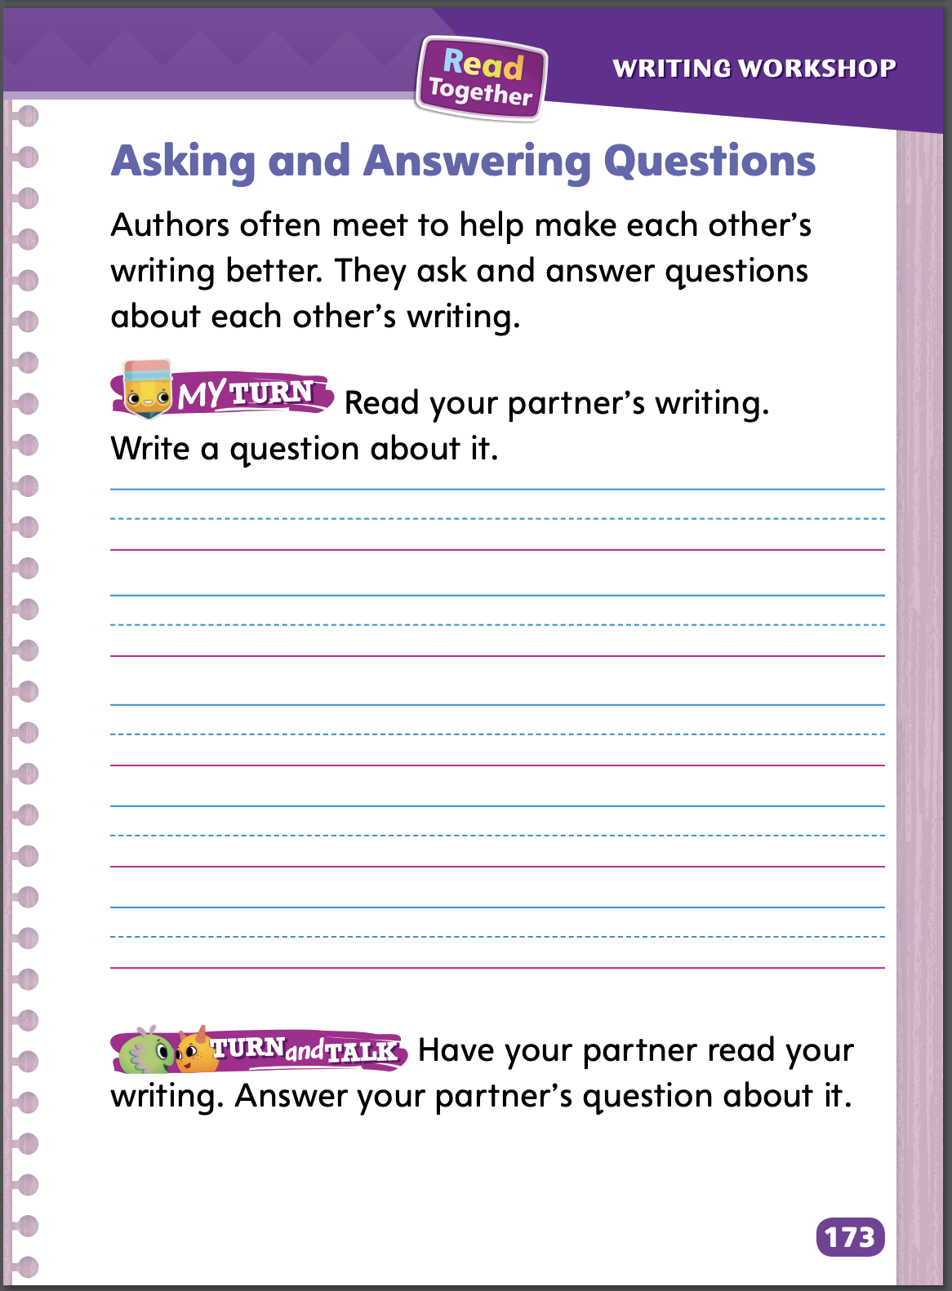
Page 173
Writing – Launching Writing Workshop
Turn to page 173 in your Student Interactive and complete the activity.
Notes:
There are a number of different ways writers try to improve their writing and make it clearer. One way is to share their writing with others and talk about how to make it clearer for readers. Good writers
ask each other questions about their writing to clarify information.
answer questions using multi-word responses to explain their writing.
Hold up a stack text and say: Authors meet with other authors to make their writing better. When they meet, they ask each other questions about their writing. Let’s read this book together and ask the author some questions. Begin reading the book aloud. Pause intermittently and give students an opportunity to ask questions to clarify information. If they need assistance, model asking questions yourself.
Record some questions on the board. When you finish reading the book, say: Now let’s pretend we are the authors of this book. Let’s answer these questions. Have students help you come up with multi-word responses to answer the questions on the board.
Direct students to p. 173 of the Student Interactive. Read aloud the introduction and the directions to My Turn. Pair up students and have partners share the sentences they wrote on p. 172. After completing My Turn, have students read their questions to each other, then complete the Turn and Talk activity.

Slide 76
Spelling
Did you set the alarm?
We met at the store.
The fish is my pet.
Catch it in the net!
I have a new pen.
Who are they?
Notes:
(Note: Move the orange boxes to cover each bold spelling word before you read aloud the words and sentences.)
Read aloud the words and sentences. Have students spell the words with initial consonant blends and the high-frequency words they have been practicing this week.
Did you set the alarm?
We met at the store.
The fish is my pet.
Catch it in the net!
I have a new pen.
Who are they?
Reveal the spelling word and have students check their work.

Slide 77
Language and Conventions
The girl walks in her new shoes.
Which word in the sentence is an example of an adjective
shoes
new
her
in
Notes:
Display the following sentence and guide students to complete the question.
The girl walks in her new shoes.
Which word in the sentence is an example of an adjective?
shoes
new
her
in
Have students complete Language and Conventions p. 39 from the Resource Download Center.. Click path: Table of Contents -> Resource Download Center -> Language and Conventions -> U1 W4

Slide 78
Unit 1: Week 4
Grade 1

