Slide 1
Unit 1: Week 5
Grade 4

Slide 2
Copyright © Savvas Learning Company LLC. All Rights Reserved.
This publication is protected by copyright, and permission should be obtained from the publisher prior to any prohibited reproduction, storage in a retrieval system, or transmission in any form or by any means, electronic, mechanical, photocopying, recording, or otherwise. For information regarding permissions, request forms, and the appropriate contacts within the Savvas Learning Company Rights Management group, please send your query to:
Savvas Learning Company LLC, 15 East Midland Avenue, Paramus, NJ 07652
or
k12learningpermissions@savvas.com
myView Literacy® is an exclusive trademark of Savvas Learning Company LLC in the U.S. and/or other countries.

Slide 3
Lesson 1

Slide 4
Page
152, 153
Interact with Sources
Discuss how people influence the places where they live.
Paraphrase the text or put it in your own words.
Notes:
Explain that Student Interactive pp. 152–153 present a text that contains information in both words and pictures. Point out that the pages contain text from a primary source: the act signed by President Grant. The pages also include information about Yellowstone Park and President Grant. Have students read the pages.
Read aloud the Week 5 Question with students: How can people influence the places where they live? Have students read Sec. 2 and then think about how President Grant influenced the Yellowstone area.
WEEKLY QUESTION Reread the Week 5 Question: How can people influence the places where they live? Tell students they have just discussed a way the people in the past influenced a place and that this week they will read more about how people influence where they live.
Read aloud the Turn and Talk. Pair students and have partners take turns reading the sections of the primary source aloud to each other.
Then review the definition of paraphrase and have partners collaborate to paraphrase each section of the primary source. Point out that Sec. 2 provides information on natural resources. Remind students that readers actively connect texts to society. Guide students to make connections between what they read in the primary source and what they know about our society.
Have partners discuss these ideas using the questions in the Turn and Talk, along with the following questions:
What people or institutions in our society work to preserve natural resources like the ones you read about?
What influence did President Grant have on the Yellowstone area?
What is the “natural condition” of a public park? How do you know?
Why might a community want to “set apart” a tract, or area, of land?
What is something you could do to have an influence on the place you live?
Ask partners to take notes on their discussion.
Call students together and have partners share their responses to the questions. Guide students to connect the primary source to their personal experiences, including details about natural resources in their communities.

Slide 5
Listening Comprehension
Babe Ruth
Notes:
Tell students that they will listen to a biography. A biography gives facts and details about a person’s life. Biographies are usually written in a sequential or chronological order. They usually use past tense because they tell about events that have already happened. Encourage students to be active listeners by looking at you and thinking about what you are saying as you read aloud.
READ-ALOUD ROUTINE
PURPOSE Have students listen actively for elements of a biographical text, such as time-order signal words.
READ the entire text aloud without stopping for the Think Aloud callouts.
REREAD the text aloud, pausing to model Think Aloud strategies related to the genre.
THINK ALOUD Identify elements of a biography as you read the first paragraph. I can tell this is a biography. The date 1895 tells me when George was born. The author uses the words “when he was a boy” and “he was only seven” to show a change in time. I can tell that the subject of the biography is George Herman Ruth Jr., or Babe Ruth as he was later called.
THINK ALOUD Model other ways the author shows time order as you read the second paragraph on this page. Later, the author uses dates to help me understand the chronological order. However, there are no dates in this paragraph. To understand the order of events, I need to ask myself, “What happened first? Then what happened?”
Draw a long horizontal line. Ask students to list, in order, the major events of Babe Ruth’s life.

Slide 6
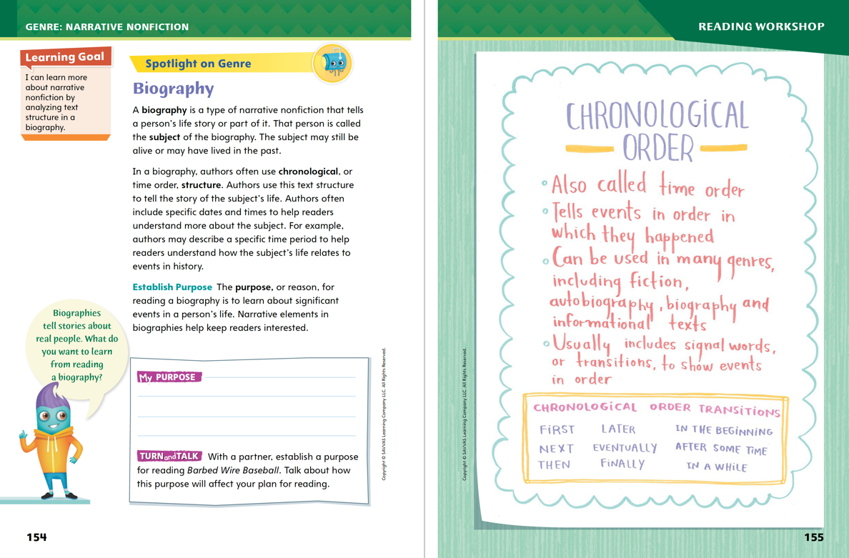
Page 154, 155
Narrative Nonfiction
Turn to page 154 in your Student Interactive.
Notes:
Tell students that they will be reading a biography. Remind them that a biography gives true details about a person’s life.
the text structure of a biography. Tell students that a biography uses a chronological text structure. This means that the events happen in a specific order over time. Have students look at p. 155 in the Student Interactive. Explain that these are some words that signal chronological order.
Say: I know that other types of texts can have a chronological order: informational texts that explain how or why something happens, informational texts that tell about an event in history, procedural text that tells how to do something, and fiction.
To help students analyze a biography, provide these prompts:
Pay attention to time-order words.
Look for dates that signal time has passed.
Ask yourself, which event happened first? What happened next?
Have students use the strategies to discuss biography.
Use the Anchor Chart Have students work with a partner to discuss the characteristics of biography. Circulate to determine if students show understanding. Editable Anchor Chart Click Path: Table of Contents -> Reading Anchor Charts -> Unit 1 Week 5: Chronological Order Editable Reading Anchor Chart

Slide 7
Page 154
Apply
Establish a purpose for reading Barbed Wire Baseball. Talk about how this purpose will affect your plan for reading.
Notes:
Have students complete the Turn and Talk activity on p. 154 of the Student Interactive.
Call on volunteers to share their purpose with the class.

Slide 8
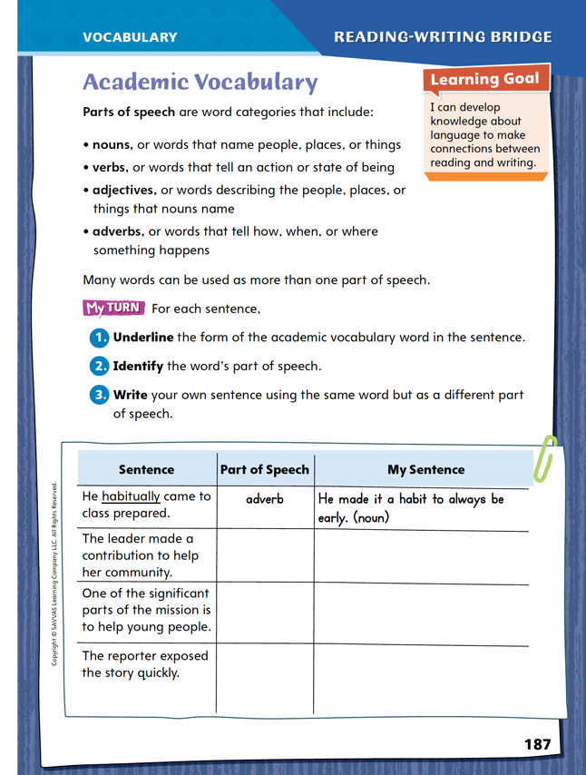
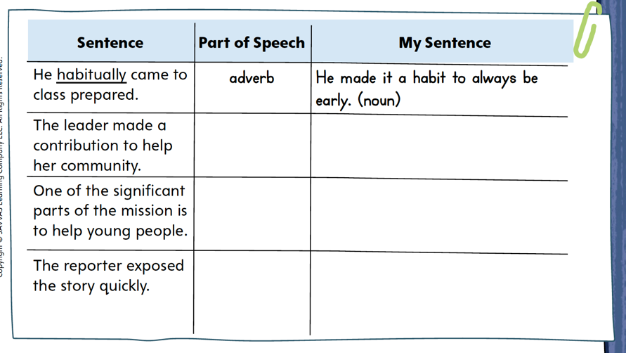
Page 187
Academic Vocabulary
Complete the chart on pg. 187 in your Student Interactive.
Notes:
Knowing parts of speech can help readers understand unfamiliar words, such as academic vocabulary. Words play different roles in a sentence, and identifying this role can help with finding the meaning of a word.
When you come across an unfamiliar word in your reading, think about the type of word it is and the role it plays—is it a person or an action? Is it describing something else in the sentence?
Ask yourself what category the word fits into. Find what question it answers: who, what, where, when, or how?
Often, a related word has a similar meaning but is a different part of speech.
Model this strategy using the chart on p. 187 in the Student Interactive. When I read habitually, one way I determine its meaning is by figuring out its part of speech. I look at the other words in the sentence. The subject is He and the verb is came. Habitually is a word that describes the verb. The part of speech that modifies a verb is an adverb. I can think of a noun, habit, that is related to the adverb habitually. I can write a new, related sentence using this noun. Point out the sentence containing habit in the chart on p. 187. Have students use a print or digital dictionary to find and clarify the precise meaning of the phrase make it a habit to.
Have students apply the strategy you modeled to another word from the chart. Then discuss responses and correct misunderstandings.
Have students follow the same strategy as they complete the chart on p. 187. Remind students that they will use these academic words throughout this unit.

Slide 9
Word Study
mis-, em-, en-
courage
encourage
gulf
engulf
Notes:
Prefixes are word parts added to the beginning of main, or base, words. The prefix mis- means “not” or “the opposite of.” The prefixes em- and en- can mean “in,” “provide with,” or “cause to be.” These prefixes change the meaning of a base word.
When you decode, or read, a word with a prefix, the base word is read the same.
To demonstrate how prefixes change the meaning of a word, use the words courage and encourage. Courage is a noun that means “bravery.” Encourage is a verb that means “to provide with courage.” Point out that the base word courage is decoded the same when the prefix en- is added.
Guide students to determine the relationship between gulf and engulf. Encourage them to use dictionaries to check meanings if needed.

Slide 10
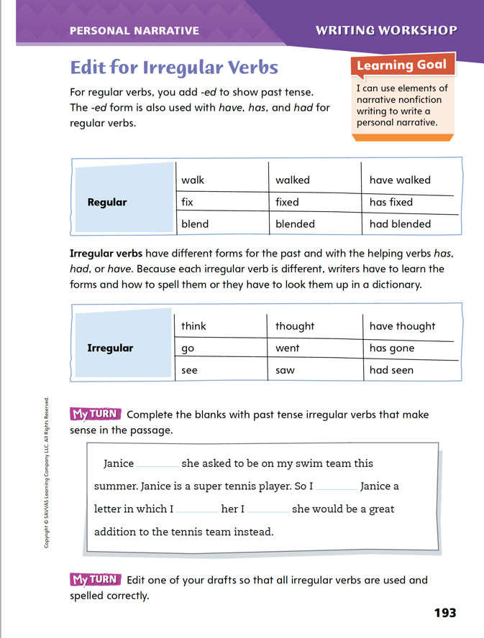
Page 193
Writing – Personal Narrative
Turn to page 193 in your Student Interactive.
Notes:
Preparing writing for publication includes editing for appropriate verb tenses, including correct use of irregular verbs. Typically, personal narratives are written in the past tense. Irregular verbs
have different forms for the past.
do not have rules for forming the past tense.
have forms and spellings that must be learned or looked up in a dictionary.
Inform students that they will be editing drafts of their personal narratives for correct forms and spellings of irregular verbs.
Say: Verbs we use all the time such as buy and fall are irregular, which means we do not add –ed to the verb to form the past. Guide students to identify the past tense of buy (bought) and fall (fell). Write the verb forms. Then say: We must learn the past tense forms and spellings of irregular verbs or look them up in a dictionary.
Have students read aloud with you the regular and irregular verbs in the tables on p. 193 in the Student Interactive.
For irregular verbs, point out the different forms for the past and those with the helping verbs has, had, and have.
Have pairs of students work together to edit the paragraph on the page so that all irregular verbs are used and spelled correctly. If necessary, review the past tense forms of the verbs in the paragraph.

Slide 11
Independent Writing
Edit one of your drafts to make sure all irregular verbs are used and spelled correctly.
Share a few sentences from your writing. Describe any errors you made with past tense forms and how you corrected them.
Notes:
After the minilesson, students should transition into independent writing.
If students are unsure of the correct past tense form or correct spelling, remind them to use a dictionary.
Writing Support:
Modeled Do a Think Aloud to model how to correct the irregular past tense verb in the first sentence of the boxed paragraph.
Shared Have students name irregular verbs that they use every day and identify the past tense forms. Make a list of the verbs. Then invite students to form sentences using the past tense forms. Record their contributions.
Guided Use a stack text to provide explicit instruction on irregular past tense verbs.
If students demonstrate understanding, invite pairs of students to review each other’s work and make any further edits. See the Conference Prompts on p. T432.
Call on a few students to share a few sentences from their writing with past tense forms of the irregular verbs. They may want to describe any errors that they made with past tense forms in their first drafts and how they corrected them.

Slide 12
Spelling
1. The sheep are enclosed in a field.
2. The rainstorm made their day at the park a misadventure.
3. She wanted to embed a rock in the sand.
4. I can enlighten you on my favorite subjects.
5. Some people misspell my name.
6. I misjudge distances without my glasses.
7. Dropping plates is one way to mishandle dinner.
8. New shoes will enable me to run faster.
9. The dog likes to misbehave when we are away.
10. The mountain gorilla is an endangered animal.
Notes:
(Note: Move the orange boxes to cover each bold spelling word before you read aloud the words and sentences.)
Read aloud the words and sentences to assess students’ prior knowledge of prefixes.
1. The sheep are enclosed in a field.
2. The rainstorm made their day at the park a misadventure.
3. She wanted to embed a rock in the sand.
4. I can enlighten you on my favorite subjects.
5. Some people misspell my name.
6. I misjudge distances without my glasses.
7. Dropping plates is one way to mishandle dinner.
8. New shoes will enable me to run faster.
9. The dog likes to misbehave when we are away.
10. The mountain gorilla is an endangered animal.
Reveal the spelling word and have students check their work.
For students who understand how to spell words with prefixes, include the following challenge words: misinterpret, misrepresent, encapsulate

Slide 13
Language and Conventions
I went to the store and bought bread the clerk placed it in a bag.
Create your own sentences with three related clauses. Use punctuation or connecting words to avoid run-ons.
Notes:
Review the language-and-conventions topic from the previous week about fixing run-on sentences. See p. T417.
Share with students this sentence: I went to the store and bought bread the clerk placed it in a bag. Then guide students to change the original sentence by adding a period after bread.
Ask volunteers to highlight the subjects (I, clerk) and underline the predicates (went to the store, bought bread, placed it in a bag).
As a class, try other ways to split up the sentence, such as: I went to the store. I bought bread, and the clerk placed it in a bag.
Have students create their own sentences with three related clauses, using punctuation or connecting words to avoid run-ons.

Slide 14
Lesson 2

Slide 15
Page 156
Preview Vocabulary
descent
internment
desolate
diverted
spectators
Notes:
Read aloud the vocabulary words on p. 156 with students.
descent: the family background or national origin of a person
internment: related to confinement, as if in a prison, often during a war
desolate: empty, lonely, and unhappy
diverted: changed the direction of
spectators: people who watch an event
Ask students what they know about the words and provide definitions if needed.
Say: The Latin root spec means “see.” How does this help you understand the word spectator? How do you think spectator relates to Barbed Wire Baseball? The Latin root vert means “turn.” What do you think diverted means? What do you predict diverted has to do with the book?

Slide 16
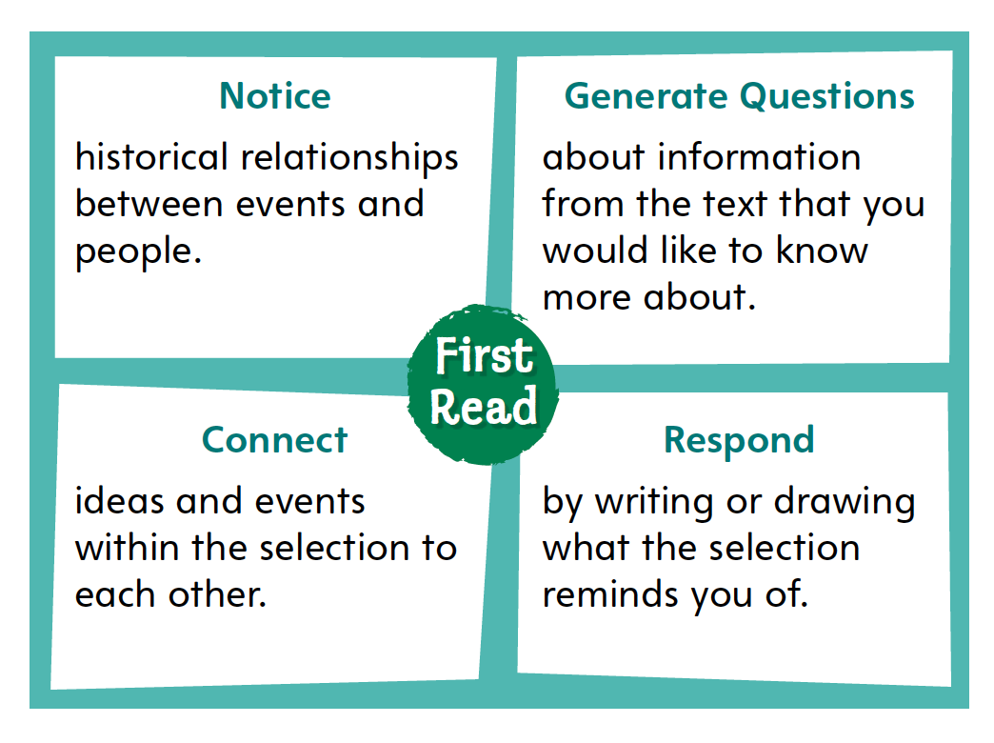
Page 156
First Read Strategies
Notes:
Discuss the First Read Strategies. Prompt students to establish that the purpose of reading the selection is for understanding and enjoyment.
FIRST READ STRATEGIES
NOTICE Remind students to focus on what the text is about. Ask them to pay attention to people and significant events.
GENERATE QUESTIONS Encourage students to write down questions they have as they read.
CONNECT Ask students to think about how events and ideas in the text are connected.
RESPOND Have students keep a record of things they think about as they read
Students may read the text independently, in pairs, or as a class. Use the First Read notes to help them connect with the text and guide their understanding.

Slide 17
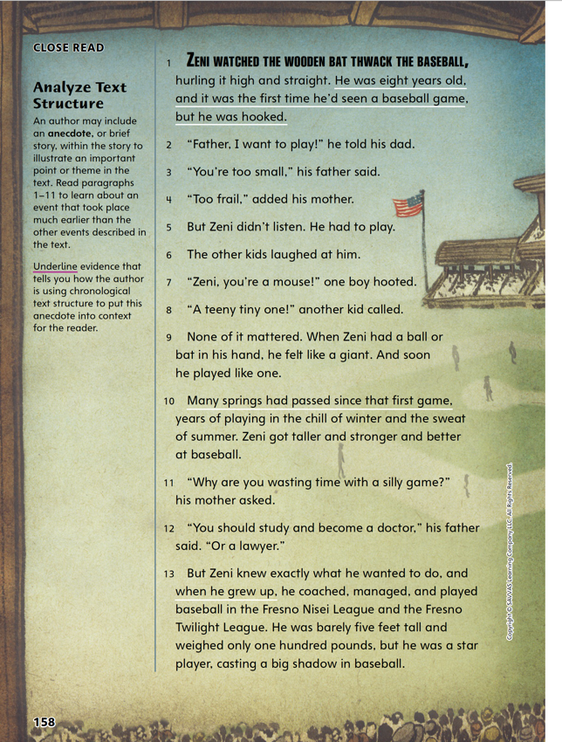
Page 158
First Read – Barbed Wire Baseball
Notes:
Students may read the text independently, in pairs, or as a class. Use the First Read notes to help them connect with the text and guide their understanding.
THINK ALOUD I am going to look for the elements of a biography as I read. This will help me understand when events in the text occurred. I will pay attention to words that signal time passing and events that let me know time has passed.

Slide 18
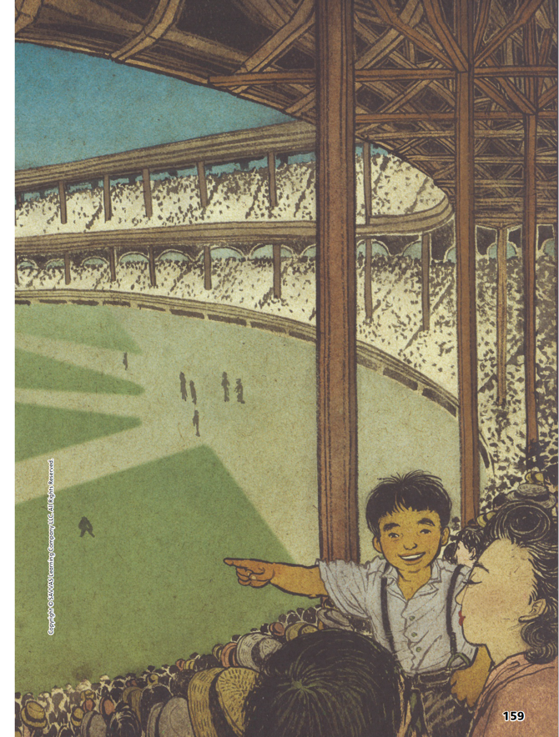
Page 159
First Read – Barbed Wire Baseball
Notes:
Students may read the text independently, in pairs, or as a class. Use the First Read notes to help them connect with the text and guide their understanding.
THINK ALOUD I know it is unusual for someone of Zeni’s size to become a great baseball player. Zeni must have been very passionate about the game to have such success.

Slide 19
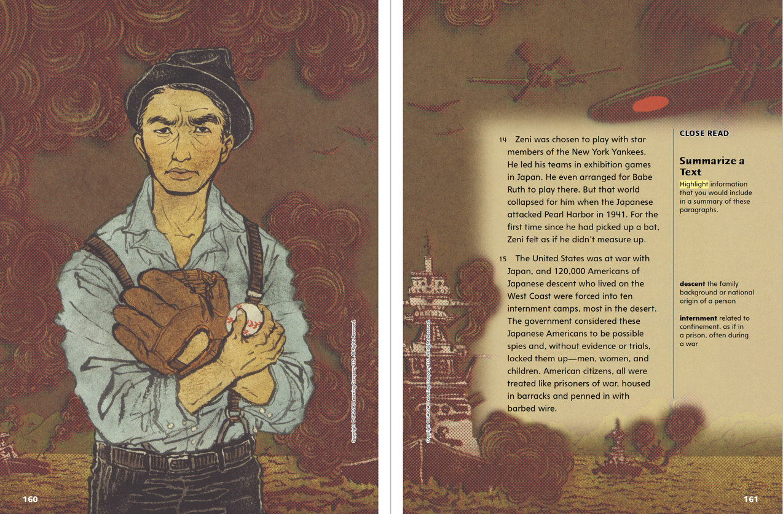
Page 160, 161
First Read – Barbed Wire Baseball
Notes:
Read the text. Pause to discuss the First Read notes with students.
THINK ALOUD I know that illustrations support the text. This one shows Zeni as an adult who appears to like baseball. It makes me wonder what the warships in the background have to do with Zeni. I will look for an answer as I read.
THINK ALOUD When I read the text I think of what happened to Native Americans in our country when settlers arrived. The Native Americans were not put in internment camps, but they were forced to move to reservations.

Slide 20
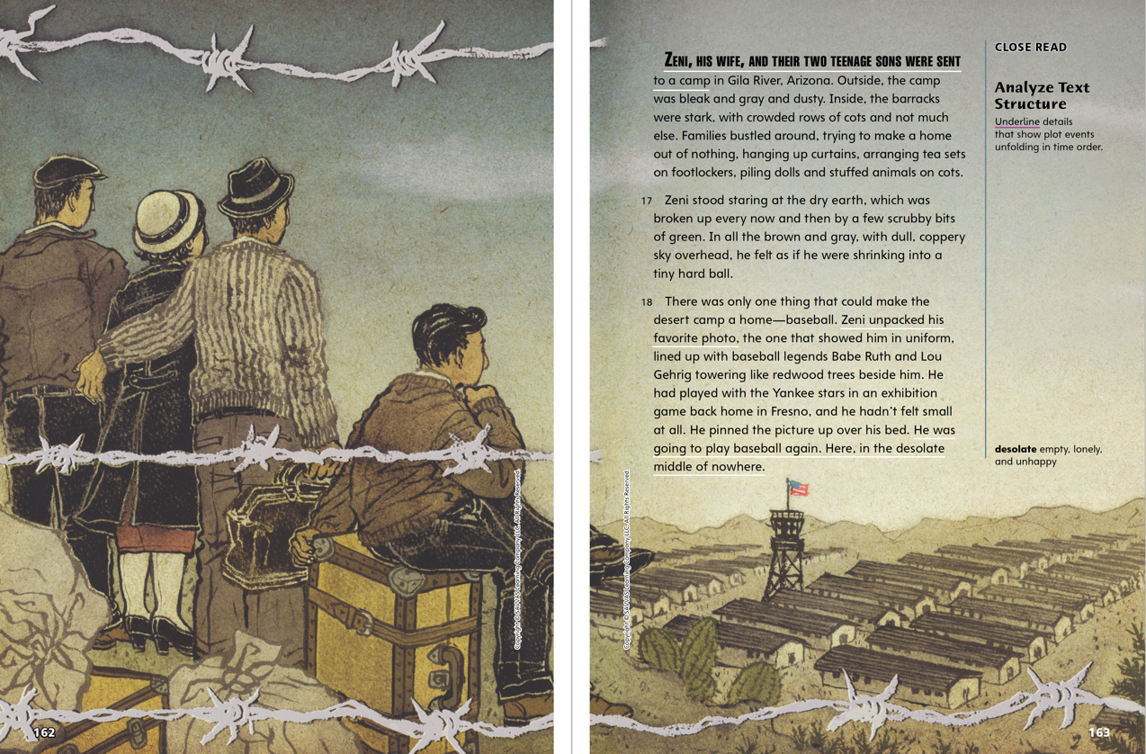
Page 162, 163
First Read – Barbed Wire Baseball
Notes:
Read the text. Pause to discuss the First Read notes with students.
THINK ALOUD The image on these pages makes me feel worried and sad. The barbed wire reminds me that this family did not come to this place by choice. I cannot see their faces, but I see that they are looking out onto “brown and gray” “dry earth.”
THINK ALOUD I know from my experience with reading other biographies that the author does not always use sequential language such as first, next, and then. I know that sometimes the sequence is shown through plot events.

Slide 21
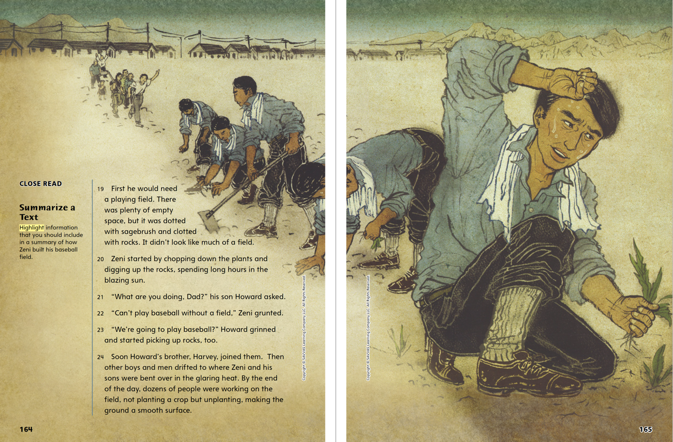
Page 164, 165
First Read – Barbed Wire Baseball
Notes:
Read the text. Pause to discuss the First Read notes with students.
THINK ALOUD To help me focus on the text, I ask myself questions as I read. If I do not know the answer, I know I need to go back and reread or keep reading to find out. Here I might ask, How did the other people in the camp react to Zeni’s work in the sun? Why did they react this way?
THINK ALOUD This illustration reminds me of movies and TV shows I’ve seen where prisoners do work like this. In a prison, the inmates are watched by guards and often have chains on. While Zeni and his friends are in an internment camp much like prison, they are doing this because they want to.

Slide 22
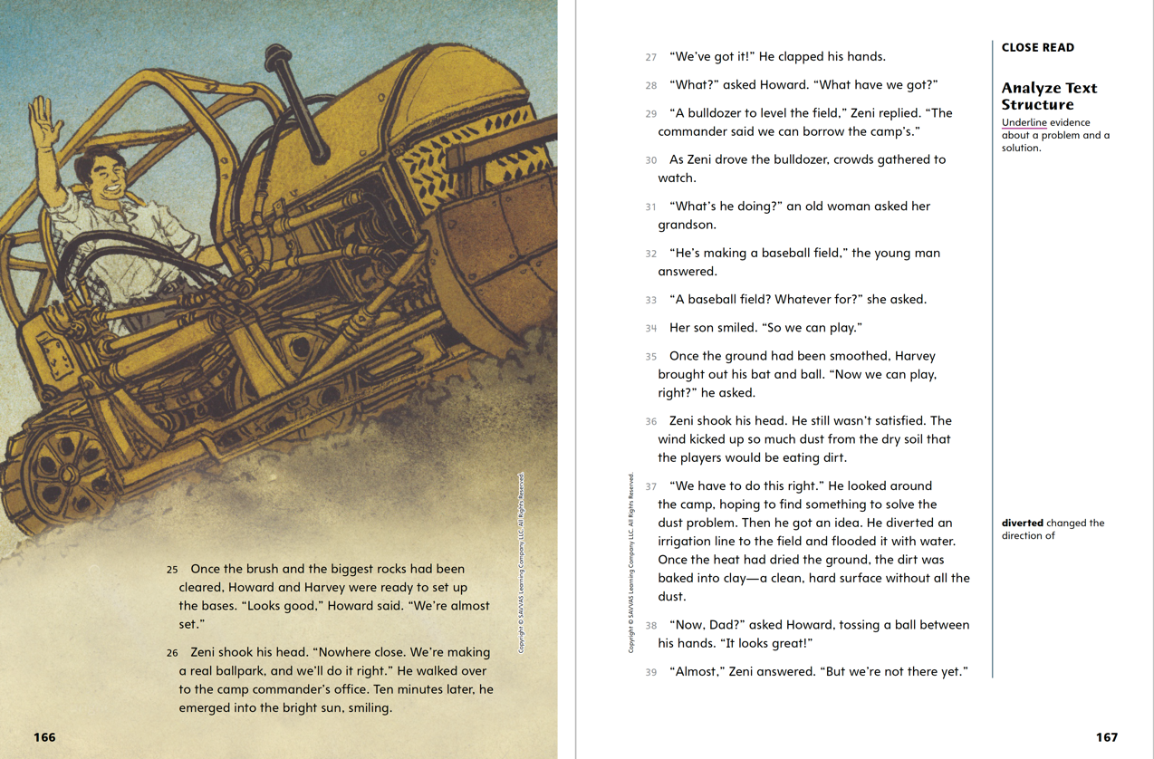
Page 166, 167
First Read – Barbed Wire Baseball
Notes:
Read the text. Pause to discuss the First Read notes with students.
THINK ALOUD The illustration shows Zeni driving a bulldozer. I wonder where he got it and what he used it for. I will continue reading to learn more.
THINK ALOUD When Zeni says “We have to do this right,” it reminds me of how I feel about the things I do. I want to make sure to get it right too. I can understand how Zeni feels.

Slide 23
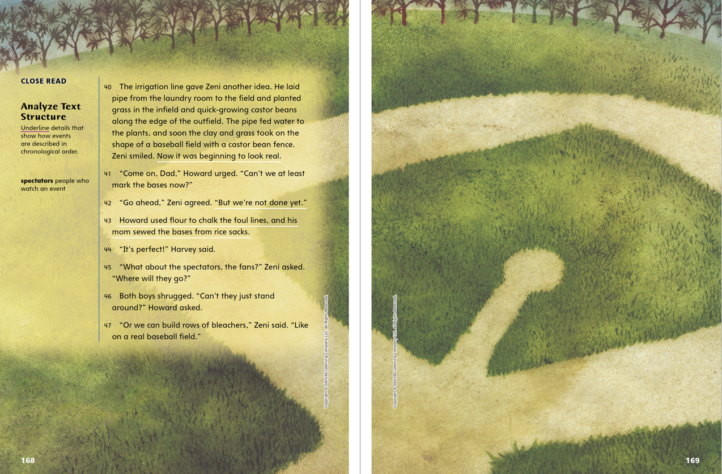
Page 168, 169
First Read – Barbed Wire Baseball
Notes:
Read the text. Pause to discuss the First Read notes with students.
THINK ALOUD I know that in a biography, an author tells the life story of a person. The author is painting a picture of Zeni. I am going to look for examples the author uses to show that Zeni was determined to make the best of his situation.
THINK ALOUD I notice the definition of spectators. When I read the sentence with the word, I see that the author has given a synonym, fans, for the word. I always try to notice clues to help me read new words.

Slide 24
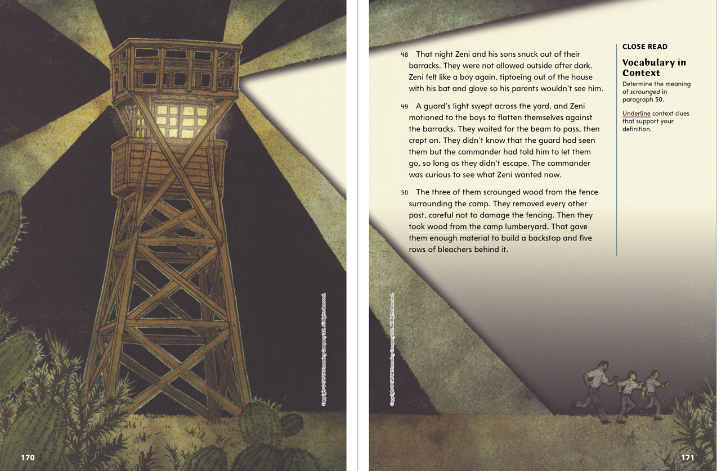
Page 170, 171
First Read – Barbed Wire Baseball
Notes:
Read the text. Pause to discuss the First Read notes with students.
THINK ALOUD I think the author has done a good job bringing Zeni to life. I am getting a picture of him as a person. This makes me want to find out more about him.
THINK ALOUD It is interesting that the guard was not worried about what Zeni and his friends were doing. This makes me think that the rules might not have been as rigid as in some other camps.

Slide 25
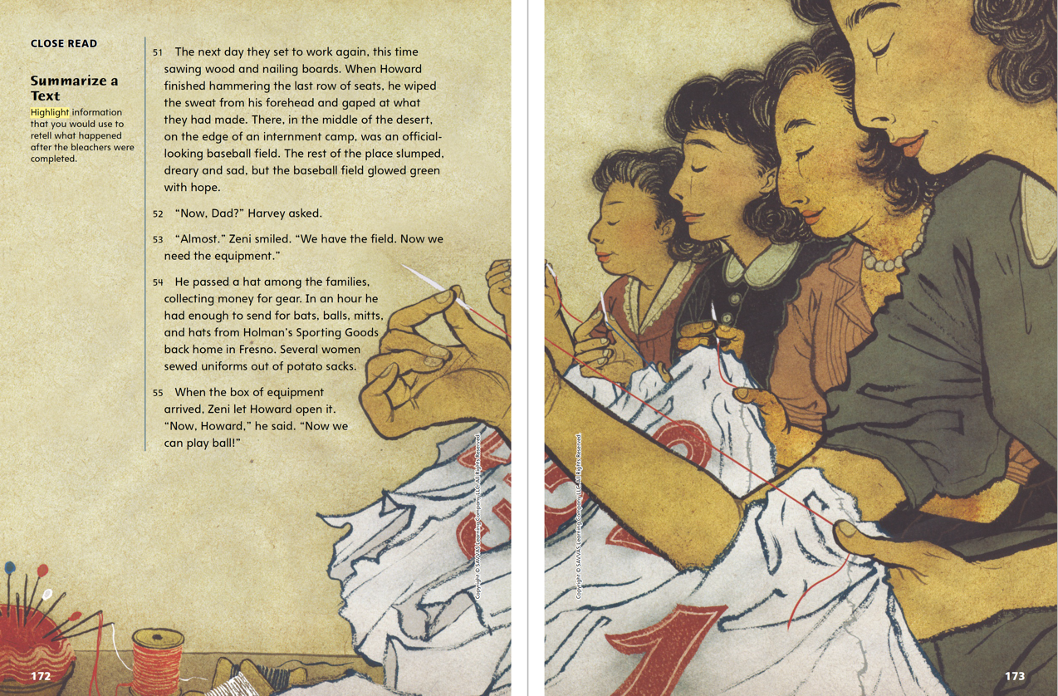
Page 172, 173
First Read – Barbed Wire Baseball
Notes:
Read the text. Pause to discuss the First Read notes with students.
Connect. When I read, I try to connect events in the text with my own experience. This helps me relate to the characters and events and helps me understand the text better.
Ask: Have you ever come up with an idea and worked hard for many days in a row to make your idea come to life? What makes something important enough to work for? How does it feel to put effort into something you think is important? Possible Response: It feels good to work hard for your own ideas and what you think is important, even if it is not easy.
THINK ALOUD It makes me feel good to know that so many people in the camp believed in Zeni and his dream of building a baseball field.

Slide 26
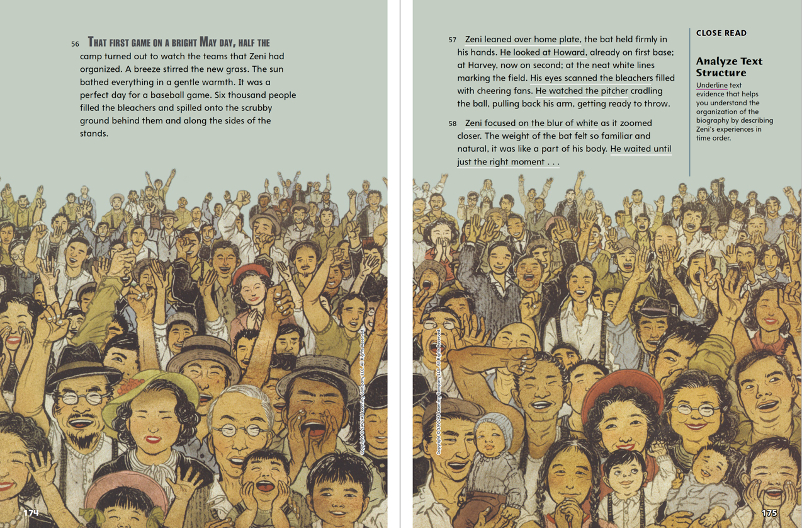
Page 174, 175
First Read – Barbed Wire Baseball
Notes:
Read the text. Pause to discuss the First Read notes with students.
THINK ALOUD The illustrations help me better understand the setting and the people involved in the biography. From this illustration, I can appreciate how much the people in the camp needed something like the baseball field and a baseball game to help them forget for a minute where they were and help them feel like they were living normal lives.
THINK ALOUD The illustration reminds me of the baseball games I have been to and how excited the spectators were. Making a connection to my own experience helps me understand more about the characters and what they were feeling.

Slide 27
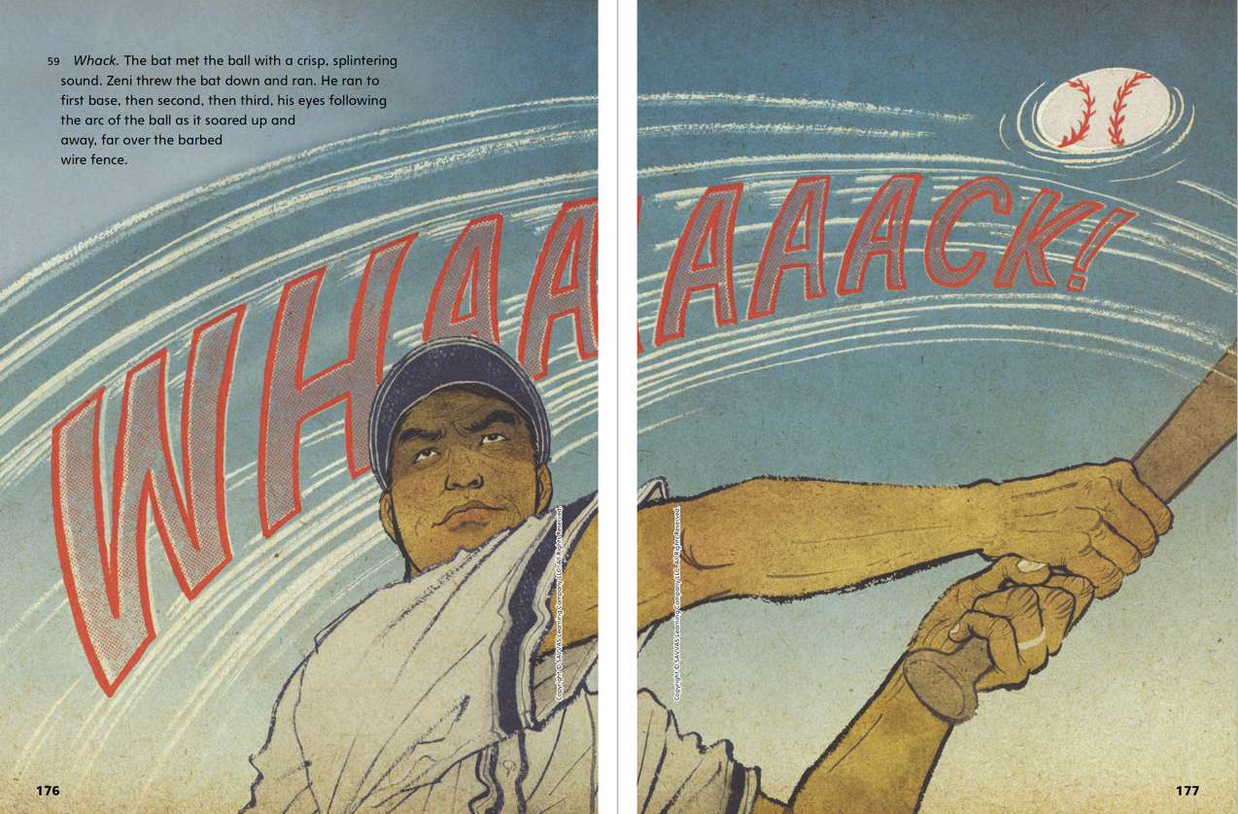
Page 176, 177
First Read – Barbed Wire Baseball
Notes:
Read the text. Pause to discuss the First Read notes with students.
THINK ALOUD From this illustration, I can tell how Zeni felt when his bat connected with the ball. The text does not say how he felt, but I can use what I know about him from what I have read and the expression on his face to tell me that he felt powerful and that he had achieved something great.
THINK ALOUD The text reminds me of how I feel when I achieve something I have worked on for a long time and am finally successful. This helps me understand the feelings that Zeni must be having.

Slide 28
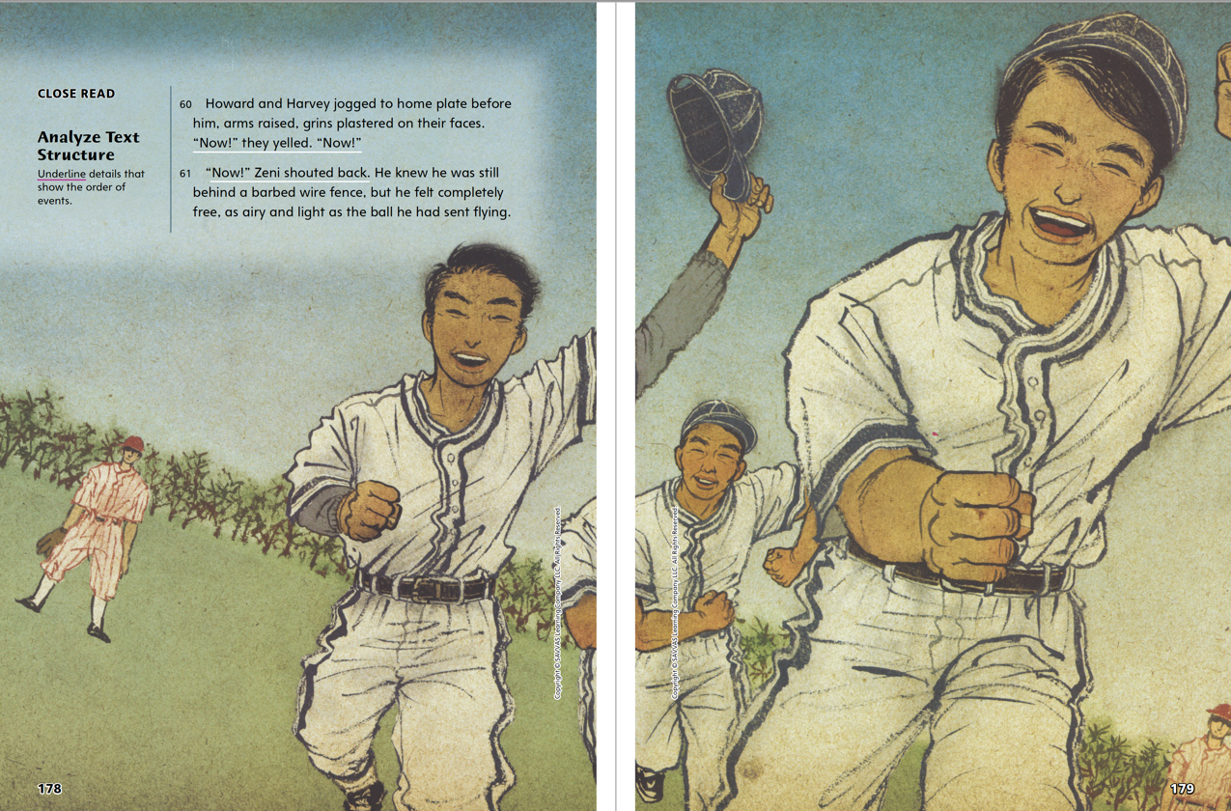
Page 178, 179
First Read – Barbed Wire Baseball
Notes:
Read the text. Pause to discuss the First Read notes with students.
Connect The illustration helps me connect to baseball games I have seen where a players raise their hats when they hit a home run. This helps me understand the excitement that Zeni felt. Ask: What connections can you make to the text and illustrations on this page?
THINK ALOUD It makes me happy to see that Zeni succeeded in building his baseball field and in getting a home run that brought in two other runs. I like it when a character’s hard work and perseverance get rewarded in the end.

Slide 29
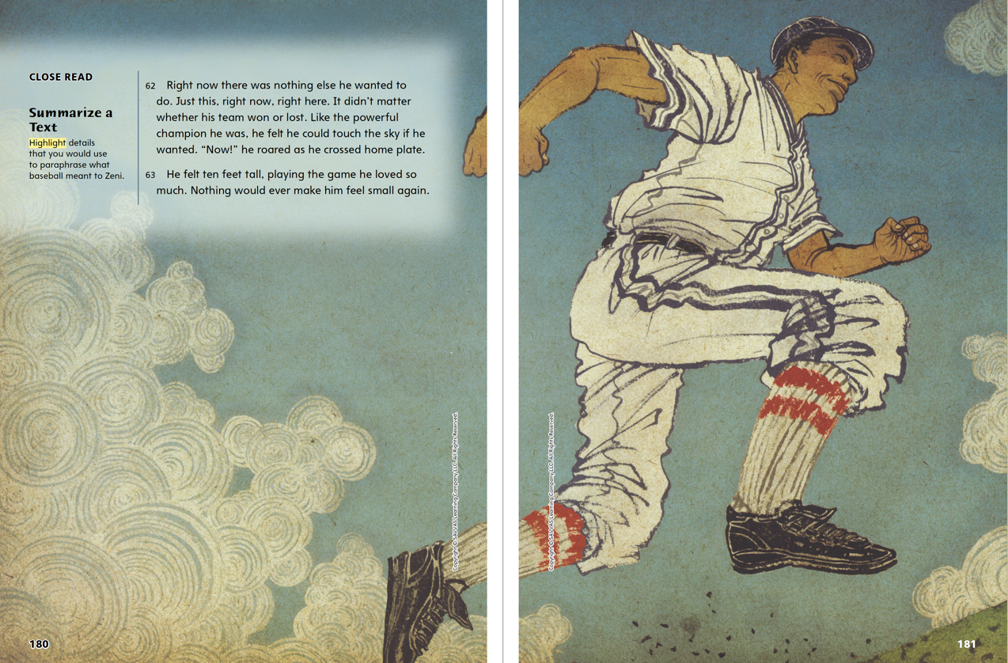
Page 180, 181
First Read – Barbed Wire Baseball
Notes:
Read the text. Pause to discuss the First Read notes with students.
THINK ALOUD After reading the text and looking at the illustrations, I have a complete picture of Zeni. I also have an idea of how difficult it was living in an internment camp. That Zeni was able to turn a bad situation into a positive one tells me about the kind of person he was.
THINK ALOUD I had never heard of Zeni before, and this text makes me want to find out more about him. I wonder what he did when he got out of the camp.

Slide 30
Respond and Analyze
Brainstorm: How did the baseball field help the people in the camp?
Discuss: What was your reaction to the camp as you read the text?
Notes:
Use these suggestions to prompt students’ responses to their reading of Barbed Wire Baseball.
• Brainstorm How did the baseball field help the people in the camp?
• Discuss What was your reaction to the camp as you read the text?

Slide 31
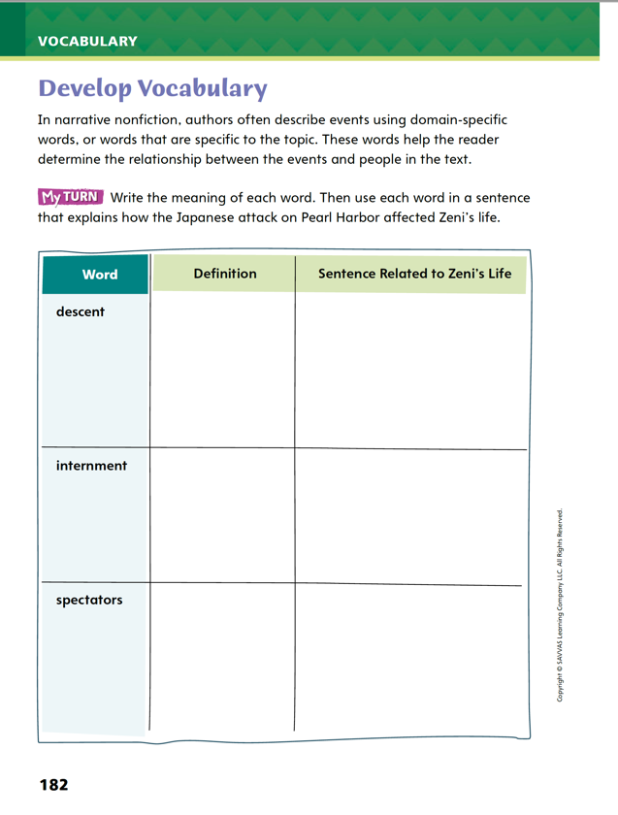
Page 182
Develop Vocabulary
Turn to page 182 in your Student Interactive and complete the activity.
Notes:
Read aloud the words related to the topic of the biography Barbed Wire Baseball. Students should
Go back and reread the word in context if they don’t know what it means.
Think about how the word relates to the biography.
Model responding to a prompt using newly acquired vocabulary as appropriate. Show how you would fill out the chart using the word descent. I will write the meaning of the word and a sentence showing how the word is related to the biography: After the attack on Pearl Harbor, the government treated Zeni and other Americans of Japanese descent like prisoners of war.
Have students talk with a partner about the meaning of the remaining words and how they relate to the biography.
Have students use the strategies for developing vocabulary.
Have students complete the chart on p. 182 of the Student Interactive. They should think about how the words relate to the text as they write their sentences.

Slide 32
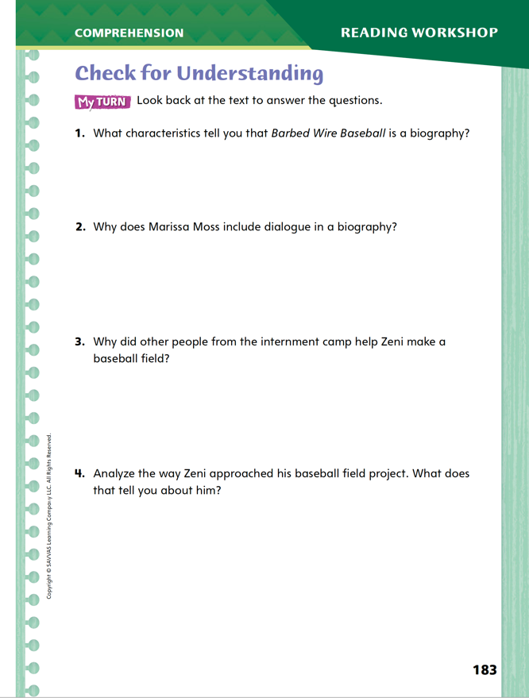
Page 183
Check for Understanding
Complete page 183 in your Student Interactive.
Notes:
Have students complete p. 183 of the Student Interactive.

Slide 33
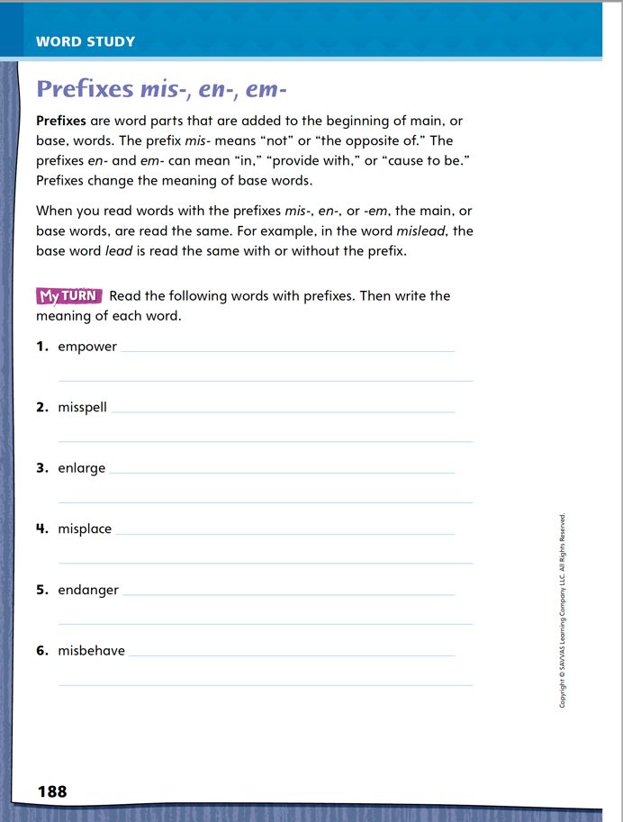
Page 188
Word Study
mis-, em-, en-
Complete page 188 in your Student Interactive.
Write three sentences that us prefixes mis-, en-, or em-.
Notes:
Direct students to complete p. 188 of the Student Interactive.
Then have students write three sentences that use prefixes mis-, en-, or em-.

Slide 34
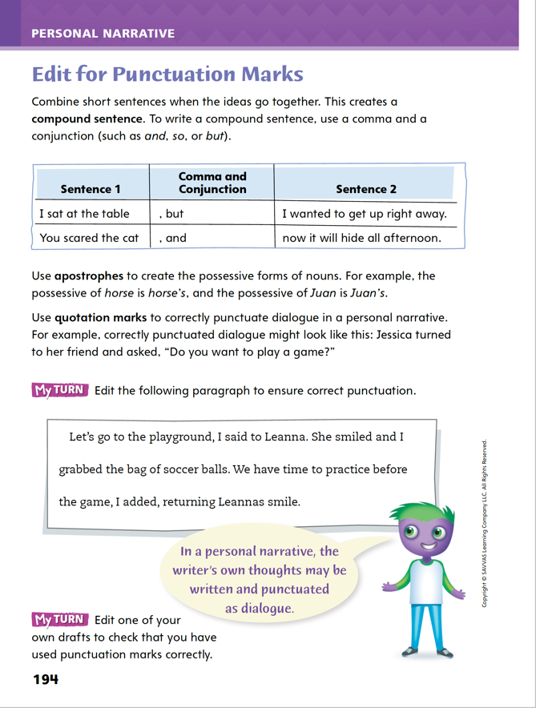
Page 194
Writing – Personal Narrative
I read a lot of fiction stories.
I like mysteries the best.
Turn to page 194 in your Student Interactive.
Notes:
Making sure punctuation marks are used correctly is an important part of preparing writing for publication. When editing their writing, students should
Use a comma and a conjunction in compound sentences.
Use apostrophes to form the possessive case of nouns.
Use quotation marks in dialogue.
Remind students that they can combine two short sentences to form a compound sentence. Write the following sentences: I read a lot of fiction stories. I like mysteries the best. Ask: What punctuation do I use to join the sentences? What word do I use after the punctuation to form a compound sentence (but)?
Write the compound sentence and have students transcribe it, circling the comma and the conjunction.
Then read aloud the two compound sentences in the chart at the top of p. 194 in the Student Interactive. Guide students to identify the two short sentences in each example and the conjunction.
Explain that the apostrophe is used to show possession; someone owns something. Write the following sentences: This book belongs to Sarah. This is Sarah’s book. Underline Sarah’s and say: The apostrophe –s shows that Sarah owns the book.
Read aloud the examples of possessive nouns in the second paragraph on p. 194.
Challenge students to make up sentences using the possessive nouns horse’s and Juan’s.

Slide 35
Independent Writing
Edit one of your own drafts to make sure you used punctuation correctly.
Exchange drafts with a partner to revise.
Make any edits needed to your work.
Notes:
After the minilesson, students should transition into independent writing.
Invite pairs of students to review each other’s work and make any further edits.
Writing Support:
Modeled Use a stack text to model use of commas in compound sentences, apostrophes in possessive nouns, and quotation marks in dialogue.
Shared Work with students to find and copy examples of each type of punctuation.
Guided Provide explicit instruction on the use of quotation marks around a narrator’s thoughts.
Call on a few students to describe errors in punctuation (correct use of commas in compounds, apostrophes in possessive nouns, and quotations in dialogue) that they made in their own first drafts and how they corrected them. Invite students to explain why correct punctuation is important.

Slide 36
Spelling
misspell
enable
empower
Notes:
(Note: Move the blue boxes to cover each prefix for the lesson.)
Explain that prefixes are word parts added before a base word that do not change the spelling of the base word.
Write or display the words misspell, enable, and empower. For each word, cover the prefix. Say and spell the word without the prefix, then uncover and repeat the process with the whole word to show that the base word spelling stays the same.

Slide 37
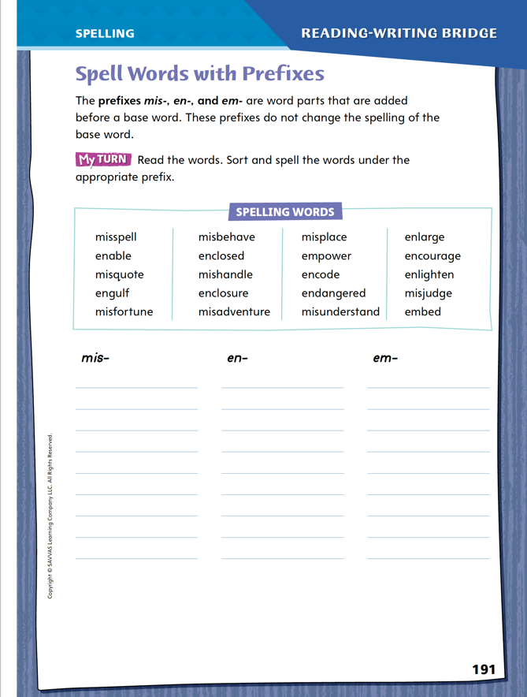
Page 191
Spelling
Turn to page 191 in your Student Interactive and complete the activity.
Notes:
Have students complete the activity on p. 191 of the Student Interactive.

Slide 38
Language and Conventions
Jimmy whistled a song.
Notes:
Introduce sentence fragments by giving oral examples, such as “went to school” and “As I arrived.” Explain that complete sentences have a subject and a predicate.
Write a complete simple sentence on the board, such as “Jimmy whistled a song.” Read the sentence aloud but omit part of it, and ask students if it is a fragment or not. For example, “Jimmy whistled” is complete; “whistled a song” is a fragment. Try a couple of variations.
Help students practice recognizing that fragments can be fixed by adding a subject or a predicate to create a complete thought.
Have students work in pairs to create an oral sentence that contains a subject and a predicate and forms a complete thought. Ask partners to share their sentence with another pair and then identify which words make up each component.

Slide 39
Lesson 3

Slide 40
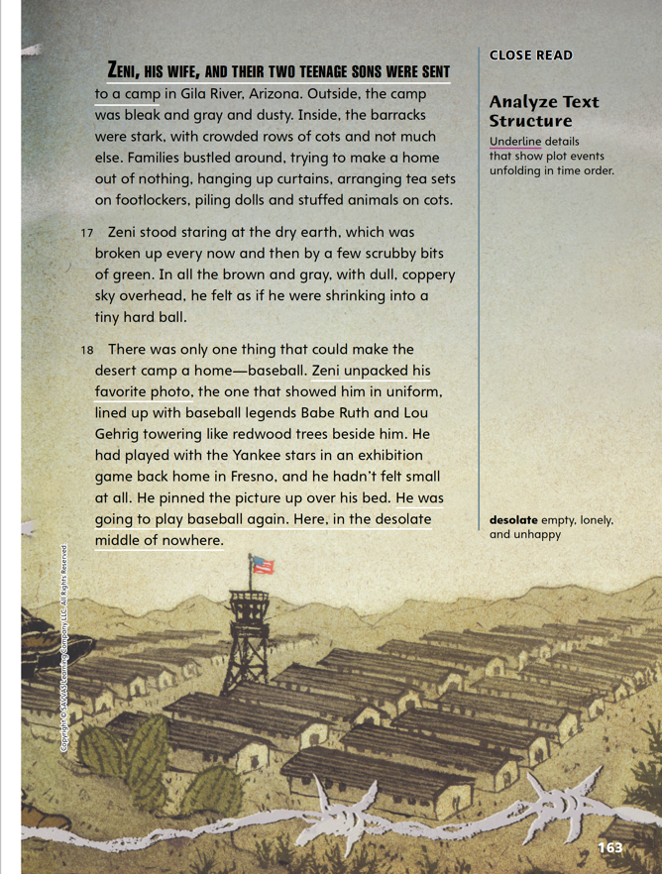
Page 163
Close Read – Analyze Text Structure
Turn to page 163 in your Student Interactive.
Notes:
Explain that the author’s purpose in a biography is to tell about a person’s life. Writers use chronological order to tell about events in the order in which they happened. Readers should:
Look for signal words, such as first, then, after, and finally.
Think about what is happening. Ask, what happened first? What happened next?
Think about what the events tell about the main person in the biography.
Use the Close Read note on p. 163 of the Student Interactive to model how to determine the sequence.
I look for signal words in paragraph 16 but I do not see any. I think about what is happening, asking myself, “What event is described here?” I read that Zeni and his family were sent to the internment camp. This is the first event. This event tells me about an important event in Zeni’s life.
Ask students to turn and talk with a partner about the next event. Have them underline it.
Then ask them to look for events in the remaining paragraphs and tell what these events tell them about Zeni.

Slide 41
Page 158
Close Read – Analyze Text Structure
Turn to page 158 in your Student Interactive.
Notes:
Have students scan paragraphs 1–9. Identify the anecdote and explain that these paragraphs present a brief story about an event early in Zeni’s life. Have students identify examples that show how the author indicates when the event took place. Ask students to explain: What can you tell about the time in Zeni’s life from these paragraphs? How does this information suggest where Zeni’s life might take him? See student page for possible responses. DOK 2

Slide 42
Page 163
Close Read – Analyze Text Structure
Turn to page 163 in your Student Interactive.
Notes:
Tell students they need to think about the plot events and when they happen. Ask students to scan the text on p. 163 to look for plot events that occur in sequence or time order. See student page for possible responses. DOK 2

Slide 43
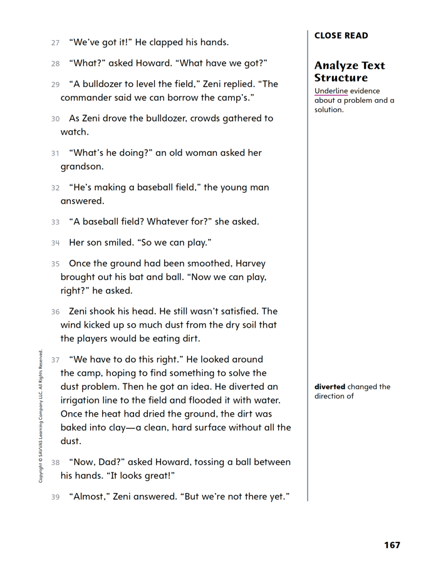
Page 167
Close Read – Analyze Text Structure
Turn to page 167 in your Student Interactive.
Notes:
Remind students that authors may explain a problem and then tell how the problem is solved. Often this helps readers better understand characters and events. Ask students to find and underline the part of the text on p. 167 that tells what the problem was.
Then ask them to find and underline the part of the text that explains how the problem was solved. See student page for possible responses. DOK 2

Slide 44
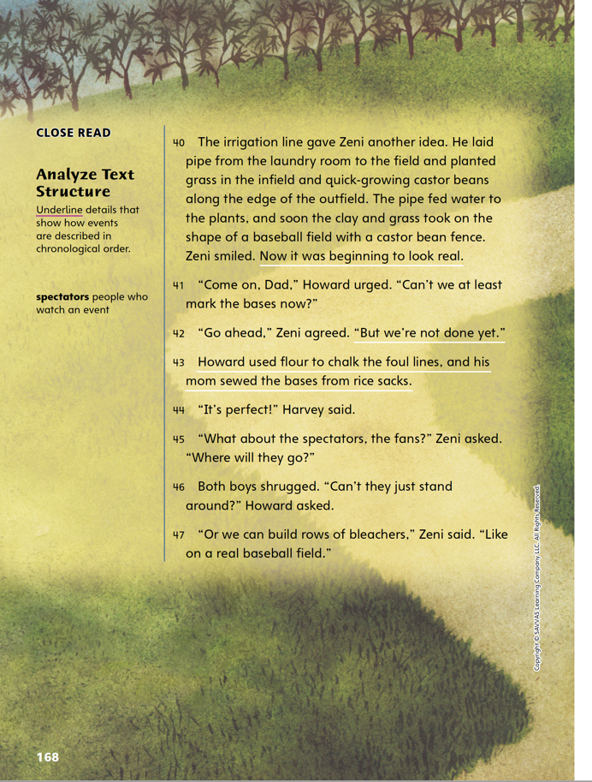
Page 168
Close Read – Analyze Text Structure
Turn to page 168 in your Student Interactive.
Notes:
Remind students that authors of biographies often use time-order signal words, but sometimes the reader has to use story details to understand the order of events.
Ask students to scan the text on p. 168 and underline details that show events in chronological order. See student page for possible responses. DOK 2

Slide 45
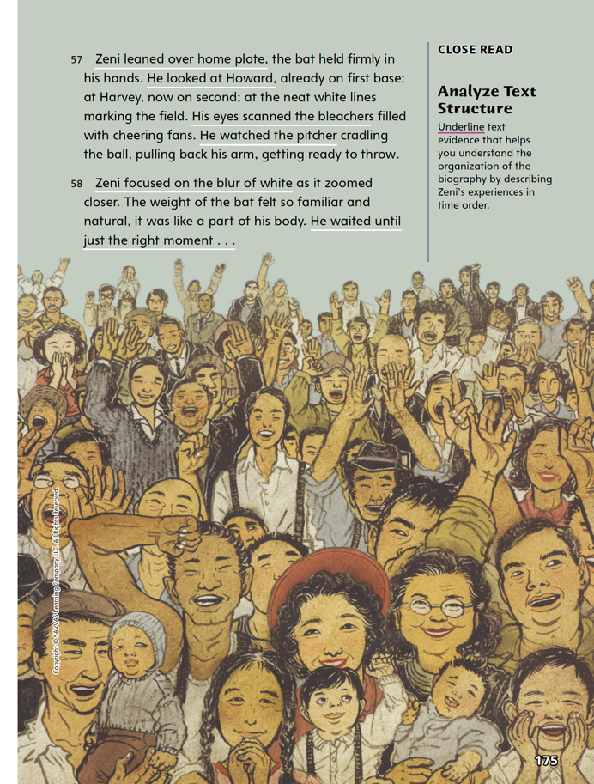
Page 175
Close Read – Analyze Text Structure
Turn to page 175 in your Student Interactive.
Notes:
These pages describe what happened when Zeni stepped up to home plate. The author’s sentences illustrate the order of events. Find evidence in the text on p. 175 that helps you understand the order of events and underline it. See student page for possible responses. DOK 2

Slide 46
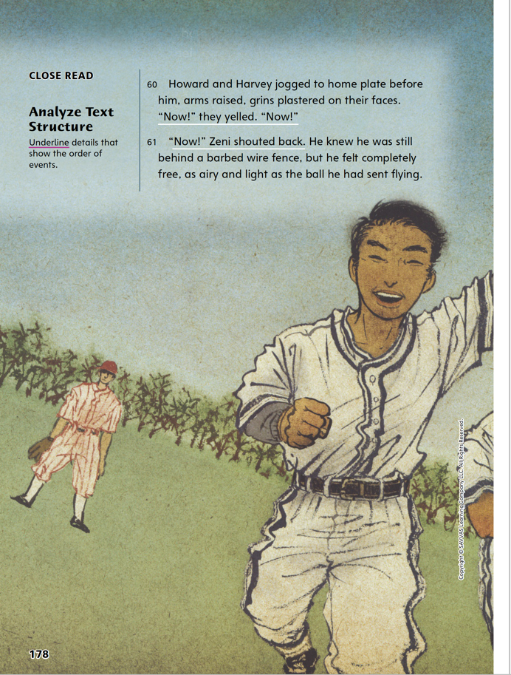
Page 178
Close Read – Analyze Text Structure
Turn to page 178 in your Student Interactive.
Notes:
Ask: In what order did the players jog to home plate? What word gives you a clue? (before) What other word in the text signals order of events? (Now)
Ask students to underline the details on p. 178 that show the order of events. See student page for possible responses. DOK 2

Slide 47
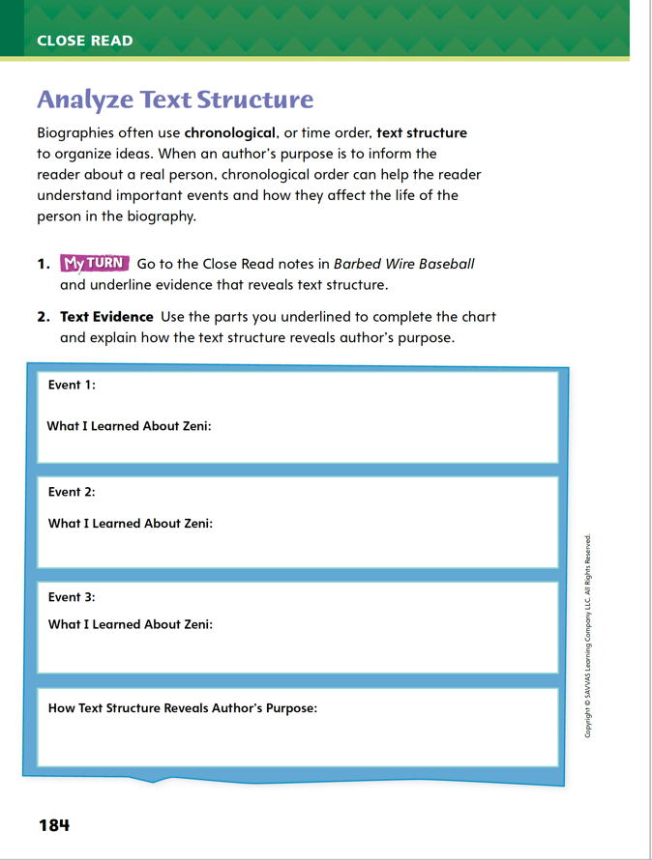
Page 184
Analyze Text Structure
Turn to page 184 in your Student Interactive and complete the activity.
Notes:
Have students use the strategies for analyzing text structure.
Have students annotate the text using other Close Read notes for Analyze Text Structure and then use text evidence from their annotations to complete the chart on p. 184.

Slide 48
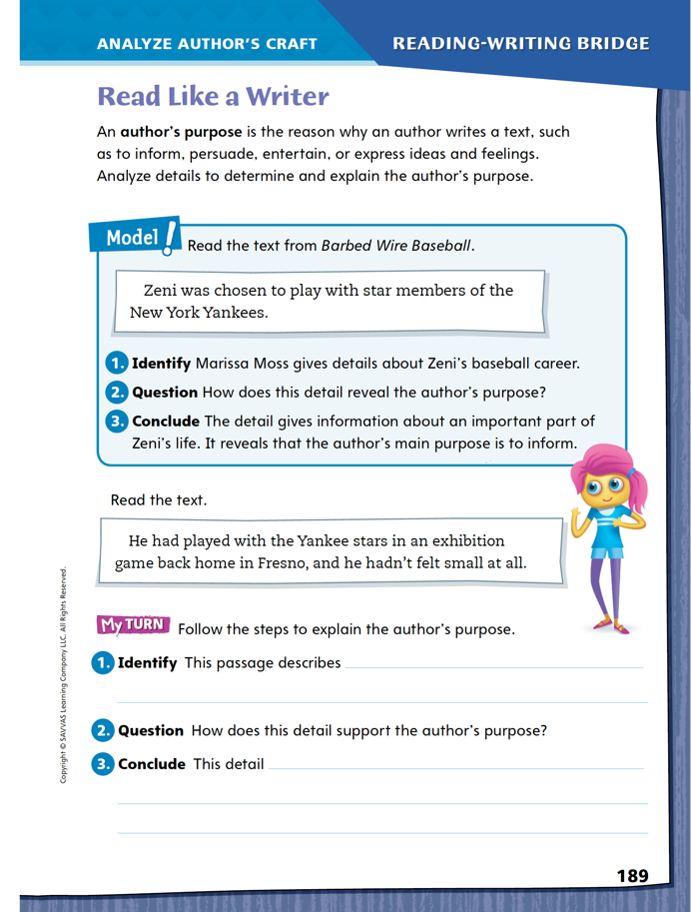
Page 189
Read Like a Writer
Turn to page 189 in your Student Interactive.
Notes:
An author’s purpose is his or her reason for writing.An author may want to inform readers about a topic, persuade them to adopt a certain point of view, entertain, or express ideas and feelings. Analyze details in the text to determine the author’s purpose and message.
Notice what details the author includes; what do the details tell us about the topic?
Ask yourself why the author wanted to include these details.
Model analyzing the author’s purpose by directing students to the top of p. 189 of the Student Interactive. Have students follow along as you complete the steps: First, identify the details that we receive. (Zeni played with the Yankees.) In this case we get a detail about Zeni’s baseball career. Second, we ask questions about the details. We want to know how the detail reveals the author’s purpose. The author is not making an argument or trying to tell a joke. The author does not say how Zeni feels or how the Yankees feel. This detail only tells us more about Zeni’s career. Therefore, we can conclude that the author wants to inform us about Zeni’s life.
Have student pairs explain the author’s purpose within a text they have previously read. Then have them complete the activity on p. 189.
Direct students to return to the Barbed Wire Baseball selection and underline a detail that is informative, circle a detail that expresses a feeling, and draw a star by a detail that is entertaining.
Then have them complete the activity on p. 189.

Slide 49
Word Study
judge
misjudge
fortune
misfortune
Notes:
Remind students that adding a prefix changes the meaning of the base word, but it does not affect how the base word is decoded.
Judge is a noun or a verb, and as a verb it means “to form an opinion about something.” Misjudge is a verb and means “to form a wrong opinion about something.” In both words, the base word judge is decoded the same way. Have students define and discuss fortune and misfortune.
Have students complete Word Study p. 5 from the Resource Download Center. Click path: Table of Contents -> Resource Download Center -> Word Study -> U1W5

Slide 50
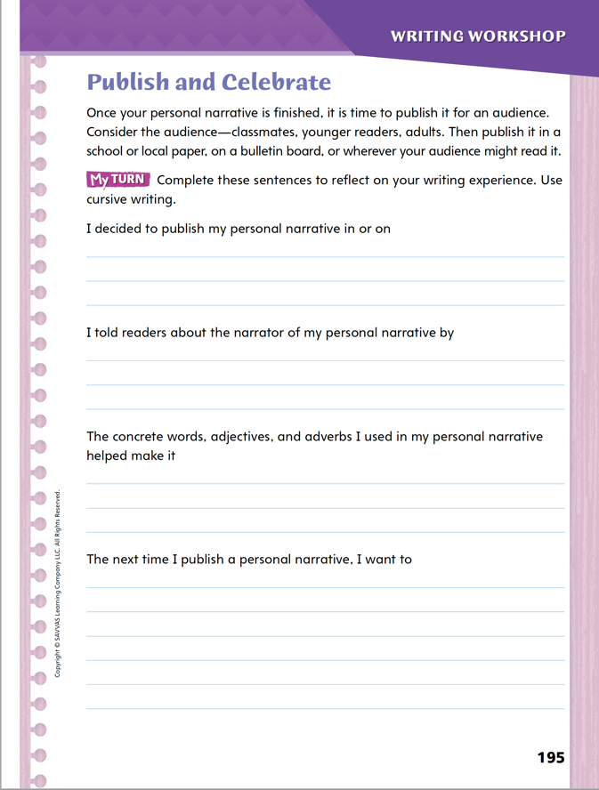
Page 195
Writing – Personal Narrative
Turn to page 195 in your Student Interactive.
Notes:
After students finish their personal narratives, explain that the next steps are to publish them and reflect on their work. During these steps, writers should
Think about who might be interested in their writing.
Consider where their audience might read it.
Finally reflect on their writing.
Explain that an audience for a personal narrative may include classmates, younger readers, adults, or a mixture of groups. Have students choose an audience and discuss where their audience would be most likely to read the personal narrative, such as in a local newspaper or on a bulletin board.
Have students choose where to publish their piece based on this discussion.
Inform students that after sharing their work, they will think about, or reflect, on their writing experience, and write down their thoughts. Then say: Reflecting helps me think more deeply about what I did so that I can learn from my experience of writing a personal narrative. I can use what I learned from this writing experience next time I write a personal narrative.
Direct students to p. 195 of the Student Interactive, and read aloud with students each sentence starter. As necessary, discuss possible responses to each.
Have students complete the activity. Remind them to write legibly in cursive.

Slide 51
Independent Writing
Revise and edit your personal narrative if you have not published it yet. Write legibly.
Begin a new personal narrative.
Notes:
After the minilesson, students should transition into independent writing.
Have students begin a new personal narrative or revise and edit a draft they have not yet published. Remind students to write legibly
WRITING SUPPORT
Modeled Use a Think Aloud to reflect on the experience of writing a personal narrative. Make a list of some key points resulting from the reflection.
Shared Have students work in pairs to first discuss orally their reflections on the writing experience. Then invite them to share their reflections as you transcribe them.
Guided Provide explicit instruction on reflecting on writing a personal narrative.
Share Back: Invite several students to explain what they learned by reflecting on their writing experience and how they might use this learning the next time they write a personal narrative.

Slide 52
Spelling
Dora _____ the pies in the baking contest.
The baby bird _____ the height of its nest.
Notes:
Remind students that adding a prefix does not change the spelling of the base word.
Display or write the sentences below. Then have students spell the correct response using their knowledge of prefixes.
1. Dora ____ the pies in the baking contest. (judged)
2. The baby bird ____ the height of its nest. (misjudged)
Have students complete Spelling p. 10 from the Resource Download Center. Click path: Table of Contents -> Resource Download Center -> Spelling -> U1W5

Slide 53
Language and Conventions
Climb trees and eat leaves.
Sheep and cows in Ireland.
Notes:
Say that a complete sentence needs a subject and a predicate, which together form a complete thought. When one or more of these things is missing, the group of words is called a sentence fragment.
Explain to students that a fragment can be fixed by adding a subject, predicate, or complete thought. By supplying the missing part, a fragment can be changed into a simple or compound sentence.
To reinforce the instruction, describe an animal using a fragment. For example, “climb trees and eat leaves.” (missing a subject) and “Sheep and cows in Ireland” (missing a predicate). Ask students what is missing and how to complete each sentence.
Then write another sentence together as a class, and have students identify that it has a subject, predicate, and complete thought.

Slide 54
Lesson 4

Slide 55
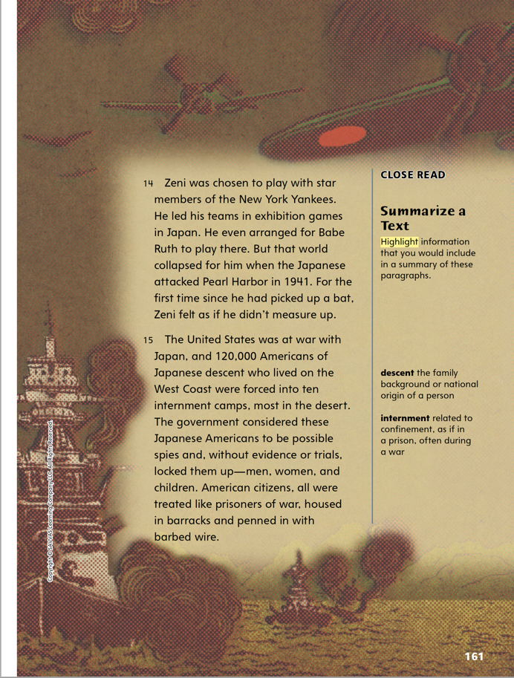
Page 161
Close Read – Summarize a Text
Turn to page 161 in your Student Interactive.
Notes:
Explain that when we summarize a text, we choose only important events to retell. We retell the events in the same logical order that the text did. Tell students they can use these questions to help them summarize a text.
What is this paragraph/page/text mostly about? What is its main idea?
What details tell about the main idea? Which details are interesting but do not directly support the main idea?
the Close Read note on p. 161 of Barbed Wire Baseball to model how you select details to summarize the text. When I summarize a text, I start at the beginning and highlight important details through the text. I know that a summary is concise and needs to contain only the most important information. I ask myself, “Is this an important detail, or is it just interesting information not related to the main point of the text?” Once I have the details I need, I keep them in logical order when I write a summary in my own words. Have students use this process to summarize a section of the text.
Have students use this process to summarize a section of the text.

Slide 56
Page 161
Close Read – Summarize a Text
Turn to page 161 in your Student Interactive.
Notes:
Remind students that a summary includes only the most important information from the text. Have students scan the text on p. 161 to find information about the internment camps they could use in a summary of the text. See student page for possible responses. DOK 2

Slide 57
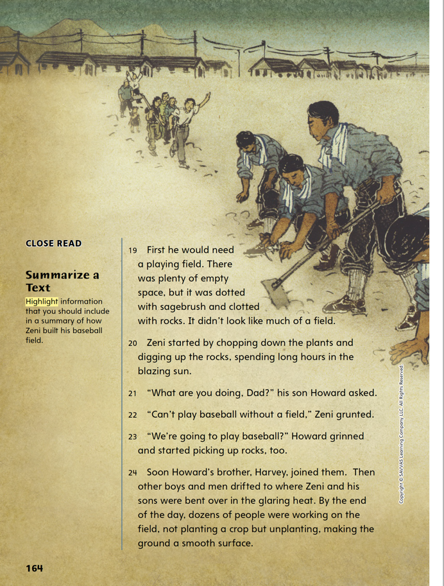
Page 164
Close Read – Summarize a Text
Turn to page 164 in your Student Interactive.
Notes:
Ask students what Zeni had to do first to begin creating a baseball field.
Then ask them what details on p. 164 they would include in a summary of the text. Highlight the details. See student page for possible responses. DOK 2

Slide 58
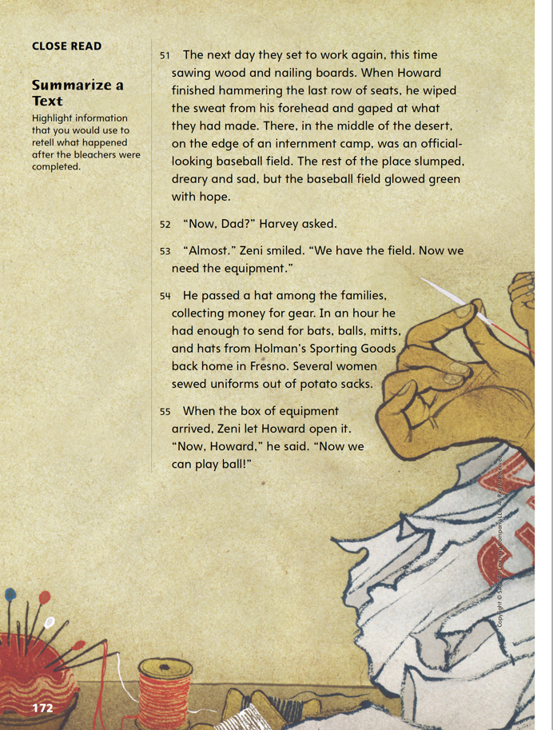
Page 172
Close Read – Summarize a Text
Turn to page 172 in your Student Interactive.
Notes:
Ask students to explain what is happening on p. 172. Then ask them to highlight key information about building the bleachers that they would include in a summary of the text. See student page for possible responses. DOK 2

Slide 59
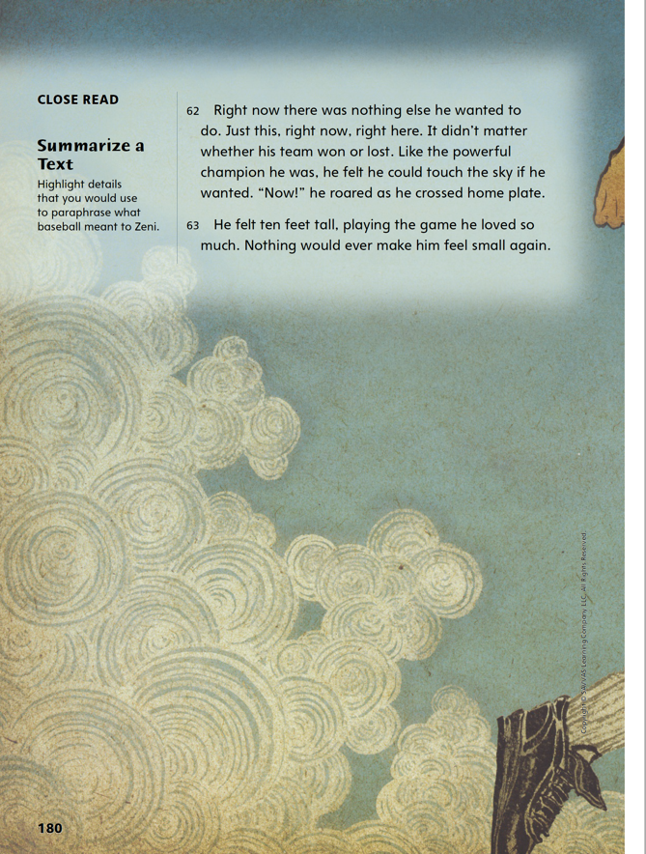
Page 180
Close Read – Summarize a Text
Turn to page 180 in your Student Interactive.
Notes:
Remind students that when they paraphrase a text, they restate the text in their own words, retelling only the most important events and details. Have students highlight details on p. 180 they would use to paraphrase what baseball meant to Zeni. See student page for possible responses. DOK 2

Slide 60
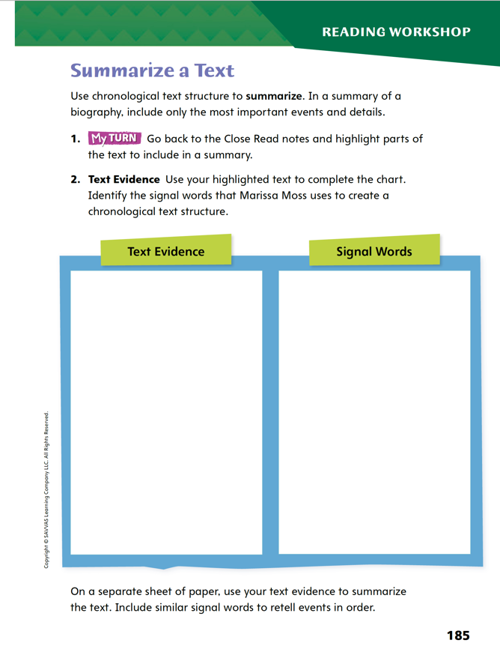
Page 185
Close Read – Summarize a Text
Complete page 185 in your Student Interactive.
Notes:
Have students use the strategies for summarizing text.
Have students annotate the text using other Close Read notes for summarizing a text. Remind them that they should only highlight important details, which means details that support what the text is mostly about. Have them use the text evidence from their annotations to complete the chart on p. 185.

Slide 61
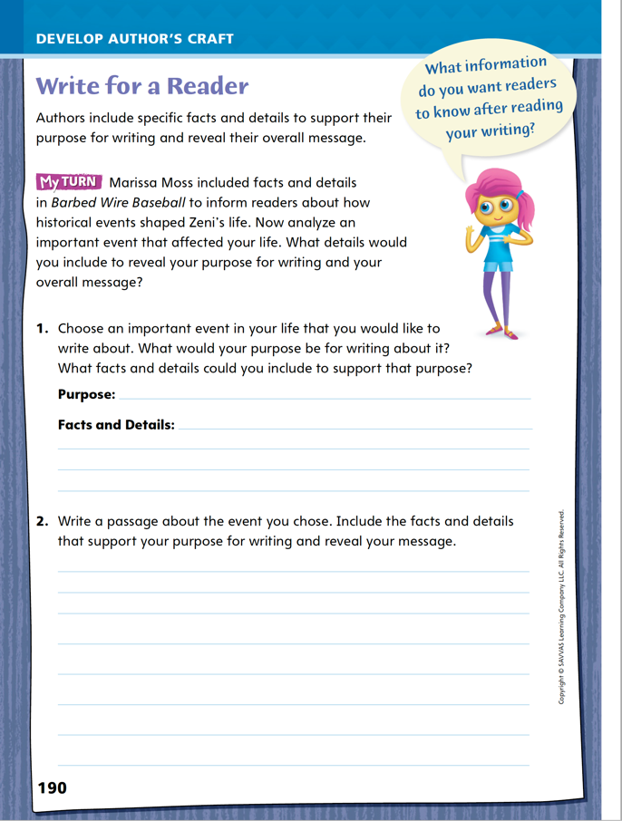
Page 190
Writing for a Reader
Turn to page 190 in your Student Interactive and complete the activity.
Notes:
An author’s choice of details is a clue for readers about the author’s purpose for writing. Elements like repetition, details that reveal emotions, and descriptions can help focus a reader’s attention. In this way, details are how writers share their messages with readers.
Remind students that they just analyzed how an author includes details for a specific purpose. Discuss how students might use a similar technique in their own writing using p. 190 of the Student Interactive. Model an example.
Identify an event to write about, such as a lunchtime last week. Suggest what kind of purpose you can have: to inform, to entertain, to persuade, to express an emotion.
Consider words and phrases that would help emphasize what you want readers to understand about lunchtime. Explain: I might list the food options or where people eat. Or I might describe what people are like when they eat. I might detail some of the bad things about lunchtime and suggest improvements. Or I might detail how I feel right before or during lunch.
Together as a class, draft a brief paragraph with one of these choices to illustrate the effect. Have volunteers offer suggestions for how to enhance the scene.
Have students refer to the reading selection for examples of details that help the author convey a message, and suggest they use it as an example for their own writing. Then guide students to complete the activity on p. 190 of the Student Interactive.

Slide 62
Word Study – Review Vowel Teams and Digraphs
ee
ea
Pick a vowel team and write a list of words using your vowel team. Try to get five or more words.
Notes:
Review strategies from the previous week about vowel teams and digraphs.
Call on a student to give an example of a vowel team that makes a long e sound, such as ee or ea as in feed or lead. Discuss how knowing that multiple vowels can create one sound can help students pronounce words.
Have each student pick a vowel. Then have pairs of students create a list of words using their specific vowel team. Challenge them to think of five or more words. Allow students to share their lists.

Slide 63
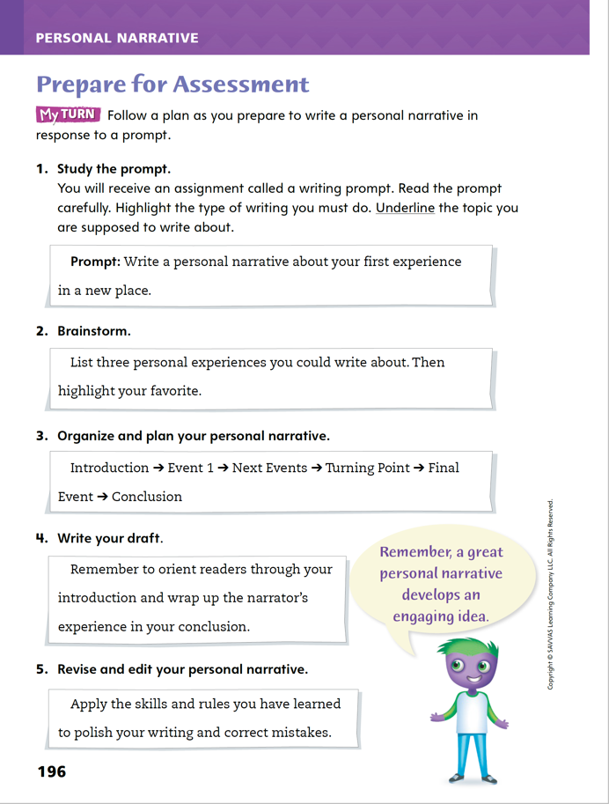
Page 196
Writing – Prepare for Assessment
Turn to page 196 in your Student Interactive.
Notes:
A five-step plan will help you write an effective personal narrative in response to a prompt. The five steps are
Study the prompt.
Brainstorm.
Organize and plan the personal narrative.
Write the draft.
Revise and write the personal narrative.
Inform students that the five-step plan on p. 196 in the Student Interactive will help them prepare, write, and edit the personal narrative that they will later write for their assessment.
Direct students to p. 196 in the Student Interactive. Ask the following questions about each step and discuss students’ responses:
Step 1: Why is it important to identify the topic in the prompt? Why should you think about the type of writing required? In this case, what are the characteristics of a personal narrative?
Step 2: How will brainstorming help you write your personal narrative?
Step 3: Why is planning the order of events useful? What is a turning point?
Step 4: What is the purpose of an introduction? What is the purpose of a conclusion?
Step 5: What do you look for when you edit your writing?
Have students complete the first three steps on p. 196.

Slide 64
Page 196
Independent Writing
Write a personal narrative about your first experience in a new place.
Use the characteristics you learned about personal narratives.
Revise and edit your work.
Notes:
After the minilesson, students should transition into independent writing.
Have students draft a personal narrative in response to the prompt on p. 196 in the Student Interactive. Remind them to use the characteristics they learned about personal narratives in their own writing. Then have them revise and edit their work.
WRITING SUPPORT
Modeled Provide a graphic organizer to help students complete Step 3. Model completing the organizer.
Shared Present the organizer for Step 3 and have students suggest a sequence of events, including a turning point, as you fill in the organizer.
Guided Invite students to share which step in the planning process they find most difficult. Then provide explicit instruction on that step.
Invite volunteers to describe their experience using the five-step writing plan.

Slide 65
Spelling
The truck incresed its pouer to continu up a steip hill.
Notes:
Review the spelling rule from the previous week about vowel teams and digraphs.
Display the following sentence, and ask for volunteers to identify the misspelled words. The truck incresed its pouer to continu up a steip hill. Explain that if writers know vowel teams, they can pronounce and spell words like increased, power, continue, and steep.
Using the spelling words from last week, have partners make a chart grouping together words with the same vowel teams and then quiz each other on the correct category.

Slide 66
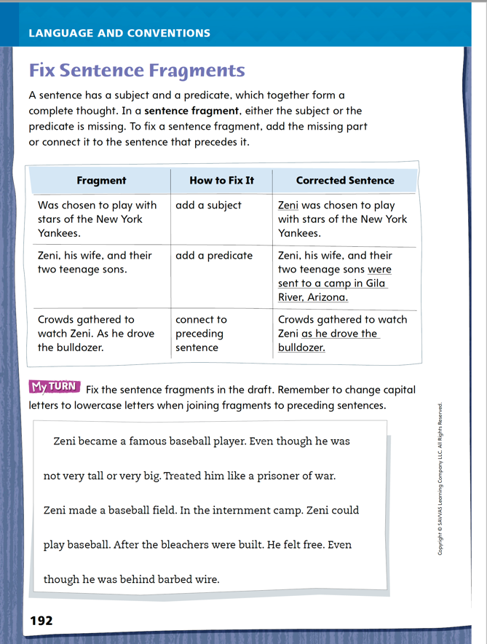
Page 192
Language and Conventions
Turn to page 192 in your Student Interactive and complete the activity.
Notes:
Have students complete page 192 of the Student Interactive.

Slide 67
Lesson 5

Slide 68
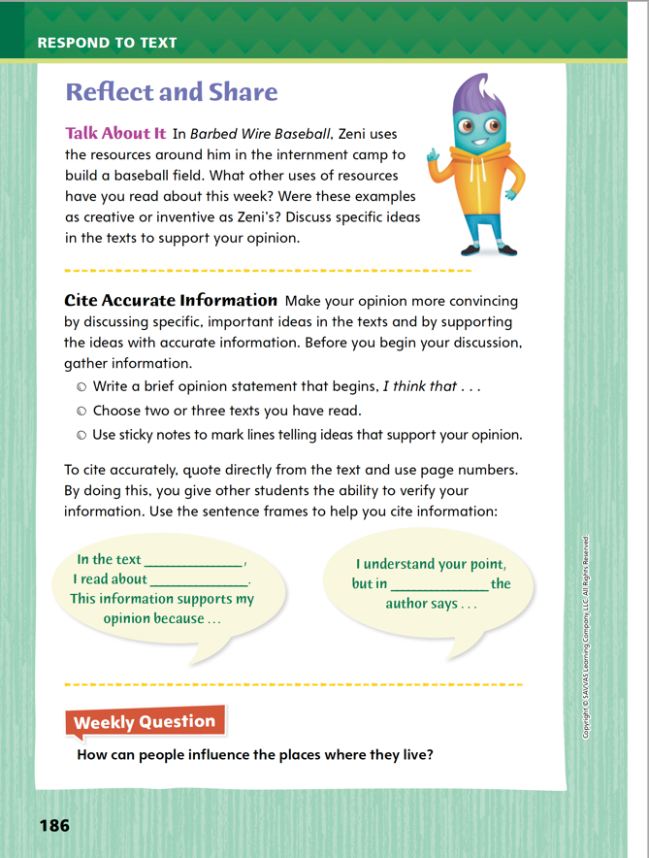
Page 186
Reflect and Share
Turn to page 186 in your Student Interactive.
My opinion is ______ because _________.
I think ______ because ________.
My opinion is supported by the text on page _____.
Notes:
Review how to discuss specific ideas that are important to meaning with others.
Stay on topic.
Listen carefully without interrupting.
Ask questions and add to the comments of others.
Refer to p. 186 of the Student Interactive. Ask student pairs to share their opinions about creative uses of resources based on what they have read this week. Remind them to provide text evidence to support their opinions.
how to discuss specific, important ideas and share an opinion. Speakers should state their opinions clearly, provide supporting reasons and evidence from texts they have read, and connect text evidence to their opinions.
Point out that the speech bubbles on p. 186 provide examples of how to use text evidence to support an opinion and respectfully disagree.
Have student pairs discuss specific ideas in the text by using additional sentence frames: My opinion is ____ because ____; I think ____ because___; My opinion is supported by the text on page____.
Have students use the strategies for making connections between texts.
Have students discuss ideas about creativity and how those ideas relate to texts they read this week. During this discussion, students should form and support opinions about an inventive use of resources. Remind them to follow the guidelines for supporting an opinion on p. 186 of the Student Interactive.

Slide 69
Apply
How can people influence the places where they live?
Notes:
Have students use evidence from this week's texts to respond to the Weekly Question. Tell them to discuss in small groups or write their response on a separate sheet of paper.

Slide 70
Word Study
The newspaper misquoted the mayor’s speech.
The wide handle enables easy opening.
Notes:
To assess students’ understanding of the prefixes mis-, en-, and em-, provide them with the following words: misquoted and enable. Offer sample sentences:
The newspaper misquoted the mayor’s speech.
The wide handle enables easy opening.
Have students use their knowledge of prefixes to define each word. (Possible definitions: misquoted: “to state a remark incorrectly”; enable: “to make possible”) Have students decode the words and their base words.

Slide 71
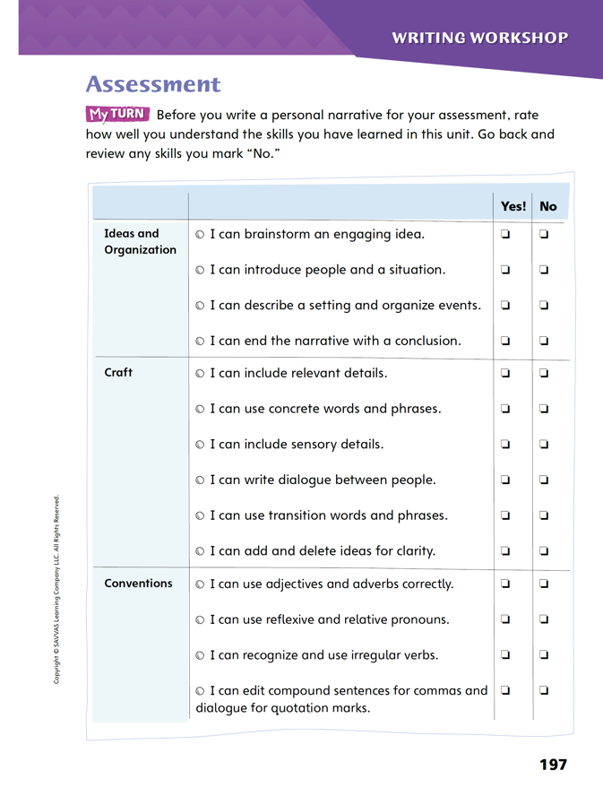
Page 197
Writing – Assessment
Turn to page 197 in your Student Interactive.
Complete the writing checklist.
Notes:
When writing a personal narrative, consider
Ideas and their organization.
Elements of the writer’s craft.
Conventions of the English language.
A checklist is a useful tool for evaluating understanding of the skills in each category.
Remind students that craft refers to the techniques and language a writer uses to tell a story, for example, inclusion of key details and use of concrete words. Review that conventions includes correct use of grammar and punctuation.
Direct students to the skills checklist on p. 197 in the Student Interactive and explain that before they write the personal narrative that will be assessed, they will complete this checklist. Ask: What do you think is the purpose of the checklist? Why is it important to answer the questions honestly? Make sure students understand that by answering each item honestly, they can identify what they need to review before moving on to the final assessment. By reviewing the skills, they will then be better prepared to complete the assessment successfully.
Direct students to complete the checklist.

Slide 72
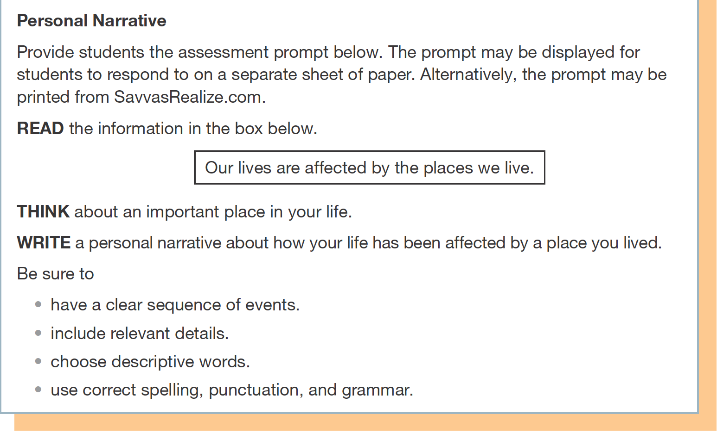
Writing – Assessment
Notes:
Inform students that they are going to take a writing assessment. Using the skills they have learned this unit, they should respond to the prompt on p. T451. Alternatively, assess the students’ published writing using the rubric on p. T451.

Slide 73
Spelling
1. The sheep are enclosed in a field.
2. The rainstorm made their day at the park a misadventure.
3. She wanted to embed a rock in the sand.
4. I can enlighten you on my favorite subjects.
5. Some people misspell my name.
6. I misjudge distances without my glasses.
7. Dropping plates is one way to mishandle dinner.
8. New shoes will enable me to run faster.
9. The dog likes to misbehave when we are away.
10. The mountain gorilla is an endangered animal.
Notes:
(Note: Move the orange boxes to cover each bold spelling word before you read aloud the words and sentences.)
Use the following sentences for the spelling test:
1. The sheep are enclosed in a field.
2. The rainstorm made their day at the park a misadventure.
3. She wanted to embed a rock in the sand.
4. I can enlighten you on my favorite subjects.
5. Some people misspell my name.
6. I misjudge distances without my glasses.
7. Dropping plates is one way to mishandle dinner.
8. New shoes will enable me to run faster.
9. The dog likes to misbehave when we are away.
10. The mountain gorilla is an endangered animal.

Slide 74
Language and Conventions
Could not find. They in the closet. Before school.
Which revision best fixes the sentence fragments?
She could not find the closet before school.
She could not find them in the closet before school.
Before school, she could not find them. They were in the closet.
They were not in the closet.
Notes:
Display the sentence fragments, and have students respond independently.
Could not find. They in the closet. Before school.
Which revision best fixes the sentence fragments?
A She could not find the closet before school.
B She could not find them in the closet before school.
C Before school, she could not find them. They were in the closet. (correct answer)
D They were not in the closet.
APPLY Have students complete Language and Conventions p. 15 in the Resource Download Center. Click path: Table of Contents -> Resource Download Center -> Language and Conventions -> U1 W5

Slide 75
Unit 1: Week 5
Grade 4

