Slide 1
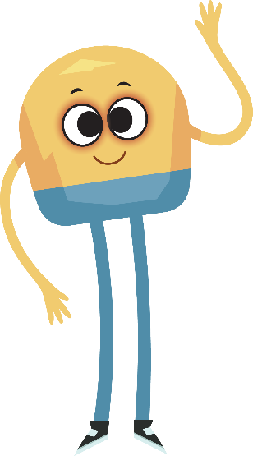
Unit 1: Week 6
Grade 2

Slide 2
Copyright © Savvas Learning Company LLC. All Rights Reserved.
This publication is protected by copyright, and permission should be obtained from the publisher prior to any prohibited reproduction, storage in a retrieval system, or transmission in any form or by any means, electronic, mechanical, photocopying, recording, or otherwise. For information regarding permissions, request forms, and the appropriate contacts within the Savvas Learning Company Rights Management group, please send your query to:
Savvas Learning Company LLC, 15 East Midland Avenue, Paramus, NJ 07652
or
k12learningpermissions@savvas.com
myView Literacy® is an exclusive trademark of Savvas Learning Company LLC in the U.S. and/or other countries.

Slide 3
Lesson 1

Slide 4
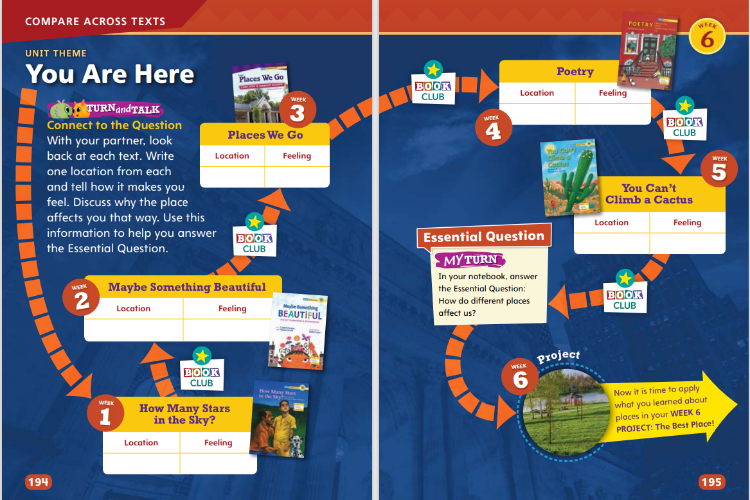
Page
194, 195
Compare Across Texts
Write one location from each and tell how it makes you feel.
Discuss why the place makes you feel that way.
Notes:
In a class discussion, remind students of the unit theme, You Are Here, and the Essential Question, How do different places affect us?
Tell students they will be reading informational texts that relate to the theme in different ways. They will be synthesizing, or putting together, the information from the texts to gain new understanding about the theme.
Have students work in pairs to look back at weekly questions. Circulate as pairs discuss and answer these questions. Tell them to use their answers to answer the Essential Question. Prompt students to push their thinking further and ask follow-up questions with their partners.

Slide 5
Page
194, 195
Compare Across Texts
In your notebook, answer the essential question:
How do different places affect us?
Notes:
Remind students that all of the readings in this unit are connected by the unit theme, You Are Here.
Then use the questions below to help students find text evidence to help them compare themes.
How is a city like the countryside? How is a city different from the countryside? (Possible response: Alike: They are both places where people can live or visit, and animals and plants can live in both the city and the country. Different: Cities are home to many more people than the countryside, and there are many more buildings in cities.)
Point out that the readings You Can’t Climb a Cactus and Places We Go describe different places that people might visit. How do you think these two readings could connect to the theme of You Are Here? (Possible response: Both readings provide settings. One is the desert, and one is a library.)
Which place would be the most interesting to visit? To live? (Possible response: I like visiting the library because there are so many books to read. I would like to live in a desert because of all the interesting animals.)
Have students answer the Unit 1 Essential Question: How do different places affect us?

Slide 6
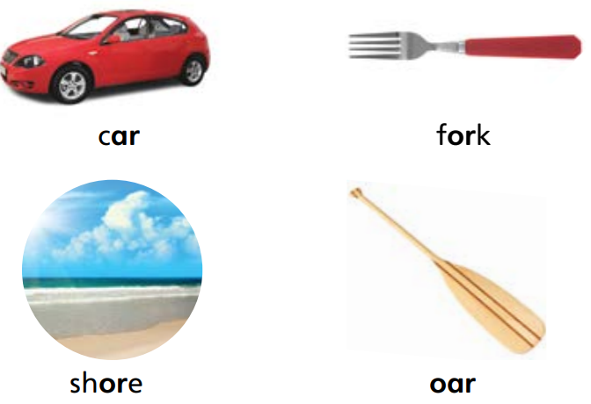
Page
196
Phonics
Notes:
Point to the picture of the car at the top of p. 196 in the Student Interactive. Say: Let’s say the sounds of the word: /k//ar/.
Point to the letter combination ar and explain that this is an example of an r-controlled vowel group. Tell students this lesson is about r-controlled vowels with the sounds /ar/ and /or/.
Explain that when students see the letter combination ar they should read, or decode, it as /ar/, as in the word car. Have students look again at SI p. 196 and run their fingers under the ar in car while saying /ar/. Repeat the process with fork, pointing out that the letter combination or generally spells the sound /or/. Continue with the two remaining words at the top of the page (shore/oar) and emphasize that these r-controlled vowel words also should be read as /or/.
Have students complete the rest of the page by underlining the r-controlled vowel groups and decoding the words on SI p. 196.

Slide 7
Page 196
Apply
Turn to page 196. Read the words in the chart.
Underline the r-controlled vowel groups in each word.
Notes:
Have students complete the rest of the page by underlining the r-controlled vowel groups and decoding the words on SI p. 196.

Slide 8
High-Frequency Words
also
large
small
Notes:
Display the words: also, large, small.
Point to each word as you read it.
Then spell the word and read it again.
Have students spell and say the words with you.

Slide 9
Spelling
The horse pulls a cart.
There is a mark on the wall.
We have a garden in the yard.
The bear is in the forest.
Mice do not roar.
The apple has a core.
We tore the paper in half.
I do a chore each night.
They build a fort in the tree.
Do you like to write on the board?
Notes:
(Note: Move the orange boxes to cover each bold spelling word before you read aloud the words and sentences.)
Read aloud the words and sentences. Have students spell the words with the sound /kw/, the other spelling words, and the two high-frequency words.
The horse pulls a cart.
There is a mark on the wall.
We have a garden in the yard.
The bear is in the forest.
Mice do not roar.
The apple has a core.
We tore the paper in half.
I do a chore each night.
They build a fort in the tree.
Do you like to write on the board?
Reveal the spelling word and have students check their work.

Slide 10
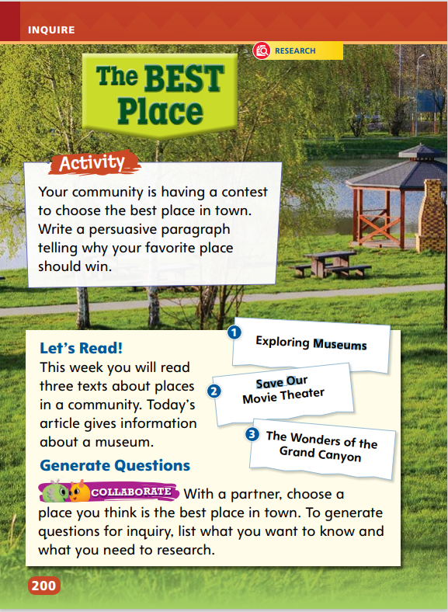
Page
200
Inquire – Introduce the Project
Think of the best place in your town.
Share your place with a partner and talk about why that place deserves to win the best place in town.
Notes:
This week, each student will write and present a persuasive paragraph about a favorite place in his or her community.
Students will do research and interview a person who works at this place.
Read the prompt at the top of p. 200 of the Student Interactive aloud. Motivate students by activating prior knowledge, asking questions about their favorite places, and setting a purpose for the project.

Slide 11
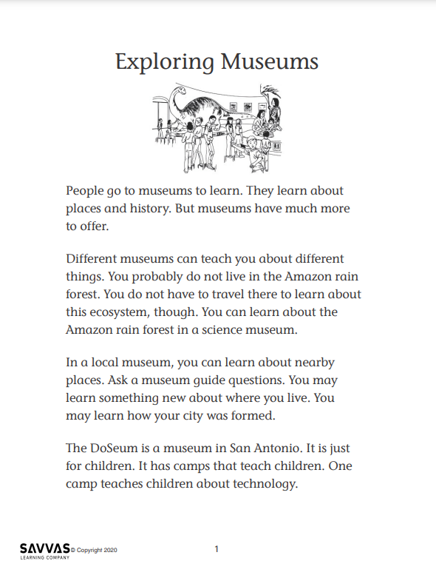
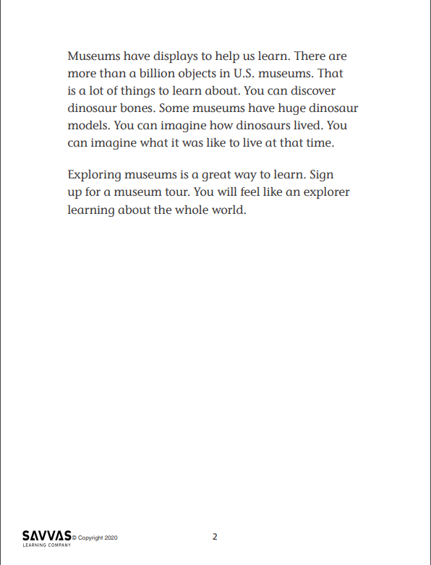
Inquire – Build Background
Read “Exploring Museums.”
Take turns reading paragraphs with a partner and make connections.
This section of the text reminds me…
When I went to a museum, I saw…
I would like to go to a museum that had lots of …
Notes:
Distribute copies of “Exploring Museums.” Click path: Table of Contents -> Unit 1: You Are Here-> U1 W6: Project-Based Inquiry -> U1 W6: Lesson 1
Note: This article is available at 3 different Lexile levels. The slide image is the middle range.
Use the article to help students build background for the topic.
Have partners take turns reading the article aloud, switching off every few sentences. After each paragraph, partners should share their connections to the text.
Write these stems on the board to start conversations.
This section of the text reminds me of …
When I went to a museum, I saw …
I would like to go to a museum that had lots of …
For differentiated support:
Have pairs of students read the article together, with pauses between paragraphs. Make a T-chart with students. Label the columns “Things I Have Seen in a Museum” and “Things I Would Like to See in a Museum.” Begin by putting an item of your own in each category. Then have students suggest additions to the chart, telling you which column each item belongs in and using, if possible, some Academic Vocabulary. Review the list with students and have them complete the stem sentences with you.
If pairs read and answer the stem statements quickly, have them begin to generate ideas about their favorite places, whom they might interview to find out about those places, and what words make for engaging language to build a persuasive essay.

Slide 12
Page
200, 201
Inquire – Generate Questions
Let’s brainstorm lists of things found in museums.
Now we will take what we have learned about inquiry and think of our own questions.
With a partner, choose a place you think is the best place in town.
Write questions about, what you want to know and what you need to research.
Notes:
Have pairs brainstorm lists of things found in museums.
As students work, circulate and ask questions about their lists:
What object interests you? Why?
What would you like to learn about this object?
Tell students that these are questions for formal inquiry, and explain what that means.
To help partners think of their own questions for formal inquiry, assist them in generating similar questions and research ideas about a place in their community.

Slide 13
Page
200, 201
Inquire – Academic Vocabulary
Turn to pp. 200-201 in your Student Interactive.
Talk about the picture using your Academic Vocabulary.
Notes:
Guide students to read and define the academic words on p. 201 in the Student Interactive.
Students should incorporate some of this newly acquired vocabulary in their discussions of places they like.
Tell students that they will use some of these words in their persuasive paragraphs.
Tell students that they will develop and follow a research plan in order to complete the project in a week. Walk students through the Favorite Place Research Plan on p. 201. Students should begin by choosing their favorite place. Then have students check off the first step by generating and writing questions for research, using some Academic Vocabulary if possible.

Slide 14
Lesson 2

Slide 15
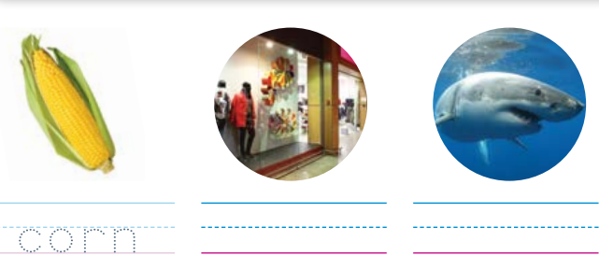
Page 197
Phonics
Complete page 197 in your Student Interactive.
Notes:
Explain that ar is the most common way of spelling the sound /ar/, but that there are other ways of spelling the sound /or/.
Point out three different ways to students: or, ore, and oar. Tell students that they will probably need to memorize which words go with which spellings.
Read the words in the box on SI p. 197. Point out that the first word, board, contains the sound /or/ and that the spelling of that sound is oar.
For the remaining words, have students identify whether the word contains the r-controlled vowel sound /ar/ or /or/. Then have them identify the letter combination that stands for the vowel sound and decode the word.

Slide 16
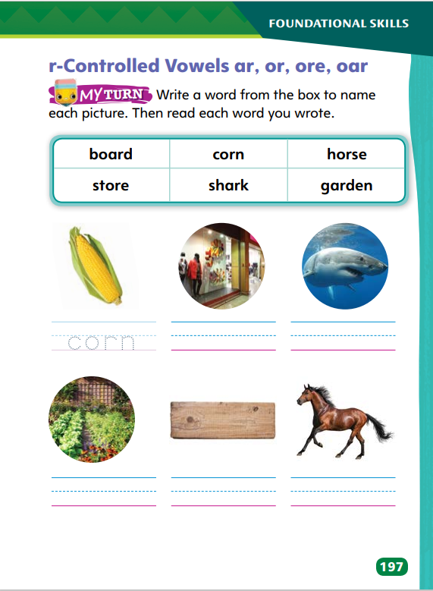
Page 197
Apply
Turn to page 197.
Write a word from the box to name each picture.
Notes:
Have students complete SI p. 197 by writing the correct word with an r-controlled vowel group under each picture. Have students decode the words aloud to you or to a partner.

Slide 17
High-Frequency Words
also
large
small
Notes:
Display the words: also, large, small.
Point to each word as you read it.
Then spell the word and read it again.
Have students spell and say the words with you.

Slide 18
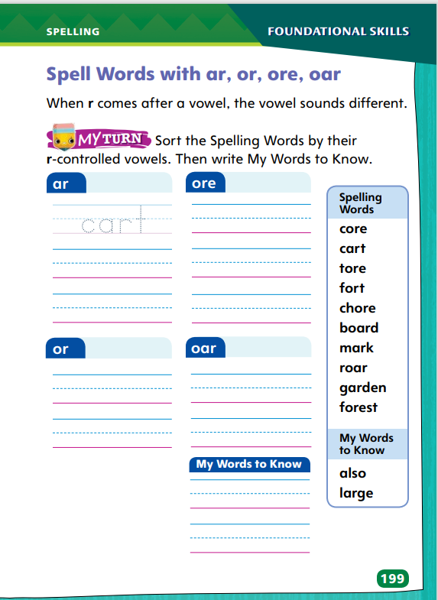
Page 199
Spelling
bore
corn
cellar
Turn to page 199 in your Student Interactive and complete the activity.
Notes:
Explain that spelling an r-controlled syllable means writing the letter r after the vowel.
Write bore, corn, and cellar. Say and spell each word aloud and have students repeat the spelling. Point out that /r/ makes the vowel in each word sound neither long nor short.
Have students complete SI p. 199 to spell one-syllable and multisyllabic words with r-controlled syllables.

Slide 19
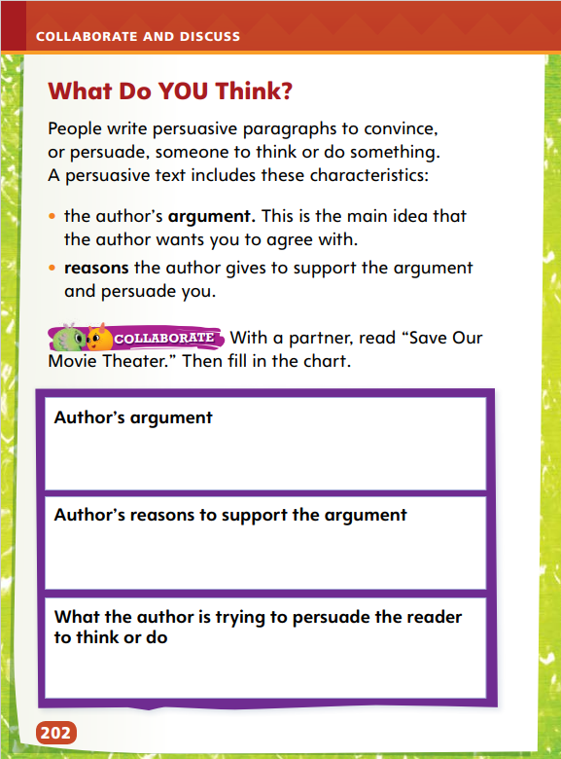
Page
202
Explore and Plan – Persuasive Text
Turn to p. 202 in your Student Interactive.
Notes:
Use the article “Save Our Movie Theater” to help students recognize the characteristics of persuasive texts, including stating what the author is trying to persuade the reader to think or do.
Review with students that writing to persuade is about giving an opinion. Read aloud the information about persuasive writing at the top of SI p. 202 while students follow along.
Point out that the word argument, in this case, means “opinion.” Remind students to include persuasive words in their persuasive paragraphs.

Slide 20
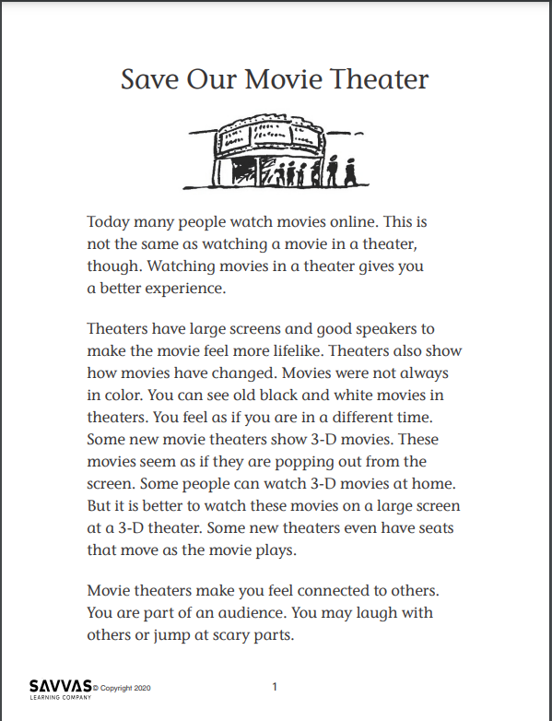
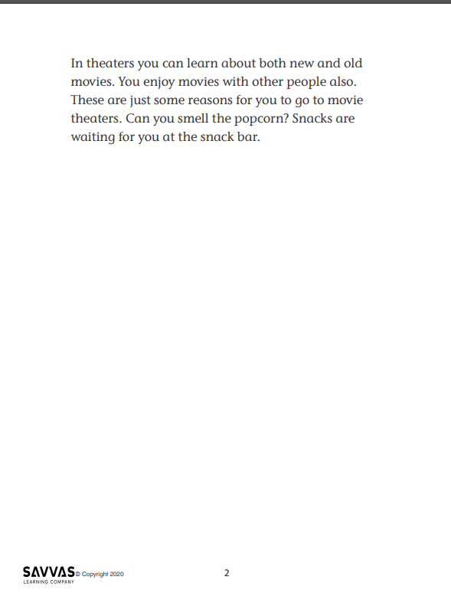
Explore and Plan – Informational Text
Read “Save Our Movie Theatre.”
Identify what you find most interesting.
Who is the audience?
Find a word you think the class should know.
Highlight words that persuade you to believe the author.
Notes:
Distribute copies of “Save Our Movie Theater.” Click path: Table of Contents -> Unit 1: You Are Here-> U1 W6: Project-Based Inquiry -> U1 W6: Lesson 2
Note: This article is available at 3 different Lexile levels. The slide image is the middle range.
Use the research article to help students identify the characteristics that make this a persuasive text.
Have students take turns reading paragraphs from the article to a partner. After each paragraph, have students discuss what they learned and share the connections they made to the text. Have students use sticky notes to highlight important information.
Write the following tasks on the board:
Identify what you find most interesting about the article.
Determine the audience for this article.
Find a word you think the class should know.
Find words that persuade you to believe the author
After reading, have students discuss their answers. Remind them that this article is an example of persuasive writing, and they will need to use persuasive language and strong arguments in their own writing for the week.

Slide 21
Page
202
Apply
Turn to p. 202 in your Student Interactive and complete the activity with a partner.
Notes:
After recording their ideas, have pairs complete the What Do You Think? chart on SI p. 202 about “Save Our Movie Theater.”
Call on each pair to state what the author of the article is trying to persuade the reader to think or do.

Slide 22
Check For Understanding
State what you want to persuade your audience to think or do.
Use these ideas to guide your research.
Notes:
Remind students to use formal language for their persuasive writing to show that they are serious about their opinions. Offer questions to stimulate critical thinking about audience: How do you think your audience would feel about your favorite place? What events does your favorite place offer? Would your audience like these things? Why?
Check students’ recognition of the characteristics of persuasive texts by asking them to state what they as the author want to persuade the audience to think or to do.
Do they want to convince the audience to visit their favorite place? Do they want to convince the audience to donate money or time to keep the place running? These questions should help guide their research.

Slide 23
Page
203
Conduct Research
With your partner, interview each other about a favorite place in the community.
Notes:
Tell students that their community includes many people who know a lot about the places they visit and enjoy. Use the following Model and Practice on interviewing to help students identify questions and gather relevant information about their topics.
Model the process for conducting interviews. Use the “Interview an Expert.” Tell Students:
There was an old movie theater in a town where I used to live. It was called the Crestwood Theater. I wanted to know more about the theater. I knew a woman named Ms. Lee. Ms. Lee had been a girl when the theater was built, and she knew a lot about it. I decided to interview Ms. Lee about the theater.
First, I made a list of questions for her. I wanted to know what the theater had looked like when it was built. I wanted to know what she liked about the theater and what it was like to go to a show there.
Then, I talked to Ms. Lee. I read from my list of questions. She told me that the Crestwood had been one of the tallest buildings in town when it was built. I learned a lot from Ms. Lee, and I wrote down all her answers.
Have pairs use the process you modeled to interview each other about a favorite place in the community.

Slide 24
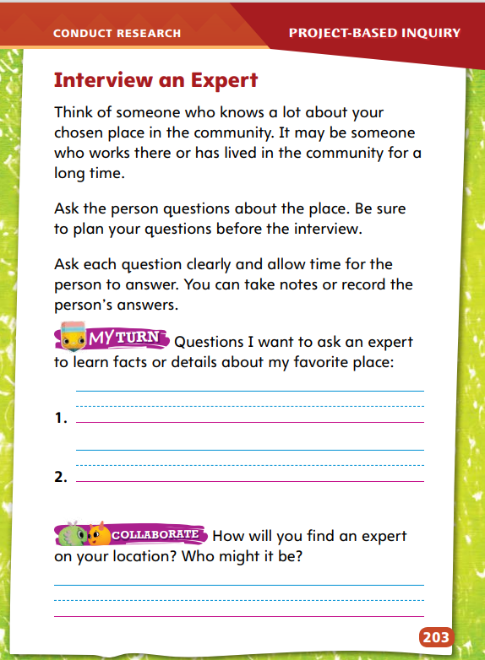
Page
203
Conduct Research
Turn to p. 203 in your Student Interactive.
Write two questions you would ask an expert about your favorite place.
How will you find an expert on your location? Who might it be?
Notes:
Tell students to read the top of SI p. 203 in the Student Interactive. Then have them begin writing questions to ask an expert.
Have student pairs complete SI p. 203.
For differentiated support:
Give struggling students sentence frames to support writing research and interviews, such as: My favorite place is _____. I like this place because _____. Does this place need help to stay open? What is it like to work at this place? What does this place look like?
If students readily grasp the process of asking questions to find out more information, offer them the opportunity to fill in a graphic organizer, such as a Main Idea grid. Have them list what they know about their favorite place and then add new information in the space provided.
Next Steps: If students struggle with deciding who they might interview, give them a list of potential people and have them decide whether each might be a good source. Possibilities include a person who has just moved to the community (no), a person who works at the place they have chosen (yes), a person who has lived in the community for many years (yes), a student's younger brother or sister (no). If students know who they would like to interview, encourage students to reach out or make an appointment for an interview.

Slide 25
Lesson 3

Slide 26
Phonics
One partner will pick a spelling word from the list and will say the word.
The other partner will say the r-controlled vowel and how it is spelled.
Switch roles.
cart
core
mark
tore
garden
chore
forest
fort
roar
board
Notes:
Have students play the following game to help them read and spell words with r-controlled vowels ar, or, oar, and ore. Have students work in pairs. Provide pairs with a list of spelling words with r-controlled vowels.
Have students work in pairs. Instruct one student in each pair to choose a word from the list of spelling words with r-controlled vowels. The first student says the word, and the second student says the r-controlled vowel and tells how that vowel is spelled. For example, if the first student says roar, the second student says or and then spells oar. Players then switch roles until all ten words have been used. Players score one point for each word they spell correctly.

Slide 27
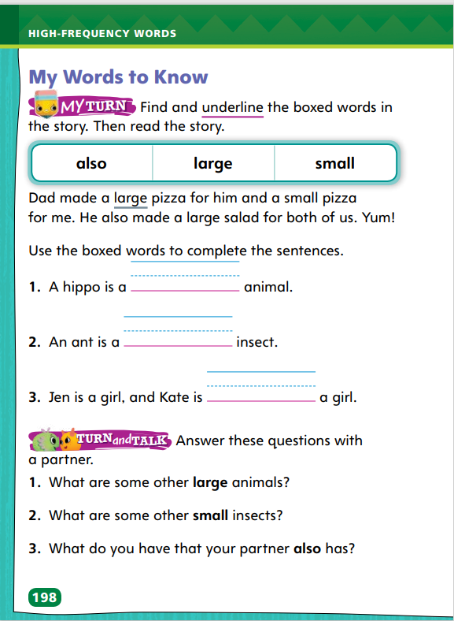
Page 198
High-Frequency Words
also
Turn to page 198 in your Student Interactive and complete the activity.
large
small
Notes:
Tell students that there are many word spellings that cannot be determined just from listening carefully to the words’ sounds. Explain that the three high-frequency words (also, large, and small) are in this category.
Have them look at the number of letters in each word and pay attention to how they look, noticing letters that stretch up or down. For instance, small has five letters, and the last two letters (ll) are taller than the rest.
Read each high-frequency word aloud. Use it in a sentence. Have students work with partners to read and spell the words and use them in sentences of their own.
Have students complete the three sentences on p. 198 of the Student Interactive.
Have students answer the Turn and Talk questions on p. 198 of the Student Interactive with a partner.

Slide 28
Spelling
part
horn
boar
restore
Notes:
Explain that the letter combination ar is the most common way to spell the sound /ar/, and that the sound /or/ is usually represented by or, oar, or ore.
Write these words: part, horn, boar, and restore. Say each word aloud and point out how the r changes the vowel sound. Have students identify the letter combinations. Then have them say and spell each word.
Have students complete Spelling p. 28 from the Resource Download Center to spell one-syllable and multisyllabic words with r-controlled vowels.. Click path: Table of Contents -> Resource Download Center -> Spelling -> U1W6

Slide 29
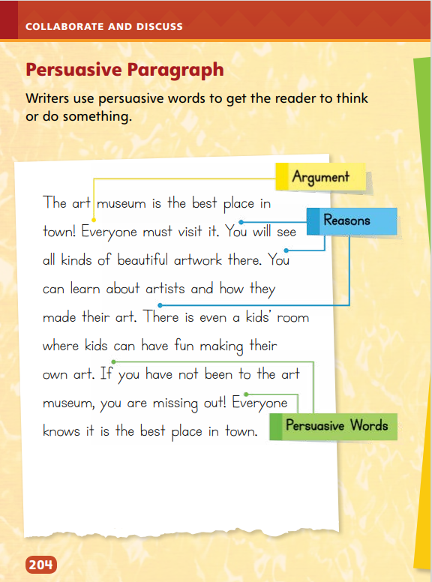
Page
204
Collaborate and Discuss
Turn to p. 204 in your Student Interactive.
Notes:
Say: A persuasive paragraph states a point of view or opinion of an author. This is the argument. The author supports the argument by giving good reasons for the opinion or point of view. The author also uses strong words to convince the reader.
Read aloud the student model on p. 204 in the Student Interactive.
Use the paragraph on p. 204 to model the parts of a persuasive paragraph. Say: The paragraph begins with an argument, or strong opinion about the art museum. The body lists reasons to support the argument. Toward the end, the student includes some persuasive words. What persuasive words do you see?
Have partners discuss the model and identify the argument, the reasons, and persuasive words. Be sure they understand what the author wants readers to do or to believe.

Slide 30
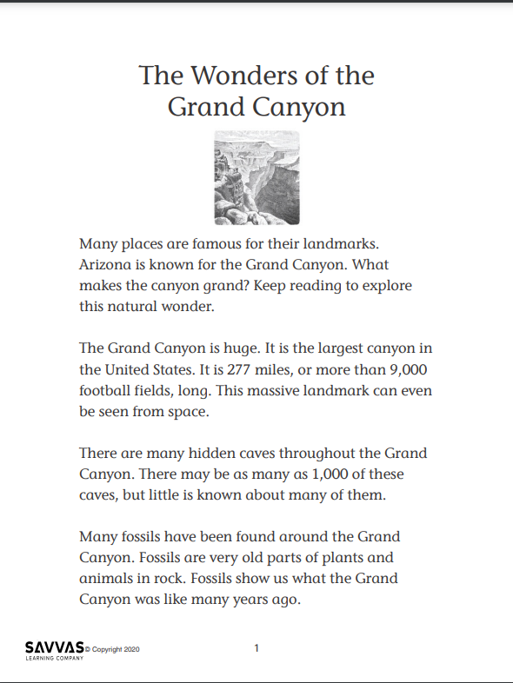
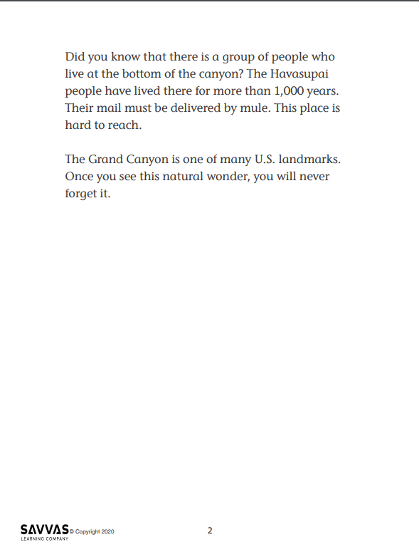
Collaborate and Discuss – Author’s Purpose
Read “The Wonders of the Grand Canyon” with a partner.
Use the sentence stems compare museums and the Grand Canyon.
The information about museums reminds me of …
The information about the Grand Canyon reminds me of …
Museums are like the Grand Canyon because …
Museums are different from the Grand Canyon because …
Notes:
Distribute copies of “The Wonders of the Grand Canyon.” Click path: Table of Contents -> Unit 1: You Are Here -> U1 W6: Project-Based Inquiry -> U1 W6: Lesson 3
Note: This article is available at 3 different Lexile levels. The slide image is the middle range.
Use the article to help students recognize characteristics of an informational text.
Have partners read one paragraph at a time. After each paragraph, have students recap it and ask one question about it.
Write the stems below. Have students use the stems to compare what they have learned about museums (from the first research article, “Exploring Museums”) and the Grand Canyon.
The information about museums reminds me of…
The information about the Grand Canyon reminds me of …
Museums are like the Grand Canyon because …
Museums are different from the Grand Canyon because …

Slide 31
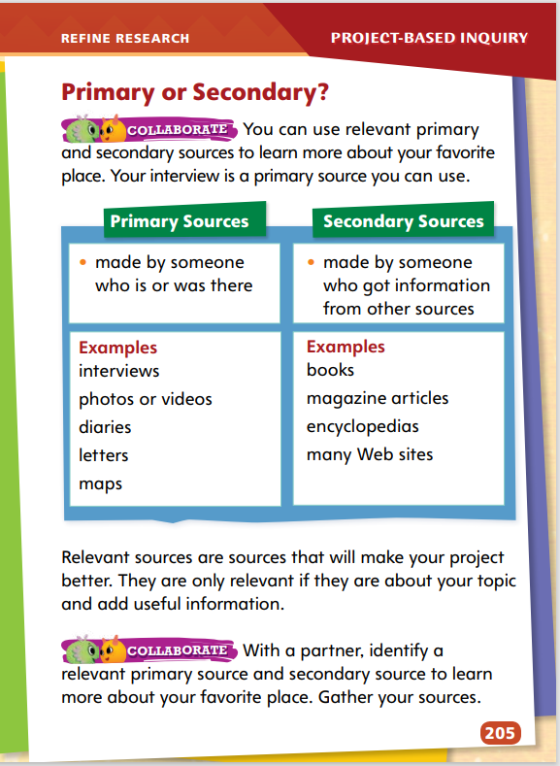
Page
205
Refine Research
Turn to p. 205 in your Student Interactive.
With a partner, identify a relevant primary source and secondary source to learn more about your favorite place. Gather your sources.
Notes:
Discuss what makes a source relevant.
Then remind students that a primary source, such as a letter or interview, is made by someone who witnessed the event or has first-hand knowledge about a topic. Secondary sources, such as textbooks, are based on information from other sources.
Help students see that who made the source is important. Explain that their interview is a primary source because they made it. Help partners identify one relevant primary source and one relevant secondary source to use.
Next Steps: Check in with student pairs as they begin writing their paragraphs. Emphasize that the paragraph should begin with an opinion, such as: I think __________ is the best place in my neighborhood. Be sure students keep in mind that they are trying to get their readers to do or think something when they have finished the paragraph.

Slide 32
Lesson 4

Slide 33
Phonics
ar
cart
oar
soar
or
corn
ore
shore
Write your own word. Circle the letters that form r-controlled vowels and share with a partner.
Notes:
Remind students of each type of r-controlled vowel they learned about in this lesson.
Write an example word for ar, or, oar, and ore on chart paper or the board. For example, write: ar (cart), or (corn), oar (soar), and ore (shore). Then have students write their own word for each r-controlled vowel phonogram.
When students have completed writing their own words, have them circle the letters in each word that form r-controlled vowels. Have students read their words to a partner.

Slide 34
Spelling
foxes
grades
rugs
patches
smiled
making
gripped
mopped
Notes:
Review with students how to read and write words with the endings -s, -es, -ed, and -ing. Stress that the final consonant of the base word may need to be doubled.
Write or display these words with endings -s, -es, -ed, and -ing: foxes, grades, rugs, patches, smiled, making, gripped, and mopped. Have students read the words aloud.
Have students sort the words by ending. Then have them sort the words according to whether the base word needs to be changed before the ending is added.
As students proofread their work, remind them to check the spellings of words with endings -s, -es, -ed, and -ing.

Slide 35
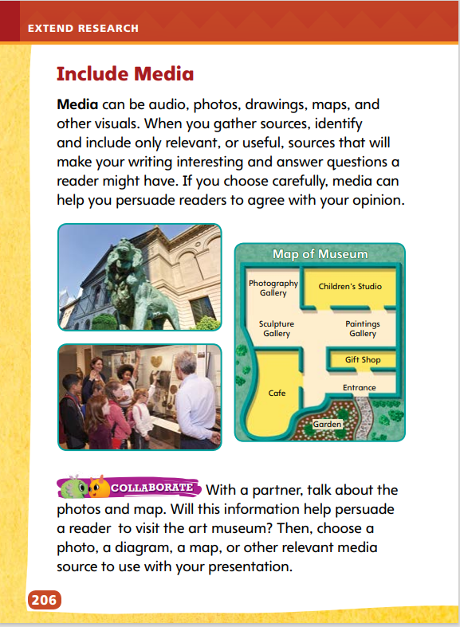
Page
206
Extend Research – Include Media
Turn to p. 206 in your Student Interactive and complete the activity.
Notes:
Authors can make their writing stronger and their arguments more convincing by incorporating relevant media sources, such as pictures, drawings, videos, and other graphic sources, into their work.
Use the examples on SI p. 206 to model how students can identify, gather, and incorporate relevant media sources and information that answers questions.
Writers use images to help readers visualize, or see, their topic. In an argumentative text, a writer might use an image to illustrate a point.
A map can show where a place is or what the different parts of the place are. Say: The map shows the different rooms in an art museum. Which part of the museum would you most like to visit? Why?
Labels in a diagram should relate to the point the writer is making in the text.
Explain that relevant sources and relevant information relate directly to the topic of an argument and answer a writer’s questions. Have students identify and gather relevant media sources. Then have them identify and gather relevant information from those sources. Guide them to include information that answers their questions and supports their arguments.

Slide 36
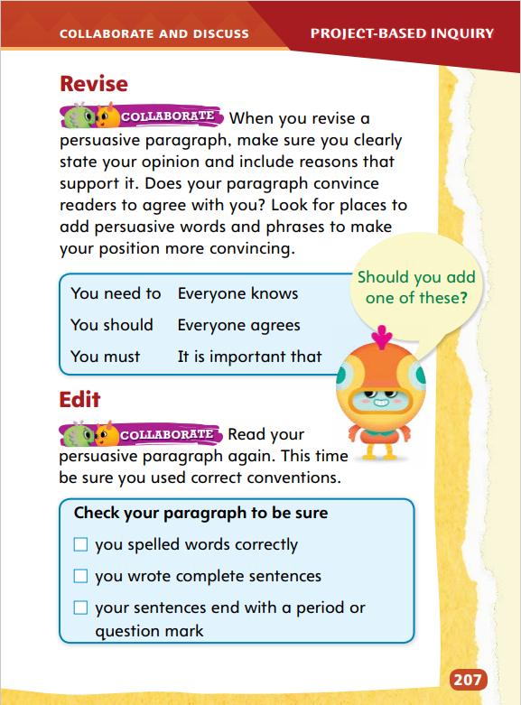
Page
207
Collaborate and Discuss
Turn to p. 207 in your Student Interactive and complete the activity with a partner.
Notes:
Writers should use words and phrases that will help convince their audience. Remind students to use words that will make their arguments sound serious and credible.
Model how writers revise and edit their work by going over the Revise and Edit activities on SI p. 207. Show students how they can use the checklist to ensure that they have used conventions correctly.
Review the phrases on SI p. 207 and discuss how they help persuade readers that the argument is correct. Have students check their own work and ask themselves what word choices will make their writing more vivid and persuasive.

Slide 37
Apply
Edit your persuasive paragraph to be sure you used correct conventions.
Use the checklist on p. 207 in the Student Interactive to help you.
Write a clean, edited, final copy of your persuasive paragraph.
Notes:
Remind students that their essays are formal, and that they should include vocabulary words and engaging language to convince the audience of their arguments. Be sure students understand that their purpose is to convince their audience to do or think something in particular.
For differentiated support:
If students struggle to use the Edit checklist, write a few sentences on the board that contain several spelling mistakes, a sentence fragment, and at least one sentence without final punctuation. Model how to look for and fix each error. Then work with students as they check their own writing.
Have students circle the words and phrases in their paragraphs that they think are the most persuasive. Then have pairs tell another pair what makes these words and phrases so convincing.
Next Steps: Remind students that they will have to finish dictating or composing their essays so that they can read them to the class the next day.

Slide 38
Lesson 5

Slide 39
Phonics
-s
-es
-ed
-ing
stopping
pitches
looked
packs
hugged
caring
marching
Notes:
Review with students that the endings -s, -es, -ed, and -ing can be added to words to change tense or show amounts.
Remind students that in many cases, inflected endings are simply added to a base word as in house/houses and cook/ cooked/cooking. In some cases the base word needs to be changed slightly, as in face/facing (a final e is dropped when -ing is added) and tap/tapped (doubling a final consonant when -ed is added).
Work with students to read the following words aloud and identify any spelling changes in the base words: stopping, pitches, looked, packs, hugged, caring, and marching.
Have students add the following endings to these base words independently: call + ed (called), fit + ing (fitting), dish + es (dishes), and park + s (parks).
Ask students to read aloud the words and tell a partner how they knew how to write the completed word.

Slide 40
High-Frequency Words
also
large
small
Notes:
Remind students that high frequency words are words that they will hear and see over and over in texts.
Use the words also, large, and small in example sentences.
Have students write each word three times: once with pencil, once with crayon, and once with marker.

Slide 41
Spelling
We put the groceries in the cart.
He ate the apple all the way to the core.
He made a mark on the paper.
She tore the bread in half.
We will plant a garden in the spring.
I had to do a chore for my mom.
The rabbit lives in the forest.
They built a fort this summer.
I heard a lion roar.
She wrote a word on the board.
Notes:
(Note: Move the orange boxes to cover each bold spelling word before you read aloud the words and sentences.)
Read aloud the words and sentences. Have students spell the words with the sound /kw/, the other spelling words, and the two high-frequency words.
We put the groceries in the cart.
He ate the apple all the way to the core.
He made a mark on the paper.
She tore the bread in half.
We will plant a garden in the spring.
I had to do a chore for my mom.
The rabbit lives in the forest.
They built a fort this summer.
I heard a lion roar.
She wrote a word on the board.
Reveal the spelling word and have students check their work.

Slide 42
Page
208
Celebrate and Reflect
Turn to p. 208 in your Student Interactive.
Read your persuasive paragraph to a small group.
Use a lively voice to convince them about the best place in town.
Notes:
Before final publication, discuss appropriate modes of delivery, such as posting essays on the school Web site, creating multimodal presentations with video or graphics, and reading essays aloud to an audience. Explain that the mode identified in the text is appropriate because arguments are often presented orally. Provide examples, such as speeches.
Tell students that pretending there are judges in the audience will help them present arguments in a convincing way. Then have pairs share information and ideas by presenting their essays orally to another team. Tell students who have incorporated media to use an appropriate mode for delivering the media.
Read aloud the Student Model on SI p. 204. When you finish, point out the traits of effective speech. Say:
When I read the essay aloud, I did not stare down at my paper. Once in a while, I looked up to make eye contact with my audience.
I shared my ideas by speaking clearly at an appropriate pace. I did not rush. I read a little more slowly than I usually talk so the audience could hear and understand every word.
To make sure others understood the information and ideas I shared, I followed language conventions, including speaking in complete sentences. I pronounced each word correctly.
Allow students time to practice their oral delivery and make adjustments. Remind students that they need to be active, respectful listeners as well as effective speakers. To help students share ideas, tell them to focus on the topic of the paragraph, speak clearly at an appropriate pace, and use the conventions of language.

Slide 43
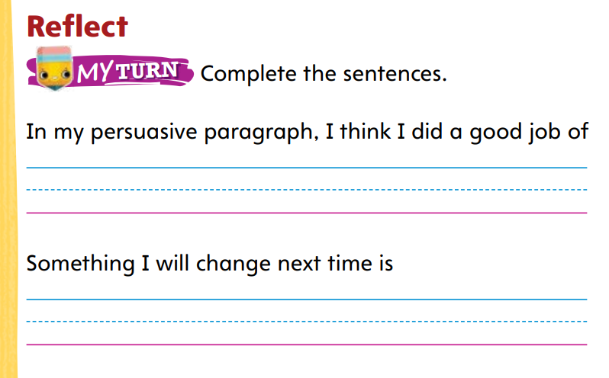
Page
208
Celebrate and Reflect
Turn to p. 208 in your Student Interactive and complete the activity.
Notes:
Students should evaluate their own work using the questions on SI p. 208.
Ask them to consider what worked well, what surprised them, what was most challenging, and what they might do differently next time.
Wrap up by reminding students that they learned new persuasive language, checked their work for spelling, punctuation, and other conventions, and learned to research using primary and secondary sources.
Ask students what they learned about working with a partner and how they formulated the questions they wanted to have answered.

Slide 44
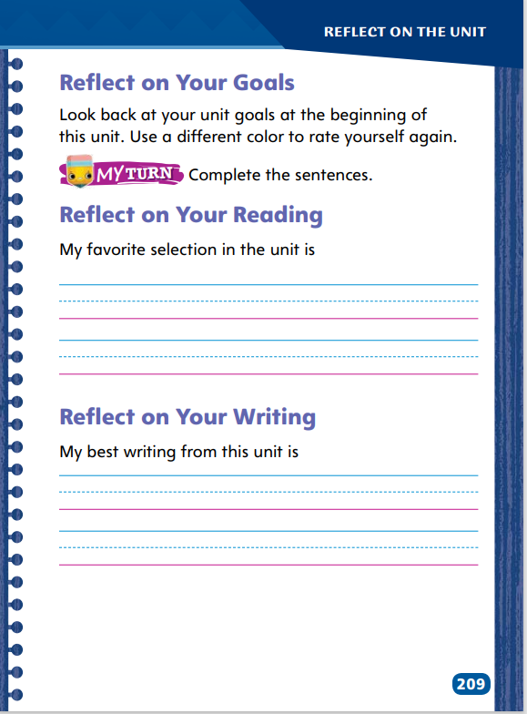
Page
209
Reflect on the Unit
Turn to p. 209 in your Student Interactive and complete the activities.
Notes:
Direct students’ attention to the Unit Goals page at the beginning of this unit. Ask students to reflect on how they would assess their own reading and writing skills.
Reread the Essential Question, and invite volunteers to respond to it. Have them use information they learned in this unit in their responses.
Next, ask them to address their progress in relation to the unit goals.
Ask student volunteers to discuss each reading selection. Have them summarize the text they are discussing to remind the class what it was about. Then ask them to share a specific fact or detail about the selection, such as its author or title or what it said about the unit theme You Are Here. Finally, ask them to share their opinion of the selection, including something specific that they liked or did not like about it (the topic, the pictures, the characters, and so on).
Have students look back at the writing they have done in this unit. Have them identify their favorite piece of writing. Ask them to discuss what inspired them or what they modeled their writing after. Finally, instruct each student to identify one thing they learned about writing in this unit.

Slide 45
Unit 1: Week 6
Grade 2

