Slide 1
Unit 1: Week 1
Grade 1

Slide 2
Copyright © Savvas Learning Company LLC. All Rights Reserved.
This publication is protected by copyright, and permission should be obtained from the publisher prior to any prohibited reproduction, storage in a retrieval system, or transmission in any form or by any means, electronic, mechanical, photocopying, recording, or otherwise. For information regarding permissions, request forms, and the appropriate contacts within the Savvas Learning Company Rights Management group, please send your query to:
Savvas Learning Company LLC, 15 East Midland Avenue, Paramus, NJ 07652
or
k12learningpermissions@savvas.com
myView Literacy® is an exclusive trademark of Savvas Learning Company LLC in the U.S. and/or other countries.

Slide 3
Page 6
Introduce the Unit
Essential Question:
What is a neighborhood?
What did you learn from the sounds in the video?
What did you learn from the pictures?
Notes:
Introduce the Essential Question for Unit 1: What is a neighborhood? Tell students they will read many texts to learn about the things that you can see and do in a neighborhood. Explain that reading texts in a variety of genres is important because each author gives different information.
Watch the Unit Video –Tell students that a multimedia text can use both sound and pictures. A video is a multimedia text. Have students pay attention to sound and pictures as they watch “Welcome to My Neighborhood.” Click Path: Table of Contents -> Unit 1: My Neighborhood-> Unit 1: Introduction
Tell partners to discuss what they learned about animal tracks by watching the video.
What did you learn from the sounds in the video?
What did you learn from the pictures?

Slide 4
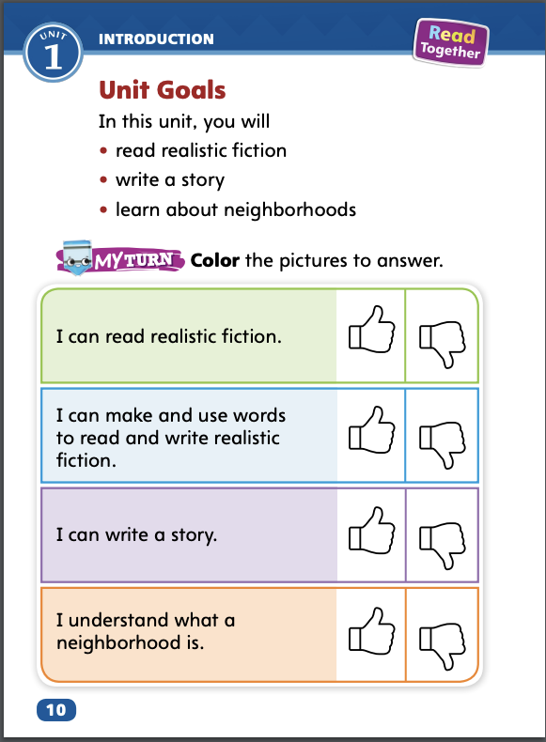
Page 10
Unit Goals
Turn to page 10 in your Student Interactive.
Color the “Thumbs Up” or the “Thumbs Down” for each goal.
Notes:
Read aloud the bulleted list of goals on pg. 10 in the Student Interactive.
Have students color the ”Thumbs Up” if they feel they have already accomplished the goal, or the “thumbs down” if they think they have more the learn. Students will revisit this page in Week 6.

Slide 5
Page 11
Academic Vocabulary
Expand: A pencil is a type of writing tool.
Ask: What types of books do you like to read?
Expand: You and your classmates are an example of a group.
Ask: What is another group you are a part of?
Expand: To settle in a place means to begin living there.
Ask: If you could live anywhere in the world, where would you settle?
Expand: A box of crayons has various colors.
Ask: What are some of the various shapes you see in the classroom?
Notes:
Academic vocabulary is language used to talk about ideas. Explain that as students work through the unit, they will learn and use these academic words to talk about neighborhoods.
Read the paragraph aloud on p. 11 in the Student Interactive. Then use the EXPAND and ASK questions for each word. Have students respond, or say something in reply to someone else, using the newly acquired Academic Vocabulary as appropriate.

Slide 6
Lesson 1

Slide 7
Page 14
Phonological Awareness
Notes:
Point to the picture of the cat on p. 14 in the Student Interactive. Tell students to watch you and listen. As you say each sound in the word cat, hold up your index, middle, and ring fingers to indicate the number of sounds.
Repeat the sounds in the word cat several times: /k/ /a/ /t/. Then repeat the activity with the pictures for hat and fan. Say: Each picture name has different sounds. What sound do you hear in the middle of each picture name?
Say: Listen carefully as I say the sounds in pad: /p/ /a/ /d/. Extend your pronunciation of the medial /a/ sound. Now repeat the sounds in pad with me: /p/ /a/ /d/. What sound do you hear in the middle of the word pad? Yes! It is the sound /a/. Keep practicing the medial a sound with the following words: cab, sad, mad, tap. Say the sounds and have students repeat the sounds.

Slide 8
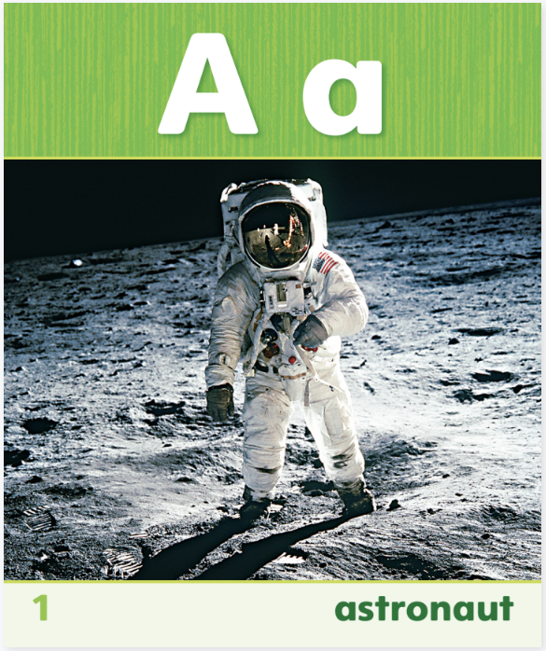
Page 14
Phonics
Read the words on page 14 in your Student Interactive.
Notes:
Use Sound-Spelling Card 1 (astronaut) to introduce how to spell the short a sound. Tell students that the sound /a/ at the beginning of astronaut is spelled a.
Say: This is a picture of an astronaut. Astronaut begins with the sound /a/. Listen: /a/ (pause) /a/ (pause) /a/ (pause) astronaut. Say the sound with me. Have students say the sound several times.
Then ask: What sound does astronaut begin with? Elicit responses. Good job! Point to the Aa at the top of the card. The sound /a/ is called the short a sound and is spelled with the letter a. What letter spells the short a sound? That’s right, the letter a.
Click path -> Table of Contents -> Unit 1 Week 1 Realistic Fiction-> Lesson 1
Direct students to the bottom of p. 14 in the Student Interactive. Have them practice saying each picture name. Tell them to listen to the middle sound in each picture name. If they hear the sound /a/, they should write the letter a on the line

Slide 9
High-Frequency Words
a
his
I
see
is
Notes:
Write the high-frequency words a, I, is, his, see on index cards or sticky notes. Display the words. Tell students that there are some words we learn by remembering the letters instead of by saying the sounds.
Point to each word as you read it.
Then spell the word and read it again. (Tell students that the word I must always be capitalized.)

Slide 10
Page 12,13
Interact with Sources
There are ways of helping that help one person or family. There are ways of helping that help a whole neighborhood.
Notes:
Remind students of the Essential Question for Unit 1: What is a neighborhood? Point out and read the Week 1 Question: How can neighbors help each other?
Have students follow along in their Student Interactive, pp. 12–13, as you read aloud “Neighbor to Neighbor.” Then organize students into small groups and have them use the pictures to share information about how neighbors help each other. During the group discussions, encourage students to ask questions to clear up any confusion about the topic of the infographic.
Display the following statements as ideas groups might discuss:
There are ways of helping that help one person or family.
There are ways of helping that help a whole neighborhood.
Then ask: What can you notice by looking at different ways of helping? Guide students to go back to the infographic. Then have each group reach a consensus on an answer and choose a representative to share the group’s answer with the class.
Assist students by explaining that when readers ask questions for informal inquiry, they often want to learn more about topics they find interesting. Then have students turn to a partner and start an informal inquiry by generating questions about the information in the infographic on pp. 12–13 in the Student Interactive. Provide assistance as needed. Tell students to speak clearly and to take turns speaking.
Point out the Weekly Question: How can neighbors help each other? Tell students that creating little libraries, making placemats for healthy foods that neighbors receive, and training animals to help others are just a few ways neighbors can help each other. Students will read more about being helpful neighbors this week.

Slide 11
Listening Comprehension
What she says | What she does
Notes:
Tell students that you are going to read aloud a realistic fiction text. Have students listen as you read “Trash on the Trail.” Tell students to be active listeners by looking at you and thinking about what makes the characters and their actions seem real. Have students ask and answer questions about the key details.
Purpose Have students listen actively for elements of realistic fiction.
READ the entire text aloud without stopping for the Think Aloud callouts.
REREAD the text aloud, pausing to model Think Aloud strategies related to the genre.
Ask students: What did you learn about the character Jessica in this text? Use a T-chart to record student responses. Explain that a character’s actions and words are details that help readers better understand a story.

Slide 12
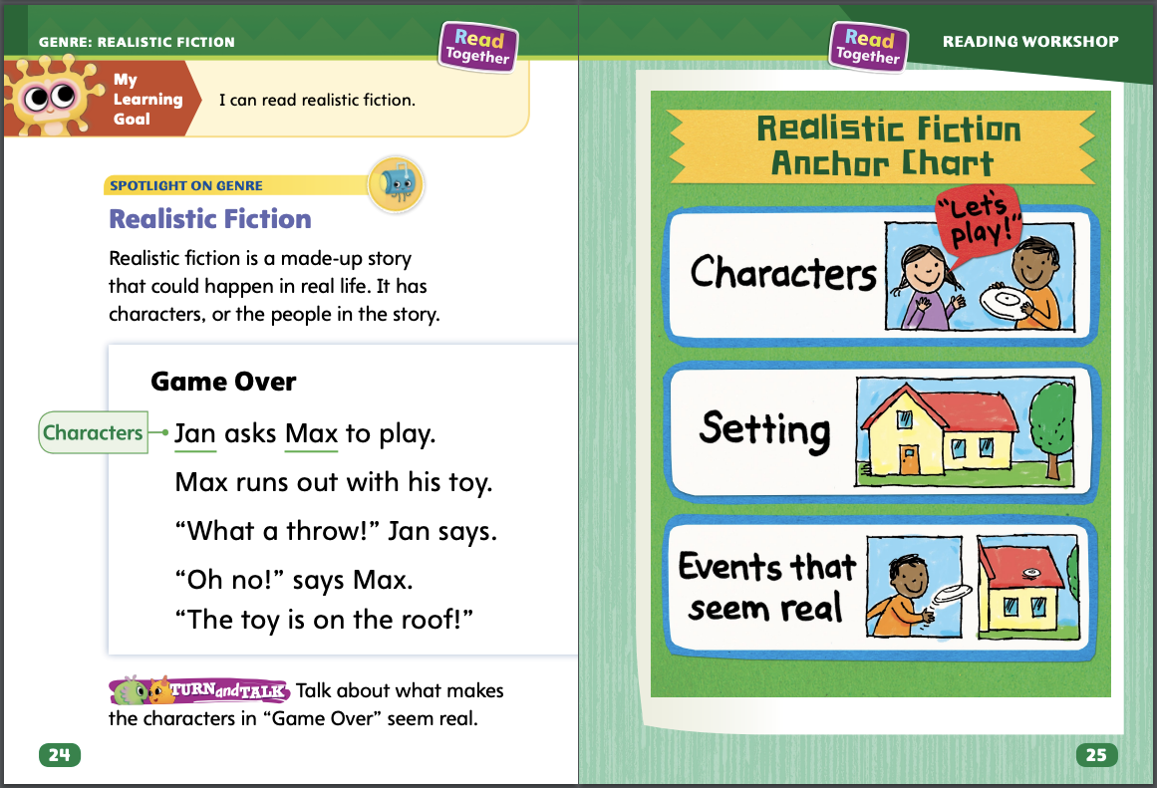
Page 24
Realistic Fiction
Turn to page 24 in your Student Interactive.
Notes:
A realistic fiction text is a made-up story that could happen in real life. Realistic fiction has characters. Characters are the people in the story. Realistic fiction also has a setting and events that are or seem real.
Examine the characters. Do they seem like people you might know?
Think about the setting. Does the place seem like somewhere you could go in real life?
What happens in the story? Do the events seem like they could really happen?
Read the model “Game Over” on p. 24 of the Student Interactive with students. Then model how you can tell it is realistic fiction. Max and Jan are the two people in the story “Game Over.” I can tell that they like to play together. They act like other children that I know. Just as they start to play, Max throws the toy up and it gets stuck. That seems like something that could really happen. Even though the story is made-up, it has characters and actions that seem real. I can tell that “Game Over” is realistic fiction. Then read the Anchor Chart on p. 25 together. Editable Anchor Chart Click Path: Table of Contents -> Reading Anchor Charts -> Unit 1 Week 1: Realistic Fiction Editable Reading Anchor Chart

Slide 13
Page 25
Apply
Talk to a partner to find the characters and say what makes them seem real.
Notes:
Have students use the strategies to identify realistic fiction.
Have students turn and talk with a partner about the realistic fiction text “Game Over” on p. 24 of the Student Interactive. Students should identify the characters and discuss what makes the characters seem real.

Slide 14
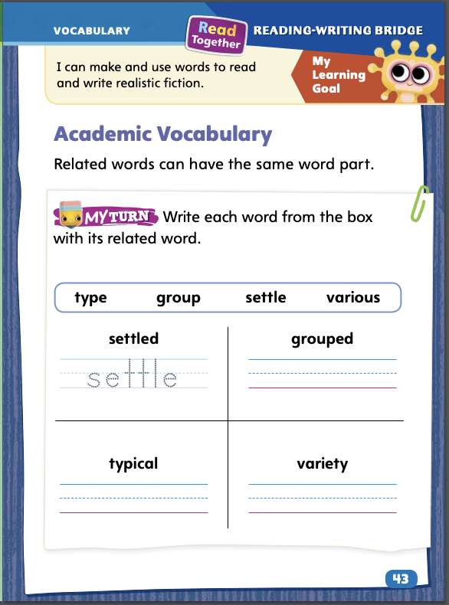
Page 43
Academic Vocabulary
Turn to page 43 in your Student Interactive and complete the activity.
Notes:
Remind students of the Academic Vocabulary for the unit: type, group, settle, and various. Explain that related words are words that have one word part that is the same but also might have a different ending.
Look for words that start with the same groups of letters as the vocabulary words you are learning.
Then look to see what is different about the word. It might have a different ending.
Model an example: We are learning the word settle in this unit. But I found the word settled. Settled has the same first six letters as settle. That makes them related words. They begin the same way but have a different ending.
Have students complete the activity on p. 43 in the Student Interactive.

Slide 15
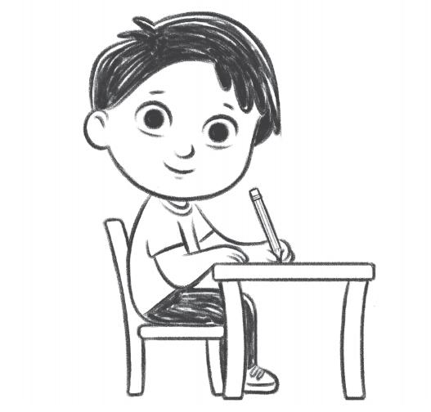
Handwriting
Proper Sitting Position
Sit straight in your chair.
Lean your shoulders forward slightly.
Sit with your feet flat on the floor.
Notes:
Tell students that there is a proper way to sit at their desks when they write.
Model a sitting position that enables you to write properly and without strain. Show how sitting up straight and resting one’s arms on a desk or table are ways to get ready to write. Work with students to explain and help them to achieve a healthy, proper sitting position for writing at a desk.
Have students use Handwriting p. 19 in the Resource Download Center to see and practice a proper sitting position for handwriting at a desk or table. Click path: Realize -> Table of Contents -> Resource Download Center -> Handwriting Practice -> U1W1L1 Handwriting Practice

Slide 16
Writing – Launching Writing Workshop
When you read about the author of a book you can learn
who the author is
the author’s background
interesting facts about why the author wrote the book
Notes:
An author is a writer. An author writes books. When you read about the author of a book you can learn
who the author is.
the author’s background.
interesting facts about why the author wrote the book.
Explain that students will be reading all kinds of books this week. Today they will focus on the authors of those books. Hold up a book from the stack. Every book we read will have an author. Let’s look for the page in this book that tells about the author. Turn to the author page and read the name of the author. Read any author information given. Ask: Who is the author of this book? What did you learn about the author? Remind students that the author is the person who wrote the book. Say: This year, you will be authors. You will write books just like this author did.
Read the book aloud. When you finish reading, ask students why they think the author chose to write this book. Point out any connections between the author biography and the content of the author’s book. Hold up one or two more books from the stack and repeat.

Slide 17
Independent Writing
Let’s review our understand of authors and continue to read books.
You can be an author and write about anything that you want.
Notes:
During independent writing time, students should read additional books from the stack to continue developing their understanding of authors and the books they write.
Modeled Choose a stack book and do a Think Aloud to model how to identify the author.
Shared Have students choose a stack book. Prompt students to name the author. Lead a discussion about the author.
Guided Use the stack books to provide explicit instruction on how to find the author of the book and look for specific information.
If students show understanding, distribute stapled books for students to write in. Tell students that they can become authors today. They can write in any mode about anything that interests them. Remind students to put their name on the first page. They are the authors!
As students write, use the conference prompts in the Teacher’s Edition or Resource Download Center to provide support. Click path: Table of Contents -> Resource Download Center -> Writing Workshop Conference Notes
Have a few students share what they have learned about authors.

Slide 18
Spelling
I am going to school.
Ben sat on the chair.
I will bring a box.
The mat is brown.
Does he see us?
Lee will wait at the door.
Notes:
(Note: Move the orange boxes to cover each bold spelling word before you read aloud the words and sentences.)
Read aloud the words and sentences. Have students spell each word with initial consonant blends and the two high-frequency words.
I am going to school.
Ben sat on the chair.
I will bring a box.
The mat is brown.
Does he see us?
Lee will wait at the door.
Reveal the spelling word and have students check their work.

Slide 19
Language and Conventions
The little ___ has a blue ___ in her ___.
girl
ball
hand
Notes:
Tell students that a noun names a person, animal, place, or thing.
Display this sentence frame for students: The little ___ has a blue ___ in her ___. Insert the words girl, ball, and hand. As students read the sentence aloud with you, circle the nouns. Then invite volunteers to suggest other nouns to use in the frame and, as a class, write these sentences on the board.
Have partners create sentences of their own. Ask them to underline the nouns in their sentences.

Slide 20
Lesson 2

Slide 21
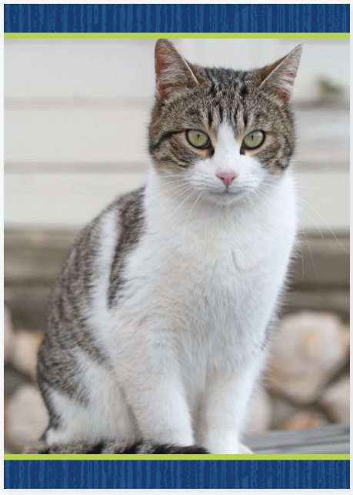
Page 15
Phonics
Turn to page 15 in your Student Interactive.
Notes:
Tell students that the short a sound is spelled a. The sound /a/ can be at the beginning or middle of a word.
Practice spelling the short a sound. Hold up the cat Picture Card. Say: What does this picture show? Elicit a response. Yes, this is a picture of a cat. Say cat again, and have students repeat the word after you. Remember to stretch out the sound /a/ as before. Write the letters c and t separated by a space on the board. Then say: What is the middle sound in cat? Yes, /a/. What letter spells the sound /a/? Elicit a response from students. Say: Yes, a spells the sound /a/. Write a to complete the spelling of cat. Repeat the exercise with man, cap, and van Picture Cards. Click path -> Table of Contents -> Unit 1 Week 1 Realistic Fiction-> Lesson 2
Ask students to turn to the top of p. 15 in the Student Interactive and draw a picture of something that has the short a sound. Then ask them to write the letter that spells the sound.

Slide 22
Page 15,16
Apply
Turn to page 16 in your Student Interactive and complete the activity.
Notes:
Have students complete the rest of p. 15 and p. 16 in the Student Interactive.

Slide 23
High-Frequency Words
a
I
is
his
see
Notes:
Write the words a, I, is, his, see. Point to a word and have students
spell that word.
clap as they say each letter.
repeat for all words.
Tell students that his is used for males (men, boys) only. Demonstrate with examples.

Slide 24
Page 26
Preview Vocabulary
check
quiet
listen
mutters
Notes:
Introduce the words check, quiet, listen, and mutters from p. 26 in the Student Interactive.
Have students share what they already know about the words. Ask questions such as: What do you do when you check on someone or something? What are some times when you need to listen well? Where is your favorite quiet place?
Have students demonstrate what it means to be quiet. They can mime what it looks like to listen to their favorite music on headphones. They can roleplay someone as he or she mutters.
Provide definitions of the vocabulary words as needed. Definitions appear on the selection pages that follow. Then say: These words tell what characters do in The Blackout.

Slide 25
First Read Strategies
Notes:
Discuss the First Read Strategies with students. For this first read, tell students to read for understanding and enjoyment.
READ Tell students to read or listen as you read the text aloud. During the first read, students should work to understand the characters.
LOOK Ask students to look at the pictures to help them understand what is happening in the story.
ASK Have students generate, or ask, questions about what the characters do.
TALK Guide students to talk to a partner about the text.
Students may read the text independently, in pairs, or as a whole class. Use the First Read notes to help students connect with the text and guide their understanding.

Slide 26
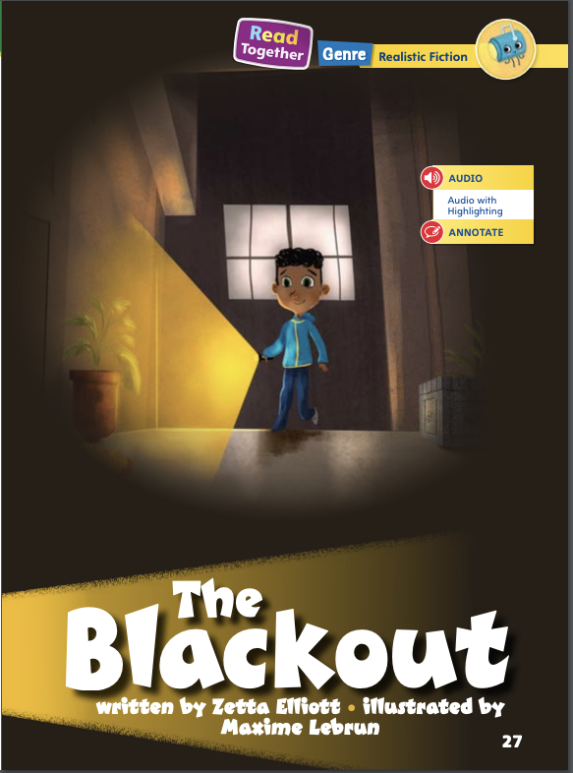
Page 27
First Read – The Blackout
Notes:
Read Together.

Slide 27
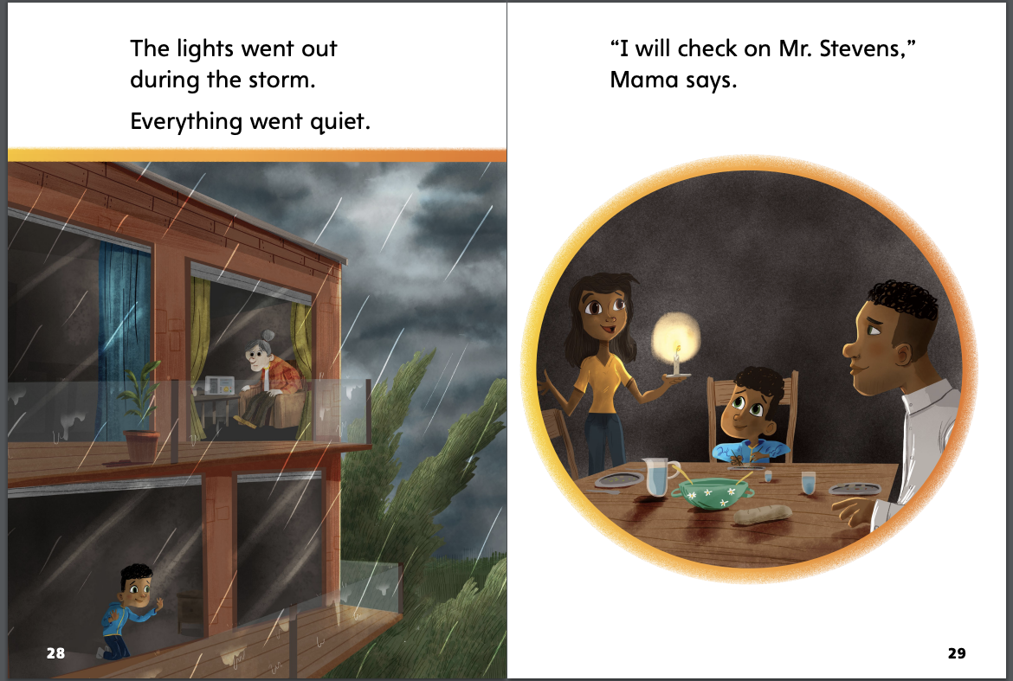
Page 28,29
First Read – The Blackout
Notes:
Read together.
THINK ALOUD I see when I read page 29 that Mama wants to check on Mr. Stevens. I am going to go back to the text and read to make sure I understand. The text says, “The lights went out during the storm. Everything went quiet.” Mama probably is worried that Mr. Stevens is alone in the dark.
THINK ALOUD I can talk with a partner about what I read. Talking can help me understand the story better. I want to talk about the text on page 28. It says, “The lights went out during the storm.” I think the lights going out is important. Then I will ask my partner, “What do you think?

Slide 28
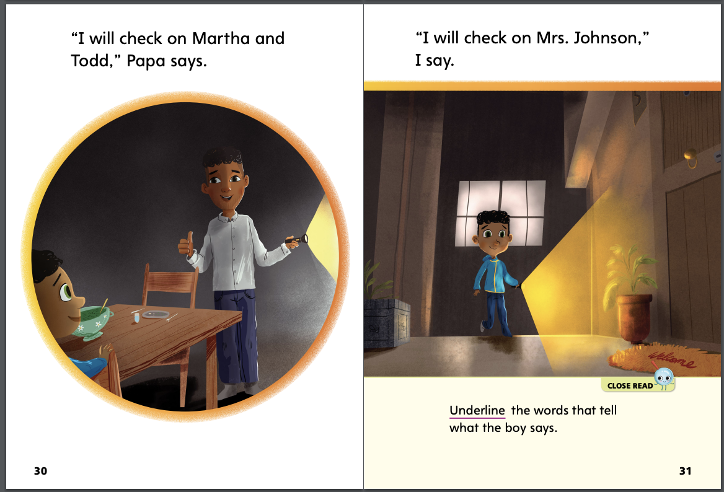
Page 30,31
First Read – The Blackout
Notes:
Read together.
THINK ALOUD I can see from the picture on page 31 that the boy has a flashlight. He is going up some stairs. The boy must be going to see Mrs. Johnson. I can tell that the boy is being careful. I can also tell that he is not afraid. He is smiling.

Slide 29
Page 32,33
First Read – The Blackout
Notes:
Read together.

Slide 30
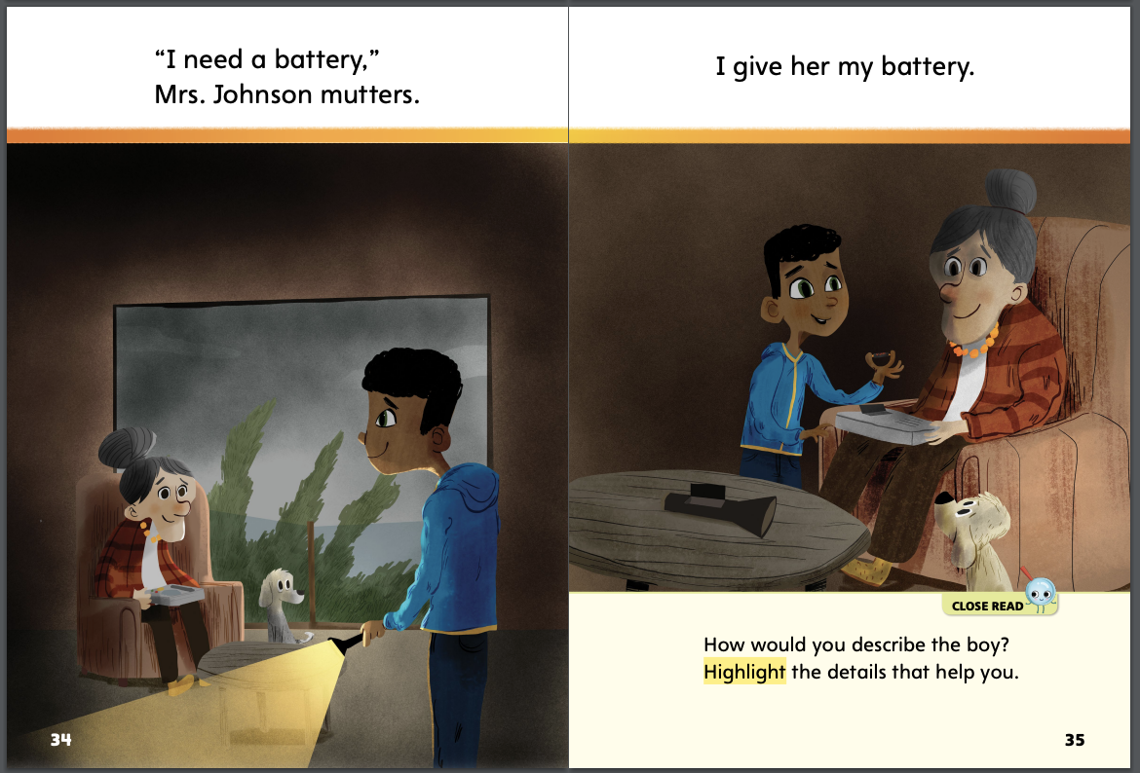
Page 34,35
First Read – The Blackout
Notes:
Read together.
THINK ALOUD I can find out about what the characters do by asking, How does the boy act toward the other people in the story? I will look in the story to find out. I think the boy is a good neighbor. I can see that he wants to help others. For example, on page 35, he gives Mrs. Johnson his battery. I think that was a very kind thing to do. It shows that the boy is nice and caring to other people.

Slide 31
Page 36,37
First Read – The Blackout
Notes:
Read together.

Slide 32
Respond and Analyze
Retell Work with a partner to recall and retell the text in your own words. Share which part they liked best.
Describe Think about the infographic “Neighbor to Neighbor” and the text you read. Using both texts, how would you describe a good neighbor?
Notes:
Use these suggestions to prompt students’ initial responses to reading The Blackout.
Retell Work with a partner to recall and retell the text in your own words. Share which part they liked best.
Describe Think about the infographic “Neighbor to Neighbor” and the text you read. Using both texts, how would you describe a good neighbor?

Slide 33
Page 38
Develop Vocabulary
Turn to page 38 in your Student Interactive and complete the activity.
Notes:
Tell students that authors choose words that can help a reader picture what happens in a story. The vocabulary words check, quiet, listen, and mutters tell what happens and what the characters are doing.
Remind yourself of the word’s meaning.
Look for pictures that can help you understand a word’s meaning.
Have students turn to p. 38 in the Student Interactive. Read the directions aloud: Underline the word that tells what you would do to help your friends. Could you check on them? Yes. Would you mutters on them? No, that doesn’t sound right.
Have students practice developing vocabulary by completing p. 38 in the Student Interactive.

Slide 34
Page 39
Check for Understanding
How do you know this text is realistic fiction?
How does the author describe the characters?
How can you describe Mrs. Johnson? Use text evidence.
Notes:
Have students use text evidence to complete p. 39 in the Student Interactive.

Slide 35
Page 42
Writing – Launching Writing Workshop
Turn to page 42 in your Student Interactive.
Notes:
Knowing about the author of a book you read can make the book more interesting.
Authors write books for many different reasons.
Authors write about what they know and what they like.
Anyone can be an author.
Remind students that all books have an author. Hold up one book from the stack. Have students practice identifying the author and the kind of information given about the author. Ask: Based on the title and author information, why do you think the author wrote this book? Read the book together. Allow students to point out what they notice on each page. When you have finished reading, point out any connections between the author biography and the information the author chose to write in his or her book. Repeat with a second stack text.
Direct students to p. 47 in the Student Interactive. Reread the definition of author. Read the directions and information about the author together with students. After students underline the author’s name and highlight the information, ask: Who is the author? When did he start writing? What does he like to write about?

Slide 36
Independent Writing
You will write about anything that interests you.
Notes:
After the minilesson, students should transition into independent writing.
If students need additional opportunities to develop their understanding of what an author writes, they should investigate additional books from the stack.
Modeled Choose a stack book and do a Think Aloud to model understanding author information.
Shared Have students choose a stack book. Prompt students to identify the author and share information about him or her.
Guided Use the stack books to provide explicit instruction on finding specific information about the author.
If students demonstrate understanding, they should transition to writing in any genre that interests them in stapled booklets.
As students write, use the conference prompts in the Teacher’s Edition or Resource Download Center to provide support. Click path: Table of Contents -> Resource Download Center -> Writing Workshop Conference Notes
Call on a few students to share spelling patterns they identified and words that follow no pattern in their own poems.

Slide 37
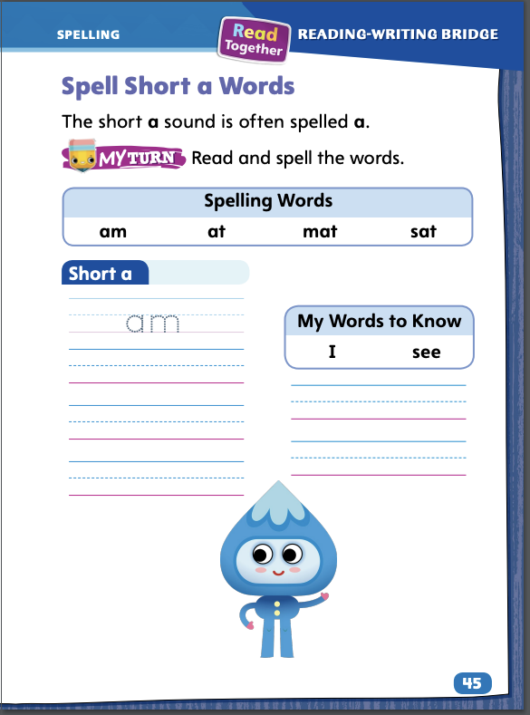
Page 45
Spelling
Turn to page 45 in your Student Interactive and complete the activity.
Notes:
Explain that the letter a spells the short a sound.
Write or display these short a words: tap, as, Sam. Say each word aloud. Guide students to point out that the letter a spells the short a sound in these words.
Have students complete the activity on p. 45 in the Student Interactive independently.

Slide 38
Language and Conventions
Leila and Dan read a book about a dog.
Notes:
Remind students that nouns are words that name a person, animal, place, or thing. Answer any questions students may have about nouns.
Write this sentence on the board: Leila and Dan read a book about a dog. Read aloud the sentence.
Say: Which words name people? (Leila, Dan) Which word names a thing? (book) Which word names an animal? (dog) All these naming words are nouns. There are three noun groups: people, animals, and things.
Have students create oral sentences using one or more nouns. Have them identify which word or words in their sentences are nouns

Slide 39
Lesson 3

Slide 40
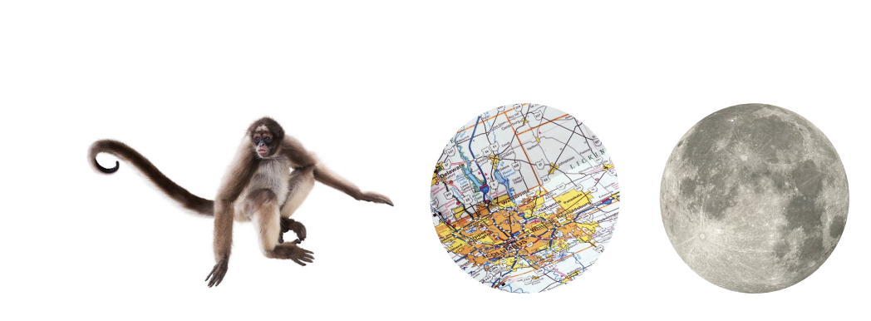
Page 17
Phonological Awareness
Notes:
Tell students sometimes a group of words begins with the same onset or initial sound. Point to the picture of the monkey on p. 17 in the Student Interactive. Say: What sound does monkey begin with? Listen as I say the sound: /m/ (pause) /m/ (pause) /m/ (pause) monkey. Monkey begins with the sound /m/. Say the sound with me: /m/. Repeat with the words map and moon. Then say: What sound do monkey, map, and moon begin with? Yes, they all begin with the sound /m/.
Say the following tongue twister to model words that begin with the same sound, which is called alliteration. Say: Matt makes muffins most Mondays. Have students repeat the words. Ask: What is the initial, or beginning, sound in the group of words? For additional practice in the initial sound /m/, use the Mm Picture Cards.

Slide 41
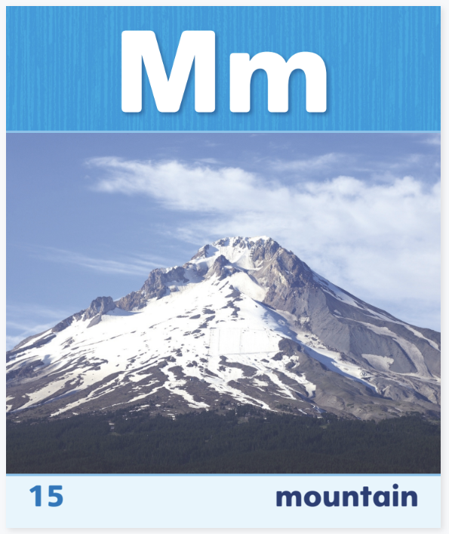
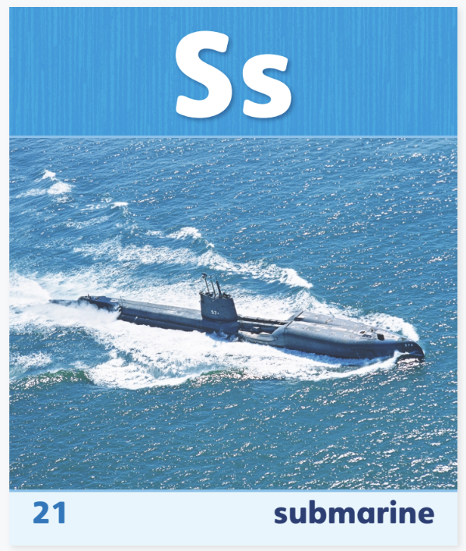
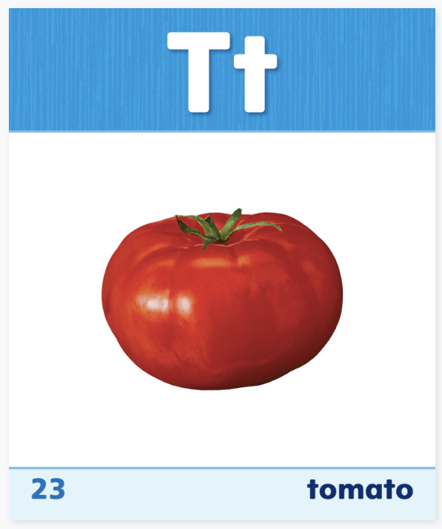
Phonics
Notes:
Use Sound-Spelling Cards 15 (mountain), 21 (submarine), and 23 (tomato) to introduce the sound /m/ spelled m, sound /s/ spelled s, and sound /t/ spelled t. Tell students they can decode, or read, words by using common letter sound correspondences.
Model the sound of each letter as you write it on the board: the sound /m/ spelled m, sound /s/ spelled s, and sound /t/ spelled t. Then write the word mat. Listen as I say this word: mat. I will say the sounds in the word slowly: /m/ (pause) /a/ (pause) /t/. What beginning sound do you hear? The beginning sound in mat is spelled with the letter m. What ending sound do you hear? The ending sound /t/ in mat is spelled with the letter t. Repeat this activity with the word Tam and tell students that the letters can make the same sound whether they begin or end a word. Click path -> Table of Contents -> Unit 1 Week 1 Realistic Fiction -> Lesson 3

Slide 42
Page 17
Phonics
Turn to page 17 in your Student Interactive.
Notes:
Read aloud the text at the bottom of p. 17 in the Student Interactive. Then have students read the decodable words sat and Tam. Students first segment and say the phonemes in each word (short arrows), then blend the phonemes together to read it (long arrow).

Slide 43
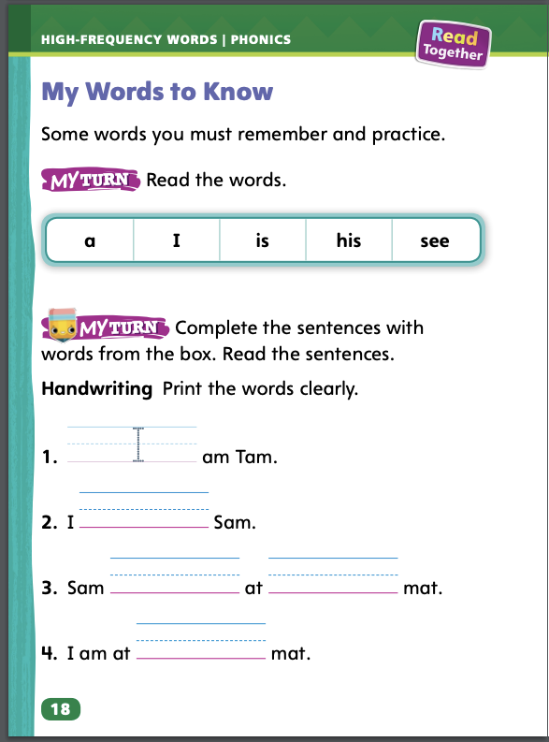
Page 18
High-Frequency Words
Turn to page 18 in your Student Interactive and complete the activity.
Notes:
Review the high-frequency words for the week: a, I, is, his, see. Tell students that remembering these words helps them read the words quickly.
Write a. This is the word a. It has only one letter. The letter a spells the word a. What other word has only one letter? (Write I on the board.) The word I, right? Have students say and spell each high-frequency word. Then have them use the words in a sentence.
Have students identify, read, and write high-frequency words on p. 18 in the Student Interactive.

Slide 44
Page 27
Describe a Character
Notes:
Characters are the people or animals in a story. When readers describe characters, they tell about what the characters say, do, think, and feel. They also tell what the characters look like. These details can help readers describe the reasons characters do things.
Have students turn to p. 29 in the Student Interactive to model how to describe the reason for a main character’s actions. Say: Mama says, “I will check on Mr. Stevens.” I will underline those words. I wonder why Mama wants to check on a neighbor. I will look at the pictures and think about what I’ve read so far. In the pictures, I see that it is dark, and Mama is holding a candle. I know from reading the text that the lights have gone out. So, I think the reason that Mama is checking on Mr. Stevens is that she wants to make sure he is OK. I think she is checking on him because she is kind and thoughtful. Then have students go back to the Close Read notes on p. 31 and underline details about the boy.

Slide 45
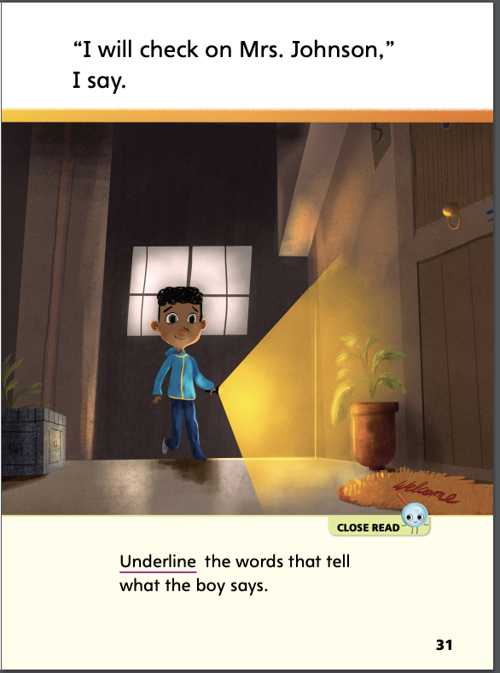
Page 31
Close Read – Describe a Character
Turn to page 31 in your Student Interactive.
Notes:
Have students follow the prompt on p. 31. Then ask: What do the boy’s words tell you about the kind of person he is? (possible response: a nice person) DOK 2

Slide 46
Page 40
Describe a Character
Turn to page 40 in your Student Interactive and complete the activity.
Notes:
Have students use the strategies for describing characters and the reasons for their actions.
Have students complete the activity on p. 40 in the Student Interactive.

Slide 47
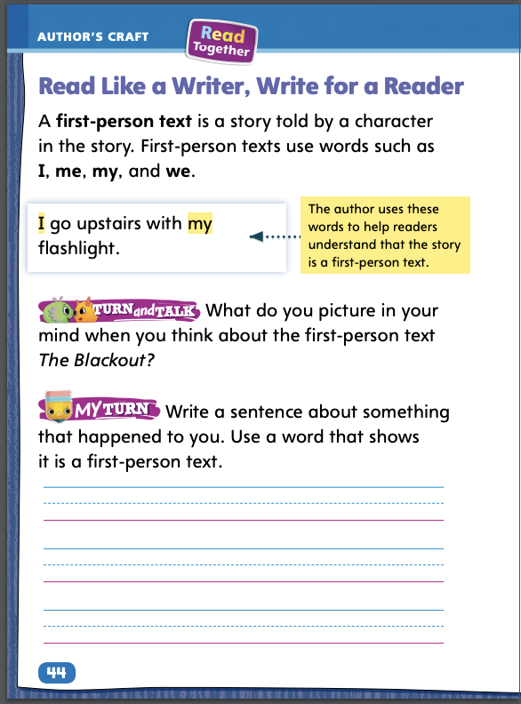
Page 44
Read Like a Writer, Write Like a Reader
Turn to page 44 in your Student Interactive and complete the activity.
Notes:
When a story is told by one of the characters in the story, it is called a first-person text. Readers can listen to first-person texts and then experience the text by picturing the story in their minds.
Look for words such as I, me, my, and we.
The author uses these words to show that the story is a first-person text.
A first-person text is told by a character in the story.
Model using the example on p. 44 in the Student Interactive to demonstrate listening to and experiencing first-person texts. Say: When I read the sentence I go upstairs with my flashlight, I notice that the author uses the words I and my. This is a first-person text. The boy is telling the story. I can picture in my mind the boy walking up the stairs carrying his flashlight. Have students listen to a sentence from a first-person text and then tell how they experience the text.
Have students listen to and experience a first-person text by completing p. 44 in the Student Interactive.

Slide 48
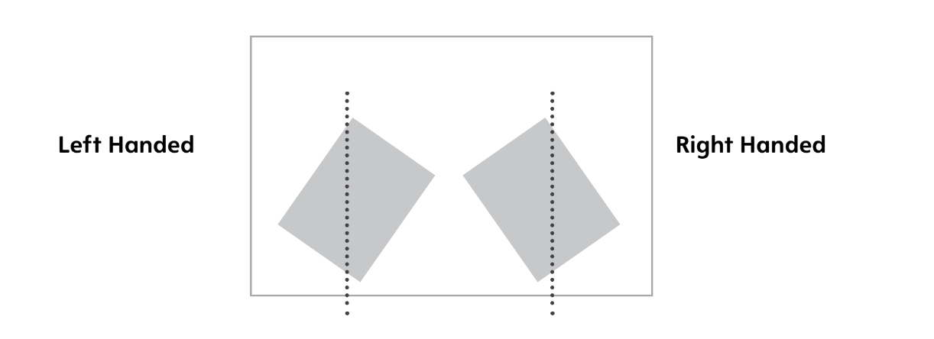
Handwriting
Proper Paper Position
Notes:
Tell students that there is a proper paper position for both left-handed and right-handed students as they write.
Model the proper paper position. Place the paper flat on the desk or table surface. Hold the paper in place with one hand while writing with the other. Work with students to explain and help them achieve a proper paper position for writing at a desk.
Have students use Handwriting p. 20 from the Resource Download Center to see and practice proper paper position for handwriting at a desk or table. Explain to students that left-handed writers and right-handed writers must position their paper differently. Click path: Table of Contents -> Resource Download Center -> Handwriting Practice -> U1W1L3 Handwriting Practice

Slide 49
Writing – Launching Writing Workshop
Good writers know and follow steps throughout the writing process. They
plan what to do before they write.
write a first draft.
get help from others to revise and edit their work.
Notes:
Good writers know and follow steps throughout the writing process. They
plan what to do before they write.
write a first draft.
get help from others to revise and edit their work.
Inform students that they will be exploring different things good writers do to make their writing clear and interesting. Today, they will explore what authors did before they wrote their book and what they did as they wrote.
Select two to three stories from the stack. Read aloud each one. Pause in between to brainstorm ideas about what the author may have done before and during the writing process. Say: Good writers go through a process when they write.
What do you think the author did before writing about this topic?
What questions do you think the author had while writing this book?
How do you think the author may have answered these questions?

Slide 50
Independent Writing
Like a good writer, sit quietly at your desk while you write.
You will continue writing your book.
Notes:
Good writers sit and write quietly at their desks during Independent Writing time. They pay attention during Share Back.
Modeled Choose a stack book and do a Think Aloud to model what the author did before and during writing.
Shared Have students choose a stack book. Prompt students to talk about an author’s writing process.
Guided Use the stack books to provide explicit instruction on what specific things the author may have done.
If they haven’t done so already, have students begin writing their own books. They can write in any genre they choose.
As students write, use the conference prompts in the Teacher’s Edition or Resource Download Center to provide support. Click path: Table of Contents -> Resource Download Center -+ Writing Workshop Conference Notes
Select a few students to share what they wrote in their booklets. Remind students to pay attention as each selected student shares.

Slide 51
Spelling
am
mat
at
sat
I
see
Notes:
Remind students that the short a sound is spelled with the letter a.
Have students spell the following words as you isolate each phoneme: mat, /m/ /a/ /t/; sat, /s/ /a/ /t/; tam, /t/ /a/ /m/; am, /a/ /m/. Ask students to tell what letter spells the short a sound.
Have students complete Spelling p. 29 from the Resource Download Center. Click path: Table of Contents -> Resource Download Center -> Spelling -> U1W1

Slide 52
Language and Conventions
A noun is a person, animal, place or thing
With a partner, find people or things in the classroom.
Notes:
Explain that a noun is a word that names a person, animal, place, or thing.
To reinforce the instruction on nouns, walk around the classroom and name people and things you see, tagging them with a sticky note as you say the noun. Then give each student five sticky notes and have them take turns saying nouns and tagging five people or things in the classroom.

Slide 53
Lesson 4

Slide 54
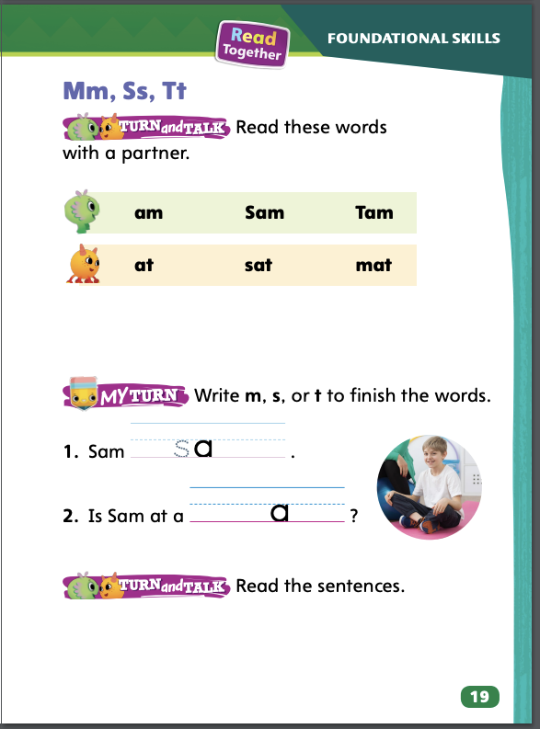
Page 17
Phonics
am
Decode the words with your partner.
Notes:
Review the letter names and sounds for a/a/; m/m/; s/s/; and t/t/.
Write am. Say: Listen as I say am: /a/ (pause) /m/. Say each sound slowly two times and then have students repeat. Now let’s tap the sounds we hear in am. Model how to tap the sounds in the palm of your hand. How many sounds can you hear in am? Elicit responses. Draw two empty boxes. Next, model how to write the letters for each sound. Say: What letter spells the sound /a/? Write a in the first box. What letter spells the sound /m/? Write m in the second box. Read the word. Have students practice reading the word with you. Repeat with the words at and mat.

Slide 55
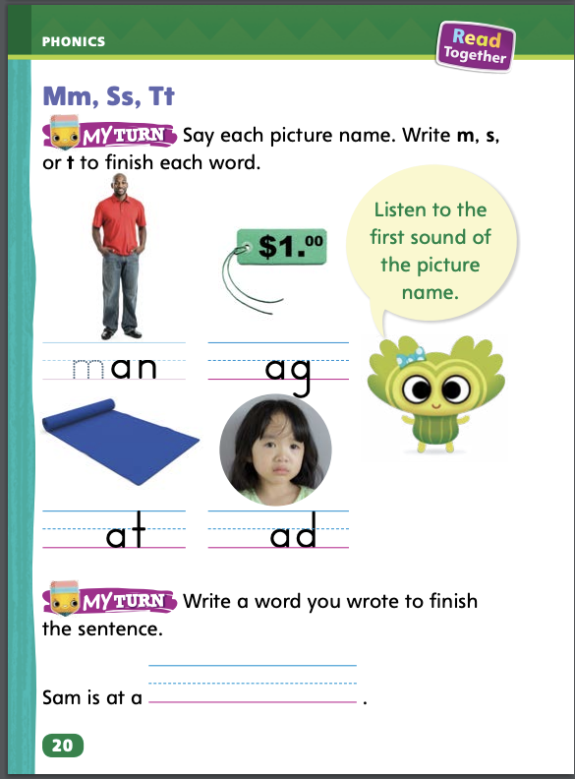
Page 19,20
Phonics
Turn to page 19 and 20 in your Student Interactive and complete the activity.
Notes:
Have students complete the rest of p. 19 and p. 20 in the Student Interactive.

Slide 56
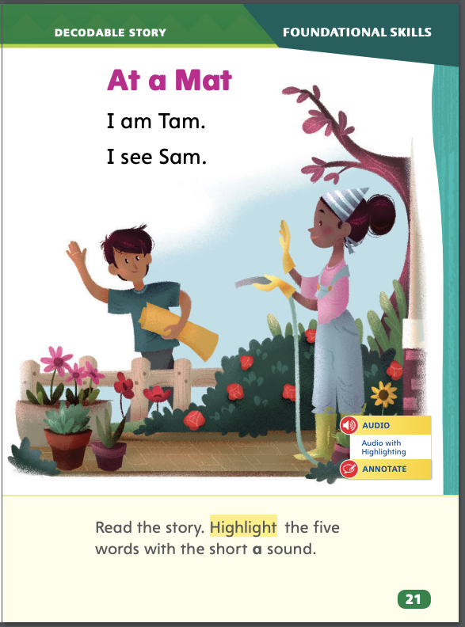
Page 21
Decodable Story
Turn to page 21 in your Student Interactive. Read “At a Mat” with your partner.
Notes:
FOCUS Have students turn to p. 21 in the Student Interactive. We are going to read a story today about Tam and Sam. Point to the title of the story. The title of the story is At a Mat. I hear the short a sound in the words at and mat. What letter spells the sound /a/? Wait for responses. Yes, the letter a spells the sound /a/! We will read other words with the short a sound spelled a and words with the letters m, s, and t in our story.
Before reading, review this week’s high-frequency words: a, I, is, his, see. Tell students that they will practice reading these words in the story At a Mat. Display the words. Have students read them with you. Say: When you see these words in today’s story, you will know how to read them.

Slide 57
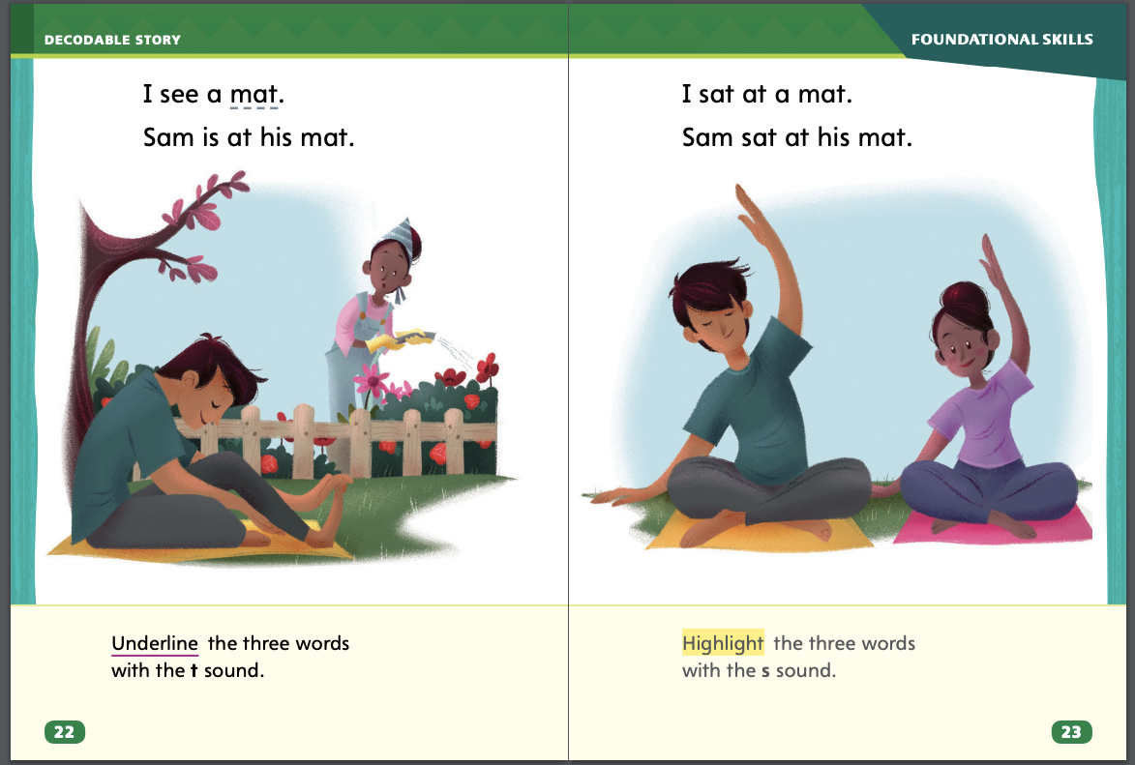
Page 22,23
Decodable Story
Notes:
Pair students for reading and listen carefully as they use letter-sound relationships to decode. One student begins. Students read the entire story, switching readers after each page. Partners reread the story. This time the other student begins.
Call students’ attention to the title on p. 21. I see the letter A in the word At. What sound does the letter a make? Have students decode the word At. Then have them identify words with the short a sound spelled a on p. 21 and highlight them.
Have students turn to p. 22. Which words have the sound /t/? Students should supply the words mat and at. Which letter spells the sound /t/ in mat and at? Students should say the sound /t/ is spelled with the letter t. Have them underline the words.
Have students turn to p. 23. Which words have the sound /s/? Students should supply the words sat and Sam. Which letter spells the sound /s/ in sat and Sam? Students should say the sound /s/ is spelled with the letter s. Have them highlight the words.

Slide 58
Page 27
Use Text Evidence
Find evidence in the words in the text that describe the character.
Look for evidence in pictures that show what the character does.
Notes:
Readers can use the details in the text to support their ideas. These details are called text evidence. They can tell about a character.
Find evidence in the words in the text that describe the character.
Look for evidence in pictures that show what the character does.
Say: Characters are a very important part of the story. If I understand the main characters in a story, I can better understand what is happening. When I have an idea about characters or something else I read, I look for details in the words and pictures that caused me to think of that idea. Text evidence is the details in the words and pictures that support an idea about a text. In The Blackout, I saw how the boy acted while the lights were out. He thought about his neighbors and went to check on Mrs. Johnson. He shared what he had with her. Those actions help me understand what the boy is like. Have students go back to the Close Read note on p. 35 of the Student Interactive and highlight their answers. Talk about what the details tell about the boy.

Slide 59
Page 31
Close Read – Use Text Evidence
Turn to page 31 in your Student Interactive.
Notes:
Have students read the Close Read note on p. 35. Prompt them to find text evidence that tells about the boy. Then ask, What does this text evidence tell about the boy? (Possible response: He cares for others.) DOK 2

Slide 60
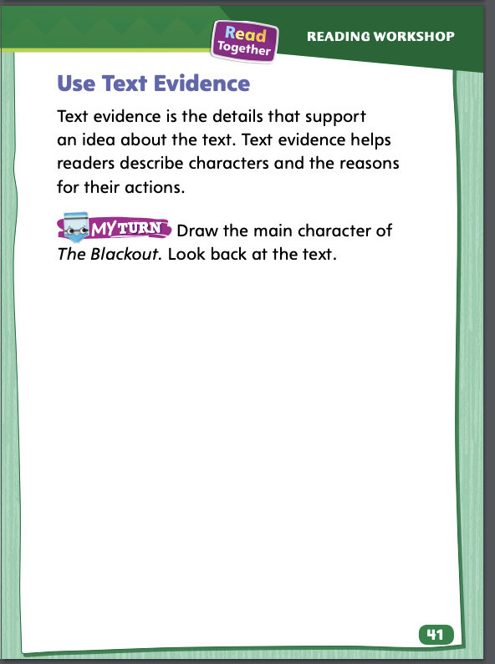
Page 41
Use Text Evidence
Turn to page 41 in your Student Interactive and complete the activity.
Notes:
Have students use the strategies for using text evidence to learn about characters.
Have students use text evidence from The Blackout to complete p. 41 in the Student Interactive.

Slide 61
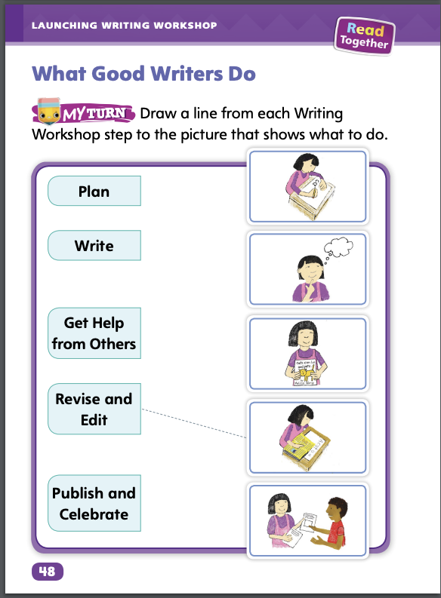
Page 45
Writing – Launching Writing Workshop
Turn to page 45 in your Student Interactive and complete the activity.
Notes:
Good writers follow steps before and during the writing process.
Writers think about what they will write.
Writers write a draft.
Writers work with others to improve and share their writing.
Read aloud a book from the stack. Model the steps the writer followed before writing that book. For example, This writer probably liked ____ and looked up information about _____. Then the writer wrote a draft. The writer added illustrations and asked others what they thought of his writing. Then the writer made changes to make the book better. Repeat with another book, soliciting answers from students.
Direct students to p. 48 in the Student Interactive. Here they can trace the steps in the writing process. Read the directions and each part of the Writing Workshop together with students. After students draw lines to show the order of the steps, ask: What do good writers do before they write? What do good writers do to make their writing better? What do good writers do when they are finished writing?
Have students look back at the pictures on p. 48. Tell students to pretend they are the child in each illustration. Ask: What do you think this writer is saying?

Slide 62
Independent Writing
Continue writing your book.
Notes:
Have students transition into independent writing. • If students need help thinking of an idea to write about, suggest that they write about something they like. When writing, students should follow the steps they just learned.
Modeled Do a Think Aloud to model how an author plans what to write.
Shared Prompt students to talk about what it means to revise and edit their writing.
Guided Provide explicit instruction on how to follow the specific steps discussed in the Writing Workshop.
As students write, use the conference prompts in the Teacher’s Edition or Resource Download Center to provide support. Click path: Table of Contents -> Resource Download Center -> Writing Workshop Conference Notes
Call on a few students to share what they wrote and what they did to be a good writer.

Slide 63
Spelling
a
m
t
s
Notes:
Continue reviewing short a words as well as the consonants m/m/, s/s/, and t/t/.
Read the following words and have students spell them: at, tat, sat, am, mat, Sam, tam.
Give each student letter tiles a, m, t, and s. Have them work in pairs to make as many words as possible from these tiles.

Slide 64
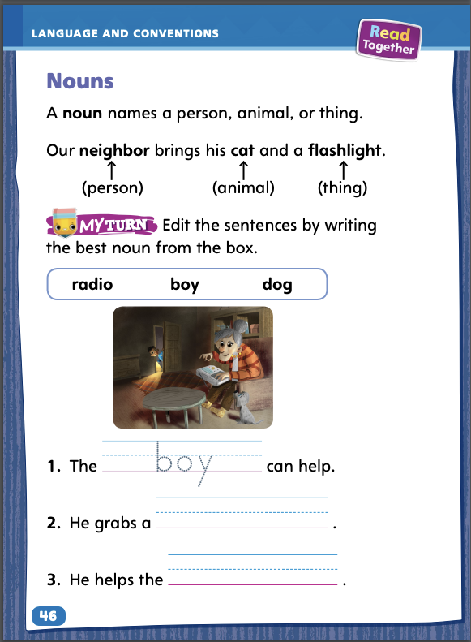
Page 46
Language and Conventions
Turn to page 46 in your Student Interactive and complete the activity.
Notes:
Have students complete the practice activity on p. 46 in the Student Interactive.

Slide 65
Lesson 5

Slide 66
Phonological Awareness
cat /k/ /a/ /t/
hat
dad
bag
Notes:
Segmenting and blending spoken words into phonemes is an important beginning reading skill. Model how to segment and blend phonemes. Say: Listen as I say each sound in the word cat: /k/ (pause) /a/ (pause) /t/. Remember to stretch the /a/ sound. Say the individual sounds in cat again and clap each sound as students clap and repeat the sounds after you. How many sounds do you hear in cat? How many times did we clap? Right! Three times. So cat has three sounds. Let’s say the sounds a little faster now. (Pause) Now let’s say them even faster. Monitor students’ pronunciation to ensure they are saying the sounds correctly.
Have students practice segmenting and blending other short a words, such as hat, dad, and bag. They can also practice words with initial and final sounds of m, s, and t, such as mad, sat, and tap.

Slide 67
Phonics
Sam sat.
Sam sat at a mat.
Tam sat.
Tam sat at a mat.
Notes:
Write or point out the letters Aa, Mm, Ss, and Tt. Have students name each letter as you point to it. Then review the sound for each letter.
Write the sentences below. Have students read the sentences with a partner. Model reading the first sentence.
Sam sat.
Sam sat at a mat.
Tam sat.
Tam sat at a mat.

Slide 68
High-Frequency Words
a
I
is
his
see
Notes:
Tell students that high-frequency words are words that they will hear and see over and over in texts. Write the words a, I, is, his, see. Have students work with a partner..
Have students work with a partner.
One student spells a word.
The other student says the word.
Repeat.

Slide 69
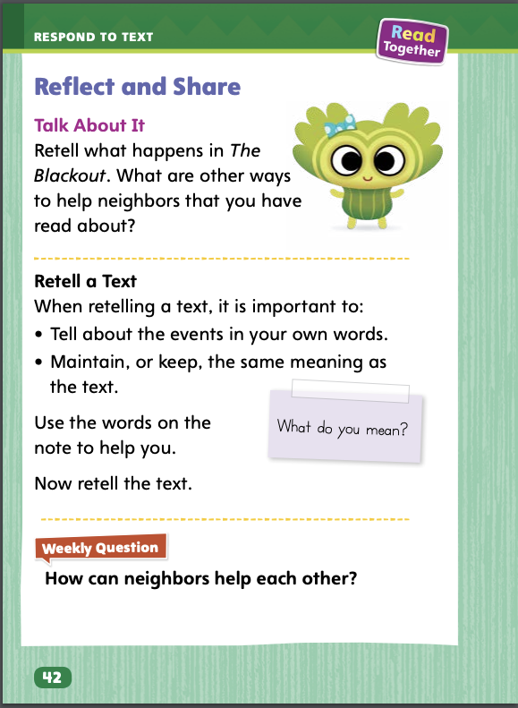
Page 42
Reflect and Share
Turn to page 42 in your Student Interactive.
Notes:
Readers often read and compare two or more texts. Before comparing texts, readers retell the texts to check their understanding. Then they share information and ideas about both texts.
Retell the story events using your own words. Maintain, or keep, the same meaning as the text by telling the events in order and not changing any details.
Compare the texts.
Model retelling part of The Blackout using your own words and maintaining meaning, and then comparing it to another text using the Talk About It prompt on p. 42 of the Student Interactive. Say: First, there is a big storm that causes the electricity to go out in the building. Mama thinks she should check on one of the neighbors. This makes me think of something I read in “Neighbor to Neighbor” about helping neighbors. Neighbors can bring healthy foods to each other. Tell students to finish the retelling. Then have them compare the neighbors’ actions in The Blackout to other ways neighbors have helped in other texts.

Slide 70
Page 42
Apply
How can neighbors help each other?
Notes:
Have students use the strategies for comparing across texts.
Use the Shared Read Have students retell The Blackout using their own words and maintaining the meaning of the original text. Then have them make connections to other texts about how people can help one another. If desired, distribute Speaking and Listening practice pages from the Resource Download Center. Click Path: Table of Contents -> Resource Download Center -> Speaking and Listening
Have students use evidence from the texts they have read this week to respond to the Weekly Question. Tell them to write their responses or discuss them in small groups.

Slide 71
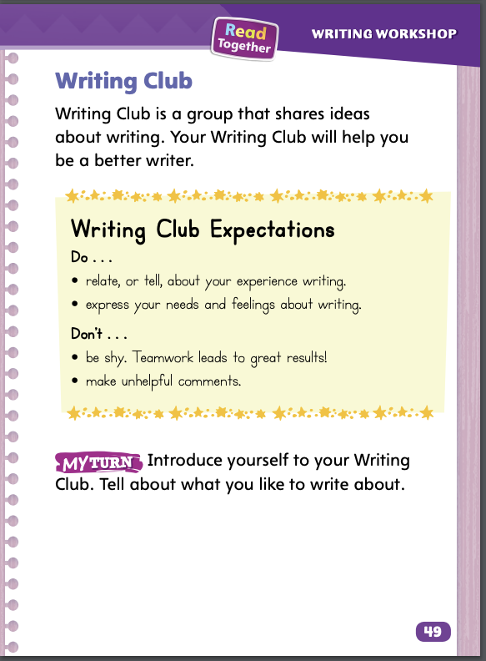
Page 49
Writing – Launching Writing Workshop
Turn to page 49 in your Student Interactive and complete the activity.
Notes:
Writing Club is a group of student authors who share writing ideas by speaking and listening cooperatively. Speakers tell about their writing ideas. Listeners are polite and helpful. Sharing makes good writers better. Writing Club can be a time for students to develop social communication.
Tell students that they will be participating in Writing Club once a week. Explain that in Writing Club, they will be working with others. Ask: When is a good time to get help from others? What kind of help can you give others? Tell students that today they will learn some rules about working in a Writing Club group.
Direct students to p. 49 of the Student Interactive. Read aloud the information about what Writing Club is and how students are expected to work together in Writing Club. Ask questions to reinforce students’ understanding.
How do you come prepared to your Writing Club?
What are some ways to show respect when you are listening to others read their writing?
Why shouldn’t you be shy?
What are some helpful comments that you might make?

Slide 72
Spelling
Let’s see a movie.
I am a good helper.
I was sad to leave.
They have a mat by their door.
We saw penguins at the zoo.
The children sat in a circle.
Notes:
(Note: Move the orange boxes to cover each bold spelling word before you read aloud the words and sentences.)
Read aloud the words and sentences. Have students spell the words with initial consonant blends and the high-frequency words they have been practicing this week.
Let’s see a movie.
I am a good helper.
I was sad to leave.
They have a mat by their door.
We saw penguins at the zoo.
The children sat in a circle.
Reveal the spelling word and have students check their work.

Slide 73
Language and Conventions
The boy runs quickly.
Which word in the sentence is a noun?
the
boy
run
quickly
Notes:
Display the following sentence, and guide students to complete the question.
The boy runs quickly.
Which word in the sentence is a noun?
the
boy
runs
quickly
Have students complete Language and Conventions p. 35 from the Resource Download Center.. Click path: Table of Contents -> Resource Download Center -> Language and Conventions -> U1 W1

Slide 74
Unit 1: Week 1
Grade 1

