Slide 1
Unit 1: Week 4
Grade 2

Slide 2
Copyright © Savvas Learning Company LLC. All Rights Reserved.
This publication is protected by copyright, and permission should be obtained from the publisher prior to any prohibited reproduction, storage in a retrieval system, or transmission in any form or by any means, electronic, mechanical, photocopying, recording, or otherwise. For information regarding permissions, request forms, and the appropriate contacts within the Savvas Learning Company Rights Management group, please send your query to:
Savvas Learning Company LLC, 15 East Midland Avenue, Paramus, NJ 07652
or
k12learningpermissions@savvas.com
myView Literacy® is an exclusive trademark of Savvas Learning Company LLC in the U.S. and/or other countries.

Slide 3
Lesson 1

Slide 4
Page 130
Phonological Awareness
Notes:
Point to the pictures of the sock and clock on p. 130 in the Student Interactive. Have students say the name of each picture aloud. Ask:
What are the ending sounds in each word?
Do the words rhyme?
What are other words that rhyme with sock and clock?
Explain that words rhyme when they have the same vowel and ending sounds.
Provide examples of words that rhyme and don't rhyme. Tell students:
See and me are rhyming words. They have a different beginning sound but the same ending sound.
Flag and dog do not rhyme. I can hear that they both end with /g/, but their vowel sounds are different.
Call and ball are rhyming words. They have the same vowel sound and ending sound.
Have students work in pairs to say the name of each picture on p. 130 and say words that rhyme with each.

Slide 5
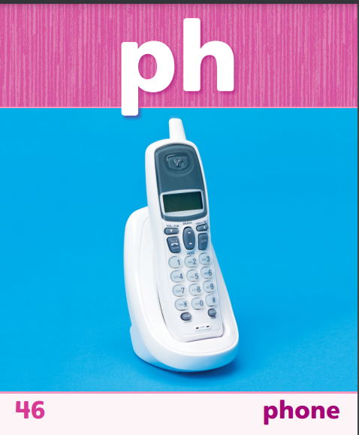
Phonics
lunch
Notes:
This week students will be reading words with consonant digraphs. Write lunch.
Say: There are five letters in the word lunch, but there are only four sounds: /l/ /u/ /n/ /ch/. That’s because the letters ch stand for one sound: /ch/.
Provide another example: Write think. Say: There are five letters in the word think but four sounds: /th/ /i/ /n/ /k/. The letters th are a consonant digraph that stands for one sound. Point out that think ends with a blend.
Show students Sound-Spelling Cards 46, 47, and 49. Point out the consonant digraphs in the words. Click path -> Table of Contents -> Unit 1 Week 4 Poetry-> Lesson 1

Slide 6
High-Frequency Words
great
before
means
Notes:
Display the high-frequency words great, before, and means. Remind students that there are some words we need to practice so we can recognize them quickly. This helps us read more fluently.
Point to each word, read it aloud, and have students repeat the word.
Use the words in oral sentences: I had a great time; We have math before lunch; That dark cloud means it will rain.
Call on several students to use one of the words in an oral sentence.

Slide 7
Page 128,129
Interact with Sources
Circle words that relate to senses of sound, sight, smell.
Underline words that show or tell how the narrator feels.
Discuss what it means to say the city “never sleeps.”
Write a sentence that tells how the narrator feels about the city.
Notes:
Remind students of the Essential Question for Unit 1: How do different places affect us? Point out the Week 4 Question: How do different places make us feel?
Direct students’ attention to the poem on p. 128 in the Student Interactive. Point out that a poem is a text that has lines and stanzas. Explain that a poem often expresses the writer’s feelings and may also include rhythm and rhyme to give the poem a musical quality. Read the poem to students as they follow along.
Divide the class into small groups to discuss the feelings of the narrator in the poem.
Display these instructions for students to follow:
Circle words that relate to the senses of sound, sight, and smell.
Underline words that show or tell how the narrator feels.
Discuss what the narrator means when he or she says that the city “never sleeps.”
Write a sentence that tells how the narrator feels about the city.
Remind students of the Weekly Question: How do different places make us feel? Point out that students have discovered ways that poetry can help to tell about feelings. Explain that students will read more about poetry and will explore feelings about places this week.
Have students write responses to the Quick Write questions on p. 129 of the Student Interactive. Afterward, ask them to share their responses.

Slide 8
Listening Comprehension
A Traveling Alphabet
The Poem is About | The Poem has These Elements
Notes:
Tell students you are going to read aloud a poem. Have them listen as you read “A Traveling Alphabet.” Tell them you will hold up a finger each time you finish reading a stanza, or group of lines. Encourage students to be active listeners by looking at you and thinking about what you are reading.
Have students listen actively for elements of poetry.
Read the entire text aloud, without stopping for the Think Aloud callouts.
Reread the text aloud, pausing to model Think Aloud strategies related to the genre.

Slide 9
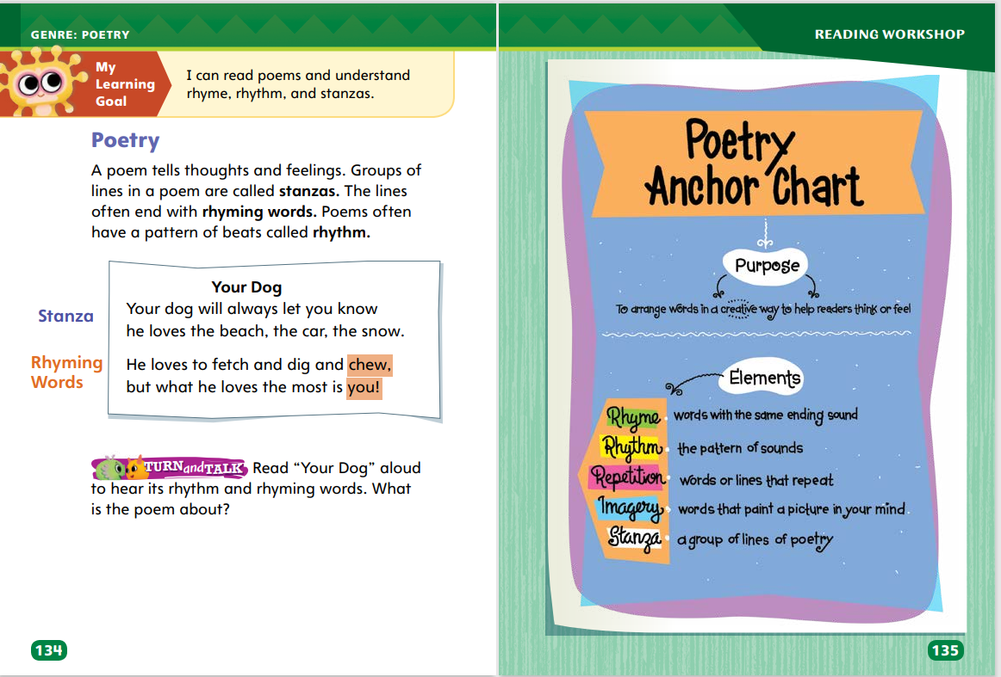
Page 134,135
Poetry
Turn to page 134 in your Student Interactive.
Notes:
Explain the features of poems for students.
Poems do not have sentences and paragraphs like stories. Instead they have lines and stanzas. Thoughts in one line often continue into the next line. Groups of lines are called stanzas.
Writers of poems try to create pictures in a reader’s mind by using descriptive language. We call this imagery.
Some poems rhyme. The words at the end of lines have the same middle and ending sounds.
Poems have some kind of rhythm or a pattern of beats. You can clap the rhythm of a poem.
Some poems tell stories, while other poems simply describe people, places, or things.
Have students look at “Your Dog” on Student Interactive p. 134. Say: I will figure out if this text is a poem. I can see that this text has two stanzas made up of two groups of two lines, like a poem. Next, I want to check for rhyming.
Underline know and snow, and read them aloud. Repeat with chew and you. Say: These words rhyme. Now, I want to check for a pattern of beats.
Model clapping to the two stanzas as you read them aloud. Yes, the text does have rhythm. I can see that the text has stanzas, rhyming, and rhythm, so I think it is a poem.
Ask students to tell about poems they have read. Have them describe the features these poems have.
Read the Anchor Chart on page. 135 in the Student Interactive together. Editable Anchor Chart Click Path: Table of Contents -> Reading Anchor Charts -> Unit 1 Week 4 : Poetry Editable Reading Anchor Chart

Slide 10
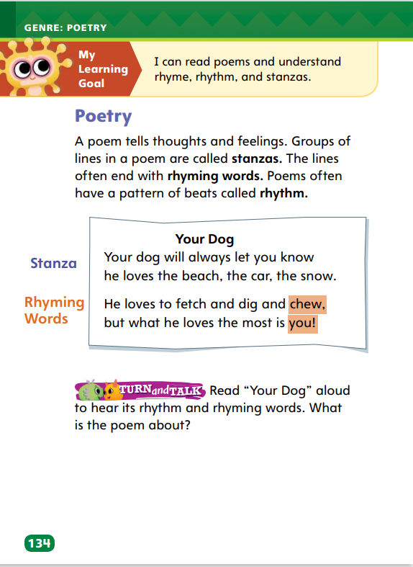
Page 134
Apply
What is the poem about?
Notes:
Have students work with a partner to complete the Turn and Talk activity on p. 134 of the Student Interactive. Circulate as students discuss the poem to determine whether they are able to recognize features of poetry and tell what the poem is about.

Slide 11
Page 151
Academic Vocabulary
quick
quickly
loud
loudly
Notes:
Review the meanings of the Academic Vocabulary words: affect, compare, different, location, and region. Explain that word parts give clues to meaning and use in a sentence.
A suffix is a word part added to the end of a word.
When you add a suffix, a word has a new meaning.
The new meaning is connected to the meaning of the word you add to, but the words are used differently in a sentence.
On a display surface, write quick. Below quick, write quickly. Circle the suffix -ly. Say: The word quick means “fast.” When I add the suffix -ly, the new word means “in a fast way.” The words are used differently in a sentence: The dog is quick. The dog runs quickly. Write: loud, loudly. Have students tell you how the meaning of loudly is different from the meaning of loud. Then have students use each word correctly in an oral sentence.
Then point to the suffix -al and say: The suffix -al means “related to.” So, when we add it to the word nation, the new word national means “related to the nation.” Then show how the words are used. Say: The United States is a nation. The bald eagle is our national bird.
Have students complete the activity on p. 151 in the Student Interactive.

Slide 12
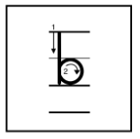
Handwriting
Notes:
Display uppercase and lowercase letters Uu, Ss, and Bb.
Model writing U and u. Then write up, run, and the name Ulee, showing proper letter formation and correct letter size. Have students copy the words. Repeat the routine with letters Ss (Sue, as, last) and Bb (before, rub, ribbon, Bob, Belle).
Have students use Handwriting p. 19 from the Resource Download Center to practice writing the uppercase and lowercase letters Uu, Ss, Bb. Click path: Realize -> Table of Contents -> Resource Download Center -> Handwriting Practice -> U1W4L1 Handwriting Practice

Slide 13
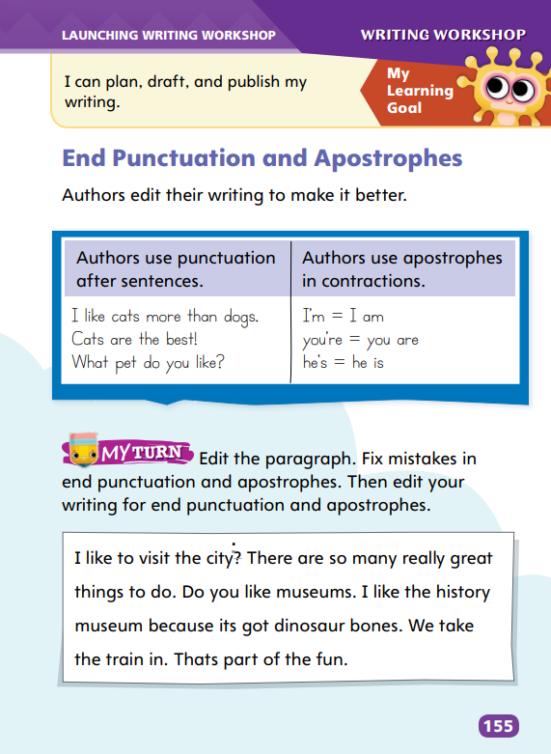
Writing – Launch Writing Workshop
Page 155
Turn to page 155 in your Student Interactive.
Notes:
Authors use punctuation marks as tools in their writing. These punctuation tools can affect the way words function or the way sentences are meant to be read. For example, authors:
use apostrophes to create contractions.
use appropriate end punctuation for clarity or effect.
Direct students to p. 155 in the Student Interactive. Say: Authors use apostrophes to make contractions. A contraction is when two words are joined together to become one word. For example, “I am” can be written as “I’m,” and it means the same thing. The apostrophe connects “I” and “am” and takes the place of “a.” Write: you’re. What two words does you’re stand for? What letter does the apostrophe take the place of? Repeat with don’t.
Say: Authors use correct end punctuation for their sentences. Sentences with periods state or tell something. A question mark asks a question. An exclamation point expresses a strong feeling.
Display sentences with different end punctuation. Point to a period. Say: Most times, authors use periods to end sentences. Point to a question mark. Ask: What does this sentence do? Point to an exclamation point. Why does the author use an exclamation point?

Slide 14
Independent Writing
Your turn! Try adding contractions and end punctuation to your sentences.
Share examples of contraction and punctuation in your draft with the class.
Notes:
During independent writing time, students should try varying sentences with contractions and end punctuation. If students have difficulty, change end punctuation on a sample sentence and discuss how it changes the effect of the sentence.
Writing Support
Modeled - Do a Think Aloud to model how to add the correct end punctuation to a sentence.
Shared - Create a word wall of words that can be joined to make contractions, then work with students to create the contractions.
Guided - Provide explicit instruction on how to use apostrophes or end punctuation.
Students with a strong grasp of the conventions should incorporate them as they edit their drafts.
Have students share examples of contractions and end punctuation that they edited into their drafts.

Slide 15
Spelling
I ate a bunch of grapes.
The dog will chase the cat.
We will visit the pumpkin patch.
I like math class best.
What is your name?
Did you brush your hair?
Who is calling on the phone?
I’ll thank her for the gift.
When does the party start?
Did you wash the dish?
A great wind blew the door open.
I will get my coat before I leave.
Notes:
(Note: Move the orange boxes to cover each bold spelling word before you read aloud the words and sentences.)
Read aloud the words and sentences. Have students spell each word with initial consonant blends and the two high-frequency words.
I ate a bunch of grapes.
The dog will chase the cat.
We will visit the pumpkin patch.
I like math class best.
What is your name?
Did you brush your hair?
Who is calling on the phone?
I’ll thank her for the gift.
When does the party start?
Did you wash the dish?
A great wind blew the door open.
I will get my coat before I leave.
Reveal the spelling word and have students check their work.

Slide 16
Language and Conventions
I have a dog brush. You may use it to brush your dog.
I have a dog brush, and you may use it to brush your dog.
Write two related sentences and join them to make a compound sentence.
Notes:
Flexible Option
Review by reminding students that ideas in two sentences are sometimes related, and these sentences can be joined to form a compound sentence.
On a display surface, write these sentences: I have a dog brush. You may use it to brush your dog. Read the sentence aloud. Then write: I have a dog brush, and you may use it to brush your dog. Point out the comma and the conjunction that you have used to join the sentences.
Have students write two related sentences of their own and then join those sentences to form a compound sentence.

Slide 17
Lesson 2

Slide 18
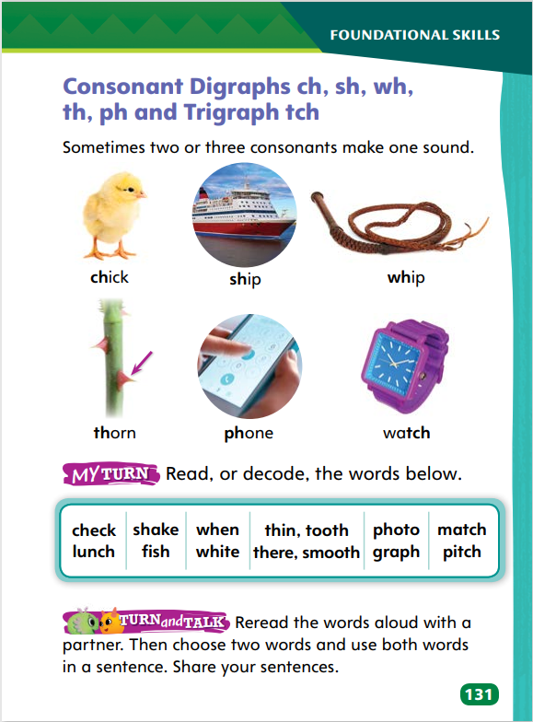
Page 131
Phonics
ship
bush
Turn to page 131 in your Student Interactive.
Notes:
Write the digraphs and the trigraph. Point to the digraphs and explain that consonant digraphs stand for one sound. Point to the trigraph and say that a trigraph is made of three letters that stand for one sound.
Write the words ship and bush. Say: I need to learn to recognize consonant digraphs in words and remember that they stand for one sound. I know that ship only has three sounds because the consonant digraph stands for one sound. I know that bush also has three sounds and that the consonant digraph at the end of the word stands for one sound: /sh/. Ask students to read the words under the two rows of pictures and identify the consonant digraphs and the trigraph
Have students decode the words in the table on p. 131 of the Student Interactive. Then review by reading the words together.

Slide 19
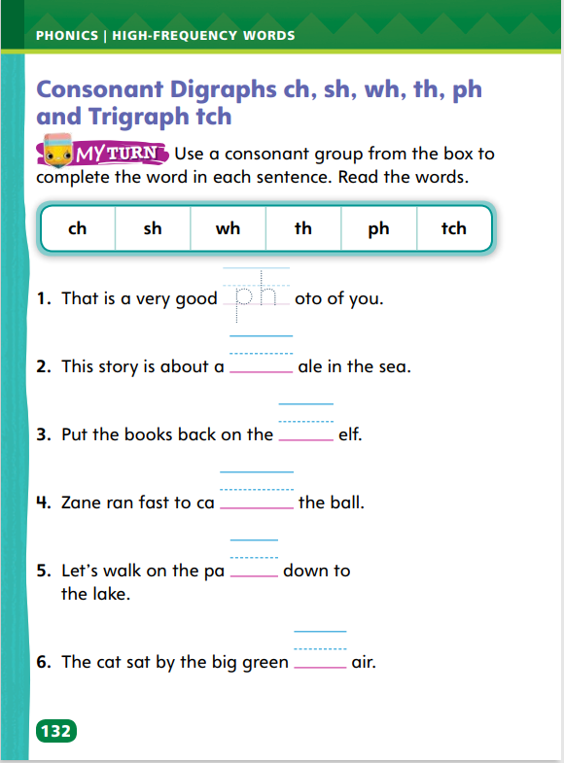
Page 132
Apply
Turn to page 132 in your Student Interactive and read the words.
Complete the rest of the sentences.
Notes:
Remind students that some letters stand for one sound. When they write words with consonant digraphs and trigraphs, they need to listen for that sound and record the two or three letters that stand for that sound.
Tell students: I want to write the word fresh. I hear four sounds. I know that fresh starts with the blend fr. I hear a short vowel sound /e/ in the middle. I hear /sh/ at the end. I remember that the letters s and h stand for the /sh/ sound. Read aloud the first sentence on p. 132, leaving out the word photo. Ask students what word makes sense in the sentence and what digraph they hear at the beginning. Have them write photo in the blank. Repeat with the second sentence
Have students complete the rest of the sentences on SI p. 132 to decode words with consonant digraphs and the trigraph tch

Slide 20
High-Frequency Words
great
before
means
Notes:
Write the words great, before, and means.
Have students work with a partner to use each word in a sentence.
Have students write the high-frequency words on index cards and take turns showing the words while their partners read the words aloud. Remind students to print each word legibly.

Slide 21
Page 136
Preview Vocabulary
lonely
stamp
might
scolding
spread
Notes:
Introduce the vocabulary from p. 136 in the Student Interactive and define the words as needed.
lonely: without company; alone
stamp: to forcefully put a foot down
might: power; strength
scolding: speaking in an angry way
spread: stretch out or apart
Tell students: These words will help you understand what the poems are about. The words can also help you understand the places and the feelings of the people discussed in the poems. As you read, highlight the words when you see them in the poems. Ask yourself how these words help you understand the poems better.

Slide 22
First Read Strategies
Notes:
Discuss the First Read Strategies with students. Prompt students to establish the point that the purpose for reading this selection is understanding and enjoyment.
Explain the four steps of the first read.
READ Explain that students will read to understand the meaning of each poem. Challenge students to think about how they can relate to or connect with each poem.
LOOK Direct students’ attention to the illustrations to help them understand what the poet is describing.
ASK Help students generate questions about parts they find interesting.
Have students take notes as they read and retell or summarize after they have read.
Students may read the text independently, in pairs, or as a whole class. Use the First Read notes to help students connect with the text and guide their understanding.

Slide 23
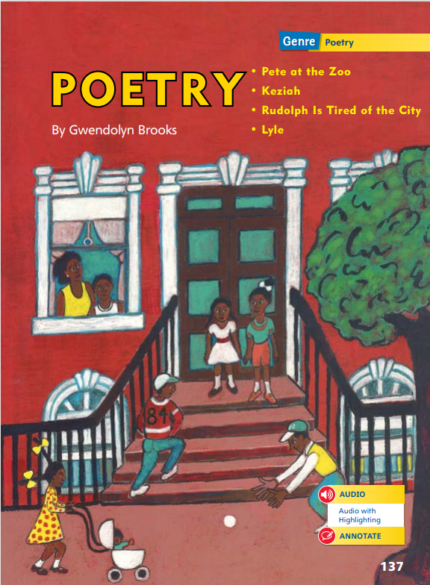
Page 137
First Read – Poetry
Notes:
Students may read the text independently, in pairs, or as a whole class. Use the First Read notes to help students connect with the text and guide their understanding.

Slide 24
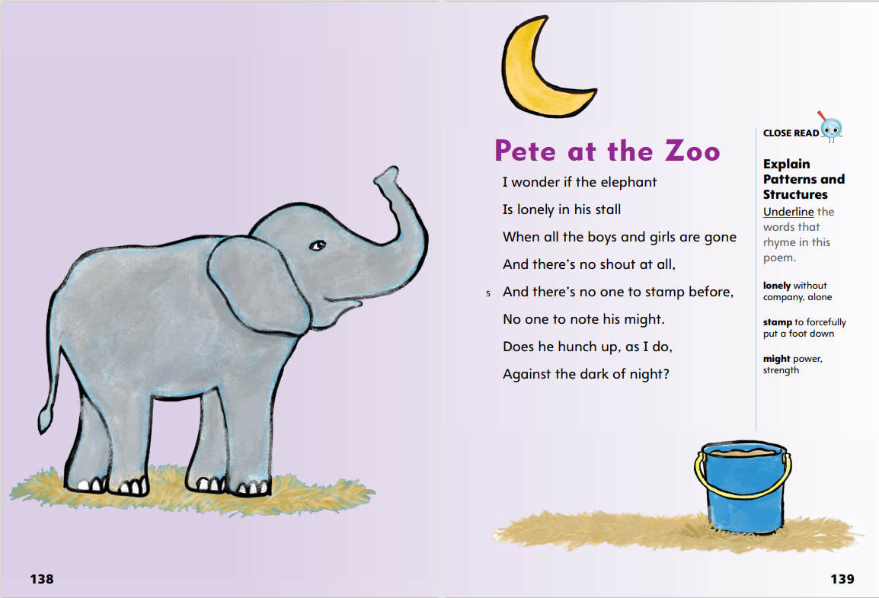
Page 138, 139
First Read – Poetry
Notes:
Read Together.
THINK ALOUD Before I read the poem, I’ll look at the illustration to see if I can tell what the poem will be about. The illustration shows an elephant, but I can’t tell where the elephant is. When I look at the poem on the next page, I see that the title is “Pete at the Zoo.” I think the elephant must be Pete, and the title tells me he is at the zoo. I’ll read the poem to find out more about him.
THINK ALOUD The first time I read the poem, I want to figure out what it’s about. I’ll go line by line to make sure I understand. In the first two lines, the speaker wonders if the elephant “is lonely in his stall.” I see the definition of lonely means “alone” or “without company.” The speaker is wondering if the elephant feels sad to be alone when the people leave the zoo.

Slide 25
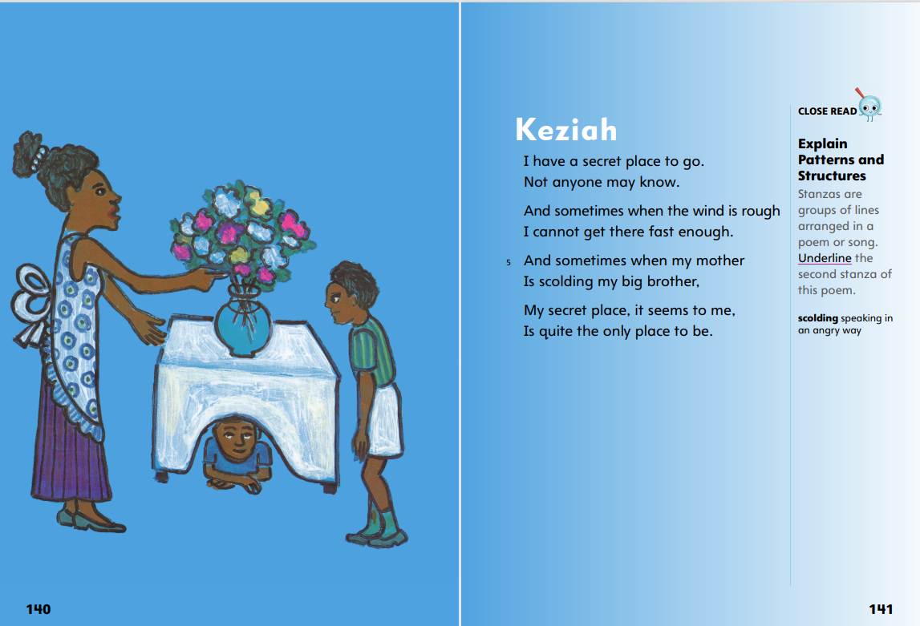
Page 140, 141
First Read – Poetry
Notes:
Read Together.
THINK ALOUD I can use the illustration to learn about the characters in the poem. I see a woman talking to a boy. It looks like she might be upset with him because she is pointing at him. The second boy in the illustration is hiding under the table. I can understand wanting to hide in an uncomfortable situation. I will take notes on these ideas so I can use what I learn from the illustration when I retell the poem.
THINK ALOUD As I read, I write questions I have about the parts of the poem I’m most interested in. I read that the speaker has a “secret place to go.” Where is the speaker’s secret place? Why does he want to hide?

Slide 26
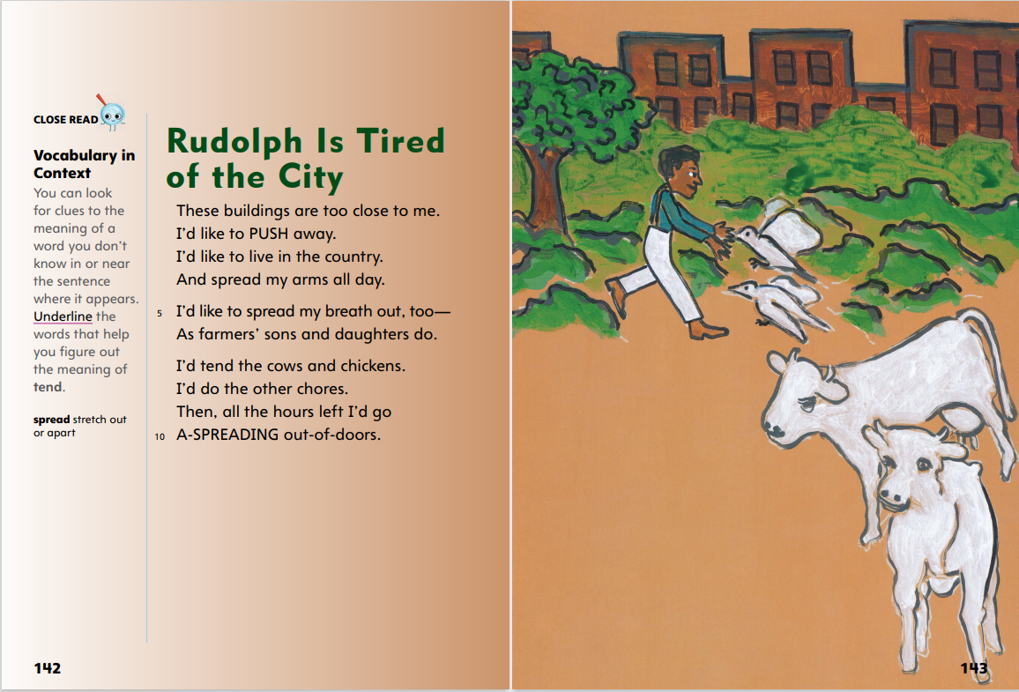
Page 142, 143
First Read – Poetry
Notes:
Read Together.
Help students understand the contrast in the poem between the city and the country. Ask: Where does the speaker live now? How do you know? Guide students to understand that the speaker lives in a city, with “buildings” that are “close” together. Point out the phrase “tired of the city” in the title. Ask: How would life in the country be different?
Possible Response: The speaker would have more room and space to play and work outdoors.
In pairs, have students choral-read the poem aloud. Have students act out the action words as they read. Point out phrases such as “PUSH,” “spread,” and “A-SPREADING.” After partners reread the poem, have them summarize the events and ideas in the poem to each other.

Slide 27
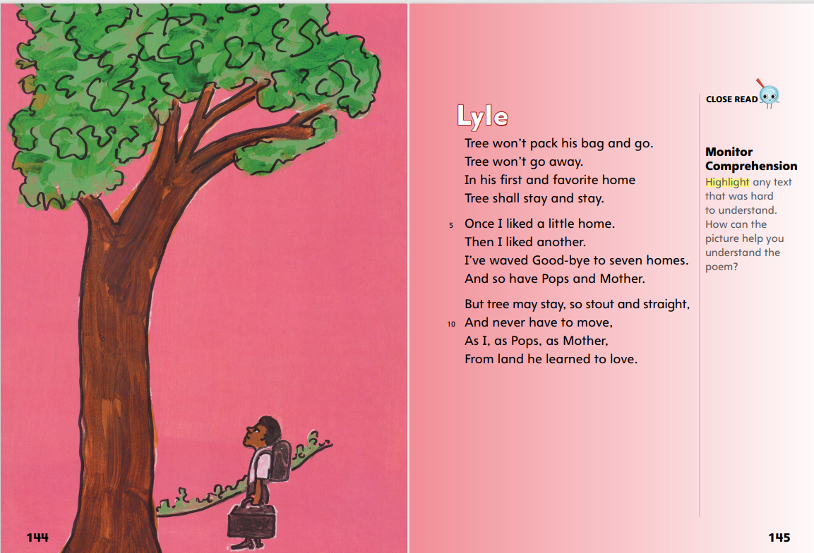
Page 144, 145
First Read – Poetry
Notes:
Read Together.
THINK ALOUD Before I read the poem, I look at the illustration to see if I can find clues that help me understand the poem. I see a man looking up at a tree. He is carrying a suitcase and a backpack. It looks like he’s about to go on a trip. The tree must be important because the man is looking at it, but I’m not sure why. I’ll read the poem to find out.
Explain that looking at repeated words and phrases can help readers understand a poem. Ask: What words does the speaker repeat when talking about Tree? (won‘t go, stay) Explain that these repeated words help the reader understand that Tree lives in one place. Ask: What words does the speaker repeat when he’s talking about himself? (liked, home) Ask: How does the speaker feel about having to move?
Possible Response: The speaker is sad when he has to leave homes that he likes.

Slide 28
Respond and Analyze
Tell a partner what you liked best. Use words like location, different, stanza, rhythm, rhyme.
Draw an illustration to show details of each poem.
Notes:
Use these suggestions to prompt students’ initial responses to reading Poetry.
Retell - Tell a partner the poem you liked the best. Explain why you made this choice. Include vocabulary words and the language of poetry as you explain. Use words such as location, different, stanza, rhythm, and rhyme.
Illustrate - Details Divide a sheet of paper into four sections and draw an illustration of your own to show details of each poem. Label each illustration with the poem’s title.

Slide 29
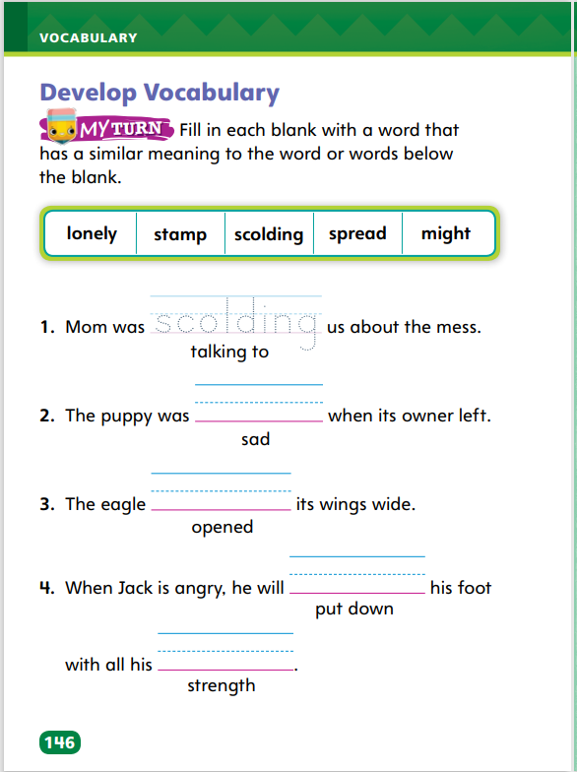
Page 146
Develop Vocabulary
Turn to page 146 in your Student Interactive and complete the activity.
Notes:
Tell students that authors writing poetry choose words carefully to tell about thoughts and feelings. The vocabulary words lonely, stamp, scolding, spread, and might can all be used to tell about thoughts and feelings in the poems students recently read.
Stop to think about the word’s meaning.
Think about what the author is saying about thoughts and feelings.
Model completing item 1 on p. 146 of the Student Interactive.
Say: If a place is a mess, I know a mom or dad probably wouldn’t be happy about it, and I can tell from the sentence that scolding is something the mom is doing. I’ll try the word scolding to see if it fits in the sentence . . . Mom was scolding us about the mess. That makes sense. I can see that I made the right choice. Scolding is correct.
Have students practice developing vocabulary by completing the activity on p. 146 in the Student Interactive and then using vocabulary to explain their pictures.

Slide 30
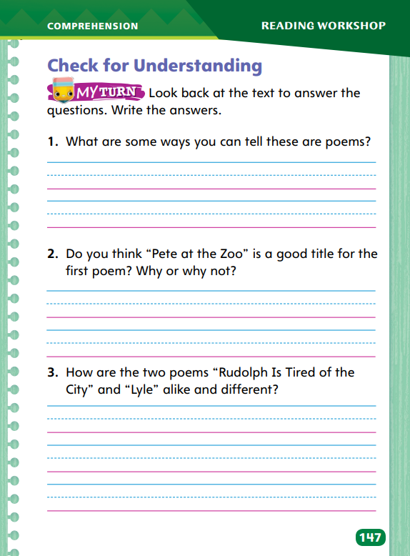
Page 147
Check for Understanding
Turn to page 147 in your Student Interactive and complete the activity.
Notes:
Have students complete p. 147 of the Student Interactive.

Slide 31
Page 155
Writing – Launch Writing Workshop
Turn to page 155 in your Student Interactive.
Notes:
Authors vary their sentences by using appropriate end punctuation and making contractions with apostrophes. Punctuation marks at the ends of sentences can express statements, questions, or exclamations, while contractions can give text a more conversational tone.
Direct students to p. 155 in the Student Interactive. Ask: How do authors use apostrophes in contractions? Review how to make a contraction. Write: I will take a walk. I’ll take a walk. Have students echo-read the sentences with you, and discuss whether the contraction makes the sentence sound less formal.
Give students pairs of words and ask them to turn them into contractions. When students answer correctly, ask them to spell the contractions.
Ask: Why do authors use periods/question marks/exclamation points? Then review using end punctuation. Note the different effects of periods, question marks, and exclamation points on sentences.
Have students complete the exercise at the bottom of p. 155.

Slide 32
Independent Writing
Let’s review your draft and find places to use contractions and different forms of end punctuation.
Share your revised words and sentences.
Notes:
During independent writing time, students should revisit their drafts to see where they might use contractions and different forms of end punctuation. If students have difficulty, read their sentences aloud in tones that indicate specific end punctuation.
Writing Support
Modeled - Do a Think Aloud that models how to choose between a period and an exclamation point.
Shared - Circle words and sentences in student writing that need to be revised. Have students revise using apostrophes or different end punctuation.
Guided - Provide explicit instruction on when and when not to use contractions.
Students who show understanding should experiment with using contractions to make dialogue sound authentic.
Have students share their revised words and sentences. Instruct other students to offer feedback as appropriate.

Slide 33
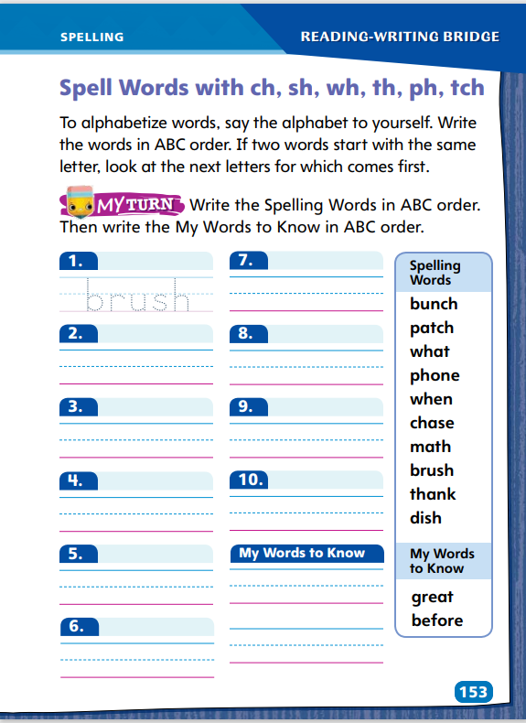
Page 153
Spelling
Turn to page 153 in your Student Interactive and complete the activity.
Notes:
Explain that two or more letters can stand for one sound. When alphabetizing, use the first letter of the word.
Display: bunch, phone, and patch. Say each word, circling its digraph or trigraph. Underline the first two letters of each word and say: In alphabetical order, this series of words is bunch, patch, phone. Point out that ch and tch can stand for the same sound, /ch/. Explain that students must memorize these spellings.
Have students complete Student Interactive p. 153 to alphabetize words. Use the leveled supports on p. T408 for ELLs.

Slide 34
Page 154
Language and Conventions
Turn to page 154 in your Student Interactive.
Notes:
Remind students that a complete sentence begins with a capital letter and ends with a punctuation mark. Read aloud the information in the chart on Student Interactive p. 154.
Say these sentences: I am lucky. Am I lucky? How lucky I am! Read each sentence with appropriate expression, and write the end punctuation as you complete the oral statement of each type of sentence: declarative, interrogative, and exclamatory.
Say the following sentences and ask students to identify the end punctuation needed: Where is the book? The book is on the table. The book is gone! Then ask students to provide oral examples of declarative, interrogative, and exclamatory sentences.

Slide 35
Lesson 3

Slide 36
Phonics
phone
graph
ph
photo
phonics
phrase
digraph
Notes:
Remind students that some consonant pairs stand for one sound and these letters are called consonant digraphs. Explain that trigraphs are three letters that stand for one sound. Ask students to name some consonant digraphs as you record them on the board. Then ask students to name some words with the digraphs. Do the same for the trigraph.
Model how you make a word web. Say: I am going to make a word web for consonant digraphs. I will make one for the digraph ph. Draw a center circle with the letters ph in the middle. Then add six outer circles connected to the center circle, each with a word inside: phone, photo, phrase, graph, phonics, digraph.
Give pairs of students a sheet of unlined paper. Have them draw a word web similar to the one you made. Assign consonant digraphs or the trigraph to different pairs of students: sh, ch, th, wh, and tch. Have partners write their assigned digraph or trigraph in the center of the web and see how many words they can write around it. After students have completed their work ask partners to show their webs and read aloud their words.
Ask partners to choose two words from their webs and write two sentences, each using one of the words.

Slide 37
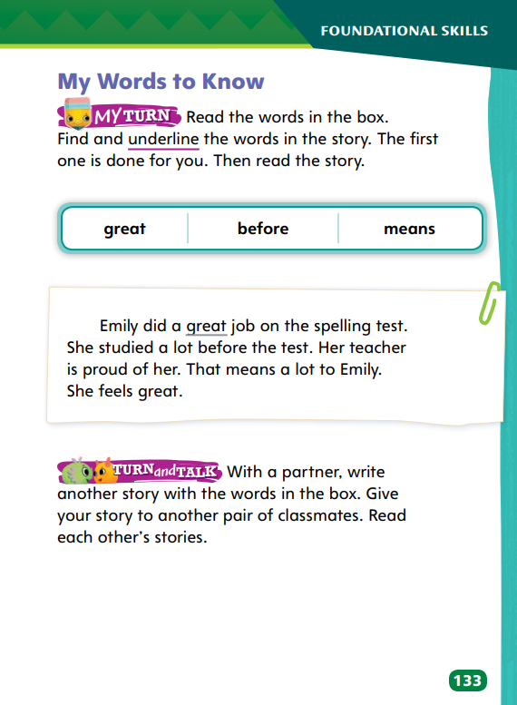
Page 133
High-Frequency Words
great
Turn to page 133 in your Student Interactive.
before
means
Notes:
Point to the words in the box at the top of p. 133. Remind students that they need to practice reading these words so they can read them quickly. Ask students to read them with you.
Tell students: I look at each word carefully so I can recognize it later. I notice that great starts with the blend /gr/. Before starts with the little word be. Means starts with m and ends with -s. Then I practice reading the words.
Write each word on large index cards and flash the cards for students to read as quickly as they can.
Have students underline the high-frequency words in the paragraph on p. 133. Read the story together as a group.

Slide 38
Page 137
Explain Patterns and Structures
Notes:
Readers can identify and explain visual patterns and structures in poems by examining stanzas, rhyme, and rhythm.
Notice how the poem is structured. Does it have stanzas, or groups of lines?
Look for rhyming words. Do any end sounds match?
Check for rhythm. Is there a structure of repeating beats?
Use the Close Read on Student Interactive p. 141 to explain visual patterns and structures. Display the poem and read it aloud.
Tell students: I can see that the lines are structured in four groups, or stanzas. Some lines end with words that rhyme. I can clap the rhythm. Read aloud two stanzas, clapping the rhythm emphasizing lines that rhyme. This text has stanzas, rhyme, and rhythm, so I think it is a poem.
Have students describe how the poem looks and identify rhyming words. Have them clap the rhythm of the two remaining stanzas. Ask them to explain the poem’s visual pattern and structure.

Slide 39
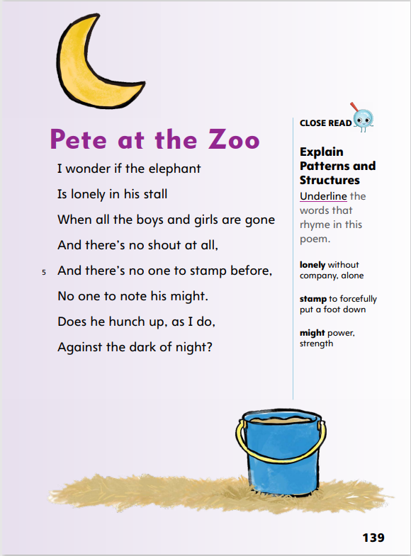
Close Read – Explain Patterns and Structures
Page 139
Turn to page 139 in your Student Interactive.
Notes:
Remind students that rhyming words have endings with the same sound. Explain that in a poem, rhyming words are often at the ends of lines. Have students identify the last word in each line and read it aloud. Then ask: Which words have the same ending sounds? Underline the pairs of words that rhyme. See student page for possible response. DOK 2

Slide 40
Close Read – Explain Patterns and Structures
Page 141
Turn to page 141 in your Student Interactive.
Notes:
Ask students to read the Close Read note. Designate four groups of students. Have each group choral-read a stanza. Ask: How did we know how to break the text up into four parts?
Possible Response: There is an extra space between sections of the poem.
Explain that each section of the poem is called a stanza. Then direct students to complete the Close Read activity. See student page for possible response. DOK 2

Slide 41
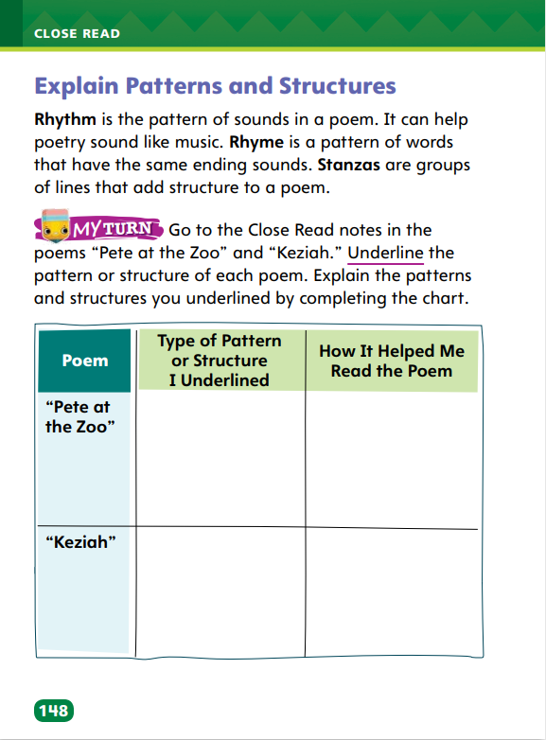
Page 148
Explain Patterns and Structures
Turn to page 148 in your Student Interactive and complete the activity.
Notes:
Have students complete p. 148 in the Student Interactive.

Slide 42
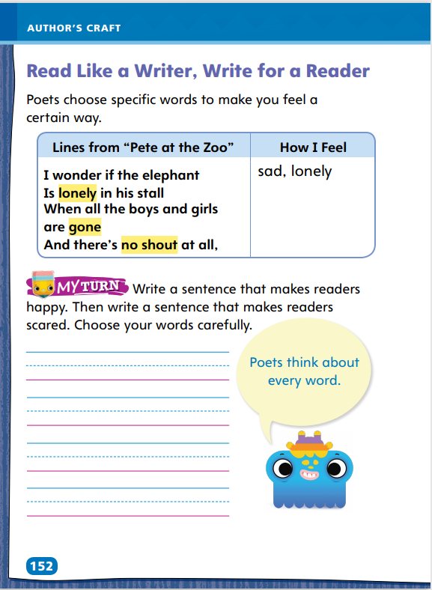
Page 152
Read Like a Writer, Write for a Reader
Turn to page 152 in your Student Interactive and complete the activity.
Notes:
When poets write, they have reasons for choosing specific words to make the reader have specific kinds of feelings.
Poems are often written to make the reader feel a specific way.
Poets are careful with the words they choose. They might choose words to make a reader feel happy. They might choose words that make a reader feel sad.
Having these feelings can help a reader better connect to and understand a poem.
Read the lines from “Pete at the Zoo” on p. 152 of the Student Interactive. Then say: The poet uses the words lonely, gone, and no shout. These words make me feel sad and lonely. I picture the elephant alone in the quiet. Tell students to create a picture in their minds to help them write sentences and make readers feel a specific way.
Have students complete the activity on p. 152 of the Student Interactive.

Slide 43
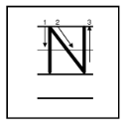
Handwriting
Notes:
Display uppercase and lowercase letters Pp, Rr, and Nn.
Model writing Pp. Then write paw, apple, and peel, showing proper letter formation and correct letter size. Have students copy the words. Repeat the routine with letters Rr (Ruiz, art, far, run) and Nn (now, and, Nate, fanning).
Have students use Handwriting p. 20 in the Resource Download Center to practice writing letters Pp, Rr, and Nn. Click path: Table of Contents -> Resource Download Center -> Handwriting Practice -> U1W4L3 Handwriting Practice

Slide 44
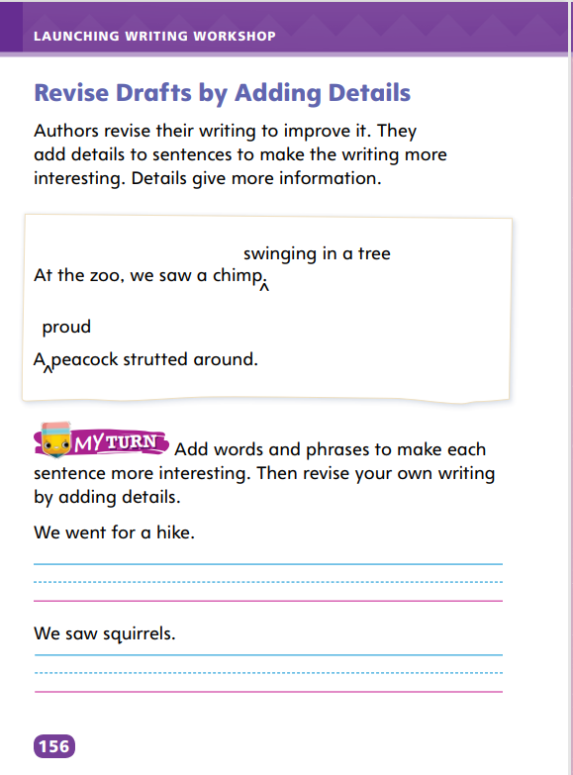
Page 156
Writing – Launch Writing Workshop
Turn to page 156 in your Student Interactive.
Notes:
Authors revise their writing to improve it. One way to revise it is to add details. Details supply more information about a topic and also make it more interesting. Writers add details by
including adjectives that describe their subjects
giving more information about their subjects
writing about where and when things happened
Direct students to p. 156 in the Student Interactive. Read aloud the first paragraph.
Hold up a text from the stack. Say: This author started with a topic or idea. He or she wrote more about the topic or idea and then made revisions to the writing. The author wanted to make the writing interesting to readers and used details to do this. Details give more information. Read the text aloud, pointing out interesting details throughout. Read sentences with details omitted, and then reread them with details restored. Ask: How do these details make the sentence more interesting?
Repeat the same routine using two or more texts from the stack, varying genre. Have students identify details as you read.

Slide 45
Independent Writing
Let’s add details to your writing.
You will continue to work on your draft and add details to your writing.
Share interesting details you have added to your drafts.
Notes:
During independent writing time, students should add details to their drafts. If students have difficulty, suggest a detail that would improve a draft and help them place it effectively.
Writing Support
Modeled - Do a Think Aloud to model finding a detail that offers more information about a topic.
Shared - Put students in groups and assign each group a stack text. Instruct groups to list a detail from each page of the text.
Guided - Point out spots in students’ writing where they can add details.
Students who grasp the concept should start working on adding details to their own writing.
Ask two or three students to share interesting details they have read or added to their drafts.

Slide 46
Spelling
ph
ch
tch
chase
wash
bunch
Notes:
Flexible Option
Help students recall the single sound represented by the letters ph, ch, and tch.
Have students spell the following words: chase, wash, bunch. Afterward, ask how students knew the correct spelling (because they had memorized how to spell the words).
Have students complete Spelling p. 26 from the Resource Download Center. Click path: Table of Contents -> Resource Download Center -> Spelling -> U1W4

Slide 47
Language and Conventions
Your friend is kind.
Is your friend kind?
We will edit sentences for correct punctuation.
Notes:
Remind students of the three types of sentences––declarative, interrogative, and exclamatory––and the correct end punctuation for each.
On a display surface, write these sentences: Your friend is kind. Is your friend kind? Your friend is so kind! Read the sentences aloud, pointing out the end punctuation for each type of sentence and explaining why it is correct. Then display two sentences with errors in end punctuation and have students edit the sentences for correct punctuation.

Slide 48
Lesson 4

Slide 49
Phonics
these
match
wheel
church
shave
chase
Notes:
Write shape and circle the digraph sh.
Say: I know that the letters s and h stand for one sound: /sh/. They are a consonant digraph. Even though shape has five letters, it has only three sounds: /sh/ /ā/ /p/. The word shape has a CVCe pattern, so the final e is silent. I know that consonant digraphs can be at the beginning or end of words.
Write these words: these, match, wheel, church, shave, chase
Read each word with students. Ask them how many sounds the word has, and have them tell you what the consonant digraph in the word is. Write brush. Say: The word brush has both a blend and a consonant digraph. It has four sounds: /b/ /r/ /u/ /sh/. There are many words that have both blends and consonant digraphs. Write the following words and ask students to identify the blends and the digraphs: clash, flunk, glitch, strong, strength, and tramp.

Slide 50
Phonics
brush
clash
flunk
glitch
strong
tramp
Notes:
Read each word with students. Ask them how many sounds the word has, and have them tell you what the consonant digraph in the word is. Write brush. Say: The word brush has both a blend and a consonant digraph. It has four sounds: /b/ /r/ /u/ /sh/. There are many words that have both blends and consonant digraphs.
Write the following words and ask students to identify the blends and the digraphs: clash, flunk, glitch, strong, strength, and tramp.

Slide 51
Page 99
Monitor Comprehension
What to do if you do not understand:
Read again.
Look closely at pictures.
Keep reading.
Ask questions.
Notes:
Monitoring your comprehension means making sure you understand what you are reading. If you do not understand, there are strategies you can use to help.
Read again. You might understand better or find details you missed.
Look closely at the pictures. Pictures may contain details that give a better understanding of the text.
Keep reading. There may be details as you read on that make the earlier details more clear.
Ask questions. You can ask a teacher, partner, or any other group member.
Use the Close Read note on p. 145 of the Student Interactive to model how to monitor comprehension of poetry.
Say: I read that the tree won’t pack his bags and go. I didn’t understand what this meant, so I used a plan to figure it out. I decided to read on in case it would help me understand. I read that the tree will stay and stay. I know trees can’t walk, so I see the poet is pointing out that the tree has just one home, forever. This is different from people, who can move from place to place.

Slide 52
Page 145
Close Read – Monitor Comprehension
Turn to page 145 in your Student Interactive.
Notes:
Ask students to read the Close Read note and highlight text in the first stanza that is difficult to understand. See student page for possible response.
Guide students to apply strategies such as re-reading, using background knowledge, using pictures, and asking questions to improve their understanding. DOK 2

Slide 53
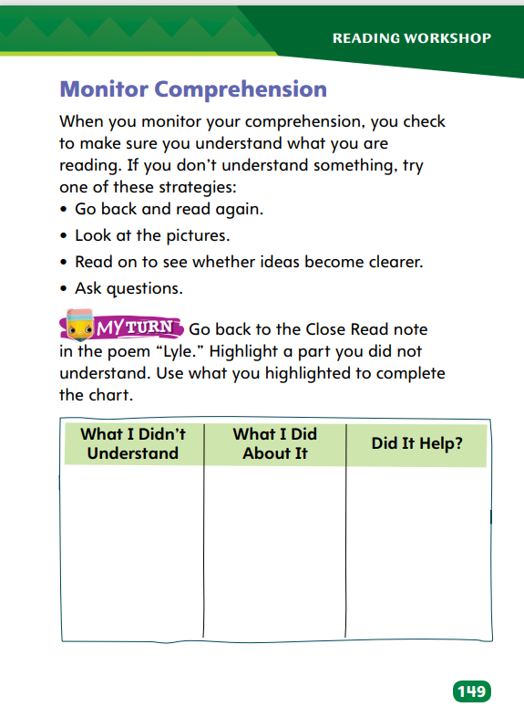
Page 149
Monitor Comprehension
Turn to page 149 in your Student Interactive and complete the activity.
Notes:
Have students complete the chart on p. 149 in the Student Interactive.

Slide 54
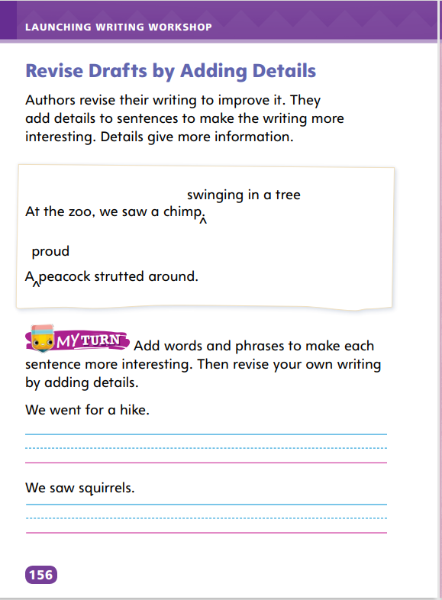
Page 156
Writing – Launch Writing Workshop
Turn to page 156 in your Student Interactive.
Notes:
Authors revise their drafts to add words, phrases, or sentences that provide more information and make their writing more interesting to readers.
Direct students to p. 156 in the Student Interactive. Ask: Why do authors revise their drafts to add words, phrases, or sentences that provide more detail to their writing? Review how authors revise their writing by adding interesting details that provide more information.
Read: At the zoo, we saw a chimp. A detail about the chimp can make this sentence more interesting. Let’s add “swinging in a tree.” At the zoo, we saw a chimp swinging in a tree. The detail “swinging in a tree” adds more information—it tells the reader what the chimp is doing. The detail makes the sentence more interesting. Read the second sentence aloud. Say: Let’s add a detail about the peacock to the sentence. A proud peacock strutted around. Proud tells us more about the peacock’s attitude. It is an interesting detail.
Read aloud a text from the stack. Ask students to point out sentences that have details and explain what purposes the details serve.
Have students complete the exercise on the bottom of p. 156. Reinforce how students can add details about the “we” in the sentence, how long the hike was, and where the hike took place.

Slide 55
Independent Writing
Now you will add words, phrases and sentences.
Share your original sentences that you have created.
Notes:
Instruct students to spend independent writing time revising their drafts to add words, phrases, or sentences that provide more detail. If students have trouble, ask them to verbally describe their topics and make notes while they do so.
Writing Support
Modeled - Do a Think Aloud to model how to add a detail to a sentence to make it more interesting and informative.
Shared - Create a list of sentences without details, then go around the room asking each student to add a detail to a sentence.
Guided - Provide explicit instruction on where to add details in students’ sentences.
Students who show understanding should vary the kinds of details they add.
As students write, use the conference prompts in the Teacher’s Edition or Resource Download Center to provide support. Click path: Table of Contents -> Resource Download Center -+ Writing Workshop Conference Notes
Ask students to share their original sentences and their revised sentences with words, phrases, or sentences added to provide more detail.

Slide 56
Spelling
nest
past
spring
Let’s review the consonant blends.
spend
strong
frog
Notes:
Flexible Option
Have students recall the spelling lesson from the previous week for words with consonant blends. Distinguish words that have consonant blends from this week’s spelling words, explaining that in words with consonant blends, both letters are pronounced.
Display: nest, spring, and strong. Say each word aloud, circling the consonant blend (in bold) in each and stressing the pronunciation of each letter in the consonant blend.
Have students write: past, spend, and frog.

Slide 57
Page 154
Language and Conventions
Turn to page 154 in your Student Interactive and complete the activity.
Notes:
Have students complete the practice activity on p. 154 to edit drafts using end punctuation. Use the leveled supports on p. T417 for ELLs.

Slide 58
Lesson 5

Slide 59
Phonics
scrape
tent
plank
Beginning | End | Both
Notes:
Remind students that consonant blends are consonants whose sounds blend together at the beginnings and ends of words. Provide these examples: scrape, tent, plank
Circle the blends in the words. Say: I know that consonant blends are two or three letters whose sounds blend like the blend /s/ /c/ /r/ in scream. I know they can be at the beginning and at the end of words. Some words, such as plank, have blends at the beginning and at the end.
Create a three-column chart with the headings: Beginning, End, Both. Ask partners to copy the chart. Provide the following words: slept, place, stand, bank, herd, skunk, quest, sprain, prune, brown, limp, and quilt. Ask partners to sort the words by writing them in the appropriate columns. Then have them circle the blends in the words. Ask partners to share how they sorted the words.

Slide 60
High-Frequency Words
 | g | r | e | a | t
b | e | f | o | r | e
 | m | e | a | n | s
great
before
means
Notes:
Remind students that high-frequency words are words that they will hear, see, and use more often than other words. Explain that recognizing these words will help them read fluently. They will also be able to concentrate on new or unfamiliar words.
Ask students to review the chart. Have them say each word and repeat after you the letters each word contains. Then have volunteers give clues about the words, such as: Which word has a long a sound? After a student identifies the word, he or she spells the word.

Slide 61
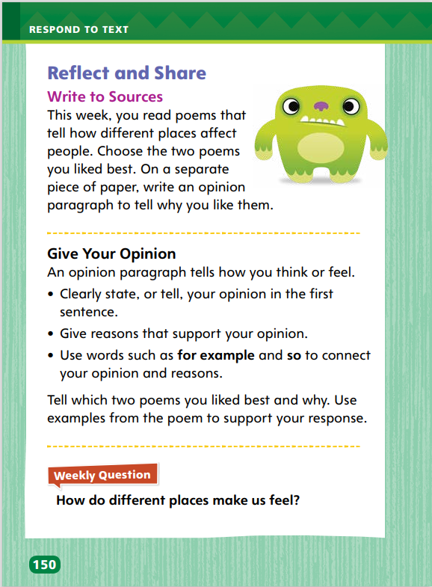
Page 150
Reflect and Share
Turn to page 150 in your Student Interactive.
Notes:
Tell students that writing is a way to interact with texts in a deep, meaningful way. For example, they can write opinions about poems they have read. Point out that opinions tell what they think or feel about something. Guide them in writing opinions.
Clearly tell your opinion in the first sentence.
Support your opinions with reasons and details from the poems.
Use connecting words to join thoughts about the poems.
Model sharing opinions about two poems.
Say: I think “Pete at the Zoo” and “Rudolph Is Tired of the City” were the best poems. I write this as my first sentence. Write the sentence. Continue writing as you continue modeling.
Say: I think they are the best because they do a good job of showing feelings. One poem shows how the elephant feels lonely, and I understand that feeling. The other poem shows how much Rudolph really wants to make a change. Point out that this is an example of how to interact meaningfully with texts. Have students use this model to help them complete the activity on p. 150 of the Student Interactive.

Slide 62
Page 137
Apply
How do different place make us feel?
Notes:
Have students use the strategies for comparing and contrasting texts. Remind them that opinion writing is one way to interact meaningfully with texts they have read.
Use the Shared Read Have students use text evidence from the poems to discuss their opinions of the poems.
Have students use evidence from this week’s poems, including “City Sights!” in the weekly opener, to express their opinions in response to the Weekly Question.
If desired, distribute Speaking and Listening tips from the Resource Download Center. Click Path: Table of Contents -> Resource Download Center -> Speaking and Listening

Slide 63
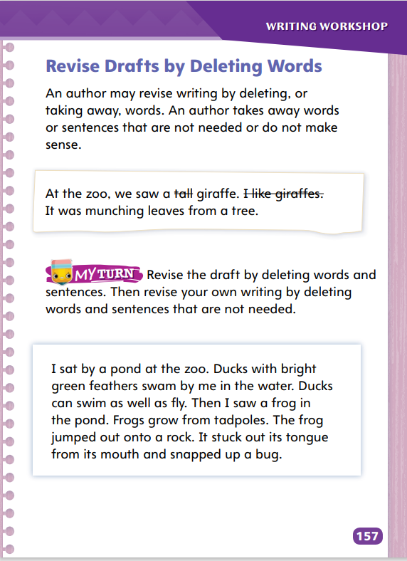
Page 157
Writing – Launch Writing Workshop
Turn to page 157 in your Student Interactive.
Notes:
While revising their work, authors often find that they can strengthen their writing by deleting words, phrases, or sentences. Authors might decide to delete parts of their work because
they have included items that distract from their main point
they have written something that readers already know
they think that their ideas will be more powerful if expressed in fewer words
they realize that something they wrote does not make sense
Direct students to p. 157 of the Student Interactive.
Say: Authors delete, or take away, words, phrases, or sentences when they revise their writing. They delete words that do not make sense. They delete words that are not needed.
Read the giraffe paragraph from the top of p. 157 without omitting tall and “I like giraffes.” Then reread the sentence without those words. Say: Tall can be deleted because it is not needed in the sentence. Readers know that giraffes are tall.
Tell students: “I like giraffes” can be deleted too. The first sentence tells the reader what the author saw. The last sentence tells the reader what the giraffe is doing. Readers do not need to know how the author feels about giraffes here. The middle sentence is not needed.
Direct students to complete the exercise on the bottom of p. 157. Reinforce to students that authors want their writing to make sense to readers.

Slide 64
Spelling
I bought a bunch of bananas.
The dog will chase the ball.
It is fun to visit the pumpkin patch.
My favorite subject is math.
What is the time?
I will brush my hair.
Please answer the phone.
I’ll thank him for his help.
When will you be home?
He will wash the dish.
A great flash of lightning filled the sky.
I will eat breakfast before I go to school.
Notes:
(Note: Move the orange boxes to cover each bold spelling word before you read aloud the words and sentences.)
Read aloud the words and sentences. Have students spell each word with initial consonant blends and the two high-frequency words.
I bought a bunch of bananas.
The dog will chase the ball.
It is fun to visit the pumpkin patch.
My favorite subject is math.
What is the time?
I will brush my hair.
Please answer the phone.
I’ll thank him for his help.
When will you be home?
He will wash the dish.
A great flash of lightning filled the sky.
I will eat breakfast before I go to school.
Reveal the spelling word and have students check their work.

Slide 65
Language and Conventions
Which of these is correct?
Are they here yet
Are they here yet?
Are they here yet.
Are they here yet!
Notes:
Flexible Option
Display the following sentences. Have students choose the sentence that is correctly written
Are they here yet
Are they here yet?
Are they here yet.
Are they here yet!
Have students complete Language & Conventions p. 32 from the Resource Download Center. Click path: Table of Contents -> Resource Download Center -> Language and Conventions -> U1 W4

Slide 66
Unit 1: Week 4
Grade 2

