Slide 1
Unit 1: Week 1
Grade 5

Slide 2
Copyright © Savvas Learning Company LLC. All Rights Reserved.
This publication is protected by copyright, and permission should be obtained from the publisher prior to any prohibited reproduction, storage in a retrieval system, or transmission in any form or by any means, electronic, mechanical, photocopying, recording, or otherwise. For information regarding permissions, request forms, and the appropriate contacts within the Savvas Learning Company Rights Management group, please send your query to:
Savvas Learning Company LLC, 15 East Midland Avenue, Paramus, NJ 07652
or
k12learningpermissions@savvas.com
myView Literacy® is an exclusive trademark of Savvas Learning Company LLC in the U.S. and/or other countries.

Slide 3
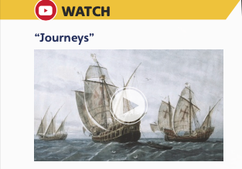
Page 8
Introduce the Unit
Essential Question: How do journeys change us?
What did you learn about journeys by seeing the images?
What did you learn about journeys by listening to the sounds in the video?
Notes:
Introduce the Unit 1 Essential Question, How do journeys change us? Tell students they will read many texts to learn how exploring new places shape who we are. Explain that reading a variety of genres is important because each text provides a unique perspective about the theme.
Watch the Unit Video Tell students that a video is a multimodal text because it comes with sound and pictures. Have them watch the video, “Journeys.” Click Path: Table of Contents -> Unit 1: Journeys> Unit 1: Introduction
Then tell students to make a list of examples in the video that show the influence of journeys
Encourage partners to discuss what they learned about journeys by watching the video. Use the following questions to guide their discussions.
What did you learn about journeys by seeing the images?
What did you learn about journeys by listening to the sounds in the video?

Slide 4
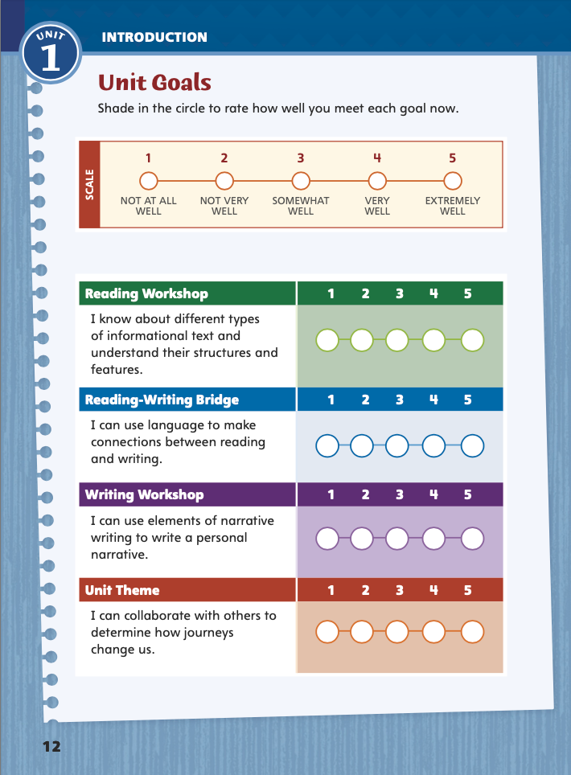
Page 12
Unit Goals
Turn to page 12 in your
Student Interactive.
Rate how well you think you already meet the unit goals.
Notes:
1. Review the Unit Goals on p. 12 of the Student Interactive.
Have students rate how well they think they already meet the unit goals.
Have them use their ratings to reflect on how well they are meeting their personal learning goals during the unit.
2. Students will revisit their ratings in Week 6.

Slide 5
Academic Vocabulary
Expand: When you share your experience, you give insight.
Ask: What topic can you give insight on?
Expand: Raj wandered into the kitchen, going into the room without thinking about it.
Ask: What place might people wander into?
Expand: A hallway is a long passage between rooms.
Ask: Which passage is closest to our classroom?
Expand: Exploring an underground cave is an adventure.
Ask: What adventure would you like to go on?
Expand: Being curious means wanting to learn new things.
Ask: Which other countries are you curious about?
Notes:
Academic vocabulary is language used to discuss ideas. As students work through the unit, they will use these words to discuss journeys.
Read each word's definition.
Have students respond to the Expand and Ask questions using the newly acquired academic vocabulary as appropriate.

Slide 6
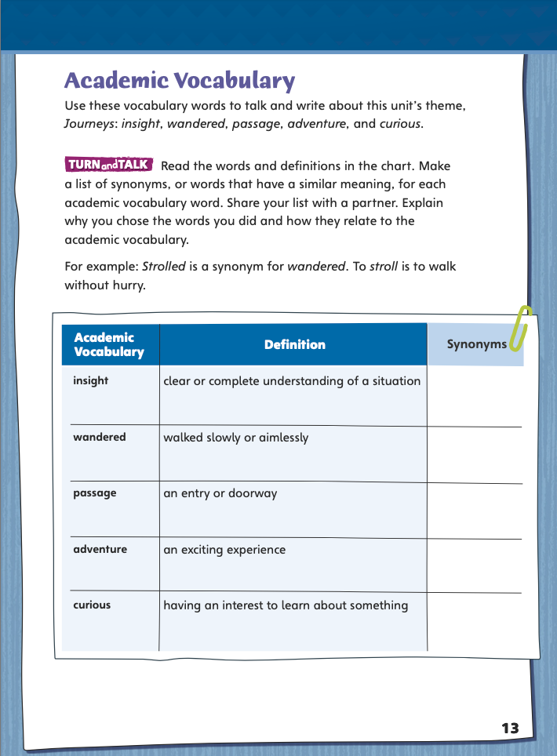
Page 13
Academic Vocabulary
Complete the chart on page 13 in your Student Interactive.
Notes:
Have students use the Academic Vocabulary to complete the chart on p. 13.
Have partners share their answers.

Slide 7
Lesson 1

Slide 8
Page
14-15
Interact with Sources
Discuss what motivates people to leave a place they call home.
Freewrite to answer the Quick Write on p. 15.
Notes:
Remind students of the Essential Question for Unit 1: How do journeys change us? Point out the Week 1 Question: What motivates people to leave a place they call home?
Direct students’ attention to the infographic on pp. 14–15 in the Student Interactive. Explain that an infographic combines words and pictures to provide information. An infographic time line can tell a story by connecting dates with historic events that affected people in personal ways.
Arrange students in groups and make sure that each group member has an assigned role, such as notetaker or timekeeper, to carry out.
Use the following questions to guide discussion:
Why do you think immigrants from Europe and Asia went to different immigration stations?
What laws are described in the infographic? Why do you think these laws were created during the time that the infographic covers?
What does this time line suggest about how immigration changed over time?
Reread the Week 1 Question: What motivates people to leave a place they call home? Tell students they just learned about some important dates and events in the history of immigration in the United States. Explain that they will learn about immigration experiences this week.
Have students freewrite to answer the Quick Write question on p. 15 and then share their responses.

Slide 9
Listening Comprehension – Informational Text
Main Idea | Text Evidence
Notes:
Tell students you are going to read an informational text aloud. Have students listen as you read “Call Me Joe.” Explain that students should listen actively, paying careful attention to the main ideas of the text. Prompt them to ask questions to clarify information and follow agreed-upon discussion rules..
Have students actively listen for elements of informational text. READ the entire text aloud without stopping for Think Aloud callouts. (Page T22 in Teacher’s Edition)
REREAD the text aloud, pausing to model Think Aloud strategies related to the main ideas of the text.
THINK ALOUD: I notice that there’s a whole paragraph about Song Jin’s Uncle Joe. The story says, “He shared his experiences with Song Jin and taught him about American sports.” Those words in the text tell me that Song Jin spent a lot of time with Uncle Joe.
THINK ALOUD: The text says “They studied hard” and “After breakfast, they asked each other questions from their practice exam.” This tells that becoming a U.S. citizen takes some work and that the Lim family wanted very much to do it.
After reading, have students report on the text by summarizing what they heard. Remind them to include the main idea and details in a logical sequence.
Use a T-chart to help students identify text evidence that supports ideas in the text.

Slide 10
Page 16
Informational Text
Turn to page 16 in your Student Interactive.
Notes:
Tell students: Characteristics of informational text include the main, or central, idea and its supporting evidence. Text features, another characteristic, give clues about the central idea and structure of a text. Organizational patterns, such as cause and effect or comparison and contrast, also create structure in an informational text.
Look for text features, such as the title, headings, bold words, and graphic images that suggest the central ideas and structure of the text.
As you read each paragraph, think about its structure and organizational pattern. Look for signal words and transitions that reveal the pattern.
Ask yourself what the most important idea of the paragraph is. Identify the details in the paragraph that support the central idea.
2. Model determining a main idea of informational text: The title of this text is “Call Me Joe.” Joe is the uncle who teaches Song Jin about the United States and whose name he later adds to his own. So the title suggests that the main idea is that Joe and what he taught are very important to Song Jin.
3. Lead a class discussion about why people tell stories about immigration. Guide students to discuss what readers can learn from such stories and how they might help other immigrants. Remind students to clearly express their own ideas and build on the ideas of others.
4. Read the Anchor Chart on page 16 in the Student Interactive together. Editable Anchor Chart Click Path: Table of Contents -> Reading Anchor Charts -> Unit 1 Week 1: Informational Text Editable Reading Anchor Chart

Slide 11
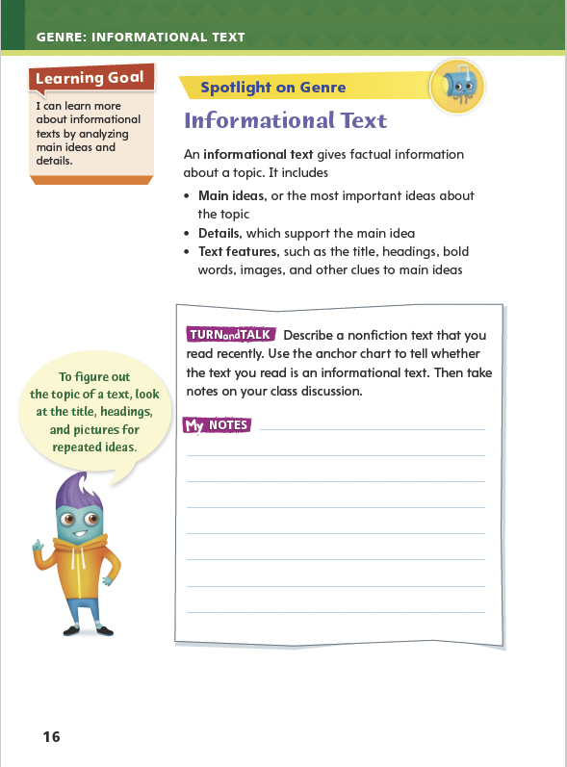
Page 16
Apply
Talk about a nonfiction text that you read recently and determine if it was an informational text.
Notes:
Have students use the strategies to identify informational text.
Have students work with a partner to complete the Turn and Talk activity on p. 16 of the Student Interactive.
Circulate to discover whether students can determine informational texts.

Slide 12
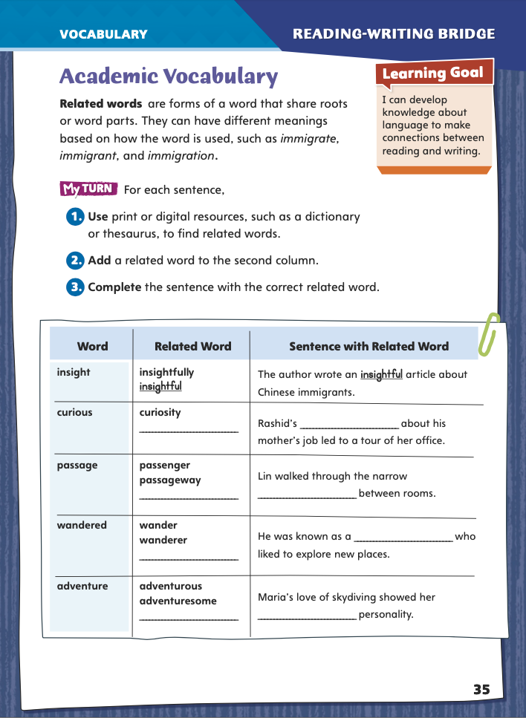
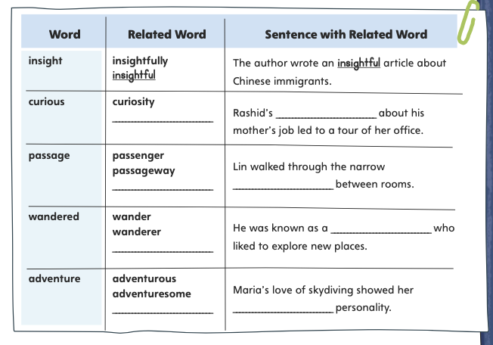
Page 35
Academic Vocabulary
insightfully
Notes:
Related words share roots or base words. Their meanings are related but may differ based on their parts of speech, affixes, or the ways in which they are used. Recognizing related words can help readers understand unfamiliar words and phrases.
When you come across an unfamiliar word in your reading, identify its root or base word, affix(es) (prefixes or suffixes), and/or ending.
Figure out the root or base word’s meaning. Ask yourself whether you have seen the root in words you already know.
Ask yourself whether the prefix, suffix, or ending gives you clues to the meaning of the unfamiliar word.
Model this strategy using the Academic Vocabulary word insightfully from the chart on p. 35 in the Student Interactive.
I can use print or digital resources, such as dictionaries and thesauruses, to confirm and clarify the meanings and pronunciations of words and phrases and to find related words. If I read the word insightfully in a text, I can use a resource to look up the base word and affixes. Adding the suffix -ful changes the noun insight into an adjective, and adding -ly changes the adjective insightful into an adverb. I will write insightful in the second column in the chart. I see that the sentence needs an adjective to correctly complete it, so I will write insightful.
Have students apply this strategy on their own to another word on the chart. Then discuss responses and correct misunderstandings.
Have students follow the same strategy as they complete the chart on p. 35 in the Student Interactive. Remind students that they will use these academic words throughout the unit.

Slide 13
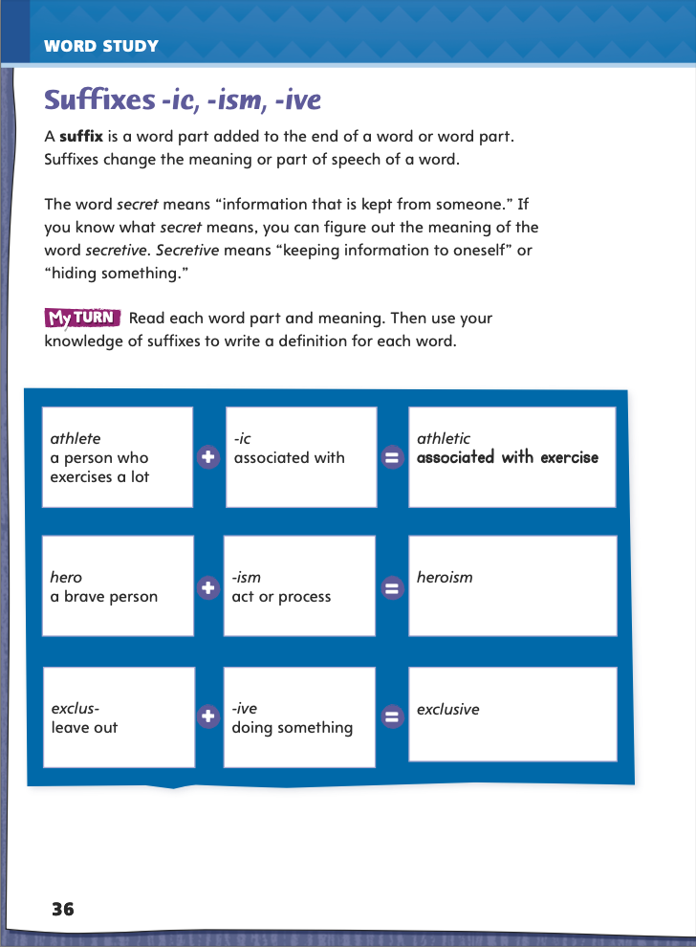
Page 36
Word Study
-ic
-ism
Turn to page 36 in your Student Interactive.
-ive
Notes:
A suffix is a word part at the end of a root or base word. Adding a suffix changes the meaning; it also usually changes the part of speech.
Point out to students the first row of the My Turn Activity on Student Interactive p. 36. Tell them that adding the suffix -ic to the end of the noun athlete (after dropping the e) changes the noun to an adjective, athletic. Explain that since -ic means “associated with,” athletic means “associated with exercise.”
To demonstrate how to add the suffixes -ism and -ive to base words, use the suffix definitions on p. 36 of the Student Interactive.

Slide 14
Word Study
escape escapism
divide divisive
-ic
-ism
-ive
allergy
favorite
adopt
Notes:
Display the following pairs: escape/ escapism and divide/divisive. For each pair, point out each word’s meaning and part of speech. Also point out the spelling changes in escape/escapism and divide/ divisive.
Guide students to add -ic, -ism, or -ive to the base words allergy, favorite, or adopt. Have students guess the meanings of the new words and check them in a dictionary.

Slide 15
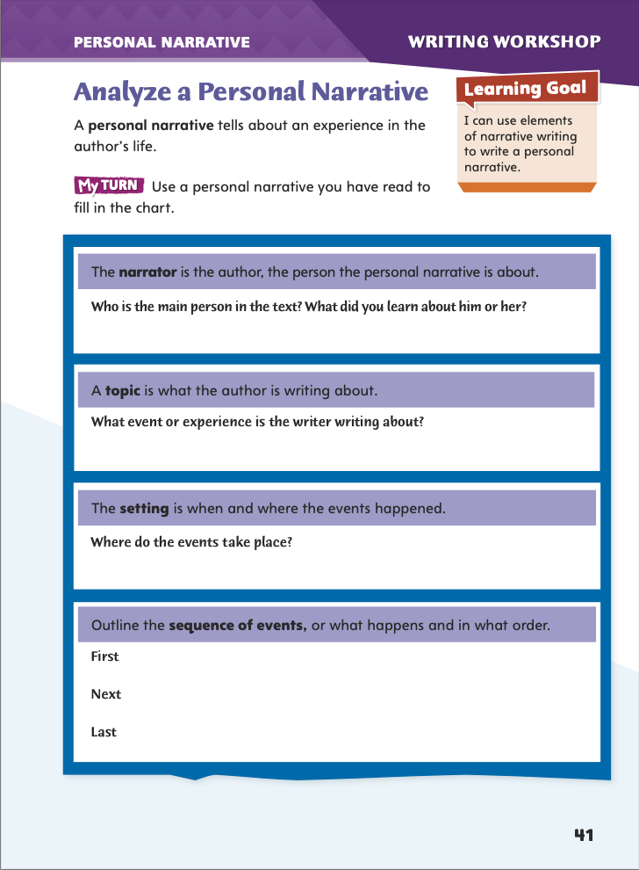
Page 41
Writing – Personal Narrative
Turn to page 41 in your Student Interactive and complete the activity.
Notes:
An author usually writes personal narratives to describe a significant, meaningful, or life-changing experience in his or her life. Personal narratives usually include
a narrator and other major and minor characters.
a setting of a specific time and place.
a sequence of real events, often involving a problem or conflict.
Explain that students will be reading and analyzing various personal narratives over the next three days in preparation for writing their own personal narratives. Today they will begin to explore the main elements of personal narratives.
Read aloud at least two personal narratives from the mentor stack. Pause to discuss the narrator, topic, setting, and/or sequence of events in each one. To prompt discussion, ask questions such as the following:
Who is telling the story? What have you learned about him or her?
What is the narrative about? Why do you think the author decided to write about this experience?
When and where do these events take place? How were the events influenced by the time period and place in which they happened?
How did the experience described in the narrative change the author’s life?
Direct students to p. 41 in the Student Interactive. Have them complete the activity using one of the narratives you just read together or another narrative from the stack.
Invite a few volunteers to share their notes about the narrator, topic, setting, and/or sequence of events in the personal narrative they analyzed.

Slide 16
Independent Writing
Plan and begin writing your own personal narrative in your writer’s notebook.
Notes:
After the genre immersion lessons, students should transition into independent writing. If they need additional opportunities for understanding personal narratives, they should read additional narratives from the mentor stack. If they demonstrate understanding, they should transition to planning and writing their own personal narratives in their writer’s notebook. See the Conference Prompts on p. T72.

Slide 17
Spelling
1. We saw a comic play that made us laugh for two hours.
2. Don’t be so dramatic about that tiny scratch on your finger!
3. We went on a tour of Boston and saw historic buildings.
4. These hotels depend on tourism to stay in business.
5. Under capitalism, people can invest in business.
6. Under federalism, U.S. government laws may replace or
change state laws.
7. Don’t get so defensive simply because someone suggests
that you make a change in your work.
8. Try to look at the situation from my perspective instead of
seeing it your way. .
9. A narrative text may tell a true story or an invented one.
10. Please don’t judge us all by one member’s rude behavior,
because she is not representative of our club.
Notes:
(Note: Move the orange boxes to cover each bold spelling word before you read aloud the words and sentences.)
Use the spelling sentences to assess students’ prior knowledge of words with suffixes –ic, -ism, and –ive.
We saw a comic play that made us laugh for two hours.
Don’t be so dramatic about that tiny scratch on your finger!
We went on a tour of Boston and saw historic buildings.
These hotels depend on tourism to stay in business.
Under capitalism, people can invest in businesses.
Under federalism, U.S. government laws may replace or change state laws.
Don’t get so defensive simply because someone suggests that you make a change in your work.
Try to look at the situation from my perspective instead of seeing it your way.
A narrative text may tell a true story or an invented one.
Please don’t judge us all by one member’s rude behavior, because she is not representative of our club.
2. Reveal the spelling word and have students check their work.
3. For students who understand that adding a suffix to a base word often involves spelling changes such as dropping a final e, include the following Challenge Words with the spelling list.
Challenge Words: possessive, aerobic, athleticism

Slide 18
Language and Conventions
Late last night.
Played the guitar.
Watched the buses go by.
On the other side of the net.
When we get home.
Notes:
Remind students that sentences need a subject (who or what does the action) and predicate (action) to be complete.
Display the following for students:
Late last night. Played the guitar. Watched the buses go by.
On the other side of the net.
When we get home.
For each statement, have students tell you if it is a complete sentence or a fragment. Then have students tell how to fix the sentence by adding a subject, predicate, or both.
Have students create their own fragments to have their partners rewrite as complete sentences.

Slide 19
Lesson 2

Slide 20
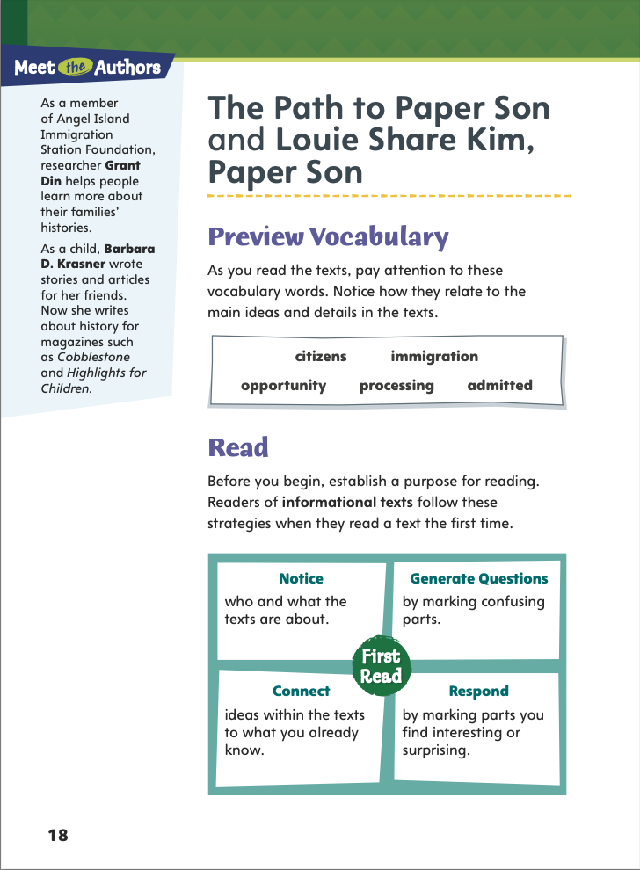
Page 18
Preview Vocabulary
citizens
immigration
opportunity
processing
admitted
Notes:
Introduce the vocabulary words on p. 18 in the Student Interactive and define them as needed.
citizens: people who belong to a particular place
immigration: the act of moving to a new country to live there
opportunity: an agreeable situation or chance processing: a series of steps in a legal action admitted: granted access to a place
These words will help you understand the events of “The Path to Paper Son” and “Louie Share Kim, Paper Son.” As you read, highlight the words when you see them in the text. Pay attention to how each word is used.

Slide 21
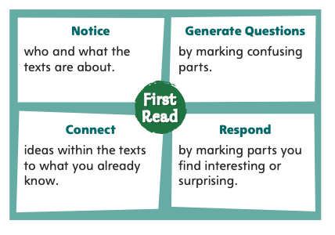
Page 18
First Read Strategies
Notes:
Discuss the First Read Strategies. Prompt students to establish that the purpose for reading this selection is to learn about a topic.
Explain the four steps of the first read.
NOTICE Remind students to notice who the story is about and what happens.
GENERATE QUESTIONS Tell students to write questions next to any parts of the text that they do not understand.
CONNECT Ask students to think about ideas in the text that connect to what they know.
RESPOND Encourage students to mark parts of the text that they find interesting, surprising, or important to them in some way.
Students may read independently, in pairs, or as a class. Use the First Read notes to help them connect with the text and guide their understanding.

Slide 22
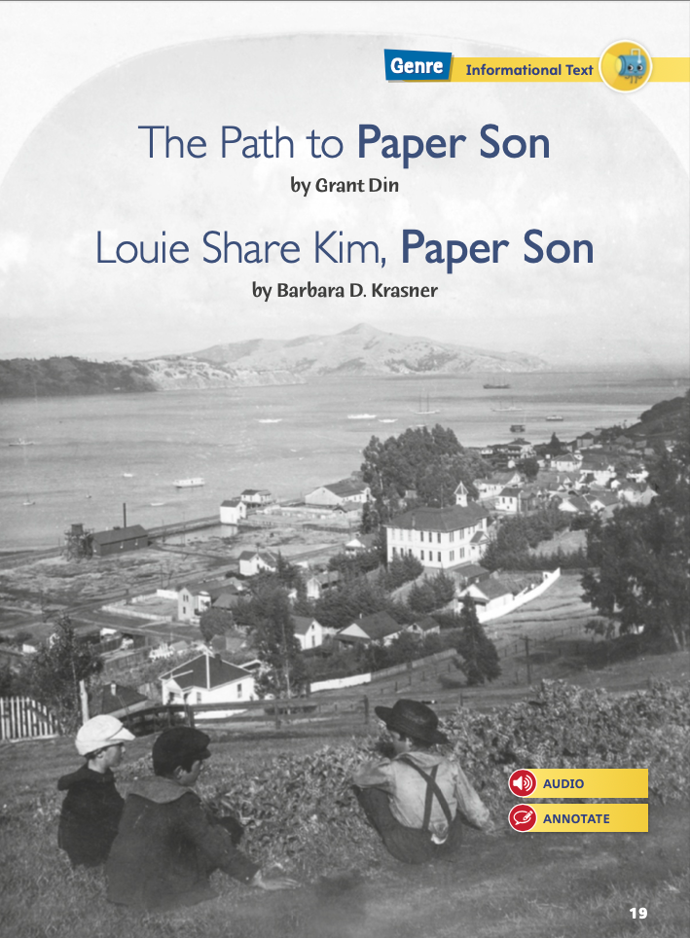
Page 20
First Read – The Path to Paper Son
Notes:
Students may read independently, in pairs, or as a class. Use the First Read notes to help them connect with the text and guide their understanding. Pause to discuss the First Read notes with students.

Slide 23
Page 20,21
First Read – The Path to Paper Son
Notes:
Students may read independently, in pairs, or as a class. Use the First Read notes to help them connect with the text and guide their understanding. Pause to discuss the First Read notes with students.
THINK ALOUD I notice that the first two paragraphs of the text mention Chinese workers, the United States, immigration, 1882, and 1906. So I think the “paper sons” in the title may have something to do with Chinese people who came to the United States around 1900.
THINK ALOUD. I think the idea of buying a new identity is really interesting. Imagine becoming someone else, with a new name, a new family, and a new country. I think that would make me feel scared and nervous.

Slide 24
Page 22, 23
First Read – The Path to Paper Son
Notes:
Students may read independently, in pairs, or as a class. Use the First Read notes to help them connect with the text and guide their understanding. Pause to discuss the First Read notes with students.
THINK ALOUD At the beginning of the text, I find out that a boy named Louie Share Kim traveled from China to the United States by himself. He didn’t speak English or even have a place to live. He sounds brave. I want to keep reading to find out how things worked out for him.
THINK ALOUD Louie Share Kim knew Louie Share Jung because they were from the same village in China. I would feel more comfortable staying with a neighbor than a stranger. Louie Share Kim must have been glad that he was a paper son of someone that he and his family knew well.

Slide 25
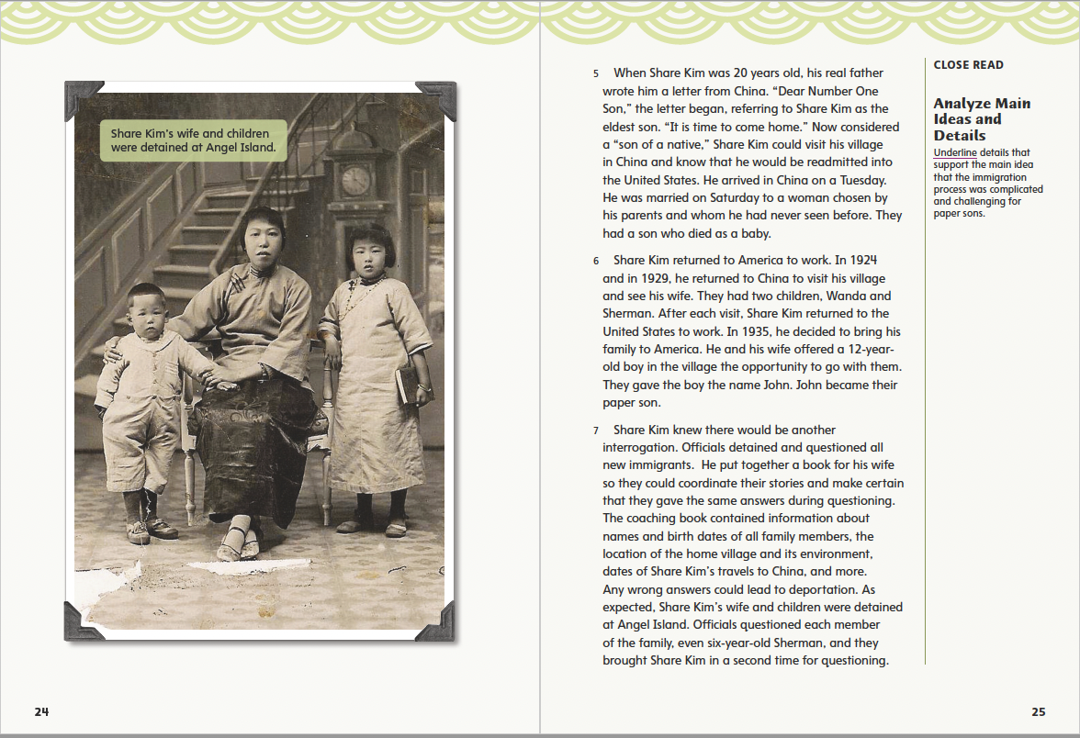
Page 24, 25
First Read – The Path to Paper Son
Notes:
Students may read independently, in pairs, or as a class. Use the First Read notes to help them connect with the text and guide their understanding. Pause to discuss the First Read notes with students.
THINK ALOUD I like that the author included this photo of the people this text is about. It helps me picture them and get an idea about what they were like. I see that Share Kim’s wife has her arm around her small son. It suggests that she is protective of him. I see the daughter is holding a book. I think she is trying to be a good student in the new land to which she has come.
THINK ALOUD As I read, I’m going to think of questions I have about the text. I’ll circle paragraph 7 because I’m wondering about these books men like Share Kim made to help others through immigration. Did people coming into the United States have to hide these books? Would immigration officials know what they were?

Slide 26
Page 26, 27
First Read – The Path to Paper Son
Notes:
Students may read independently, in pairs, or as a class. Use the First Read notes to help them connect with the text and guide their understanding. Pause to discuss the First Read notes with students.
THINK ALOUD This is the first time the author mentions that Share Kim had a “twin” paper brother. When did this boy arrive? Did he arrive after Share Kim?
THINK ALOUD Well, I can see why officials had their doubts about these two being twin brothers. Still, they could have been the kind of twins who don’t look alike—fraternal twins I think they’re called. I wonder if immigration officials were just looking for excuses to turn people away.

Slide 27
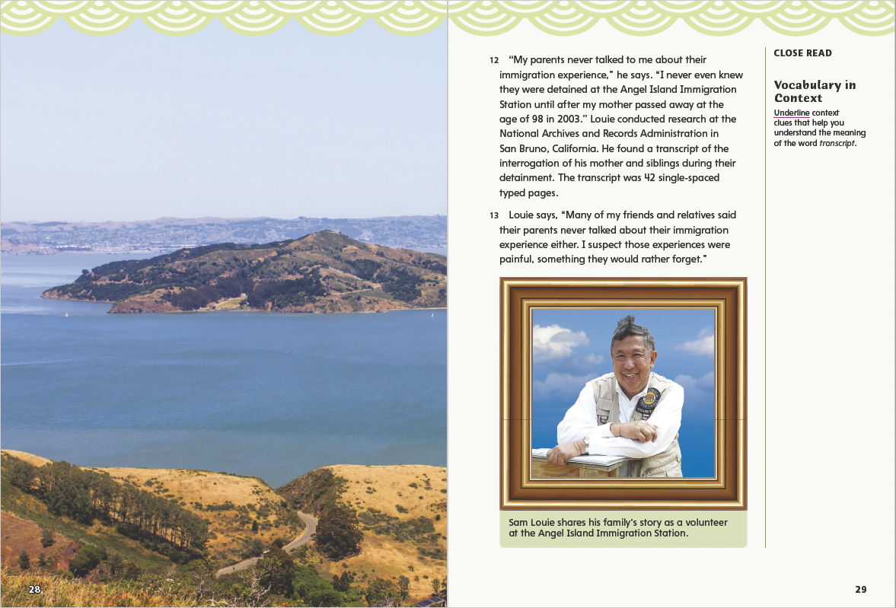
Page 28, 29
First Read – The Path to Paper Son
Notes:
Students may read independently, in pairs, or as a class. Use the First Read notes to help them connect with the text and guide their understanding. Pause to discuss the First Read notes with students.
THINK ALOUD I don’t think I’d like to be stuck on an island where I can see the place I want to go but cannot go there. I’d be worried about getting in. I can see why Louie’s parents didn’t want to talk about their experience on the island.
THINK ALOUD Sam Louie says that his parents never talked to him about their immigration experience. I know I don’t want to talk about things sometimes. What are some reasons that people don’t want to talk about things? Possible Responses: People don’t like to talk about bad memories. Some don’t like to talk about personal things. Sometimes they want to put the past behind them and not think about it.

Slide 28
Respond and Analyze
Discuss What did you find most interesting about the reading?
Infer Why do you think Sam Louie decided to be a volunteer at Angel Island?
Notes:
Use these suggestions to prompt students’ initial responses to reading “The Path to Paper Son” and “Louie Share Kim, Paper Son.”
Discuss What did you find most interesting about the reading?
Infer Why do you think Sam Louie decided to be a volunteer at Angel Island?

Slide 29
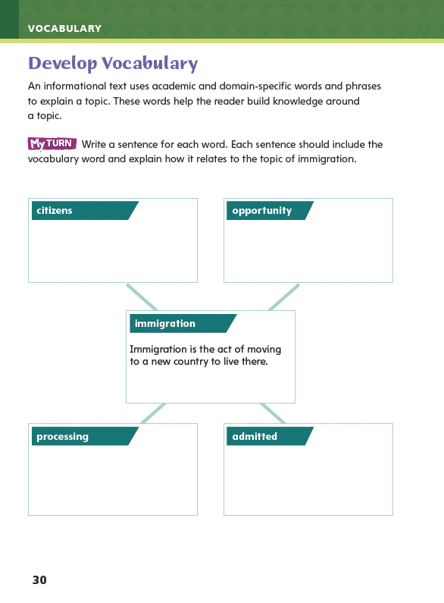
Page 30
Develop Vocabulary
Turn to page 30 in your Student Interactive.
Notes:
Tell students that authors use academic and domain-specific words when they write about specific topics. The vocabulary words citizens, immigration, opportunity, processing, and admitted are frequently used when discussing the topic of “paper sons.”
Find the vocabulary words in the text and read the sentences in which they appear.
Review of the meaning of each word.
Model filling out the chart on Student Interactive p. 30 using the word immigration:
What is immigration? Immigration happens when a person moves to and lives in a new country.
I could write a sentence that defines immigration, or I could write a sentence about an event or a situation related to immigration.
Lead a class discussion, encouraging students to correctly use the vocabulary words as they express their own ideas and build on the ideas of others.
Have students use the strategies for developing vocabulary.
Have students write sentences with the new vocabulary as they complete p. 30 of the Student Interactive. Their sentences should be related to the topic of immigration.

Slide 30
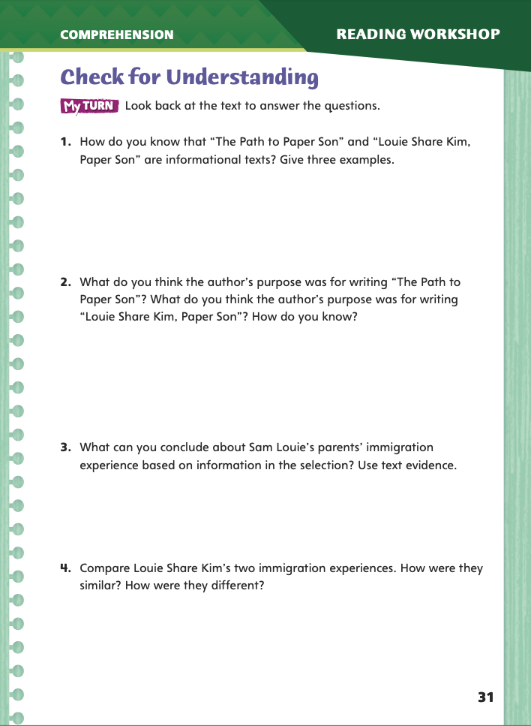
Page 31
Check for Understanding
Complete page 31 in your Student Interactive.
Notes:
Have students complete p. 31 of the Student Interactive.

Slide 31
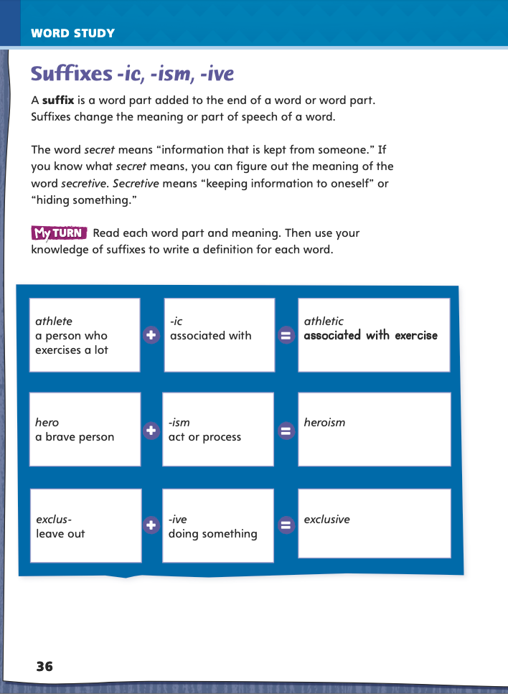
Page 36
Word Study
athlete athletic
hero heroism
exclude exclusive
Notes:
Direct students to complete the chart on p. 36 of the Student Interactive.
Then have students write a strong context sentence for each of the following words: athlete, athletic, hero, heroism, exclude, exclusive.

Slide 32
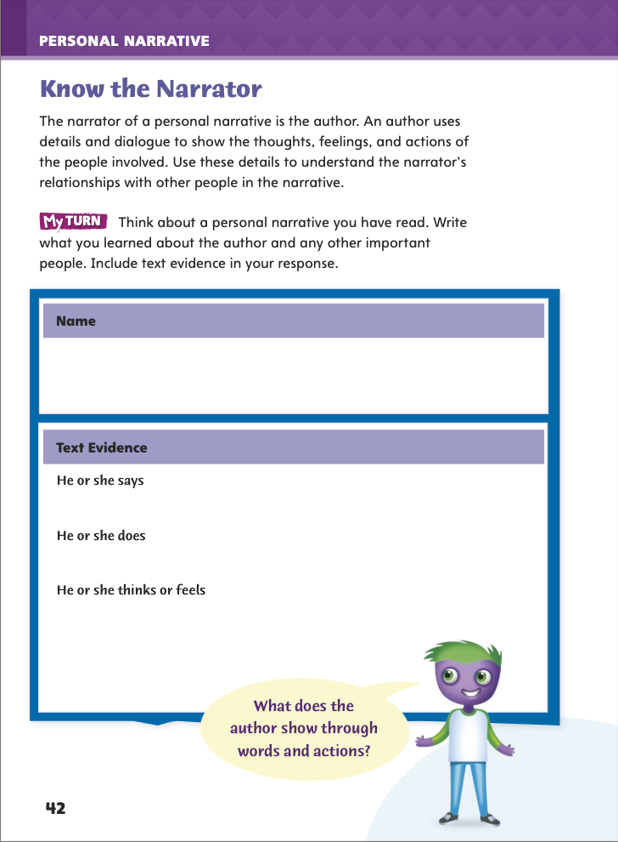
Page 42
Writing – Personal Narrative
Turn to page 42 in your Student Interactive.
Notes:
Personal narratives are written from the first-person perspective and describe the author’s own experiences. Explain that:
the author and the narrator are the same person.
the author uses description and dialogue to show what he or she did, said, thought, and felt.
the author usually learns something or changes in some way.
Tell students that they will be reading some personal narratives and thinking about the narrator in each one.
Read two personal narratives from the stack, pausing at appropriate times to discuss the narrator’s thoughts, feelings, words, or actions. Use questions such as these to prompt discussion:
Why do you think the narrator did that?
How did the narrator feel when _____ happened? How can you tell?
What can you tell about the narrator’s personality?
How would you describe the relationship between the narrator and _____?
Direct students to p. 42 in the Student Interactive. Have them complete the activity using one of the narratives you just read or another narrative from the stack.
Have students share their notes about the narrator in the narrative they analyzed. Ask what the narrator’s words and actions show about him or her.

Slide 33
Independent Writing
Plan and write your own personal narrative in your writer’s notebook.
Notes:
After the genre immersion lessons, students should transition into independent writing. If they need additional opportunities to develop their understanding of narrators, they should read additional narratives from the mentor stack. If they demonstrate understanding, they should transition to planning and writing their own personal narratives in their writer’s notebook. See the Conference Prompts on p. T72.

Slide 34
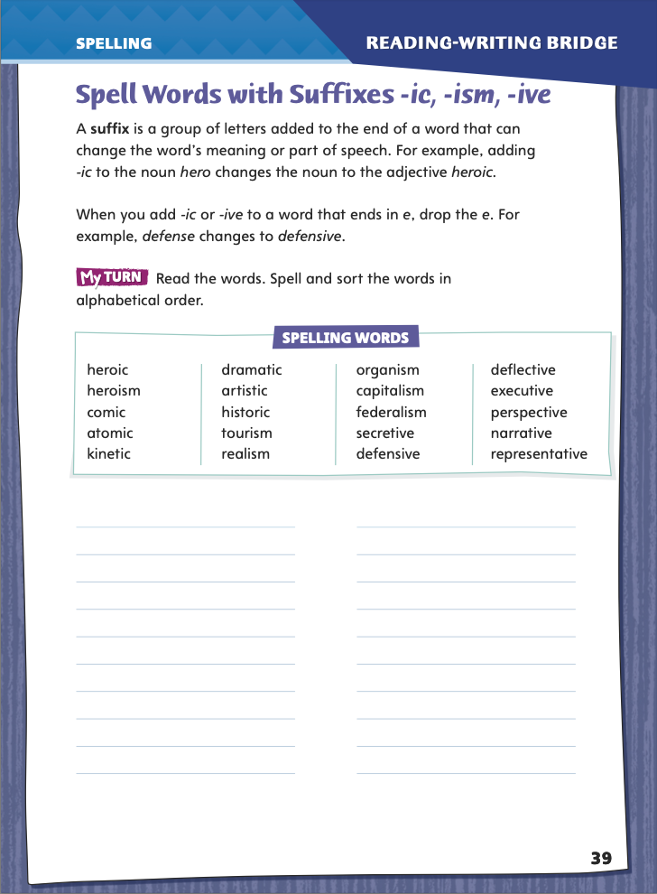
Page 39
Spelling
drama dramatic
history
defense
represent
Turn to page 39 in your Student Interactive. Complete the activity.
Notes:
Point out that some base words do not change spellings when adding a suffix. Other base words, however, do change spellings.
Model adding the suffix -ic to the base word drama: If I didn’t add the t to drama, the word would sound odd: drama-ic.
Write the base words history, defense, and represent. Guide students to change each word’s spelling before adding a suffix.
Have students complete the activity on p. 39 of the Student Interactive.

Slide 35
Language and Conventions
Sentence Types:
declarative
interrogative
exclamatory
imperative
Write a sentence for each type of sentence. Circle the subject and underline the verb in each one.
Use correct subject-verb agreement.
Notes:
Introduce simple sentences by giving oral examples of the four kinds: declarative, interrogative, exclamatory, and imperative.
In each sentence, point out the subject and the verb.
Tell students that a fragment does not have a subject or does not have a verb. A comma splice happens when two independent clause are incorrectly connected with a comma. Tell students to avoid fragments and comma splices when they write.
Guide students to write declarative, interrogative, exclamatory, and imperative simple sentences. Have them circle the subject and underline the verb in each. Check to make sure they use correct subject-verb agreement.
Write a comma splice. Model using end punctuation to make two simple sentences.
Have students work in pairs to create one oral simple sentence of each type. Ask partners to share their sentences with another pair who can identify each sentence type.

Slide 36
Lesson 3

Slide 37
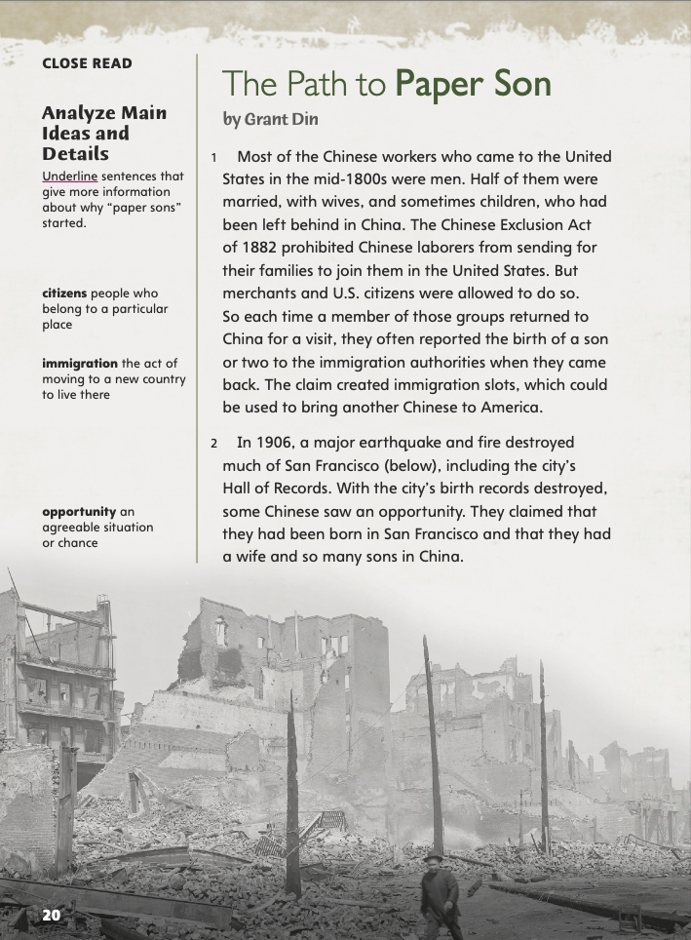
Close Read – Analyze Main Ideas and Details
Page 20
Turn to page 20 in your Student Interactive.
Notes:
Tell students that when they read informational text, it is important to focus on main, or central, ideas and supporting details.
Identify the most important ideas in the text.
Identify details that the text provides.
Ask yourself which of these details support or give more information about the central ideas.
Use the Close Read note on p. 20 of the Student Interactive to model how to identify details that help in understanding central ideas of a text.
Which details explain why paper sons started? In the first paragraph, the information about the Chinese Exclusion Act explains that it was difficult for Chinese people to immigrate to the United States. I’m going to underline that part because it tells me one reason that paper sons started.
Have student pairs work together to find and underline one more detail on the page that explains why paper sons started.

Slide 38
Page 20
Close Read – Analyze Main Ideas and Details
Turn to page 20 in your Student Interactive.
Notes:
Have students scan paragraphs 1 and 2. Ask: What two events made it necessary and possible for people to create “paper sons”? Have students underline supporting evidence for this central idea. See student page for possible responses.
Ask students how the Chinese Exclusion Act made it necessary to create “paper sons” and how the 1906 earthquake made “paper sons” possible. Possible Responses: The act made it hard for Chinese people to immigrate, so they pretended to be related to someone already here. The earthquake destroyed records, so people were able to make up information. DOK 2

Slide 39
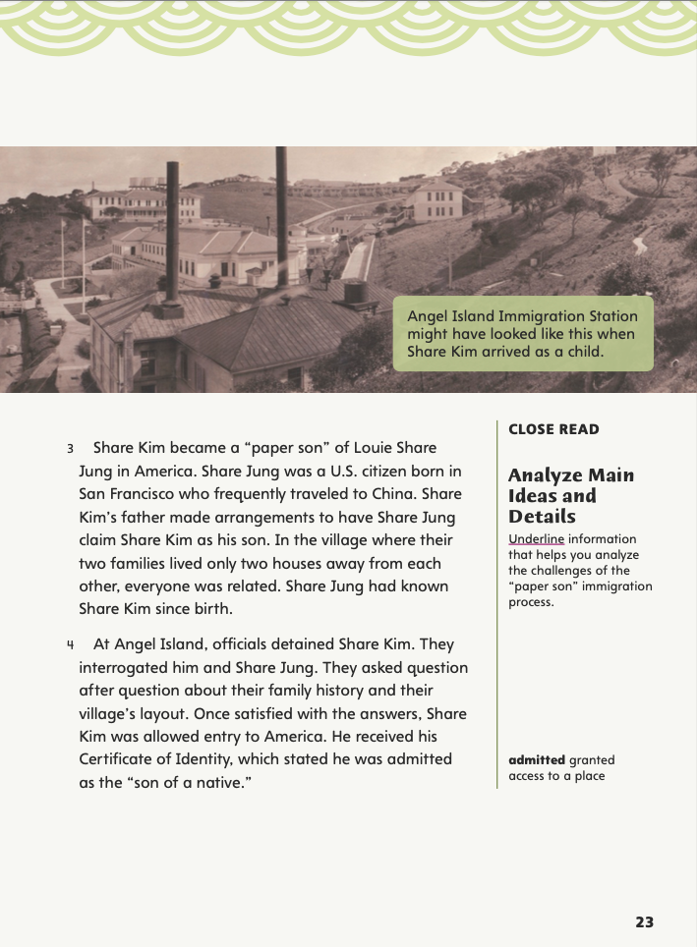
Page 23
Close Read – Analyze Main Ideas and Details
Turn to page 23 in your Student Interactive.
Notes:
Have students scan paragraph 4. Ask: What information in the paragraph helps you analyze the types of challenges that a paper son faced? Underline supporting evidence about Share Kim’s experience at Angel Island. See student page for possible responses.
Ask students to explain why Share Kim’s time at Angel Island might have been challenging. Possible Responses: He had to answer a lot of questions, and it was important for him to answer them correctly, but he was in an unfamiliar place and didn’t know the language. DOK 3

Slide 40
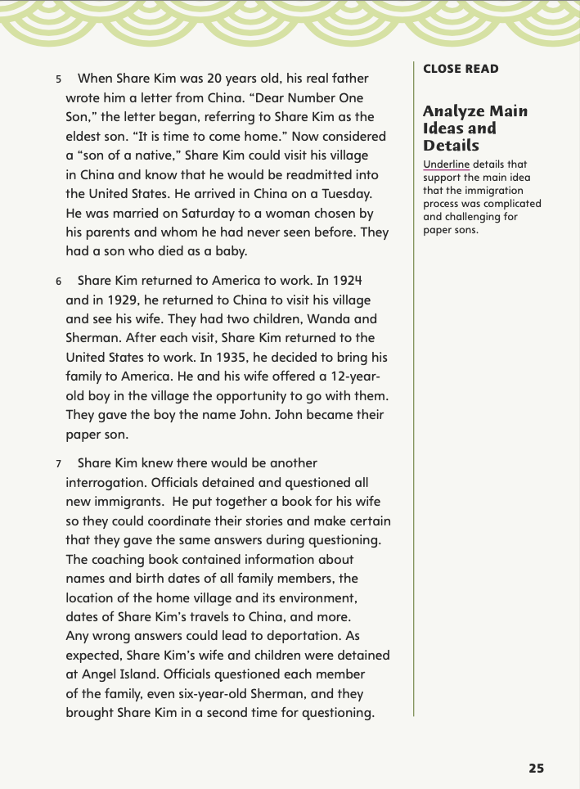
Page 25
Close Read – Analyze Main Ideas and Details
Turn to page 25 in your Student Interactive.
Notes:
Have students scan paragraphs 5–7. Ask: What information in the paragraphs support the main idea that the immigration process was difficult and complicated for paper sons? Underline supporting details about the immigration process. See student page for possible responses.
Ask students to describe what Share Kim’s wife and children had to do. Possible Response: They had to study a book of personal information and then answer questions about it correctly or risk being sent back to China. DOK 2

Slide 41
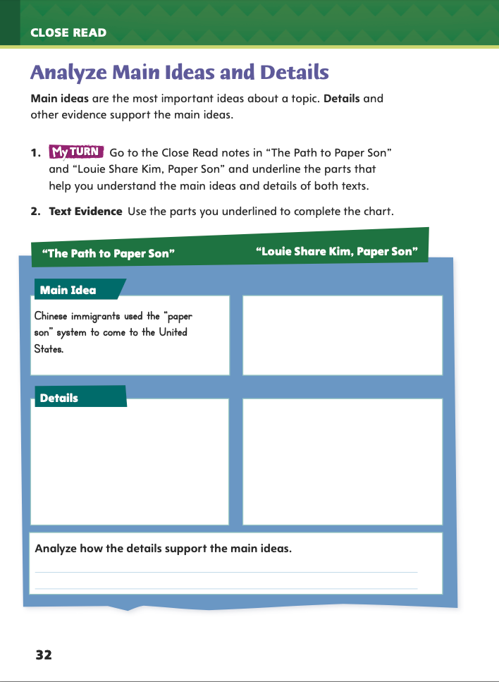
Page 32
Analyze Main Ideas and Details
Turn to page 32 in your Student Interactive and complete the chart.
Notes:
Have students use the strategies for analyzing main ideas and details.
Have students annotate the text using the other Close Read notes for Analyze Main Ideas and Details and then use the text evidence from their annotations to complete the chart on p. 32 of the Student Interactive.

Slide 42
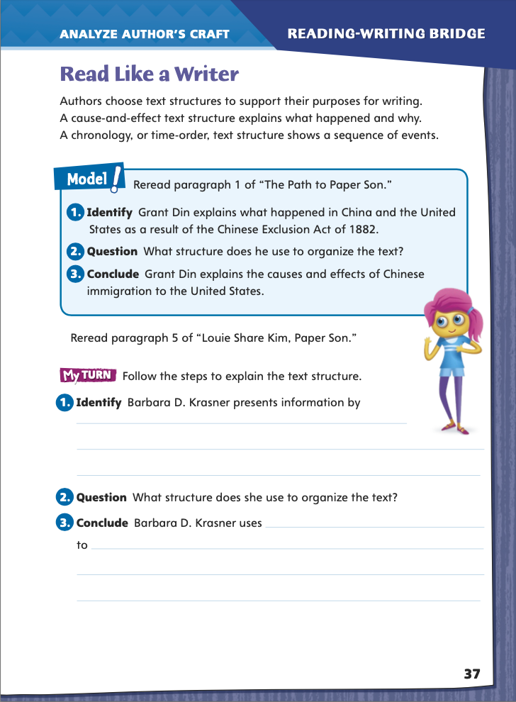
Page 37
Read Like a Writer
Turn to page 37 in your Student Interactive.
Notes:
Authors purposefully select the methods they use to organize their texts. Chronological, or time-order, structure is often used in biographies and other informational texts about a sequence of events. Authors use the cause-and-effect structure to tell how one event led to, or resulted in, another. Informational texts can also use a compare-and- contrast structure to highlight similarities and differences between events or ideas. Problem-and-solution structure can be found in informational or argumentative texts.
Ask yourself how the author is explaining the relationships between events, ideas, concepts, and information.
When you compare multiple texts, consider how the text structure of each has a different effect.
Look for signal words to help you identify text structure. Sequence words, such as first, next, and finally, can indicate chronological order. Because, as a result, or leading to can help you identify cause-and- effect text structure.
Model explaining text structure.
Ask whether Grant Din focuses on problems and solutions, similarities and differences, causes and effects, or the order of events.
Guide students to recognize that Grant Din uses a cause-and-effect text structure.
Direct students to the middle of p. 37 of the Student Interactive. Have them read the passage from “Louie Share Kim, Paper Son” and complete the activity to explain text structure.
Lead a discussion in which students compare and contrast both authors' use of text structure to achieve specific purposes.

Slide 43
Word Study
symbol
symbolic
decide
decisive
Notes:
Remind students that a suffix is a word part at the end of a root or base word, and that adding a suffix changes the word’s meaning and may change its part of speech.
Say: A symbol (such as the U.S. flag) is something that stands for something else. A heart shape is symbolic of love. To decide means “to choose or make a decision.” A decisive person is good at making decisions.
Have students complete Word Study p. 1 from the Resource Download Center. Click path: Table of Contents -> Resource Download Center -> Word Study -> U1W1-> p.1

Slide 44
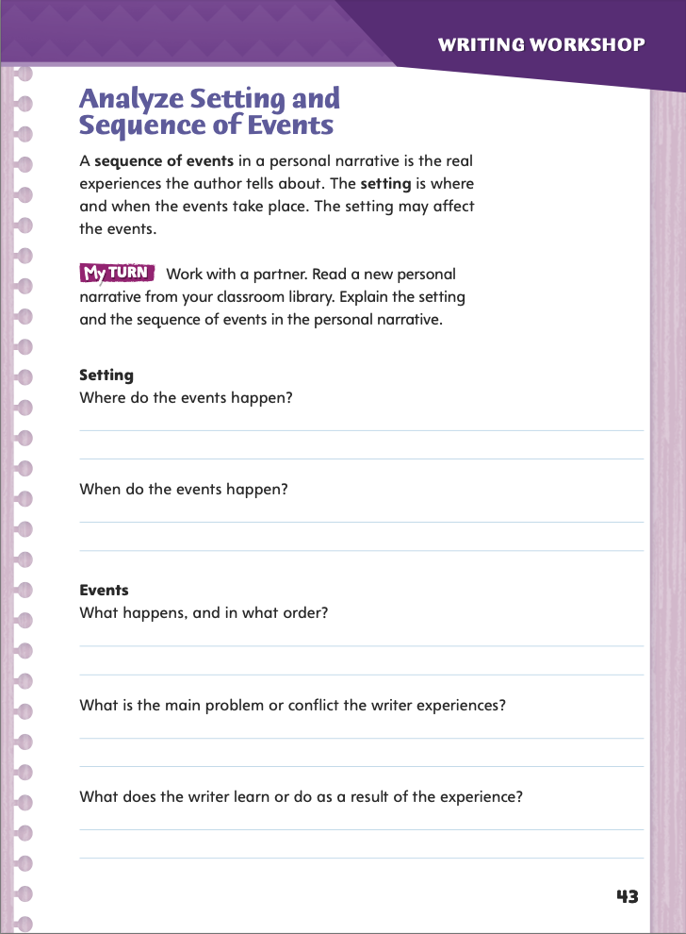
Page 43
Writing – Personal Narrative
Turn to page 43 in your Student Interactive.
Notes:
As in fiction, personal narratives have a setting and sequence of events. Remind students that in personal narratives the setting is a real place and the events really happened. Help them understand that
the setting of a narrative includes both a time and a place.
the setting often affects the events.
the sequence of events has a beginning, middle, and end.
the events often focus on a problem or conflict that is usually solved by the end.
Using one of the stack narratives that you have already discussed, work with students to create a time line of the events in the narrative. Ask: Which events seem the most important? Why? Where and when do these events take place? If relevant, discuss how the setting influences the events.
Direct students to work in pairs on the activity on p. 43 in the Student Interactive, analyzing the setting and sequence of events in a narrative you assign from the classroom library.
Call on a few student pairs to share their ideas about the setting and events in the personal narrative they analyzed.

Slide 45
Independent Writing
Continue writing your personal narrative in your writer’s notebook.
Think about a significant experience in your own life and write what you remember about the setting and events.
Notes:
If students need additional opportunities to analyze setting and sequence of events, they should read additional personal narratives from the stack. If they demonstrate understanding, they can transition to planning and writing their own personal narratives in their writing notebooks. Tell students to think about a significant experience in their own lives and record what they remember about the setting and events. See the Conference Prompts on p. T72.

Slide 46
Spelling
1. How do you get from hero to heroic?
2. How do you get from narrate to narrative?
Notes:
Remind students that the spelling of many base words must change before a suffix is added.
Write or display the following questions. Have students work in pairs to answer them.
1. How do you get from hero to heroic? (Add -ic.)
2. How do you get from narrate to narrative? (Drop the e and add -ive.)
Have students complete Spelling p. 6 from the Resource Download Center. Click path: Table of Contents -> Resource Download Center -> Spelling -> U1W1

Slide 47
Language and Conventions
Dad cooks dinner on weekends.
What does he usually cook on Saturday night?
I love my dad’s homemade pizza!
Drink all the milk in your glass.
Notes:
Say that a simple sentence expresses one complete idea and has a subject and a verb. It begins with a capital letter and ends with an end punctuation mark: a period, a question mark, or an exclamation mark.
Explain that subject-verb agreement means that a singular subject goes with a singular verb (Ana plays) while a plural or compound subject goes with a plural verb (The sisters play; Ana and Addie play).
Tell students that if a statement is missing a subject or verb, it is a fragment. Writers usually avoid fragments. Writers should also avoid comma splices, or two independent clauses connected with a comma.
Write four kinds of simple sentences:
declarative—Dad cooks dinner on weekends.
interrogative— What does he usually cook on Saturday night?
exclamatory—I love my dad’s homemade pizza!
imperative—Drink all the milk in your glass.
For each sentence, have a volunteer circle the subject and underline the verb.

Slide 48
Lesson 4

Slide 49
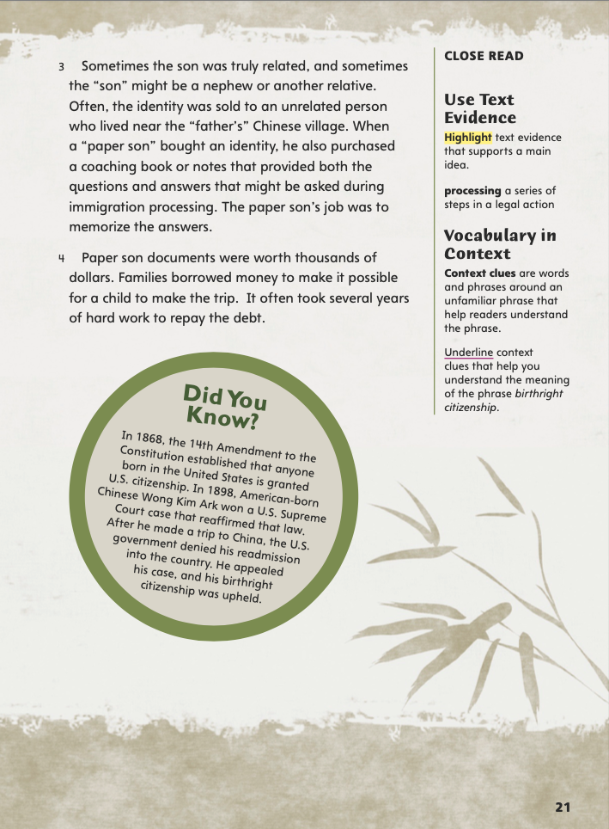
Page 21
Close Read – Use Text Evidence
Turn to page 21 in your Student Interactive.
Notes:
Tell students that when they identify main ideas in informational texts, they need to find text evidence to support them.
Identify the main, or most important idea, in the text.
Think back and try to remember details that give more information about the main idea.
Think about the details. Which ones do you really need to know to understand the main idea?
Look for the evidence in the text that supports the main idea.
Use the Close Read note on p. 21 of the Student Interactive to model how to annotate text to identify evidence that supports a main idea. The sentence that begins “When a ‘paper son’ bought an identity” tells me more about paper sons. I will highlight that sentence.

Slide 50
Page 21
Close Read – Use Text Evidence
Turn to page 21 in your Student Interactive.
Notes:
Tell students that text evidence is actual details in a text that support a main idea. Reinforce that these details give more information about main ideas.
Have students scan paragraphs 3 and 4 to identify and highlight phrases and sentences in the text that explain what a paper son had to do. See student page for possible responses. DOK 1

Slide 51
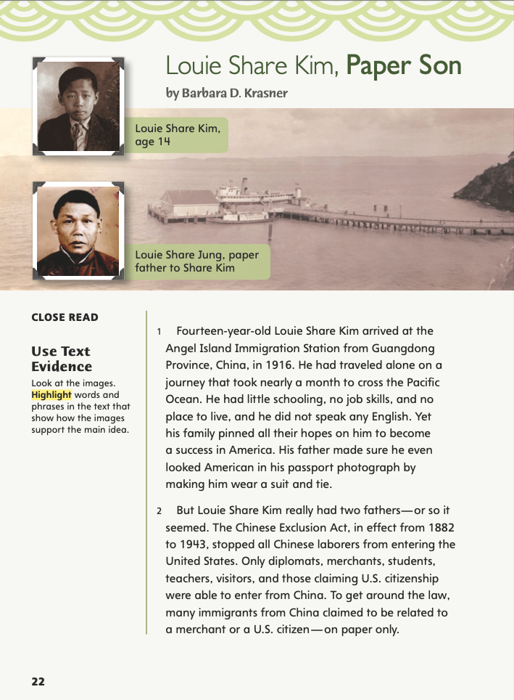
Page 22
Close Read – Use Text Evidence
Turn to page 22 in your Student Interactive.
Notes:
Have students scan paragraphs 1 and 2 to identify phrases and sentences in the text that describe how Louie was a “paper son.” See student page for possible responses. DOK 1

Slide 52
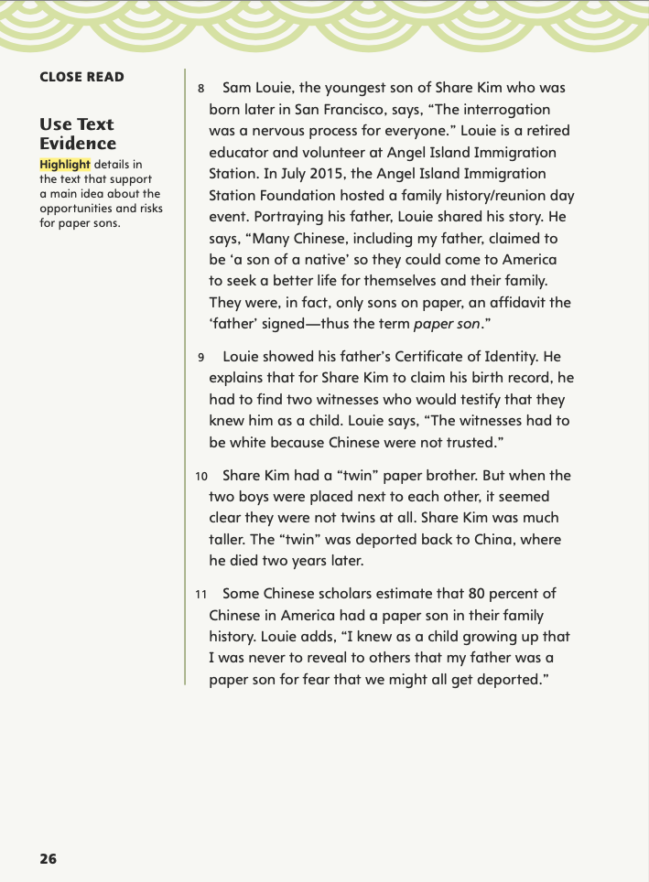
Page 26
Close Read – Use Text Evidence
Turn to page 26 in your Student Interactive.
Notes:
Have students scan paragraphs 8, 10, and 11 to identify phrases and sentences in the text that describe the opportunities and risks for “paper sons.” Ask: What were some opportunities that paper sons had? What were some dangers or risks of being a paper son? See student page for possible responses. DOK 2
Have students study the two photos and their captions. Ask: Why do you think the author included these photos? What main idea do these two text features, taken together, help to convey? Possible Responses: The photos help show that immigration was difficult and officials were strict with Chinese Americans trying to enter the United States in the early twentieth century. The author probably included these photos to convey that idea and also to illustrate that the “twins” did not look alike. DOK 3

Slide 53
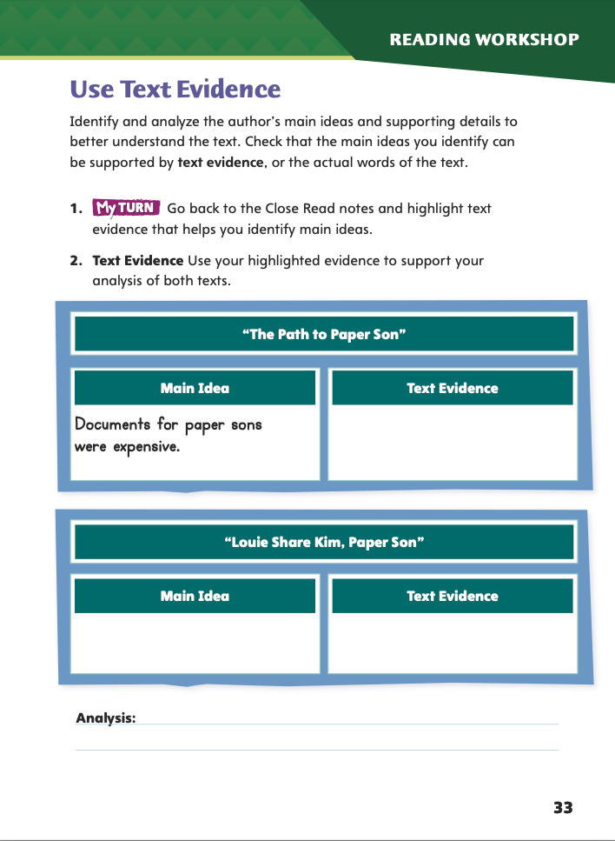
Page 33
Close Read – Use Text Evidence
Complete page 33 in your Student Interactive.
Notes:
Have students use the strategies for using text evidence.
Have students annotate the text using the other Close Read notes for Use Text Evidence, and then have them use that text evidence to complete the chart on p. 33 of the Student Interactive.

Slide 54
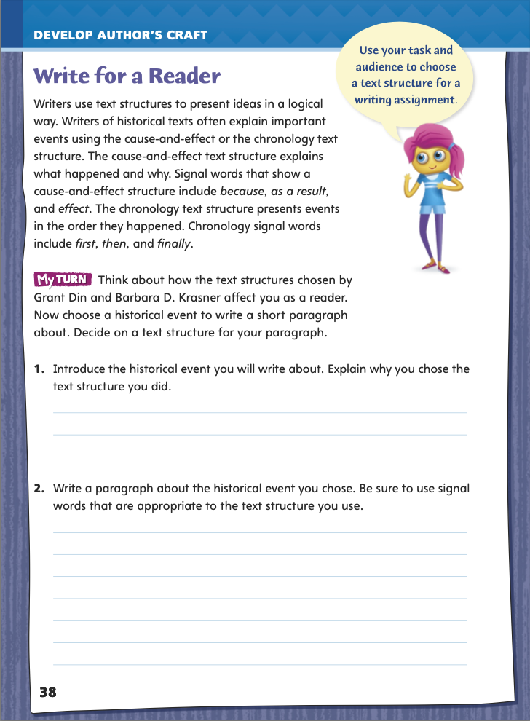
Page 38
Writing for a Reader
Turn to page 38 in your Student Interactive and complete the activity.
Notes:
Writers of informational texts arrange their ideas in a logical way. To help readers understand how one event led to or affected another, writers use cause-and-effect text structure. This text structure often uses signal words, such as effect, led to, and as a result. To present events in the order they happened, writers use chronology, or time order. Writers include signal words, such as second, third, later, and next, and specific times or dates in time-order texts. Remind students that they just analyzed and compared the text structures used by Grant Din and Barbara D. Krasner.
Discuss how students can choose an appropriate text structure for a paragraph about a historical event.
Select a historical event to write about. I will write about the American Revolution. I want readers to learn about certain important battles.
Select a text structure and explain your choice. I want to present information about battles in the order they were fought. I will use chronology, or time-order, text structure.
Together as a class, draft a brief paragraph about key battles in the American Revolution. Have students identify signal words that correspond to the text structure. Have volunteers explain how this text structure is more or less effective than another would be.
Guide students to complete the writing activity on p. 38 of the Student Interactive. Remind them to keep their audience in mind as they write and to organize their ideas logically, using signal words as needed to show relationships between ideas and events.

Slide 55
Word Study
-er
-est
Write sentences to compare three objects in the classroom or at school.
Notes:
Review the suffixes -er and -est that show comparative and superlative forms.
Ask for a volunteer to compare the size of two objects (possible responses: larger, smaller, longer, taller). Then add a third object, and have students compare all three (possible responses: largest, smallest, tallest, widest).
Discuss how -er and -est adjectives are used to compare two items or describe items in a group.
In small groups, have students write sentences using comparative and superlative forms to compare three objects in the classroom or on school grounds.

Slide 56
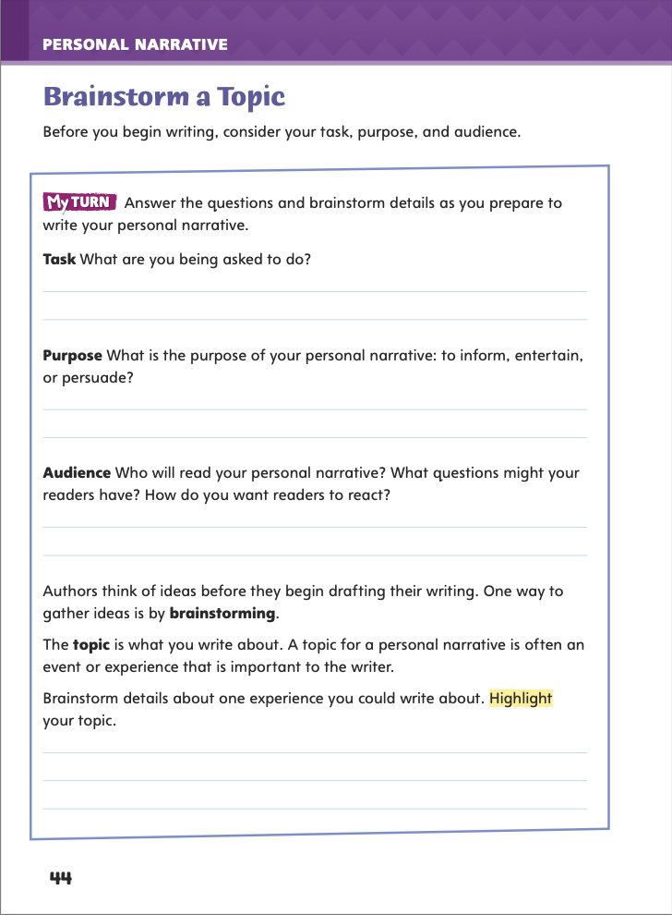
Page 44
Writing – Personal Narrative
Turn to page 44 in your Student Interactive.
Notes:
Explain to students that before they write, authors need to select a purpose and an intended audience for their work. The purpose can be to inform, entertain, or persuade. Keeping their audience in mind allows authors to focus their writing.
Remind students that authors of personal narratives write about events that really happened to them. When brainstorming ideas for a personal narrative, students should think about personal experiences that:
• they remember very well, • changed their lives in some way,
• will be interesting to readers.
Review a few personal narratives that you have read with your students this week. For each narrative, ask: What is this narrative mainly about? Why do you think the author decided to write about this topic? Ask students to explain which topics they found most interesting and why.
Direct students to p. 44 in the Student Interactive, and tell them to use the prompts to help them brainstorm ideas for their own personal narratives.
Ask several students to share the topic that they have decided to write about. Also have them share the purpose of their personal narrative as well as their intended audience.

Slide 57
Independent Writing
Brainstorm personal narrative topics to write about.
Once you have your topic, write additional details about it.
Notes:
Transition students to independent writing. If students need to finalize a topic, they may use this time to continue brainstorming. If they have already decided on a topic, they can use this time to record additional details about it. See the Conference Prompts on p. T72.
Ask several students to share the topic that they have decided to write about. Also have them share the purpose of their personal narrative as well as their intended audience.

Slide 58
Spelling
Lee was young___ then Elena.
Maya was young___ than Lee.
Maya was the young___ of the three.
Notes:
Review spellings for comparative and superlative forms (adding -er and -est).
Display the following sentences and have volunteers change the underlined words to comparative or superlative form.
Lee was young than Elena.
Maya was young than Lee.
Maya was the young of the three. (younger, younger, youngest)
Invite pairs to alternate writing sentences in the following format: Kim is wise. Christa is wiser than Kim. Keira is the wisest of all.

Slide 59
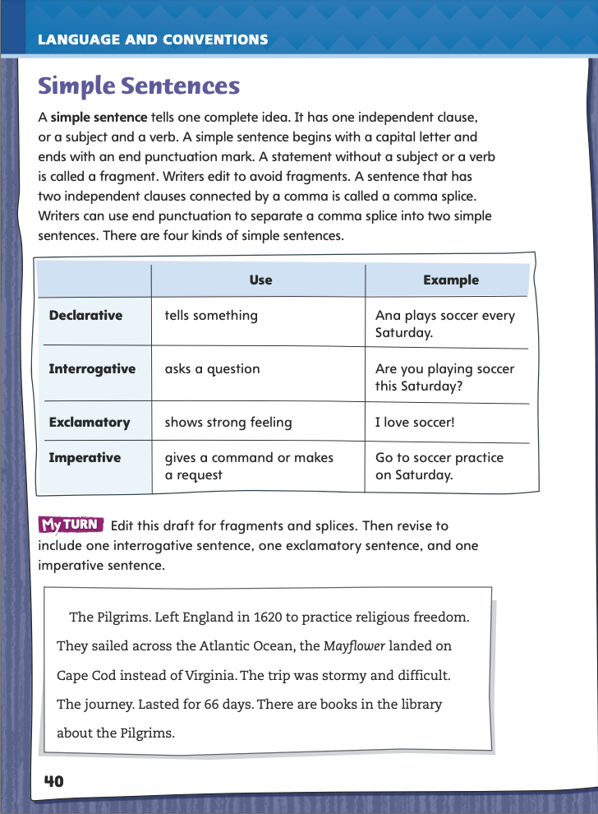
Page 40
Language and Conventions
Turn to page 40 in your Student Interactive and edit the draft.
Notes:
Have students edit the draft paragraph on Student Interactive p. 40.

Slide 60
Lesson 5

Slide 61
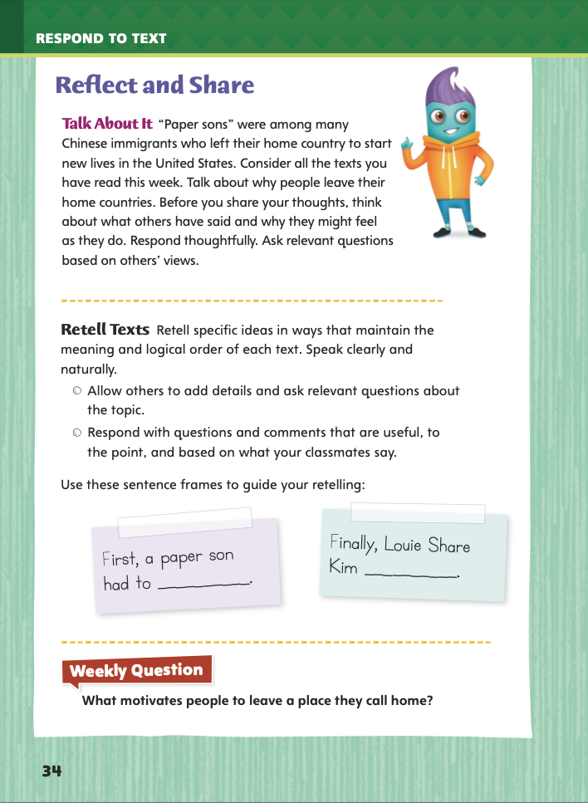
Page 34
Reflect and Share
Turn to page 34
in your Student Interactive.
Notes:
Tell students that retelling key ideas or events from a text can help them remember and understand what they read. Explain the process of retelling:
Identify the key idea or event you want to retell.
Use your own words to recount the specific part of the text.
Make sure your retelling follows the logical order of the text.
When your classmates ask questions and add comments, listen carefully. If needed, address relevant comments and questions.
Model retelling an important idea from the text using the sentence frame on p. 34 in the Student Interactive.
I have to share my thoughts about why some people leave their home countries. I think some people move to find a better life. To support this opinion, I’m going to retell how some Chinese immigrants became “paper sons.” The sentence frame begins, “First, a paper son had to.” The paragraph on page 21 tells me that a paper son could be related to someone, but sometimes the “son” was an unrelated person from the “father’s” village. I will complete the first sentence frame: First, a paper son had to have a connection to someone who was born in the United States.
Have students use the strategies for making connections to texts.
Have students express opinions about why people leave their home countries. Tell them to draw on their personal experiences or those of people they know as well as what they read in “Louie Share Kim, Paper Son.” Remind students to listen actively when their classmates speak.

Slide 62
Apply
What motivates people to leave a place they call home?
Notes:
Have students use evidence from the texts they have read this week to respond to the Weekly Question. Tell them to write their response on a separate sheet of paper.

Slide 63
Word Study
chronic
favoritism
receptive
Notes:
To assess students’ understanding of the suffixes -ic, -ism, and -ive, provide them with the following words: chronic, favoritism, and receptive. Explain that the Greek root chron means “time.” Offer sample sentences:
Dr. Gutierrez explained that the chronic illness might last for the rest of the patient’s life.
When the club president appointed his three best friends to be vice president, treasurer, and secretary, other members complained that this was favoritism.
Someone who is struggling with a difficult decision may not be receptive to suggestions.
Have students use their knowledge of suffixes -ic, -ism, and -ive to define each word. (chronic—continuing over time; favoritism—the act of favoring some people over others; receptive—open to new ideas or happy to receive suggestions)

Slide 64
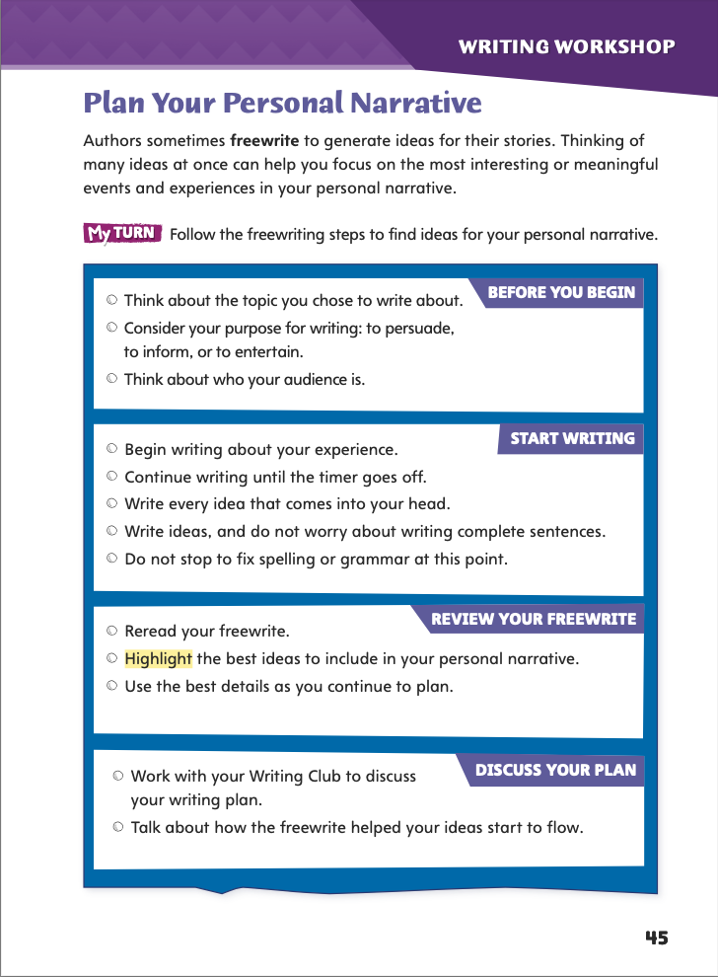
Page 45
Writing – Personal Narrative
Freewrite ideas for your personal narrative.
Follow the steps on page 45 to plan your narrative.
Notes:
Freewriting can be a helpful way to plan a personal narrative. Explain that freewriting helps the narrative writer:
decide if he or she still wants to write about a particular topic.
gather thoughts, feelings, and memories about an experience in order to decide which details are most important to include.
Have pairs of students reexamine a stack text they have read. Say: What idea do you think started the writer on this narrative? What new ideas did he or she add? Share your thoughts with your partner.
Tell students that today they will plan their own personal narratives. Say: Once you know what topic you want to write about, you need to think about how you are going to write a whole personal narrative about it. One good way to generate ideas for your narrative is by freewriting, or writing every idea that comes into your head. Follow the freewriting steps on page 45 to plan your narrative.
Ask volunteers to explain how the freewriting process helped them plan their personal narratives.

Slide 65
Independent Writing
Discuss
Why did you decide to write about _____?
What did you learn from this experience? How did it change your life?
What characters, other than you, are in your narrative? Why are they important?
What is your setting? Why is it important?
What do you think will be most challenging about writing about this experience?
Notes:
Place students into Writing Club groups. See p. T79 for information on how to run Writing Club. See the Conference Prompts on p. T72.
In this Week’s Writing Club, students will discuss the experience they plan to write about for their personal narrative.
As this is the first week of Writing Club, students should spend 5–10 minutes discussing rules for their group, including:
• how to listen attentively and respectfully when others are sharing. • appropriate ways to give and receive feedback. • the process for taking turns during discussions.
Students should share and discuss the personal experience they plan to write about. Some students may want help planning a specific element of their personal narratives, such as the setting or the sequence of events. Others may want help deciding which details about the experience are important to include. Students should inform their Writing Club of any specific element on which they want help.

Slide 66
Spelling
1. We saw a comic play that made us laugh for two hours.
2. Don’t be so dramatic about that tiny scratch on your finger!.
3. We went on a tour of Boston and saw historic buildings.
4. These hotels depend on tourism to stay in business.
5. Under capitalism, people can invest in business.
6. Under federalism, U.S. government laws may replace or
change state laws.
7. Don’t get so defensive simply because someone suggests
that you make a change in your work.
8. Try to look at the situation from my perspective instead of
seeing it your way.
9. A narrative text may tell a true story or an invented one.
10. Please don’t judge us all by one member’s rude behavior,
because she is not representative of our club.
Notes:
(Note: Move the orange boxes to cover each bold spelling word before you read aloud the words and sentences.)
1. Use the following sentences for the spelling test:
We saw a comic play that made us laugh for two hours.
Don’t be so dramatic about that tiny scratch on your finger!
We went on a tour of Boston and saw historic buildings.
These hotels depend on tourism to stay in business.
Under capitalism, people can invest in businesses.
Under federalism, U.S. government laws may replace or change state laws.
Don’t get so defensive simply because someone suggests that you make a change in your work.
Try to look at the situation from my perspective instead of seeing it your way.
A narrative text may tell a true story or an invented one.
Please don’t judge us all by one member’s rude behavior, because she is not representative of our club.

Slide 67
Language and Conventions
Does you talk to the teacher about the test?
She ask good questions!
Which revisions are needed for subject-verb agreement?
Change teacher to teachers.
Change does to did and ask to asks.
Change questions to question.
No revisions are needed.
Notes:
Display these sentences and have students respond independently.
Does you talk to the teacher about the test? She ask good questions!
Which revisions are needed for subject-verb agreement?
A Change teacher to teachers.
B Change does to did and ask to asks. C Change questions to question. D No revisions are needed.
Have students complete Language and Conventions p. 11 from the Resource Download Center. Click path: Table of Contents -> Resource Download Center -> Language and Conventions -> U1 W1

Slide 68
Unit 1: Week 1
Grade 5

