Slide 1
Unit 1: Week 4
Grade 3

Slide 2
Copyright © Savvas Learning Company LLC. All Rights Reserved.
This publication is protected by copyright, and permission should be obtained from the publisher prior to any prohibited reproduction, storage in a retrieval system, or transmission in any form or by any means, electronic, mechanical, photocopying, recording, or otherwise. For information regarding permissions, request forms, and the appropriate contacts within the Savvas Learning Company Rights Management group, please send your query to:
Savvas Learning Company LLC, 15 East Midland Avenue, Paramus, NJ 07652
or
k12learningpermissions@savvas.com
myView Literacy® is an exclusive trademark of Savvas Learning Company LLC in the U.S. and/or other countries.

Slide 3
Lesson 1

Slide 4
Page 130, 131
Interact with Sources
Which solution for surviving in an environment described here do you think is the most creative? Why? Use text evidence to support your response.
Notes:
Remind students of the Essential Question for Unit 1: How does our environment affect us? Point out the Week 4 Question: What creative solutions do people come up with to survive in their environment?
Direct students’ attention to the infographic on pp. 130–131 in the Student Interactive. Explain that an infographic is a source that gives information using words and pictures. Have students read the infographic and discuss the different ways people survive in challenging environments.
Use the following questions to guide discussion:
Which fact about how people learned to survive in challenging environments surprised you the most?
Why do you think the solutions to surviving in each environment are different?
What do the facts tell you about the importance of finding creative solutions to survive in different environments?
Reread the Week 4 question: What creative solutions do people come up with to survive in their environment? Tell students they just learned about four creative solutions people came up with to survive in four challenging environments. Explain that they will read about more creative solutions this week.
Have students freewrite to answer the Quick Write question on p. 131 and then share their responses.

Slide 5
Listening Comprehension
Desert Survival
Problem | Solution
Ruby Bridges
Notes:
Tell students you are going to read an informational text aloud. Have students listen as you read “Surviving in the Four Corners.” Explain that students should listen actively, paying careful attention to the facts in the passage as you read. Prompt them to ask relevant questions to clarify information and to make pertinent comments.
Have students actively listen for elements of informational text.
Read the entire text aloud without stopping for Think Aloud callouts.
Reread the text aloud, pausing to model Think Aloud strategies related to genre and the information in the text.
Use a T-chart to help students note the desert survival problems the Hopi have solved and the ways they solved them.

Slide 6
Page 132, 133
Informational Text
Turn to page 132 in your Student Interactive.
Notes:
Informational text is text that provides a reader with facts and informs the reader about a topic. Some traditional tales use character, plot, and setting to explain natural events. Comparing and contrasting informational texts and traditional tales of this kind will help students recognize the unique characteristics and structures of informational text.
Look for text features such as sections, tables, and graphs in both informational text and traditional tales.
Ask yourself, “What facts are given to the reader in each text?”
Figure out if each text has a text structure, such as cause and effect or problem and solution.
Model determining how an informational text is different from a traditional tale. In “Surviving in the Four Corners,” I ask myself if the text presents facts that can be found in a resource like a dictionary or an encyclopedia. Yes, I see the fact that the Anasazi were the first people to live in the Four Corners region 2,000 years ago. A traditional tale is not driven by facts, but describes a problem that characters attempt to solve. The texts are different regarding the information they tell the reader.
Encourage students to find similarities between informational texts and some traditional tales they know.

Slide 7
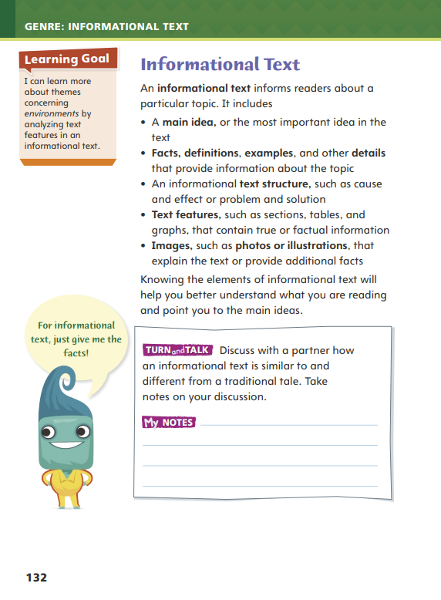
Page 132
Apply
Discuss how informational text is similar to and different from a traditional tale.
Notes:
Have students work with a partner to complete the Turn and Talk activity on p. 96 of the Student Interactive.
Circulate to discover if students can determine similarities and differences between realistic fiction stories and traditional tales. Editable Anchor Chart Click Path: Table of Contents -> Reading Anchor Charts -> Unit 1 Week 4: Informational Text Anchor Chart

Slide 8
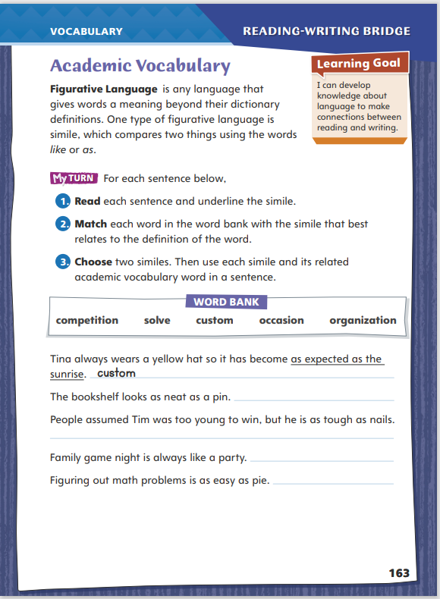
Page 163
Academic Vocabulary
Turn to page 163 in your Student Interactive.
Notes:
A word or phrase can have both a literal meaning, or a dictionary meaning, and a nonliteral meaning, beyond a dictionary meaning. Figurative language is language that gives words a meaning beyond their dictionary definitions. One common form of figurative language is the simile. A simile compares two things using the word like or as.
Identify what the simile compares.
Think about what similarity the simile emphasizes.
Consider how the simile relates to the overall message of the text.
Model this strategy using the first example in the chart on p. 163 of the Student Interactive.
Read the first example. Say: The simile compares how often Tina wears the hat to the sunrise. The two things are similar because they happen regularly. They can be expected. I'm looking for a word in the word bank that relates to something that happens often or is expected.
Ask volunteers to suggest which word from the word bank is related to something being expected or happening regularly. Then have them use the word in an original sentence that contains a simile.
Have students apply the strategy to another sentence.
Have students follow the same strategy as they complete the chart on p. 163 of the Student Interactive. Remind students that they will use these Academic Vocabulary throughout this unit.

Slide 9
Word Study
shadow
needy
Friday
Notes:
Words with vowel digraphs have two letters that combine to spell one vowel sound. The vowel sound is usually, but not always, long. The vowel digraphs ee and ea form a long e sound. Digraphs ai and ay form a long a sound. Digraphs ow and oa form a long o sound. Knowing digraphs can help readers figure out how to pronounce unfamiliar multisyllabic words.
To demonstrate how to use vowel digraphs to decode words, write the words shadow, needy, and Friday on the board. Guide students to identify the vowel digraph in each word. Then use the pattern to identify the vowel sound and pronounce each word. (shadow, ow, long o; needy, ee, long e; Friday, ay, long a)
Guide students to identify the vowel digraphs in painter and easy and decode the words.

Slide 10
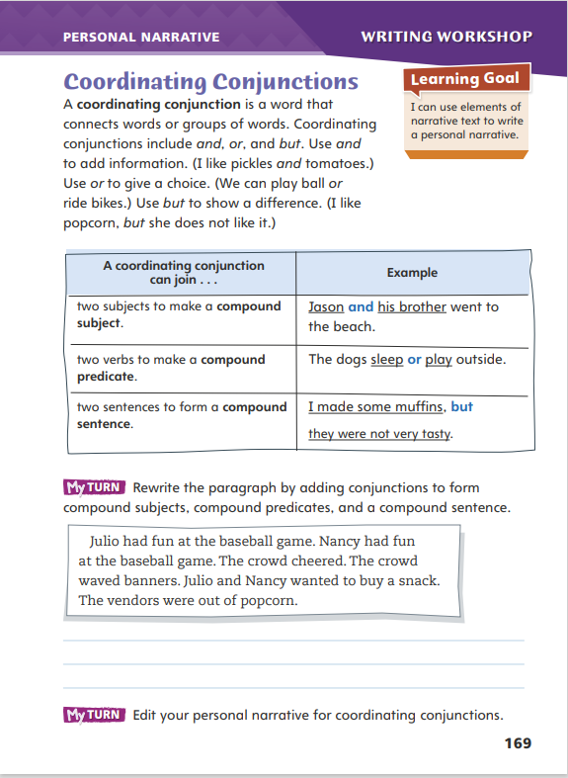
Page 169
Writing – Personal Narrative
Turn to page 169 in your Student Interactive.
Notes:
Coordinating conjunctions connect words and phrases within a single sentence to form a compound subject or predicate. They also join entire sentences to form a compound sentence.
And is used to add information.
Or is used to give a choice.
But is used to show a difference.
When a coordinating conjunction joins two complete sentences, a comma often precedes the conjunction.
Explain that coordinating conjunctions help writers combine ideas and vary the lengths and types of sentences they use. Coordinating conjunctions can improve the rhythm in a piece of writing and make it easier to read.
Read personal narratives from the stack. With students, locate coordinating conjunctions in them. Ask: How could this sentence be formed without using a coordinating conjunction? Why do you think the author used the conjunction?
Direct students to p. 169 in the Student Interactive. Have them read the page and complete the first My Turn.

Slide 11
Independent Writing
Edit your personal narrative for coordinating conjunctions.
Share your personal narrative and point out where you added conjunctions.
Notes:
After the minilesson, students should transition into independent writing. The My Turn on p. 169 in the Student Interactive directs students to edit their personal narratives for coordinating conjunctions. They should make sure the conjunctions they have already used are correct and add or delete conjunctions as needed.
Writing Support
Modeled - Choose a stack text and think aloud about why the writer used coordinating conjunctions to combine certain sentences.
Shared - Start a compound sentence and have students complete it.
Guided - Ask students where they could add variety to their sentences through the use of coordinating conjunctions.
Have a few students share their personal narratives. Ask them to point out where they added coordinating conjunctions and to explain why they decided to do so.

Slide 12
Spelling
1. The owner of the store is friendly.
2. These peaches are sweet.
3. I fell asleep at 8:30 last night.
4. My parents display our pictures on the wall.
5. My shadow is tall early in the morning.
6. I had a dream about scoring a goal.
7. She braided her hair to keep it neat.
8. My parents use charcoal in the grill.
9. We all agree that lunch today was tasty.
10. I do my schoolwork so that I can maintain good grades.
Notes:
(Note: Move the orange boxes to cover each bold spelling word before you read aloud the words and sentences.)
Read aloud the words and sentences. Have students spell each word with initial consonant blends and the two high-frequency words.
The owner of the store is friendly.
These peaches are sweet.
I fell asleep at 8:30 last night.
My parents display our pictures on the wall.
My shadow is tall early in the morning.
I had a dream about scoring a goal.
She braided her hair to keep it neat.
My parents use charcoal in the grill.
We all agree that lunch today was tasty.
I do my schoolwork so that I can maintain good grades.
Reveal the spelling word and have students check their work.

Slide 13
Language and Conventions
Addison plays the piano.
She sings in the choir.
Identify a word that would make these sentences a compound sentence.
Write two sentences. One that is a compound and one that is not.
Exchange with a partner.
Notes:
Flexible Option
Review the language and conventions topic of compound sentences. See p. T409 in Unit 1.
Display the following sentences: Addison plays the piano. She sings in the choir. Ask a volunteer to suggest how to turn these sentences into a compound sentence. (Addison plays the piano, and she sings in the choir.) Then have students identify the word that helped make the two sentences a compound sentence.
Have students write two sentences: one that is compound and one that is not. Have partners exchange sentences and identify which is a compound sentence. Ask students to explain their reasoning.

Slide 14
Lesson 2

Slide 15
Page 134
Preview Vocabulary
shield
lack
exposure
nomadic
landscape
Notes:
Introduce the vocabulary words on p. 134 of the Student Interactive encouraging the use of dictionaries and glossaries to clarify meanings as needed.
shield: to protect by covering
lack: the state of not having something
exposure: the condition of being unprotected from severe weather, such as extreme heat
nomadic: moving around a lot
landscape: the natural features seen in an area
Say: These words will help you understand the meaning of scientific phrases in Living in Deserts. As you read, highlight the words when you see them in the text. Ask yourself what information they convey.

Slide 16
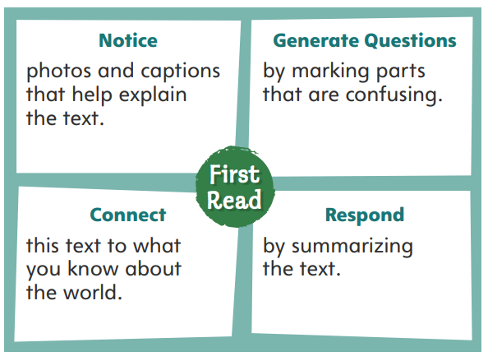
First Read Strategies
Notes:
Discuss the First Read Strategies. Prompt students to establish what they want to know about deserts.
Explain the four steps of the first read.
NOTICE Tell students to look for photos and captions that help them understand the text.
GENERATE QUESTIONS Encourage students to mark anything they find confusing.
CONNECT Have students make connections to the text and what they already know about the desert.
RESPOND Have students respond by summarizing the text.
Students may read the text independently, in pairs, or as a whole class. Use the First Read notes to help students connect with the text and guide their understanding.

Slide 17
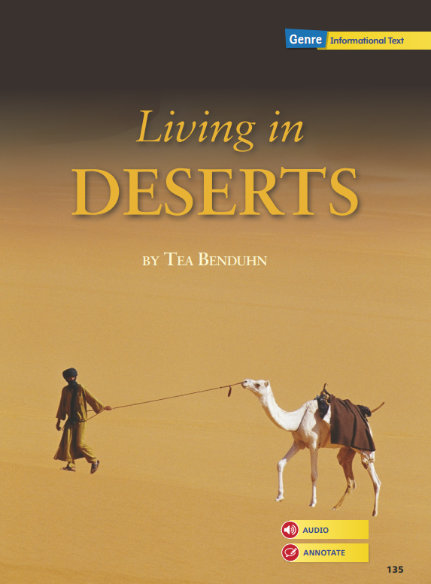
Page 135
First Read – Living in Deserts
Notes:
Students may read the text independently, in pairs, or as a whole class. Use the First Read notes to help students connect with the text and guide their understanding.

Slide 18
Page 136, 137
First Read – Living in Deserts
Notes:
Students may read the text independently, in pairs, or as a whole class.
THINK ALOUD When I begin reading Living in Deserts, I first notice the chapter number and the chapter title, “Welcome to the Desert.” Based on these text features, I know that this text is divided into sections. As I begin reading, the author’s descriptive language makes me feel like I am actually in a desert. This “welcome” makes me want to keep reading to find out more about deserts.
THINK ALOUD As I read, I ask myself questions about the text. The first sentence in paragraph 2 uses the word extreme to describe a desert. I ask myself, I wonder what makes deserts extreme places to live? I will look for answers to this question as I continue reading the text.

Slide 19
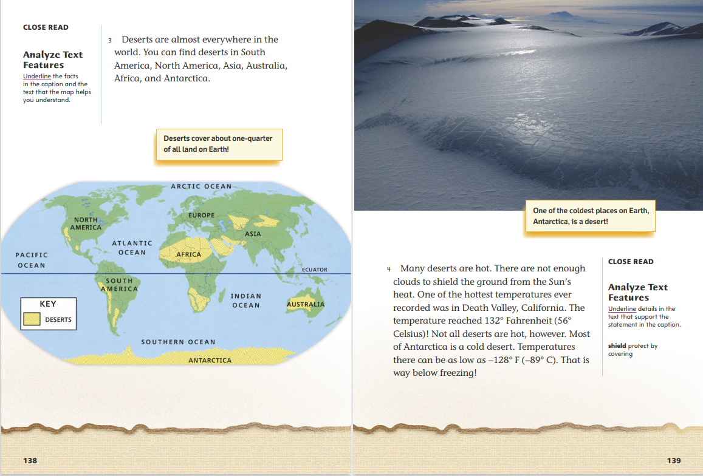
Page 138, 139
First Read – Living in Deserts
Notes:
Students may read the text independently, in pairs, or as a whole class.
THINK ALOUD As I read the text and examine the map, I know that this map represents the world. I recognize the continents and oceans. The map helps me better understand the information in the text by showing me the size and location of deserts. The map is surprising to me because I did not know Antarctica was a desert.
THINK ALOUD After reading the text and caption, I’ll summarize what I have read so far. When I summarize, I tell the key ideas, or most important ideas, in the text. A summary of this text could be: Earth has different kinds of deserts. Some deserts can be very hot, and some can be very cold.

Slide 20
Page 140, 141
First Read – Living in Deserts
Notes:
Students may read the text independently, in pairs, or as a whole class.
THINK ALOUD The first sentence in paragraph 5 tells me that deserts can be dangerous. I know that a sunburn can really hurt and it’s not good for you. I can infer that heatstroke and dehydration are also problems that can affect people, and I can infer that they are even more serious than a sunburn.
THINK ALOUD I find the yurts to be very interesting. However, I am confused by the text that states that nomadic people carry their yurts with them. How do people put up and take down yurts? How do people carry yurts as they move from place to place? I’ll mark the text that is confusing and write my questions in the margin. As I read, I’ll look for answers to my questions.

Slide 21
Page 142, 143
First Read – Living in Deserts
Notes:
Students may read the text independently, in pairs, or as a whole class.
THINK ALOUD When I turned the page, the photograph immediately caught my attention. The text and caption help me understand that the photograph shows an underground home that people build to stay cool in hot deserts.
THINK ALOUD As I read the text, I am a bit confused by how the author is using the words traditional and modern. If I look at the photograph and read the caption about the modern city, it helps me better understand the meaning of these words and how they are used in the text.

Slide 22
Page 144, 145
First Read – Living in Deserts
Notes:
Students may read the text independently, in pairs, or as a whole class.
THINK ALOUD I notice that a new chapter begins on this page. I’ll summarize the text on this page to help me figure out what this chapter will be about: Deserts have harsh conditions that make living in them difficult, but people have figured out ways to get what they need to survive.
THINK ALOUD As I read the text, I am surprised to learn that people can grow crops in deserts. If deserts are places with little rainfall, how can crops grow? I’ll mark this text because I’m confused by how crops can grow in deserts. I will keep reading to look for an answer to my question.

Slide 23
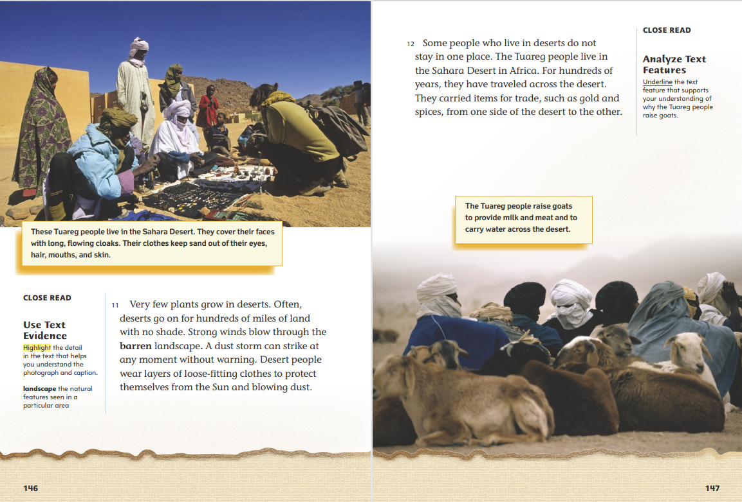
Page 146, 147
First Read – Living in Deserts
Notes:
Students may read the text independently, in pairs, or as a whole class.
THINK ALOUD After reading the text on this page, it’s good to stop and summarize the key idea that the author presents. I understand that desert conditions can be dangerous for people. Some desert people wear special clothes that help to protect them from these harsh conditions.
THINK ALOUD The text and caption tell me that some desert people travel a lot and depend on goats for food and carrying water. My family and the Tuareg people both need food and water. However, my family doesn’t live in a desert or move from place to place. We only travel long distances to vacation or to see friends and relatives.

Slide 24
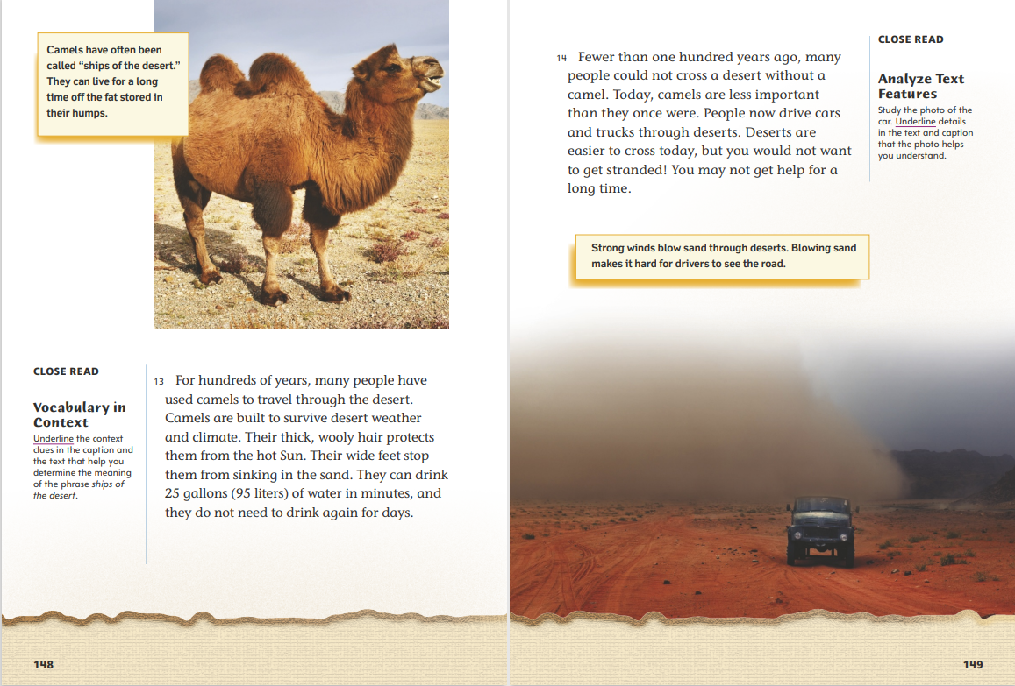
Page 148, 149
First Read – Living in Deserts
Notes:
Students may read the text independently, in pairs, or as a whole class.
Ask: How do the photograph and caption help you understand the text?
Possible Response: The photograph and caption help me picture the text details, such as a camel’s hair and wide feet, and they also help me understand how well-suited camels are to survive in a desert environment.
THINK ALOUD As I continue to read, I have questions about the text. I will mark the second sentence in paragraph 14 because I have questions about how desert people use camels today.

Slide 25
Page 150, 151
First Read – Living in Deserts
Notes:
Students may read the text independently, in pairs, or as a whole class.
Ask: How would you summarize the text on this page to help you understand what this chapter will be about?
Possible Response: People living at the edges of deserts can cause problems by using more resources than the land can support.
THINK ALOUD When the author describes what happens to plants when the soil is weak and dry, it reminds me of a time I tried to grow a plant, but I forgot to have someone water it when I went on vacation. The plant became so dried out that it died. The experience with my plant helps me better understand what happens to plants in the process of desertification.

Slide 26
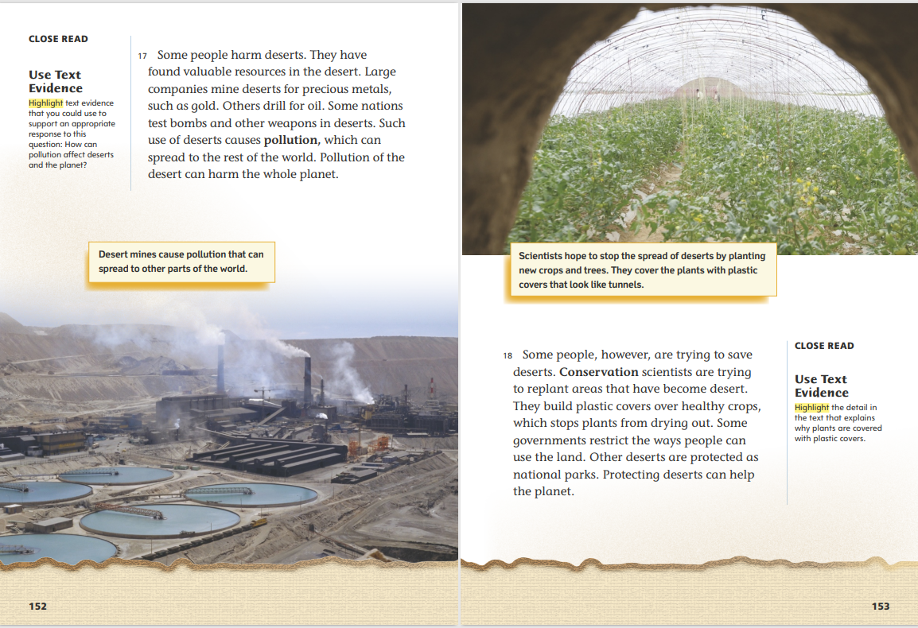
Page 152, 153
First Read – Living in Deserts
Notes:
Students may read the text independently, in pairs, or as a whole class.
Ask: What does the author want me to understand by reading the text on this page?
Possible Response: Some people and companies harm and pollute deserts through their activities.
THINK ALOUD As I read, I recognize that this text is focused on how people try to save deserts. What does the author mean when she says, “Some governments restrict the ways people can use the land”? I’m not sure what this sentence means, so I’ll mark it and look for information that can help me answer my question.

Slide 27
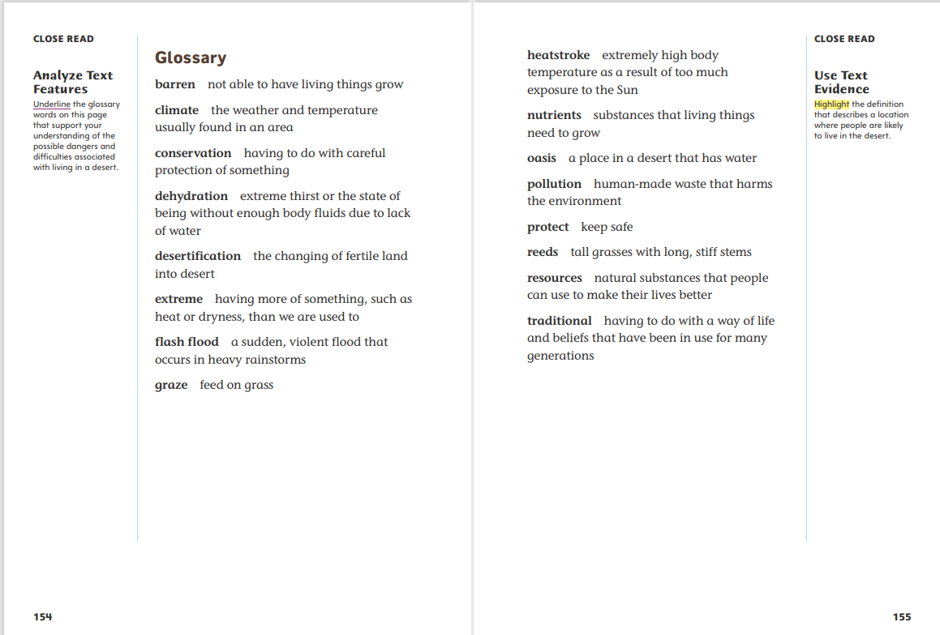
Page 154, 155
First Read – Living in Deserts
Notes:
Students may read the text independently, in pairs, or as a whole class.
THINK ALOUD When I turn the page, I notice that the text about deserts has ended and that the author has included a glossary. I know a glossary is a list of important words in a text and their definitions, and it can help me understand the meanings of unfamiliar words.
Ask: What do you notice about the way the words in the glossary are organized? Why do you think glossary words are organized this way?
Possible Response: The glossary words are organized in alphabetical, or ABC, order. This order helps readers quickly find a specific word or words in the list.

Slide 28
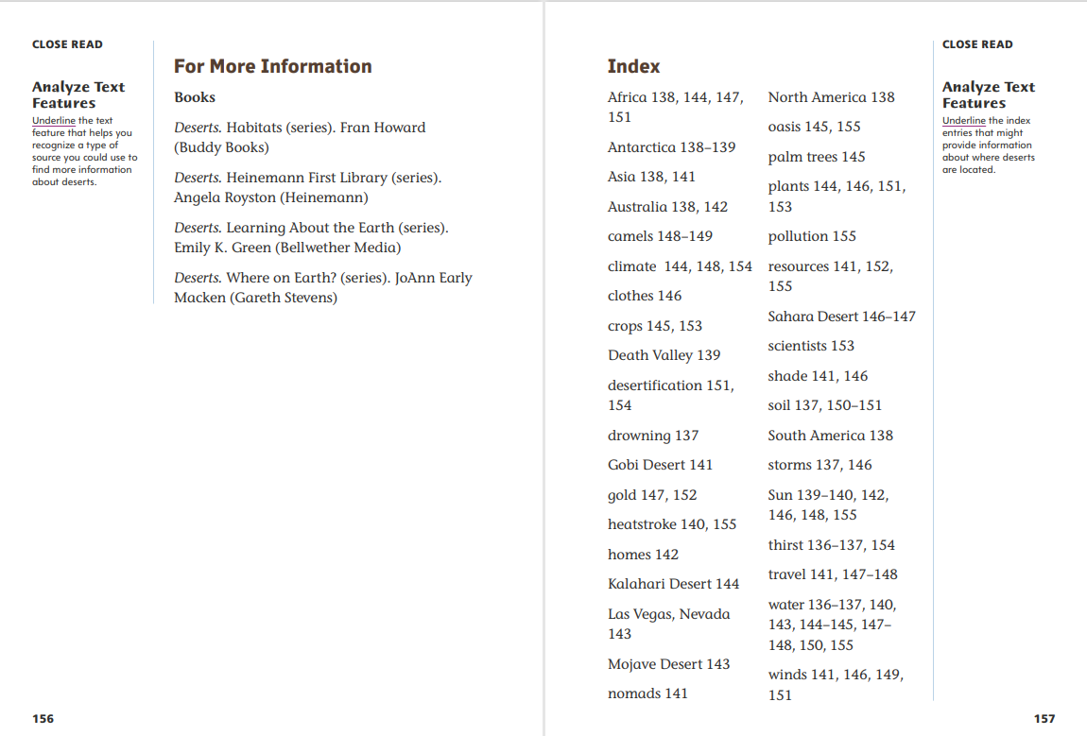
Page 156, 157
First Read – Living in Deserts
Notes:
Students may read the text independently, in pairs, or as a whole class.
THINK ALOUD When I turn to this page, I read the heading “For More Information.” The heading helps me understand that this is a list of sources with additional information about deserts that I can read on my own.
When I turn to this page, I scan the list to review the topics or key words that are used in the text. I can use this index to help me find information about these concepts in the text. I also review the list to consider which topics or key words I understand after reading Living in Deserts and which are unclear to me. How could I use the index to find out more about the topics or key words that I do not fully understand.

Slide 29
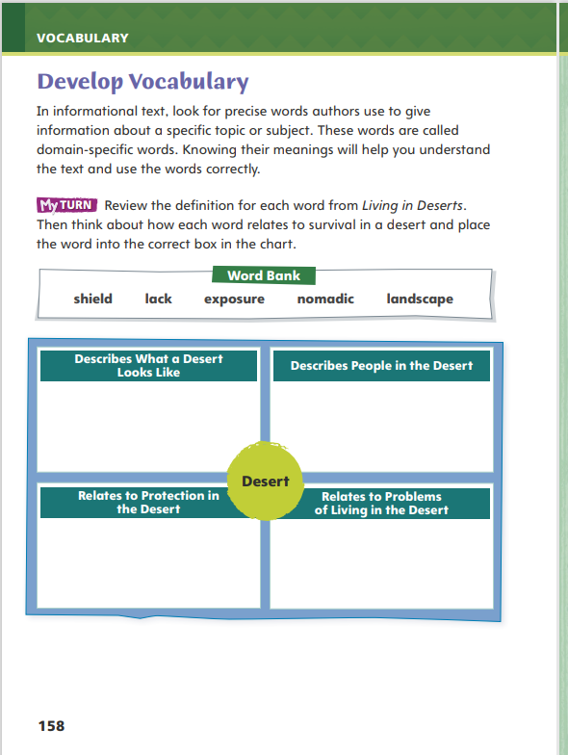
Page 158
Develop Vocabulary
Turn to page 158 in your Student Interactive and complete the activity.
Notes:
Tell students that authors of informational text use domain-specific words, or words that are related to a specific topic or subject. The vocabulary words shield, lack, exposure, nomadic, and landscape are words related to desert environments.
Review the meaning of each vocabulary word.
Ask yourself what the word tells you about survival in deserts.
Model filling out the chart on p. 158 of the Student Interactive using the word shield.
I read that shield means “to protect by covering.”
I determine that shield best fits into the section titled “Relates to Protection in the Desert” because the word shield relates to protection.
Have students respond using newly acquired vocabulary as they complete p. 158 of the Student Interactive. Evaluate students’ completion of the activity to assess their understanding of the vocabulary words.

Slide 30
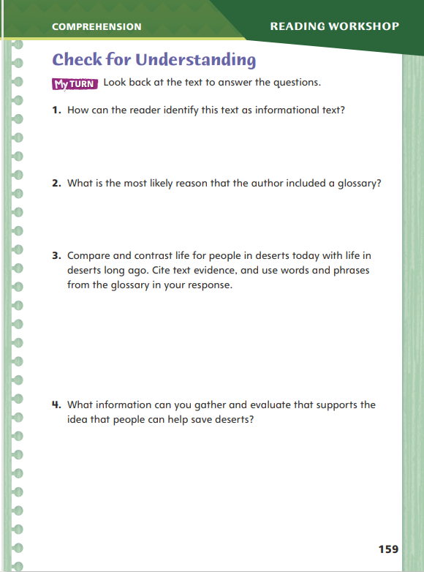
Page 159
Check for Understanding
Turn to page 159 in your Student Interactive and complete the activity.
Notes:
Have students complete p. 159 of the Student Interactive.

Slide 31
Word Study
ee
ea
ai
ay
ow
oa
Notes:
Direct students to complete the activity on p. 164 of the Student Interactive.
Explain that since high-frequency words are ones that appear often in texts but do not follow regular word study patterns, students need to practice reading them.

Slide 32
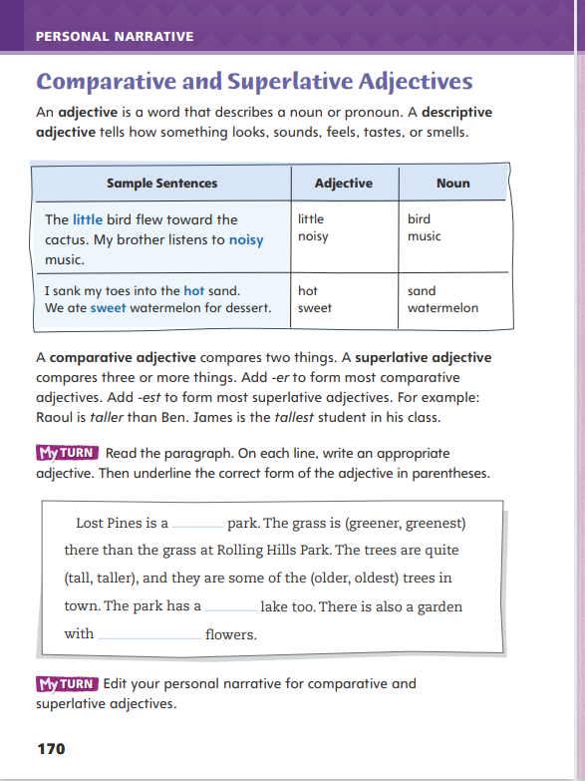
Page 170
Writing – Personal Narrative
Turn to page 170 in your Student Interactive.
Fill in the chart.
Notes:
An adjective describes a noun (person, place, or thing). A comparative adjective compares two nouns. A superlative adjective compares three or more nouns.
Comparative adjectives usually end in -er.
Superlative adjectives usually end in -est.
Explain that we use comparative and superlative adjectives when we want to compare a characteristic of two or more people, places, or things. For example, to compare the height of two people, we might say one person is taller than the other. Ask students what they would say if they were comparing three people—or a hundred!
As you read personal narratives from the stack together, help students identify comparative and superlative adjectives and verbally explain the function of each in several sentences.
Then direct students to p. 170 in the Student Interactive. Have them read the page and complete the My Turn. Encourage each student to read the paragraph aloud, demonstrating that they know how to use these adjectives correctly.

Slide 33
Independent Writing
Edit your personal narrative for comparative and superlative adjectives.
Share sentences from your drafts.
Identify each adjective and what it compares.
Notes:
After the minilesson, students should transition into independent writing. The My Turn on p. 170 of the Student Interactive asks students to edit their personal narrative for comparative and superlative adjectives.
Writing Support
Modeled - Think aloud how to compare items in the classroom using descriptive adjectives.
Shared - Read a stack text. Identify where nouns could be compared and make up sentences for them.
Guided - Prompt students to locate a place in their draft where they can compare using descriptive adjectives.
Have a few students share sentences from their drafts that use comparative and superlative adjectives. Ask the class to identify each adjective and what it compares.

Slide 34
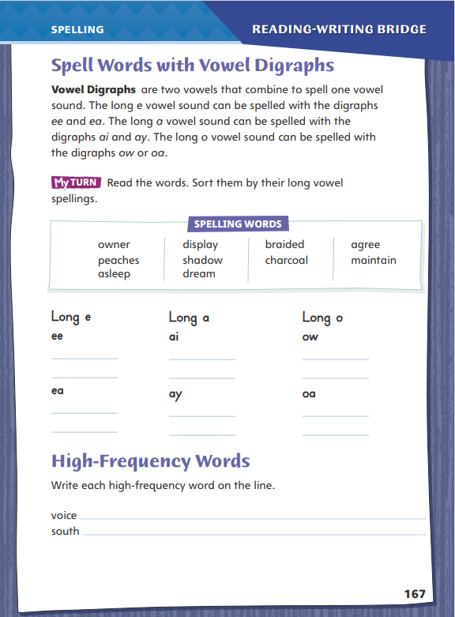
Page 167
Spelling
owner
charcoal
peaches
asleep
display
maintain
Turn to page 167 in your Student Interactive and complete the activity.
Notes:
Explain that words with the vowel digraphs ee, ea, ai, ay, ow, and oa can be multisyllabic words. The words with these digraphs will usually have a long vowel sound.
Write or display the words owner, charcoal, peaches, asleep, display, and maintain. Say each word aloud, emphasizing the long vowel sounds. Have students repeat the words after you.
Have students complete the activity on p. 167 of the Student Interactive independently.

Slide 35
Language and Conventions
The soup smells and tastes great.
Work with your partner.
Write a sentence.
Have your partner edit the sentence and identify the compound subject or compound predicate.
Notes:
Flexible Option
Explain that a sentence with a compound subject has two or more subjects joined by the coordinating conjunction and or oak. A compound predicate tells two or more actions someone or something did. Compound predicates are joined by and, but, or oak.
Write the following sentence on the board: The soup smells and tastes great. Have a volunteer read aloud the sentence and identify the conjunction. Then ask the volunteer to tell whether this sentence has a compound subject or a compound predicate.
Have students work in pairs. Each student writes a sentence. Then the partner edits the sentence so that it has a compound subject or predicate and reads the new sentence aloud. The writer of the sentence listens carefully and identifies the conjunction used to make the compound subject or compound predicate.

Slide 36
Lesson 3

Slide 37
Page 135
Introduce Analyze Text Features
Notes:
Explain that authors sometimes structure informational text to include features, such as sections, tables, graphs, bullets, numbers, and bold and italicized font. Maps, photos, and captions are other features common in informational text. Point out to students that recognizing structures of informational text, including text features, can help support their understanding of the text.
Recognize and identify a text feature in the informational text.
Think about what the text feature tells you.
Analyze how the text feature supports your understanding of the topic.
Use the Close Read note on p. 136 of the Student Interactive to model how to annotate the text to analyze text features.
Which text feature on this page tells me that the text will be presented in a certain order? I scan the page and recognize that the chapter title is a text feature that tells me the text will be organized into chapters and presented in a certain order. So I will underline “Chapter 1.”
Have partners work together to read the Close Read note on p. 138 of the Student Interactive to practice annotating the text to analyze text features. Help students recognize the connection between the map and the second sentence of paragraph 3. Discuss students’ annotations to monitor their comprehension of the reading skill.

Slide 38
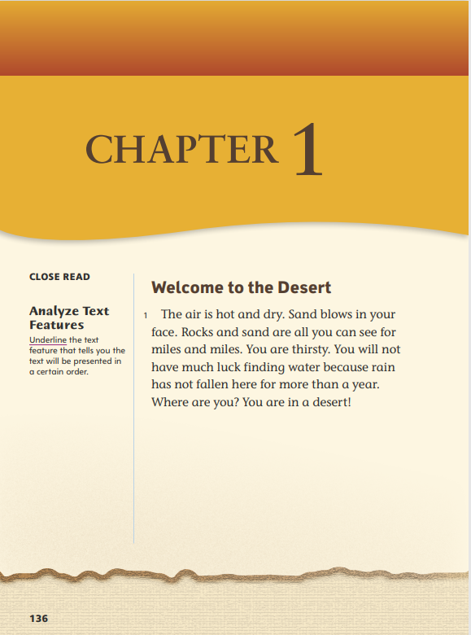
Page 136
Close Read – Analyze Text Features
Turn to page 136 in your Student Interactive.
Notes:
Have students examine the text features above paragraph 1. Have students underline a text feature that tells the text will be presented in a certain order. See student page for a possible response.
Guide students in recognizing the difference between the chapter numbers and the chapter titles. Ask them to compare and contrast these text features.
Possible Response: Both types of text features divide the informational text into sections. The chapter numbers show the sequence of chapters, and the chapter titles tell the focus or key idea that will be discussed in each chapter. DOK 2

Slide 39
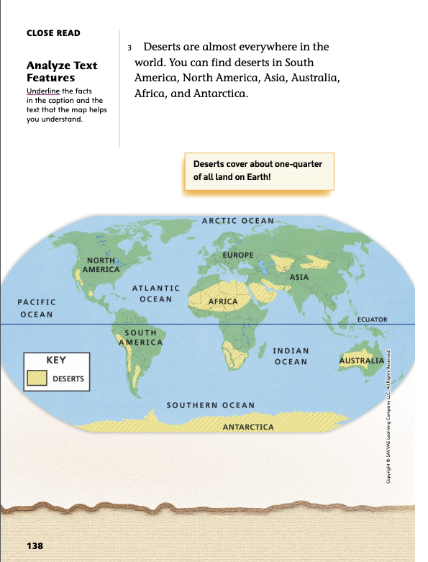
Page 138
Close Read – Analyze Text Features
Turn to page 138 in your Student Interactive.
Notes:
Have students examine the map, text, and caption, and ask them to underline facts in the caption and in paragraph 3 that the map helps them understand. See student page for possible responses.
Encourage students to examine the details of the map and think about how those details relate to the text in paragraph 3. Ask: What do you think was the author’s purpose for including this map?
Possible Response: The author included the map to provide readers with additional details about the sizes and locations of deserts on Earth. DOK 2

Slide 40
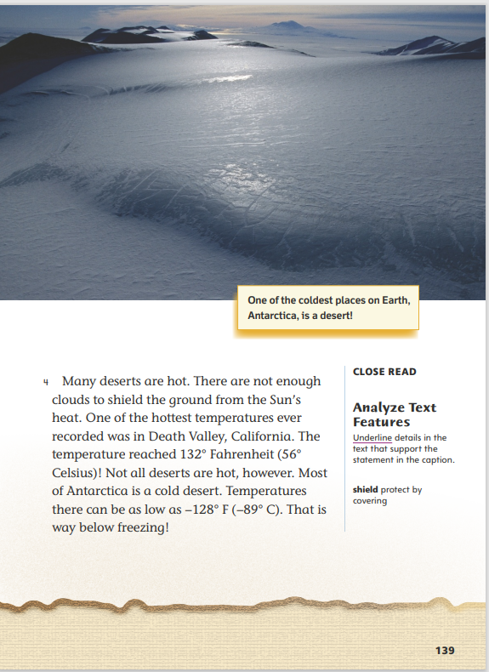
Page 139
Close Read – Analyze Text Features
Turn to page 139 in your Student Interactive.
Notes:
Have students reread the caption and scan paragraph 4 to identify and underline text details that support the caption. See student page for possible responses.
Point out that the regions near the equator experience a hot climate. To have students synthesize information, ask: How would you describe the distance between Antarctica and the equator? Using the information in the text features, what can you conclude about how a desert’s distance from the equator affects the desert’s temperature?
Possible Response: Antarctica is far from the equator. The text and caption say that Antarctica can be very cold, so a desert area far from the equator can have low temperatures. DOK 2

Slide 41
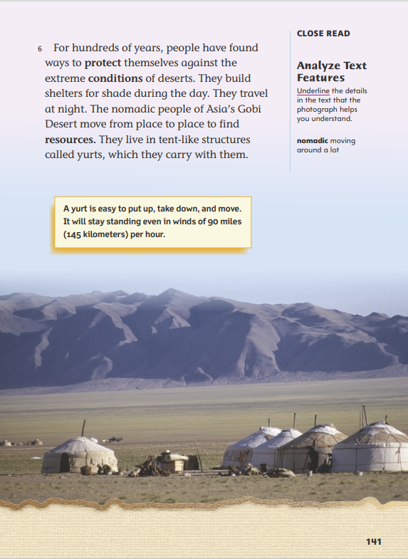
Page 141
Close Read – Analyze Text Features
Turn to page 141 in your Student Interactive.
Notes:
Have students scan paragraph 6 to find details in the text that the photograph helps them understand. See student page for possible responses.
Ask students to analyze the details in the text, photograph, and caption to explain why yurts are good homes for nomadic desert people.
Possible Response: Nomadic people move from place to place, and yurts can be set up and taken down as the people move. Yurts provide shelter from the sun and can stay standing even in high winds. The yurts also appear to be good-sized homes for people and their families. DOK 2

Slide 42
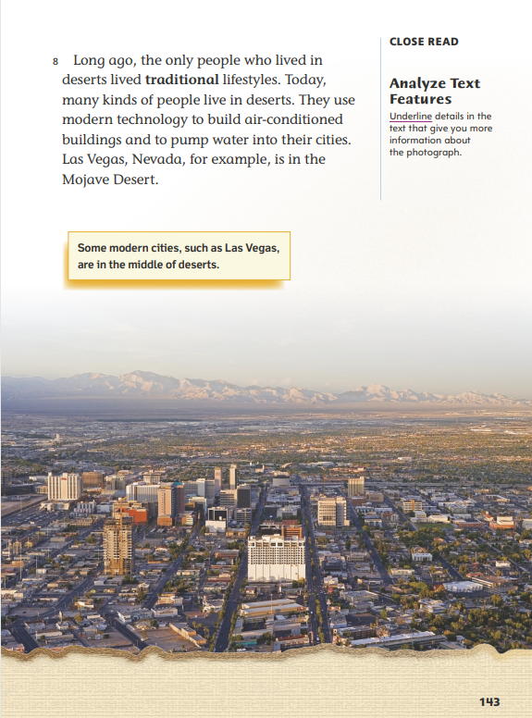
Page 143
Close Read – Analyze Text Features
Turn to page 143 in your Student Interactive.
Notes:
Have students study the photograph on the page and scan paragraph 8. Ask: What can you tell me about this photograph? What details in the text give you more information about this photograph? Underline details that give more information about the photograph as students point them out. See student page for possible responses. DOK 2

Slide 43
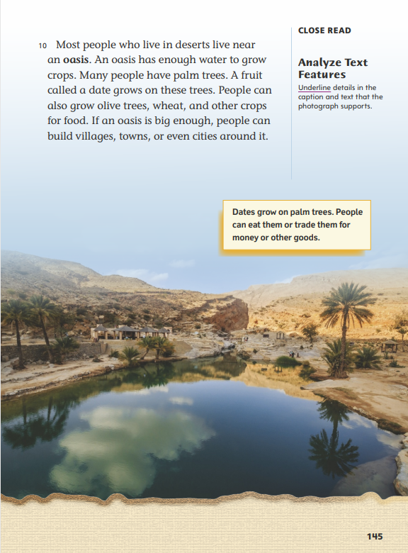
Page 145
Close Read – Analyze Text Features
Turn to page 145 in your Student Interactive.
Notes:
Have students scan paragraph 10 to find and underline details in the caption and text that the photograph supports. See student page for possible responses.
Guide students in recognizing the characteristics and structures of informational text. Ask: What features of informational text can you identify on this page? What information do these features help you understand about the topic?
Possible Response: The page includes a photograph, a caption, and bold font. These features help me understand the topic of living in deserts by providing information about an oasis and the types of trees and crops that can grow near an oasis. DOK 2

Slide 44
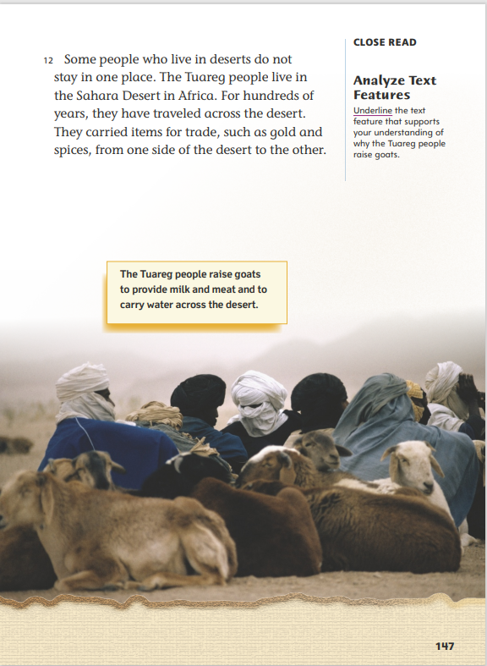
Page 147
Close Read – Analyze Text Features
Turn to page 147 in your Student Interactive.
Notes:
Have students scan paragraph 12 and the caption to identify and underline a feature of informational text on the page that supports their understanding of why the Tuareg people raise goats. See student page for a possible response.
Remind students that the word nomadic means “moving around a lot.” Have students cite evidence that the Tuaregs are a nomadic people.
Possible Response: The text states that the Tuareg people have traveled across the desert “for hundreds of years” and “do not stay in one place.” DOK 1

Slide 45
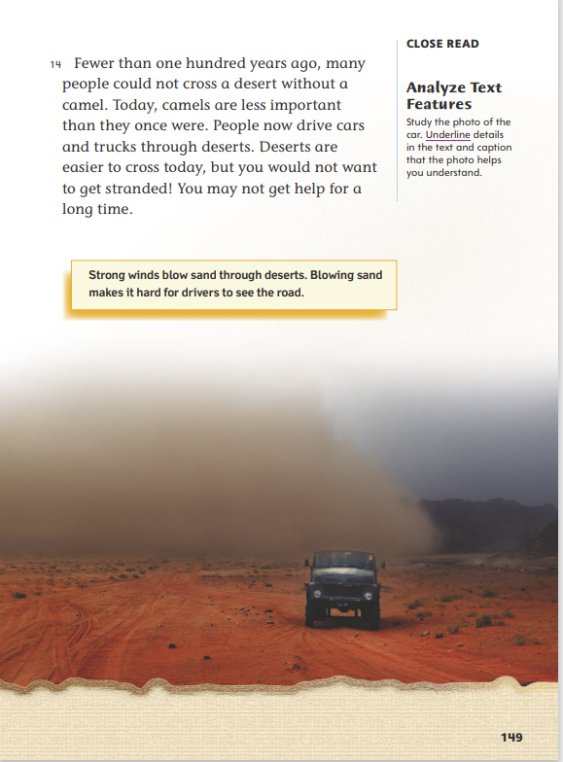
Page 149
Close Read – Analyze Text Features
Turn to page 149 in your Student Interactive.
Notes:
Have students examine the details in the photograph on p. 149. Then direct students to scan the caption and the text in paragraph 14 to find and underline details that the photo helps them understand. See student page for possible responses.
To extend students’ analysis of text features, ask: What do the text features on pages 148 and 149 tell you about how transportation in the desert today compares with transportation in the past?
Possible Response: The text features on page 148 help me understand why camels have been an important form of transportation for desert people. The photo and caption on page 149 help me understand that the cars and trucks used for transportation today make crossing deserts easier than traveling on a camel. DOK 2

Slide 46
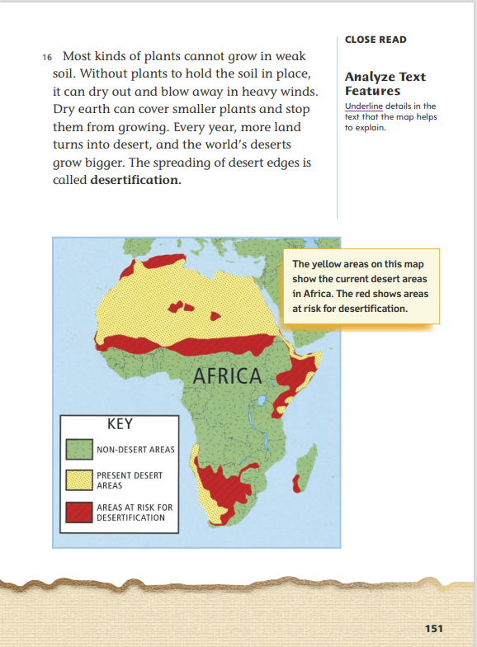
Page 151
Close Read – Analyze Text Features
Turn to page 151 in your Student Interactive.
Notes:
Ask students to examine the map on p. 151. Have them scan paragraph 16 to identify and underline details that the map helps to explain. See student page for possible responses.
Then ask students to explain the author’s purpose for including the map.
Possible Response: The author included the map to help readers understand that desertification happens at desert edges and also understand that large areas are in danger of desertification. DOK 2

Slide 47
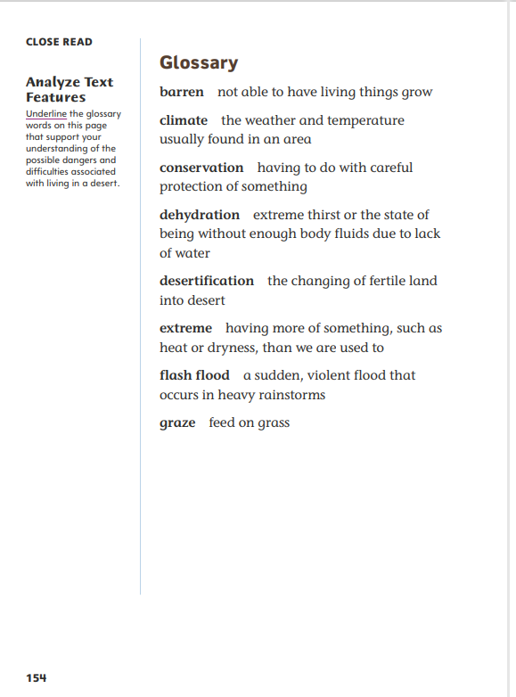
Page 154
Close Read – Analyze Text Features
Turn to page 154 in your Student Interactive.
Notes:
Have students scan p. 154. Ask: What words on this page support your understanding of the possible dangers and difficulties associated with living in a desert? Have students find and underline glossary words. See student page for possible responses.
Ask students why a glossary is a helpful text feature in an informational text.
Possible Response: There are a lot of content-area words in an informational text. The glossary helps me understand the meanings of words that may be unfamiliar or challenging. DOK 2

Slide 48
Page 156, 157
Close Read – Analyze Text Features
Turn to page 156 in your Student Interactive.
Notes:
Have students scan the text on p. 156. Then have them underline the text feature that helps them recognize a type of source they could use to find more information about deserts. See student page for a possible response. Ask: What is the author’s purpose for including this information in Living in Deserts?
Possible Response: The author wants to give readers a list of other books they can read to learn more about deserts. DOK 2
Have students examine the information in the index on p. 157. Ask: Why is an index a useful text feature?
Possible Response: The index can help readers find the page on which specific information appears in a text.
Have students scan the page and underline the index entries that might provide information about where deserts are located. See student page for possible responses. DOK 2

Slide 49
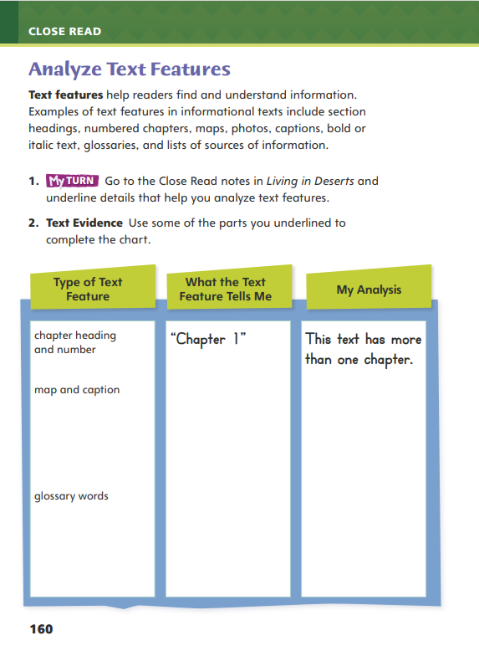
Page 160
Analyze Text Structure
Turn to page 160 in your Student Interactive and complete the activity.
Notes:
Have students annotate the text using the other Close Read notes for Analyze Text Features. Students can use the text evidence to complete the chart on p. 160 of the Student Interactive.

Slide 50
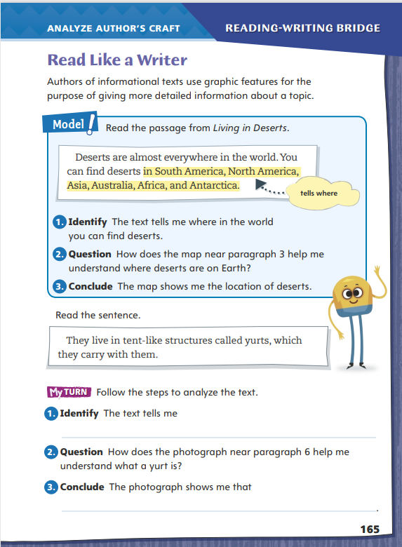
Page 165
Read Like a Writer
Turn to page 165 in your Student Interactive.
Notes:
Graphic features include maps, charts, graphs, photographs, and illustrations. Authors of informational texts use graphic features for specific purposes. Graphic features can be used to achieve some or all of the following purposes:
Graphic features provide additional information to help readers understand the text.
Graphic features provide information that cannot be easily explained in words alone.
Graphic features help make a text more interesting.
Model explaining the author’s use of graphic features by directing students to the top of p. 165 of the Student Interactive. Have students follow along as you complete the steps.
Identify that the author Tea Benduhn uses the text to tell readers where in the world a person can find deserts.
Ask how the graphic feature on the page helps readers understand where deserts can be found. Ask students how the map provides information to help them better understand the text.
Guide students to understand that the map shows more details about the information in the text. By including a map, the author makes it easier for readers to understand the text.
Direct students to go back to Living in Deserts and identify other graphic features. Help guide their search by reminding them that photographs and maps are graphic features. Then have them focus on specific examples of graphic features by completing the activities on Student Interactive p. 165.

Slide 51
Word Study
teacher
coasted
mailbox
Notes:
Flexible Option
Remind students that decoding words that have vowel digraphs can help them pronounce unfamiliar words.
Display the words teacher, coasted, and mailbox. Guide students to identify the vowel digraph in each word. Then have them identify the vowel sound each digraph makes. (teacher, ea, long e; coasted, oa, long o; mailbox, ai, long a)
Have students complete Word Study p. 4 from the Resource Download Center.

Slide 52
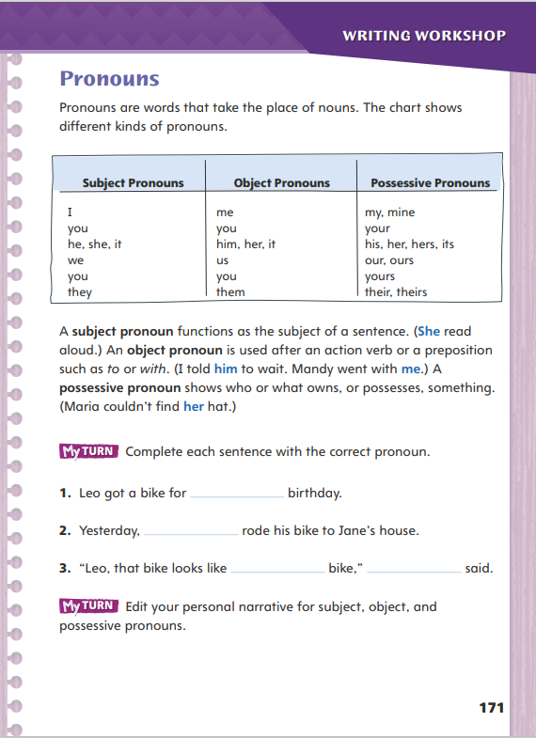
Page 171
Writing – Personal Narrative
Turn to page 171 in your Student Interactive.
Notes:
A pronoun is a word that takes the place of a noun (e.g., neighbor) or noun phrase (e.g., the neighbor next door).
Subject pronouns are found in a sentence’s subject.
Object pronouns are found in the predicate.
Possessive pronouns show who owns or possesses something.
You and it can be both subject and object pronouns.
Read aloud the following passage from Living in Deserts, explaining that the pronouns have been changed to nouns. “Camels are built to survive desert weather and climate. Camels’ thick, wooly hair protects camels from the hot sun. Camels’ wide feet stop camels from sinking in the sand. Camels can drink 25 gallons (95 liters) of water in minutes, and camels do not need to drink again for days.”
Ask students how the passage sounds to them. Challenge students to reread the paragraph above, replacing nouns with pronouns to demonstrate their ability to use pronouns while speaking. Remind students that when they speak or write, they must always make clear which noun a pronoun represents.
Read personal narratives from the stack, and help students identify the use of subject, object, and possessive pronouns. Ask: What is the pronoun in this sentence? What noun does it take the place of? Why is it used here?
Direct students to p. 171 in the Student Interactive. Have them read the page and complete the first My Turn.

Slide 53
Independent Writing
Edit your personal narrative for subject, object, and possessive pronouns.
Read your personal narrative.
As you listen identify the pronouns you hear.
Notes:
After the minilesson, students should transition into independent writing. The My Turn on p. 171 in the Student Interactive directs students to edit their personal narratives for subject, object, and possessive pronouns.
Writing Support
Modeled - Use a sample text to model how to decide which nouns should be replaced with pronouns.
Shared - Rewrite a paragraph of a stack text without using pronouns. Compare it with the original.
Guided - Have students make sure no pronouns occur before their antecedents are introduced. Intervention Refer to the Small Group Guide for support.
Have a few students read their personal narratives. Ask the class to identify the pronouns they hear and the nouns those pronouns represent.

Slide 54
Spelling
asleep
charcoal
maintain
Notes:
Flexible Option
Remind students that identifying vowel digraphs in words will help them spell the words.
Write or display the following words. Have students work in pairs to identify the digraph and the long vowel sound in each word.
asleep
charcoal
maintain.
Have students complete Spelling p. 9 from the Resource Download Center. Click path: Table of Contents -> Resource Download Center -> Spelling

Slide 55
Language and Conventions
The player scores a goal.
The team celebrates.
Rewrite the sentences to have a compound subject or compound predicate.
Notes:
Tell students that a compound subject has two subjects joined by a coordinating conjunction. Then tell them that a compound predicate has two actions joined by a conjunction.
Display the following sentences: The player scores a goal. The team celebrates. Have volunteers help you rewrite the sentences so that they have a compound subject or compound predicate. (Possible responses: The team and the player celebrate a goal. The player scores a goal and celebrates.)

Slide 56
Lesson 4

Slide 57
Page 135
Use Text Evidence
Notes:
Explain that text evidence refers to details in the text that support an idea. Point out that evaluating details in the text and utilizing text features can deepen readers’ understanding.
Identify a key detail in the text that is supported by a text feature.
Determine what the text evidence tells about the topic and how the text feature supports the evidence.
Decide how the text evidence and the details in the text feature work together to help you understand the topic.
Use the Close Read note on Student Interactive p. 137 to model how to annotate the text to use text evidence to support an idea.
The Close Read note prompts me to find the detail in the text that supports what the photograph shows. The caption helps me understand that the photograph is showing a flash flood. Then I reread paragraph 2 and highlight “rainfall can cause a flash flood” because this text evidence supports what the photograph shows.
Have students work with a partner to practice annotating the text using the Close Read note on Student Interactive p. 140. Provide support.

Slide 58
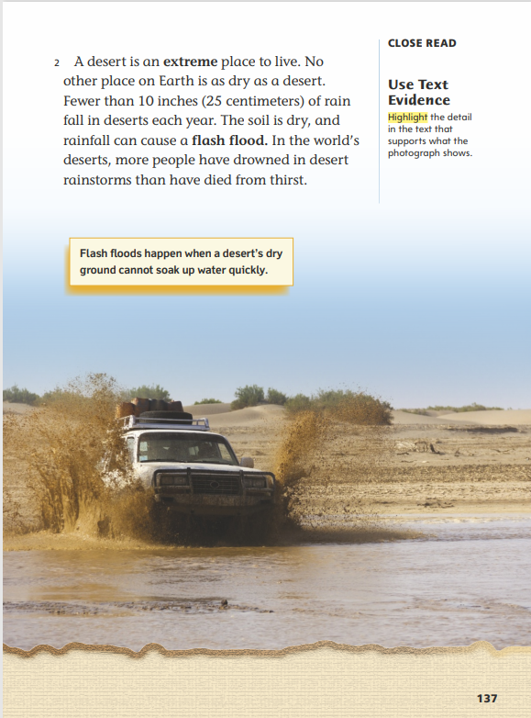
Page 137
Close Read – Use Text Evidence
Turn to page 137 in your Student Interactive.
Notes:
Remind students that text evidence refers to facts and details in a text that support an idea or a response.
Have students scan paragraph 2 to find and highlight the detail that supports what the photograph shows. See student page for possible responses.
Have students reread the last sentence of paragraph 2. Ask: Do you find this fact surprising? Why or why not? Discuss students’ responses. Then ask students to identify specific details in the photo that help them visualize and better understand flash flooding and how flash flooding affects people living in deserts.
Possible Response: The water rushing over the roadways and the car moving through the deep water help me understand what a flash flood is and how dangerous it can be. DOK 2

Slide 59
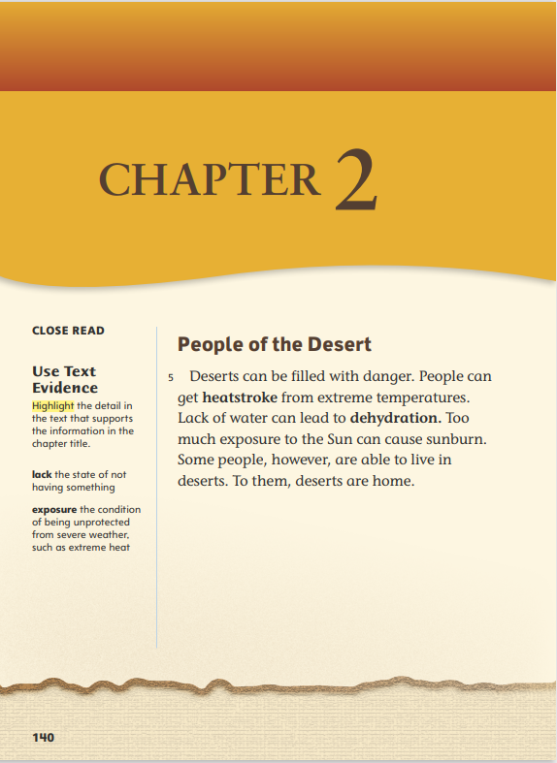
Page 140
Close Read – Use Text Evidence
Turn to page 140 in your Student Interactive.
Notes:
Have students read the title “People of the Desert.” Ask: Using the text features on this page, what prediction can you make about how the information in this chapter will be similar to and different from the information in Chapter 1?
Discuss students’ predictions, guiding them to understand that the chapter title indicates that this chapter will include information about deserts, similar to Chapter 1, but that this chapter will also be about people, which is different from Chapter 1.
Have students scan paragraph 5 to find and highlight the detail that supports the information in the chapter title. See student page for possible responses. Have students use their highlighted text as evidence to confirm or correct their predictions. DOK 2

Slide 60
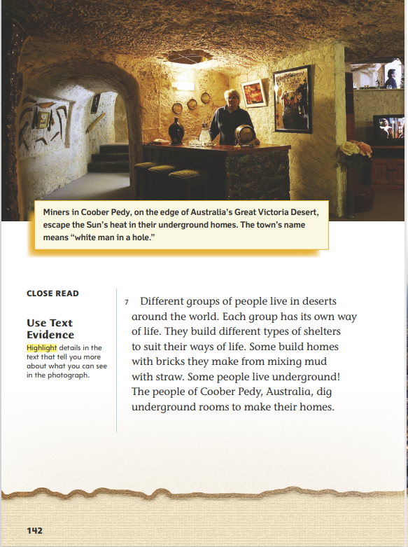
Page 142
Close Read – Use Text Evidence
Turn to page 142 in your Student Interactive.
Notes:
Direct students’ attention to the photograph and caption on p. 142. Ask: What details in the photograph help you understand how an underground room can help people “escape the Sun’s heat” in the desert? Then have students scan paragraph 7 to find and highlight details in the text that tell them more about the photograph. See student page for possible responses. DOK 2

Slide 61
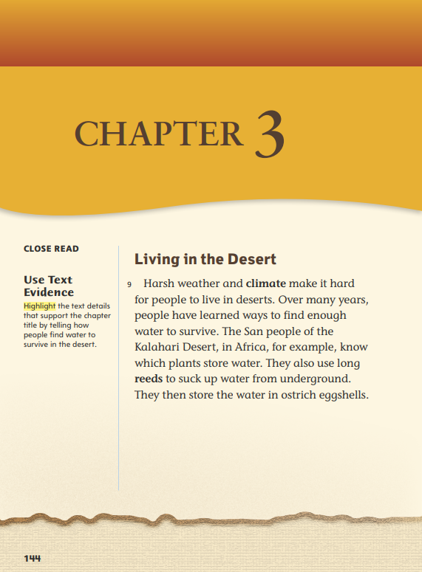
Page 144
Close Read – Use Text Evidence
Turn to page 144 in your Student Interactive.
Notes:
As students scan the text, remind them that using text evidence means using facts and details to support an idea or response. Explain that text evidence must be relevant to, or directly relate to, their idea or response.
Direct students’ attention to the chapter title. Then have students scan paragraph 9 to find and highlight text details that support the chapter title by telling how people find water in the desert. See student page for possible responses. DOK 2

Slide 62
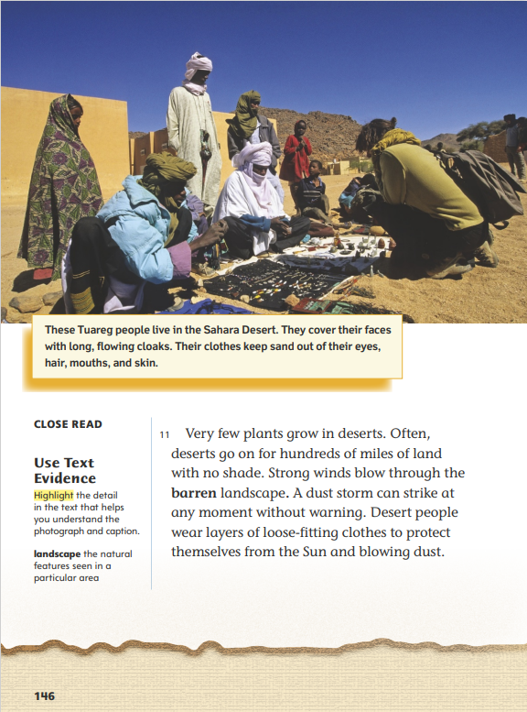
Page 146
Close Read – Use Text Evidence
Turn to page 146 in your Student Interactive.
Notes:
Have students scan paragraph 11. Ask: What conditions make living in the desert difficult? How do people protect themselves in these conditions? Have students highlight the detail in the text that helps them understand the photograph and caption. See student page for possible responses.
Ask students to identify the words and phrases in the caption that relate to how people protect themselves. Then have students use text evidence from the caption and text to support the idea that desert people’s clothes help them to survive in desert environments.
Possible Response: Desert people wear “loose-fitting clothes” and “long, flowing cloaks” that keep “sand out of their eyes, hair, mouths, and skin” and protect them from “the Sun and blowing dust.” DOK 1

Slide 63
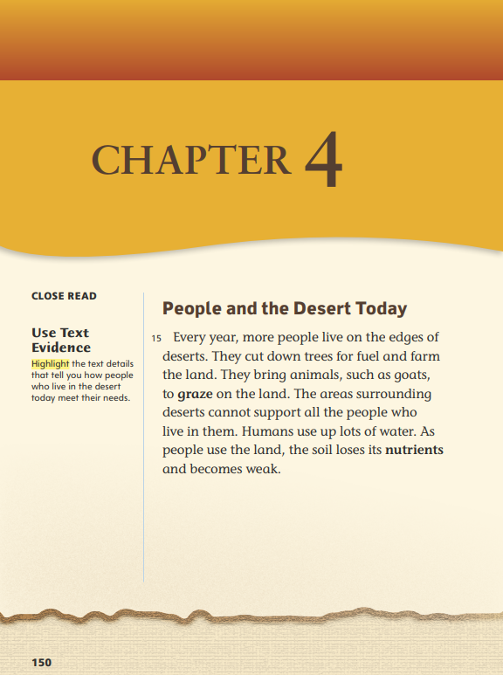
Page 150
Close Read – Use Text Evidence
Turn to page 150 in your Student Interactive.
Notes:
To help students recognize structures of informational text, ask: What text feature on page 150 helps you know what this chapter is about? (chapter title)
Then have students scan paragraph 15 to find and highlight details that tell how people who live in the desert today meet their needs. See student page for possible responses. DOK 2

Slide 64
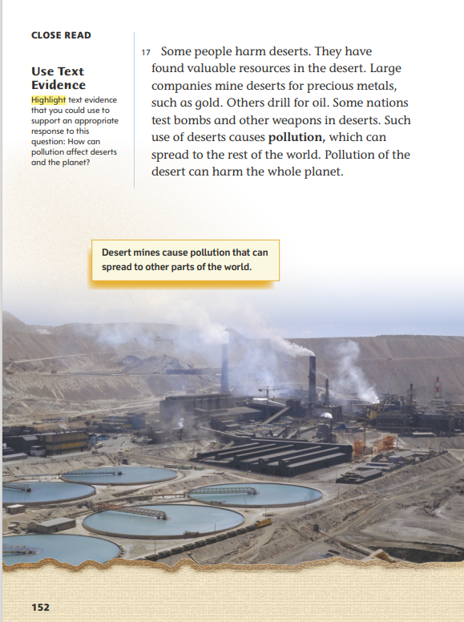
Page 152
Close Read – Use Text Evidence
Turn to page 152 in your Student Interactive.
Notes:
Remind students that when they use text evidence to support a response, they must find facts and details that are relevant to and confirm their answer. Explain that identifying a key word in their response can help them find and use text evidence.
Ask: How can pollution affect deserts and the planet? Have students scan paragraph 17 and find text evidence to support an appropriate response. Remind them to use a key word, such as pollution, to locate relevant text evidence and highlight it. See student page for possible responses. DOK 1

Slide 65
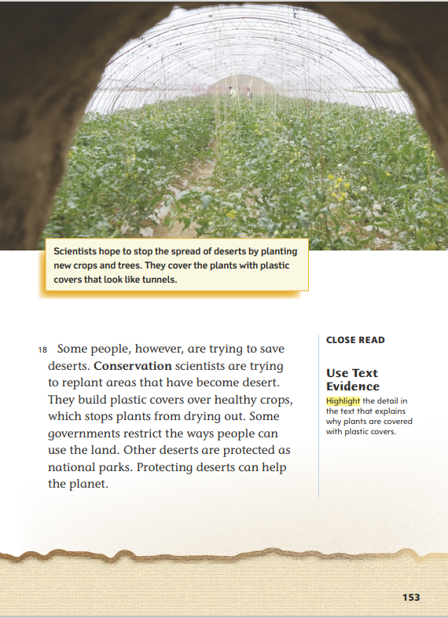
Page 153
Close Read – Use Text Evidence
Turn to page 153 in your Student Interactive.
Notes:
Have students review the photograph and caption on p. 153. Ask: Why are the plants covered with plastic? Highlight the text detail in paragraph 18 as students point it out. See student page for possible responses.
Then have students use text evidence to explain why conservation scientists want to protect deserts and stop desertification.
Possible Response: Conservation scientists want to protect deserts and stop desertification because protecting deserts “can help the planet.” DOK 2

Slide 66
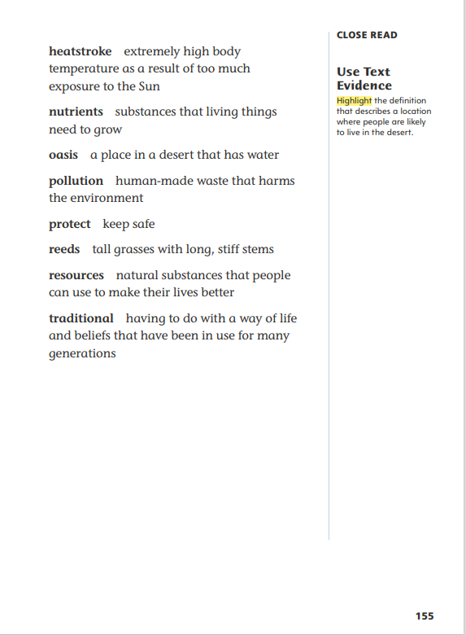
Page 155
Close Read – Use Text Evidence
Turn to page 155 in your Student Interactive.
Notes:
Have students review the words and definitions on p. 155 to find and highlight a word that is a location where people are likely to live in the desert. See student page for possible responses.
Encourage students to ask questions about key ideas in the text and to use text evidence from the glossary to answer their questions. DOK 2

Slide 67
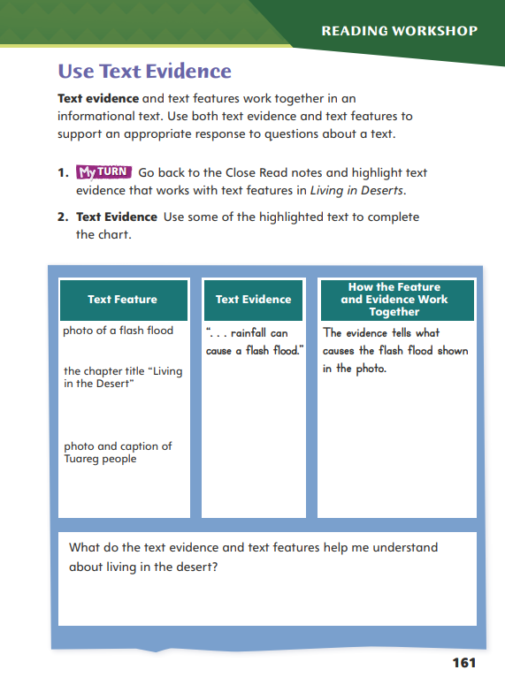
Page 161
Use Text Evidence
Turn to page 161 in your Student Interactive and complete the activity.
Notes:
Have students annotate the text using the other Close Read notes for Use Text Evidence and then use the text evidence to complete p. 161 of the Student Interactive.

Slide 68
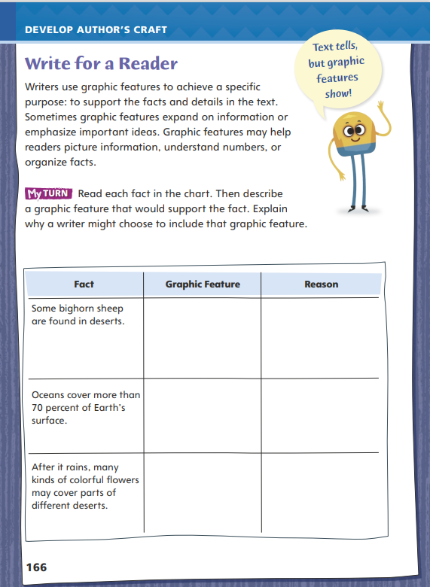
Page 166
Write for a Reader
Turn to page 166 in your Student Interactive.
Notes:
Writers often include graphic features, such as maps and graphs, to elaborate on the ideas and facts in the text. They choose graphic features that accomplish specific purposes.
Graphic features may illustrate or summarize facts and ideas in the text.
Graphic features may provide additional details to help readers better understand a topic.
Graphic features may show information that is not easily explained in words.
Discuss how students might use graphic features in their own writing, using p. 166 of the Student Interactive. Model as an example:
Write the following on the board: The Great Basin Desert is the largest desert in the United States.
Think aloud as you consider a graphic feature that could support this statement. Say: I want to help readers understand the size of this desert. I also want to give them more information about it. A map could show the size of the desert, and it could also show that it is in Nevada.
Have students brainstorm other graphic features that could accompany this fact and explain the purpose of each.
Refer students to author Tea Benduhn’s use of graphic features in Living in Deserts as an example of how to use graphic features in their own writing. Then guide students to complete the activity on Student Interactive p. 166.

Slide 69
Word Study
smarter
hardest
rooted
jumping
Notes:
Flexible Option
Review the strategies from the previous week about using base words and the endings -ing, -ed, -er, and –est.
Write the following words on the board: smarter, hardest, rooted, and jumping. Have volunteers identify the base word and ending in each word. Then ask if they can make a new word by using the base word with one of the other endings.
Have students work independently to find words that have -ing, -ed, -er, or -est endings in a story they recently read. Tell students to write each and circle the ending. Challenge them to write new words using the base words and one of the other endings

Slide 70
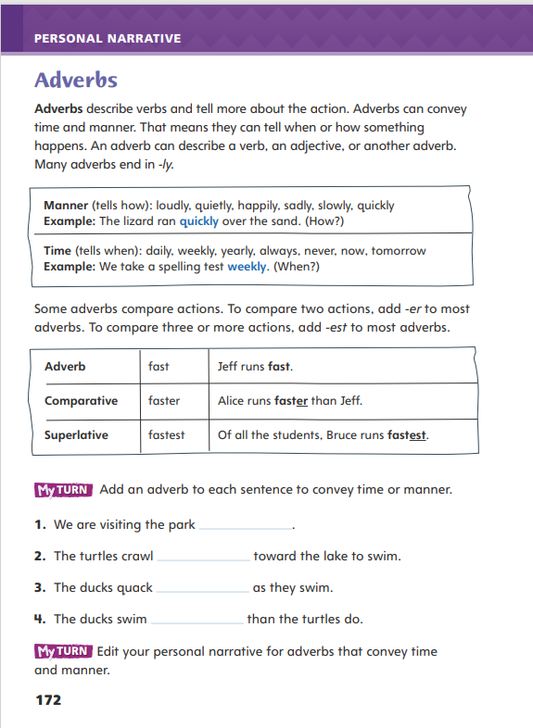
Page 172
Writing – Personal Narrative
Turn to page 172 in your Student Interactive.
Notes:
An adverb describes a verb. It can tell when something happens or how something happens. Most adverbs end in -ly: quickly, badly, rudely, quietly.
A comparative adverb compares two actions and usually ends in -er.
A superlative adverb compares three or more actions and usually ends in –est.
Explain that when writers use adverbs to describe when or how something happens, they are adding more details to a piece of writing. Those details add interest and even excitement for the reader. Share examples of personal narratives from the stack. As you encounter adverbs, ask: What ending does this adverb have? What verb does it describe? What does it tell you?
Direct students to p. 172 in the Student Interactive. Study the examples on the page together. For each example, ask: What other adverbs could be used in this sentence? Then have students complete the first My Turn.

Slide 71
Independent Writing
Edit your personal narrative for adverbs that convey time and manner.
Read your personal narrative to the class.
Identify –ly adverbs and if they are time or manner adverbs.
Notes:
After the minilesson, students should transition into independent writing. The My Turn on p. 172 in the Student Interactive directs students to edit their personal narrative for adverbs that convey time and manner.
Writing Support
Modeled - Model the thinking process behind choosing the right adverb for a sentence.
Shared - Create a word web of possible adverbs to use with a verb in a student’s draft.
Guided - Have students write sentences using adverbs that describe verbs.
If students need further support in understanding how to use adverbs, have them review the three-column chart on p. 172 in the Student Interactive. Ask them to add adverbs to their draft that come from the lists of adverbs in the first box.
Invite a few students to read their personal narratives. Ask the class to identify -ly adverbs and say whether they are adverbs of time or manner.

Slide 72
Spelling
move
flip
copy
Notes:
Flexible Option
Review the spelling rules for dropping the final e, changing y to i, and doubling final consonants when adding endings to base words.
Display the following base words: move, flip, and copy. Ask volunteers to add -ing to each word, using the correct spelling rule. Then have students add -ed to each word. Note that copy retains its y when adding -ing, but the y changes to i when adding -ed.
Have students create flashcards of the spelling words from the previous week. On the back, have them write the base word of each word. Students can then use the flashcards to tell which spelling rule to apply when adding the ending.

Slide 73
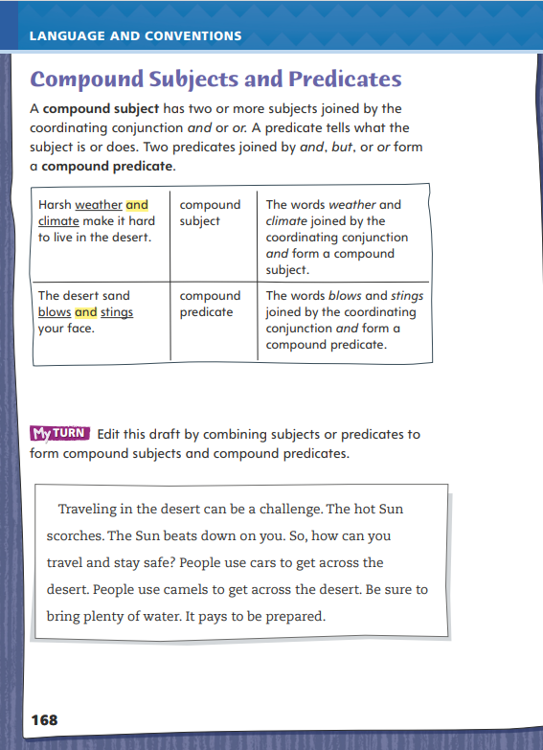
Page 168
Language and Conventions
Turn to page 168 in your Student Interactive and complete the activity.
Notes:
Have students edit the draft paragraph on Student Interactive p. 168.

Slide 74
Lesson 5

Slide 75
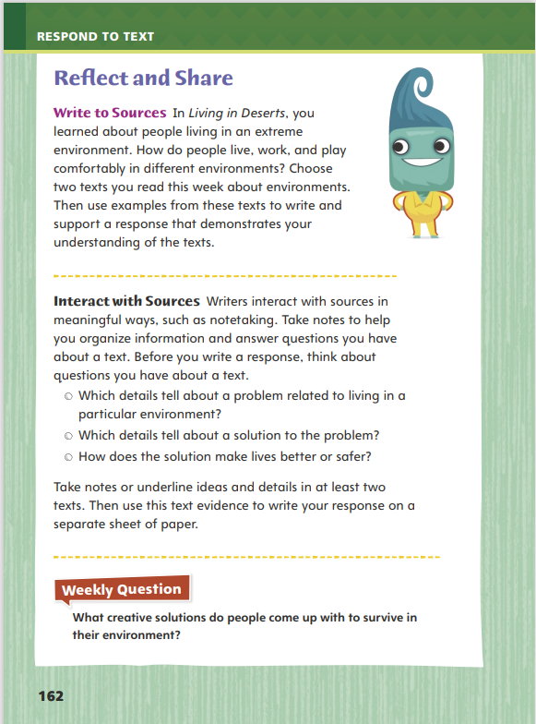
Page 162
Reflect and Share
Turn to page 162 in your Student Interactive.
Notes:
Explain that interacting with sources involves carefully analyzing texts. Remind students that notetaking is one way to interact with a text to help deepen their understanding.
As you read, identify key details in the texts that relate to a topic or idea.
Write down the key details or underline them in the texts. • Compose a brief explanation telling why the details are important.
Model how to take notes using the Write to Sources prompt on p. 162 in the Student Interactive.
Tell Students: To write a response to the Write to Sources prompt, I need to find examples in two texts demonstrating how people live, work, and play comfortably in their environment. I choose two texts that I read this week that take place in different environments. I scan the texts and take notes that describe how people solve problems to live, work, and play comfortably in each environment. Then I use this text evidence to support my response.
Have students work with a partner to practice identifying key details and taking notes that will support their response to the Write to Sources prompt.

Slide 76
Page 162
Apply
What creative solutions do people come up with to survive in their environment?
Notes:
Have students use evidence from the texts they have read this week to respond to the Weekly Question. Tell them to write their responses on separate sheets of paper.

Slide 77
Word Study
please
seed
peeler
snowball
loaded
tailor
reading
delay
Notes:
Flexible Option
Display the words please and seed. Read aloud the words, and identify the sound each vowel digraph makes. Note that they make the same sound. To assess students’ understanding of vowel digraphs, provide them with the following words:
peeler
loaded
reading
snowball
tailor
Delay
Have students use their knowledge of vowel digraphs to sort the words into pairs whose vowel digraphs have the same long vowel sound. (peeler, reading; tailor, delay; snowball, loaded)

Slide 78
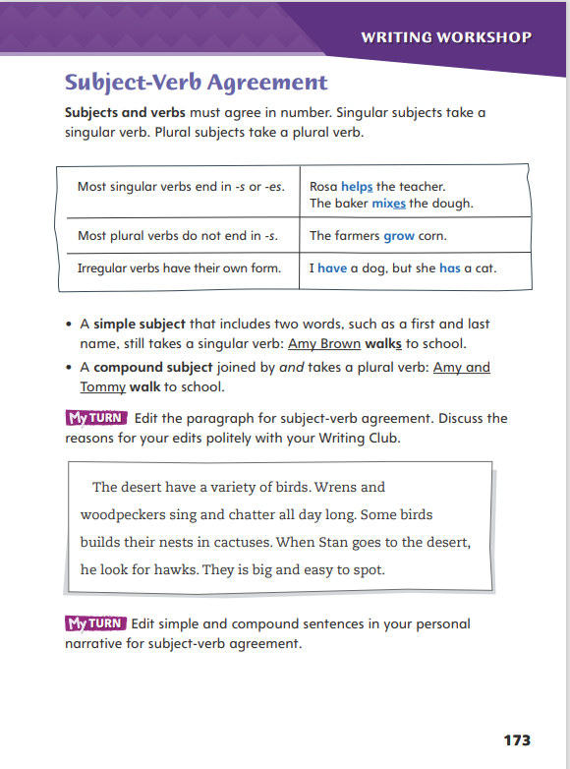
Page 173
Writing – Personal Narrative
Turn to page 173 in your Student Interactive.
Notes:
Subject-verb agreement is the correct pairing of singular subjects with singular verbs and of plural subjects with plural verbs. Most singular verbs end in -s, most plural verbs do not end in -s, and other verbs are irregular. Below are rules for certain situations:
If a subject is singular but composed of more than one word, it takes a singular verb. Antonio Davis lives next door.
Two or more singular subjects joined by and create a compound subject that takes a plural verb. Carmen and Mason ride the bus to school.
Collective nouns usually take a singular verb. The class arrives before the bell.
Tell students that subject-verb agreement is important to authors because it makes their writing easier to understand. Sometimes it is obvious how to make the subject and verb of a sentence agree. Other times, it may be necessary to cross out other parts of the sentence (such as prepositional phrases) to make the subject-verb pair stand out.
Read some personal narratives from the stack. Help students identify different types of subject-verb agreement. Ask: What is the subject? What is the verb? Are they singular or plural?
Direct students to p. 173 in the Student Interactive. Review the top of the page together, and have students complete the activities independently.

Slide 79
Independent Writing
Choose one topic you would like help with during Writing Club.
Share your draft of your personal narrative.
Notes:
Tell students to ask any questions they have about subject-verb agreement, including challenging situations they found while editing their own work. Assign students who have a strong understanding of subject-verb agreement to answer the questions of their peers.
Before sharing their work, students should review the topics covered in this week’s minilessons and choose one topic that they would like help with in today’s Writing Club. Before students share the draft of their personal narrative, they should inform their Writing Club of the topic they chose. The discussion after each share will focus on the way the writer presents this element in the personal narrative

Slide 80
Spelling
1. The owner of the store is friendly.
2. These peaches are sweet.
3. I fell asleep at 8:30 last night.
4. My parents display our pictures on the wall.
5. My shadow is tall early in the morning.
6. I had a dream about scoring a goal.
7. She braided her hair to keep it neat.
8. My parents use charcoal in the grill.
9. We all agree that lunch today was tasty.
10. I do my schoolwork so that I can maintain good grades.
Notes:
(Note: Move the orange boxes to cover each bold spelling word before you read aloud the words and sentences.)
Read aloud the words and sentences. Have students spell each word with initial consonant blends and the two high-frequency words.
The owner of the store is friendly.
These peaches are sweet.
I fell asleep at 8:30 last night.
My parents display our pictures on the wall.
My shadow is tall early in the morning.
I had a dream about scoring a goal.
She braided her hair to keep it neat.
My parents use charcoal in the grill.
We all agree that lunch today was tasty.
I do my schoolwork so that I can maintain good grades.
Reveal the spelling word and have students check their work.

Slide 81
Language and Conventions
The bee buzzes _____ flies from flower to flower.
Which conjunction could be added to make the sentence have a compound predicate?
but
and
either
however
Notes:
Flexible Option
Display these sentences and have students respond independently.
The bee buzzes ____ flies from flower to flower.
Which conjunction could be added to the sentence to make the sentence have a compound predicate?
but
and
either
however
Have students complete Language and Conventions p. 14 from the Resource Download Center

Slide 82
Unit 1: Week 4
Grade 3

