Slide 1
Unit 1: Week 5
Grade 2

Slide 2
Copyright © Savvas Learning Company LLC. All Rights Reserved.
This publication is protected by copyright, and permission should be obtained from the publisher prior to any prohibited reproduction, storage in a retrieval system, or transmission in any form or by any means, electronic, mechanical, photocopying, recording, or otherwise. For information regarding permissions, request forms, and the appropriate contacts within the Savvas Learning Company Rights Management group, please send your query to:
Savvas Learning Company LLC, 15 East Midland Avenue, Paramus, NJ 07652
or
k12learningpermissions@savvas.com
myView Literacy® is an exclusive trademark of Savvas Learning Company LLC in the U.S. and/or other countries.

Slide 3
Lesson 1

Slide 4
Page 160
Phonological Awareness
Notes:
Say the word cat. Explain that the word cat has three sounds or phonemes: /k/ /a/ /t/. Tell students you can change the word cat by taking away the /k/ sound at the beginning and adding the /m/ sound to make the word mat.
Point to the picture of the lock on p. 160 of the Student Interactive. Tell students to listen carefully to the beginning sound as you say lock. Have students say the word. Point to the second picture on p. 160. Tell students to listen carefully to the beginning sound as you say block. Point to the first picture again and say lock. Point to the second picture and say block. Show students that the sound /b/ was added to the beginning of lock to make the word block. Say: We can change words by adding and taking away sounds. Have students repeat the two words with you several times.
Point to the picture of the tape and say the word. Ask students to repeat the word. Ask them what word they can make if they take away /t/ from tape. Provide practice with other words. Say: Say the word book with me. What word do we have if we take away /b/ and add /k/? Say the word hand with me. What word do we have if we take away /h/ and add the blend /s/ /t/? Say the word short. What word do we have if we take away the digraph /sh/ and add the blend /s/ /p/?
Have partners say the word for each picture at the bottom of p. 160. Then have them circle the picture that adds a sound to the beginning of the first word and underline the picture of the word that takes away a sound from the first word. Finally, have students say each word several times.

Slide 5
Phonics
jump
cat
jumped
glass
jumping
Notes:
This week students will be working with inflected endings. Write: jump. Tell students you can change the word and its meaning by adding an ending. Add -ed to jump. Say: The word jump is happening now. Adding -ed changes the meaning. Jumped means that we jumped in the past. Erase -ed and add -ing. Ask students: When are we jumping?
Write: cat. Say: If I add an s to this word, I make a word that means more than one cat. Write: glass. Say: If I want to show there is more than one glass, I need to add -es. Words that end in -s need -es to show plural.

Slide 6
High-Frequency Words
follow
show
form
Notes:
Display the high-frequency words follow, show, and form. Tell students these are the high-frequency words they will practice reading this week.
Read each word and have students repeat it. Use the words in oral sentences: My dog likes to follow me; Show me what to do; I can form letters.
Call on several students to use one of the words in an oral sentence.
Have students close their eyes. Erase one of the words. Ask students to open their eyes and tell which word is missing. Repeat several times.

Slide 7
Page 158,159
Interact with Sources
Look at the information about Washington and Arizona.
How are these places alike?
How are these places different?
How would life be different in each place?
Notes:
Remind students of the Essential Question for Unit 1: How do different places affect us? Point out the Week 5 question: How can a new place help us change and grow?
Direct students’ attention to the infographic on pp. 158–159 in the Student Interactive. Divide the class into small groups. Have them read the infographic and make connections by comparing and contrasting Washington and Arizona. Ask students to underline information that is different for each place.
Then use these questions to guide discussion on the infographic:
How do the mountains look different in Washington and Arizona?
How are the two small photos on the page different?
What do the bar graphs show?
How much rain does each place get?
How are these places like where you live? How are they different?
Would you rather live in Washington or Arizona? Why?
Reread the Week 5 Question: How can a new place help us change and grow? Tell students they just learned how different places affect how we live. Explain that they will learn more about this topic this week.
Have students discuss and answer the questions on p. 159 in the Student Interactive.

Slide 8
Listening Comprehension
PLOT ELEMENTS
Problem:
Main Events:
1.
2.
3.
Resolution:
Notes:
Tell students you are going to read aloud a realistic fiction story. Explain that students should listen actively, paying careful attention to the events as you read. Prompt them to ask relevant questions to clarify information, to answer questions using multi-word responses, and to follow agreed-upon discussion rules.
Have students listen actively for elements of realistic fiction.
Read the entire text aloud without stopping for the Think Aloud callouts.
Reread the text aloud, pausing to model Think Aloud strategies related to the genre and the plot elements.
Use a story map to help students identify the plot elements in “A New Home.”

Slide 9
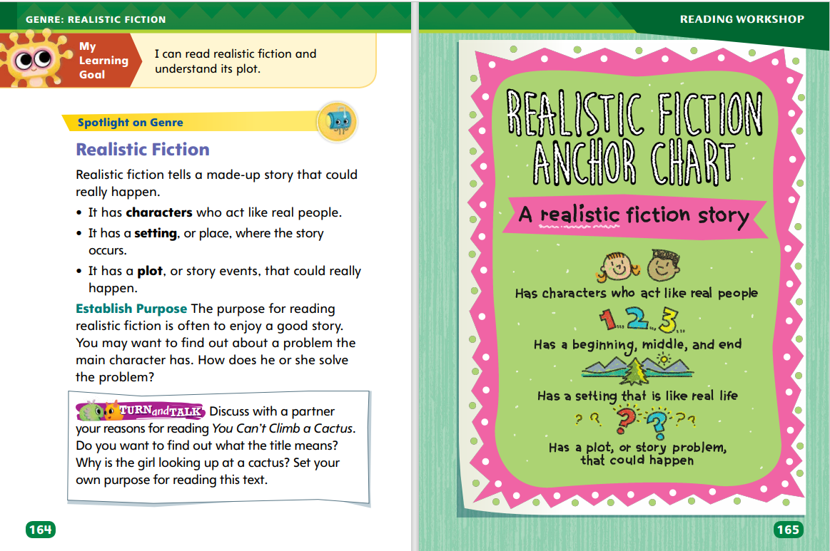
Page 164,165
Realistic Fiction Qualities
Turn to page 164 in your Student Interactive.
Notes:
Explain that realistic fiction is a made-up story that could really happen. The plot, or events in the story, are often told in the order that they happened. The main character faces a problem and often finds a resolution, or solution, by the end of the story. Tell students to think about the following questions as they read realistic fiction.
What is your purpose for reading realistic fiction? Do you want to enjoy the story or find out how a character solves a problem?
What are the main events in the story? What happens first, next, and last? How can I describe the main events of the plot?
Look for details about the character’s problem. How is the problem solved by the end of the story?
Model determining a purpose for reading realistic fiction. Say: Before I read “A New Home,” I need to set a purpose for reading. This will help guide my reading. The title tells me that the new home is an important part of the story. I wonder if the new home is the main problem in the story. As I read, I will pay attention to the plot events to find out what the home has to do with main events.
Discuss the plot elements of traditional texts with which students are familiar. Talk about whether these stories are realistic and how the characters solve their problems.
Read the Anchor Chart on page. 165 in the Student Interactive together. Editable Anchor Chart Click Path: Table of Contents -> Reading Anchor Charts -> Unit 1 Week 5 : Realistic Fiction Editable Reading Anchor Chart

Slide 10
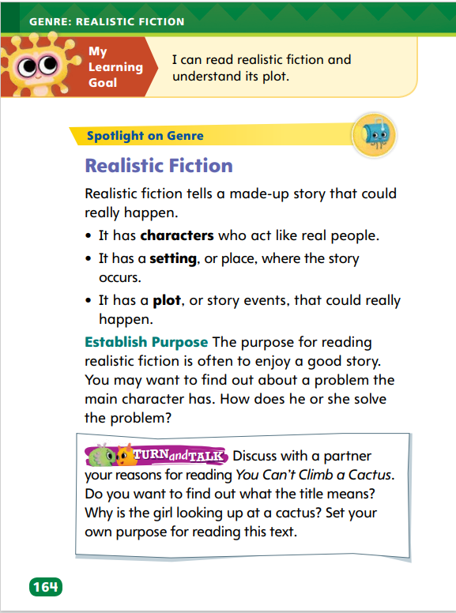
Page 164
Apply
Discuss with a partner your reasons for reading You Can’t Climb a Cactus.
Notes:
Have students complete the Turn and Talk activity on p. 164 of the Student Interactive. Call on volunteers to share their purpose with the class.

Slide 11
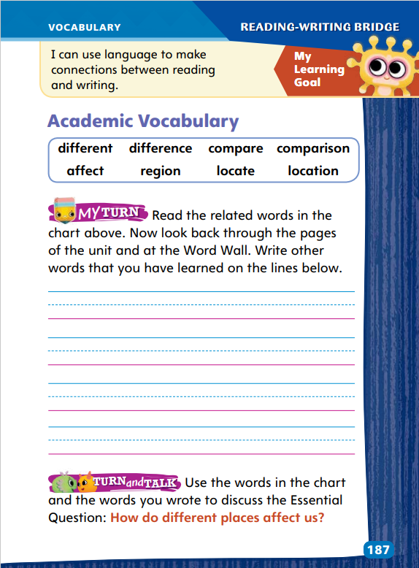
Page 187
Academic Vocabulary
different
compare
locate
Notes:
Review the Academic Vocabulary from the unit with students. Remind them that some words are related and have similar meanings but are used differently in sentences. Tell them they can learn to use new words they read in texts.
Record new words you read in texts.
Read the context for the new word.
Think of a word with a similar meaning.
Notice any suffixes and how the word is used in the sentence.
After students have followed these steps, have them use new words in their discussions and writing.
Have students look at the words on the top of p. 187 in the Student Interactive. Say the following words and have students name a related word: different (difference), compare (comparison), locate (location). Then say: I know the word difference is related to different and has a similar meaning. I’ll look back in the text to see how the words are used. Then I’ll know how to use the words on my own. Ask volunteers to use the words different and difference in sentences.
Have students complete the activity on p. 187 on the Student Interactive.

Slide 12
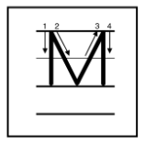
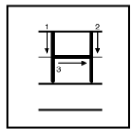
Handwriting
Notes:
Display uppercase and lowercase letters Mm, Hh, and Vv.
Model writing uppercase and lowercase Mm, Hh, and Vv. Work with students to explain how to form the letters properly.
Have students use Handwriting p. 21 in the Resource Download Center to practice writing Mm, Hh, and Vv. Click path: Realize -> Table of Contents -> Resource Download Center -> Handwriting Practice -> U1W4L1 Handwriting Practice

Slide 13
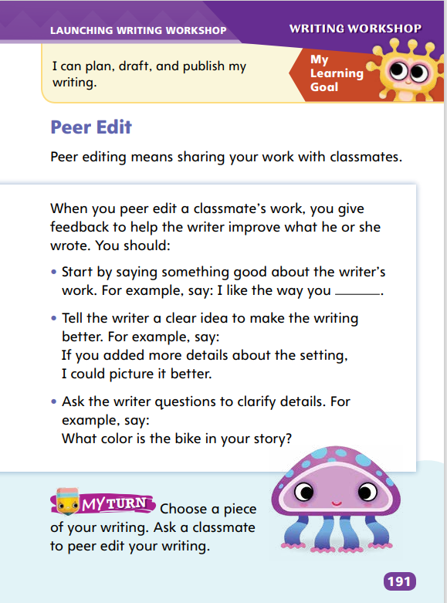
Writing – Launch Writing Workshop
Page 191
Turn to page 191 in your Student Interactive.
Notes:
Giving classmates thoughtful feedback to improve their writing is called peer editing. Peer editing includes
pointing out strong points in the writing
providing clear suggestions for improvement in a respectful way
asking questions to clarify details
Say: You will make comments about your classmates’ writing to help improve their work. This process is called peer editing. When you peer edit, you make comments on both strong points and weak points in the writing. You should give feedback in a positive and respectful way. For example, if someone tells me that my story is so boring it puts them to sleep, my feelings would be hurt. Also, that comment doesn’t tell me how to make the story better. However, if the person says, “I do not really understand where the story is taking place,” my feelings would not be hurt and I know that I have to explain more clearly where the action is happening. Point out that using negative language such as boring, stupid, and dumb is not useful or polite.
Direct attention to the bulleted list on p. 191 in the Student Interactive. Have students echo-read each item with you. Ask volunteers to offer suggestions on how to complete the comment in the first bullet. Emphasize that students should use these steps when giving their classmates feedback.
Redirect students’ attention to the My Turn activity. Have them select a piece of writing for a classmate to peer edit. Pair students for this activity. Then transition students to independent writing.

Slide 14
Independent Writing
Your turn! Use the questions on page 191 to give suggestions to a classmate to improve their writing.
Share a positive comment you made and a helpful suggestion you received.
Notes:
Have students use the approach on p. 191 to offer suggestions to classmates on how to improve their writing.
Writing Support
Modeled - Do a Think Aloud to model how to make a clear suggestion for improving a classmate’s writing.
Shared - Read a page from a familiar text. Have students offer positive comments about the writing. Record students’ responses as models for peer editing
Guided - Provide explicit instruction on how to make positive comments that help a writer improve a draft.
Have students share a positive comment they made to a classmate and a suggestion they received that will improve their writing.

Slide 15
Spelling
I dropped my book.
The light switches on at night.
Follow me to the end of the trail.
How many boxes are in the basement?
She smiled at me from across the room.
Thank you for taking my sister to the game.
I left three notes on the kitchen counter.
Can you show me how to play soccer?
The babies are cute.
We all brought our lunches today.
I cannot stop dropping the wet football.
What are your favorite tunes?
Notes:
(Note: Move the orange boxes to cover each bold spelling word before you read aloud the words and sentences.)
Read aloud the words and sentences. Have students spell each word with initial consonant blends and the two high-frequency words.
I dropped my book.
The light switches on at night.
Follow me to the end of the trail.
How many boxes are in the basement?
She smiled at me from across the room.
Thank you for taking my sister to the game.
I left three notes on the kitchen counter.
Can you show me how to play soccer?
The babies are cute.
We all brought our lunches today.
I cannot stop dropping the wet football.
What are your favorite tunes?
Reveal the spelling word and have students check their work.

Slide 16
Language and Conventions
What is your favorite food.
Correct the punctuation for this sentence.
Work with your partner to correct the sentences given to you.
Notes:
Flexible Option
Review the types of sentences (declarative, interrogative, and exclamatory) and the corresponding end punctuation for each.
Share the following sentence with students: What is your favorite food. Then guide students to correct the sentence by adding the correct end punctuation and identifying the type of sentence as interrogative. (What is your favorite food?)
Have pairs work together to correct sentences, such as: Cheese sandwiches are my favorite food? (Cheese sandwiches are my favorite food.

Slide 17
Lesson 2

Slide 18
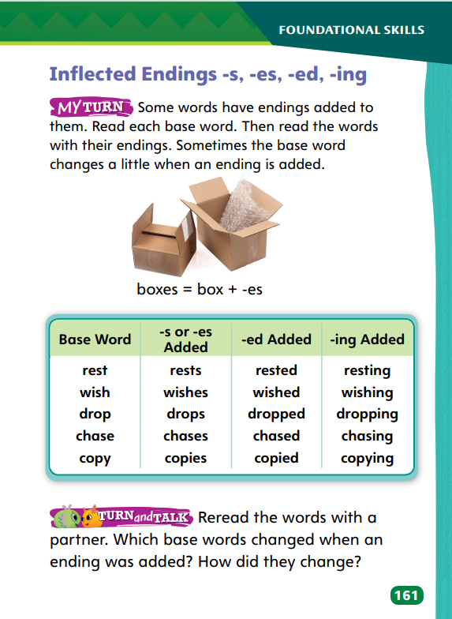
Page 161
Phonics
-s
-es
-ed
-ing
Turn to page 161 in your Student Interactive.
Notes:
Write the inflected endings: -s, -es, -ed, and -ing. Explain that these endings can be added to words to change their meaning or part of speech. Point out that adding -s or -es changes a word to its plural, meaning more than one. Explain that -s, -es, and -ing can be added to a verb to show something is happening now. The ending -ed can be added to a verb to show that something happened in the past.
Write these sentences, and model decoding the words with inflected endings: Dan rests. He is resting. Dan wishes he had rested yesterday. Then say: By decoding the inflected endings on the base words rest and wish, I can learn when Dan rests and wishes. Write: Dan keeps falling asleep. Dan dozes in the chair he painted. Have students demonstrate phonetic knowledge by decoding the words with the inflected endings -s, -es, -ing, and -ed and telling you their meanings.
Have pairs take turns decoding the base words and the words with inflected endings -s, -es, -ed, and -ing in the chart on SI p. 161.
Have pairs complete the activity on SI p. 161.

Slide 19
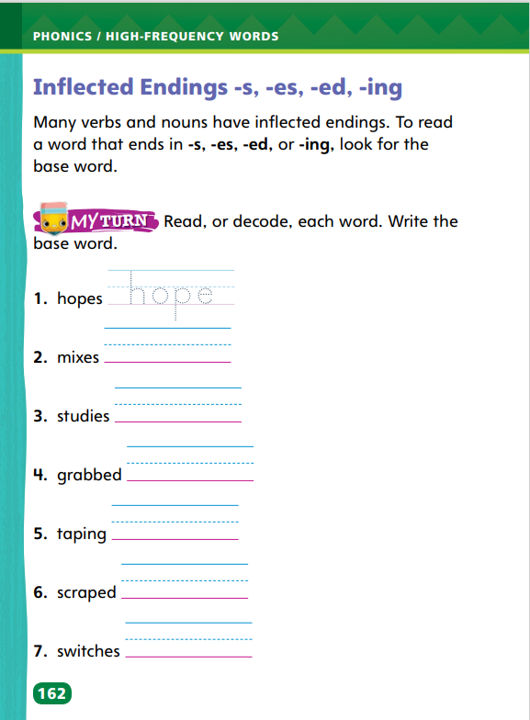
Page 162
Apply
Turn to page 162 in your Student Interactive.
Write the base word on the lines.
Notes:
Read aloud the text at the top of SI p. 162 with students.
Write wish, drop, and copy. Then write wishes next to wish, dropped and dropping next to drop, and copying and copied next to copy. Have students write all these words, and discuss as a class how each base word changes when the inflected ending -es, -ed, or -ing is added. Next, have students read the word hopes in item 1, noting the inflected ending -s. Ask them what the base word is and have them write it on the lines.
Have students use these strategies for decoding and writing words with inflected endings.
Have students decode and legibly print the base word for items 2-7 on SI p. 162.

Slide 20
High-Frequency Words
follow
form
show
Notes:
Display the high-frequency words follow, form, and show. Read aloud the words with students.
Have students point to the word form. Then repeat with the words show and follow.
Randomly point to the words and have students say each word you point to.
Have students point to a word, say it, and use it in a sentence.

Slide 21
Page 166
Preview Vocabulary
excited
favorite
tour
guide
explore
Notes:
Introduce the words on p. 166 in the Student Interactive and define them as needed.
excited: thrilled; looking forward to
favorite: liked better than others
tour: a visit to see things
guide: a person who shows people around
explore: to look around a place to learn things
To reinforce the meanings of the words for students, ask them questions about the words: When was a time you got excited? What is your favorite food? What kind of tour would you like to take? How could you use a guide in an unfamiliar city? What is something you would like to explore?

Slide 22
First Read Strategies
Notes:
Discuss the First Read Strategies with students. Prompt students to establish the point that the purpose for reading this selection is understanding and enjoyment.
Explain the four steps of the first read.
LOOK Have students use the pictures and title to make a prediction about the story. Remind them to revise and confirm their predictions as they read.
ASK Encourage students to ask themselves what the story is about.
READ Have students keep their purpose for reading in mind as they read.
TALK Ask students to talk about how the story answers the weekly question..
Students may read the text independently, in pairs, or as a whole class. Use the First Read notes to help students connect with the text and guide their understanding.

Slide 23
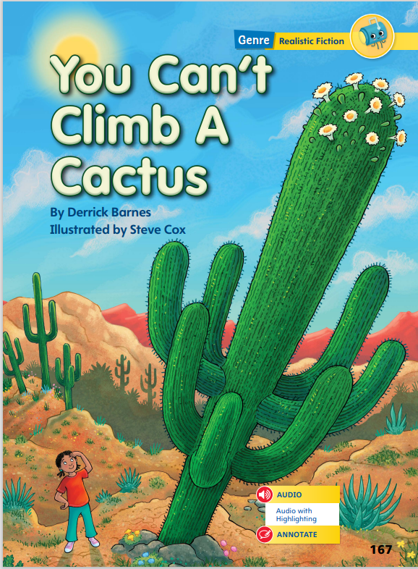
Page 167
First Read – You Can’t Climb a Cactus
Notes:
Students may read the text independently, in pairs, or as a whole class. Use the First Read notes to help students connect with the text and guide their understanding.

Slide 24
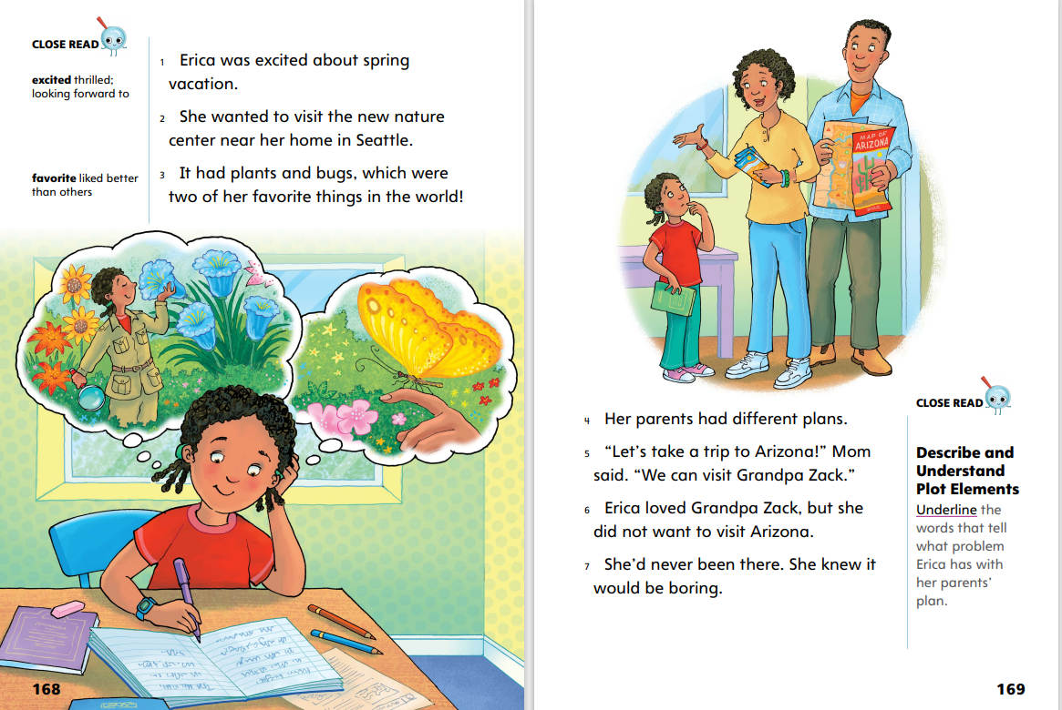
Page 168, 169
First Read – You Can’t Climb a Cactus
Notes:
Read Together.
THINK ALOUD Before I read, I set a purpose, or a goal, for reading. I know that this text is realistic fiction, or a made-up story that could really happen. I want to read to enjoy the story, but I want to set a more specific purpose too. I read on this page that Erica is excited for her vacation. My purpose for reading the next few pages will be to find out more about Erica and her vacation.
THINK ALOUD As I read, I ask myself: What is this text about? At first, I thought it would be about Erica’s trip to visit a nature center near her home in Seattle. Now, I read that her parents have a different plan for her. They want to take a trip to Arizona instead. Where will they decide to go? What will happen? I’ll keep reading to find out.

Slide 25
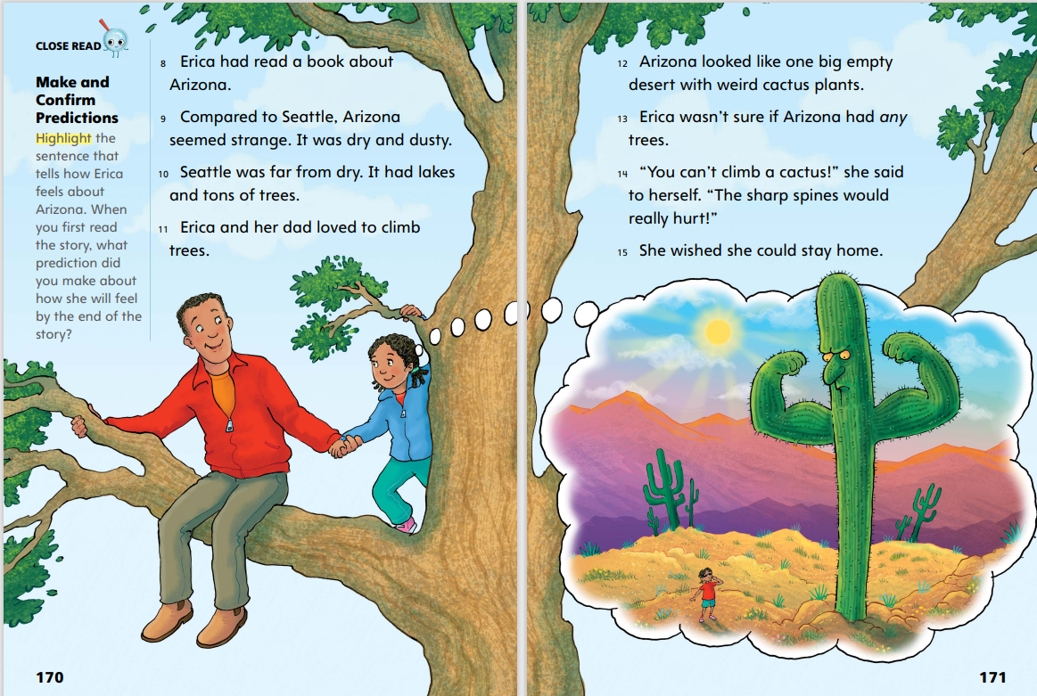
Page 170, 171
First Read – You Can’t Climb a Cactus
Notes:
Read Together.
THINK ALOUD As I look at the text and the illustrations, I make predictions about what will happen in the story. I see in the picture that Erica and her dad have a lot of fun in Seattle, and I read that Erica thinks Arizona is “strange.” Erica is worried that she won’t have any fun in Arizona, but I predict that she might like it more than she thinks she will.
THINK ALOUD As I read this story, I think about the weekly question: How can a new place help us change and grow? I talk with a partner about how Erica would answer this question. Erica thinks Arizona is a “big empty desert with weird cactus plants.” She doesn’t want to go to a new place because she doesn’t think she’ll like it. If she goes somewhere new, she might learn something new or try something she wouldn’t be able to do at home. The trip might help her change and grow.

Slide 26
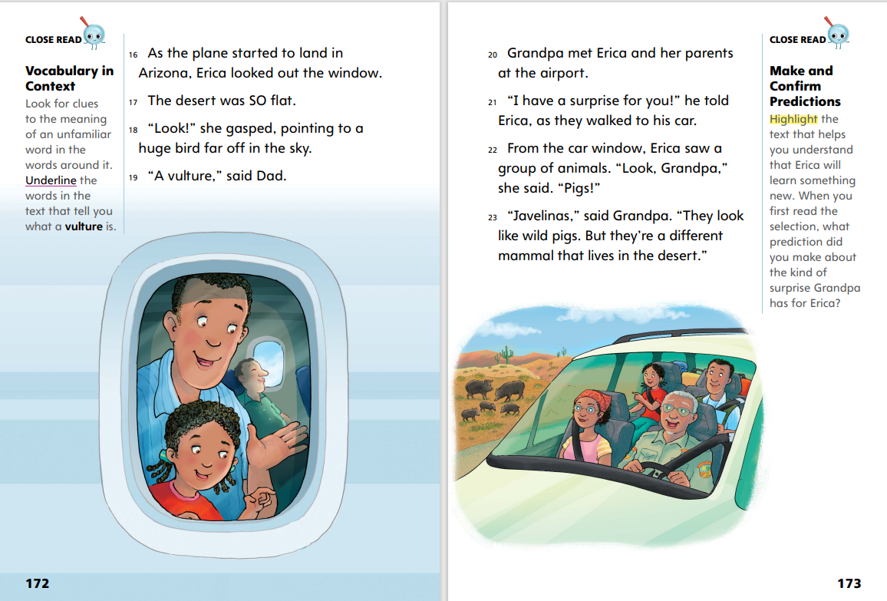
Page 172, 173
First Read – You Can’t Climb a Cactus
Notes:
Read Together.
THINK ALOUD As I look at the text and the illustration, I think about the prediction I made about Erica’s feelings. She wasn’t happy about going to Arizona, but now I see her smiling and pointing out the window. She “gasped” as she pointed at the bird, which tells me she’s excited. I think she might be starting to change her mind about Arizona.
THINK ALOUD As I read, I think about my purpose for reading. At the beginning of the story, I said my purpose for reading was to find out more about Erica’s vacation. While reading, I mark details related to that purpose. For example, Erica sees a family of pigs called javelinas while she’s on her vacation to Arizona. I pay attention to details like this about her vacation.

Slide 27
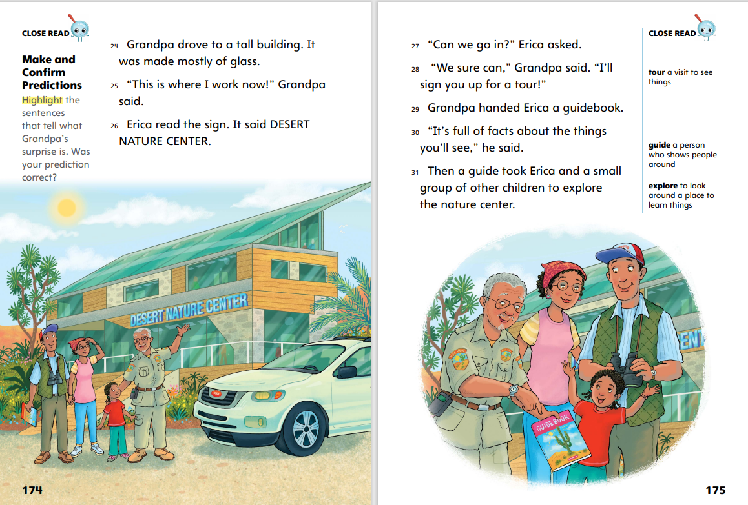
Page 174, 175
First Read – You Can’t Climb a Cactus
Notes:
Read Together.
THINK ALOUD As I read, I remember to ask questions to help me understand what the text is about. What kind of place is the desert nature center? Is it like the nature center near Erica’s home in Seattle? I’ll read to find out more.
THINK ALOUD As I keep reading, I look again at the weekly question: How can a new place help us change and grow? I can see that already, Erica is changing her ideas about the new place. At this nature center, Erica can learn about nature in Arizona, which is different from nature in Seattle. Talk with a partner about how, by being in a new place and trying new things, Erica is learning more about the world around her.

Slide 28
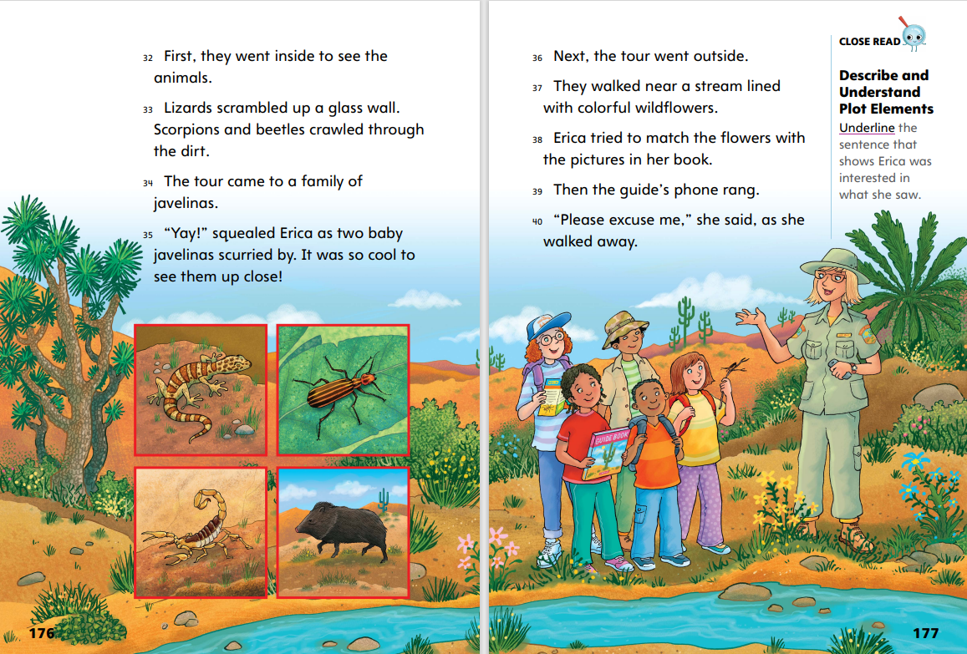
Page 176, 177
First Read – You Can’t Climb a Cactus
Notes:
Read Together.
THINK ALOUD As I read, I think about the prediction I made earlier. I predicted Erica would start to like Arizona by the end of the story. On this page, I see some clues that she is starting to have fun in Arizona. She squeals “Yay!” when she sees the javelinas, which tells me she is excited. She thinks it’s “so cool” to see the javelinas up close. I think my prediction will be correct.
THINK ALOUD As I read, I ask myself “What is this story about?” After I read each page, I can retell what happens in the story to help me understand what it’s about. On this page, Erica looks at wildflowers while she takes the nature tour. At the end of the page, the guide’s phone rings and she walks away from the group. I wonder what will happen when the guide leaves.

Slide 29
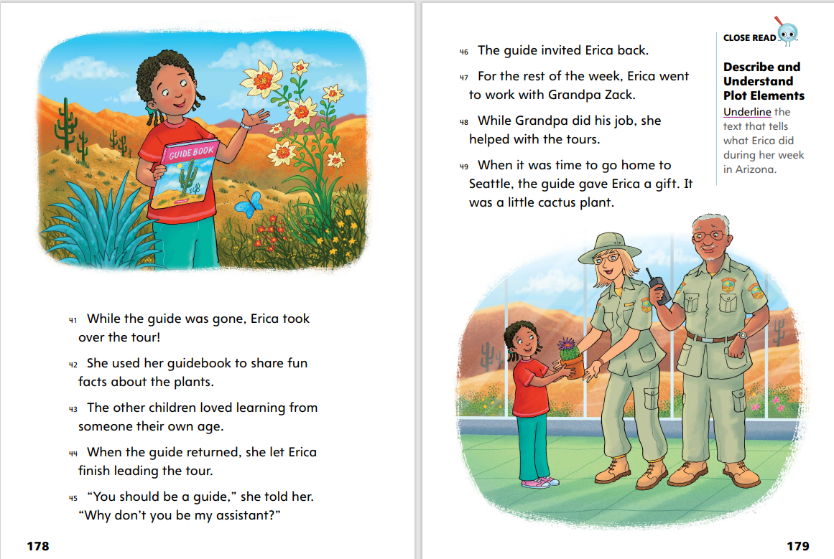
Page 178, 179
First Read – You Can’t Climb a Cactus
Notes:
Read Together.
THINK ALOUD As I read, I think back to my purpose for reading. I wanted to learn more about Erica’s vacation. I learn on this page that Erica chose to lead the nature tour while the guide was away. This seems like it would be a hard thing to do, especially in a new place! But I know that Erica knows a lot about nature, and she has the guidebook to help her. I think leading the tour will be a very important part of her vacation.
In pairs, have students revisit the weekly question: How can a new place help us change and grow? Have students discuss specific examples from the text that support their answers. To guide students, provide sentence frames such as: Erica changes because_______ and Erica grows and learns by_________.

Slide 30
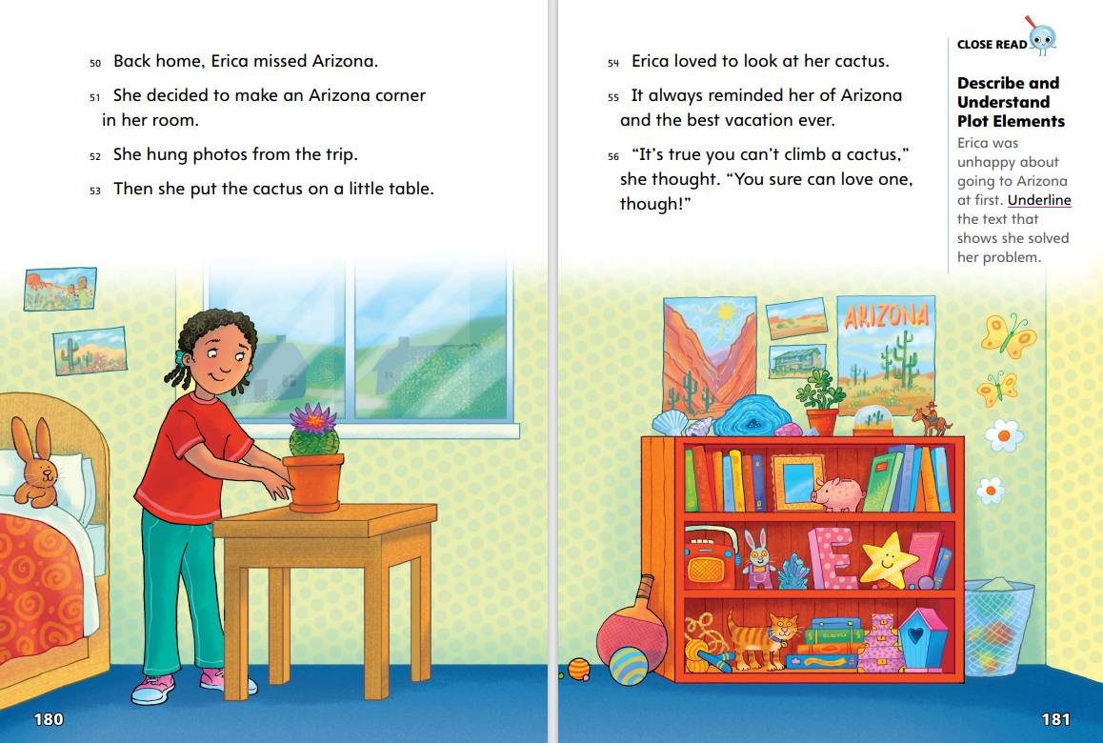
Page 180, 181
First Read – You Can’t Climb a Cactus
Notes:
Read Together.
THINK ALOUD As I read the ending of the story, I look at the illustrations and think about the prediction I made. I thought Erica would end up enjoying her trip to Arizona. I’ll look for evidence or clues in the text that can tell me if my prediction was correct. I read that Erica missed Arizona, and that she hung photos from her trip. The illustration shows that she puts the cactus in a special place. All of these things tell me she has good memories from her trip to Arizona and she wants to be reminded of these memories when she is in her room. My prediction about Erica’s feeling was correct.
THINK ALOUD When I read the ending of the story, I ask myself: What was this story about? What did the author want me to learn from this story? The story was about Erica’s vacation. I know that at first, Erica didn’t want to go to Arizona, but in the end, it was “the best vacation ever.” I think the author was trying to send a message about trying new things and exploring new places.

Slide 31
Respond and Analyze
Discuss: What did you think about this text?
React: What part surprised you or interested you the most?
Notes:
Use these suggestions to prompt students’ initial thoughts and feelings about You Can’t Climb a Cactus.
Discuss What did you think about this text?
React What part surprised you or interested you the most?

Slide 32
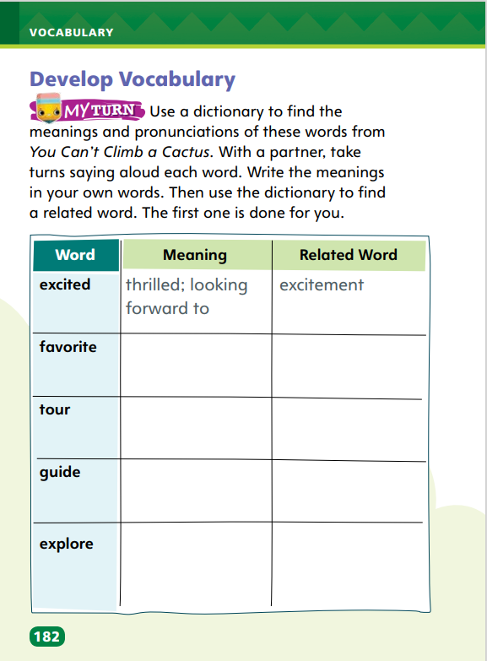
Page 182
Develop Vocabulary
Turn to page 182 in your Student Interactive and complete the activity.
Notes:
Tell students that authors choose vocabulary to describe key plot elements. The vocabulary words excited, favorite, tour, guide, and explore help describe the main events in the plot.
Remind yourself of the word’s meaning.
Ask yourself what the author is trying to describe about events in the plot.
Model filling out the chart on p. 182 in the Student Interactive using the word excited.
Discuss the importance of using appropriate vocabulary for plot elements when writing realistic fiction.
Say: I looked up the meaning of excited in the dictionary. It means “thrilled” or “looking forward to.” I’ll write this in the middle column.
Say: Now I need to look in the dictionary for a word that is related to excited. I’ll write excitement in the column under “Related Word.
Have students respond using newly acquired vocabulary as they complete p. 182 of the Student Interactive.

Slide 33
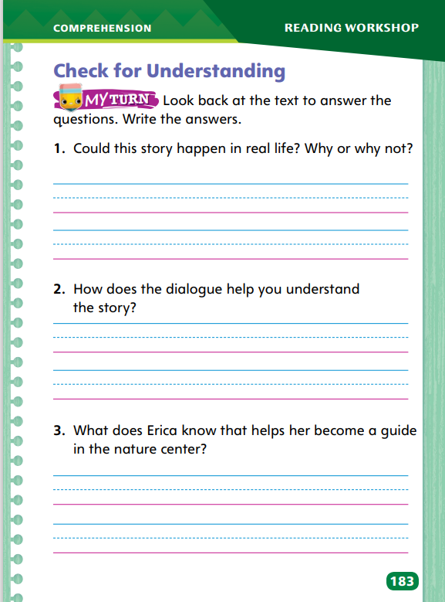
Page 183
Check for Understanding
Turn to page 183 in your Student Interactive and complete the activity.
Notes:
Have students complete p. 183 of the Student Interactive.

Slide 34
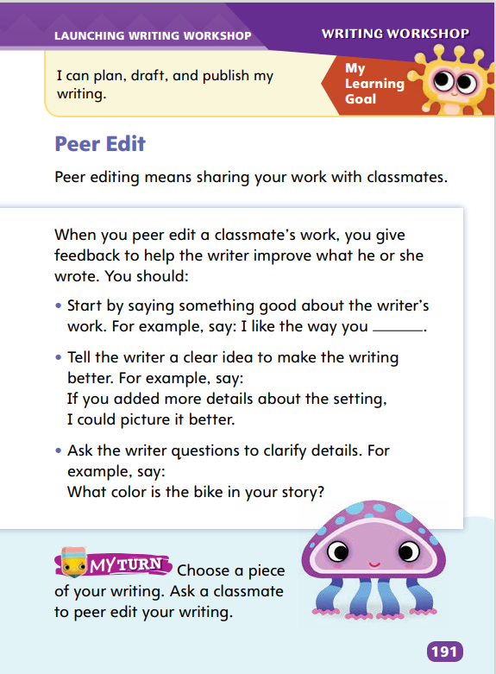
Page 191
Writing – Launch Writing Workshop
Turn to page 191 in your Student Interactive.
Notes:
Writers carefully review feedback from peers and then make revisions based on that feedback to improve their writing.
Direct students to p. 191 in the Student Interactive. Review the types of feedback that result from peer editing: affirming positive qualities, offering clear suggestions to improve the writing, and asking questions to clarify details.
Point out that writers, even famous ones, improve their work by asking others to read it and make comments.
Say: Sometimes, getting a lot of feedback can seem confusing. But following a few steps can help you understand and use the feedback so that you end up with a stronger piece of writing.
Have students echo-read the following steps with you:
Read one comment at a time. Start with the first comment on the page.
Ask yourself whether you understand the comment.
As needed, politely discuss the comment with your classmate.
Once you understand the comment, make the change if you agree with it.
Ask questions, such as: Why is it helpful to read one comment at a time? and What might you say to your classmate if you don’t understand a comment?

Slide 35
Independent Writing
Let’s review the feedback from your peers.
Write notes about any feedback you want clarified.
Share your reaction to feedback you received. Explain how you will use the feedback.
Notes:
Have students think about the feedback they received from their peers. Tell students to write notes about any feedback they would like to have clarified. Suggest that they also note whether they agree with the feedback.
Writing Support
Modeled - Do a Think Aloud to model how to politely discuss comments with classmates.
Shared - Provide a sentence or two that could be improved by adding a detail. Invite volunteers to suggest revisions. Then make the revision and discuss how it improves the writing.
Guided - Provide explicit instruction on evaluating and understanding comments.
If they disagree, tell them to write an explanation of their response that they can use to explain changes they decide not to make.
Invite one or two volunteers to describe their reactions to feedback they received. Ask them to explain how they plan to use the feedback.

Slide 36
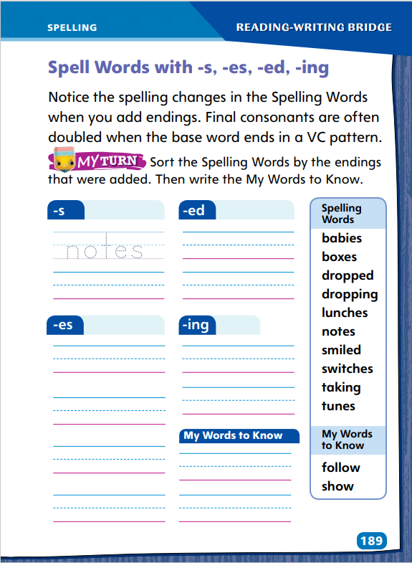
Page 189
Spelling
Turn to page 189 in your Student Interactive and complete the activity.
Notes:
When the inflectional endings -s, -es, -ed, and -ing are added to base words, the spelling of the base word may or may not change.
Display: tune/tunes, drop/dropped, take/taking, box/boxes. Help students identify the base words. Then explain how the spelling of each word changes when an ending is added, including the doubling of final consonants when the base word ends in a VC pattern. Have students practice each spelling.
Have students complete Student Interactive p. 189 to spell words with -s, -es, -ed, and -ing. Use the leveled supports on p. T432 for ELL’s.

Slide 37
Language and Conventions
It was sweltering at the picnic.
Find sweltering in the dictionary.
seemed
Find seemed in the dictionary.
Notes:
Explain that it is often helpful to use a dictionary or glossary to find and spell unfamiliar words. Words in both these resources are listed alphabetically.
Read the following sentence to students: It was sweltering at the picnic. Guide students to search for the word sweltering in a dictionary or glossary, sounding out the beginning of the word to help students search in the correct area of the resource under s. Review steps for looking at the second letter to find the word alphabetically under sw. After the class has located the word, spell the word with students. Then read the definition and discuss how it felt at the picnic.
Have student pairs look up the word seemed in a dictionary or glossary and spell the word to each other orally.

Slide 38
Lesson 3

Slide 39
Phonics
stop
carry
stops
carrying
stopped
carries
stopping
carried
Notes:
Remind students that endings can be added to words to change the way they are used. Point out that sometimes the spelling of the base word changes when endings are added. Write: stop, stops, stopped, stopping and carry, carrying, carries, carried. Have students read the words aloud with you. Discuss the changes in spelling with students.
Tell students: I need to remember how to add inflected endings. This will help me read and spell words. I know that nouns that end in ss, ch, sh, and x have an -es plural ending. In CVC verbs, I double the final consonant before adding an ending. In words that end in y, I delete the y, then add i and es.
Create a set of verb and noun cards, such as: pass (v), rip (v), help (v), kick (v), stamp (v), spot (v), trip (v), guess (v); plan (v), heat (v), flash (v), knot (v), box (v), bus (v), brush (n), lunch (n), plant (n), grade (n), wish (n), bus (n), list (n), stitch (n), tax (n), guess (n). Divide students into teams of about four. Mix up the cards and place them in a box. Tell teams they will take turns drawing a card. If it is a noun, they will say and write the plural form. If it is a verb, they will say and write the past tense form. Correctly spelled words earn a point.
Have students choose a verb and write three sentences, one using the verb with an -s or -es ending, one with an -ed ending, and one with an -ing ending. Ask students to read and check their sentences with a partner.

Slide 40
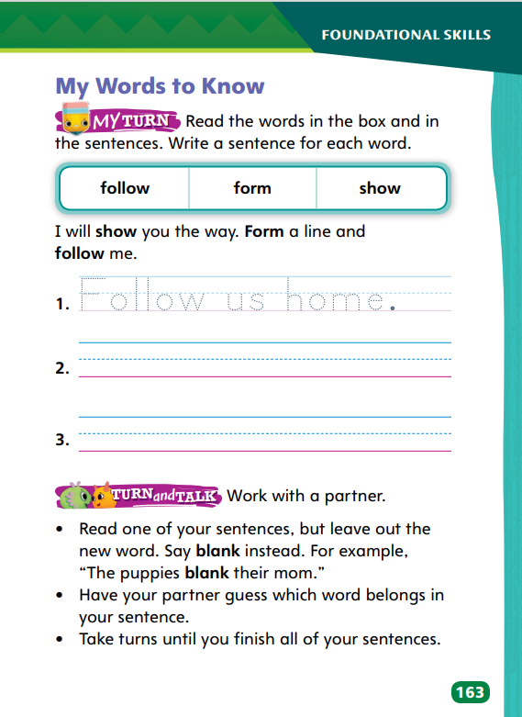
Page 163
High-Frequency Words
follow
Turn to page 163 in your Student Interactive.
form
show
Notes:
Remind students that the words on SI p. 163 are words that they need to practice so they can recognize and read them quickly. Ask students to read aloud the words with you.
I remember words if I pay attention to how they look. I can do this by closing my eyes and picturing them. I can also write them. Have students write each word, checking their spelling by referring to SI p. 163. Then have them trace the word in different colors.
Have students identify, read, and write sentences using the high-frequency words on p. 163 in the Student Interactive.
Have students work with a partner to complete the activity at the bottom of p. 163 in the Student Interactive.

Slide 41
Page 167
Describe and Understand Plot Elements
Notes:
Plot elements include the main events, the problem for the main character, and a resolution of the problem.
Think about the main events. In what order do they happen?
Pay attention to the main character’s problem. What does he or she need to do to solve it?
How was the problem resolved? Did the main character solve it?
Use the Close Read note on p. 169 of the Student Interactive to model how to underline text that helps readers describe and, therefore, understand plot elements.
Say: In paragraph 6, the author writes that even though Erica loves Grandpa Zack, “she did not want to visit Arizona.” In paragraph 7, the author writes, “She knew it would be boring.” I will underline those words.
Have student find and underline the text on SI p. 181 that shows how Erica solves her problem.

Slide 42
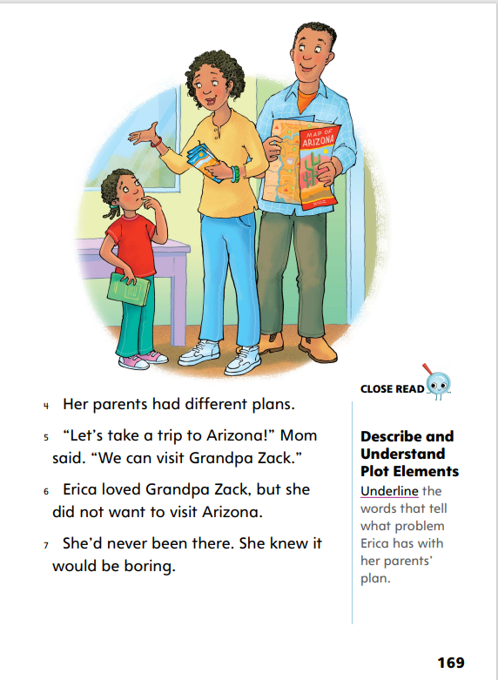
Close Read – Describe and Understand Plot Elements
Page 169
Turn to page 169 in your Student Interactive.
Notes:
Explain that an author uses plot elements in realistic fiction to organize the story. An author often states the main character’s problem early in the story. Readers keep reading to learn how the problem will be resolved.
Have students read paragraphs 6–7 to underline details about Erica’s problem with her parents’ plan. To guide students, ask: What is Erica’s parents’ plan? Why doesn’t Erica like the plan? Find details in the text to support your answer. See student page for possible responses. DOK 2

Slide 43
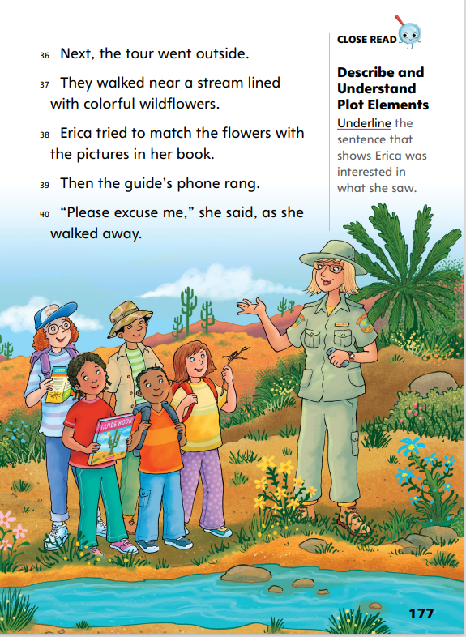
Close Read – Describe and Understand Plot Elements
Page 177
Turn to page 177 in your Student Interactive.
Notes:
Help students find evidence that Erica is changing her mind about the trip. Explain that sometimes, characters’ actions show how they feel. The author won’t always say exactly how a character feels, but his or her actions are clues.
Have students scan paragraph 38 to find and underline the sentence that shows that Erica is interested in what she sees. See student page for possible responses. DOK 2

Slide 44
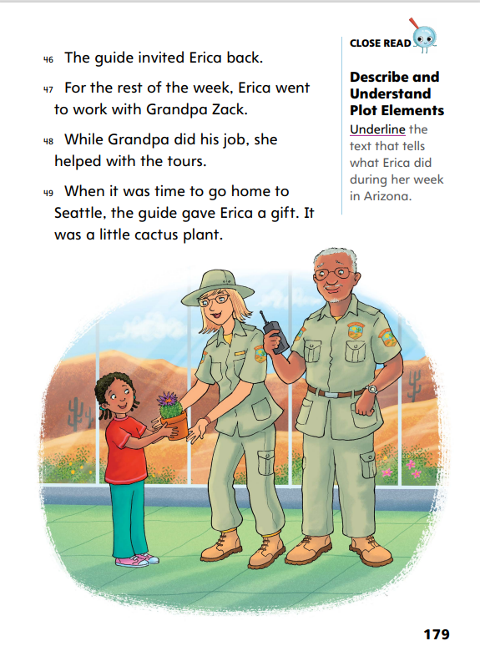
Close Read – Describe and Understand Plot Elements
Page 179
Turn to page 179 in your Student Interactive.
Notes:
Explain that students should keep track of the main events as they read a story. Main events can include the things that characters do and things that happen in a story.
Have students scan paragraphs 47–48 to find and underline the text that tells what Erica did during her week in Arizona. See student page for possible responses. DOK 2

Slide 45
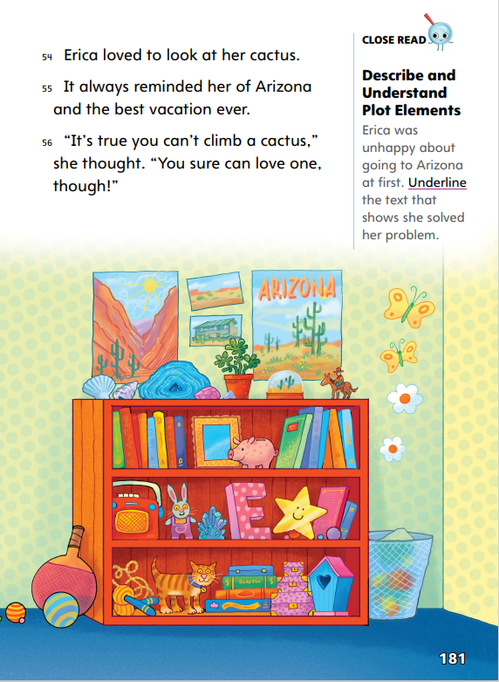
Close Read – Describe and Understand Plot Elements
Page 181
Turn to page 181 in your Student Interactive.
Notes:
Explain that an important plot element in realistic fiction is the resolution of the character’s problem. This resolution is found near the end of the story.
Tell students to think about how unhappy Erica was about going to Arizona at the beginning of the story. This was her problem. Have Erica’s feelings changed?
Have students read paragraphs 55–56 to find and underline the text that shows that Erica solved her problem. See student page for possible responses. DOK 2

Slide 46
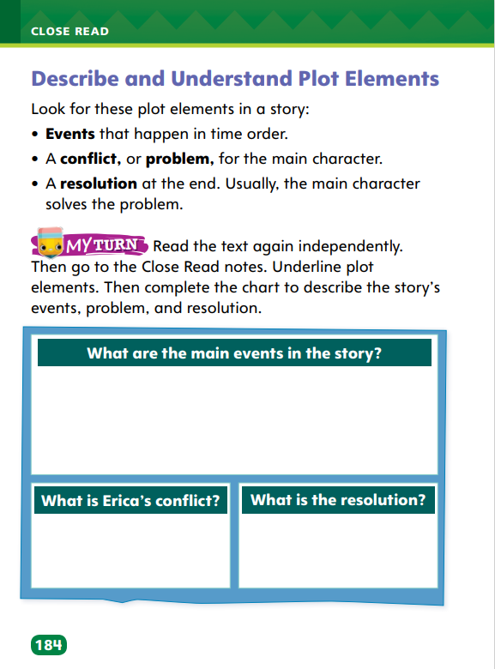
Page 184
Describe and Understand Plot Elements
Turn to page 184 in your Student Interactive and complete the activity.
Notes:
Have students annotate the text using the other Close Read notes for Describe and Understand Plot Elements and then use the text evidence from their annotations to complete the chart on p. 184.

Slide 47
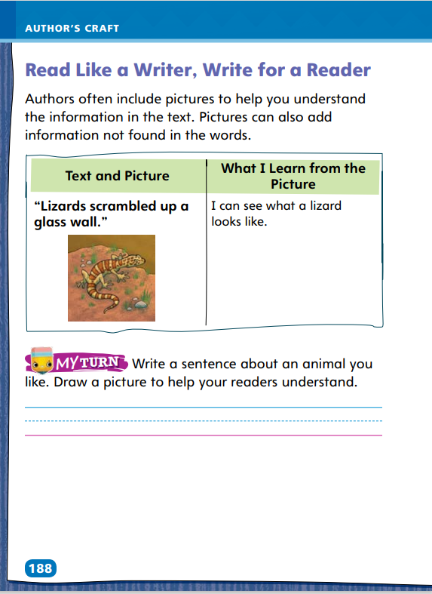
Page 188
Read Like a Writer, Write for a Reader
Turn to page 188 in your Student Interactive and complete the activity.
Notes:
Authors sometimes include print or graphic features to achieve specific purposes. Graphic features might help you understand the information in the text or add information that is not found in the text.
Authors choose graphic features that illustrate what the text is talking about.
Looking at the pictures might help you visualize what the text is describing.
Pictures might also add information about something that is not described in detail in the text.
Model using the example on p. 188 in the Student Interactive to show students how graphic features can enhance understanding and achieve a specific purpose. Tell students: The text says “Lizards scrambled up a glass wall,” and the picture shows a lizard. In the picture, the lizard has a head like a snake. It has stripes and spots on its head. I can see its small legs and long tail. This picture helps me understand what a lizard is. I can also see that it’s in the sand. I think the picture also shows that a lizard lives in a desert. The purpose of this picture is to show details that the text doesn’t describe.
Have students complete the activity on p. 188 of the Student Interactive.

Slide 48
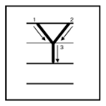
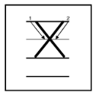
Handwriting
Notes:
Display uppercase and lowercase letters Yy, Ww, and Xx.
Model writing letters Yy, Ww, and Xx. Work with students to help them understand how to form the letters correctly.
Have students use Handwriting p. 22 in the Resource Download Center to practice writing letters Yy, Ww, and Xx. Click path: Table of Contents -> Resource Download Center -> Handwriting Practice -> U1W5L3 Handwriting Practice

Slide 49
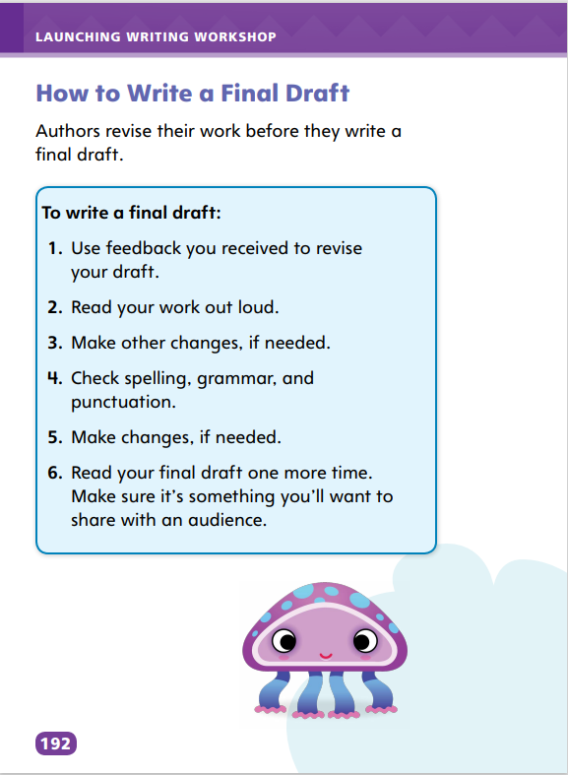
Page 192
Writing – Launch Writing Workshop
Turn to page 192 in your Student Interactive
Notes:
Authors revise their work to create a final, polished draft by incorporating feedback, making other changes that improve content and organization, and checking spelling, grammar, and punctuation.
Say: Today, you will revise the piece of writing you selected for peer editing. To create a draft that is ready to share, you will incorporate revisions your classmates suggested and make other changes that you think are necessary.
Direct students to p. 192 in the Student Interactive. Have students echo-read the steps with you. After reading each step, pose the following question or questions:
Step 1: Do you want to make changes based on the feedback from your classmate? Which ones?
Steps 2 and 3: How does reading your writing aloud to yourself help improve your work? Elicit responses such as “I can identify where words are missing,” “I can identify confusing explanations or details,” “I can hear that the order of information is hard to follow.”
Steps 4 and 5: How can you check the spelling of a word? What kind of grammar mistakes should you look for? Where should you use punctuation?
Step 6: Ask yourself, “Is my writing interesting to my audience? Can others understand what I am trying to say?”
Remind students to use the steps as they revise.

Slide 50
Independent Writing
Let’s make revisions to your writing.
You will use the steps on page 192 in your student interactive to help you.
Share how using the steps helped improve your writing.
Notes:
Have students make revisions to their writing using the steps on p. 192. Help them by listing the types of changes recorded in Step 3.
Writing Support
Modeled - Do a Think Aloud to model reading a piece of writing aloud and identifying necessary revisions.
Shared - Have students read their writing aloud to a partner and then work together to identify text that is confusing or unnecessary.
Guided - Provide explicit instruction on reading aloud to catch mistakes and locate text that needs more clarification.
Ask students to describe how using the steps helped them improve their writing.

Slide 51
Spelling
bones
watches
watched
driving
Notes:
Flexible Option
Remind students that an inflectional ending changes a base word to show tense on a verb or amount on a noun. Write: bones, watches, watched, and driving. Underline each inflectional ending and discuss changes to the spelling of the base word drive.
Write: drop + -ed, baby + -es, take + -ing, and note + -s. Have students spell each base word and then spell each word with the added inflectional ending.
Have students complete Spelling p. 27 from the Resource Download Center. Click path: Table of Contents -> Resource Download Center -> Spelling -> U1W5

Slide 52
Language and Conventions
Name a word you would like find the spelling of.
Find it in the dictionary.
Write the correct spelling and any forms of the word with inflectional endings.
Notes:
Remind students that they can use a dictionary or glossary to find and spell words. Tell them that if a word changes when an inflectional ending is added, this will be shown in a dictionary.
To reinforce the instruction, ask students to name a word they would like to find the spelling of. Ask students to find the correct spelling in a dictionary and then write that spelling on notebook paper, along with any forms of the word that contain inflectional endings.

Slide 53
Lesson 4

Slide 54
Phonics
foxes
chatted
toys
running
Notes:
Write these inflected endings: -s, -es, -ed, and -ing. Remind students that the endings -s and -es can be used to show plural, and the endings -ed and -ing show a change in verb tense.
Write: foxes, chatted, toys, running
Say: I notice that these words have inflected endings, such as -s, -es, -ed, and -ing. To read each word, first I circle the endings. Circle the inflected ending in each word. Then I look for the base word. Underline each base word and read it aloud. Have students repeat after you. Then read the base word with the inflected ending and have students repeat. Note any spelling changes.

Slide 55
Page 185
Make and Confirm Predictions
Remind yourself of what you already know about the story.
Look at clues in the text and combine them with what you already know to guess what will happen next.
Notes:
Tell students that readers should continue to make and confirm or correct predictions as they read.
Remind yourself of what you already know about the story.
Look at clues in the text and combine them with what you already know to guess what will happen next.
Model filling out the chart on SI p. 185 using text from p. 170.
Say: I use what I know about the genre to make predictions: realistic fiction has a problem that needs to be resolved, and my predictions can be about how the problem might be solved. I highlighted “Arizona seemed strange” because this is how Erica feels about Arizona. I will write this in the column “Text I highlighted.” Now I need to write what I predicted after I highlighted this text. I predicted that Erica would not like Arizona. I’ll write that in the next column. I have finished the story, so I now know that Erica loved Arizona. I’ll write that in the last column. This means my prediction was incorrect.
Have students use the process you modeled to confirm or correct a prediction they made about the text.

Slide 56
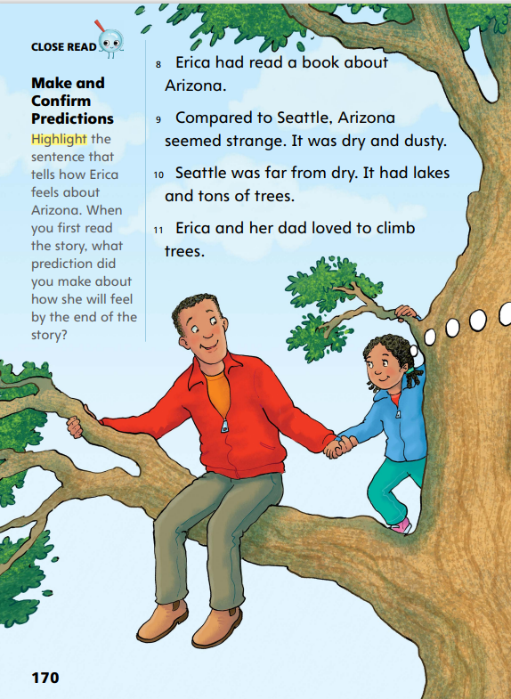
Close Read – Make and Confirm Predictions
Page 170
Turn to page 170 in your Student Interactive.
Notes:
Tell students to look at illustrations to help make a prediction about a realistic fiction story. Tell them that as they read, they should use details about how a character feels or what he or she does to make, correct, or confirm their predictions.
Have students read paragraph 9 to find and highlight the sentence that tells how Erica feels about Arizona. See student page for possible responses.
Ask: How do you think Erica will feel about Arizona by the end of the story? How does she feel right now? Do you think her feelings will change? DOK 2

Slide 57
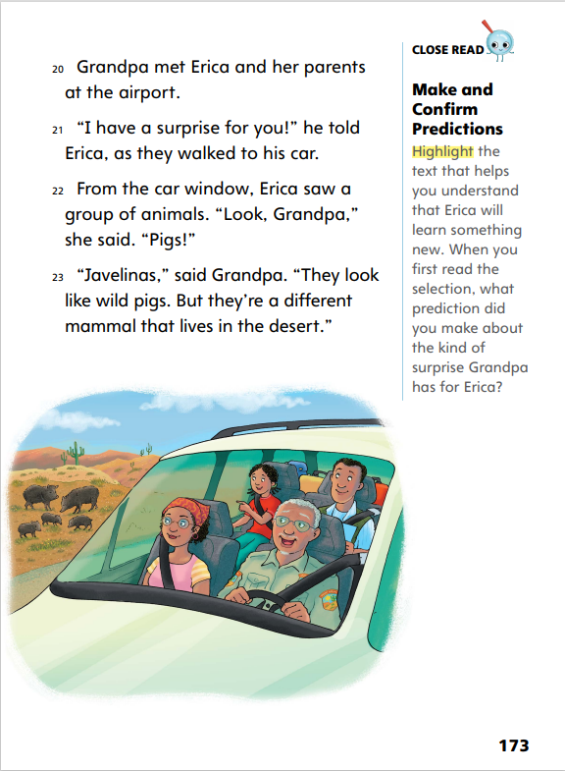
Close Read – Make and Confirm Predictions
Page 173
Turn to page 173 in your Student Interactive.
Notes:
Tell students that as they read, they should continue to make predictions about what will happen next in the story.
Have students read paragraph 21 to find and highlight the text that reveals Erica will learn something new. See student page for possible responses.
Ask: What do you think the surprise will be? What type of things do you think Erica will learn?
Possible Response: Students may suggest that Erica will learn more about plants or animals, as it seems Grandpa understands she is interested in nature. DOK 2

Slide 58
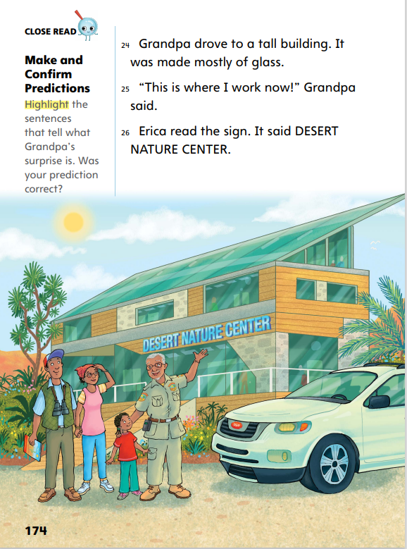
Close Read – Make and Confirm Predictions
Page 174
Turn to page 174 in your Student Interactive.
Notes:
Remind students to confirm or correct their predictions as they read.
Ask: What did you think Grandpa’s surprise for Erica would be? Were you correct? What words and phrases do you find in the text that can help you confirm or correct your prediction?
Have students read paragraphs 25–26 to find and highlight the text that tells what Grandpa’s surprise is. See student page for possible responses. DOK 2

Slide 59
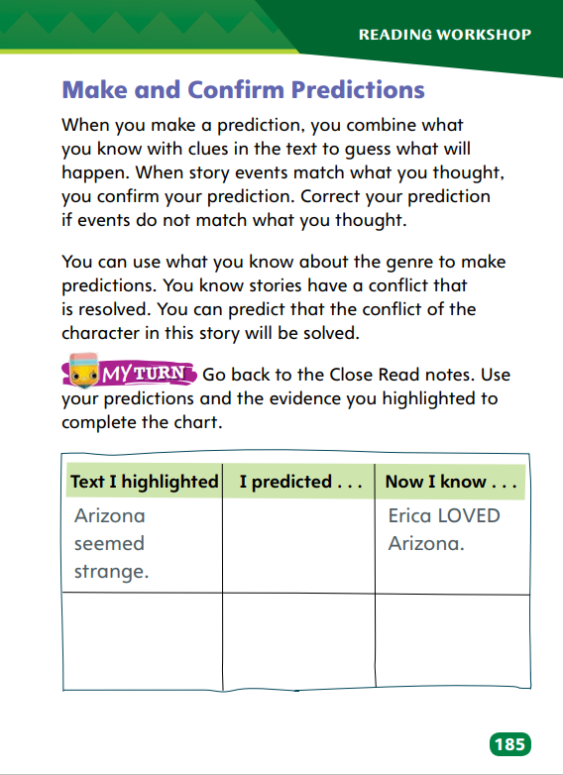
Page 185
Make and Confirm Predictions
Turn to page 185 in your Student Interactive and complete the activity.
Notes:
Have students use strategies for making, confirming, and correcting predictions. Check that students use what they know about the genre, realistic fiction, to help make, correct, and confirm predictions.
Have students complete the activity on p. 185 of the Student Interactive. Circulate to discover if students can confirm or correct their predictions.

Slide 60
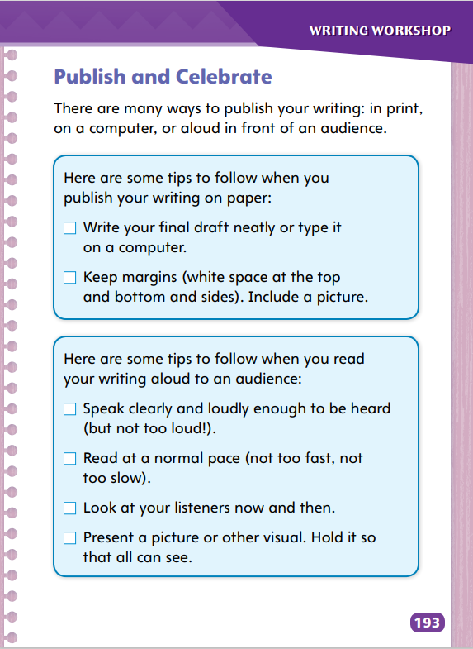
Page 193
Writing – Launch Writing Workshop
Turn to page 193 in your Student Interactive.
Notes:
Writers share their final drafts by publishing them. They take opportunities to celebrate their writing.
Explain to students that they will celebrate their writing by either publishing it on paper or a computer or by reading it aloud to an audience. Direct students to the first box on p. 193 in the Student Interactive. Say: Follow these tips if you decide to write your final draft on paper or type it on a computer. Have students echo-read the two tips with you. Use one or more stack texts to demonstrate print margins and pictures in text. Discuss how the pictures relate to the writing. Point out that students should select pictures that help explain their writing. Then ask: Where can you find pictures to include with your writing? Make sure students understand that they can also draw pictures or other visuals to use with their writing.
Redirect students’ attention to the second box on p. 193. Say: Follow these tips when you decide to read your writing aloud to an audience. Have students echo-read the tips with you. Read aloud a passage from a familiar text to demonstrate using the tips. For each tip, first read the text improperly (too loudly and too slowly, too fast and too quietly, without making eye contact, and holding a picture where it is difficult to see) and discuss the effect of each improper reading. Then reread the text as directed in the tip and discuss the positive effect on listeners.
Have students decide how to publish and celebrate their writing. Remind students to write legibly if they decide to write a final draft on paper.

Slide 61
Independent Writing
Decide which method you will use to write your final draft.
Share the method you chose to write your final draft.
Notes:
Students who plan to read their writing aloud should also create a clean final draft on paper, which will help make their reading successful.
Writing Support
Modeled - Do a Think Aloud to model deciding whether to publish by writing or typing the final draft, or by reading aloud to an audience.
Shared - Have pairs of students work together to check margins and select visuals or to practice speaking clearly at an appropriate pace.
Guided - Provide explicit instruction on keeping margins when publishing on paper and on selecting or creating a visual.
Call on students to explain why they chose to write their final draft on paper, type it on a computer, or present it orally.

Slide 62
Spelling
patch
chase
phone
dish
thank
what
Notes:
Flexible Option
Review the rules for spelling words with ch, sh, wh, th, ph, and tch. See pp. T412 and T416.
Read the following words and have students spell them: patch, phone, thank, chase, dish, what.
Have pairs work together to underline the consonants in each word that stand for one sound. (patch, phone, thank, chase, dish, what)

Slide 63
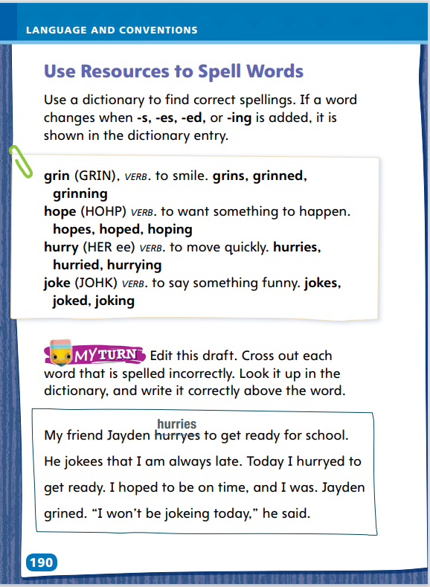
Page 190
Language and Conventions
Turn to page 190 in your Student Interactive and complete the activity.
Notes:
Have students complete the activity on p. 190 in the Student Interactive independently. Use the leveled supports on p. T441 for ELLs.

Slide 64
Lesson 5

Slide 65
Phonics
ch sh wh th ph tch
catch
thank
chin
watch
shop
phone
why
Notes:
Write: ch, sh, wh, th, ph, and tch. Have students say their sounds.
Write these words: catch, thank, chin, watch, shop, phone, why
Read catch and identify the trigraph. Have students read the remaining words and identify the digraph or trigraph in each one.

Slide 66
High-Frequency Words
f | o | l | l | o | w
 |  | s | h | o | w
 |  | f | o | r | m
follow
show
form
Notes:
Remind students that high-frequency words are words that they will hear, see, and use more often than other words. Explain that recognizing these words automatically will allow them to concentrate on other less common words they will need to sound out. Explain that reading high-frequency words without hesitation will lead to fluent reading.
Ask students to review the chart. Have them say each word and repeat after you the letters each word contains. Partners can then take turns saying and spelling the words

Slide 67
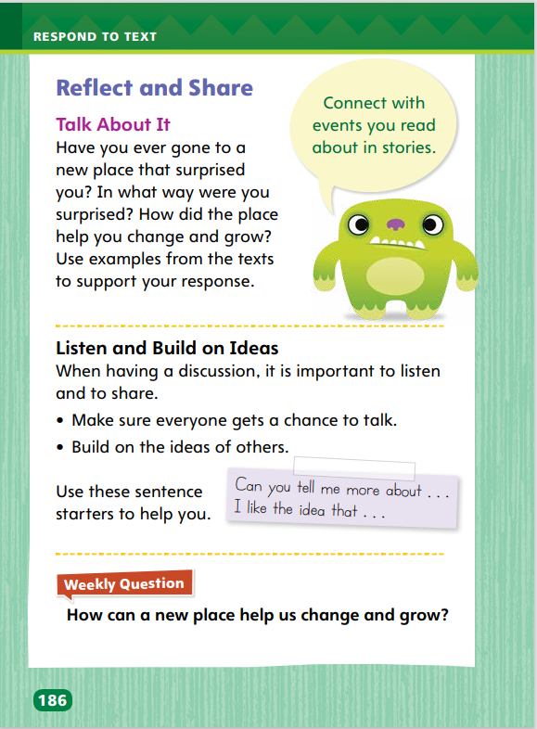
Page 186
Reflect and Share
Turn to page 186 in your Student Interactive.
Notes:
Explain to students that in a discussion, it is important to listen actively, to share, and to build on ideas.
Ask relevant questions to clarify information for yourself and others.
Make sure everyone gets a chance to answer questions using multi-word responses.
Model listening actively and answering questions using the Talk About It prompt on p. 186 in the Student Interactive.
Tell Students: My discussion partner looks at the text on p. 169 that says Erica doesn’t want to go to Arizona because she thinks it will be boring. If my discussion partner makes a connection to the text by saying, “Before I went on a camping trip last year, I thought camping was going to be dirty, uncomfortable, and boring,” I could listen and reply, “Can you tell me what you think about camping now?

Slide 68
Page 186
Apply
How can a new place help us change and grow?
Notes:
Have students use strategies for making connections between texts.
Use the Shared Read Have students use text evidence from You Can’t Climb a Cactus and other books they have read to discuss what made Erica change her mind about Arizona.
Have students use evidence from the texts they have read this week to respond to the Weekly Question. Have them write their response on a separate sheet of paper.
If desired distribute Speaking and Listening tips from the Resource Download Center. Click Path: Table of Contents -> Resource Download Center -> Speaking and Listening

Slide 69
Writing – Assessment
Prompt: Think about how it feels to visit a new place. Write about moving into a new house in the genre of your choice. For example, you may write a fictional story, a personal narrative, or an informational text.
Be sure to:
organize your writing
include interesting details
include specific concrete words
edit for correct spelling, punctuation,
and grammar
Notes:
Today you will be assessed on your skill in writing in a genre of your choice. You will use the writing skills you learned in this unit to successfully compose a piece in response to a prompt.
Provide the prompt that appears on p. T447 and have students echo-read it with you. As needed, discuss different genres. Point out that the prompt states the topic but not the type of writing students must do. Ask: What is the topic in the prompt? Circle “moving into a new house.” Invite students to suggest details about the topic that would be suitable for informational text or fictional text.
Pose the questions to help students generate ideas.
What events can lead a family to move into a new house?
What is involved in leaving one home and getting settled in a new home?
How does it feel to be in a new place?
Have volunteers take turns reading aloud items in the list beneath the prompt. Tell students to refer to the list as they write, and advise them to check their finished draft against the list before submitting it for assessment.
Tell students to use the skills they have learned in this unit to complete the writing assessment, or assess students’ published writing using the rubric on p. T447.

Slide 70
Spelling
I dropped my book.
The light switches on at night.
Follow me to the end of the trail.
How many boxes are in the basement?
She smiled at me from across the room.
Thank you for taking my sister to the game.
I left three notes on the kitchen counter.
Can you show me how to play soccer?
The babies are cute.
We all brought our lunches today.
I cannot stop dropping the wet football.
What are your favorite tunes?
Notes:
(Note: Move the orange boxes to cover each bold spelling word before you read aloud the words and sentences.)
Read aloud the words and sentences. Have students spell each word with initial consonant blends and the two high-frequency words.
I dropped my book.
The light switches on at night.
Follow me to the end of the trail.
How many boxes are in the basement?
She smiled at me from across the room.
Thank you for taking my sister to the game.
I left three notes on the kitchen counter.
Can you show me how to play soccer?
The babies are cute.
We all brought our lunches today.
I cannot stop dropping the wet football.
What are your favorite tunes?
Reveal the spelling word and have students check their work.

Slide 71
Language and Conventions
Which of the following would be helpful when finding information about spelling?
dictionary
index
table of contents
illustrations
Notes:
Flexible Option
Display the following question and have students respond independently:
Which of the following would be helpful when finding information about spelling?
A dictionary
An index
A table of contents
illustrations
Have students complete Language & Conventions p. 33 from the Resource Download Center. Click path: Table of Contents -> Resource Download Center -> Language and Conventions -> U1 W5

Slide 72
Unit 1: Week 5
Grade 2

