Slide 1
Unit 1: Week 2
Grade 4

Slide 2
Copyright © Savvas Learning Company LLC. All Rights Reserved.
This publication is protected by copyright, and permission should be obtained from the publisher prior to any prohibited reproduction, storage in a retrieval system, or transmission in any form or by any means, electronic, mechanical, photocopying, recording, or otherwise. For information regarding permissions, request forms, and the appropriate contacts within the Savvas Learning Company Rights Management group, please send your query to:
Savvas Learning Company LLC, 15 East Midland Avenue, Paramus, NJ 07652
or
k12learningpermissions@savvas.com
myView Literacy® is an exclusive trademark of Savvas Learning Company LLC in the U.S. and/or other countries.

Slide 3
Lesson 1

Slide 4
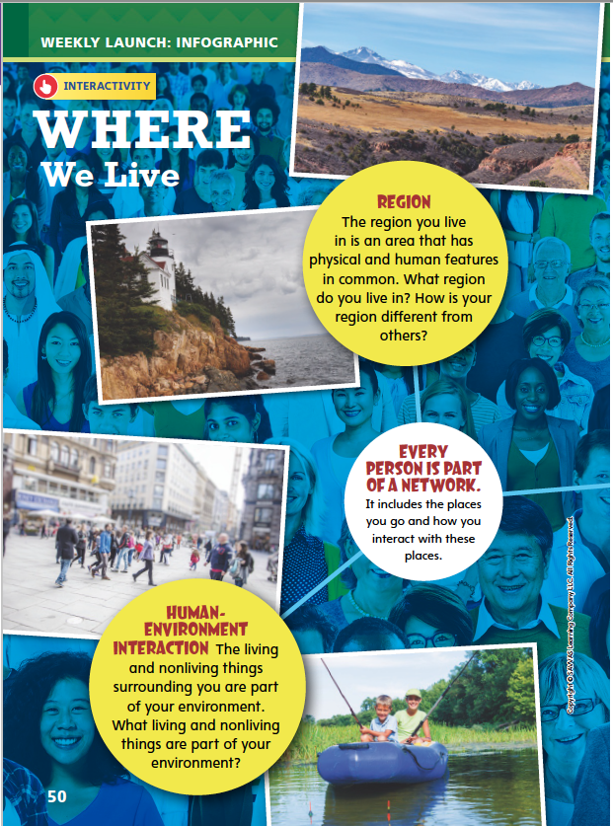
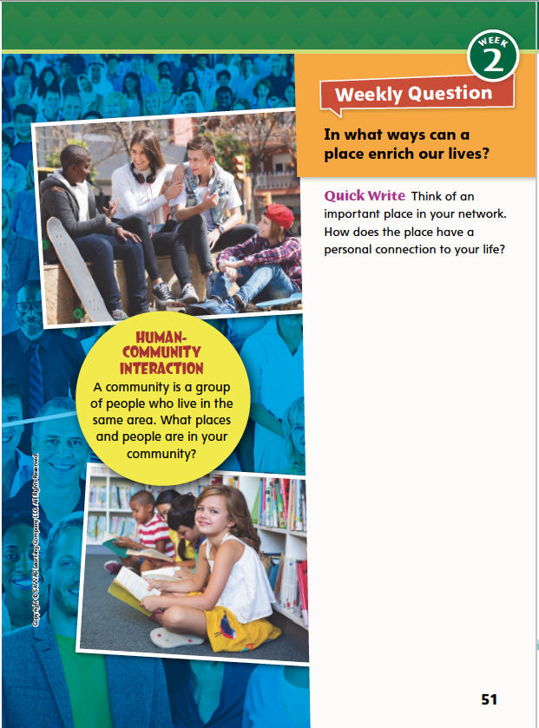
Page 50, 51
Interact with Sources
Freewrite the answer to the Quickwrite on p. 51.
Notes:
Remind students of the Essential Question of Unit 1: How can a place affect how we live?
Point out the Week 2 question: In what ways can a place enrich our lives?
Direct students’ attention to the infographic on pp. 50–51 in the Student Interactive.
Point out that an infographic combines words and pictures to provide information.
Have students read the infographic and discuss how the region, environment, and community networks affect people’s lives.
Use the following questions to guide discussion:
What do you like about our region?
What parts of your daily environment are most interesting to you?
Where, besides school, do you meet other members of your community?
WEEKLY QUESTION Reread the Week 2 Question: In what ways can a place enrich our lives? Tell students they just learned the “ingredients” of place. Explain that this week they will read about how a place influenced a unique girl.
QUICK WRITE Freewrite Have students freewrite to answer the Quick Write question on p. 51 and then share their responses.

Slide 5
Listening Comprehension
CENTRAL IDEA
Notes:
Tell students you are going to read a biography aloud. Have students listen as you read “Defying Gravity.” Remind students to listen actively for elements of biography and pay careful attention to main ideas and details. Prompt them to ask questions to clarify information and follow agreed-upon discussion rules.
Purpose Have students actively listen for elements of biography, the main idea, and supporting details.
READ the entire text aloud without stopping for the Think Aloud callouts.
REREAD the text aloud, pausing to model Think Aloud strategies related to the main idea and the details that support that idea.
Think Aloud: It’s easy to identify this piece as a biography. It has all the elements. Several dates help me put the story in chronological order. A narrator tells what happened, so I know the story is written from the third-person point of view. There are lots of facts and details. Finally, reading it helps me imagine that George Nissen was a smart and determined person, and I can see how his persistence resulted in something useful and fun.
Think Aloud: As I reread the story, I’m thinking that one of the main ideas is how the trampoline changed. There are several details to support this. George started with a metal frame and canvas. Then he added strips of rubber. Later he replaced the canvas with nylon. All these changes made the trampoline better and gave it more bounce.
Use a main idea/details chart to help students note the central idea and supporting facts in the biography.

Slide 6
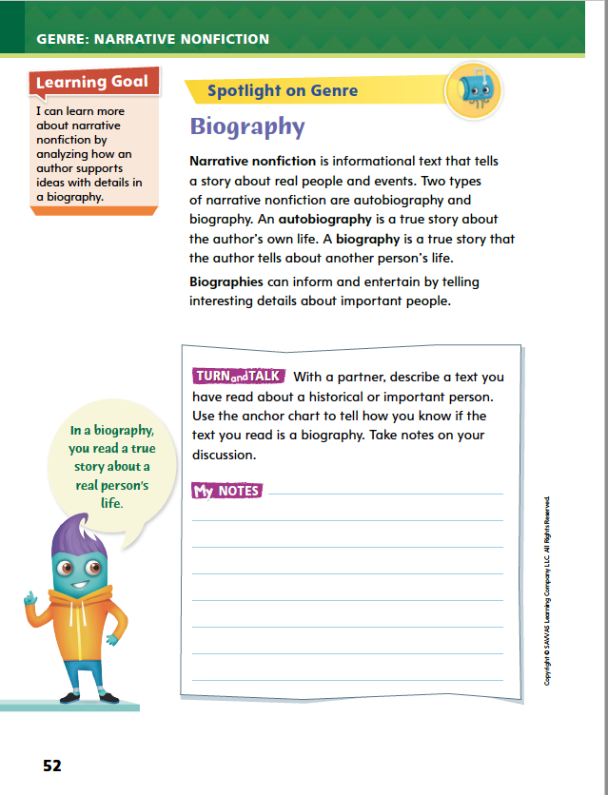
Page 52, 53
Biography
Turn to pages 52 and 53 in your Student Interactive.
Notes:
Because biographies are a kind of narrative nonfiction, they include many literary elements found in narrative fiction. These include descriptive language, plot events, and suspense.
Ask yourself how the biography demonstrates what makes the person special, unique, or famous.
Think about the challenges or problems the person faces and how he or she overcomes them.
Look for details that support the main idea of the biography. The details will help explain what makes the person special.
Model focusing on details that support the biography’s central idea. Say: In “Defying Gravity,” we learn about how Nissen turned a question into an invention used by everyone from children to astronauts. The author tells when, where, and how important events took place.
Talk about biographies or biographical facts with which students may be familiar. Invite them to share biographical details of a person they admire
Use the Anchor Chart and have students use the strategies to identify elements of a biography. Editable Anchor Chart Click Path: Table of Contents -> Reading Anchor Charts -> Unit 1 Week 2: Text Feature Editable Reading Anchor Chart

Slide 7
Page 52
Apply
Describe a text you have read about a historical or important person.
Use the anchor chart to tell how you know if the text your read is a biography.
Take notes on your discussion.
Notes:
Have students work with a partner to complete the Turn and Talk activity on p. 52 of the Student Interactive.
Circulate to see if students can identify biographies.

Slide 8
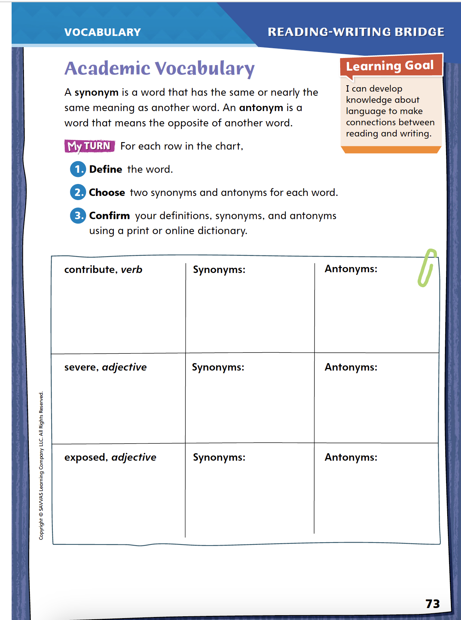
Page 73
Academic Vocabulary
Complete the graphic organizer on pg. 73 in your Student Interactive.
Notes:
Knowing synonyms and antonyms can help students better understand academic vocabulary and other unfamiliar words.
When looking for a synonym, think about the meaning of the word and whether there is another word to express the same idea.
When looking for an antonym, think about the word's meaning and what its opposite would be.
Model this strategy using the academic vocabulary word exposed.
If I encountered the word exposed in a text, I would ask myself the meaning of the word. Can anyone tell me what exposed means? (Wait for response. Ask someone to use a dictionary if needed.) What is another word that we could use to say the same thing? (Possible responses: visible, uncovered) These are synonyms and share the same meaning as exposed. What words express the opposite idea? (Possible response: hidden, covered) These are antonyms of exposed because they mean the opposite.
Have students apply this strategy on their own to the first word in the chart on Student Interactive p. 73. Then discuss responses and correct misunderstandings.
No have students follow the same strategy as they complete the activity on p. 73. Remind students that they will use these academic words throughout this unit.

Slide 9
Word Study
payment
pay
-ment
microscope
microscopic
Notes:
Suffixes are word parts added at the end of a word. Suffixes can change the way a word is read, or decoded. Suffixes also change the meaning of the base word. For example, the suffixes -ty and -ity mean “state of” or “quality.” The word creativity, then, means “the state or quality of being creative.”
To show how suffixes modify the way a word is decoded and its meaning, use the word payment. Say: Pay is decoded the same way as the main part of the word payment. The suffix -ment means “action or process of” and indicates a noun. So what does payment mean? (action of paying)
Guide students to determine the relationship between microscope and microscopic. How are the words decoded? (Both have the main word microscope. The word microscopic ends with the short i and k sounds.) What do both words mean? (microscope: an instrument to see small particles; microscopic: tiny; visible only with a microscope) Then what is the meaning of the suffix -ic? (“relating to”)

Slide 10
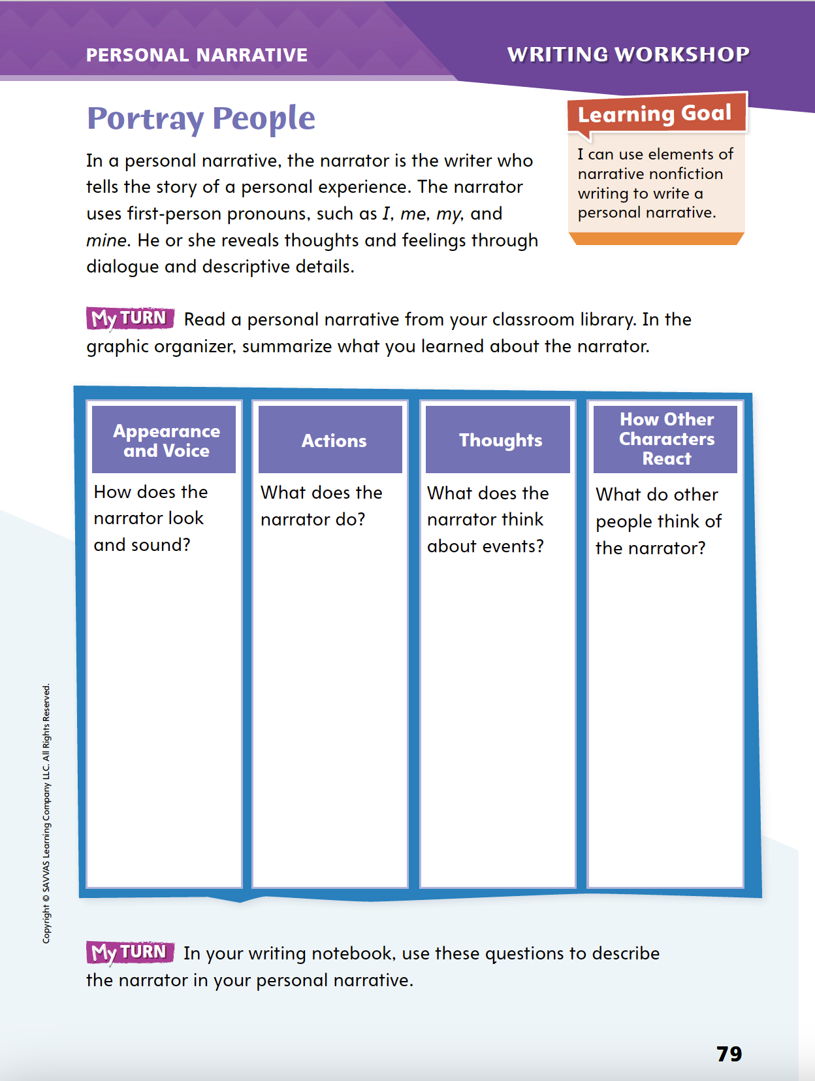
Page 79
Writing – Personal Narrative
Turn to page 79 in your Student Interactive.
Use your notes to focus on an idea for your own narrative.
Notes:
The narrator of a personal narrative reveals some personality traits with first-person pronouns, but readers also learn a lot about the narrator from
dialogue, and
the actions of other people and animals.
Tell students that they will be developing the character of the narrator. Remind them that the narrator is the writer of a personal narrative: This means that you will choose how to portray yourself. You are the narrator and the main character in the narrative, so decide how much readers need to know about your thoughts, feelings, words, and actions.
Read the first three or four paragraphs of a personal narrative from the stack.
Prompt students to use text evidence to identify traits of the narrator. Then ask:
How did the writer use words and phrases to communicate those traits?
What other methods did the writer use to portray the narrator?
Direct students to p. 79 in the Student Interactive. Have them choose a text from the stack or classroom library and complete the activity.

Slide 11
Independent Writing
Use the questions on p. 79 to describe the narrator in your personal narrative.
Share the traits you have decided to emphasize in your narrators.
Notes:
After the minilesson, students should transition into independent writing.
If students need additional opportunities to understand how narrators are portrayed, have them read additional texts from the stack and summarize the narrators’ characteristics.
Modeled Choose a stack text and model summarizing a narrator’s traits.
Shared Discuss with students the qualities they want their narrators to have.
Guided Instruct students on developing the narrator as a character
If students demonstrate understanding, they should transition to drafting their personal narratives in their writing notebooks. See the Conference Prompts on p. T360.
Ask several volunteers to share the traits they have decided to emphasize in their narrators.

Slide 12
Spelling
1. They visited an amusement park.
2. A microscope is used to see small objects.
3. The community garden is popular in summer.
4. Gerardo is able to swim across the lake.
5. The payment was made on time.
6. Ann liked the festive colors of the fall leaves.
7. Bread and potatoes are basic foods.
8. Crossing guards are trained in safety.
9. Chefs share their creativity with recipes.
10. The audience showed enjoyment by clapping.
Notes:
(Note: Move the orange boxes to cover each bold spelling word before you read aloud the words and sentences.)
Read aloud the words and sentences. Have students spell each word to assess their prior knowledge of suffixes.
They visited an amusement park.
A microscope is used to see small objects.
The community garden is popular in summer.
Gerardo is able to swim across the lake.
The payment was made on time.
Ann liked the festive colors of the fall leaves.
Bread and potatoes are basic foods.
Crossing guards are trained in safety.
Chefs share their creativity with recipes.
The audience showed enjoyment by clapping.
Reveal the spelling word and have students check their work.
For students who understand that word spellings may change with certain suffixes, include the following Challenge Words with the spelling list. Challenge Words: diversity, requirement, opportunity

Slide 13
Language and Conventions
A crowd gathered to watch the rocket launch.
Write your own sentences and identify the complete subject and the complete predicate.
Notes:
Review the language and conventions topic about subjects and predicates from the previous week. See p. T345.
Share the following sentence with students: A crowd gathered to watch the rocket launch.
Ask a volunteer to use a mark to separate the subject from the predicate (between crowd and gathered).
Then have students suggest different subjects and predicates. For instance, change the subject to “Marlon's family” or change the predicate to “passed by my house.”
Once you have reviewed what subjects and predicates are and their functions in sentences, write a new sentence as a class and identify the subject and the predicate.
Have students create their own sentences and identify the complete subject and the complete predicate.

Slide 14
Lesson 2

Slide 15
Page 54
Preview Vocabulary
poverty
pursued
treacherous
remarkable
assembled
Notes:
1. Introduce the vocabulary words on p. 54 in the Student Interactive and define them as needed.
poverty: the state of being extremely poor
pursued: worked without stopping to get or accomplish something
treacherous: unsafe because of hidden dangers
remarkable: extraordinary or outstanding assembled: put or brought together
2. Say: These words will help you understand Mary Anning and some of the biographical details in Rare Treasure: Mary Anning and Her Remarkable Discoveries. As you read, highlight the words when you see them in the text. Ask yourself what they contribute to your understanding of Mary.

Slide 16
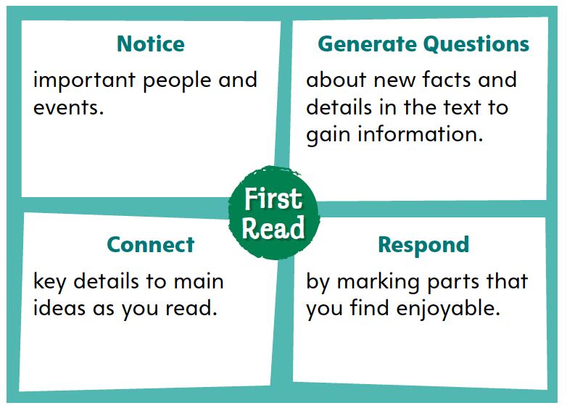
Page 54
First Read Strategies
Notes:
1. Discuss the First Read Strategies. Prompt students to establish that the purpose for reading this selection is for understanding and enjoyment.
NOTICE Remind students to focus on the key people and events in the biography.
GENERATE QUESTIONS Encourage students to jot down questions about information that is new to them.
CONNECT Guide students to think of how an interesting detail links to the central idea of the biography.
RESPOND Have students mark any parts of the text they find inspiring, interesting, or entertaining.
2. Students may read the text independently, in pairs, or as a whole class. Use the First Read notes to help students connect with the text and guide their understanding.

Slide 17
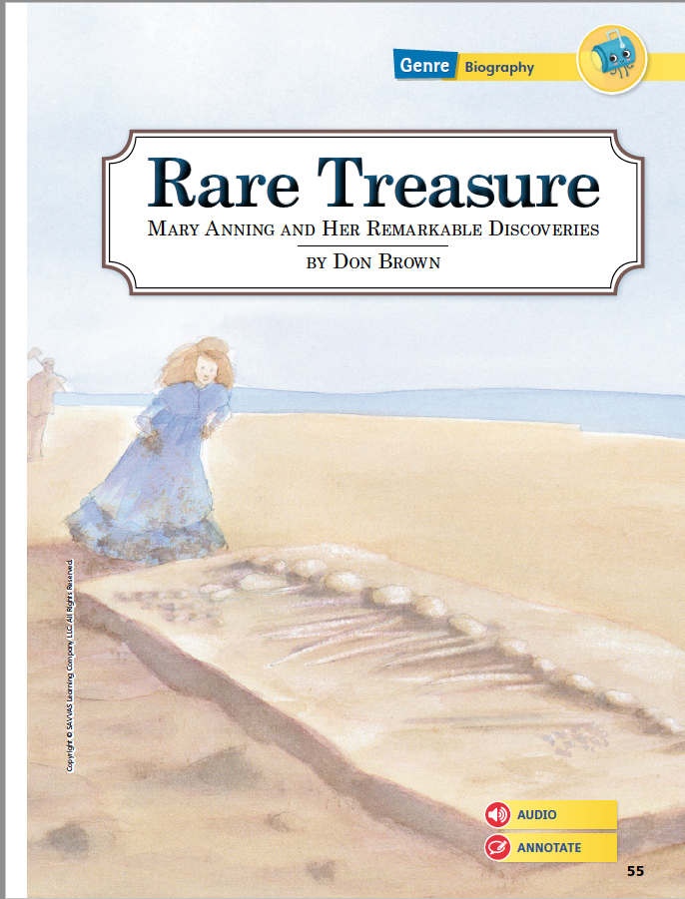
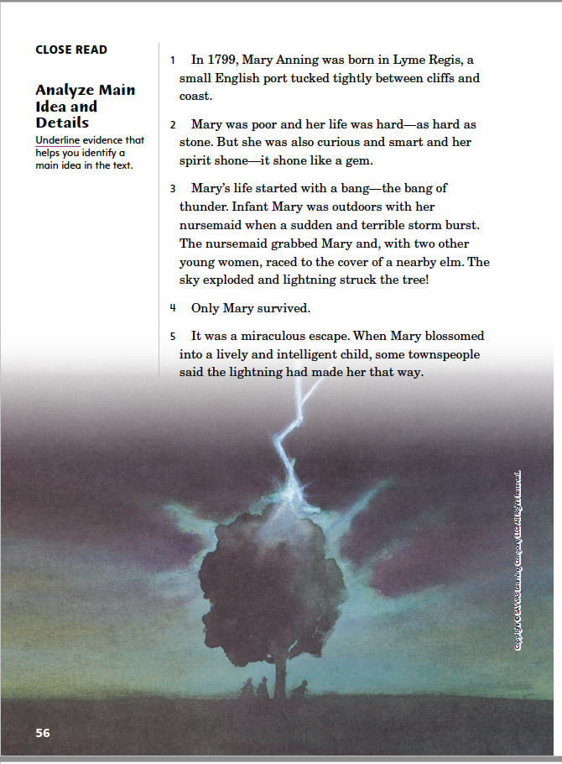
Page 55, 56
First Read – Rare Treasure
Notes:
Students may read independently, in pairs, or as a whole class. Use the First Read notes to help them connect with the text and guide their understanding.
THINK ALOUD At the beginning of the biography, I notice that Mary Anning was born at the end of a century in a place between cliffs and the sea. That seems like a dramatic setting, and I want to keep reading to see if dramatic events unfold there.

Slide 18
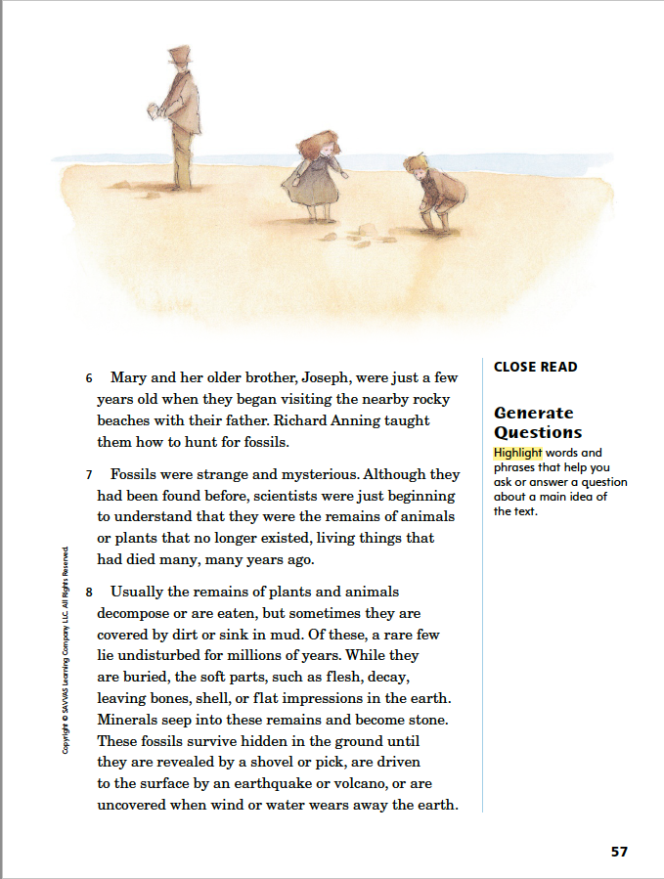
Page 57
First Read – Rare Treasure
Notes:
Students may read independently, in pairs, or as a whole class. Use the First Read notes to help them connect with the text and guide their understanding.
THINK ALOUD. A lot of what the writer says about fossils is information I don’t know. I will pay close attention and reread sentences with unfamiliar facts or details. I will focus on paragraphs 7 and 8, where I see a lot of details that are new to me.

Slide 19
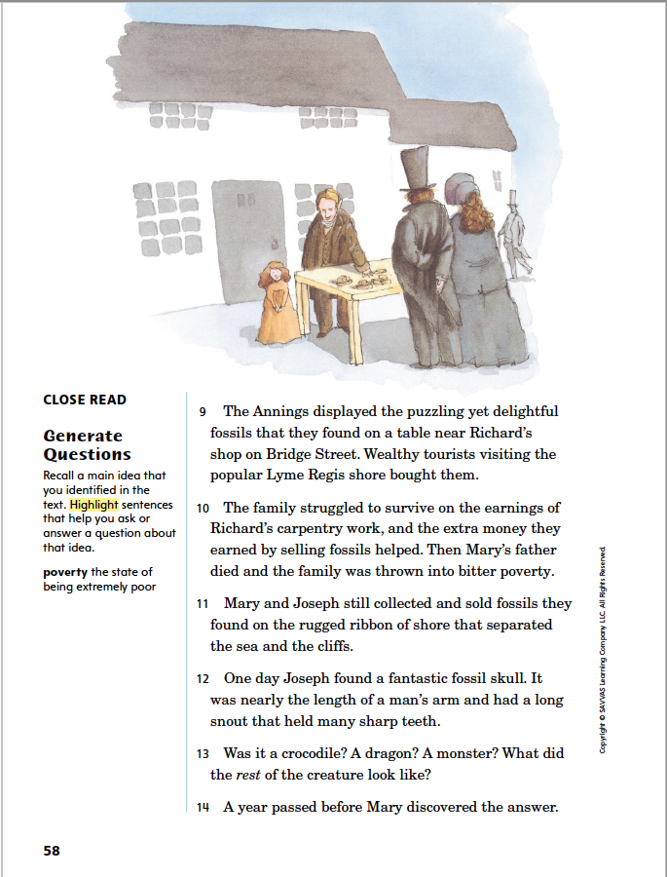
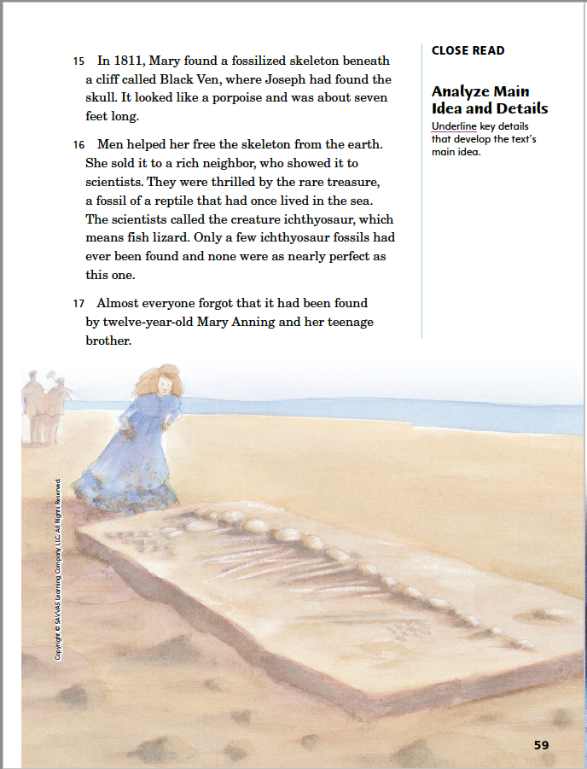
Page 58, 59
First Read – Rare Treasure
Notes:
Students may read independently, in pairs, or as a whole class. Use the First Read notes to help them connect with the text and guide their understanding.
THINK ALOUD I notice that the topic of money is developed in paragraphs 9 and 10. The Anning family has to struggle, or try very hard, to live on the combined amount of Richard’s carpentry earnings plus what they get from selling fossils to wealthy tourists. Without Richard’s earnings, the family suffers.
THINK ALOUD I see a connection here between paragraph 16 and the title.
Possible Responses: It was rare because no one had ever found one as complete, and it was a treasure because it helped scientists learn more about dinosaurs.

Slide 20
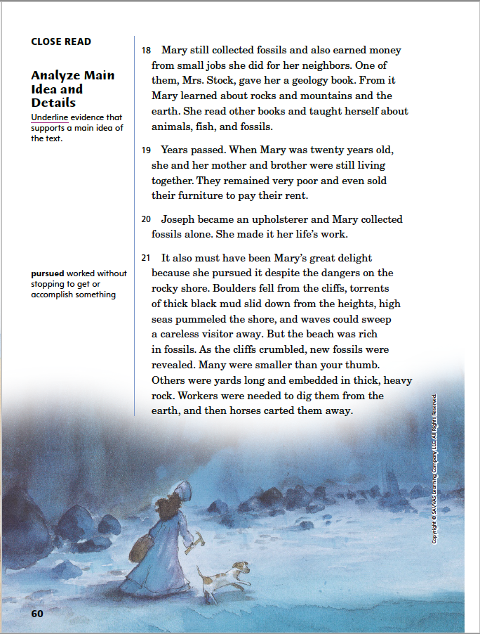
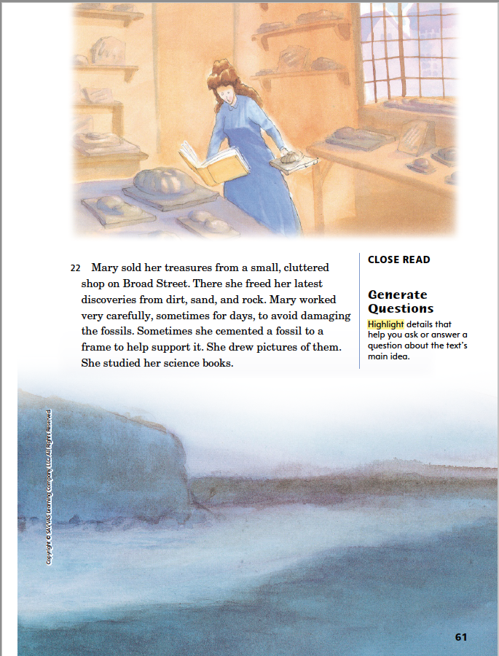
Page 60, 61
First Read – Rare Treasure
Notes:
Students may read independently, in pairs, or as a whole class. Use the First Read notes to help them connect with the text and guide their understanding.
THINK ALOUD At the beginning of the biography, what effect did people think the lightning strike had on Mary? What do her actions here show about her intelligence? Possible Responses: People thought the lightning made her “lively and intelligent.” Mary’s actions here show that her intelligence comes from her curiosity and desire to learn.
THINK ALOUD Mary Anning “worked very carefully, sometimes for days...” After growing up in poverty with little formal education, Mary had to work hard to pursue her interest in fossils. The effort that she puts into her shop shows that studying fossils is very important to her.

Slide 21
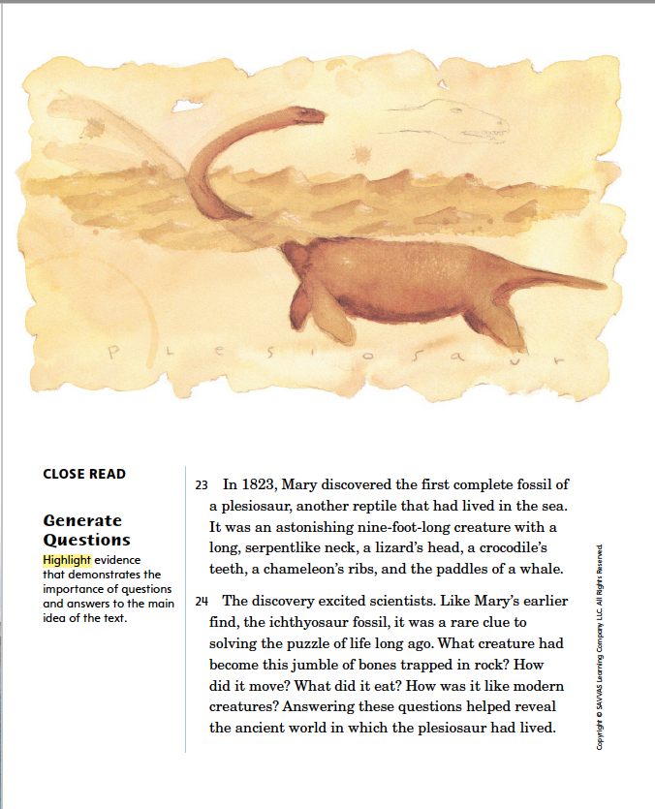
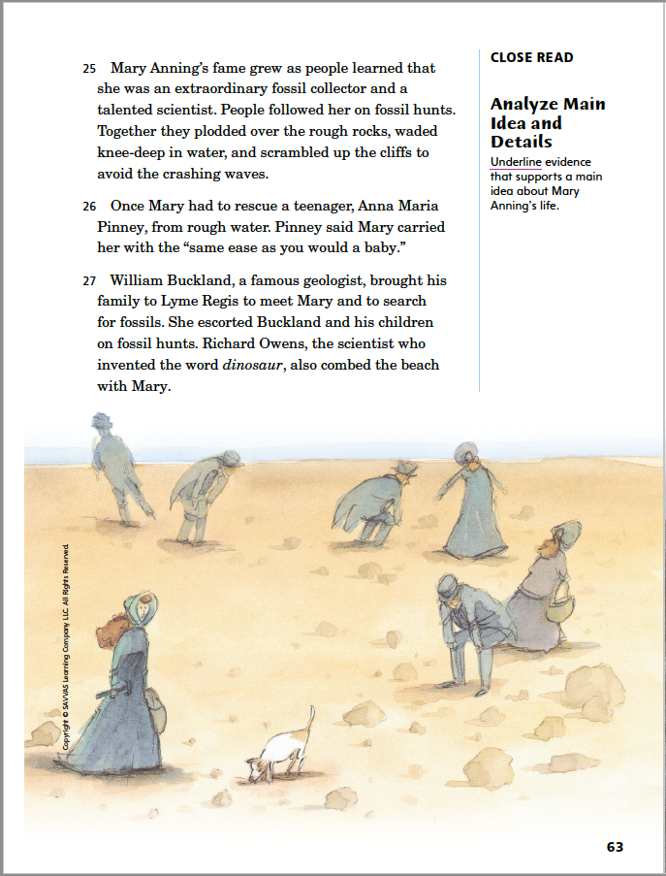
Page 62, 63
First Read – Rare Treasure
Notes:
Students may read independently, in pairs, or as a whole class. Use the First Read notes to help them connect with the text and guide their understanding.
THINK ALOUD The description in paragraph 23 makes me think that scientists were right to be “excited” by the discovery. I would be very excited to learn more about a sea creature that had physical traits similar to a serpent, a lizard, a crocodile, a chameleon, and a whale.
THINK ALOUD I am pleased to read that Mary’s fame grew as a result of her finding the plesiosaur skeleton. I did not like that she was not given much credit for her discovery of the ichthyosaur. Now it seems like her hard work is starting to pay off.

Slide 22
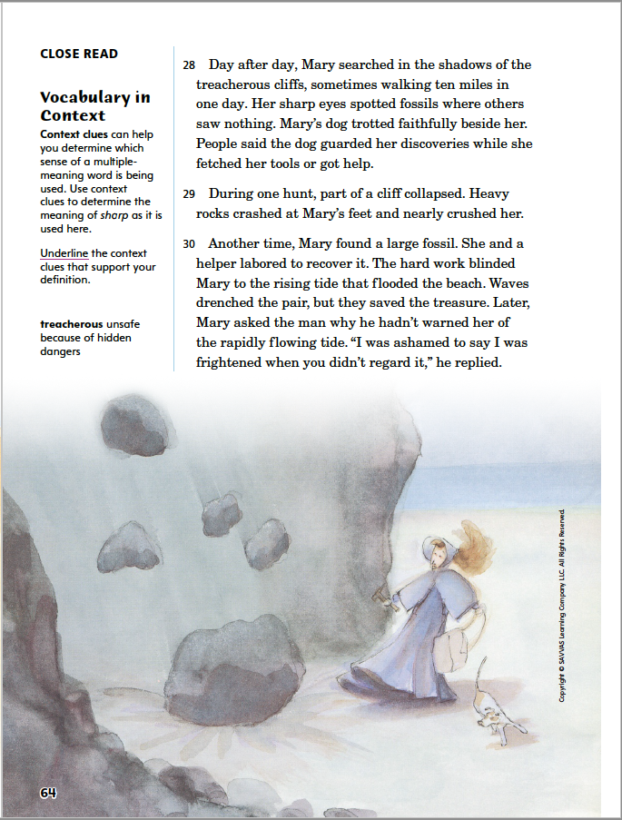
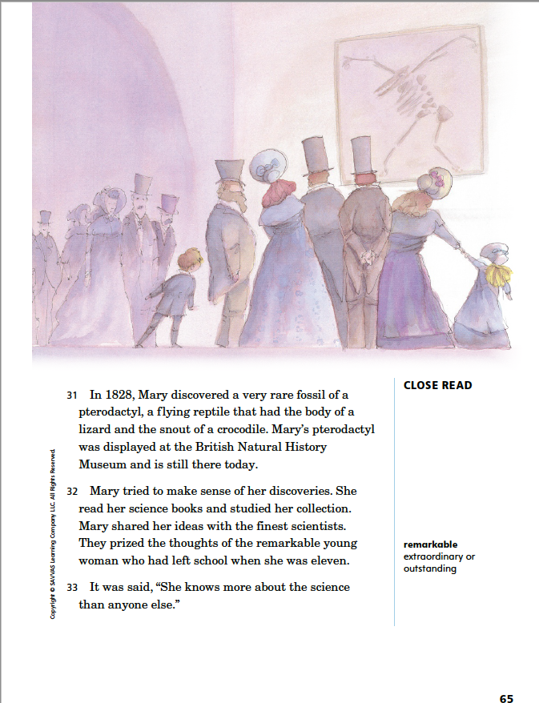
Page 64, 65
First Read – Rare Treasure
Notes:
Students may read independently, in pairs, or as a whole class. Use the First Read notes to help them connect with the text and guide their understanding.
THINK ALOUD What makes the Lyme Regis cliffs treacherous? Possible Responses: Previously the text says that “boulders fell from the cliffs,” mudslides came down the cliffs, and strong waves could wash a person into the sea. Here the text describes a rock slide and a dangerous high tide.
THINK ALOUD Mary Anning did not have the opportunity to get much formal education. Despite her challenges, she eventually mastered a scientific topic. Her drive, determination, and curiosity led her to achieve great things and become highly respected.

Slide 23
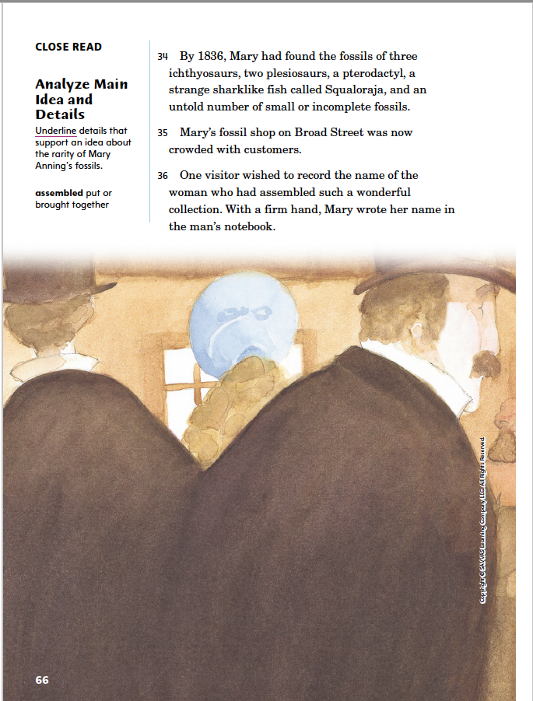
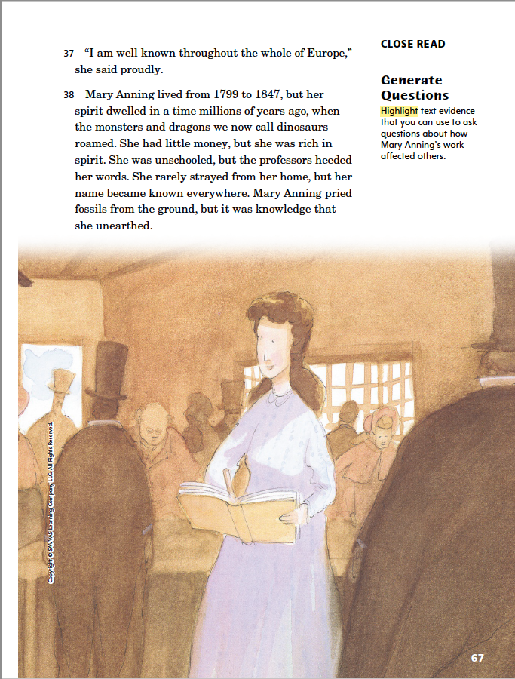
Page 66, 67
First Read – Rare Treasure
Notes:
Students may read independently, in pairs, or as a whole class. Use the First Read notes to help them connect with the text and guide their understanding.
THINK ALOUD How does Mary’s success support a central idea of the biography? Possible Responses: Mary’s success supports the central idea that she was intelligent, hard-working, and passionate about fossils.
THINK ALOUD I am inspired by Mary’s success. She overcame poverty, the early death of her father, and a lack of education to achieve her expertise in fossil study and the fame that it brought. This makes me feel like I can, and I should, work hard to accomplish the things that are important to me.

Slide 24
Respond and Analyze
Brainstorm: What events and ideas are most important in this historical text? Explain them, including what happened and why, using text evidence.
Discuss: What did you find most interesting about the biography?
Notes:
Use these suggestions to prompt further responses to Rare Treasure.
Brainstorm What events and ideas are most important in this historical text? Explain them, including what happened and why, using text evidence.
Discuss What did you find most interesting about the biography?

Slide 25
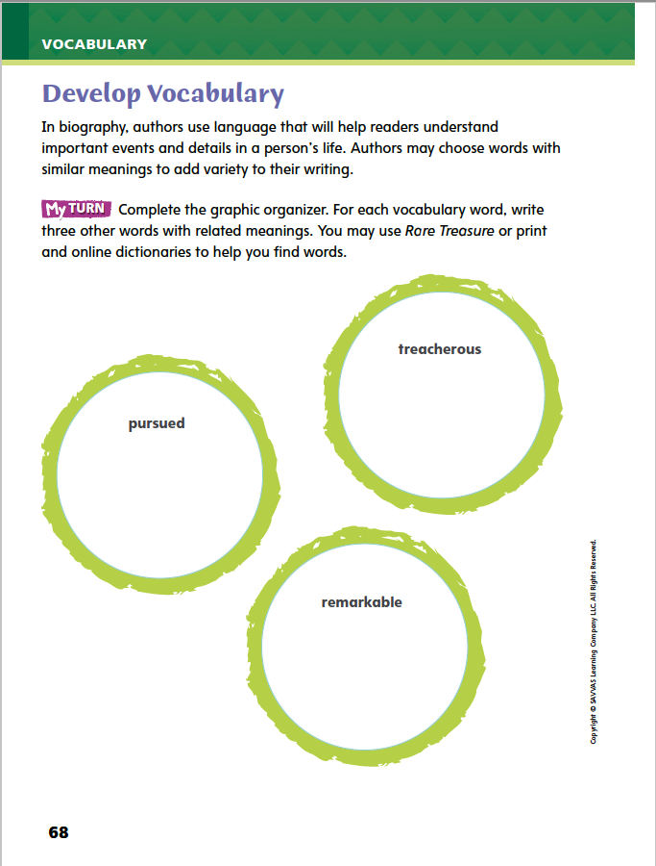
Page 68
Develop Vocabulary
Turn to page 68 in your Student Interactive and complete the activity.
Notes:
Tell students that authors of narrative nonfiction choose certain words for their power to describe key details. The vocabulary words treacherous, pursued, and remarkable describe the setting and the subject, Mary Anning.
Recall the definition of the word or look back in the text to reread it.
Determine which detail in the text this word describes.
Model filling out the chart on p. 68 by adding a related word under treacherous.
Say: In the biography, Mary must take care while on the shore to not get buried by a mudslide, crushed by falling rock, or swept out to sea by the rising tides. The author describes these sudden threats as treacherous.
Say: When the author calls these threats treacherous, he is showing that Mary must risk dangerous events to hunt for fossils. I will write dangerous under the vocabulary word treacherous.
Ask a volunteer to supply another word related to treacherous.
Prompt the student to support the response with text evidence.
Have students work in pairs with a dictionary to list synonyms and related words as they complete p. 68 of the Student Interactive.

Slide 26
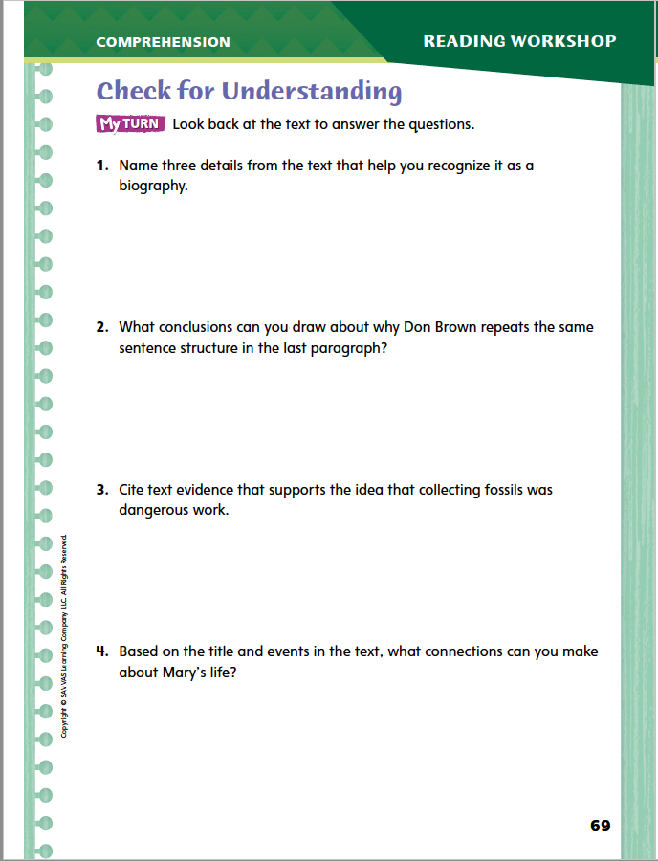
Page 69
Check for Understanding
Complete page 69 in your Student Interactive.
Notes:
Have students complete p. 69 of the Student Interactive.

Slide 27
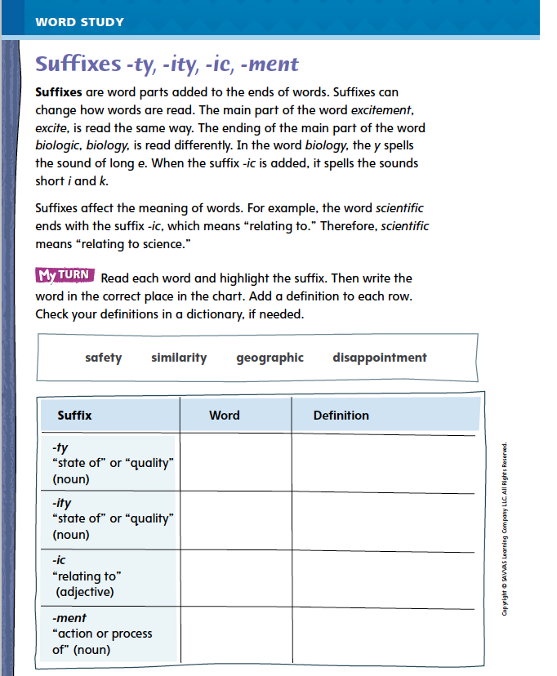
Page 74
Word Study
-ty
Turn to page 74 in your Student Interactive and complete the activity.
-ity
-ic
-ment
Notes:
Direct students to complete the activity on p. 74 in the Student Interactive.
Then have students write four sentences, correctly using each of the suffixes in the lesson.
Have partners trade papers and take turns reading their sentences to each other, using the words with suffixes in context.

Slide 28
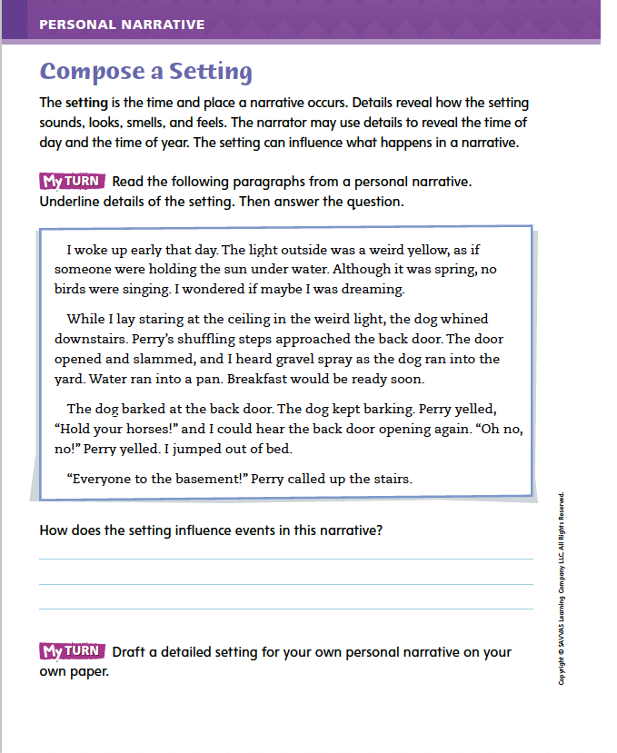
Page 80
Writing – Personal Narrative
Turn to page 80 in your Student Interactive.
Notes:
A detailed description of the setting of a personal narrative
creates a frame for the conflict or problem the narrator faces and
gives readers the background they need to understand the early events in the narrative.
Point out that all the events in a personal narrative occur in particular places at particular times. Have students think about the events they want to include in their narratives. Ask: Where or when does the turning point take place? What events lead up to that, and where do they take place? What times of day and times of year are involved in your story?
Let’s see how one writer answers these questions. Read aloud a text from the stack. Ask volunteers to name the time and place of each key event. Challenge students to imagine how the narrative would be different if readers did not know where and when the events took place.
Then direct students to Student Interactive p. 80 and have them complete the activity.

Slide 29
Independent Writing
Draft a detailed setting for your own personal narrative on your own paper.
Share the name and time and place in which your personal narrative begins.
Notes:
After the minilesson, students should transition into independent writing.
If students need additional opportunities to develop ideas for the setting of their personal narratives, provide several examples from the stack for them to use as models.
Additional writing support may be provided.
Modeled Do a Think Aloud with a stack text to show students how to discern the time and place in which an event occurs.
Shared Have students identify the setting of each key event in a text from the stack.
Guided Use stack texts to provide explicit instruction on how a setting influences events.
If students demonstrate understanding, they should transition to drafting personal narratives in their writing notebooks. See the Conference Prompts on p. T360.
Share Back Call on two or three students to name the time and place in which their personal narratives begin.

Slide 30
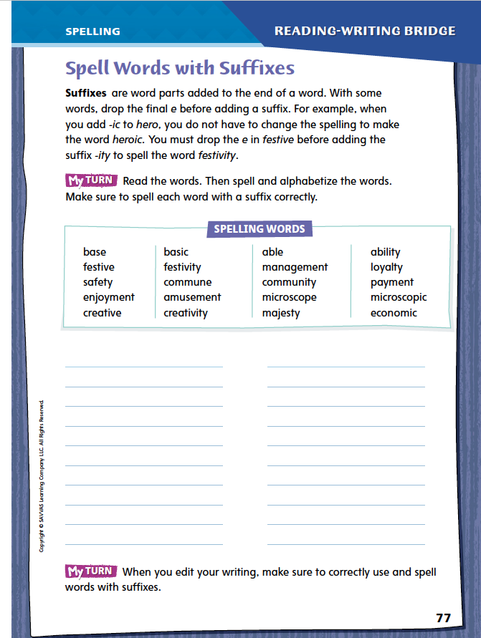
Page 77
Spelling
able
ability
loyal
Turn to page 77 in your Student Interactive and complete the activity.
loyalty
majesty
majestic
Notes:
Explain how the spelling of the base word may change when a suffix is added. For example, drop the e before adding a suffix starting with a vowel, such as -ic and -ity. Keep the e before adding a suffix that starts with a consonant.
Remind students to follow these spelling rules when they edit their own writing.
Display able, ability, loyal, loyalty, majesty, majestic. Point out where the base word has changed or stayed the same.
Have students complete the activity on p. 77 of the Student Interactive independently.

Slide 31
Language and Conventions
Fiona fed the dog.
Fiona washed the car.
Fiona fed the dog and washed the car.
With a partner, create an oral sentence that contains a compound subject and a compound predicate. Share with another pair and identify which words make up each component.
Notes:
Introduce compound subjects and compound predicates by giving oral examples. Explain that simple subjects are combined using the conjunction and to create a compound subject. Explain that a compound predicate is made when two or more simple predicates are joined by a conjunction.
Display two simple sentences with the same subject, such as Fiona fed the dog. Fiona washed the car. Model combining these into one sentence using the conjunction and to form a compound predicate “fed the dog and washed the car.” Write two new simple sentences. Have students combine them to create a new sentence with a compound subject or a compound predicate.
Have students work in pairs to create an oral sentence that contains a compound subject and a compound predicate. Ask partners to share their sentence with another pair and then identify which words make up each component.

Slide 32
Lesson 3

Slide 33
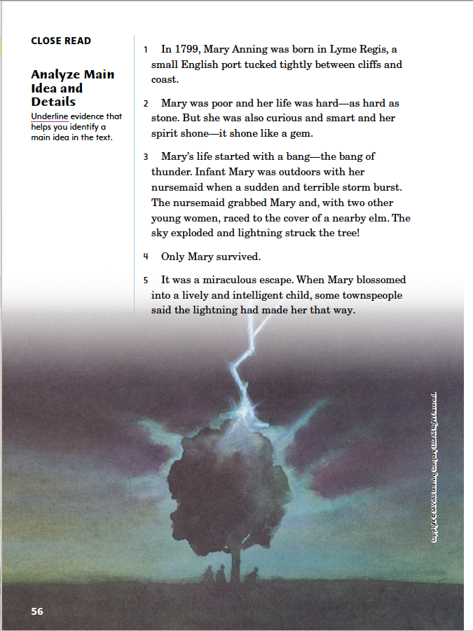
Page 56
Close Read – Analyze Main Idea and Details
Turn to page 56 in your Student Interactive.
Notes:
Readers of nonfiction determine the main idea by noticing the structure of the text and focusing on information or opinions appearing at or near the beginning of the text. Then they relate key details they encounter later in the text to this main idea.
Look for big ideas at the beginning that relate to the title or subject of the text.
Think: What evidence or details does the author give to support this idea?
Note key details as you read, and decide how they support the main idea. Be open to how details may change your understanding of the main idea.
Ask yourself how the key details add to your understanding of the subject.
Use the Close Read note on p. 56 of the Student Interactive to model how to annotate evidence in the text that helps identify the main idea of the biography.
Say: I know from the title that the biography is about Mary Anning. What information on this page would be of great importance about her life? I see she was born in an English seaside town in 1799. I’ll underline that information.
Say: What details does the second paragraph provide? It’s about Mary’s nature and the challenges in her life. I’ll underline that whole paragraph because people’s traits and the challenges they face tell a lot about their lives.
Have partners underline another piece of text on p. 56 that may support the main idea. Then have them write why this text may be worth noting and remembering.

Slide 34
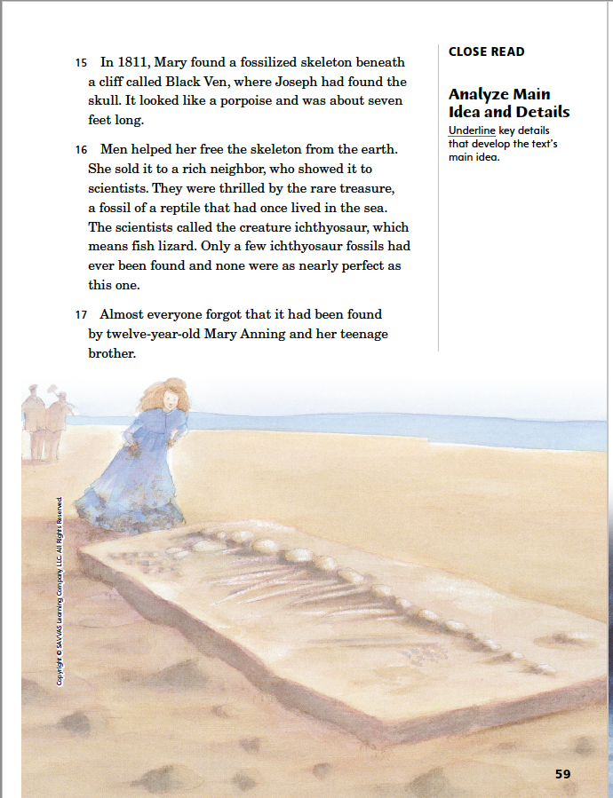
Page 59
Close Read – Analyze Main Idea and Details
Turn to page 59 in your Student Interactive.
Notes:
Have students scan paragraphs 16 and 17.
Say: What main idea is expressed in these paragraphs? How do people react to Mary’s discovery? Underline key details. See student page for possible responses.
Ask students to explain why “almost everyone forgot” that Mary and her brother had unearthed an important fossil and to cite details to support their answers. Possible response: People may have ignored Mary's accomplishment because she and her brother were young; the text says that Mary was just twelve years old at the time. DOK 2

Slide 35
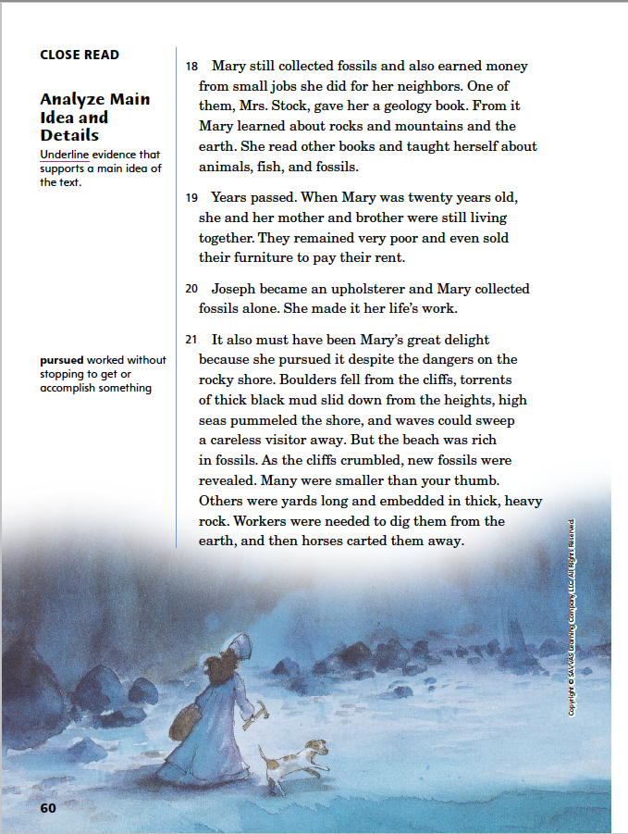
Page 60
Close Read – Analyze Main Idea and Details
Turn to page 60 in your Student Interactive.
Notes:
Have students scan paragraphs 18–21.
Say: What details relate to the main ideas of Mary’s special qualities? Underline the relevant details about these qualities of Mary’s. See student page for possible responses.
Ask students what qualities make Mary special. Possible Response: Her intelligence and curiosity about science along with her hard work and dedication in finding and studying fossils and geology make her special. DOK 2

Slide 36
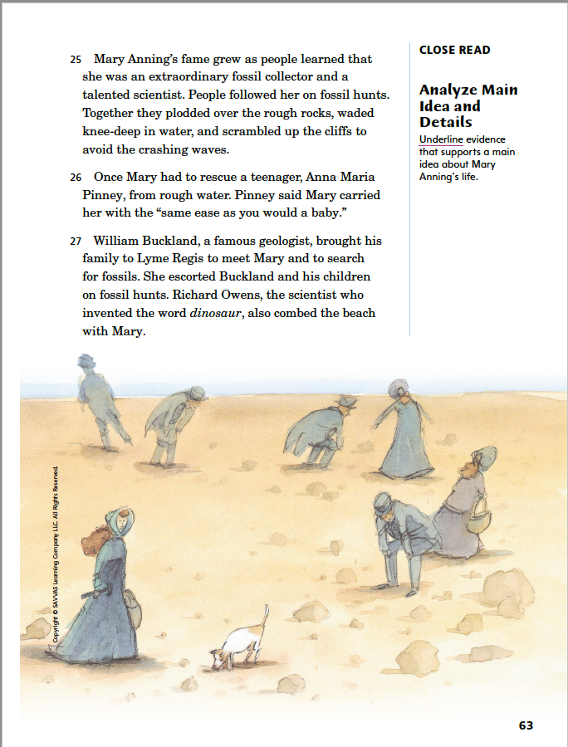
Page 63
Close Read – Analyze Main Idea and Details
Turn to page 63 in your Student Interactive.
Notes:
Have students use characteristics and structures of informational text to analyze main idea and details in paragraphs 25 and 27.
Say: How do people react to Mary’s plesiosaur discovery? Underline the parts of these paragraphs that show how people, especially scientists, reacted to the find. See student page for possible responses.
Ask students to explain how the scientists’ reaction contrasts with the reaction that followed her discovery of the ichthyosaur when she was twelve. Possible response: The Annings were almost entirely forgotten in connection to the 1811 discovery of the ichthyosaur. The 1823 discovery of the plesiosaur was more widely connected with Mary Anning’s name. She got credit for the fossil collection and scientific work she had been doing. DOK 2

Slide 37
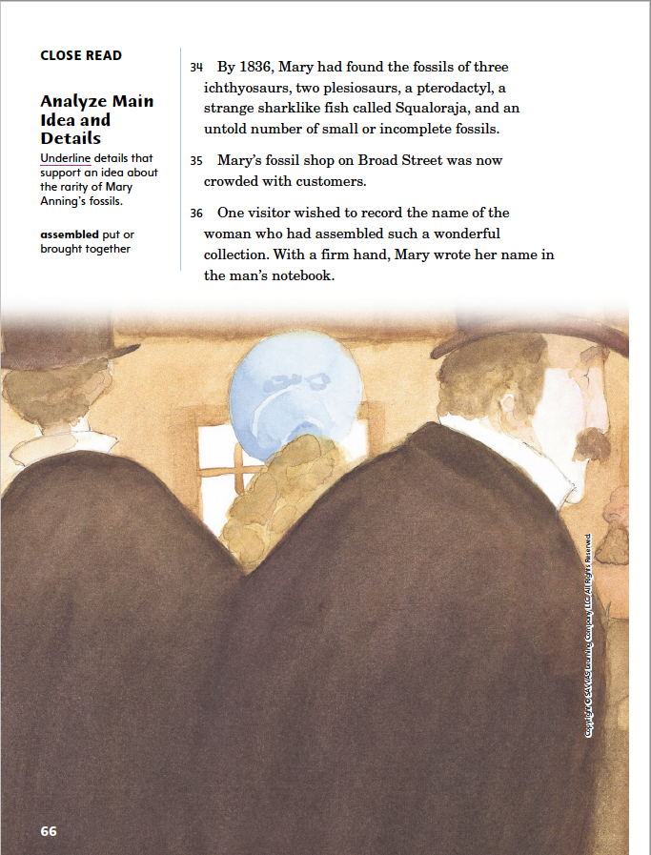
Page 66
Close Read – Analyze Main Idea and Details
Turn to page 66 in your Student Interactive.
Notes:
Have students use characteristics and structures of informational text to analyze main idea and details.
Say: In 1836, Mary Anning was 37 years old. She started fossil hunting when she was only “a few years old.”
Have students scan paragraph 34.
Ask: How many complete fossils had she found by 1836? (seven) Underline details that help you determine whether complete fossils were common, or rare. DOK 2

Slide 38
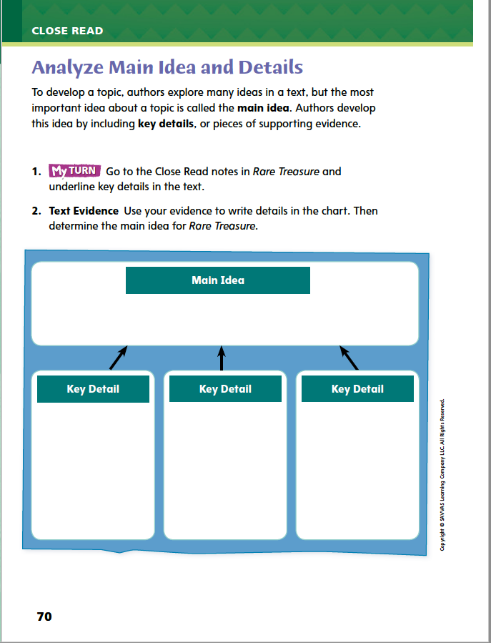
Page 70
Analyze Main Idea and Details
Turn to page 70 in your Student Interactive and complete the activity.
Notes:
Have students use the strategies for analyzing main idea and details.
Have students annotate the text using the other Close Read notes for Analyze Main Idea and Details and then use the text evidence from their annotations to complete the chart on p. 70.

Slide 39
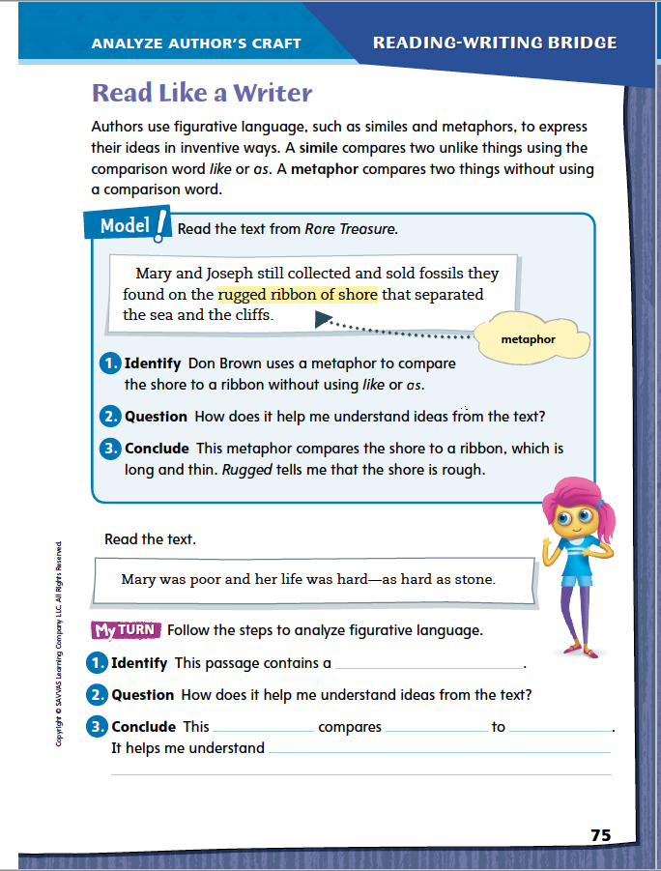
Read Like a Writer
Page 75
Turn to page 75 in your Student Interactive.
Notes:
Authors use specific words and images such as figurative language to express ideas in rich, memorable ways. Two common types of figurative language are similes and metaphors. A simile compares two unlike things using like or as. A metaphor compares two things implicitly, without using like or as to directly state the comparison. Each type of comparison creates an image in the reader's mind.
Notice if any comparisons are being made, either implicitly or with like or as.
Ask yourself why the author might be comparing these two things.
Model analyzing the author’s use of figurative language by directing students to the top of p. 75.
Identify any similes or metaphors. Say: Here the author describes the shore using the words “rugged ribbon.” The shore is not actually a ribbon. This is a metaphor, or implied comparison.
Say: How can we use this metaphor to understand the text better? Does the metaphor help us picture the shoreline?
Say: A ribbon is long and thin, and rugged suggests rough terrain. We can conclude that the shore looks like a long, thin strip of rough terrain.
Have student pairs identify another example of simile or metaphor in the text. Then have them describe how the author uses figurative language to achieve specific purposes.
Direct students to go back to Rare Treasures to highlight similes and underline metaphors. Then have them complete the activity on p. 75.

Slide 40
Word Study
commune
-ity
community
Notes:
Remind students that a suffix can change how a word is decoded. A suffix can also change the meaning of a word, because suffixes themselves have particular meanings.
Commune means “share ideas.” Adding the suffix -ity, which means “quality or state of,” gives us the word community. Adding the suffix does not change how the main word part commune is decoded. Community means “a group that shares beliefs or cultural background.” Have students define and discuss able and ability.
Have students complete Word Study p. 2 from the Resource Download Center. Click path: Table of Contents -> Resource Download Center -> Word Study -> U1W2

Slide 41
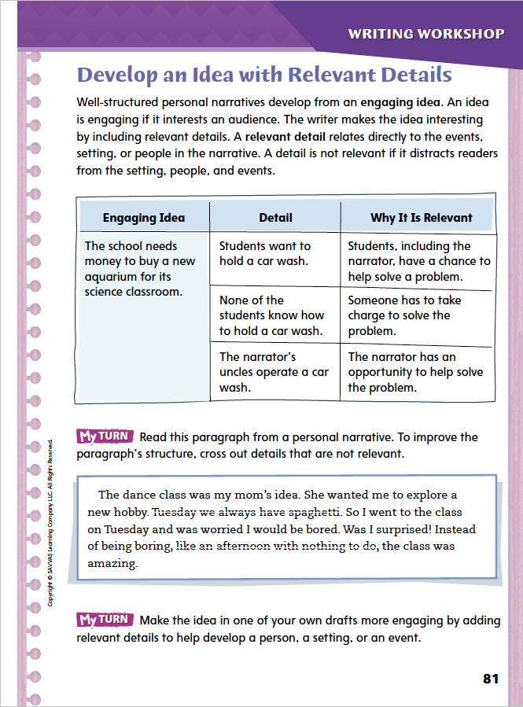
Page 81
Writing – Personal Narrative
Turn to page 81 in your Student Interactive.
Notes:
Writers of well-structured personal narratives develop engaging ideas by determining which details are relevant and which are not. This means choosing details that
relate directly to events and people in the narrative,
reveal aspects of the setting that influence people and events, and
readers must have in order to understand the narrator’s experience
Read aloud a personal narrative from the stack. Then ask the following questions and model responding if students hesitate to answer:
What are three relevant details about one of the characters?
What is the most relevant detail about the setting in this narrative?
Which details would completely change the narrative if the writer left them out? Which details make the narrative engaging?
Direct students to p. 81 of the Student Interactive and have them look at the chart. Point out that for the narrative to make sense, it needs to include each detail in the center column. Discuss the explanations in the right column. Then have students complete the activity to improve structure.

Slide 42
Independent Writing
Make the idea in on of your own drafts more engaging by adding relevant details to help develop a person, setting, or event.
Share details that you deleted from your draft. Explain how you decided these details were distracting.
Notes:
After the minilesson, students should transition into independent writing.
If students struggle to understand relevant details, suggest that they use the categories of people, setting, and events to evaluate whether they have incorporated all the relevant details.
Additional support may be provided.
Modeled Using a stack text, do a Think Aloud to model determining that a detail is relevant.
Shared Help students develop an organizer for recording relevant details about the people, events, and setting in their own personal narratives.
Guided Provide explicit instruction on how students can decide whether a detail is relevant by asking, “Why do readers need to know this?”
If students demonstrate understanding, they may use the entire independent writing time to work on this, or they may continue drafting narratives in their writing notebooks. See the Conference Prompts on p. T360.
Ask several students to share examples of details they deleted from their drafts and explain how they decided these details were distracting.

Slide 43
Spelling
I cooperate with the people in my (commune).
Food and water are (base) necessities.
Notes:
Remind students that adding a suffix can change the spelling of a base word. Students should use these rules when spelling words in their own writing.
Display the following sentences. Have students rewrite the sentences with the correct spelling of the base word with suffix.
I cooperate with the people in my (commune).
Food and water are (base) necessities
APPLY Have students complete Spelling p. 7 from the Resource Download Center. Click path: Table of Contents -> Resource Download Center -> Spelling -> U1W2

Slide 44
Language and Conventions
Simple Subject
Simple Subject
Sentence with a compound simple subject.
Sentence with a compound predicate.
Notes:
Every sentence needs a subject and a predicate. A simple subject is a noun or pronoun telling who or what the sentence is about. A compound subject is two or more simple subjects joined by a conjunction, such as and. A simple predicate is the main verb, which tells what the subject is or does. A compound predicate is two or more simple predicates joined by a conjunction.
To reinforce the instruction, ask students to suggest two simple subjects and as a class write a sentence with a compound simple subject. Then replace the period with the word and, and ask “what else did they do?” Fill in the phrase to create a sentence with a compound predicate.
Write another example together as a class and have students identify each subject, each predicate, and the conjunction to confirm that that the sentence has a compound subject and a compound predicate.

Slide 45
Lesson 4

Slide 46
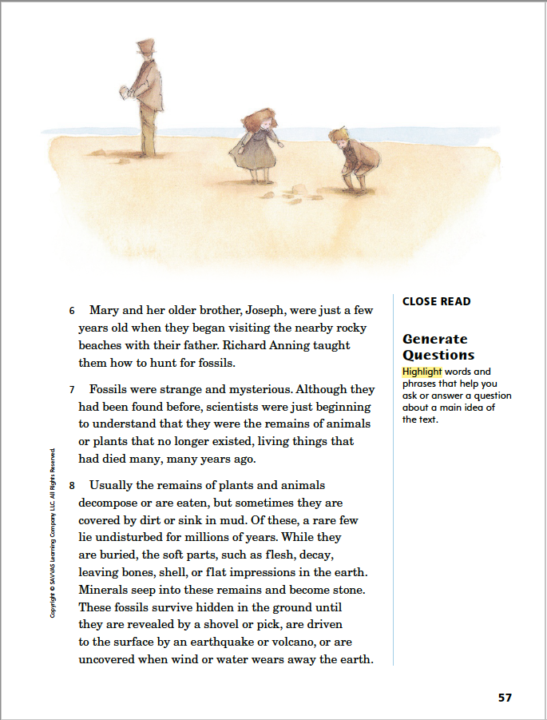
Page 57
Close Read – Generate Questions
Turn to page 57 in your Student Interactive.
Notes:
Active readers ask themselves questions about a text before, during, and after reading. Then they look for answers to those questions as they read further.
Think about information you read in the text that interests you, makes you wonder, or is unclear, and ask yourself a question about it.
Keep the question in mind as you continue to read, looking for details in the text that lead to an answer.
Use the Close Read note on p. 57 of the Student Interactive to model how to generate questions.
Say: In the sentence in paragraph 6, I read that Mary was “just a few years old” when her father taught her to hunt for fossils on the rocky beach near their home.
Say:This makes me wonder what led Mary to start collecting fossils at such a young age. I will highlight these words and write my question in the chart. I will keep this question in mind as I continue reading.
Say: When I read the second sentence in paragraph 6, I realize that it answers my question. What led young Mary to start collecting fossils was that her father taught her how. I will highlight this sentence and record it as evidence in the chart.
Have partners read paragraphs 9–15 together, alternating paragraphs. Then have them generate a question to clarify an idea.

Slide 47
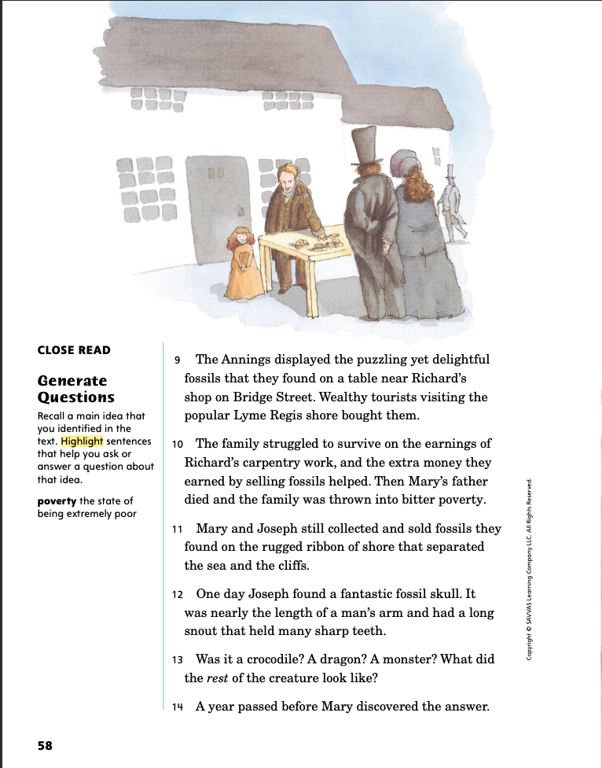
Page 58
Close Read – Generate Questions
Turn to page 58 in your Student Interactive.
Notes:
Have students reread paragraphs 12-14..
Say: What questions did Mary have about their fossil find, and when did she find an answer? Highlight the relevant details about Mary’s curiosity. See student page for possible responses.
Ask students to keep the selection title in mind to explain why the question they generated might be important. Possible response: With the “remarkable discoveries” mentioned in the title, I think the answer to the question “Why is Mary’s father teaching her to find fossils?” will relate to the main idea. DOK 2

Slide 48
Page 61
Close Read – Generate Questions
Turn to page 61 in your Student Interactive.
Notes:
Have students scan paragraph 22.
Say: Besides selling fossils, why might Mary have had a shop? Highlight the parts of this paragraph that describe what Mary did in her shop. See student page for possible responses.
Ask students to generate and record questions related to the information in this paragraph. Possible responses: How did Mary pursue her interest in fossils? What books did she study? What did her drawings look like? DOK 2

Slide 49
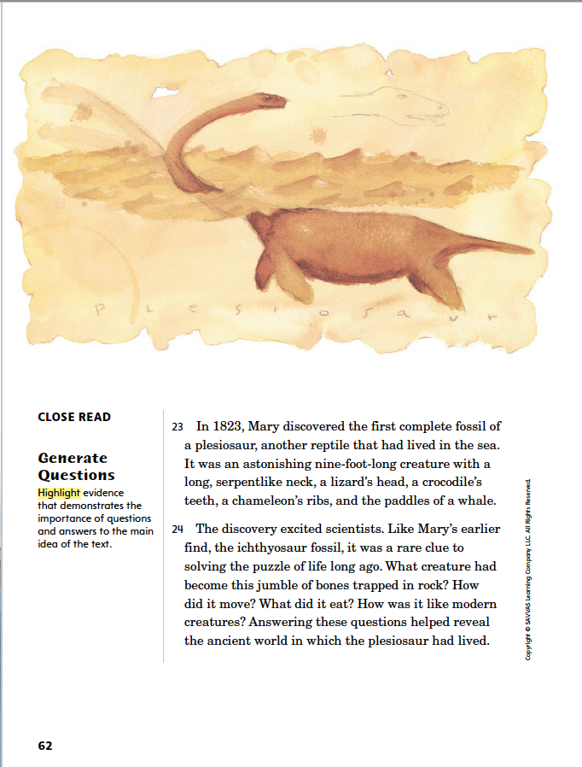
Page 62
Close Read – Generate Questions
Turn to page 62 in your Student Interactive.
Notes:
Have students scan paragraph 24.
Say: How do the questions in the paragraph relate to science? Highlight the questions and a detail about their purpose. See student page for possible responses.
Ask students how the answers to these questions relate to the main idea. Possible Response: They reflect Mary’s scientific curiosity, which is among the things that made her special. DOK 2

Slide 50
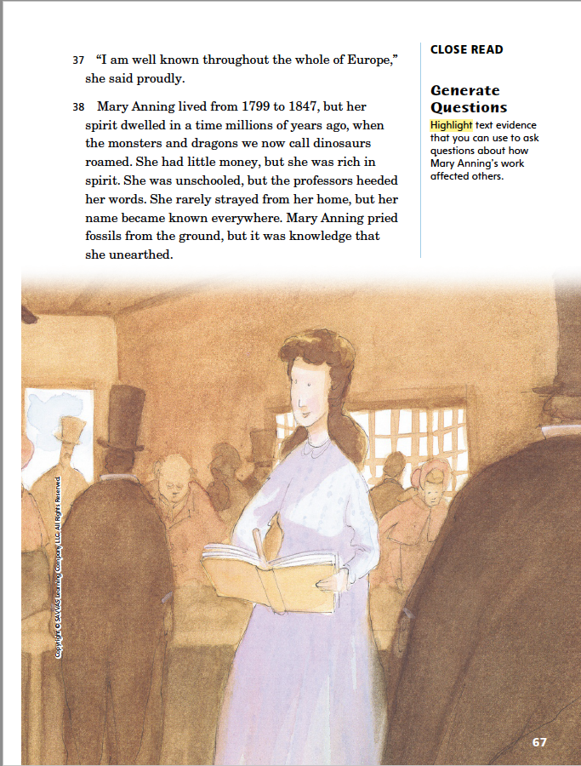
Close Read – Generate Questions
Page 67
Turn to page 67 in your Student Interactive.
Notes:
Have students scan the text on this page.
Ask: What details show that Mary had an effect on the science of her time? Highlight the parts of the text that discuss Mary’s fame and influence. See student page for possible responses.
Ask students to generate further questions about Mary’s impact on paleontology, the study of prehistoric life. Possible responses: What credit has Mary received from paleontologists? What did Mary’s studies of fossils contribute to science? DOK 2

Slide 51
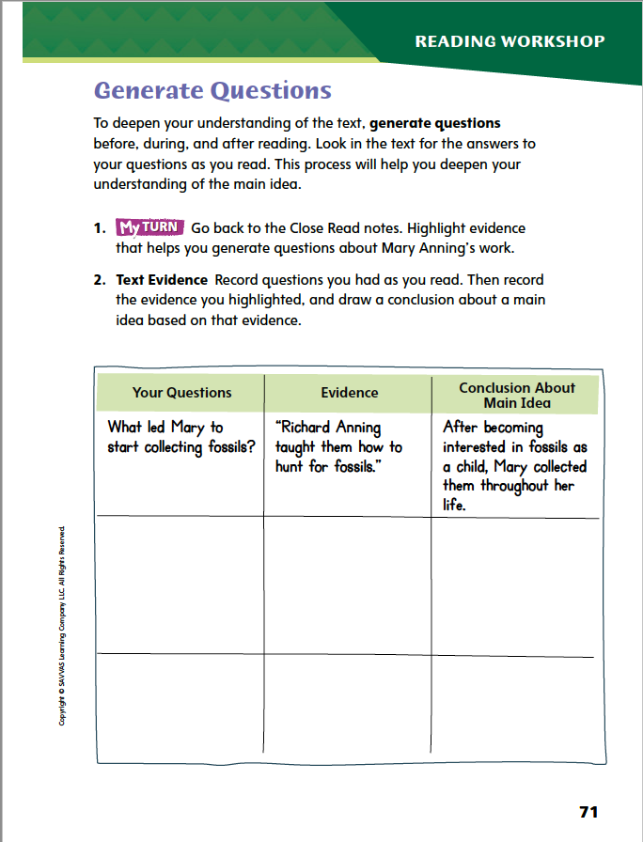
Page 71
Close Read – Generate Questions
Complete page 71 in your Student Interactive.
Notes:
Have students use the strategies for generating questions.
Have students annotate the text using the other Close Read notes for Generate Questions and then apply the text from their annotations to complete the chart on p. 71.

Slide 52
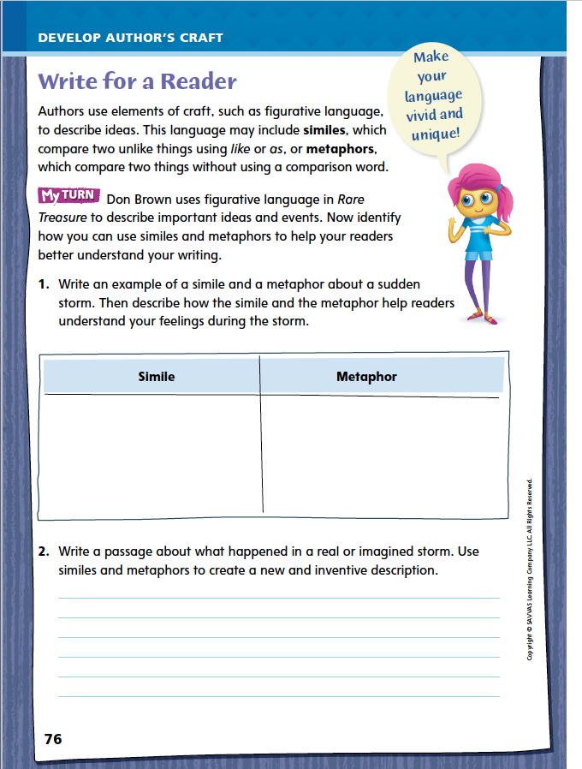
Page 76
Writing for a Reader
Turn to page 76 in your Student Interactive and complete the activity.
Notes:
Authors choose words carefully to help readers understand complex life events, important concepts, and main ideas. Use author’s craft techniques such as figurative language to add detail and imagery to your writing.
Remind students that they just analyzed how an author includes figurative language in a biography. Discuss how students might use a similar technique in their own writing. Model an example.
Say: Identify an event to write about, such as going to an outdoor fair on a hot day.
Say: Think about the image you want to convey. What emotions or sensations do you want to illustrate? Prompt for a few ideas, such as heat, excitement, crowds, or games.
Say: Consider words or phrases that emphasize the quality you want to highlight. Explain: I call attention to the temperature by saying it is “as hot as an oven” or “a blanket of heat.” As a class, make a list of similes and metaphors that create a vivid image of the event.
Together as a class, discuss how the suggestions on your list enhance the picture you are creating with words. Explain that these images make the event more lively and complex.
Have students refer to Rare Treasures for figurative language that makes the writing more vivid, and suggest they use it as an example for their own writing. Then guide students to complete the activity on p. 76 of the Student Interactive.

Slide 53
Word Study
-ed
Play “I Spy” with a partner.
Use comparative -er and -est words in your hints.
-ing
-s
-er
-est
Notes:
Review the strategies about adding suffixes -ed, -ing, -s, -er, and -est to words from last week.
Call on a student to give an example of a suffix that tells us an action is happening in the present. (-ing or -s)
Discuss how knowing that suffixes modify the meaning of a word can help students understand and use new word forms.
Have students pair up to play “I spy” using comparative -er and -est words in their hints. For example, I spy a book bigger than the dictionary. I spy the greenest object in the room.

Slide 54
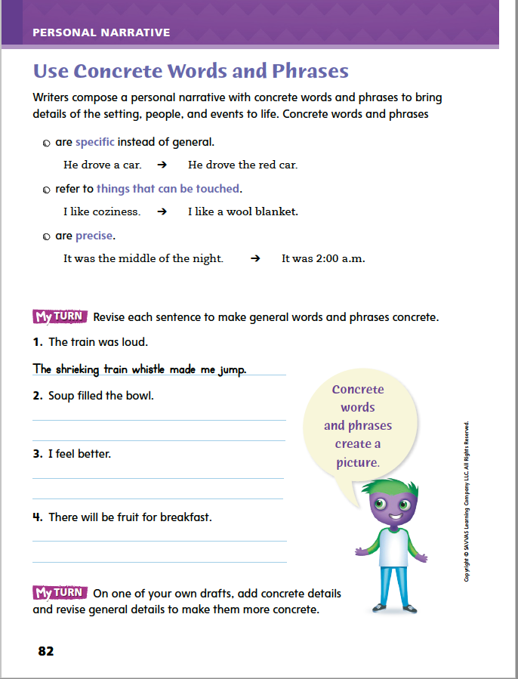
Page 82
Writing – Personal Narrative
Turn to page 82 in your Student Interactive.
Notes:
Abstract language refers to intangible concepts, such as ideas, feelings, and qualities. To avoid vague or dull writing, authors use concrete language as much as possible. Concrete language
is easy for readers to visualize and imagine precise, specific descriptions.
helps readers visualize and imagine so they feel involved in a narrative.
Use an example of recent weather to model choosing concrete words over abstract words. For example, ask: If I say, “The weather was nice yesterday,” what picture comes into your mind? How is the picture different if I say, “Yesterday was cool and breezy with lots of sunshine”? I replaced the word nice with words that were specific, precise, and about things a person can feel—a cool temperature, a breeze, and sunshine. I used concrete words to express my idea fully without leaving anything up to the reader to decide.
Walk students through the examples on Student Interactive p. 82. After that, have students complete the activity.

Slide 55
Independent Writing
On one of your own drafts, add concrete details and revise general details to make them more concrete.
Share examples of concrete words and phrases from your writing.
Notes:
After the minilesson, students should transition into independent writing.
If students need additional practice identifying concrete language, have them find vivid images in a text from the stack and then isolate the words that are most specific and precise.
Additional support may be provided.
Modeled Model using several concrete words and phrases to describe your school setting, and have students write sentences using those words and phrases.
Shared Ask students to describe the school setting using several concrete words and phrases, then record the vivid images that concrete description creates.
Guided Use a stack text to provide explicit instruction on concrete words and phrases.
If students demonstrate understanding, they should continue working on their draft personal narratives in their writing notebooks. See the Conference Prompts on p. T360.
Have several volunteers share examples of concrete words and phrases from their own writing.

Slide 56
Spelling
-ed
-ing
-s
-er
-est
He wears a bright shirt so he is easyer to spot when joging.
Notes:
Review the spelling rule about suffixes from the previous week.
Display this sentence: He wears a bright shirt so he is easyer to spot when joging. Call on a student to correct the misspelled words (easier and jogging). Explain that if authors know how suffixes change base words, they will be able to add and remove suffixes correctly in their writing.
Using the spelling words from last week, invite students to create a word search, crossword puzzle, or illustrated dictionary entries for ten of the words.

Slide 57
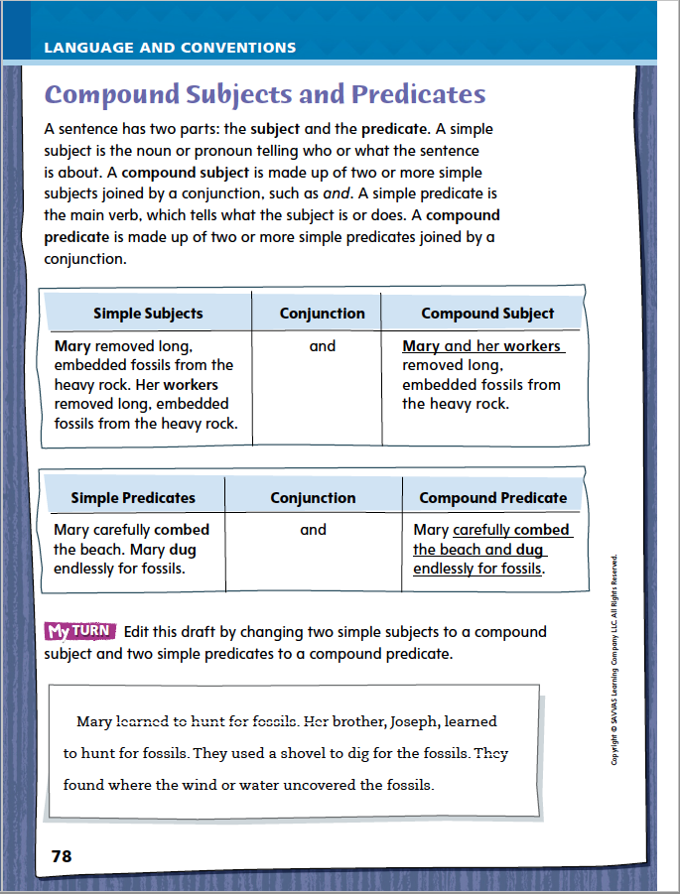
Page 78
Language and Conventions
Turn to page 78 in your Student Interactive and complete the activity.
Notes:
Have students complete p. 78 of the Student Interactive.

Slide 58
Lesson 5

Slide 59
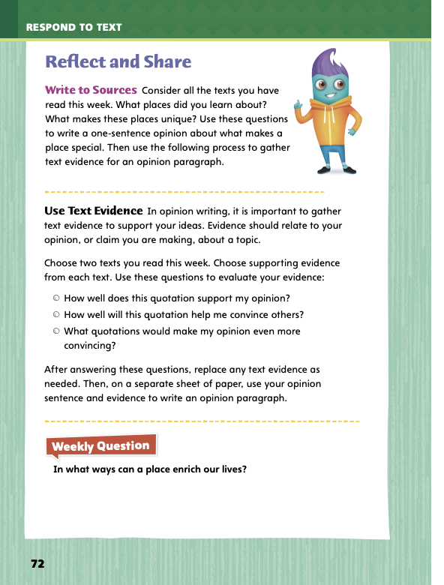
Page 72
Reflect and Share
Turn to page 72 in your Student Interactive.
Notes:
Remind students to closely follow directions when they create a written response. Explain that in this case, they have a chance to share their own opinions. Point out that supporting an opinion with text evidence is an essential part of their response.
Review the places you read about this week. Reread details about those settings to help you form an opinion.
As you reread, use sticky notes or notecards to record text evidence, such as quotations, that supports your opinion.
Model forming an opinion and supporting it with text evidence. Use Student Interactive p. 72. Say: As I review settings I have read about this week, I will look for descriptions of places. I like this description in paragraph 11 of Rare Treasure “the rugged ribbon of shore that separated the sea and the cliffs.” I read on the same page that the Annings sold fossils to “wealthy tourists visiting the popular Lyme Regis shore.” I will write my opinion sentence to include both geography and people. Then I will look back at a second text I read this week to gather additional evidence to support my opinion.
Have students practice forming an opinion about the topic and supporting it with text evidence.
Have students use evidence from two texts they read this week to form and support an opinion about what makes a place special.

Slide 60
Apply
In what ways can a place enrich our lives?
Notes:
Have students use evidence from the texts they have read this week to respond to the Weekly Question.
Tell them to write their response on a separate sheet of paper or discuss in small groups.

Slide 61
Word Study
Every year hikers experience the majesty of the Rockies.
The majestic stallion runs free through the plains.
Notes:
To assess students’ understanding of the suffixes -ty, -ity, -ic, and -ment, provide them with the following words: majesty and majestic. Offer them sample sentences:
Every year hikers experience the majesty of the Rockies.
The majestic stallion runs free through the plains.
Have students use their knowledge of suffixes to define each word. (Possible responses: majesty: noun; imposing character, grandeur; majestic: adjective; stately, possessing majesty)

Slide 62
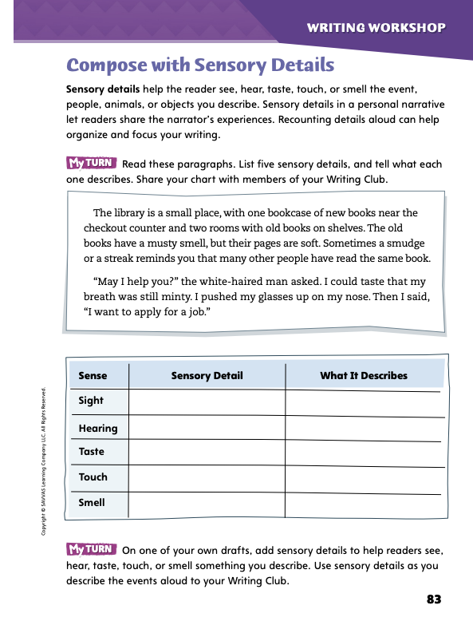
Page 83
Writing – Personal Narrative
Turn to page 83 in your Student Interactive.
Notes:
Sensory details, like concrete words and phrases, let readers share the narrator’s experience. They give readers access to what the narrator sees, hears, smells, tastes, feels, and touches. Recounting these details aloud can allow writers to organize and focus their writing.
Point out that sensory details help readers relate to the experiences and events described in a text. Not every sentence of a narrative needs sensory details. Writers use them judiciously. Say: If I am narrating a personal experience and I want to express how I feel, I could say, “I feel happy.” I could also say, “I feel the corners of my mouth twitch with the beginnings of a smile.” That sentence uses sensory details to let readers know I feel happy. Readers can relate to the feeling of starting to smile. The sentence I choose for my narrative depends on what I want to emphasize for readers.
Read several paragraphs that include sensory details from a personal narrative in the stack. Then have students answer these questions:
Does the writer use sensory details? What are some examples?
How do the sensory details affect a reader’s or listener’s experience of the text?
Where would you use sensory details like this in your own writing?
Direct students to Student Interactive p. 83 and have them complete the activities.
For the second activity, students should add sensory details to a draft and use these details to recount the events orally.
Place students into Writing Club groups. See p. T379 for details of how to run Writing Club. See the Conference Prompts on p. T360.
Have volunteers share sensory details from their own writing.

Slide 63
Independent Writing
Discuss
What more—or less—do you need to know about this narrator?
What details would help you appreciate how the setting affects events?
Are there any details the writer could leave out of this draft?
Is the writer’s language concrete enough?
What sensory details would help make the writing more interesting to you?
Notes:
In this week’s Writing Club, students practice identifying sensory details and adding them to their own personal narratives. They also begin evaluating the narrator, setting, and details in their drafts.
Point out that everyone is working on a personal narrative at his or her own pace. As they prepare to share and discuss their work, remind students to:
listen actively by focusing on the speaker, not on their own thoughts.
ask relevant questions about other writers’ choices.
make pertinent comments that are helpful to the group.
Before sharing their work, students should decide what they would like feedback on in today’s Writing Club. They may want to focus on how they portray the narrator or the setting, on choosing relevant details, or on developing concrete sensory language. Students should inform their Writing Club of their interest before they begin reading.

Slide 64
Spelling
1. They visited an amusement park.
2. A microscope is used to see small objects.
3. The community garden is popular in summer.
4. Gerardo is able to swim across the lake.
5. The payment was made on time.
6. Ann liked the festive colors of the fall leaves.
7. Bread and potatoes are basic foods.
8. Crossing guards are trained in safety.
9. Chefs share their creativity with recipes.
10. The audience showed enjoyment by clapping.
Notes:
(Note: Move the orange boxes to cover each bold spelling word before you read aloud the words and sentences.)
Use the following sentences for a spelling test.
They visited an amusement park.
A microscope is used to see small objects.
The community garden is popular in summer.
Gerardo is able to swim across the lake.
The payment was made on time.
Ann liked the festive colors of the fall leaves.
Bread and potatoes are basic foods.
Crossing guards are trained in safety.
Chefs share their creativity with recipes.
The audience showed enjoyment by clapping.
Reveal the spelling word and have students check their work.
For students who understand that word spellings may change with certain suffixes, include the following Challenge Words with the spelling list. Challenge Words: diversity, requirement, opportunity

Slide 65
Language and Conventions
The limber monkey swings through the trees and finds some food.
compound subject, simple predicate
simple subject, compound predicate
compound subject, compound predicate
simple subject, simple predicate
Notes:
Display the sentence and have students respond independently to select the best description.
The limber monkey swings through the trees and finds some food.
A compound subject, simple predicate
B simple subject, compound predicate
C compound subject, compound predicate
D simple subject, simple predicate
APPLY Have students complete Language and Conventions p. 12 from the Resource Download Center. Click path: Table of Contents -> Resource Download Center -> Language and Conventions -> U1 W2

Slide 66
Unit 1: Week 2
Grade 4

