Slide 1
Unit 1: Week 2
Grade 1

Slide 2
Copyright © Savvas Learning Company LLC. All Rights Reserved.
This publication is protected by copyright, and permission should be obtained from the publisher prior to any prohibited reproduction, storage in a retrieval system, or transmission in any form or by any means, electronic, mechanical, photocopying, recording, or otherwise. For information regarding permissions, request forms, and the appropriate contacts within the Savvas Learning Company Rights Management group, please send your query to:
Savvas Learning Company LLC, 15 East Midland Avenue, Paramus, NJ 07652
or
k12learningpermissions@savvas.com
myView Literacy® is an exclusive trademark of Savvas Learning Company LLC in the U.S. and/or other countries.

Slide 3
Lesson 1

Slide 4
Page 52
Phonological Awareness
Notes:
Point to the picture of the pin on p. 52 in the Student Interactive. Tell students to listen to each sound as you say the word pin. Repeat the sounds in the word pin several times: /p/ /i/ /n/. Ask: What sound do you hear in the middle of pin? Then have students repeat the activity with the pictures for six and pig. Ask students to say each picture name again and identify the middle sound in each picture name.
Say: Listen carefully as I say the sounds in the word hit: /h/ /i/ /t/. Extend your pronunciation of the medial sound /i/. Now repeat the sounds in hit with me: /h/ /i/ /t/. What sound do you hear in the middle of the word hit? Correct! It is the sound /i/. Keep practicing the sound medial i with the following words: lip, pit, wig, zip. Say the sounds and have students repeat.

Slide 5
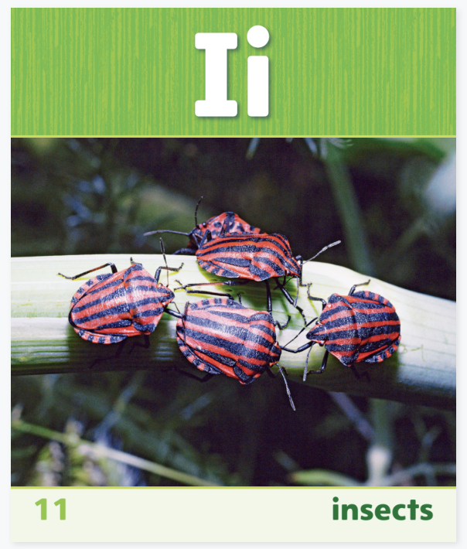
Phonics
Notes:
Use Sound-Spelling Card 11 (insects) to introduce how to spell the short i sound.
Say: This is a picture of insects. Insects begins with the sound /i/. Listen: /i/ (pause) /i/ (pause) /i/ (pause) insects. Say the sound with me. Have students say the sound several times. Then ask: What sound does insects begin with? Elicit responses. Great work! Point to the Ii at the top of the card. The sound /i/ is called short i and is spelled with the letter i. What letter spells the short i sound? That’s right, the letter i. Click path -> Table of Contents -> Unit 1 Week 1 Realistic Fiction -> Lesson 1

Slide 6
Page 52
Apply
Turn to page 52 in your Student Interactive.
Notes:
Direct students to the bottom of p. 52 in the Student Interactive. Read aloud the text. Students first segment and say the phonemes in each word (short arrows), then blend the phonemes together to read it (long arrow)

Slide 7
High-Frequency Words
do
the
like
we
one
Notes:
Display the high-frequency words do, like, one, the, we. Tell students that there are some words we learn by remembering the letters instead of by saying the sounds.
Point to each word as you read it.
Then spell the word and read it again.
Have students spell and say the words with you.

Slide 8
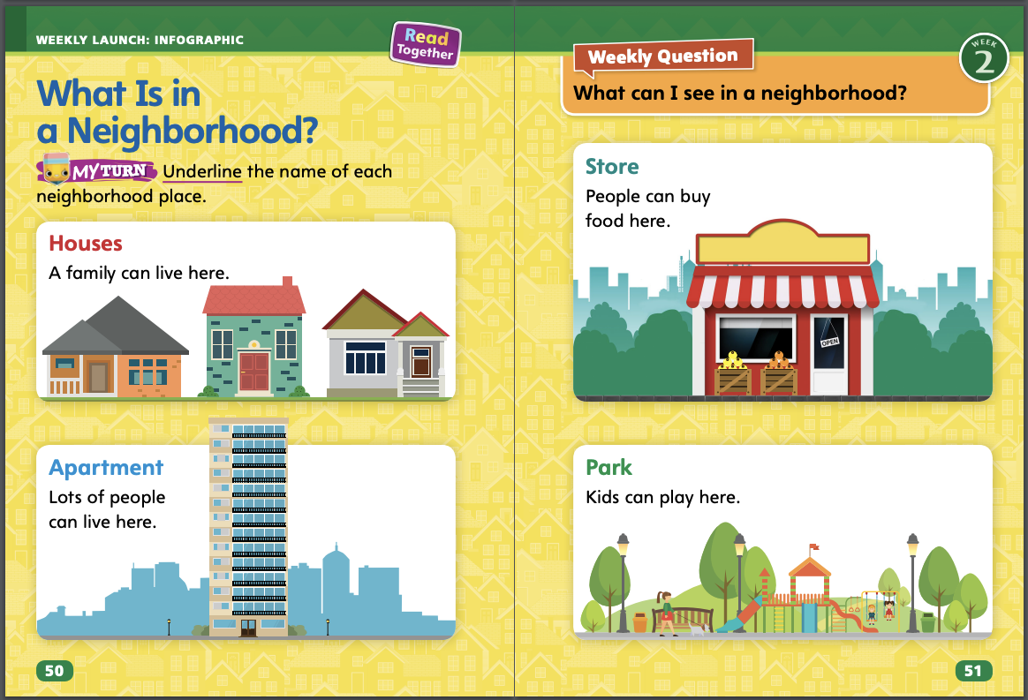
Page 50,51
Interact with Sources
What various things can people do at these places in a neighborhood?
How many different types of buildings can you find?
Notes:
Review the Essential Question for Unit 1: What is a neighborhood? Point out the Weekly Question: What can I see in a neighborhood? Have students follow along in their Student Interactive, pp. 50–51, as you read aloud “What Is in a Neighborhood?” Then organize students into small groups and ask them to use the pictures to share information about what they see in the neighborhood. Display the following questions that groups might discuss:
What various things can people do at these places in a neighborhood?
How many different types of buildings can you find?
Then ask: What types of buildings can you find in a neighborhood? Guide students to go back to the infographic to find the answer. Ask each group to choose a representative to share one type of building with the class.
Have students interact with the infographic source by underlining the names of the neighborhood places on pp. 50–51 in the Student Interactive. Explain that when you interact with a text, you read it and then respond to it in a way that helps you understand it. Underlining can help readers remember important information.
Remind students of the Weekly Question: What can I see in a neighborhood? Explain that you can see houses, stores, and parks in a neighborhood. Tell students that you can see other things in a neighborhood, too. Students will explore other places in a neighborhood this week.

Slide 9
Listening Comprehension
What do they see in a neighborhood?
Notes:
Tell students that you are going to read aloud a realistic fiction story. Have students listen as you read the text, “A Neighborhood Walk.” Encourage students to be active listeners by looking at you and thinking about the characters and where the story takes place.
Purpose Have students listen actively for elements of realistic fiction.
READ the entire text aloud without stopping for the Think Aloud callouts.
REREAD the text aloud, pausing to model Think Aloud strategies related to the genre.
Ask students: What do Lila and Jacob see on their walk? Use the chart to record student responses.

Slide 10
Page 62,63
Realistic Fiction
Turn to page 62 in your Student Interactive.
Notes:
Setting in a fiction story is where and when the story takes place. In realistic fiction, the setting is a real place or somewhere that seems real. The time the story takes place is also real or seems real. For example, the story could take place in the morning or on a Tuesday or in the winter. Realistic fiction is often illustrated with pictures. To check if a story is realistic fiction, ask yourself:
Is the setting somewhere that is or seems real?
Does the story take place in a time that is or seems real?
Model determining if a story is realistic with the Read Aloud on pp. T80–T81. In the story, “A Neighborhood Walk,” Lila and Jacob are taking a walk. I ask myseIf, could this really happen? Yes, of course children walk in their neighborhood all the time. I think about the setting. The children see a park. Does that seem real? Yes, I go to the park all the time. So these things help me decide that “A Neighborhood Walk” is realistic fiction. The characters and setting are like real life.
Then review the Anchor Chart about characters on p. 63 in the Student Interactive. Editable Anchor Chart Click Path: Table of Contents -> Reading Anchor Charts -> Unit 1 Week 2: Realistic Fiction Editable Reading Anchor Chart

Slide 11
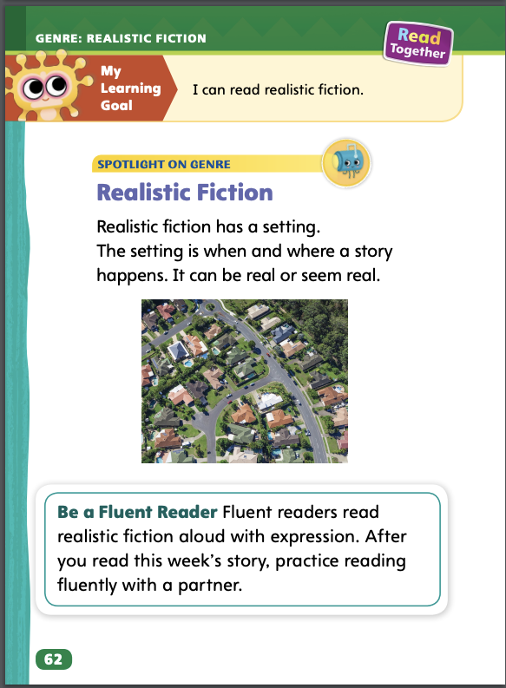
Page 62
Apply
Work with a partner to complete the fluency activity.
Notes:
Have students use the strategies to identify realistic fiction.
Prompt students to work with a partner to discuss the characteristics of setting in realistic fiction. Circulate to determine if students show understanding.
Explain that fluent readers read with prosody, or expression. Have students work with a partner to complete the fluency activity on p. 62 of the Student Interactive.

Slide 12
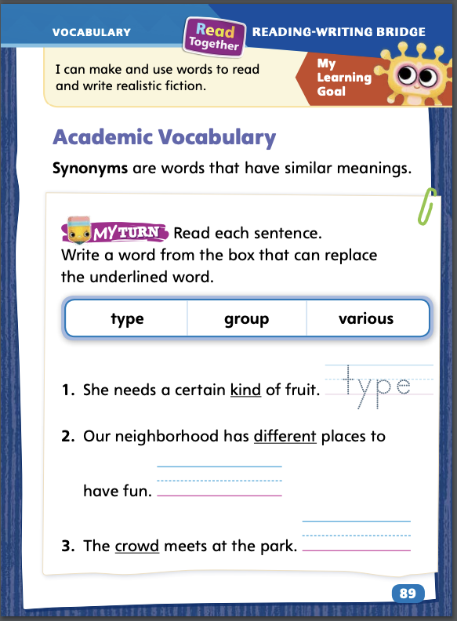
Page 89
Academic Vocabulary
Turn to page 89 in your Student Interactive and complete the activity.
Notes:
Remind students of the Academic Vocabulary for the unit: type, various, settle, and group. Explain that synonyms are words that have similar meanings.
Read the sentence that has the unfamiliar word.
Look for synonyms for the unfamiliar word that might be in the sentence or in the sentences before or after.
Read the sentence again, substituting the synonym for the unfamiliar word. See if the sentence makes sense.
Model an example: I like to eat various fruits, such as apples, pears, and mangoes. I eat three different kinds of fruit. The word different seems like a synonym for various. I can substitute different in the first sentence to see if it makes sense. I like to eat different fruits, such as apples, pears, and mangoes. Yes, that makes sense. Different is a synonym of various.
Have students complete the activity on p. 89 in the Student Interactive.

Slide 13
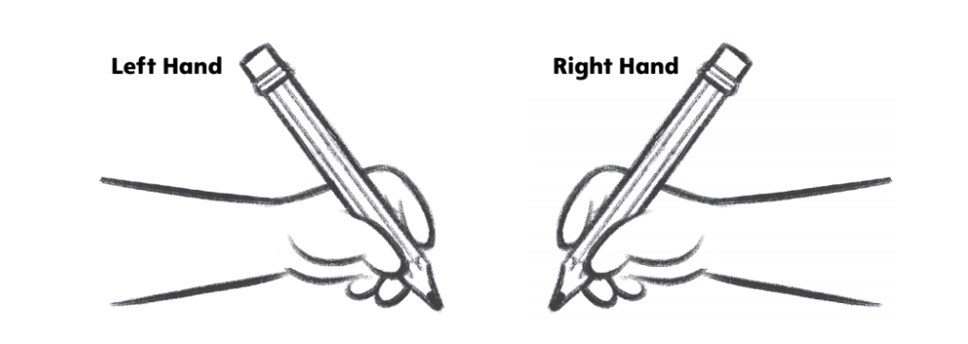
Handwriting
Proper Pencil Grip
Notes:
Explain to students that there is a correct way to hold a pencil when writing that will help them write faster and make letters correctly.
Model using a proper pencil grip.
Start by making a fist.
Then release the first three fingers.
Touch the three fingers into a tripod grip.
Slip the pencil through the first two fingers.
Make sure your fingers are close to the pointed end of the pencil.
Have students use Handwriting pg. 21 from the Resource Download Center to practice practice the proper pencil grip. Click path: Realize -> Table of Contents -> Resource Download Center -> Handwriting Practice -> U1W2L1 Handwriting Practice

Slide 14
Writing – Launching Writing Workshop
What will this book be about?
Where do you think the author got ideas for this book?
Do you think the ideas came from real experiences or the author’s imagination or both? Why?
Notes:
Authors get their ideas for writing in many different ways. Sometimes they get ideas from
people and places they know.
experiences they’ve had.
their imagination.
Explain that the authors of all of the books we will read had ideas about what they would write before they began writing. Have students brainstorm a list of where authors might get ideas. Discuss the difference between real-life experiences and imagination. Then hold up a book from the stack. Read the title. Ask:
What will this book be about?
Where do you think the author got ideas for this book?
Do you think the ideas came from real experiences or the author’s imagination or both? Why?
Hold up one or two more books from the stack and repeat the procedure.

Slide 15
Independent Writing
Write about something that you like.
Notes:
During independent writing time, students should write independently about anything they like.
Modeled Choose a stack text and read an excerpt. Do a Think Aloud to model how an author may have gotten an idea for a specific excerpt.
Shared Have students choose a stack text and select an excerpt to read together. Prompt students to talk about where the author may have gotten the ideas in that excerpt.
Guided Use the stack texts to provide explicit instruction on whether an author used a real life experience or imagination for a specific excerpt.
As students write, use the conference prompts in the Teacher’s Edition or Resource Download Center to provide support. Click path: Table of Contents -> Resource Download Center -> Writing Workshop Conference Notes
Call on a few students with whom you conferred to share what they are writing about and explain where they got the idea..

Slide 16
Spelling
Where did it go?
Tom likes to sit on the floor.
He catches the ball in the mitt.
I miss my friends when they go away.
I have one sister named Jill.
I like the color blue.
Notes:
(Note: Move the orange boxes to cover each bold spelling word before you read aloud the words and sentences.)
Read aloud the words and sentences. Have students spell each word with initial consonant blends and the two high-frequency words.
Where did it go?
Tom likes to sit on the floor.
He catches the ball in the mitt.
I miss my friends when they go away.
I have one sister named Jill.
I like the color blue.
Reveal the spelling word and have students check their work.

Slide 17
Language and Conventions
The boy plays with a toy.
My dog likes to run.
Notes:
Remind students that a noun names a person, an animal, or a thing. Ask students for examples of nouns in the three categories and write them on the board.
Write these sentences on the board: The boy plays with a toy. My dog likes to run. Read each sentence aloud. Ask volunteers to name the nouns in each sentence. Underline the nouns and discuss their categories (person, animal, or thing).
Have students fold a sheet of paper in thirds and label each section: People, Animals, and Things. Remind students that these are noun groups. Then tell students to write a few nouns for each section. Have partners share the words they wrote.

Slide 18
Lesson 2

Slide 19
Page 53
Phonics
Read the sentences on page 53 in your Student Interactive.
Notes:
Review that the short i sound is spelled i. Say the short i sound as you write the letter i on the board.
Write the letters T, t, s, m, and i on their own note cards. Display the s, i, t note cards in a row. Say: We can use what we know about letters and sounds to read this word. Point to each letter and say: What is this letter? What sound does this letter spell? Blend the sounds with students to say the word sit. Say: We just read this word. Continue the routine with the words Tim and it.
Have partners read the sentences at the top of p. 53 in the Student Interactive. Before students read the sentences, point out the word can and help students read it. Monitor students to make sure they are reading the word can correctly.

Slide 20
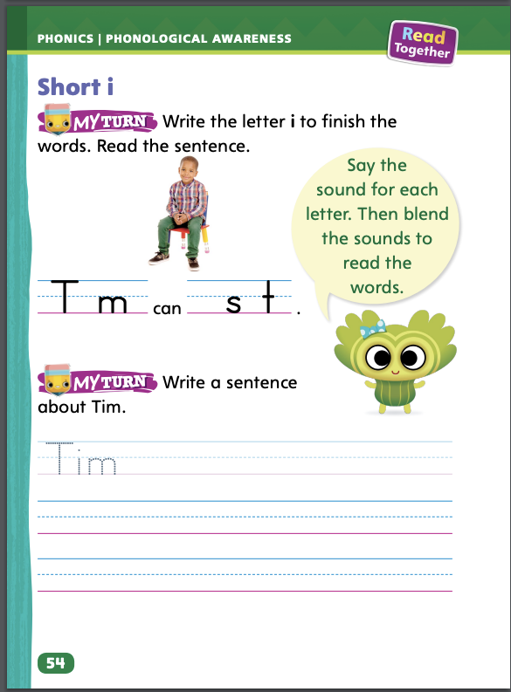
Page 53,54
Apply
Turn to page 54 in your Student Interactive and complete the activity.
Notes:
Have students complete the rest of p. 53 and p. 54 in the Student Interactive.

Slide 21
High-Frequency Words
do
like
one
the
we
Notes:
Write the words do, like, one, the, we. Have students
spell each word.
clap as they say each letter.
repeat for all words.

Slide 22
Page 64
Preview Vocabulary
sand
block
street
corner
Notes:
Introduce the words sand, block, street, and corner from p. 64 in the Student Interactive.
Have students share what they already know about the words. Ask questions such as: Where can you find sand? What is the name of the street where you live? Do you know another name for street? (block) What is the word for the place where two streets meet? (corner)
Have students demonstrate what they know about the words. They can use their hands to demonstrate how to play in the sand. Ask students to predict what the story will be about based on these words.
Provide definitions of the vocabulary words as needed. Definitions appear on the selection pages that follow. Say: These words will help you understand and describe the setting in the text Henry on Wheels.

Slide 23
First Read Strategies
Notes:
Explain that readers monitor their comprehension as they read a text. Readers can make adjustments by rereading when their understanding breaks down. Talk about the First Read Strategies with students. Have them read for understanding and enjoyment during this first read.
READ Have students monitor their comprehension as they read. If students’ understanding of the text breaks down, prompt them to make adjustments by rereading.
LOOK Remind students to look at the pictures to help them understand the text.
ASK Have students generate, or ask, questions about the setting of the story to deepen their understanding.
TALK Guide students to talk to a partner about the text.
Students may read the text independently, in pairs, or as a whole class. Use the First Read notes to help students connect with the text and guide their understanding.

Slide 24
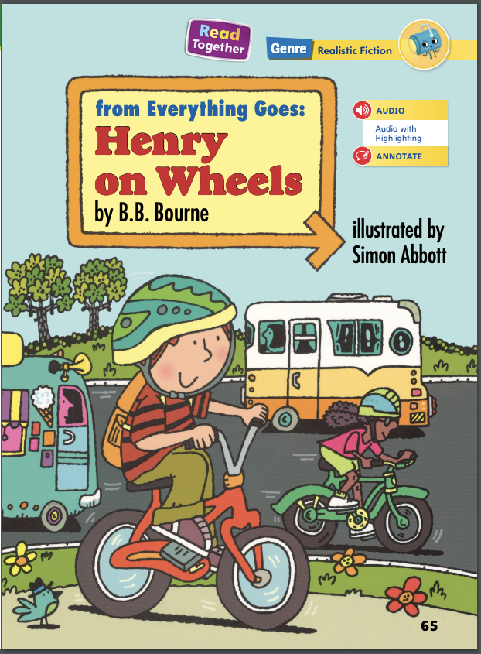
Page 65
First Read – Henry on Wheels
Notes:
Read together.
THINK ALOUD I ask questions as I read. I can find out about the setting by asking, When does the story take place? I see the picture on the title page. Maybe it can help me answer my question. Let’s take a closer look at the picture. The sky is blue. Kids are riding bikes. It looks like it is daytime. Now I know when the story takes place—daytime.

Slide 25
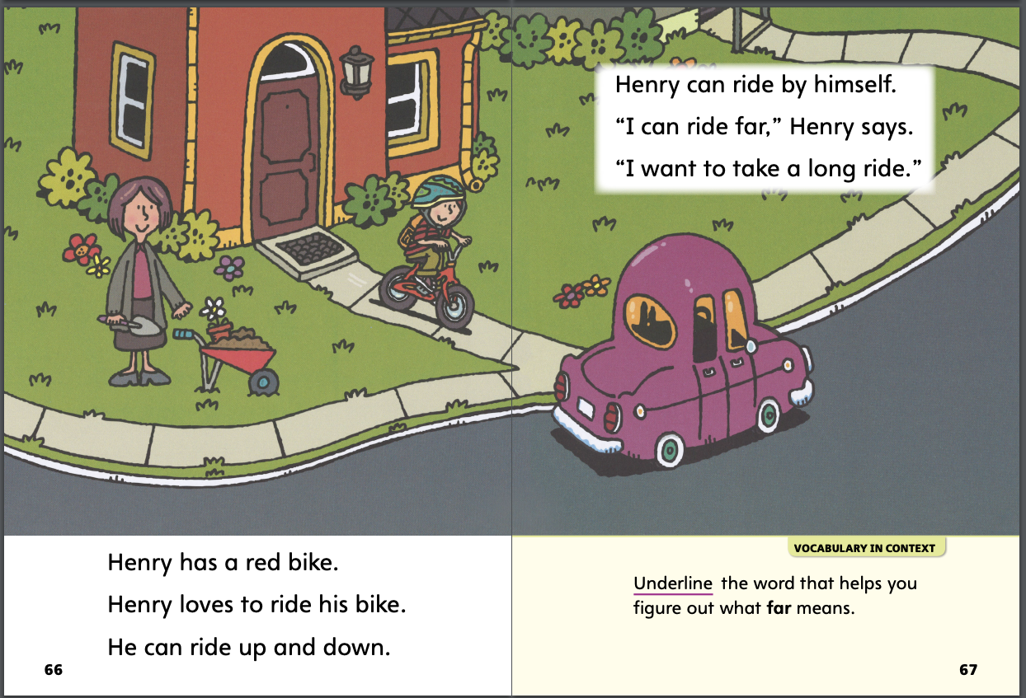
Page 66,67
First Read – Henry on Wheels
Notes:
Read together.

Slide 26
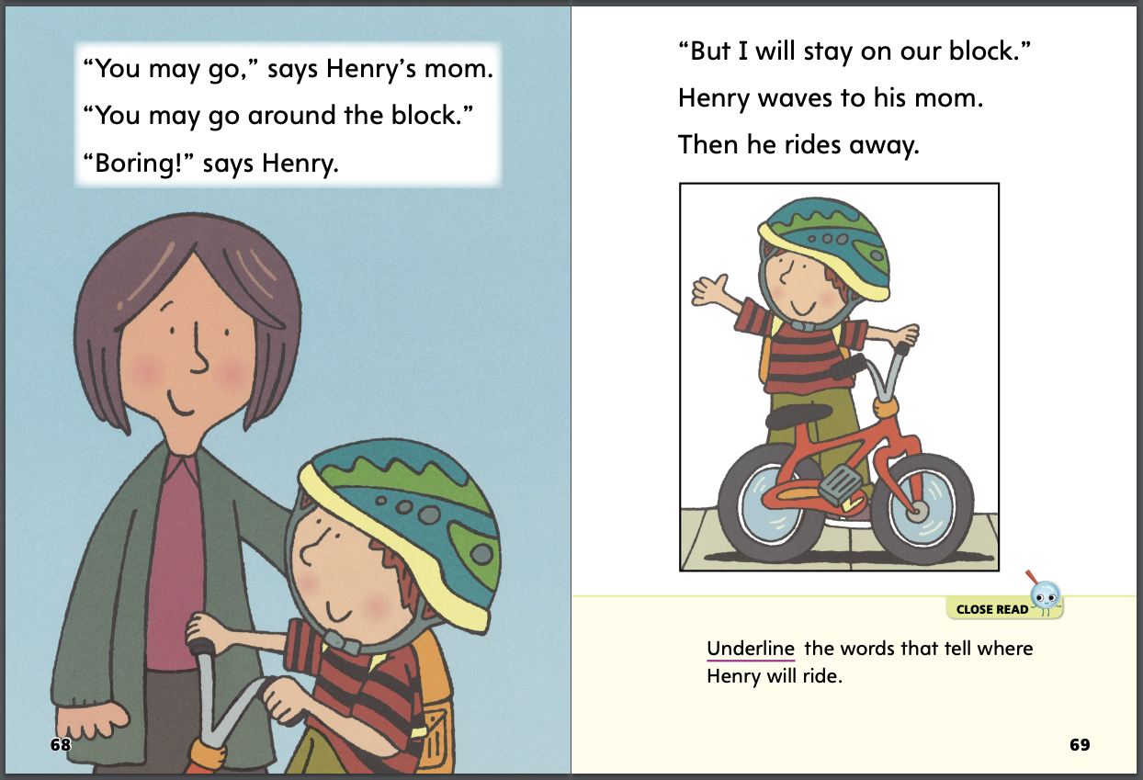
Page 68,69
First Read – Henry on Wheels
Notes:
Read together.
THINK ALOUD I should look at the pictures. The pictures can help me understand what is happening. I see Henry with his mom on page 68. He is on a bike and has a helmet on. Then page 69 shows Henry waving. I think he is waving goodbye to his mom. He must be leaving to go on a bike ride.

Slide 27
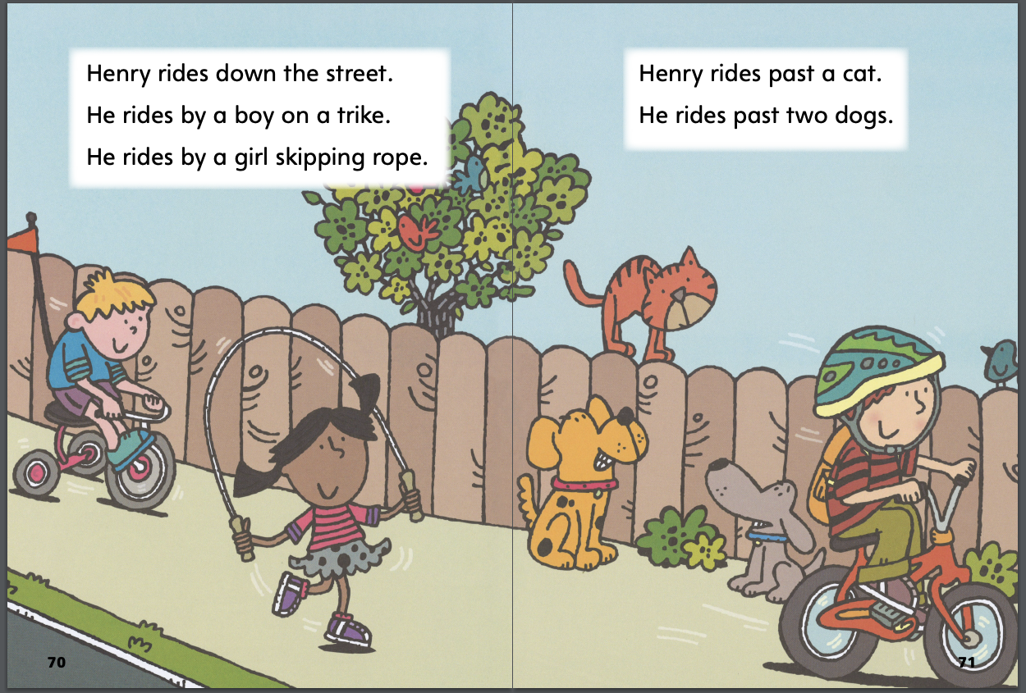
Page 70,71
First Read – Henry on Wheels
Notes:
Read together.

Slide 28
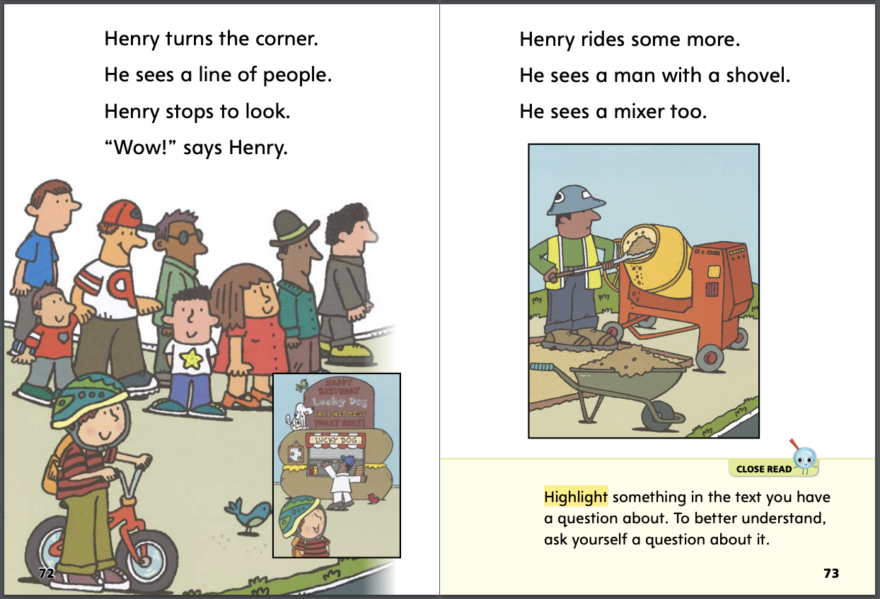
Page 72,73
First Read – Henry on Wheels
Notes:
Read together.
THINK ALOUD I could talk with a partner about page 72. I like that Henry stops to look. He wants to know what the people are doing. I would stop to look too. I talked about the story. Now I want to know what my partner thinks. So, I could ask, “Would you stop or keep riding? Why?”

Slide 29
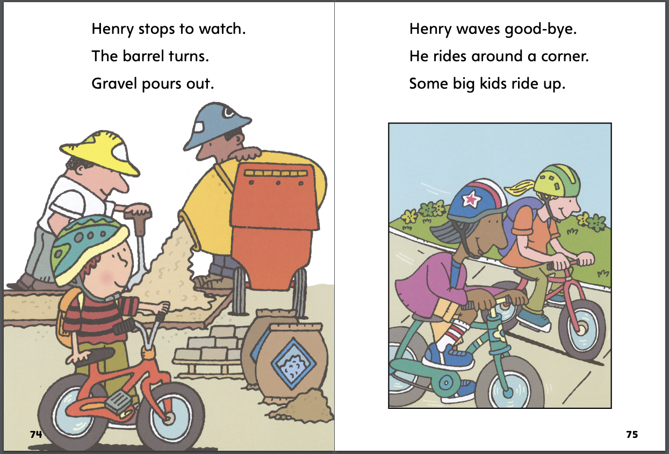
Page 74,75
First Read – Henry on Wheels
Notes:
Read together.

Slide 30
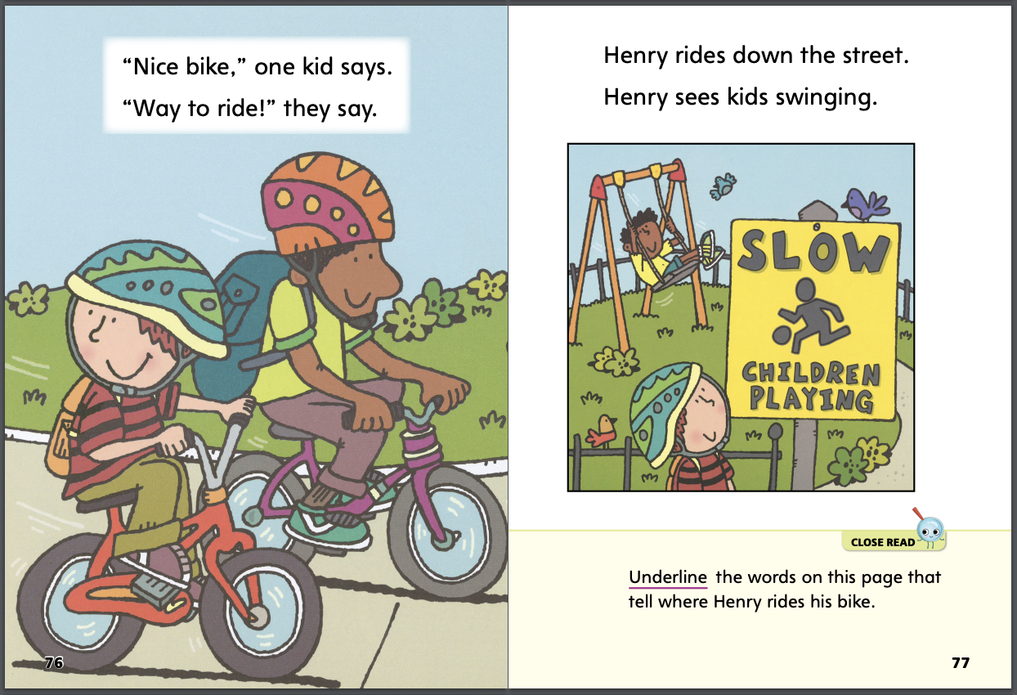
Page 76,77
First Read – Henry on Wheels
Notes:
Read together.
THINK ALOUD I can find out about the setting by asking where Henry is on page 77. I look at the picture on page 77. I see a sign that says, “SLOW” and “Children Playing.” The text says that “Henry sees kids swinging.” I can see one kid swinging in the picture too. I know that playgrounds have swings. So, I think Henry is by a playground.

Slide 31
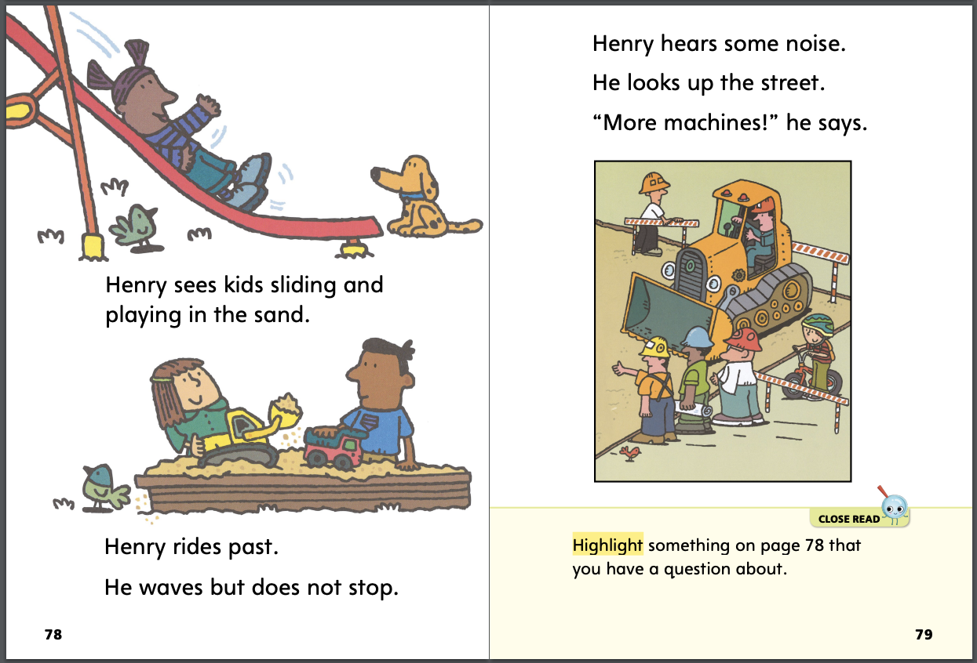
Page 78,79
First Read – Henry on Wheels
Notes:
Read together.

Slide 32
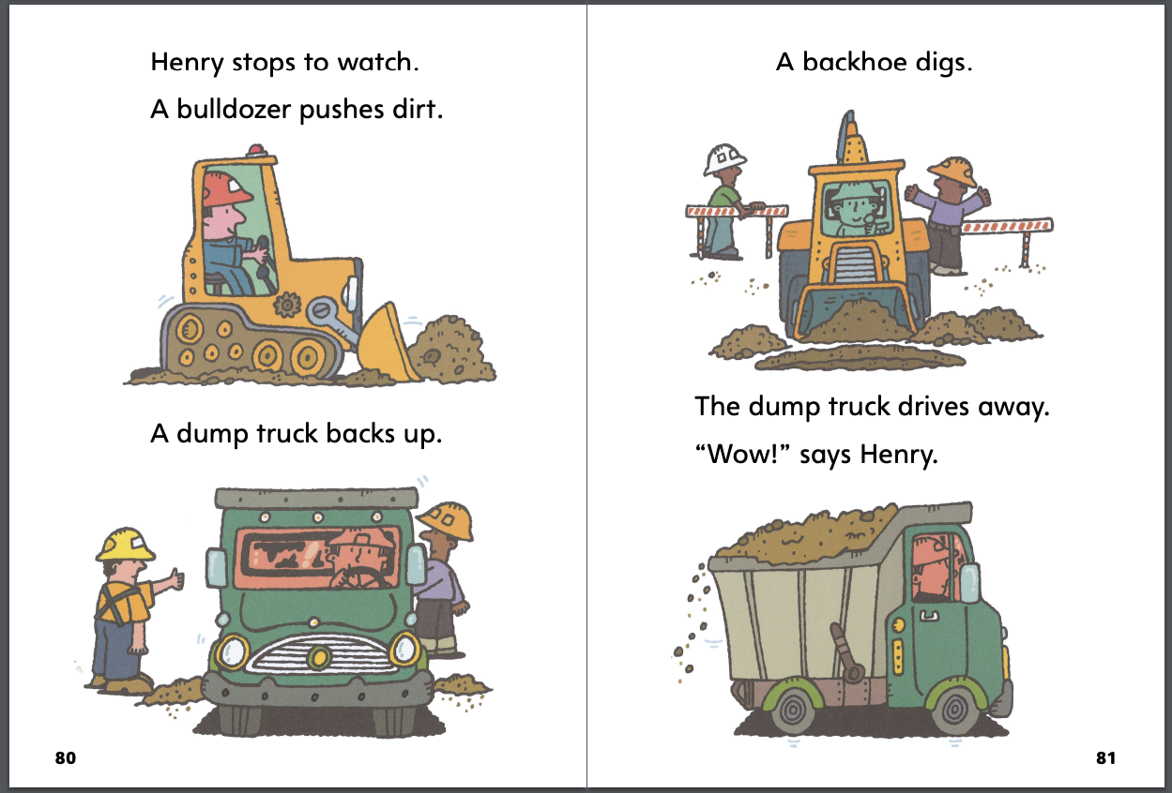
Page 80,81
First Read – Henry on Wheels
Notes:
Read together.
THINK ALOUD I do not understand why Henry stops riding his bike again. I can reread the text to help me understand. I reread parts of the text. I found out that Henry likes machines. He stops riding when he sees machines. Now I understand the text better.

Slide 33
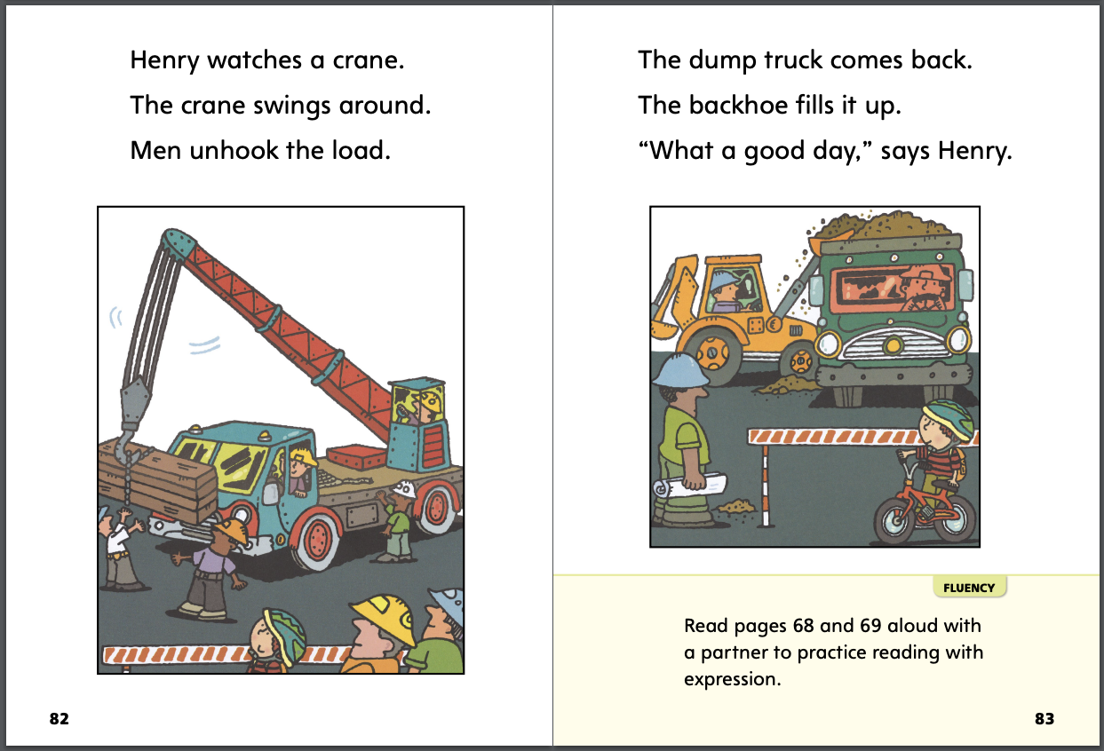
Page 82,83
First Read – Henry on Wheels
Notes:
Read together.

Slide 34
Respond and Analyze
Retell Tell a partner about the part of the story that is most like an experience you have had. How are they the same?
Make Connections Share with a partner how you feel about Henry. Is he someone like you? Do you like to do the same types of things? Does he seem like a real person to you?
Notes:
Use these suggestions to prompt students’ initial responses to reading Henry on Wheels.
Retell Tell a partner about the part of the story that is most like an experience you have had. How are they the same?
Make Connections Share with a partner how you feel about Henry. Is he someone like you? Do you like to do the same types of things? Does he seem like a real person to you?

Slide 35
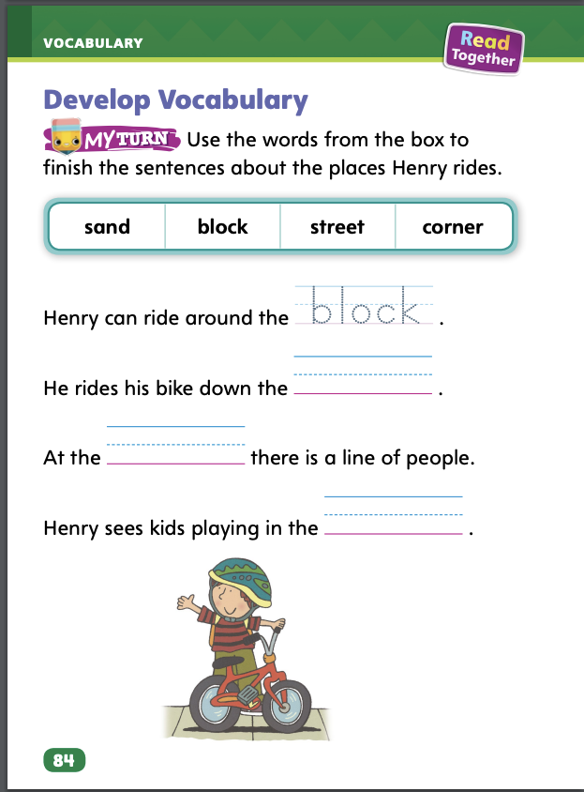
Page 84
Develop Vocabulary
Turn to page 84 in your Student Interactive and complete the activity.
Notes:
Remind students that they learned some new words as they read Henry on Wheels: sand, block, street, and corner. These words all tell where Henry rode his bike and what he saw.
Remind yourself about what each word means.
Look for pictures that help you understand the words.
Think about why the author used these words. How are they related to each other? What is the author describing?
Have students turn to p. 84 in the Student Interactive. Model how to complete the activity with the word block. Read the directions aloud and ask students to look at the words in the boxes. Which word finishes the first sentence about Henry?
Have students practice developing vocabulary by completing p. 84 in the Student Interactive.

Slide 36
Page 85
Check for Understanding
What makes the setting realistic?
Why does the author keep Henry on his block?
How is your neighborhood like Henry’s neighborhood? Use text evidence.
Notes:
Have students complete p. 85 in the Student Interactive.

Slide 37
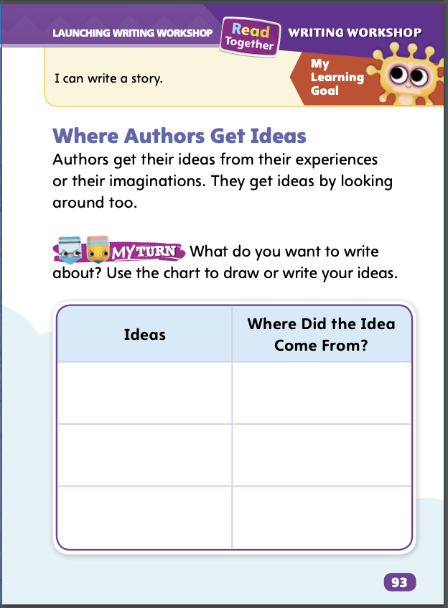
Page 93
Writing – Launching Writing Workshop
Turn to page 93 in your Student Interactive and complete the activity.
Notes:
You can do what good writers do to get ideas for your writing. Using a variety of resources can make the writing process easier and fun.
You get ideas from your real-life experiences.
You get ideas from your imagination.
You list ideas to help you decide what to write about.
Hold up a book from the stack. Read the story. Stop at specific events or information. Work with students to brainstorm where they would get ideas to write about this event or information. Encourage them to be as specific as possible. Repeat with one or two more books from the stack.
Direct students to p. 93 in the Student Interactive. Read the introductory paragraph and directions together with students. Emphasize that the Ideas column is to show ideas for topics they would like to write about. Remind them that they can get ideas from real-life people, places, and experiences. After students complete their charts, ask: Which is your favorite idea? Where did you get that idea from? Was this a real-life experience or from your imagination?

Slide 38
Independent Writing
You will continue to write and draw your books.
Notes:
Students should transition into independent writing.
If students need additional opportunities to develop their understanding of where to get ideas, they should look back at their charts before writing.
Modeled Do a Think Aloud to model how you would fill in the chart on p. 93 in the Student Interactive.
Shared Have partners share and discuss their ideas recorded in the chart on p. 93 in the Student Interactive.
Guided Use the stack texts to provide explicit instruction on how to complete the chart.
If students demonstrate understanding, they should transition to drawing and writing their books.
As students write, use the conference prompts in the Teacher’s Edition or Resource Download Center to provide support. Click path: Table of Contents -> Resource Download Center -+ Writing Workshop Conference Notes
Invite several students to share the stories they have drawn and written down. Have them then tell where their ideas came from.

Slide 39
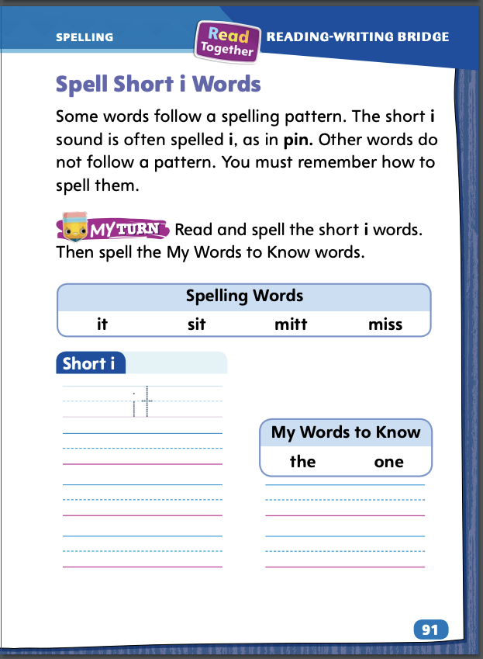
Page 91
Spelling
dig
fix
lid
Turn to page 91 in your Student Interactive and complete the activity.
Notes:
Sound-spelling patterns can help students spell words. Explain that the sound short i is often spelled i, as in pin.
Write or display these words: dig, fix, lid. Say each word aloud and point out that the middle letter in each word is an i. Tell students that in the consonant-vowel-consonant pattern, the vowel sound is short.
Have students use sound-spelling patterns to complete the activity on p. 91 in the Student Interactive.

Slide 40
Language and Conventions
Henry rides his bike.
Notes:
Explain that a verb tells about action. A present tense verb describes action that is happening right now. Demonstrate for students examples of present tense verbs as you say: I walk (as you walk around the room); I sit (as you sit in your chair); I write (as you write the words walk, sit, and write on the board).
Display this sentence: Henry rides his bike. Ask: What does Henry do? (rides) When does Henry ride? (now) Yes, Henry rides now, so the word rides is a present tense verb.
Have student partners work together to create oral sentences with present tense verbs. Have partners share their sentences with the class, telling which word is the verb.

Slide 41
Lesson 3

Slide 42
Page 55
Phonological Awareness
Notes:
Tell students sometimes a group of words begins with the same sound. Point to the picture of the nest on p. 55 in the Student Interactive. Say: What sound does nest begin with? Listen as I say the sound: /n/ (pause) /n/ (pause) /n/ (pause) nest. Nest begins with the sound /n/. Say the sound with me: /n/. Repeat with the words nine and net. Then say: What sound do nest, nine, and net begin with? Yes, they all begin with the sound /n/.
Say: Nana needs nine nuts now. Have students repeat the words. Ask: What is the initial, or beginning, sound in these words? Elicit responses. Yes, they start with the sound /n/. Then ask:. Are the beginning sounds of these words the same? Elicit responses. Right! All the beginning sounds are the same. For additional practice with alliteration, use some of the c and p Picture Cards.

Slide 43
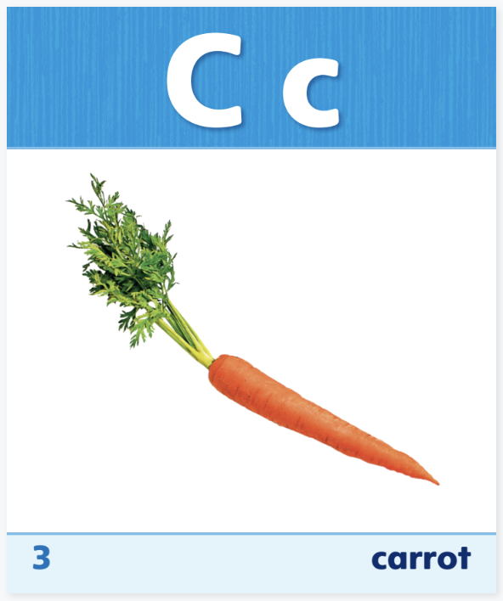
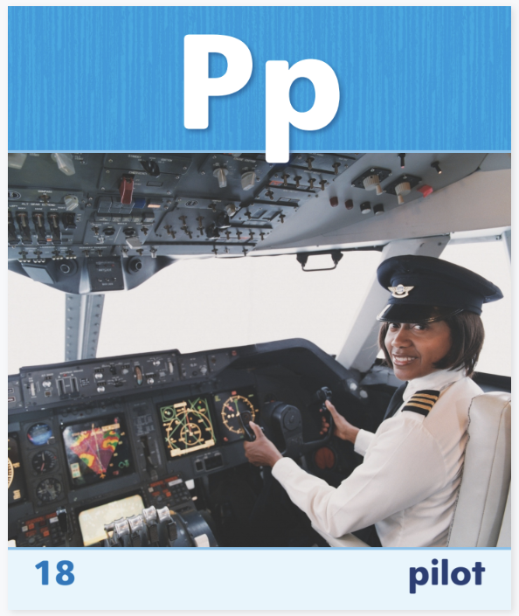
Phonics
Notes:
Use Sound-Spelling Cards 3, 16, and 18 to introduce the sound /k/ spelled c, sound /p/ spelled p, and sound /n/ spelled n. Display each card. Name the picture, isolate the initial sound, and name the letter that spells the sound. Ask students to name the sound that each letter can spell. Explain to students that they can decode, or read, words by using common letter sound correspondences.
Write the word pan on the board. We can read this word. Let’s name the letters. Then say the sounds slowly: /p/ /a/ /n/. Ask: What is the first sound? (/p/) What letter spells that sound? Yes, the sound /p/ is spelled p. Continue with the sound /a/ spelled a and the sound /n/ spelled n. Then have students read the word. Repeat the routine with can, pin, nap, cat, and tin. Click path -> Table of Contents -> Unit 1 Week 2 Realistic Fiction -> Lesson 3

Slide 44
Page 55
Phonics
Turn to page 55 in your Student Interactive.
Notes:
Read aloud the text at the bottom of p. 55 in the Student Interactive. Students first segment and say the phonemes in each word (short arrows), then blend the phonemes together to read it (long arrow).

Slide 45
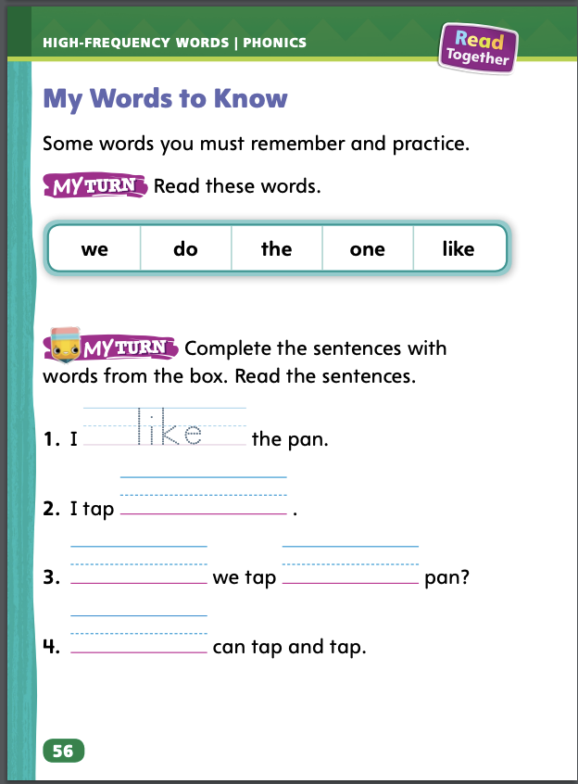
Page 56
High-Frequency Words
Turn to page 56 in your Student Interactive and complete the activity.
Notes:
Reread the high-frequency words for the week: do, like, one, the, we. Tell students that learning these words will make it easier to read more quickly.
Write the word one on the board. Tell students that this is a word that they must remember. Say the word one, then spell the word. Have students do the same. Repeat with the rest of the high-frequency words. Then have student pairs complete this sentence starter: We like to ____. Tell students to pick something that they both like. Invite students to share their sentences.
Direct students to p. 56 in the Student Interactive and have them identify, read, and write the high-frequency words.

Slide 46
Page 65
Describe the Setting
Notes:
Remind students that the setting is where and when the story takes place. In realistic fiction, the story happens in a time and place that seem real. • Look at the pictures in the story to see where the story takes place. • See how the characters look and act for clues about when the story happens. • Find words in the story that tell about the setting.
Use the Read Aloud on pp. T80–T81. To describe the setting of a story, I need to read to find out where the story happens. I can pay attention to where the characters go in the story to help me understand where the story takes place. Read aloud the text to the students. Then ask: Where does this story take place? Guide students to describe the setting of the story. (Lila and Jacob’s neighborhood) Then have them go back to the Close Read notes on pp. 69 and 77 and underline details about the setting of Henry on Wheels.

Slide 47
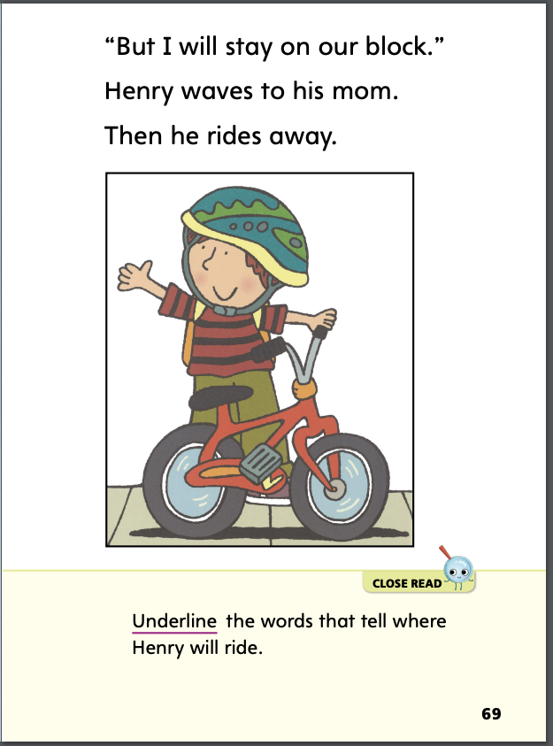
Page 69
Close Read – Describe the Setting
Turn to page 69 in your Student Interactive.
Notes:
Have students describe the setting by underlining the words on p. 69 that tell where Henry will ride. Then ask: What is one place Henry sees on his block? (Possible response: a street) DOK 1

Slide 48
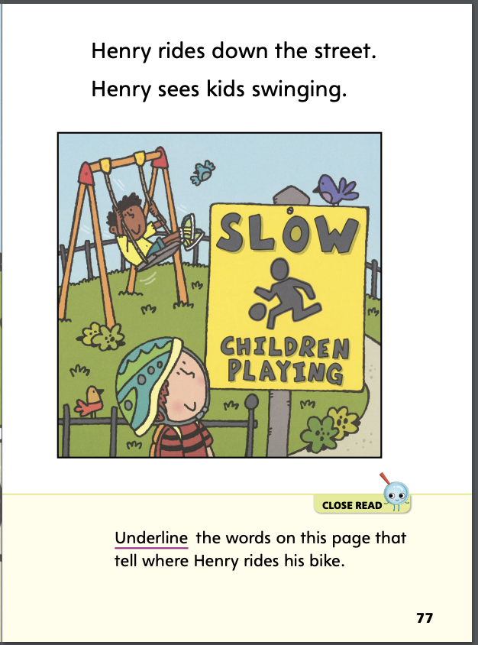
Page 77
Close Read – Describe the Setting
Turn to page 77 in your Student Interactive.
Notes:
Have students describe the setting by underlining the words on p. 77 that tell where Henry rides his bike. DOK 1

Slide 49
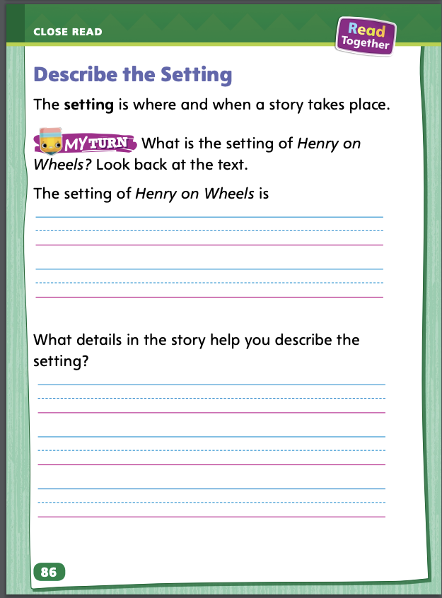
Page 86
Describe Main Events and Setting
Turn to page 86 in your Student Interactive and complete the activity.
Notes:
Have students use the strategies for describing the setting.
Have students complete p. 86 in the Student Interactive.

Slide 50
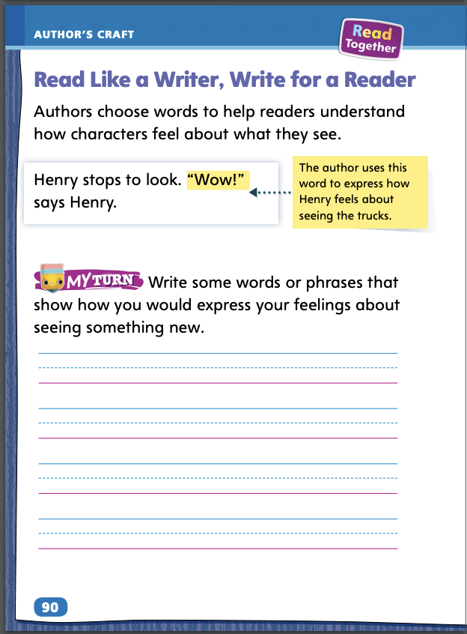
Page 90
Read Like a Writer, Write Like a Reader
Turn to page 90 in your Student Interactive and complete the activity.
Notes:
Authors choose words carefully to help readers understand how characters feel about what they see.
Read words closely.
Think about what the words tell you about how a character feels.
Model using the example on p. 90 in the Student Interactive to show students how writers use word choice. Say: In Henry on Wheels, Henry sees a lot of interesting things as he rides his bike in his neighborhood. At one point, he says, “Wow!” The author chose this word to show that Henry is excited by what he sees.
Have students use the bottom of p. 90 to write some words or phrases that show how they would express their feelings about seeing something new.

Slide 51
Handwriting
Notes:
Write vertical lines starting from the top to the bottom.
Model writing vertical lines on the board. Draw typical handwriting lines on the board (solid line, dotted line, solid line).
Tell students to always start at the top line. Say as you write the vertical line: The top line is the sky, the middle (dotted) line is the fence, and the bottom line is the ground. Come down from the sky, through the fence, and to the ground. Click path: Table of Contents -> Resource Download Center -> Handwriting Practice -> U1W2L3 Handwriting Practice

Slide 52
Writing – Launching Writing Workshop
What do you like to do on a computer?
Have you ever written anything on a computer? Was it easy or hard?
How can a computer help you write?
How can you fix a mistake when you write using a pencil? A computer?
What digital tools do you think were used to write and illustrate this page?
Notes:
There are many kinds of digital tools writers can use. Some digital tools help writers produce and improve their writing. These tools include
computers, tablets, and laptops.
various software programs (word processing, art tools).
video tools.
Explain how you use digital tools, such as computers and grading software, to help you do your job as a teacher. Have students share experiences they have had using computers and tablets. Ask:
What do you like to do on a computer?
Have you ever written anything on a computer? Was it easy or hard?
How can a computer help you write?
How can you fix a mistake when you write using a pencil? A computer?
Select a book from the stack. Open to a part of the story and hold up the book for students to view. Ask: What digital tools do you think were used to write and illustrate this page? Repeat with other pages and books.

Slide 53
Independent Writing
You will continue to work on your
books.
Notes:
After the minilesson, students should transition into independent writing.
Students should write about whatever they like and be presented with the opportunity to use digital tools if resources allow.
Modeled Do a Think Aloud to model identifying digital tools that help produce writing.
Shared Prompt students to name as many digital tools as they can that they have seen or used.
Guided Provide explicit instruction on which digital tools are used to produce writing and specifically what they do.
As students write, use the conference prompts in the Teacher’s Edition or Resource Download Center to provide support. Click path: Table of Contents -> Resource Download Center -+ Writing Workshop Conference Notes
Call on a few students to share their pictures and stories and talk about how they think a digital tool can help improve their writing.

Slide 54
Spelling
big /b/ /i/ /g/
did /d/ /i/ /d/
win /w/ /i/ /n/
fit /f/ /i/ /t/
Notes:
Remind students that words with the sound short i are often spelled with the letter i.
Have students spell the following words, as you isolate each phoneme: big, /b/ /i/ /g/; did, /d/ /i/ /d/; win, /w/ /i/ /n/; fit, /f/ /i/ /t/.
Have students complete Spelling p. 30 from the Resource Download Center. Click path: Table of Contents -> Resource Download Center -> Spelling -> U3W4

Slide 55
Language and Conventions
The cat plays in the yard.
Notes:
Explain to students that present tense verbs can be action words that tell what is happening now. A present tense verb ends in -s if one person is doing the action. It does not end in -s if there are two or more people doing the action.
Ask students to name things you do in the classroom and write the verbs on the board (write, read, walk, talk, draw). Explain that these words are all present tense verbs and label the list of words: Verbs.
Display and read aloud this sentence: The cat plays in the yard.
Ask: Which word is a verb? (plays) Have a student underline the word on the board. Ask: When does the cat play? (now) Yes, the cat does something now. She plays. The word plays is a present tense verb. It ends in -s because one cat is doing the action.
Display sentence frames for students to edit for present tense verbs. Ask them to add the correct present tense verbs to complete the sentences.

Slide 56
Lesson 4

Slide 57
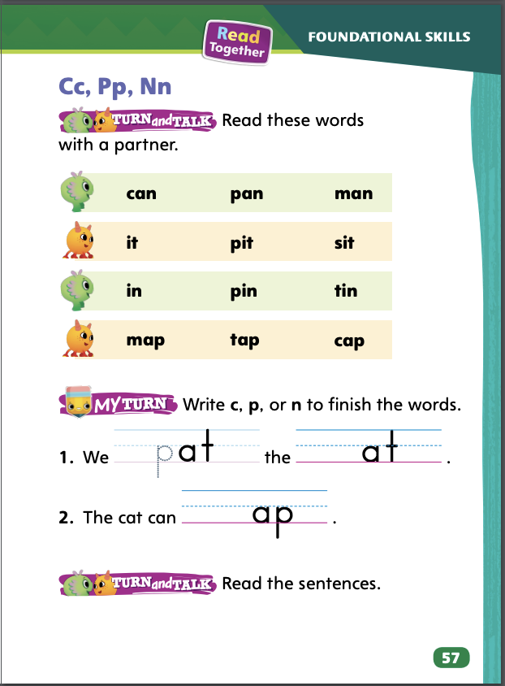
Page 57
Phonics
in
Decode the words with your partner.
Notes:
Review the sound /k/ spelled c, the sound /p/ spelled p, and the sound /n/ spelled n.
Write in. Say: Listen as I say the word in slowly: /i/ (pause) /n/. Say each sound slowly so students can hear the individual sounds. Stretch the short i sound. Say the sounds in in again and have students repeat. Draw two empty boxes. Model how to write the letter for each sound. Say: What letter spells the sound /i/? Write i in the first box. What letter spells the sound /n/? Write n in the second box. Slide your finger under the boxes and read the word. Have students practice reading the word with you. Repeat with the words can, pit, tin, nap, and pin.
Have partners decode the words at the top of p. 57 in the Student Interactive.

Slide 58
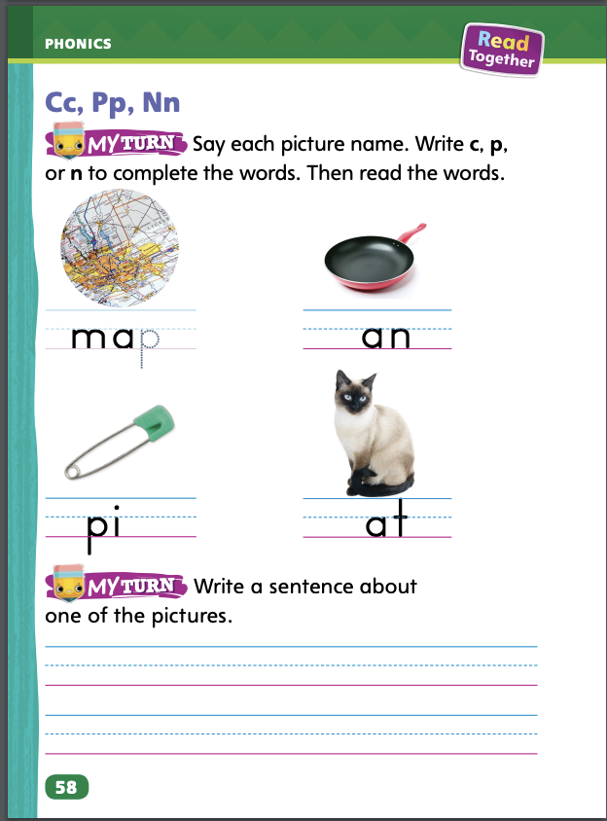
Page 57,58
Phonics
Turn to page 57 and 58 in your Student Interactive and complete the activity.
Notes:
Have students complete the rest of p. 57 and p. 58 in the Student Interactive by printing the letters c, p,and n. Be sure they read the words in context by reading their completed sentences.

Slide 59
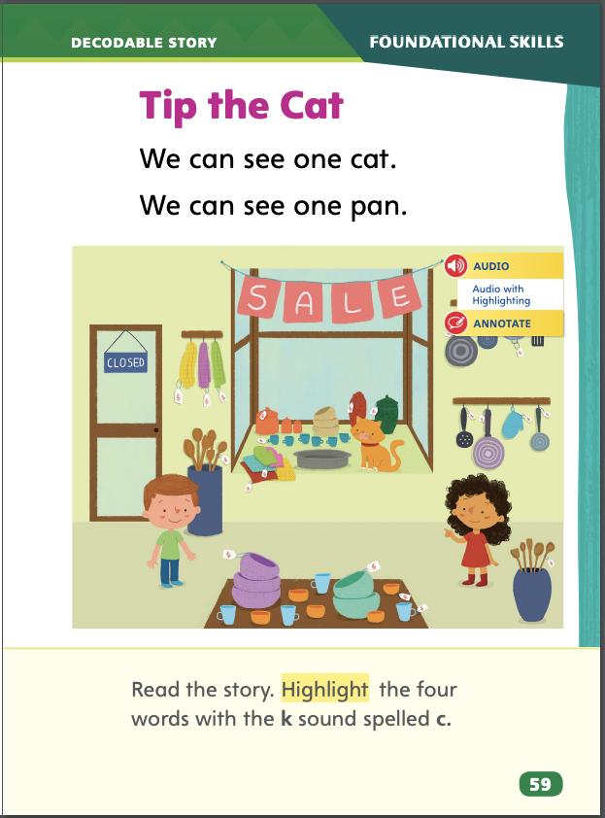
Page 59
Decodable Story
Turn to page 59 in your Student Interactive. Read “Tip the Cat” with your partner.
Notes:
Have students turn to p. 59 in the Student Interactive. We are going to read a story today about Tip. Point to the title of the story. The title of the story is Tip the Cat. I hear the short i sound in the word Tip. What letter in Tip spells the sound /i/? Wait for responses. Right! The i spells the sound /i/. Point to the i in Tip. We will read other words with the short i sound spelled i and words with the letters c, p, and n in our story.
Before reading, review this week’s high-frequency words: do, like, one, the, we. Tell students that they will practice reading these words in the story Tip the Cat. Display the words. Have students read them with you. Say: When you see these words in today’s story, you will know how to read them.

Slide 60
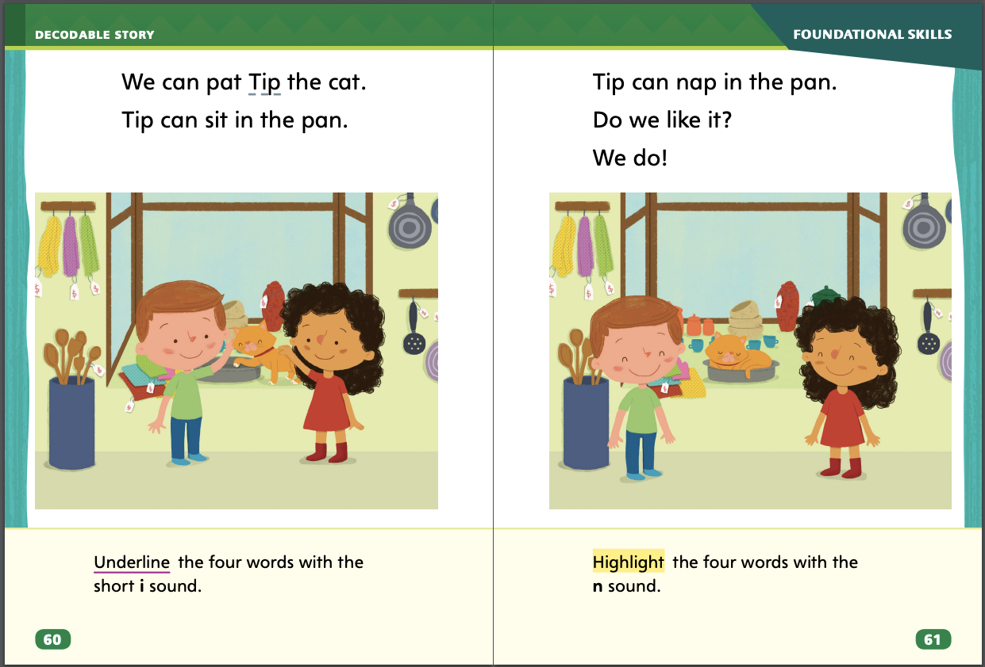
Page 60,61
Decodable Story
Notes:
Pair students for reading and listen carefully as they use letter-sound relationships to decode. One student begins. Students read the entire story, switching readers after each page. Partners reread the story. This time the other student begins.
Call students’ attention to the title on p. 59. I see the letter c in the word Cat. What sound do you hear at the beginning of the word cat? (/k/) Have students decode the word Cat. Then have them identify words with the sound /k/ spelled c on p. 59 and highlight them.
Have students turn to p. 60. Which words have the sound /i/? Students should supply the words Tip, sit, and in. Which letter spells the sound /i/ in Tip, sit, and in? Students should say the sound /i/ is spelled with the letter i. Have them underline the words.
Have students turn to p. 61. Which words have the sound /n/? Students should supply the words can, nap, in, and pan. Which letter spells the sound /n/ in can, nap, in, and pan? Students should say the sound /n/ is spelled with the letter n. Have them highlight the words.

Slide 61
Page 65
Ask and Answer Questions
Do you know where the character is in the story?
What sorts of things are happening in the story? Where are they happening?
Ask yourself other questions about the story’s pictures to get information about the setting. What sorts of places do the pictures show?
Notes:
Sometimes you may not be sure where a story is happening or why a character does something. If you ask questions about where a character goes in the story or what the character sees, it can help you understand where the story takes place. As you read the story, asking questions about the setting and finding answers will help you have a better understanding of the text.
Do you know where the character is in the story?
What sorts of things are happening in the story? Where are they happening?
Ask yourself other questions about the story’s pictures to get information about the setting. What sorts of places do the pictures show?
Say: In Henry on Wheels, Henry rides around his block on his bicycle and sees many things. That is the setting of the story. I remember that Henry sees a line of people and says, “Wow!” As I was reading, I asked the question: Why does Henry say, “Wow!”? To answer the question, I looked at the pictures on the page. I saw that the people were waiting for free hot dogs! No wonder they were standing in a line. Have students go back to the Close Read notes on pp. 73 and 79 in the Student Interactive and highlight the answers.

Slide 62
Page 72,73
Close Read – Ask and Answer Questions
Turn to page 72 in your Student Interactive.
Notes:
Ask students to read the Close Read note. Prompt them to look at the large picture on p. 72. Assist students with deepening their understanding by having them generate a question about the people standing in line. (Possible response: Why are the people standing in line?) Ask: Does the small picture give clues about the answer? DOK 3

Slide 63
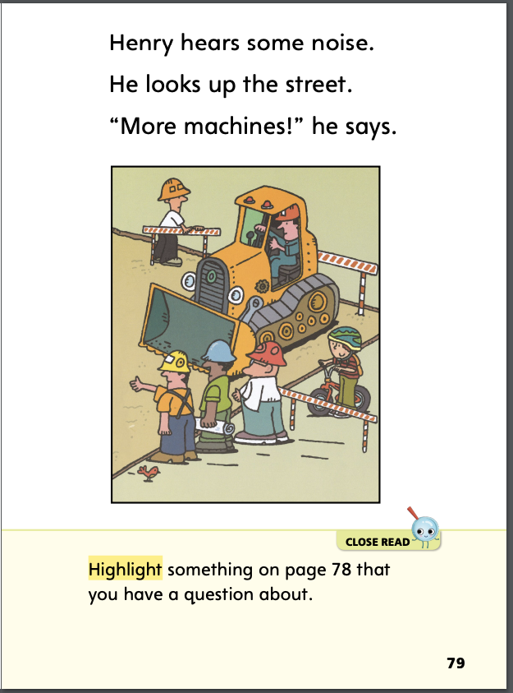
Page 72,73
Close Read – Ask and Answer Questions
Turn to page 79 in your Student Interactive.
Notes:
Have students read the prompt on p. 79. Ask: What is your question? (possible response: What makes the noise?) DOK 3

Slide 64
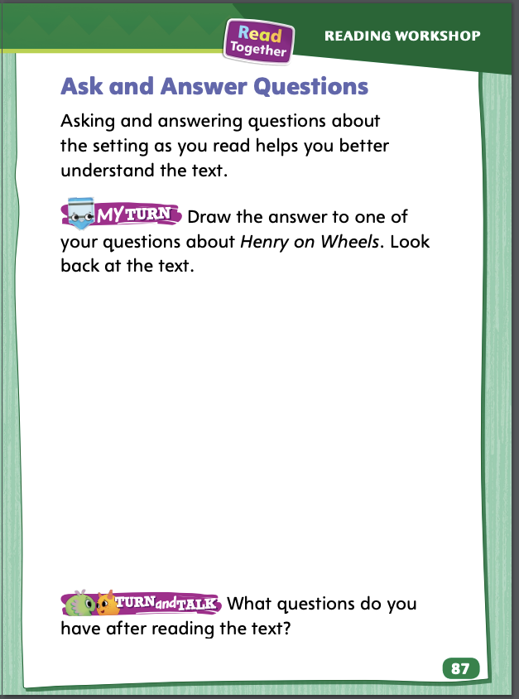
Page 87
Ask and Answer Questions
Turn to page 87 in your Student Interactive and complete the activity.
Notes:
Have students use the strategies for asking and answering questions on the setting.
Have students complete p. 87 in the Student Interactive.

Slide 65
Page 94
Writing – Launching Writing Workshop
Turn to page 94 in your Student Interactive.
Notes:
After using digital tools to produce writing, writers can also use digital tools to publish what they wrote. Some tools writers use to publish writing are:
printers
e-mail
publishing software
Web sites
Explain to students that authors use digital tools to publish their writing. Some digital tools include printers and Web sites. Hold up several books from the stack. Ask: How would these books look if the writers had no digital tools to publish them? How do digital tools help to publish books? Include a handwritten book in your stack as a comparison.
Direct students to p. 94 in the Student Interactive. Read the introduction and directions together with students. Point out that the writer used a computer to write and publish the sentences. After students highlight the differences, say: The author of these sentences used a computer. The author went back to the word big and changed it to capital letters. Then the author added a picture of a cat. When we use a digital tool like a computer, we can make changes to the words we have written to make them more interesting to read.
For Turn and Talk, encourage partners to also talk about other digital tools, such as printers, publishing software programs, and e-mail that can be used to publish writing.

Slide 66
Independent Writing
You will use a computer to type your book and email it.
Notes:
After the minilesson, students should transition into independent writing.
If possible, allow students with adult help to use a computer to compose their books. They can then e-mail that file or a scanned version of their handwritten book to you.
Modeled Do a Think Aloud to model how digital tools can be used to publish writing.
Shared Prompt students to talk about what tools they have used to publish their writing.
Guided Provide explicit instruction on understanding how specific tools are used to publish writing
As students write, use the conference prompts in the Teacher’s Edition or Resource Download Center to provide support. Click path: Table of Contents -> Resource Download Center -+ Writing Workshop Conference Notes
Have students talk about how using e-mail can help them share their writing.

Slide 67
Spelling
Spell words with short a and m, s, and t
Notes:
Have students recall the previous spelling rules for spelling words with the sound short a and for m/m/, s/s/, and t/t/.
Read aloud the following words and have students spell them: man, Sam, tap, sad, tan, map.
Have pairs work together to sort the words according to their spelling rules. (m/m/: man, map; s/s/: Sam, sad; t/t/: tap, tan).

Slide 68
Page 92
Language and Conventions
Turn to page 92 in your Student Interactive and complete the activity.
Notes:
Have students edit the sentences to complete the activity on p. 92 in the Student Interactive.

Slide 69
Lesson 5

Slide 70
Phonological Awareness
pit /p/ /i/ /t/
six
pig
hit
Notes:
Segmenting and blending spoken phonemes is an important beginning reading skill. Model how to segment and blend phonemes.
Say: Listen as I say each sound in the word pit: /p/ (pause) /i/ (pause) /t/. Remember to stretch the sound /i/. Say the individual sounds in pit again and have students repeat the sounds after you. Let’s say the sounds a little faster now. (pause) Now let’s say the sounds even faster. Monitor students’ pronunciation to ensure they are saying the sounds correctly.
Have students practice segmenting and blending other short i words, such as six, pig, and hit. They can also practice words with initial and final sounds of c, p, and n, such as cat, pan, and nap.

Slide 71
Phonics
pan
man
can
tap
cap
nap
Notes:
Write the letters Aa, Mm, Ss, and Tt. Point to one letter at a time and ask students to name it. Review the sound for each letter. Ask students to take turns pointing to a letter and naming the sound it spells.
Write the words listed below. Point to a word and have students segment the sounds and then blend the sounds to read the word. Point to two words, such as pan and man, and ask students to tell how the words are different. (One begins with p and one begins with m.) Continue with other word pairs.

Slide 72
High-Frequency Words
I ____ the cat.
____ you, Tip?
I see ____ mat.
____ like ____ pan.
do
the
like
we
one
Notes:
Write the words in a box. Then write the sentences with the blanks. Say: With your partner, complete the sentences with the My Words to Know from the box. Then circle two words you already know. You can look in your notebooks to find the words. (I and see) Take turns reading the complete sentences.
I like the cat.
Do you, Tip?
I see one mat.
We like the pan.

Slide 73
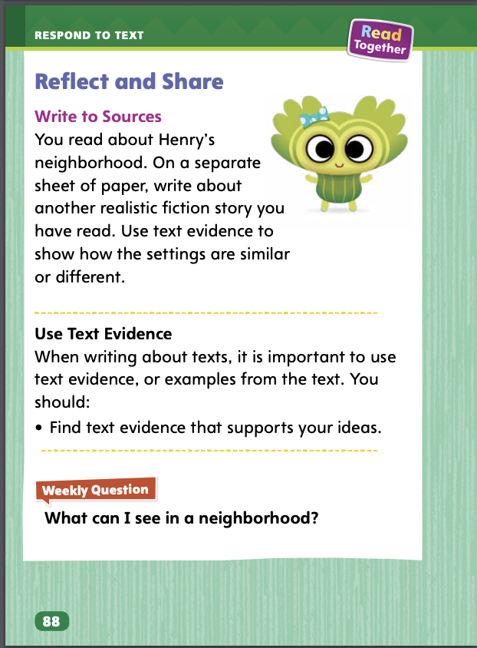
Page 88
Reflect and Share
Turn to page 88 in your Student Interactive.
Notes:
Tell students that sometimes they will be asked to write comments about a topic or text. When they write, they can compare ideas about what they read. Students can compare the settings of stories.
Find text evidence from both stories that tells about the settings. Text evidence, or examples from the texts, can support a response.
Note the ways in which the settings are the same or different.
Model finding text evidence about the story setting using the Decodable Story “Tip the Cat” on pp. 59–61 in the Student Interactive. Say: I can see that the characters are in a shop. The pictures show things with tags. They are for sale. The words in “Tip the Cat” do not help me figure out the setting, but the pictures do. Pictures are one type of text evidence. Have students compare the text evidence that shows the setting in Henry on Wheels with that of “Tip the Cat.”

Slide 74
Page 88
Apply
What can I see in a neighborhood?
Notes:
Have students use text evidence from this week’s texts to make connections about settings in realistic fiction.
Have students use evidence from the texts they have read this week to respond to the Weekly Question. Tell them to discuss in small groups.

Slide 75
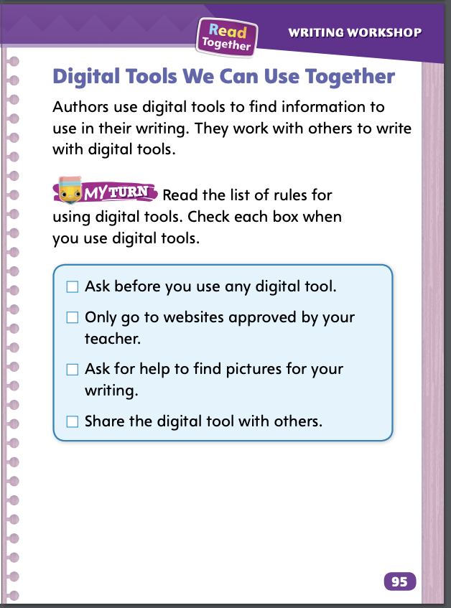
Page 95
Writing – Poetry
Turn to page 95 in your Student Interactive.
Notes:
Sometimes writers use digital tools made by others to help them find important information to use in their writing. Some tools they might use are
an online dictionary, thesaurus, or encyclopedia.
Web sites that have information about their topic.
online photos, drawings, and diagrams to support their writing.
Authors also use digital tools to collaborate with other authors. They might use e-mail, instant messaging tools, and message boards to communicate.
Hold up a nonfiction book from your stack that you read during genre immersion days. Explain that the author used outside sources to find some of the information. Often authors use computers to help find information for these types of books. Review some of the digital tools writers can use for research.
Hold up a second stack text that has two authors or an author and an illustrator. Tell students that the authors can communicate and write books together by using digital tools. The authors might send their books via e-mail and communicate using instant messaging and message boards.
Direct students to p. 95 in the Student Interactive. Read aloud the introduction and directions. Point out that sometimes you will work with a classmate to use digital tools together. It is especially important to follow rules when working together. Then read each rule aloud. For each rule, ask:
Can you use your own words to explain this rule?
Why is this rule important when using digital tools?
How can classmates help one another follow these rules?

Slide 76
Spelling
Hurry, I don’t want to miss the bus.
The catcher has a big baseball mitt.
I don’t see it anywhere.
I sit at my desk at school.
He waters the flowers.
Mom says I can have one carrot today.
Notes:
(Note: Move the orange boxes to cover each bold spelling word before you read aloud the words and sentences.)
Read aloud the words and sentences. Have students spell the words with initial consonant blends and the high-frequency words they have been practicing this week.
Hurry, I don’t want to miss the bus.
The catcher has a big baseball mitt.
I don’t see it anywhere.
I sit at my desk at school.
He waters the flowers.
Mom says I can have one carrot today.
Reveal the spelling word and have students check their work.

Slide 77
Language and Conventions
The girl runs around the block
Which word in the sentence is a verb?
girl
runs
around
block
Notes:
Display the following sentence and guide students to answer the question.
The girl runs around the block.
Which word in the sentence is a verb?
girl
runs
around
block
Have students complete Language and Conventions p. 36 from the Resource Download Center.. Click path: Table of Contents -> Resource Download Center -> Language and Conventions -> U3 W2

Slide 78
Unit 1: Week 2
Grade 1

