Slide 1
Unit 1: Week 4
Grade 5

Slide 2
Copyright © Savvas Learning Company LLC. All Rights Reserved.
This publication is protected by copyright, and permission should be obtained from the publisher prior to any prohibited reproduction, storage in a retrieval system, or transmission in any form or by any means, electronic, mechanical, photocopying, recording, or otherwise. For information regarding permissions, request forms, and the appropriate contacts within the Savvas Learning Company Rights Management group, please send your query to:
Savvas Learning Company LLC, 15 East Midland Avenue, Paramus, NJ 07652
or
k12learningpermissions@savvas.com
myView Literacy® is an exclusive trademark of Savvas Learning Company LLC in the U.S. and/or other countries.

Slide 3
Lesson 1

Slide 4
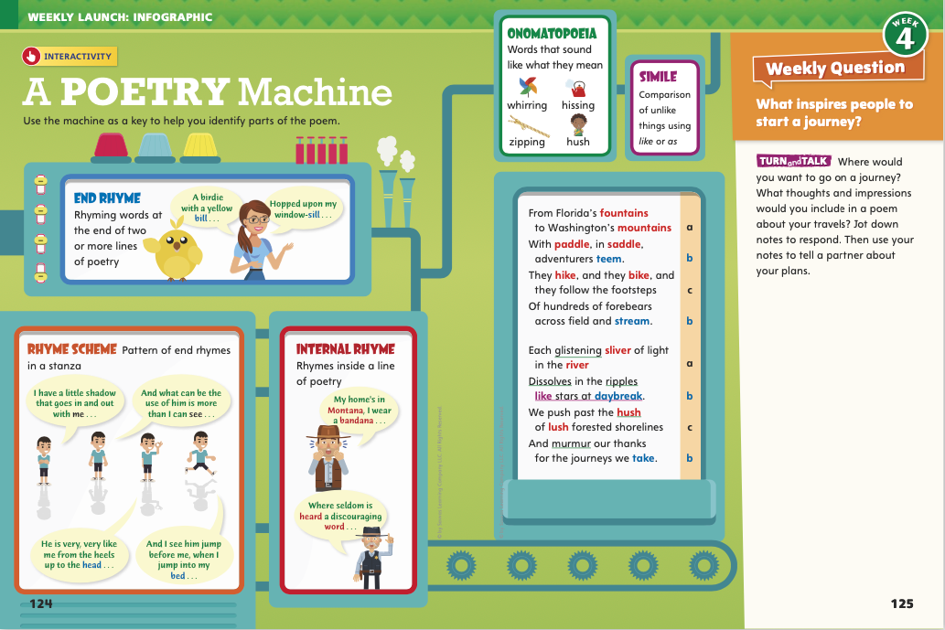
Page
124, 125
Interact with Sources
Discuss your ideas about what to include in a poem about your travels.
Notes:
Remind students of the Essential Question for Unit 1: How do journeys change us? Point out the Week 4 Question: What inspires people to start a journey?
Direct students’ attention to the infographic on pp. 124–125 in the Student Interactive. Explain that in poetry the use of sound devices, such as rhyme and rhythm, and figurative language, such as similes and metaphors, expresses ideas and emotions differently than other genres do. Have students read the infographic and discuss the elements of poetry.
Use these questions to guide discussion:
How is poetry different from prose?
What makes a poem a poem?
Is poetry fiction or nonfiction?
WEEKLY QUESTION Reread the Week 4 question: What inspires people to start a journey? Ask students if the poem in the infographic inspires them to take a journey. Invite them to explain their response and identify the language that inspires them.
Have students read the statement on p. 125 and jot down a few quick notes. Then have them discuss their ideas with a partner.

Slide 5
Listening Comprehension
Rhyming Pairs
Notes:
Tell students you are going to read a poem aloud. Have them listen as you read “I Hold the World.” Explain that students should listen actively, paying careful attention to rhyme, rhythm, and figurative language. Prompt them to ask questions and share their reactions, following agreed-upon discussion rules.
Purpose Have students actively listen for elements of poetry. READ the entire text aloud without stopping for the Think Aloud callouts.
REREAD the text aloud, pausing to model Think Aloud strategies related to the genre.
THINK ALOUD The speaker calls the world “a spinning mix of blues and greens/a swirling blur of lands.” As I read that, I can visualize holding a spinning globe in my hands
THINK ALOUD The steady rhythm and regular rhyme of this poem make it easy to read. I know that the last words in the second and fourth lines of each stanza are going to rhyme.
Use a T-chart to help students record pairs of rhyming words in the poem.

Slide 6
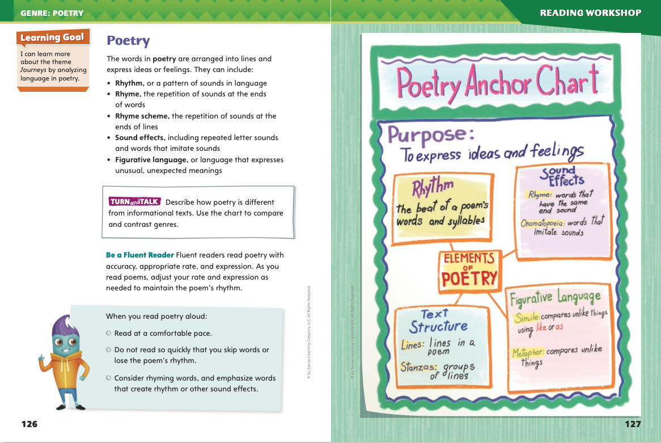
Page 126, 127
Poetry
Turn to page 126 in your Student Interactive.
Notes:
Important elements of poetry include structure, rhythm, rhyme, and figurative language. However, not all poems are written using the same elements. Some poems rhyme, and some do not. Some have a predictable rhythm, and some do not. Some tell a story, and some describe.
Ask yourself how the poem is structured. Are the lines the same lengths or different lengths? Are the lines broken into stanzas?
Think about how the poem sounds. Are there rhyming words or words that are repeated? What elements add rhythm, or beat, to the poem?
Scan the poem for figurative language. What comparisons do you notice? What vivid details stand out?
distinguishing between poetry and prose. I can tell that “I Hold the World” is a poem just by looking at it. I see that, instead of paragraphs, it is arranged in lines and stanzas. Reading the first stanza, I notice there is end rhyme, and this rhyme scheme stays the same throughout the poem. I also notice a regular rhythm to the language. I can feel and hear how syllables alternate between stressed and unstressed, which creates a natural rhythm.
Talk about poems with which students are familiar. Discuss the rhyme and rhythm.
FLUENCY Have students build fluency by reading aloud a stanza from a poem in your classroom library. Emphasize reading expressively, accurately, and with an appropriate rate.
When you read expressively, your phrasing, or the way you group words, and tone of voice work together to reflect the emotional content of the text.
When you read accurately, you read words correctly. If you read a word that doesn’t make sense, correct it by rereading a word that makes sense in the context of the sentence.
When you read at an appropriate rate, you read at a natural pace, neither too slow nor too fast. Read so that your listeners can understand you.
Display a stanza or a short poem and have the class echo-read with you. Then have students read individually. Check their fluency, focusing on accuracy and appropriate rate.
Have students work with a partner to complete the fluency activity on p. 126 of the Student Interactive. Editable Anchor Chart Click Path: Table of Contents -> Reading Anchor Charts -> Unit 4 Week 5: Drama Editable Reading Anchor Chart

Slide 7
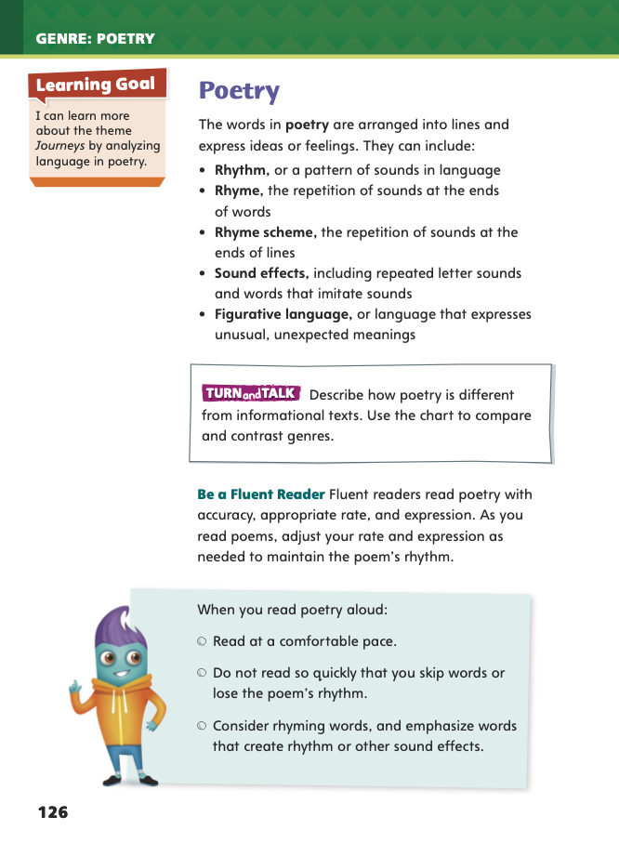
Page 126
Apply
Describe how poetry is different from informational texts.
Notes:
Have students use the strategies to identify poetry.
Have students work with a partner to complete the Turn and Talk activity on p. 126 of the Student Interactive. Circulate to discover if students can identify elements of poetry.

Slide 8
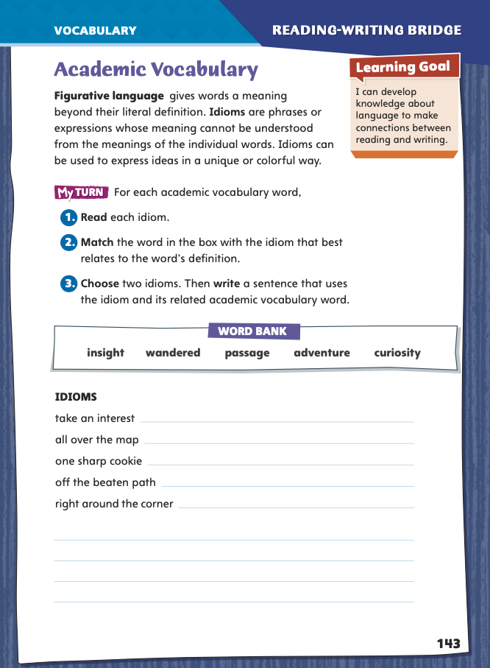
Page 143
Academic Vocabulary
Complete the chart on pg. 143 in your Student Interactive.
Notes:
Figurative language expresses a meaning beyond its literal meaning. An idiom is a figurative expression that means something different from the literal meaning of the words that make it up. For example, the idiom “raining cats and dogs” means that it was raining heavily, not that animals were falling from the sky.
When you come across an unfamiliar expression, look at its context to understand what it means.
Decide if it is an idiom, meaning something different from the words that make it up.
Model this strategy.
I was reading a book the other day and a character said, “I’ll never move. I’ll leave my hometown when pigs fly!” The literal meaning of “when pigs fly” would indicate pigs soaring through the air. However, the context suggests a different meaning. Pigs can’t fly, and the character also says he will never move. So I think “when pigs fly” is an idiom that means “never.”
Have students apply this strategy on their own to the first idiom on p. 143 of the Student Interactive. Ask them to match it to an Academic Vocabulary word from the Word Bank. Then discuss responses and correct misunderstandings.
Have students follow the same strategy as they complete the chart on p. 143 in the Student Interactive. Remind students that they will use these academic words throughout this unit.

Slide 9
Word Study
-able
-ible
measurable
accessible
enjoyable
convertible
Notes:
Explain to students that a suffix is a word part that can be added to the end of a base word. The suffixes -able and -ible mean “can be done.” When you add them to a verb, the verb becomes an adjective that means the action of the verb can be done.
To demonstrate the use of the suffixes -able and -ible, display these words: measurable, enjoyable, accessible, and convertible. Explain that measurable means “can be measured.” Point out that spelling changes sometimes occur when the suffixes are added; for example, when -able is added to measure, the final silent e of measure is dropped. Work with the class to identify the definitions of enjoyable, accessible, and convertible, keeping the meaning of the suffixes in mind.

Slide 10
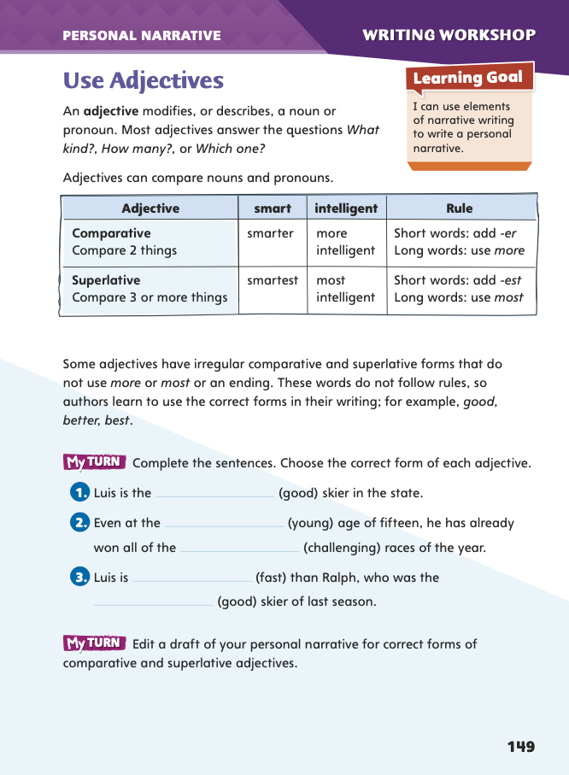
Page 149
Writing – Personal Narrative
Turn to page 149 in your Student Interactive.
Notes:
Adjectives modify or describe nouns and pronouns. There are three ways in which writers use adjectives:
to describe without comparing: a fine writer, a suspenseful book
to compare two things (comparative): a finer writer, a more suspenseful book
to compare three or more things (superlative): the finest writer, the most suspenseful book
Provide students with three sentences, one with an adjective, one with a comparative adjective, and one with a superlative adjective. Have students use these questions to identify each type of adjective and its function:
What is the adjective in this sentence?
What noun or pronoun does it modify?
Does it make a comparison? If so, does it compare two things or three or more things?
Have students look at the chart on p. 149 of the Student Interactive. For comparative adjectives, we add -er to most short adjectives and more to long adjectives. For superlative adjectives, we add -est to most short adjectives and most to long adjectives. A few adjectives have irregular comparative and superlative forms, such as good, better, best.
Have students work in pairs to write comparative and superlative forms of a list of adjectives you provide. Then direct them to complete the activity on p. 149.
Ask several volunteers to share from their drafts examples of sentences with comparative and superlative adjectives.

Slide 11
Independent Writing
Read through your draft. Add and edit comparative and superlative adjectives to your draft.
Notes:
Direct students to read through their drafts to add and edit adjectives. If students need additional opportunities to use comparative and superlative adjectives, have them look for examples in stack texts and identify what each adjective is modifying. If they demonstrate understanding, have them revise their drafts in their writing notebooks. See the Conference Prompts on p. T276.

Slide 12
Spelling
1. Our teacher said it was advisable to read the chapter before the test.
2. We think this fix is workable and will help us finish the job.
3. The witness was not credible, and the jury thought she was lying.
4. When the police investigated the robbery, they saw signs of a forcible entry.
5. Can you let me know when the jersey will be available in my size?
6. The automobile runs on a combustible engine.
7. It is allowable to pay half now and the other half within a month.
8. Those items are perishable and should go in the refrigerator.
9. The chef made a dessert using the prettiest edible flowers.
10. Marta is not usually cranky, but her cold is making her irritable.
Notes:
(Note: Move the orange boxes to cover each bold spelling word before you read aloud the words and sentences.)
Read aloud the words and sentences. Have students spell each word using the correct suffix.
1. Our teacher said it was advisable to read the chapter before the test.
2. We think this fix is workable and will help us finish the job.
3. The witness was not credible, and the jury thought she was lying.
4. When the police investigated the robbery, they saw signs of a forcible entry.
5. Can you let me know when the jersey will be available in my size?
6. The automobile runs on a combustible engine.
7. It is allowable to pay half now and the other half within a month.
8. Those items are perishable and should go in the refrigerator.
9. The chef made a dessert using the prettiest edible flowers.
10. Marta is not usually cranky, but her cold is making her irritable.
Reveal the spelling word and have students check their work.
For students who understand the ways to spell words with -able and -ible, include the following Challenge Words with the spelling list.
Challenge Words: conceivable, incombustible, apprehensible

Slide 13
Language and Conventions
After we saw the baseball game, we went out for dinner.
We watched the game first, and we went to dinner afterward.
Write one compound sentence and one complex sentence.
Notes:
Review the language-and-conventions topic, compound and complex sentences. See pp. T210–T211.
Display these sentences:
After we saw the baseball game, we went out for dinner.
We watched the game first, and we went to dinner afterward.
Ask students to identify which sentence is compound (the second) and which is complex (the first). Remind them that compound sentences are two independent clauses joined by a conjunction such as and or or; complex sentences join a dependent and independent clause. Compound sentences use a comma before the conjunction; complex sentences use one after a dependent clause if it comes first in the sentence.
Have students work individually to write one example of a compound sentence and one example of a complex sentence.

Slide 14
Lesson 2

Slide 15
Page 128
Preview Vocabulary
peering
traversed
via
girth
intersecting
Notes:
Introduce the vocabulary words on p. 128 in the Student Interactive and define them as needed.
peering: looking closely or in a searching manner
via: by way of; by means of; through traversed: traveled through; moved across girth: the distance around something, circumference
intersecting: crossing
These words will help you understand the poems you read this week. As you read, highlight the words when you see them in the text. Try to visualize what the poet is saying by using these words.

Slide 16
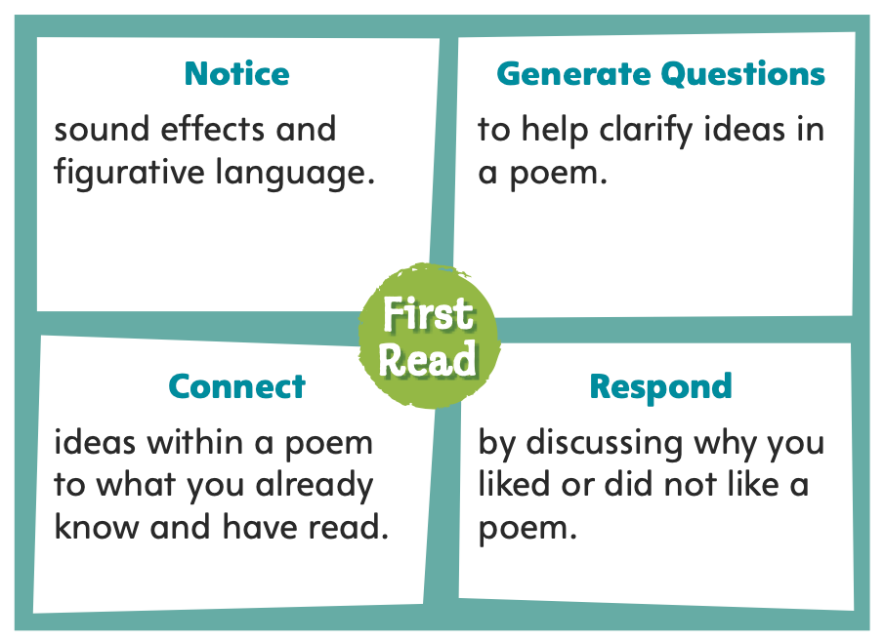
Page 128
First Read Strategies
Notes:
Discuss the First Read Strategies. Prompt students to establish that the purpose for reading these selections is for understanding and enjoyment.
Explain the four steps of the first read.
NOTICE Remind students to listen for sound effects, such as rhyme, and figurative language, such as similes and metaphors.
GENERATE QUESTIONS Encourage students to jot down questions before, during, and after reading and to clarify ideas in the poem.
CONNECT Ask students to consider how the poems connect with their own experiences and readings of travel, maps, and daydreaming.
RESPOND Have students mark parts that illustrate why they did or did not like a poem.
Students may read independently, in pairs, or as a class. Use the First Read notes to help them connect with the text and guide their understanding.

Slide 17
Page 130
First Read – Poetry Collection
Notes:
Read the text. Pause to discuss the First Read notes with students.

Slide 18
Page 131
First Read – Poetry Collection
Notes:
Read the text. Pause to discuss the First Read notes with students.
THINK ALOUD In the second stanza, the poet repeats the word wishing: “wishing it were a telescope, wishing I could see past my street, wishing I could see.” This sound effect helps me feel how strong and important the wishing is to her. The poet is so curious about the world and wants to experience it. Learning the world, traveling the world, is a dream that she very much wants to come true.
THINK ALOUD From the title, “Learning the World,” I wasn’t sure what the poem would be about. I thought about the unit theme, Journeys, and predicted the poem would be about traveling. In a way the speaker is traveling. He or she is traveling in his or her mind, using a map to visualize places he or she could go.

Slide 19
Page 132, 133
First Read – Poetry Collection
Notes:
Read the text. Pause to discuss the First Read notes with students.
THINK ALOUD The poem begins mentioning how Magellan and Columbus sailed in ships to discover parts of the world. It ends by calling Earth a ship. Is the poet leading me to think I am on a ship of discovery?
THINK ALOUD Before I start reading, I want to know what the words latitude and longitude mean because they are in the title. I also see the word dreams in the title and in the second stanza. I’m going to circle the second stanza because I think it might help me find the connection between longitude and latitude and dreams.

Slide 20
Page 134, 135
First Read – Poetry Collection
Notes:
Read the text. Pause to discuss the First Read notes with students.
THINK ALOUD The first thing I notice about this poem is the short line length. I am curious about how the short lines are going to work as a sound effect that affects the poem’s rhythm.
THINK ALOUD When I read lines like “Maps are keys to secret places, vast new worlds, and unknown faces,” it reminds me of how excited I get when I am planning a vacation. It helps me understand how excited the speaker feels.

Slide 21
Page 136, 137
First Read – Poetry Collection
Notes:
Read the text. Pause to discuss the First Read notes with students.
THINK ALOUD As I read the poem silently, I notice the structure of the lines on the page. When I read the poem aloud, I realize that the organization of the lines affects the way the poem sounds.
THINK ALOUD When I read a poem, sometimes I read all the way to the end. Then I close my eyes and try to picture what the poem is about. I ask myself, “What picture do the words create in my mind?” How do these images influence whether you liked or disliked the poem?

Slide 22
Respond and Analyze
Discuss: How does each poet reflect on the topic of his or her poem?
Brainstorm: What is the collective theme?
Notes:
Have students look back at the poetry, and prompt them to respond to their initial readings.
What are the individual themes of the poems?
Discuss How does each poet reflect on the topic of his or her poem?
Brainstorm What is the collective theme?

Slide 23
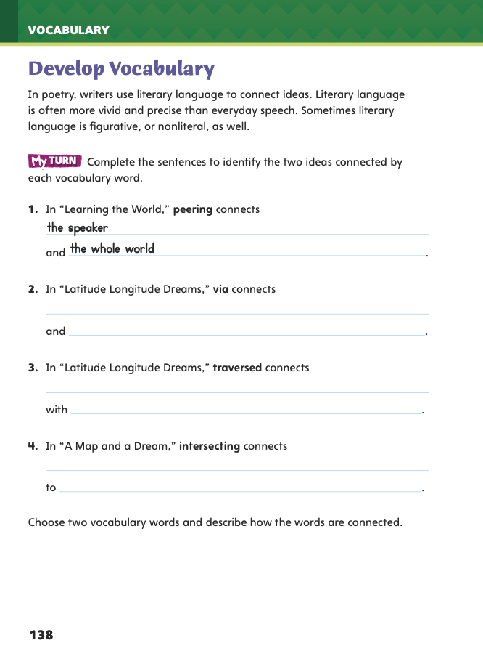
Page 138
Develop Vocabulary
Turn to page 138 in your Student Interactive and complete the activity.
Notes:
Explain to students that poets use both literal and nonliteral, or figurative, language when writing poems. Read the introductory paragraph on p. 138 of the Student Interactive aloud. Help students understand the difference between literal and nonliteral language.
Look for connections between words.
Remind yourself of the literal meaning of the words.
Model completing the sentences on p. 138, using the word peering. In “Learning the World,” the speaker rolls a map into a tube and looks, or peers, through it like a telescope because he or she wants to see the whole world. Peering connects the speaker with the whole world. I’ll reread the other poems to identify how each poet uses literal and nonliteral language.
Have students apply the strategies for developing vocabulary.
Have students respond using newly acquired vocabulary as they complete p. 138 of the Student Interactive. They should use text evidence in their answers.

Slide 24
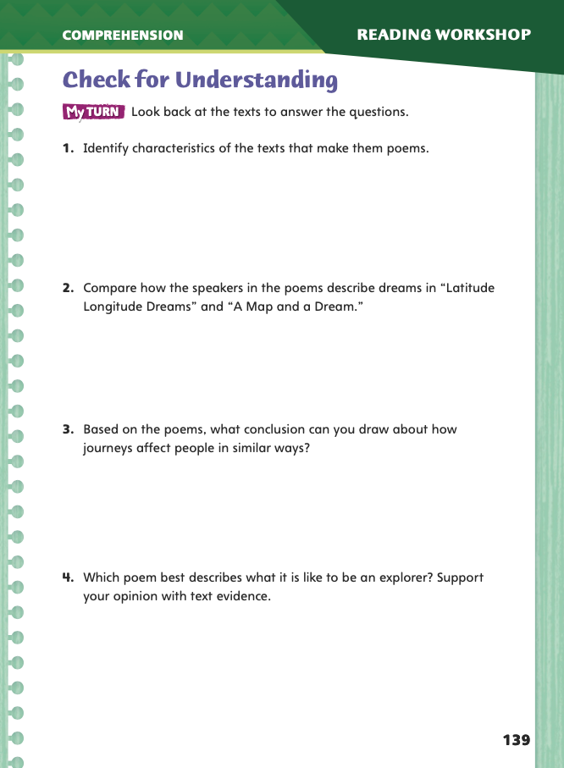
Page 139
Check for Understanding
Complete page 139 in your Student Interactive.
Notes:
Have students complete p. 139 of the Student Interactive.

Slide 25
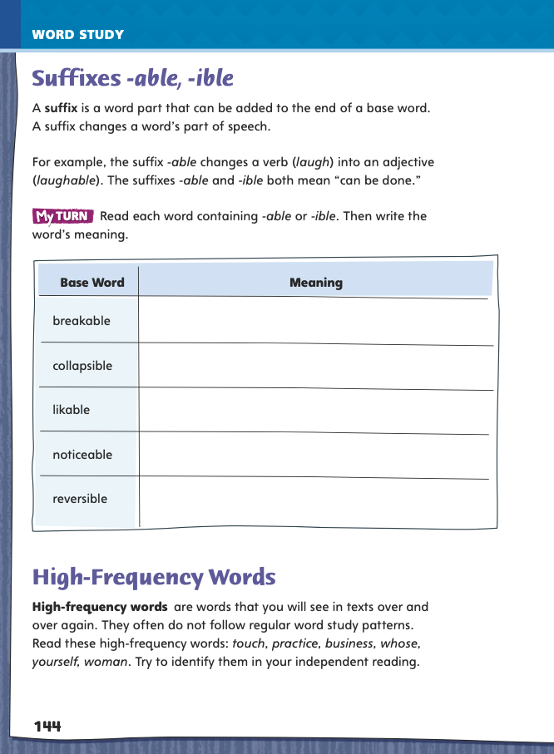
Page 144
Word Study - Suffixes
Complete page 144 in your Student Interactive.
Notes:
Direct students to complete the chart on p. 144 in the Student Interactive.
Then have students write three sentences using three of the words from the chart.

Slide 26
High-Frequency Words
touch
whose
practice
yourself
business
woman
Notes:
Explain that since high-frequency words, which appear often in texts, do not follow regular word study patterns, so students need to practice reading them.
Display and say the high- frequency words touch, practice, business, whose, yourself, and woman. Ask students what practice and whose have in common. (Both words end with silent e).

Slide 27
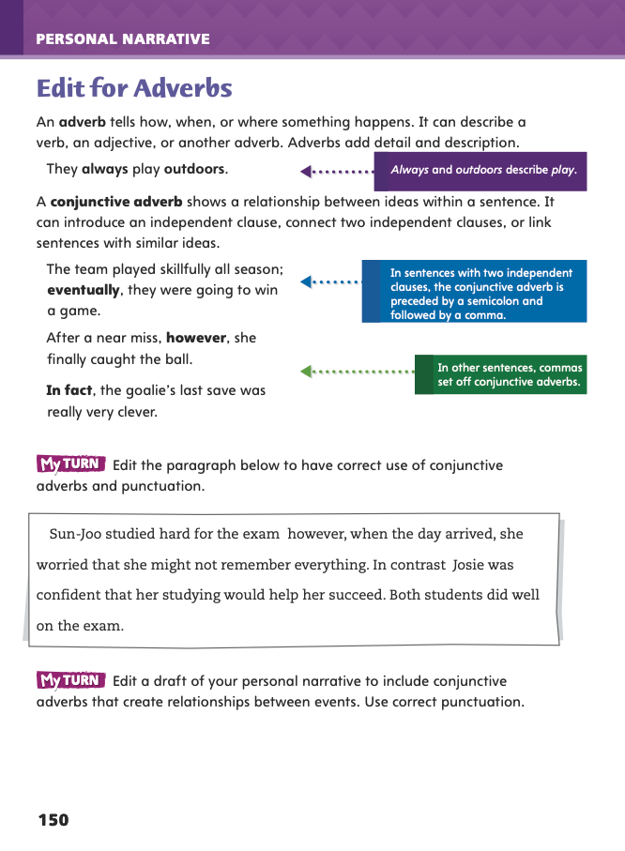
Page 150
Writing – Personal Narrative
Turn to page 150 in your Student Interactive.
Notes:
Adverbs describe verbs, adjective, or other adverbs. They provide additional information by
Telling how, when, or where something happens.
Connecting the ideas in two independent clauses or sentences to show relationships such as contrast, sequence, and cause and effect.
Display a few sentences from the stack texts to illustrate the use of conjunctive adverbs. Underline the adverbs and ask what two ideas each connects.
Then ask: What happens if we leave the adverbs out? (We don’t understand how the two ideas are connected.)
Direct students’ attention to the Student Interactive p. 150 and have them study the punctuation in each sentence. Ask: What punctuation comes after a conjunctive adverb? (a comma) When does a semicolon come before conjunctive adverb? (when it separates independent clauses)
Have students generate a list of common conjunctive adverbs and the relationships they show that includes:
contrast: however, nevertheless, nonetheless, in contrast, on the other hand
sequence or time: first, finally, eventually, meanwhile
cause and effect: therefore, as a result clarification or emphasis: for example, for instance, in fact
Then have them complete the activity.
Call on two or three students to share from their drafts sentences that contain conjunctive adverbs and explain how they punctuated them.

Slide 28
Independent Writing
Examine your draft for sentences or independent clauses you can connect with conjunctive adverbs.
Edit your draft to include conjunctive adverbs.
Notes:
Have students examine their drafts to see if there are any sentences or independent clauses that they can connect with conjunctive adverbs. If students need more models of conjunctive adverb use, have them study stack texts for examples and identify the kind of relationship each adverb shows. If students demonstrate understanding, have them edit their own drafts for conjunctive adverbs. See the Conference Prompts on p. T276.

Slide 29
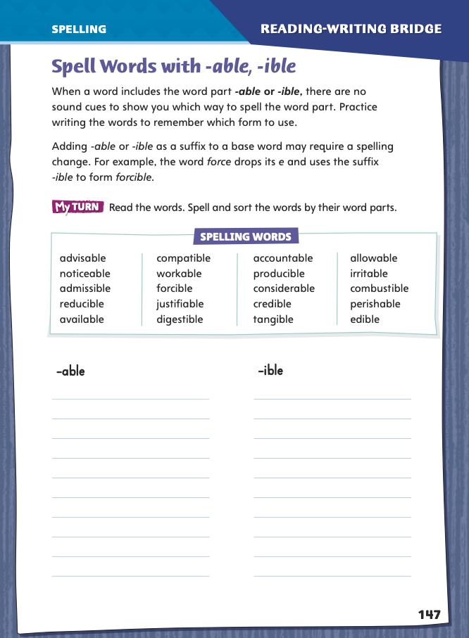
Page 147
Spelling
advisable
forcible
Turn to page 147 in your Student Interactive.
conceivable
Notes:
Explain that when you add -able or -ible, the spelling of the base word may change. For example, when you add -able to advise, you drop the e to form advisable. In noticeable, however, the silent e is retained because dropping it would change the s sound to a k sound.
Write or display the words advisable, forcible, and conceivable. Say each word aloud and point out the different spellings. Then have student pairs identify the base word of each word, noting how the suffix changed its spelling.
Have students complete the activity on p. 147 of the Student Interactive independently.

Slide 30
Language and Conventions
Create a list of nouns using people and things in your classroom.
Make sentences that include two or more nouns from the list you created.
player
Ramon Diaz
team
Leeville Glee Club
Notes:
Introduce the different types of nouns by giving oral examples, such as player (common noun), Ramón Díaz (proper noun), and team (collective noun). Explain that proper nouns usually begin with capital letters; common nouns, with lowercase letters. Collective nouns may be common (club) or proper (Leeville Glee Club).
Help students identify common, proper, and collective nouns using people and things in the classroom. Work together to create a list that you write on the board and then to form an oral sentence using two or more nouns from the list.
Have students work in pairs to practice forming oral sentences that include two or more nouns from the list you created as a class.

Slide 31
Lesson 3

Slide 32
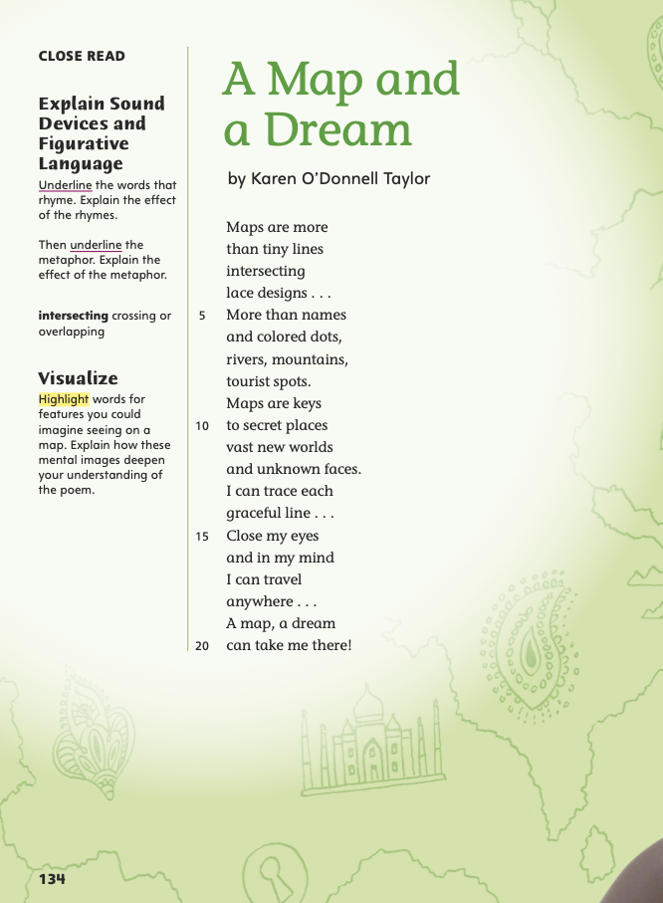
Page 134
Close Read – Sound Devices and Figurative Language
Turn to page 134 in your Student Interactive.
Notes:
Readers learn about sound devices in poetry by listening for rhyme, rhythm, and onomatopoeia. They learn about figurative language by paying attention to descriptive language, comparisons, and sometimes surprising connections.
Listen for rhymes at the ends of lines of poems.
Listen for words that sound like what they name.
Consider words with meanings different from their literal meanings.
Take note of similes and metaphors.
Consider how the author’s use of figurative language and sound devices achieved his or her purpose.
Use the Close Read note on p. 134 of the Student Interactive to model how to annotate the text to identify rhyme.
Rhyme is easier to identify when you read aloud than when you read silently. Read aloud the first four lines of “A Map and a Dream.” I hear an end rhyme: lines and designs. They are in lines 2 and 4. I am going to underline those words.
Have students read the first eight lines aloud to a partner, listening for how the rhyme affects the poem’s rhythm. Have pairs discuss the purpose of this sound device as well as the purpose of figurative language used in the first eight lines.

Slide 33
Page 134
Close Read – Sound Devices and Figurative Language
Turn to page 134 in your Student Interactive.
Notes:
Have students identify and underline examples of end rhyme in lines 1–4. See student page for possible responses.
Ask: How does rhyme affect the poem? Possible Response: Rhyme creates rhythm. It also has the effect of making a poem sound lyrical, like a song.
Have students identify and underline the metaphor. See student page for possible responses.
Ask: What does the poet compare? What does the poet mean by this metaphor? Possible Response: maps and keys; The metaphor "Maps are keys" in line 9 makes maps more meaningful. Keys open physical doors, and maps open figurative "doors" to information and imagination. DOK 2

Slide 34
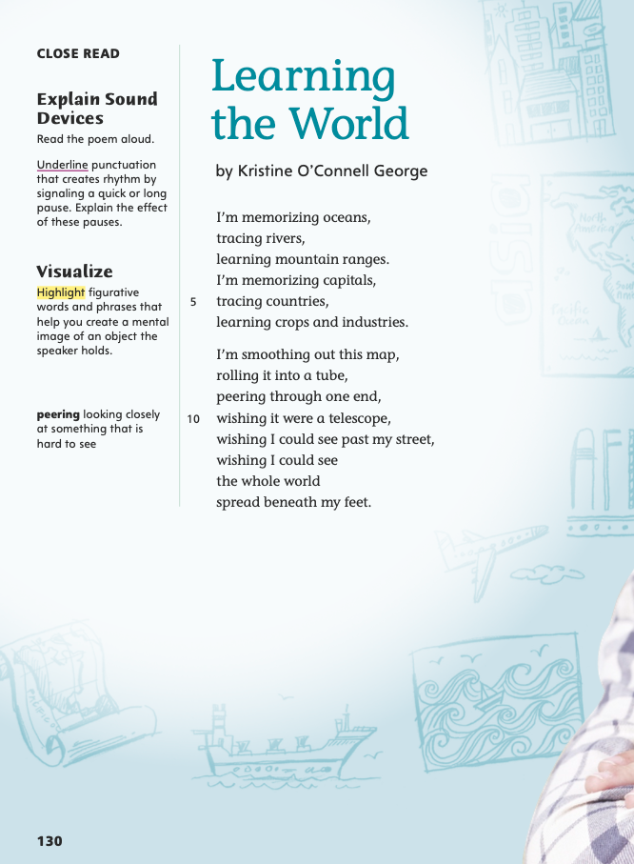
Page 130
Close Read – Sound Devices and Figurative Language
Turn to page 130 in your Student Interactive.
Notes:
Have students scan the poem. Ask: What punctuation marks does the poet use? Where are they? Underline commas and periods as students point them out. See student page for possible responses.
Ask students to explain how the pauses and stops help create rhythm and how they affect meaning. Possible Response: Pausing and stopping change the rhythm. The commas connect ideas, and the periods signal a new idea is coming. DOK 2

Slide 35
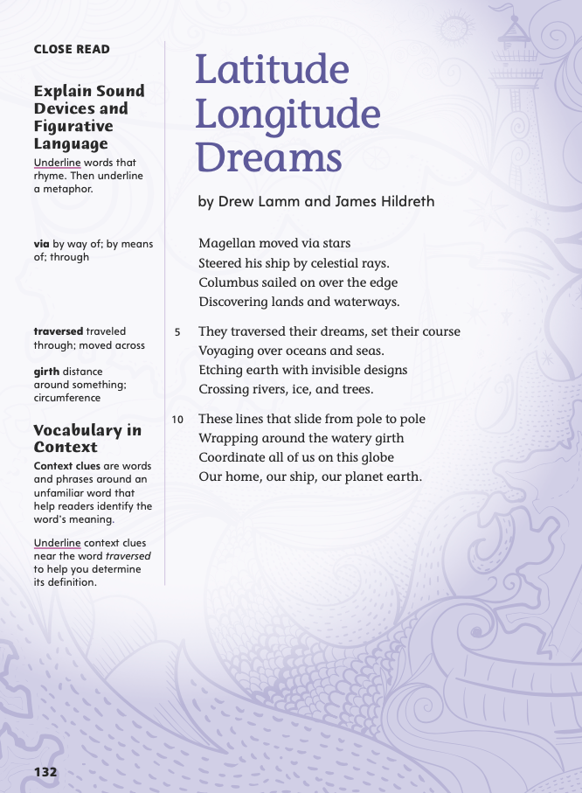
Page 132
Close Read – Sound Devices and Figurative Language
Turn to page 132 in your Student Interactive.
Notes:
Have students identify and underline rhyming words throughout the poem. See student page for possible responses.
Ask: How does rhyme affect the poem? Possible Response: Rhyme creates balance and rhythm. It also makes the lines more predictable because you know what sound is coming next.
Have students identify and underline the metaphor. Ask: What does the poet compare? See student page for response. Possible Response: The poet uses the metaphor "Our home, our ship, our planet earth" to compare Earth to a ship. DOK 2

Slide 36
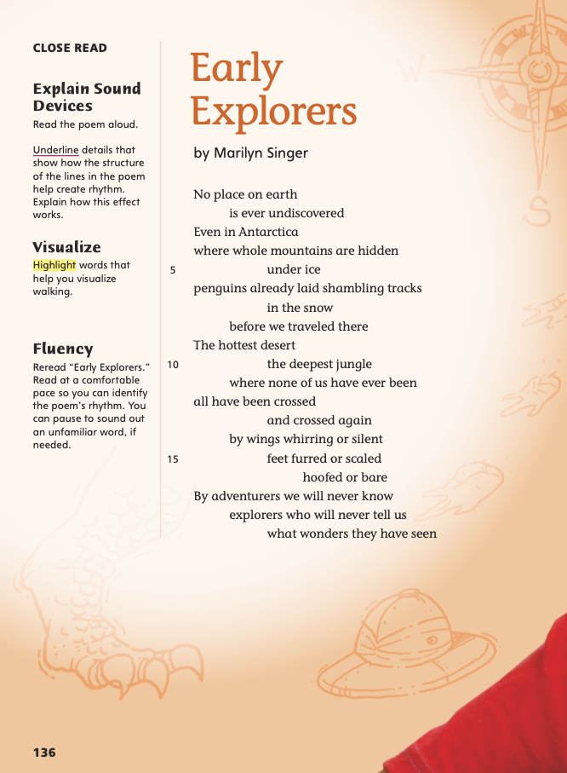
Page 136
Close Read – Sound Devices and Figurative Language
Turn to page 136 in your Student Interactive.
Notes:
Have students identify and underline lines that show how the poet uses structure to help create rhythm. See student page for possible responses.
Ask: How does this structure affect the rhythm? Possible Response: The poem is made up of short and long lines. The poem moves fast in the short lines, and then the long lines slow it down. The poem does not rhyme, but the long and short lines create a rhythm of their own. DOK 2

Slide 37
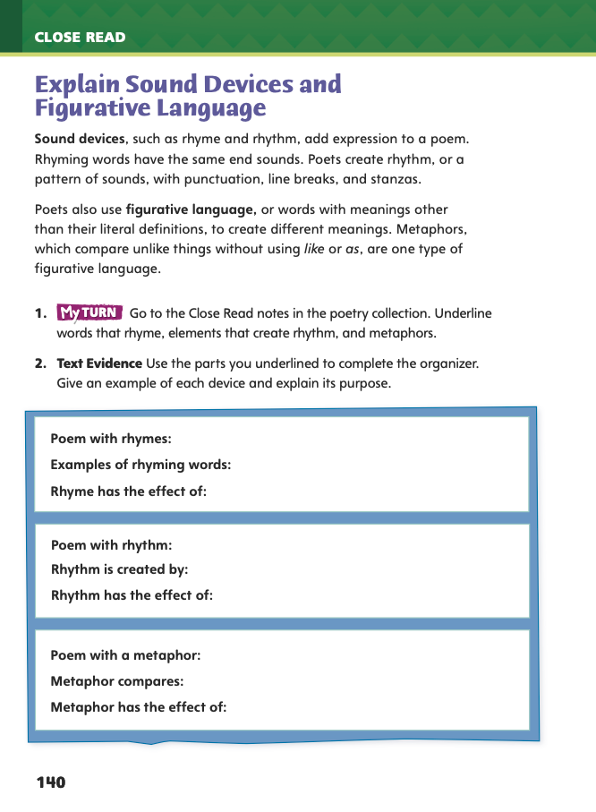
Identify Sound Devices and Figurative Language
Page 140
Turn to page 140 in your Student Interactive and complete the activity.
Notes:
Have students use the strategies for explaining sound devices and figurative language.
Have students annotate the text using the Close Read notes for Explain Sound Devices and Figurative Language and then use their annotations to complete the chart on p. 140 in the Student Interactive.

Slide 38
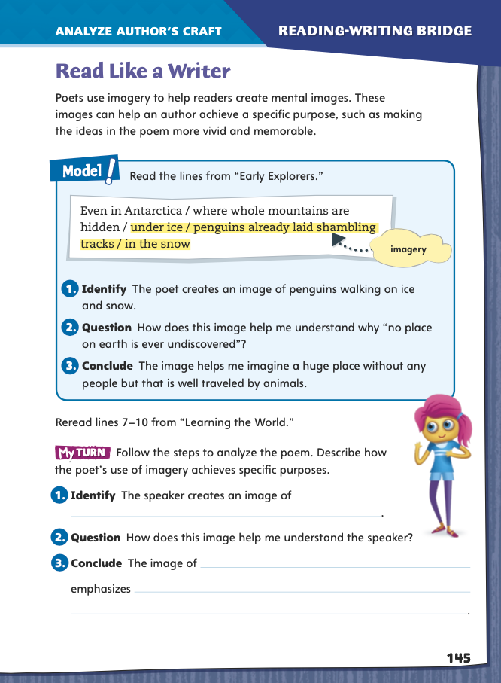
Page 145
Read Like a Writer
Turn to page 145 in your Student Interactive.
Notes:
Define imagery as language that appeals to one or more of the five senses. Explain that imagery helps the reader picture or sense things in his or her mind and can make writing more vivid and memorable. Say this sentence to the class: It was a winter day. Note to students that the words do not paint a picture for the reader. Now say this sentence: Cold, heavy snow fell from the darkened sky. The use of imagery helps the reader picture the scene by “feeling” the cold and “seeing” the snow.
Model analyzing the author’s craft of using imagery by directing students to p. 145 in the Student Interactive. Have them follow along as you read aloud the lines from “Early Explorers” and complete the steps.
Identify the highlighted language the poet uses to create imagery.
Ask students to describe the mental images that this language helped
them form in their minds.
Guide students to draw a conclusion about the poet’s use of imagery. Point out that the imagery helps readers visualize what the poet is describing and better understand the poem’s meaning.
Direct students to go back to the Poetry Collection and circle other instances of imagery. Then have them focus on a specific example by completing the activity on p. 145 in the Student Interactive.

Slide 39
Word Study - Suffixes
visible
in-
aud
invisible
tang
audible
cred
tangible
credible
Notes:
Remind students that the suffixes -able and -ible mean “can be done.”
Explain that sometimes -ible is added to a root instead of a base word. For example, in visible, it is added to the Latin root vis, which means “see.” Visible means “can be seen.” Provide these Latin roots: aud—“hear”; tang—“touch”; cred—“believe.” Explain that the prefix in- can mean “not.” Display invisible, audible, tangible, and credible. Have students decode, or read, these words and then explain the meaning of each word.
Have students complete Word Study p. 4 from the Resource Download Center Click path: Table of Contents -> Resource Download Center -> Word Study -> U1W4

Slide 40
Writing – Personal Narrative
Someone is knocking on the door.
Nobody wants to go to the movies.
Everything is late.
Notes:
Writers use indefinite pronouns when they are not referring to a specific person or thing. Some examples are someone, nobody, and everything. Writers must make sure the proper verb form is used with each indefinite pronoun.
Singular indefinite pronouns, such as everyone, must be matched with singular verbs, such as goes.
Plural indefinite pronouns, such as many, must be matched with plural verbs, such as go.
Display sentences using indefinite pronouns; for example, Someone is knocking on the door. Nobody wants to go to the movies. Everything is late. Read the sentences aloud. Then ask: Do we know definitely who or what someone, nobody, and everything are? (No, the author was not specific.)
Explain that someone, nobody, and everything are indefinite pronouns.
Ask students to identify the verbs in the sentences, and elicit that they are all singular.

Slide 41
Writing – Personal Narrative
Singular Pronouns | Indefinite Pronouns
Notes:
Draw a T-chart on the board. Write a few singular indefinite pronouns on the left and plural ones on the right.

Slide 42
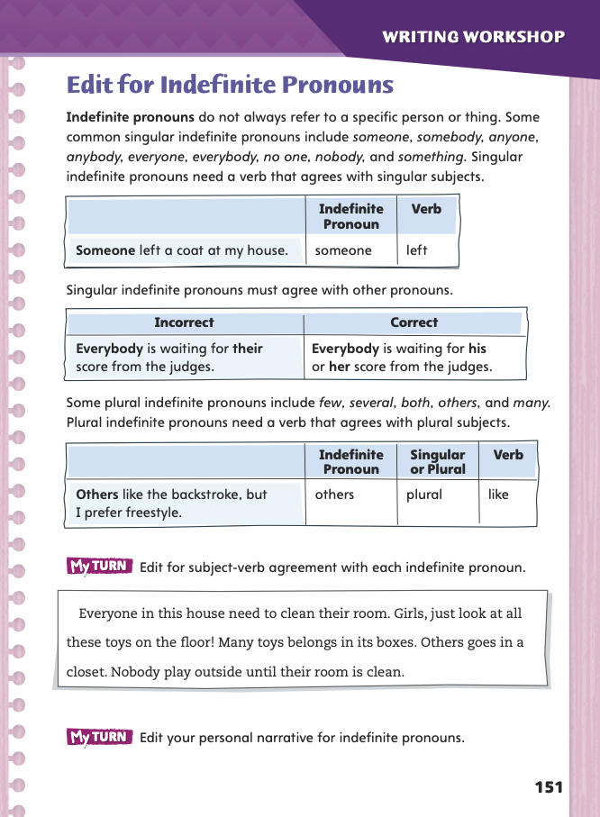
Page 151
Writing – Personal Narrative
Turn to page 151 in your Student Interactive.
Notes:
Direct students to read on p. 151 of Student Interactive and suggest more pronouns to add to each section of the chart. Then have students to complete p. 151.
Ask three or four volunteers to share from their drafts examples of indefinite pronouns and their verbs.

Slide 43
Independent Writing
Read your draft. Edit for indefinite pronouns and subject-verb agreement.
Notes:
Direct students to read through their drafts and edit for indefinite pronouns and subject-verb agreement. If students need additional opportunities to understand indefinite pronouns, have them look back at the text to find examples of indefinite pronouns and subject-verb agreement. If students demonstrate understanding, have them revise their drafts in their writing notebooks. See the Conference Prompts on p. T276.

Slide 44
Spelling – Words with Suffixes
It is _______ to read the instructions first.
I think I found a _______ solution to the problem.
Notes:
Explain that with roots rather than base words, -ible is usually used: credible, tangible. Otherwise, there is no spelling rule for when to add -able vs. -ible. Students must practice writing the words to remember how to spell them.
Write or display the following sentences. Have students work in pairs to fill in the blanks.
1. It is _____to read the instructions first. (advisable)
2. I think I found a ________ solution to the problem. (workable)
Have students complete Spelling p. 9 from the Resource Download Center. Click path: Table of Contents -> Resource Download Center -> Spelling -> U1W4

Slide 45
Language and Conventions - Nouns
There’s a new teacher on the faculty named Damon Jackson.
Notes:
Remind students that common nouns name general people, places, or things. Proper nouns name specific people, places, and things. Collective nouns name a group of people, places, or things.
MODEL AND PRACTICE To reinforce the instruction, display the sentence as There’s a new teacher on the faculty named Damon Jackson. Identify each type of noun in the sentence: teacher (common noun), faculty (collective noun; also a common noun), and Damon Jackson (proper noun).
Provide students with a list that includes a variety of nouns of the three types. Have them use the list to write three sentences. Each sentence should include at least two nouns of different types. Remind them to follow the capitalization rules for nouns.

Slide 46
Lesson 4

Slide 47
Page 130
Close Read – Visualize
Turn to page 130 in your Student Interactive.
Notes:
Readers analyze figurative language and visualize, or create mental pictures of, what they are reading.
Notice how the poet uses figurative language to describe an action, a person or animal, or an object.
Consider how the poet uses language to create and build on images.
Pay attention to how the lines and stanzas fit together to provide the
poem’s structure.
Connect what you know with what the writer has said to visualize what you are reading about.
MODEL AND PRACTICE Use the Close Read note on p. 130 of the Student Interactive to model how to annotate the text and then visualize. In “Learning the World,” the poet fits together images to make lines, which build into stanzas. What figurative words and phrases help me create a mental image of what the speaker imagines? In line 14, the speaker says he or she wishes to see “the whole world / spread beneath my feet.” This language is figurative because it does not describe something that could really happen.

Slide 48
Page 130
Close Read – Visualize
Turn to page 130 in your Student Interactive.
Notes:
Explain that poets and other writers use figurative language to give the reader a clearer picture and to make their writing more interesting. In most instances figurative language cannot be taken literally, but it will often create an image that is more clear and powerful than a plain description. Mental images help to deepen a reader's understanding of a poem.
Have students reread the second stanza to find and highlight words and phrases that help them visualize what the speaker is holding and what he or she is doing. See student p.130 for possible responses.
Tell students to demonstrate what they visualize using a sheet of paper. Ask them to explain why the speaker is looking through a tube. Possible Response: The speaker is pretending the rolled-up map is a telescope. A telescope would help him or her see the whole world—or at least see past his or her street. DOK 2

Slide 49
Page 134
Close Read – Visualize
Turn to page 134 in your Student Interactive.
Notes:
Have students reread the poem and highlight words that help them visualize features on a map. See student p. 134 for possible responses.
Ask: How do these words help you create mental images? How do they deepen your understanding of the poem? Possible Response: Words such as intersecting, names, dots, and tourist spots help me see a map in my mind. I can visualize how the highway lines connect the dots that mark towns and cities. I can imagine the tiny names of those cities and towns all over the map too. DOK 2

Slide 50
Page 136
Close Read – Visualize
Turn to page 136 in your Student Interactive.
Notes:
Visualizing images from poetry can help a reader better understand ideas the poet wants to state and feelings he or she wants to express. Have students identify and highlight words that help them visualize walking. See student p. 136 for possible responses.
Ask: How does a penguin walk? What do you think the word shambling means? Possible Response: Penguins have very short legs, and they look kind of clumsy when they walk. I think shambling means something like “shuffling” or “waddling.”
Let students check their responses in a dictionary. Then ask students to identify words that could describe a penguin's walk. Possible Responses: shuffling, waddling, hobbling DOK 2

Slide 51
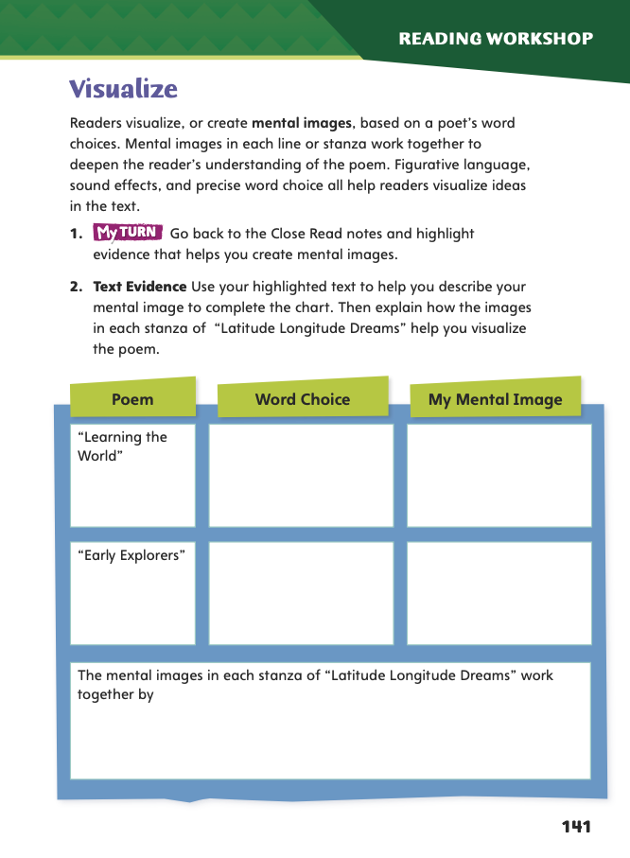
Page 141
Close Read – Visualize
Complete page 141 in your Student Interactive.
Notes:
Have students use the strategies for visualizing.
Have students annotate the text using the Close Read notes for Visualize and then use their annotations to complete the chart on p. 141.

Slide 52
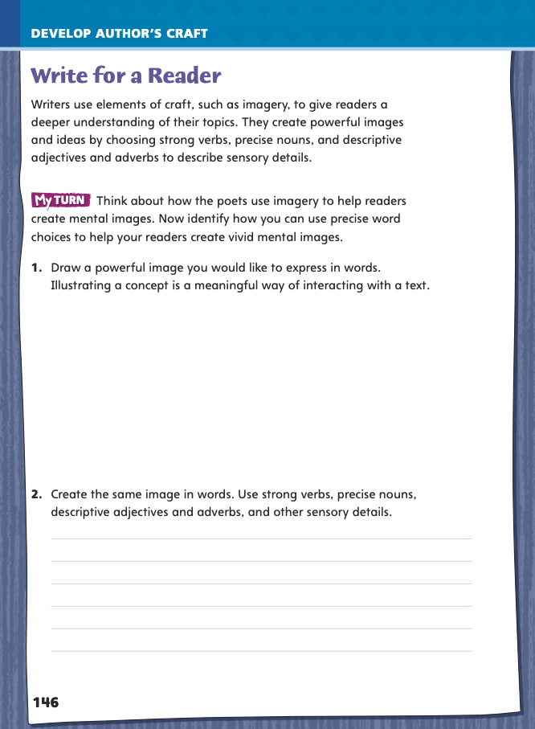
Page 146
Write for a Reader
Turn to page 146 in your Student Interactive and complete the activity.
Notes:
Explain that imagery helps a writer to express ideas and paint a picture in the mind of the reader. To add images, writers use strong verbs, precise nouns, and descriptive adjectives and adverbs. For example, to describe being stung by a bee, a writer may say “A sharp needle pierced my forearm.” The strong verb pierced, the precise nouns needle and forearm, and the descriptive adjective sharp combine to form an image that appeals to the senses of touch and sight and helps the reader sense what the sting felt like.
MODEL AND PRACTICE Discuss how students might use a similar technique in their own writing using Student Interactive p. 146. Model an example.
Identify an idea that could be expressed in a poem or a personal narrative.
Consider an image that could express this idea. I want to describe the excitement of seeing a popular movie on opening night. Imagery would help convey this idea. I could say, “A line snaked down the sidewalk from the theater door. There was a hum in the air from the murmuring ticket holders.” The use of strong verbs, precise nouns, and descriptive adjectives and adverbs all help to convey my idea by expressing what I see and hear.
As a class, draft a paragraph that includes imagery. Have volunteers offer ways to include strong verbs, precise nouns, and descriptive adverbs and adjectives to create a powerful image.
Have students refer to the use of imagery in the Poetry Collection as an example for their own writing. Then guide students to complete the activity on p. 146 in the Student Interactive.

Slide 53
Word Study – Vowel Team Review
enjoyable
waitress
List other words that include vowel teams that create those five sounds.
pleasant
season
nighttime
soil
greetings
Notes:
Review the strategies on pp. T202–T203 about how vowel teams can create different vowel sounds, including digraphs and diphthongs.
MODEL AND PRACTICE Provide students with the following list of words: enjoyable, pleasant, nighttime, greetings, waitress, season, soil. Identify the vowel team and vowel sound in the first word: oy, blended oi sound.
Then have students identify the vowel teams and sounds for the remaining words:
short e (ea in pleasant) long i (igh in nighttime) long e (ee in greetings, ea in season) long a (ai in waitress) blended oi (oi in soil)
APPLY Have students work in pairs or independently to list other words that include vowel teams that create those five vowel sounds. Ask students to share and compare their word lists.

Slide 54
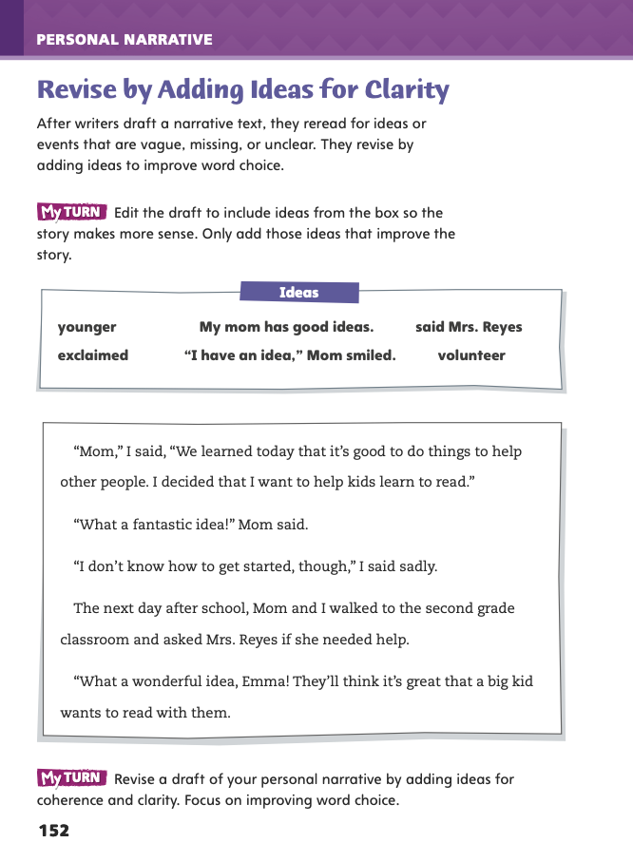
Page 152
Writing – Adding Ideas for Clarity
Turn to page 152 in your Student Interactive.
Notes:
Vague, missing, or unclear information can make a text difficult to understand. Authors clarify ideas and word choice to:
• Help the reader follow a sequence of events. • Help the reader understand cause-effect relationships. • Help the reader visualize events. • Make the narrative more interesting and exciting.
MODEL AND PRACTICE Hand out copies of a paragraph from a stack text that you have modified by blacking out important details and changing specific words to vague ones that you have underlined. Read the paragraph as a class. Ask:
• What information do you think appeared in the blacked-out parts?
• How can the underlined words be made clearer by adding details?
After discussion, hand out copies of the original paragraph. Read it as a class and share ideas about what makes it better than the modified paragraph you handed out.
Direct students to complete p. 152 of the Student Interactive.
Ask three or four volunteers to share portions of their drafts before and after revision to show how they revised by adding details for clarity.

Slide 55
Independent Writing
Examine your draft for places where information is vague or missing or the narrative is unclear.
Make notes on ideas you want to add and words you want to change.
Edit your draft by adding ideas for clarity.
Notes:
Direct students to examine their drafts for places where information is vague or missing or the narrative is unclear.
Ask them to take notes on ideas they want to add and words that they want to change.
If students need additional support in developing their understanding of how to add details to clarify ideas in their narratives, provide individual feedback in conferences.
If students demonstrate understanding, have them use this time to revise their drafts in their writing notebooks by adding ideas for clarity. See the Conference Prompts on p. T276.

Slide 56
Spelling – Vowel Team Review
The president held a press conference to proclam that she was signing a new law.
Notes:
See pp. T208–T209 to review the spelling of vowel teams, reminding students that the same sound can be spelled with different using different vowel teams and the same vowel team can spell different vowel sounds.
MODEL AND PRACTICE Display this sentence: The president held a press conference to proclam that she was signing a new law. Call on a volunteer to correct the misspelled word. Explain that understanding vowel teams can help students know how to spell words that contain them.
APPLY Using the spelling words on p. T208, invite students to make flashcards for the words, to quiz each other on the correct spellings, or to create a word search or crossword puzzle using the words.

Slide 57
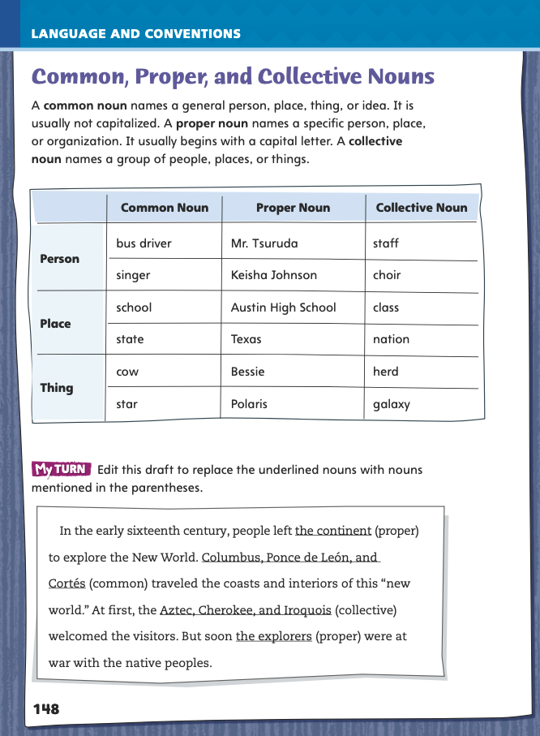
Page 148
Language and Conventions
Turn to page 148 in your Student Interactive and complete the activity.
Notes:
Have students edit the draft paragraph on Student Interactive p. 149.

Slide 58
Lesson 5

Slide 59
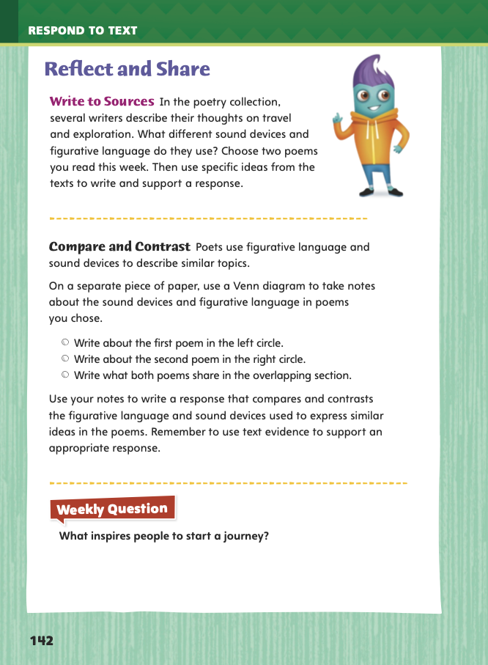
Page 142
Reflect and Share
Turn to page 142 in your Student Interactive.
Notes:
Explain to students that when they write to sources, they must first study the sources. Then they can respond to them.
Before writing, choose two poems that you will compare and contrast.
Make sure you understand how you are to use the poems in your
response.
Identify figurative language and sound devices from each poem to compare and contrast in your diagram.
MODEL AND PRACTICE Model to compare and contrast two poems using the Write to Sources prompt on p. 142 in the Student Interactive.
In my Venn diagram I will compare and contrast figurative language and sound devices in each poem. I am going to choose “A Map and a Dream” and “Early Explorers.” I will reread each poem looking for examples of figurative language. I will record those examples in my Venn diagram on the right and left sides. Then I will reread my notes and move any common details into the middle part of the diagram to show that both poems have these elements.
After students complete their own Venn diagrams to compare and contrast their chosen poems, have them describe how the sound devices in each poem achieve specific purposes.
Direct students to use the strategies for comparing and contrasting texts.
Have students use evidence from the poems they read this week to complete the writing assignment. Direct students to choose only two of the poems to compare and contrast.

Slide 60
Apply
What inspires people to start a journey?
Notes:
Have students use evidence from the poems they read this week to respond to the Weekly Question. Tell them to write their response on a separate sheet of paper.

Slide 61
Word Study – Suffixes
comfortable
Use the following words in a sentence.
flexible
reversible
movable
traceable
visible
dependable
forcible
Notes:
To assess students’ understanding of the suffixes -able and -ible, provide them with these words: comfortable, dependable, forcible. Ask them to identify the meaning of each.
Then have students work individually or in pairs to use each of the following words in a sentence.
1. flexible 2. reversible
3. movable
4. traceable
5. visible

Slide 62
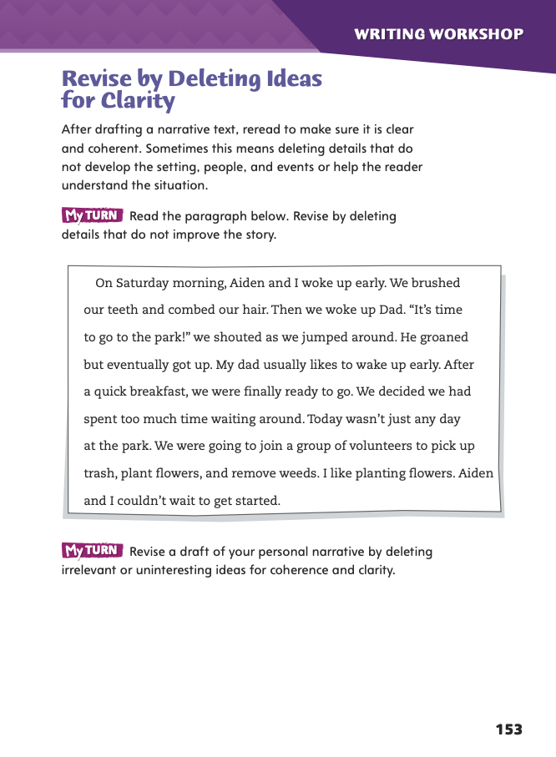
Page 153
Writing – Delete Ideas for Clarity
Turn to page 153 in your Student Interactive.
Notes:
When we revise, we go back to a draft to make sure it is clear and coherent. We remove details that distract or mislead readers. We also revise the draft to improve sentence structure and word choice by deleting ideas. In order to make sure that a personal narrative is clear, it is important to
• Delete details that are not important to the narrative. • Delete repetitious details. • Delete ideas to improve sentence structure and word choice.
MODEL AND PRACTICE Hand out copies of a paragraph from a stack text that you have changed by adding irrelevant or redundant details or by adding ideas that make the sentences and wording unclear.
Read the paragraph as a class. Then read it a second time, sentence by sentence, and ask students: Are there any details that do not move the narrative along, do not belong in it, or were already mentioned elsewhere in the paragraph? (Have students identify such information.)
After discussion, provide the original paragraph and have a volunteer read it aloud. Ask: How is the original paragraph from the stack text better? (The narrative is clearer and less repetitive, and all the details are relevant.)
Direct students to complete p. 153 of the Student Interactive to continue practicing deleting ideas for clarity and to improve sentence structure and word choice.
Call on students to share examples of information they deleted and explain why they deleted it.

Slide 63
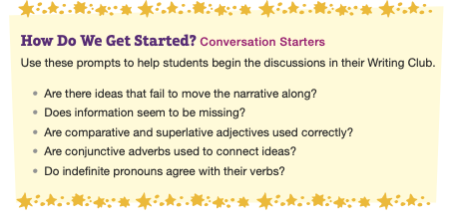
Writing
Blurry page
Notes:
Place students into Writing Club groups. See p. T283 for details of how to run Writing Club. See the Conference Prompts on p. T276.
Students will share revised drafts of their personal narratives. To ensure that students give feedback in an organized manner, they should spend the first 5-10 minutes in their groups discussing the following:
the order in which they will share their drafts
the situations in which it is appropriate to ask a writer to pause or repeat
what he or she just read
the way to organize feedback—one person at a time, for example, or one issue at a time
Before sharing their narratives, students should decide on which elements of their work they would like feedback in today’s Writing Club. To help the group focus, students should mention these concerns before they begin.

Slide 64
Spelling
1. Our teacher said it was advisable to read the chapter before the test.
2. We think this fix is workable and will help us finish the job.
3. The witness was not credible, and the jury thought she was lying.
4. When the police investigated the robbery, they saw signs of a forcible entry.
5. Can you let me know when the jersey will be available in my size?
6. The automobile runs on a combustible engine.
7. It is allowable to pay half now and the other half within a month.
8. Those items are perishable and should go in the refrigerator.
9. The chef made a dessert using the prettiest edible flowers.
10. Marta is not usually cranky, but her cold is making her irritable.
Notes:
(Note: Move the orange boxes to cover each bold spelling word before you read aloud the words and sentences.)
Use the following sentences for the spelling test:
1. Our teacher said it was advisable to read the chapter before the test.
2. We think this fix is workable and will help us finish the job.
3. The witness was not credible, and the jury thought she was lying.
4. When the police investigated the robbery, they saw signs of a forcible entry.
5. Can you let me know when the jersey will be available in my size?
6. The automobile runs on a combustible engine.
7. It is allowable to pay half now and the other half within a month.
8. Those items are perishable and should go in the refrigerator.
9. The chef made a dessert using the prettiest edible flowers.
10. Marta is not usually cranky, but her cold is making her irritable.

Slide 65
Language and Conventions
The Principal, Mr. Lee, holds an assembly at the beginning of each semester.
Which revision would correct the sentence?
Principal should begin with a lowercase letter.
Lee should begin with a lowercase letter.
Semester should begin with a capital letter.
Notes:
Display the sentence and have students respond independently.
The Principal, Mr. Lee, holds an assembly at the beginning of each semester.
Which revision would correct the sentence?
A Principal should begin with a lowercase letter. (correct answer)
B Lee should begin with a lowercase letter.
C Semester should begin with a capital letter.
APPLY Have students complete Language and Convention p. 14 from the Resource Download Center. Click path: Table of Contents -> Resource Download Center -> Language and Conventions -> U1 W4

Slide 66
Unit 1: Week 4
Grade 5

