Slide 1
Unit 1: Week 1
Grade 4

Slide 2
Copyright © Savvas Learning Company LLC. All Rights Reserved.
This publication is protected by copyright, and permission should be obtained from the publisher prior to any prohibited reproduction, storage in a retrieval system, or transmission in any form or by any means, electronic, mechanical, photocopying, recording, or otherwise. For information regarding permissions, request forms, and the appropriate contacts within the Savvas Learning Company Rights Management group, please send your query to:
Savvas Learning Company LLC, 15 East Midland Avenue, Paramus, NJ 07652
or
k12learningpermissions@savvas.com
myView Literacy® is an exclusive trademark of Savvas Learning Company LLC in the U.S. and/or other countries.

Slide 3
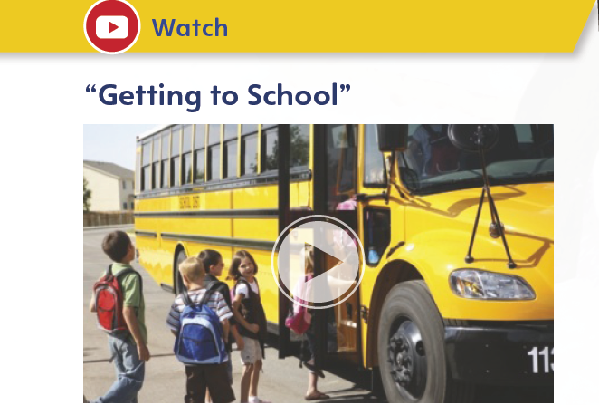
Page 8
Introduce the Unit
Essential Question: How can a place affect how we live?
What was the most memorable image from the video?
What surprised you when listening to the video?
Notes:
Introduce the Unit 1 Essential Question: How can a place affect how we live? Tell students they will read many texts to learn about what shapes the relationships between places and people. Explain that reading a variety of genres is important because each text provides a unique perspective about the theme.
Watch the Unit Video Tell students that a video is a multimodal text because it combines sound and pictures. Have students watch “Getting to School” and take notes about how it helps us understand connections between places and people. Click Path: Table of Contents -> Unit 1: Networks> Unit 1: Introduction
Encourage partners to discuss what they learned about networks by watching the video. Use the following questions to guide their discussions.
What was the most memorable image from the video?
What surprised you when listening to the video?

Slide 4
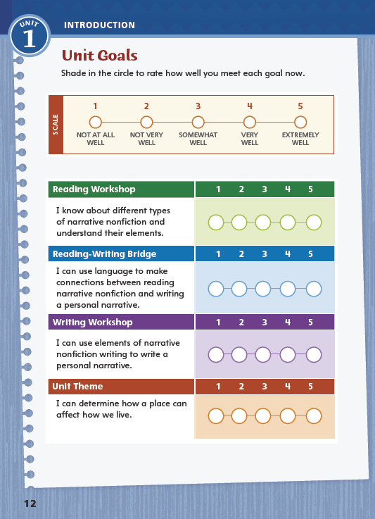
Page 12
Unit Goals
Turn to page 12 in your
Student Interactive.
Rate how well you think you already meet the unit goals.
Notes:
1. Review the Unit Goals on p. 12 of the Student Interactive.
Have students rate how well they think they already meet the unit goals.
Have them use their ratings to reflect on how well they are meeting their personal learning goals during the unit.
2. Students will revisit their ratings in Week 6.

Slide 5
Academic Vocabulary
Expand: When you give something, you contribute.
Ask: What would you ask each group member to contribute as you work on a project together?
Expand: I took the lid off and exposed the contents of the box.
Ask: What would be exposed if your removed one wall of a building?
Expand: Our class is in the habit of raising our hands before we speak
Ask: How can we work to build healthy habits?
Expand: What we thought would be a mild rain turned into a severe storm.
Ask: Is a paper cut a severe injury or not?
Expand: Practicing an extra half hour each day made a significant difference in her playing.
Ask: What significant events have taken place in our community lately?
Notes:
Academic vocabulary is language used to discuss ideas. As students work through the unit, they will use these words to discuss journeys.
Read each word's definition.
Have students respond to the Expand and Ask questions using the newly acquired academic vocabulary as appropriate.
Expand: When you give something, you contribute.
Ask: What would you ask each group member to contribute as you work on a project together?
Expand: I took the lid off and exposed the contents of the box.
Ask: What would be exposed if your removed one wall of a building?
Expand: Our class is in the habit of raising our hands before we speak
Ask: How can we work to build healthy habits?
Expand: What we thought would be a mild rain turned into a severe storm.
Ask: Is a paper cut a severe injury or not?
Expand: Practicing an extra half hour each day made a significant difference in her playing.
Ask: What significant events have taken place in our community lately?

Slide 6
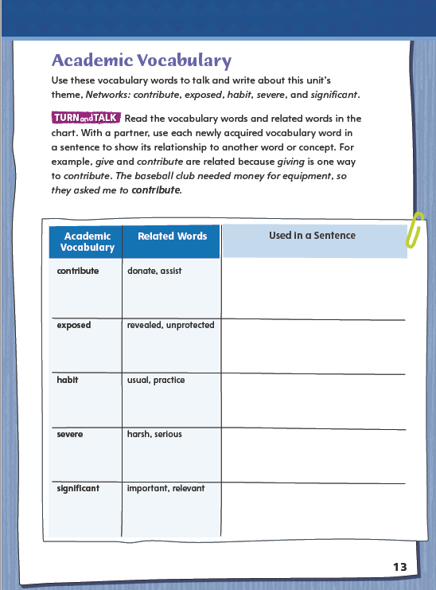
Page 13
Academic Vocabulary
Complete the chart on page 13 in your Student Interactive.
Notes:
Have students use the Academic Vocabulary to complete the chart on p. 13 for the listed words.
Have partners share their answers using their newly acquired vocabulary.

Slide 7
Lesson 1

Slide 8
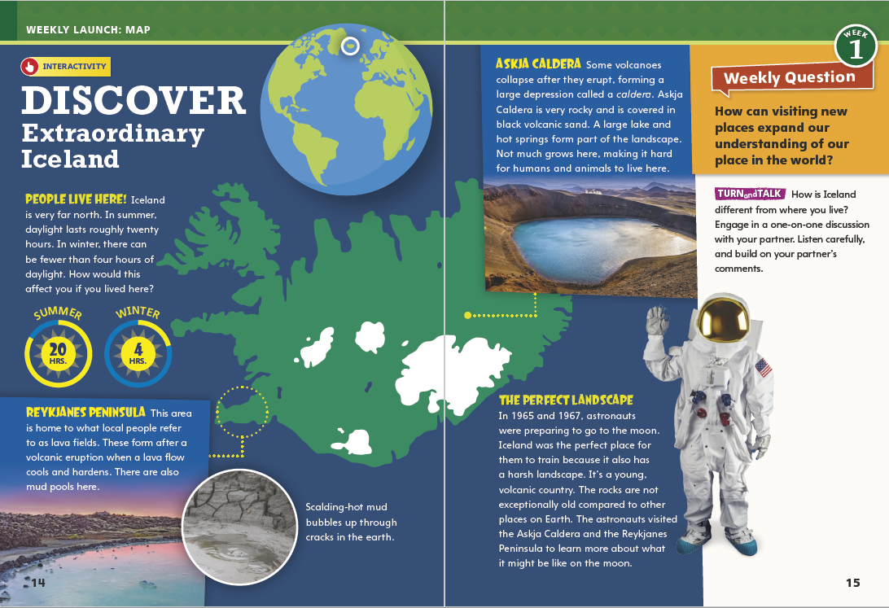
Pages
14-15
Interact with Sources
How is Iceland different from where you live?
Engage in a one-on-one discussion with your partner. Listen carefully and build on your partner’s comments.
Notes:
Remind students of the Essential Question for Unit 1: How can a place affect how we live?
Point out the Week 1 Question: How can visiting new places expand our understanding of our place in the world?
Direct attention to the map on pp. 14–15 in the Student Interactive. Explain that this map is a multimodal text that combines a map with words and pictures to provide information. Have students notice where Iceland is on the globe.
Point out that two of the text paragraphs are linked to specific locations on the map of Iceland. Then have students read the other text around this map and discuss how having more or less daylight might affect people
Use the following questions to guide discussion:
How would you feel about having so much daylight every day in summer and so little in winter?
What other parts of the world might be like Iceland, and why?
What would you most like to see in Iceland?
What would you most like to do?
WEEKLY QUESTION Reread the Week 1 Question: How can visiting new places expand our understanding of our place in the world?
Tell students they just learned some facts about Iceland and saw pictures of things they might see there. Point out that some things have to be experienced, such as a 20-hour summer day, in order to truly expand one’s understanding of a new place and our place in the world.
Explain that students can learn more about a topic when they generate questions for informal inquiry. Students should ask if their questions make sense. If not, they should clarify them.
Have students work in pairs to generate questions about Iceland, its landscape, and other topics introduced with the map. Have them clarify questions as needed.
Then have them ask and answer the Turn and Talk question. Remind students to ask relevant follow-up questions to elicit a more detailed response and to take notes about interesting ideas.

Slide 9
Listening Comprehension
Networks
People | Events
Notes:
Tell students you are going to read aloud a narrative nonfiction piece about a famous astronaut. Have students listen as you read “Sally Ride.”
Explain that students should listen actively, paying careful attention to the details as you read. Prompt them to ask questions to clarify information and follow agreed-upon discussion rules.
READ the entire text aloud without stopping for Think Aloud callouts.
REREAD the text aloud, pausing to model Think Aloud strategies related to the genre and the author‘s purpose for writing.
After reading, ask students to report on the text by paraphrasing its main ideas. Have them include appropriate facts and relevant, descriptive details from the text to support the main ideas.
THINK ALOUD: I notice that the text has descriptive details about real people and events. The author includes dates so I know when these events happened
THINK ALOUD: As I reread the last paragraph of the article, I’m thinking about how Sally Ride did a great job as an astronaut but also influenced young people.
After reading, ask students to report on the text by paraphrasing its main ideas. Have them include appropriate facts and relevant, descriptive details from the text to support the main ideas.
Use a T-chart to help students create a time line of Sally Ride’s life. Students should include dates and facts from the text.

Slide 10
Pages 16-17
Narrative Nonfiction
Turn to pages 16-17 in your Student Interactive.
Notes:
Tell students: Narrative nonfiction tells a story about real people. People in narrative nonfiction grow and change like characters in a fictional narrative, or story.
Look for the names of real people and descriptions of real events.
Look for dates and other clues about when and in which order events took place.
Think about the descriptive details in the text. Why did the author include those facts?
Model determining that a text is narrative nonfiction. Say: In “Sally Ride,” the author writes about real people and events with dates, so I decide that “Sally Ride” is an example of narrative nonfiction.
Lead a class discussion of other narrative nonfiction texts with which students are familiar.
Make a web on the board for the genre “Narrative Nonfiction” and include sub-genres, such as autobiography, biography, essay, personal narrative, and interview, as students discuss texts. Have students refer to the web as they engage in collaborative discussion on the topic.
Read the Anchor Chart on page 16 in the Student Interactive together. Editable Anchor Chart Click Path: Table of Contents -> Reading Anchor Charts -> Unit 1 Week 1: Narrative Nonfiction Editable Reading Anchor Chart

Slide 11
Page 16
Apply
Describe to a partner a story you have read about a real person or event.
Use the anchor chart to tell how you know whether the story is narrative nonfiction.
Take notes and then share your ideas with the class.
Notes:
Have students work with a partner to complete the Turn and Talk activity on p. 16 of the Student Interactive.
Circulate to discover if students can identify narrative nonfiction pieces.

Slide 12
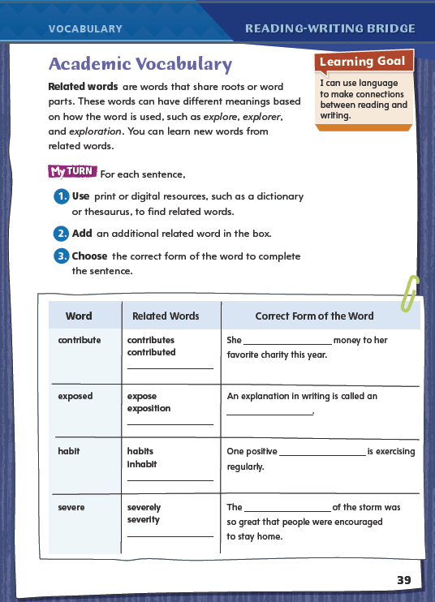
Page 39
Academic Vocabulary
contribute
Complete the chart on pg. 39 in your Student Interactive.
Notes:
Prefixes and endings can create new, related words. Related words are used differently but they have related meanings because they share word parts. Readers can use what they know about related words to understand new terms.
When you come across an unfamiliar word, notice its root or base word and if it has a prefix or suffix.
Consider the meaning of the root or base word and if it’s familiar.
Ask yourself if another prefix or suffix can be used to change the word.
Model this strategy using the Academic Vocabulary word contribute in the chart on p. 39 in the Student Interactive.
Say: If I encountered the word contribute in a text, I would mentally break it into parts. Then I would think about words with the same base word that I already know. Then I would see if I could modify contribute to use it in a new way. In the Related Words box, we see the word with the endings –s and -ed. We can use these words in ways that we cannot use the related word contribute. Let's turn contribute into a noun. What is another ending we could add to change this word? (contribution). Which related word has the correct meaning to complete the sentence in the last column? (contributed).
Have students apply this strategy to the word habit. Then have them use a print or digital dictionary to find and clarify the precise meaning and pronunciation of the phrase in the habit of.
Have students follow the same strategy as they complete the chart on p. 39. Remind students that they will use these academic words throughout this unit.

Slide 13
Word Study
-ed
-ing
-s
-er
-est
She _______ (jump)_______ (high).
Notes:
Adding a suffix to a word changes how the word is used. The suffixes -ed, -ing, and -s are added to verbs to tell us when something happened. If Ann walked to the store, for example, the suffix –ed tells us that this happened in the past. If Ann is walking to the store, then we know the action is in the present. If Ann walks to the store, it is also happening now.
Adding the suffixes -er or –est to an adjective allows us to compare different things. Saying that a room is quieter at night, or that a room is the smallest room in the house would be ways to use adjectives to compare by adding a suffix.
To demonstrate that suffixes change the time of a verb and make adjectives comparative, use the example She ___(jump) ___(high).
Ask students to use a suffix to express that the action happens in the present, and another suffix to show it happened in the past. (jumps, jumped)
Then have a volunteer use suffixes to make comparisons. (higher, highest)

Slide 14
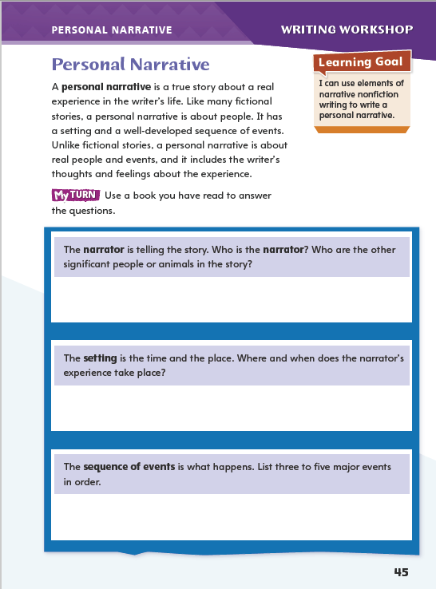
Page 45
Writing – Personal Narrative
Turn to page 45 in your Student Interactive.
Notes:
Writers compose personal narratives to tell about a significant experience they have had. They write about
a specific setting,
a sequence of events that leads to a turning point, and
a change in their lives that resulted from the experience.
Tell students that they will be exploring personal narratives over the next two days to prepare to write their own. Today, they will focus on elements that set personal narratives apart from other narrative nonfiction, such as biography and autobiography.
Read aloud a personal narrative from the stack. Pause to identify the narrator and the setting. Use the following questions to prompt discussion
How do we know that the sequence of events is real?
How does the narrator respond to events?
What language does the narrator use that seems personal?
What does the setting of the narrative contribute to the events and to the narrator’s response?
Direct students to p. 45 in the Student Interactive. Have them use another narrative they have read or heard to complete the activity.

Slide 15
Independent Writing
Plan and begin writing your own personal narrative in your writer’s notebook.
Notes:
After this genre immersion lesson, students should transition to independent writing. If students need additional opportunities to develop their understanding of personal narratives, they should read additional texts from the stack.
If students demonstrate understanding, they should transition to writing personal narratives in their writing notebooks. See the Conference Prompts on p. T76.
Additional support may be provided:
Modeled- Choose a stack text and do a Think Aloud to model identifying elements of personal narrative.
Shared- Discuss common elements of personal narratives and write what students identify.
Guided- Use stack texts to provide explicit instruction on elements of personal narratives.
Call on a few students to share what they have written about the narrator, setting, and sequence of events in the personal narrative they chose from the stack.

Slide 16
Spelling
The shipping box was too heavy for me to carry.
I am lazier on the weekend.
The movie was sadder than I expected.
Diego brought his supplies to class.
The puppy cried when he was lonely.
Amanda had the prettiest costume in the school play.
The father comforted the crying baby.
The witness denied any involvement in the crime.
Going down the mountain is scarier than ascending.
The earliest time I can visit is tomorrow.
Notes:
(Note: Move the orange boxes to cover each bold spelling word before you read aloud the words and sentences.)
Use the spelling sentences to assess students’ prior knowledge of suffixes.
The shipping box was too heavy for me to carry.
I am lazier on the weekend.
The movie was sadder than I expected.
Diego brought his supplies to class.
The puppy cried when he was lonely.
Amanda had the prettiest costume in the school play.
The father comforted the crying baby.
The witness denied any involvement in the crime.
Going down the mountain is scarier than ascending.
The earliest time I can visit is tomorrow.
Reveal the spelling word and have students check their work.
For students who understand that adding a suffix to a base word often involves spelling changes such as dropping a final e, include the following Challenge Words with the spelling list: magnified, iciest, interfering.

Slide 17
Language and Conventions
The wooden boat sailed out of the harbor.
Notes:
A sentence has two parts: a subject, which is who or what the sentence is about, and a predicate, which is what the subject is or what the subject does. For example, take the sentence Jane dropped the jar. The subject is Jane—she is the “who” in the sentence. Dropped the jar is the predicate, because that is what she did.
Share with students the sentence: The wooden boat sailed out of the harbor.
Ask volunteers to underline once the sentence’s subject (boat) and underline twice the predicate (begins with sailed).
Split the sentence between boat and sailed and explain that the complete subject includes the subject and the modifiers ‘The wooden,’ and that the complete predicate includes the verb and words that modify it.
As a class, write another sentence and split the complete subject from the complete predicate.
Have students create their own sentences and identify the complete subject and complete predicate.

Slide 18
Lesson 2

Slide 19
Page 18
Preview Vocabulary
determination
independence
specialized
struggled
confidence
Notes:
1. Introduce the vocabulary words on p. 18 in the Student Interactive and define them as needed.
determination the will to achieve a difficult task
independence freedom from being controlled or needing help from others
specialized gained specific knowledge
struggled made a great and difficult effort
confidence a feeling that a person can succeed or do well
2. Say: These words will help you understand Reaching for the Moon. As you read, highlight the words when you see them in the text. Ask yourself what they convey about Buzz Aldrin.

Slide 20
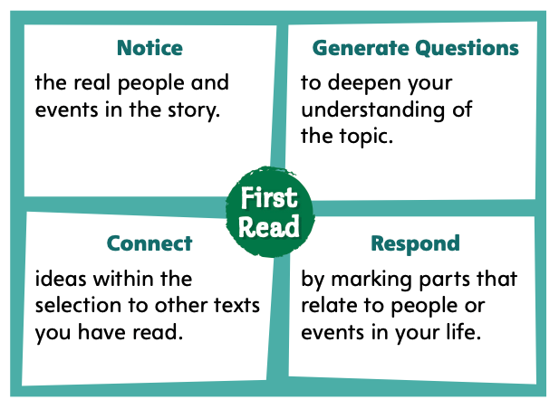
Page 18
First Read Strategies
Notes:
Discuss the First Read Strategies. Prompt students to establish that the purpose for reading this selection is to learn about a topic.
Explain the four steps of the first read.
NOTICE Remind students to focus on real people and events in the story.
GENERATE QUESTIONS Have students jot down questions before, during, and after reading and mark anything they find confusing.
CONNECT Have students determine how the text connects to their own lives and to ideas in other texts they have read.
RESPOND Have students mark any parts of the text that they find interesting, surprising, or significant, as well as parts that relate to people or events in their lives.
Students may read independently, in pairs, or as a class. Use the First Read notes to help them connect with the text and guide their understanding.

Slide 21
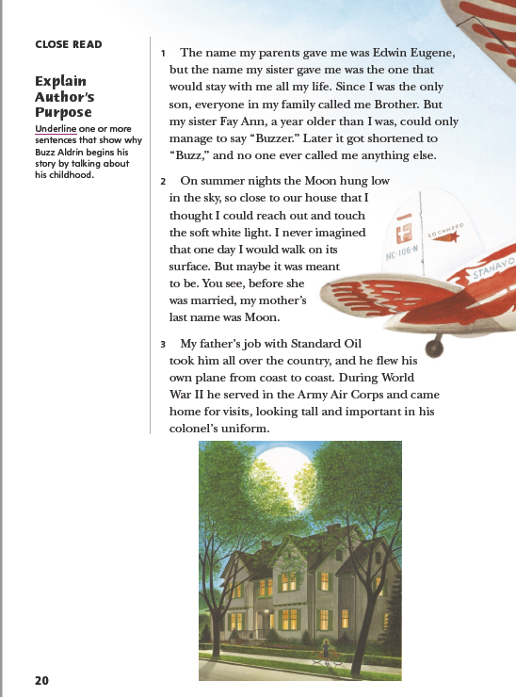
Pages 19-20
First Read – Reaching for the Moon
Notes:
Students may read independently, in pairs, or as a class. Use the First Read notes to help them connect with the text and guide their understanding. Pause to discuss the First Read notes with students.
THINK ALOUD I notice that the author uses information about his sister, his mother, and his father to tell his story. This reminds me of the unit theme, Networks. The author begins by describing himself as part of a kind of network: a family. I can connect what Aldrin says about networks to other texts I read in this unit.

Slide 22
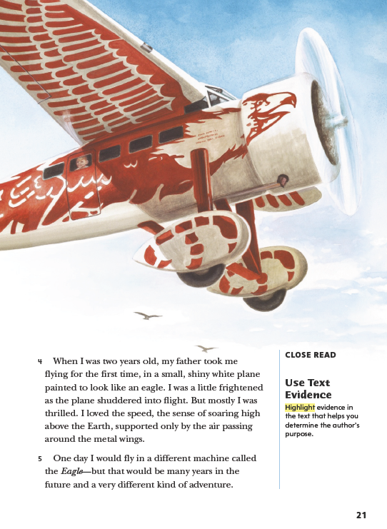
Page 21
First Read – Reaching for the Moon
Notes:
Pause to discuss the First Read notes with students.
THINK ALOUD When Aldrin describes how he felt the first time he flew in a plane, it reminds me of the first time I flew in a plane as a child. I was thrilled, too. When I looked out the window, I saw places in a whole new way. Remembering this experience helps me understand what motivates the author to keep working toward being able to fly.

Slide 23
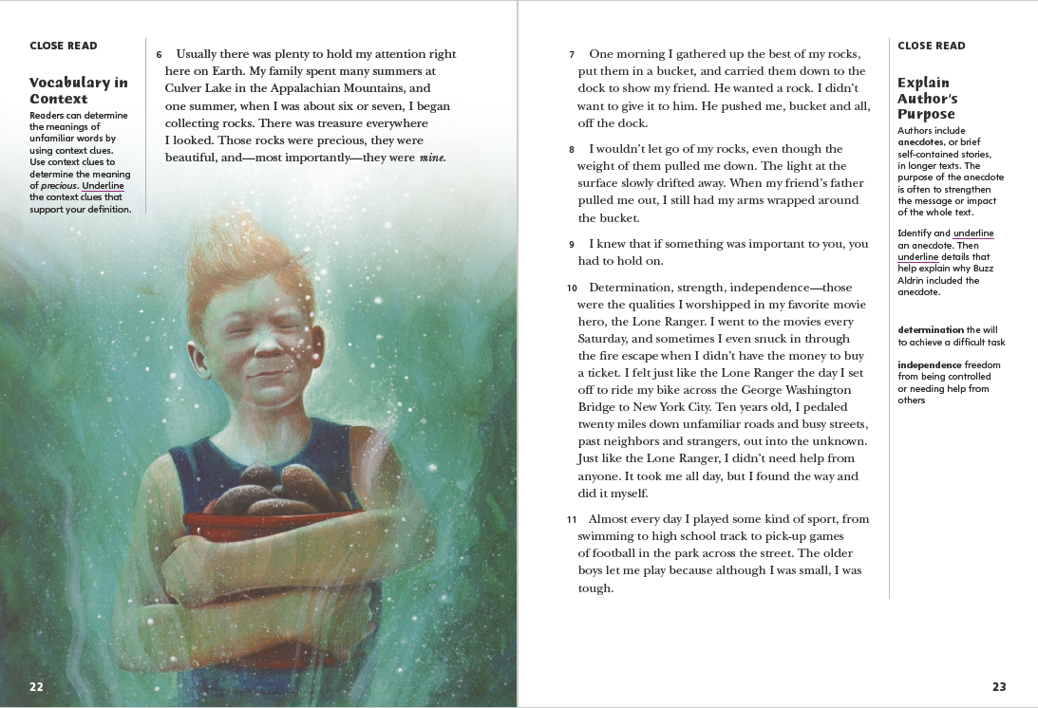
Pages 22,23
First Read – Reaching for the Moon
Notes:
Pause to discuss the First Read notes with students.
THINK ALOUD The author says he collected rocks when he was six or seven. I liked collecting shells from the beach when I was little. I thought they were pretty and I liked to look at them.
THINK ALOUD As I read, I am going to think of questions I have about the text. I notice that Aldrin mentions a fictional character called the Lone Ranger. I wonder why the author does that.

Slide 24
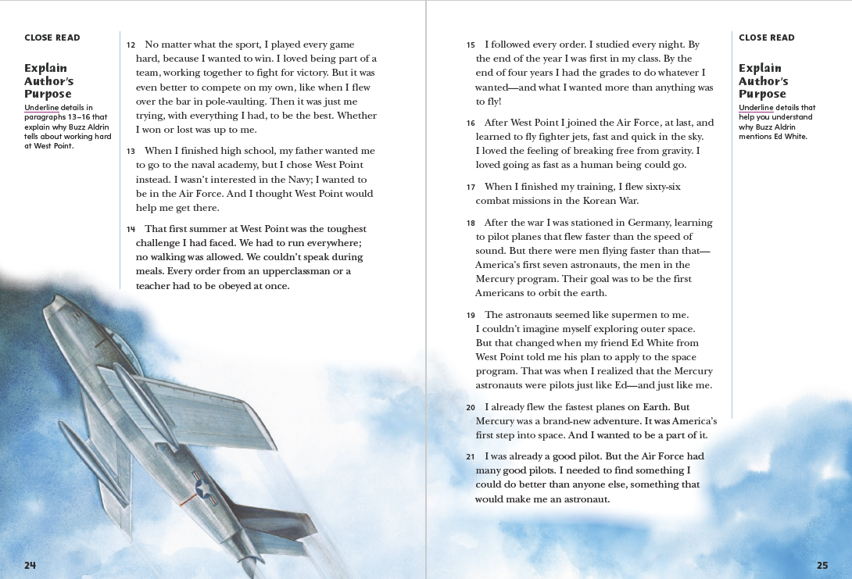
Pages 24,25
First Read – Reaching for the Moon
Notes:
Pause to discuss the First Read notes with students.
THINK ALOUD I notice the author says he flew over the bar in pole-vaulting. The author’s word choice helps me picture his action clearly. What other references to flight appear in this story? What do these events tell me about Aldrin?
THINK ALOUD I notice the author is naming real events, like the Korean War, and real places, like West Point and Germany, in his story. This helps me remember that Aldrin is telling the true, factual story about his life.

Slide 25
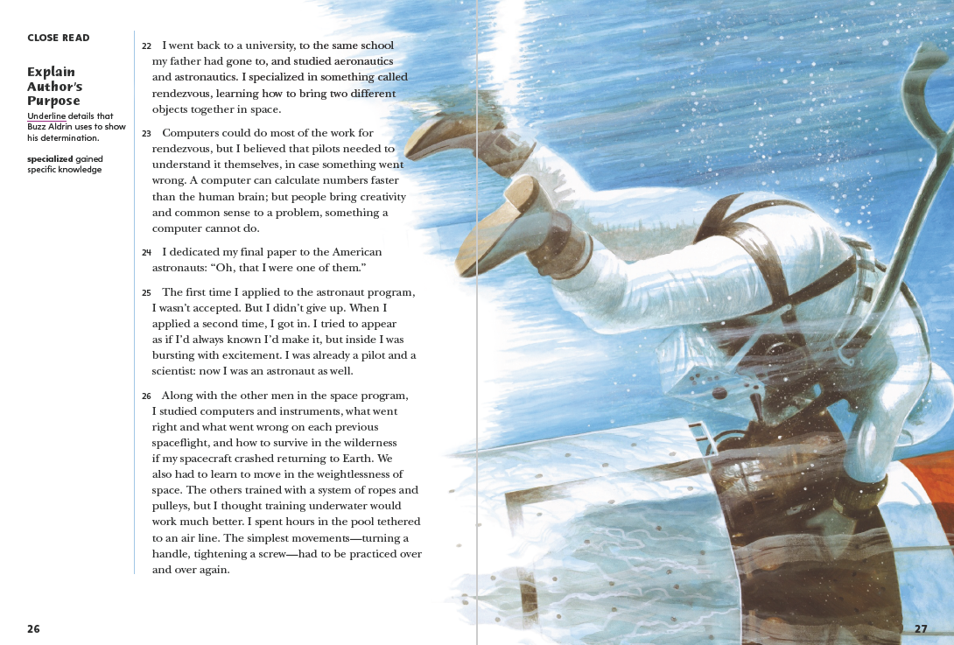
Pages 26,27
First Read – Reaching for the Moon
Notes:
Pause to discuss the First Read notes with students.
THINK ALOUD The author tells about not getting accepted to the astronaut program the first time he applied. If he had given up after that, he would never have walked on the Moon.
THINK ALOUD I see air bubbles in the illustration, so I know it is supposed to show an astronaut training underwater. I can connect this with details in paragraph 26. The text and illustration tell me different things about the same idea.

Slide 26
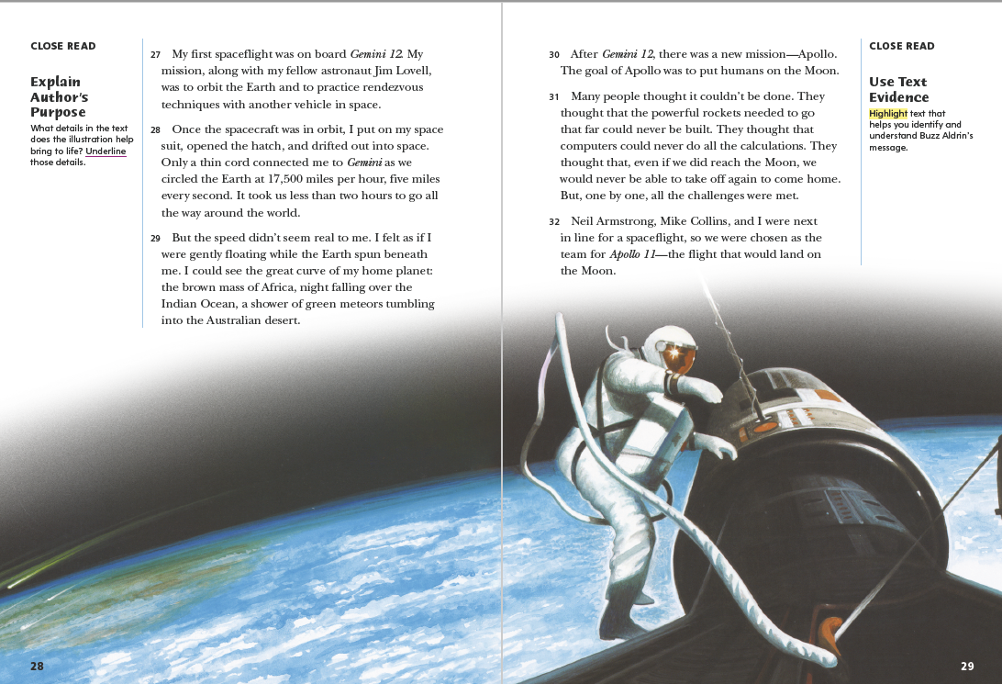
Pages 28,29
First Read – Reaching for the Moon
Notes:
Pause to discuss the First Read notes with students.
THINK ALOUD The author talks about the Gemini 12 mission. I wonder what happened on the Gemini 1 through 11 missions.
THINK ALOUD I notice the author mentions some people by name. These are the astronauts who went with him to the Moon on the Apollo 11 mission.

Slide 27
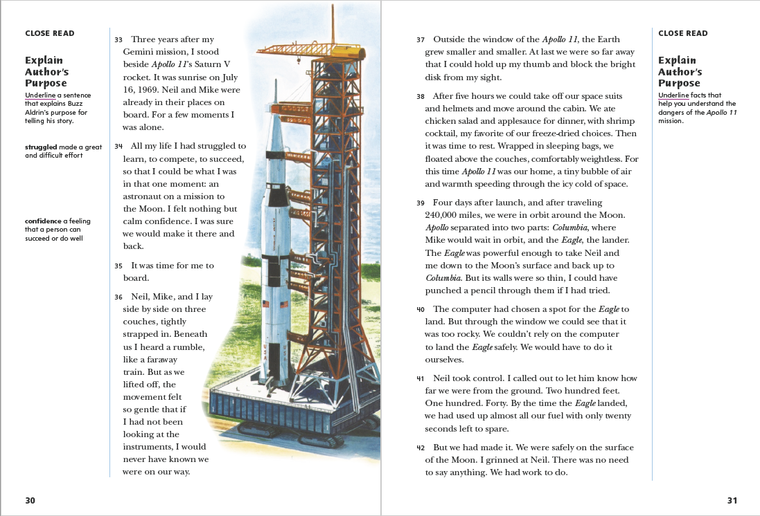
Pages 30,31
First Read – Reaching for the Moon
Notes:
Pause to discuss the First Read notes with students.
THINK ALOUD The author mentions the Saturn V rocket. I would like to know more about how rockets work, and how space travel has changed since the Apollo mission.
THINK ALOUD Remind students that active readers note parts of the text that surprise or confuse them and write sentences about these parts to help them learn. Say: I'm surprised to learn that the walls of the Eagle were so thin. I would have thought the walls of a spacecraft for landing on the Moon would be thick and strong. Otherwise, how would it keep the astronauts safe? I will mark this confusing detail and write some questions about it.

Slide 28
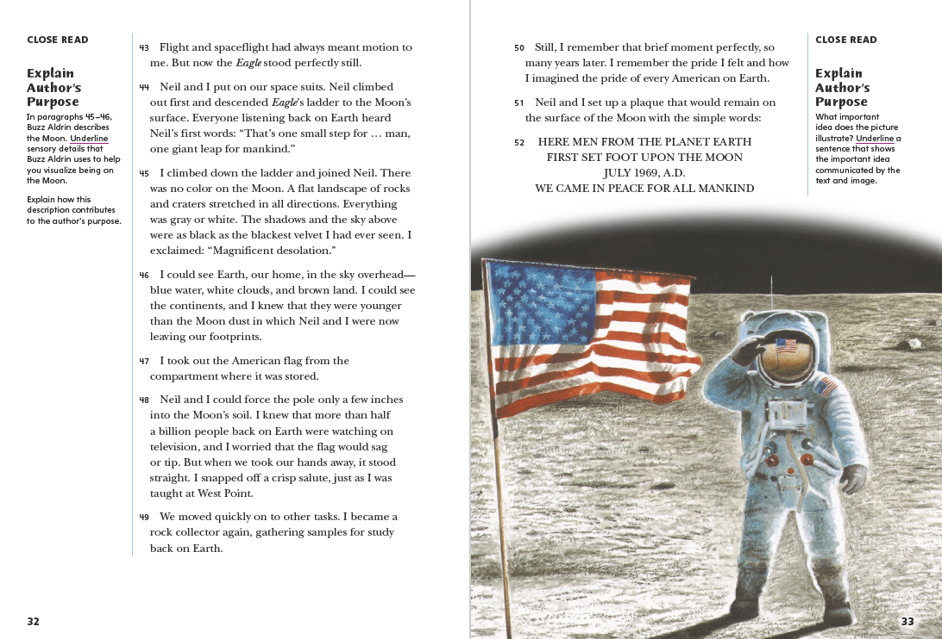
Pages 32,33
First Read – Reaching for the Moon
Notes:
Pause to discuss the First Read notes with students.
THINK ALOUD I have heard that famous quote—“one small step for man, one giant leap for mankind”—before.
THINK ALOUD I notice the American flag in the picture, but the plaque says for all mankind, not just for the United States. This reminds me again of the theme Networks because every place on Earth has the same kind of relationship to the Moon.

Slide 29
Respond and Analyze
Brainstorm What did you think of the text? What did you like about it?
Discuss What part of this text did you find most interesting? What part of the author’s life would you like to hear more about?
Notes:
Use these suggestions to prompt students’ initial responses to Reaching for the Moon.
Brainstorm What did you think of the text? What did you like about it?
Discuss What part of this text did you find most interesting? What part of the author’s life would you like to hear more about?

Slide 30
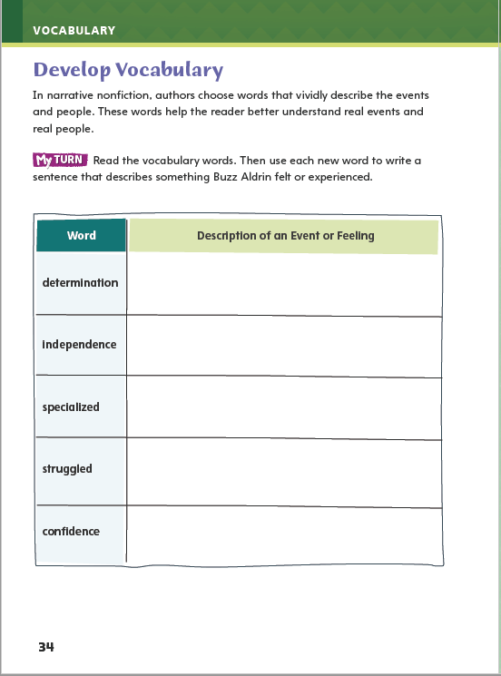
Page 34
Develop Vocabulary
Turn to page 34 in your Student Interactive and complete the activity.
Notes:
Tell students that authors of autobiographies choose words carefully to describe themselves so readers can better understand their purpose for writing their life story and the message, or main idea, they want to convey.
Say: The words determination, independence, specialized, struggled, and confidence all can be used to discuss Aldrin’s purpose and message.
Present the following points and lead a class discussion on this idea:
Remind yourself of each word’s meaning.
Ask yourself what the author is trying to convey about himself and the space program.
Ask a volunteer to help you model filling out the chart on Student Interactive p. 34 using the word determination.
What word does the author use to describe a quality he admires in the Lone Ranger? It means to keep trying to reach a goal.
When did Buzz Aldrin show determination? (He didn’t give up after he wasn’t accepted to the astronaut program.) We can write that in the chart.
Have students respond using newly acquired vocabulary as they complete p. 34 of the Student Interactive.

Slide 31
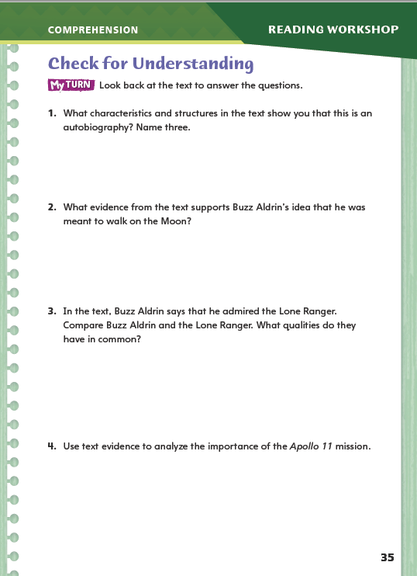
Page 35
Check for Understanding
Complete page 35 in your Student Interactive.
Notes:
Have students complete p. 35 of the Student Interactive.

Slide 32
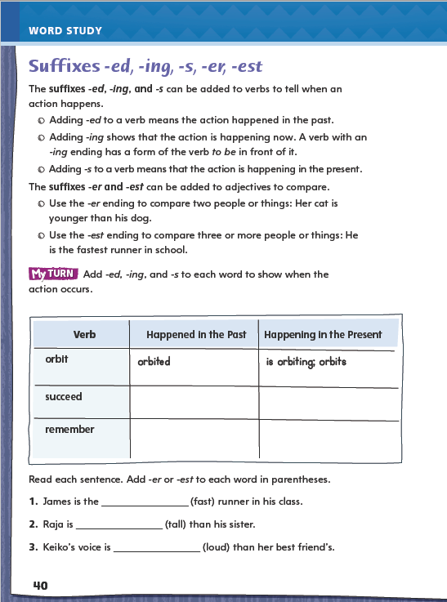
Page 40
Word Study
Turn to page 40 in your Student Interactive.
Notes:
Direct students to complete the chart on p. 40 of the Student Interactive.

Slide 33
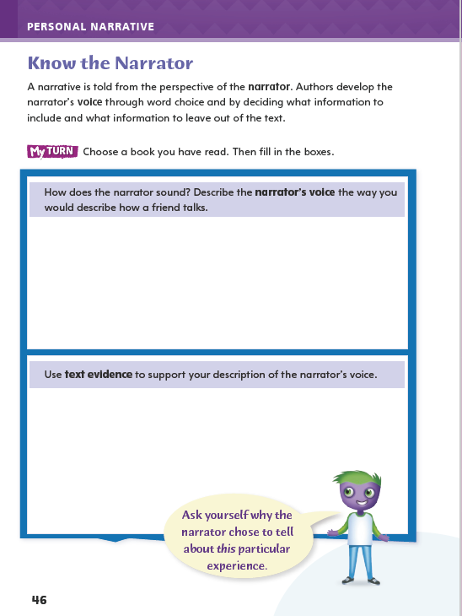
Page 46
Writing – Personal Narrative
Turn to page 46 in your Student Interactive. Choose a book you have read. Then fill in the chart.
Notes:
Say: The narrator is the writer, or author, of the personal narrative. Through the text, readers get to know the narrator as a person.
The narrator uses a personal, distinctive voice to tell a story.
This voice reflects the narrator’s personality and comes through in the narrator’s word choices, images, and attitudes toward events and other people.
Compare two personal narratives from the stack to discuss distinct narrative voices.
Read aloud a representative excerpt from each narrative and invite students to tell how the narrators are different.
Focus on examples of word choice and descriptive images that reinforce the differences between the narrators’ use of language.
Elicit student responses with these questions: How can you tell the two narrators apart? Which words help you tell the narrators apart?
Reread the first excerpt and ask: What is different or unique about the way this narrator tells the story? Reread the second excerpt and ask the same question.
Direct students to p. 46 in the Student Interactive and have them complete the activity.

Slide 34
Independent Writing
Plan and write your own personal narrative in your writer’s notebook.
Develop your narrator’s qualities.
Share a description of your narrator’s voice.
Notes:
After this genre immersion lesson, students should transition into independent writing,
If students need additional opportunities to develop their understanding of the narrator’s voice, they should read additional texts from the stack.
Additional support may be provided for students.
Modeled Choose a stack text and do a Think Aloud to model identifying elements of personal narrative.
Shared Discuss common elements of personal narratives and write what students identify.
Guided Use stack texts to provide explicit instruction on elements of personal narratives.
If students demonstrate understanding, they should transition to developing an idea of their narrators’ qualities. They may begin writing their personal narratives in their writing notebooks.
Invite a few students to share their description of narrators’ voices. Ask them for examples of descriptions, images, and word choices that helped them characterize the voices.

Slide 35
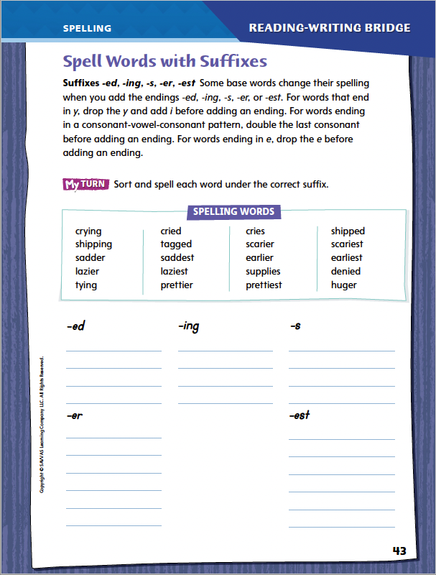
Page 43
Spelling
crying
cried
cries
Turn to page 43 in your Student Interactive.
Notes:
Explain that when adding the suffixes -ed, -ing, -s, -er, or -est to a base word, we may have to change the spelling of the base word. For words that end in y, drop the y and add i. For words ending in e, drop the e. For words ending in a consonant vowel-consonant (CVC) pattern, double the last consonant.
Display the words crying, cried, and cries. Say and spell each word.
Underline the endings -ing, -ed, and -es.
Point out how the spelling of the base word has changed for two of these words.
Have students complete the activity on p. 43 of the Student Interactive.

Slide 36
Language and Conventions
mailman (subject)
Work in pairs to create an oral sentence that contains a subject and a predicate.
Share your sentence with another pair and identify which words make up each component.
walked up the stairs (predicate)
The mailman walked up the stairs.
Notes:
Review subjects and predicates by giving oral examples, such as He laughed. The dog barked.
Explain that a subject and a predicate are the two parts of every sentence.
Help students list a number of subjects (or people) and predicates (or actions) on the board.
Pick a subject and connect it to a predicate to form a simple sentence. For example, with the subject mailman and predicate walked up the stairs, we can make the sentence: The mailman walked up the stairs.
Ask volunteers to form their own complete sentence.
Have students work in pairs to create an oral sentence that contains a subject and a predicate.
Ask partners to share their sentence with another pair and then identify which words make up each component.

Slide 37
Lesson 3

Slide 38
Page 20
Close Read – Explain Author’s Purpose
Turn to page 20 in your Student Interactive.
Notes:
Explain that authors of narrative nonfiction often have two purposes for writing: to provide information and to entertain readers with an interesting and inspiring story. By analyzing an author’s purpose, readers can better understand the main idea, or message, of the text.
Pay attention to descriptive details about real people and events, and ask yourself what purpose the author was trying to achieve by including these descriptive details.
Identify anecdotes, or brief self-contained stories within a text, and infer why the author included them.
Analyze the author’s purpose for writing to determine the message, or main idea of the text, if it is not stated explicitly.
Use the Close Read note on p. 20 of the Student Interactive to model how to annotate the text to explain author’s purpose:
Why does Buzz Aldrin begin his story by talking about his childhood? In paragraph 2, the author looks back at what he thought about when he looked up at the Moon. I am going to underline details in the text that explain why he told that story and think about how this connects to his purpose and message.
Have students find another anecdote in the text, paraphrase the anecdote, and underline a detail in the text that helps them explain the author’s purpose for writing the anecdote.

Slide 39
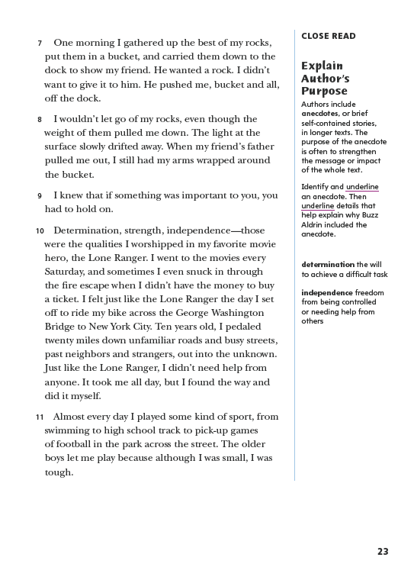
Page 23
Close Read – Explain Author’s Purpose
Turn to page 23 in your Student Interactive.
Notes:
Identify the anecdote and explain to students that it is a brief story within a longer text.
Then have students scan paragraphs 7–10 to identify and underline an anecdote and details that help explain why the author included the anecdote. See student page for possible responses.
Ask students to retell the anecdote in their own words and discuss how an anecdote is self-contained. (It is its own little story in a bigger story.)
Ask: Why did the author include this anecdote? How does this anecdote relate to the author’s purpose for writing Reaching for the Moon?
Possible response: The author is telling readers about an important part of his life and how it shaped him as a person. DOK 2

Slide 40
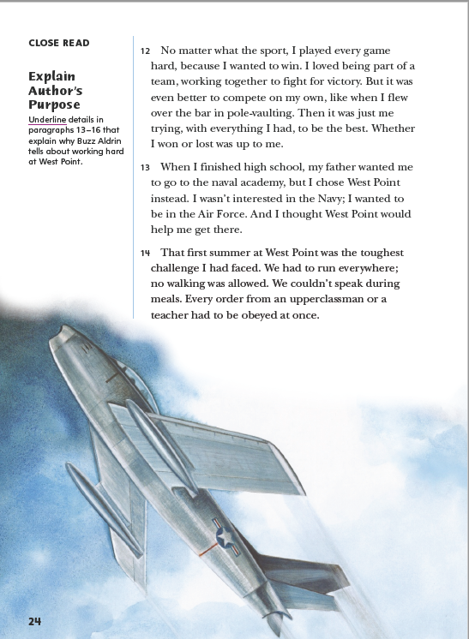
Page 24
Close Read – Explain Author’s Purpose
Turn to page 24 in your Student Interactive.
Notes:
Have students scan paragraphs 13–16 to find and underline details that explain why Aldrin worked hard at West Point. See student page for possible responses.
Have students use the details they underlined to explain in their own words why Aldrin worked hard at West Point.
Possible Response: He worked hard at West Point because he thought this would help him get into the Air Force, and he wanted to fly. DOK 2

Slide 41
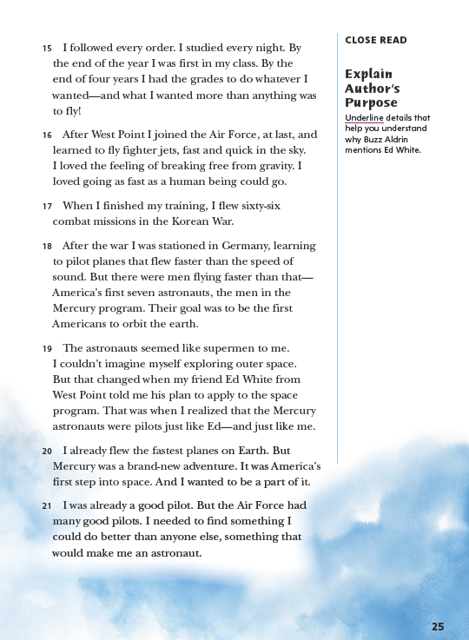
Page 25
Close Read – Explain Author’s Purpose
Turn to page 25 in your Student Interactive.
Notes:
Have students read paragraph 19 to identify and underline details that explain why Buzz Aldrin mentions Ed White. See student page for possible responses.
Ask: What was the author’s purpose for including the real person Ed White in his story?
Possible response: Aldrin wants readers to know how he changed his mind about outer space. At first, Aldrin thought it was impossible to study outer space, but then Ed White helped him see that it was possible to become an astronaut. DOK 2

Slide 42
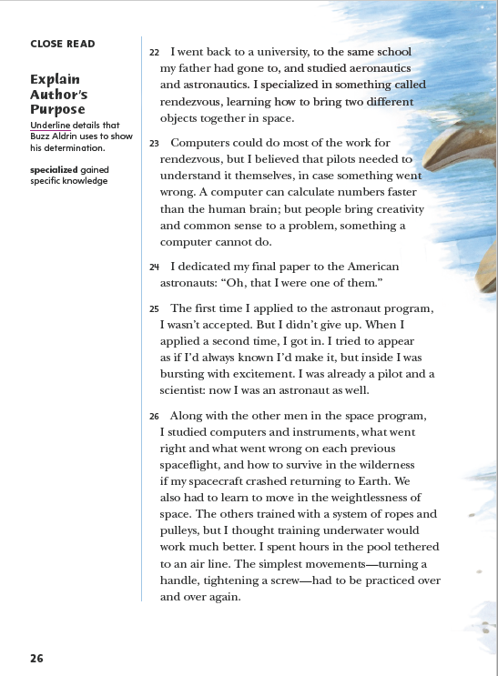
Page 26
Close Read – Explain Author’s Purpose
Turn to page 26 in your Student Interactive.
Notes:
Have students scan paragraphs 23–26 to find and underline details that show the author’s determination. See student page for possible responses.
Have students define determination in their own words and explain why the details they underlined are examples of determination.
Possible Response: Determination means not giving up, and these details are examples of how the author kept trying to do something that was important to him. DOK 2

Slide 43
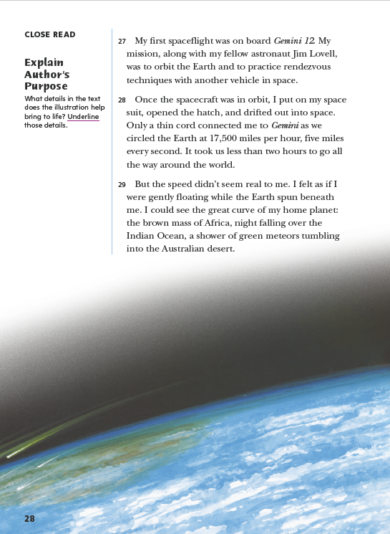
Page 28
Close Read – Explain Author’s Purpose
Turn to page 28 in your Student Interactive.
Notes:
Have students scan paragraphs 28 and 29 to find and underline details that are represented in the illustration. See student page for possible responses.
Have students identify something in the illustration that is not explained in the text.
Then have students explain how the illustration supports the author’s purpose.
Possible Response: The text does not describe the box on the front of the spacesuit. I don’t know what it is, but I think it helps the astronaut breathe. I think that Aldrin included an illustration with this detail to help students see what his spacesuit may have looked like. DOK 2

Slide 44
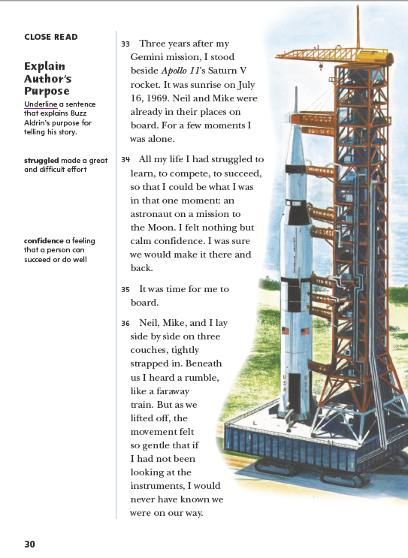
Page 30
Close Read – Explain Author’s Purpose
Turn to page 30 in your Student Interactive.
Notes:
Have students read paragraph 34 to find and underline the first sentence, which explains the author’s purpose for telling his story. See student page for possible responses.
Have students state the author’s purpose in their owns words using a detail from the sentence that they underlined.
Possible Response: The author’s purpose is to tell his audience that he achieved his goal to be an astronaut on a mission to the Moon. DOK 2

Slide 45
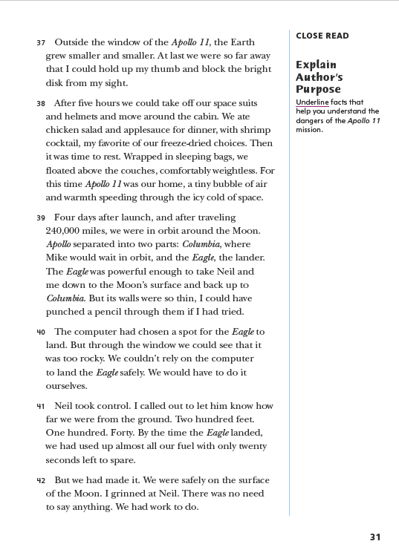
Page 31
Close Read – Explain Author’s Purpose
Turn to page 31 in your Student Interactive.
Notes:
Have students scan paragraphs 39-41 to identify and underline facts that support the idea that the Apollo 11 mission was dangerous. See student page for possible responses.
Have students describe how reading these details affects them..
Possible Response: Knowing that there were a lot of ways for the mission to go wrong makes me worried for the author. It makes me want to keep reading.
DOK 2

Slide 46
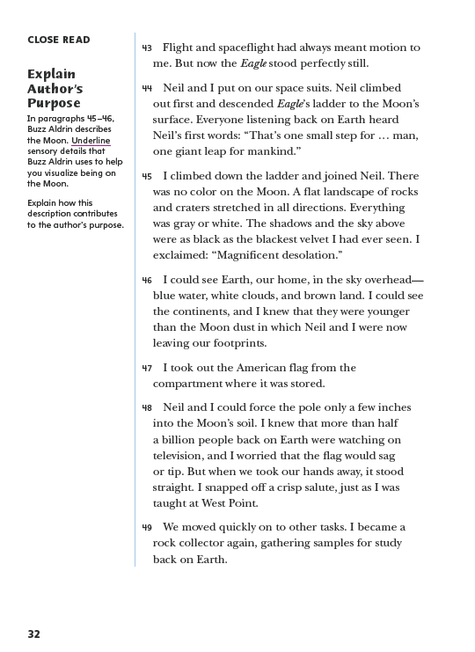
Page 32
Close Read – Explain Author’s Purpose
Turn to page 32 in your Student Interactive.
Notes:
Tell students that a description text structure often includes sensory details that help readers imagine what the author sees, hears, and feels.
Have students scan paragraphs 45 and 46 to find and underline sensory details that help readers visualize being on the Moon. See student page for possible responses.
Ask students to explain how the details they underlined contribute to the author’s purpose, and how the description text structure adds to their ideas about what it would be like to walk on the Moon.
Possible Response: The text structure focuses my attention on what Buzz Aldrin saw. I did not know there were no colors to see on the Moon. This description supports the author’s purpose because it tells me more about Aldrin's life and his experiences in space. DOK 2

Slide 47
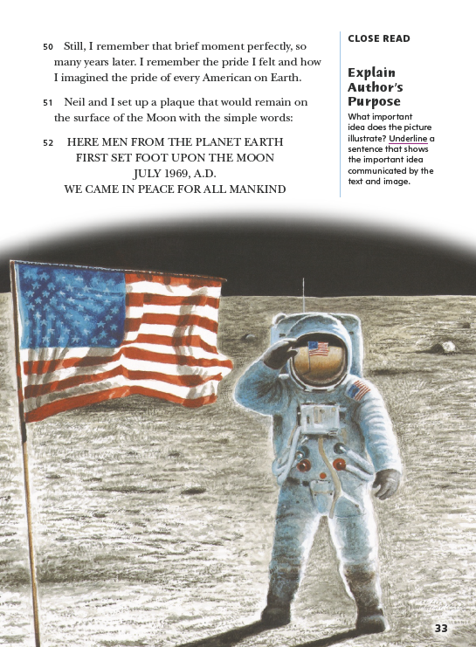
Page 33
Close Read – Explain Author’s Purpose
Turn to page 33 in your Student Interactive.
Notes:
Have students scan paragraph 50 to find and underline the second sentence in the paragraph, which shows the important idea communicated by the text and in the image.
Then have students state the important idea in their own words.
Possible Response: It was a proud moment, and Aldrin saluted his country’s flag to demonstrate his pride that Americans were the first humans to set foot on the Moon. DOK 2

Slide 48
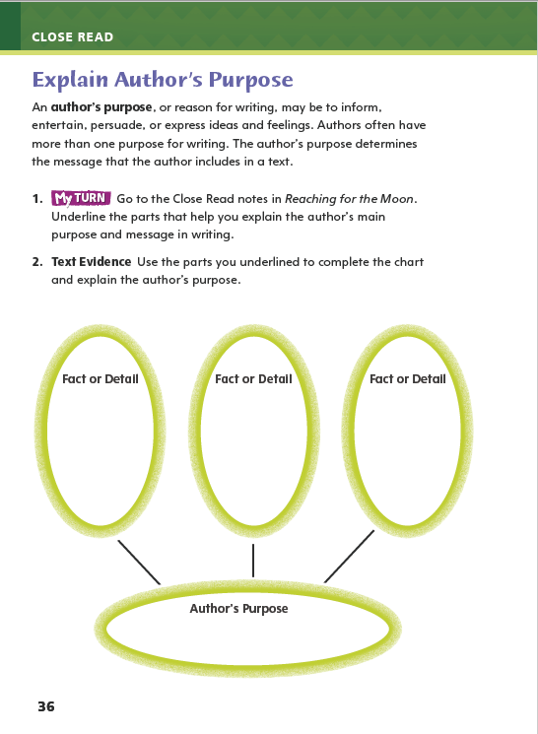
Page 36
Explain Author’s Purpose
Annotate the text using other Close Read notes for Explain Author’s Purpose.
Use the text evidence from your annotations to complete the chart on page 36 in your Student Interactive.
Notes:
Have students use the strategies for explaining author’s purpose.
Have students annotate the text using the other Close Read notes for Explain Author’s Purpose and then use the text evidence from their annotations to complete the chart on p. 36 of the Student Interactive.

Slide 49
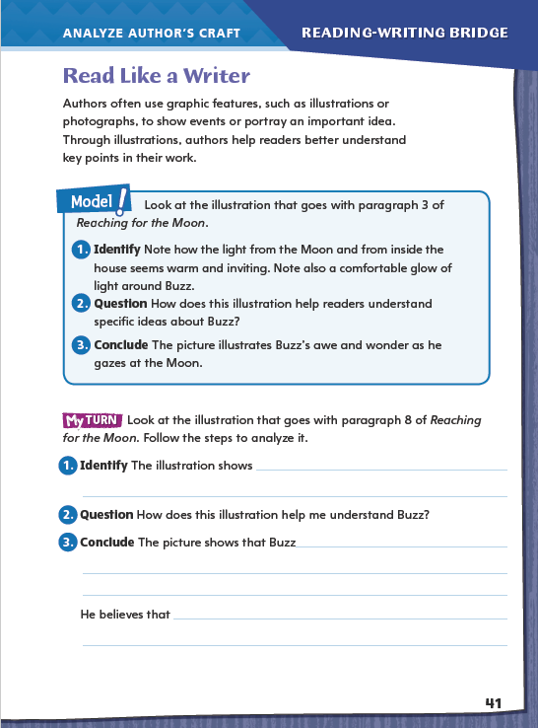
Page 41
Read Like a Writer
Turn to page 41 in your Student Interactive.
Notes:
Authors choose graphic features, including illustrations or photographs, to show events or to clarify key ideas in their work. Images can help readers understand a main point in the story and add to the author’s message.
Identify what details you notice in the graphic.
Question what these details tell you about the story.
Connect the graphic to the story. Ask yourself why the author wanted to include this graphic.
Model analyzing the author’s use of graphics by directing students to the top of p. 41 in the Student Interactive.
Have students follow along as you complete the steps:
If we look at the illustration, what details do we see? There is light from the moon, and where else is there light? The house looks warm and cozy, and the illustration also puts a glow of light around Buzz.
Light is often used to show warmth, love, or knowledge. Here, light is connecting Buzz and the moon. When we look again at paragraph 3, how does this illustration support the paragraph?
One conclusion we can draw based on the graphic’s use of light is that it shows that Buzz is in awe when he looks at the moon.
4. Direct students to go back to Reaching for the Moon and circle lines in the paragraphs that connect to the graphics features in the story. Then have them complete the activity on p. 41.

Slide 50
Word Study
waiting
waited
long
listen
big
Notes:
Remind students that adding a suffix allows you to change when an action happened or compare.
If I am waiting for my turn to speak, waiting is what I am doing now. After my turn, I can say that I waited. It is in the past. If I say that I waited longer than usual, then I am using the adjective long with an -er ending to compare the time I waited with the usual wait time. Have students do the same activity with the verb listen and the adjective big.
Have students complete Word Study p. 1 from the Resource Download Center. Click path: Table of Contents -> Resource Download Center -> Word Study -> U1W1-> p.1

Slide 51
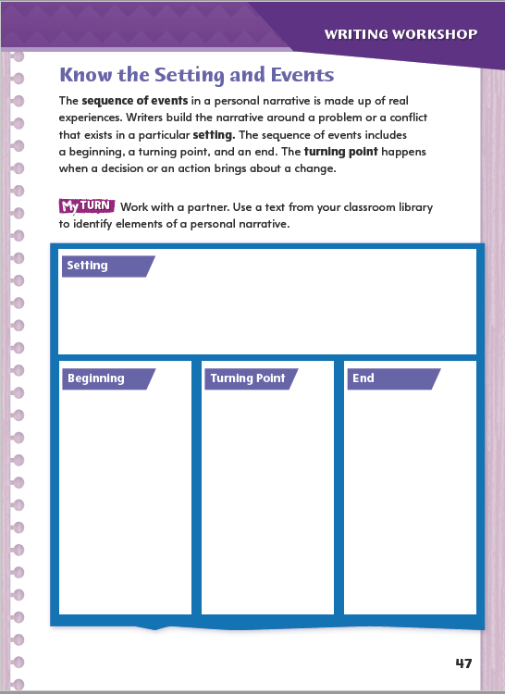
Page 47
Writing – Personal Narrative
Turn to page 47 in your Student Interactive.
Notes:
A personal narrative includes some elements of narrative fiction, including a sequence of events and a beginning, middle, and end. A key event in the middle is the turning point. In a personal narrative
the beginning includes the setting and launches a sequence of events about an experience,
the middle includes the turning point, which, like the climax of a story’s plot, is a key event that brings about a change, and
the end focuses on the change the narrator experienced.
Using a personal narrative you have already read and discussed with students, work together to identify the time, place, and key events of the experience the writer describes. Reread the piece if necessary. Then use questions such as these to help students recognize elements of the personal narrative:
How does the narrator begin the narrative? What does the narrator want readers to know right away?
What events lead up to the turning point in the narrative? Where and when do they take place?
What is the turning point? After the turning point, what happens? Why do you think the narrator includes this information?
Direct students to p. 47 in the Student Interactive. Have partners complete the activity.

Slide 52
Independent Writing
Begin recording ideas for setting and events in your own personal narrative.
Start writing your personal narrative in your own writing notebook.
Notes:
Direct students to begin recording ideas for their own personal narratives.
If students need additional opportunities to identify setting and events, they should analyze additional personal narratives from the stack.
Additional support may be provided:
Modeled Choose a stack text and model identifying a turning point.
Shared Help students organize events from a stack text into beginning, middle, and end.
Guided Use the stack texts to provide explicit instruction on the setting and events in a narrative.
If students demonstrate understanding, they should transition to writing their own personal narratives in their writing notebooks.
Call on two or three students to share the setting and events they identify in the narratives they chose from the stack.

Slide 53
Spelling
cry
crying
crier
skate
skating
skater
ship
shipping
shipper
Notes:
Remind students that adding a suffix can change the spelling of the base word.
Display or write the base words cry, skate, and ship on the board and have students help you add the suffixes -ing and -er to each word.
Show that e is removed in skate and the p in ship becomes a double consonant. The y in cry does not change for crying but changes to i when adding an ending that does not start with i.
Remind students that the spelling of many base words must change before a suffix is added.
Have students complete Spelling p. 6 from the Resource Download Center. Click path: Table of Contents -> Resource Download Center -> Spelling -> U1W1

Slide 54
Language and Conventions
A pilot flies a plane.
Notes:
Say that every sentence has a subject and a predicate.
To reinforce the instruction, describe a profession and what someone in that profession does. For example, A pilot flies a plane. Ask students to identify the subject and predicate.
Then write another example together as a class and have students identify that it has a complete subject and complete predicate.

Slide 55
Lesson 4

Slide 56
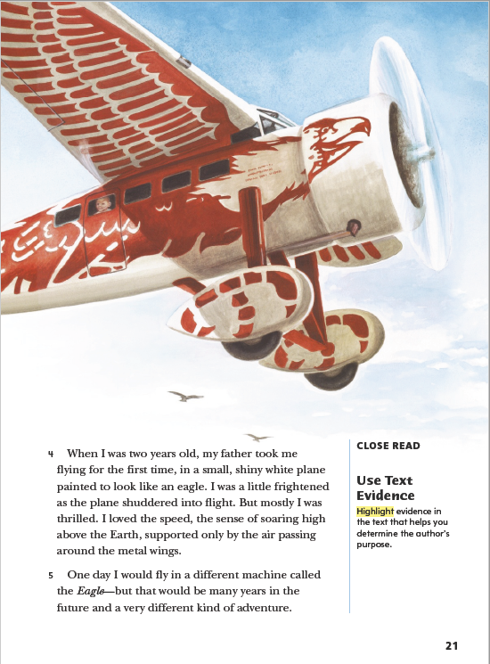
Page 21
Close Read – Use Text Evidence
Turn to page 21 in your Student Interactive.
Notes:
Explain that readers use text evidence to identify the author’s purpose and determine the author’s message, or main idea. Text evidence can be facts, details, or other information that helps readers make inferences. Using evidence allows others to understand how you reached your conclusions. Skilled readers use background knowledge along with text evidence to connect specific details, facts, or information in the text to the author’s purpose.
Consider what you already know about the topic and about why authors write narrative nonfiction.
Identify details, facts, or other information in the text that relate to the author’s purpose.
Combine text evidence and the author’s purpose to explain the author’s message.
Use the Close Read note on p. 21 of the Student Interactive to model how to connect text evidence to the author’s purpose:
I know that Buzz Aldrin is mainly informing readers about being an astronaut and going to the Moon, so I look for text evidence that connects to that experience. In paragraph 5, I see the author tells a story from his childhood about flying in a plane painted to look like an eagle. He connects this with something that happened when he was an adult.
Have students reread paragraph 5. Then have them use text evidence to support a response about the author's purpose.

Slide 57
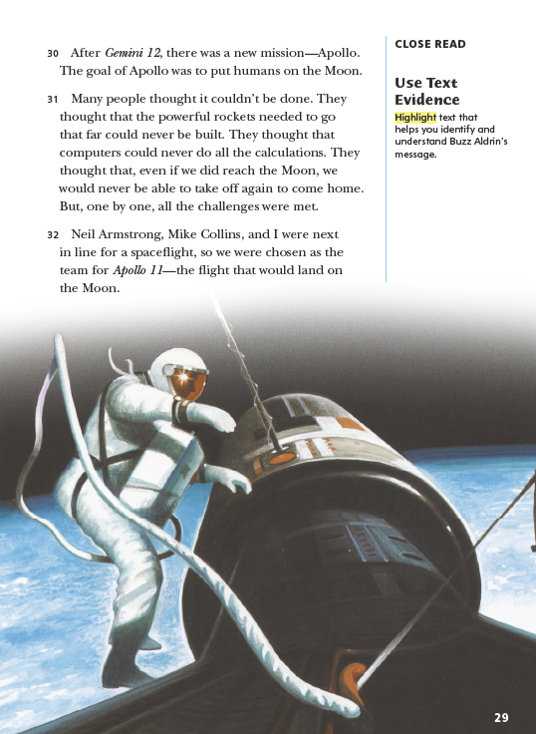
Page 29
Close Read – Use Text Evidence
Turn to page 29 in your Student Interactive.
Notes:
Have students scan paragraphs 30–32 to identify and highlight details that help them identify the author’s message, or the main idea the author is trying to express. See student page for possible responses.
Have students state the author’s message in their own words.
Possible response: The Apollo team overcame challenges to achieve the goal of the mission. DOK 2

Slide 58
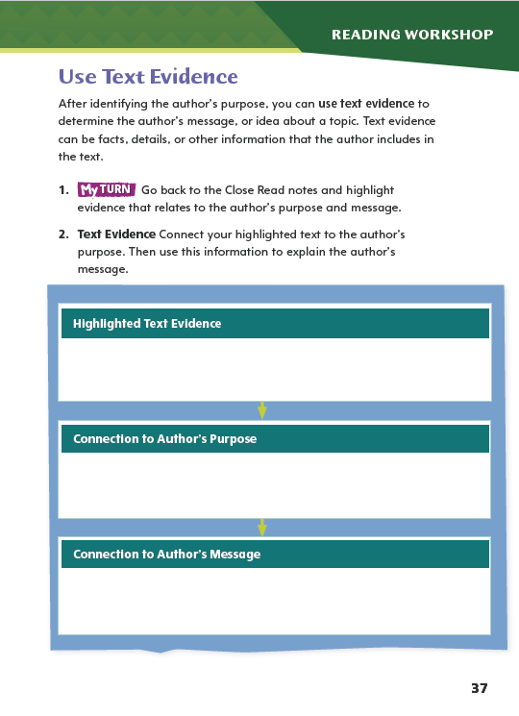
Page 37
Use Text Evidence
Annotate the text using the other Close Reading notes for Use Text Evidence.
Use the text evidence from your annotations to complete page 37 in your Student Interactive.
Notes:
Have students use the strategies for using text evidence.
Have students annotate the text using the other Close Read notes for Use Text Evidence, and then have them use that text evidence from their annotations to complete the chart on p. 37 of the Student Interactive.

Slide 59
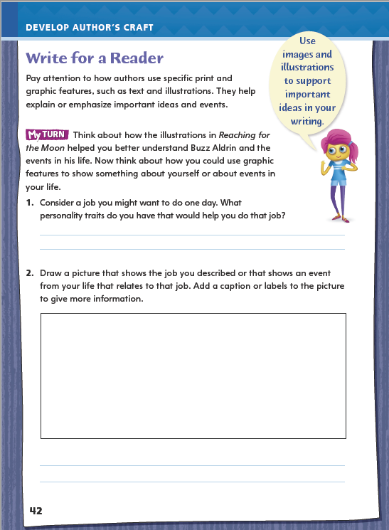
Page 42
Writing for a Reader
Turn to page 42 in your Student Interactive and complete the activity.
Notes:
As readers, we see how authors include graphics to create specific effects. Writers can enhance their ideas by including images or drawings that support the text. If we pay attention to how authors use graphic features, like enlarged text or added illustrations, we can see how authors choose to emphasize important ideas and events.
Remind students that they just analyzed how an author includes graphics for a specific purpose. Discuss how students might use a similar technique in their own writing using p. 42 of the Student Interactive. Model an example.
1. Identify an event to write about, such as welcoming home the first person who traveled in space.
2. Consider words and phrases that would emphasize what you want readers to know. Explain: I might describe the excitement or awe of the onlookers. Or I might write about the triumph of the scientists. Many people would be there and they all have a story to tell.
Together as a class, draft a brief paragraph about the event.
Have students draw an image to support a key idea from the paragraph.
Have students refer to the text for an example of a graphic that helps the author convey a message, and suggest they use it as a model for their own writing. Then guide students to complete the activity on p. 42 of the Student Interactive.

Slide 60
Word Study
-er
Pick an adjective that ends in
–est.
Work with a partner and write about a person or thing these combined adjectives could describe.
-est
Notes:
Review the strategies this week about adding suffixes to words.
Ask for a volunteer to compare the size of two classroom objects (Possible answers: bigger, smaller). Add a third object and have another volunteer compare the heaviness of the objects (Possible answers: heaviest, lightest). Discuss how -er and -est adjectives are used to compare two items or describe items in a group.
Have students pick an adjective that ends in -est. Pair up students and ask them to write about a person or thing these combined adjectives could describe.

Slide 61
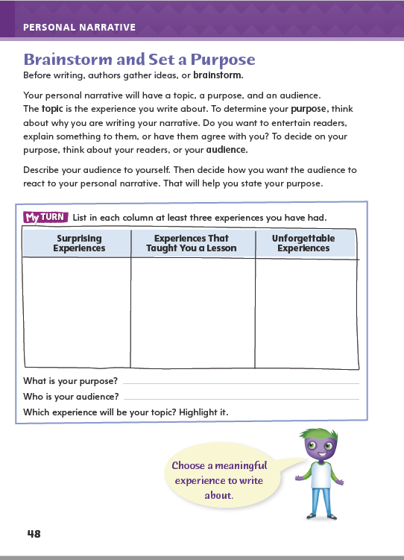
Page 48
Writing – Personal Narrative
Turn to page 48 in your Student Interactive.
Notes:
Emphasize that a personal narrative tells readers about a meaningful experience.
Remind students that the narrator of a personal experience is the writer. Even though the narrative is constructed with elements of a story, the experience is real. Therefore, in a personal narrative, students will
write about a real setting, real events, and their response to events, and
“speak” to readers in a consistent, recognizable voice.
Tell students that they will be brainstorming a topic for their personal narratives. The topic should be an experience that will interest readers. Model generating ideas for a personal narrative: I want to write about an experience that had an effect on me. It also has to interest my readers. I need to keep that purpose and audience in mind as I come up with ideas. OK . . . I could write about my first time riding a bike on my own or the time I tripped right at the end of a relay race. How did the experience change me? My answer to that will help me choose a topic.
Direct students to p. 48 of the Student Interactive. Tell them to use the chart to brainstorm ideas for a topic. Remind them to keep their purpose and audience in mind as they choose. If students come up with ideas they like, have them write the ideas in their writing notebooks.

Slide 62
Independent Writing
Finalize your topic of choice.
Continue making modifications based on today’s minilesson.
Notes:
Transition students to independent writing. Students may use this time to finalize their choice of topic.
Additional support may be provided.
Modeled-Do a Think Aloud to model recalling a surprising experience.
Shared-Have students choose a topic idea and work together to explore how they would identify the setting and the turning point.
Guided-Invite students to imagine a specific audience of readers. Challenge them to identify possible topics that will interest that audience.
If students have started their narratives, they should continue and make any modifications they wish based on today’s minilesson.
Invite a few students to share one or two possible topics they have listed for their personal narratives, and have them invite input from others as to which topic would be most appealing to an audience.

Slide 63
Spelling
The lazyest puppy was prettyer, and it stopped criing when we brought supplys.
Notes:
Review the spelling rule about suffixes.
Display the following sentence and ask for volunteers to identify the misspelled words. The lazyest puppy was prettyer, and it stopped criing when we brought supplys. Explain that if writers know suffix rules, they can pronounce and spell words like laziest, prettier, crying, and supplies.
Using the spelling words from this week, invite students to make word trees of the base word and its matching vocabulary word or words. Have them explain to a partner how the spelling of the base word changes when adding a suffix.

Slide 64
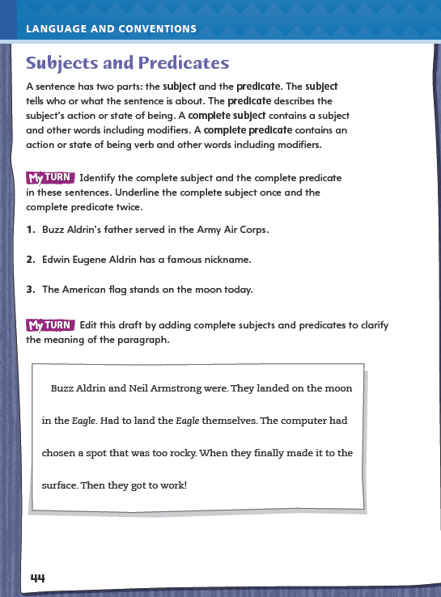
Page 44
Language and Conventions
Turn to page 44 in your Student Interactive and edit the draft.
Notes:
Have students edit the draft paragraph on Student Interactive p. 44.

Slide 65
Lesson 5

Slide 66
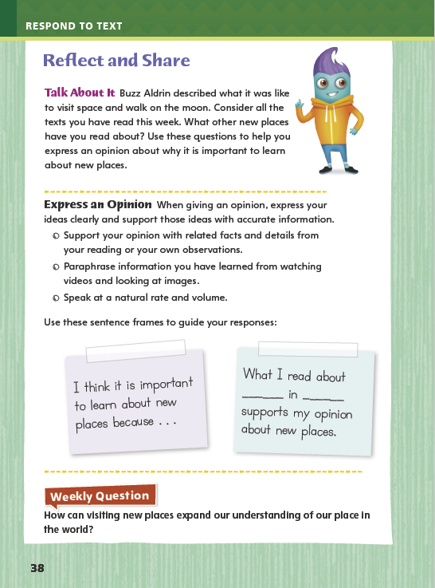
Page 38
Reflect and Share
Turn to page 38
in your Student Interactive.
Notes:
1. Explain to students that when they participate in discussions with other readers, they should express their ideas or opinions clearly, at an appropriate speaking rate and volume, and support them with accurate information.
Before expressing an opinion, consider whether you can support your idea with accurate information.
Acknowledge others’ opinions before expressing your own.
Model speaking at an appropriate rate and volume to express an opinion using the Talk About It prompt on p. 38 in the Student Interactive. I think it is important to learn about new places because it helps us understand ways places can be different. What I read about the surface of the Moon made me appreciate how bright and colorful my neighborhood is.
Have student pairs discuss their opinions. As needed, help them paraphrase information they have learned from watching videos and viewing images.
Offer feedback on speaking rate and volume.
Have students complete the rest of p. 38 in the Student Interactive.

Slide 67
Apply
How can visiting new places expand our understanding of our place in
the world?
Notes:
Have students use evidence from the texts they have read this week to respond to the Weekly Question. Tell them to write their response on a separate sheet of paper.

Slide 68
Word Study
The bear hibernates last winter and in the spring he was hungrier than a lion.
Notes:
To assess students’ understanding of the suffixes -ed, -ing, -s, -er, and -est, provide them with the following sentence: The bear hibernates last winter and in the spring he was hungrier than a lion.
What change should be made to the sentence?
Change hibernates to hibernating.
Change hungrier to hungriest.
Change hibernates to hibernated.
Change hungrier to hungry.
Change hibernates to hibernate.
3. Have students use their knowledge of suffixes to explain the correct choice. (It is choice 3 because the action happened last winter, and the suffix -ed shows that the verb is in the past.)

Slide 69
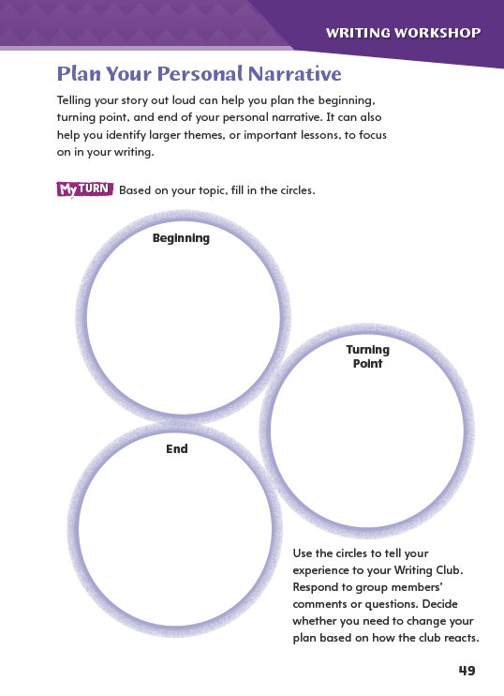
Page 49
Writing – Personal Narrative
Turn to page 49
in your Student Interactive.
Notes:
Mapping a personal narrative is like outlining an informational text or organizing a story using a plot diagram. The writer chooses key ideas or events that serve as guideposts for developing a draft. Mapping a personal narrative involves
• identifying and describing the turning point, or the event that caused a significant change,
deciding how much information the audience needs about the setting, problem, and events leading up to the turning point, and
choosing what to report about the events and thoughts that follow the turning point.
Have students select a personal narrative from the stack that they have already read.
Say: Find the turning point in the personal narrative you have chosen. When students have located the turning point, ask: How much of the narrative comes before the turning point? What do those paragraphs contain? How much of the personal narrative comes after the turning point? What do those paragraphs contain?
Encourage students to compare and contrast the amount of text each writer has included before and after the turning point.
Direct students to p. 49 in the Student Interactive. Say: Now that you have seen what other writers do in their personal narratives, decide how long you want each part of your narrative to be. You can change your mind later as you work on drafts. Have students make notes on the activity page about the parts of their plans.
Then have them use these notes to tell their narratives orally. As students do so, have them use this information to identify larger themes and main ideas that their narratives suggest.

Slide 70
Independent Writing – Writing Club
Conversation Starters
What key elements should a personal narrative have?
What role does the narrator play in this piece?
How does the setting contribute to the personal narrative?
Why does the topic in a personal narrative have to be interesting to the audience?
Where should the turning point fall in a personal narrative?
Notes:
Place students into Writing Club groups.
In this week’s Writing Club, students will tell each other about experiences they plan to include in their personal narratives. They will share reactions to one another’s stories for the purpose of helping one another plan.
Because students are in new Writing Club groups, they should spend the first 5–10 minutes in their groups discussing the following:
the role of the audience when someone is reading aloud a plan or a draft
a process for taking turns during discussions
appropriate ways to offer feedback and to ask and answer questions
Students will be sharing the experience on which they plan to base their personal narratives. Their stories should be roughly organized into a beginning with a setting, events that lead to a turning point, and an ending. Instruct the group to offer constructive comments and ask questions that focus on how much detail each writer should include in the three main parts of the narrative.
Use these prompts to help students begin discussions in their Writing Club.
What key elements should a personal narrative have?
What role does the narrator play in this piece?
How does the setting contribute to the personal narrative?
Why does the topic in a personal narrative have to be interesting to the audience?
Where should the turning point fall in a personal narrative?

Slide 71
Spelling
The shipping box was too heavy for me to carry.
I am lazier on the weekend.
The movie was sadder than I expected.
Diego brought his supplies to class.
The puppy cried when he was lonely.
Amanda had the prettiest costume in the school play.
The father comforted the crying baby.
The witness denied any involvement in the crime.
Going down the mountain is scarier than ascending.
The earliest time I can visit is tomorrow.
Notes:
(Note: Move the orange boxes to cover each bold spelling word before you read aloud the words and sentences.)
1. Use the following sentences for a spelling test.
Spelling Sentences
1. The shipping box was too heavy for me to carry.
2. I am lazier on the weekend.
The movie was sadder than I expected.
Diego brought his supplies to class.
The puppy cried when he was lonely.
Amanda had the prettiest costume in the school play.
The father comforted the crying baby.
The witness denied any involvement in the crime.
Going down the mountain is scarier than ascending.
The earliest time I can visit is tomorrow.

Slide 72
Language and Conventions
The red robin sang a pretty tune from its nest.
Which correctly identifies the complete subject of this sentence?
The red robin
robin
a pretty tune
The red robin sang.
Notes:
Display the sentence and have students respond independently. The red robin sang a pretty tune from its nest.
Which correctly identifies the complete subject of this sentence?
The red robin
Robin
a pretty tune
The red robin sang.
3. Have students complete Language and Conventions p. 11 from the Resource Download Center. Click path: Table of Contents -> Resource Download Center -> Language and Conventions -> U1 W1

Slide 73
Unit 1: Week 1
Grade 4

